Slide 1
121.03.09 – Beam Instrumentation
Instrumentation
L3 Manager – Vic Scarpine & Brian Drendel
PIP-II IPR
4-6 December 2018

Slide 2
Outline
Scope/Deliverables
Requirements
Interfaces
Preliminary Design, Maturity
Technical Progress to Date
ESH&Q
Risks and Mitigations
Summary

Slide 3
About Me:
Vic Scarpine – L3 Manager for PIP-II beam instrumentation
Accelerator Division Application Physicist III in FNAL AD Instrumentation Department
15 years experience in development and operation of beam instrumentation
Relevant linac experience
Development of HINS front-end beam instrumentation
Development of Fermilab RFQ commissioning beam instrumentation
Development of PIP2IT beam instrumentation

Slide 4
About Me:
Brian Drendel – CAM for PIP-II beam instrumentation
Engineering Physicist
27 years of operational accelerator experience with an emphasis on controls and instrumentation
Seven years of Level 3 and CAM project management experience
FNAL AD/Muon Department
L3 AIP Controls and Instrumentation (completed)
L3 and CAM g-2 Controls and Instrumentation (completed)
L3 and CAM Mu2e Controls and Instrumentation (currently in implementation phase)
CAM PIP2 Controls

Slide 5
Scope and Deliverables
Charge #2
Scope
Design, procurement, fabrication, and testing of beam instrumentation systems for the commissioning and operation of the PIP-II accelerator.
Includes warm front-end, SC linac and linac-to-booster transfer line
Includes PIP2IT
PIP-II beam instrumentation WBS is divided into:
Beam Position Monitor System
Beam Current Monitor System
Beam Loss Monitor System
Beam Profile Monitor Systems
Transverse Profile Monitors
Transverse Emittance Monitors
There are no in-kind contributions for PIP-II or PIP2IT beam instrumentation

Slide 6
WBS L3 System Requirements
Charge #2
Beam instrumentation functional requirements defined in FRS ED0008303
Beam instrumentation systems shall be capable of measurements of short commissioning beam pulses as well as nominal length operational beam pulses, for pulses repetition rates up to 20 Hz.
Beam position monitor (BPM) system shall:
Measure the average transverse position, phase and intensity via warm and cold BPMs for each beam pulse
Measure the beam energy in the linac-to-booster transfer line dispersion region for each beam pulse
FRS ED0008303 – Beam Instrumentation
FRS ED0003675 – MEBT BPM

Slide 7
WBS L3 System Requirements
Charge #2
Beam loss monitor (BLM) system shall:
Detect beam loss through the measure of ionizing particles and neutrons
Measure relative beam loss for each beam pulse in the linac and transport line.
Provide relative beam loss information for each beam pulse to the Machine Protection System.
FRS ED0008303 – Beam Instrumentation

Slide 8
WBS L3 System Requirements
Charge #2
Beam current monitor (BCM) system shall:
Measure the average current and intensity of the beam transported through the warm front-end, SC Linac, and linac-to-booster transfer beamline for each beam pulse.
Provide differential beam current measurements to the Machine Protection System for each beam pulse.
Measure the MEBT chopper bunch-by-bunch extinction efficiency
FRS ED0008303 – Beam Instrumentation

Slide 9
WBS L3 System Requirements
Charge #2
Beam transverse profile monitor (BTP) systems shall:
Measure average beam transverse profiles in the warm front-end, SC linac and linac-to-booster transfer line when requested
Be non-invasive and meet particle-free requirements in the SC linac
FRS ED0008303 – Beam Instrumentation
FRS ED0004340 – MEBT wire scanner
Beam transverse emittance monitor (BTE) systems shall:
Measure the beam transverse emittance in the warm front-end, SC linac and linac-to-booster transfer line when requested
FRS ED0008303 – Beam Instrumentation
FRS ED0004080 – MEBT emittance scanner

Slide 10
Interfaces
Charge #2
Important interfaces for beam instrumentation:
Mechanical installation and alignment of detectors on beamline
Timing and controls from Controls system
Clock signals from LLRF
Beam diagnostic information to Controls
Beam information to machine protection (Controls)
Infrastructure:
Power, rack space, cables, etc
Laser hut and laser-light transport through linac
Interfaces identified and being managed though interface controls documents
Teamcenter document ED0007694

Slide 11
Preliminary Design and Design Maturity
Charge #2
Beam Current Measurements
Three types of Beam Current Monitor (BCM) pickups
Toroids or ACCTs
DC (Direct Current) Current Transformer (DCCT)
Wall current monitors
Based on systems currently operating at Fermilab
Raw signals are conditioned in a “transition board,” digitized and processed by a digitizer, and interfaces to the control system through a front-end
All three types of pickups have been installed and operated at PIP2IT
Resources will be applied to the design, programming, and testing of alternatives to the current electronics front end standard
Tie to industry standards to reduce customization
Use common framework for high-performance systems
Very Mature

Slide 12
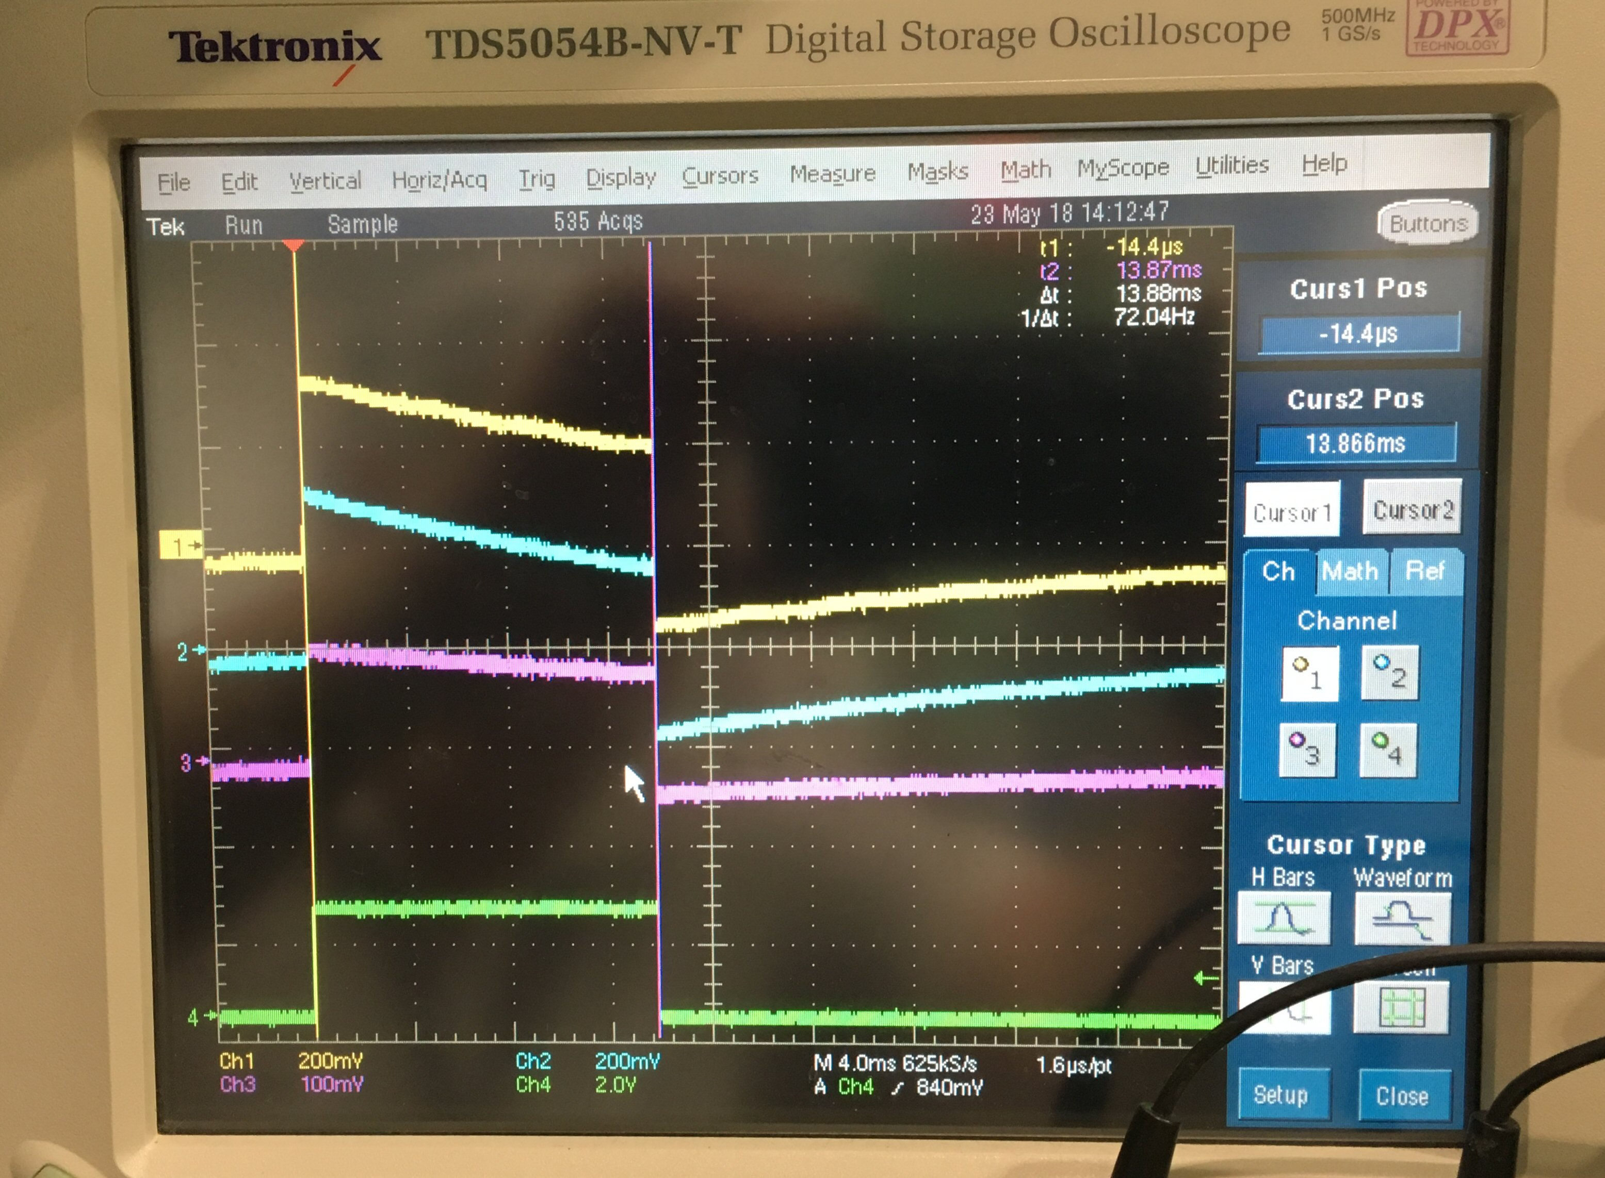
Progress to date – ACCT at PIP2IT
Charge #1
Full scale: ±12 mA
BW: < 3 Hz to 1 MHz
Droop: < 2% per ms
Risetime: 350 ns (10-90%)
Noise at 10 mA: ~1.5 μA rms
Sensor saturation: 2 mT
Magnetic shielding
In-flange design
Installed in PIP2IT beamline
Installed
in MEBT
15 ms
Toroid
ACCT

Slide 13
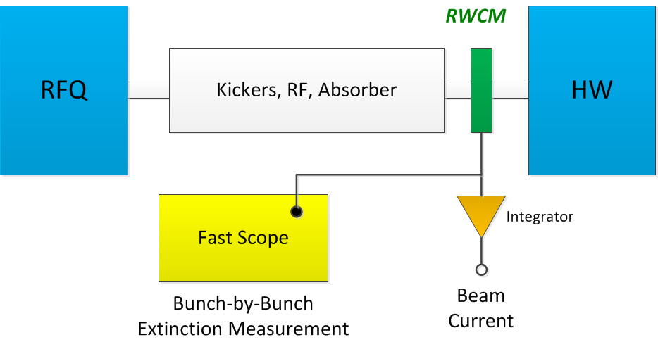
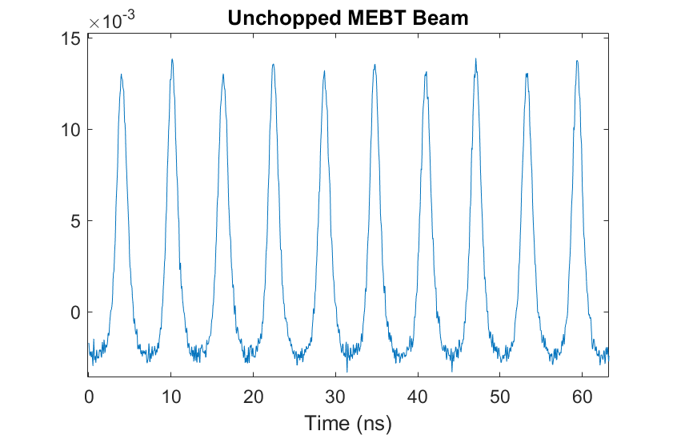
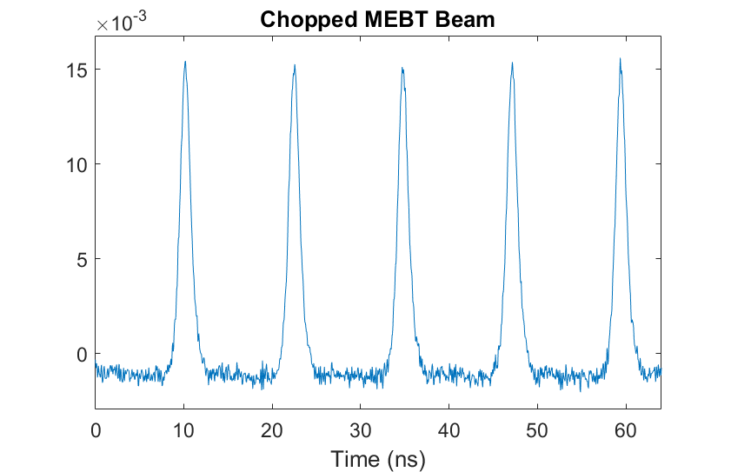
Progress to date – MEBT Chopper Extinction Measurement
Charge #1
Use downstream Resistive Wall Current Monitors (RWCM)
Extinction
Can average over many bunches or take a single shot measurement
Measurement BW < 1 Hz
Fits to bunch shape
Measure impact on adjacent bunches
Installed in PIP2IT MEBT
MEBT Measurements

Slide 14
Preliminary Design and Design Maturity
Charge #2
Beam Position Monitors
4-button BPM vacuum pickup
Separate designs for warm and cold BPMs
Electronics
Analog transition boards
FPGA-controlled digitizers for signal analysis
Software
FPGA firmware
Front-end controller
Controls interface
MEBT BPMs installed and operational at PIP2IT
Beam Loss Monitors
Pickups
Ionization beam loss monitors
Fast PMT-based beam loss monitors
Neutron detectors
Electronics
Analog transition boards
FPGA-controlled digitizers for signal analysis
Software
FPGA firmware
Front-end controller
Controls interface
Very Mature
Very Mature

Slide 15
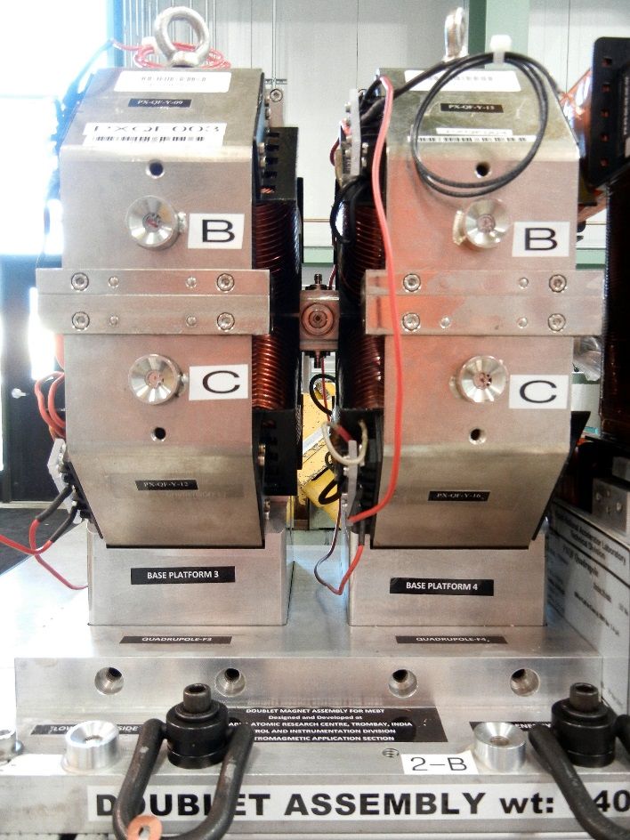
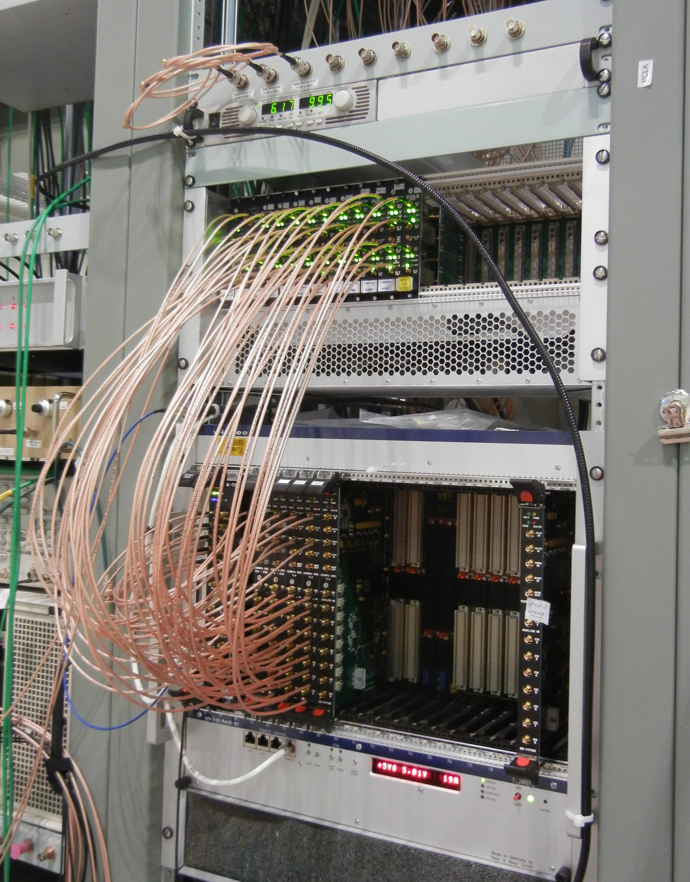
Progress to date – MEBT BPM Development at PIP2IT
Charge #1
Warm 4-buttom BPMs imbedded in quad doublets
Narrow-band DAQ with FPGA-based electronics
12 channel, 14 bit, 125 MHz boards
Analog filter and amplifier boards
Status:
BPMs operational
Average position, phase, intensity per beam pulse
Position resolution ~10 μm
Phase resolution ~0.2 deg
Time-of-flight BPM installed and tested
BPM on movable stage
Energy resolution ~0.3%

Slide 16
Preliminary Design and Design Maturity
Charge #2
Transverse beam profiles
Wire-based transverse profile monitor – Very Mature
Two-wire secondary emission monitors
Linear motion actuators and FPGA-based signal processing electronics
Installed into warm MEBT and transfer beamline
Laser-based transverse beam profile monitor – Under Development
Installed in cold section of SC Linac
Single laser source located in a laser room, outside of the beam enclosure and near the ion source.
Enclosed line transports laser light from the laser room via fiber optics or free-space to each laser transverse profile monitor locations
Laser monitor will include a light-tight optics box with required optics and motion to provide the required laser scanning across the beam, as well as electron collection to measure the profile

Slide 17
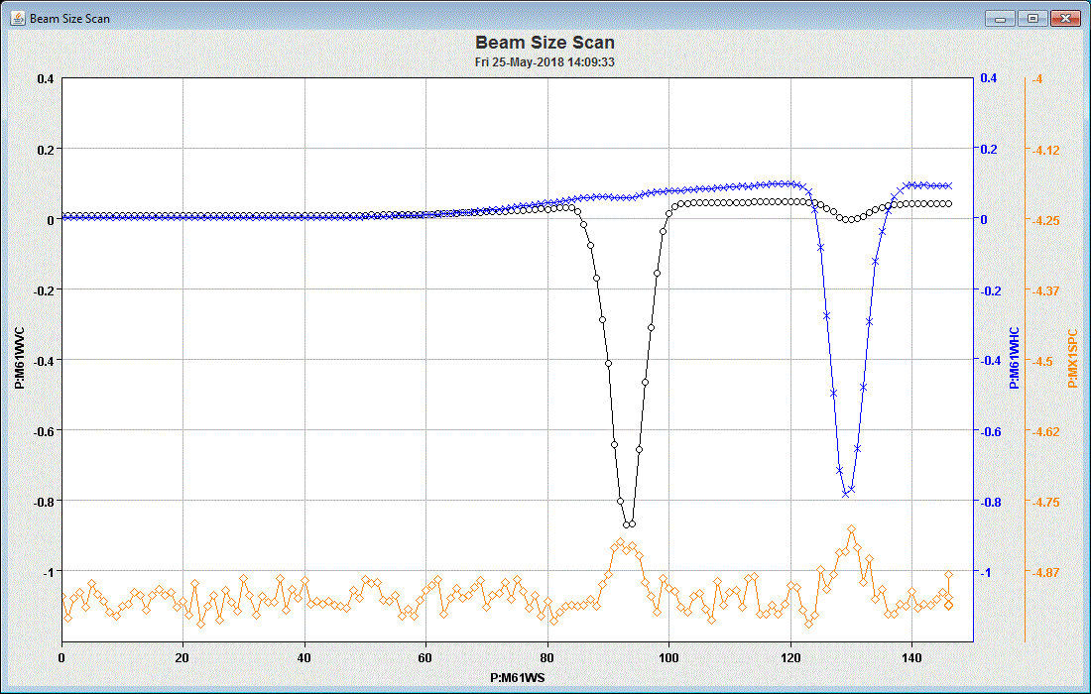
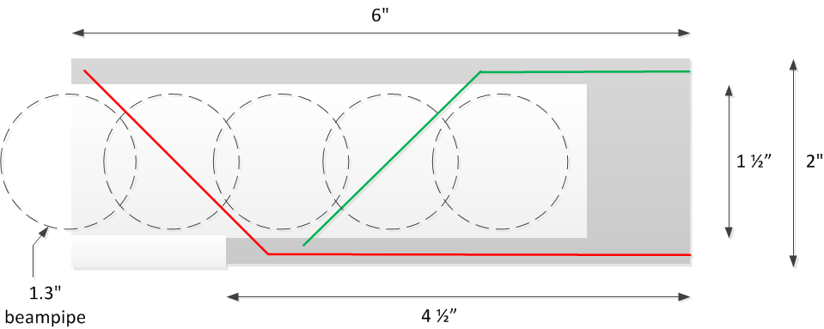
Progress to date – Prototype Wire Scanner at PIP2IT
Charge #1
Installed in MEBT
Vert
Horz
Beam Current

Slide 18
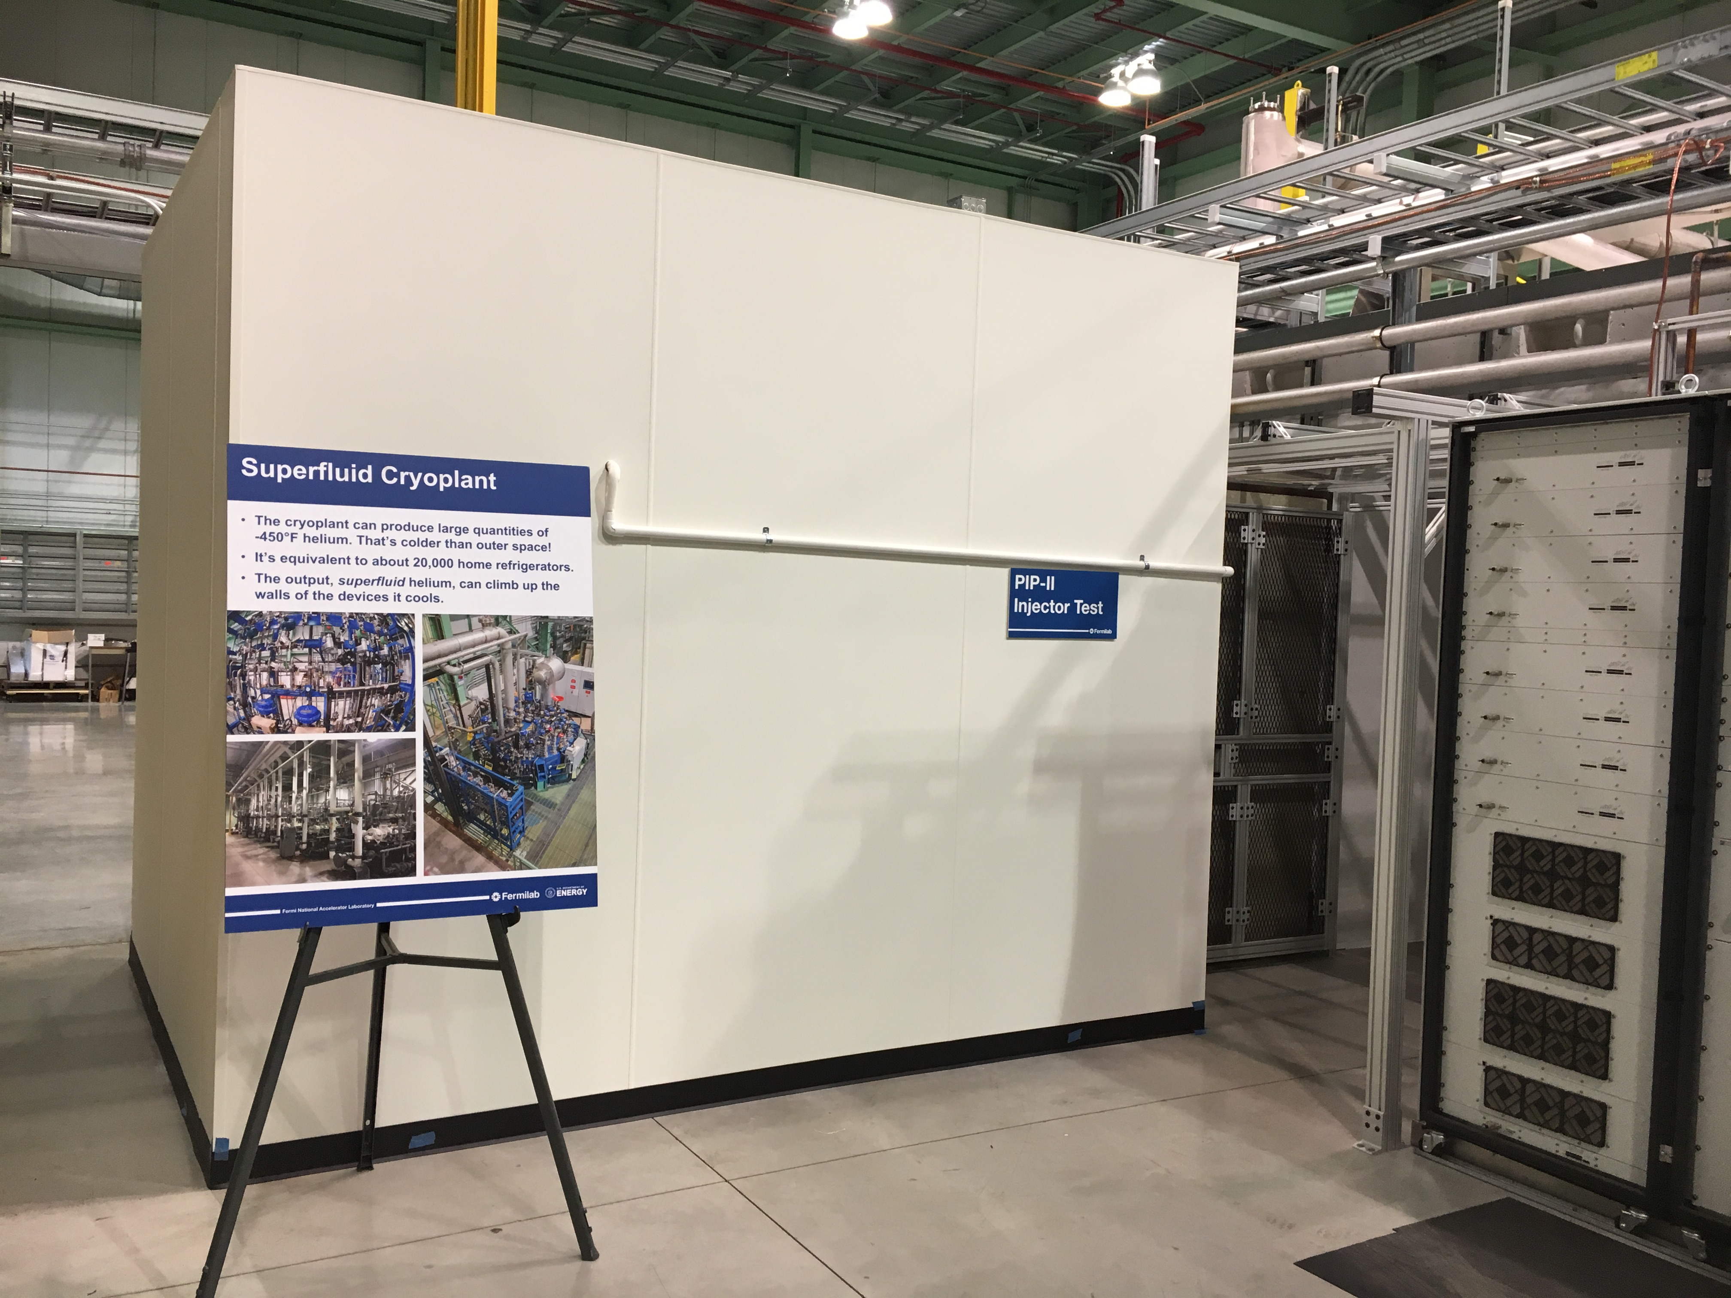
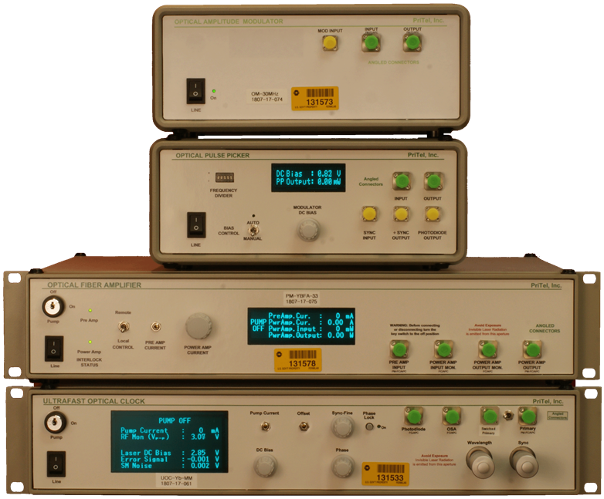
Progress to date – Prototype Laser Wire Profiler
Charge #1
Components all coming together
Laser and optics testing underway in A0 laser lab
Testing and characterizing laserwire
PIP2IT vacuum chamber constructed
PIP2IT Laser hut nearly complete
Need to install safety interlock system
Laserwire
Laser System under test in A0 laser lab
Laser Hut
PIP2IT Door

Slide 19
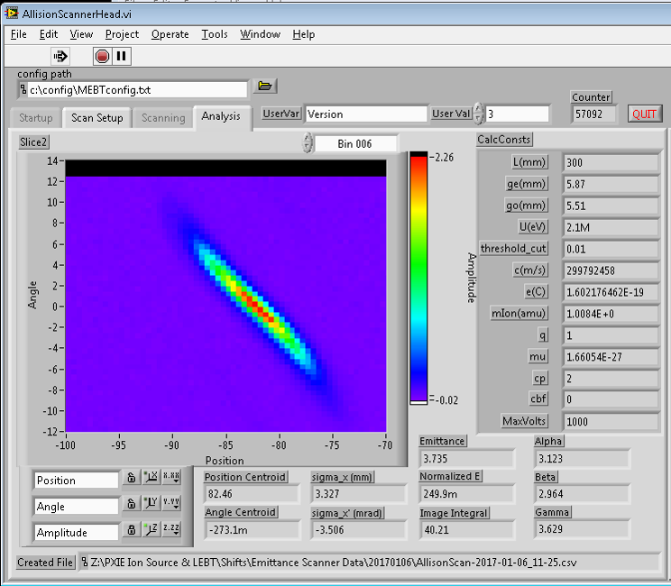
Preliminary Design and Design Maturity
Charge #1,2
Transverse emittance monitor systems
LEBT and MEBT
Allison-style emittance scanners
PC-based data acquisition and controls
Very mature
Transfer line
laser-based emittance scanner
Similar to existing system at Spallation Neutron Source (SNS)
Under development
MEBT Emittance

Slide 20
ESH&Q
Charge #6
Safety is an essential element in all work we do
Project Integrated ES&H Management Plan (docdb #141)
Laboratory and DOE standards and practices
Fermi Radiological Control Manual
Fermi ES&H Manual
Quality Assurance and Control
Project Quality Assurance Plan (docdb #142)
Primary issues for beam instrumentation are electrical and laser safety
Electrical hazards associated with these systems are covered under the codes below:
National Electrical Code, NFPA 70
OSHA 29 CFR, Part 1910, Subpart S, Electrical
Fermilab ESH&Q Manual, Fermilab Electrical Safety Program
Lasers present a unique hazard for PIP-II profile instrumentation. These systems are covered under safety documents:
Fermilab FESHM 4260 – Lasers
ANSI Z136.1 – Safe Use of Lasers
Inclusion of lab laser safety officer in design and development

Slide 21
Risk Management
Charge #2,7
Medium-level and low-level risks for beam instrumentation in project risk registry:
RT-121-03-008 – Choice of laser profiling technology impacts infrastructure design – medium risk
Low-power laser system VS high-power laser system
Beam instrumentation integration into MPS – medium risks
RT-121-03-010 – Adequate real-time bandwidth between instrumentation and MPS
Does communication between MPS and instrumentation meet performance requirements?
RT-121-03-009 – Adequate instrumentation performance for MPS
Does beam instruments supplying MPS information have adequate performance?
RT-121-03-016 – Adequate linac physical space for beam instrumentation – low risk

Slide 22
Risk Mitigation: Choice of laser profiling technology for transverse beam profiles
Charge #2,7
Two options for laser profiling: (1) low-power lasers or (2) high-power lasers
Low-power laser option is preferred but needs beam measurements as proof of operation
High-power laser option has been demonstrated at SNS but is more complicated and has risk of damage to optical vacuum windows from laser power
Plan to test low-power option with beam at PIP2IT in MEBT and HEBT – this is critical to laser profiling system choice
If unsuccessful then fall back to high-power option for PIP-II
Laser profiling PIP-II infrastructure design allows for possibility of either laser option as final choice

Slide 23
Risk Mitigation: Beam instrumentation integration into MPS
Charge #2,7
RT-121-03-010 – Adequate real-time bandwidth between instrumentation and MPS
Mitigate by architecture of instrumentation and MPS systems
Architecture drives design of instrumentation electronics and software development requirements
Test system performance on bench and PIP2IT
RT-121-03-009 – Adequate instrumentation performance for MPS
Mitigate by choice of instrumentation architecture
Pickups and electronics
System noise presents biggest unknown
Using PIP2IT to understand noise issues

Slide 24
Summary
Instrumentation development for PIP-II proceeding
Instrumentation designs based on well tested technology
Many systems evolved for other FNAL beam instrumentation
New systems (e.g. laser profiling) leveraging experience from other laboratories
Path to completing preliminary design is understood
Many instrumentation systems being tested at PIP2IT
Testing at PIP2IT invaluable to instrumentation development
PIP2IT is essential to reducing project risk

Slide 25
END

