Slide 1
SBN Program Status
Peter Wilson – SBN Program Coordinator
SBN Oversight Board
30 November 2018

Slide 2
Outline
ICARUS technical progress
SBND technical progress
December Director’s review

Slide 3
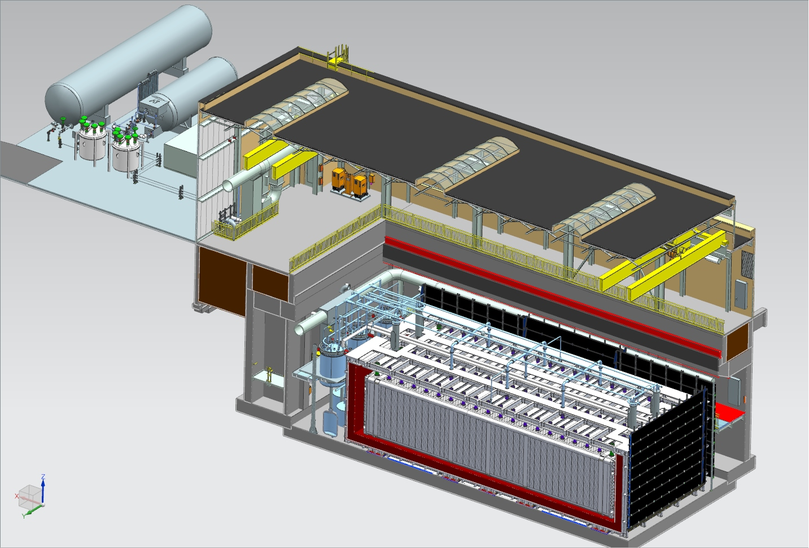
Far Detector - ICARUS
Cryogenic Dewars
TPC Electronics
(not shown)
Top CRT and Overburden
(not shown)
Exterior Filters
Removable Wall Panel
Two 33 ton cranes
Proximity Cryogenics
Not shown in alcoves (mezzanine and pit):
DAQ racks
Controls racks
Cold Vessels (TPCs and PMTs inside)
Bottom CRT
Side CRT

Slide 4
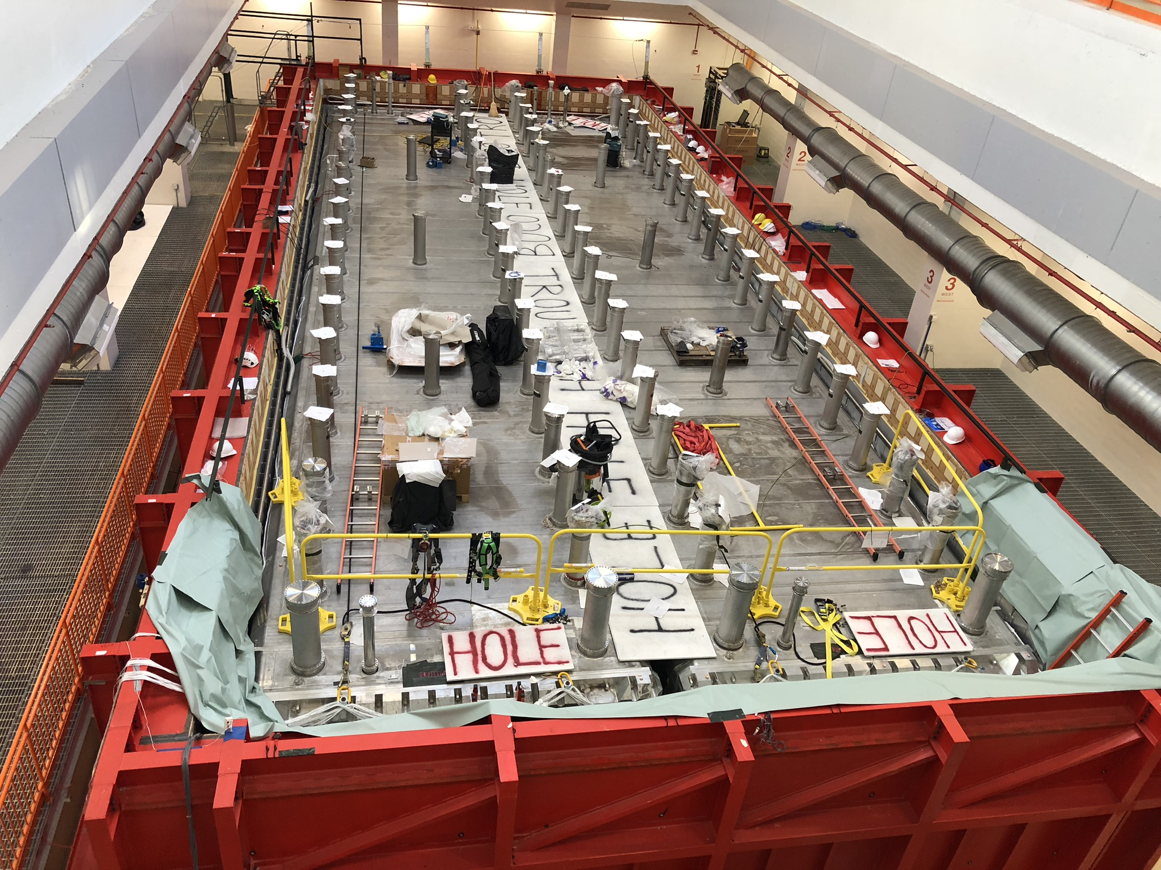
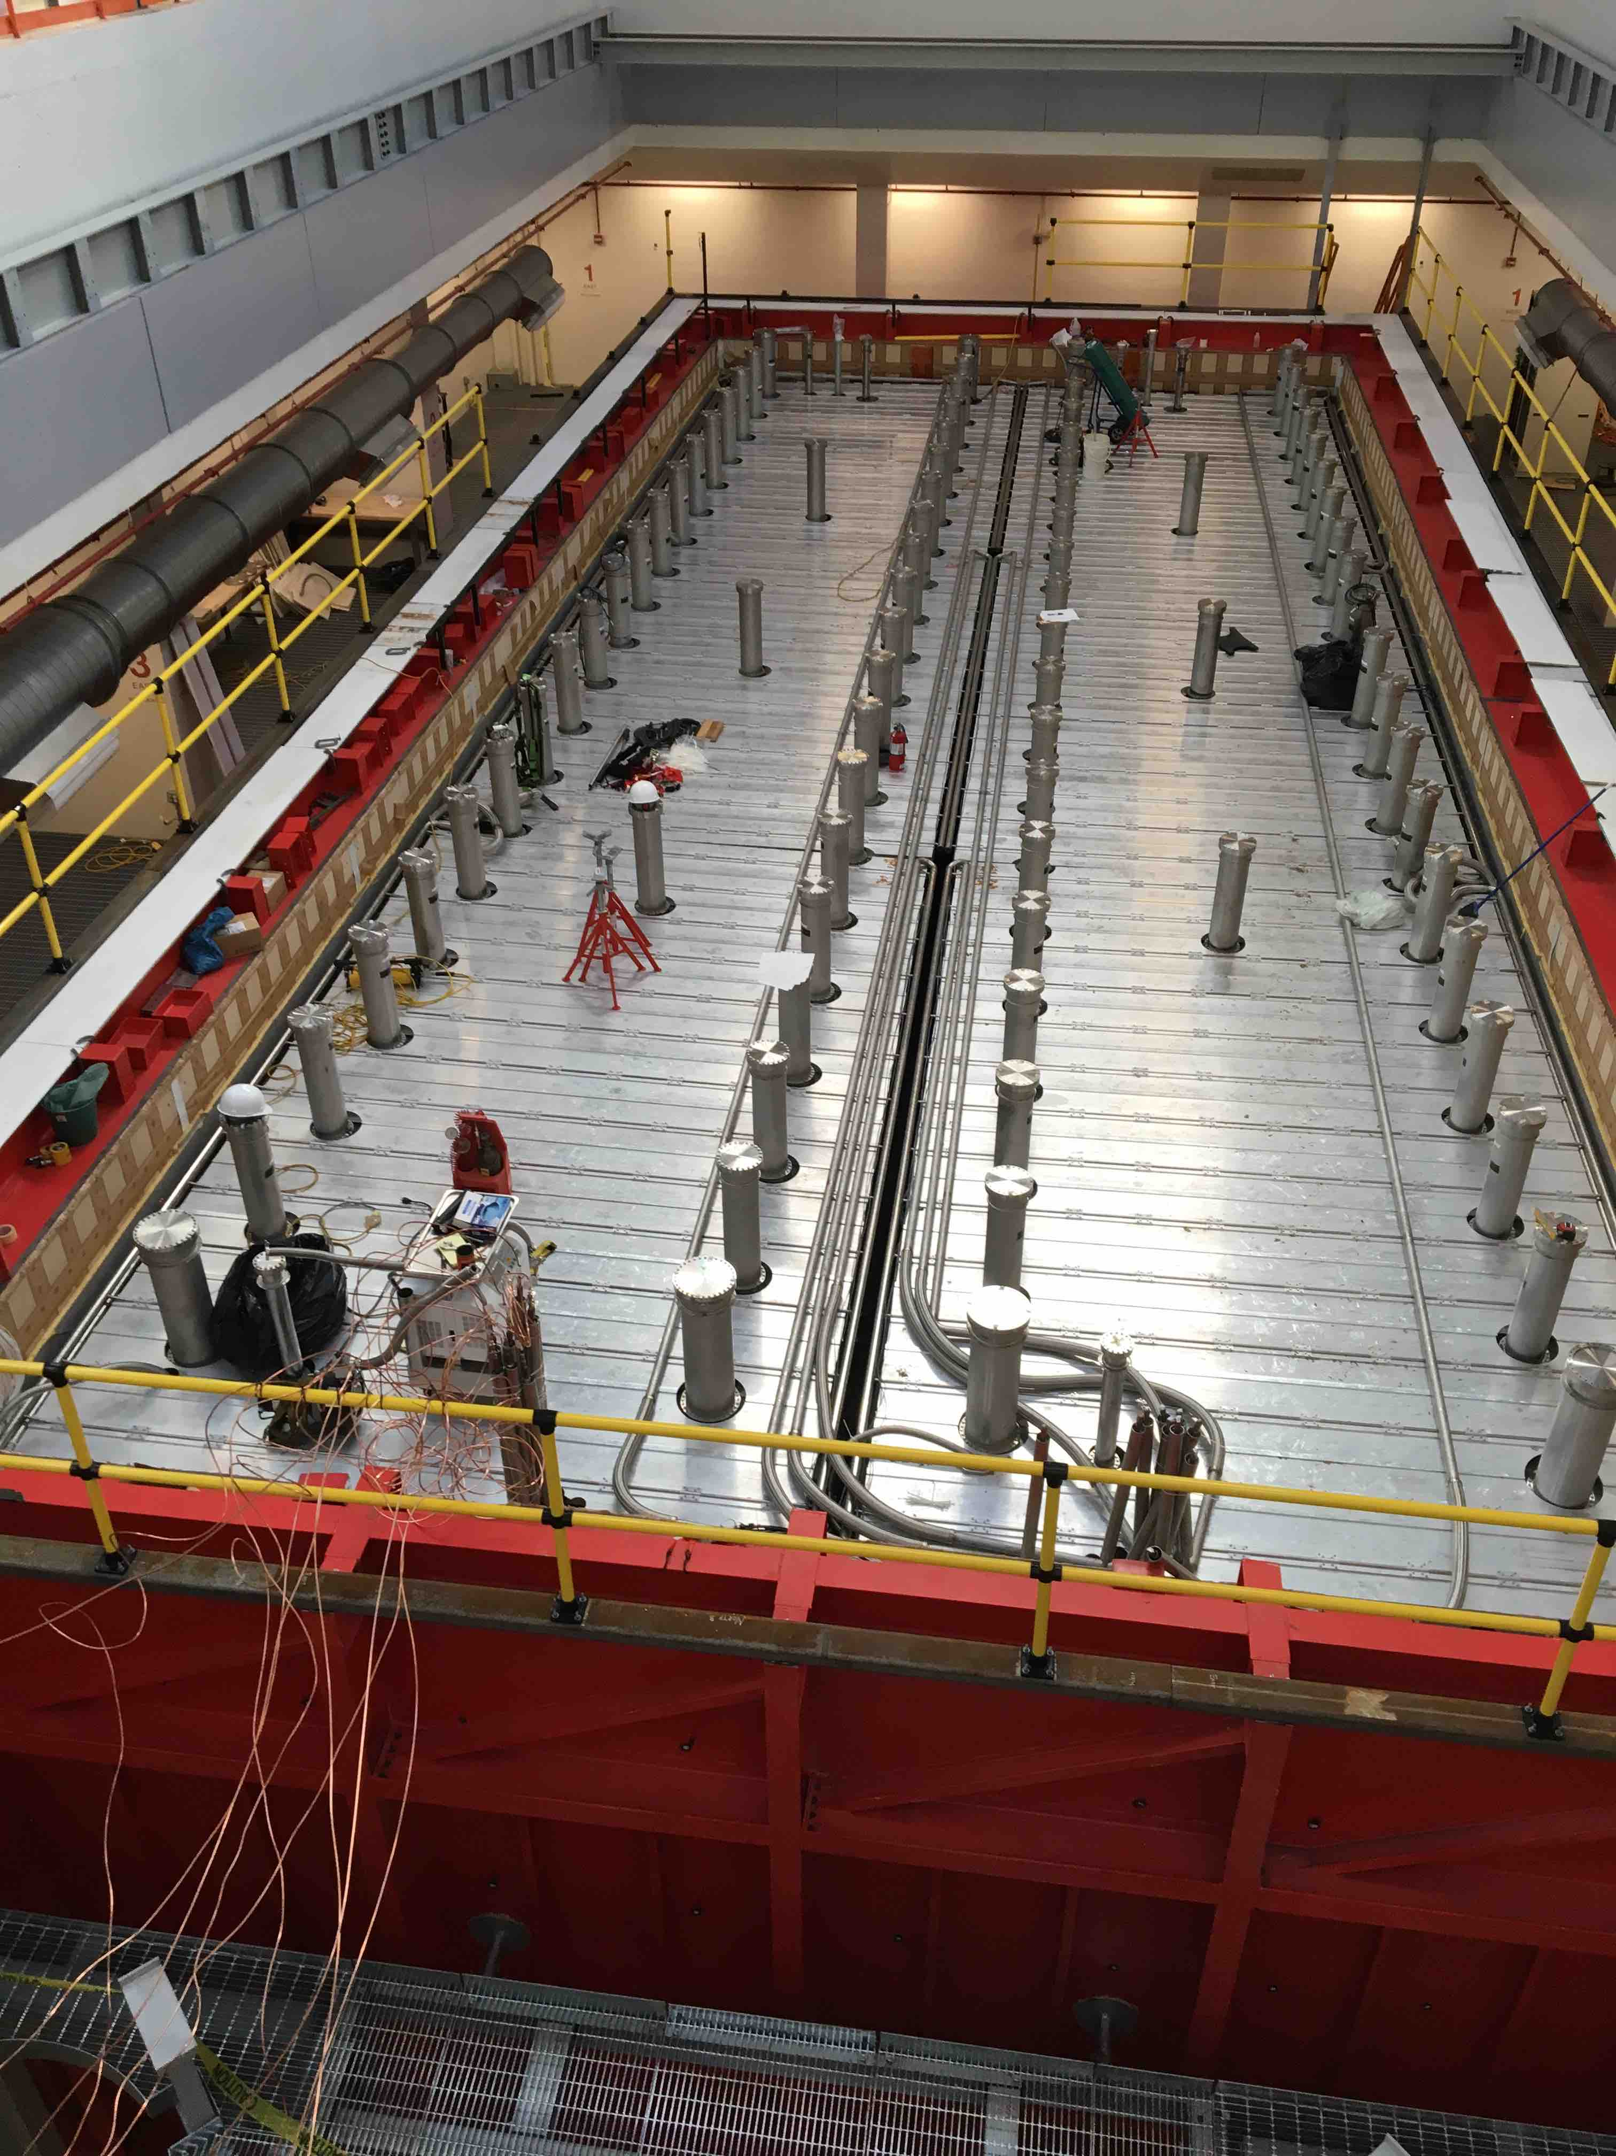
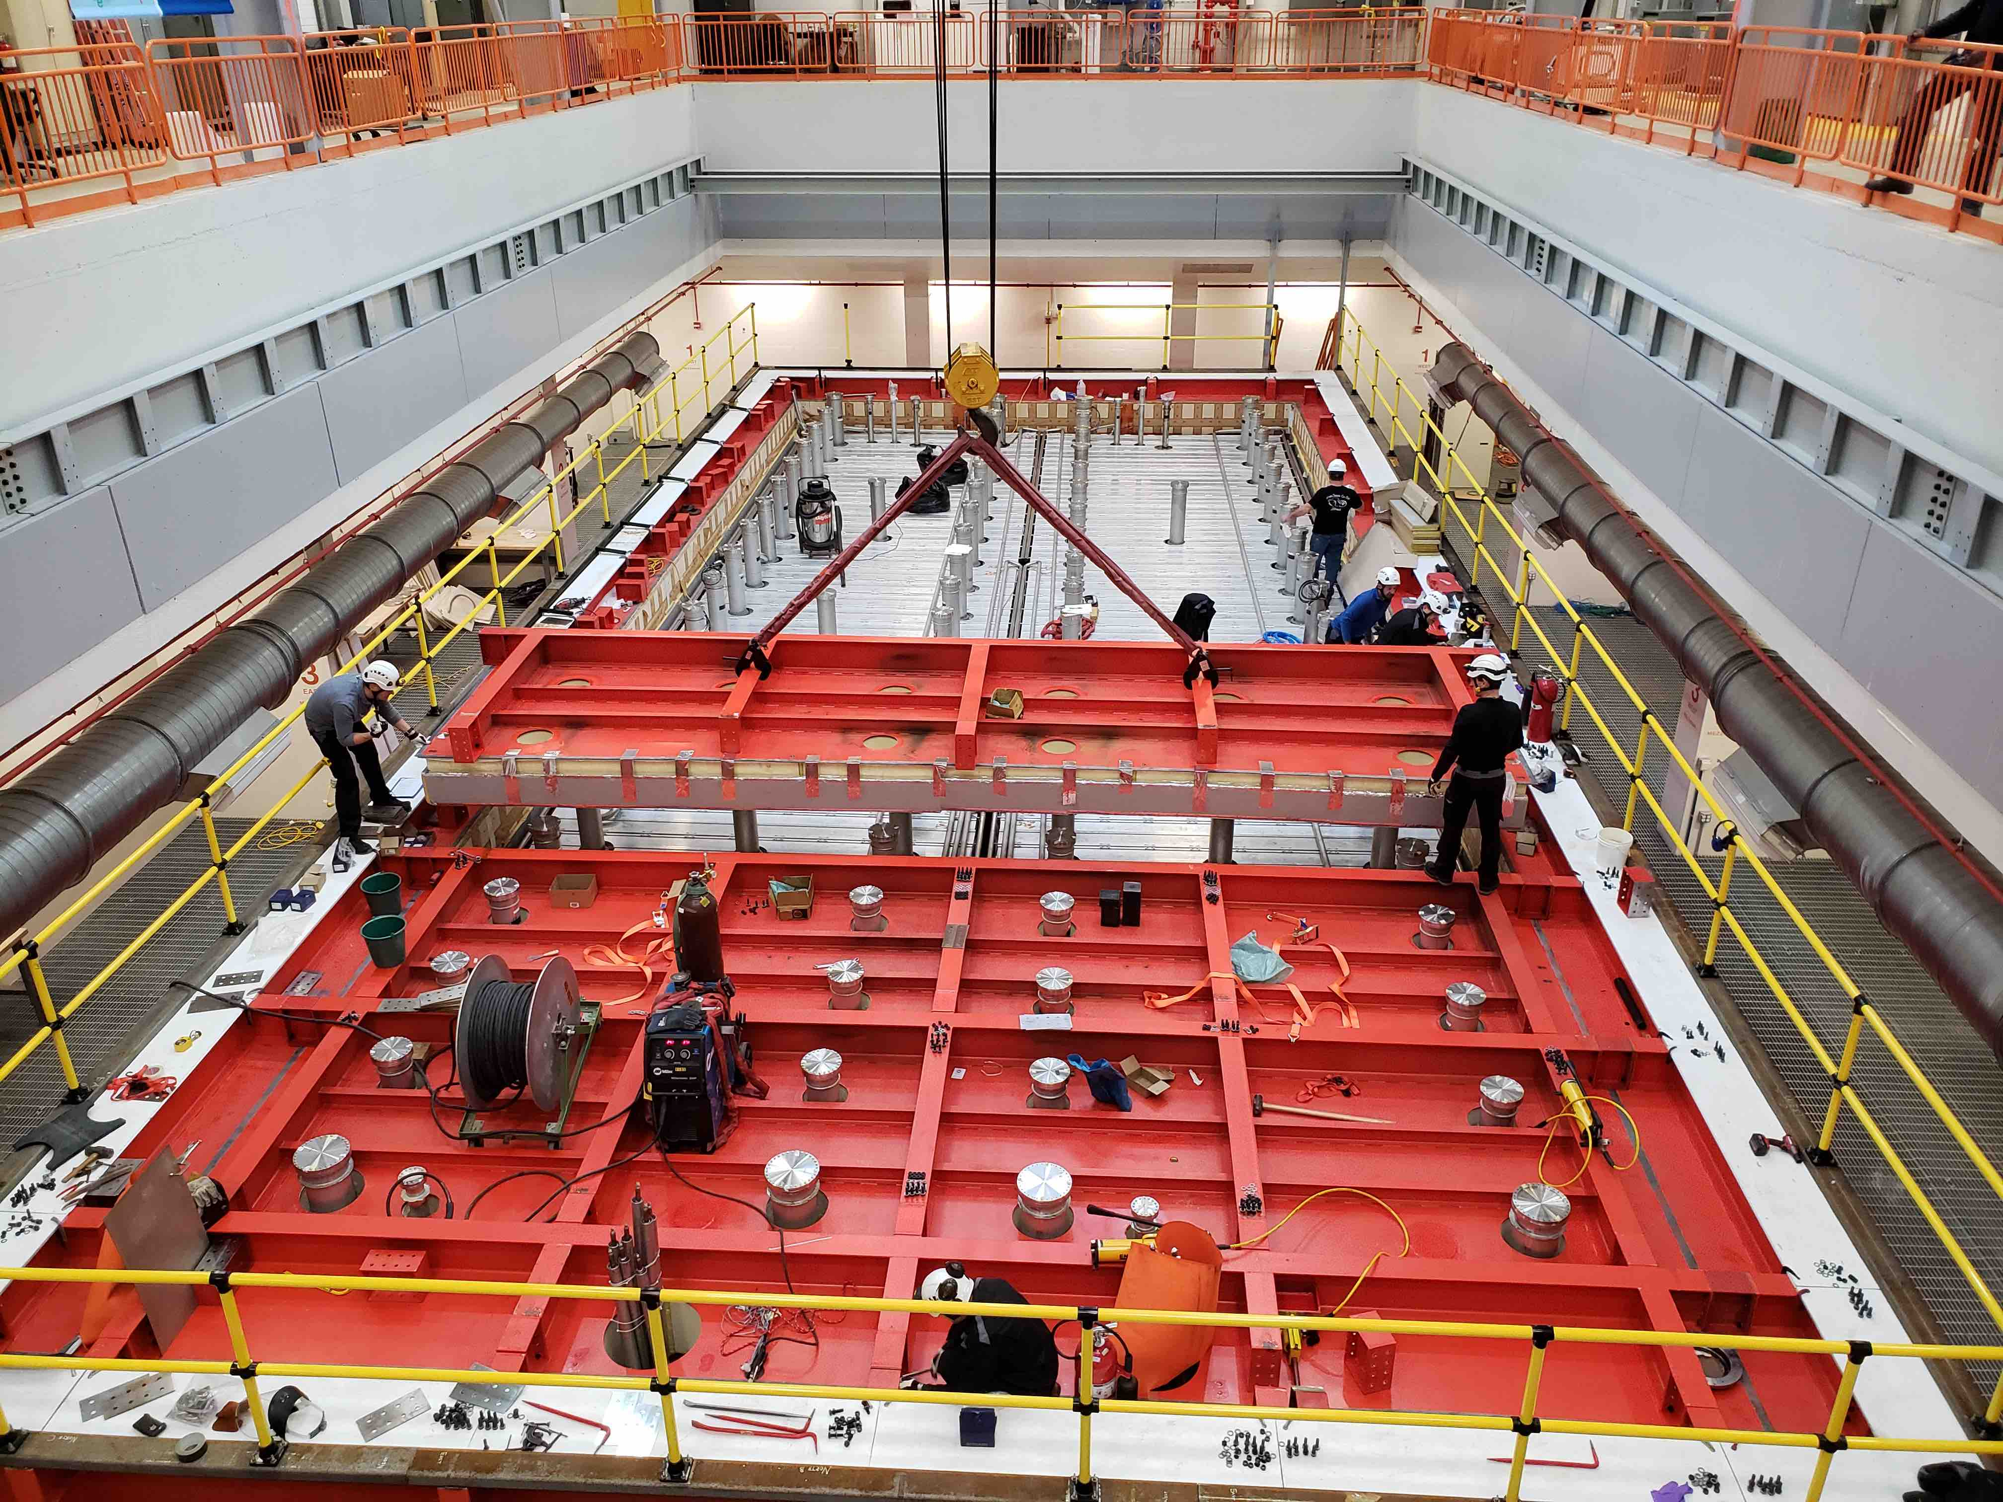
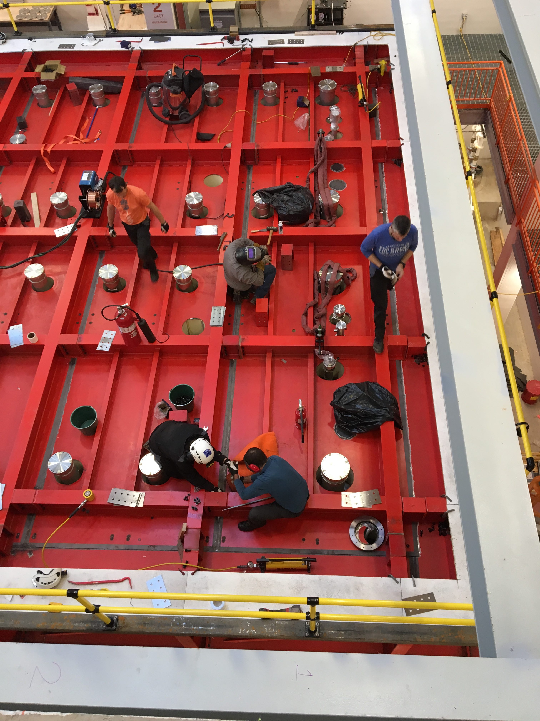
ICARUS Installation Progress
Vessel 2 Ready
Chimney Installation
(collaboration)
TPC 1 Complete
Post rigging installation on schedule:
  Vacuum test completed
  Top cold shield installed and complete system pressure tested
  Warm vessel roof installed, welded and leak checked
  Installation of steel structures completed:
    CRT top steel, cryogenic platform and stairs
    Guardrails
  Installation of feedthrough crosses is in progress
  Installation of feedthrough flanges to start next week
  Proximity cryogenics components in transit from CERN
    Arrived in New York this week, delivery to FNAL early December
  Demaco (CERN contractor) scheduled to start proximity cryogenics installation on Jan 28
Cold shield pressure test
Warm vessel roof installation

Slide 5
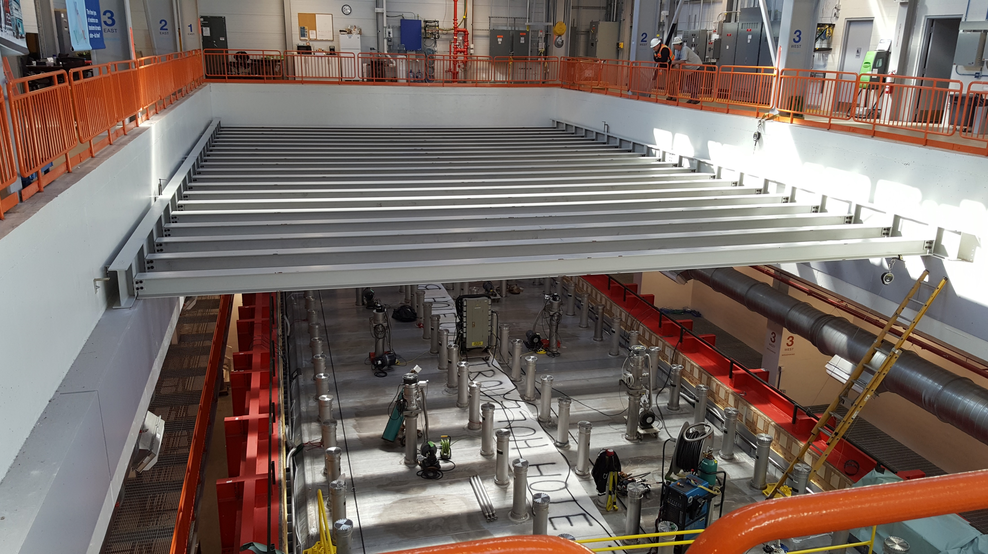
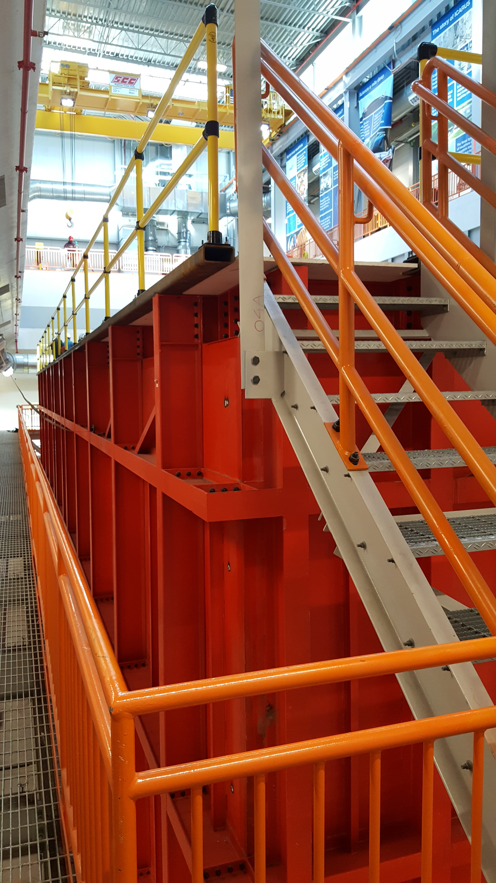
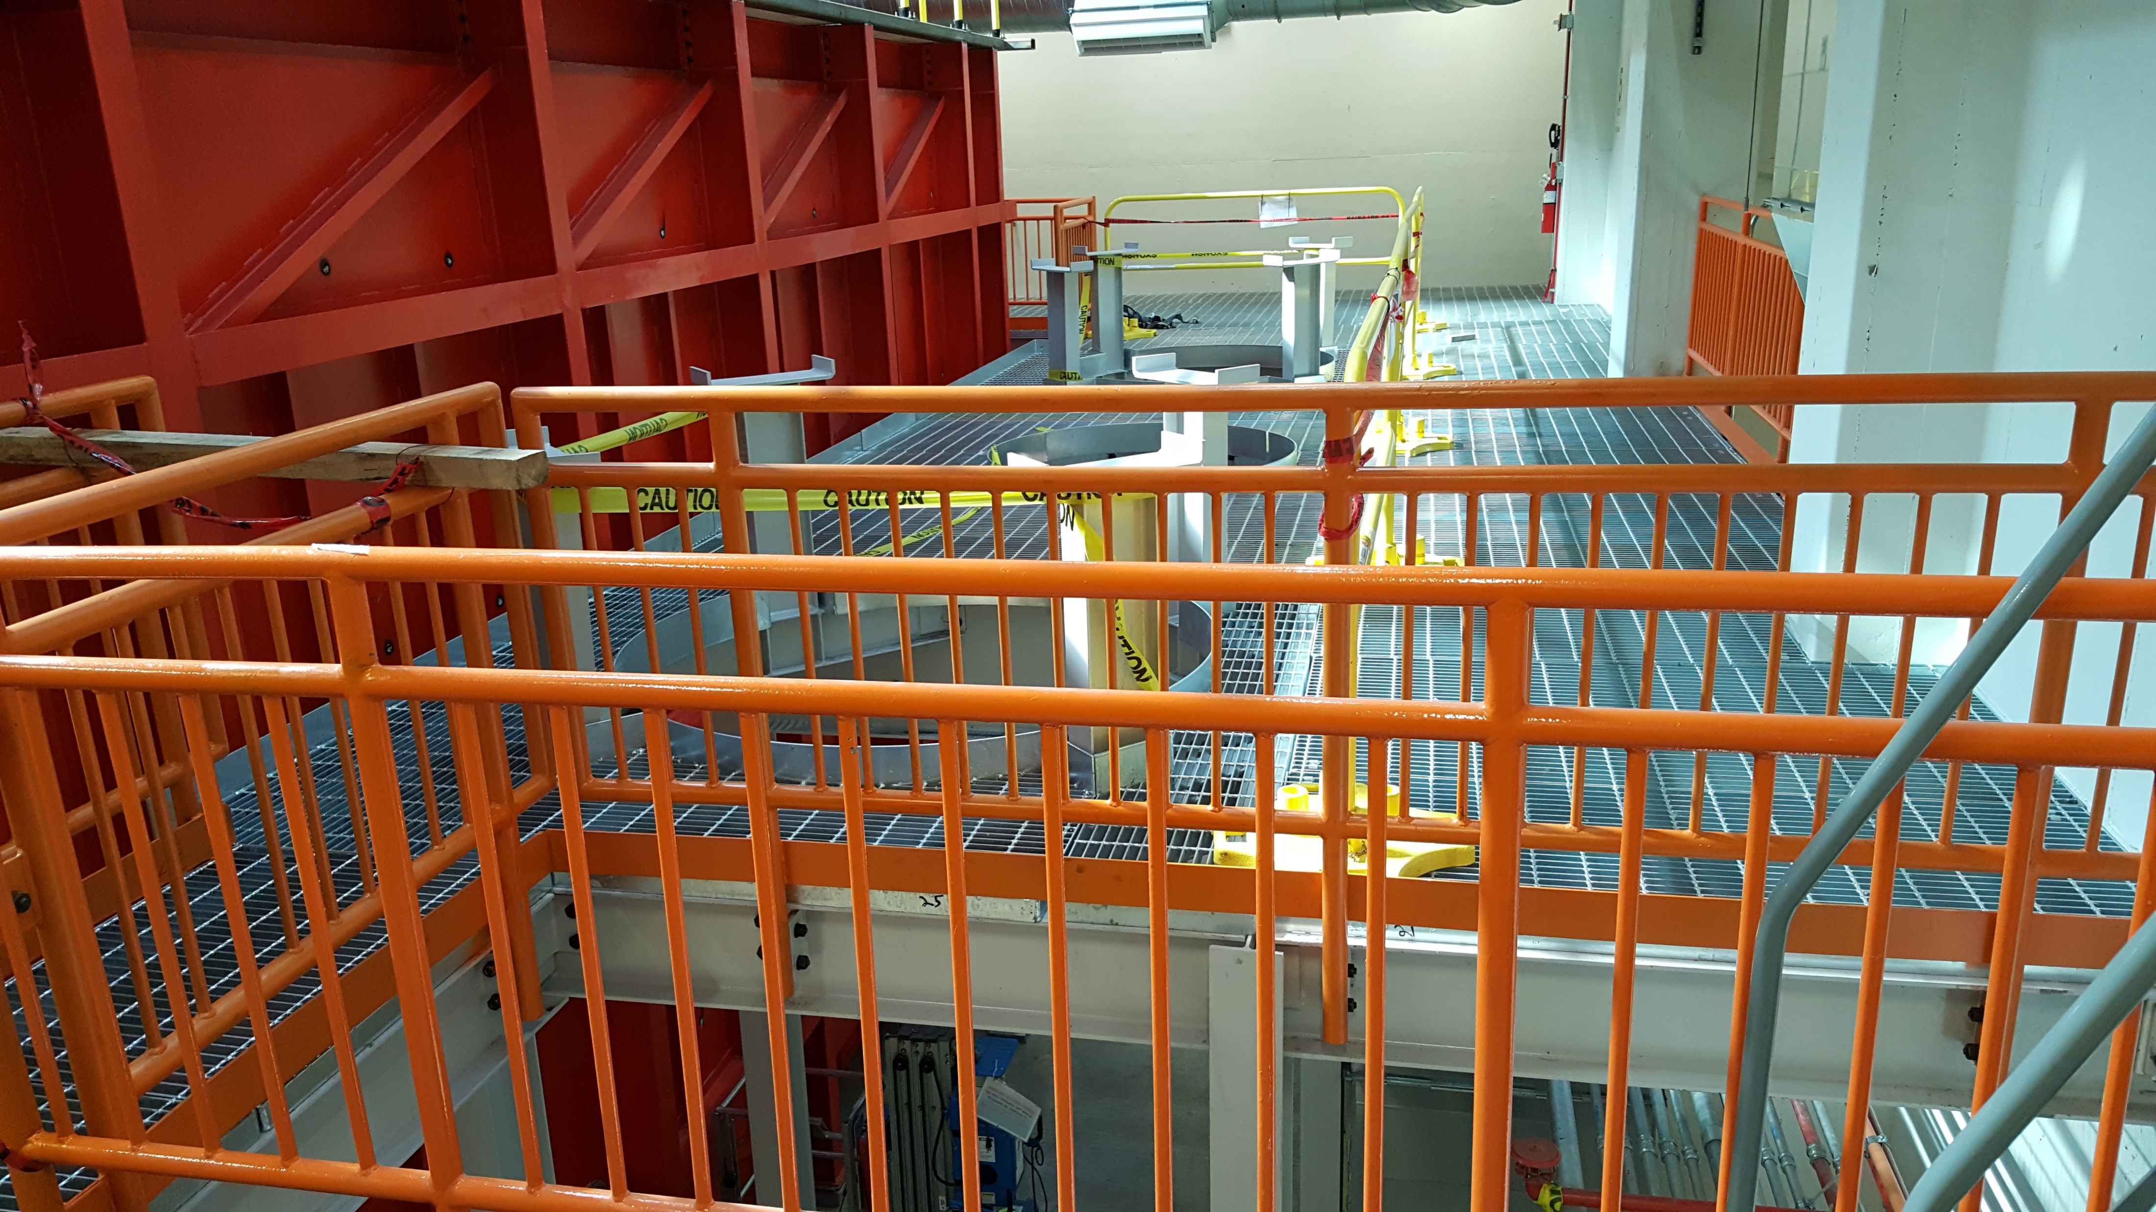
ICARUS Installation Progress
Vessel 2 Ready
TPC 1 Complete
Post rigging installation on schedule:
  Vacuum test completed
  Top cold shield installed and complete system pressure tested
  Warm vessel roof installed, welded and leak checked
  Installation of steel structures completed:
    CRT top steel, cryogenic platform and stairs
    Guardrails
  Installation of feedthrough crosses is in progress
  Installation of feedthrough flanges to start next week
  Proximity cryogenics components in transit from CERN
    Arrived in New York this week, delivery to FNAL early December
  Demaco (CERN contractor) scheduled to start proximity cryogenics installation on Jan 28
Top CRT structure
Access stairs
Cryogenics platform

Slide 6
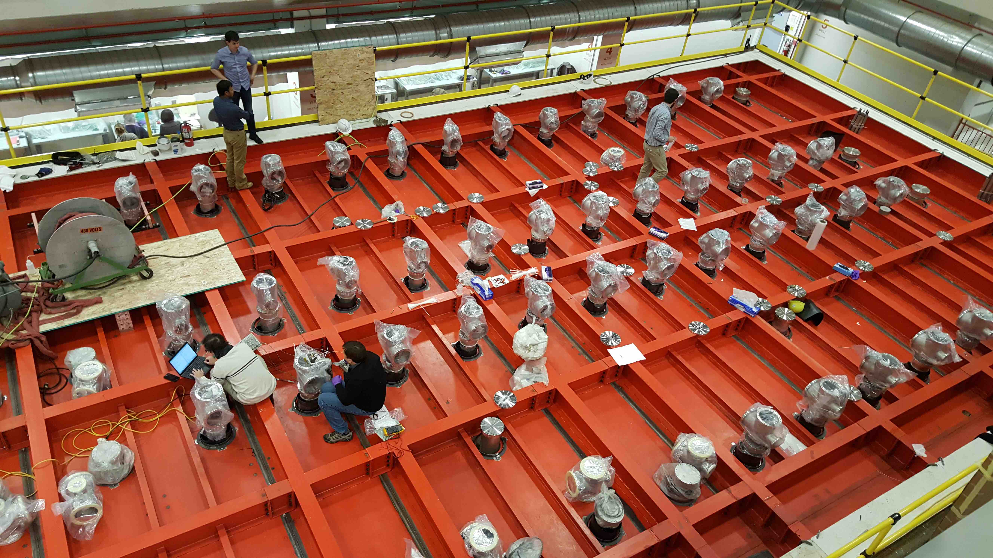
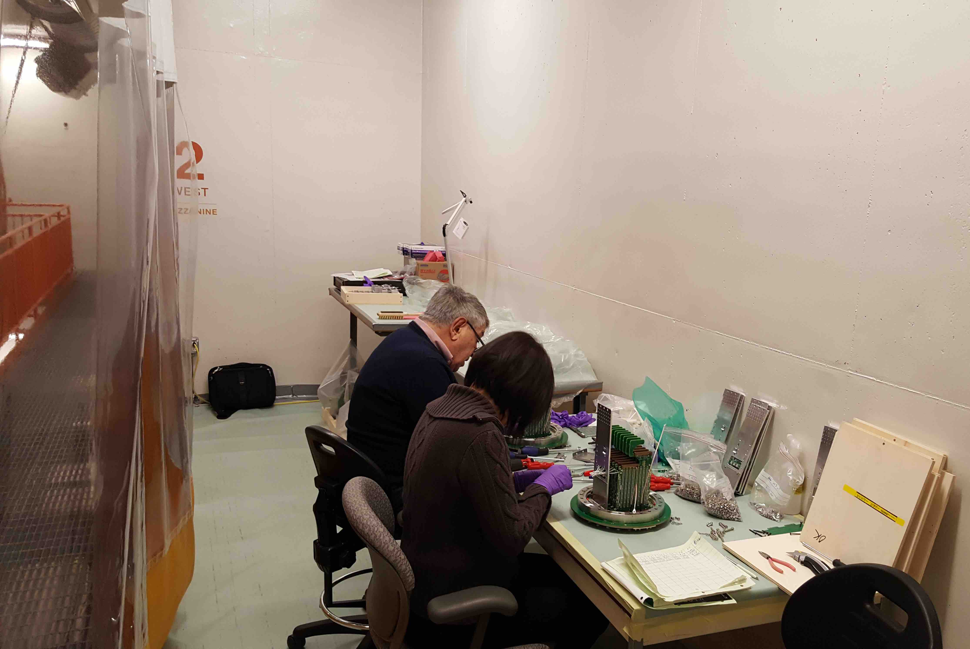
ICARUS Installation Progress
Vessel 2 Ready
TPC 1 Complete
Post rigging installation on schedule:
  Vacuum test completed
  Top cold shield installed and complete system pressure tested
  Warm vessel roof installed, welded and leak checked
  Installation of steel structures completed:
    CRT top steel, cryogenic platform and stairs
    Guardrails
  Installation of feedthrough crosses is in progress
  Installation of feedthrough flanges to start next week
  Proximity cryogenics components (far and near detector) in transit from CERN
    Six of ten containers at port in New York, delivery to FNAL in early December
  Demaco (CERN contractor) scheduled to start proximity cryogenics installation on Jan 28
Installing feedthrough crosses
Attaching decoupling cards to flanges

Slide 7
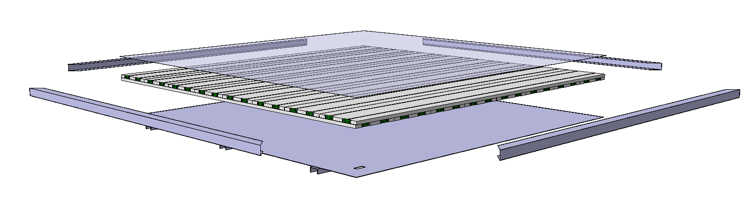
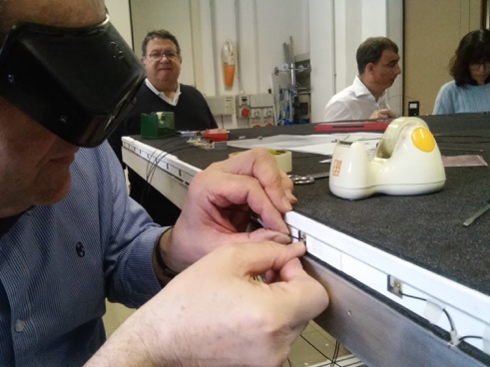
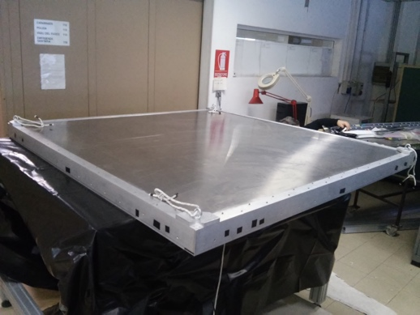

ICARUS Progress
TPC electronics production in final phase (INFN)
  On track to complete delivery to FNAL by May
Cosmic Ray Tagger (CRT)
  Bottom modules installed in 2017 (Double Chooz spares courtesy of U. Chicago)
  Top module production has at Frascati (CERN/INFN)
    First modules complete in January 2019
    Complete assembly in summer 2019
  Sides re-use MINOS far detector modules (FNAL/US), completing design of SiPM board
    Review of final prototype in January 2019
    SiPMs ordered
  Common electronics for top, sides and SBND – designed by U. Bern, commercialized by CAEN
  DAQ/event builder code
DAQ servers ordered (FNAL/INFN)
PreProduction Top CRT Module
@ Bologna
Prototype SiPM board and cable shroud for MINOS Modules

Slide 8
ICARUS Milestones to I-1 Ready to Fill
Intermediate Milestone | Owner | Baseline Date | Forecast Date |  | Actual Date
Vessels rigged into building | P. Wilson | 16-Aug-2018 | 16-Aug-2018 | ✓ | 16-Aug-2018
Manholes welded and vacuum test successful | C. Montanari | 10-Oct-2018 | 03-Oct-2018 | ✓ | 11-Oct-2018
Warm Vessel roof complete | C. James | 15-Nov-2018 | 9-Nov-2018 | ✓ | 31-Oct-2018
Cryo Platform complete | C. James | 15-Dec-2018 | 12-Oct-2018 | ✓ | 04-Oct-2018
Proximity cryogenics installation begins | B. Norris | 15-Jan-2019 | 30-Jan-2019
DBB & flanges installation complete and tested | A. Fava | 15-Feb-2019 | 21-Feb-2019
Cold proximity cryogenics installation complete | B. Norris | 15-Apr-2019 | 23-Apr-2019
1st T300 readout installation complete | A. Fava | 15-Mar-2019 | 11-Mar-2019
All detector readout installed | A. Fava | 1-May-2019 | 19-Apr-2019
Begin vacuum pumping | C. Montanari | 15-Jul-2019 | 15-May-2019
Cryogenic operation approved | B. Norris | 15-Jul-2019 | 28-Jun-2019
I1: ICARUS detectors ready to fill with LAr | P. Wilson | 30-May-2019 | 28-Jun-2019

Slide 9
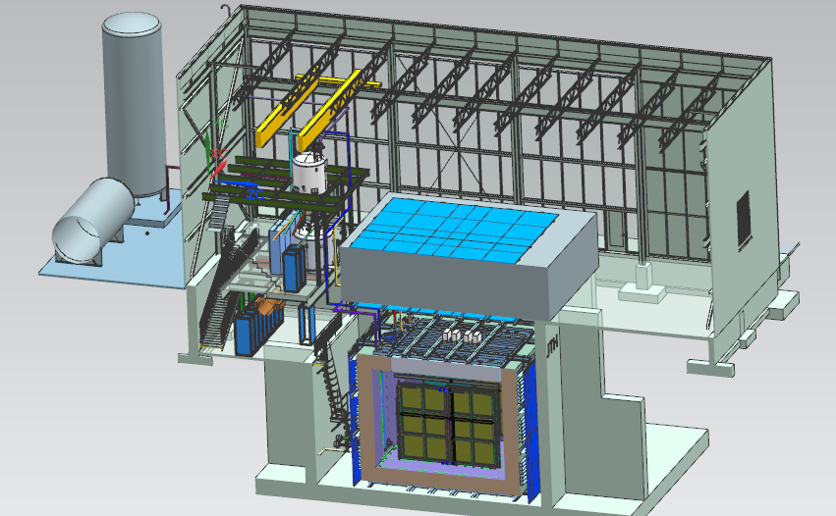
Near Detector - SBND
20 ton crane
Top CRT and Overburden
Cryogenic Dewars
Proximity Cryogenics
Readout racks
Top CRT
TPC
Cryostat
Side CRT

Slide 10
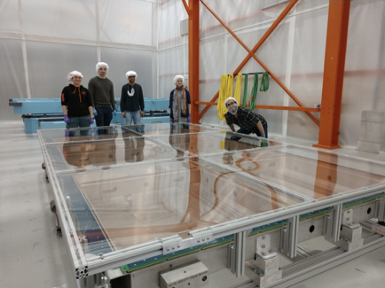
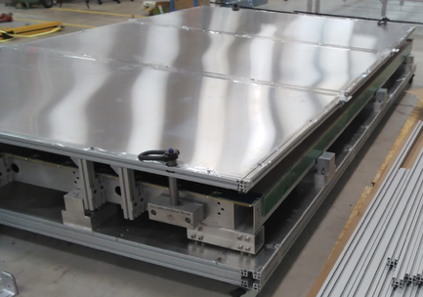
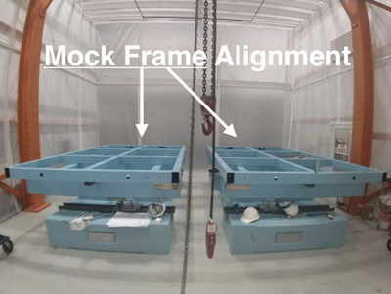
SBND TPC Progress
Joint responsibility of UK, US-NSF, FNAL
UK: Cathode plane, two anode planes, HV feedthrough
US-NSF: field cage, two anode planes, HV feedthrough
FNAL: support integration and assembly
Recent Milestones:
Aug 2018 1st UK and US anode planes completed
Sept 2018 Field cage completed
Oct 2018 1st UK anode delivered to FNAL
Sept 2018 Test of assembly fixture at FNAL
Nov 2018 2nd US anode plane completed
Dec 2018 US anodes delivered to FNAL
Feb 2019 2nd UK anode delivered to FNAL
1st Manchester APA at FNAL in DZero clean tent
Yale – 2nd APA ready to ship
Assembly facility at Dzero Assembly
building

Slide 11
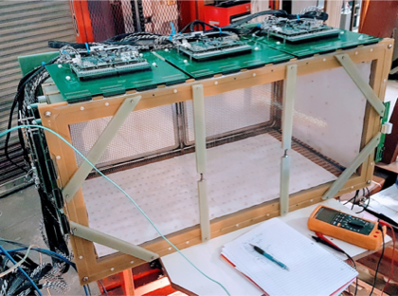
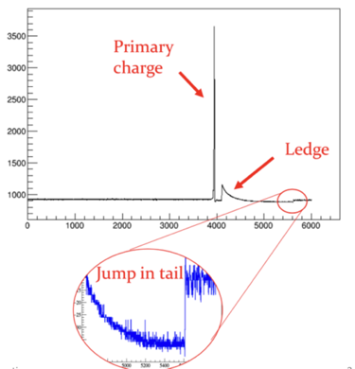
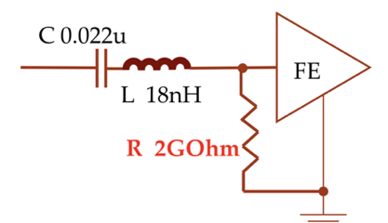
SBND TPC Electronics Progress
Cold electronics (BNL):
  Design very similar to ProtoDUNE (eg same FE ASIC)
  Use cold qualified commercial off the shelf ADC
Warm backend (Columbia – Nevis)
  Update of MicroBooNE design
Vertical slice test in summer 2018 with LArIAT TPC
  good noise performance
  No major issues with Nevis electronics
  Proximity of HV to cables and electronics caused FE channel failures and data corruption, very different detector configuration than SBND
Addressing lessons from ProtoDUNE
  FE ASIC “ledge effect” – large charge depositions cause a dead period of several hundred microsecs
  Ongoing investigations by ProtoDUNE and at BNL
  Mitigated by modifying layout of FE board to include 1-2GOhm resistor and operation with higher baseline setting
  Continuing study of physics effects
Production Readiness Review – Nov 29
  Recommends proceeding with production
LArIAT TPC w/ SBND electronics
amplitude
Time tic
Ledge effect @protoDUNE

Slide 12
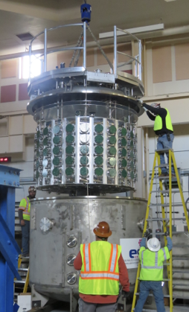
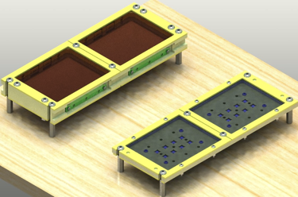
SBND Photo Detection Progress
120 SBND PMTs are now in the Coherent CAPTAIN-Mills Detector (CCM)
  Fill with LAr ~now
Electronics and DAQ are ready, the HV breakout boxes will be finished soon
ARAPUCA group has made prototypes to be tested in argon at the end of November
ARAPUCA group ready to purchase feedthroughs as soon as bar group makes a final decision about connectors and costs
CCM preparing to test PMTs at LANL
ARAPUCA prototypes

Slide 13
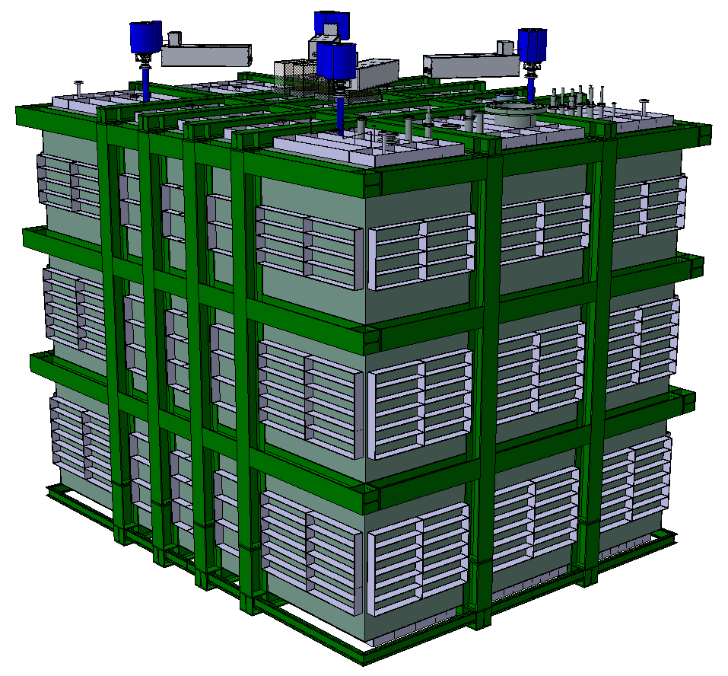
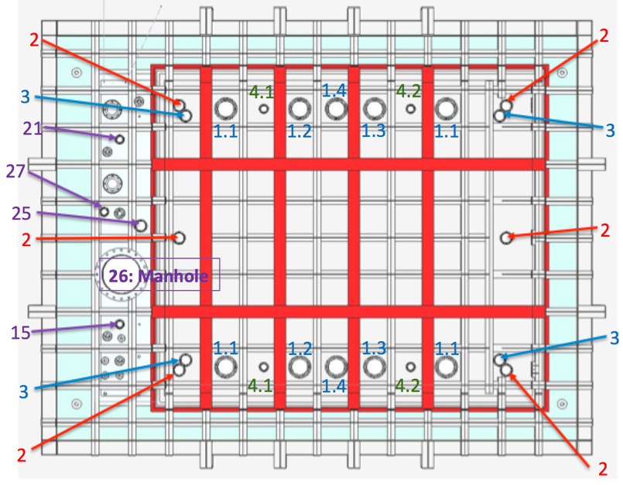
SBND Cryostat
Outer steel structure + GTT designed membrane cryostat
  Joint responsibility of CERN, FNAL and INFN
SBND will be 3rd generation prototype for DUNE designed by CERN:
  WA105 1x1x3 ➔ protoDUNEs ➔ SBND
  Steel structure design updated to match LBNF/DUNE as closely as possible
Status:
  General agreement between CERN-FNAL-INFN on sharing of responsibilities
  Final design of steel structure nearly complete
  Ready to start final design study for membrane cryostat by GTT
SBND Cryostat Model
Cryostat Top Interfaces

Slide 14
SBND Milestones to S-1 SBND ready to move
Intermediate Milestone | Owner | Baseline Date | Forecast Date (Schedule) |  | Actual Date
First set of APAs shipped to Fermilab | K. Mavrokoridis | 24-Sept 2018 | 28-Dec-2018
PO for COTS ADCs placed | H. Chen | 10-Oct-2018 | 30-Nov-2018 | ✓ | 30-Oct-2018
All TPC Components at Fermilab | K. Mavrokoridis | 1-Mar-2019 | 26-Feb-2019
Complete atf assembly at DAB | J. Zennamo | 1-May-2019 | 8-Apr-2019
50% of motherboards delivered to Fermilab | H. Chen | 15-May-2019 | 15-Apr-2019
APAs and CPAs installed in atf | J. Zennamo | 15-Jun-2019 | 23-May-2019
Field cage assembly complete | J. Zennamo | 15-Jul-2019 | 2-Jul-2019
Cold electronics installed and tested | H. Chen | 23-Aug-2019 | 8-Aug-2019
S1: TPC ready to move to SBN ND | A. Schukraft | 30-Aug-2019 | 8-Aug-2019

Slide 15
SBND Milestones to S-2 Ready to Fill
Intermediate Milestone | Owner | Baseline Date | Forecast Date |  | Actual Date
GTT Design Study Begins | M. Nessi | 1-Feb-2019 | 1-Jan-2019
Delivery of warm box steel | M. Nessi | 15-Jun-2019 | 30-Apr-2019
Warm vessel installation complete | M. Nessi | 15-Jul-2019 | 29-May-2019
TPC Transport to ND building complete | J. Zennamo | 15-Sept-2019 | 16-Aug-2019
Cryostat material arrives at Fermilab | M. Nessi | 1-Oct-2019 | 22-Aug-2019
Cryostat top plug is ready to attach to atf | M. Nessi | 1-Nov-2019 | 23-Sept-2019
Membrane Cryostat Completed | M. Kim | 1-Mar-2020 | 22-Jan-2020
Plug welded to cryostat | M. Kim, J. Zennamo | 15-Apr-2020 | 6-Mar-2020
Cryogenic operation approved | M. Geynisman | 1-Jul-2020 | 1-Jun-2020
S2: SBND detector is ready to fill with liquid Argon | A. Schukraft | 15-Jul-2020 | 1-Jun-2020

Slide 16
SBN Director’s Review – Dec 2018
A Director’s Review for SBN will be held Dec 17-19 2018
The charge and review format will be similar to the June 2018 review:
  Focus on schedule elements and integrated schedule
  Will include more detail on commissioning plans
  Session on DOE costs
Charge is posted on the indico page for this meeting
Review agenda is being finalized now
Preparation for review
  Schedules for both ICARUS and SBND have been updated in October
    Includes integration of commissioning milestones
  Updated estimate of DOE costs including commissioning costs

Slide 17
Backup

Slide 18
ICARUS Milestones to I-2 Detector Filled
Intermediate Milestone | Owner | Baseline Date | Forecast Date |  | Actual Date
Cold shield cooldown complete | C. Montanari | 7-Aug-2019 | 15-Jul-2019
Vessels filled with LAr, ready for HV | M. Geynisman | 30-Sept-2019 | 10-Sept-2019
Drift HV operational | F. Garcia | 15-Oct-2019 | 30-Sept-2019
PMTs operational | G. Raselli | 30-Oct-2019 | 15-Oct-2019
Cryogenics commissioning complete | M. Geynisman | 30-Nov-2019 | 22-Oct-2019
Cosmic tracks are observed in the TPC | A. Fava | 30-Nov-2019 | 22-Oct-2019
I2: detector is filled with liquid argon and ready for physics commissioning (LAr purity adequate for physics has been achieved) | P. Wilson | 30-Nov-2019 | 22-Oct-2019

Slide 19
ICARUS Milestones to I-3a ready for physics data – CRT operational
Intermediate Milestone | Owner | Baseline Date | Forecast Date |  | Actual Date
Top CRT panels delivered to Fermilab | U. Kose | 30-Sept-2019 | 31-Jul-2019
Slow controls operational for all detector systems | K. Biery | 31-Oct-2019 | 30-Sept-2019
DAQ operational with >5Hz output | K. Biery | 31-Oct-2019 | 30-Sept-2019
Detector system timing synchronized with beam | K. Biery | 30-Nov-2019 | 31-Oct-2019
Trigger system operational | A. Guglielmi | 31-Dec-2019 | 30-Nov-2019
Top CRT panels are installed and ORC’ed | U. Kose/A. Fava | 31-Jan-2020 | 5-Dec-2019
I3a: ICARUS detectors are ready for physics data – CRT is operational | P. Wilson | 31-Jan-2020 | 5-Dec-2019

Slide 20
ICARUS Milestones to I-3a ready for physics data – shielding in place
Intermediate Milestone | Owner | Baseline Date | Forecast Date |  | Actual Date
Shielding blocks in place | C. James | 28-Feb-2020 | 6-Feb-2020
I3b: ICARUS detectors are ready for physics data – Shielding in place | P. Wilson | 28-Feb-2020 | 6-Feb-2020

Slide 21
SBND Milestones to S3 Detector Filled
Intermediate Milestone | Owner | Baseline Date | Forecast Date |  | Actual Date
Laser system installation complete | I. Kreslo | 1-Oct-2020 | 31-Mar-2020
Detector checkout at 130-150 K complete | M. Stancari | 15-Nov-2020 | 16-Oct-2020
Vessels filled with LAr, ready for HV | M. Geynisman | 21-Dec-2020 | 30-Oct-2020
Drift HV operational | A. Schukraft | 31-Jan-2021 | 1-Dec-2020
PMTs operational | R. Van de Water | 31-Jan-2021 | 20-Nov-2020
Cryogenics commissioning complete | M. Geynisman | 28-Feb-2021 | 15-Dec-2020
Cosmic tracks are observed in the TPC | M. Stancari | 28-Feb-2021 | 15-Dec-2020
S3: SBND detector is filled with liquid argon and ready for physics commissioning (LAr purity adequate for physics has been achieved) | A. Schukraft/M. Stancari | 28-Feb-2021 | 15-Dec-2020

Slide 22
SBND Milestones to S-4a ready for physics data – CRT operational
Intermediate Milestone | Owner | Baseline Date | Forecast Date |  | Actual Date
Top CRT panels delivered to Fermilab | I. Kreslo | 1-Jul-2019 | 1-Apr-2019
Slow controls operational for all detector systems | S. Gallopini | 15-Sept-2020 | 17-Jul-2020
DAQ operational with >5Hz output | W. Badgett | 1-Nov-2020 | 2-Oct-2020
Detector system timing synchronized with beam | W. Badgett | 15-Nov-2020 | 11-Sept-2020
Trigger system operational | W. Badgett | 15-Jan-2021 | 15-Dec-2020
Top CRT panels are installed and ORC’ed | I. Kreslo | 31-Mar-2021 | 11-Jan-2021
S4a: SBND detectors are ready for physics data – CRT is operational | M. Stancari | 31-Mar-2021 | 19-Jan-2021

Slide 23
SBND Milestones to S-4b ready for physics data – shielding in place
Intermediate Milestone | Owner | Baseline Date | Forecast Date |  | Actual Date
Shielding blocks in place | C. James | 21-Apr-2021 | 8-Feb-2021
CRT system complete and fully commissioned | I. Kreslo | 30-Apr-2021 | 15-Feb-2021
S4b: SBND detectors are ready for physics data – Shielding | M. Stancari | 30-Apr-2021 | 15-Feb-2021

