Slide 1
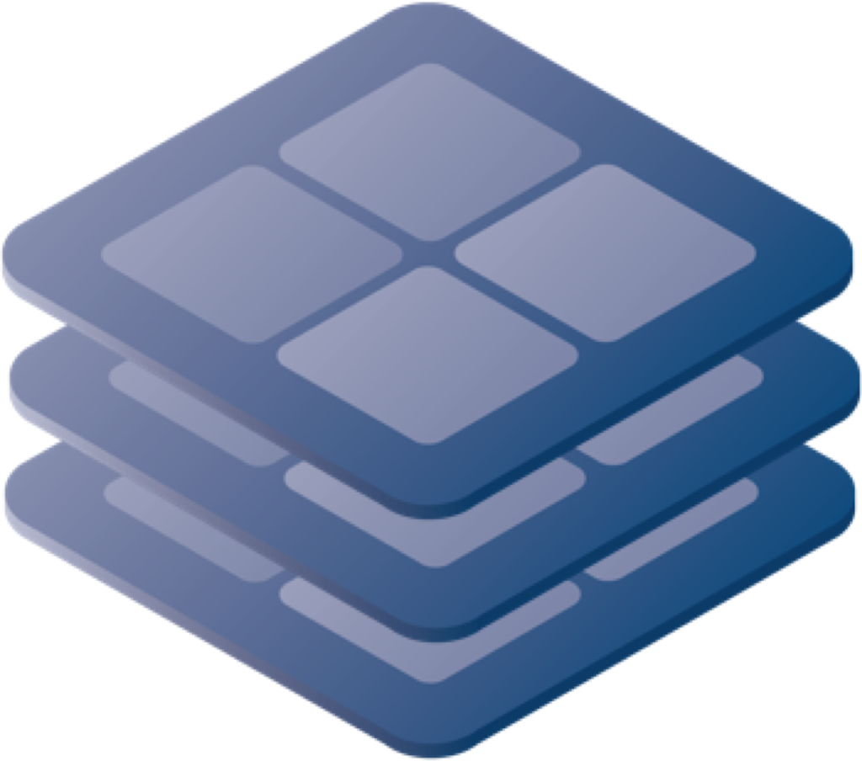
SLATE Client and Server Architecture
Chris Weaver
August 29, 2018

Slide 2
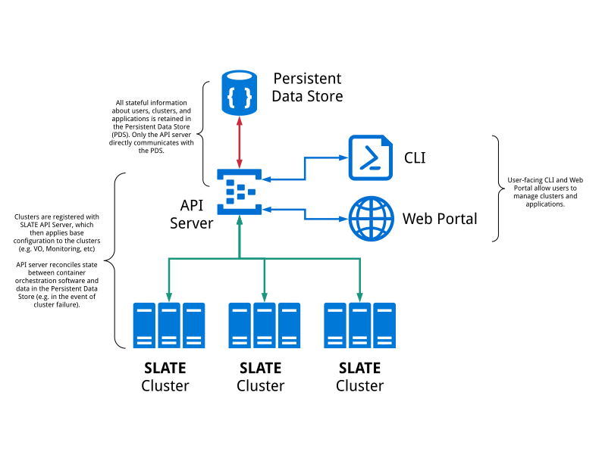
Architecture
August 29, 2018

Slide 3
SLATE Goals
Simplicity
Many potential users have no experience with Kubernetes. Well written Helm charts should enable them to install applications anyway.
Security
Allowing only curated charts simplifies what we ask site administrators to trust
Limited access to edge clusters—SLATE is a regular, limited cluster user
Flexibility
Both dedicated and otherwise existing clusters should be able to participate in SLATE federation
August 29, 2018

Slide 4
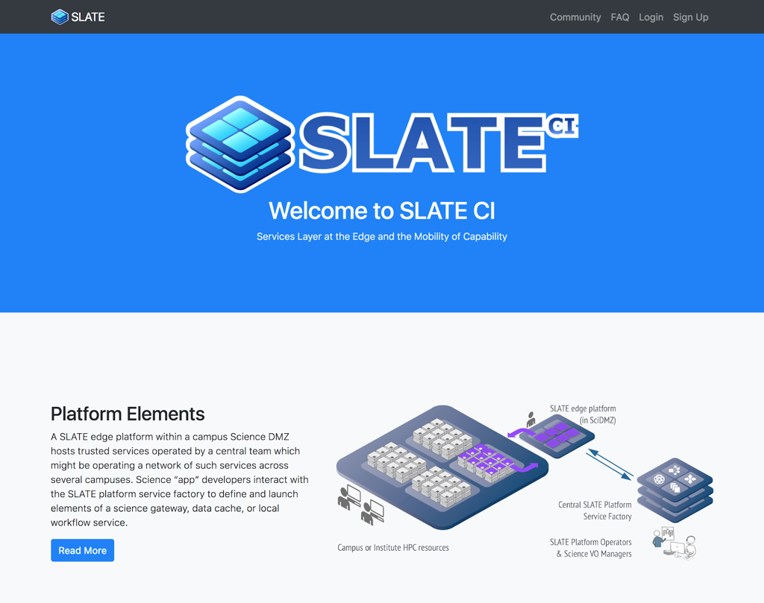
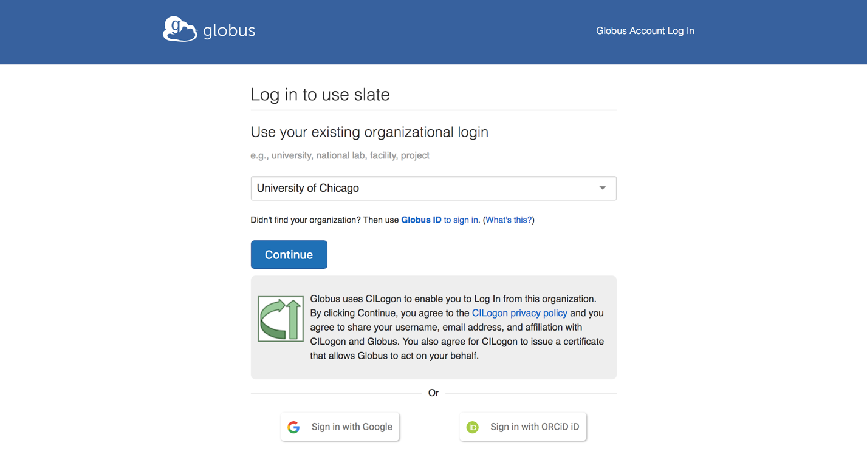
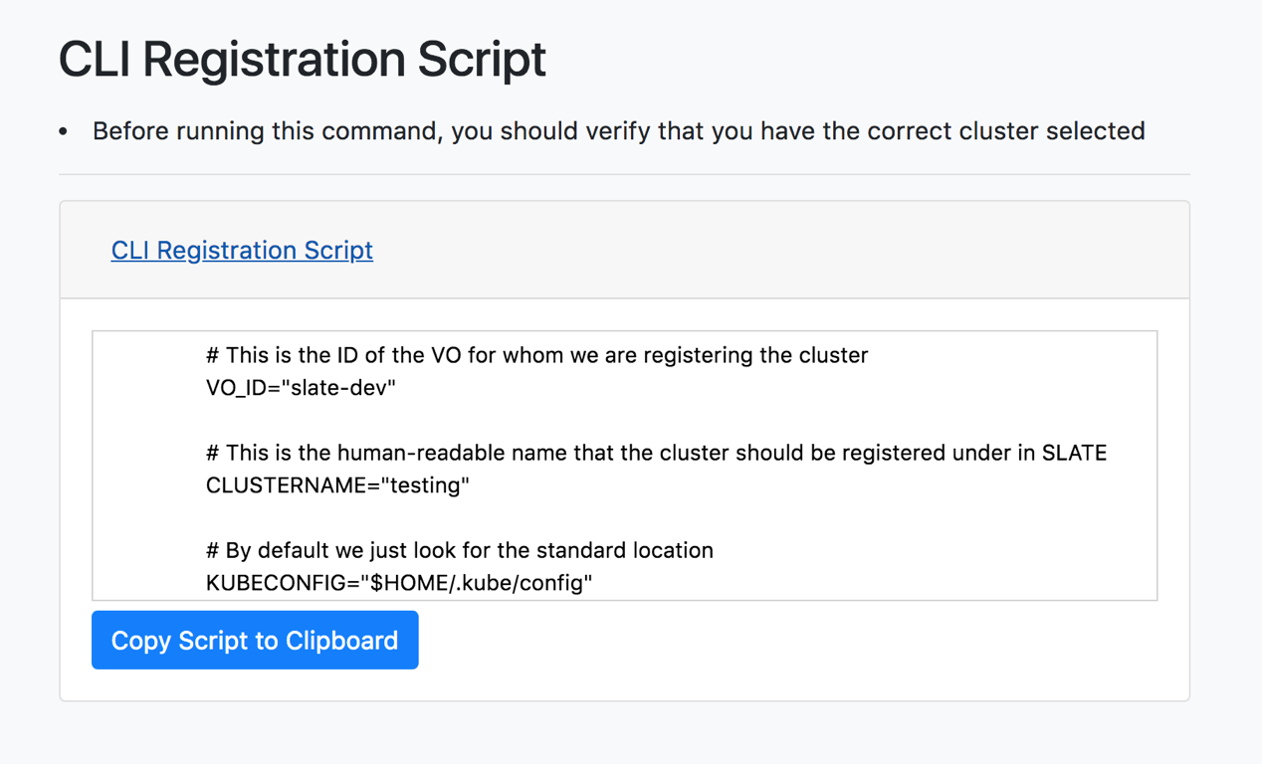
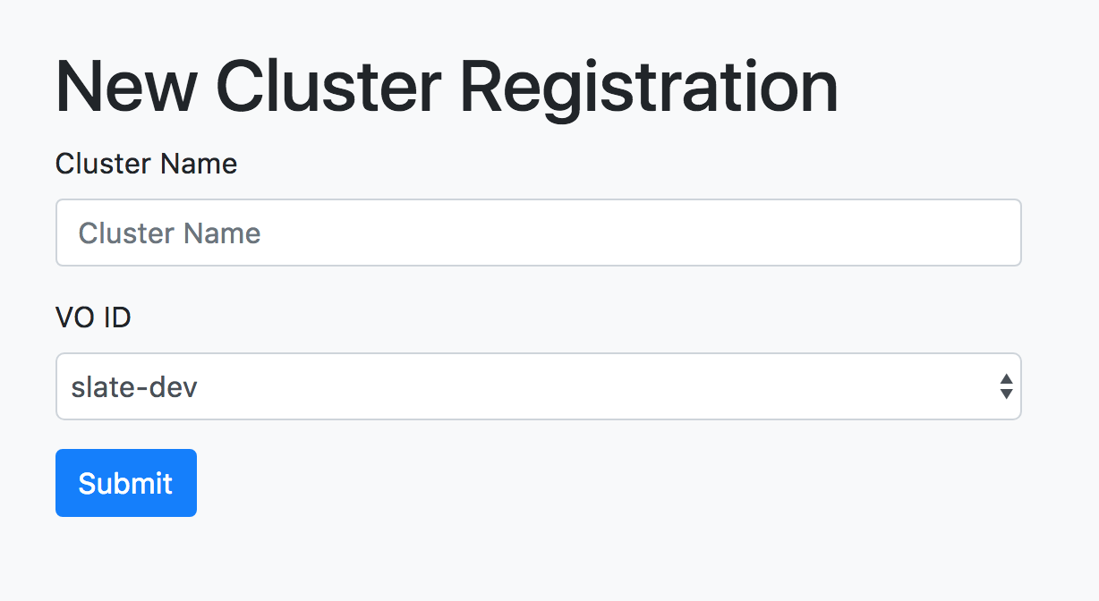
Web Portal
Globus Auth
Signup/Login
Application and Cluster Admins
Cluster Admins
August 29, 2018

Slide 5
Command-Line Interface
Niobium-III $ ./slate-client cluster list
Name ID
us-chicago-minikube Cluster_71da4abf-6340-4169-aec9-446816d36d79
Niobium-III $ ./slate-client app list --dev
Name App Version Chart Version Description
slate-dev/elasticsearch 0
slate-dev/fluentbit-kibana 0.1
slate-dev/jupyterhub v0.8.1 v0.7-dev Multi-user Jupyter installation
slate-dev/osg-frontier-squid squid-3 0.2.0 A Helm chart for configuration and deployment...
slate-dev/perfsonar 1.0 0.1.0 A Helm chart for Kubernetes
Niobium-III $ ./slate-client app install --dev --vo test-vo --cluster us-chicago-minikube osg-frontier-squid
Successfully installed application "osg-frontier-squid" as instance "osg-frontier-squid" with ID "Instance_e4357b8c-8176-482e-be2e-5917b686159d"
Niobium-III $ ./slate-client instance info Instance_e4357b8c-8176-482e-be2e-5917b686159d
Name Started VO Cluster ID
osg-frontier-squid 2018-Jul-13 16:24:45 UTC test-vo us-chicago-minikube Instance_e4357b8c-8176-482e-be2e-5917b686159d
Services:
Name Cluster IP External IP ports
osg-frontier-squid-global 10.96.65.120 <pending> 3128:30822/TCP
Configuration: (default)
Interface very much inspired by kubectl
Similar, but simpler, set of capabilities
August 29, 2018

Slide 6
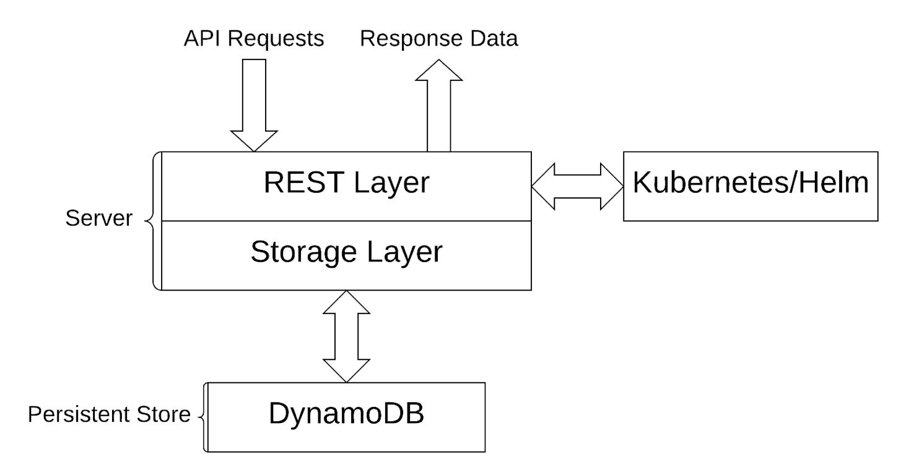
API Server Structure
API server performs authentication and authorization checks on all user requests
If authorized, carries them out by issuing commands to kubectl, helm, or recording information in the Persistent Store
Server itself has no important state
August 29, 2018

Slide 7
Design Choices
SLATE uses RBAC and a Kubernetes plugin developed by the Pacific Research Platform group to isolate user groups (VOs) while requiring minimal privileges on the Kubernetes cluster
This enables SLATE to work within cluster admins' security choices
A single cluster can belong to more than one SLATE federation
The VOs which may access a cluster can be controlled by that cluster's admins via a whitelist
Cluster admins can likewise choose to limit exactly which applications an admitted VO may deploy on that cluster
August 29, 2018

Slide 8
Design Choices
Using Helm and curating charts can boost confidence in available applications and make getting started easy for new users
Charts need to be written, which isn’t always easy
We are still figuring out best practices ourselves
Requiring Helm means that we can’t directly use applications containerized in other ways
Are Helm charts useful to Kubernetes user outside SLATE?
Helm itself can be a somewhat awkward tool, which is part of why we wrap it up as an internal detail of our API
August 29, 2018

