Slide 1
Accelerator Status
Patrick Karns
Proton PMG
06 December 2018

Slide 2
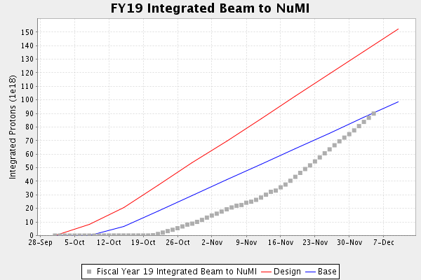
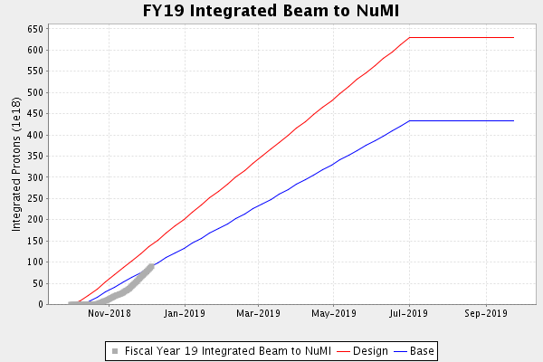
NuMI Operation
9.108e¹⁹ POT integrated as of 08:00 12/05/2018

Slide 3
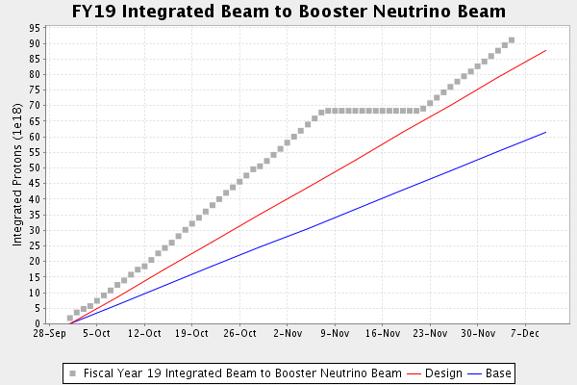
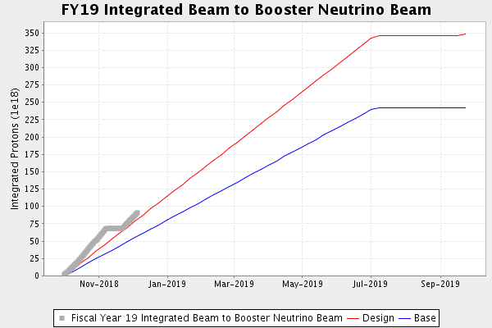
BNB Operation
9.008 e¹⁹ POT integrated as of 08:00 12/05/2018

Slide 4
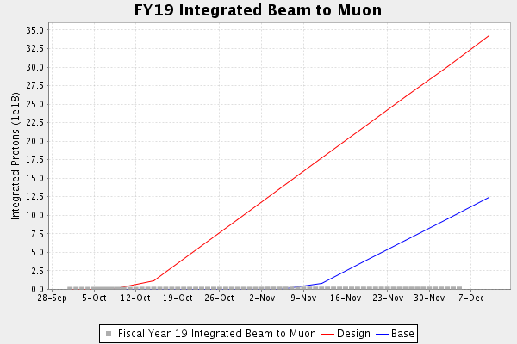
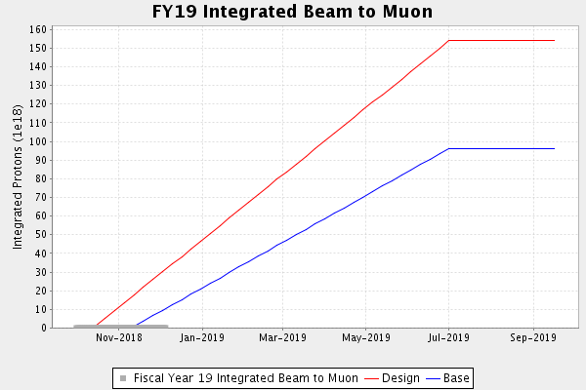
Muon Operation

Slide 5
Complex Status
Linac/Booster
Beam to BNB
Beam to RR/MI
RR/MI
Running ~700 kW to NuMI
Beam to SY, Muon Delivery Ring upon request

Slide 6
Complex Status (cont’d)
BNB
Receiving 14 Booster turns @ 5 Hz
Switchyard
MTest is receiving beam when requested
Muon
Beam to Delivery Ring for studies/commissioning
NuMI
700 kW on target

Slide 7
Upcoming Downtimes
Maintenance Day (TBD before holidays)
Clean up outstanding jobs before long holiday break
NuMI Munter dehumidifier (before holidays)
12-13 hours (4 hr cooldown + 8-9 hr work)
No beam to NuMI
BNB canopy work
Work along berm will inhibit beam to BNB
Inhibit beam to BNB 6am-4pm, run beam over night
Will last for 1-1.5 weeks, starting mid next week
Booster cavity installation (Not scheduled yet)
1 day, affects all users

