Slide 1
DUNE Computing Meeting
Heidi Schellman, Oregon State University

Slide 2
Updates
Processing with v07_08_00_04 is almost done
Warnings – some duplicates and some files were done with v07_08_00_03 which has incomplete e beam info.
samweb list-files "run_type protodune-sp and data_quality.online_good_run_list 1 and data_tier raw " --summary
File count: 62322
Total size: 509,599,300,319,977
Event count: 7920209
samweb list-files "run_type protodune-sp and data_quality.online_good_run_list 1 and data_tier full-reconstructed and version v07_08_00_%" --summary
File count: 62566
Total size: 1,044,574,293,215,059
Event count: 7940505

Slide 3
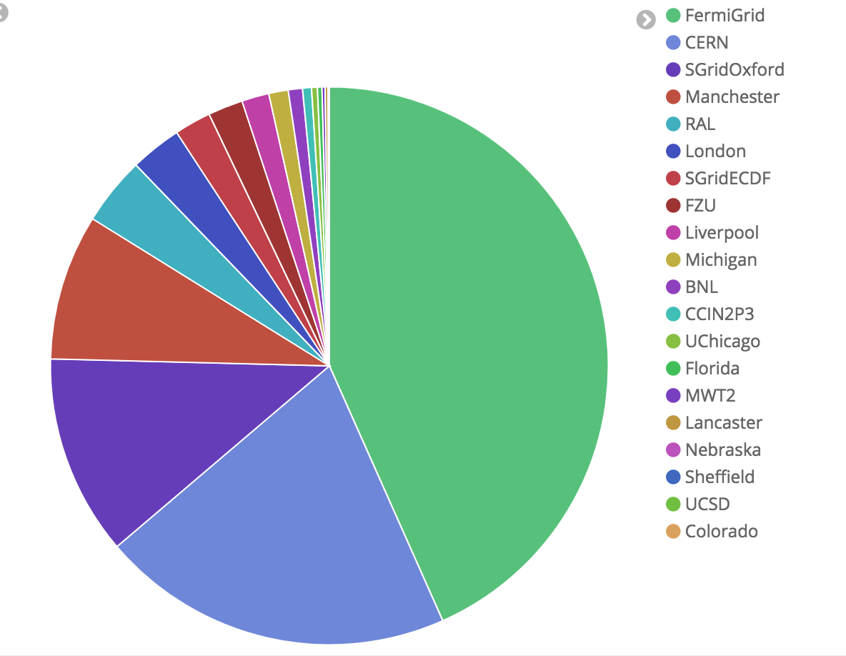
Worldwide contributions
Location of grid jobs in November
A total of ~250,000 reconstruction and simulation jobs were run.
60% were external to the dedicated resources at FNAL

Slide 4
Accessing data
Look on dune-data.fnal.gov for sim
setup sam_web_client –t
Samweb list-data-disks gives location list
samweb list-file-locations --dim="full_path cern-eos% and data_tier full-reconstructed and run_number 5766" --schema=root
lists locations for reconstructed 5766 on eos
Sam dataset definitions for raw and reco:
runset-5432-reco-v07_08_00_04-hv-180kV-beam-2GeV-v0
runset-5432-raw-hv-180kV-beam-2GeV-v0
These have been generated for all good runs.

Slide 5
Not so good news
Much of this was written to a small (but fast) dcache pool
To get a particular run
nohup samweb prestage-dataset --defname=runset-5432-reco-v07_08_00_04-hv-180kV-beam-2GeV-v0 --parallel=5 &
To check on prestage status
Need very recent duneutils
cache-state.py –d Dataset # or –q dimensions

