Slide 1
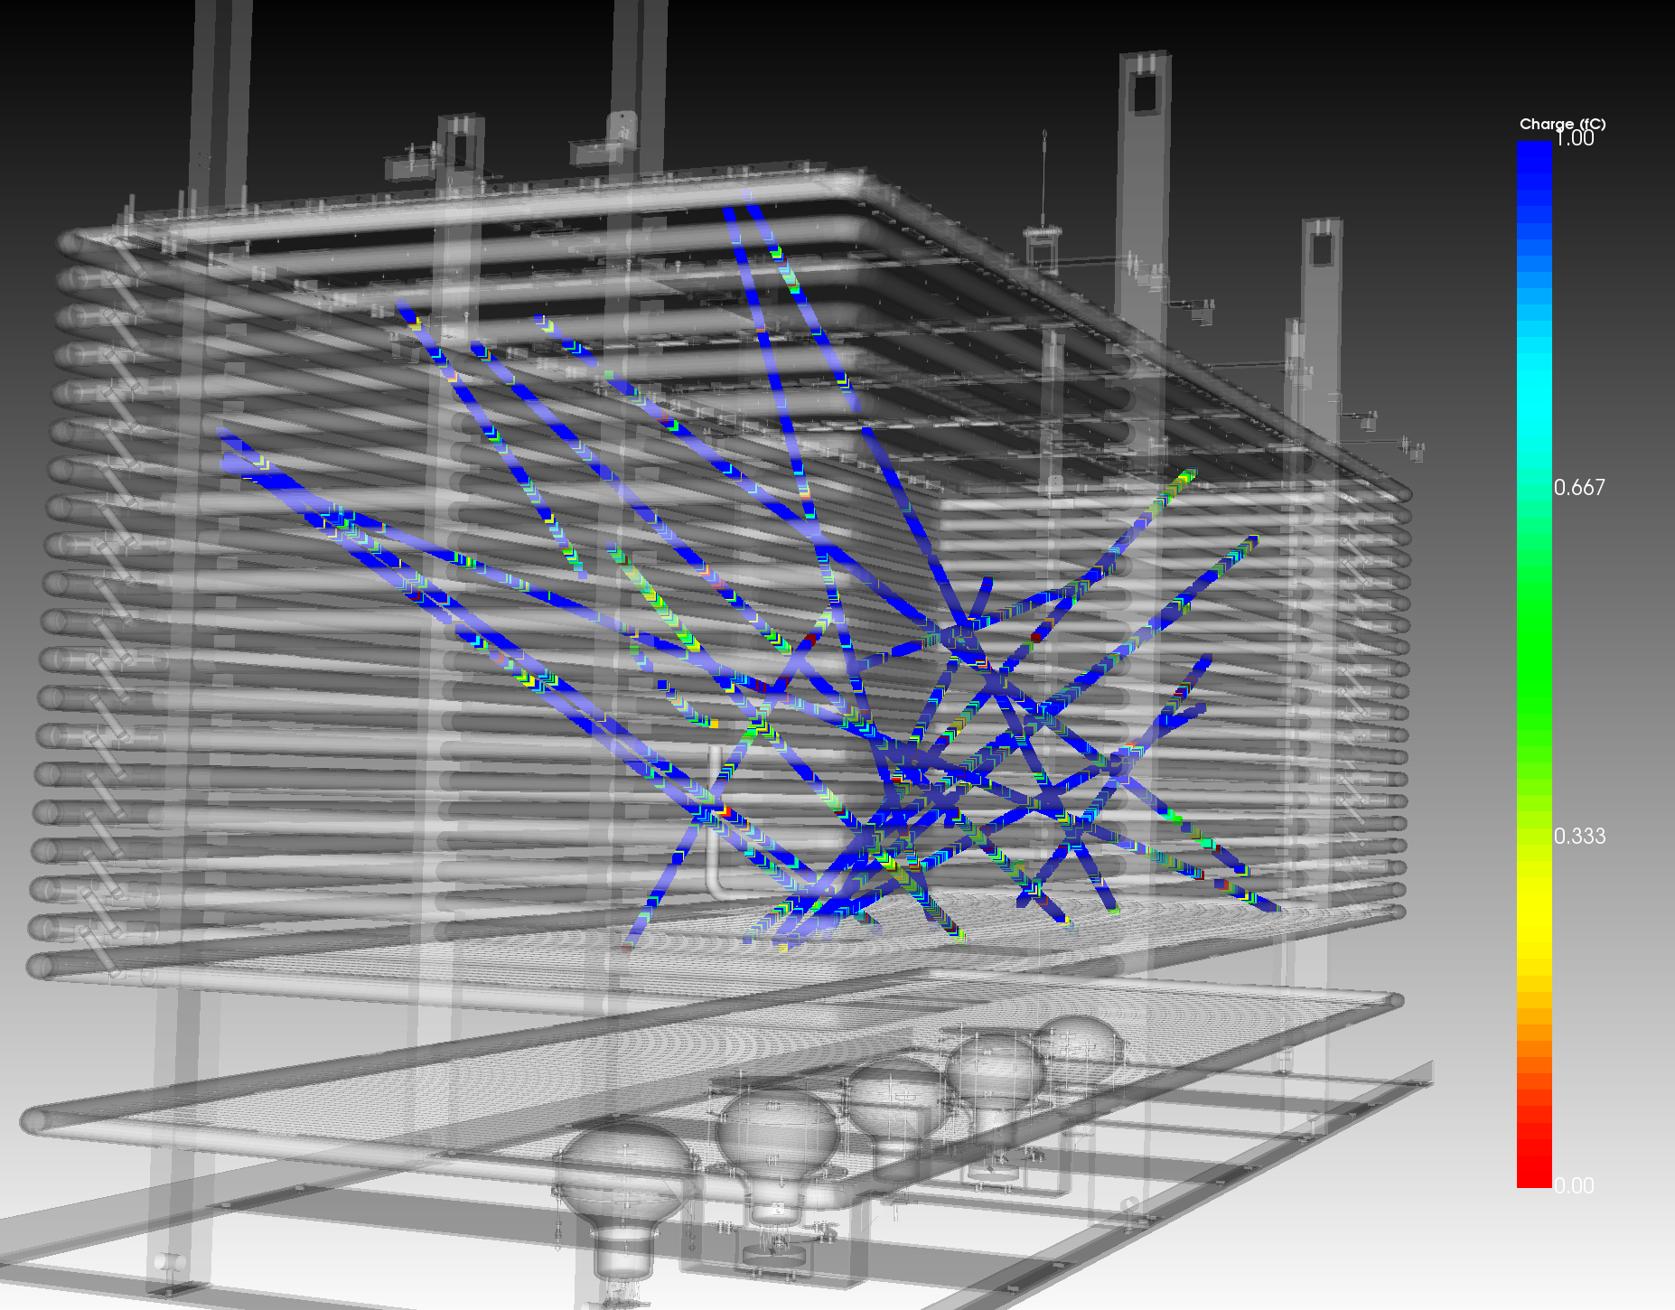
Results from the 3x1x1 m³ demonstrator
Sebastien Murphy
LBNC meeting, CERN Nov 2018

Slide 2
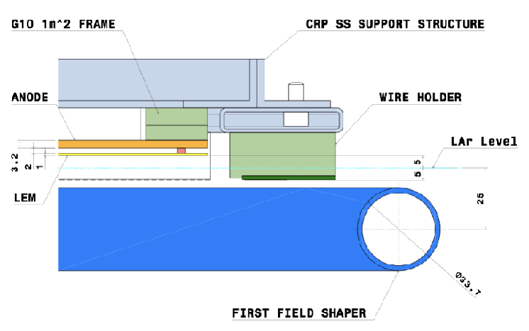
Charge Readout Plane (electron amplification + readout)
1 m
3 m
1 m passive insulation
1 m
300 kV rated HV-Feedthrough
5 PMTs
3x1x1 m³ active LAr (4.2 tons)

Slide 3
MIP
~6500 e /mm
∿∿∿∿→
~4000 γ/mm (128 nm)
∿∿∿∿→
∿∿∿∿→

Slide 4
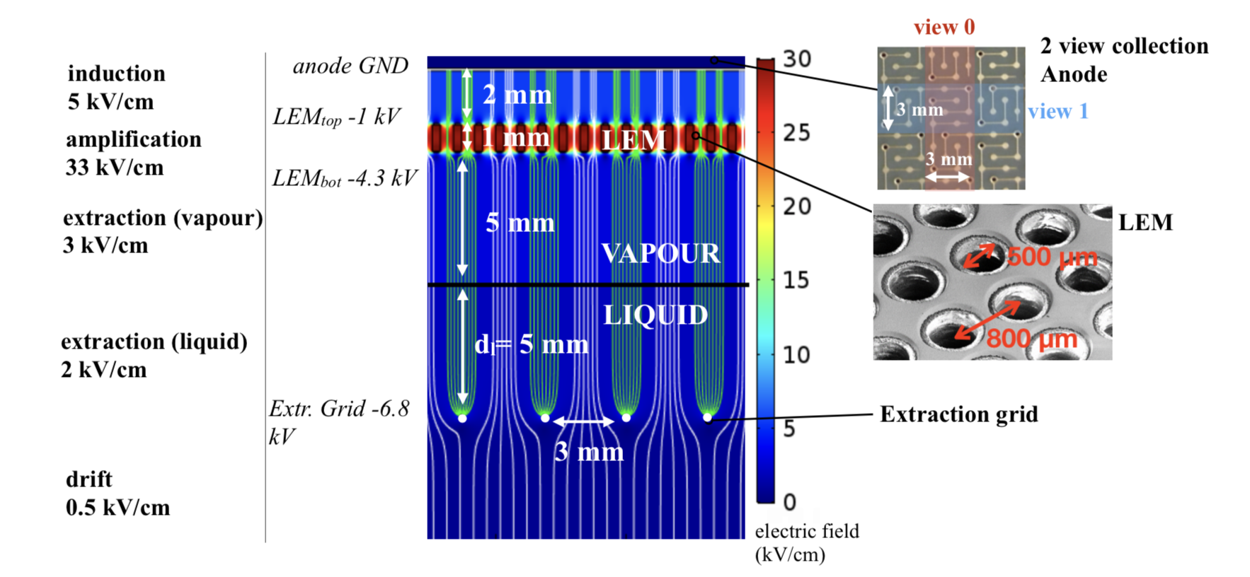
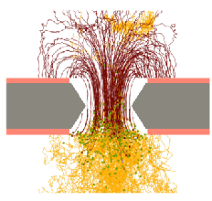
drifting charges are extracted from the liquid to the vapour phase by an electric field in the liquid of around 2 kV/cm
the charges once in pure argon vapour are multiplied inside 50x50 cm2 area LEMs (Large Electron Multipliers) assembled side by side
the amplified charges are collected on a 2D segmented anode
MIP
~6500 e /mm
∿∿∿∿→
~4000 γ/mm (128 nm)
∿∿∿∿→
∿∿∿∿→

Slide 5
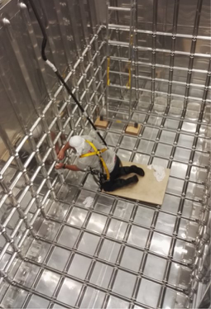
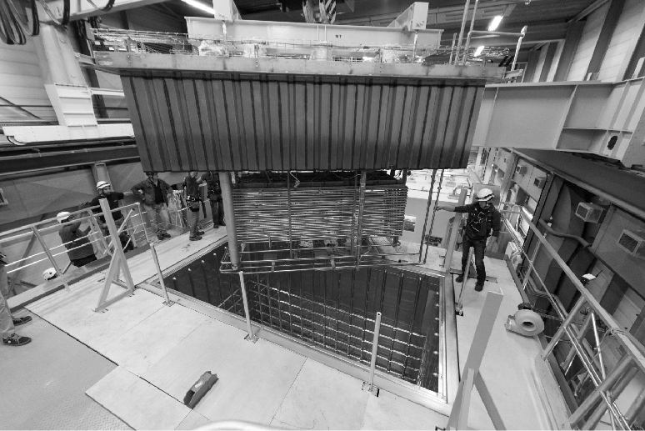
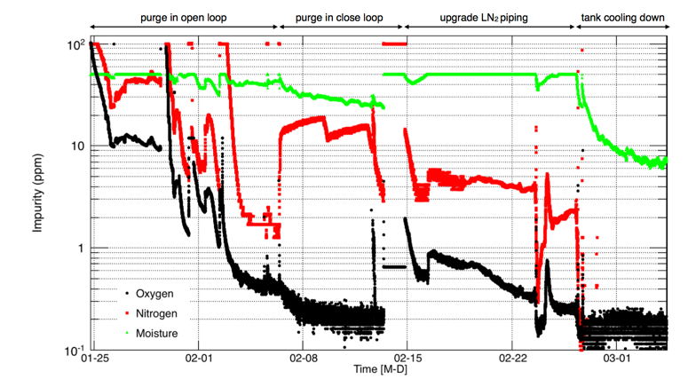
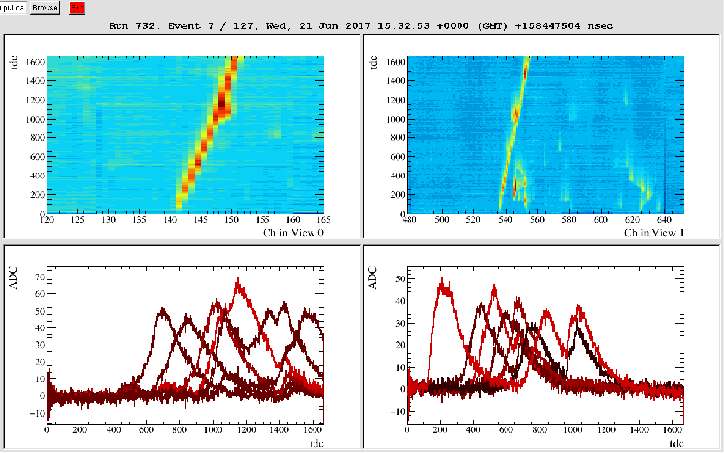
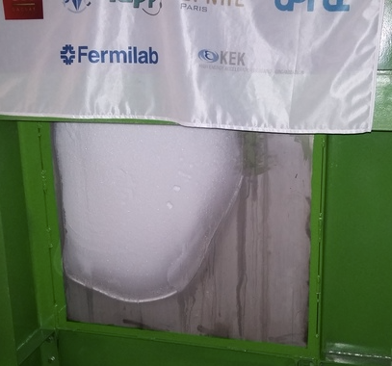
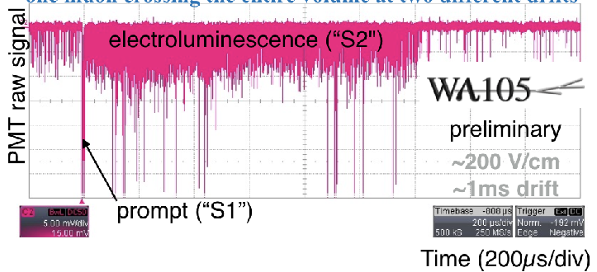
3x1x1 construction 2015-2016
2015
2016 - Detector installation completed
Jan 2017 - Commissioning started
2015 - Cryostat constructed
Mar 2017 - Operation ‘frozen’ due to cryostat issues
June 12th - Recirculation started
June 15th - evidence of extraction from LAr to GAr
June 21st 2017 - First tracks observed

Slide 6
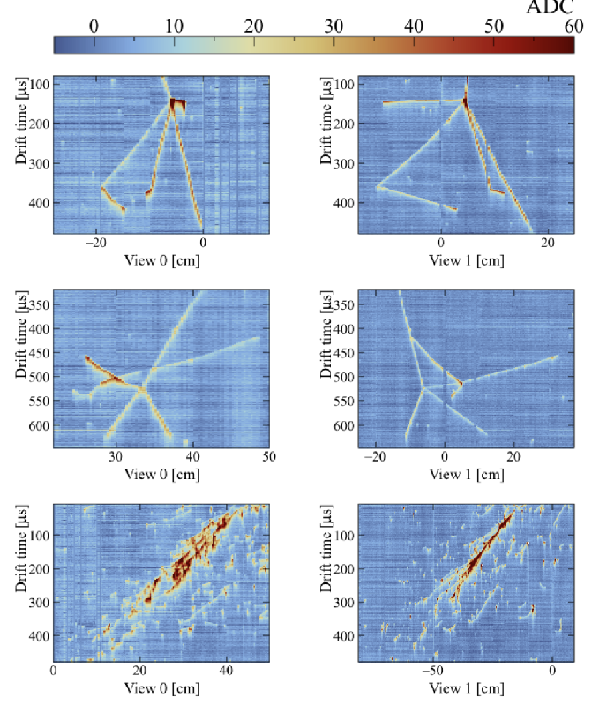
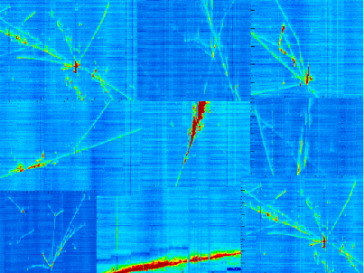
Data taking July-November 2017
~400 k cosmic events recorded.
hadronic and EM showers from cosmic rays recorder in the 3x1x1

Slide 7
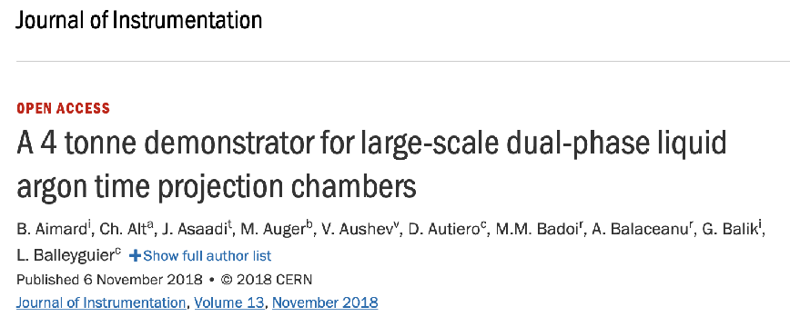
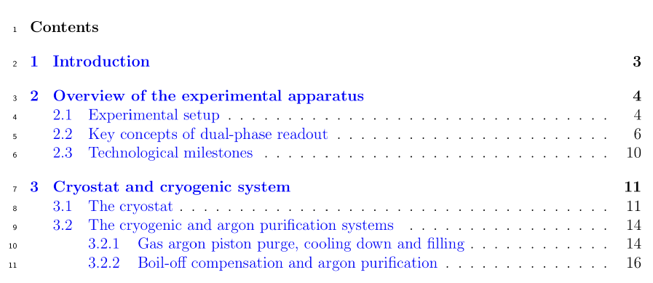
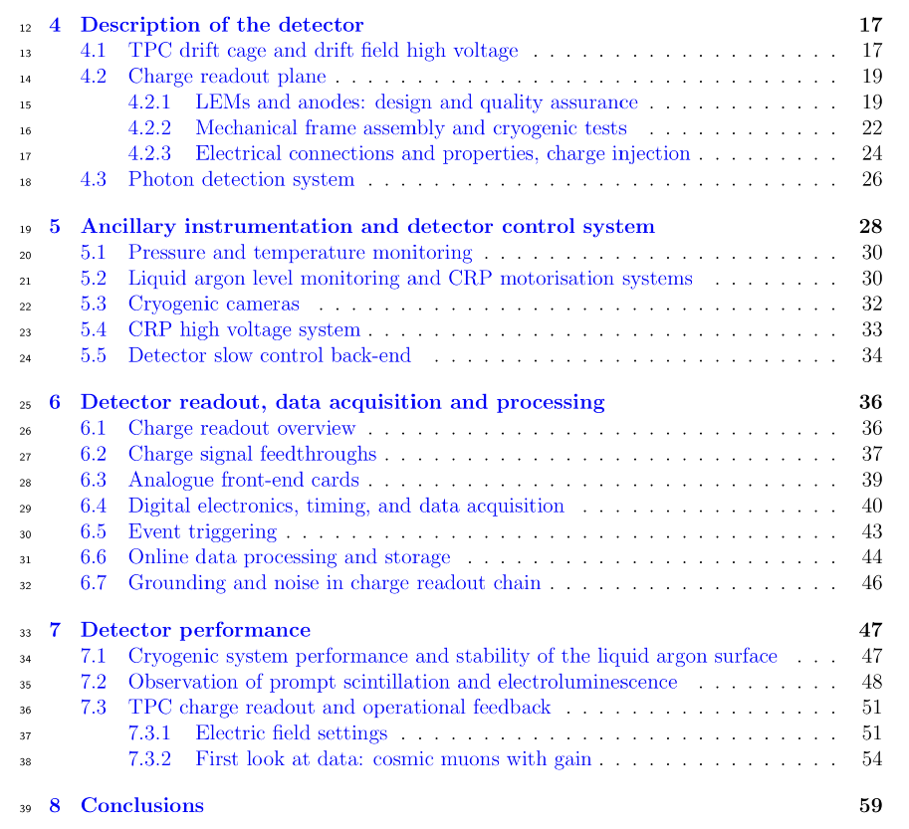
Article published in 2018
Submitted to Arxiv in June 2018, published in JINST November 2018
Detailed summary of the detector design and performance in 60 page article.

Slide 8
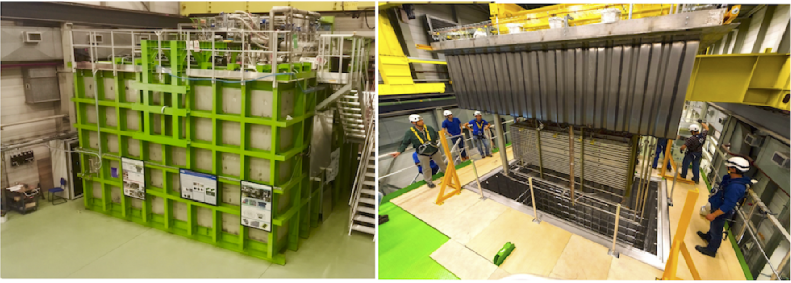
3x1x1 - key technological milestones
Performance of the cryogenic system and of the 23m³ membrane cryostat.
Extraction of the ionisation charge over an area of 3m².
Amplification in pure argon vapour by a combined operation of multiple 50 × 50 cm² LEMs
Readout of the signal on two collection planes with strips of up to 3 m length and performance of analogue front-end electronics.
Detection of prompt and secondary scintillation.

Slide 9
Cryostat and cryogenics
The goal of the cryostat and cryogenic system is to ensure during extended operating periods:
1. stable thermodynamic conditions
Uniform and stable gas argon density near 1 Atm and 90 K completely isolated from outside P,T fluctuations
operation of Front End electronics near 110 K
compensate the heat input of cryostat by active cooling
2. stable liquid level during liquid recirculation
Avoid slow fluctuations of level which might be induced by regulation of cryo system
avoid fast fluctuations (=waves) which might be induce from local heat inputs (i.e bubbling) and defect in cryostat insulation.
3. high liquid argon purity:
better than 3 ms drift or less than 100 ppt 02 equivalent impurities

Slide 10
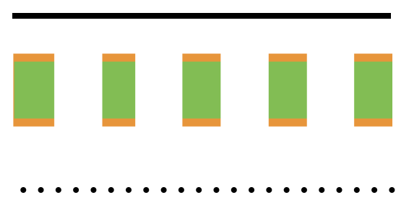
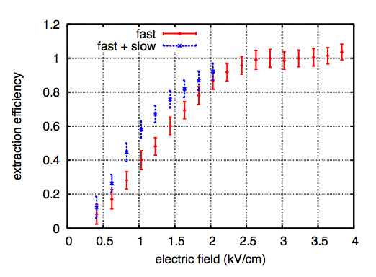
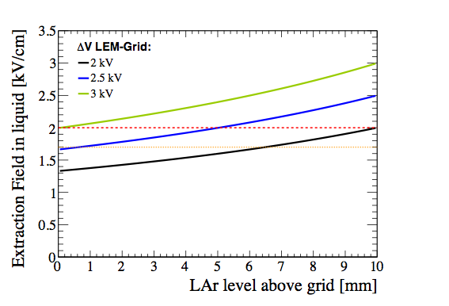
Remark on the liquid argon level
an important point on requirement of level position:
for a given ΔVLEM-grid the extraction field depends on the position of the LAr level.
At sufficiently large ΔVLEM-grid (>~2.5 kV) the extraction efficiency (hence the gain) is near maximal and therefore almost independent of the liquid level.
The boundary conditions are (of course) that the liquid should not touch the LEMs and the grid stays immersed.
->LAr level and CRP alignment to the LAr level within 1 mm and monitoring within 100 microns
?
90 % εextraction
80 % εextraction

Slide 11
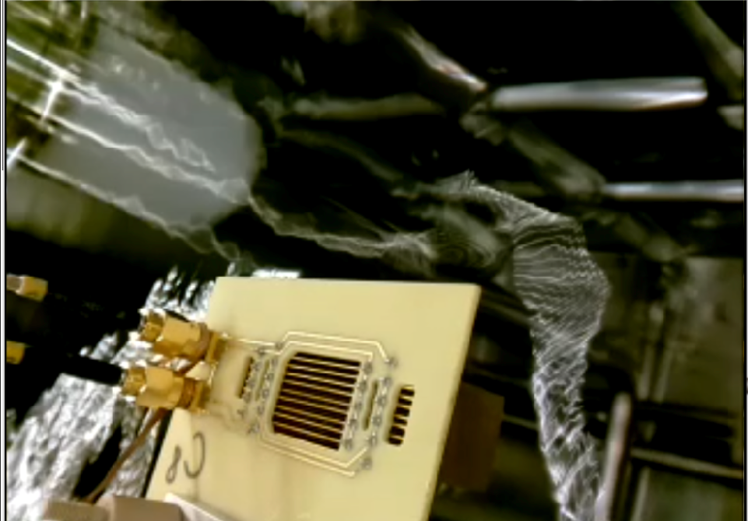
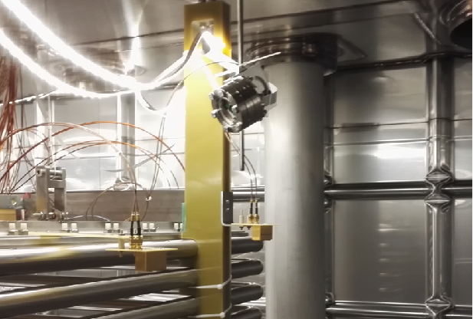
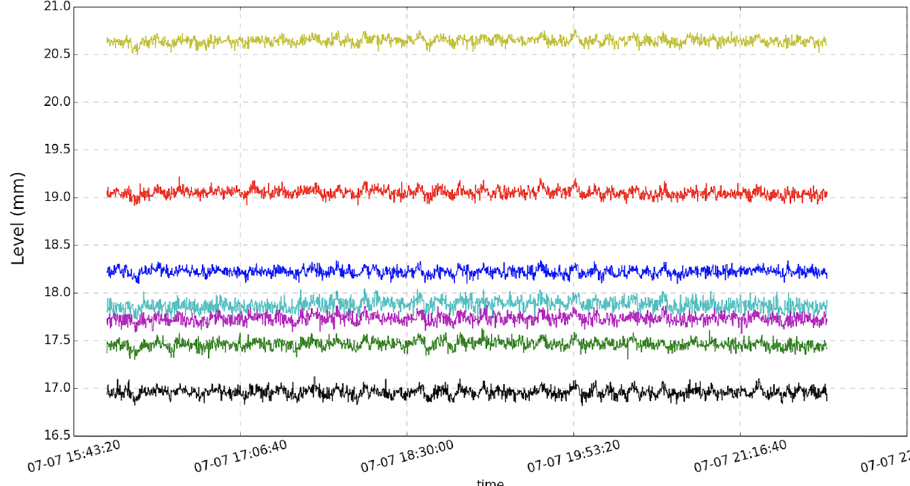
Cryostat and cryogenics - liquid argon level
readings from 7 level meters (fluctuations at the 100 micron level)

Slide 12
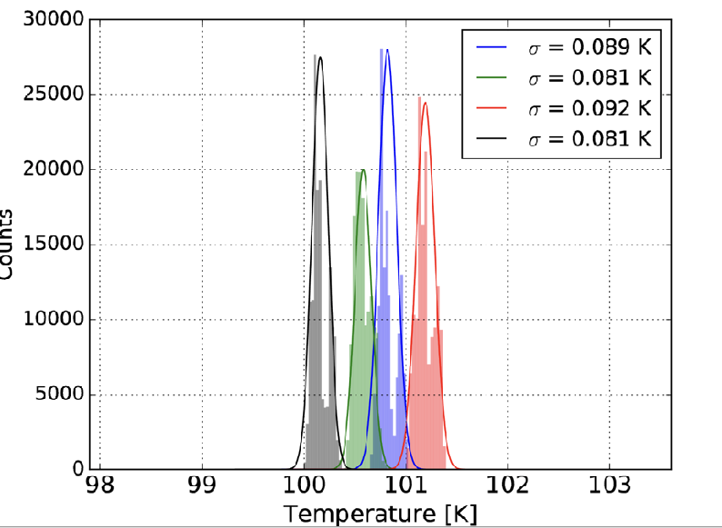
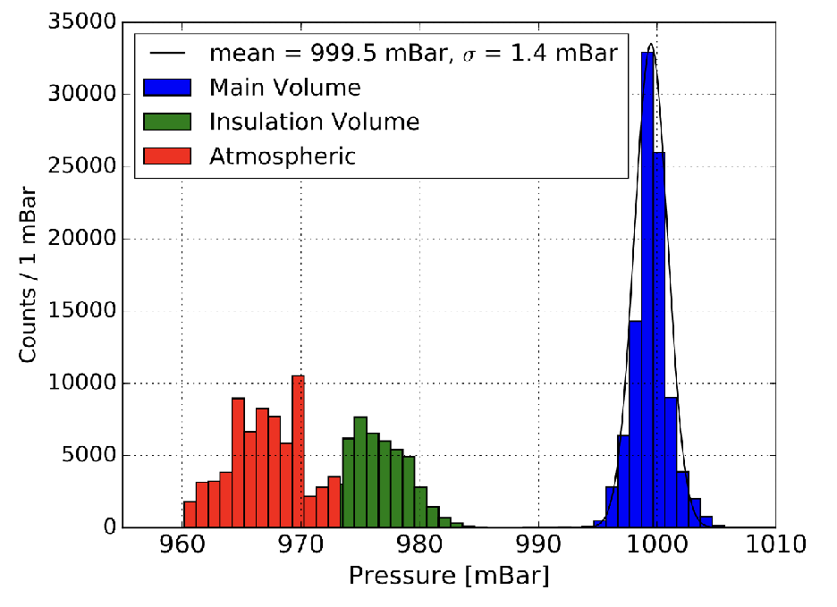
Cryostat and cryogenics - performance
~3 cm above the LEMs 4 points over the CRP area
Temperature is uniform across the CRP.
measured gradient near LAr surface is uniform at ~2 K/cm
Pressure is stable at 999±1mbar decoupled from external pressure variations

Slide 13
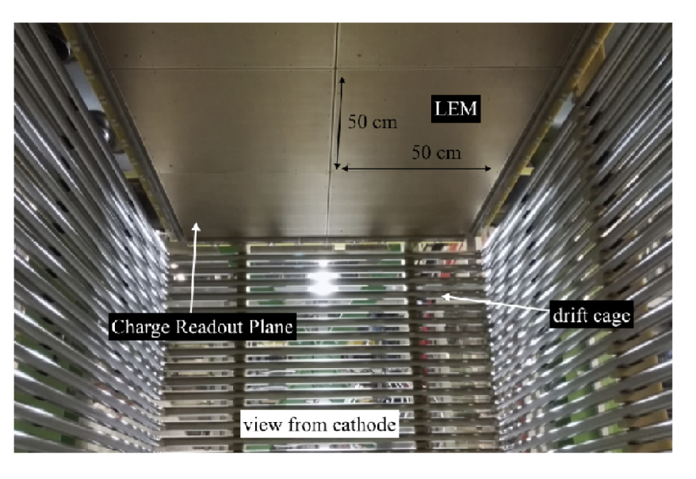
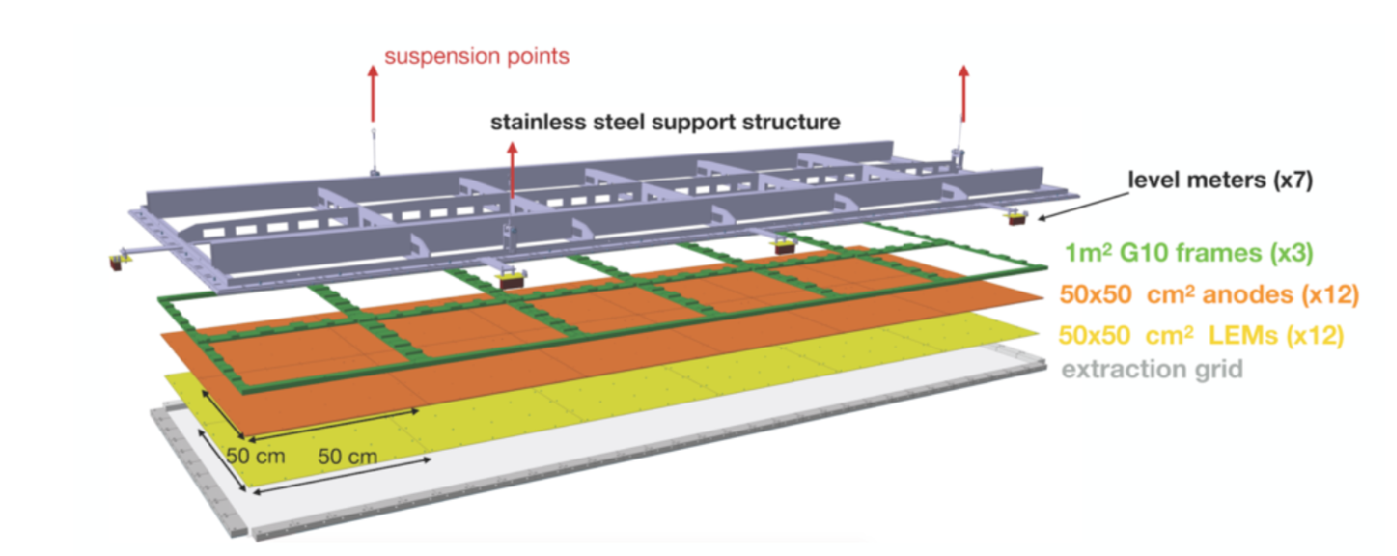
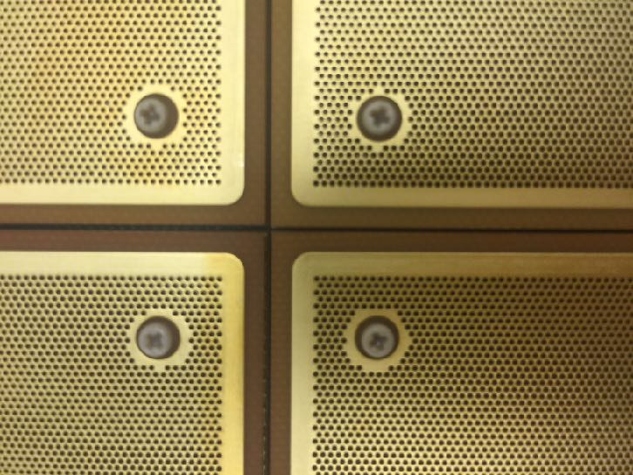
Charge amplification and readout - the CRP
Precisely machined frame that allows to position the extraction-grid, LEMs and anodes with well determined inter-stage distances.
The frame is remotely adjustable to the liquid argon level with a precision of around 100 microns
Demonstrate:
collective operation with gain of twelve LEMs arranged side by side
extraction on 3m2 area and charge readout on 3m long strips

Slide 14
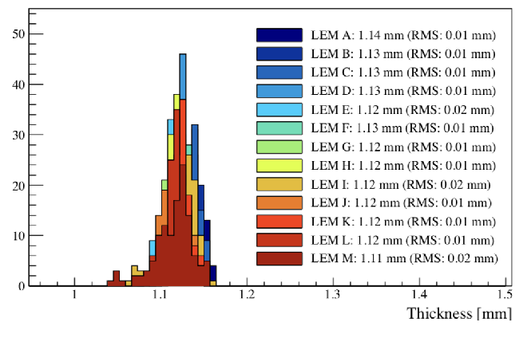
Charge amplification and readout - CRP QA/QC
CRP individual components
LEMs:
Precise survey of LEM/anodes. The thickness of all 50x50 LEMs installed in the 3x1x1 were measured with an accuracy of around 2 microns.
2 view collection anodes with fine 3 mm segmentation: designed to provide identical charge sharing between both views

Slide 15
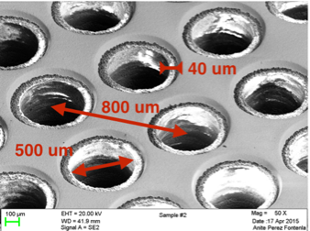
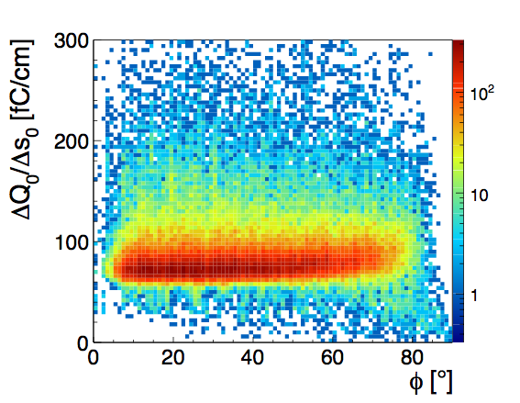
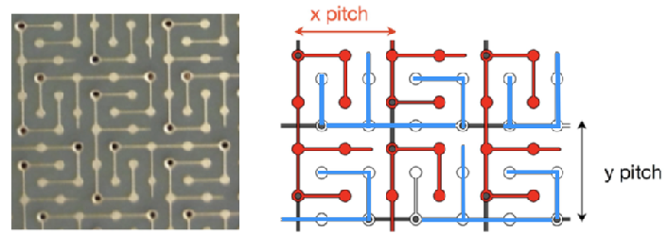
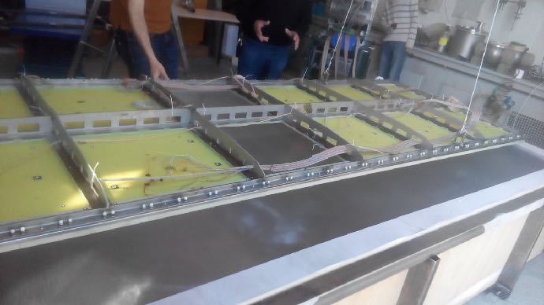
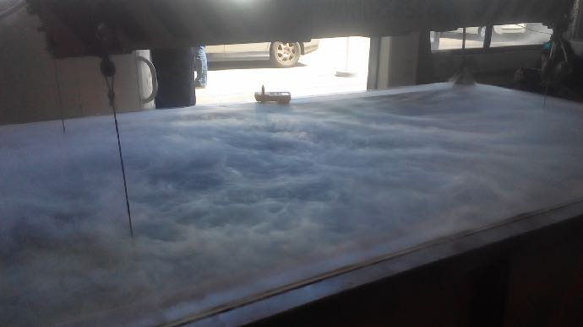
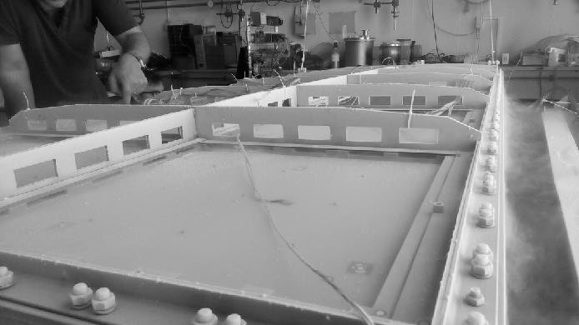
Charge amplification and readout - the CRP
LEMs and anode
literature
NIM A617 (2010) p188-192 NIM A641 (2011) p 48-57 JINST 7 (2012) P08026 JINST 8 (2013) P04012 JINST 9 (2014) P03017 JINST 10 (2015) P03017
large area LEMs (50x50 cm2) o(150) holes per cm^{2.} Intrinsic geometrical parameters (rim, hole, pitch) optimised from test on smaller devices.
Two view collection anodes with fine 3 mm segmentation: designed to provide identical charge sharing between both views with strip capacitance per unit length as low as 150 pF/m
CRP Mechanical behaviour at cold: open bath LN2 test (shock cooling) with mechanical deformations monitored by photogrammetry

Slide 16
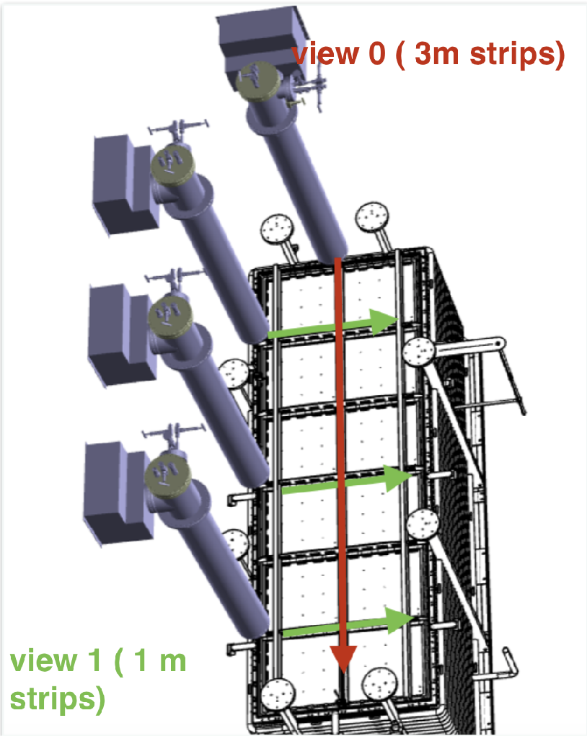
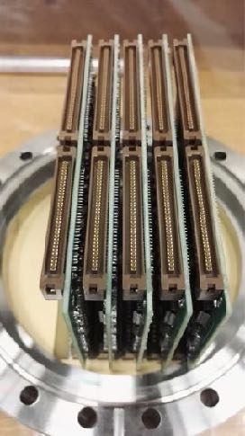
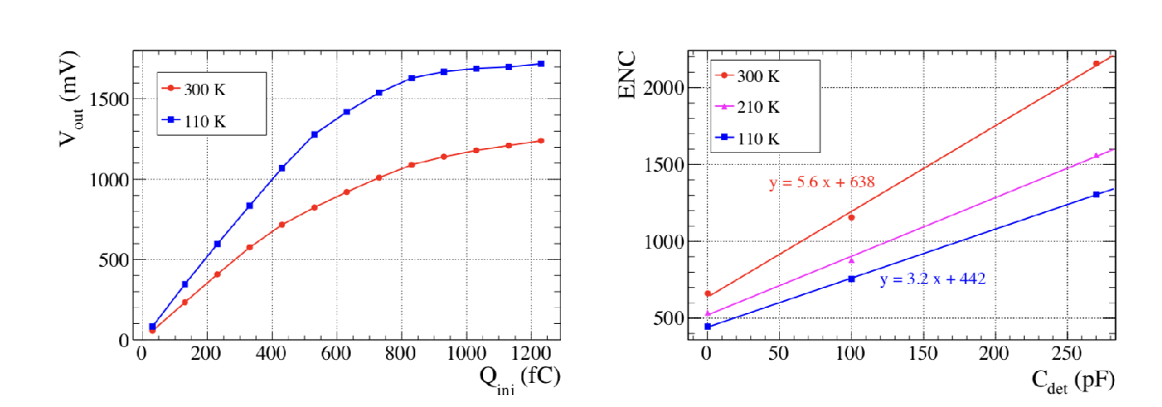
Front end amplifiers
DP detector design that allows:
the operation of FE amplifiers at cryogenic temperatures (stable ~140 K as measured during 3x1x1 data taking)
the positioning of the FE amplifiers close to the anodes.
the accessibility of the FE cards at any time during detector operation for replacement or maintenance.
digitisers (uTCA standard) located outside the cryostat
Double slope gain with dynamic range up to 1200 fC
Equivalent Noise charge vs detector capacitance
FE ASIC amplifiers located inside custom made “signal” feedthroughs isolated from main argon volume

Slide 17
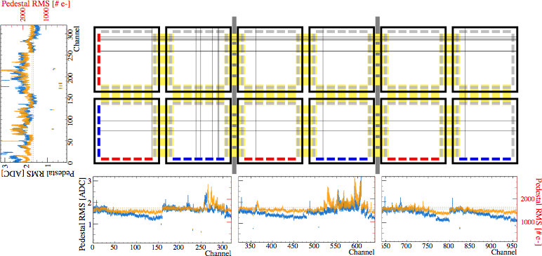
Electronic noise
View 1, 3m, 960 channels
View 0
1m
320 channels
Noise at cryogenic temperature stable at around 1550 e⁻
M.I.P Signal on one channel expected around (infinite electron lifetime):
~10 ke for effective gain 2 (S/N=10)
~100 ke for effective gain 20 (S/N=100)
Noise is below 2’000 electrons on 3 m long strips

Slide 18
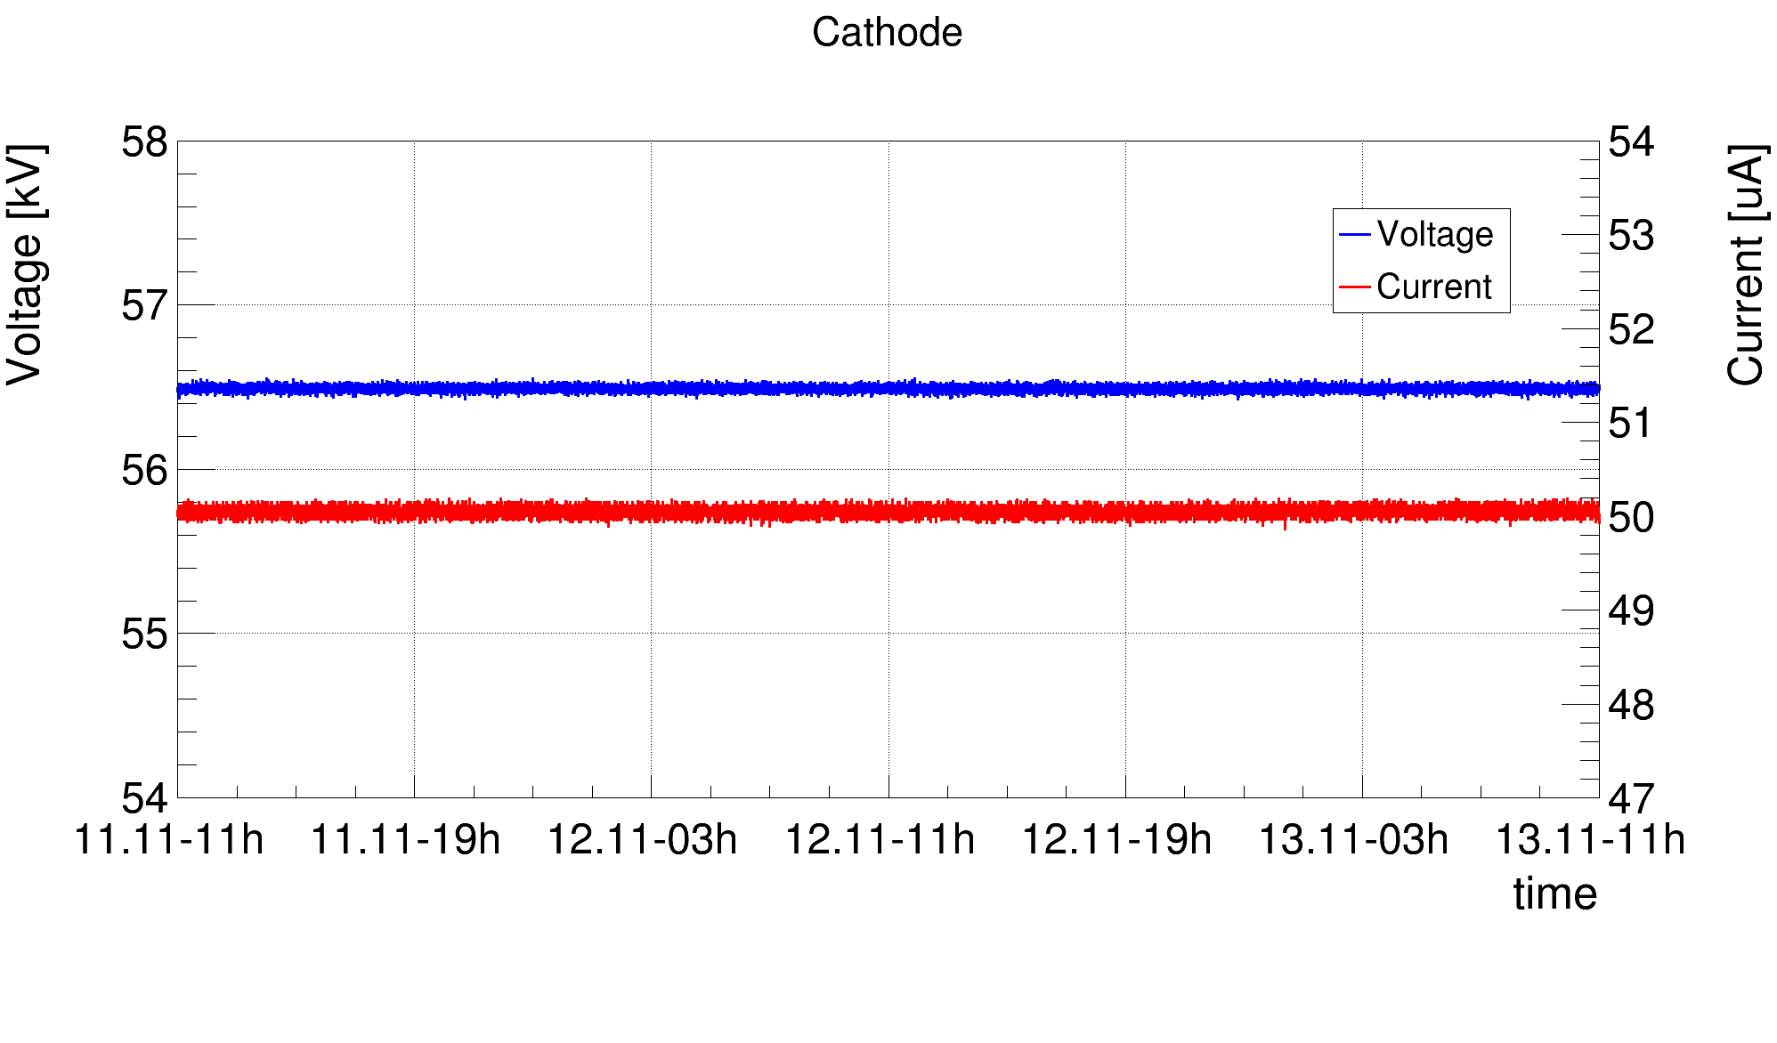
Cathode VHV during data taking
Heinzinger PNChp 100000 –neg, ethernet readout
stable:
current of 50 ±0.08 uA (as expected from the divider)
voltage 56.5 ± 0.01 kV
max voltages:
-on feedthrough alone: -300 kV
-on 3x1x1 cathode -65 kV for the entire duration of the data taking (no discharges, stable current)
JINST 12 P03021 arXiv:1611.02085

Slide 19
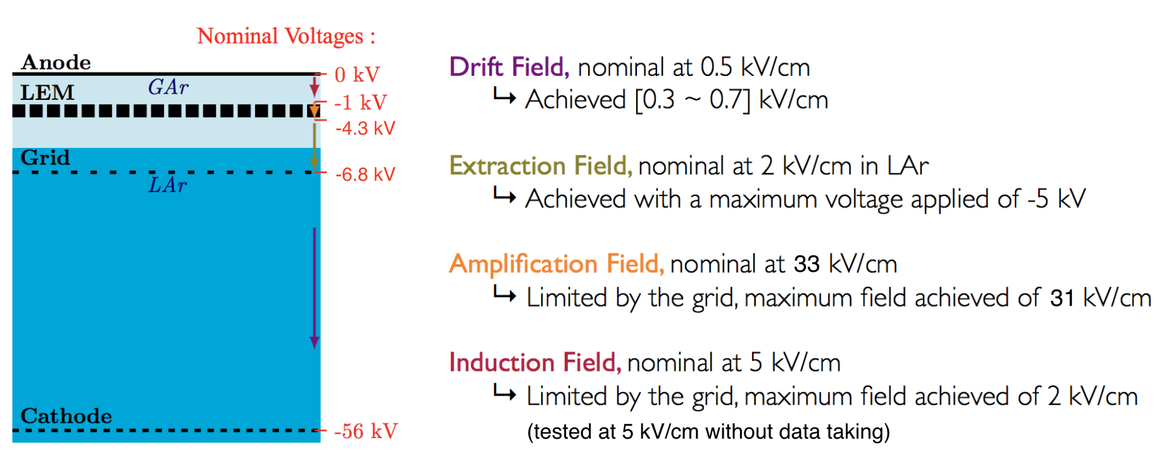
CRP HV during data taking

Slide 20
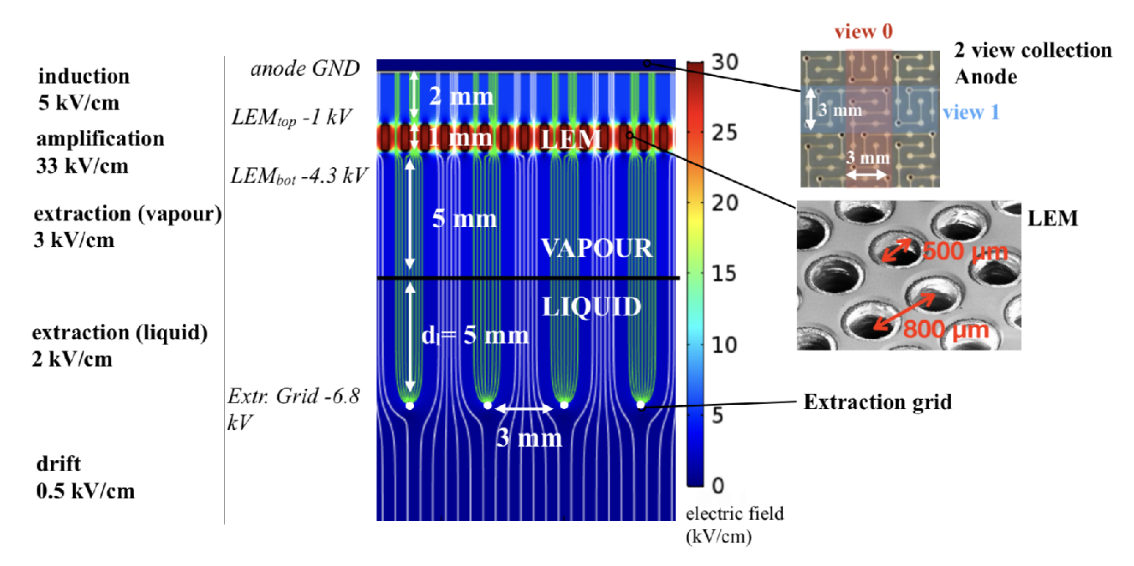
CRP HV during data taking
The extraction grid discharged at around -5 kV while the nominal voltage (for an effective gain of 20) is set to around -6.8 kV.
Evidence (after dedicated tests and visual inspection) points to a group of 32 wires which were not correctly tensioned and a faulty HV contact.
As a consequence we were not able to operate the detector at its full potential with the nominal voltages shown above.
Nevertheless we collected a large amount of good quality data at various field configurations.

Slide 21
CRP HV scanned ranges and data taking settings

Slide 22
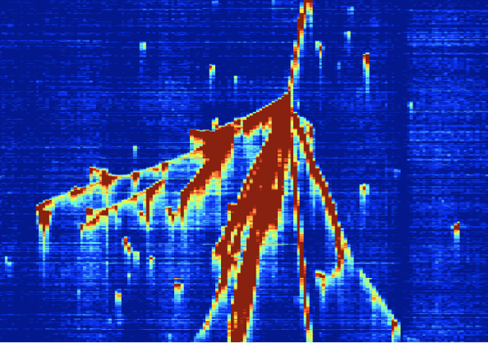
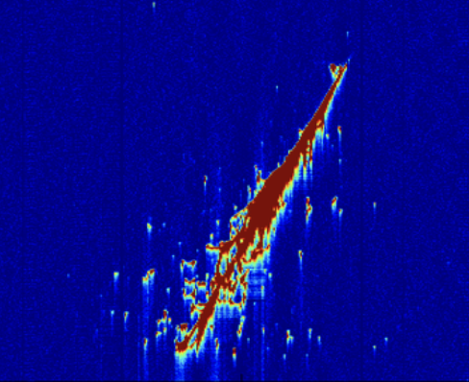
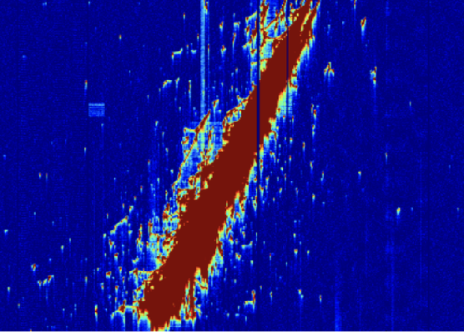
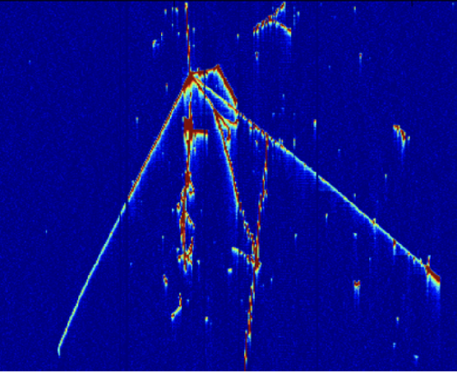
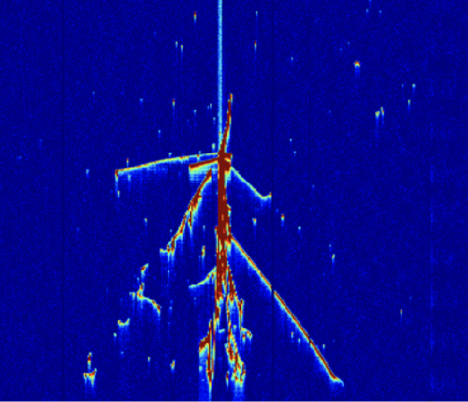
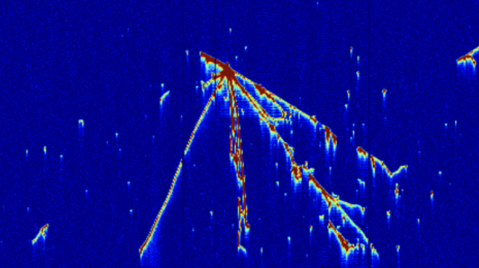
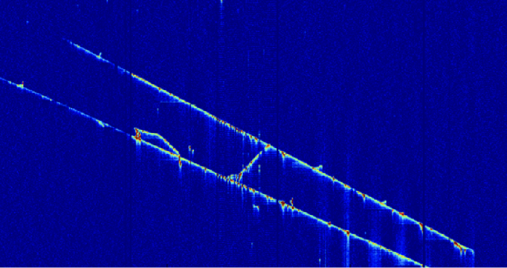
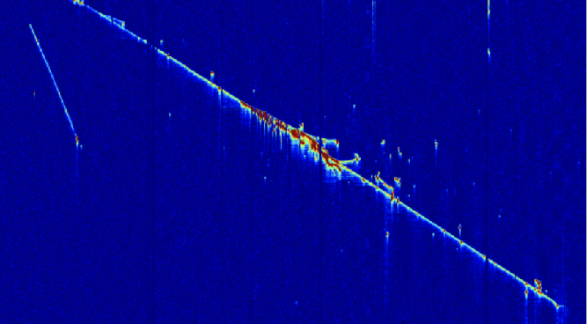
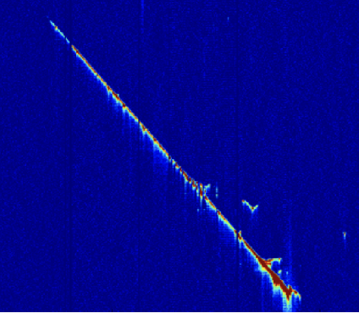
Data taking July-November 2017
more than 400 k cosmic events collected
HV: data taking settings
showers (EM)
showers (HADR)
straight tracks (MIPs)

Slide 23
Crossing muons
Crossing muons (MIPs): easy to reconstruct in 3D and deposits a know amount of charge of ~10 fC/cm in liquid argon (at 500 V/cm and w/o attenuation due to drift)
=>characterise the TPC in terms of amplification (effective gain), LAr purity, charge sharing between views,..
The signal
measured on one view
charge sharing between views
50% charge sharing
effective gain
goal 20
10 fC/cm (at 500 V/cm drift)

Slide 24
Charge sharing between views
JINST 9 (2014) P03017
anode requirements:
low capacitance per unit length (<2000 e- noise equivalent)
50:50 charge sharing between the strips.
Tested at the cm strip scale (JINST 9 (2014) P03017)
50:50 charge sharing demonstrated here on 3x1 m2 strips
example hits view 0
hits view 0
From 3D reconstructed tracks:
calculate the ΔQ/Δx per view
hits view 1
ΔQ
Δx
charge is equally shared between views

Slide 25
Liquid Argon Purity
Select tracks that cross the entire 1 m drift. Compute the dQ/dx as a function of drift.
1 m
electron lifetime of few milliseconds achieved
1 m
1 m

Slide 26
Charge collection - waveforms
view 0
view 1
selected track crosses strips at phi~45°.
Two views with similar unipolar response, signals well above the ambient noise.
similar amplitudes on both views: visual confirmation 50/50 charge sharing between views

Slide 27
Effective gain
increase of the mean and MP value of the dQ/dx distributions as a function of the LEM fields. 28 kV/cm of LEM field corresponds to an operation of the 3x1x1 TPC at Geff ≈3.
<dQ/ds>view0
The signal
measured on one view
charge sharing between views
50% charge sharing
effective gain
goal 20
10 fC/cm (at 500 V/cm drift)

Slide 29
Scintillation in liquid and gas argon
1 m drift
Clearly visible light from primary and secondary scintillation.
First check of correct event matching between charge and light events. Correlation between the quantity of light and charge detected between matched events.
Comparison between the light simulation and data.

Slide 30
Conclusions
Despite technical issues that prevented from stably operating the TPC at Geff of 20, we have demonstrated the high quality of the dual-phase TPC imaging and provided a proof of principle that such devices can be constructed and operated at the ton scale.
A total of about 400 k high quality cosmic events retrieved in many different field configuration.
Good performance of cryostat and cryogenic system: purity compatible with ms electron lifetime and LAr level stable at sub-mm scale.
Stable 500 V/cm drift field over one meter
First time ever, charge extraction over 3m² area and LEM amplification demonstrated on 50x50 cm² modules.
stable performance of FE electronics, low noise and no evidence of channels dying during detector operation.

Slide 31
Conclusions II
First LAr TPC operation in a membrane tank and excellent performance of cryogenic system
proof of stable charge extraction over a 1 cm gap on a 3 m² surface in 17m3 of LAr
First time operation of multiple side by side 50x50 cm² LEMs with gain
Operation of an entire 3m2 CRP (anode, LEM + grid) and gained a detailed understanding of the capacitive couplings between each stage.
Many methods developed to monitor level (precision level meters, LEM-grid capacitive measurements ..)
First time use in a LAr TPC of accessible cold front end electronics: they have shown to be robust to discharges and offer excellent noise performance even with readouts of ~500 pF (3 m strips)
Stable operation of the drift cage with cathode at 60 kV
excellent quality of charge readout offered by two collection views and gain.
Noise filtering and track reconstruction, many complex “neutrino like” events, unique opportunity to test and tune reconstruction algorithms.
light data: observation of S2 at different extraction and LEM fields, effect of purity, drift field,.. on S1. In general comparison of response with simulations to validate and tune photon propagation models for future LAr-TPCs

Slide 32
THANK YOU
THANK YOU
Backup
hits view 0
hits view 1

Slide 33
Gas Argon evolution purity during purge
Evolution of the impurities measured in the gas during open, closed loop piston purge and cooling down. The measured temperatures inside the gas near the bottom, middle and top of the main cryostat volume are indicated in blue.

Slide 34
Front end electronics
SGFT 1
SGFT 2
SGFT 3
SGFT 4
temperature FE: ~140 ±5 K
without SGFT cooling coils.
(see Franco’s slides for effect of cooling)

Slide 35
Charge amplification and readout - the CRP
The system can be represented by a network of capacitively coupled electrodes including the anode, the LEM down, the LEM up, the grid and the field cage. We have measured all the involved capacitance and define a ramping up procedure where all the currents involved are adjusted taking into account the capacitive couplings.

Slide 38
Dual phase R&D prior to the 3x1x1 2005-2015
CRP: optimal design of LEMs, anodes, extraction grid, FE amplifiers
instrumentation, slow control
Cryogenics, membrane cryostats
PMTs
all components designed to be scalable to k-tonne devices

