Slide 1
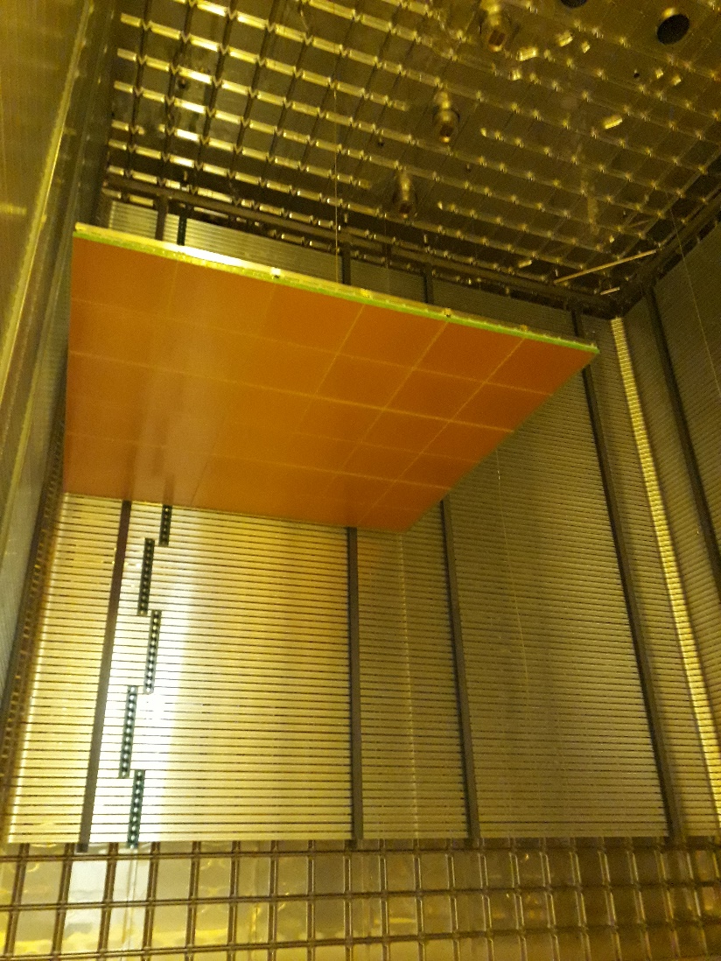
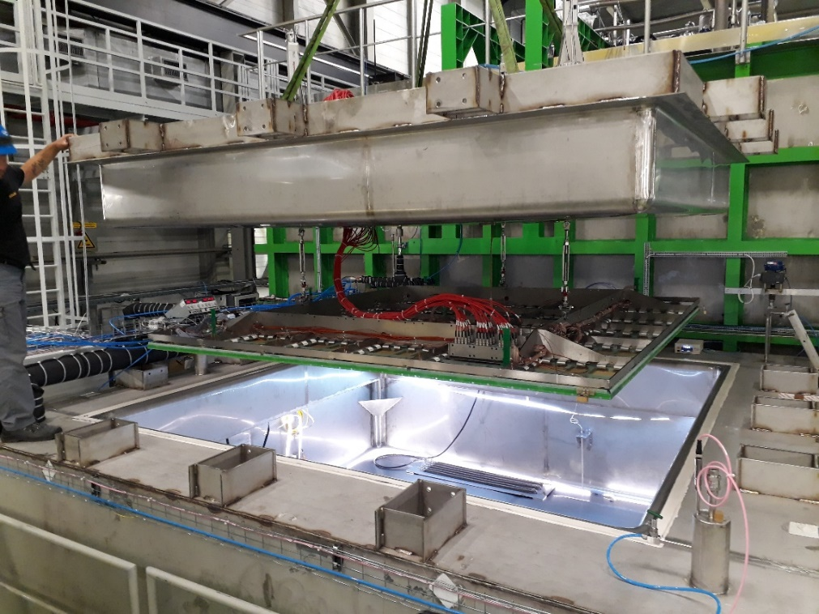
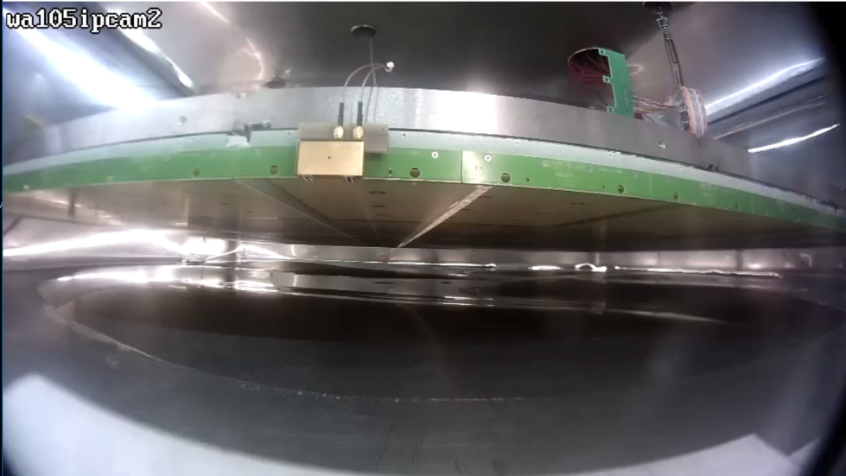
ProtoDUNE-Dual Phase
CRP construction, cold box operation and tests
D. Duchesneau
CRP construction
Cold box and CRP instrumentation
Lessons from cold tests
Summary

Slide 2
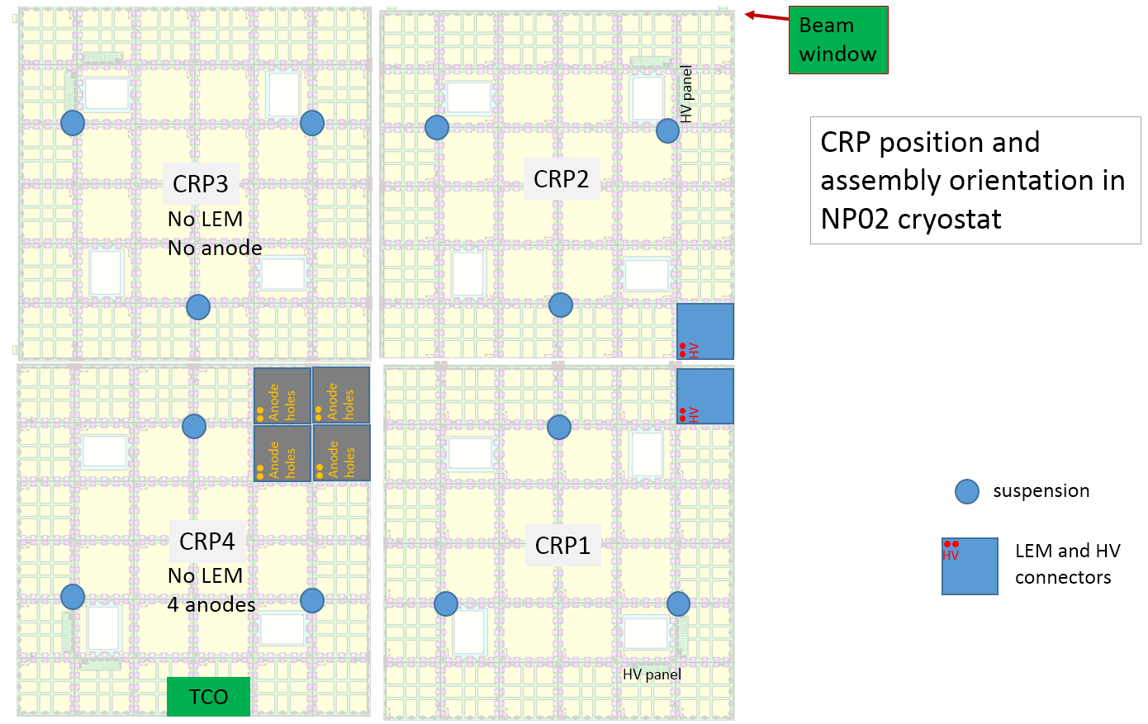
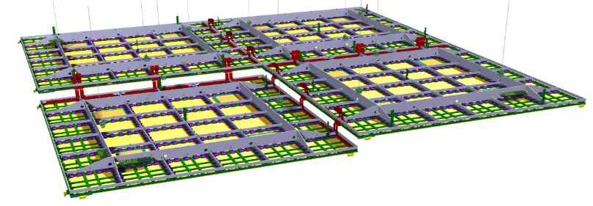
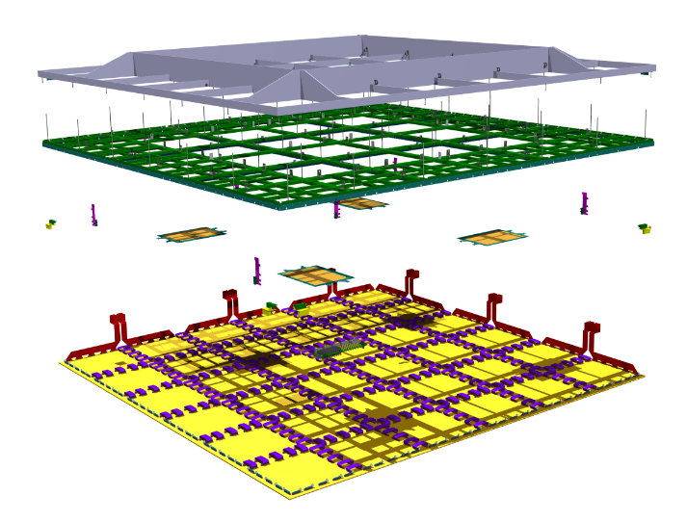
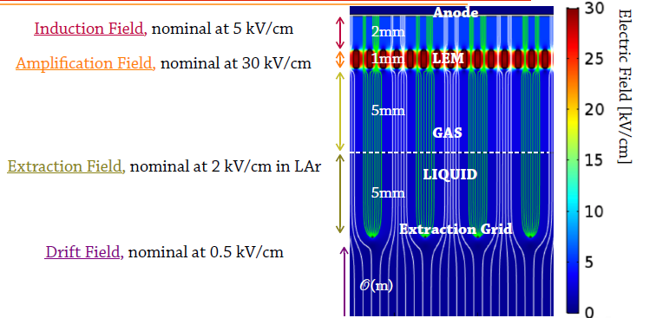
Charge Readout Plane (CRP)
Components and operating conditions
Seen from top
In NP02 CRYOSTAT
6000 mm
4 CRPs
6000 mm
Invar Frame
G10 Frame + Extraction Grid
Instrumentation
CRP
17mm
Detection plane
LEM + Anodes

Slide 3
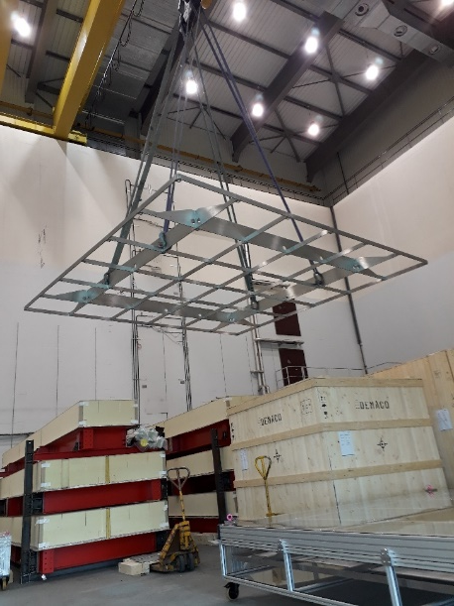
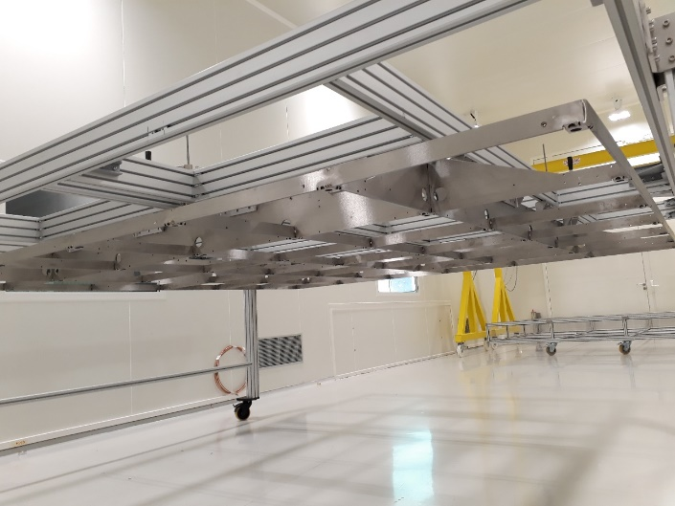
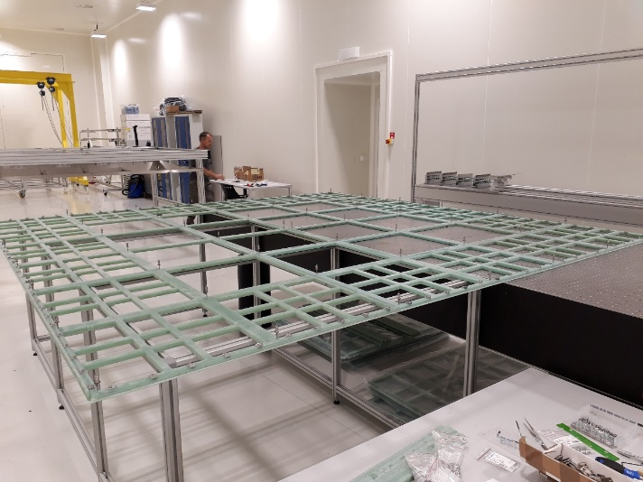
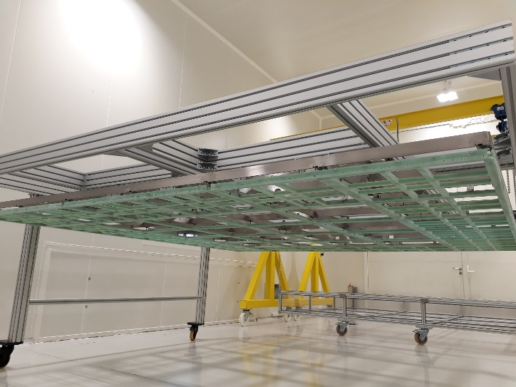
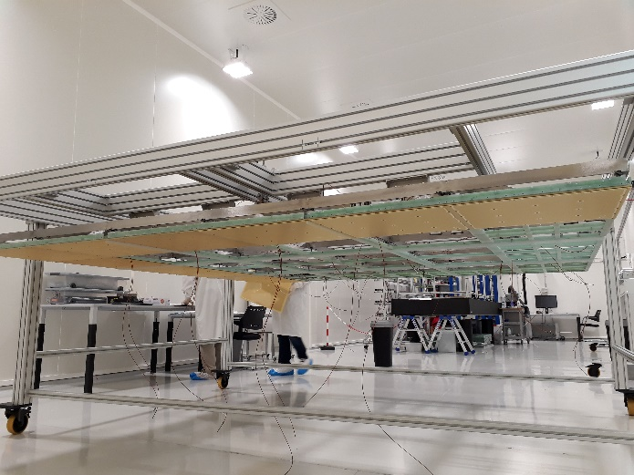
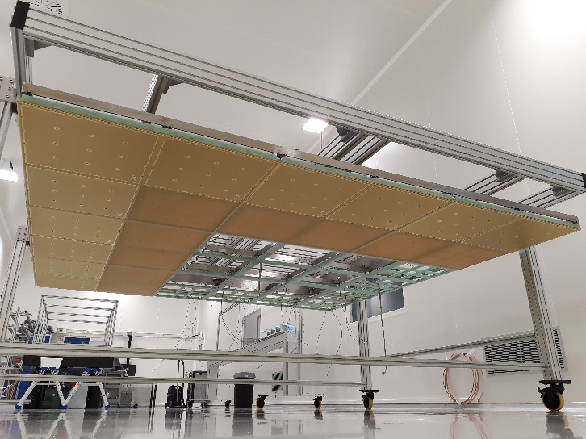
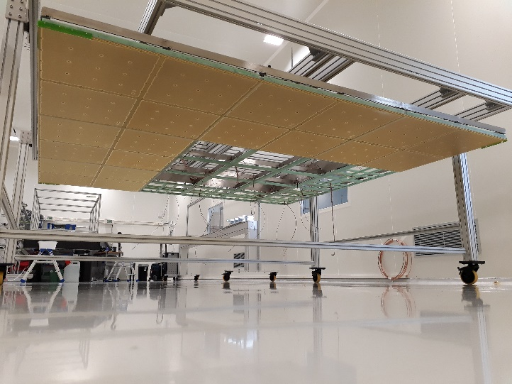
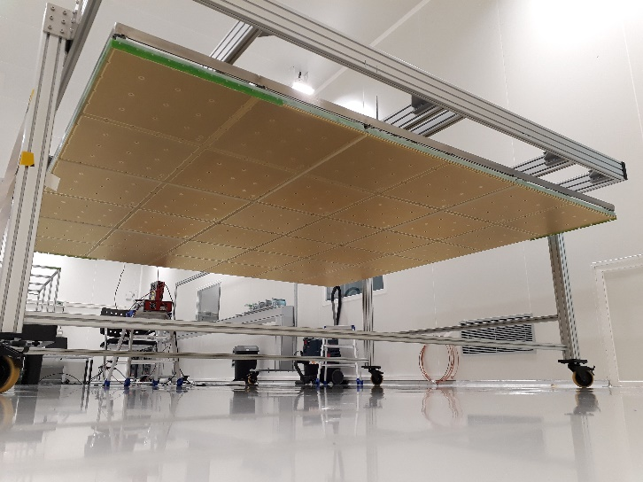
CRP construction steps: first CRP assembled in May 2018
Invar frame of 1st CRP in clean room
Complete assembly of the G10 frame from 9 submodules
Coupling of the G10 with invar frame with 50 special decouoling devuces
3/05/18
3/05/18
9/05/18
9/05/18
17/05/18
Installation of HV distribution box and cabling + anodes
24/05/18
Installation of anodes and LEMs
25/05/18
31/05/18

Slide 4
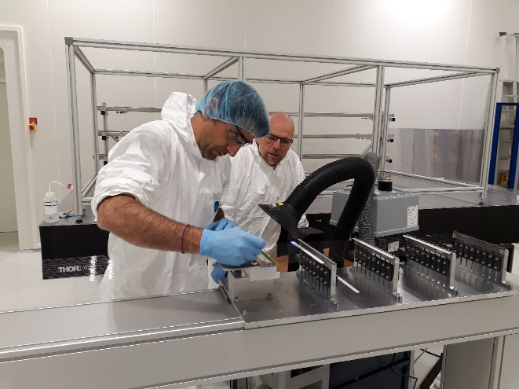
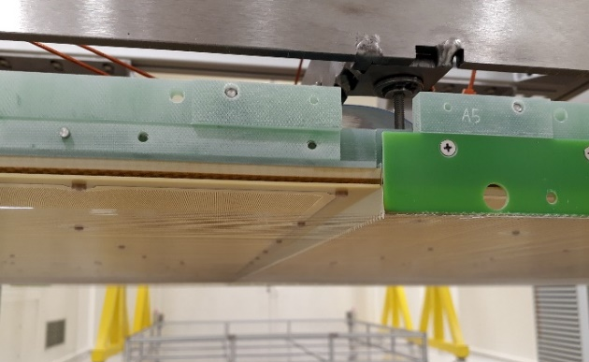
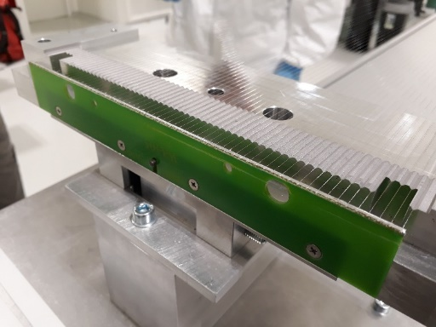
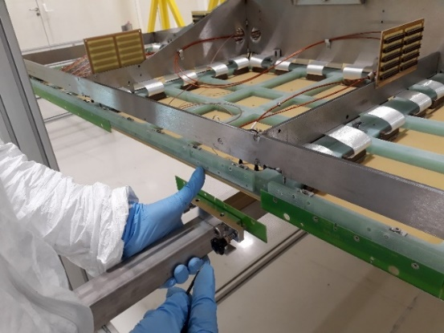
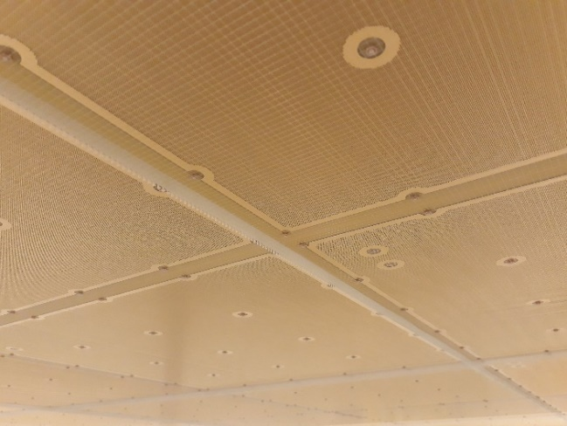
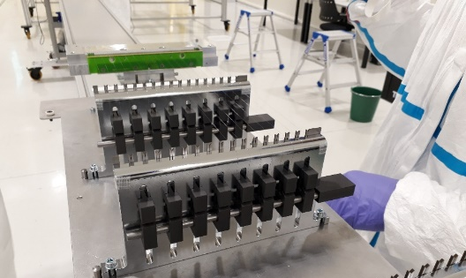
CRP: grid production
The grid production and installation: for 1 CRP 30 modules => less than 10 days
64 wires/module
The grid wires have a tension at warm of 1.5N /wire (0.6N originally)
At Liquid Argon temperature: G10 should contract less than inox
=> wire tension should increase to 3.5 N/wire
Grid + combs + LEMs seen from bottom

Slide 5
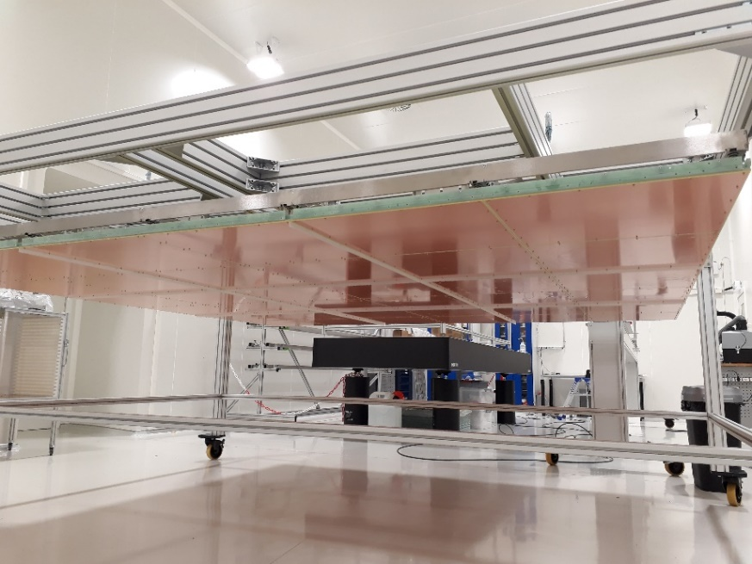
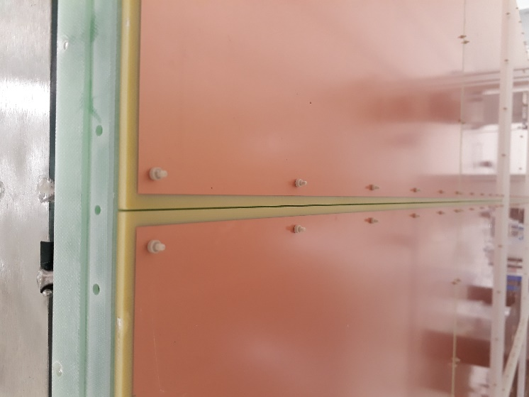
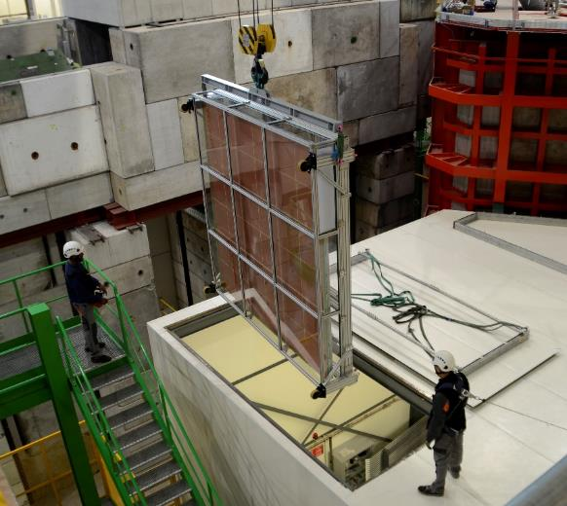
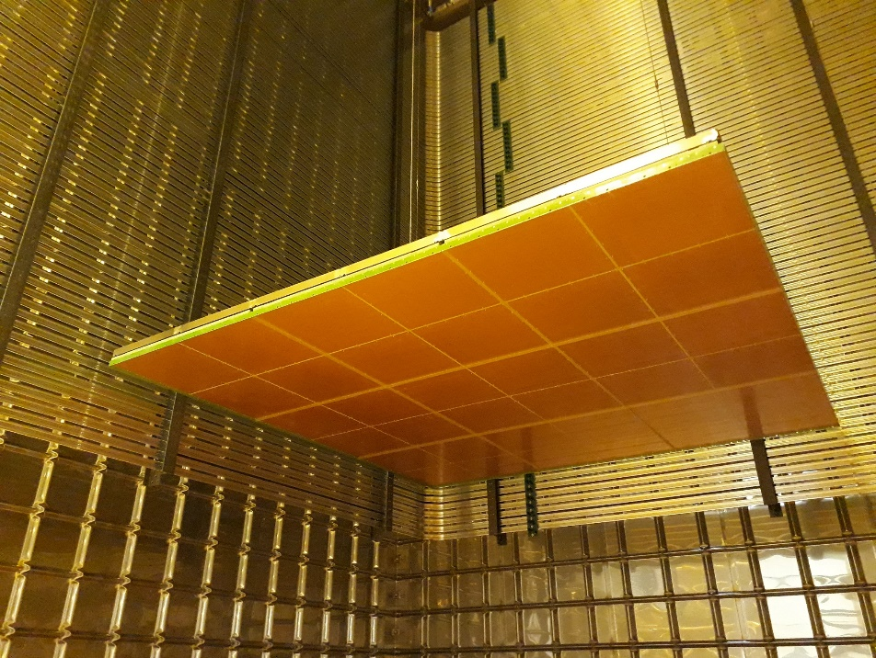
CRP3 assembly in September 2018
CRP3 and CRP4: no LEMs and anodes. Those are replaced by 'fake anodes' which are similar to real anodes but with a copper surface on one side and no strip.
+ full grid mounted
CRP3 started while waiting CRP2 LEM and anode production
« Fake » anodes
CRP3:« fake » anodes installed on 17/09
A test in cold box done beginning of October
Installation in NP02 cryostat: Nov 19th
Entering CRB on 17/10

Slide 6
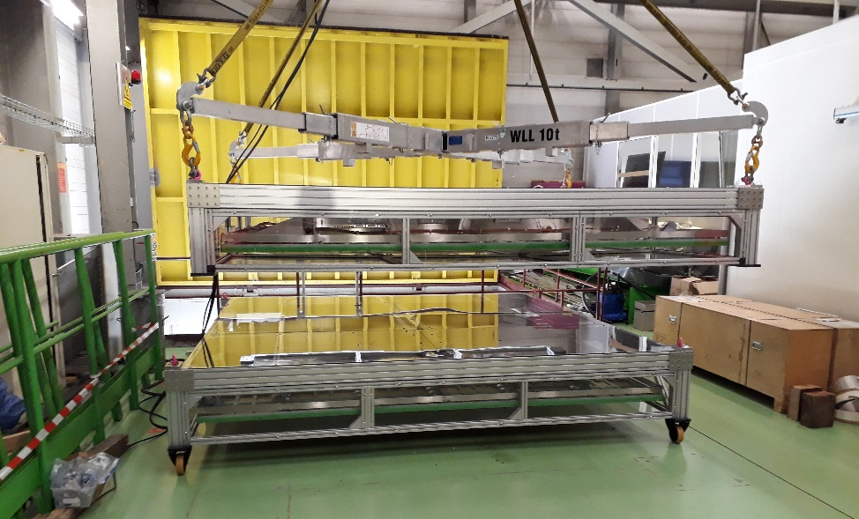
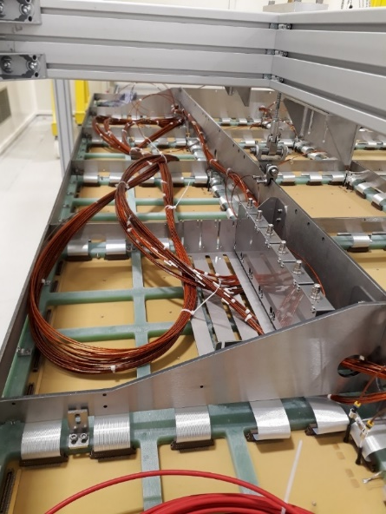
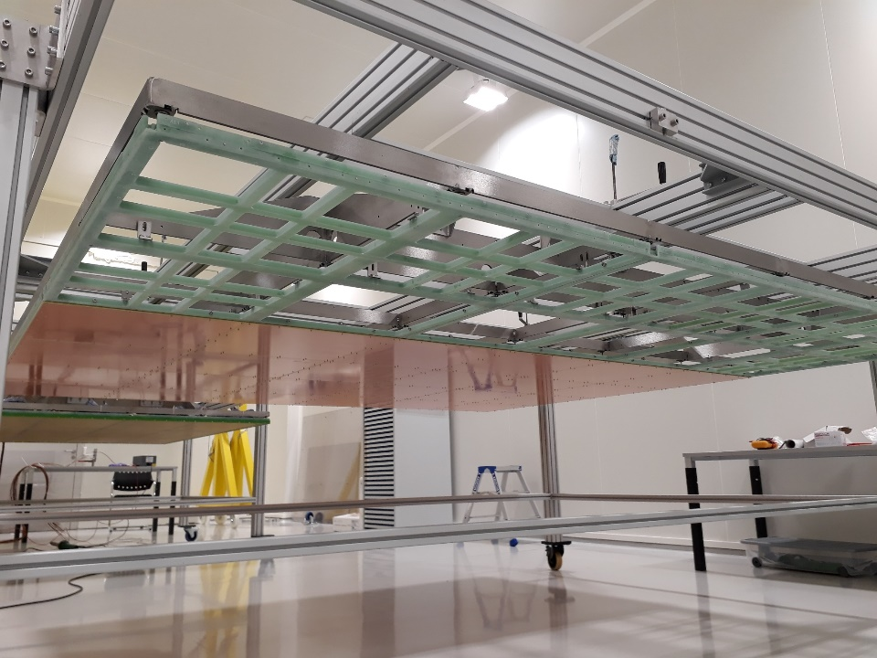
CRP2 assembly in October 2018
New top LEM HV DB
And Bottom LEM cabling
CRP2
CRP1
CRP4 assembly
Started in November but paused to allow modifications on CRP1 and CRP2
This CRP will have 4 real anodes without LEMs put on this corner
Will be resumed in January with grid production and short cold test

Slide 7
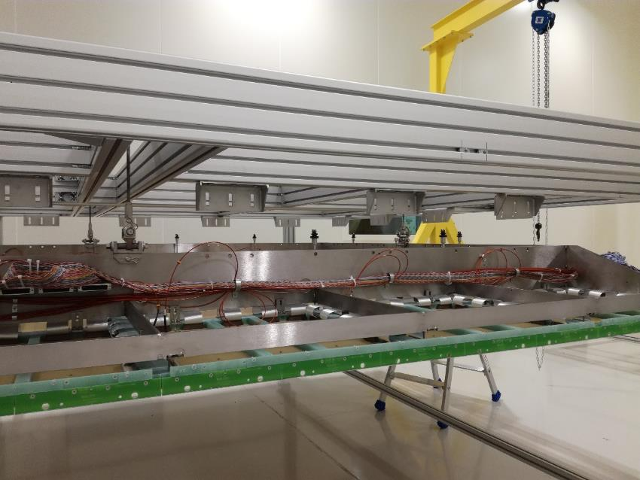
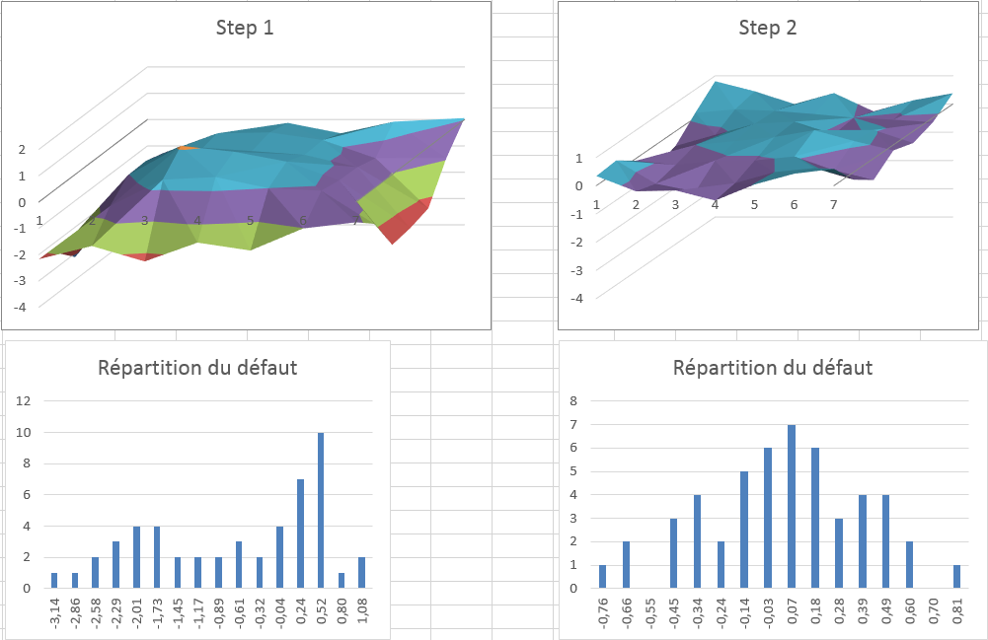
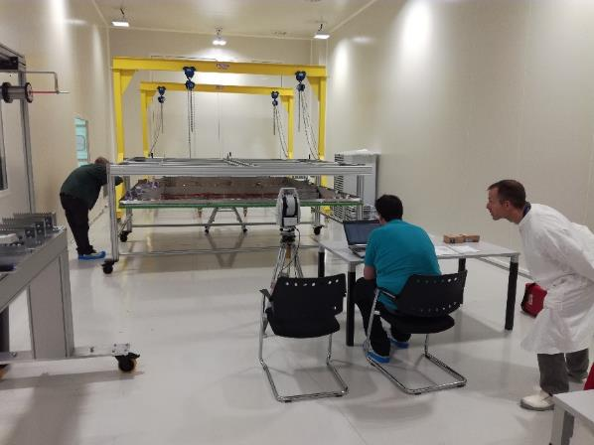
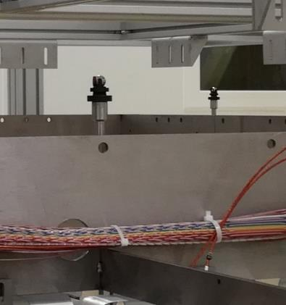
CRP planarity tuning
Planarity defect and defect repartition for CRP3 :
The planarity of the CRP is measured and adjusted on 50 points and 2-3 iterations.
This is performed in one day by CRP.
Results for measurements in CR185 (four CRPs) :

Slide 8
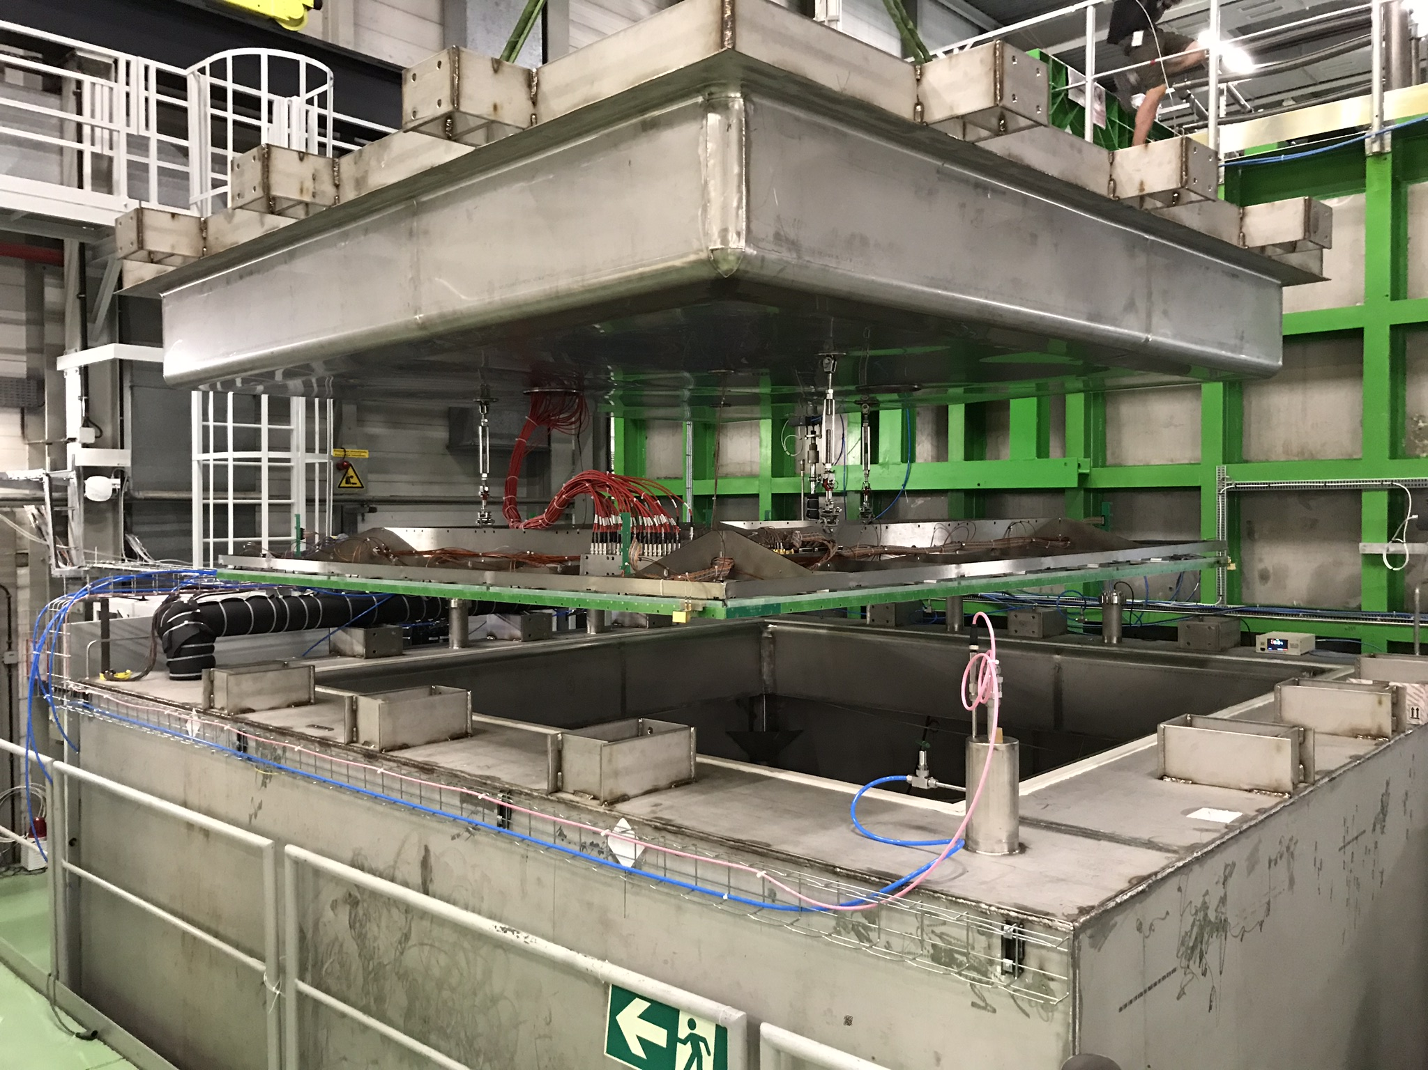
NP02 Cold box
Cold box fulfils the requirements defined in December 2017:
- Built from January and commissioned in May 2018
- O2 contamination < 50 ppm
- LAr evaporation less than 1 mm/h (< 700 W heat input)
- No boiling nor bubbles, level very quiet
- Control level +/-0.5 mm with constant refilling
Goals: Electrical and mechanical tests of each final CRP in nominal conditions on points where the 3x1x1 showed problems
- Characterisation of the operation voltage of each LEM
- Characterisation of the operation voltage of the grid
- Test the planarity of the CRP
- Test the tensioning of the extraction grid wires
- Test the HV contacts and connections (LEM & grid)
5 sessions of cold test: CRP1, CRP2 and CRP3

Slide 9
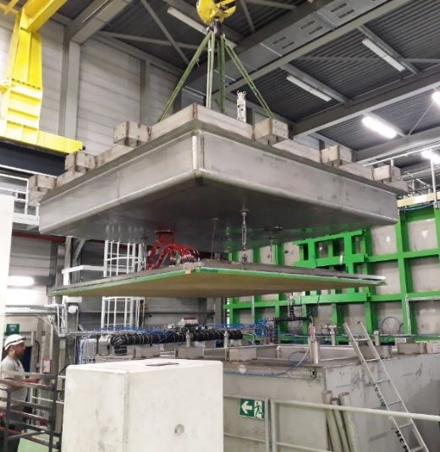
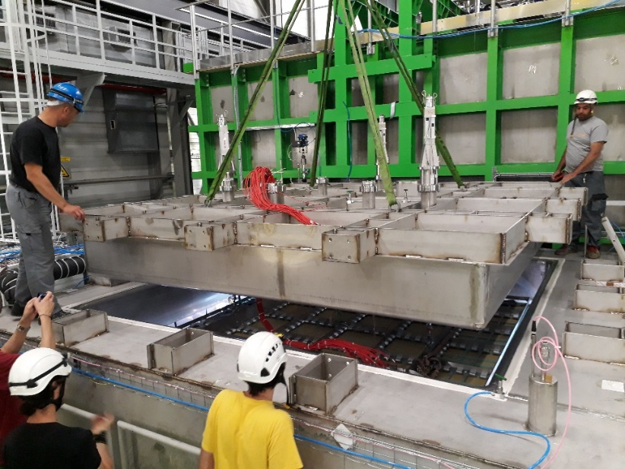
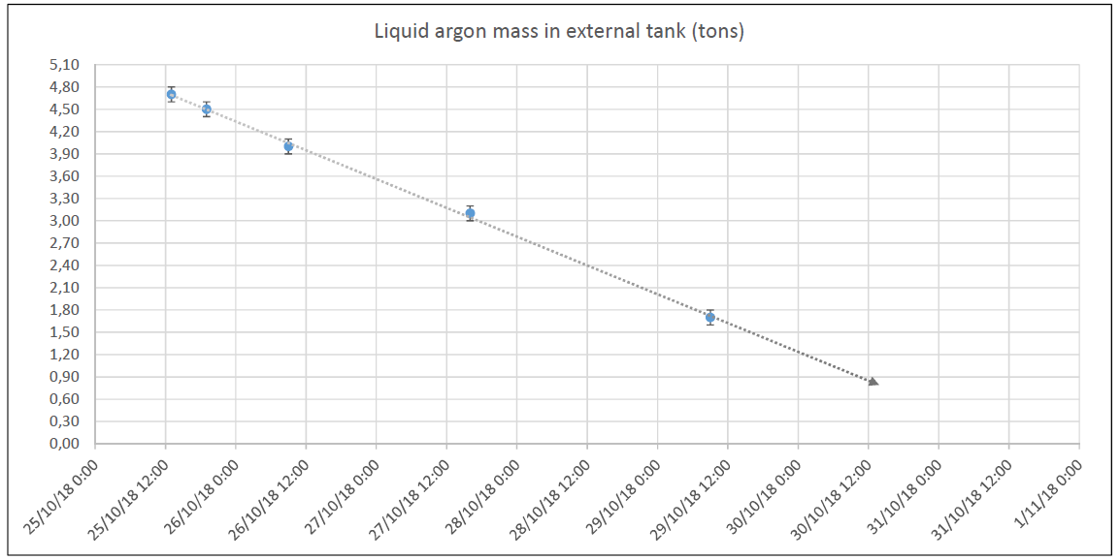
Cold box test procedure
When CRP and box closed (1 hour)
Inject dry air during > 1 day and test the LEM HV
Purge and flush with Gas argon for 1 day
Cool down and fill LAr : 10 hours
start tests of LEMs + grid
=> 3 days between closure and cold operation
The CRP is lowered or raised manually using the 3 suspension feedthroughs.
To adjust horizontality the CRP wrt the liquid argon level:
Liquid argon consumption during the various processes:
- Flushing/purge: 500Kg
- Cool-down: 750Kg
- Filling: mini 4000Kg
- Normal operation: 750Kg/24h (about 1400W)
During last CRP1 test

Slide 10
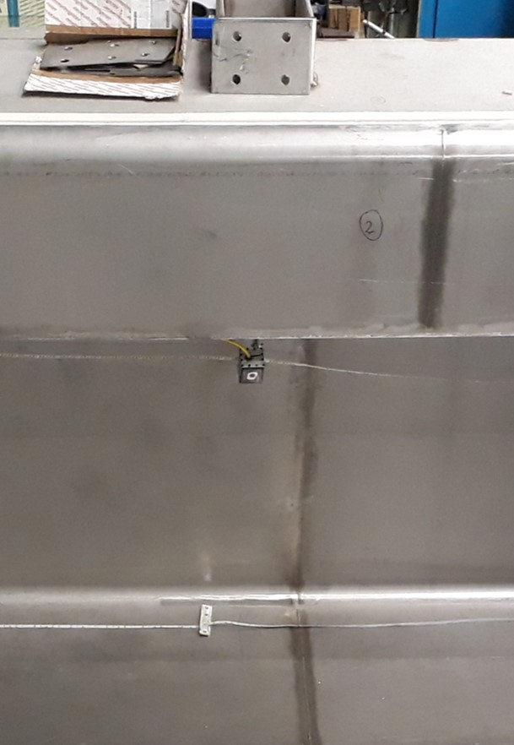
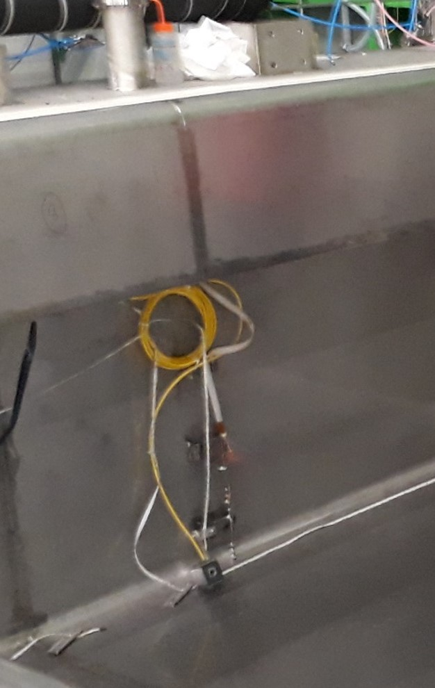
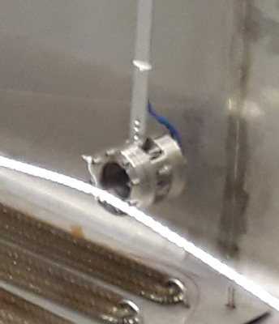
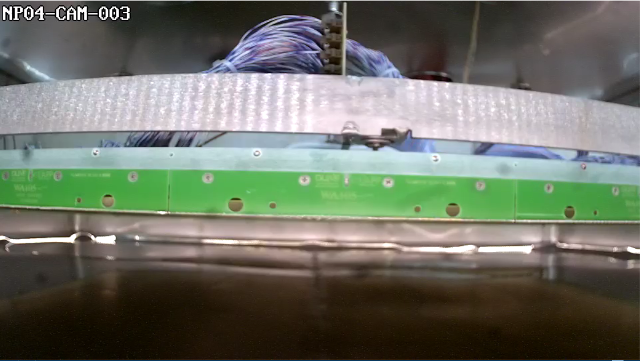
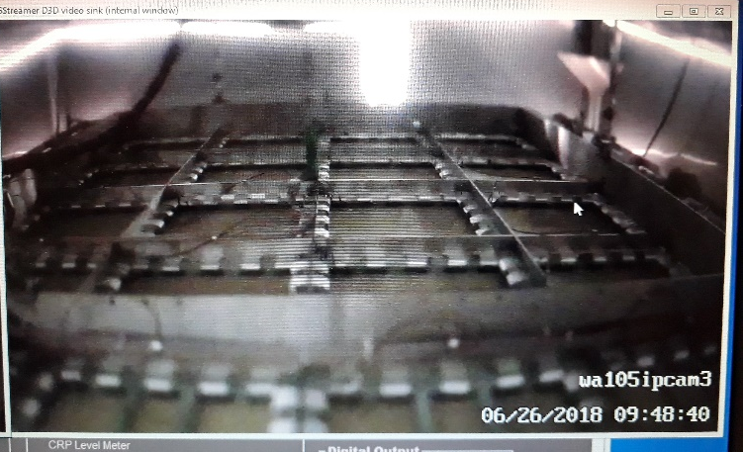
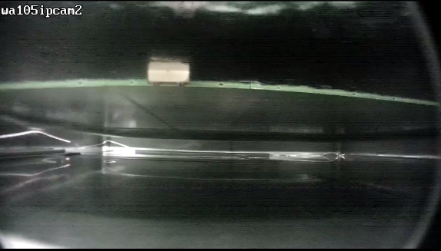
Cold box monitoring instrumentation:
3 cameras
A third camera has been added for the second test:
1 camera in the gas looking above the CRP:
1 camera in the liquid looking below the CRP:
TT118 22 cm
TT117 20 cm
TT116 18 cm
TT115 16 cm
TT114 4 cm
TT113 2 cm
TT112 0 cm
For cryo operation:
Cylindrical level meter AMI LE01 Pressure meter PE04
7 temperature probes (distance from the floor in cm):

Slide 11
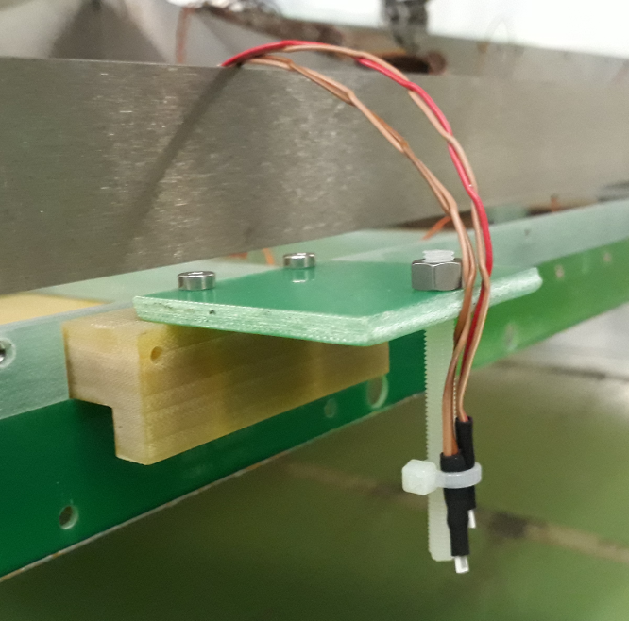
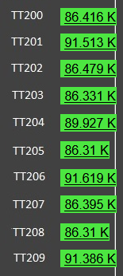
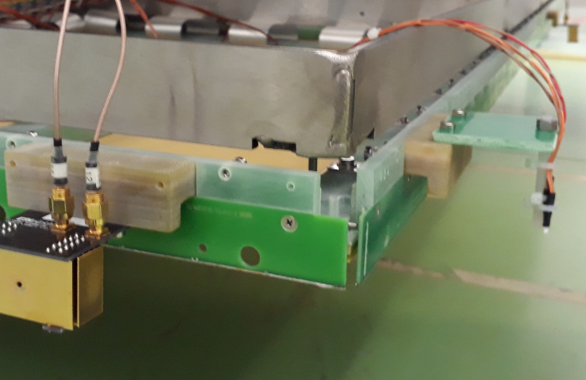
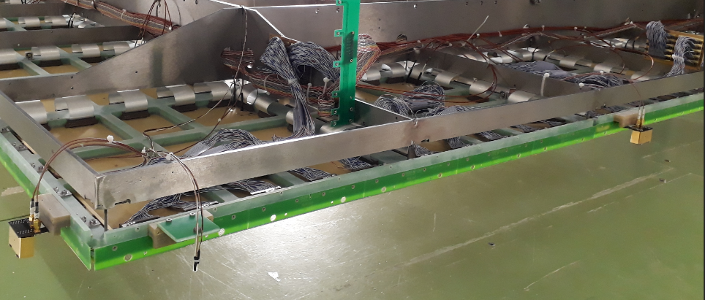
CRP instrumentation:
Level meters and Pt probes
Used after the second cold test in July
4 additional level meters have been added on the sides of the CRP
=> total + 8
Pt sensors have been added to the 4 corners to give an indication of horizontality and if liquid is between grid and LEMs
2 per corner:
1 just above the grid and the 2nd just below the LEM

Slide 12
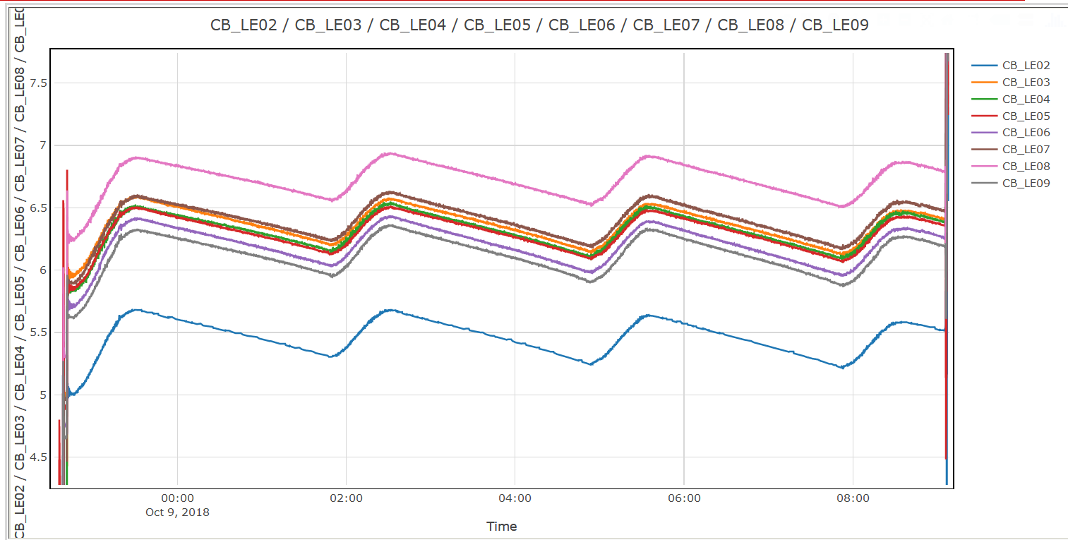
Measurements done with the 8 level meters during 3 complete regulation cycles on 9/10/18
CRP3 test in October
0.7 V = 1.75 mm
Similar spread with CRP1 and CRP2 compatible with planarity survey
The blue LM02 seems to be higher by 2mm
But same systematic offset for CRP1, CRP3 and CRP2 => the mechanical support under investigation
All 8 LM are seeing the same amplitude and level changes
The slopes are similar and trend is linear in this range

Slide 13
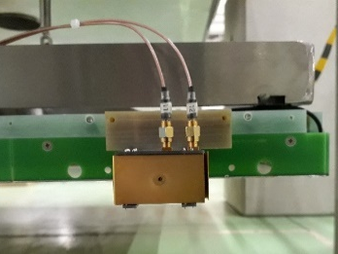
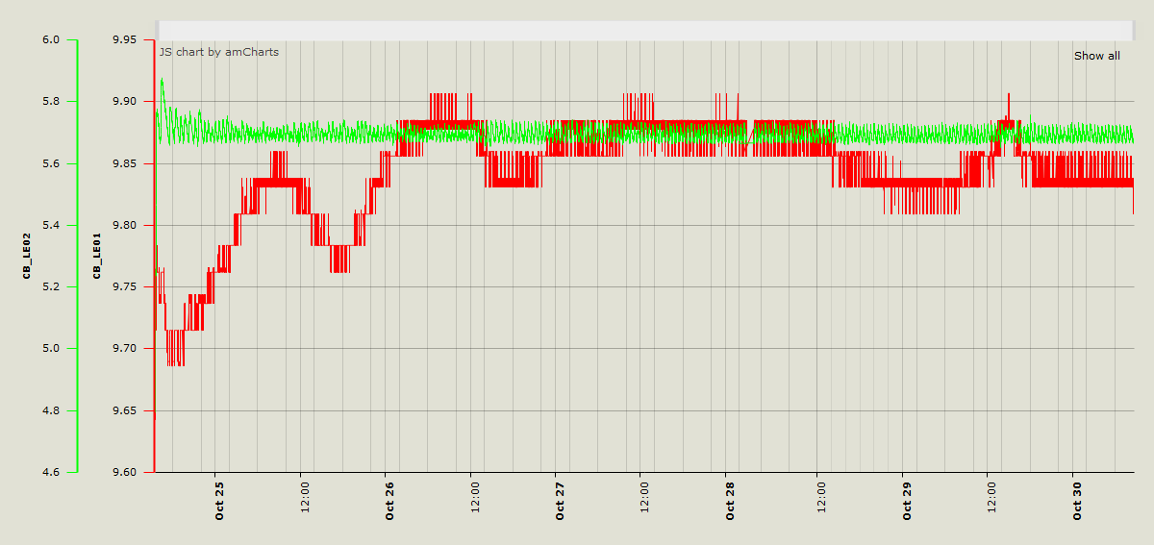
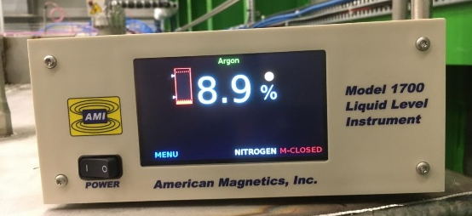
Comparisons of stability of LE01 (coaxial in cold box) with respect to LE02 (CRP level meter)
- During CRP1 third test with optimum argon level sitting between the grid and LEMs:
The regulation on CRP LE02 was 57% from 24/10 to 30/10
LE02
LE01
Variation of LE01 is of the order of 0.2 which could translate in uncertainty of 2 mm
27/10
No visible level change
Stability over 5.5 days
AMI
24/10
The coaxial level meter response varies with time and effects can be of the order of a 1-3 mm over several hours

Slide 14
Cold box tests of CRP from June to November
CRP1
CRP1
CRP3
CRP1
CRP2
22/06
09/07
27/07
17/08
03/10
15/10
30/10
12/11
27/11
10/10
Initial HV LEM DB design + Grid
Liquid argon level regulated using coaxial level meter
Regulation using 1 CRP level meter

Slide 15
Lessons from the cold box tests
Two Upgrades and modifications on CRP were performed after the first 2 cold box tests of CRP1
The grid tension and HV connection
The HV distribution to the LEM top and bottom layer
HV operation and operating points of the LEMs
=> 2 interventions needed after the last cold box tests of CRP1 and CRP2
(cf: E. Mazzucato’s talk)
CRP1: 4 LEMs showed a problem => had to remove them
CRP2: 1 LEM showed a problem => had to remove them

Slide 16
Modifications of the HV distribution of the LEM
CRP1: new bottom LEM cabling
After the second cold box test of CRP1:
Firs modification on the HV distribution of the LEMs bottom on the CRP1 in order to avoid any possible limitation due to sparking in the SHV connectors
=> distribution boxes have been removed during first week of September (3-5/09) and replaced them by 6m long HV cables going directly from LEM to outside of the cryostat.
Second modification on the LEM top distribution box (DB) done in Sept 2018
a few channels have lost the contact within the distribution box. This has been traced back, after a deep investigation, to a failure of the resistor which is embedded completely in Arathane glue in the box and suffer from some differential thermal behaviour. This happened only on 1 or 2 channel per box (each having 6).
new PCB boards without the use of Arathane
The CRP1 and CRP2 cold box tests in October and November ran with those modifications: no problem was seen with this new design

Slide 17
HV distribution for LEM and grid
For tests of CRP1 and CRP2 after September:
Connect directly the cables from the LEMs outside the box
=> Cables pass through special flange with 36 cables for LEM bot, 6 cables for LEM top DB and 1 cable for grid
The 36 Bottom LEM cables are soldered on 3 patch panels
The 36 cables with SHV are connected to a distribution box with 1 output for 6 inputs
Power supply crate used for the LEMs and grid
(cf: E. Mazzucato talk)

Slide 18
Extraction grid test and perfomance
Results of the first cold box tests of the first CRP (22/06 – 9/07):
HV tests of Grid:
Shorts were present with a few (6 to 8) LEMs
The maximum voltage was limited of the order of 2 kV in nominal CRP position
Modifications performed on CRP1 from 24/07 to 25/07 to :
Increase the tension of the grid
Spacers: 1 m long Vetronit material
Add 1.5 mm spacers to increase the grid wire tension along the 4 sides of the CRP
Net result: tension at warm went from 0.6 N to 2 N
HV connection to grid
Remove the soldered HV cable to the grid connection and the cable soldered on the main PCB plate
Replace the two by soldering an HV cable coming through the flange directly on the grid at the liquid level

Slide 19
Extraction grid: Results of the second cold box test for the CRP1
High Voltage tests: The 9 m2 CRP has been operated in the dual phase configuration with its entire system of 36 LEMs and grid powered at High voltage for several cycles of liquid argon regulation (more than 10 hours).
After drying the connector there was no limit for the grid voltage > 7500 V with current less than 2 nA
Before that the situation was not simple:
Current fluctuating and some discharges from time to time
The solution was to remove the humidity around the SHV connector outside of the cold box to avoid discharges in the connector => thanks to the hair dryer which was heating the outside connector
- The 36 LEMs have been operated for several hours at a ΔV up to 31 kV/cm
- There was no interference nor contact with the grid wires or anything else
- The grid was operated at full capacity up to 7.5 kV together with the 36 LEMs turned on over several days.
Results of the CRP3, last CRP1 and CRP2 tests: the grid has been operated successfully at any voltage needed; no problem of humidity anymore for them (HV cable outside was longer)

Slide 20
Grid wires
There are 1920 wires of 3m long on each CRP grid.
For the 3 CRPs tested in the cold there was no broken wire or faulty soldering among the nearly 6000 wires
CRP1 did also 3 times the cold test and the grid experienced the manual retensioning by 2N/wire in July
Unfortunately a problem appeared during the insertion of CRP3 in the cryostat where 3 wires broke in the process and 7 more in the following days.
The manipulation was not soft at all due to an abnormal use of the chain hoist and it has been requested to proceed much more smoothly for the next manipulations
After investigation and careful check of the 1920 wires it appeared that on a few wires of this CRP there was a sort of small coloration with small deposit along the wires. This was usually located between 1 and 10cm from the PCB supporting plate
This is identified as a possible remnant of soldering flux which was not cleaned as it should have been after soldering. This flux is usually aggressive and may attack the metal. This could eventually explained the breaking of wires.
The process of cleaning with distilled water was not properly done on a few wires for this CRP.
We artificially increase the tension of the full grid to see which wires could have been weakened.
In the meantime a thorough inspection of the other CRP grid wire by wire is going on.

Slide 21
Cold box tests of CRP from June to November
CRP1
CRP1
CRP3
CRP1
CRP2
22/06
09/07
27/07
17/08
03/10
15/10
30/10
12/11
27/11
10/10
CRP4 to complete and test in Jan. ‘19
Initial HV LEM DB design + Grid
=> some contacts of grid wires with some LEMs
New grid tensionning and HV connection
Validated
Found some broken channels on LEM top DB
Fake anodes: Test of grid + new LEM top DB + level meters => succesful => EHN1
CRP2 constructed with all upgrades
CRP1: removal of LEM bot HV DB and production of new type of LEM top DB Construction of CRP3
CRP1 with upgraded LEM HV DB
4 LEMs showed bad operating behaviour
CRP1: 4 LEMs reinstalled after cleaning and tests
New cold test next week
Liquid argon level regulated using coaxial level meter
Regulation using 1 CRP level meter

Slide 22
Next steps for the CRPs:
CRP#1:
Reinstall grid after the replacements of 4 LEMs by 10/12
Cold box test in December
Bring to EHN1 beginning of January 2019
CRP#2:
replace 1 LEM and some grid from 11/12 to 14/12
Bring to EHN1 before Christmas
CRP#4:
Resume the assembly and grid production mid January
Short cold box test
Bring to EHN1 end January

Slide 23
Summary:
3 CRPs are constructed and the last one will be completed in January.
Several modifications and upgrades have been applied to CRP1 after the various cold box tests
The CRP2 is built from this knowledge and is behaving as expected
CRP1 and CRP2 LEM HV have been studied in details and results will be shown in the next talk
Grid design and nominal performance have been reached and validated for the 3 constructed CRP
The cold box is operating in an efficient way with a reasonable turn around; The sequence of operation is well defined and can be set up rather rapidly. It has worked for CRP1, CRP2 and CRP3
The goal is to install the 4 CRPs in the cryostat by the end of January

