Slide 1



LEM Production and Tests in Cold Box for ProtoDUNE-DP
E. Mazzucato (CEA Saclay/Irfu)
LEM Production
LEM HV Tests in Cold Box

Slide 2
LEM Production

Slide 3
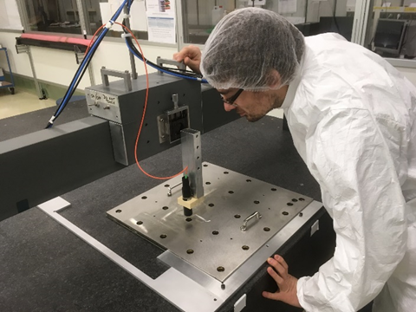
LEM manufacturing by ELTOS (Italy)
Characterization and tests @ CEA/Irfu
74 LEMs produced and tested for
CRP1 & CRP2 (Jan. – Oct./2018)
LEM production
Ultrasonic bath
LEM Survey
Soldering HV pins +
glueing MACOR insulation
Cleaning + drying
+ polymerization

Slide 4
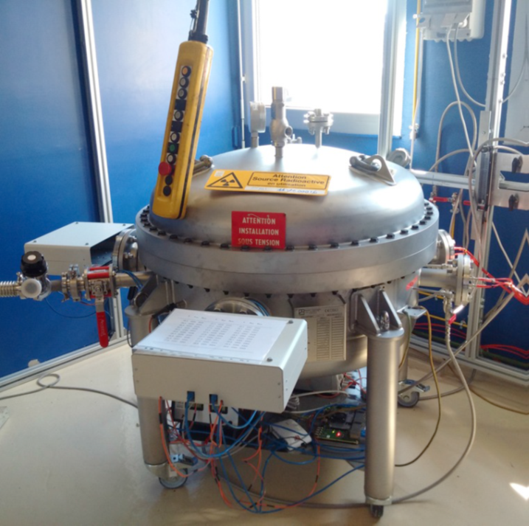
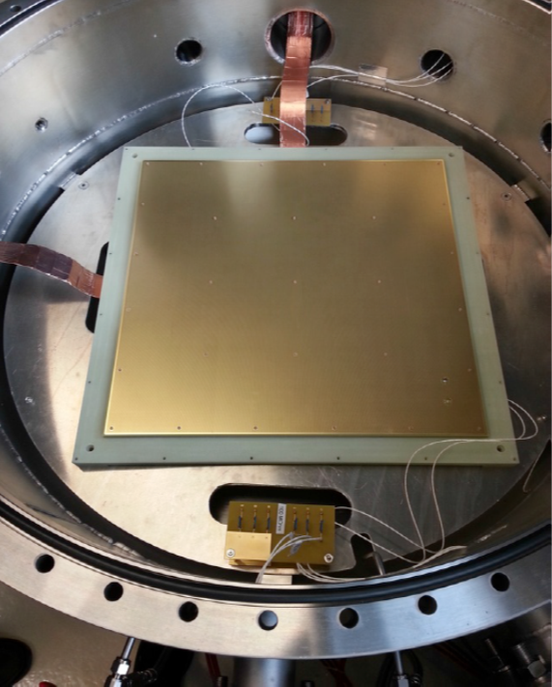
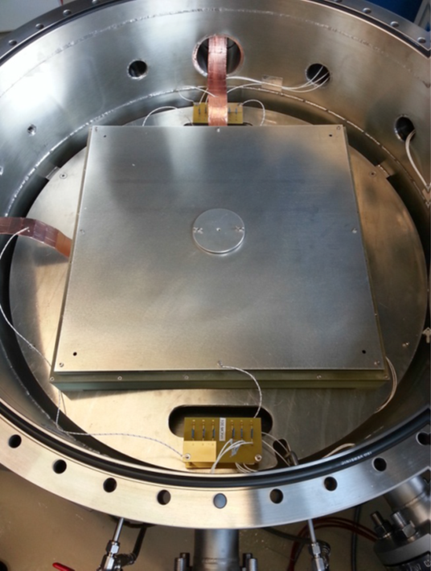
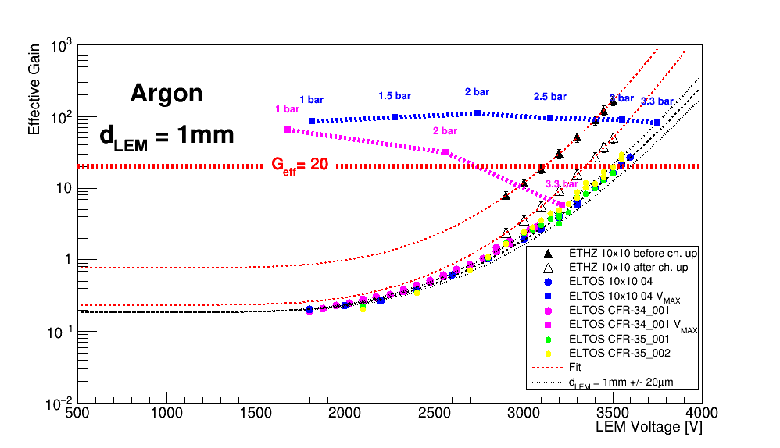
LEM HV Tests in a High Pressure Chamber
Stack of 6 LEMs
LEM + ANODE
CATHODE
collimated
α source
Amplification gain inside the LEM depends on gas density ρ or P/T :
G_{eff} = Ce^{αd} with α = Aρe^{-Bρ/E}
GAr @ 88°K and ∼1 bar ⇔ T = 20°C and P ∼3.3bar.

Slide 5
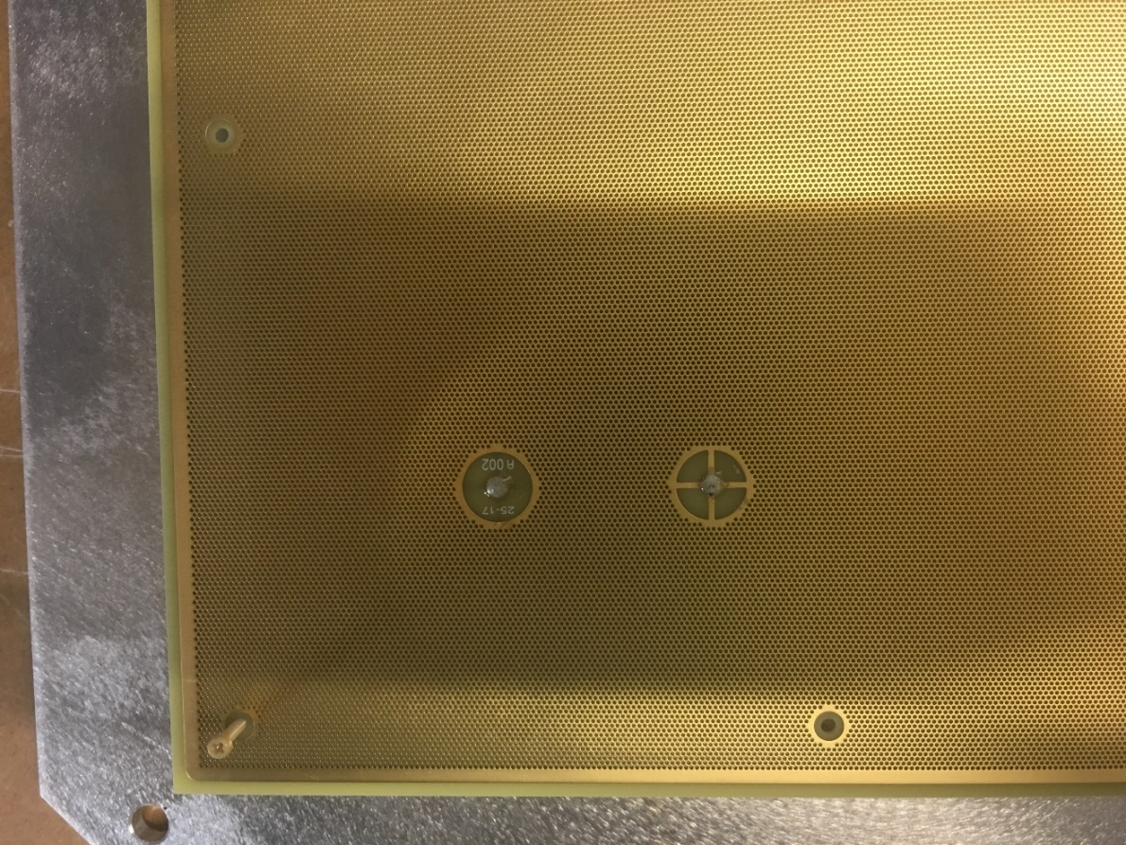
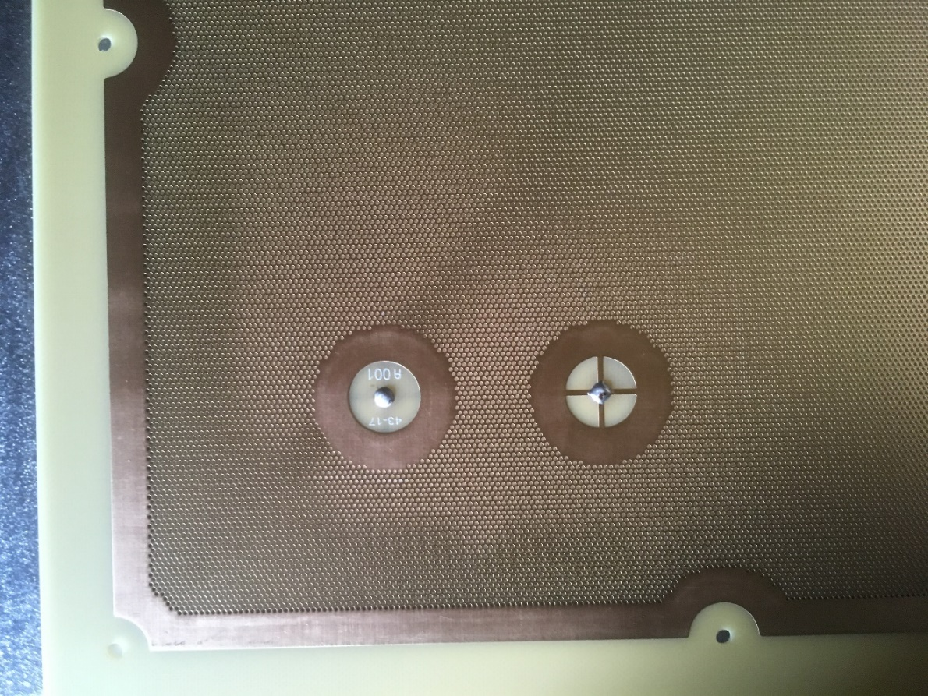
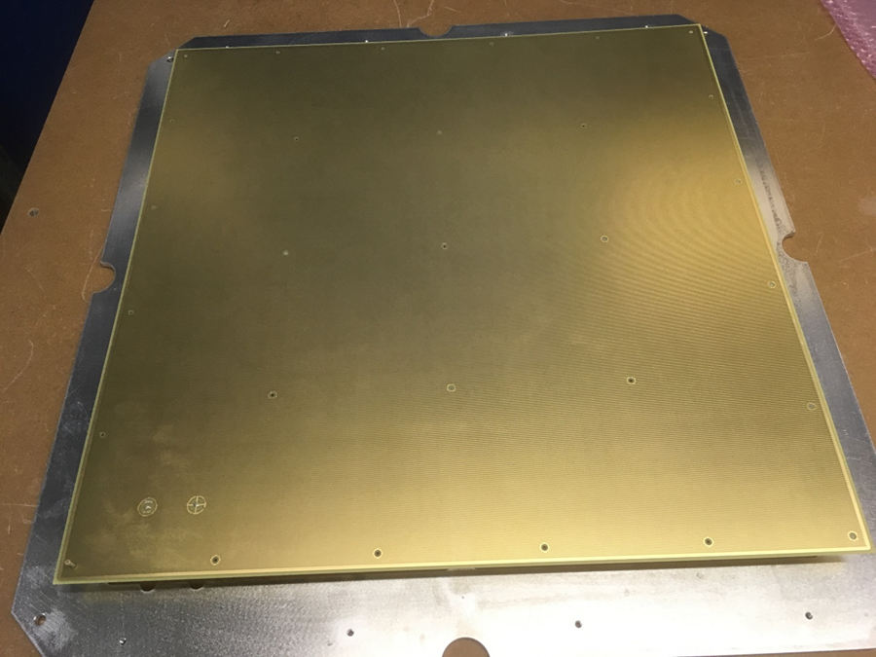
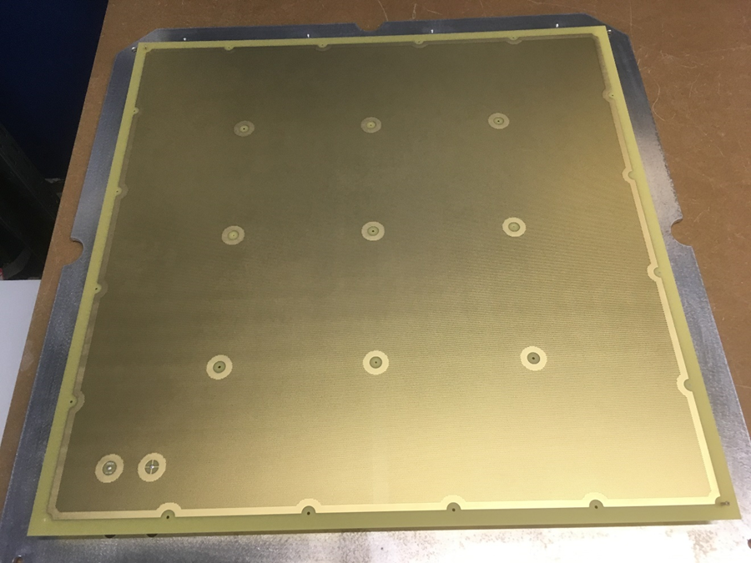
LEM Design for ProtoDUNE-DP
CFR-34 – 311 prototype
CFR-35 – NP02
2 + 2 mm
clearance
5 + 10 mm
clearance
∼ 96% active area
∼ 86% active area
Not necessarily the final design for a 10kt detector!

Slide 6
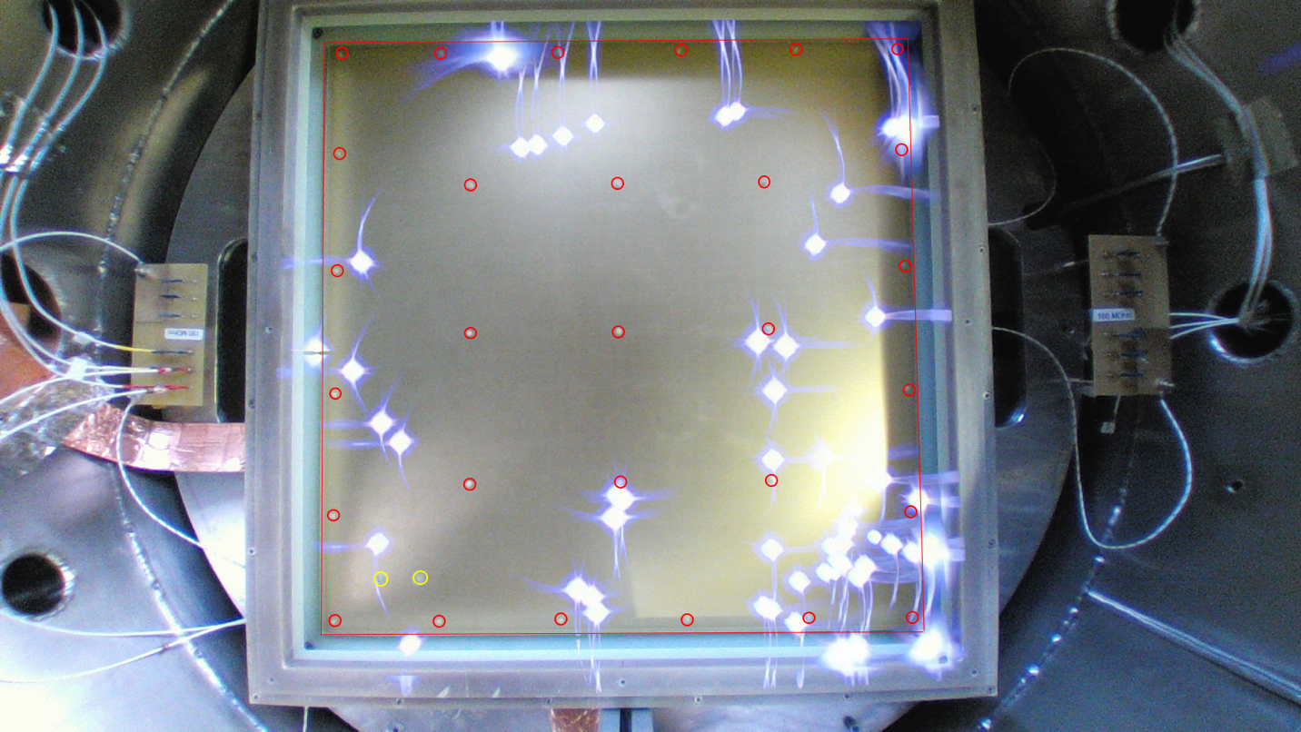
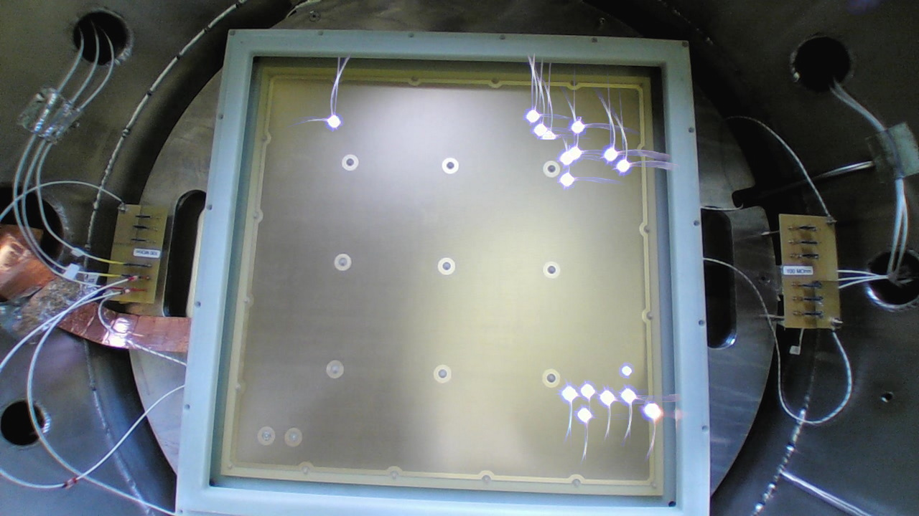
LEM HV Tests in Ar @ 3.3 bar
CFR-34 – 311
CFR-35 – NP02
ΔV_{LEM} = 3.3-3.5 kV in Ar @ 3.3 bar
ΔV_{LEM} = 3.5 kV in Ar @ 3.3 bar
multiple
sparks
- gain > 100 in DLAr (before charging up)
- no PS trip for > 40h
- spark rate : ∼3/h
- spark rate : ∼20/h
(> 45% of sparks near edges or corners)

Slide 7
LEM QA/QC by ELTOS
RIM
LEM Specifications
HOLE
FR4
PCB

Slide 8
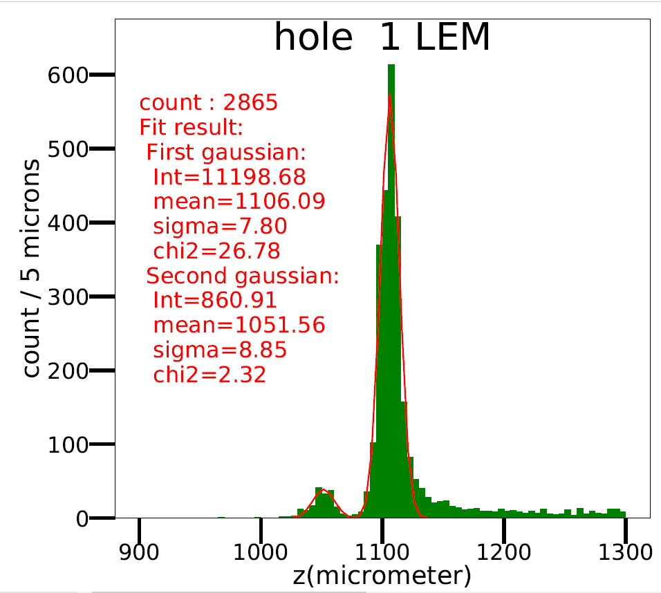
LEM Survey @CEA/Irfu
t₂
t₁
Cu
t₁
t₂
Cu
FR4

Slide 9
LEM HV training in Ar @ ∼3.3 bar
Fully automated HV training up to 3.5kV
LEM A143
3 hours @ 3.5 kV
V
I
LEM A143
All LEMs in CRP1 and CRP2 tested up to 3.4 – 3.5 kV with < 1 spark / 20 minutes

Slide 10
LEM HV Tests in Cold Box

Slide 11
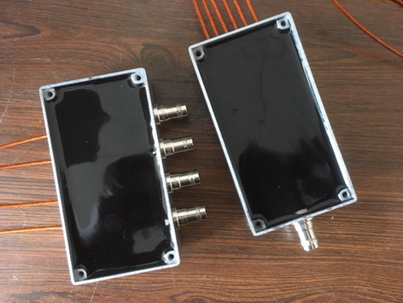
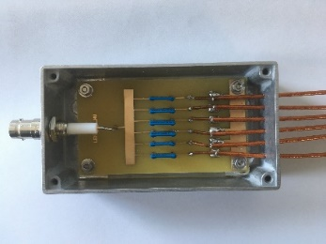
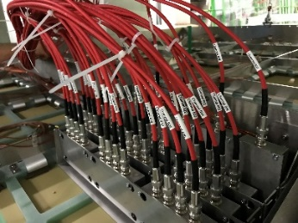
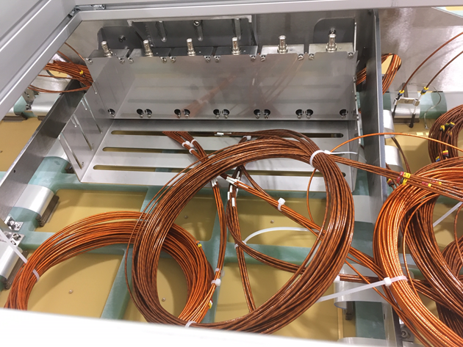
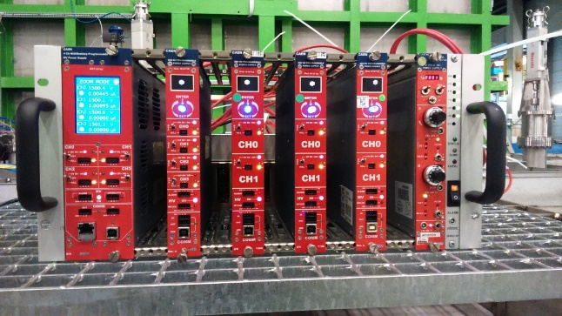
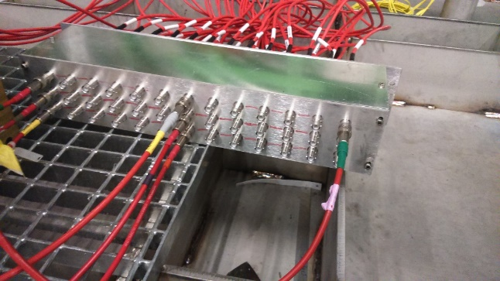
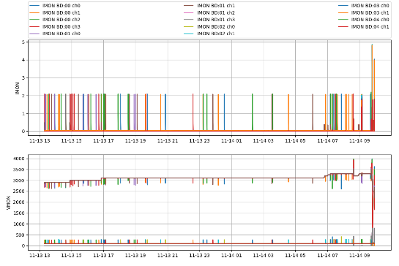
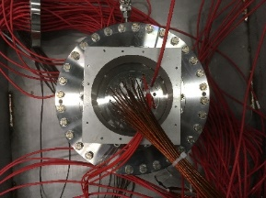
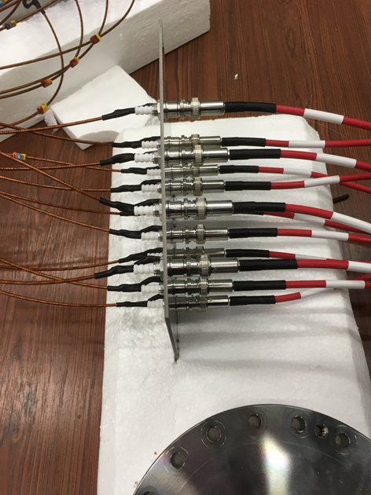
CRP1 and CRP2 HV LEM Tests
Since last July, CRP test conditions with Cold Box have been improving (LV, TP, LAr level regulation, GRID, etc…)
LEM HV system modified (DB, HV connections) for
more reliable operation in cold GAr
HV PS system and SC monitoring still temporary
with limited number of channels (LEMs grouped
by 6; 14 available LEM HV channels instead of 42)
6 LEM TOP/DB
LEM DB
and HV
CAEN HV PS
Patch Panel
SCM
36 LEM BOT

Slide 12
CRP1 and CRP2 LEM HV Tests
Will mainly address the CRP1 & CRP2 CB tests of Oct. and Nov. as CRPs were in their final configuration
No control on Ar purity (< 100 ppm) and GAr density (P_{atm})
Reminder : performance goals for ProtoDune-DP (G ∼ 20, stability) are based on the operation of a 3L TPC with an active LEM area 900 times smaller than one single CRP …
CRP1 and CRP2 operated for « long » periods of time at different HV settings with all 36 LEMs powered, exceeding by far LEM operation time with the 311
Still, some issues remain to be understood …

Slide 13
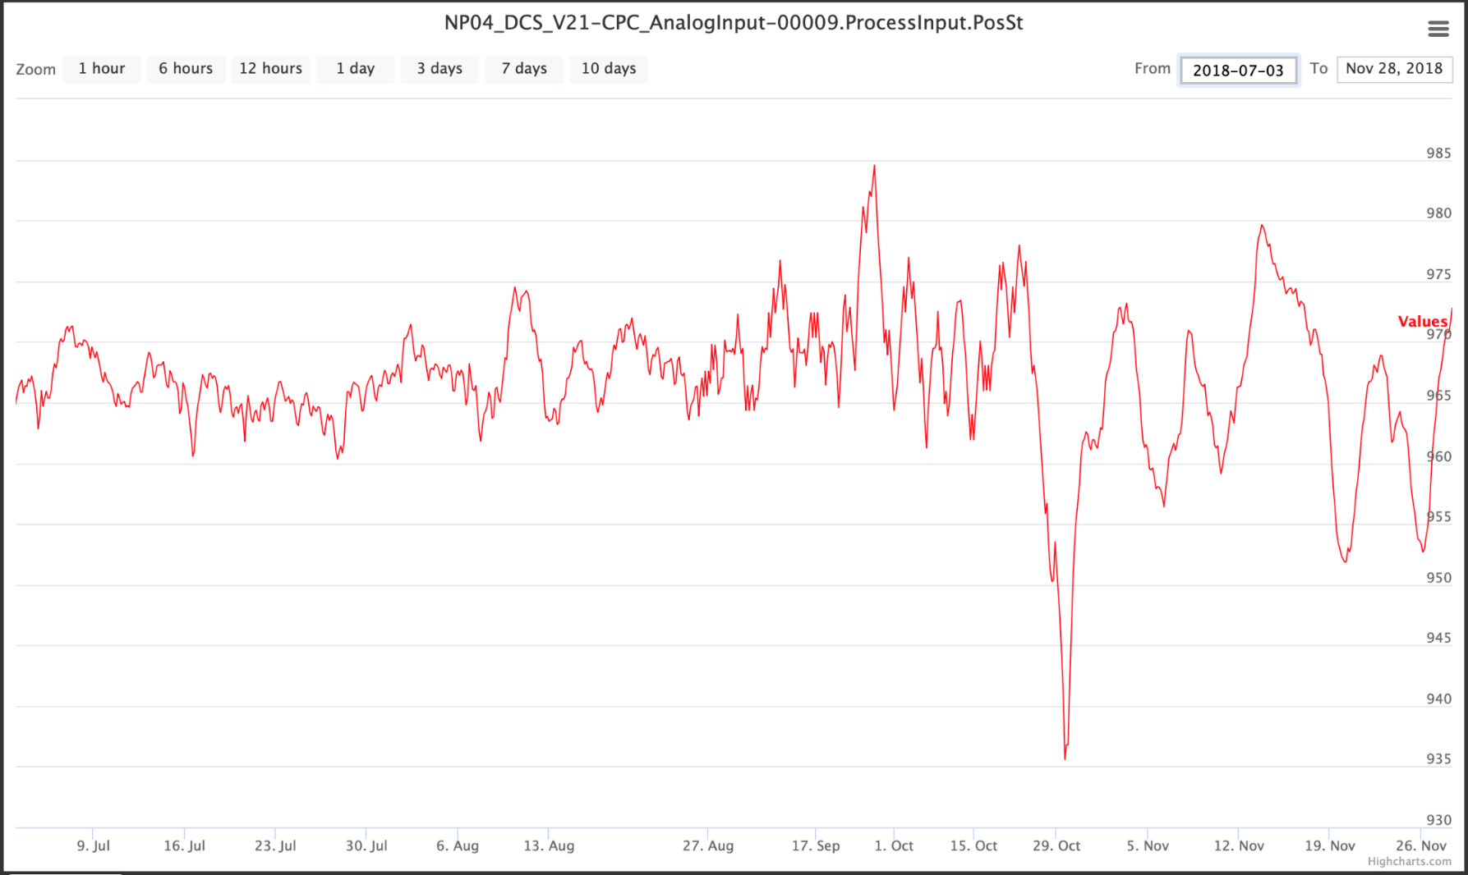
Atmospheric Pressure
From ProtoDUNE-SP
SC web page
985 mbar
965 mbar
CRP3
CRP1
CRP1
CRP1
CRP2
935 mbar

Slide 14
Dual Phase Principle
Induction : 5kV/cm
Amplification : 30kV/cm
Extr. (GAr) : 3.6kV/cm
Extr. (LAr) : 2.4kV/cm
ANODE
LEM TOP
LEM BOT
Extr. Grid
GND
-1kV
-4kV
-7kV

Slide 15
CRP1 LEM HV Test Results (Oct. 15th - 30th)
Liquid level stable to within ∼250µm (2mm rapid increase of level occured during LAr delivery on Oct. 30th)
T_{LEM} ∼ 91°K
ΔV_{LEM-GRID} = 3kV
V_{TOP} (kV) | V_{BOT} (kV) | E_{LEM} (kV/cm) | Time (h) | Spark Rate (h⁻¹) | P_{atm} (mbar) | G_{eff} (no ch. up)
0.25 | 3.35 | 31.0 | 12 | 1.3 | 968 - 972 | 20
0.50 | 3.55-3.60 | 30.5-31.0 | 13 | 1.3 | 962 - 966 | 24 - 31
0.75 | 3.70 | 29.5 | 42 | 0.6 | 943 - 953 | 20
1.00 | 3.80 | 28.0 | 18 | 2 trips* | 970 - 976 | 9
1.00 | 3.85 | 28.5 | 12 | 3 trips | 936 - 947 | 15
* TRIP time set too short
As V_{TOP} increases up to the 1kV nominal value, the field inside the LEM needs to be decreased in order to keep stable operation conditions.

Slide 16
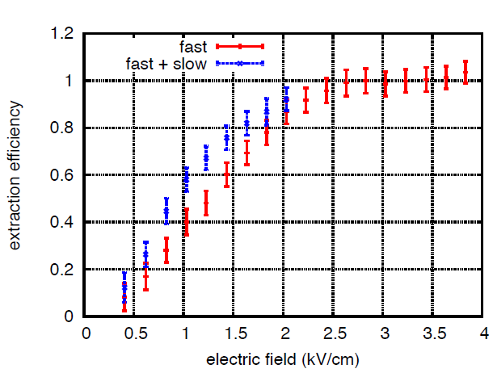
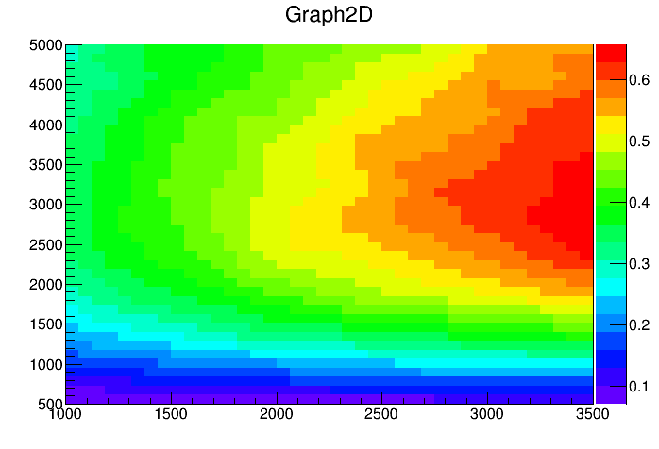
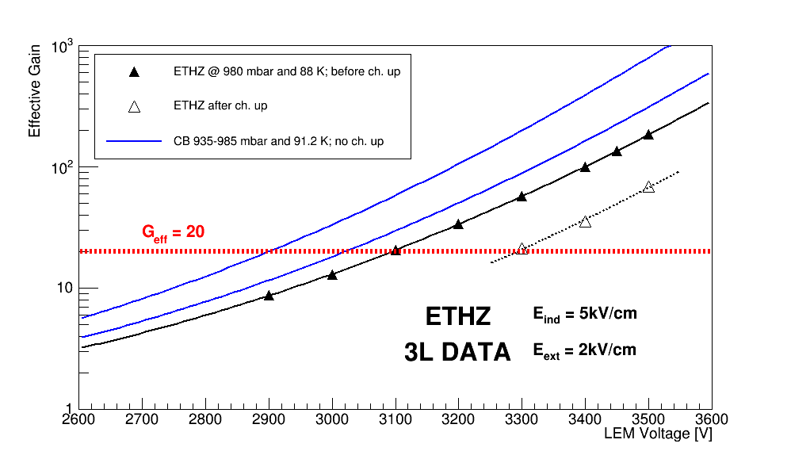
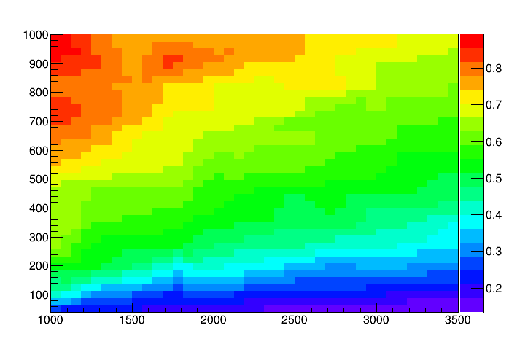
Effective gain
Gushchin et al., Sov. Phys.
JETP 55 (1982) 860-862.
G_{eff} = ε_{extr} × G_{LEM} × ε_{ind}
Extraction efficiency
ΔV_{GRID-LEM} (V)
Includes probability
for electrons to enter
LEM holes
Collection efficiency
V_{LEM_TOP} (V)
ΔV_{LEM} (V)

Slide 17
First CRP2 Results (Nov. 15th – 26th)
LEM HV tests in DLAr mode started on Nov. 15th after CRP positioned w.r.t. liquid level
Liquid level stability : ∼200µm
ΔV_{LEM-GRID} = 3kV
V_{TOP} (kV) | V_{BOT} (kV) | E_{LEM} (kV/cm) | Time (h) | Spark Rate (h⁻¹) | P_{atm} (mbar) | G_{eff} (no ch. up)
0.10 | 3.15 - 3.20 | 30.5 - 31.0 | 17 | 0.8 | 969 - 973 | 9 - 11
0.25 | 3.34 | 30.9 | 16 | 1.3 | 968 - 970 | 19
0.50 | 3.55 | 30.5 | 11 | 0.9 | 957 - 965 | 24
0.50 | 3.555 | 30.55 | 42 | 0.5 | 962 - 964 | 25
Similar trend and HV limitation for CRP2 as CRP1. Being investigated. Not observed during source tests up to 35kV/cm in HP chamber with single LEM + anode.

Slide 18
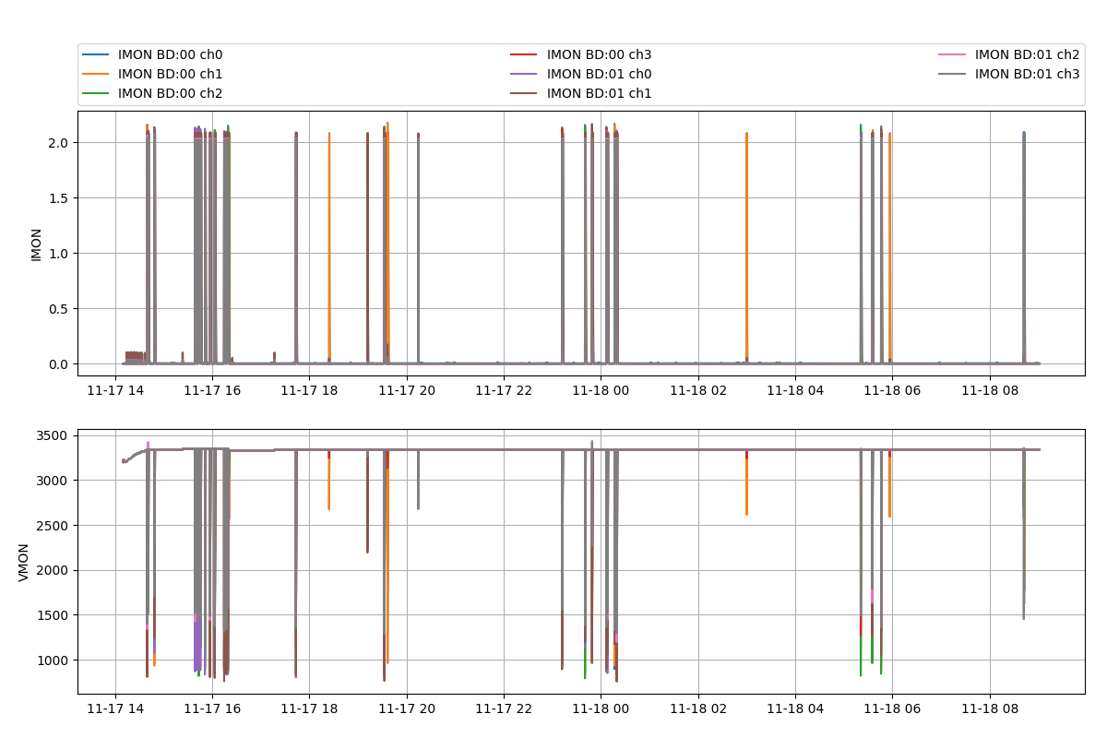
CRP2 : V_{TOP} = 0.25kV and V_{BOT} = 3.34kV
0 trip, 20 sparks @ 0.25kV/3.34kV in 16 hrs

Slide 19
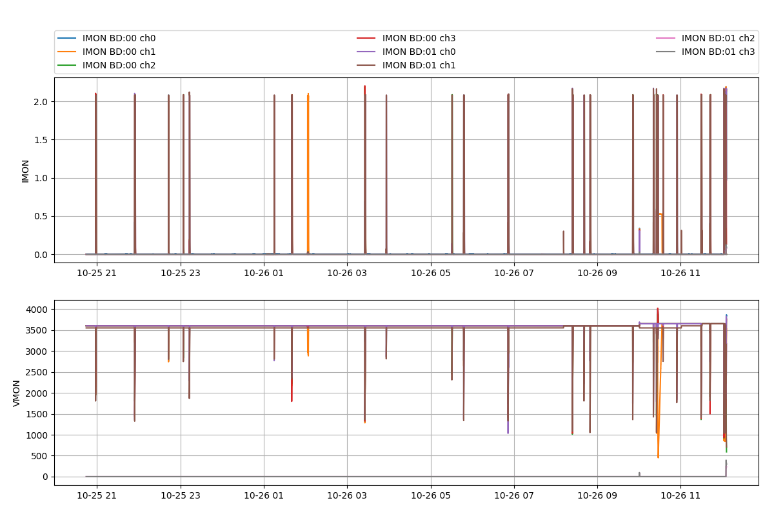
CRP1 : V_{TOP} = 0.50kV and V_{BOT} = 3.60kV
0 trip, 17sparks @ 0.50kV/3.60kV in 13 hrs

Slide 20
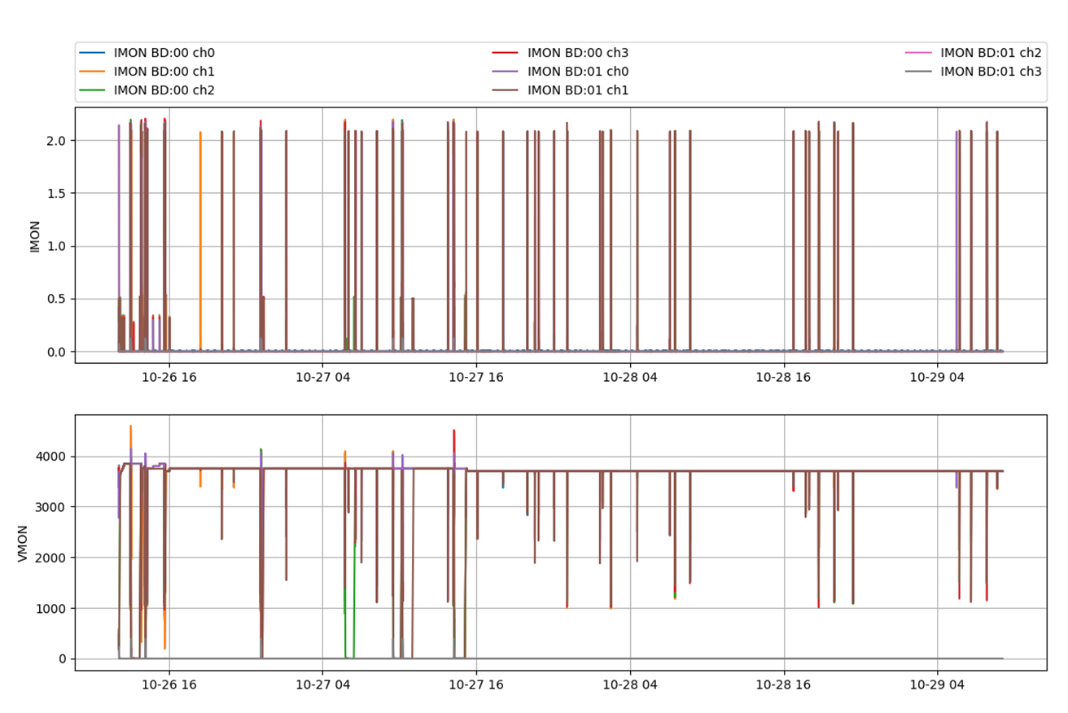
CRP1 : V_{TOP} = 0.75kV and V_{BOT} = 3.70kV
4 trips @ 0.75kV/3.75kV in 24 hrs
0 trip, 26 sparks @ 0.75kV/3.70kV in 42 hrs

Slide 21
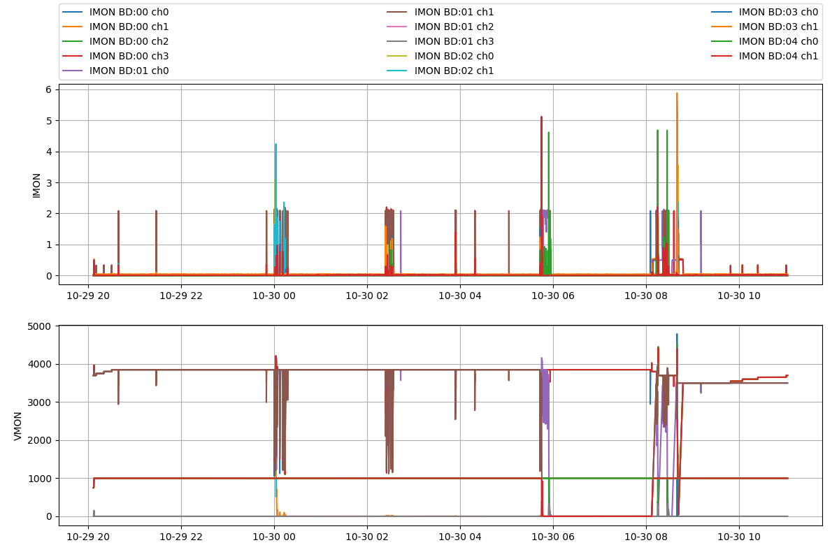
CRP1 : V_{TOP} = 1.00kV and V_{BOT} = 3.85kV
Discharges
Very unstable conditions.
Coincides with LAr delivery
that caused 2mm rapid
increase of level in CB
3 trips @ 1.0kV/3.85kV

Slide 22
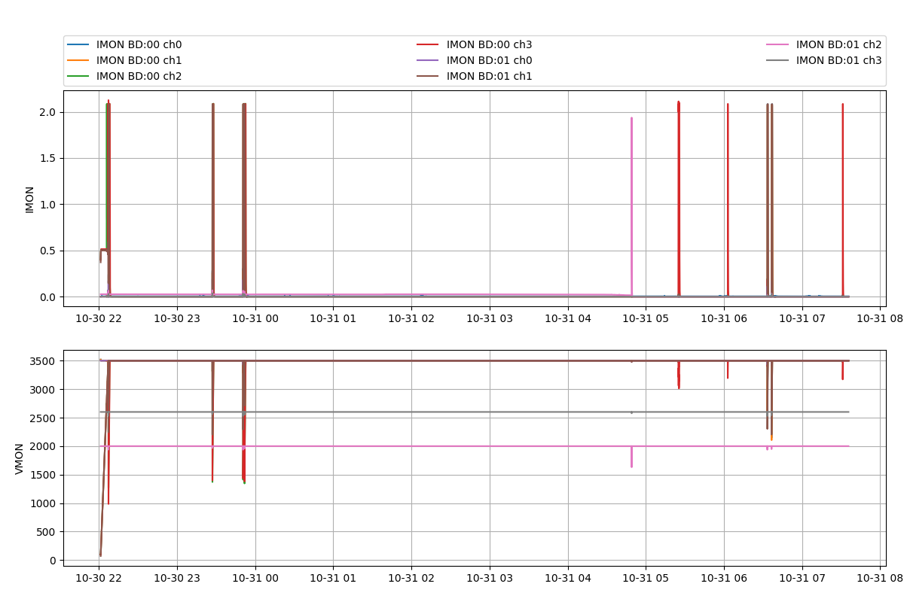
Issues with CRP1
On Oct. 30th, found 3 problematic
LEMs (16,28,30) from 2 different HV
channels with similar discharging
behaviour
Needed to lower their V_{BOT} value to
run in stable conditions
V_{TOP} = 0.50kV and V_{BOT} = 3.50kV

Slide 23
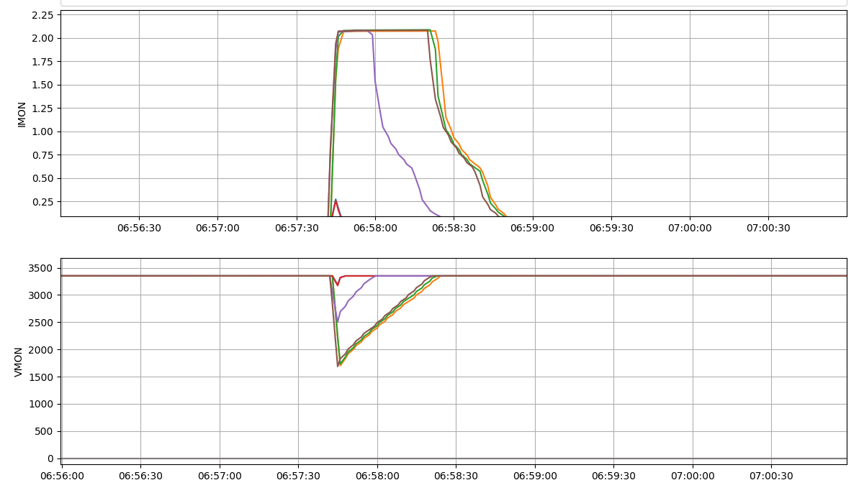
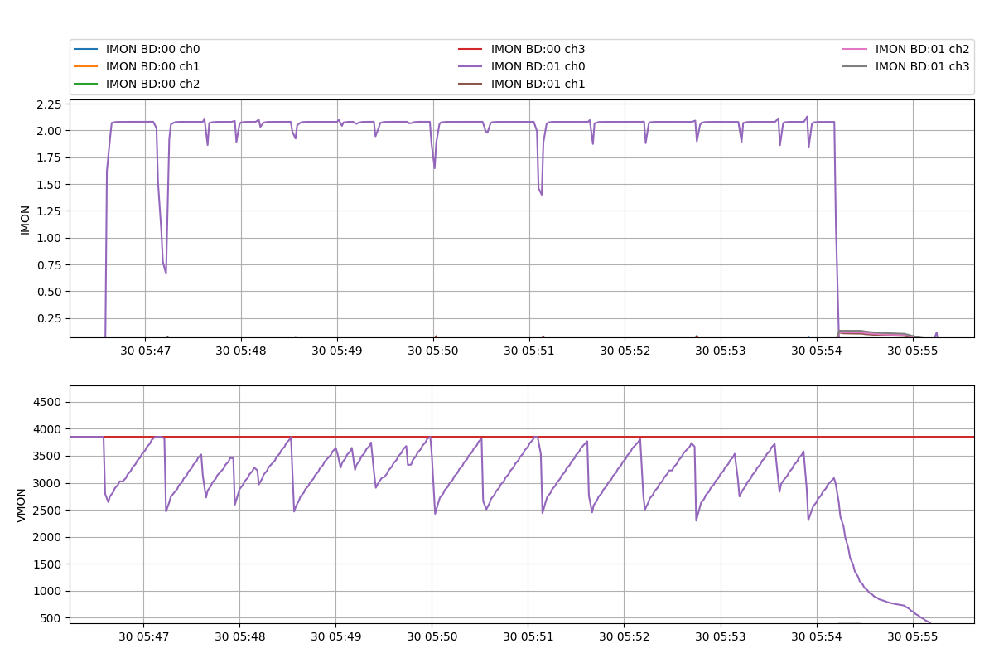
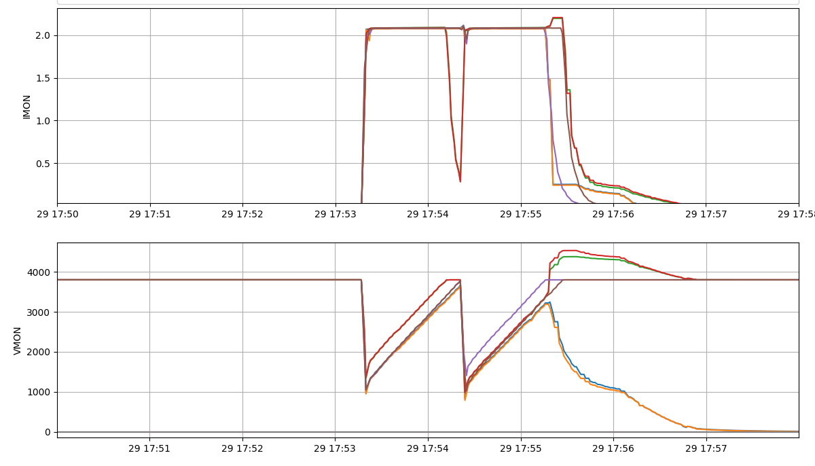
Sparks, trips and continuous discharges
1 spark
Continuously discharging
Can be detected
and stopped
with appropriate
SC monitoring
program
No Trip
Recovery time < PS TRIP time
2 sparks
Recovery time > TRIP time
PS Trip
2 Channels
tripped
Recovery time > PS TRIP time (120s)
∼8 minutes

Slide 24
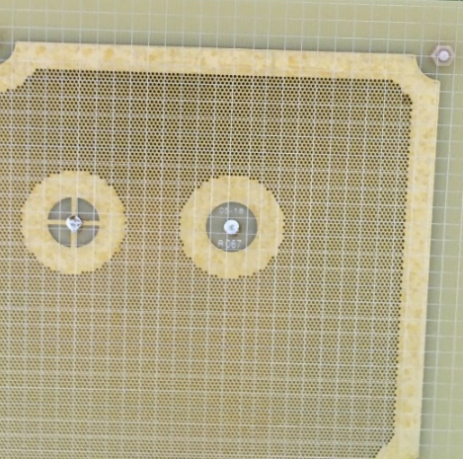
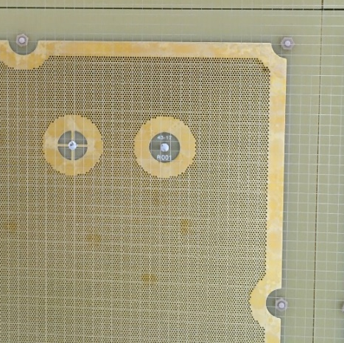
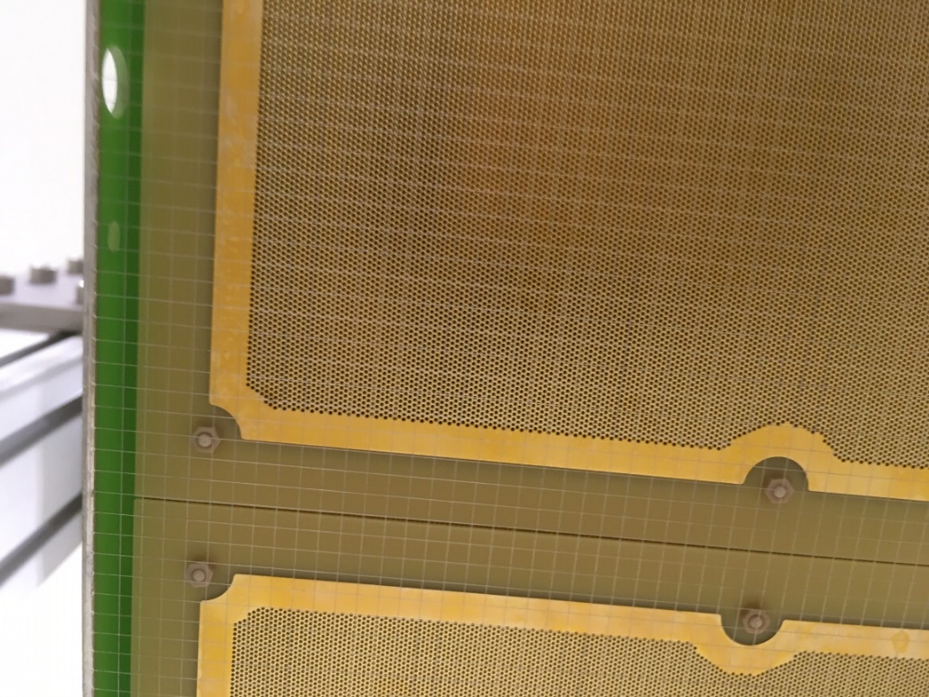
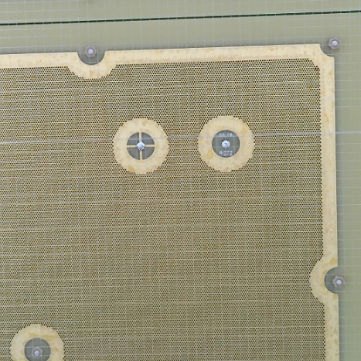
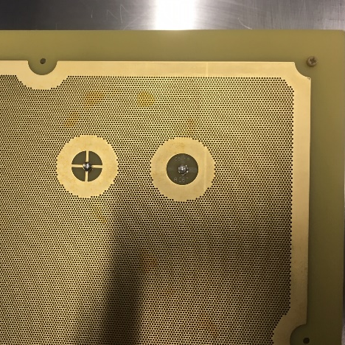
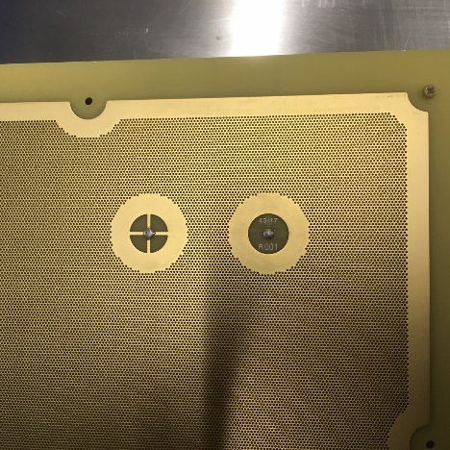
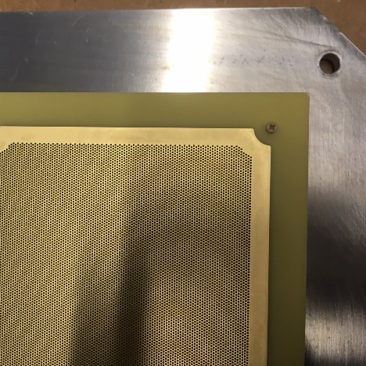
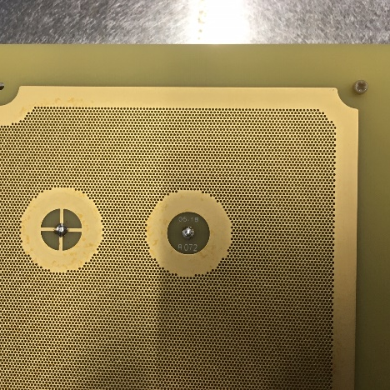
Inspection of CRP1 after removal from the CB revealed dark spots on 4 LEMs
Issues with CRP1
Points to a weaker regions of the LEM
Detailed E-field calculations needed
Treated with potassium
permanganate @ CERN to
remove carbonized FR4 inside
holes. Copper surface
unaffected.
Cleaned at CEA/Irfu and tested up to 3.2kV @ 3.3 bar
Back on CRP1
LEM 16
LEM 28
LEM 30
LEM 14

Slide 25
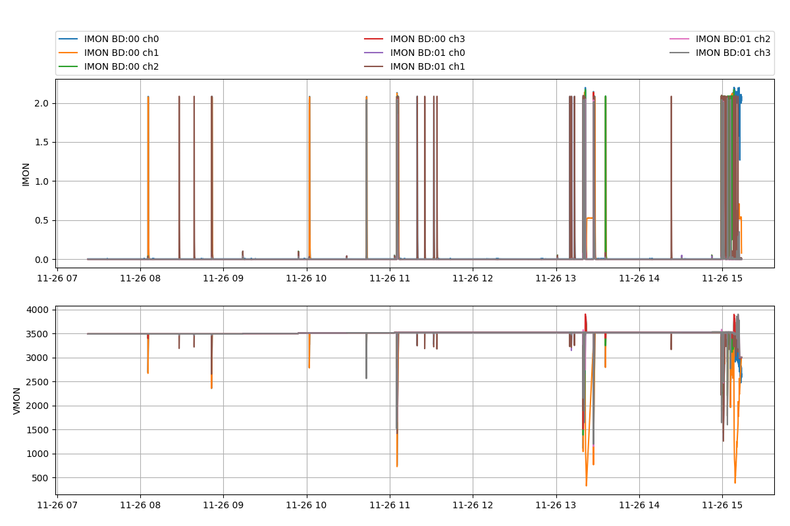
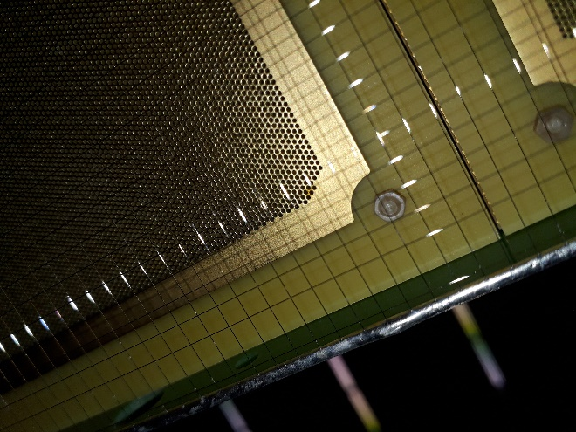
CRP2 : V_{TOP} = 0.50kV and V_{BOT} = 3.55kV
LEM 5 continuously discharging
for several minutes before HV
lowered
LEM 5
LEM 5 of CRP2 to be replaced
with a spare one

Slide 26
Summary
LEMs manufactured by ELTOS for ProtoDUNE-DP meet the required specifications. However, the production for 2 CRPs took longer than expected (×2) due to manufacturing delays.
The two CRPs are now operational although some problems developped on a few LEMs (cured now) and some HV limitation observed. Nominal effective gain of 20 before charging up is within range.
Need « intelligent » SC program to better protect LEM against multiple discharges. Question being addressed with CERN-EP-DT-DI for ProtoDUNE-DP.
Ready now to use CRPs in ProtoDUNE-DP and operate LEMs in real conditions (LAr purity and stable thermodynamic conditions, drift region) to assess performance of a large scale DLAr TPC.
Understanding/improvement of LEM performance & design can be addressed concurrently.

