Slide 1
ProtoDUNE-DP (NP02) installation status
and plans
Filippo Resnati (CERN)
LBNC Project Review Board - CERN - 7th December 2018

Slide 2
Introduction
Overview mainly the status and the activities around the components to be installed inside the cryostat.
Briefly cover also the status of the cryogenics and the detector control system.
Overview of the installation plan and schedule.
Filippo Resnati - LBNC Project Review Board - CERN - 7th December 2018

Slide 3
Detector overview
Temperature sensors
Signal feedthroughs
Level meters
CRPs
Purity monitors
Field cage
Cathode
Cameras
Ground grid
Photo detectors
Filippo Resnati - LBNC Project Review Board - CERN - 7th December 2018

Slide 4
Light detection system
Available at CERN:
- 36 + spares PMTs R5912-MOD-02 tested and TPB coated
- 36 PMT supports (being delivered)
- 36 + spares splitters tested - HV cables inside the cryostat
- 2x 19 SHV feedthroughs for PMT power and signal
- Optical fibres for PMT calibration system
- Optical feedthrough for calibration system
- HV power supply frame and modules
Filippo Resnati - LBNC Project Review Board - CERN - 7th December 2018

Slide 5
Ground grid
- Protect the PMT from high electric field
- Protect the corrugated membrane in case of a discharge
- Transparent to allow the scintillation light to reach the PMTs
- Lightweight, stiff, and simple to install
- Maximum electric field allowed ~< 30 kV/cm
Filippo Resnati - LBNC Project Review Board - CERN - 7th December 2018

Slide 6
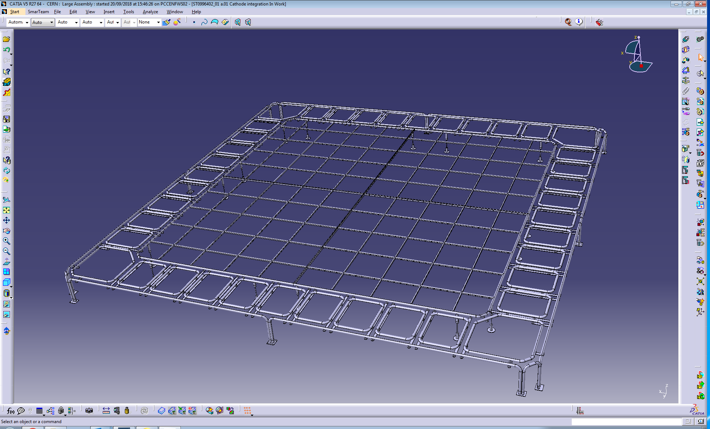
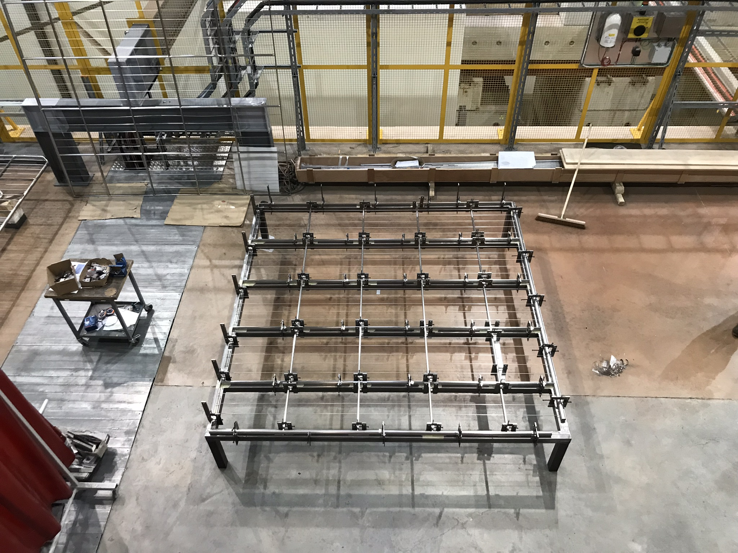
Ground grid
It consists of:
- 4 3x3 m² identical modules put together inside the cryostat
- Additional smaller modules to protect the periphery
All is resting on the cryostat floor
Status:
- Welding ongoing at EHN1: two of the four large modules completed.
- Complete the four large modules before the end of the year
Last large object to be inserted into the cryostat
Filippo Resnati - LBNC Project Review Board - CERN - 7th December 2018

Slide 7
Cathode
- Ensure electric field uniformity together with the field cage
- Transparent to allow the scintillation light to reach the PMTs
- Limit the contact to the rest of the detector
- Lightweight, stiff and simple to install
- Maximum electric field ~< 30 kV/cm
- Limit the energy released in case of a discharge
Filippo Resnati - LBNC Project Review Board - CERN - 7th December 2018

Slide 8
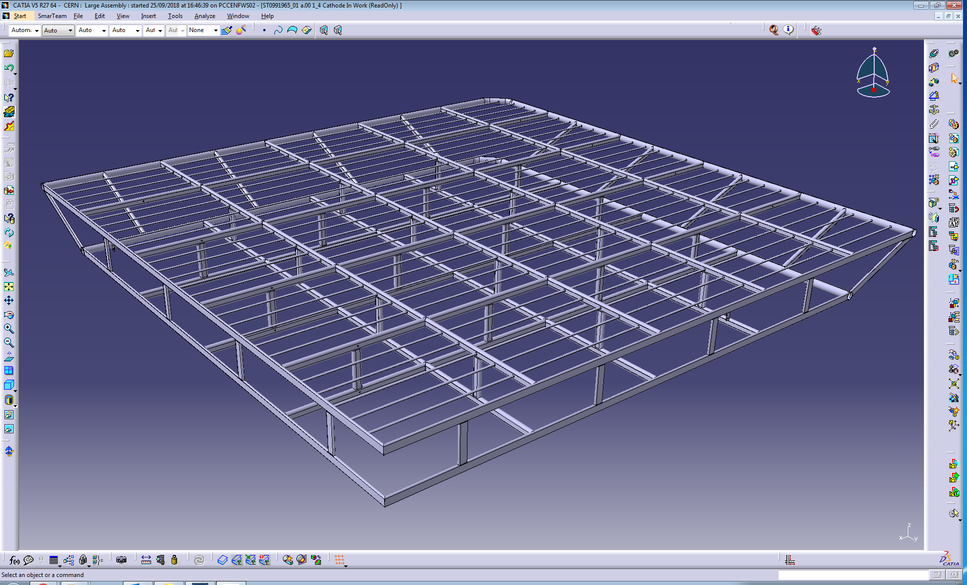
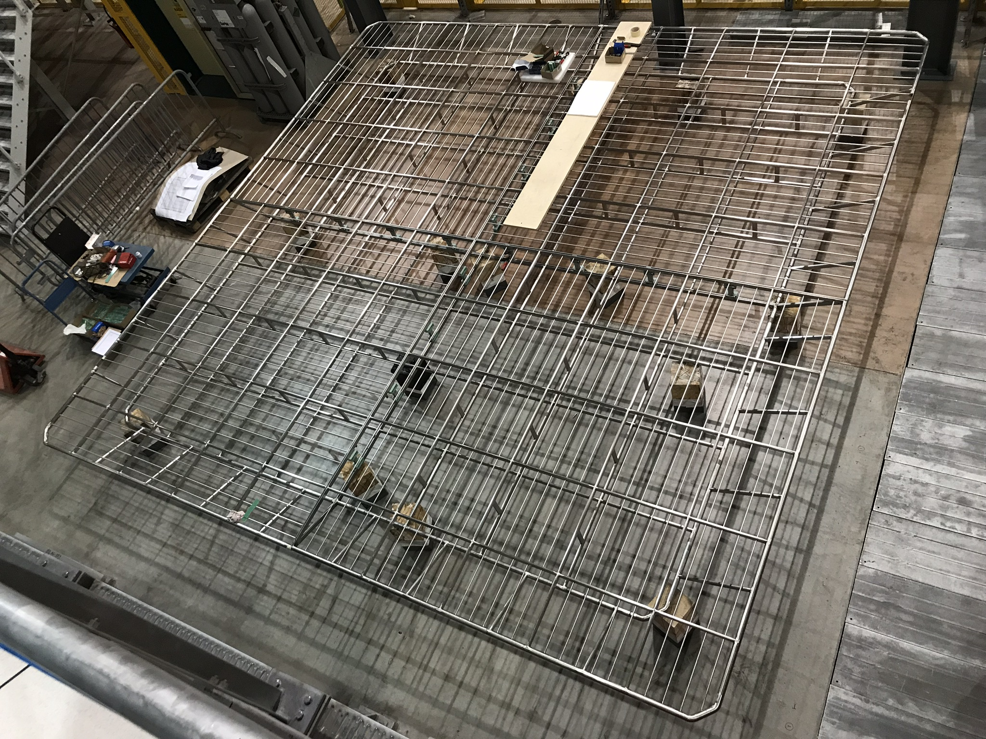
Cathode
- Two floor structure for stiffness constraints
- Large tube (40 mm) in the periphery to reduce maximum field
- Oval hollow section profiles to add mechanical strength
- 10 mm tube every 100 mm for drift field uniformity
Status:
- All four modules completed
- Mechanical trial assembly completed
- Cleaned and ready to be installed
Filippo Resnati - LBNC Project Review Board - CERN - 7th December 2018

Slide 9
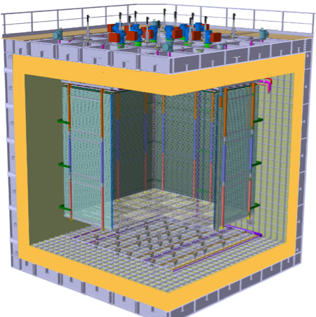
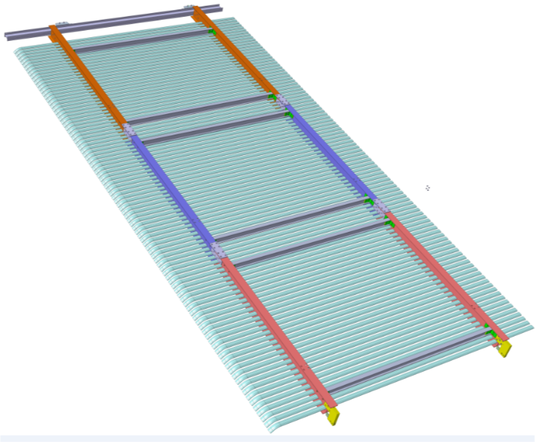
Field cage
- 8 vertical modules of 6.3 m x 3 m
- Each module consisting of 3 sub modules
- Aluminium profiles held by horizontal FRP I-beams
- Profiles will be connected mechanically and electrically to form rings
- Two series of resistive divider define the potential on each ring
Filippo Resnati - LBNC Project Review Board - CERN - 7th December 2018

Slide 10
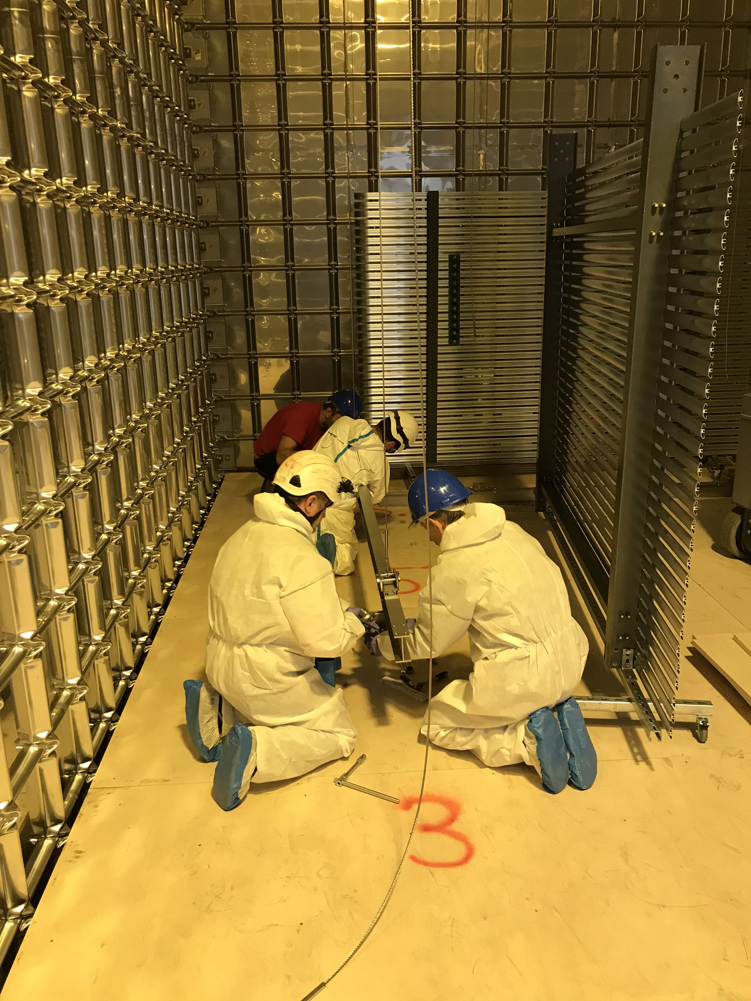
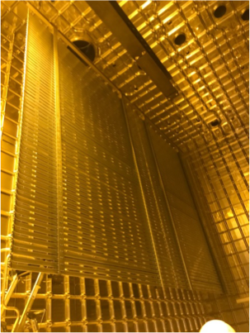
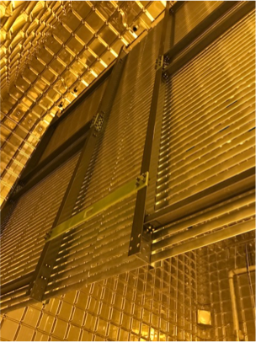
Field cage
Status:
- Fully mounted and extensively tested inside NP02 during the past several months
- Two sub module in front of the TCO removed to allow the entrance of large components
- Seven of the eight modules are in final position with all the clips and resistor dividers mounted
Filippo Resnati - LBNC Project Review Board - CERN - 7th December 2018

Slide 11
VHV feedthrough
8 m long structure composed of:
- 300 kV vacuum tight feedthrough very similar to NP04 feedthrough (already tested at 300 kV)
Status: available at EHN1
- extender/degrader to bring the HV to the cathode and reduce the electric field in LAr Status: delivery expected at the end of the year
- 300 kV power supply and cable
Status: available and tested
Filippo Resnati - LBNC Project Review Board - CERN - 7th December 2018

Slide 12
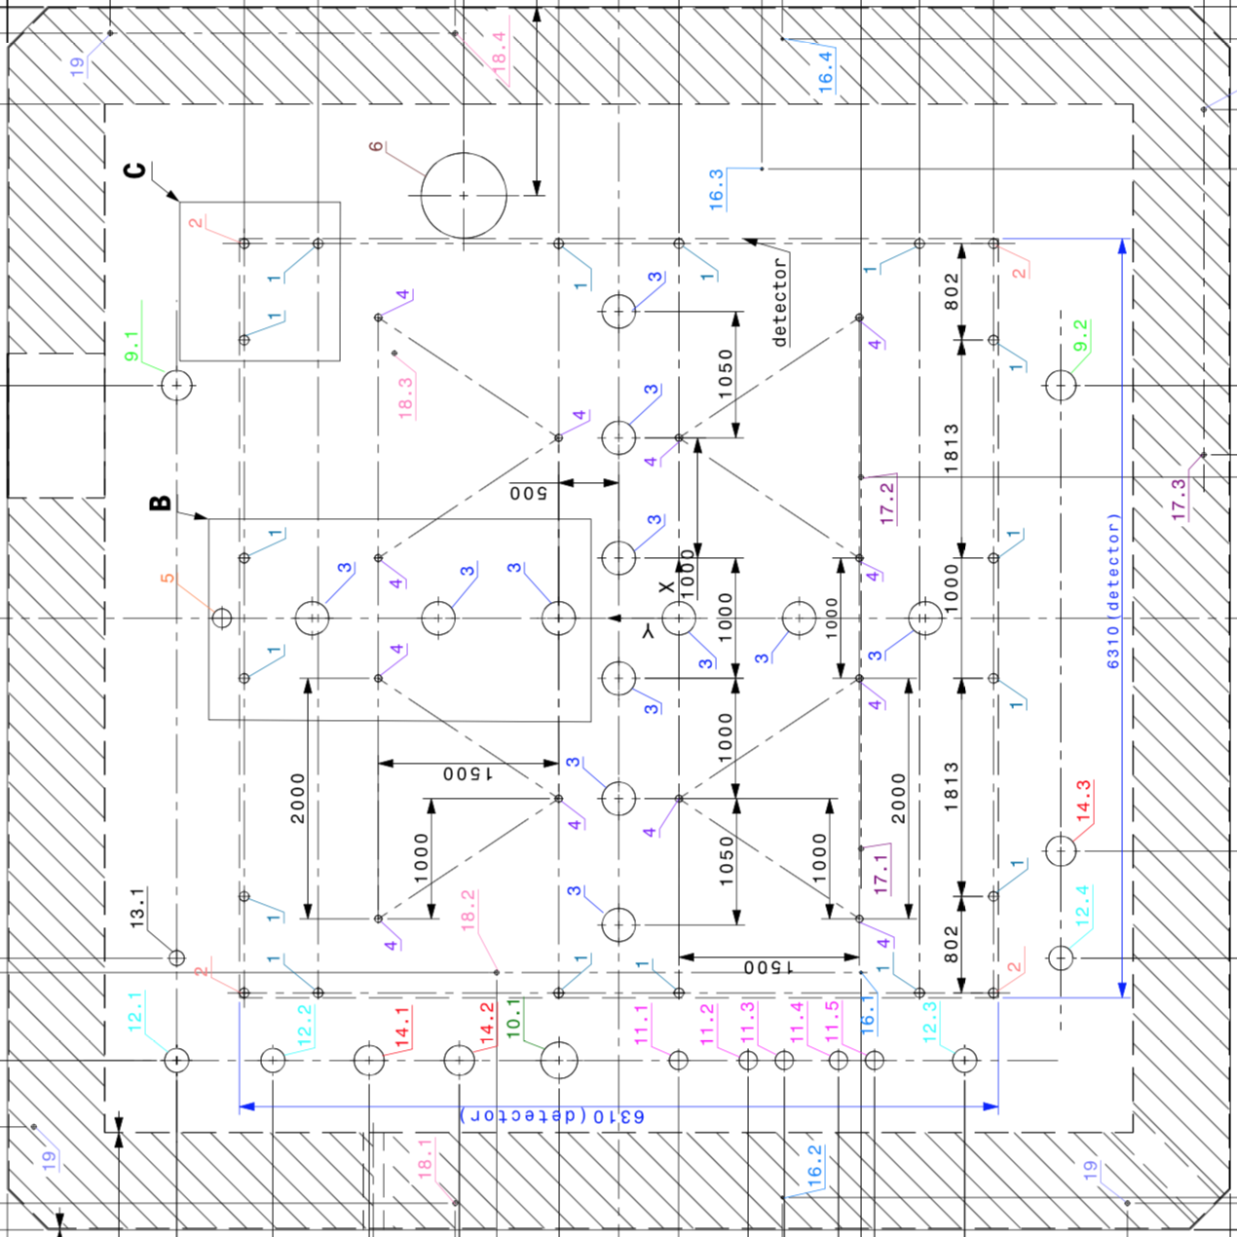
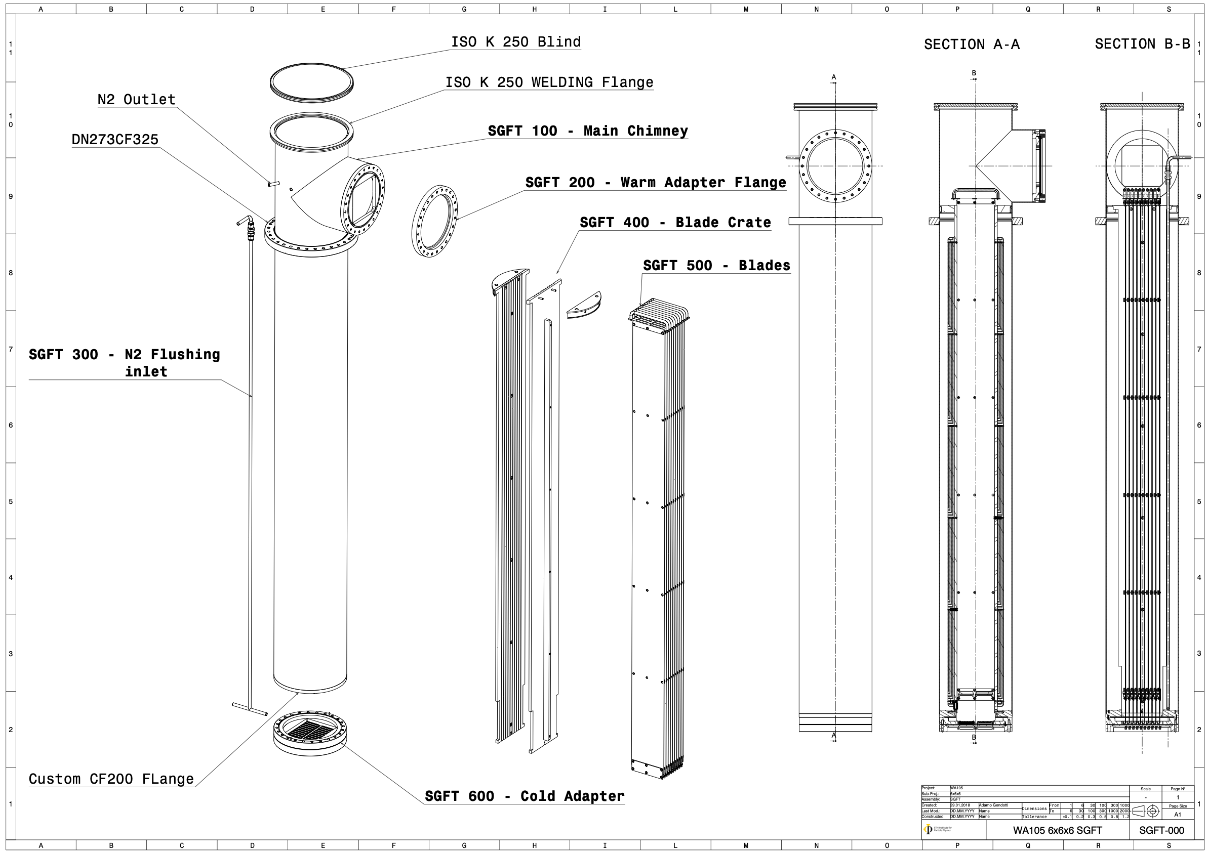
SGFTs
12 chimneys vacuum tight each with 10 sliding cards housing the cold electronics
Electronics cards are guided to match connectors on a cold flange
The cold flange separates the ultra-pure argon from the atmosphere
The electronics stays in cold but it is accessible from outside
Filippo Resnati - LBNC Project Review Board - CERN - 7th December 2018

Slide 13
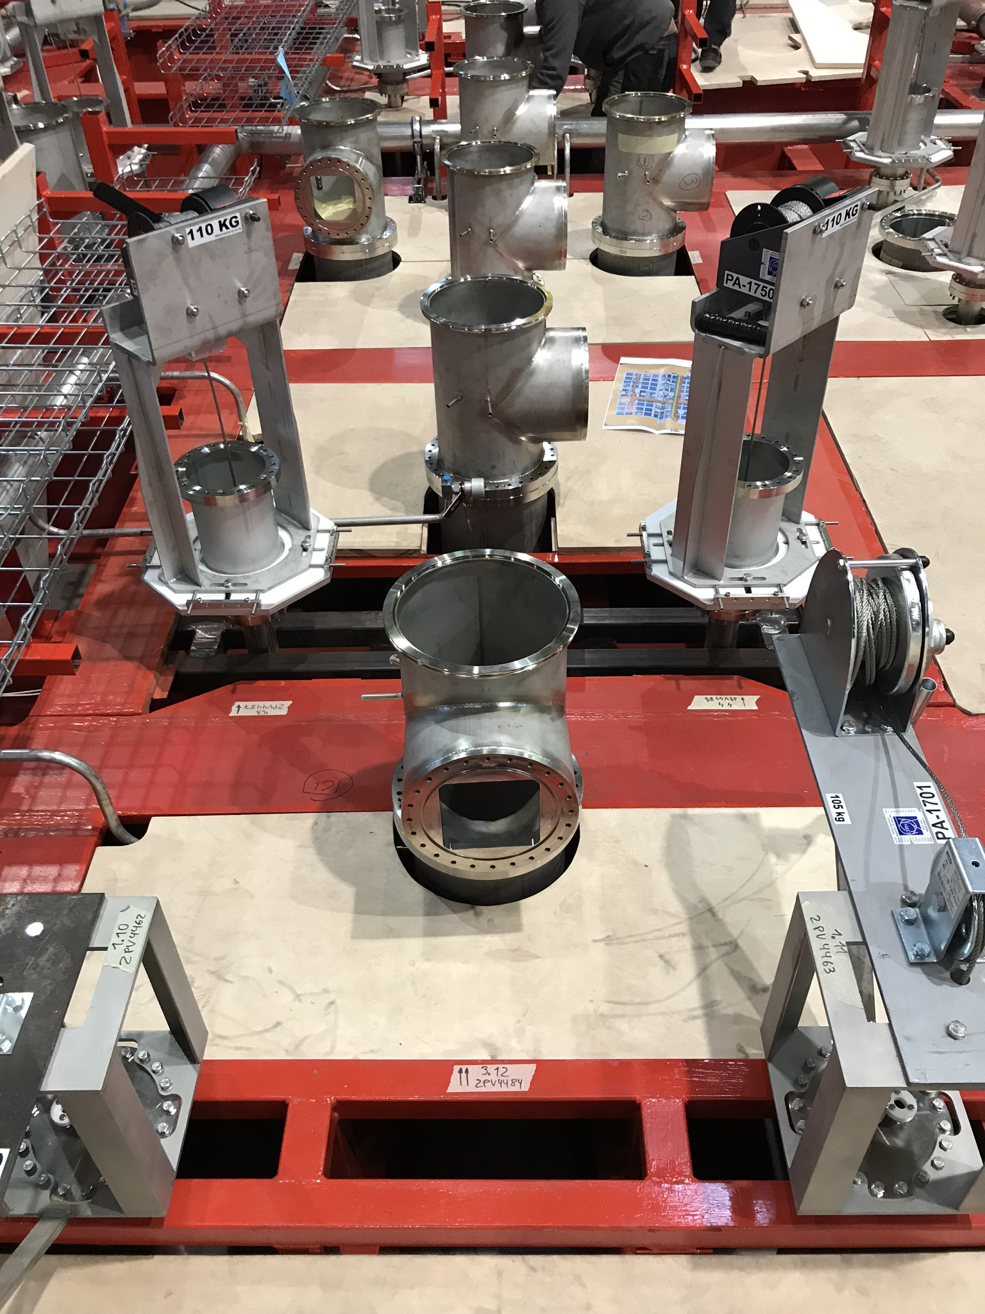
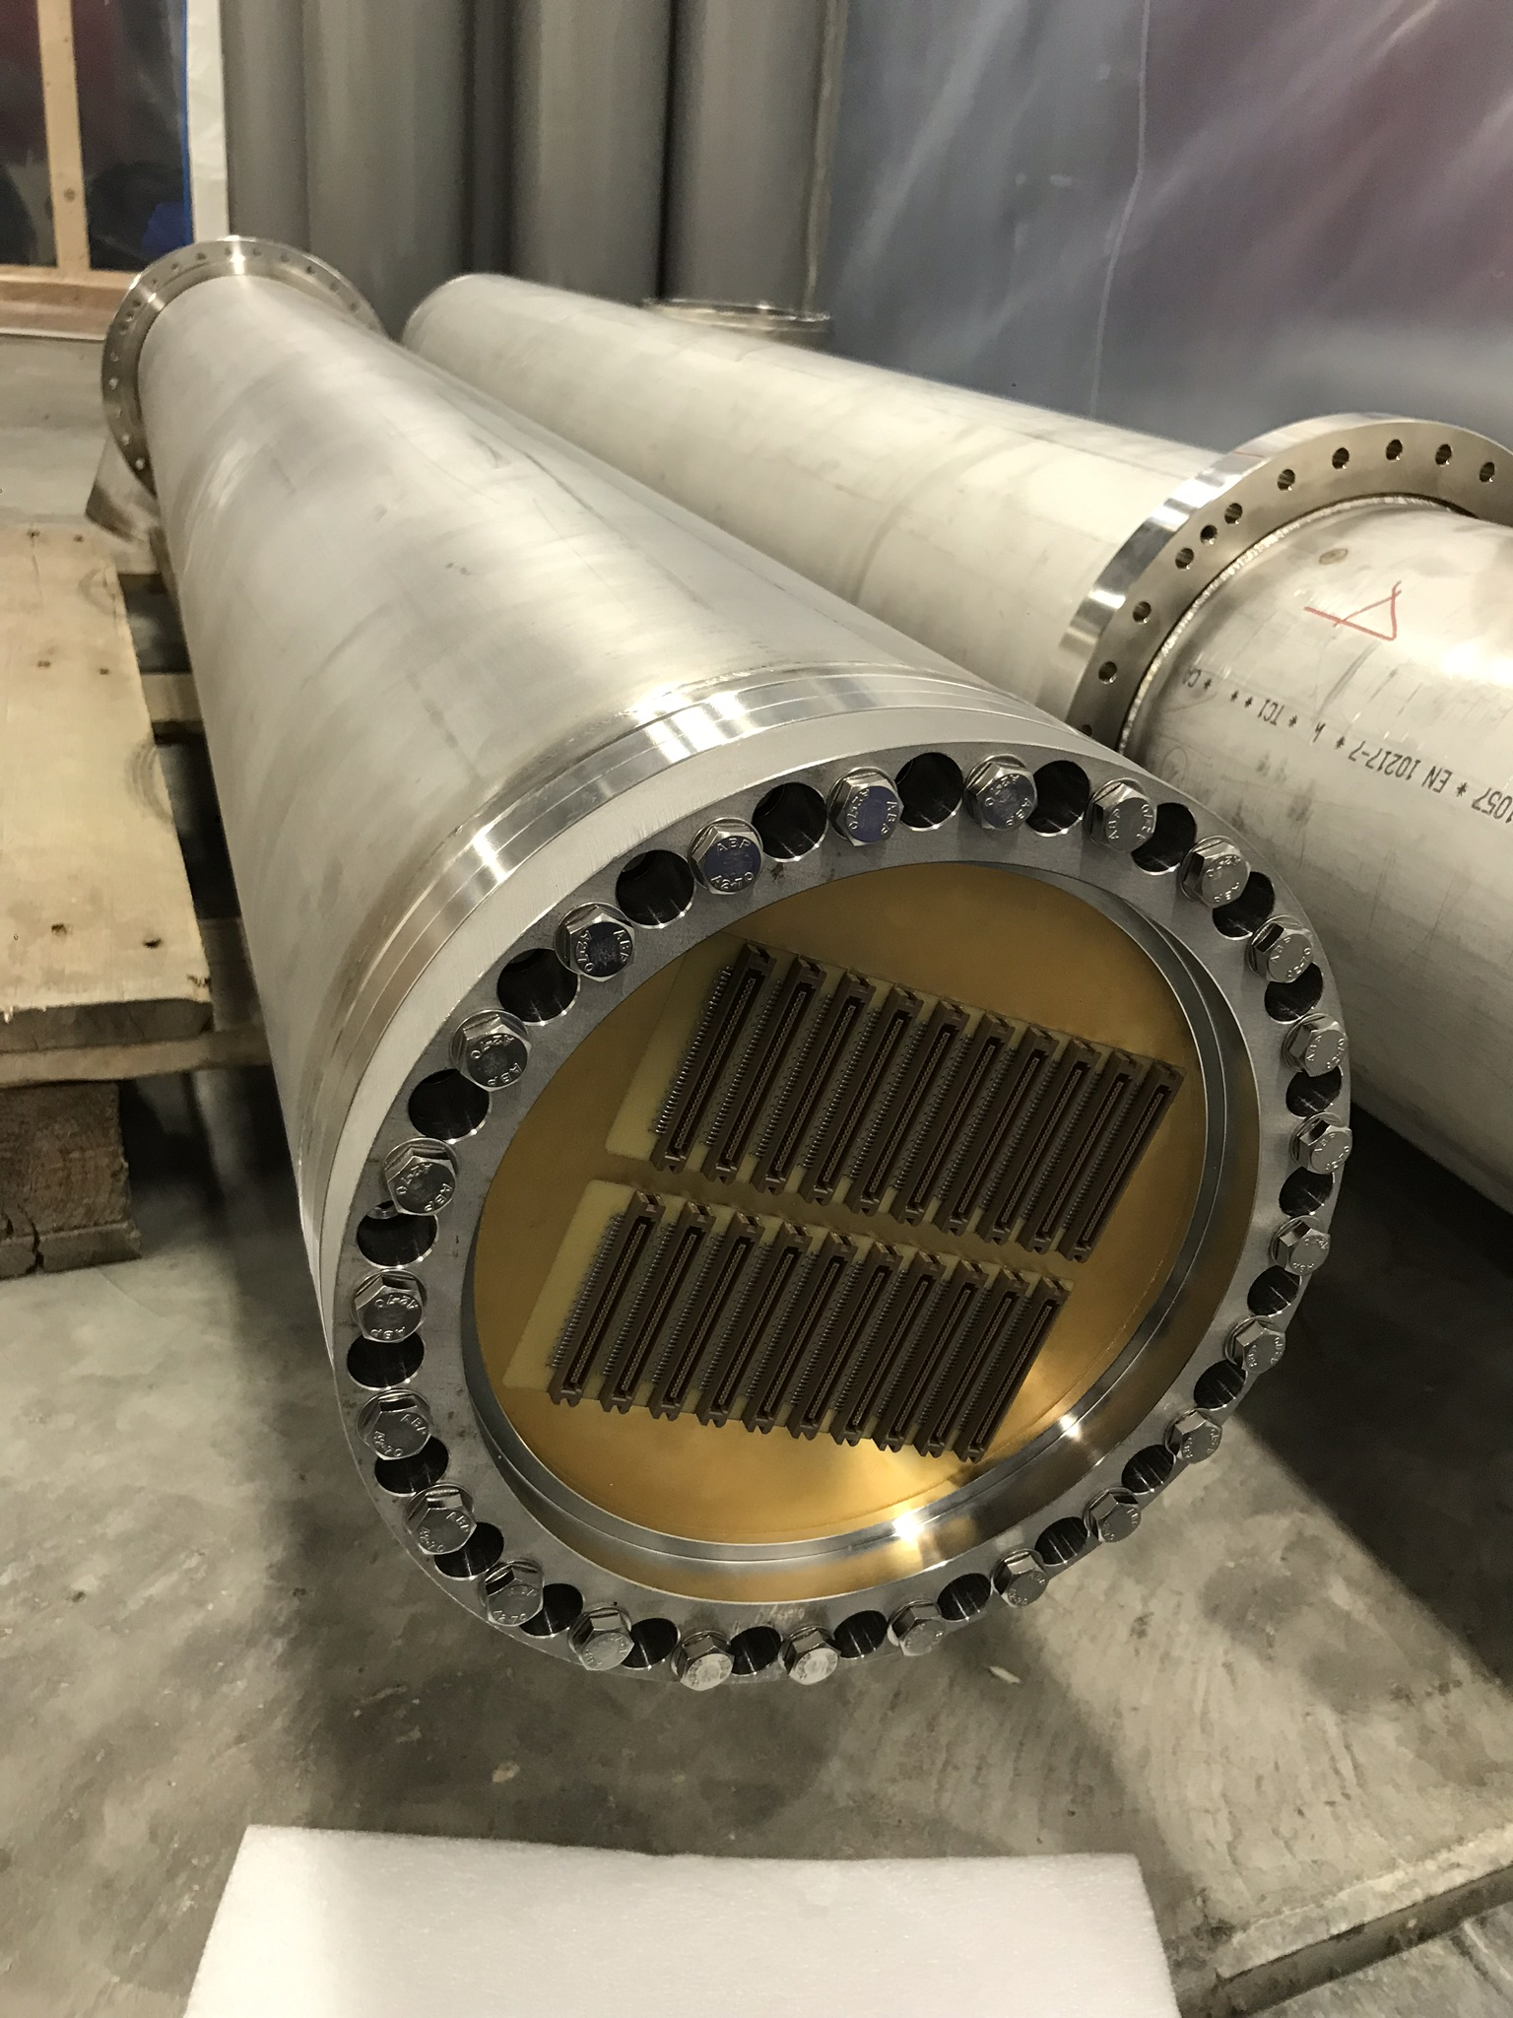
SGFTs
Status:
- All 12 SGFTs completed equipped with blades and cold flanges
- Mechanically and vacuum tested
- Presently installed in their penetration on the roof of NP02
Filippo Resnati - LBNC Project Review Board - CERN - 7th December 2018

Slide 14
Mechanical feedthroughs
CRP suspensions:
All (12x) components are mounted on the roof of NP02, and load tested. One CRP installed.
Other three suspension systems ready to hoist the respective CRPs.
Field cage suspensions:
All (16x) components are mounted on the roof of NP02, and load tested.
Seven out of eight field cage module lifted and in final position.
Still possible to move up and down the field cage modules in front of the TCO to allow completion of the field cage.
Filippo Resnati - LBNC Project Review Board - CERN - 7th December 2018

Slide 15
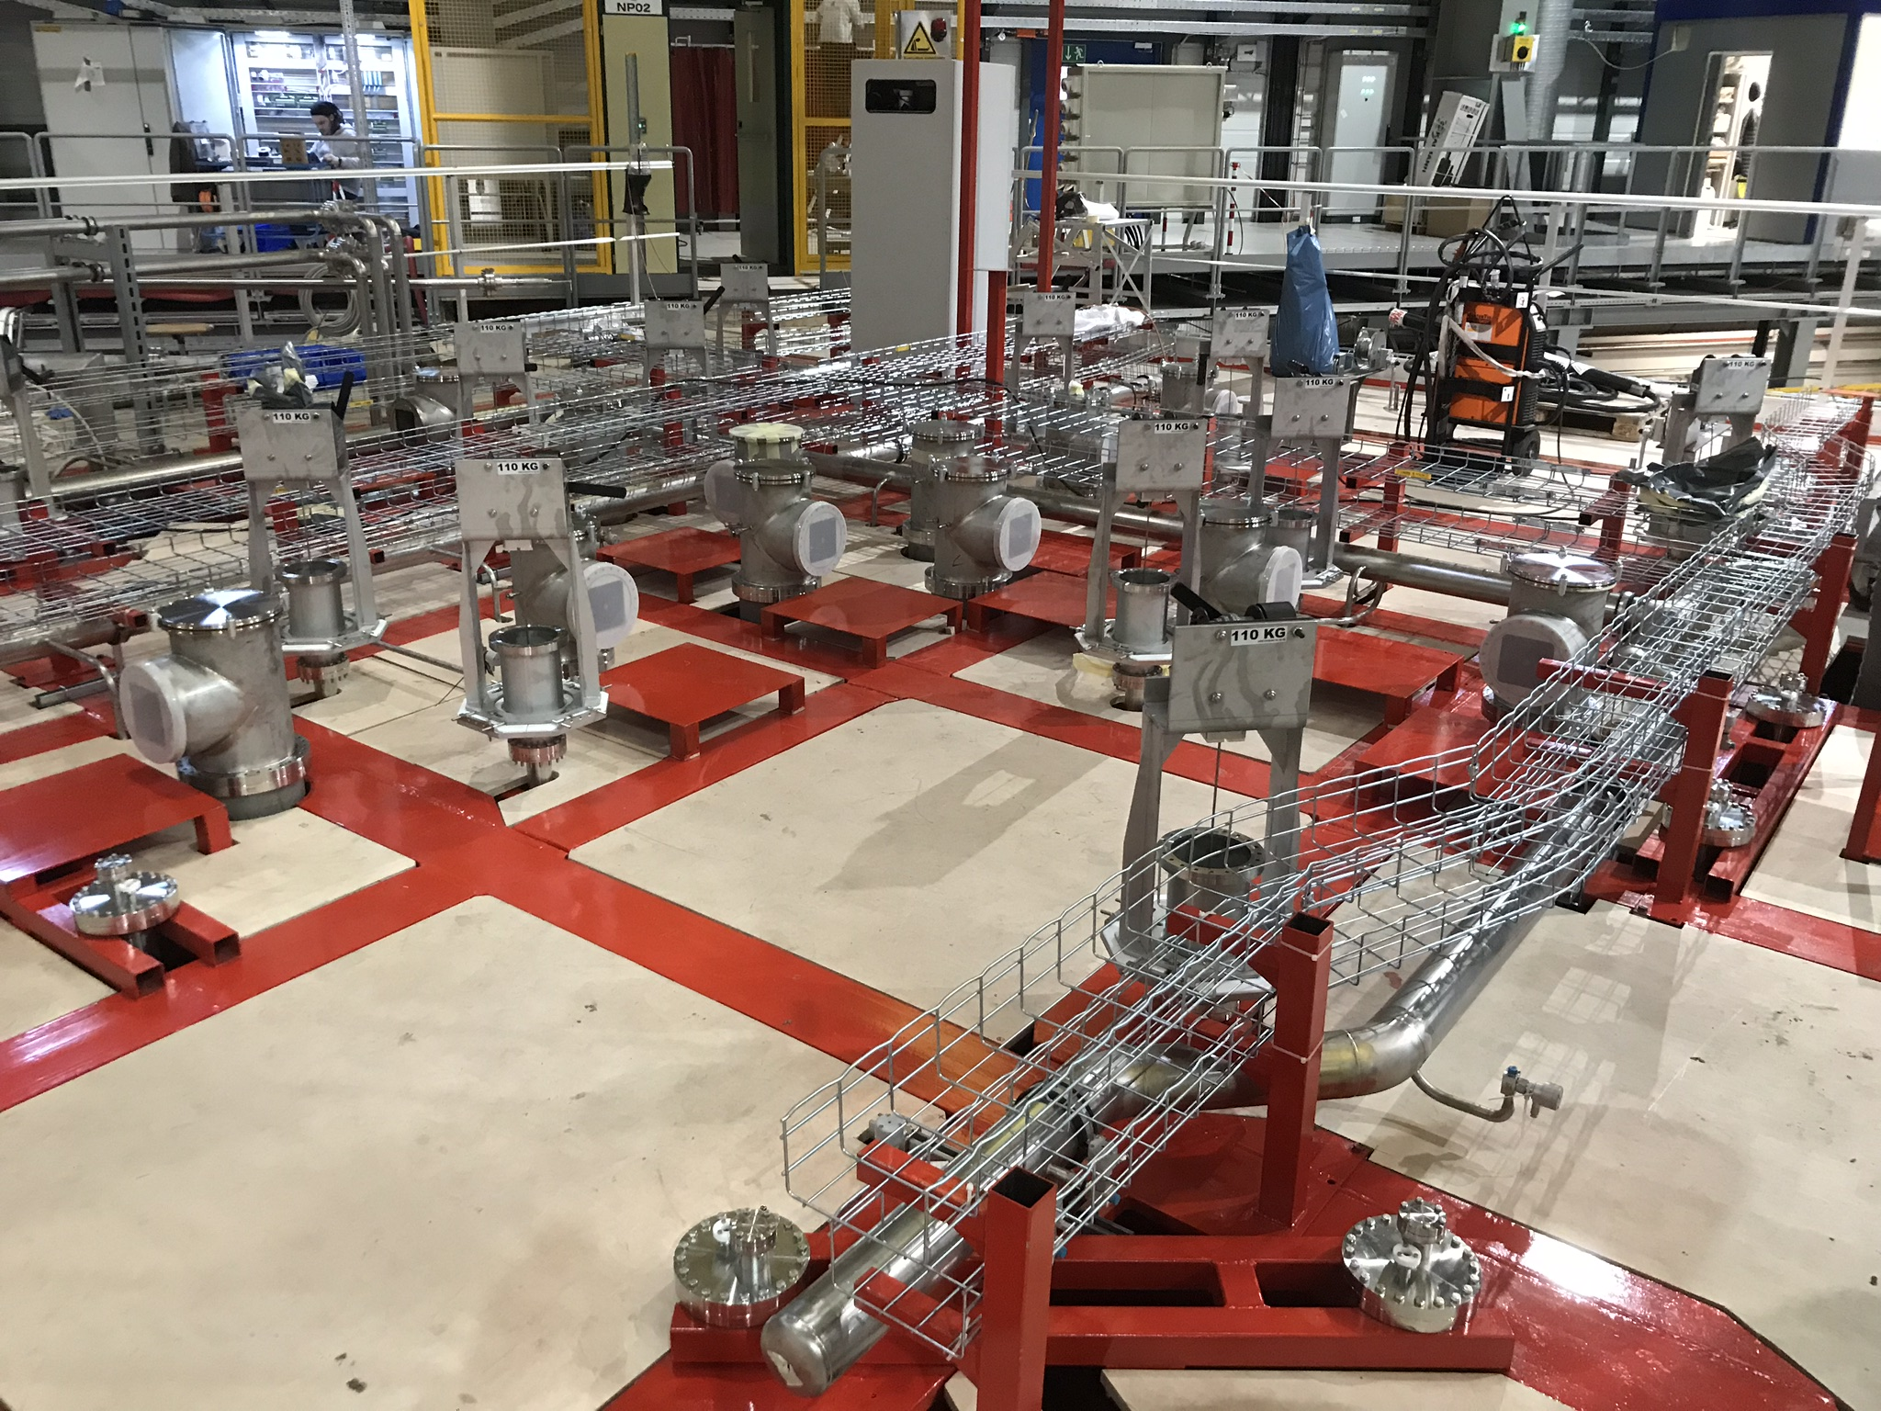
NP02 roof
Filippo Resnati - LBNC Project Review Board - CERN - 7th December 2018

Slide 16
Instrumentation
Level meters:
- 2x 4 m long capacitive level meters in production
- electronics developed, tested (V0 produced and V1 in production)
Temperature profilers:
- coarse level meter and measurement of liquid argon temperature gradient
- PCBs and Pts in hands cables and flanges purchased
Purity monitors:
- full system in hands and tested with one purity monitor
- second purity almost ready to be tested
Cameras:
- 12 cryogenic cameras in hands
- Control and acquisition system developed and ready to be integrated in the DCS
Filippo Resnati - LBNC Project Review Board - CERN - 7th December 2018

Slide 17
Giovanna Lehmann Miotto
Filippo Resnati - LBNC Project Review Board - CERN - 7th December 2018

Slide 18
Cryogenics status
Completed:
- Demaco proximity cryogenic installation - finished in September 2018
- External cryogenics - finished since commissioning of NP04
- Proximity cryogenics warm piping - completed
- Purge pipes - purge valves installed, compressed air lines laid, flexible pipes still need to be connected once the flanges are installed
Soon completed:
- Purification system - filling with purification media on December 2018
- Control cabling activities - finishing in December 2018
- PLC programming - completion for January commissioning on February
Improvements done with respect to the:
- warm and cold gas management
- filters regeneration process
- gas analyser manyfold implementation
Filippo Resnati - LBNC Project Review Board - CERN - 7th December 2018

Slide 19
Installation overview
Only installation of detector components inside the cryostat considered here.
Installation mostly sequential, but few things can be parallelised.
- CRPs must be installed first
- Then field cage must be completed
- Assembly and installation of the cathode and the ground grid
- PMT installation
- Installation of part of the cryogenic instrumentation
- TCO closure
- Installation of VHV degrader
- Installation of the ground grid perimeter
- Installation of the remaining cryogenic instrumentation
- Remove unnecessary material and close the man hole
Filippo Resnati - LBNC Project Review Board - CERN - 7th December 2018

Slide 20
Before TCO closure
Installation and cabling of the first three CRPs (SGFTs must be installed before the CRP 1 and 2 are hoisted) - work at height with man lifts | 3x 3 days
Removal of the entrance I-beam | 1 day
Installation and cabling of the CRP4. | 3 days
Installation of a modified version of the entrance I-beam | 1 day
Connection of the first field shaper through instrumentation penetration | 1 day
Installation of the VHV feedthrough | 1 day
Bring inside the two remaining field cage sub-modules | 1 day
Bring inside the four cathode sub-modules | 1 day
Bring inside the four ground grid sub-modules and move the man lift outside the TPC volume | 1 day
Lift and clip the remaining field cage sub-modules - work at height with scaffolding and possibly man lift | 3 days
Filippo Resnati - LBNC Project Review Board - CERN - 7th December 2018

Slide 21
Before TCO closure
Installation of a platform in the clean room at the height of the false floor inside NP02 to allow rolling heavy material in and out | 3 days
Assemble the four cathode sub-modules cathode | 3 days
Connect the ground grid to the cathode | 1 day
Lift and connect the cathode to the field cage and secure it to the floor | 1 day
Route instrumentation cable from the tank instrumentation penetration and install level meter and temperature profiler - work at height with scaffolding or possibly man lift | 4 days
Remove the false floor | 2 days
Install false floor around the TPC active region to possibly allow man lift to go around | 2 days
Installation and cabling of the PMTs and Pts on the floor | 5 days
Installation of ground grid feet and final positioning of the ground grid | 2 day
Filippo Resnati - LBNC Project Review Board - CERN - 7th December 2018

Slide 22
TCO closure
Installation of a SAS to protect the detector from the TCO closure works - 4 days.
TCO will be closed in two phases (halves): for the first half material can be stored in the clean room. For the second half material must be stored inside the cryostat (large enough SAS) - 4 weeks.
Due to safety reasons, avoid detector installation during this time. Minimal access allowed to check the status of the detector.
Removal of the SAS - 2 days
Clean up: 1 day
Now the cryostat is a confined space. More difficult access through the man hole. Limited number of people inside. Training required.
Filippo Resnati - LBNC Project Review Board - CERN - 7th December 2018

Slide 23
After TCO closure
Clean up at height with the scaffoldings (on false floor) | 2 days
Installation of the HV extender - work at height with scaffolding | 3 days
Install the remaining instrumentation (e.g., Purity Monitor, cameras, ground plane monitors, …) | 5 days
Remove the false floor left inside through the man hole | 1 day
Clean up the floor | 1 day
Install the ground grid frames | 2 days
Remove the scaffolding | 1 day
Time for the last tests and close the man hole.
Filippo Resnati - LBNC Project Review Board - CERN - 7th December 2018

Slide 24
Summary
Assuming to be able to proceed mostly in sequence:
- Before TCO: 45 days needed
- TCO closure: 5 weeks
- After the TCO: 15 days
7th January 2019
weeks
22th July 2019
1 | 2 | 3 | 4 | 5 | 6 | 7 | 8 | 9 | 10 | 11 | 12 | 13 | 14 | 15 | 16 | 17 | 18 | 19 | 20 | 21 | 22 | 23 | 24 | 25 | 26 | 27 | 28
Before the TCO closure
TCO closure
After the TCO closure
Purge
Cooldown
Filling
Purification
Filippo Resnati - LBNC Project Review Board - CERN - 7th December 2018

