Slide 1
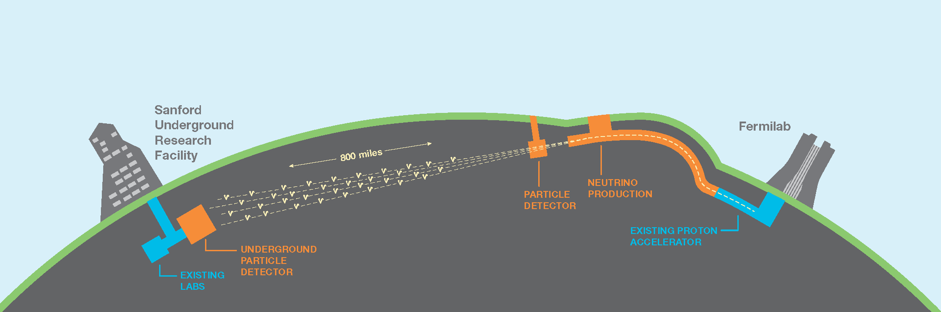
ProtoDUNE-SP Status
Gina Rameika
LBNC Meeting
December 7, 2018

Slide 2
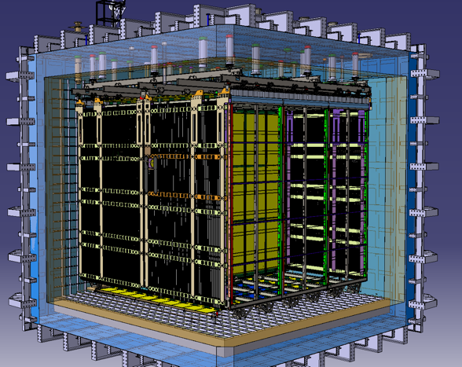
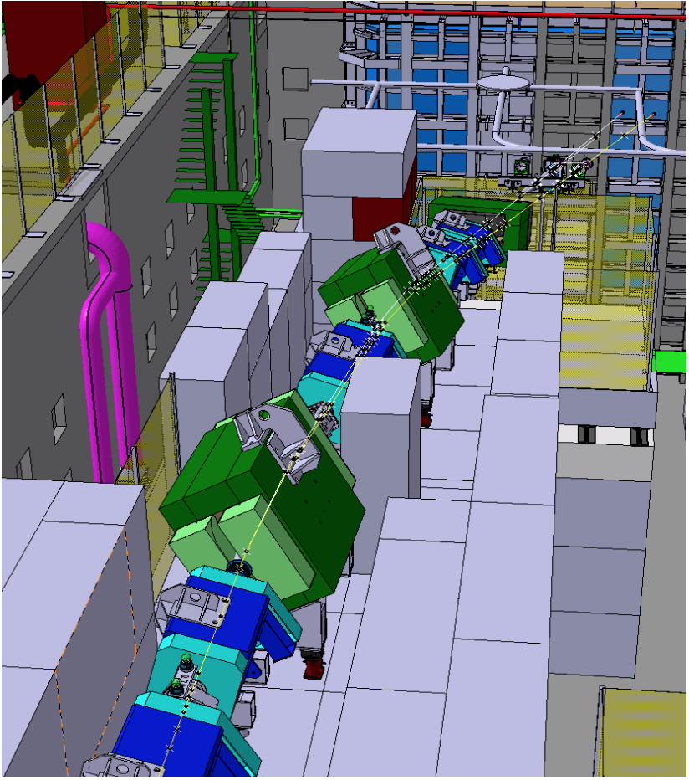
Topics
Reminder – Goals of ProtoDUNE-SP
Final construction phase
Operations
    Instrumentation
    Purity
    High Voltage
  Beam data
  TPC performance
  Photon detection
  Reconstruction
  Post-beam studies
  Lessons learned

Slide 3
High Level Goals of ProtoDUNE-SP
Engineering validation of the full-scale DUNE detector components
Develop the construction and quality control process
Validate the interfaces between the detector elements and identify any revisions needed in the final design
Validate the detector operation using cosmic rays
Study the detector response to known charged particles
Improve event reconstruction and detector response models

Slide 4
High Level Goals of ProtoDUNE-SP
Engineering validation of the full-scale DUNE detector components
Develop the construction and quality control process
Validate the interfaces between the detector elements and identify any revisions needed in the final design
Validate the detector operation using cosmic rays
Study the detector response to known charged particles
Improve event reconstruction and detector response models
By the end of this talk I
hope that I will have
convinced you that we
have achieved each of
these goals
and this work is making
good progress

Slide 5
Specifications and Goals for DUNE Far Detector
High Voltage : Spec = >250 V/cm; Goal = 500V/cm (180 kV)
  Spec met by PD-SP
Electron Lifetime : Spec > 3ms; Goal = 10 ms
  Spec met by PD-SP
Electronic noise : Spec < 1000 enc; Goal = ALARA
  Spec met by PD-SP
  Long term studies being planned to understand limitations on meeting goals for long term operation of DUNE detector

Slide 6
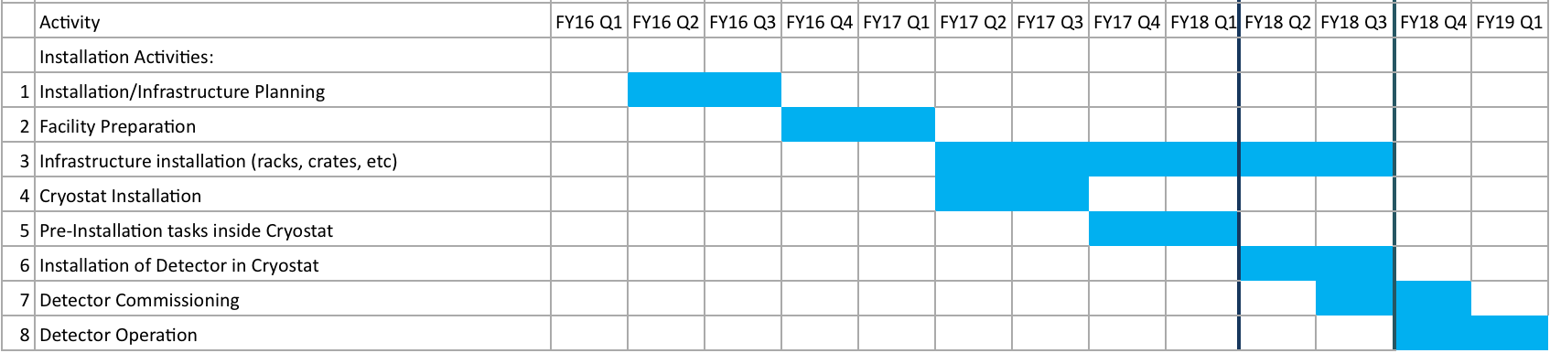
Main challenge was schedule
PD-SP was proposed to the SPSC in June 2015 (SPSC-P-351)
An MOU between CERN and FNAL, outlining responsibilities,
was signed in December 2015.
The original schedule called for the detector to be ready for filling
in Summer of 2018 and operation with test beam in Fall of 2018,
test beam running to end with the start of the LS2.
Filling took place between August 8 and September 13, 2018
Last beam triggers were recorded on the morning of November 12.
CERN Accelerator
Long Shutdown

Slide 7
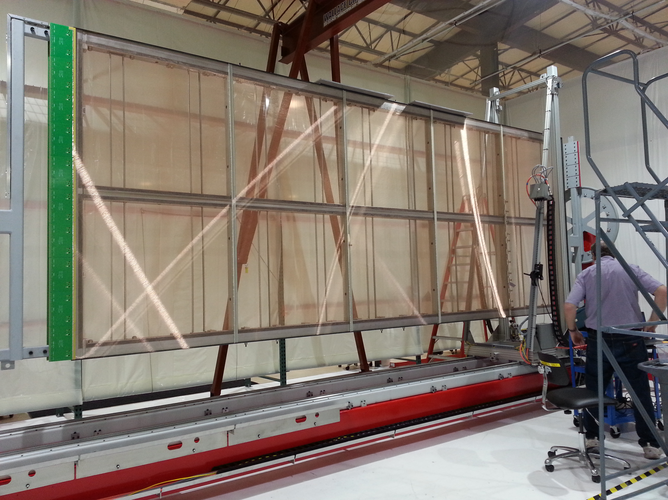
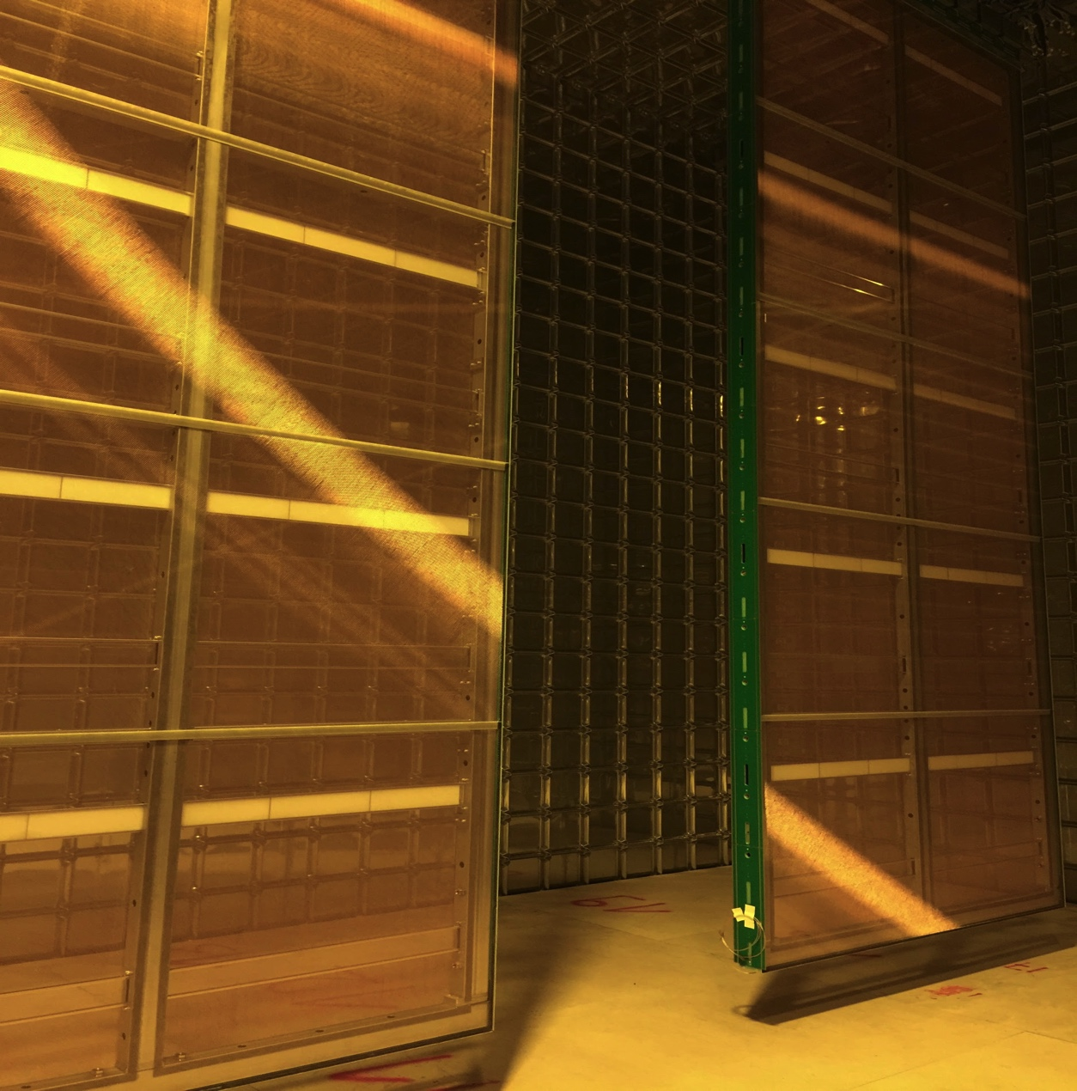
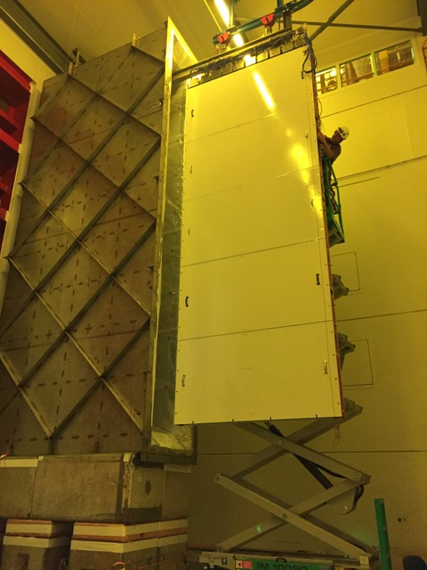
APA Journey – build, ship, prep, test, install
July 2017
October 2017
January 2018

Slide 8
APA Progress Tracking Table
developed for LBNC at October 2017
meeting at SURF

Slide 9
Slide from January 2018 collaboration meeting;
We knew we would have 4 APAs
But we thought we would be lucky to get 5 APAs
installed
Backup plan to
install blank
frames

Slide 10
Planning for APA 5 & 6
APA’s need to arrive early-mid April at the latest
They will get unpacked and inspected,
survey and tension measurements will be abbreviated;
photon detectors and CE will installed and tested locally
(no cold box)
They will then go into the cryostat.

Slide 11
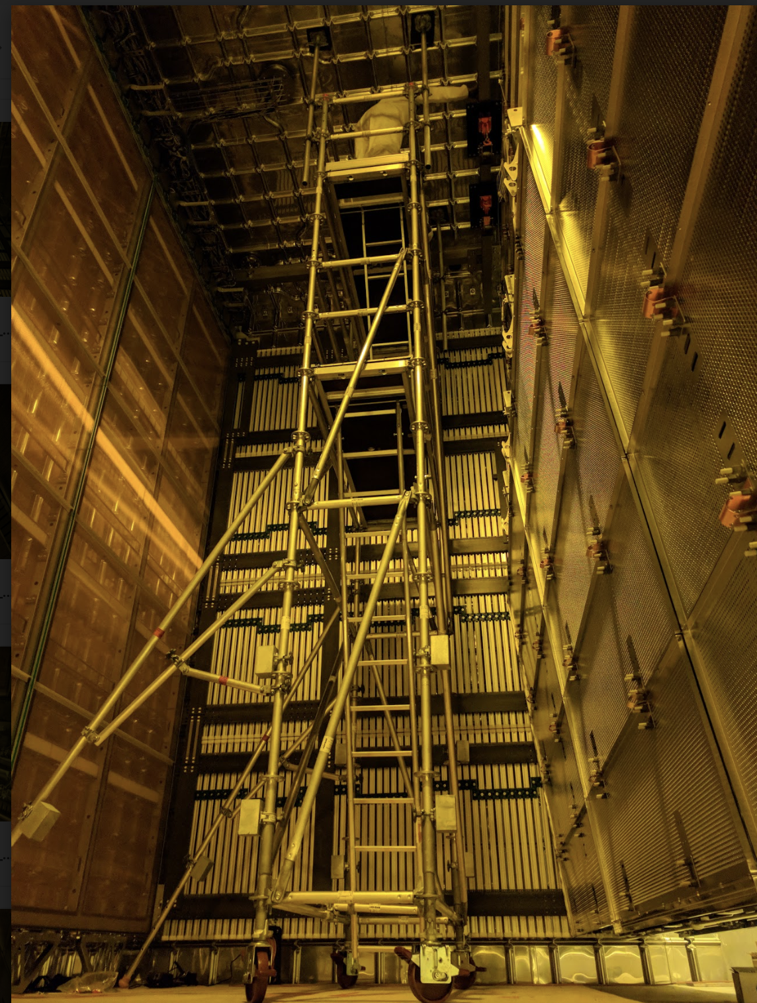
Only one APA
missed cold box
testing

Slide 12
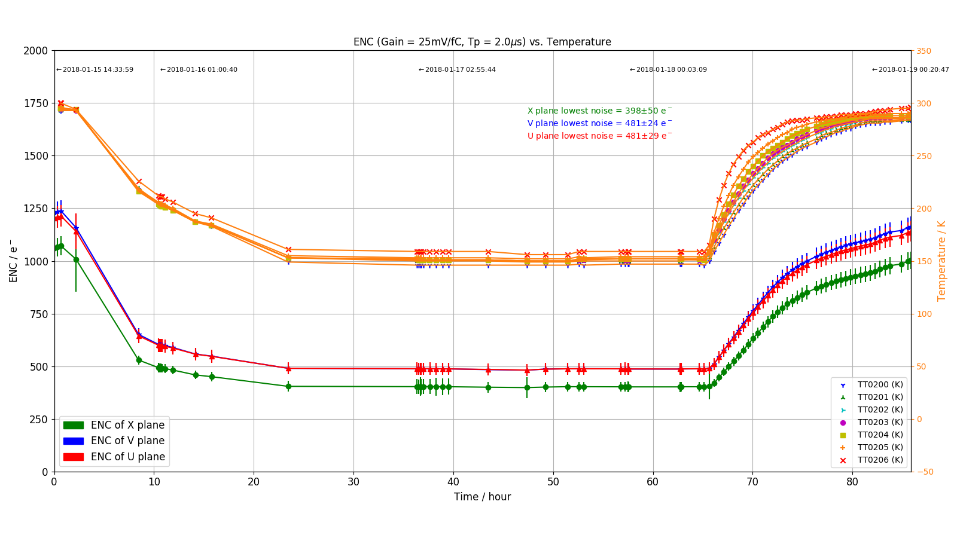
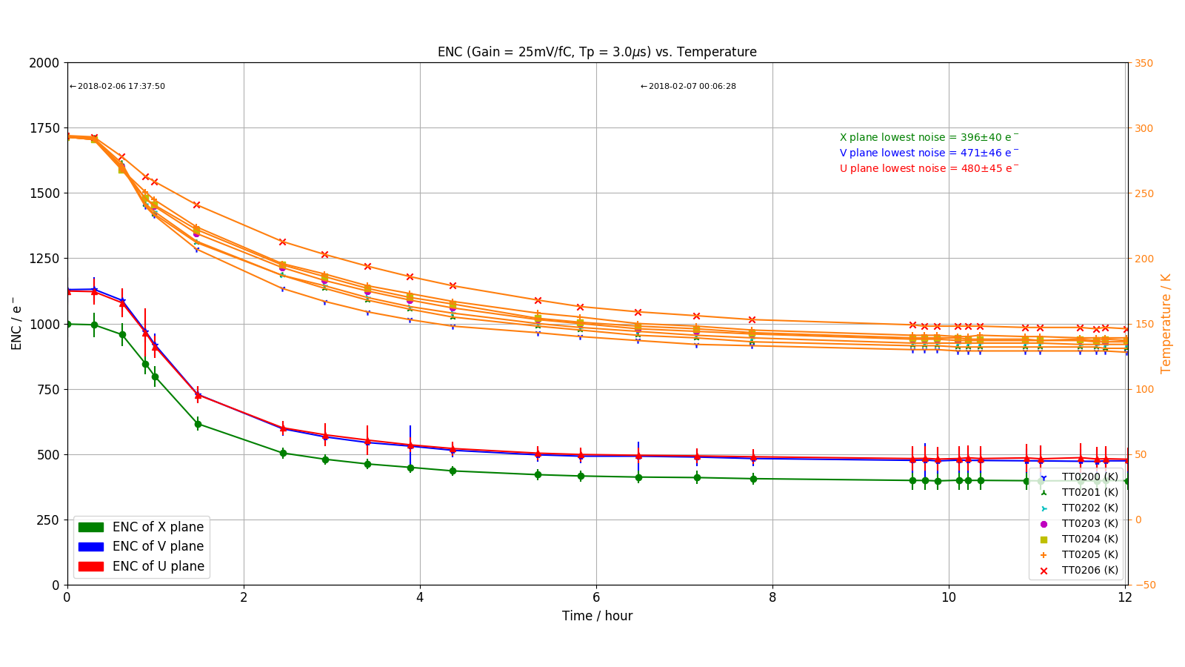
Cold Box testing of Front-end Electronics
Cold Box testing
insured QC on installation
and validated the
expected noise levels

Slide 13

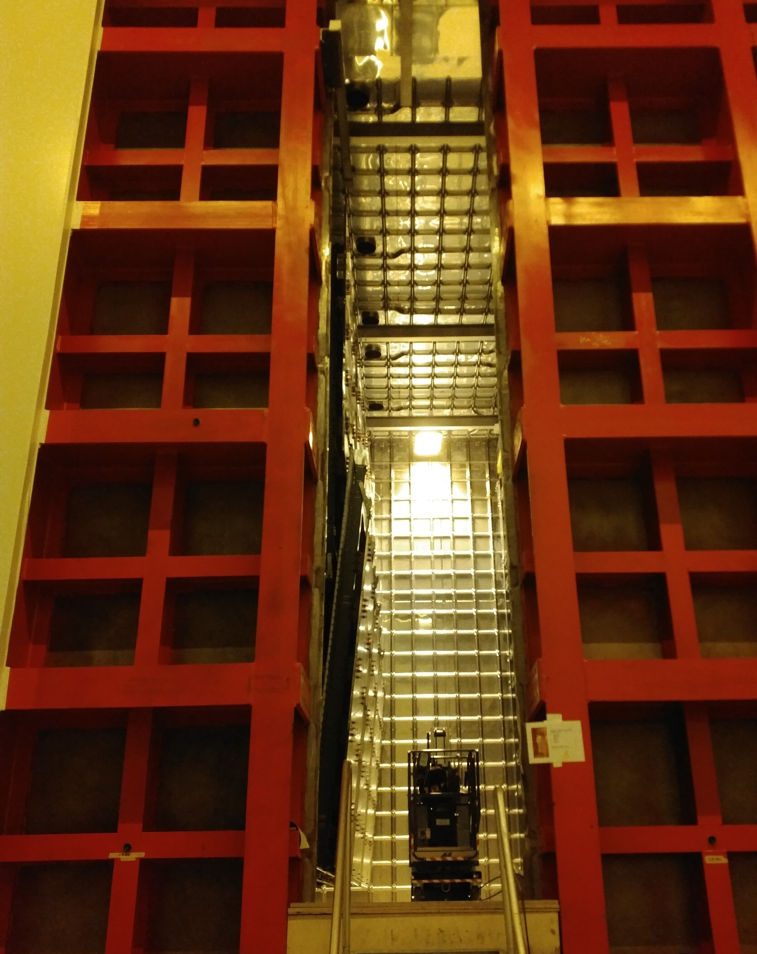
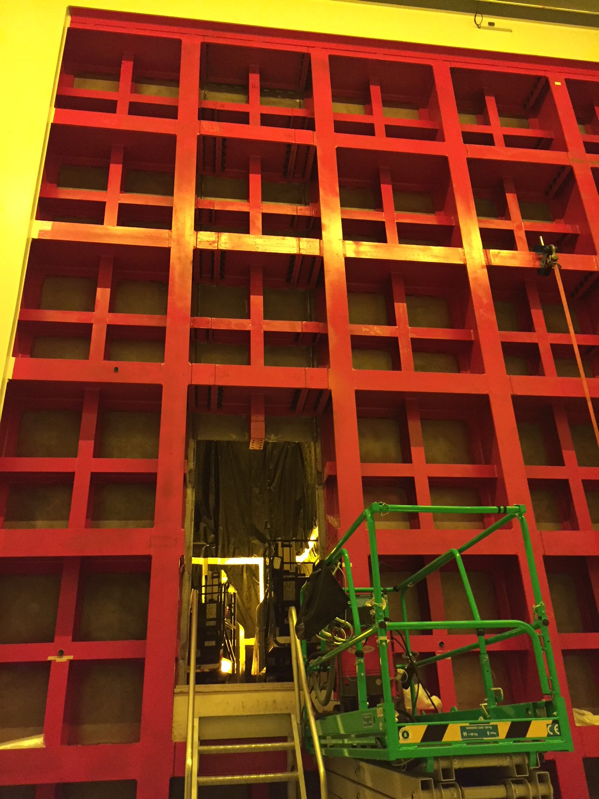
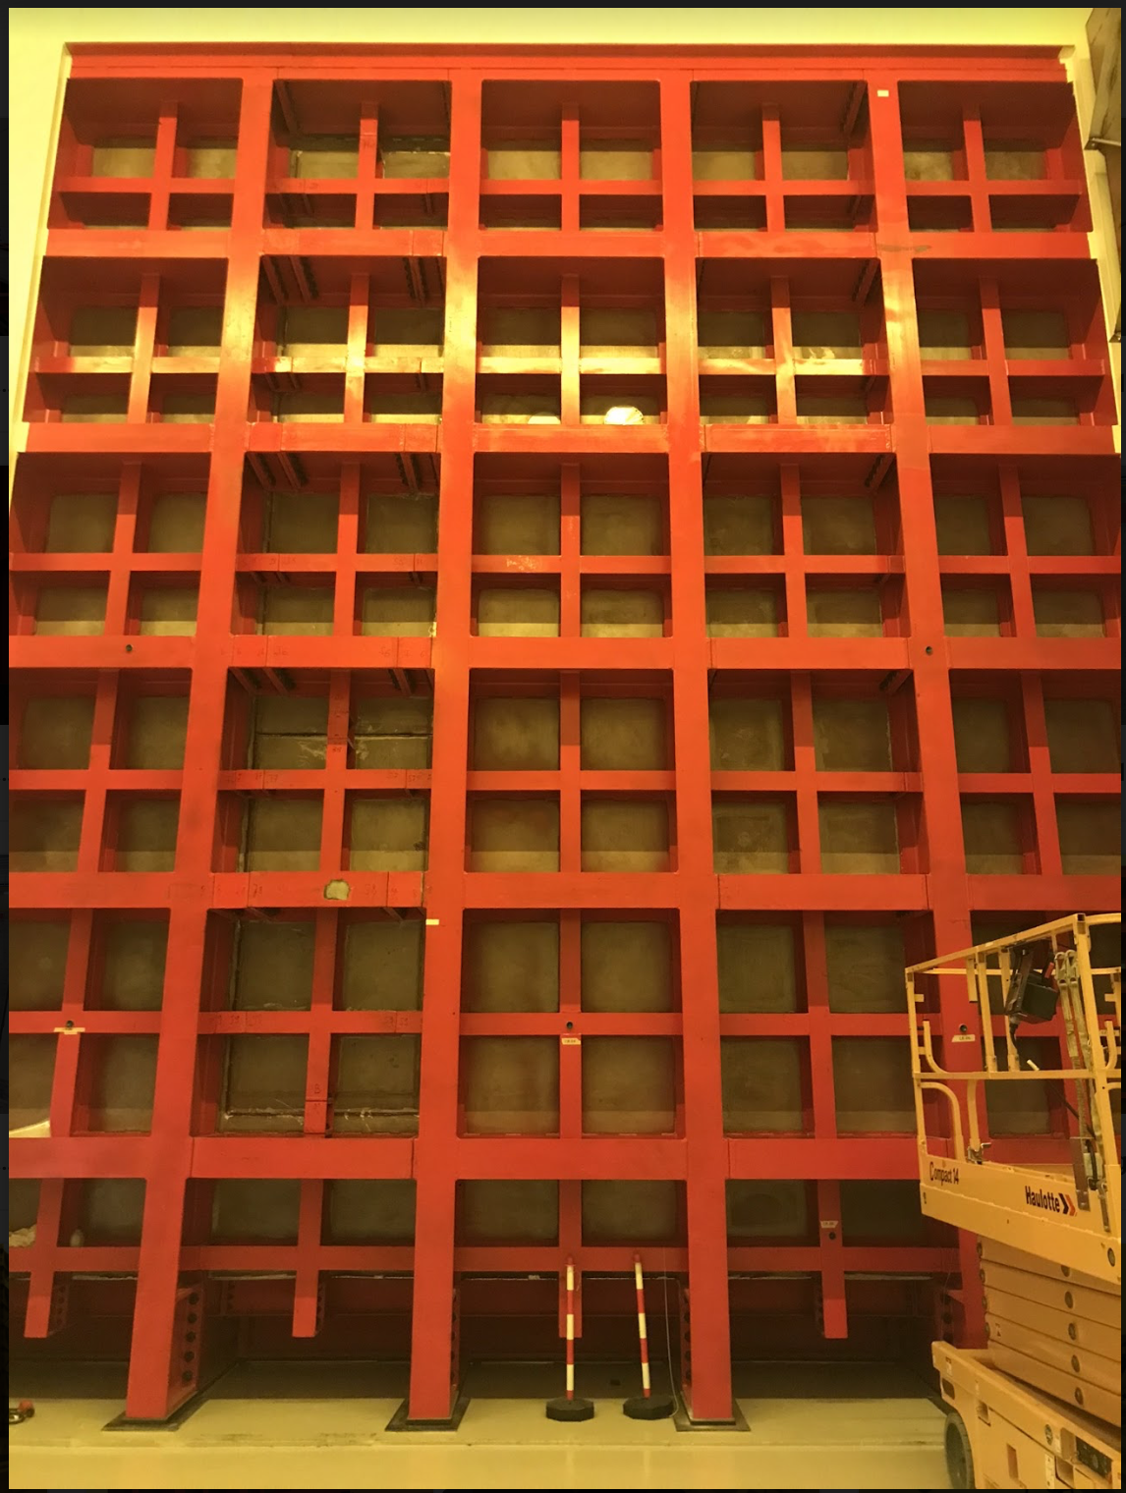
Closing the Temporary Construction Opening
a hard deadline: May 1 to June 13 - 2018

Slide 14
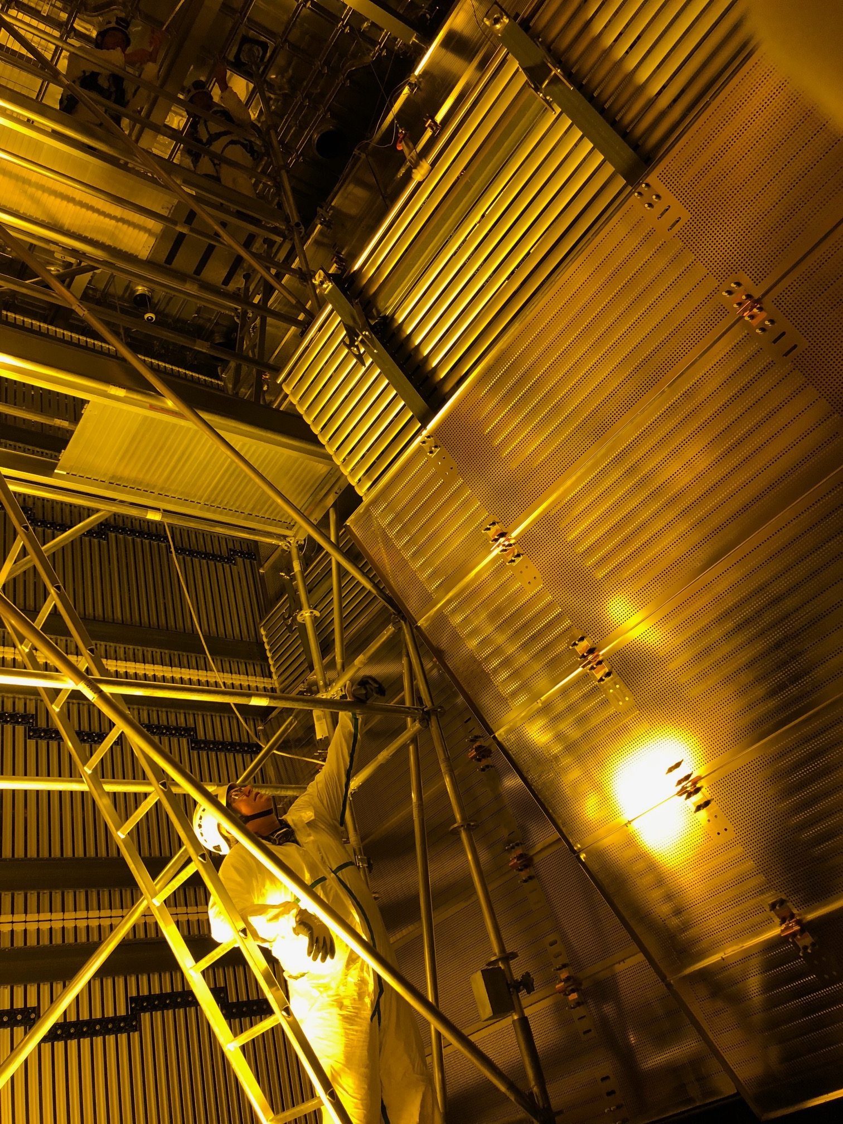
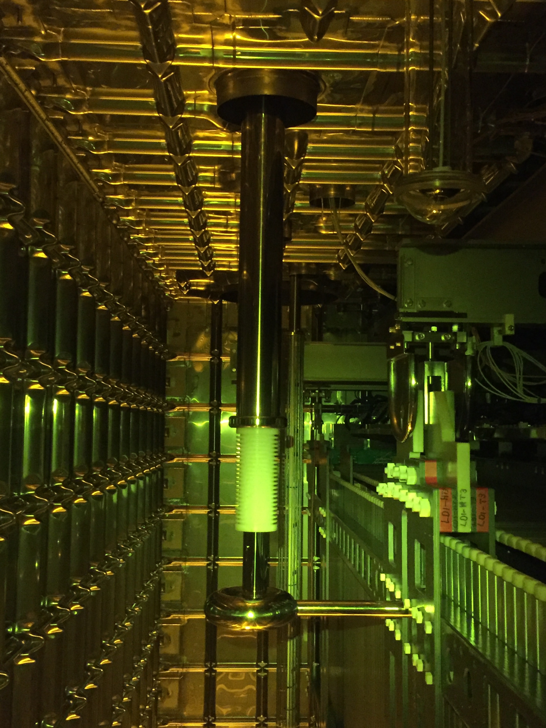
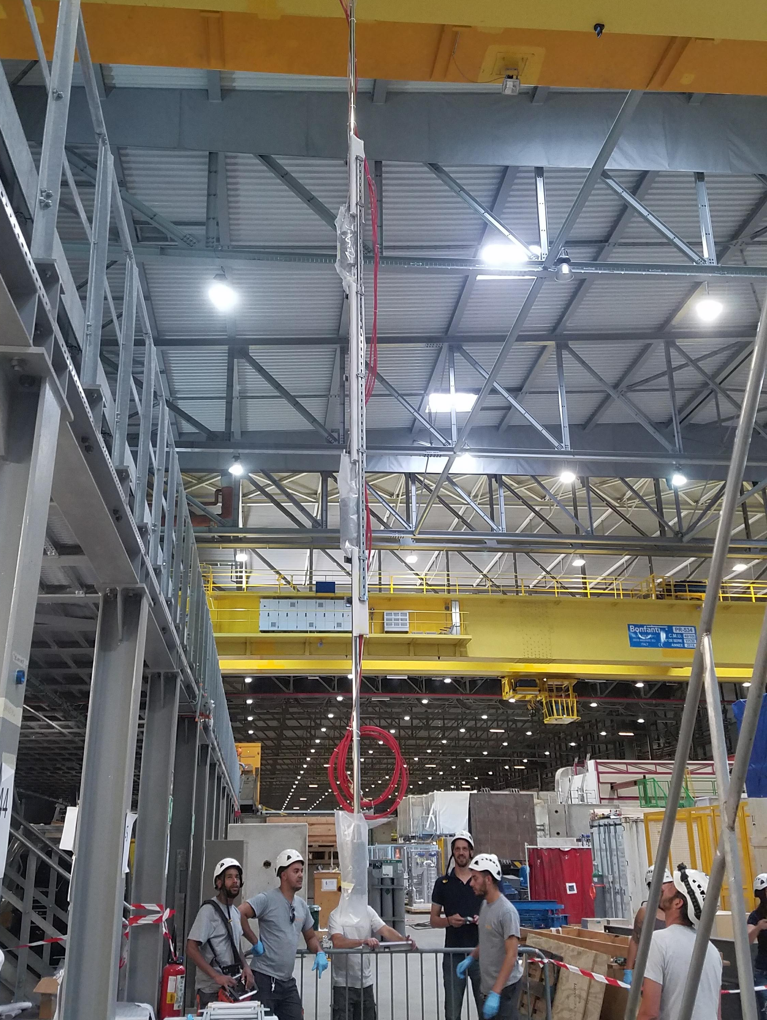
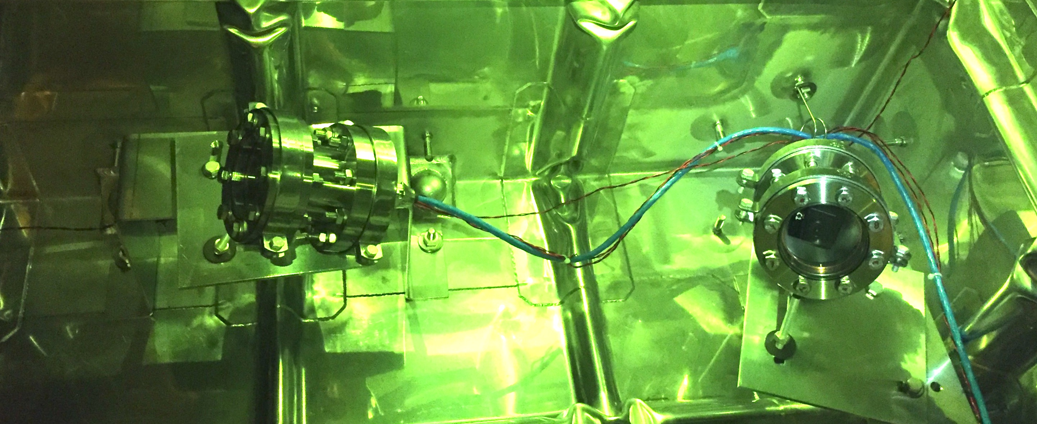
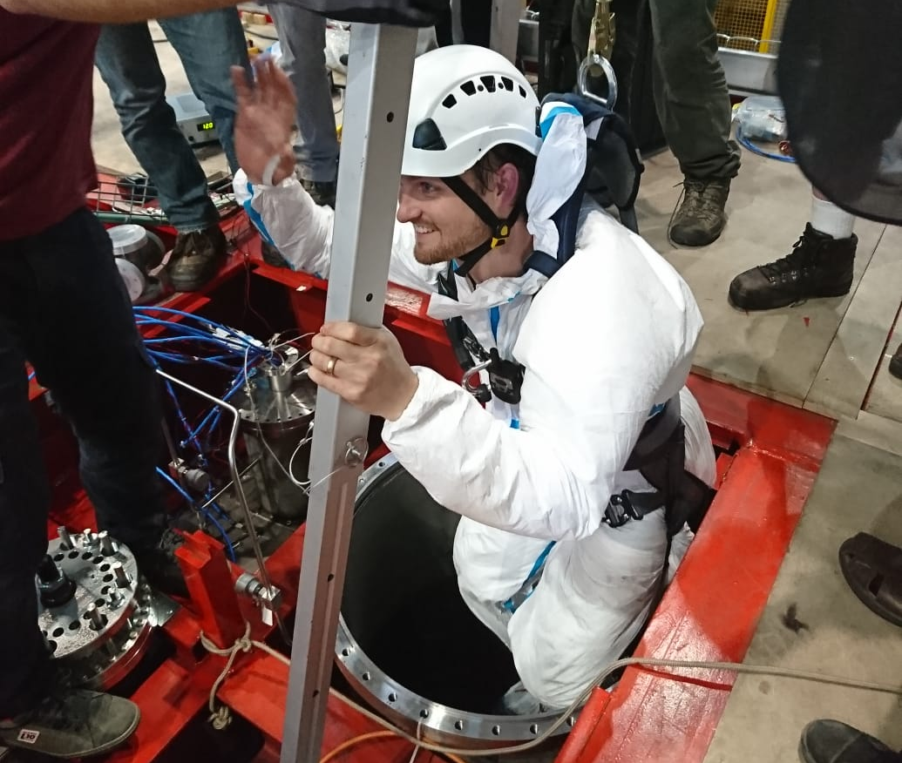
TPC mounting completed and LAr detector installation inside the Cryostat
one more step forward: June 14 to July 15 - 2018
Regained access to the cryostat June 14th after the Temporary Construction Opening was sealed
Completed the beam left drift
  Fixed APAs and end walls into final position
  Deployed top/bottom field cage units
  Installed high voltage cup and feedthrough
Installed Cryo-Instrumentation
  Cameras
  LEDs (visible and IR)
  Temperature sensors/ profilers
  Purity monitors
Final exit, June 28th
14

Slide 15
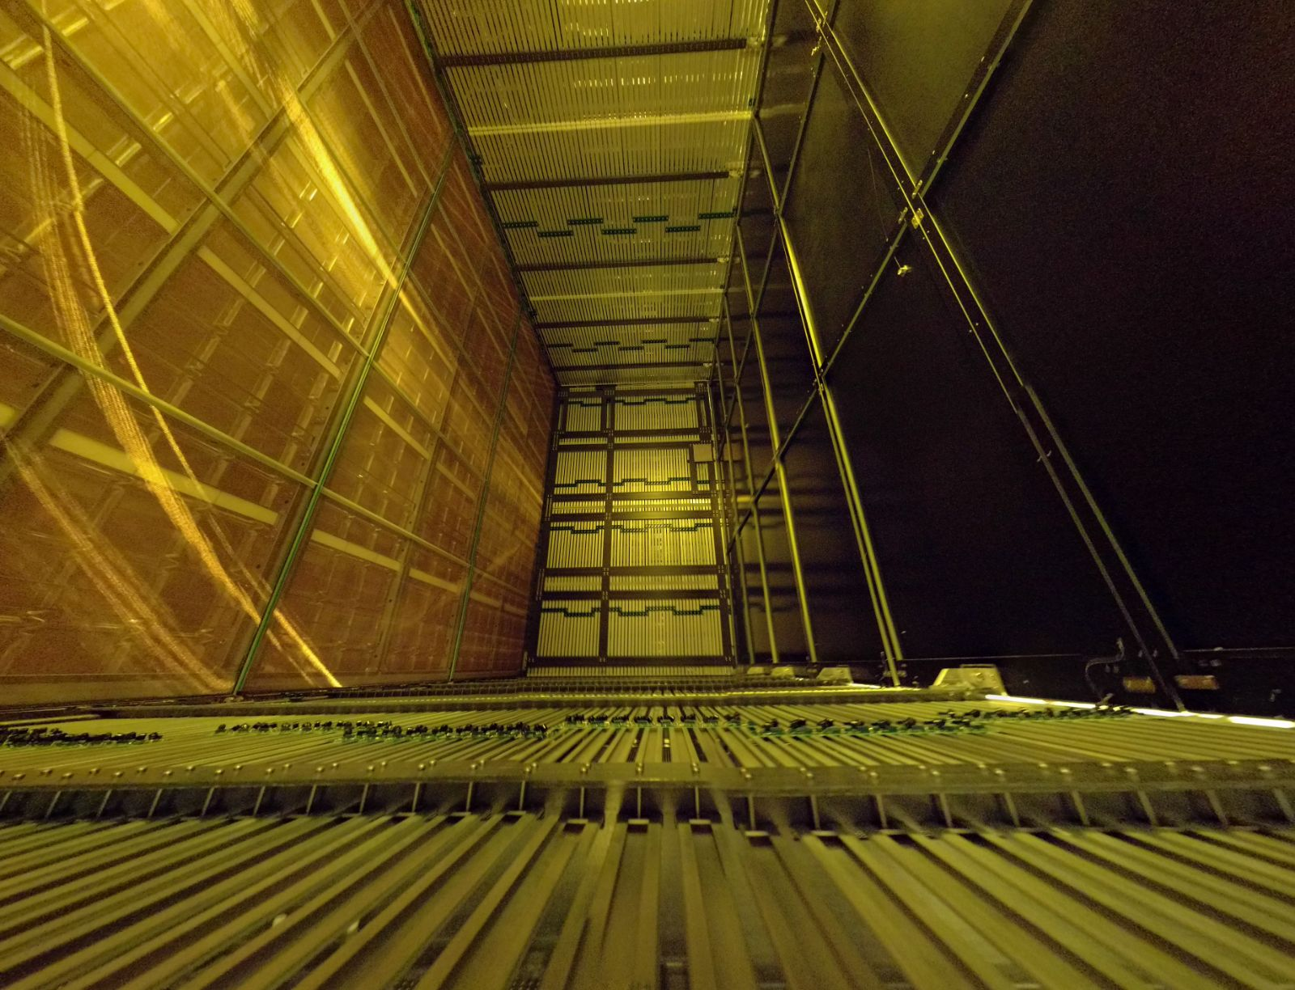
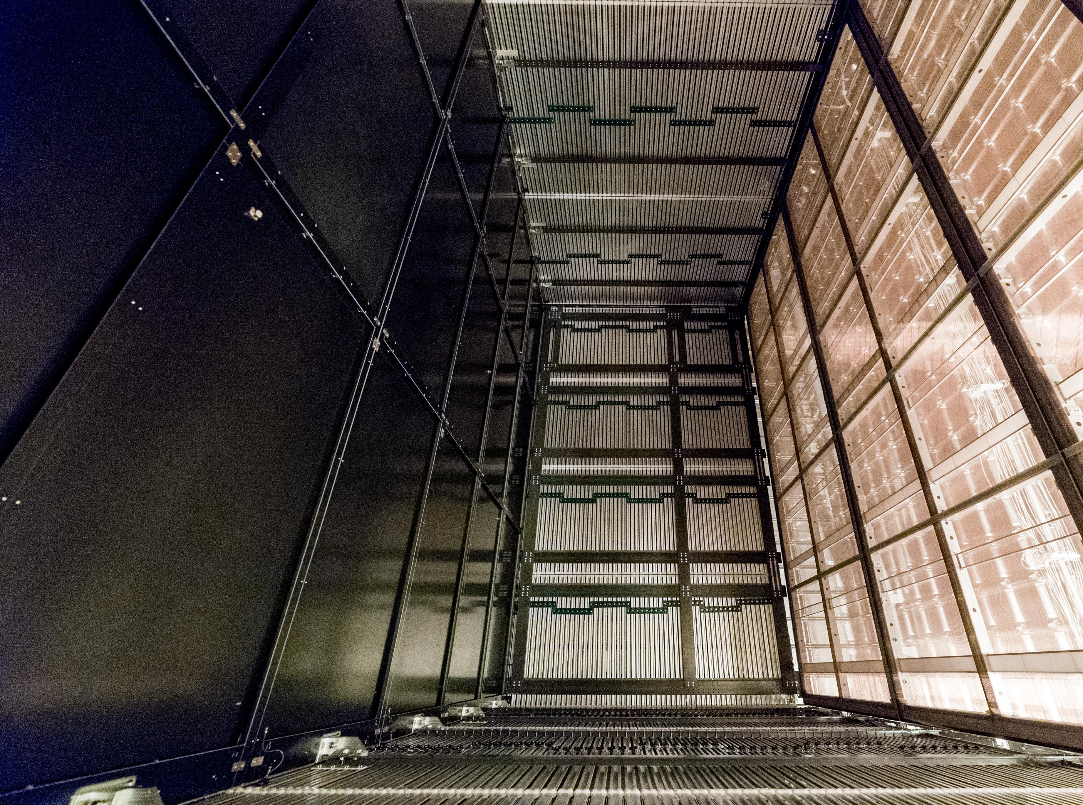

Slide 16
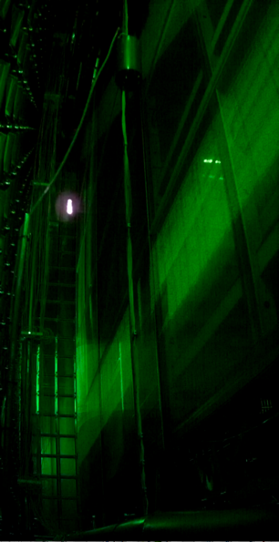
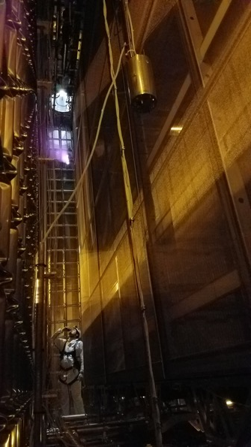
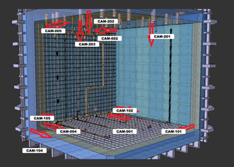
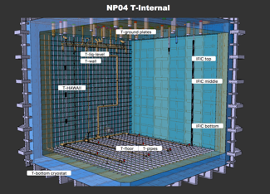
ProtoDUNE Instrumentation
92 high precision temperature sensors for detailed temperature maps
12 cameras, to monitor the state of the apparatus and localize any sparking that may occur
Purity monitors to measure the drift electron lifetime regularly, at 1.8m, 3.7m, 5.6m from floor
“Last days working in the cryostat”
From cameras inside. TPC full of LAr

Slide 18
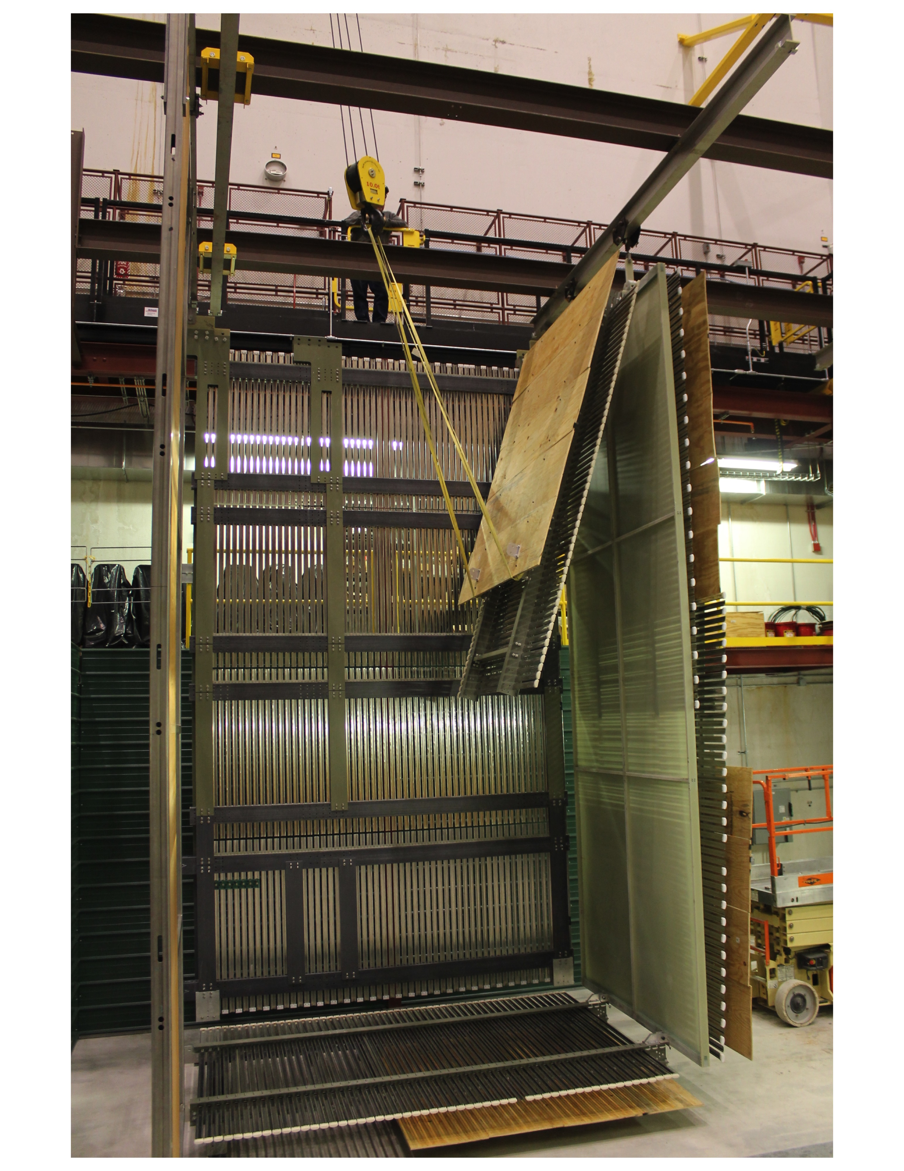
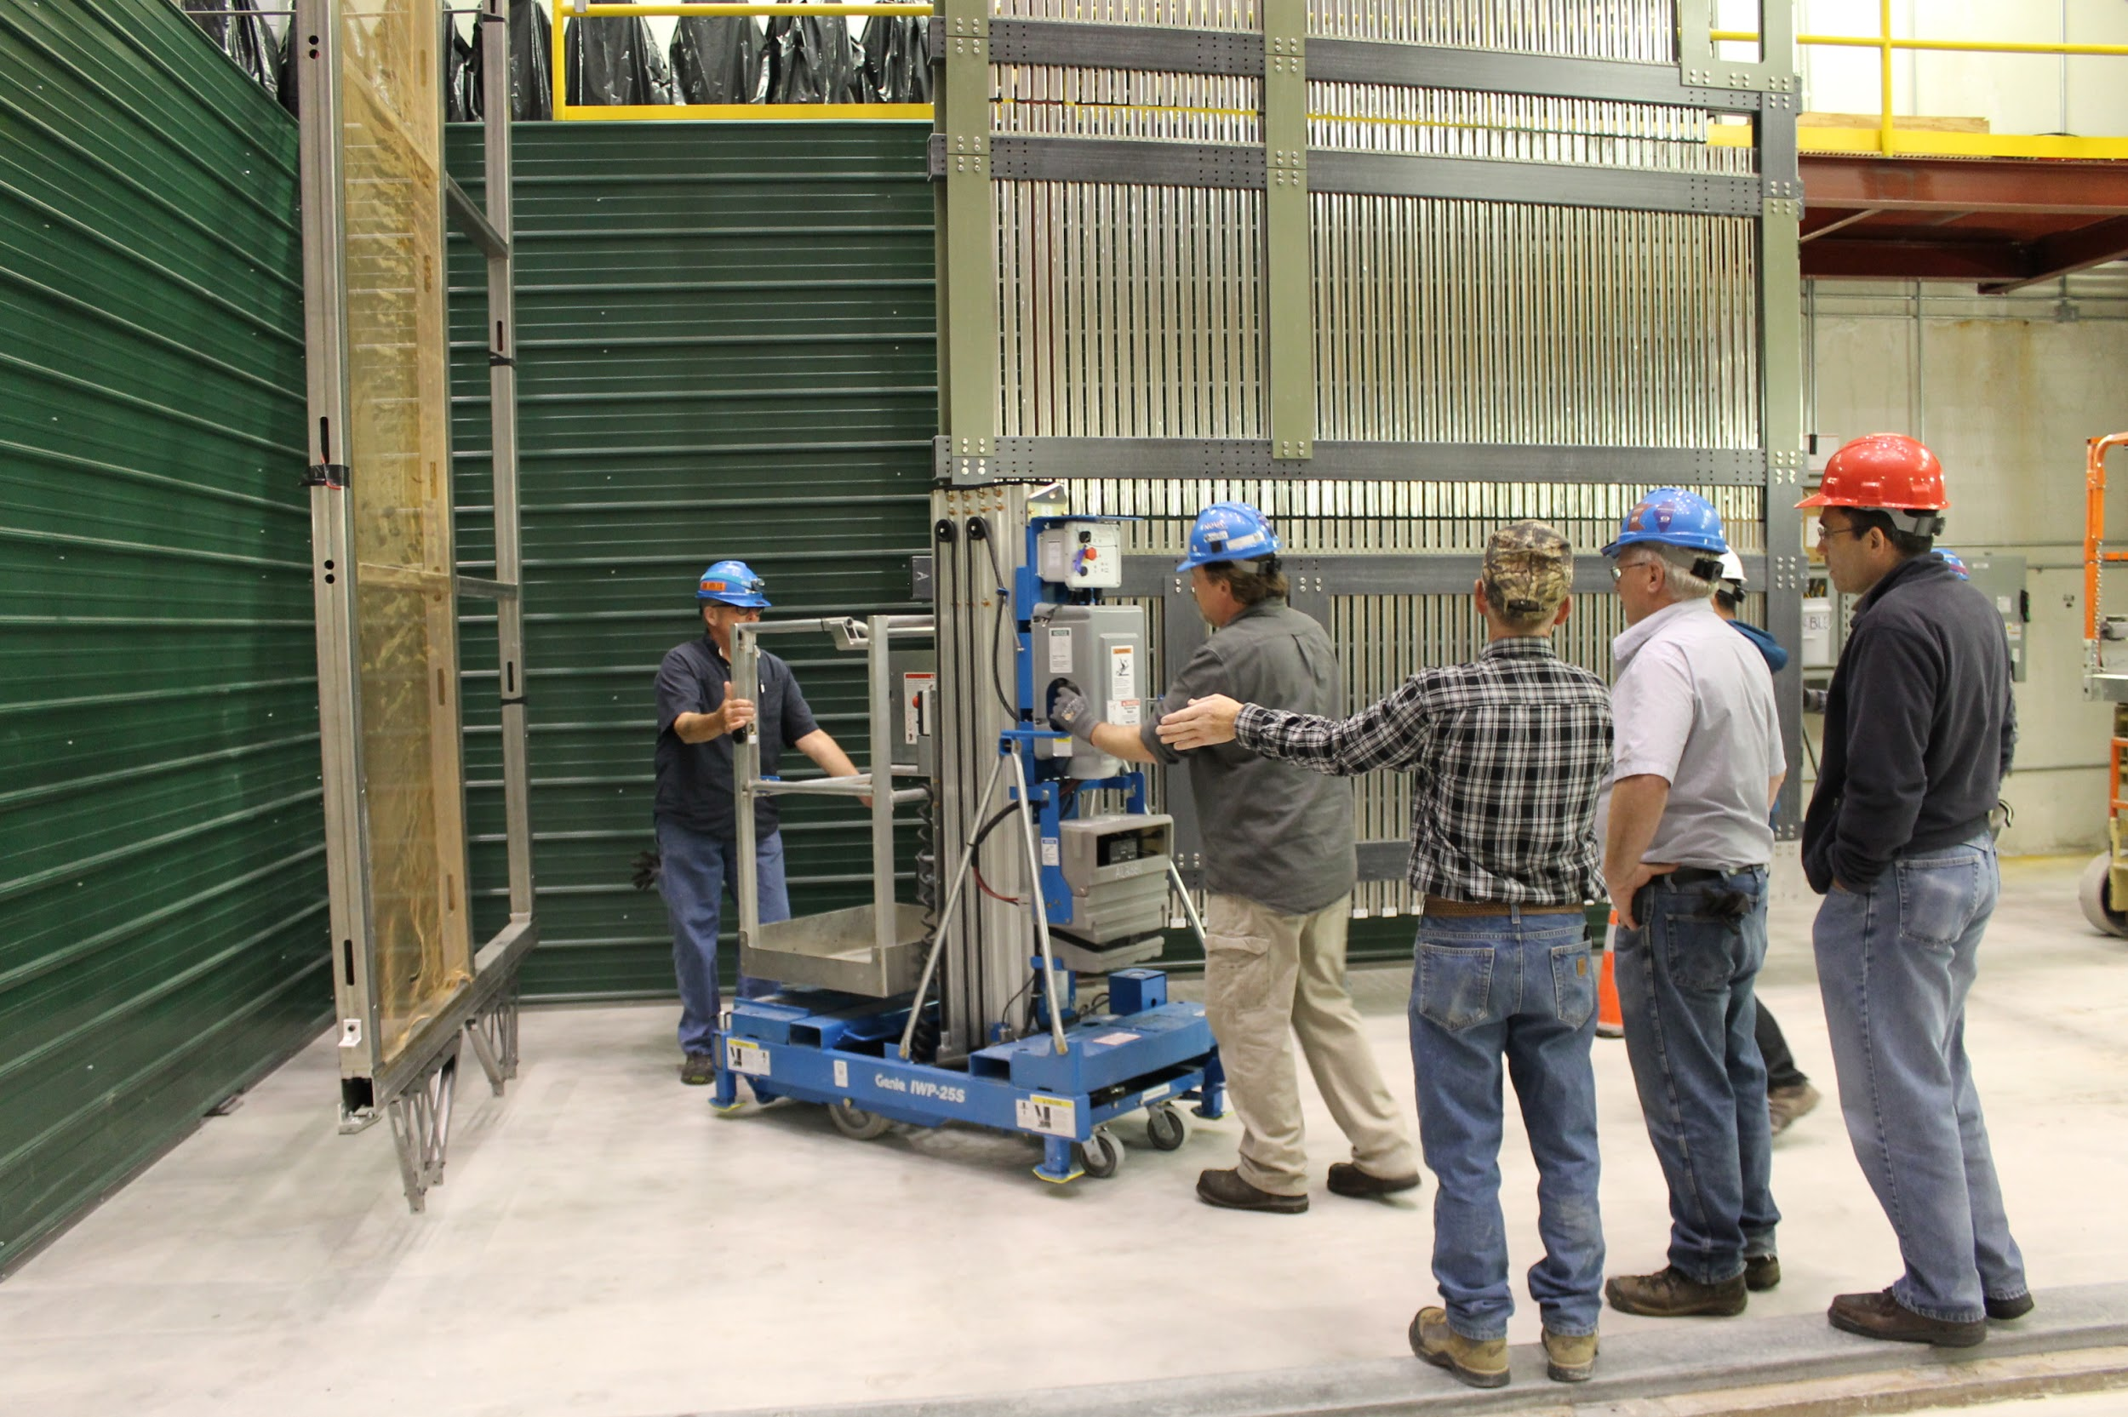
Lessons Learned (Construction/Installation Phase)
Integration Engineering and Engineering Coordination across sub-systems is essential and should receive high priority in resource planning
Documentation of engineering analyses and calculations should be done in real time – not months after the fact
Internal project engineering design and construction reviews should take place regularly throughout the lifetime of the construction phase
    Early design reviews may not uncover the real issues or flaws in the design, particularly related to integration
We had a great team,
but we could have
done better
Full scale prototyping
was essential
Final integration hardware
(latches and hinges, etc)
arrived late
Engineering resource limited
(single point problem)

Slide 19
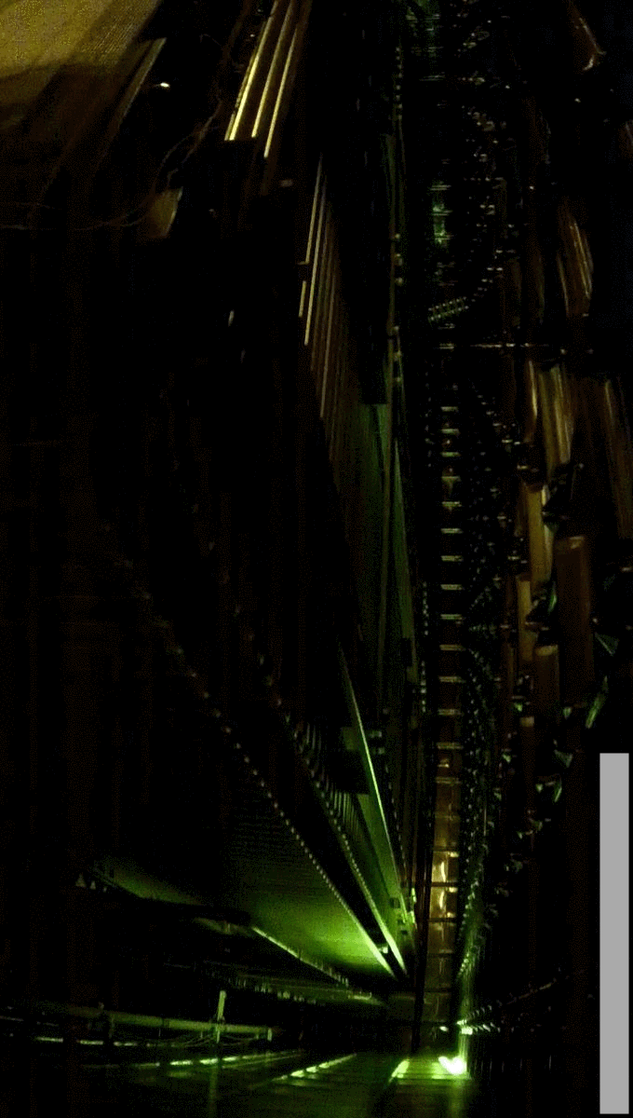

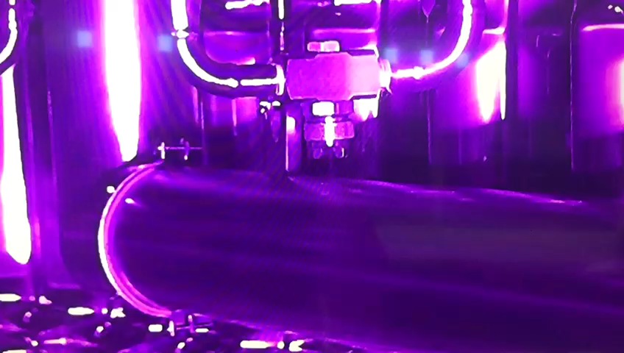
Cryogenic Commissioning
Purging, Cooling and LAr Filling
proto
SP
one last step: July 15 to Sept. 13 - 2018
LAr Filling:
LAr level going up
as seen by a camera from Bottom of the Cryostat
and Cooling:
spraying cold Ar from top of the Cryostat for cooling
  Kept the LAr level below the APA until the temperature gradient across its height was no more than 50K
August 13th, increased fill rate
September 13th, reached nominal level
19
19￼

Slide 20
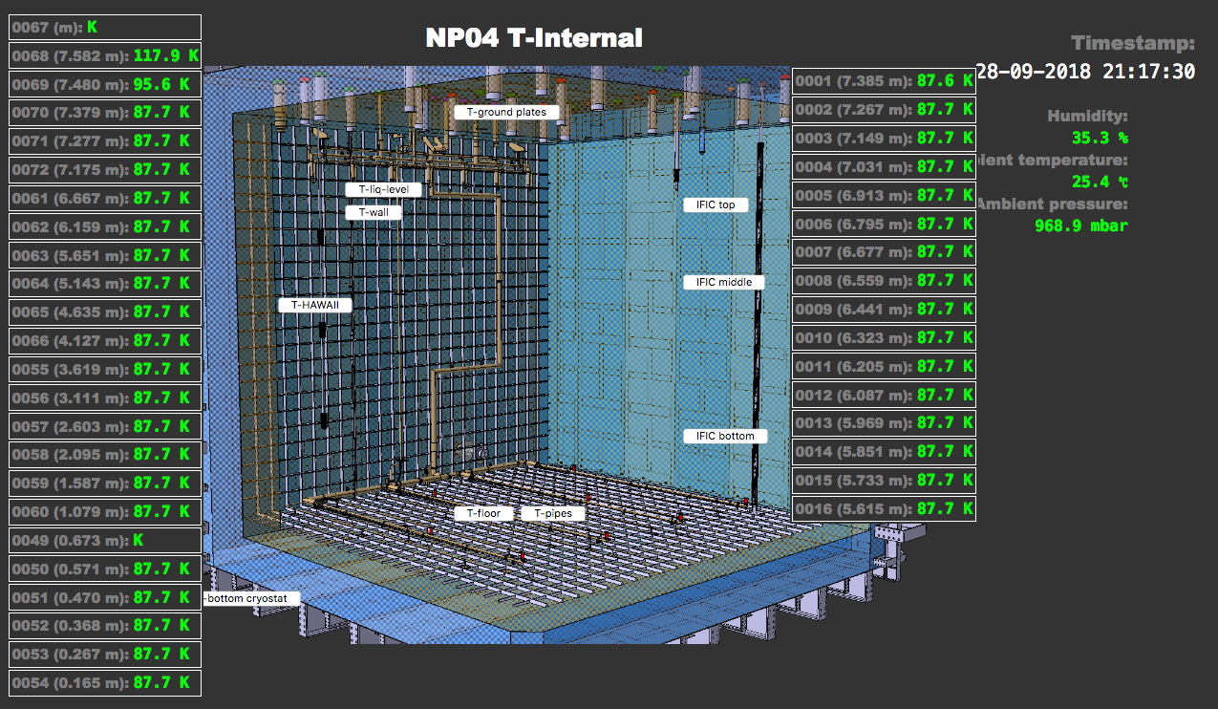
Internal temperature sensors monitored the liquid level

Slide 21
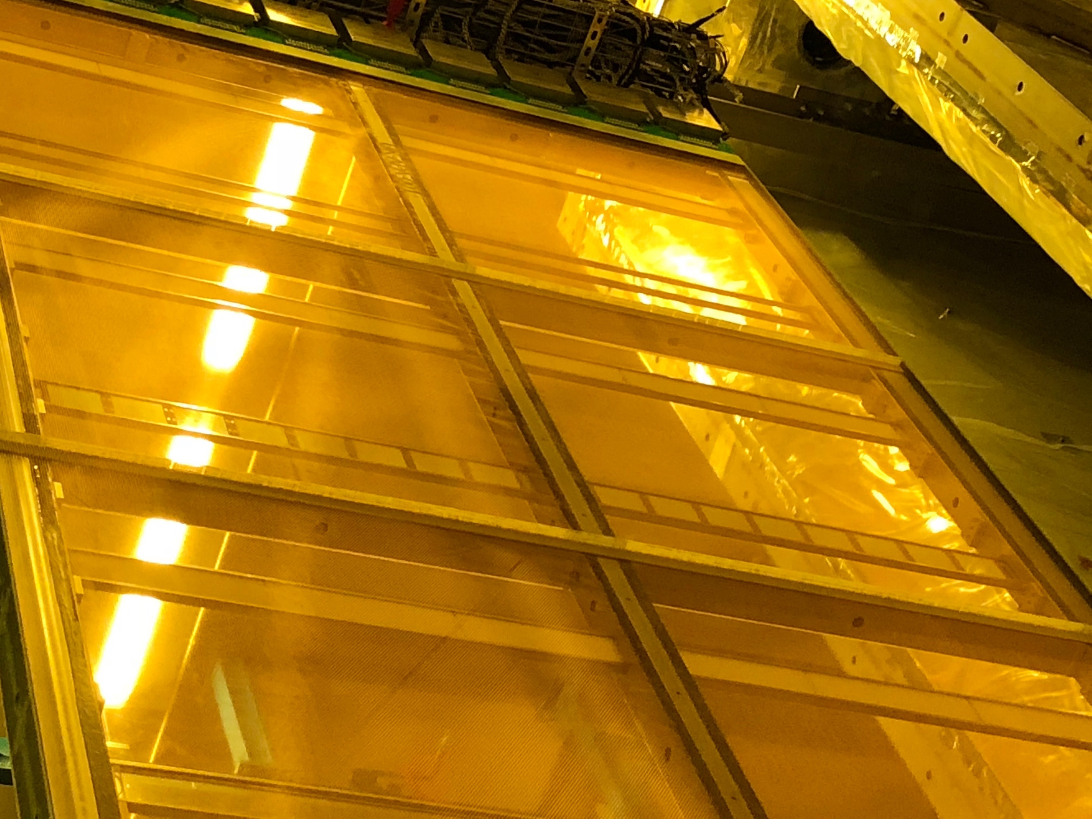
Photon Detector Module Layout
PD Module Designs
  (29)
Dip-Coated Light Guides
  (29)
Double-Shift Light Guides
  (2)
ARAPUCA (Light Trap)

Slide 22
Photon detector trigger rate tracked the filling as well
10 modules
per APA ;
4 readout
channels
per module
10
9
8
7
6
5
4
Bars in APA 1-3
have Sensel SiPMs
3
Bars in APA 4 – 6
plus Arapucas
have Hamamatsu
MPPCs
2
1
APA #

Slide 23
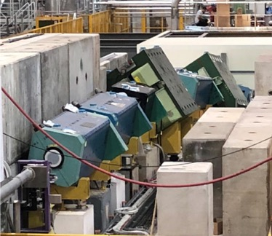
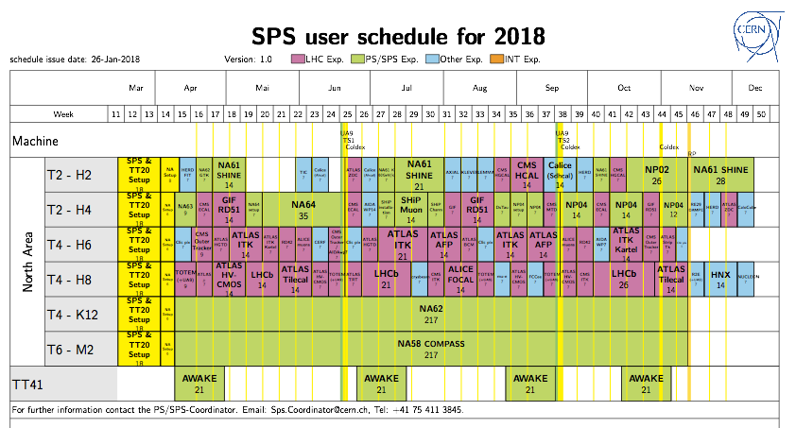
Beam operation started while we were still filling;
Beam was fully tuned by time we were ready for it.
Excellent support for beam operations through out the run.

Slide 24
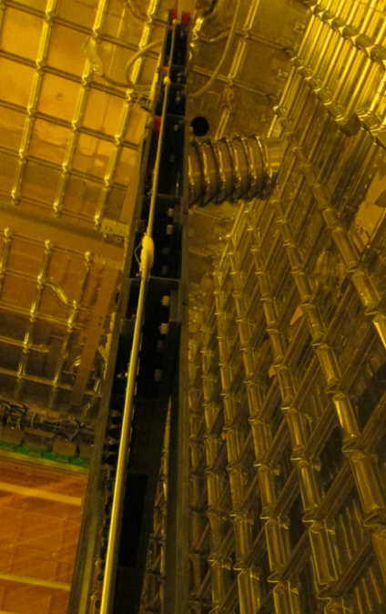
ProtoDUNE Test Beam
Beamline
400 GeV/c p beam from SPS ➜ 80 GeV/c secondary 𝜋⁺
➜ 0.5 – 7 GeV/c tertiary e⁻, p, 𝜇⁺, 𝜋⁺
TPC 2
TPC 1
Beam plug = END of beamline to get electron showers inside TPC, filled with N2
PHYS. REV. ACCEL. BEAMS 20, 111001 (2017)
EHN1 extension, H4 beamline

Slide 25
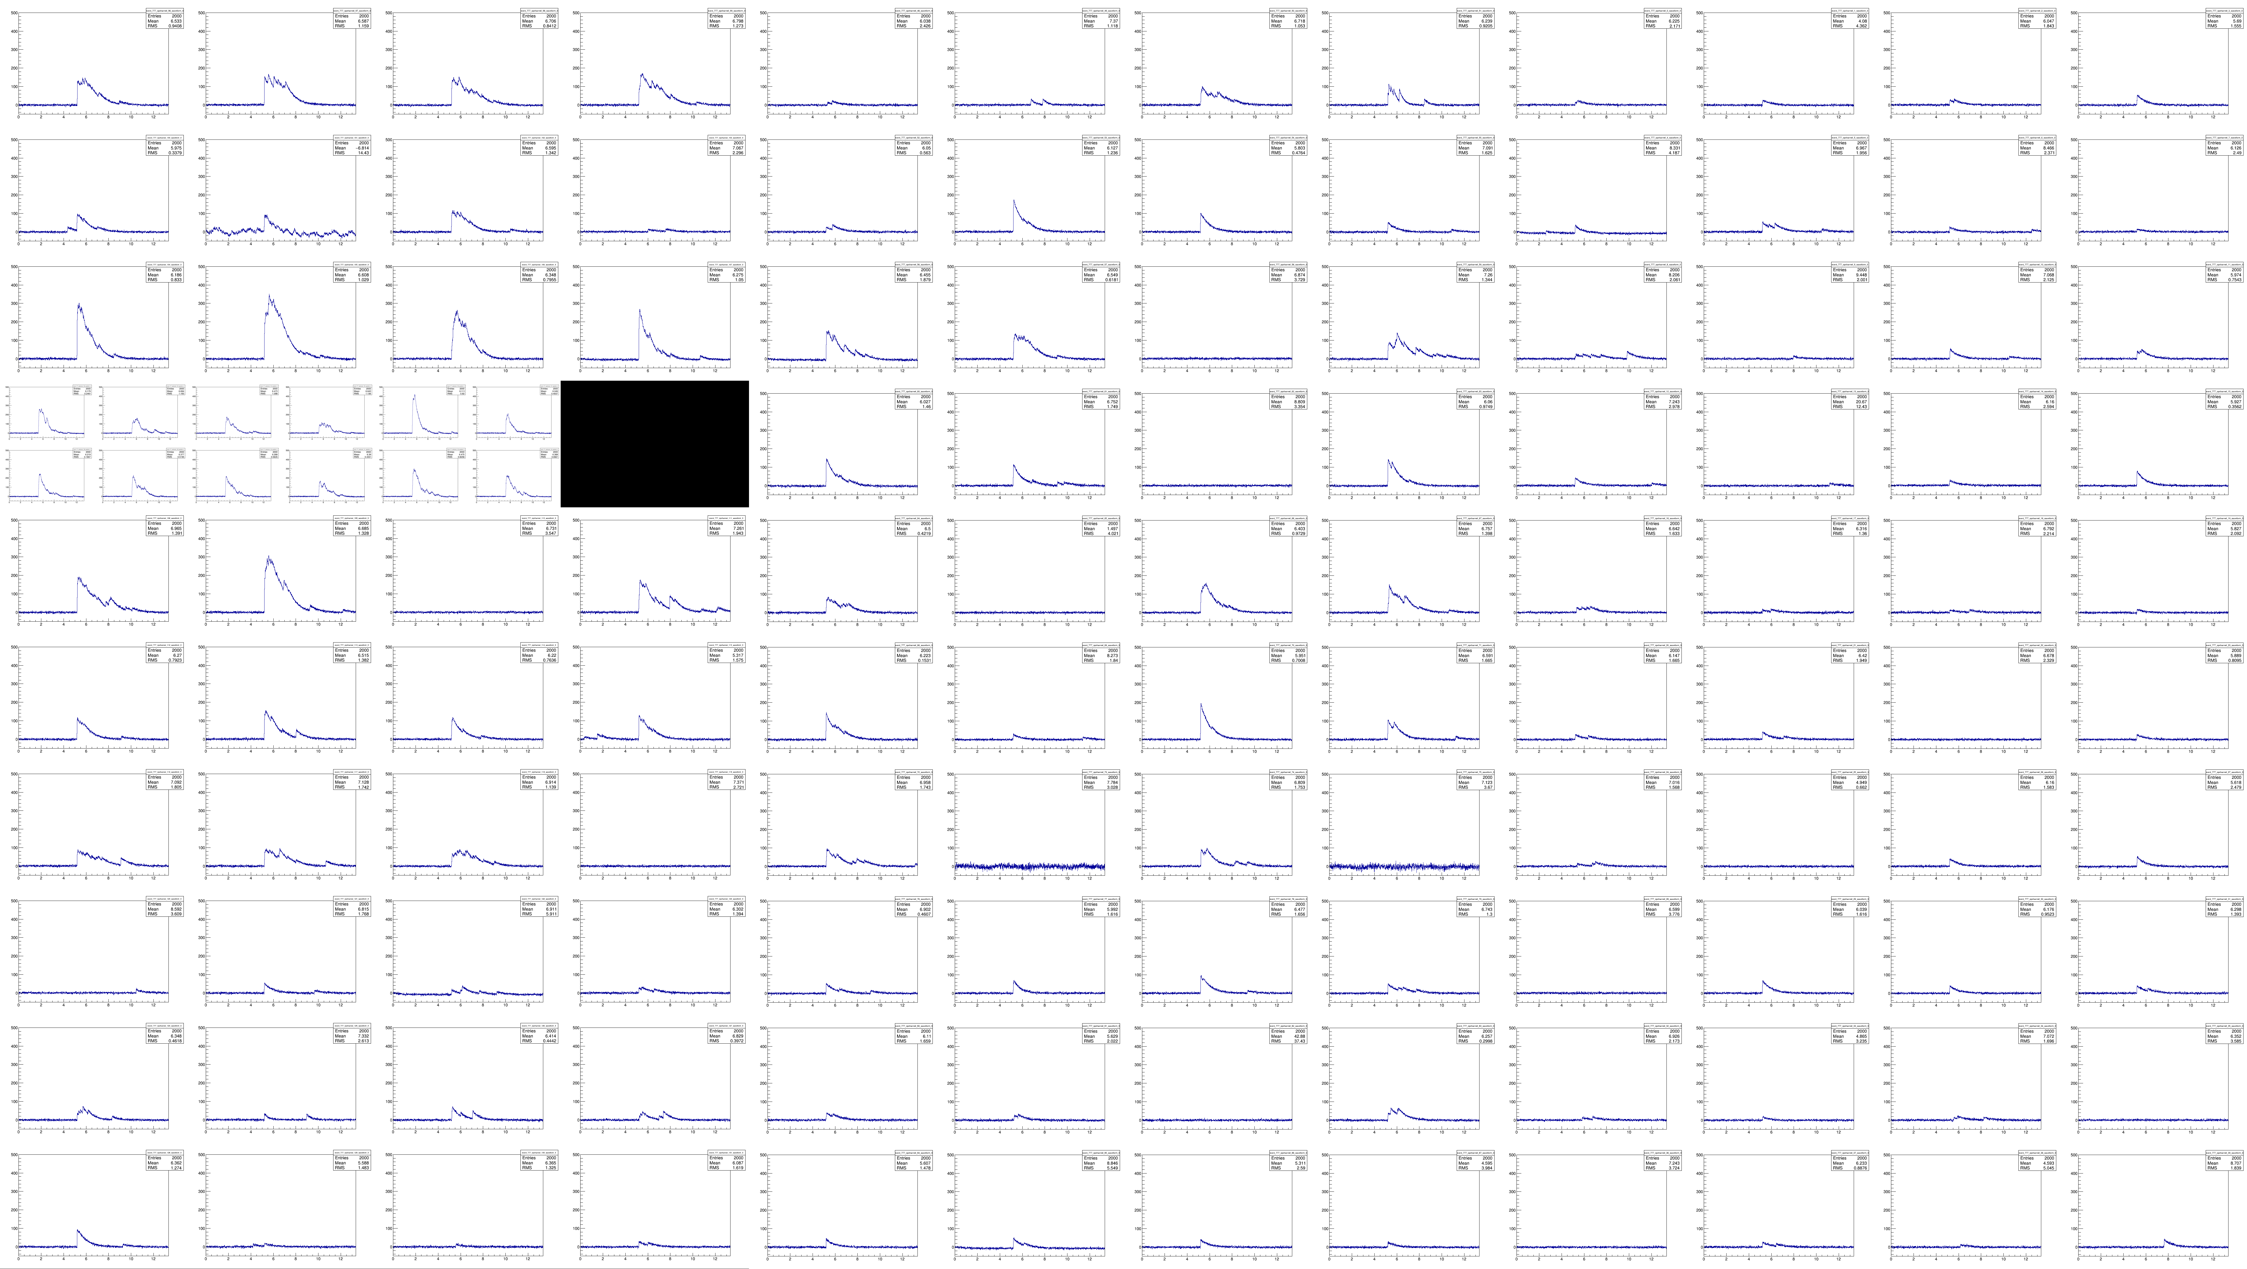
Run_5770_Event_777 – 6GeV
APA-3
APA-2
APA-1
Total channel count = 256
6 dead channels +
8 turned off for high rate
ARAPUCA

Slide 26
Beam Data
Looked at Beam Energy Scan : 1 – 7 GeV
See sensible response from the Photon Detectors on Beam Right :
  Timing
  Upstream to downstream; beam right to left, etc.
  Used the Beam right Arapuca module to look at light collected
X 10 ⁴
Beam Momenta (GeV/c)

Slide 27
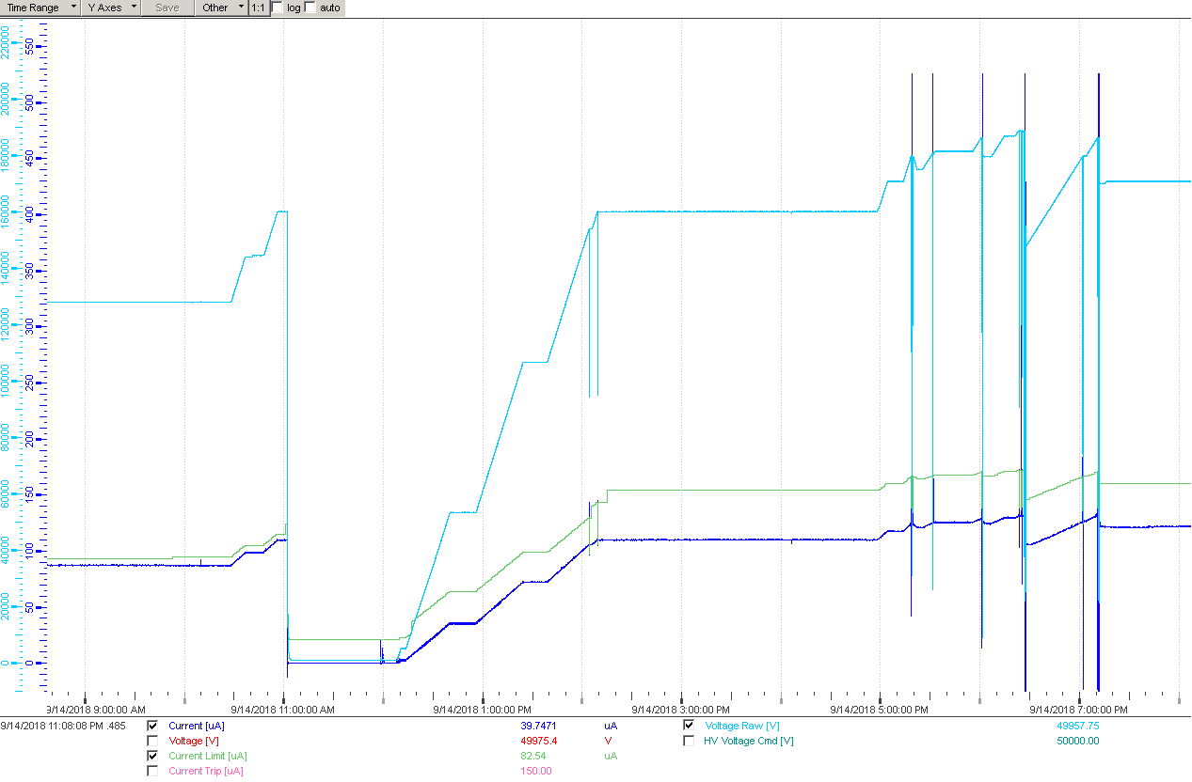
High Voltage Startup (September 13 – 20)
9/14 : 8AM – 8PM
HV
current
Some hardware challenges (Power supply, filters, cables…)/learning curve....

Slide 28
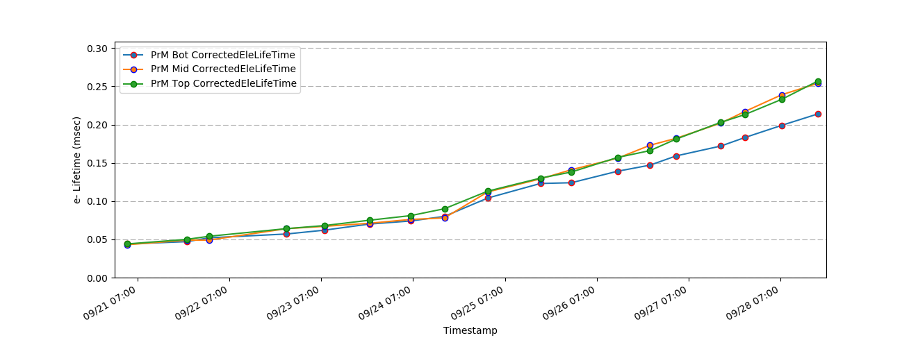
September 18 started LAr circulation pumps
LAr purity from (3)PurMon
28

Slide 29
100 𝜇s
Sep. 20
Sep. 21
Sep. 23
Sep. 24
200 𝜇s
Sep. 25
Sep. 26

Slide 30
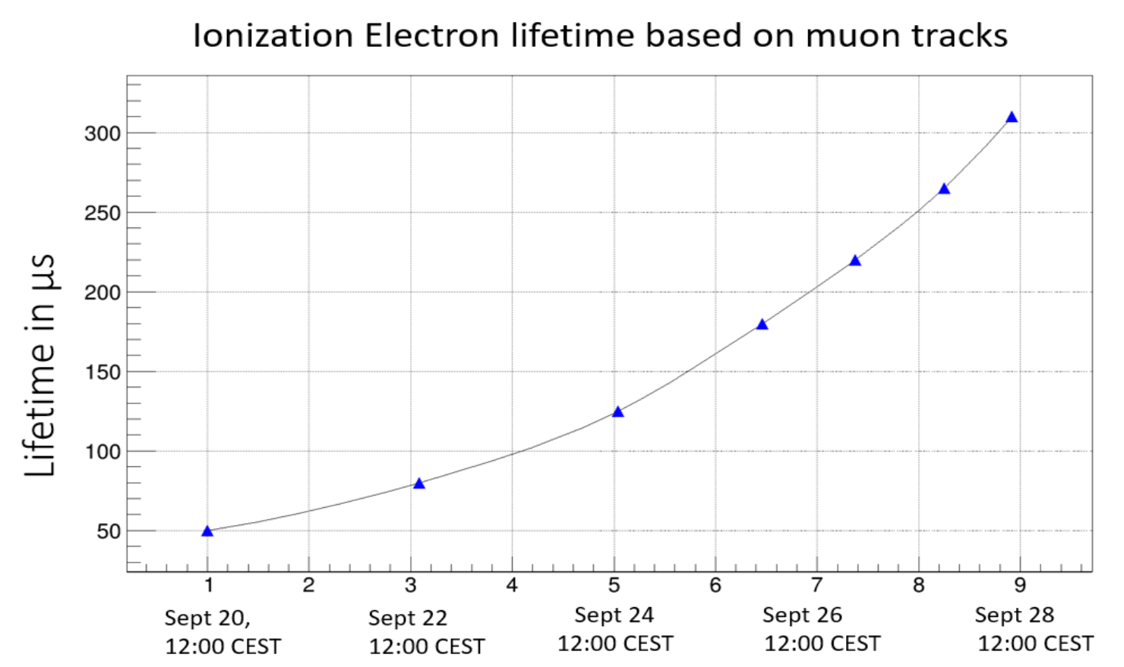
LAr purity from automatic TPC Tracks reconstruction
30

Slide 31
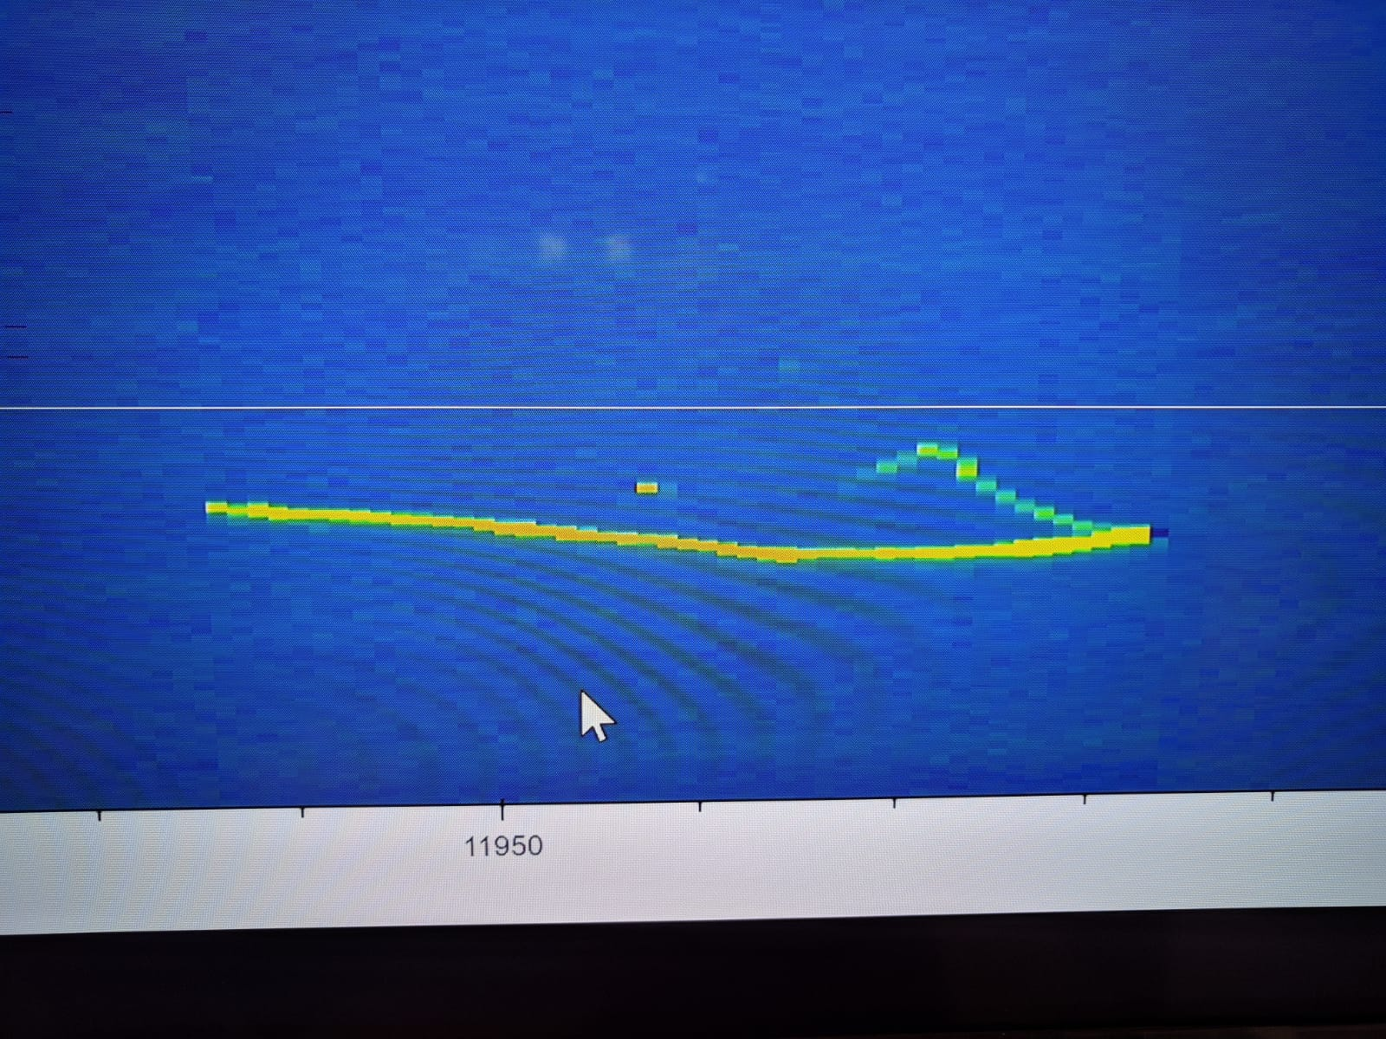
First track recorded at 180kV Field
Field + purity = operational TPC

Slide 32

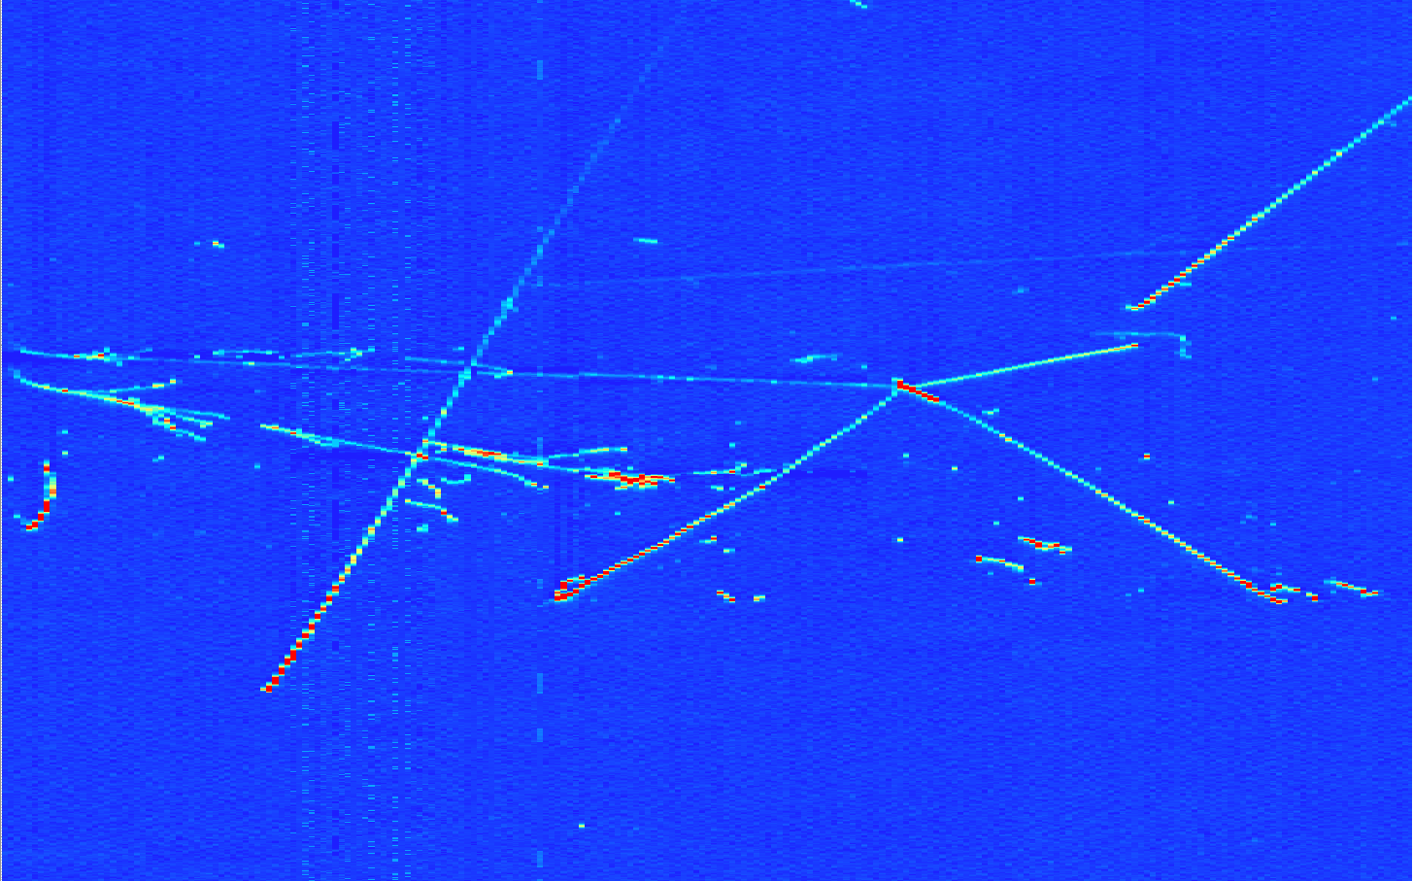
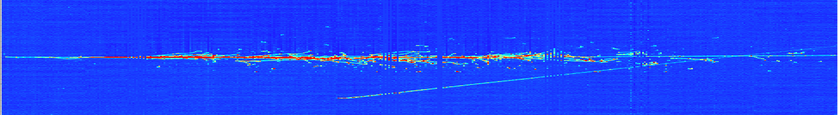
Some Events
EM showers and a pion interaction with 4 outcoming particles
Run 4696, Ev 103
Beam halo (high energy) muon with bremsstrahlung initiated EM shower
EM shower from beam, raw collection view, electronics over shoot above

Slide 33
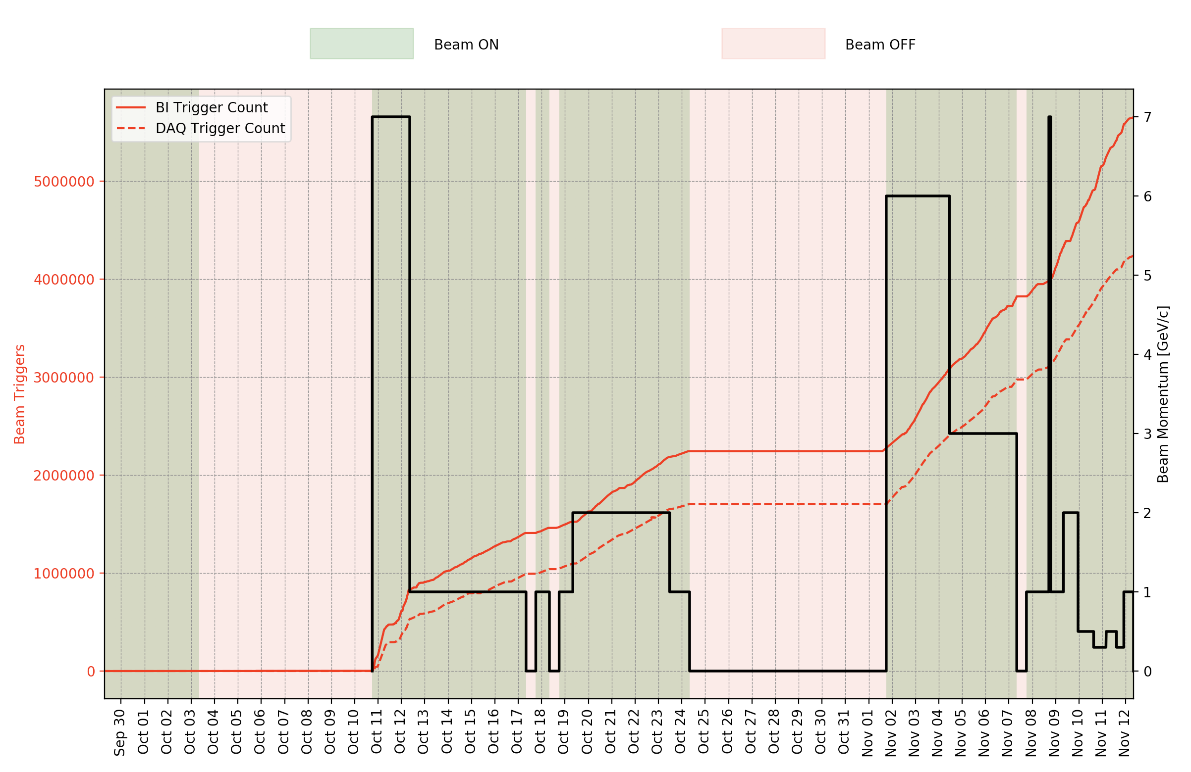
Beam Data with operational TPC

Slide 34
Beam Data Accumulation
Particle content is based on the expected rates
from the Geant simulation of the beamline
Compiled by Roberto Acciarri

Slide 35
Purity monitors
Purity monitors undergoing some
Development work right about here;
Beam (and hence HV) off, so no one
looking in real time at the lifetime from
cosmics

Slide 36
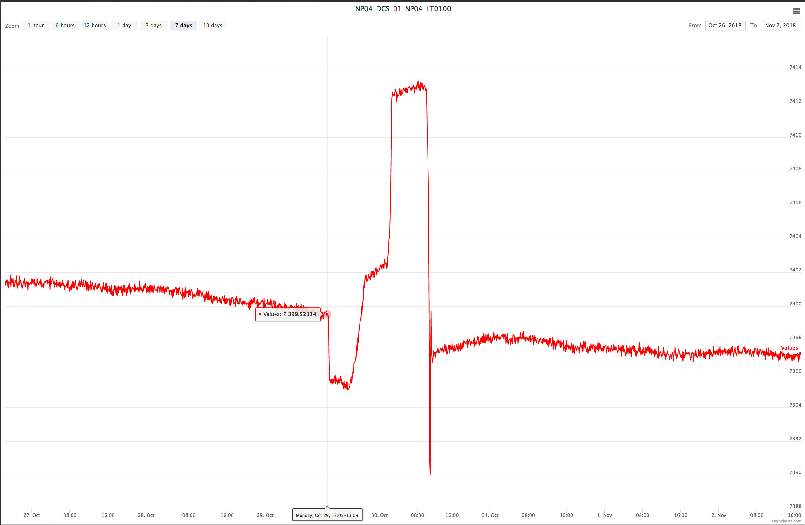
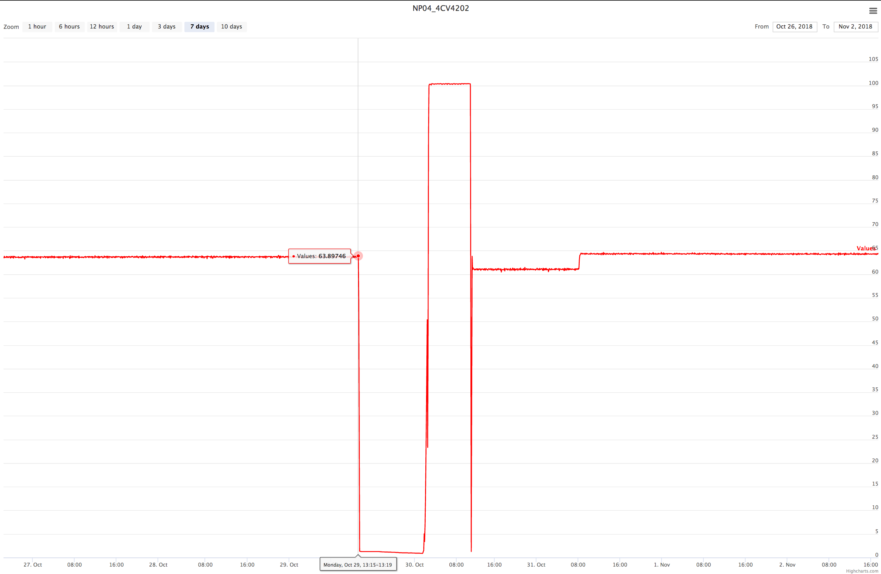
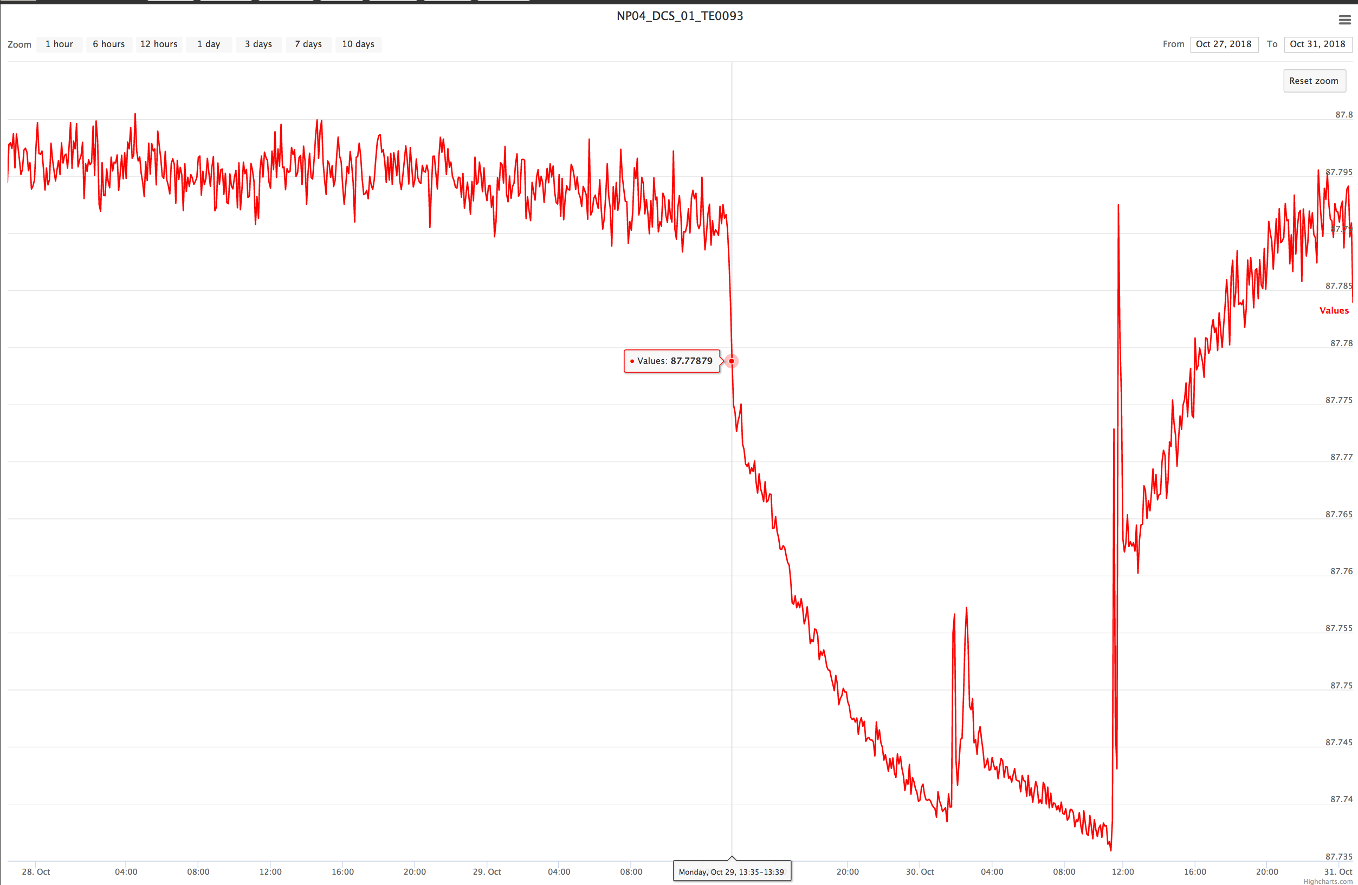
After the fact detective work by S. Pordes
Level monitor
Argon circulation pumps went off…
There were indications in the cryo-instrumentation
that something had happened, but was not picked up
In real time by either active (human) or
passive (automated) monitoring
Argon inlet valve setting
Temperature of the argon-inlet pipe

Slide 37
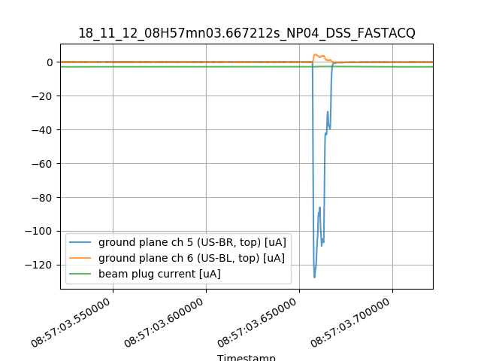
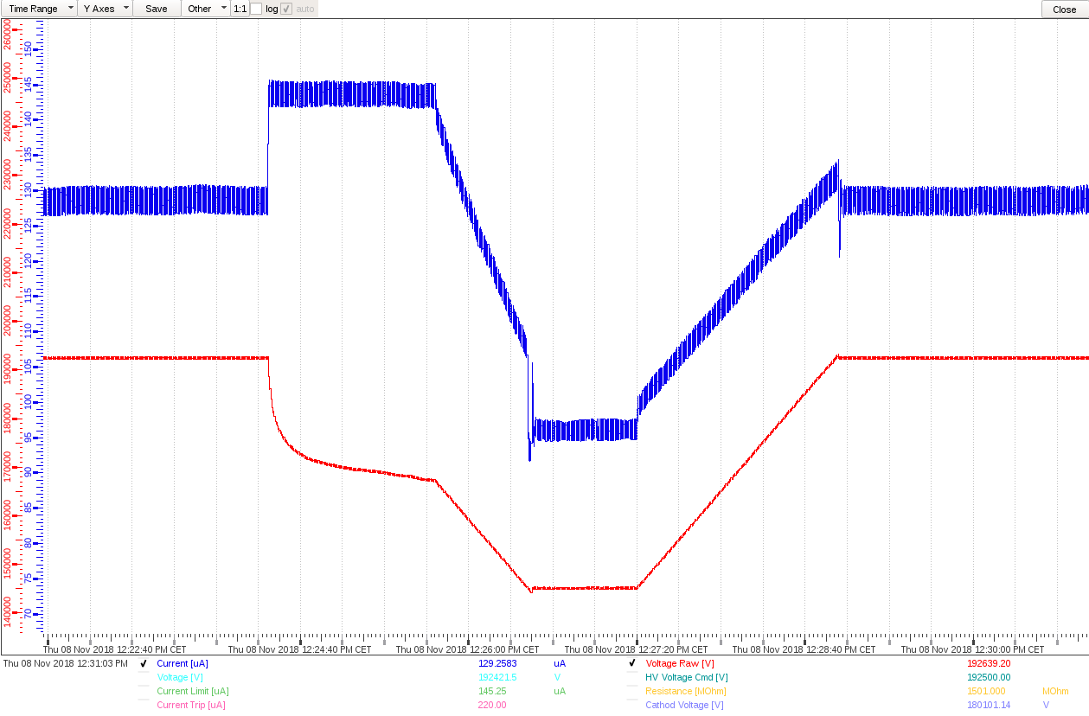
High Voltage
2 classes of HV instability:
  Fast discharges:
    O(10/day) recorded by the DCS fast acquisition
    All of them report a current signal on at least one ground plane
    Total charge from PS correspond to total charge on planes
  Sustained excessive current streams:
    Few per day (rate builds up over time)
    Typically current limiting
    Only a fraction of the PS current visible on US-BL-Top ground plane & beam plug
NOTE: The BL-US end wall’s termination point was not properly connected during installation. Therefore, we are unable to tune the voltage here. It sits at it’s ‘natural’ ~ -1kV instead of -1.665kV.
HV PS Current [uA] or Voltage [V]
5 min.

Slide 38
High Voltage
On October 17, we changed to a replacement high voltage power supply
We also changed our philosophy for dealing with “streamers” at this time
  Before: continue running when streamers open up, operate at lower voltages to try and mitigate
  After: inhibit triggers, lower the voltage until current draw returns to nominal, raise voltage to nominal, allow triggers
Typically takes ~10 minutes when a human needs to perform the recovery procedure
  At its worst, streamers open up once every 4 hours or so
  Conservatively, >95% uptime achievable
An automated recovery mode is being implemented into the PS controls soon
  Should increase uptime
not read out
HV PS Current [uA] or Voltage [V]

Slide 39
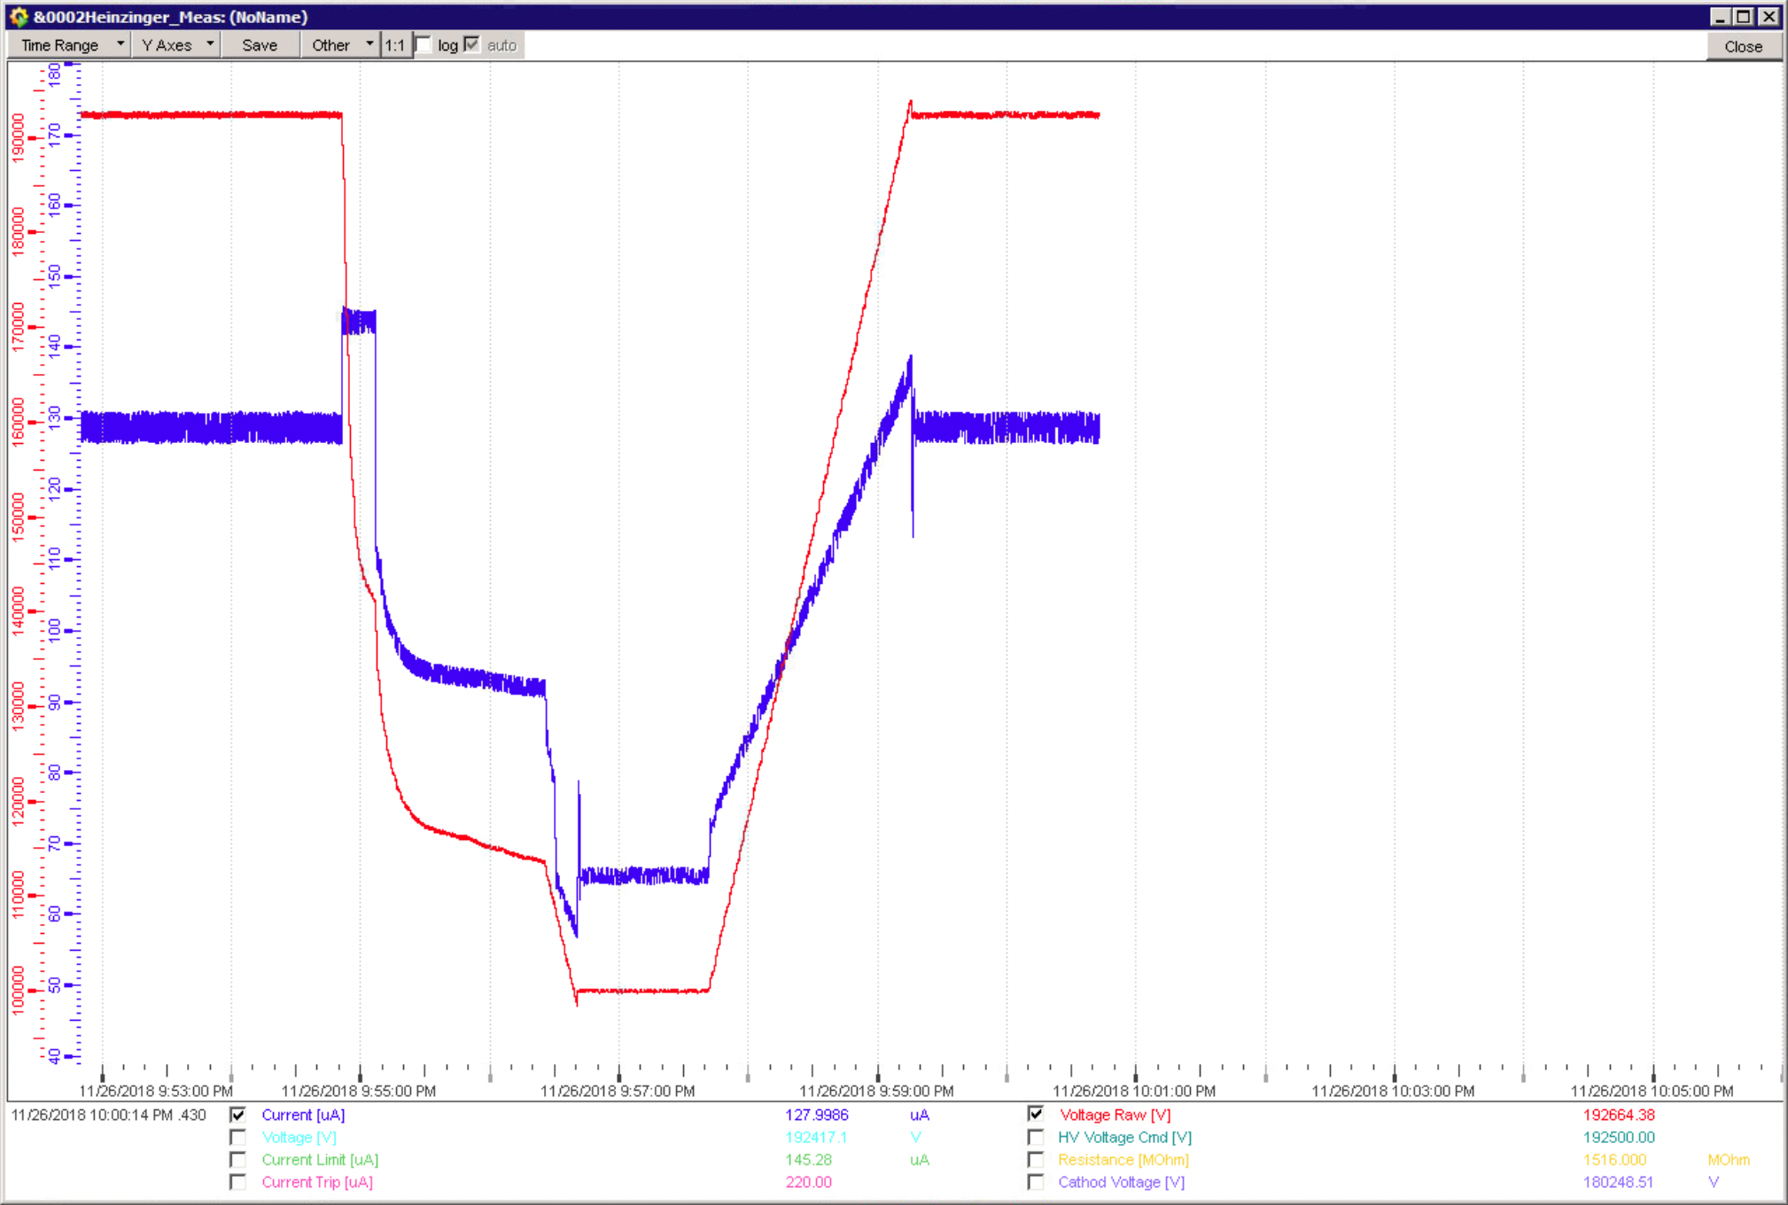
Post beam run
(11/26/18)
We just had a streamer which was successfully quenched by the automated recovery procedure. Total downtime was just under 4.5 minutes. (Now we can tune it…)

Slide 40
Operations Phase Observations
Considering the severe schedule pressure, the run went very smoothly!
Credit goes to the on-site team lead by Roberto and Fillipo.
Excellent support from CERN for Beam and Cryo.
The team of on-site experts (DAQ, CE, HV, TPC, PDS, Slow controls, Beam,..) were excellent and always available.
The shifters were dependable and learned quickly.
Control room tools reflect the generation of scientists doing most of the work (SLACK channels used more than e-log…)
Developed an efficient way to deal with the “features” of the drift HV so as to minimize the affect on data taking.
DQM team (on and off-site) worked round the clock to keep results current.
Data processing at both FNAL and CERN made for fast turnaround
Note the DAQ lessons learned posted for this meeting
For DUNE : On-line monitoring and controls (alarms and limits) need top priority;
Did not have the time to develop these properly for PD-SP

Slide 41
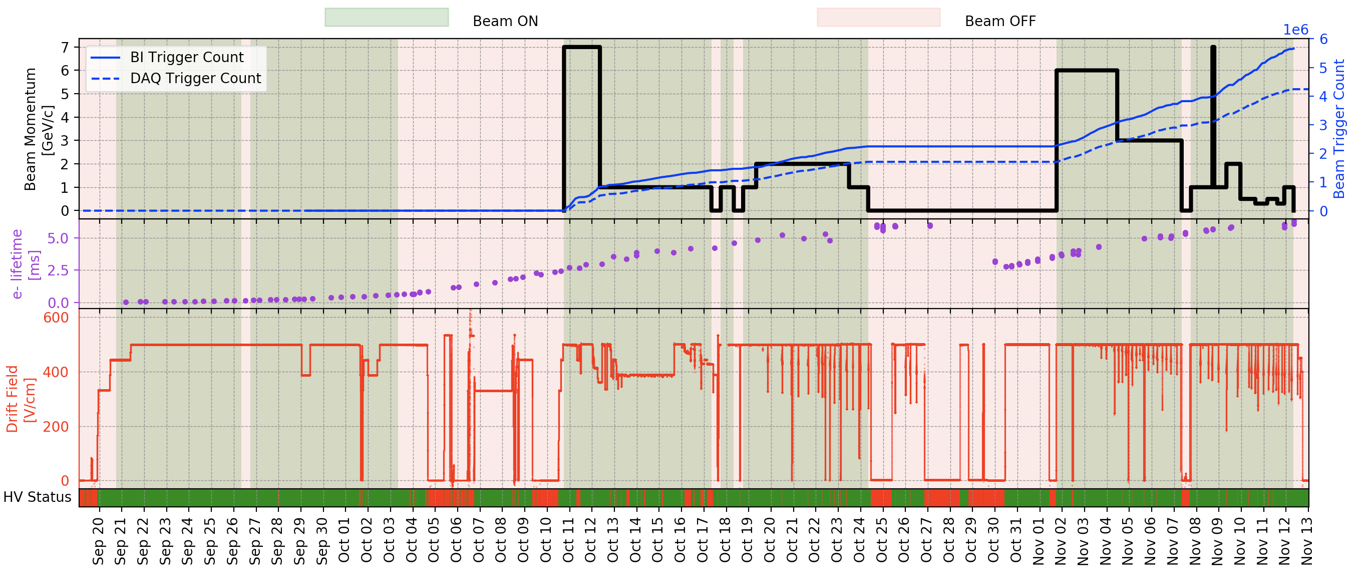
One Page Run Summary
Compiled by Kevin Wood
Physics data run

Slide 42
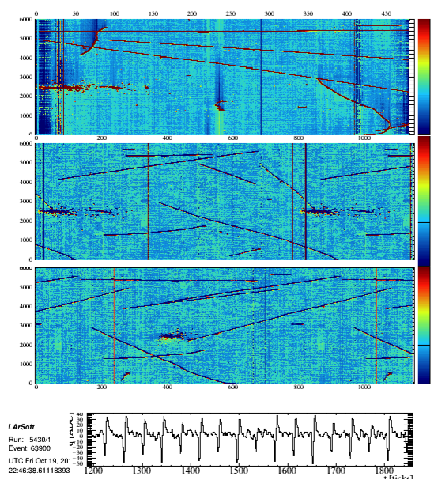
We have lots of data!
The good, the bad and the ugly…
99.7% of 15,360 channels
working
7 GeV proton interaction
Heinzinger related noise?

Slide 43
The ProtoDUNE SP DRA Organization
Tingjun Yang presentation
to LBNC physics group
DRA – Detector Reconstruction and Analysis
DRA Level 1 – overall responsibility on code development and organizing analysis effort
  T. Yang (FNAL)
  G. Christodoulou (CERN)
DRA Level 2
  Reconstruction – L. Whitehead (CERN)
  DQM – M. Potekhin (BNL)
  Calibration – M. Mooney (CSU)
  Analysis – S. Bordoni (CERN)
Weekly meeting on Wednesday 9:30 am Fermilab time, 4:30 pm CERN time
Mailing list: dune-proto-sp-dra@fnal.gov
https://web.fnal.gov/collaboration/DUNE/SitePages/ProtoDUNEs%20simulation%20and%20reconstruction%20activities.aspx

Slide 44
ProtoDUNE Analysis Goals
Short-term goals – detector performance
  Dead channels, noisy channels
  Noise level, signal to noise ratio
  Electron lifetime
Medium-term goals – detector response
  dE/dx of pions, protons, kaons, electrons
  Energy and momentum resolutions
Long-term goals – cross sections
  Inclusive pion cross section
  Exclusive channels – charge exchange, etc.
Information for DUNE physics TDR
Physics publications

Slide 45
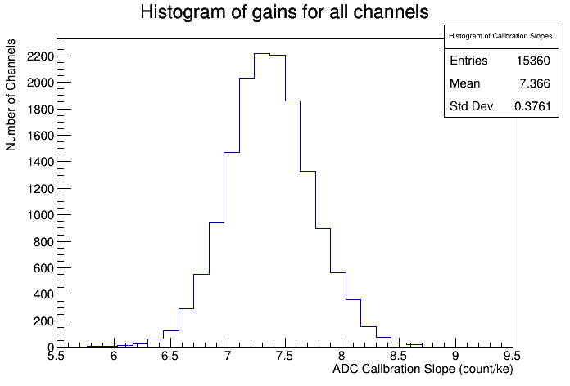



Weekly progress reported at DRA meeting
ADC gain
and linearity
Sticky codes
On-going studies :
dQ/dx, dE/dx
Pandora reconstruction
Track stiching across CPA and APA
Sticky code mitigation
Signal to noise ratio
Beam particle id
Saturation and ledge effects
Signal processing
…..
Signal processing

Slide 46

Pandora Reconstruction
Pandora pattern recognition algorithms are being optimized for data. Preliminary results look good.

Slide 47
PD-SP 2019
Organization being formulated : on on-site team + Consortia based teams
Procedure for requesting directed studies being developed [Development in progress]
    Several meetings to discuss specific tasks plus procedures have taken place
Task force(s) for High Voltage and Purity
    Longer term studies to address questions of HV “features”, monitoring, control
    Studies to address purity plateau, purity measurements (monitors and tracks), affects of space charge

Slide 48
Conclusions
The complete PD-SP detector was installed and operated, including test beam exposure with data taken at 0.3, 0.5, 1, 2, 3, 6 and 7 GeV/c beam momentum.
Electron lifetime is > 6 ms.
The majority of data was recorded with Drift High Voltage, operating in a current limiting mode, at the goal voltage of 180kV.
DAQ operated reliably at typical triggered data rates of 10 – 20 hz.
Electronics noise levels are at a level of 500 – 600 enc, within design goals.
Cosmic and beam events have been reconstructed.
Plans for operation in 2019 are under development.

Slide 49
Backup slides

Slide 50

Purity
Started to see the beam faintly on Oct. 3. The beam run started in earnest on Oct 11, around the time we achieved 3ms argon
Recirculation pumps turned off for ~22 hours on October 29th at 13:30 due to a drastic change in atmospheric pressure that affected the controls in an unforeseen way
  Purity monitor software also went offline for a few days around this time

Slide 51


Slide 52
Performance : TPC Electronics
1) front-end saturation
2) font-end ledge effect (different from saturation)
3) AC-coupling -> undershoot on the pedestal
4) sticky codes out of the ADCs
5) FEMB 302's loss of timing signals and mitigation
6) FEMB 110's ASIC with delayed signals
dead, disconnected, noisy, and otherwise problematic channels
Some noises we've seen:
1) HV-related on beam-left APA's
2) very low-frequency noise in the induction planes
And distortions seen in the data:
electron diverters grounded via a resistance instead of energized
space charge
field cage nonuniformities

Slide 53


Slide 54
Full Scale Trial Assembly at Ash River

Slide 55

35ton HV test
Operate in current-limiting mode

Slide 56


Drift field @ 100V/cm

Slide 57
Sticky Code Mitigation
Sticky code - the 6 LSBs in ADC ASIC was found to be “sticky” around 000000 (0x00) or 111111 (0x3F).
Can be mitigated through linear interpolation.
A new method is developed to interpolate through FT.
The current focus is on noise mitigation and deconvolution.

Slide 58

ADC gain and linearity
Using pulser data to measure ADC gain and linearity.
Analysis of a recent pulser run 4565.
Gain variation is ~5% over all channels.

Slide 59


Space Charge Simulation with LAr Flow
We now simulate SCE using the space charge density map with LAr flow - first study of LAr flow on SCE
Very different distributions in the two drift volumes
Essential to have data-driven calibration
Spatial distortion maps

Slide 60
Detector Calibration with Muons
Similar procedure developed by MicroBooNE: MicroBooNE-NOTE-1048-PUB (2018).
Tools are developed using MC.
dQ/dx calibration using through-going muons
  Remove spatial and temporal variations in detector response
  Calibration constants are being uploaded to database by Jon Paley
dE/dx calibration using stopping muons
  Determine absolute energy scale using muon stopping power
  More details in DRA meeting next week
dQ/dx calibration
dE/dx calibration

Slide 61
Trigger
The Central Trigger Board (CTB) drives the ProtoDUNE-SP detector readout by issuing global triggers
The trigger decision is derived from logical combinations of the following inputs:
  Beam Instrumentation (e.g. Cherenkov counters for PID, scintillator planes for position and momentum measurement)
  Cosmic Ray Tagger (Upstream and Downstream planes to detect crossing muons/beam halo particles)
  Photon Detection System (Light bars and ARAPUCAs for light readout inside the cryostat)
The trigger logic is configurable at run time and can be used to:
  Veto/Select e⁺/e⁻
  Trigger on proton/π-like events
  Trigger on crossing muons outside of the beam spill
In the absence of beam, the trigger is typically driven by the CRT

