Slide 1
DUNE-DP IDR & TDR Status
Dario Autiero (IPNL Lyon)
LBNC Meeting
December 7, 2018

Slide 2
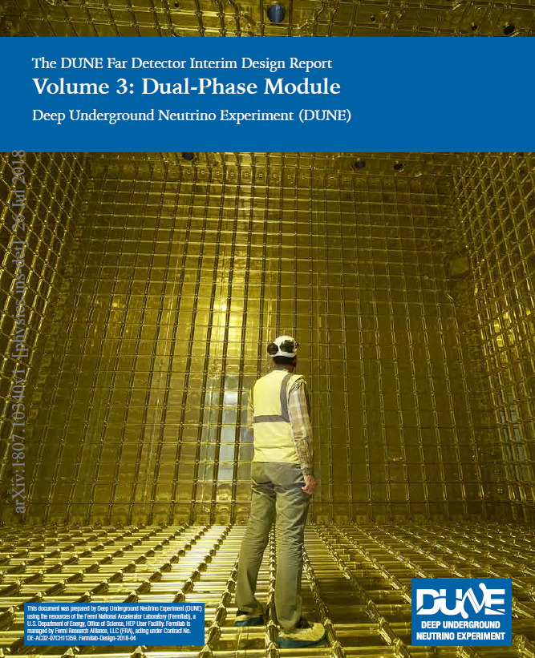
IDR Volume 3
Dual-Phase Module
280 pages, 8 chapters
Design motivations
Charge Readout Planes
TPC Electronics
HV system
Photon Detection System
Data Acquistion System
Slow Controls and Cryogenic Instrumentation
Technical Coordination
https://arxiv.org/abs/1807.10340
See presentation given at the LBNC in May → https://docs.dunescience.org/cgi-bin/private/RetrieveFile?docid=8226&filename=Autiero_DP-TP_LBNC.pptx
Editorial team:
D.A. Overview
Charge Readout Planes: Dominique Duchesneau, Edoardo Mazzucato
TPC Electronics: Jaime Dawson, Slavic Galymov
HV System: Francesco Pietropaolo, Jae Yu
Photon Detection System: Burak Bilki, Clara Cuesta
Data Acquisition System: Jim Brooke, Brett Viren
Slow Controls and Cryogenic Instrumentation: Glenn Horton-Smith, Carmen Palormares
Technical Coordination: Steve Kettell

Slide 3
Consortia:
CRP consortium (DP):
LEMs, CRP, CRP suspension system
TPC Electronics (DP):
Cold charge readout electronics, signal chimneys, digital electronics for charge and light readout
HV system (Joint):
Field cage, cathode, VHV power supply and feedthrough
Photon Detection System (DP):
Photomultipliers system, light calibration system
Data Acquistion System (Joint):
DAQ back-end for trigger and storage
Slow Controls and Cryogenic Instrumentation (Joint):
Slow control system for LAr, GAr, CRP specific SC + others
TP Chapters:
Design motivations
Charge Readout Planes
TPC Electronics
HV system
Photon Detection System
Data Acquistion System
Slow Controls and Cryogenic Instrumentation
Technical Coordination
Consortia organization and scopes take into account some specific aspects of DP design

Slide 4
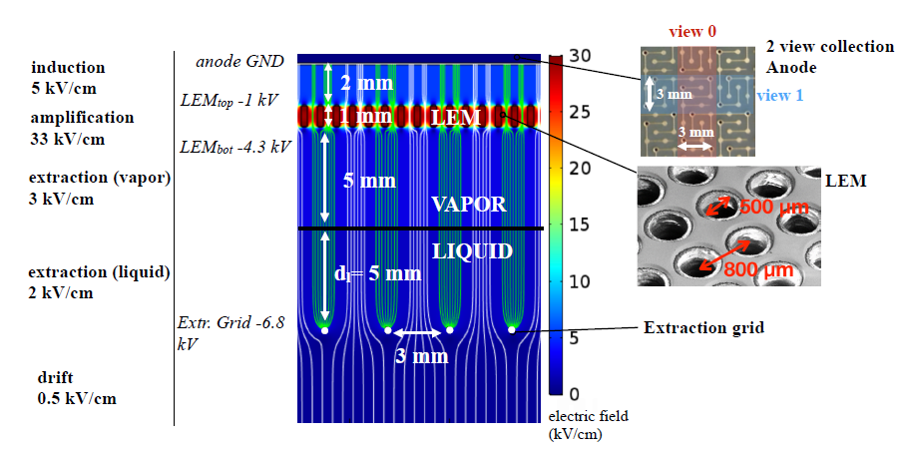
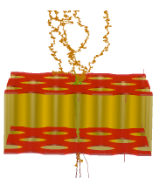
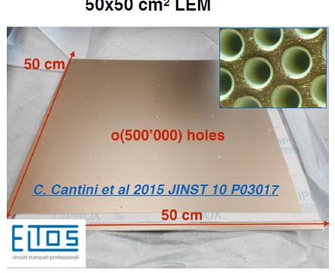
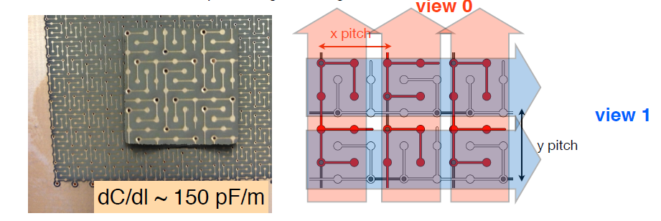
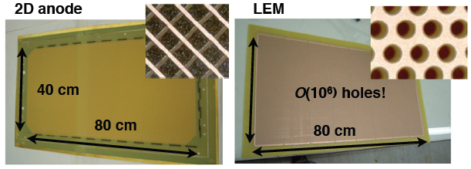
Charge Readout
Plane integrating
LEM-anode sandwiches
Electron avalanche in LEM hole
50x50 cm² LEM
50x50 cm² anodes with 2 collection views

Slide 5
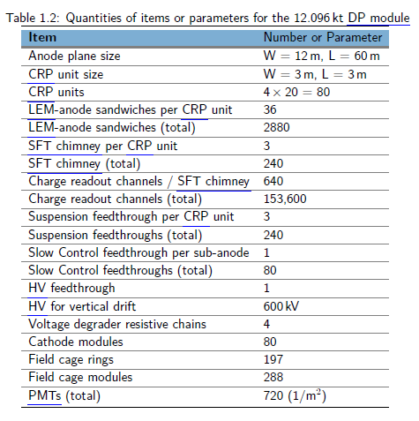
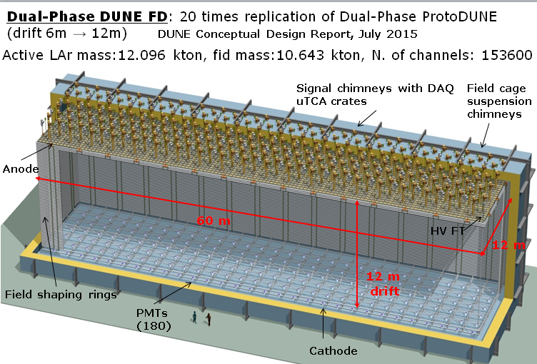
Advantages of dual-phase design:
Gain in the gas phase → robust and tunable S/N, lower detection threshold, compensation for charge attenuation due to long drift paths
Finer readout pitch (3.125 mm), implemented in two identical collection views (X,Y) on 3m long strips
Long drift projective geometry: reduced number of readout channels (153,600 for DP less than half of equivalent SP FD), absence of dead materials in the drift volume
Fewer construction modules
Full accessibility and replaceability of cryogenic front-end (FE) electronics during detector operation
Same physics requirements as SP-FD

Slide 6
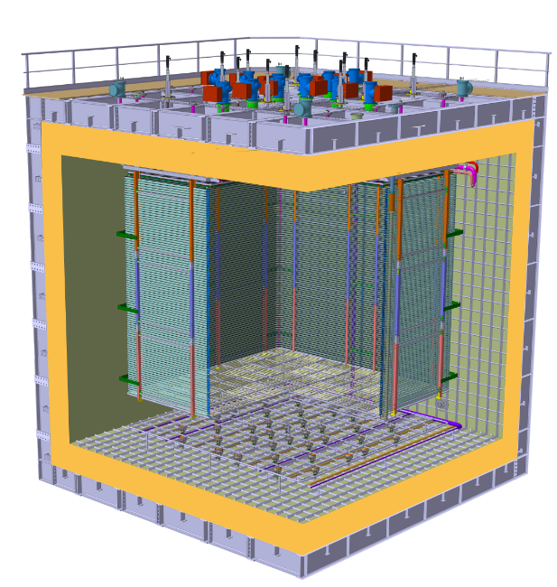
The DP-FD design described in the IDR is based on ProtoDUNE-DP design
Digital electronics in uTCA crates
Cold FE electronics in SFT “chimneys”
Charge Readout Planes
Field Cage sub-modules (common structural elements with SP)
6 m
Cathode modules
36 cryogenic photomultipliers Hamamatsu R5912-02mod with TPB coating
6 m

Slide 7
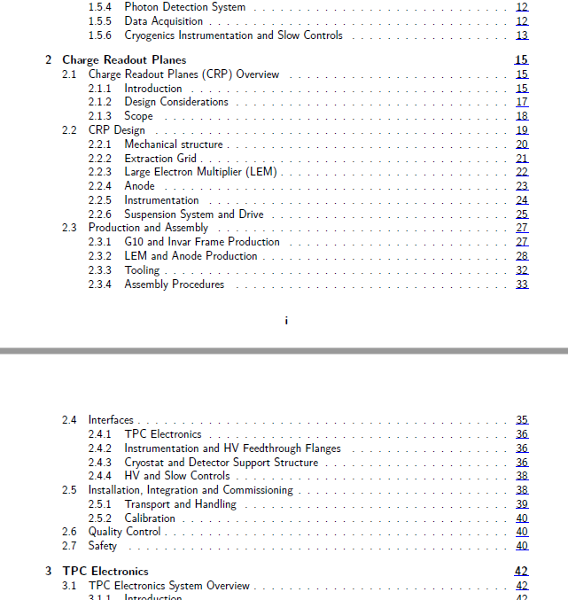
All sub-systems chapters including
Design
Production and assembly
QA and QC
Interfaces
Installation

Slide 8
Completion of the TDR
DP-TDR Editorial team (mostly the same of the IDR with some small changes):
Summary Dario Autiero
Charge Readout Planes: Dominique Duchesneau, Edoardo Mazzucato
TPC Electronics: Jaime Dawson, Slavic Galymov
HV System: Francesco Pietropaolo, Jae Yu
Photon Detection System: Burak Bilki, Michel Sorel
Data Acquisition System: Jim Brooke, Gerogia Karagiorgi, Brett Viren
Calibration Sowjanya Gollapinni, Kendall Mahn
Slow Controls and Cryogenic Instrumentation: Glenn Horton-Smith, Carmen Palormares
Integration and Installaiton: Filippo Resnati
Ongoing work:
Completion of editing, evolution from IDR to TDR, additions (costs, installation, etc ..), style standardization, inclusion of the experience of the last 6 months (productions, CRP tests, installation)
Return from ProtoDUNE-DP
Additional information from consortia activities in progress

Slide 9
TDR Schedule (DP volume):
Consortium/task | 1st Draft | 2nd Draft | LBNC
DP-ELECTRONICS | 14/12/18 | 8/2/19 | 22/2/19
HV (DP) | 1/2/19 | 1/3/19 | 29/3/19
DP-PDS | 1/3/19 | 5/4/19 | 26/4/19
IIC (DP) | 5/4/19 | 10/5/19 | 31/5/19
DAQ (DP) | 5/4/19 | 10/5/19 | 31/5/19
CISC (DP) | 5/4/19 | 10/5/19 | 31/5/19
Calibration (DP) | 10/5/19 | 7/6/19 | 28/6/19
DP-CRP | 10/5/19 | 7/6/19 | 28/6/19
Exec. Summary (DP) | 10/5/19 | 7/6/19 | 28/6/19

Slide 10
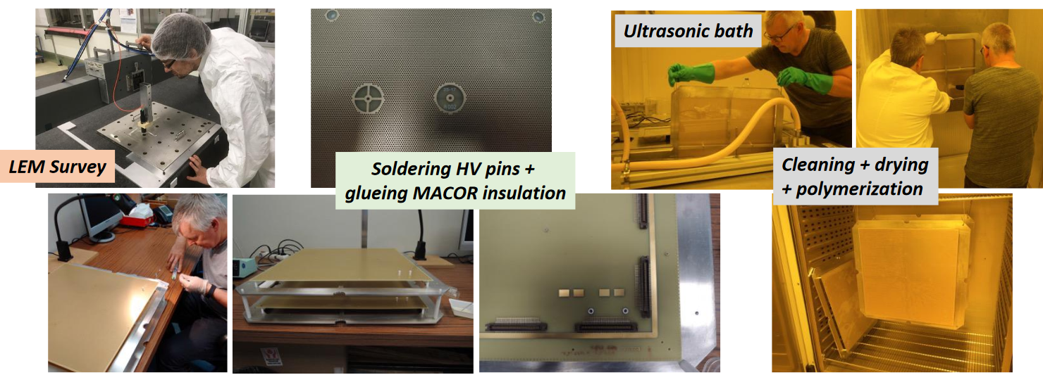
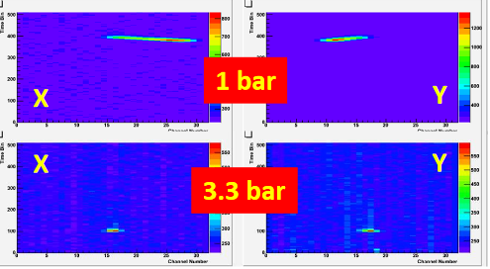
LEM production and QA/QC chain
High pressure gas chamber for LEM tests/characterization
→ 3.3 bar gas density conditions as close to LAr surface

Slide 11
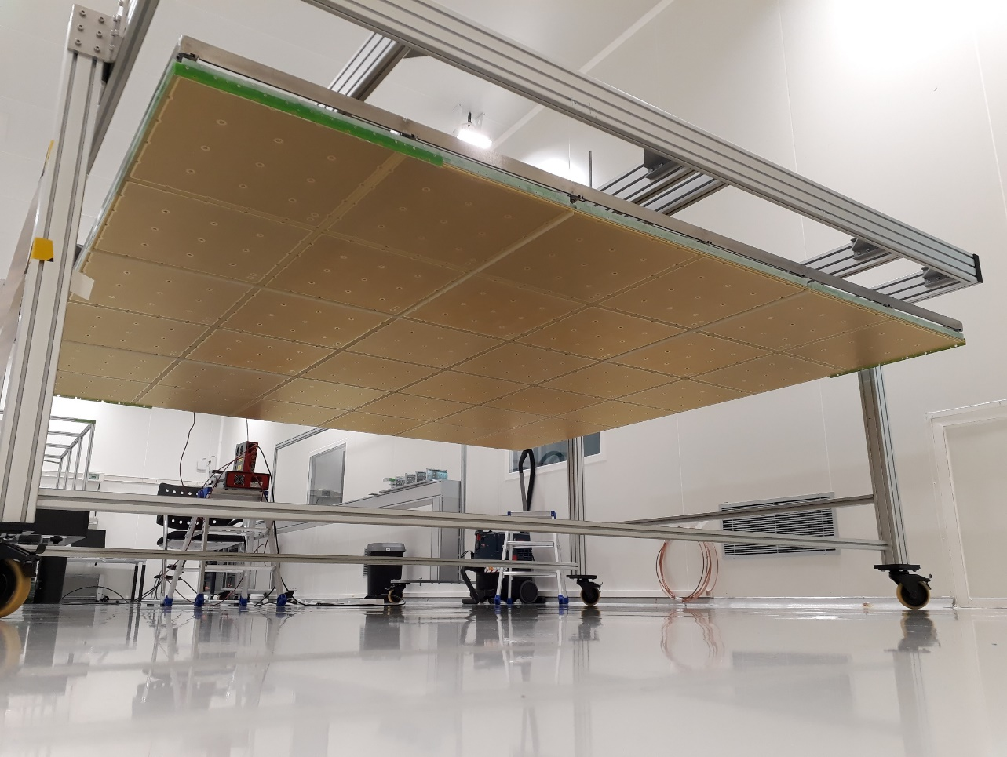
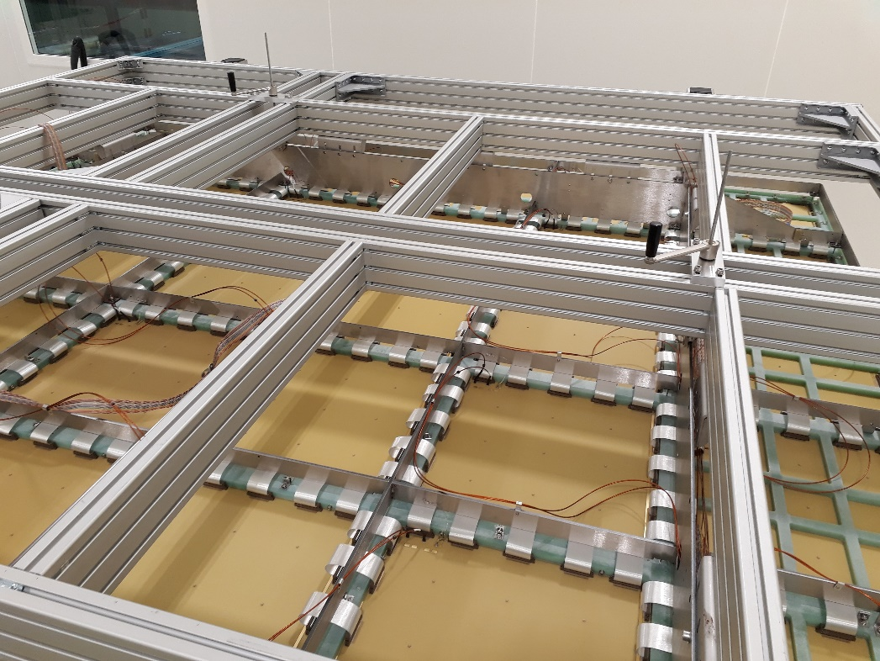
Charge Readout Plane (CRP) with LEM/anodes mounted
CRP cold--box test
Anodes interconnections for 3m long strips

Slide 12
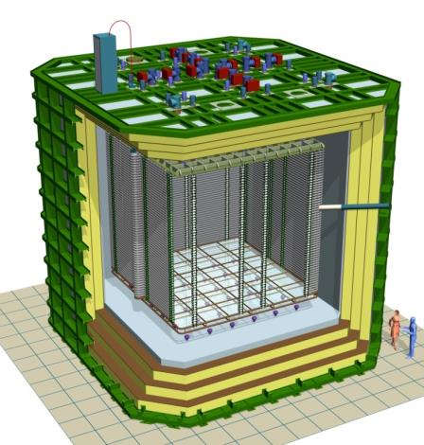
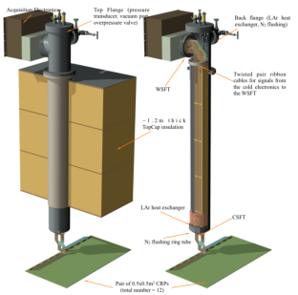


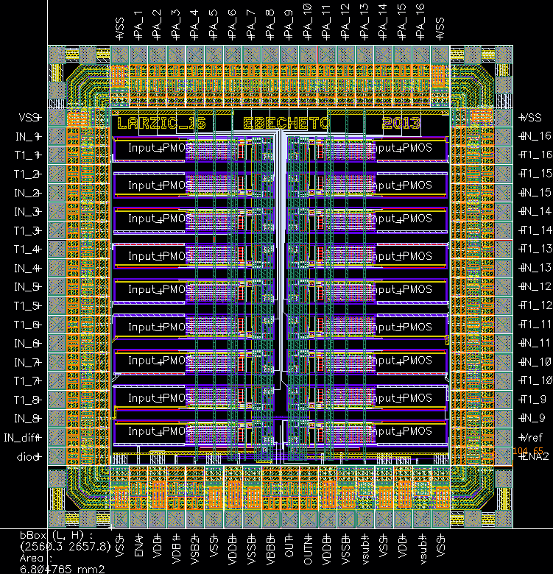
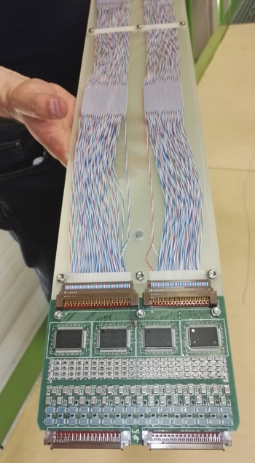
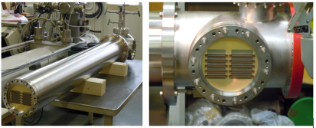
ProtoDUNE-DP accessible cold front-end electronics and uTCA DAQ system 7680 ch
Full accessibility provided by the double-phase charge readout at the top of the detector
Digital electronics at warm on the tank deck:
Architecture based on uTCA standard
1 crate/signal chimney, 640 channels/crate
→ 12 uTCA crates, 10 AMC cards/crate, 64 ch/card
Cryogenic ASIC amplifiers (CMOS 0.35um) 16ch externally accessible:
Working at 110K at the bottom of the signal chimneys
Cards fixed to a plug accessible from outside
→Short cables capacitance, low noise at low T
Warm
FE cards mounted on insertion blades
ASICs 16 ch.
(CMOS 0.35 um)
uTCA crate
Cold
CRP
Signal chimney
12

Slide 13
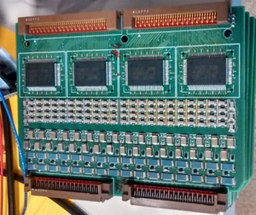
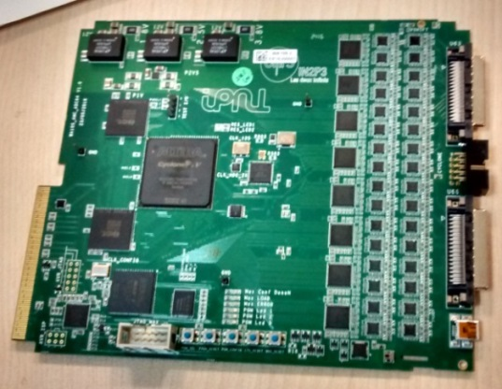
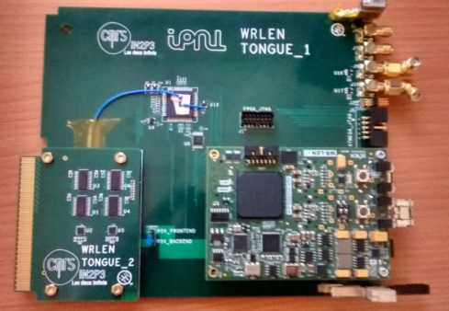
Electronics components chain implemented in ProtoDUNE-DP:
(R&D since 2006, long standing effort aimed at producing low cost analog and digital electronics)
Analog cryogenic FE:
Cryogenic ASIC amplifiers DP-V3, 0.35um CMOS (2015)
FE board
64 channels FE cards with 4 cryogenic ASIC amplifiers
First batch of 20 cards (1280 channels) operational on the 3x1x1 (fall 2016-spring 2018)
AMC digitization cards:
AMC card
uTCA 64 channels AMC digitization cards (2.5 MHz, 12 bits output, 10 GbE connectivity)
20 cards operational on the 3x1x1 (fall 2016-Spring 2018)
White Rabbit timing/trigger distribution system:
Full system architecture operational on the 3x1x1 (fall 2016-spring 2018) including uTCA White Rabbit MCH
WR MCH

Slide 14

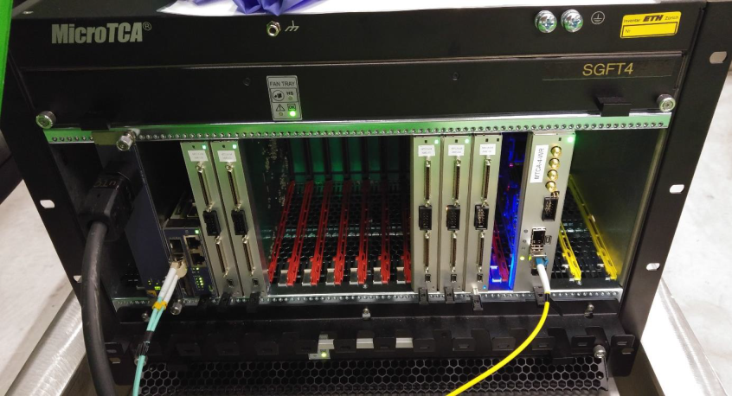
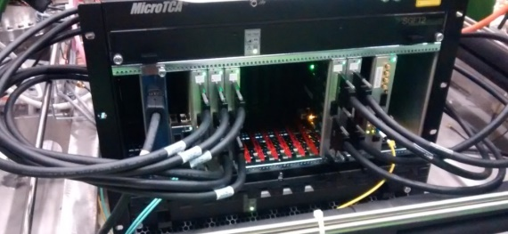
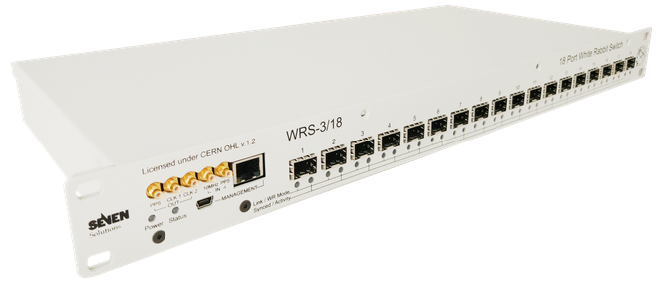
Components for a 10 kton dual-phase module
Total number of charge readout channels: 153600
(+light readout channels 720)
Cryogenic ASICs (16 ch): 9600
Cryogenic FE cards (64 ch): 2400
AMC cards (64 ch): 2400
uTCA White Rabbit MCH: 240
uTCA crates (including MCH,PU,FU): 240
10 Gbe optical links to backend: 240
VHDCI cables (32 ch) 4800
White Rabbit switches (18 ports): 16

Slide 15
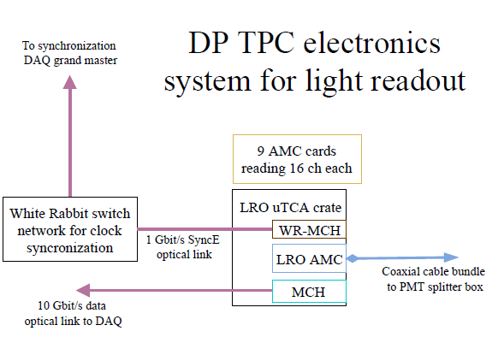
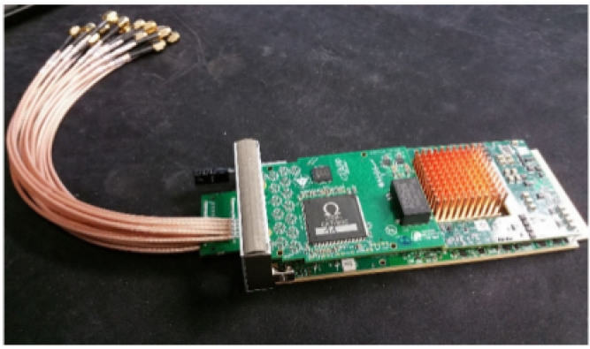
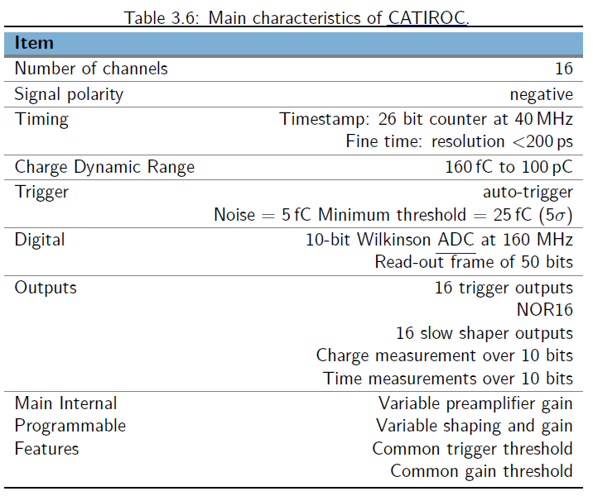
LRO AMC derived from CRO AMC:
Sharing same uTCA infrastructure, White Rabbit, etc …
Incorporating Catiroc chip for triggering
Firmware finalization for NP02, final integration to charge readout design
Needs for a 10 kton module: 45 AMC cards in 5 uTCA crates

Slide 16
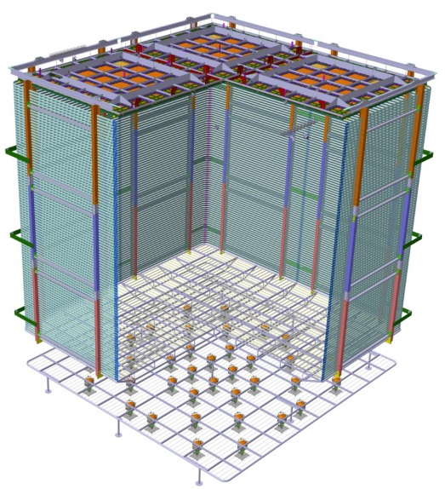
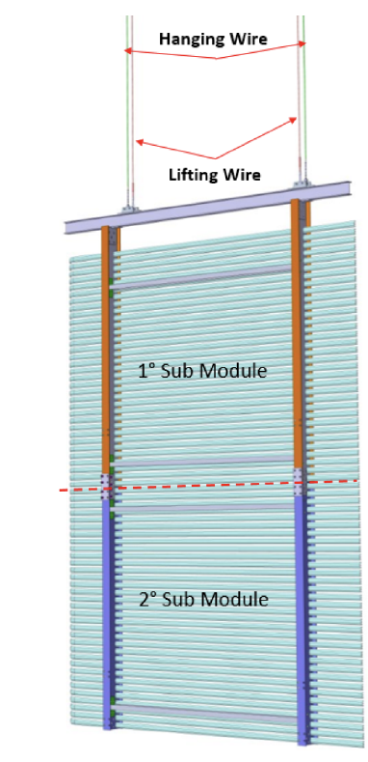
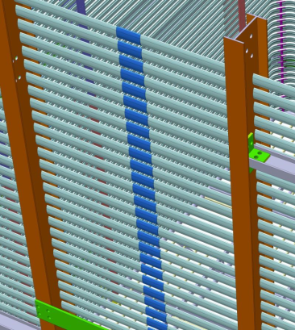
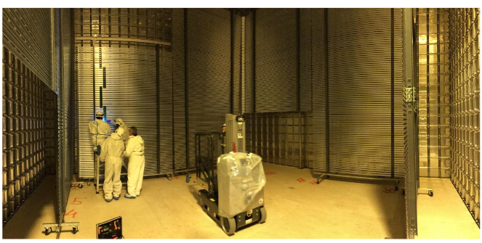
NP02 Field cage 3x2 m2 sub-modules with Aluminum profiles and FRP I-beams
Modules for FD-DP:
Hanging chains of 6 submodules rings, continuity among different chains ensured by clips (3 sub-modules in NP02)
3m
2m
Field cage assembly for NP02
288 modules needed for the field cage of FD-DP (24 submodules in NP02)

Slide 17
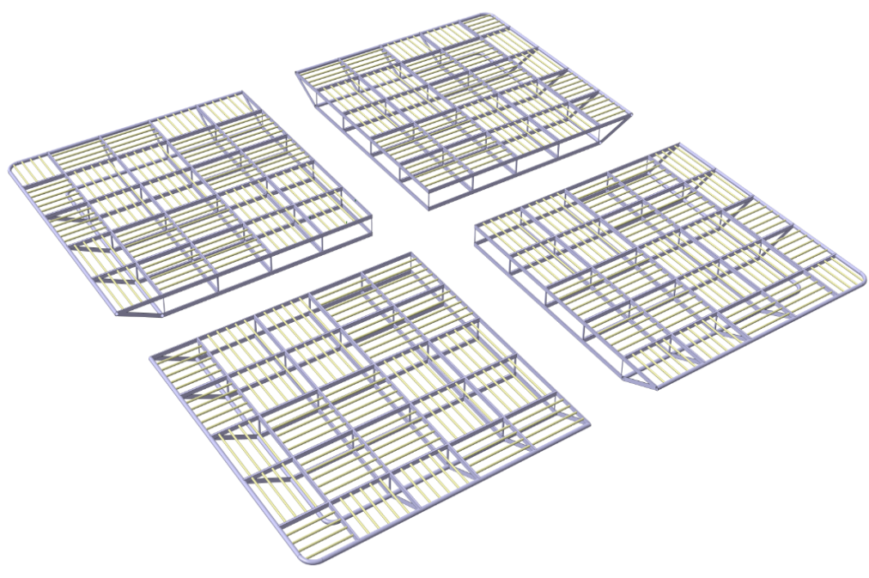
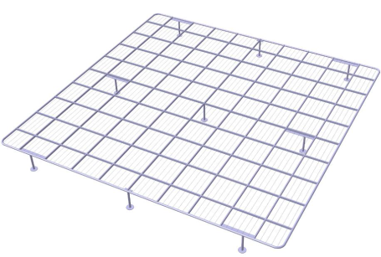
Cathode modules
NP02 Cathode plane and ground grid
(grid to protect the photomultipliers from cathode sparking)
→ All in units of 3x3 m² similar to CRP modularity
Cathode modules: structure of stainless steel pipes
Electrical segmentation: GOhm resistors interconnecting the cathode modules in order to delay discharges and prevent damages due to storage energy
Mechanical integration: cathode modules hanging from field cage and connected mechanically together, ground grid with feet laying on membrane floor
Some mechanical modifications w.r.t. NP02 in order to guarantee the cathode flatness over the longer distance of 12m compared to the 6m of ProtoDUNE-DP.
The shape of the cathode conductors could also undergo some slight modifications in order to lower the local E field values, based on the ProtoDUNE-DP experience
Ground grid

Slide 18
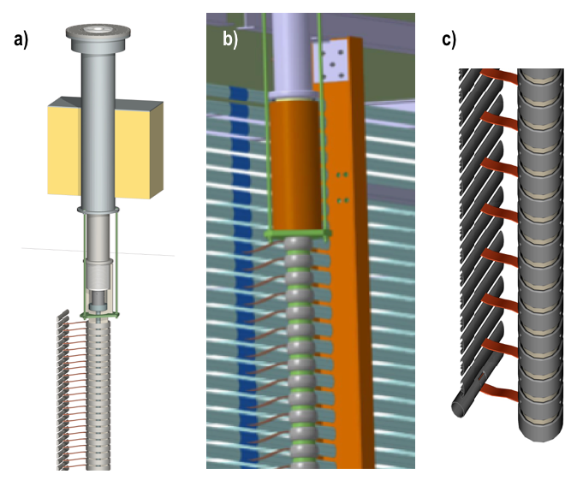
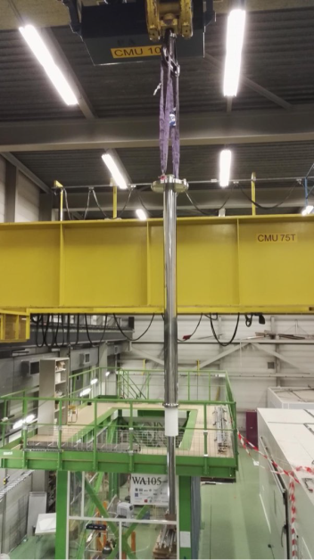
HV feedthrough of NP02 tested at 300 kV
600 kV version:
needs integration of the FT with the power supply (no cabling available at 600 kV) ongoing discussions between the HV consortium and Heinzinger

Slide 19
Field cage optimization for assembly and installation
Long super-modules (12 m wide x 12m high) assembled from 3mx2m sub-modules (à la protoDUNE) constructed inside the cryostat.
Installation “lift and hang” à la NP02. ➔ lift one row of 4 connected sub-modules (12m x 2m ) at a time
Limit clipping at height to interconnection of super-modules ➔ need to develop method to clip from inside only
Alternatively leave super modules electrically independent and terminate the profile with insulating/resistive end-caps (single phase style). ➔ May need two rows of HVDB per super module for redundancy
Row of resistive degrader every super module (1 or 2 depending on the decision above)

Slide 20
Cathode & ground grid:
Extrapolation from the NP02 concept to DUNE:
  12 m x 3m wide super-modules minimising metal components (used only to ensure mechanical strength and longevity).
  Delivered in pieces and assembled inside the cryostat.
  Hung from the field cage bridging the long sides.
Optimisation strategy:
  Replace the metal grid with resistive surfaces.
  Studies are ongoing to optimise the design to protect the system from discharges.
  Two possibilities for the resistive cathode surface:
    Resistive rods running orthogonal to the supporting structure.
    Acrylic tiles deposited with transparent resistive polymer and wavelength shifter.
Ground grid: metal modules laying on the membrane.

Slide 21
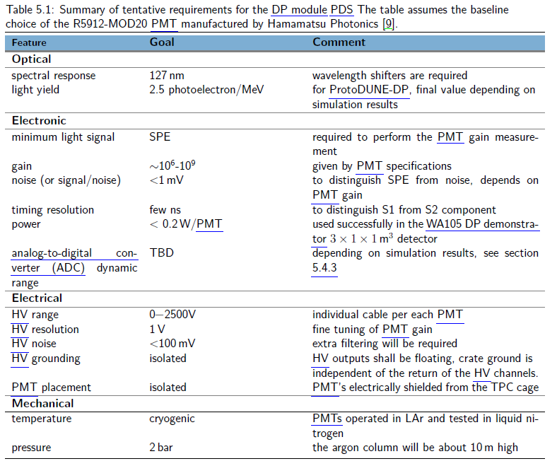
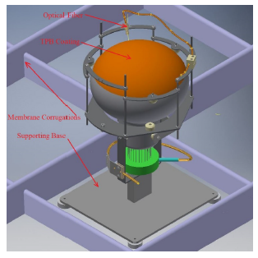
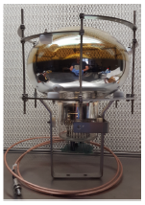
IDR:
Array of 720 TPB coated PMTs Hamatsu R5912-MOD20
(1/m² similarly as in NP02)
on the cryostat membrane floor
5 PMTs operative on 3x1x1 taking data under various conditions
36 PMTs procured and prepared for NP02

Slide 22

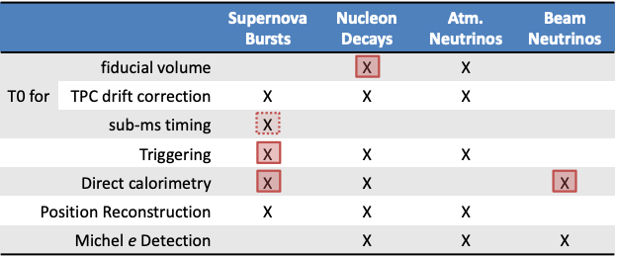
Physics requirements
Converged on same set of physics requirements for SP-PDS and DP-PDS. Photon detector has to provide:
  Event triggering
  Event t0 reconstruction
  Event energy reconstruction
to fulfil the DUNE primary physics program. In particular:
Simulation studies ongoing
Requirements
X
Additional
opportunities

Slide 23
Simulation studies for TDR
Developing TDR studies based on full sim/reco chain in LArSoft:
Event generation
Dark counts
Electronics noise
Waveform digitisation
Geant4 + fast optical simulation
Electronics simulation
Processes individual PMT waveforms to identify hits, characterised by:
  Time, Amplitude, Charge
Hit finding reconstruction
Flash finding reconstruction
Group separate PMT hits to reconstruct a flash of light produced in LAr
  Use hit time/spatial correlations
Analysis

Slide 24
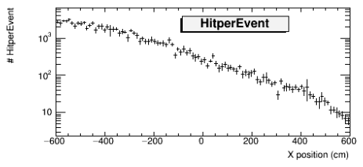
Event t0 reconstruction studies
Requirement: provide t0 for non-beam events, primarily (but not only) to fiducialize proton decay candidate events
NDK
signal
CR
background
Drift
Drift
Now: understanding no. reconstructed PMT hits in PDK signal events (example: p →νK⁺)
TDR goal: flash reconstruction efficiency versus position in FD

Slide 25
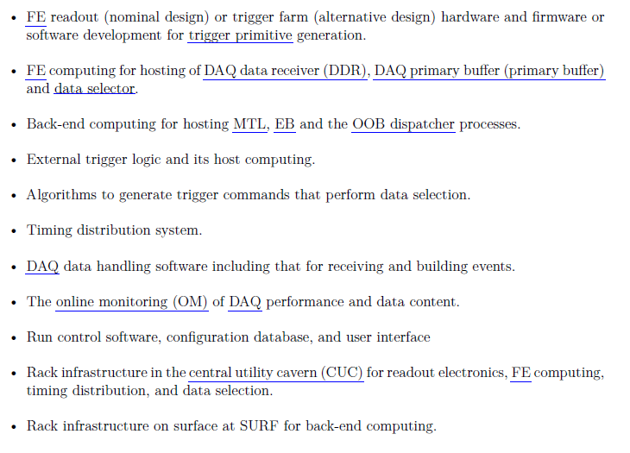
Common back-end approach for SP/DP
DAQ: receives data from 245 10 Gbit/s ethernet optical links from uTCA crates
240 Charge Readout links: continuous data streaming at 2.5 MHz, no zero skipping, with lossless compression (factor 10) → link occupancy <2 Mbit/s
5 Light Readout links
Back-end defining trigger primitives, global triggers and data persistency in streams (beam, comics, SNb etc on disk). Common developments ongoing for FPGA online processing of data received from optical links. Finalization of data formats and protocols.

Slide 26
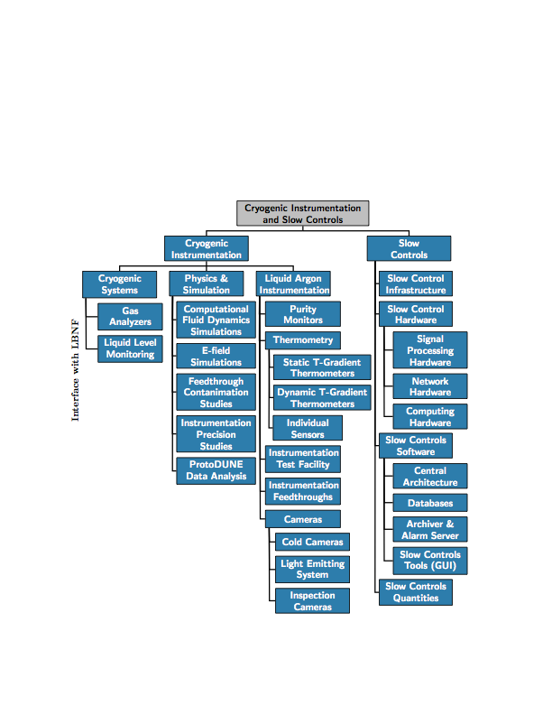

CISC-DP Scope
The scope of CISC for DP is same as SP except for the following:
  Specific to DP, CISC will provide instrumentation to monitor the temperature and pressure in the gas phase located above the liquid phase.
Specific to DP
Gaseous Argon
Instrumentation
Thermometers
(gas phase)
Pressure meters
(gas phase)
DP-specific Instrumentation Requirements

Slide 27
Plans towards the TDR
  The cryostat penetrations for DP cryostat are yet to be defined for instrumentation devices; based on final locations and port design, need to understand cable routing plans.
  For cryogenic instrumentation devices,
    same designs as SP are envisioned, but may require shielding (e.g. Purity Monitors, Temperature profilers) due to high fields in DP. A preliminary Comsol simulation will be needed to understand location and design of the proper Faraday cage.
    The base designs are largely tested in ProtoDUNE-SP; plan to test full designs (e.g. including shielding/support structure etc.) for DP in post-LS2 running of ProtoDUNE-DP
    Need to make a detailed plan with other consortia for support structure installation for some devices. E.g. RTDs can be mounted on PMT or CRP support structures or one can attach them to the ground planes — need to make a decision; 3D models of those structures will be needed to understand this.
    Need more involvement and feedback from people working on cryogenic instrumentation for ProtoDUNE-DP
  DP-specific Computational Fluid Dynamics (CFD) Simulations planned (done by SDSU group)
    Model the ProtoDUNE-DP liquid and gas regions with the same precision as the FD.
    Perform a CFD study to determine the feasibility of a wier for DP; this helps to determine if it can be used to clean the LAr surface before the extraction grid is submerged in the DP module.
  Slow controls performance of the CERN system for ProtoDUNE-DP needs to be understood/evaluated along with assessing what updates/improvements will be needed for FD
  CISC-DP TDR builds largely from the SP draft — first draft due early next year, work underway

Slide 28
Conclusions:
The DP-IDR describing the dual-phase design being evolved to the TDR level
The DP far detector design is based on the elements produced for protoDUNE-DP, some structure/electrical modifications are expected for the HV system components. Completion of simulation studies for the light readout system. Charge readout electronics already stable and compatible with common DAQ scheme. CISC specific DP aspects being finalized.
Looking forward to the return of operation of protoDUNE-DP to be mostly included in the CRP chapter.
Inclusion of costing (developed) and finalization of installation procedures → technical coordination chapter.
Many thanks to all the editorial team.

Slide 29
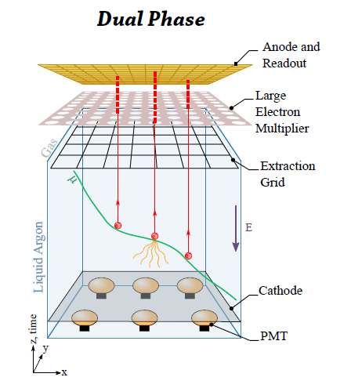
Dual-phase design:
Long drift, high S/N:
Vertical drift → extraction of electrons from the liquid and multiplication with avalanches in micro-pattern detectors LEM (Large Electron Multipliers) operating in pure argon gas
tunable LEM gain ~20 , two symmetric collection views, coupling to cold electronics
Light readout performed with an array of cryogenic photomultipliers below the cathode

Slide 30
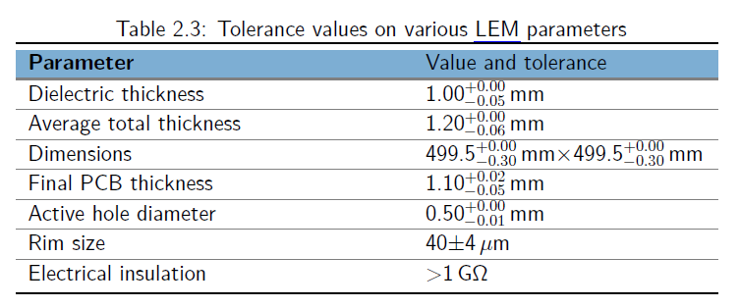
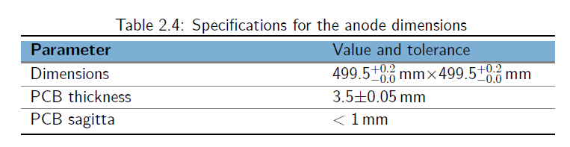
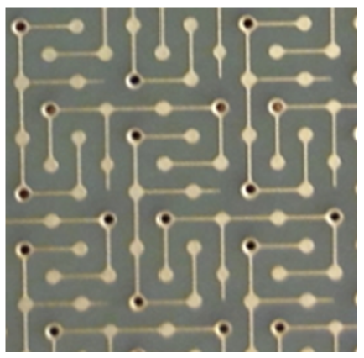
LEM design
CFR-035 for NP02
Anodes
36 LEM-Anode sandwiches per CRP
→ 2880 LEM-Anode sandwiches per FD-DP module

Slide 31
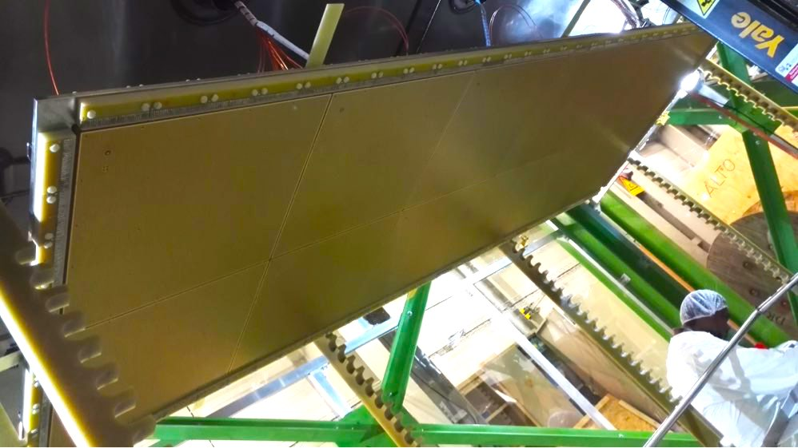
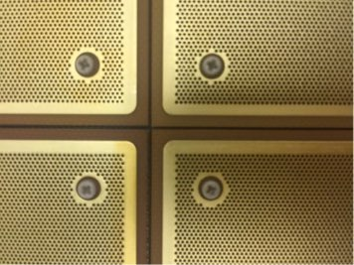
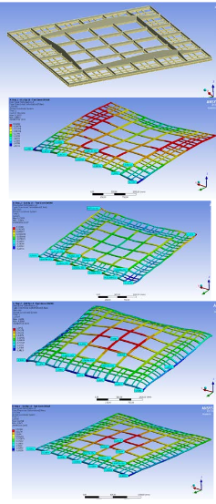


3x3 m² CRPs integrating 36 LEM-anode sandwiches (50x50 cm²) and their suspension feedthroughs.
Specifically designed for Protodune-DP, 3x1x1 CRP had different design in stainless steel →
3x1x1 CRP
50 cm
50 cm
ProtoDUNE-DP design based on Invar frame + G10 frame incorporating the LEM. Decoupling mechanisms in between Invar and G10
Ensure planarity conditions +-0.5 mm (despite gravity and temperature gradient effects) over the 3x3 m² surface
Ensure minimal dead space in between CRPs
CRP mechanical structure design:
→ Simulations + campaign of cold bath tests with photogrammetry on differential effects in thermal contraction, design of decoupling mechanism

Slide 32






CRP assembly tooling
Grid mounting tooling

Slide 33

DAQ system of 3x1x1

Slide 34

Light Readout system (assuming similar photodetectors coverage as in ProtoDUNE-DP)

Slide 35
Event triggering studies
Requirement: provide efficient triggering for galactic SN bursts
Now: understanding how SNB trigger efficiency depends on representative values for SNν efficiency and background rate. Ongoing work to estimate those.
Fake trigger rate: 1/month
Dummy inputs
TDR goal: SN burst triggering efficiency versus SN distance

Slide 36


Event energy reconstruction studies
Requirement: provide PDS-based energy measurement based on total detected light yield, for beam and SN neutrinos
Now: understanding how to correct for spatial dependence of PDS response
Light yield (PEs/MeV)
TDR goal: PDS-based neutrino energy resolution for beam and SN νe CC interactions in TPC active volume

Slide 37

Similar needs as for SP:
LAr cryogenic instrumentation
Purity monitors
Cryocameras
Gas analysers
Specific DP controls:
Gas temperature and pressure controls
CRP controls:
CRP temperature probes (36/CRP)
CRP high accuracy level meters, capacitive grid-LEM measurements, distance meters
Control of CRP step motors
CRP anodes calibration
LEM HV 41 channels/CRP, grid HV 1 channel/CRP
PDS HV controls

