Slide 1
DUNE Computing STATUS
Heidi Schellman, Oregon State University

Slide 2
Overview
Update on ProtoDUNE and what we learned
Consortium status
TDR status

Slide 3
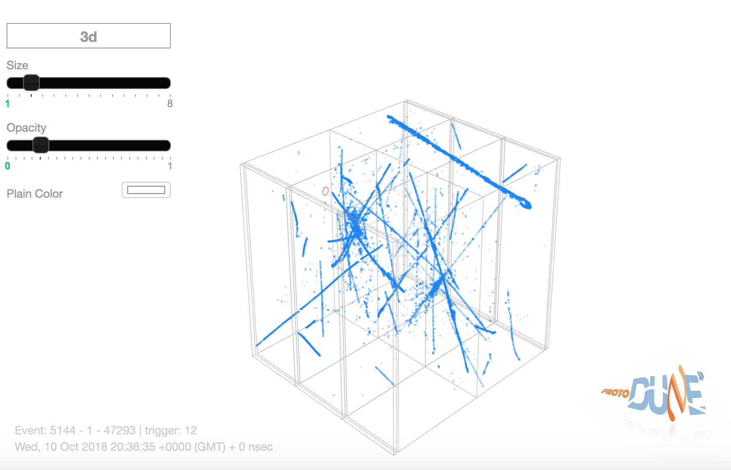
Typical protoDUNE event
https://www.phy.bnl.gov/twister/bee/set/protodune-live/event/1/?camera.ortho=false&theme=dark
7 Gev Beam + cosmics

Slide 4
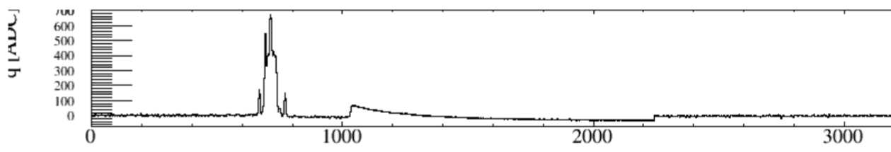
ProtoDUNE @CERN
Two walls of the cryostat are covered with 3 planes of wires spaced 0.5 cm apart. Total of 15,360 wires
The electrons take ~ 3msec to drift across and you need to detect and time them for the full time
Each wire is read out by 12-bit ADC’s every 0.5 microsecond for 3-5 msec. Total of around 6,000 samples/wire/readout.
Around 230 MB/readout → 80-100 MB compressed
ProtoDUNE was read out at 10-25 Hz for a 6 week test run
  2.5 GB/sec --> < 1 GB/sec after compression
One issue – this is a 1% prototype of the real 4-module beast
The big one won’t read out as often….
One channel

Slide 5
Raw data
Part of one of 18 readout planes

Slide 6
Data processing pass 1 complete
Total 42M raw events acquired through commissioning, detector calibration and physics running (1.8 PB)
7.9 M events in good physics runs (all triggers, not just beam) acquired for physics analysis (509 TB)
All good beam data processed in November (~ 2.5M wall-hrs)
  1.04 PB of reconstructed data events
Also produced 14M reconstructed MC events in MCC11

Slide 7
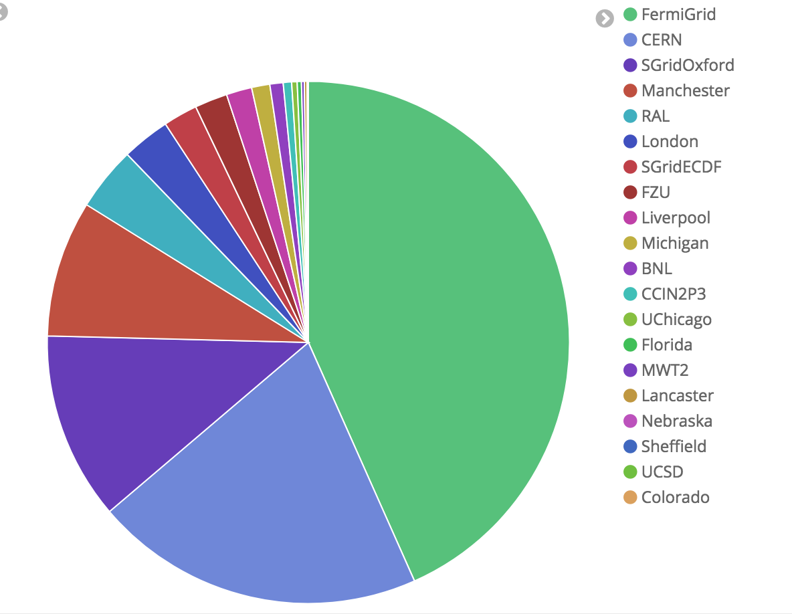
Worldwide contributions
Location of grid jobs November 1-24
A total of ~250,000 reconstruction and simulation jobs were run.
Up to 17,000 jobs at once
  ~10 (up to 24) hrs/job
60% were external to the dedicated resources at FNAL

Slide 8
Storage
Using dCache/pnfs at FNAL, EOS/CASTOR at CERN
  Moving some samples to UK
Successes
  Able to safely store data at rates of up to 2.5 GB/s
  Reconstruction code is already able to produce high quality results
Test version of Rucio able to control large datasets and interface with the SAM catalog
Issues
  Data location and cache access
  Getting info needed to catalog data fully

Slide 9
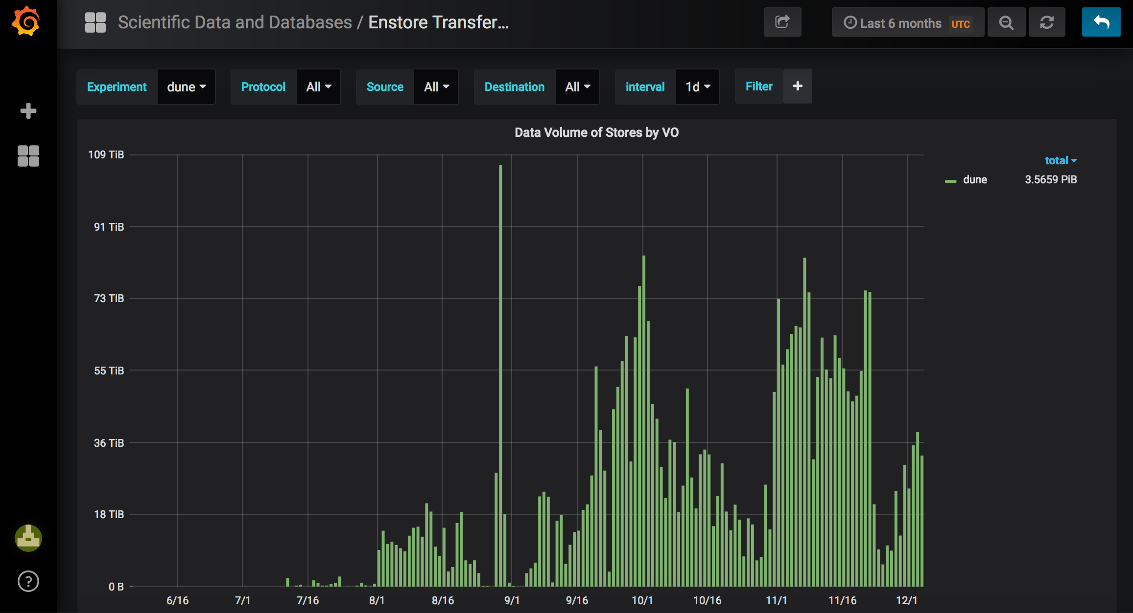
Enstore TB/day
Reconstruction
Commissioning
data

Slide 10
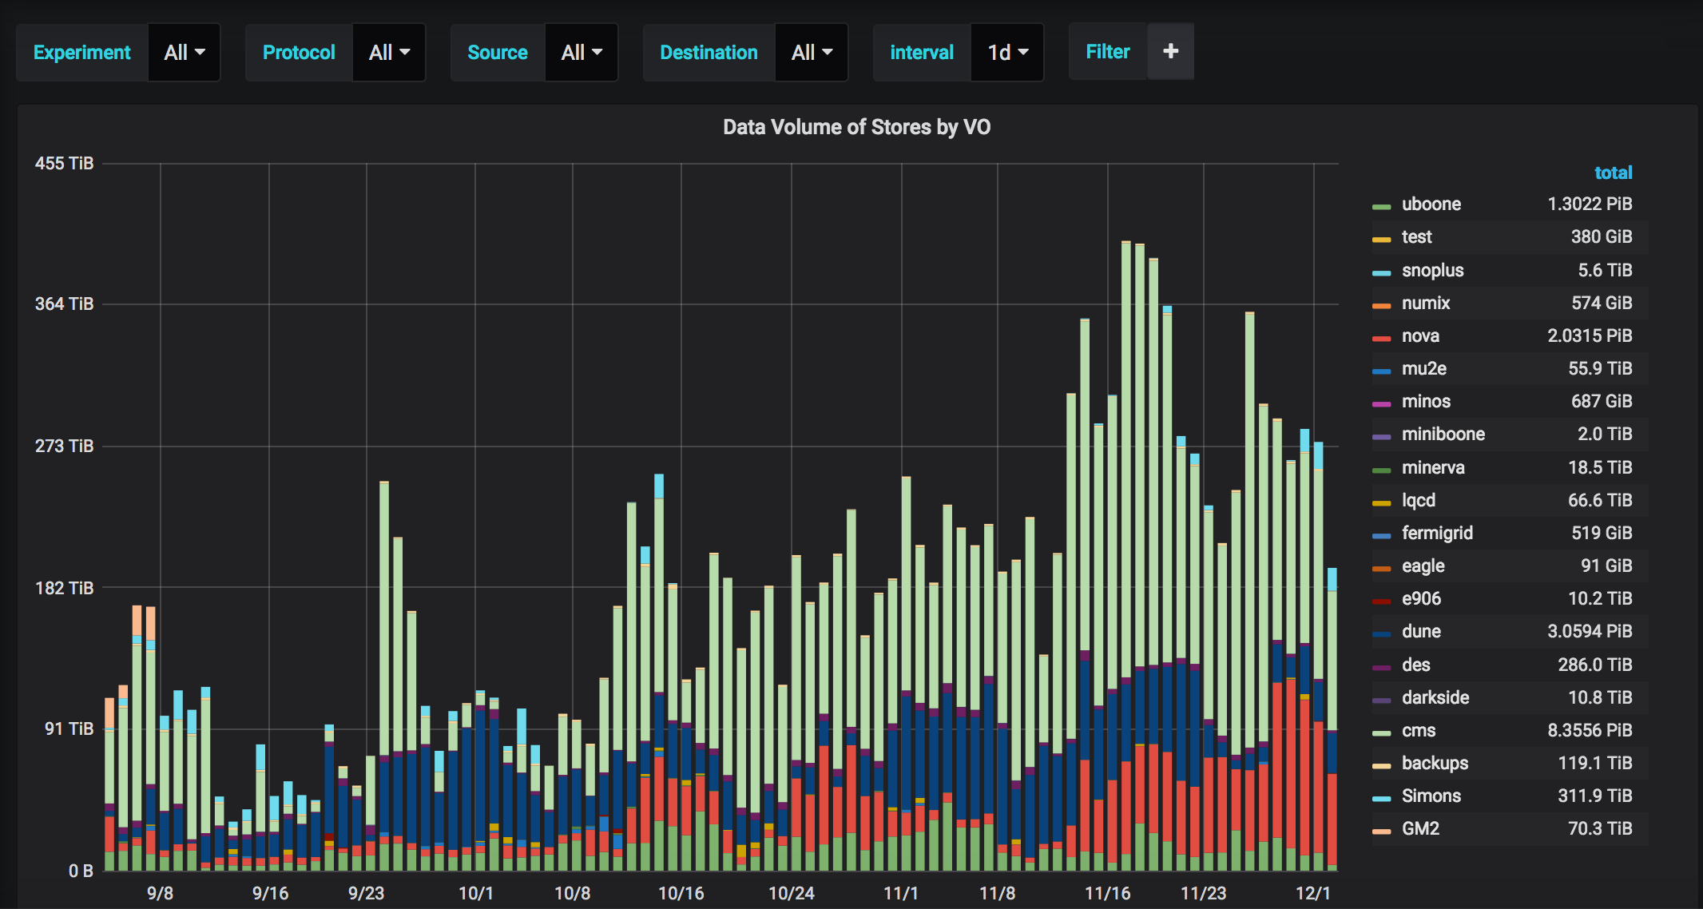
Context
(DUNE is dark blue)
Reconstruction
data

Slide 11
Upcoming: Wirecell deconvolution
Liquid Argon TPC Signal Formation, Signal Processing and Hit Reconstruction
Bruce Baller, JINST 12 (2017) no.07, P07010

Slide 12
Current 1D --> 2D

Slide 13
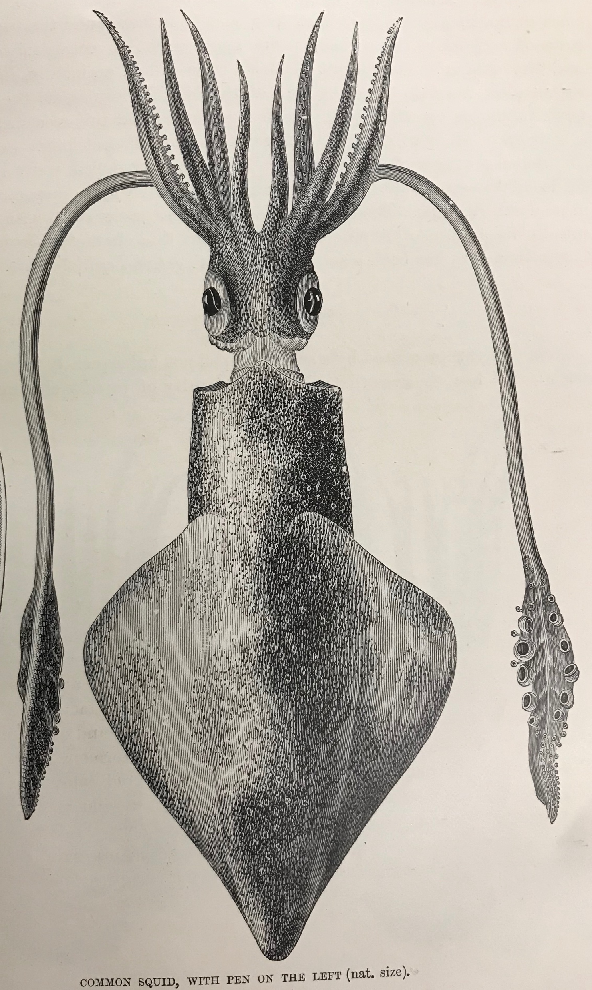
Lessons learned
HV
config
LAr works!
Larsoft/wirecell work paid off
Data challenges were very important
Many inputs needed aside from the “big” data
  3 detector systems (LAr, PD, CRT)
  Run quality
  slow controls
  Beamline info
  Configurations
  Logbook
A lot of high quality data
TPC
beam
PD

Slide 14
Part II - Consortium
DUNE is in the process of forming a Consortium to coordinate resources worldwide
In computing most of the materials cost comes from maintaining and providing services during the data-taking phase of the experiment.
Prior to commissioning and data-taking, much of the contributions will be needed in people-power to adopt and build software needed by DUNE.

Slide 15
Three pronged approach to contributions
National/Regional levels
Large institutes
All institutes
Resources
Technical
Operations
National infrastructure
DUNE standards
Shifts
Common costs
Funding agencies
Common tools
New architectures
Collaborators

Slide 16
Countries / Organizations Already Contributing Substantial CPU Resources to DUNE Computing
FNAL + contributions from US labs and Universities
CERN
  Has been discussing* broadening scope to HEP-wide computing for over a year. There is general support, DUNE could be a catalyst.
Czech Republic - Already contributing and poised to continue.
United Kingdom - Eagerly participating (3PB disk for protoDUNE) and have already taken steps to solicit funds for DUNE from their agency
France – IN2P3 has started contributing resources – emphasis on dual-phase
India, Korea, the Netherlands, Spain, Italy and Switzerland have expressed interest but not yet integrated into production

Slide 17
Future DUNE computing scope
Far Detector
  Estimate from IDR of ~16 PB/year per FD module uncompressed. Dominated by cosmics and triggers primitives.
  Negotiated limit of 30 PB/year
  With reasonable triggers/data reduction,
    instantaneous data rates at 30 PB/year ~ ProtoDUNE
Near Detector
  Unknown but rate will be ~ 1 Hz with many real interactions/gate and a complicated set of detector systems.
These rates are doable but need to be kept that way.

Slide 18
DUNE needs: Large scale resources
Many are already accessible thanks to WLCG/OSG
  Requests for enhanced resources through national funding agencies
  Access resources at institutions dedicated to local scientists
Requires local experts to help with integration
  This has been done successfully at multiple sites
We need tools to monitor/optimize resources
DUNE computing resources board will need to assess, track and allocate resources contributed by collaborating institutions and nations

Slide 19
DUNE needs: Technical Projects
These require highly trained experts. We will try to use pre-existing infrastructure where possible but need to integrate into DUNE
  RUCIO for file management
  Databases
  Accounting and monitoring systems to track performance/access
  Job management systems – need to evaluate and integrate
  Code and configuration management
  Authentication
  Adapting DUNE algorithms to use HPC’s for large scale processing
All need to be evaluated and upgraded where necessary

Slide 20
DUNE needs: Operations/Policies
Need people to keep everything running – these may be students, or computer professionals.
Interfaces with Physics/Detector groups
  → Through membership in the technical board
Data model! Who needs what when and where!
Monitoring and steering data flow
Monitoring and tracking reconstruction processing
Maintaining access lists and grid maps
Maintaining metadata relevant to physics analyses
Databases
Algorithms
Generate and upload calibrations

Slide 21
Summary
We learned a lot from ProtoDUNE.
DUNE is a truly international collaboration like the LHC experiments.
We propose following an appropriately modernized WLCG model for DUNE computing.
Do not reinvent the wheel – borrow or share where possible.
The whole collaboration will supply computing resources. We’re building the consortium to do that.
Funding for LHC computing started 7 years before data taking. It is not premature to find mechanisms to support DUNE pre-operations computing.

Slide 22
Major issues/concerns
Data volumes and reconstruction needs
  We’re optimistic after ProtoDUNE!
Resource models
  Many different models worldwide
  Can’t wait until 2024 to set up operations
Computing technologies
  HPCs
  GPUs
  Cloud
  Processor developments
Need some dedicated people
Interfaces/communication with rest of DUNE

Slide 23
TDR/CDR Prep
Computing strategy section to go into the TDR
Short white papers by subgroups
  Data Model – Andrew Norman/Georgia Karagiorgi
  Data Management – Steve Timm/Adam Aurisano
  Production – Ken Herner/Ivan Furic
  Databases – Norm Buchanan
  Data prep algorithms – David Adams/Tom Junk
  Code management – Tom Junk (mostly done)
  Integration – Schellman’s holiday…
  Due “soon” and go into docdb as standalone documents
Schellman then does integration into a summary for the TDR
CDR timeline is longer and will involve the full Consortium

Slide 24
Backup slides

Slide 25
IFBeam database -> events
Information from the beamline matched into the art record from the IFBEAM database
1% of data

Slide 26
Typical Event – 100 MB of compressed data

