Slide 1
TDR Plan and Schedule
Tim Bolton and Sam Zeller
LBNC Review
December 8, 2018

Slide 2
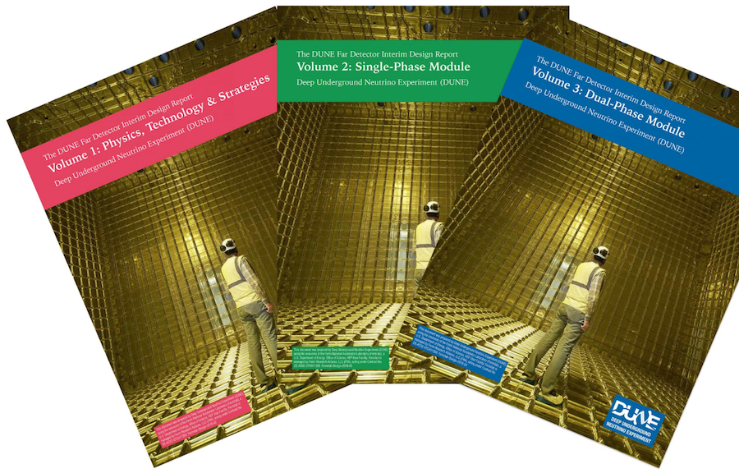
The TDR plan:
Start from IDR.
Address LBNC concerns.
Update, especially using ProtoDUNE.
Incorporate more project-level information.

Slide 3
LBNC’s big two IDR issues
Requirements: not there
New scheme:
Small set of 5 key design specifications, with ~25 more EB-held central design specifications.
Physics TDR links key design specifications set to physics goals.
Detector consortia show a design specifications solution set that meets physics goals.
Fixed format tables.
Central management/version control.
Length: too long
New scheme:
Break TDR and CDRs into readable stand-alone volumes.
Add Overview volume: collection of executive summaries.
Expanded Technical Coordination volume: one-stop shopping for all matters project.
Send all components to LBNC early at 2nd draft stage.
Hold the line on chapter length.

Slide 4
Requirements→Specifications
Tiered list of detector specifications:
Top level: five key detector specifications.
Physics driven specifications and goals (spec., goal)
Drift field (>250 V/cm, 500 V/cm), electron lifetime (>3 ms, 10ms), electronic system noise (<1000 enc, ALARA), light yield (>0.5 PE/MeV, 5 PE/MeV), photon-based timing (<1 μs,100 ns)
Level 2: central detector specifications held by the Technical Coordinator and ratified by the EB. (Note: currently mostly SP, DP additions expected.)
Comprise a non-unique working solution that meets physics goals.
Example: E-field non-uniformity.
Level 3: consortium owned specifications.
Comprise a non-unique implementation that meets physics goals.
Example: environmental light exposure for PDS units.

Slide 5
Proposed Specifications Table format
Long form version of Table will be available via a link to DocDB.
Name | Primary Text | Value | Value (LaTeX) | Goal | Rationale (brief) | Validation (brief)
Descriptive name of the specification (max 100 characters including spaces) (REQUIRED) | Full text of the req/specification. Example: The DAQ shall provide (REQUIRED) | Specification value: number plus units (as needed) (REQUIRED) | Specification value: number plus units (as needed) (REQUIRED) | Number plus units (as needed) | Max 120 characters (REQUIRED) | Max 120 characters (REQUIRED)
Minimum drift field | The drift field in the TPC shall be greater than 250 V/cm, with a goal of 500 V/cm. | >250 V/cm (goal 500 V/cm) | $>$\,\SI{250}{ V/cm} | $>$\,\SI{500}{ V/cm} | Lessens impacts of e-Ar recombination, e- lifetime, e- diffusion and space charge. | ProtoDUNE
Remainder of Level 1 key parameters block
Level 2 selected central parameters block
Level 3 consortium parameters block.

Slide 6
TDR Structure
Stand alone volumes with different functions
Overview: The DUNE big picture. DUNE for program managers, science committee staffs, new reviewers and collaborators.
Physics: The DUNE physics case and key detector parameters from physics.
SP, DP volumes: Implementing the DUNE physics program via the SP and DP technologies.
Technical coordination: Management, facilities, and methodologies; DUNE for project reviewers.
Organizational status
All editors signed on and engaged.
Technical support team in place: Corwin, DeMuth, Heavey (lead), Ransom,Viren.

Slide 7
TDR Volumes I,II
Overview: DUNE in one volume.
Executive summary (Blucher, Soldner-Rembold)
Physics summary (Urheim, de Roeck)
SP module summary (Evans)
DP module summary (Autiero)
Computing summary (Norman, Schellman) ***
Near detector summary. (Kordosky, Manly) ***
Technical Coordination summary (Kettell)
Physics: DUNE science and detector impacts
(See talk by Urheim)
*** Summaries only. Computing and Near Detector CDRs come later in 2019.

Slide 8
TDR volumes III
Single Phase Detector: DUNE science implementation
Executive summary (Evans)
APA (Schmitz)
High voltage (Plunkett)
Photon detector system (Wilson)
Cold electronics (Mooney)
DAQ (Karagiorgi, Viren)
Calibration (Gollapinni,Mahn)
CISC (Horton-Smith, Palomares)
Integration and Installation (Stewart)

Slide 9
TDR volume IV
Dual Phase Detector: DUNE science implementation
Executive summary (Autiero)
CRP (Duchesneau, Mazzucato)
High voltage (Pietropaolo,Yu)
Photon detector system (Bilki, Sorel)
Electronics (Dawson, Galymov)
DAQ (Karagiorgi, Viren)
Calibration (Gollapinni,Mahn)
CISC (Horton-Smith, Palomares)
Integration and Installation (Resnati)

Slide 10
TDR Volume V
Technical coordination: all project-like functions and methodologies
Executive Summary (James)
Project functions (Kettell)
Internal reviews (Kettell)
Integration (project engineers)
Facilities (Kettell)
LBNF Interfaces (project engineers)
Facility management (Miller)
QA (DUNE QA manager)
ESH (Andrews)

Slide 11
Details on 2^{nd-}Drafts-to-LBNC
More time for review and feedback; less to review in each batch.
Working solution: Deliver batches of TDR chapters at second draft state in small batches at staggered times.
Final complete submission moves back to summer 2019.

Slide 12
Proposed Working schedule
Consortium | 1st draft | 2nd draft | To LBNC |  | Consortium | 1st draft | 2nd draft | To LBNC
SP-HV | 2-Nov-18 | 7-Dec-18 | 21-Dec-18 |  | DP-PDS | 1-Mar-19 | 5-Apr-19 | 26-Apr-19
SP-APA | 2-Nov-18 | 14-Dec-18 | 21-Dec-18 |  | SP-Calibration | 1-Mar-19 | 5-Apr-19 | 26-Apr-19
SP-DAQ | 12-Nov-18 | 14-Dec-18 | 21-Dec-18 |  | SP-Exec Summary | 1-Mar-19 | 5-Apr-19 | 26-Apr-19
 |  |  |  |  | ND-Exec Summary | 1-Mar-19 | 5-Apr-19 | 26-Apr-19
SP-PDS | 7-Dec-18 | 11-Jan-19 | 25-Jan-19
SP-CISC | 30-Nov-18 | 11-Jan-19 | 25-Jan-19 |  | DP-IIC | 5-Apr-19 | 10-May-19 | 31-May-19
TC | 7-Dec-18 | 11-Jan-19 | 25-Jan-19 |  | DP-DAQ | 5-Apr-19 | 10-May-19 | 31-May-19
PHYSICS | 30-Nov-18 | 11-Jan-19 | 25-Jan-19 |  | DP-CISC | 5-Apr-19 | 10-May-19 | 31-May-19
SP-CE | 14-Dec-18 | 8-Feb-19 | 22-Feb-19 |  | DP-Calibration | 10-May-19 | 7-Jun-19 | 28-Jun-19
DP-Electronics | 14-Dec-18 | 8-Feb-19 | 22-Feb-19 |  | DP-CRP | 10-May-19 | 7-Jun-19 | 28-Jun-19
Computing Exec Summary | 14-Dec-18 | 8-Feb-19 | 22-Feb-19 |  | DP-Exec Summary | 10-May-19 | 7-Jun-19 | 28-Jun-19
 |  |  |  |  | Overall Exec Summary | 10-May-19 | 7-Jun-19 | 28-Jun-19
DP-HV | 1-Feb-19 | 1-Mar-19 | 29-Mar-19
SP-IIC | 1-Feb-19 | 1-Mar-19 | 29-Mar-19 |  | TDR Final |  |  | 26-Jul-19

Slide 13
Project functions
Methodologies for specifications, cost, schedule, risk, interface, ESH, and QA/QC will be described in the technical coordination volume.
Most project data will be in DocDB.
Working groups and consortia will summarize information in tables, with explanatory text added where needed, and DocDB reference links provided for more detail.

Slide 14
Editors’ Summary and Wish List
We have launched! Batch 1 (APA, SP DAQ, SP HV) is at second draft preparation stage with scheduled Dec. 21, 2018 submission to LBNC. Batch 2 (SP CISC, SP PDS, TC, Physics) is at first draft internal review stage.
Our requests to you:
Concur with overall architecture.
Concur with requirements→specifications scheme.
Concur with staged second draft submission scheme.
Concur with schedule.
Agree to schedule return of second drafts to DUNE for revision.
Please don’t treat second drafts as final drafts.

