Slide 1
Status/Preview of the
Physics Volume of the DUNE TDR
Albert De Roeck (CERN), Jon Urheim (Indiana University)
with R. Patterson, E. Worcester & the Physics WG Conveners
LBNC Meeting
9 December 2018

Slide 2
What we aim to convey
The Physics TDR should present the science opportunities for which DUNE has been developed, and describe its capabilities to realize them
Presentation of capabilities is ideally based on realistic treatments of:
  Physics signatures (including, e.g., neutrino interaction modeling)
  Properties of the LBNF beam line (flux…)
  Detector response (signal characteristics, noise, calibration, etc.)
  Event reconstruction & performance (tracking, calorimetry, particle ID, etc.)
  Experimental challenges: backgrounds, systematic error sources, etc.
In practice, many elements above are under active development
  For primary science goals, insisting on ~fully realistic analyses…
  …so for these, must also convey the provisional nature of current analyses.
Notes:
First let me describe what we are aiming to convey. The physics tdr should… presentation of capabilities…
All of the above elements are under active development. For the primary science goals – namely precision studies of 3-flavor oscillation patterns in beam data, sensitive searches for nucleon decay, and studies of neutrinos emitted in galactic core-collapse supernova– we are insisting on fully realistic analyses of experimental sensitivity. That is, utilizing monte carlo data sets produced from geant-based beam line and detector simulations and subjected to our current suite of event reconstruction tools, and performing analyses with as little cheating as is possible. Since none of the analysis tools have reached an optimal level of development, we must also convey the provisional nature of the results.

Slide 3
Top Level Outline – target: ~25 pages/chapter
Executive Summary
Introduction to LBNF and DUNE
Scientific Landscape
Tools and Methods Employed
Neutrino Oscillation Physics Program
GeV-scale Non-accelerator Physics Program
Supernova Neutrino Bursts and Physics with Low-Energy Neutrinos
Precision Physics with the Near Detector
Beyond Standard Model Physics
Summary/Outlook

Slide 4
What we have as of Dec 1 (“1st Draft” deadline)
Executive Summary
Introduction to LBNF and DUNE
Scientific Landscape
Tools and Methods Employed (27 pages + 12 for calibration)
Neutrino Oscillation Physics Program (55 pages)
GeV-scale Non-accelerator Physics Program (17 pages)
Supernova Neutrino Bursts and Physics with Low-Energy Neutrinos (25 pages)
Precision Physics with the Near Detector
Beyond Standard Model Physics (42 pages)
Summary/Outlook

Slide 5
Going through these chapters
Start with “most advanced” ones
  Tools and Methods Employed
  Supernova / Low-energy Neutrinos
  Beyond Standard Model Physics
Then onto chapters where full analyses are in progress
  Long-Baseline Oscillation Physics (3-flavor oscillations of beam neutrinos)
  GeV-Scale Non-accelerator Physics (Nucleon decay, atmospheric neutrinos, etc)
Notes:
So to give a flavor for where we are with the most substantive chapters I will go through them one by one, starting with the three that – as measured by results presented – are in the most advanced states of development. These are … (list)..
I will then go on to describe where we are with the portions of the physics program where the Working Groups are working hard to bring analyses to the state where they can be presented in the TDR. These are…

Slide 6
Chapter 4: Tools and Methods Employed

Slide 7
Chapter 4: Tools and Methods Employed
Current status:
  Basic elements of DUNE simulations & reconstruction are well described
  Separate discussion of calibration strategy is written, ready to be incorporated
What needs to be done for 2nd draft
  Reco/Sim Working Group focus is now on generating/updating high-level performance plots;
  Need to make level of technical detail more uniform
    Too much in some places, too little in others
  Work needed to integrate better within this chapter & with other chapters
    This will allow filling in of some “missing” content (i.e., flux modeling, trigger simulation..)
  Possibility of inclusion of some ProtoDUNE-SP data

Slide 8
Chapter 4: Tools and Methods Employed

Slide 9
Chapter 7: Supernova/Low-Energy Neutrinos

Slide 10
Chapter 7: Supernova/Low-Energy Neutrinos
Current Status:
  Main analyses are based on combination of simulated/parametrized detector response simulation (including impacts of de-excitation gamma & nucleon emission) with dedicated reconstruction studies
  Key Physics Results in hand:
    neutronization-burst mass-ordering sensitivity study
    thermal parameter sensitivity study.
    pointing capability for elastic scattering events (ν_{e} + e → ν_{e} + e)
  Text for chapter not complete yet, but getting close.
What needs to be done for 2nd draft
  Addition of missing material (imminent)
  More coordination with Tools and Scientific Landscape chapters.

Slide 11
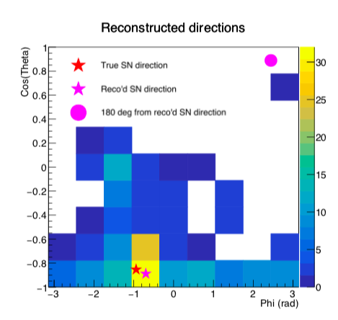
Chapter 7: Supernova/Low-Energy Neutrinos
Realistic reconstruction of SN direction using 260 fully simulated elastic scattering events (expected sample for SN at 10 kpc), after resolving electron direction ambiguity by majority rule…

Slide 12
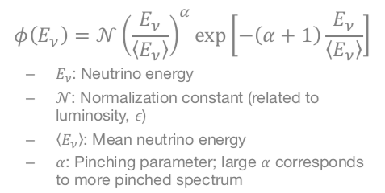
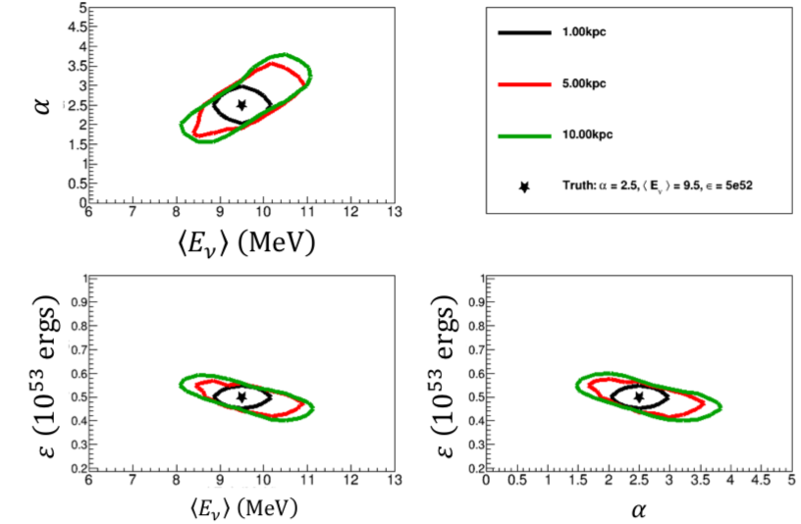
Chapter 7: Supernova/Low-Energy Neutrinos
Results from fits of the observed spectrum to “pinched-thermal” form ready for inclusion, but not in TDR draft yet…
Thermal parameters vs time from “Garching Model”

Slide 13
Chapter 9: Beyond Standard Model Physics

Slide 14
Chapter 9: Beyond Standard Model Physics
Current Status:
  Analyses are based mainly on parametrized detector response simulation, utilizing GLoBES framework.
  Many Key Physics Results in hand:
    distortions of oscillation patterns in Far Detector due to BSM phenomena including NSI’s, non-unitarity, CPT symmetry violation;
    boosted Dark Matter signatures from cosmic sources;
    studies of neutrino ”tridents” in the Near Detector.
  Other analyses nearly complete but dealing with issues pertaining to Near Detector configuration and its use in constraining systematic errors
    e.g., beam-induced light DM particle searches, sensitivity to sterile neutrinos
  Text for chapter is essentially complete
What needs to be done for 2nd draft
  Need final numbers/plots for several analyses
  More coordination with Tools and other physics chapters.

Slide 15
Chapter 9: Beyond Standard Model Physics

Slide 16
Going through these chapters
Start with “most advanced” ones
  Tools and Methods Employed
  Supernova / Low-energy Neutrinos
  Beyond Standard Model Physics
Then onto chapters where full analyses are in progress
  Long-Baseline Oscillation Physics (3-flavor oscillations of beam neutrinos)
  GeV-Scale Non-accelerator Physics (Nucleon decay, atmospheric neutrinos, etc)

Slide 17
Chapter 4: Long-Baseline Oscillation Physics
First, a reminder of CDR-era sensitivity projections (from IDR)
  Analysis was based on parameterized detector response
We are aiming to provide an updated version of these projections
  But with fully realistic analysis, including direct incorporation of ND data

Slide 18
Chapter 4: Long-Baseline Oscillation Physics

Slide 19
Chapter 4: Long-Baseline Oscillation Physics
Current Status:
  Chapter has well-defined structure; writing assignments clearly distributed.
  Lots of descriptive text in place. Very detailed.
  Presentations to LBNC in May & October demonstrated the substantial progress toward a “fully realistic” analysis, with benchmark results meeting/exceeding expectations.
  But a fully realistic analysis aiming for well justified projections of sensitivity – including systematic errors – is a complex undertaking with lots of moving parts, including integrated analysis with Near Detector elements.
    See presentations by C. Marshall & M. Wilking at October LBNC meeting.
  This ambitious push for our most prominent Physics Program element will continue on into January (at least)
What needs to be done for 2nd draft
  Need (close-to) final numbers, plots, and discussion
  More coordination with Tools and Landscape chapters

Slide 20
Chapter 5: GeV-Scale Non-accelerator Physics

Slide 21
Chapter 5: GeV-Scale Non-accelerator Physics
Current Status:
  Main focus is on nucleon decay, one of our primary science goals, with fully realistic analysis.
    Emphasis on marquee Proton → K+ nu channel; progress toward high efficiency while maintaining zero background face substantial event reconstruction challenges, especially considering impact of Final State Interactions; work ongoing.
    Simultaneous progress on other channels (such as n → K+ e), now incorporated into the text
  N-Nbar oscillation physics analysis is complete;
  more work needed to bring atmospheric neutrino analysis to appropriate level for presentation, but much text already in place.
What needs to be done for 2nd draft
  Need to reach endpoint on “fully realistic” nucleon decay analyses.
  More coordination with Tools and other Landscape chapters.

Slide 22
Wrap-up: Other Chapters & Next Stages
Introductory Chapters (Executive Summary, DUNE Overview, Scientific Landscape) remain in early stages. Authors assigned to most sections, working.
Near Detector Physics Chapter
  Would like to have this
  Content will likely focus more on “opportunities” than “capabilities”
  Some starter text in place, but clearly needs development
  Coupling to ND CDR as well as ND Summary in TDR Volume I
Linking of detector specifications to physics goals
  Editors will be working with chapter authors to incorporate more explicitly.
For 2nd Draft, we are working toward (but don’t guarantee)
  Mostly complete, mostly readable chapters
  Unified level of detail appropriate for TDR (maybe relegate material to appendices)
  But please expect some rough spots: complex physics, complex analyses !!

