Slide 1
SBN Program Status
Peter Wilson – SBN Program Coordinator
SBN Oversight Board
8 March 2019

Slide 2
Outline
ICARUS technical progress
SBND technical progress
December Director’s review
DOE Funding
Transition to Operations Planning

Slide 3
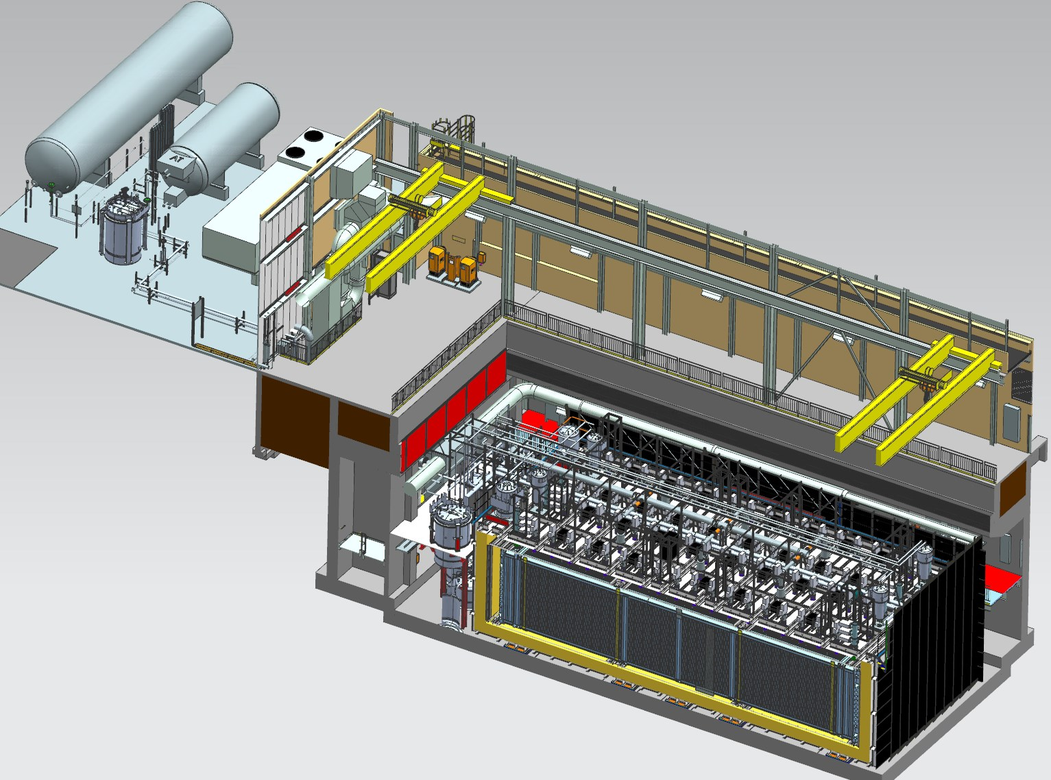
Far Detector - ICARUS
Cryogenic Dewars
TPC Electronics
Top CRT and Overburden
(not shown)
Exterior LAr Filters
Two 33 ton cranes
Proximity Cryogenics
Not shown in alcoves (mezzanine and pit):
DAQ racks
Controls racks
Cold Vessels (TPCs and PMTs inside)
Bottom CRT
Side CRT

Slide 4
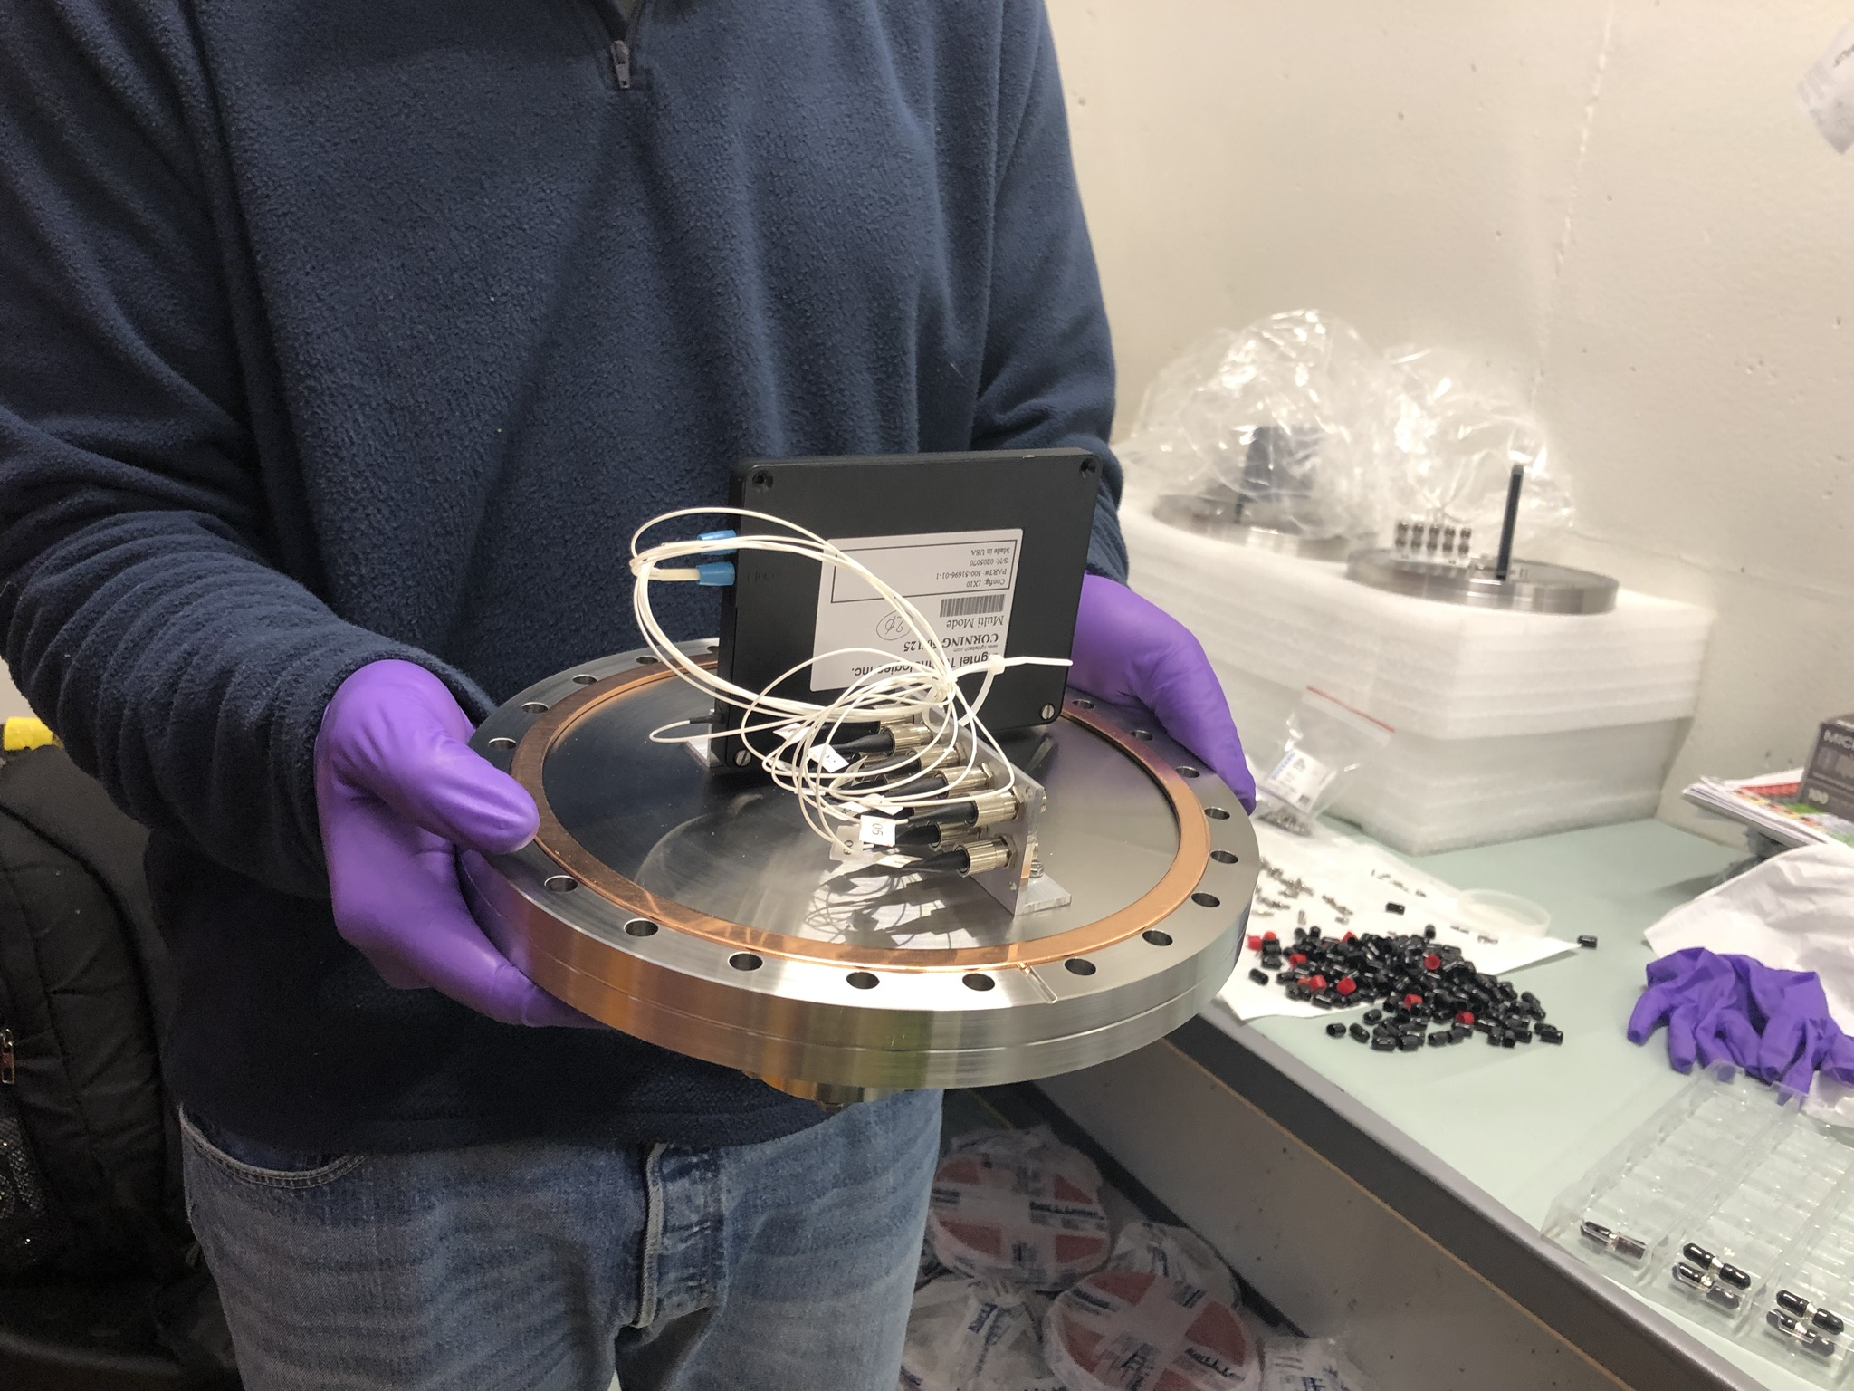
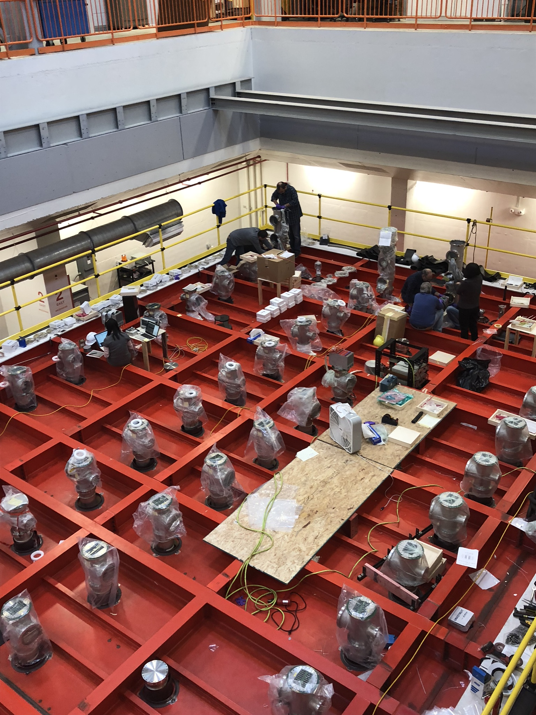
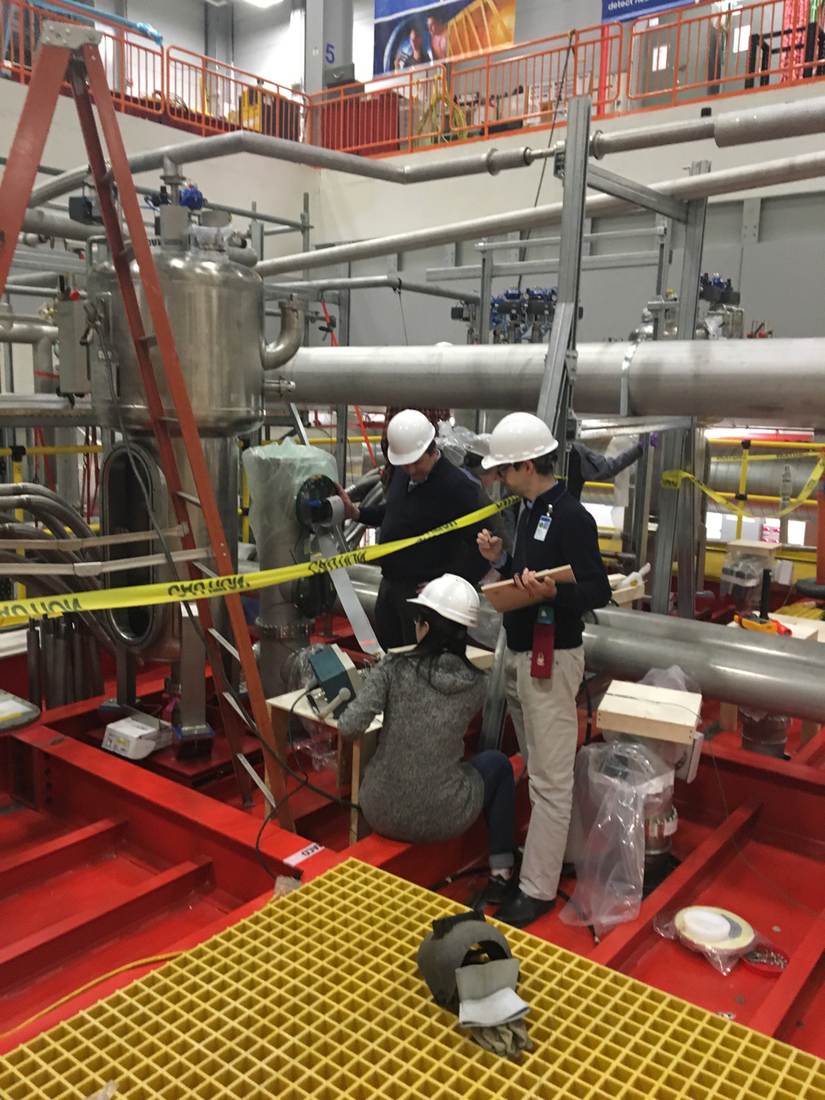
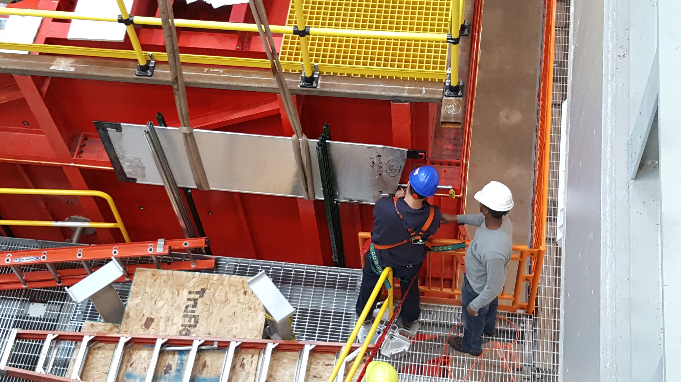
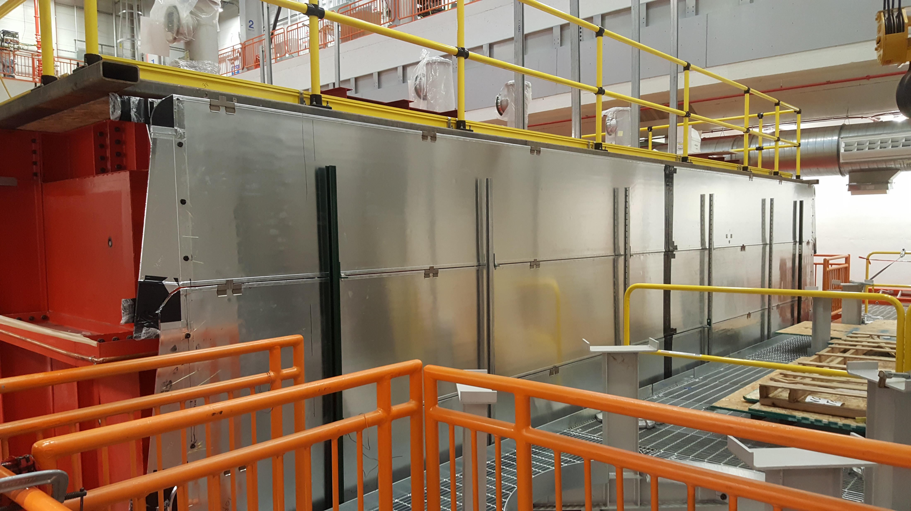
ICARUS Installation Progress
Vessel 2 Ready
TPC 1 Complete
Detector installation work continues on schedule:
Installation of feedthrough crosses completed
Feedthrough flanges installed
First checkout of feedthroughs completed finishing corrections on specific flanges
North wall CRT modules (repurposed MINOS modules) installed
Start installation of electronics and power supplies in April
On track to be ready for LAr fill in summer
Preparing a PMT fiber flange
Flange installation and vertical slice test
Testing TPC flange connectivity
North Wall CRT

Slide 5
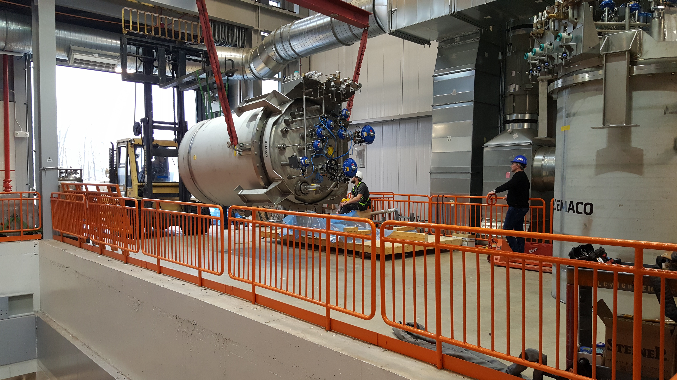
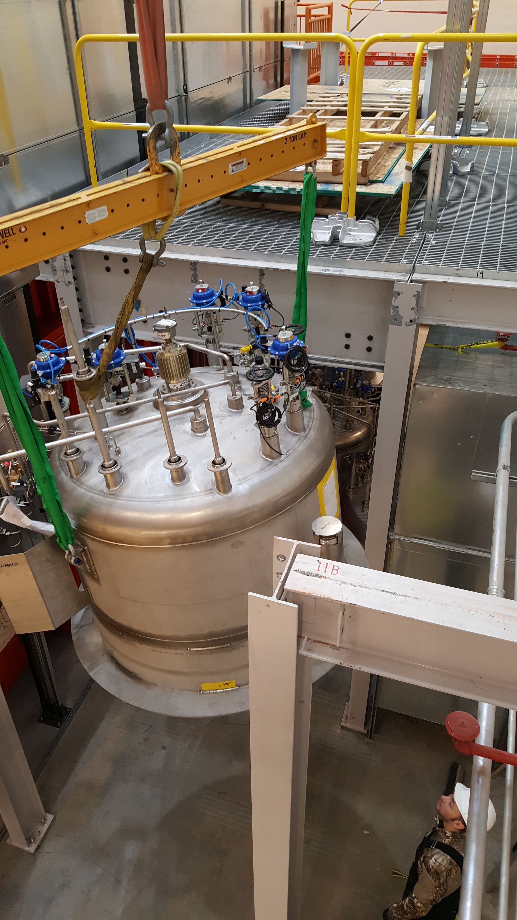
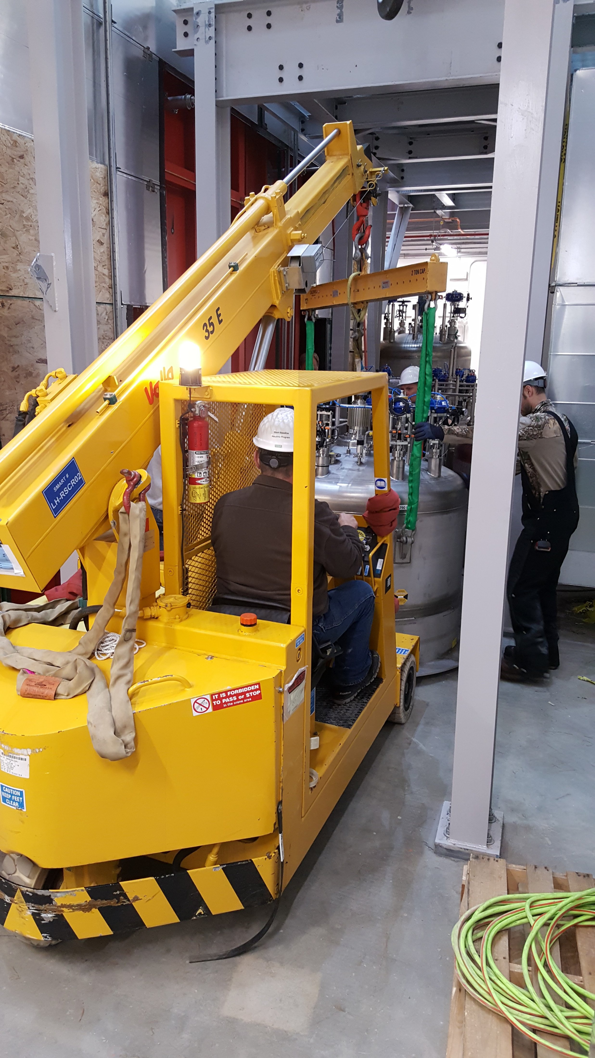
ICARUS Installation Progress
Vessel 2 Ready
TPC 1 Complete
Cryogenics installation work on schedule:
Proximity cryogenics components delivered from CERN in early December (ten shipping containers)
Installation started by Demaco on Jan 28
All 14 valve boxes installed within two weeks
Transfer line installation progressing well
Fermilab continues installation of items such as vent lines in parallel
Controls programming progressing well
Controls wiring to start shortly
3 transfer lines damaged in transport from CERN
Very fast response by CERN and Demaco
New lines being constructed at Demaco – delivered to FNAL by end of May
Installation order adjusted to accommodate
Mitigating delays to maintain LAr fill date in July
always safety first!
Rigging valve boxes

Slide 6
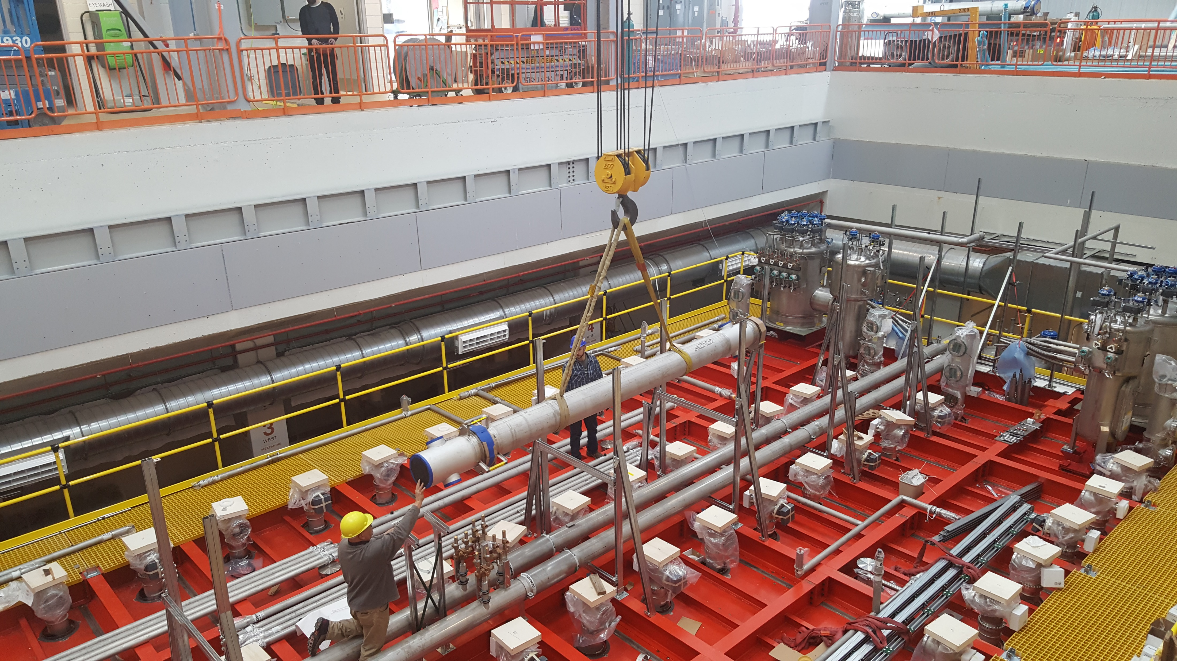
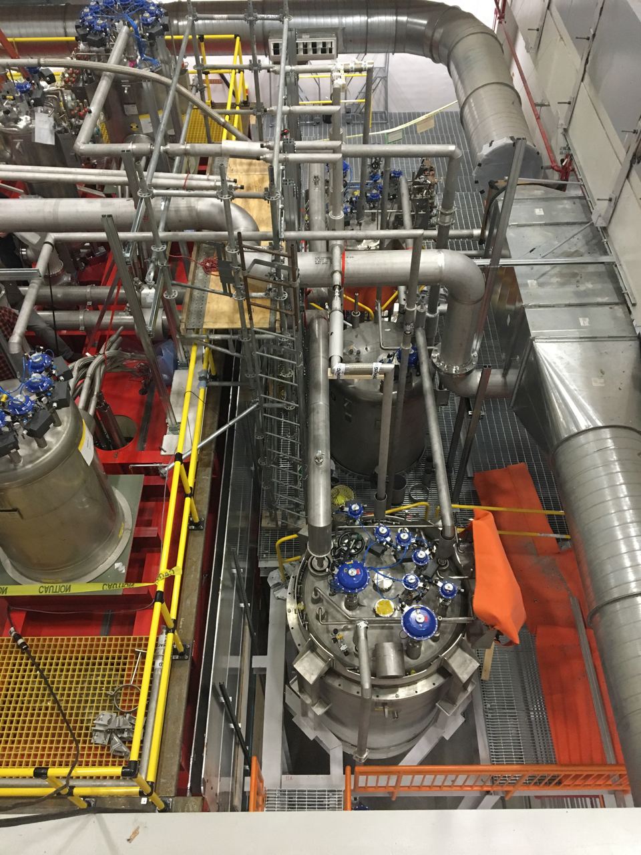
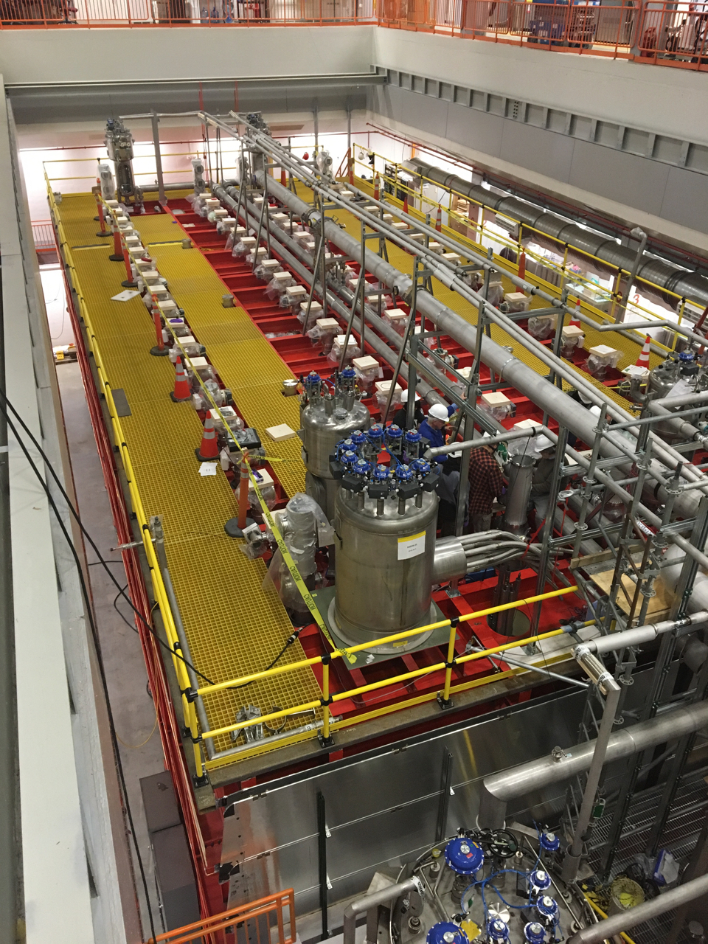
ICARUS Installation Progress
Vessel 2 Ready
TPC 1 Complete
Cryogenics installation work on schedule:
Proximity cryogenics components delivered from CERN in early December (ten shipping containers)
Installation started by Demaco on Jan 28
All 14 valve boxes installed within two weeks
Transfer line installation progressing well
Fermilab continues installation of items such as vent lines in parallel
Controls programming progressing well
Controls wiring to start shortly
3 transfer lines damaged in transport from CERN
Very fast response by CERN and Demaco
New lines being constructed at Demaco – delivered to FNAL by end of May
Installation order adjusted to accommodate
Mitigating delays to maintain LAr fill date in July
always safety first!
Installing Vent Line (FNAL Scope)
Current Status

Slide 7
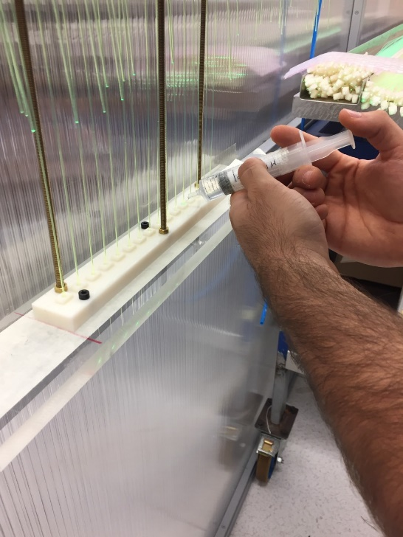
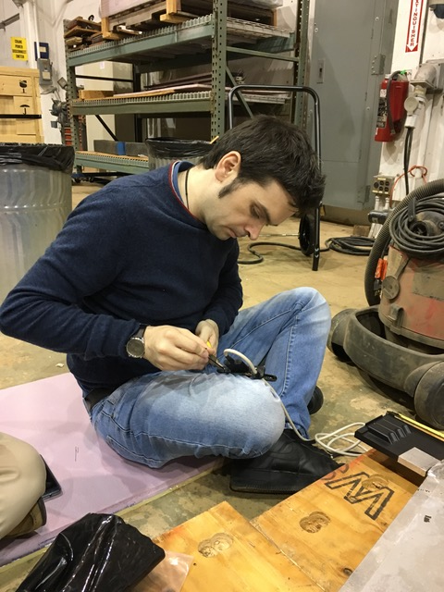
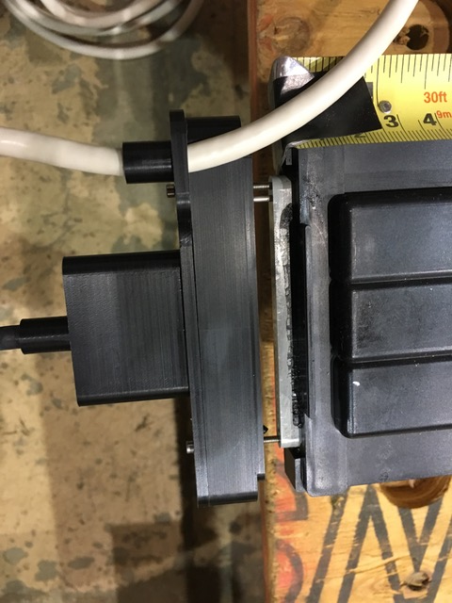
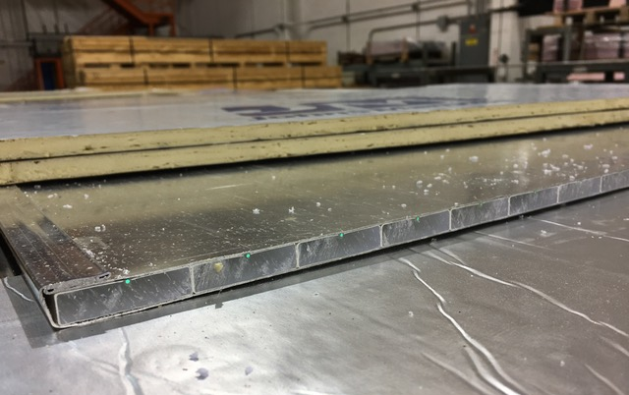
ICARUS Progress
TPC electronics production in final phase (INFN)
On track to complete delivery to FNAL by May
Cosmic Ray Tagger (CRT)
Top CRT panel production starting in Frascati
Side CRT readout: final design review for SiPM board and cabling on Jan 7
Responding to recommendations now
North side install between cryo plant and vessel
Mounts installed
Modules cut and wrapped
Modules installed at end of January
Top CRT Production in Frascati
Side CRT SiPM Board and module cutting @ Wideband lab

Slide 8
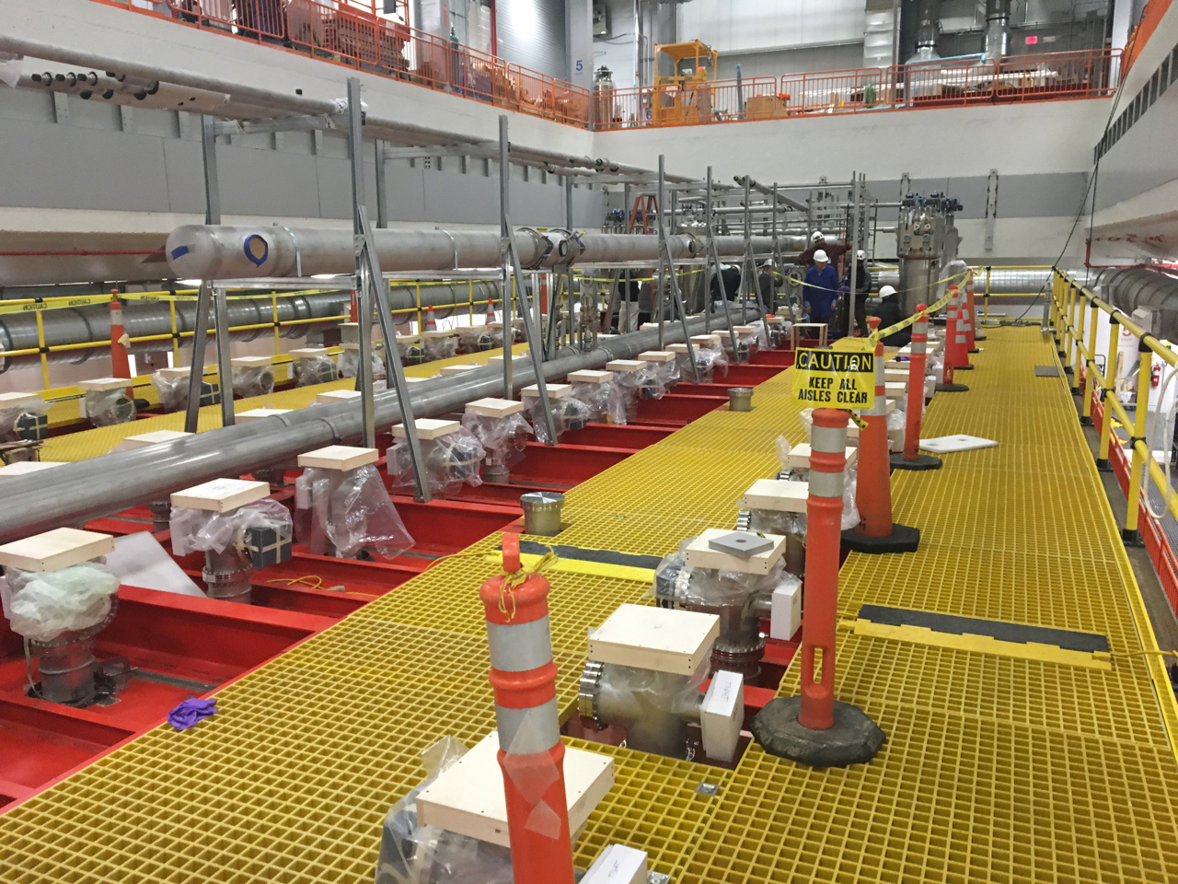
Installation work stop Mar 5-6
Vessel 2 Ready
TPC 1 Complete
Installation work on top the warm vessel was stopped for one day this week in response to three recent injuries:
Student tripped on top of the vessel (December) – bruises
Technician (Demaco) had pipe sleeve strike hand (February) – stitches
Technician (INFN) tripped on top of the vessel (March) – stitches
Paused work: address trip hazards and work rules
Removed materials and tools
Advanced the installation of additional decking by several weeks
Final decking to be installed in stages following completion of work on crosses
Added safety cones and caution tape to warn of trip hazards
Updated requirements on usage of hard hats
Held two safety briefings – at stop and restart of work
Included all collaborators and technical staff currently engaged in the work
Reinforcing daily work planning/safety meetings and communication on plans between the collaboration and Fermilab technical team

Slide 9
Far Detector Commissioning – cryogenics prep.
Cold vessel engineering note and validation
Completed verification of CERN FEA by Fermilab analysis engineer
Engineering note completed by provided to safety committee
SBN Cryo Working Group initiated: preparing validation and fill plan
Cryogenics system engineering notes completed and reviewed
Need review of installed system to complete operations clerarance
LAr contract:
Bid package completed and sent to vendors on Feb 11
Received two bids on Feb 28; first look
Both meet schedule requirement of 6 deliveries/week
Both meet meet or beat technical specifications on contaminants
Technical evaluation in progress
On track for LAr fill milestone.
Thanks to procurement for excellent response time

Slide 10
ICARUS Milestones to I-1 Ready to Fill
Intermediate Milestone | Owner | Baseline Date | Forecast Date |  | Actual Date
Vessels rigged into building | P. Wilson | 16-Aug-2018 |  | ✓ | 16-Aug-2018
Manholes welded and vacuum test successful | C. Montanari | 10-Oct-2018 |  | ✓ | 11-Oct-2018
Warm Vessel roof complete | C. James | 15-Nov-2018 |  | ✓ | 31-Oct-2018
Cryo Platform complete | C. James | 15-Dec-2018 |  | ✓ | 04-Oct-2018
Proximity cryogenics installation begins | B. Norris | 15-Jan-2019 |  | ✓ | 28-Jan-2019
DBB & flanges installation complete and tested | A. Fava | 15-Feb-2019 | 1-Mar-2019 | b
Cold proximity cryogenics installation complete | B. Norris | 15-Apr-2019 | 25-Apr-2019 | c
1st T300 readout installation complete | A. Fava | 15-Mar-2019 | 8-Apr-2019 | d
All detector readout installed | A. Fava | 1-May-2019 | 31-May-2019 | e
Begin vacuum pumping | C. Montanari | 15-Jul-2019 | 15-May-2019
Cryogenic operation approved | B. Norris | 15-Jul-2019 | 28-Jun-2019
I1: ICARUS detectors ready to fill with LAr | P. Wilson | 30-May-2019 | 11-Jul-2019 | f
Forecast update awaiting details on replacement transfer lines

Slide 11
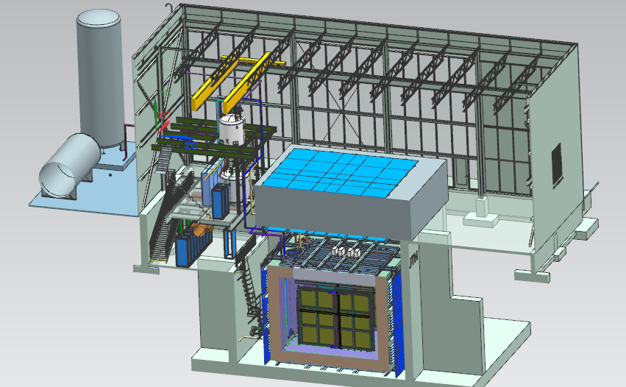
Near Detector - SBND
20 ton crane
Top CRT and Overburden
Cryogenic Dewars
Proximity Cryogenics
Readout racks
Top CRT
TPC
Cryostat
Side CRT

Slide 12
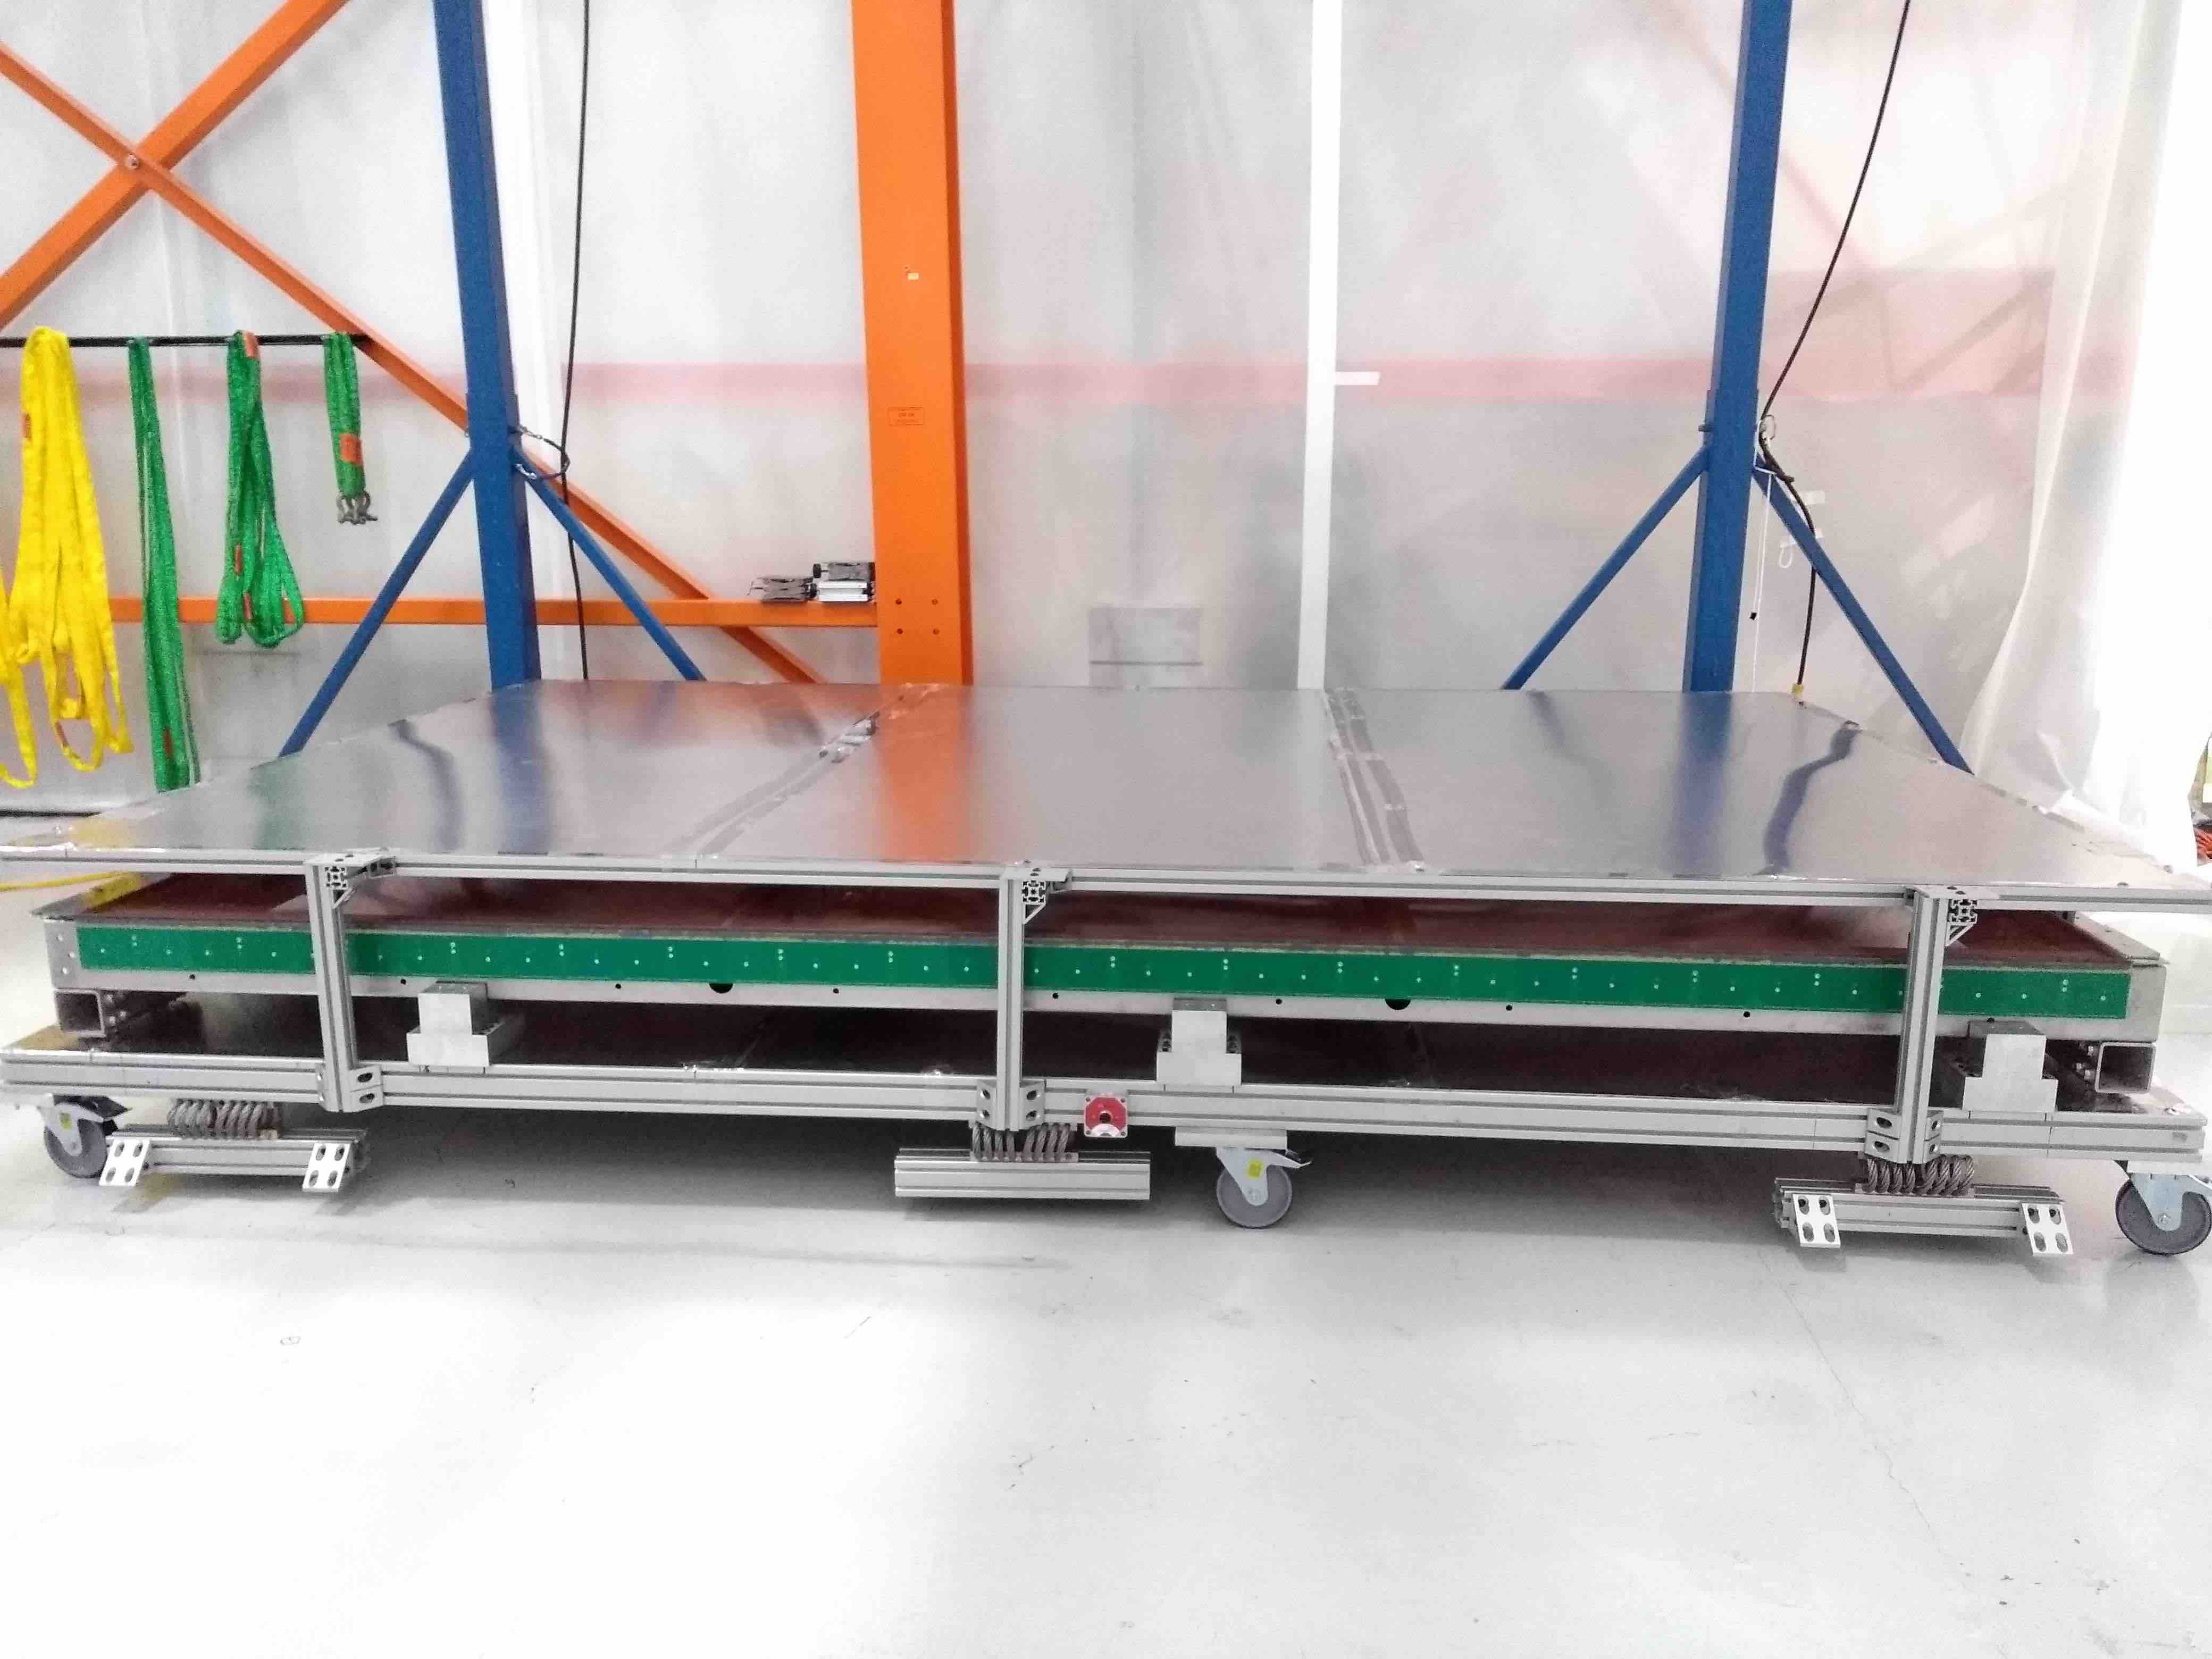
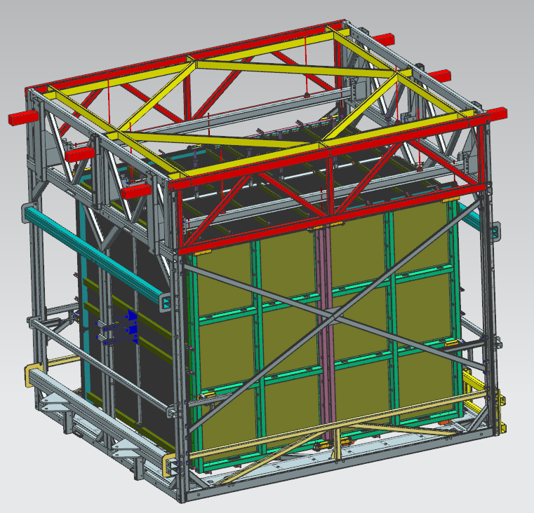
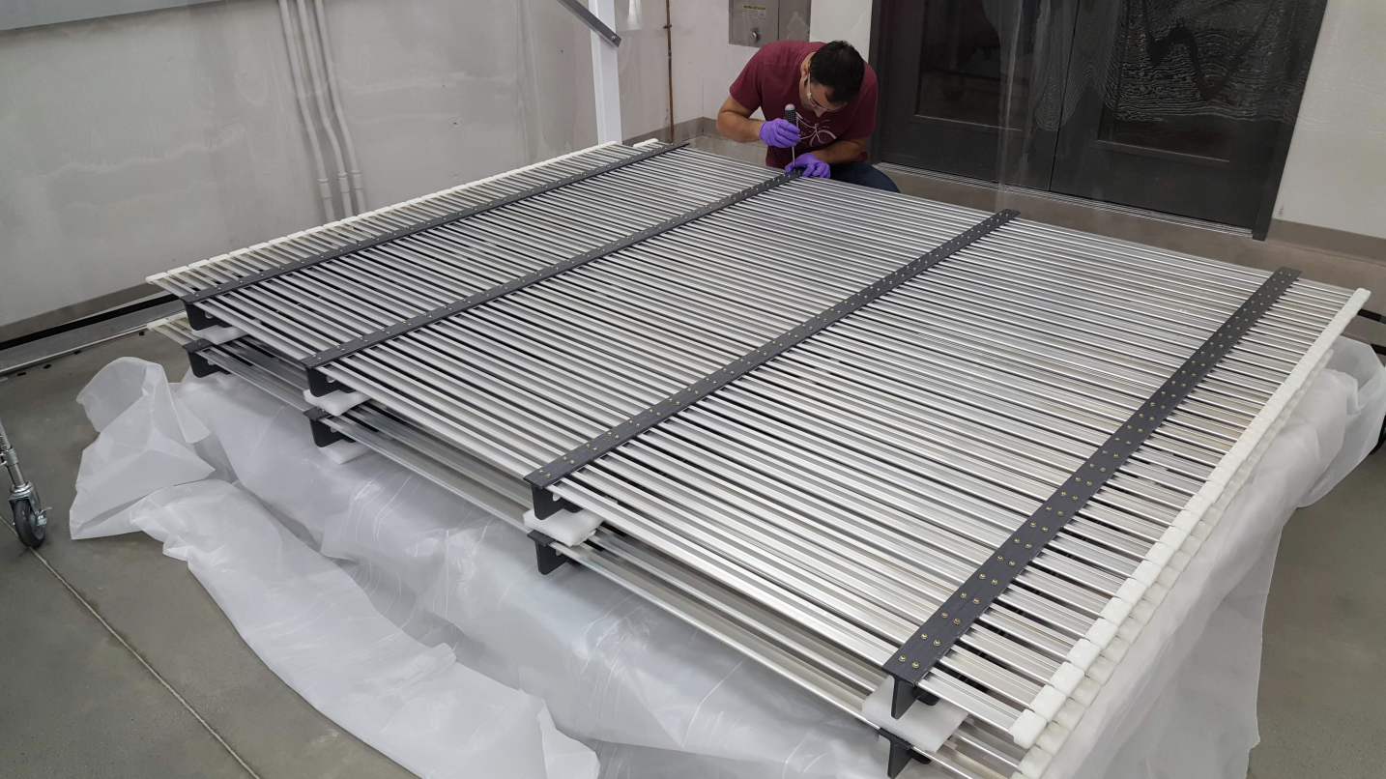
SBND TPC Progress
UK: Manchester completed wiring the 2nd APA at Daresbury lab. Shipped on Feb 25. Arrival at Fermilab in March
US: field cage and 2nd anode plane received at Fermilab on Mar 1
Three (of 4) APAs now in the Dzero assembly facility
Two in clean tent, one on the alignment fixture. Plan to pair them in late March
One stored outside tent
TPC assembly and transport frame (atf) in fabrication – delivery to FANL in April
1st UK APA on the alignment fixture
1st Yale APA in clean tent
Field cage panels at Yale
Assembly and Transport Frame

Slide 13
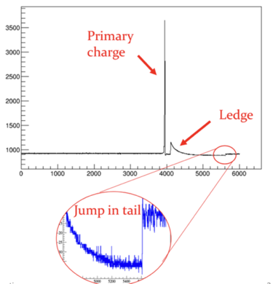
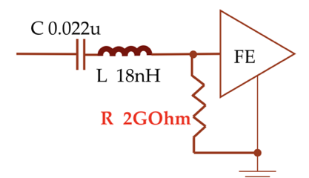
SBND TPC Electronics Progress
Cold electronics (BNL):
Design very similar to ProtoDUNE (eg same FE ASIC)
Use cold qualified commercial off the shelf ADC
Warm backend (Columbia – Nevis)
Update of MicroBooNE design
Addressed lessons from ProtoDUNE
FE ASIC “ledge effect” – large charge depositions cause a dead period of several hundred microsecs
Mitigated by modifying layout of FE board to include 1-2GOhm resistor and operation with higher baseline setting
Successful Production Readiness Review Nov 29
Both cold and warm electronics on track for completion milestones this spring/summer
amplitude
Time tic
Ledge effect @protoDUNE

Slide 14
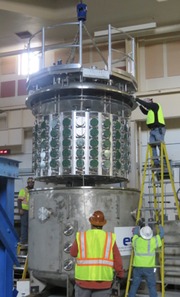
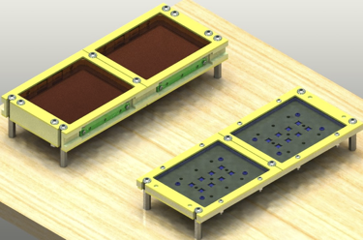
SBND Photo Detection Progress
Full PMT system under test in the Coherent CAPTAIN-Mills Detector (CCM) at Los Alamos
Ready to install in fall 2019
ARAPUCA system
tested in argon
feedthroughs ordered
Production review completed
Ready to install in summer 2019
Light guide bars
Production review completed
Ready to install in fall 2019
CCM preparing to test PMTs at LANL
ARAPUCA prototypes

Slide 15
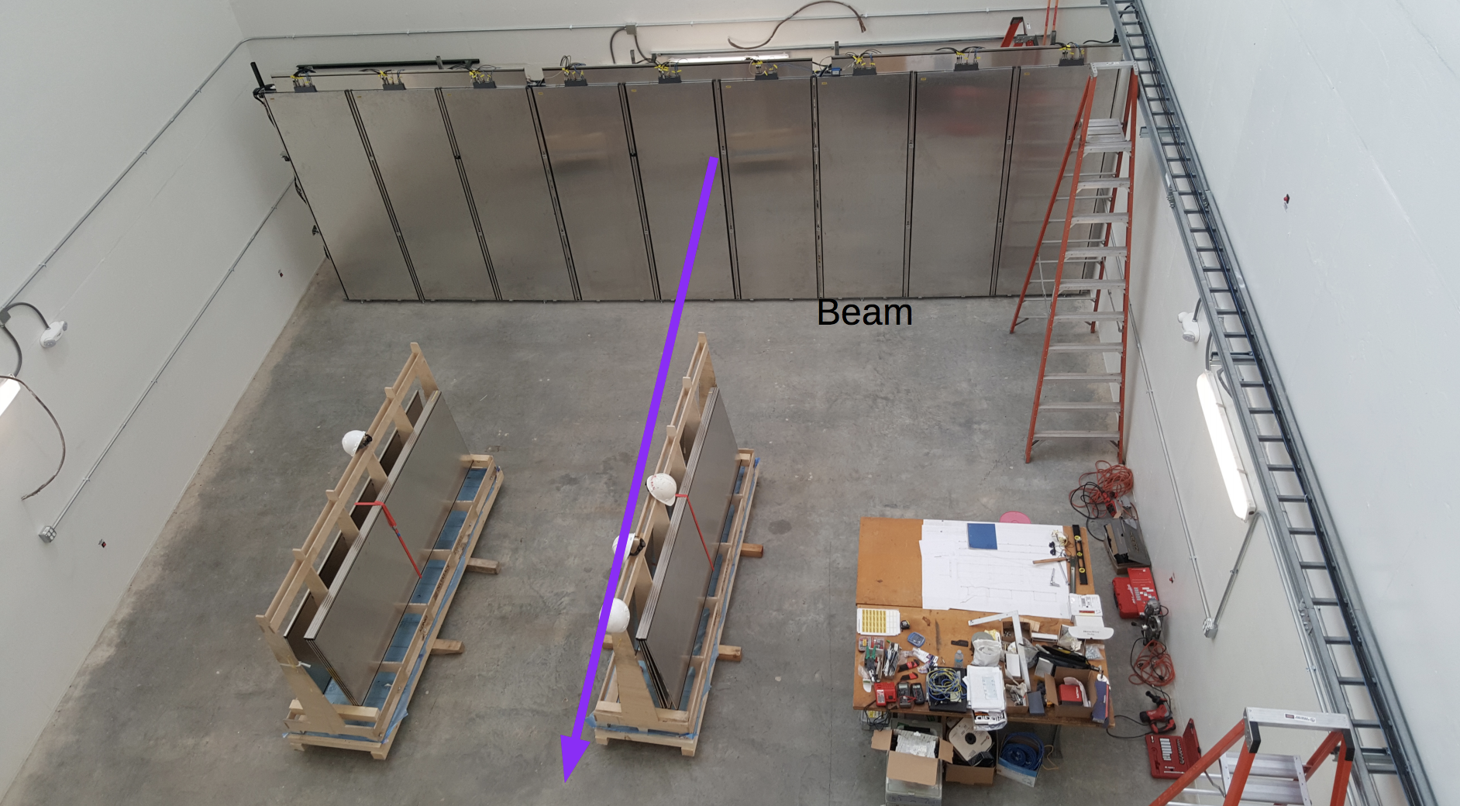
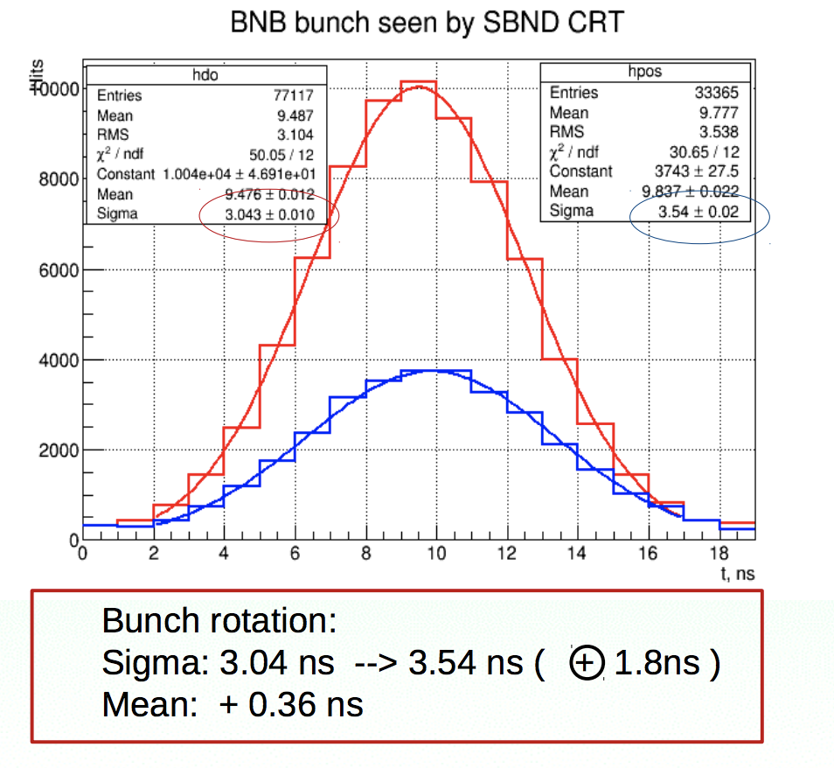
SBND CRT/Laser
Production
Bottom and side CRT modules complete
Top CRT modules and laser system production @Bern on track.
CRT Test Setup
Running successfully with 24 modules
Preliminary measurement of BNB bunch shape after BNB bunch rotation turned on on Jan 14 (DocDB #11107).
Upcoming Installation
CRT test setup to conclude data taking in March, to make space for Demaco proximity cryogenics installation
Discovered interference between six bottom CRT modules and final cryostat design.
Discussion with Bern on how to solve.

Slide 16
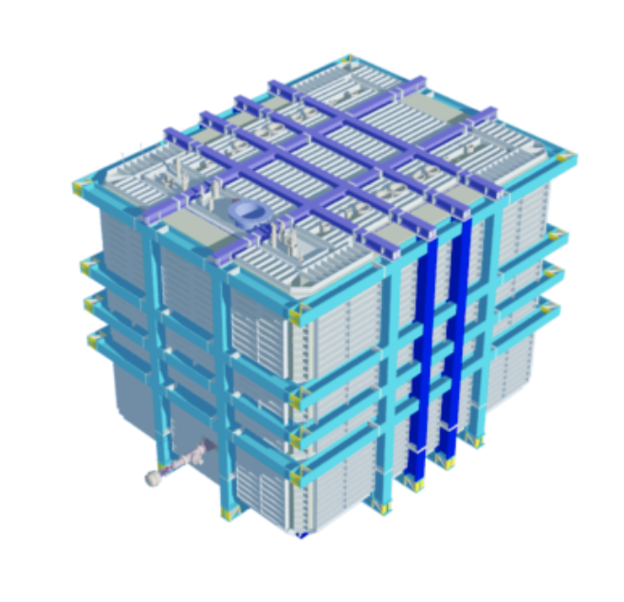
SBND Cryostat
Outer steel structure
Material delivered to CERN in February
Preassembly about to start at CERN
On track for installation at FNAL in May/June
Membrane cryostat
Design contract being placed by CERN
Design to start in March
Material delivery to FNAL in fall for installation late 2019
SBND Cryostat Model

Slide 17
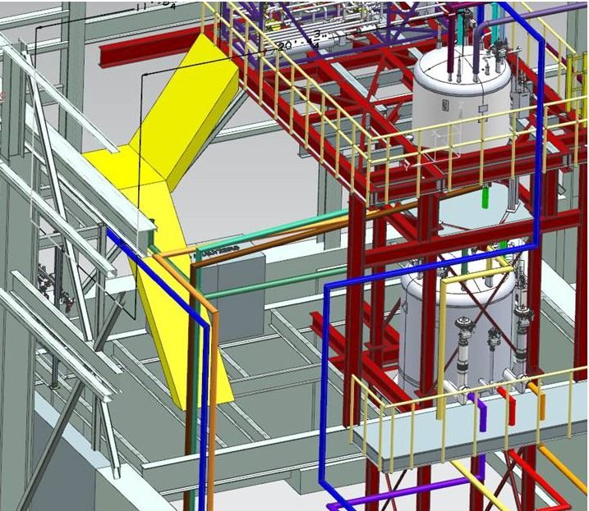
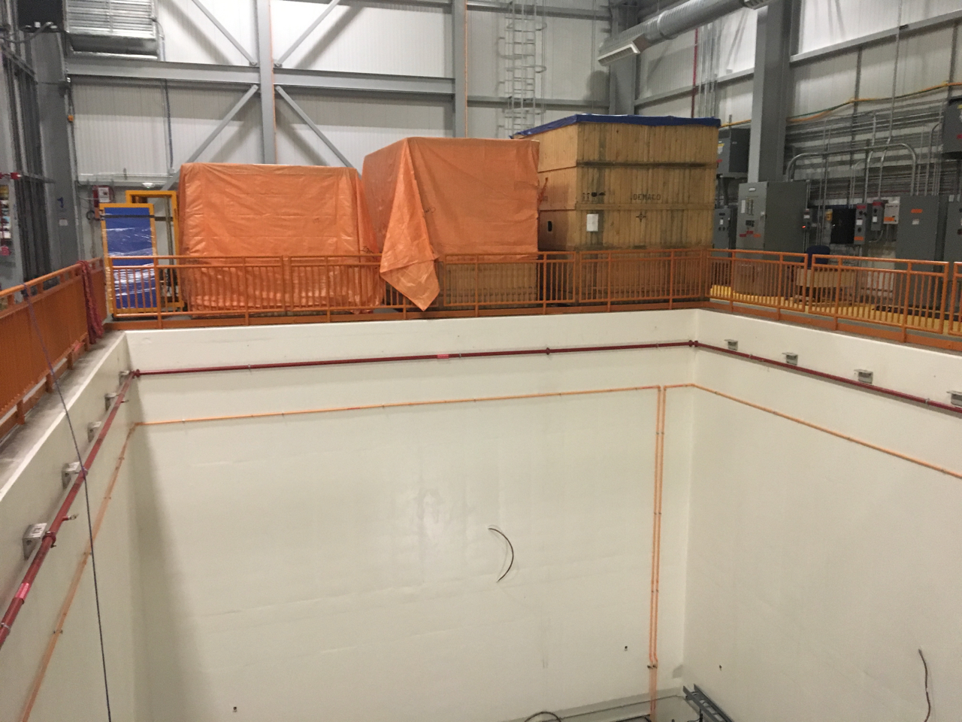
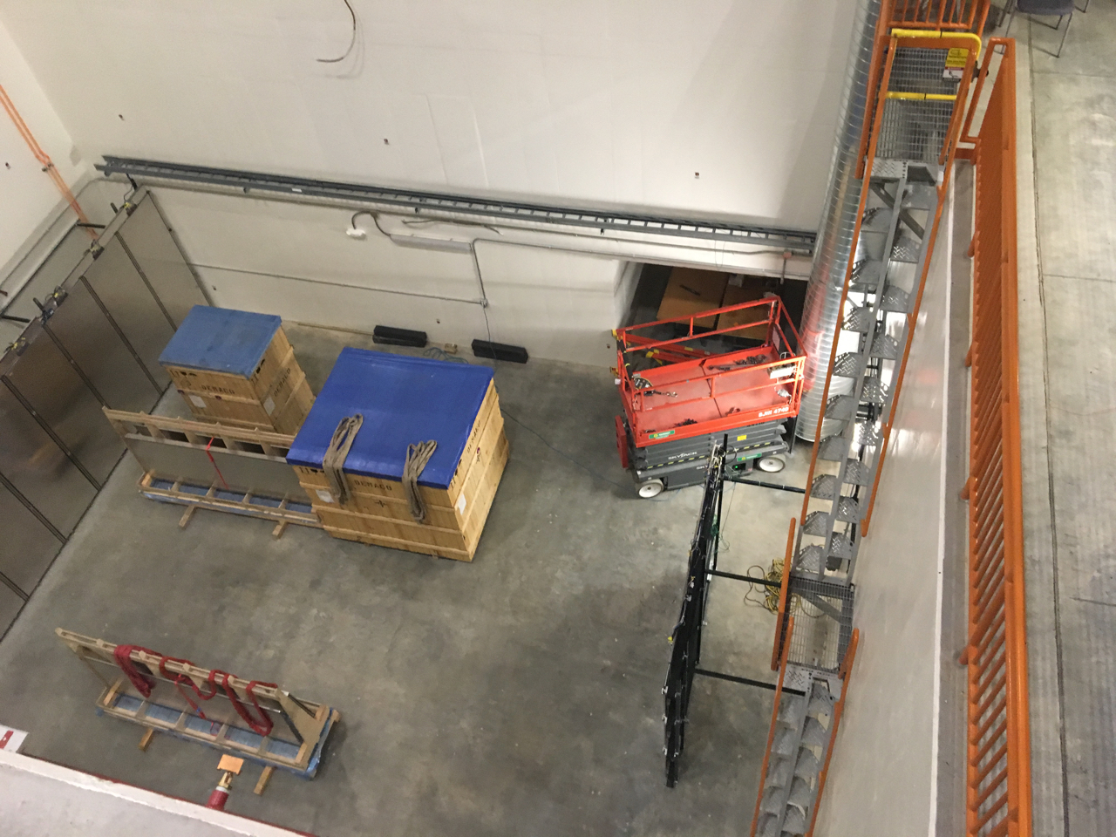
SBND Cryogenics
Cryogenics Platform
Installation started this week – complete by early April
Proximity cryogenics
Equipment delivered in December from CERN
Installation starting in April when Demaco is done with installation in FD building
Complete by end of May
Cryo platform design
Crated Valve boxes in ND Building
Preparing for platform install

Slide 18
Near Detector Personnel Changes
Anne Schukraft has taken over as Technical Coordinator
Brian Rebel has moved to a joint faculty position at U. Wisconsin / staff position at Fermilab with primary focus on DUNE
Anne has extensive experience from MicroBooNE and SBN FD CRT
Roberto Acciarri fills the new position of Installation Coordinator
Roberto has most recently been working on ProtoDUNE-SP based at CERN

Slide 19
SBND Milestones to S-1 SBND ready to move
Intermediate Milestone | Owner | Baseline Date | Forecast Date (Schedule) |  | Actual Date
First set of APAs shipped to Fermilab | K. Mavrokoridis | 24-Sept 2018 |  | a | 25-Feb-2019
PO for COTS ADCs placed | H. Chen | 10-Oct-2018 |  | ✓ | 30-Oct-2018
All TPC Components at Fermilab | K. Mavrokoridis | 1-Mar-2019 | 19-Mar-2019
Complete atf assembly at DAB | J. Zennamo | 1-May-2019 | 18-Apr-2019 | b
50% of motherboards delivered to Fermilab | H. Chen | 15-May-2019 | 19-Apr-2019
APAs and CPAs installed in atf | J. Zennamo | 15-Jun-2019 | 5-Jun-2019
Field cage assembly complete | J. Zennamo | 15-Jul-2019 | 15-Jul-2019
Cold electronics installed and tested | H. Chen | 23-Aug-2019 | 20-Aug-2019
S1: TPC ready to move to SBN ND | A. Schukraft | 30-Aug-2019 | 23-Aug-2019
Forecast update awaiting placement of atf contract
US APA group decided to ship both their APAs and field cage in one shipment, delaying shipment of the first APA from September to early February. This should have little to no impact on completion the final assembly
The atf biding process has been delayed due to holidays by about 8 days. This delay propagates through to forecast dates of subsequent milestones. We are working on absorbing this delay in the assembly process.

Slide 20
SBN Director’s Review – Dec 2018
Director’s Review for SBN was held held Dec 17-19 2018
The final review report available on the review website:
Review Final Report
The review committee was pleased with the progress made since the June 2018 review which focused primarily on schedule. The committee congratulates the team for the great progress in getting the far detector modules installed. Progress on the near detector components is also quite impressive.
Total of 16 recommendations (had 34 from June review)
Expect all but one to be addressed by end of March
Common theme in comments about need for better documentation: Steve B and Peter W decided to create our own 17th recommendation to address this
Expect next review in December 2019
Focus on SBND Installation

Slide 21
DOE Funding
In Spring 2018 we requested an additional $3,900k of funding from DOE to keep the program on track
Funds needed in the 2019 fiscal year to prevent significant delays for both far and near detectors
Repeated request at the time of the December 2018 Director’s Review
On January 29, Steve Brice, Tim Meyer and Peter Wilson visited DOE to brief them on financial status of SBN
After the briefing DOE has provided the requested additional funds
This allows critical procurements to proceed unimpeded, for example:
LAr contract for the far detector
contribution to near detector cryostat design contract
near detector cold electronics

Slide 22
Transition to Operation Planning
At January DOE briefing we also presented a plan for transition to operations
Address commissioning and operations plans for both detectors and associated support (e.g. cryogenics, online computing, data storage)
Transition to Operations Team created
Angela Aparicio – Neutrino Division (ND) Safety Officer
Steve Brice – ND Representative
Angela Fava – Far Detector Deputy Technical Coordinator and Deputy Commissioning Coordinator
Cat James – Deputy Program Coordinator
Claudio Montanari – Far Detector Technical Coordinator and Commissioning Coordinator
Barry Norris – SBN Program Engineer and Head of ND Technical Support Dept
Dave Schmitz – SBND collaboration representative
Michelle Stancari – Near Detector Commissioning Coordinator
Peter Wilson – Program Coordinator, chair of TOT
Bob Wilson – ICARUS collaboration representative
Wes Ketchum - Scientific Computing Division representative
Kick-off meeting in February
Presentations on the organization of experiment operations at Fermilab including support model and example of the MicroBooNE operations organization
Regular meetings to start in March to define organizations and prepare Experiment Operations Plan
Operations Readiness Review organized by Fermilab in fall 2019 to coincide with start of neutrino beam to far detector. Expect 2nd review in 2020 when near detector starts

Slide 23
Backup

Slide 24
Notes on milestones to I-1
Arrival of subcontractor delayed by CERN to ensure transport of equipment was completed in advance with schedule contingency
Delivery of last cross and PMT flanges from INFN/CERN completed by end of January
Start delayed by 2 weeks, see a) above. Parts to replace those damaged in shipping are expected to arrive in May, however these parts are not anticipated to impose any delay on installation of other components
Added contingency in materials transport
Added contingency in materials transport
Baseline for I-1 set in March 2018 when delays in delivery of cold shields has not been completely realized. Detailed intermediate milestones were defined and baselined in July 2018

Slide 25
ICARUS Milestones to I-2 Detector Filled
Intermediate Milestone | Owner | Baseline Date | Forecast Date |  | Actual Date
Cold shield cooldown complete | C. Montanari | 7-Aug-2019 | 15-Jul-2019
Vessels filled with LAr, ready for HV | M. Geynisman | 30-Sept-2019 | 10-Sept-2019
Drift HV operational | F. Garcia | 15-Oct-2019 | 10-Sept-2019
PMTs operational | G. Raselli | 30-Oct-2019 | 15-Oct-2019
Cryogenics commissioning complete | M. Geynisman | 30-Nov-2019 | 22-Oct-2019
Cosmic tracks are observed in the TPC | A. Fava | 30-Nov-2019 | 22-Oct-2019
I2: detector is filled with liquid argon and ready for physics commissioning (LAr purity adequate for physics has been achieved) | P. Wilson | 30-Nov-2019 | 01-Nov-2019

Slide 26
ICARUS Milestones to I-3a ready for physics data – CRT operational
Intermediate Milestone | Owner | Baseline Date | Forecast Date |  | Actual Date
Complete installation of Side CRT modules (a) | A. Schukraft | 31-July-2019 | 28-Jun-2019
Top CRT panels delivered to Fermilab | U. Kose | 30-Sept-2019 | 31-Jul-2019
Slow controls operational for all detector systems | K. Biery | 31-Oct-2019 | 30-Sept-2019
DAQ operational with >5Hz output | K. Biery | 31-Oct-2019 | 30-Sept-2019
Detector system timing synchronized with beam | K. Biery | 30-Nov-2019 | 31-Oct-2019
Trigger system operational | A. Guglielmi | 31-Dec-2019 | 30-Nov-2019
Top CRT panels are installed and ORC’ed | U. Kose/A. Fava | 31-Jan-2020 | 5-Dec-2019
I3a: ICARUS detectors are ready for physics data – CRT is operational | P. Wilson | 31-Jan-2020 | 17-Dec-2019
Notes:
This milestone is currently at T4 in the schedule file. Will promote to T3 at the next schedule statusing

Slide 27
ICARUS Milestones to I-3b ready for physics data – shielding in place
Intermediate Milestone | Owner | Baseline Date | Forecast Date |  | Actual Date
Shielding blocks in place | C. James | 28-Feb-2020 | 6-Feb-2020
I3b: ICARUS detectors are ready for physics data – Shielding in place | P. Wilson | 28-Feb-2020 | 18-Feb-2020

Slide 28
SBND Milestones to S-2 Ready to Fill
As presented at Jan 2019 PMG.
Intermediate Milestone | Owner | Baseline Date | Forecast Date |  | Actual Date
GTT Design Study Begins | M. Nessi | 1-Feb-2019 | 2-Jan-2019
Delivery of warm box steel | M. Nessi | 15-Jun-2019 | 25-Apr-2019
Warm vessel installation complete | M. Nessi | 15-Jul-2019 | 29-Jul-2019
TPC Transport to ND building complete | J. Zennamo | 15-Sept-2019 | 3-Sept-2019
Cryostat material arrives at Fermilab | M. Nessi | 1-Oct-2019 | 17-Sept-2019
Cryostat top plug is ready to attach to atf | M. Nessi | 1-Nov-2019 | 15-Oct-2019
Membrane Cryostat Completed | M. Kim | 1-Mar-2020 | 22-Jan-2020
Plug welded to cryostat | M. Kim, J. Zennamo | 15-Apr-2020 | 18-Mar-2020
Cryogenic operation approved | M. Geynisman | 1-Jul-2020 | 11-Jun-2020
S2: SBND detector is ready to fill with liquid Argon | A. Schukraft | 15-Jul-2020 | 11-Jun-2020
Comment: We expect intermediate milestone forecast dates to change in the near future as the installation sequence is undergoing some changes. Note, that this will not affect the forecast date of key milestone S2.

Slide 29
SBND Milestones to S-3 Detector Filled
As presented at Jan 2019 PMG.
Intermediate Milestone | Owner | Baseline Date | Forecast Date |  | Actual Date
Laser system installation complete | I. Kreslo | 1-Oct-2020 | 10-Apr-2020
Detector checkout at 130-150 K complete | M. Stancari | 15-Nov-2020 | 26-Oct-2020
Vessels filled with LAr, ready for HV | M. Geynisman | 21-Dec-2020 | 23-Nov-2020
Drift HV operational | A. Schukraft | 31-Jan-2021 | 9-Dec-2020
PMTs operational | R. Van de Water | 31-Jan-2021 | 2-Dec-2020
Cryogenics commissioning complete | M. Geynisman | 28-Feb-2021 | 23-Dec-2020
Cosmic tracks are observed in the TPC | M. Stancari | 28-Feb-2021 | 23-Dec-2020
S3: SBND detector is filled with liquid argon and ready for physics commissioning (LAr purity adequate for physics has been achieved) | A. Schukraft/M. Stancari | 28-Feb-2021 | 23-Dec-2020

Slide 30
SBND Milestones to S-4a ready for physics data – CRT operational
Intermediate Milestone | Owner | Baseline Date | Forecast Date |  | Actual Date
Top CRT panels delivered to Fermilab | I. Kreslo | 1-Jul-2019 | 3-Oct-2019 | a
Slow controls operational for all detector systems | S. Gollapinni | 15-Sept-2020 | 17-Aug-2020
DAQ operational with >5Hz output | W. Badgett | 1-Nov-2020 | 12-Oct-2020
Detector system timing synchronized with beam | W. Badgett | 15-Nov-2020 | 21-Sept-2020
Trigger system operational | W. Badgett | 15-Jan-2021 | 2-Dec-2020
Top CRT panels are installed and ORC’ed | I. Kreslo | 31-Mar-2021 | 20-Jan-2021
S4a: SBND detectors are ready for physics data – CRT is operational | M. Stancari | 31-Mar-2021 | 25-Jan-2021
Production of the top CRT modules has been delayed to reflect current SBN schedule and optimize load on the Bern workshop. There is no impact on the overall SBN schedule (Installation is planned to start in Dec 2020).
As presented at Jan 2019 PMG.

Slide 31
SBND Milestones to S-4b ready for physics data – shielding in place
Intermediate Milestone | Owner | Baseline Date | Forecast Date |  | Actual Date
Shielding blocks in place | C. James | 21-Apr-2021 | 16-Feb-2021
CRT system complete and fully commissioned | I. Kreslo | 30-Apr-2021 | 25-Feb-2021
S4b: SBND detectors are ready for physics data – Shielding | M. Stancari | 30-Apr-2021 | 25-Feb-2021
As presented at Jan 2019 PMG.

