Slide 1
Cherenkov scans and beam composition
December 6th, 2018
Yannis Karyotakis for N.Charitonidis, E.Nowak, M.Rosenthal, I.Ruiz, P.Sala

Slide 2
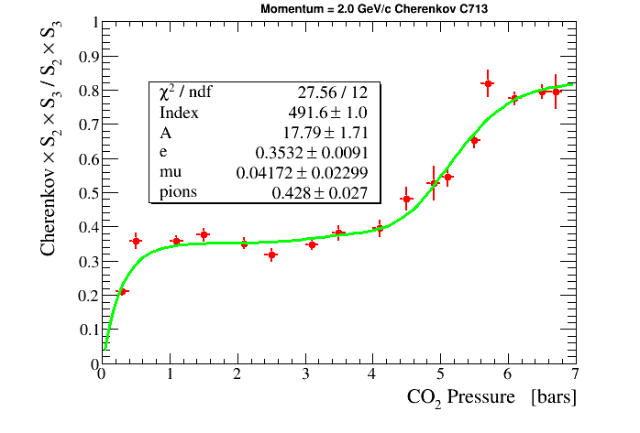
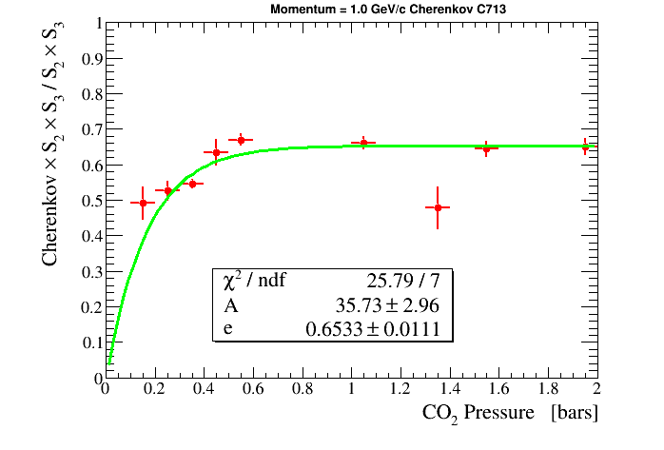
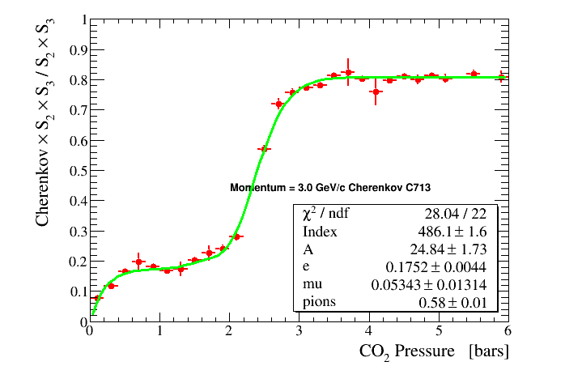
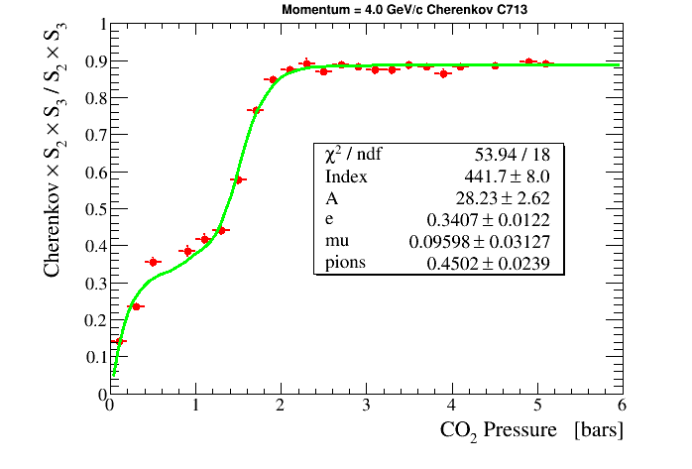

Slide 3
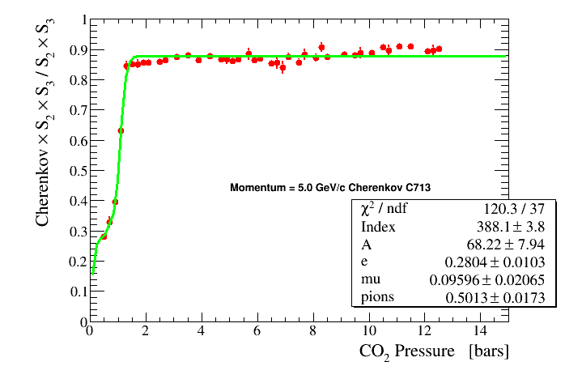
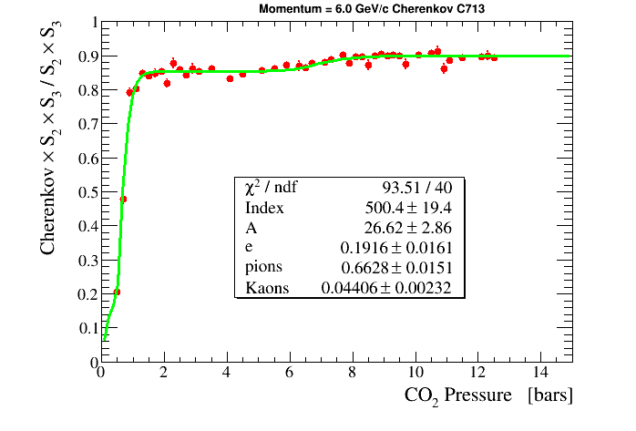
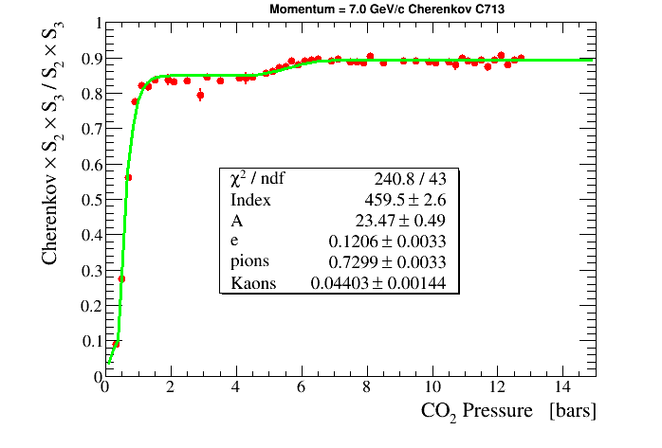

Slide 4
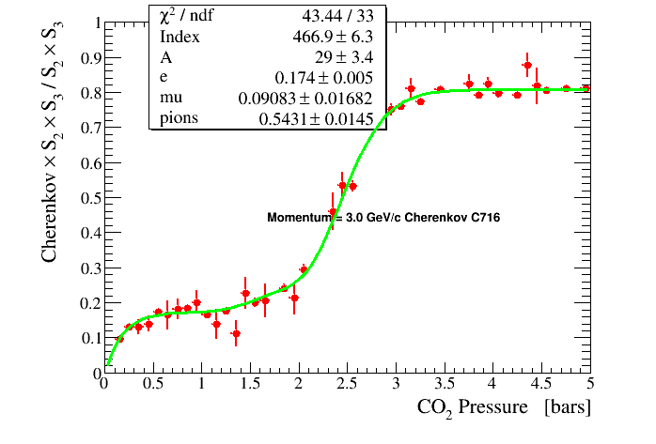
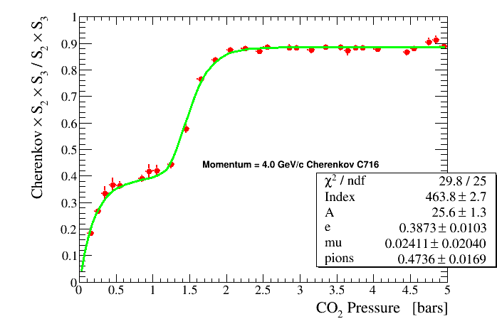
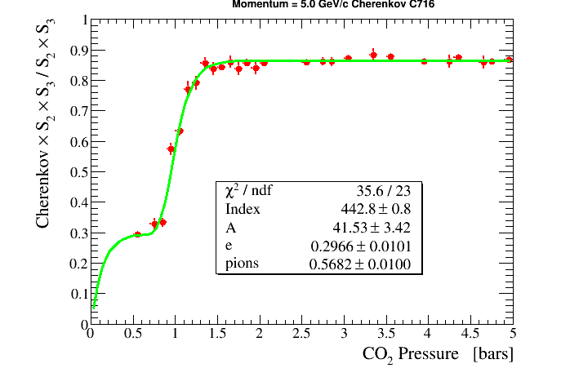

Slide 5
Beam composition only from Cherenkov data
Electrons
Pions
Kaons
Muons

Slide 6
Conclusion
Using the previous plots and the Cherenkov pressure value set during data taking you can get the PID information

