Slide 1
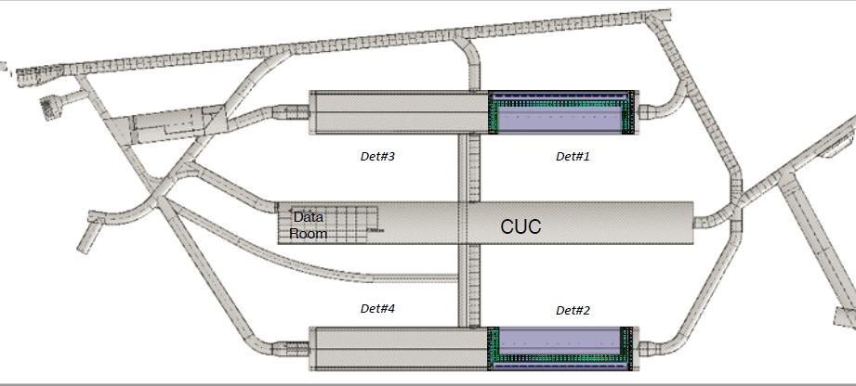
Schedule
is entirely driven by excavation delays.
TDR now says we start CUC installation October 2022, and have a year before Det#1 starts

Slide 2
What we’ve to do
Will get a bare server room, with hookups for chilled water and power, with a drop floor
So, we need to fit this in there:
Note this is old dates, add 6 months

Slide 3
Fiber runs
See Tim’s talk for data room install info
CF puts single mode fiber in the shaft. It’s unclear if they also connect that to the data room
In parallel to Rack Installation, we lay the multimode to the detector cavern
By “we” I mean fiber pros, to carefully lay out and test things: we will be close to the power budget
They will leave ends to jack into CE and FELIX
False floor will cover cryostat cable trays when done

Slide 4
Coordination
As our racks go in, two of them are CF racks: presumably safety things and general purpose networking
FNAL’s Scientific Computing Division will also be putting in the lab’s general purpose networking at this point
Both of which we will need operational before we can do much other than infrastructure work

Slide 5
Our Constraint
By the end of that year, we have to be ready to read out APAs as they go in
So, what do we need operational before then?
Timing system
Some FELIX servers
Misc. back-end stuff to run a minimal DAQ
Will also need a “DAQ Kit” test stand in the clean room for testing APAs in the cold boxes as they are
Will keep adding capacity in parallel with APA installation

Slide 6
Above Ground
There are “eight racks” aboveground, for event builder and data logger
Connected to shaft single mode fiber
It is unclear where they will be: there are drawings of them tucked in a corner of the dry room at shaft top
Since the single mode fiber has ~km of run left, it might make more sense to run them to a building in Lead, to use as a DAQ work space and aboveground control room
Not in CF scope

Slide 7
Operational Mode
What will we be doing?
Rack plumbing, power done by contractors
Fiber run, testing done by contractors
DAQ people stuff racks
In conjunction with data room and server management people from FNAL’s Scientific Computing Division
Few people actually underground!
As much work as possible done via the network, from offsite or at the mysterious Above Ground Control Room

Slide 8
Moving forward
An integration/installation group (consisting at the moment of Tim Durkin and Alec Habig) will coordinate
With Conventional Facilities (Terri Shaw), the Installation group (Jim Stewart), Scientific Computing (Bonnie King)
ProtoDUNE will be priceless for getting things sorted out in advance in a far less constrained setting than underground at SURF

