Slide 1
Inter-Plane Induction Effects (and more...)
Tom Junk, Ajib Paudel, Tingjun Yang
ProtoDUNE Sim/Reco Meeting
December 12, 2018
Ajib did all the heavy lifting.

Slide 2
Broken Channels in ProtoDUNE-SP
Tingjun Yang,
APA Consortium
Meeting
Nov. 19, 2018
Broken Channel List from
David Adams

Slide 3
Alberto's Request
Can we see the effect of the broken collection wires in the V plane?
We expect the potential map to be distorted if the collection-plane wire is floating
Less so if the collection-plane wire is jumpered to its neighbor
If a U or a V wire is broken and floating, expect less of an impact. Charge should not collect on a disconnected wire, or on a connected one.
MicroBooNE had a significant effect on neighboring plane wires due to shorted wires. We have far fewer broken wires and they are isolated. Can we see the impact?

Slide 4
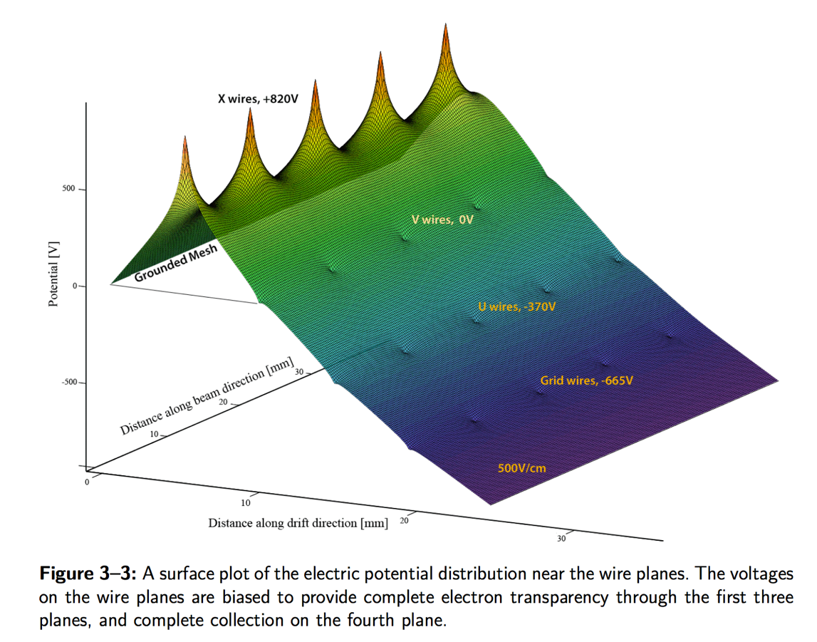
The (Proto)DUNE-SP Anode Potential Map
From The LBNE CDR, Vol. 4

Slide 5
Ajib's Median dQ/dx U plane (y,z)
Beam Right
APA 3
APA 2
APA 1
86000 Events, 1 cm x 1 cm binning

Slide 6
Ajib's Median dQ/dx V plane (y,z)
Beam Right
APA 3
APA 2
APA 1

Slide 7
Ajib's Median dQ/dx Z plane (y,z)
Beam Right
APA 3
APA 2
APA 1
And similarly for APA's 4, 6, and 5

Slide 8
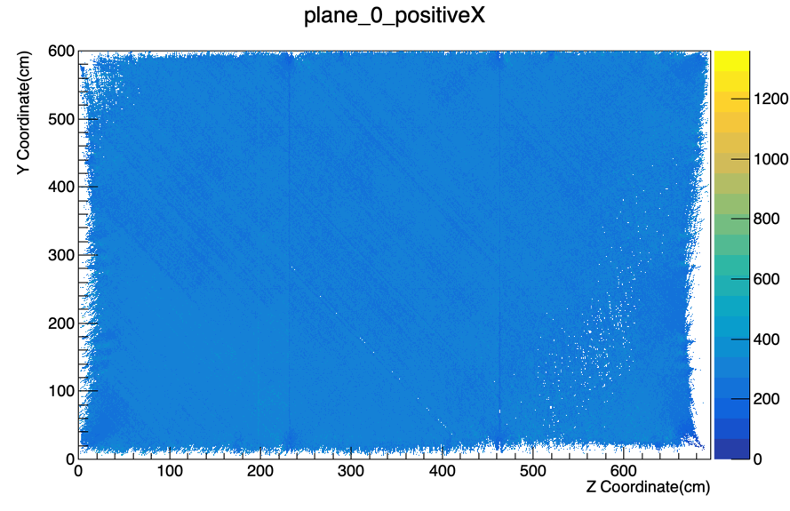
Ajib's Median dQ/dx U plane (y,z)
Beam Left
APA 5
APA 6
APA 4

Slide 9
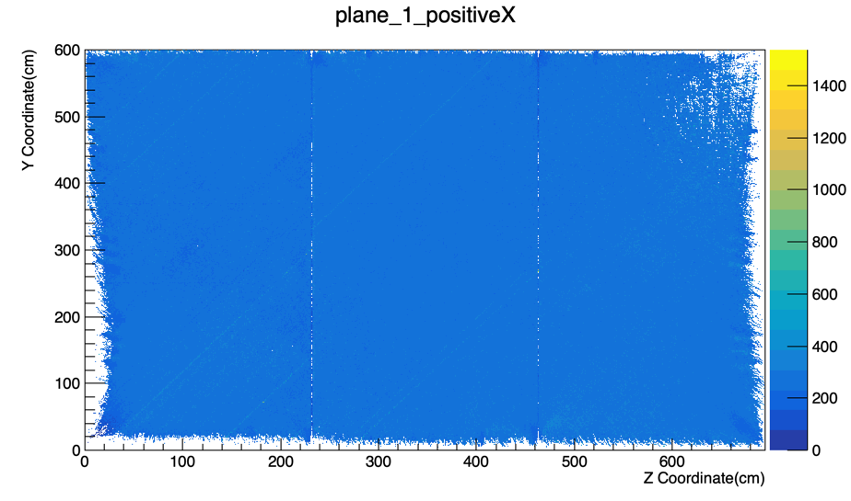
Ajib's Median dQ/dx V plane (y,z)
Beam Left
APA 5
APA 6
APA 4

Slide 10
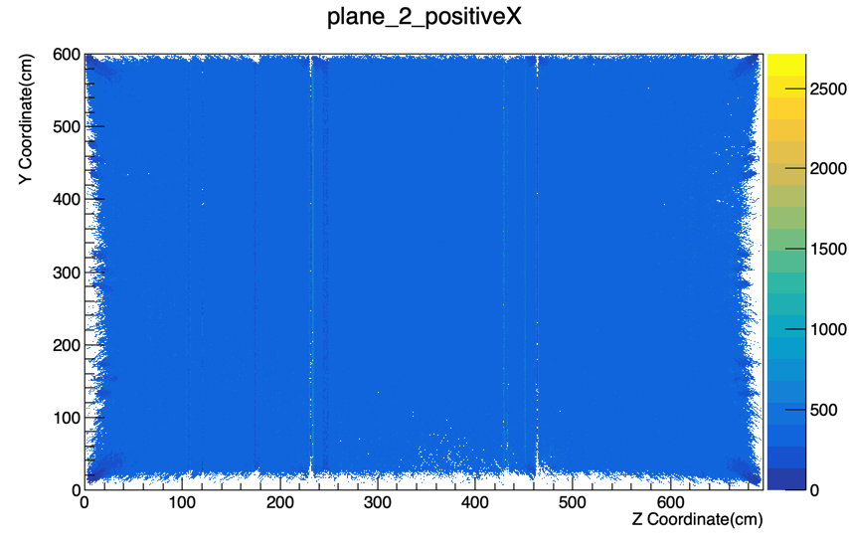
Ajib's Median dQ/dx Z plane (y,z)
Beam Left
APA 5
APA 6
APA 4

Slide 11
Projecting These Onto Axes
Features are small and expected to be hard to detect.
Average the median dQ/dx values along axes:
    U = y sin𝜃 – z cos 𝜃
    V = y sin𝜃 + z cos 𝜃
    (swap U and V for APA's 4, 6 and 5)
    Z
    Y
Do this for each plane's data in each APA:
(U, V, Z) x (1,2,3,4,6,5) x (4 projections) = 72 plots
http://home.fnal.gov/~trj/foralberto/protodune_dqdx_averages/index.html

Slide 12
Comments
These are the dQ/dx values for hits that are seen, not a count of missing ones. So an upward spike upwards due to
displaced charge is coupled with a downward dip that doesn't show up on these plots.
U wires are at constant U. V wires are at constant V. Collection wires are at constant Z.
Cryostat-side wire segments do not contribute (to a good approximation)
Some effects are due to short wires in corners only sampling signals drifting in corners. These can be in the middle of some plots.
Data are sparse on the edges and corners.

Slide 13
Some Interesting Ones
Stretching
due to
grounded
electron
diverter
Stretching
due to space
charge
inhomogeneity

Slide 14
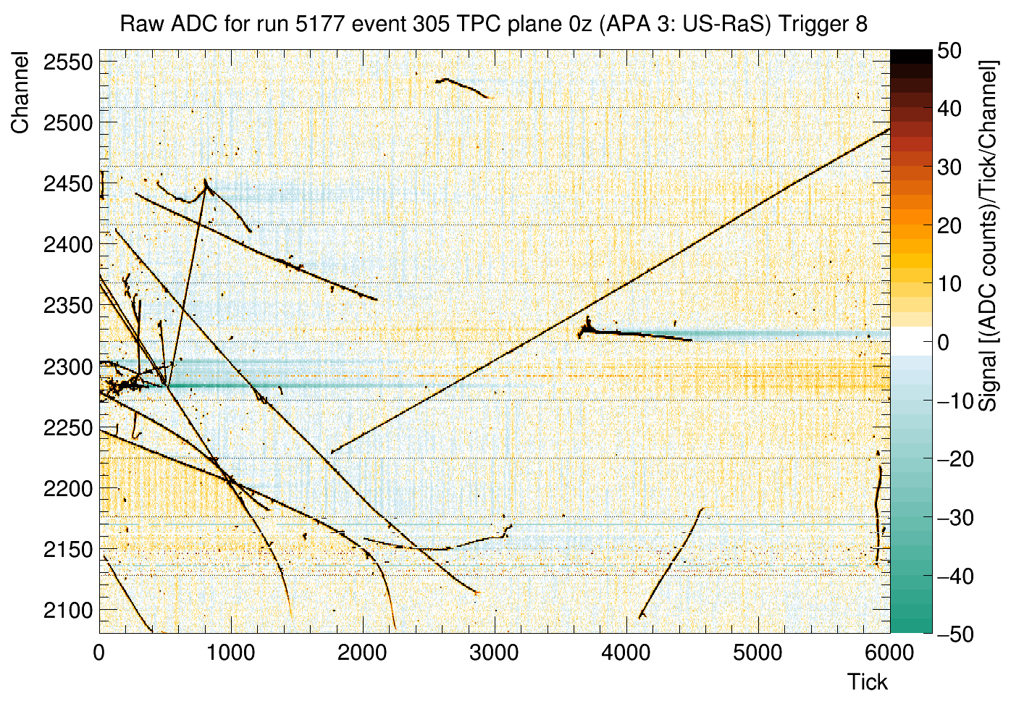
Space Charge Position Distortion
David Adams's
Raw Event
Display shows
this effect
nicely.

Slide 15
Some Interesting Ones
Four
Wire
Support
Combs
Three
Field
Cage
Rib
Pairs

Slide 16
Wire Support Combs
From the ProtoDUNE-SP TDR

Slide 17
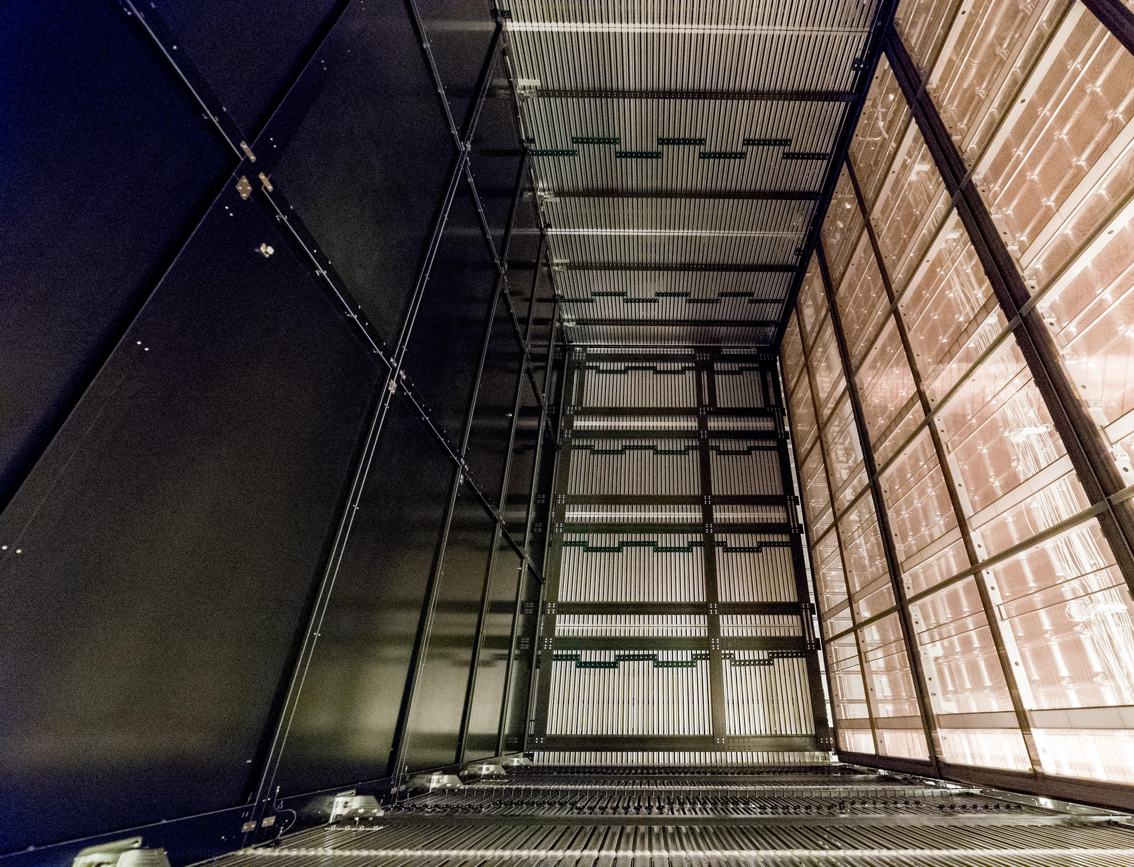
Field Cage Ribs and Support Combs
From Kevin
Wood's
Collab
Meeting
Talk
Sep 2018

Slide 18
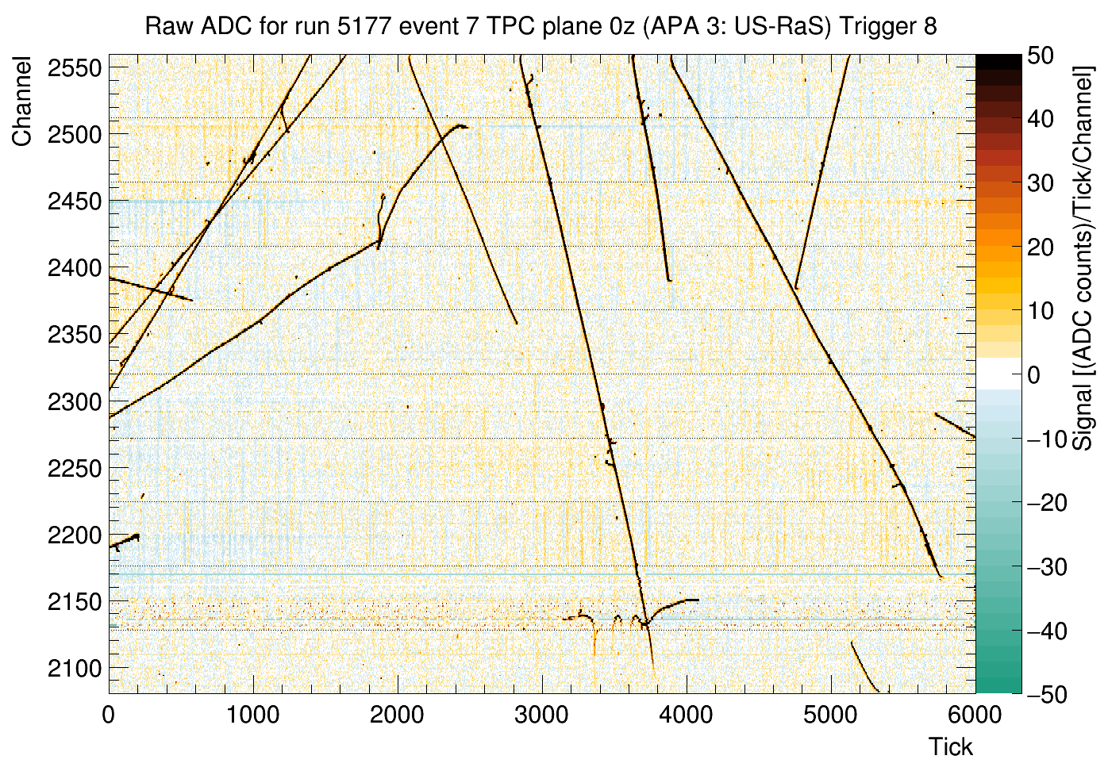
Track Distortion due to Field Cage Nonuniformities
We didn't see
this on all
tracks – now
it makes more
sense – these
are field cage
ribs.
D. Adams

Slide 19
One in the middle – no field cage or diverters
Just the
support
comb effects
visible

Slide 20
An Induced Effect
Electron Diverters on each side
Broken collection-plane wire on drift side

Slide 21
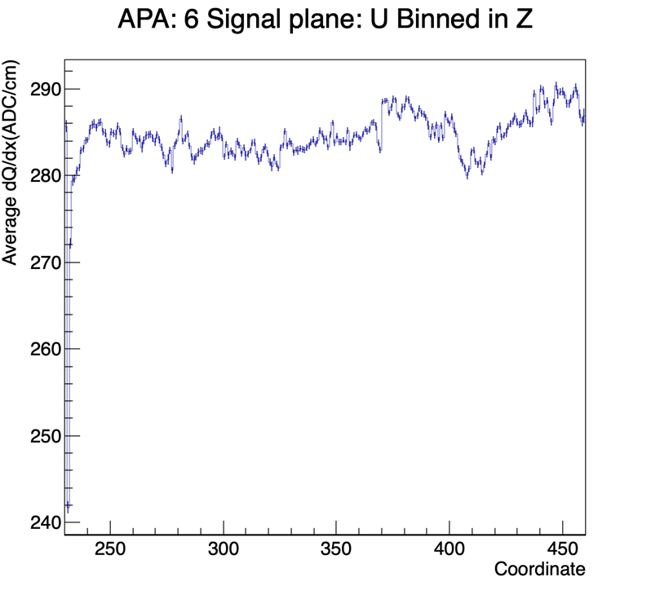
Another Pair of Induced Effects
Two broken channels in Z seen in V but not U

Slide 22
Space Charge Effects
Binning done in U and
V, not in channel number
Small signals seen in corners.

Slide 23
Some Effect of Broken U wires

Slide 24
Something Unexpected
Low
Stats
???
Grid wire broken? Seen in U but not V when projected in Z
Position not on Tingjun's map

Slide 25
Summary
More plots (72 combinations) on the web page
Not all features are understood yet.
Some of the dead wires on David's list cause induced effects on other planes' signals, but not all. Effects are small
Space charge spreads out and lowers dQ/dx.
Space charge effects are large.
Field cage ribs and combs have small but visible effects

