Slide 1
MQXFAP1b Preload Proposal Update
--- with measured pole key gap
H. Pan, D. Cheng
LBNL

Slide 2
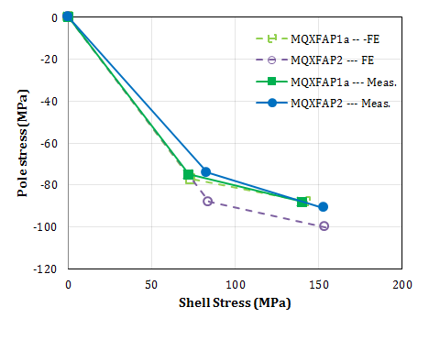
Preload Achieved in MQXFAP1a
Average stress: (MPa)
 |  | MQXFS1a (Meas.) | MQXFS1b (Meas.) | MQXFAP1a (Meas.) | MQXFAP2 (Meas.)
RT | Coil | -61 | -77 | -75 | -74
 | Shell | 72 | 95 | 72 | 83
CD | Coil | -81 | -101 | -88 (simulation) | -91
 | Shell | 140 | 173 | 140 | 153
Actual Interference (μm) |  |  |  | 580 | 710
Target average stress for MQXFAP1a: $−77 MPa$ on the pole at R.T. using 640 μm key interference.
Preload completeness criteria at R.T.:
Either average coil stress reaches -77 MPa,
Or, maximum measured coil stress measures -94.5 MPa (in any of the 3 axial locations)
The reference condition of MQXFAP1 is with 1 mil gap between pole key and collars (per side).

Slide 3
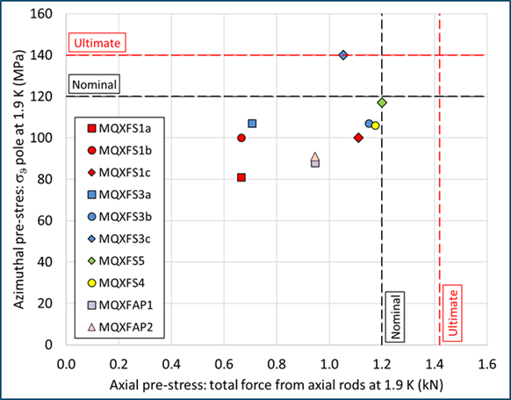
Preload Achieved in MQXF magnets
MQXFAP1a

Slide 4
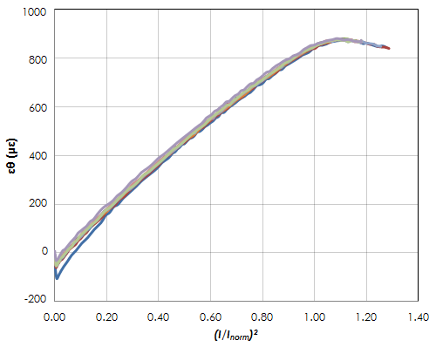
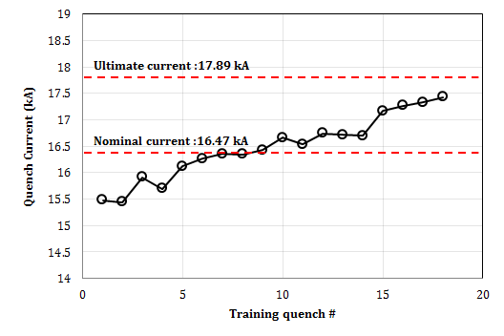
MQXFAP1a Quench Performance
MQXFAP1a Coil3 Middle
MQXFS1b Coil 5
MQXFAP1a Coil3 RE
MQXFAP1a Coil4 RE
MQXFAP1a before Coil 5 failure seemed to be accepted from the standpoint of the training curve.
Pre-stress in coils was lower than MQXFS1b.
To avoid unloading: Pole stress 120 MPa at nominal current.
Increase coil pre-stress may need to be considered.
---Shell stress needs to be limited.

Slide 5
Case Study on MQXFAP1b
Case I (baseline):
Same actual loading on MQXFAP1a
Case II (Conservative):
Large polekey gap to keep collar not close at cold (no polekey).
Remain Case I coil stress at R.T.
Case III (Aggressive):
Large polekey gap to keep collar not close at cold (no polekey).
Yield Case I shell stress at cold.
Achieve to MQXFAP1a coil stress level at cold
Achieve to MQXFS4 coil stress level at cold
Additional options without polekey (as the dot line and dash line ) to achieve different coil stress levels.
 | 300K | 1.9 K
Shell modulus in the model (GPa) | 70 | 79
Measurement at NHMFL (GPa) | 70 | 80

Slide 6
MQXFAP1b Compared with other MQXF Magnets
Case III
Case II
Case I, （=MQXFAP1a）
Coil stress in Case III is beyond the stress state needed for the ultimate, which is too extreme for the magnet.
Coil stress in Case II is very close to (and in between) the stress achieved in MQXFS4 and MQXFS1b.

Slide 7
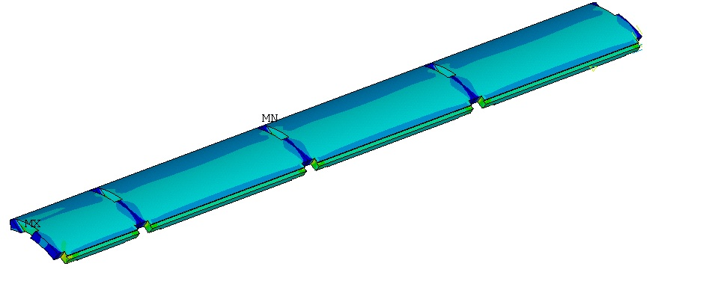
Coil and Shell Stresses in Case I
 | Value
Interference (µm) | 580
Polekey gap (µm/side) | 25
Polekey interception F_{pole}/F_{shell} | 24%
No pole stress measurement data
 | 1.9 K | 16.47 kA | 17.89 kA | 19 kA
Shell Average Von Mises Stress (MPa) | 143 | 153 | 155 | 161
Shell Peak Stress (MPa) | 578 | 577 | 577 | 578

Slide 8
Coil and Shell Stresses in Case II
 | Value
Interference (µm) | 455
Polekey gap (µm/side) | 200
Polekey interception F_{pole}/F_{shell} | 0
Shell stress margin:
Average ~28 MPa
 | 1.9 K | 16.47 kA | 17.89 kA | 19 kA
Shell Average Von Mises Stress (MPa) | 115 | 121 | 123 | 127
Shell Peak Stress (MPa) | 477 | 477 | 478 | 478

Slide 9
Coil and Shell Stresses in Case III
 | Value
Interference (µm) | 715
Polekey gap (µm/side) | 200
Polekey interception F_{pole}/F_{shell} | 0
Coil stress increases by ~43 MPa
 | 1.9 K | 16.47 kA | 17.89 kA | 19 kA
Shell Average Von Mises Stress (MPa) | 143 | 157 | 160 | 167
Shell Peak Stress (MPa) | 618 | 618 | 619 | 619

Slide 10
Case II with Actual Pole Key Gap
 | Value
Interference (µm) | 510
Polekey gap (µm/side) | 75
Polekey interception F_{pole}/F_{shell} | 9%
Coil stress remains same as MQXFAP1a.;
Shell stress has a reduction of 23 MPa
 | 1.9 K | 16.47 kA | 17.89 kA | 19 kA
Shell Average Von Mises Stress (MPa) | 120 | 130 | 134 | 140
Shell Peak Stress (MPa) | 502 | 506 | 506 | 505

Slide 11
MQXFAP1b Preload Summary
As discussed in the review (https://indico.fnal.gov/event/19361/), MQXFAP1b preload aligns with case II. The working point at cold of MQXFAP1b is predicted -89 MPa with the average measured pole key gap of 2.9 mil.
Coil / shell stress: -76MPa/60MPa at R.T.; -88 MPa / 120MPa at 4.2K.
MQXFAP1b has same coil stress as Case I, (MQXFAP1a)

Slide 12
Axial Preload Calculation
As the axial preload does not dominantly impact the magnet performance, the MQXFAP1b would retain the same axial load as MQXFAP1a:
MQXFA1b Proposal | Room Temperature | 1.9 K | Nominal Current
Preload | 580 µε | 1200 µε
Axial Force (MN) | 0.28 | 0.61 | 0.65
Ratio to the e.m. force at nominal current | 23.3% | 49.2% | 54.2%
Total axial e.m. force is 1.2 MN at nominal current.
Rod axial stress (MPa) with the case I preload level.
 | 1.9 K | 16.47 kA | 17.89 kA | 19 kA
Mu=0.2 | 218 | 231 | 235 | 238
Mu=0 | 210 | 290 | 305 | 320
σ_{y} of typical SS 316L is 380 MPa (R.T.) --- Matweb

Slide 13
Preload Proposal
MQXFAP1b will have the same coil stress as MQXFAP1a according to the average measured pole key gaps of 2.9 mil / side.
To align with case II, the resulting interference for azimuthal preload of MQXFAP1b is 510 µm.
Baseline axial preload strain at RT is still 580 με / rod.
Additional strain gauges are installed on rods RE.

