Slide 1
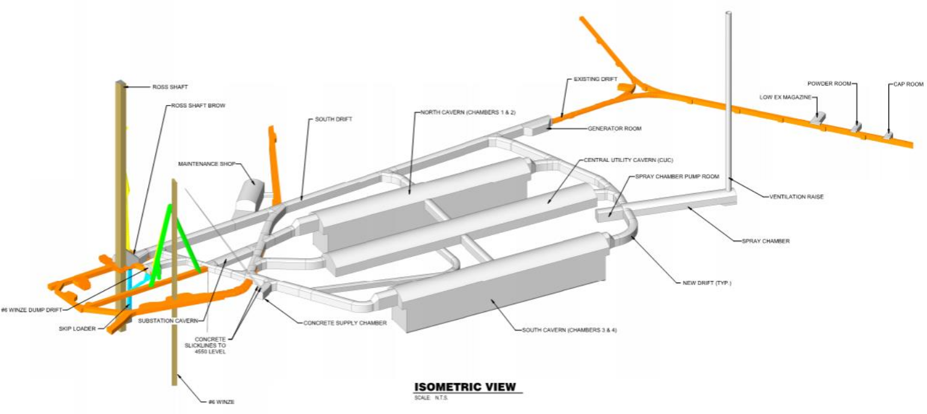
LBNF Excavation 60% Cost Reconciliation
Fermilab, December 17-20 2018

Slide 2
60% Deliverables
Drawings
Specifications
Geotechnical Baseline Report
Basis of Design Report
Not reissued (no changes):
GDR
GIR

Slide 3
Changes/Significant Developments after 30%
Re-arrangement of eastern drift configuration – deletion of secondary access drift to spray chamber raise bore
Relocation and decoupling of Maint Shop from Substation room
Addition of Pump Room opposite of spray chamber to house mech equip and associated pipe trench
Location defined for three (3) rooms for explosive mag along #4 Winze drift
Alignment of mucking ramp to the bottom of the caverns updated. This was confirmed to be constructed and utilized by CM/GC to facilitate construction and mucking of the chambers during construction.

Slide 4
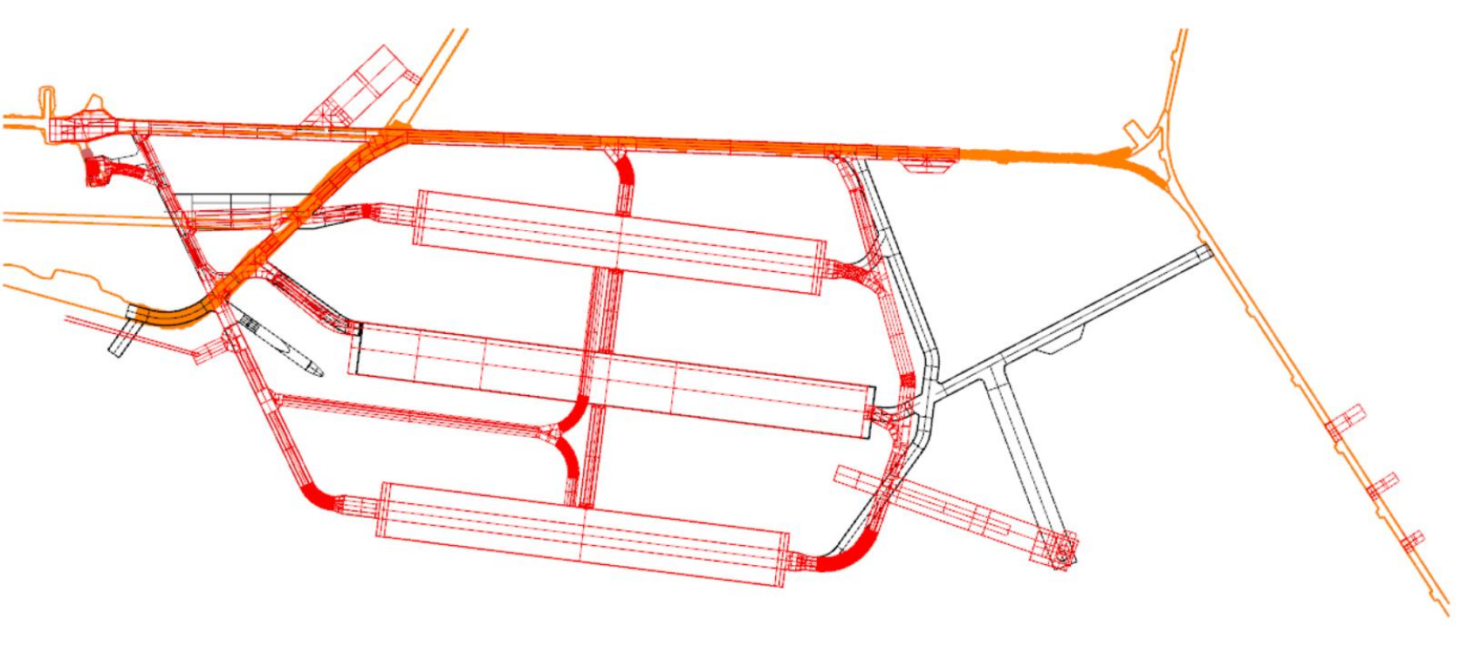
Changes/Significant Developments after 30%

Slide 5
Changes/Significant Developments after 30%
Increase in cavern rock bolt spacing (4 ft. to 5 ft.)
Reconfigured cavern benching sequence to allow for mass excavation within center cut
Differentiation of shotcrete waviness criterion between caverns and drifts (requirements relaxed in drifts)
Proof testing of each installed Mezzanine Anchor required (to 80% yield)
Cavern top heading height increased to accommodate proper install of 20 ft. rock reinforcement.
Better clarity around Ross Shaft Brow enlargement – removal of bottom 3 sets
Shotcrete thickness fixed at 4” (Instructed for Cost Estimate)

Slide 6
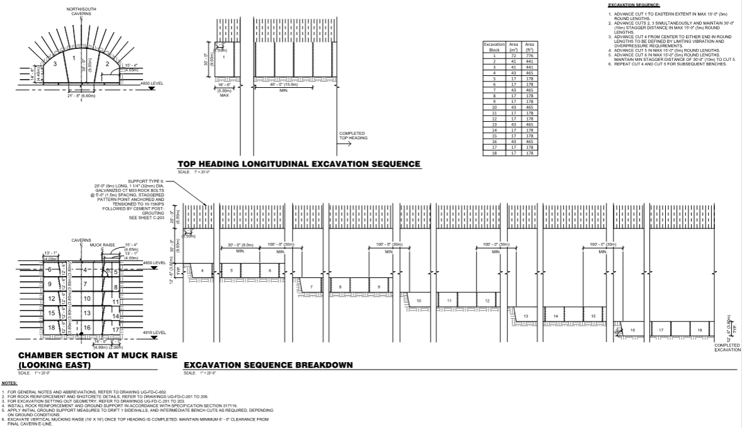

Slide 7
Changes/Significant Developments after 30%
Added frequency based vibration criterion for key sensitive receivers (#6 Winze, Ross Shaft)
Use of double blast doors on Ross Campus side to alleviate excess overpressure
The #6 Winze and west lab access drift blast doors must have a minimum opening of 9 ft. x 9 ft. The trolley drift, east lab access, and behind Ross Shaft blast door have a minimum opening of 5 ft. wide by 7.5 ft. high.
Instruments which are desired to be retained for the operational stage of the experiment (long term) have been identified.
Seismograph locations are revised based on a list of sensitive receivers developed between Arup and FRA.

Slide 8
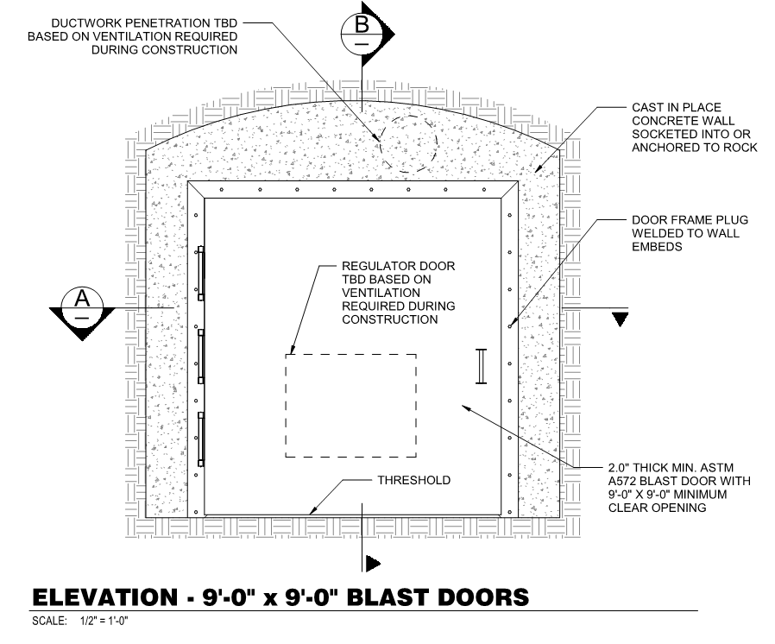

Slide 9
Changes/Significant Developments after 30%
Slabs within the CUC have been leveled and revised to show a solid slab on top of a mud slab, with a vapor membrane included in areas below the mechanical mezzanine, and to a solid slab for other areas. Local pad supports for dewars are shown, but the extent and size are not yet fully understood.
Slabs within the experiment cavern have been updated to include a Cavidrain sub-slab drainage system that extends to the perimeter walls. A granular layer and perforated pipes were previously shown in 30% FD. The use of Cavidrain provides several advantages for the project including reduced long term clogging from groundwater related mineralization, and easier installation compared to mass gravel.
A mud slab has been added below the structural slab to smooth out irregularities within the blasted invert.

Slide 10
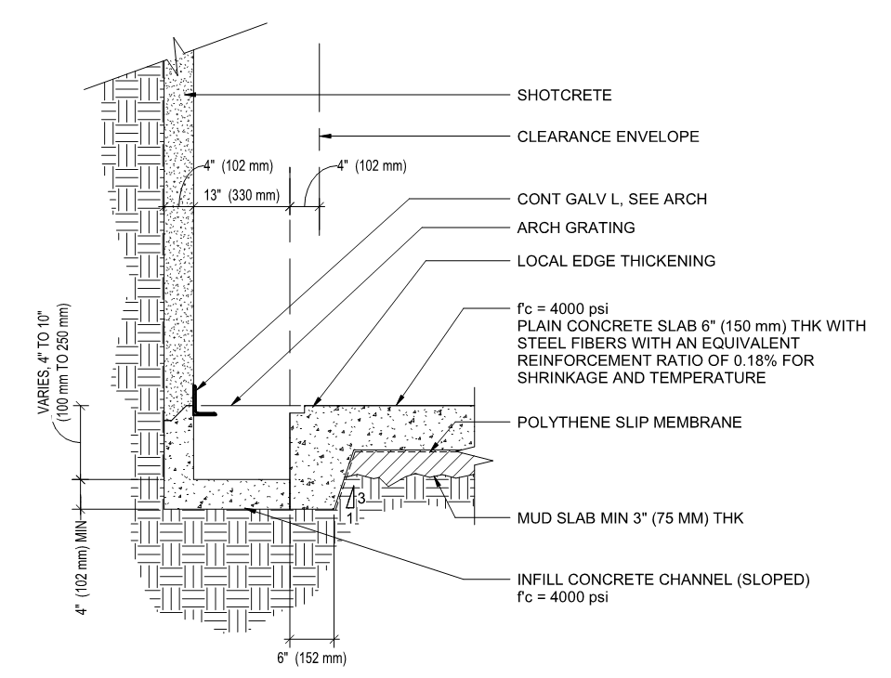
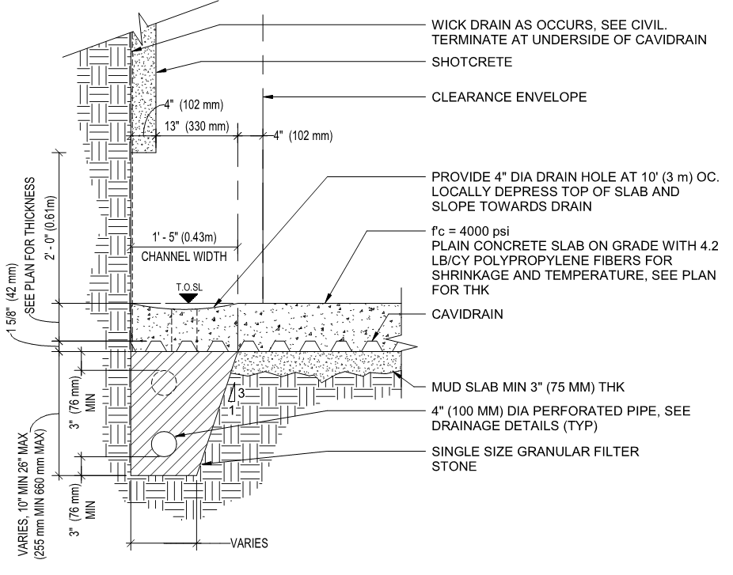

Slide 11
Changes/Significant Developments after 30%
Monorails: The design has been updated to incorporate comments from FRA. This includes changing the beam size, and raising the beams to be as high as possible.
Rail: Additional details for rails provided.

