Slide 1


Magnets 302.2.02 –
Strand Procurement and Testing
Lance Cooley – Florida State / NHMFL (L3)
Vito Lombardo – Fermilab (L3 Deputy and CAM)
HL-LHC AUP MQXFAP1b Coil QXFP06 Readiness Review – Dec. 18th 2018

Slide 2
Content
Coil | Cable | Strand | Spec.
MQXFP01 | P33OL1059 | 0.85 mm 108/127* | LARP 8002.F (2011)
MQXFP02 | P35OL1060 | 0.85 mm 132/169 | LARP 8004.B (2013)
MQXFP03 | P47OL1064 | 0.85 mm 144/169 | LARP 8004.C (2014)
MQXFP04 | P45OL1069 | 0.85 mm 132/169 | LARP 8004.B (2013)
MQXFP05 | P43OL1070 | 0.85 mm 108/127 | LARP 8004.D / HiLumi (2015)
MQXFP06 | P43OL1095 | 0.85 mm 108/127 | HiLumi (2015) / AUP Doc 40
* Data for the original coils were presented in https://indico.fnal.gov/event/14087/

Slide 3
Strands Used
Strands for coil QXFP06 were purchased by FNAL under PO 632982, from both Shipments A and B
Procurement specification was US-HiLumi-Doc-40, Original Release on 5th of May 2015
Total Volume under FNAL PO 632982
is 400 km
Strand for coil QXFP06 came from
billets 152, 179, and 181

Slide 4
Strand Procured by LARP and Supplier’s QC
A change of the heat treatment was approved in 2017 → shift in data
Final step from 665C 75hr to 665C 50hr
  4.9% reduction in I_{c}(15 T) for 14.7% gain in RRR (15% rolled)
Verification testing did not receive HT change notice in time
Round
Rolled

Slide 5
Billets in the LARP production run
PO624035
PO632982
AUP
A
B
C
D
Due to HT
Due to Test
Spec
152
181
179
Supplier is conservative by 2.1% after accounting for heat treatment
2.1% is comparable to the inter-lab test uncertainty (1.6 % in 2015) and past BNL-OST comparison (3% primarily due to strain).

Slide 6
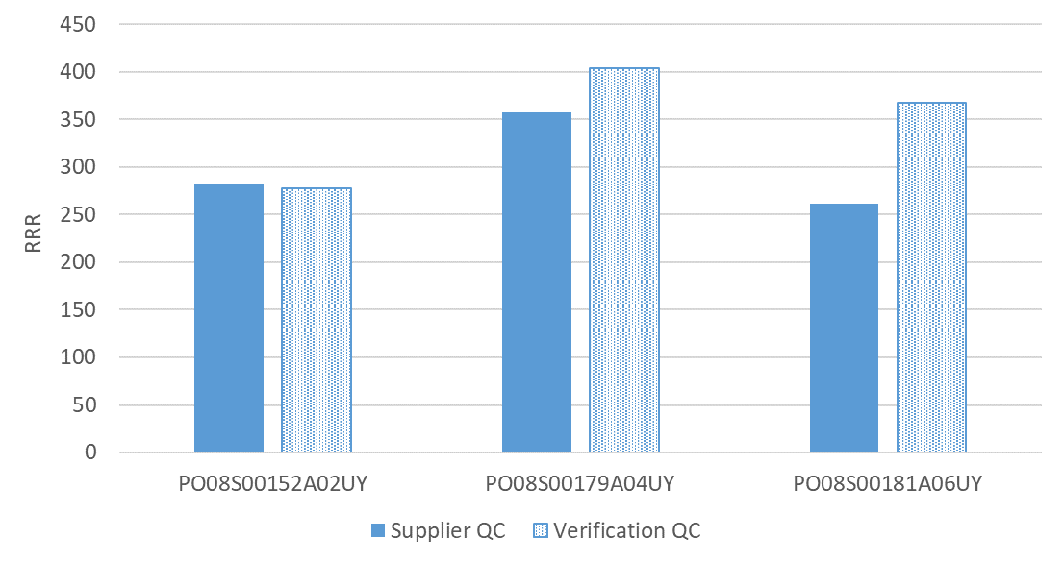
AUP Verification Testing – RRR
NHMFL ID: FNL-033
NHMFL ID: FNL-034
NHMFL ID: FNL-023
Spec
RRR test: supplier is conservative.
Differences are within uncertainty of test method and allowance for furnace cleanliness.

Slide 7
Coil QXFP06, Cable P43OL1095 Witness
Requirements
>100
>614
>311
Billet | # Respools | RRR | Ic(12T) | Ic(13T) | Ic(14T) | Ic(15T)
152 | 17 of 40 | 176, 176 | 711, 669 | 591, 552 | 484, 447 | 391, 356
179 | 15 of 40 | (no test)
181 | 8 of 40 | (no test)
152 | Round | 182 | 733 | 609 | 474 | 402
179 | Round | (no test)
181 | Round | (no test)
152 | As-received | 270 | 698 | 575 | 467 | 372
179 | As-received | 377 | 697 | 575 | 473 | 378
181 | As-received | 289 | 686 | 567 | 461 | 368

Slide 8
Coil performance analysis
24.1%
7.1 K
(need 6.1 K)

Slide 9
Coil QXFP06, Cable P43OL1095 SSL Info
Requirements in red
1.9 K SSL intercept 15.0 T, 21.9 kA
16.5 kA Operating point at 75.9% SSL (< 80%)
SSL crosses 11.4 T, 16.5 kA @ T_{CS} = 7.1 K (> 6.1 K)
T_{CS} – T_{OP} = 5.2 K (4.2 K)
Cable I_{C} at 11.4 T = 40.8 kA
16.5 kA I_{OP} = 40.8% Cable I_{C}

Slide 10
Summary of Data
Coil | SSL field (T) | SSL current (kA) | I_{OP}/I_{SSL} (%) | T margin (K) | Cable I_{C} (kA) | I_{OP}/I_{C} (%)
QXFP02 | 14.82 | 21.7 | 75.9 | 5.1 | 41.0 | 40.2
QXFP03
QXFP04 | 14.46 | 21.2 | 77.7 | 5.0 | 39.4 | 41.8
QXFP05 | 14.94 | 22.0 | 75.0 | 5.4 | 41.9 | 39.3
QXFP06 | 14.96 | 21.9 | 75.9 | 5.1 | 40.8 | 40.8
QXFP05 developed a short to ground and is being replaced by QXFP06
RECOMMENDATION: PROCEED

