Slide 1

Measurement of the Permeability (µ) & Permittivity (ε) of Aluminum doped Yttrium-Iron Garnets from 100Hz to 1GHz
Adam Lowery
Lincoln University
Supervisor: Dr. Dave Wildman
Accelerator Physics Center

Slide 2

Outline
Purpose
Microwave Circulator
Materials
Creating the stripline circuit
Measuring the permittivity (ε)
Epsilon vs. Frequency
Measuring the permeability (μ)
Mu vs. Frequency
Measuring the Permeability (μ)
Mu vs. Frequency (6 loop toroid)
Conclusions
Acknowledgements
Questions

Slide 3
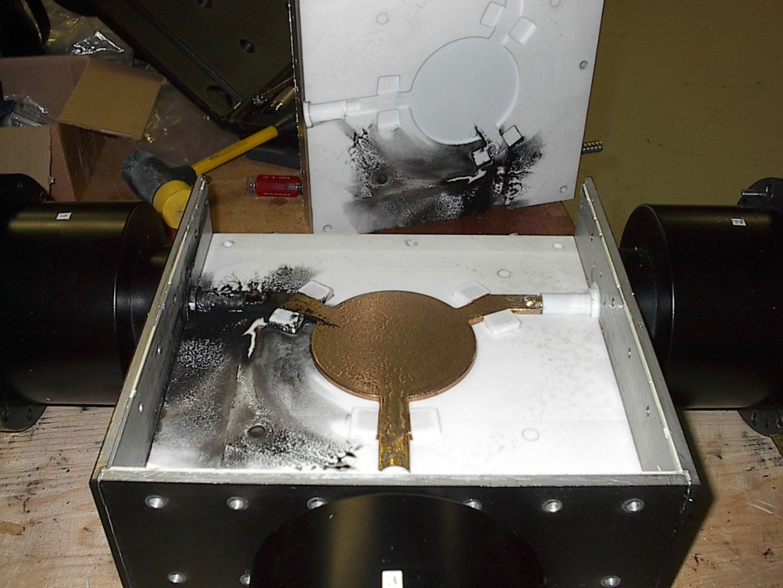
Purpose
Who could believe the this one, little microwave circulator would be responsible for such an arduous experiment?

Slide 4
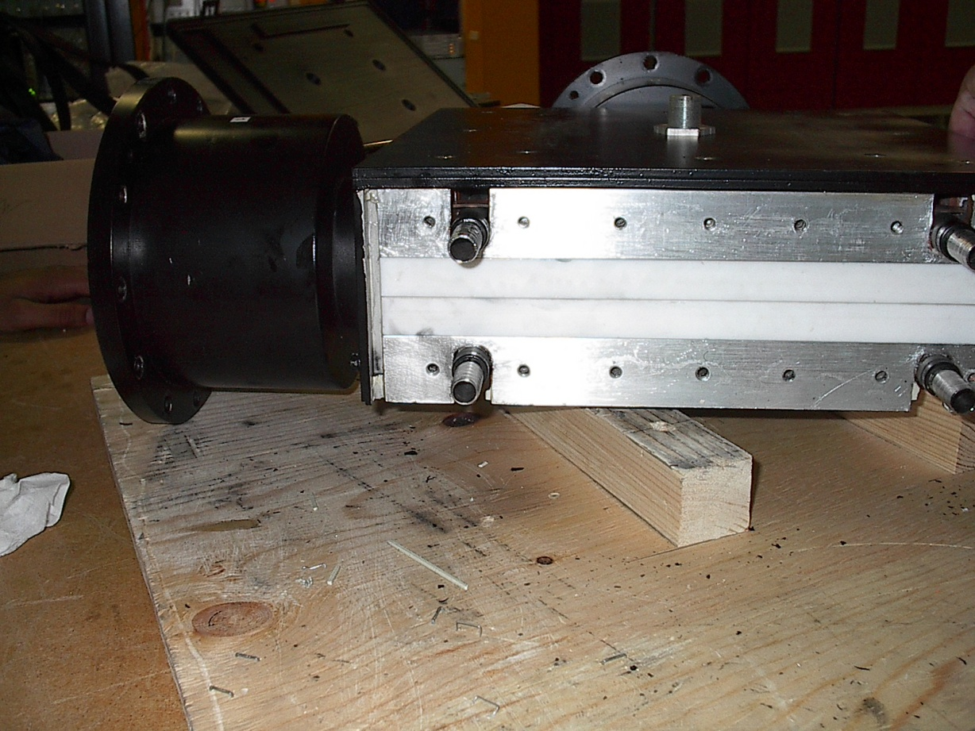
Microwave Circulator
A microwave circulator is a three-port, passive RF or microwave device made of magnets and ferrite material which is used to control the direction of signal flow in a RF or microwave circuit (DitomInc). Circulators are composed of magnetized ferrite materials, i.e. garnets, which in collaboration with a permanent magnet, produces the magnetic flux through the waveguide. This device is important for the RFQ (radio frequency quadripole) that will be installed in the High Intensity Neutrino Source (HINS) linac front end at the Meson Detector building at Fermilab.
The Aluminum doped Yttrium-Iron garnets are the ferrites found in some microwave circulators. Ferrites are usually non-conductive ferromagnetic ceramic compounds derived from iron oxides with magnetic properties.
Rear view of the Russian Microwave Circulator

Slide 5
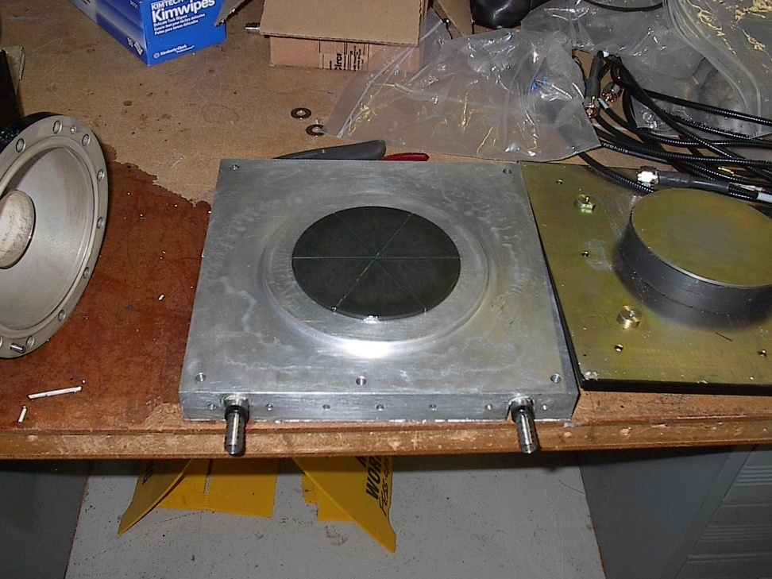
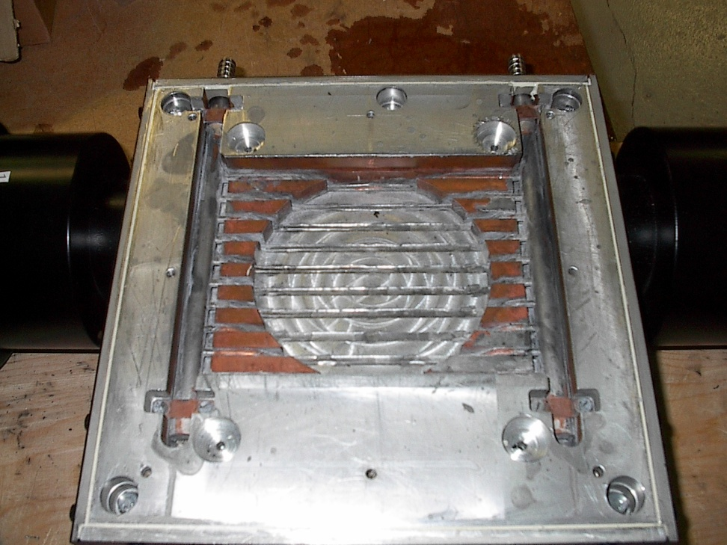
Microwave Circulator
Garnets and Magnets
Cooling structure

Slide 6
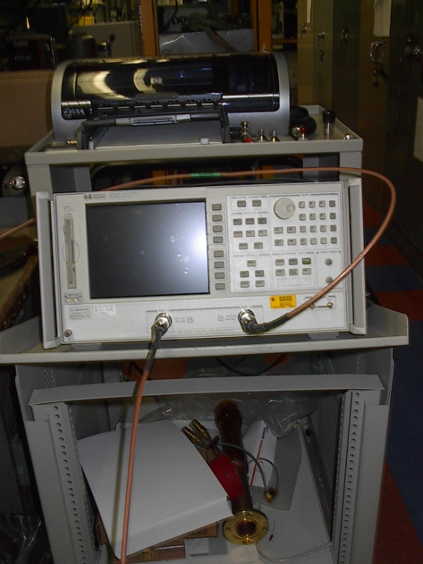
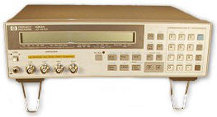
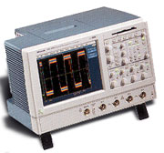
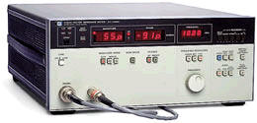
Materials
In order to find the permittivity and permeability of the Aluminum doped Yttrium-Iron garnets I had to become accustomed to a variety of scientific instruments. These devices allowed me to determine several of the components of the garnets. Some of which are the impedance , capacitance, phase , and the inductance of the garnets.
Hewlett Packard LCR Meter (1)
Tektronix Digital Oscilloscope (2)
Hewlett Packard Network Analyzer (3)
Hewlett Packard Vector Impedance Meter (4)
1
3
2
4

Slide 7
Creating a stripline circuit
(3)
One of the varies ways in which I went about solving for the permittivity (ε) and the permeability (μ) of the Aluminum doped Yttrium-Iron garnets was creating a stripline circuit. A stripline circuit is a conductor sandwiched by dielectrics between a pair of ground planes. In between these dielectrics is a center conductor that is vital to its efficiency. However for this to work you must find the dimensions of the stripline’s center conductor.
The best way I found in order to find the dimensions of the circuit was to consult some of the text at the library. One book in particular that prescribed a feasible expression to use was Harlan Howe Jr.’s, Stripline Circuit Design. It gave me the expression to the right. By rewriting this equation I could solve for the dimensions of the center conductor.
Harlan’s Expression
b
ε_{r}
t
w

Slide 8
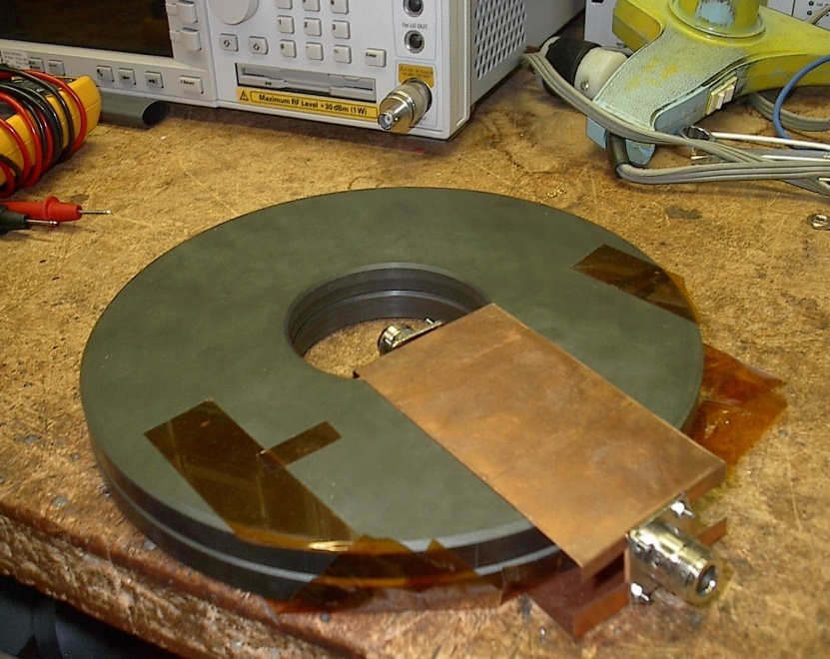
Creating a stripline circuit
With the dimensions determined for the center conductor I preceded to cut the center conductor out of a sheet of copper and solder it to two panel receptacles, who were soldered to tinned copper wire prior to the center conductor being cut. Copper was used for the center conductor because of it’s high conductivity.
After I created the center conductor it was placed in between two Aluminum doped Yttrium-Iron garnets. These garnets would be the dielectrics for the circuit. Then I created two ground planes out of copper, that would be placed parallel to the center conductor, and placed them on top and under the garnets.
The finished product:
Copper Center Conductor
Panel Receptacles
Tinned Copper wire

Slide 9
Measuring the Permittivity (ε)
Solving for the permittivity of the garnets required knowledge of their capacitance, inductance, and the impedance. Also solving for the permittivity required use the network analyzer and the LCR meter. The LCR meter was used in order to find the capacitance of the stripline at lower frequencies. Once the capacitance was found, I could use some fundamental physics equations to find the permittivity.
Notice how a permittivity is cut in half. This is due to the fact that the stripline circuit is composed of two capacitors.

Slide 10
Measuring the permittivity (ε)
While the LCR meter was excellent for solving for the permittivity at lower frequencies, I had to consult the network analyzer at higher frequencies. The network analyzer allowed me measured the impedance of the circuit. By rewriting the equation for the circuit I could solve for the capacitance.
R
L
The Impedance, Z, was given to us by the network analyzer.
Z
C
L, the inductance was found through computation and the use of a short.
R is negligible in this circuit.

Slide 11
Measuring the permittivity (ε)
In an attempt to find the permittivity of the garnets, I created another stripline circuit. However, for this stripline, only one panel receptacle was attached to the center conductor and the size of the center conductor decreased to 1/10th its original area.
By using the network analyzer, I was able to find the capacitance and the total impedance of the circuit. The inductive load was found after determining the point of resonance. Resonance is point a which the capacitive and inductive loads are of equal magnitude, causing electrical energy to oscillate between the magnetic field of the inductor and the electric field of the capacitor. After subtracting out the inductive load from the impedance finding the capacitive load of the circuit became possible. Using the prior equation for the capacitance allowed me to solve for the true capacitance and permittivity of the garnets.

Slide 12
Epsilon vs. Frequency

Slide 13
Measuring the Permeability (μ)
To solve for the permeability of the stripline circuit I put the circuit through a series of test in which a magnetic field was introduced and the phase difference and the change in voltage at the circuit underwent were measured. To get a good series of measurements I continuously increased the distance between the stripline and the magnets, which would gradually decrease the magnetic field on the stripline. In order to increase the distance, I placed aluminum beams between the stripline and the magnet that was supplying the magnetic field. By continuing to place the beams between the two, the magnetic field became relatively insignificant.
I used a Tektronix Digital Oscilloscope and the Hewlett Packard Network Analyzer to measure the time, phase difference and the change in voltage in the circuit.

Slide 14
Measuring the Permeability (μ)
By using , I was able to find the velocity .
Then I utilized the following equation to solve for the permeability.

Slide 15
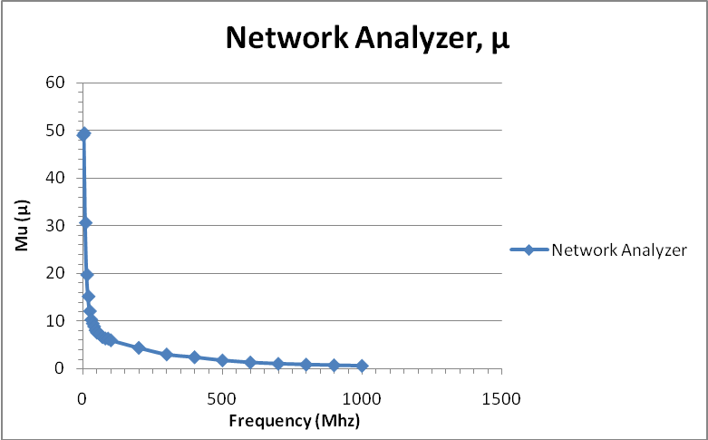
Mu vs. Frequency
As you can see from the graph as the frequency continued to raise the permeability of the stripline fell to almost zero. However, is not logically possible because in order for the permeability to fall below one, the signal would have to be going faster that the speed of light. This means that either the permittivity of the stripline is changing with frequency, at some point a mistake had been made, or there is some component about the stripline that we are not fully aware of.

Slide 16
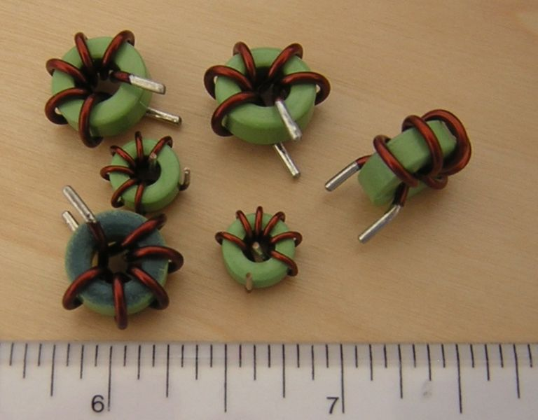
Measuring the Permeability (μ)
Another way in which I went about finding the permeability of the garnets was by turning one of the garnets into a toroid. A toroid is an electronic device, typically a magnetic core, with wire wrapped around it in order to make an inductor. For this toroid, copper tape was used instead of the wire. The copper tape was wrapped around one garnet so there were six turns. I would test this garnet in order to find the permeability. By using the LCR meter and the vector impedance meter I was able to measure the inductance and impedance of the toroid.

Slide 17
Measuring the Permeability (μ)
By using this equation I could solve for the inductance of the toroid while using the vector impedance meter:
Once the inductance was solved for, I solved for the permeability of the inductor.
a: inner radius
b: outer radius
H: height
N: number of turns
μ₀= permittivity constant
H
a
b

Slide 18
Mu vs. Frequency (6 loop toroid)

Slide 19
Conclusions
In this experiment I set out to measure the permittivity (ε) and the permeability (μ) of Aluminum doped Yttrium-Iron garnets. My values for the permittivity of the garnets were around 14. This is relatively consistent with the predetermined values of the permittivity that were measured prior to my coming to Fermilab. For the permeability of the garnets, I found values that were between 30 & 49. This is also close to the predicted values of the permeability. Overall, I would say this experiment was successful.

Slide 20
Acknowledgements
I would like to think Mrs. Dianne Engram, Mrs. Linda Diepholz, Dr. Davenport and Jamieson Olsen for allowing me to take part in this program.
I would also like to think my supervisor, Dr. Dave Wildman, and Dr. Robyn Madrak for their assistance and support throughout the course of this experiment.

Slide 21

Questions

