Slide 1
Vivian O’Dell
Fermilab PAC
17 January 2019
U.S. CMS HL-LHC Upgrades

Slide 2
Outline
Project Background
  Motivation
  Timeline
  HL-LHC upgrades
U.S. Overview
  U.S. in CMS
  U.S. planned upgrade deliverables and status
Recent reviews and review status
Conclusions
Note: due to time limitations, I will talk mainly about the DOE projects.

Slide 3
Why HL-LHC?
Many phenomena unexplained by the SM
  Light Higgs, Baryon Asymmetry of the universe, neutrino masses and mixing, flavor problem, Dark Matter / dark matter candidates
We have three basic methods for exploring this large, but as yet still largely uncharted, territory
  Searching directly for new particles and new forces
  Studying the properties of the the Higgs that through its coupling directly to mass can make contact with hidden sectors that are invisible to us otherwise
  Looking for deviations from the precise predictions of the SM, especially from quantum loops involving new particles or forces
    These can be sensitive to mass scales well above what can be reached “directly” at the LHC
All three strategies require more statistics, for which particle physics has a plan based on the extraordinary capabilities of the LHC machine and its detectors
The U.S. LHC upgrades were highlighted in the May 2014 P5 report as the highest priority near-term large project.
Notes:
Note that we normally do better than our projections in i.e. H->bb. These projections are usually conservative. Get rid of P5 science drivers.

Slide 4
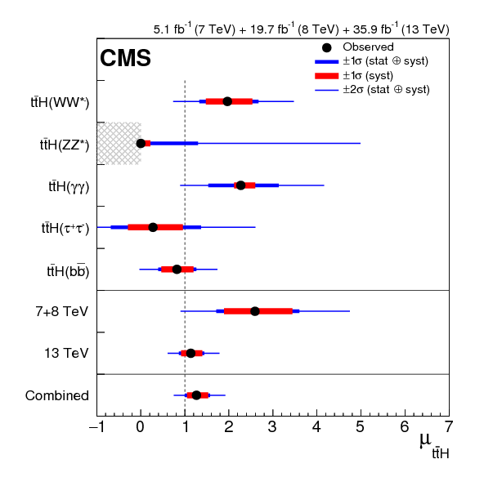
Observation of ttH: 7,8, 13 TeV Combined (PRL June, 2018)
Best fit value of couplings for (upper section) the five individual decay channels considered, (middle section) the combined result for 7+8 TeV alone and for 13TeV alone, and (lower section) the overall combined result.
CMS reached this milestone with less data than expected in 2010 when we first started data taking because we use much more advanced analysis techniques and combine many more channels together to arrive at the results.

Slide 5
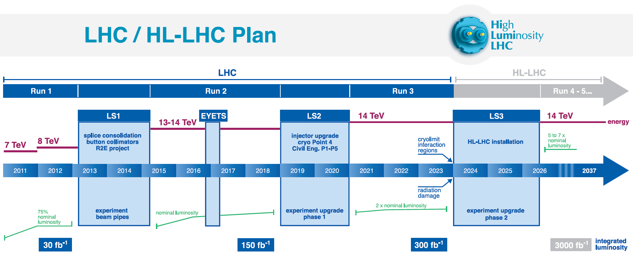
The path to the HL-LHC
Shutdowns
We are here
Run 1
0.75 10³⁴ cm⁻²s⁻¹
50 ns bunch
pileup ∼40
Run 2
1.5 10³⁴ cm⁻²s⁻¹
25 ns bunch
pileup ∼40
Run 3
1.7-2.2 10³⁴ cm⁻²s⁻¹
25 ns bunch
pileup ∼60
Run 4-6
~5(7.5!) 10³⁴ cm⁻²s⁻¹
25 ns bunch
pileup ∼140 - 200

Slide 6
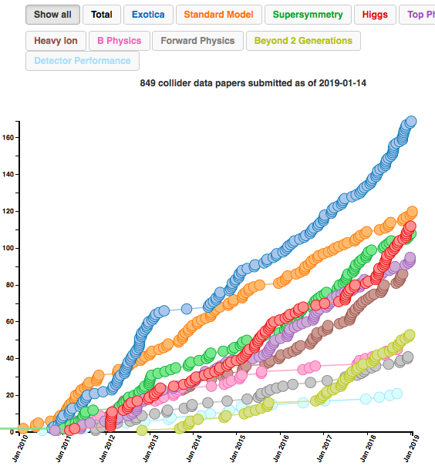
Current Status: Run 2 ended in December
)
163 fb⁻¹ delivered to CMS during Run 2 / 150 fb⁻¹ collected by the experiment
849 papers submitted by CMS
We have a great machine and detector and are doing great physics at a prodigious rate!

Slide 7
The path to the HL-LHC
Shutdowns
We are here
HL-LHC Upgrades: Installed during LS3
(CY 2024 – mid 2026)
HL-LHC operations continues through 2037

Slide 8
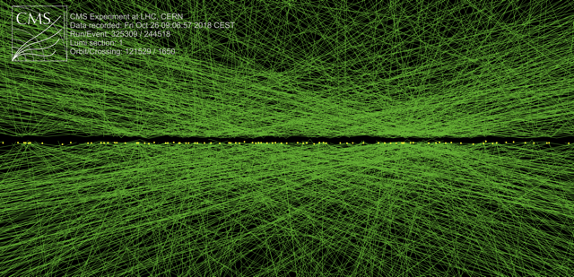
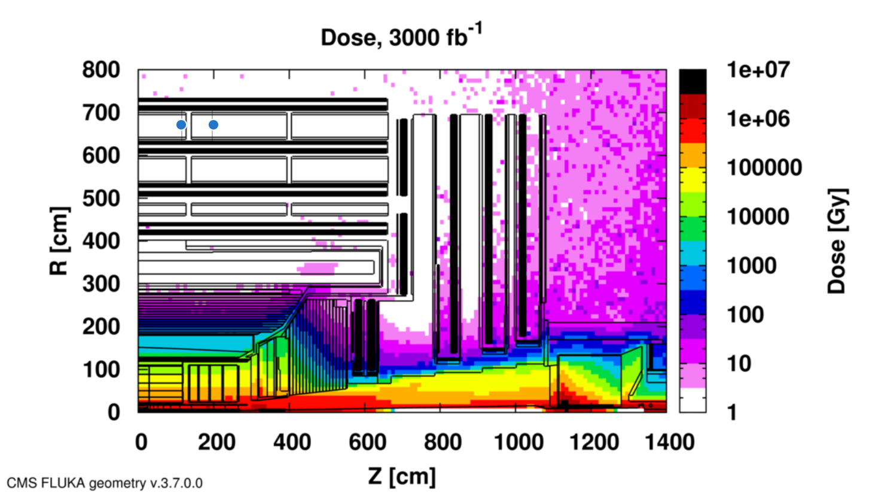
Main Challenges for CMS at the HL-LHC
HL-LHC will deliver ~140-200 collisions/beam crossing (40 MHz)
This means CMS must be able to:
  Separate and identify particles in extremely dense collision debris
  Trigger on events at 40 MHz rate, keeping only 7.5 kHz of data
  And do all of this in a high radiation environment
136 vertices
Event with 136 collisions in one pp bunch crossing from 10/26/2018 special “High Luminosity” running (only a few very bright bunches colliding). We expect the HL-LHC pileup to approach 200.
Absorbed dose in the CMS cavern after an integrated luminosity of 3000 fb⁻¹.

Slide 9


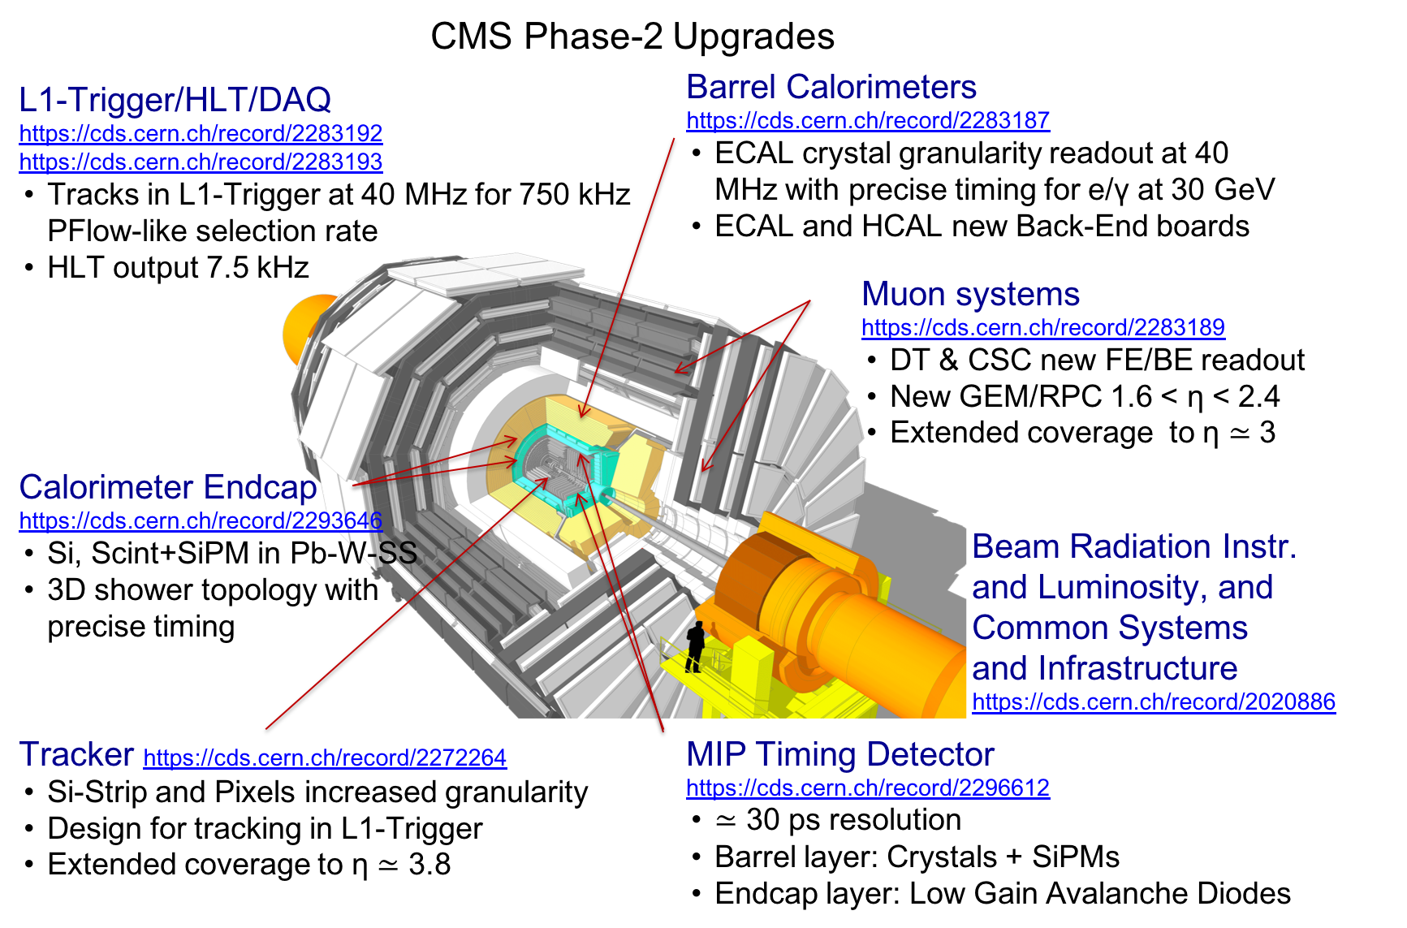
CMS Upgrades for HL-LHC
Areas where U.S. is a critical partner
Areas where Fermilab is a critical partner
*(TDR, interim TDR and TP references)

Slide 10
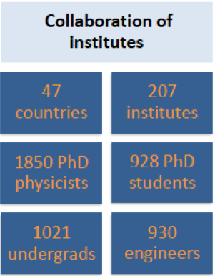
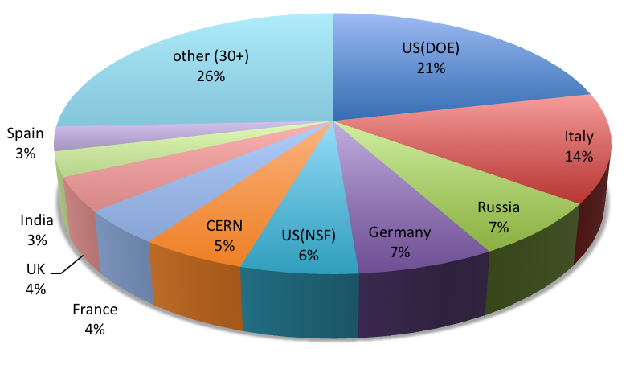
The CMS Scientific Collaboration
U.S. (DOE+NSF) 27.3%
The U.S. is by far the biggest nation in CMS
  DOE and NSF HEP taken together are 27.3% / DOE NP adds 1.9%
The U.S. has infrastructure and experience giving it even greater weight
There is no way that CMS could continue as is, if the U.S. were to significantly reduce its level of activity
Fermilab plays critical roles on CMS

Slide 11
U.S. CMS in HL-LHC Upgrades
U.S. CMS chose areas to contribute based on:
  Interest of the community and large physics impact
  Past experience
    Calorimetry, Muons, Tracker, Forward Pixels, Trigger, DAQ
  Unique capabilities and facilities
    Experience and facilities for Silicon Detectors, Electronics for Trigger, Muons, DAQ
The U.S. has an exciting suite of upgrades
  L1 Track Finder coupled with p_{T} modules in the Outer Tracker, Silicon based calorimetry, MIP Timing Detector, extended Forward Pixels and Muon detectors give upgraded CMS new capabilities and strong handles for pileup mitigation
In this talk I will focus on the DOE and Fermilab deliverables

Slide 12
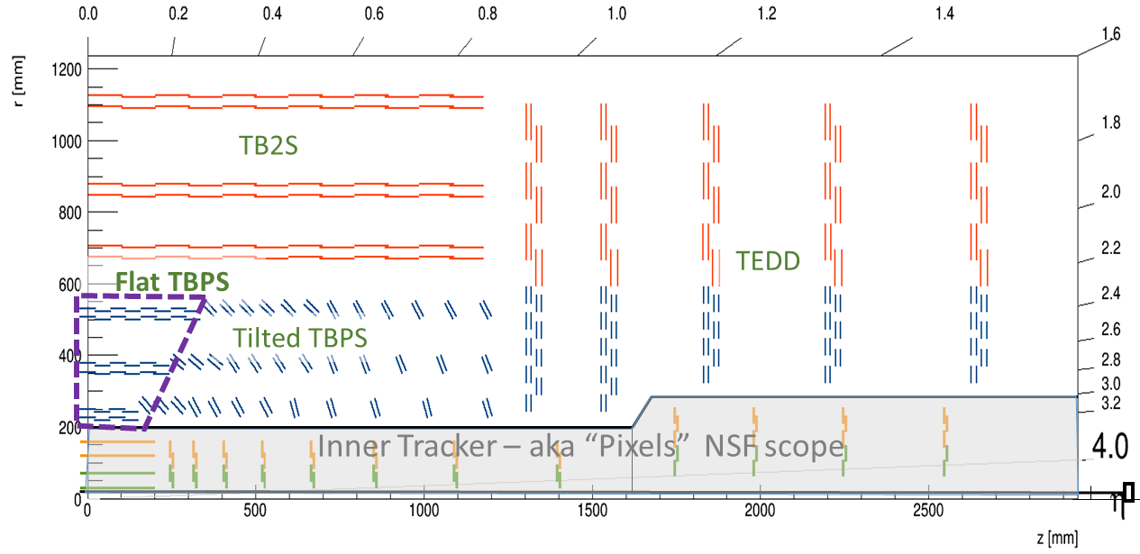
Outer Tracker – overview of the upgrade
6 Barrel+ 5 endcap layers
  Sensor “sandwich” provides local curvature information for trigger
Two types of module
  Pixel-Strip (PS): Strip sensor (PS-s) provide 1D information, Pixelated sensor (PS-p) provide 2D information at low radius
  Strip-Strip (2S): Strip Sensors (2S) for both slices of sandwich at high radius
U.S. Scope
  Assembly of ~30% of modules
    Including procurement of components and design and fabrication of QA apparatus for component and module testing
  “Flat Barrel” Structure
    Mechanics and assembly of Central portion of inner 3 layers

Slide 13
Outer Tracker– Components and Testing
Sensors
  Thickness is the last open question
    Default “deep diffusion float zone” process abruptly discarded by vendor last year, requires re-addressing thickness parameter
      Balance of charge collection capability vs. material budget vs. radiation tolerance
    Thickness variants now under pre-irradiation testing, then will be irradiated and evaluated
      Irradiation planned using FNAL Irradiation Test Area in April
  Sensor QC established at both testing sites (Brown, Rochester)
Macro-Pixel Sub Assemblies (MaPSAs)
  The pixel side of the Pixel-Strip (PS) modules
  FNAL is responsible for delivering MaPSAs for all PS modules (bump bonding chips to sensors)
  These will be bump bonded at a vendor: we are responsible for the oversight & QC
  First prototypes being assembled at vendors
  Testing apparatus designed and fabricated
Module Test stands
  Full burn-in box capable of 10 modules simultaneously at low temperature designed and in fabrication
  Development of DAQ software well advanced

Slide 14
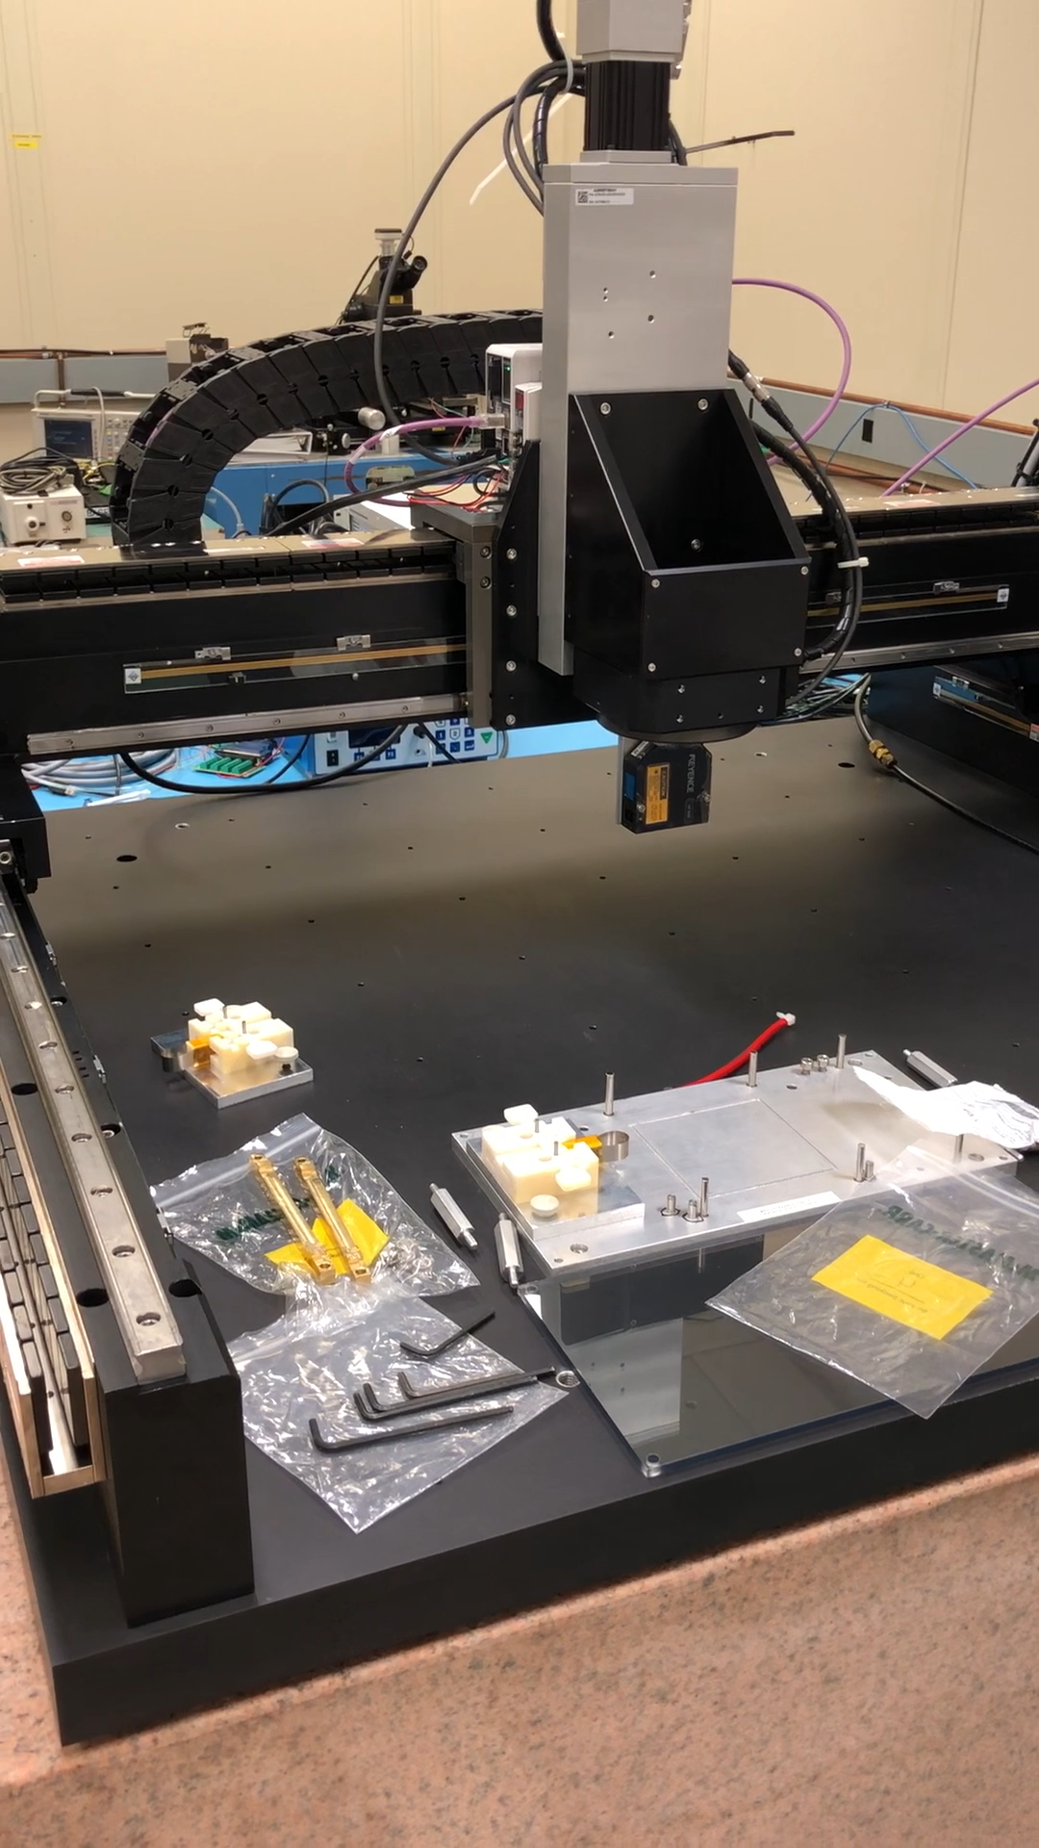
Outer Tracker – Module Assembly
Two module assembly lines to minimize site outage delays
  East Coast: Brown, Princeton, Rutgers
    R&D focused on PS
  Fermilab
    R&D focused on 2S
  Both sites assemble both types
Current focus on
  Setting up infrastructure
  R&D on materials to explore cost reductions, verify adequate performance, or simplify construction
    Adhesives, encapsulants, ultra-light support structures
  Gantry-based Assembly automation to reduce manual labor
    Certain steps can be automated, new gantry at FNAL to explore options
  Building Prototype Modules
    Somewhat limited by availability of prototype components

Slide 15
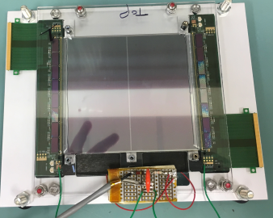
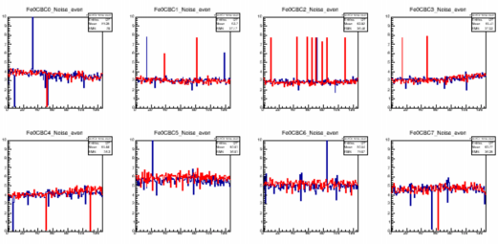
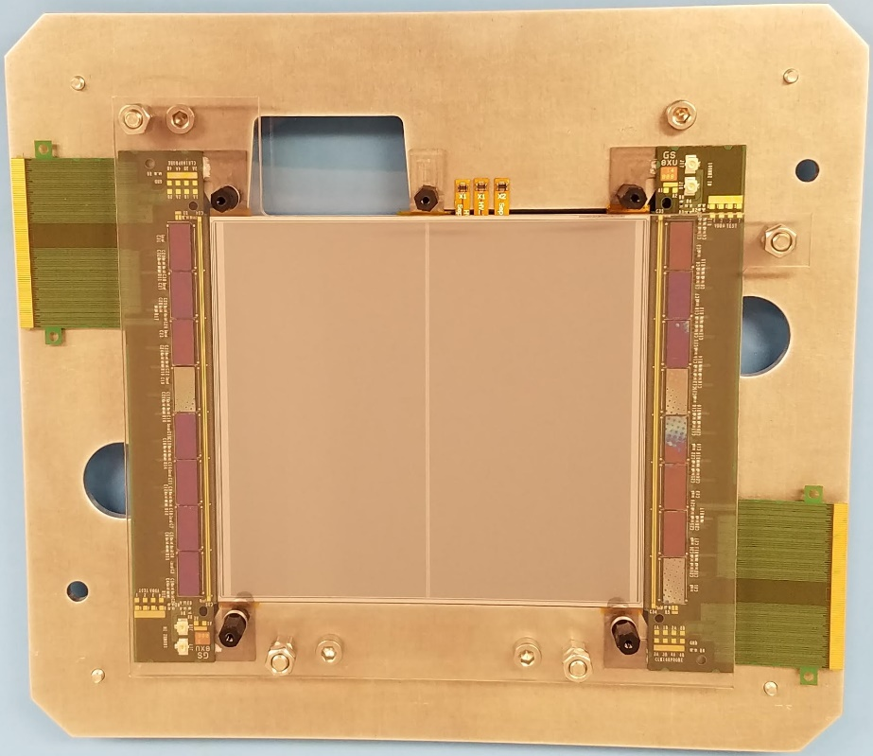
First functional modules
2S @Fermilab in March 2018
  Needed to use some workarounds for missing components
2S @Brown in January 2019
  Focused on PS assembly development while missing components
  Module is now heading for Rutgers/Princeton for wirebonding
Module readout scan: noise level as expected

Slide 16
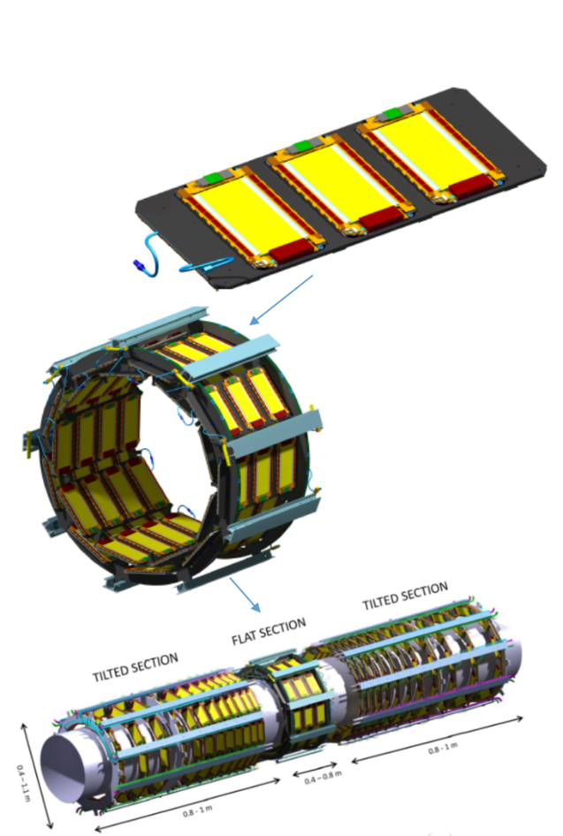
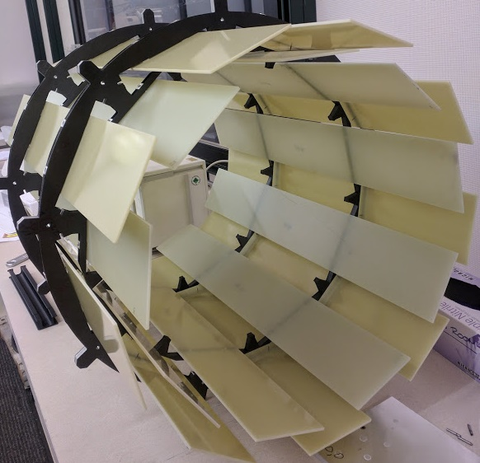
Prototype mechanics for flat barrel
Fabrication of Carbon Fiber/Carbon foam Planks and Hoops
  Stiffness, Heat transmission are key parameters
System design and integration aspects of Flat Barrel
  Challenge is mechanical strength with minimal material, adequate cooling, grounding and noise mitigation
Status: Prototype design complete, prototypes being built
Modules go on planks
Planks mount on Hoops to form Layers
(Layer 1 shown)
Mockup of layer one with prototype hoops and g10 for planks
Three layers make Flat Barrel

Slide 17
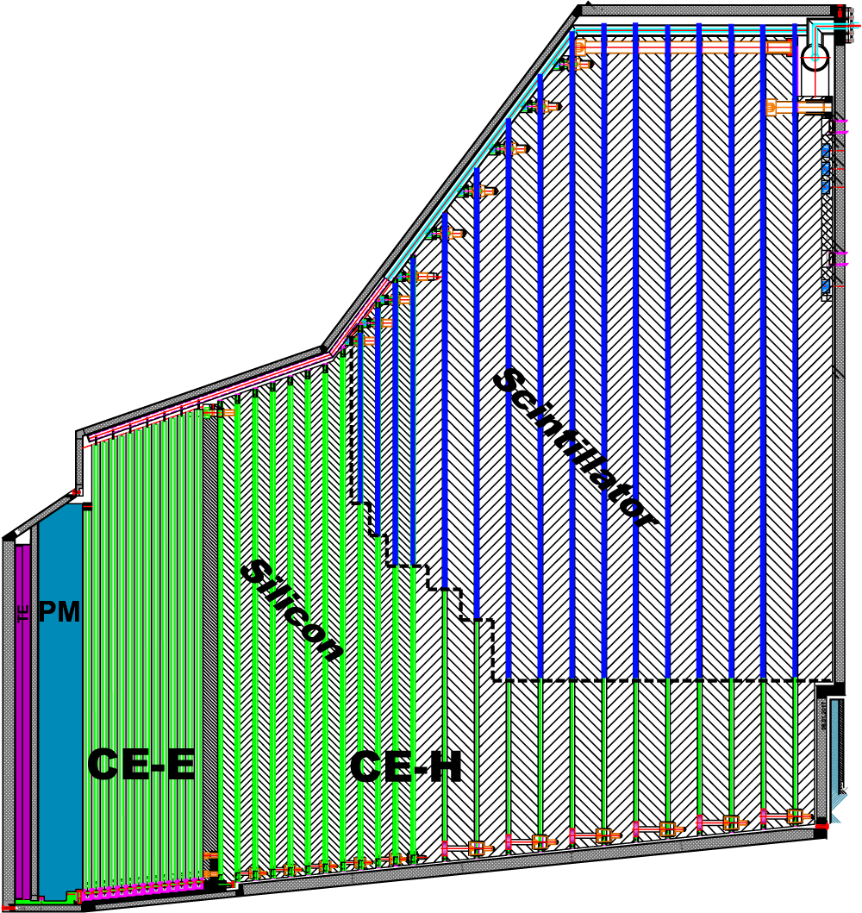
High Granularity Endcap Calorimeter
Hexagonal modules based on Si sensors
in CE-E and high-radiation regions of CE-H
Scintillating tiles with SiPM readout in
low-radiation regions of CE-H
Covers 1.5 < η < 3.0
~600m² of silicon sensors (6M channels, 28k modules)
~450m² of scintillators (350k channels)
U.S Deliverable
US Deliverables
Silicon module construction procedures + ~13k Silicon modules
Concentrator ASIC for overall calorimeter, motherboards
Cassette Assembly for front 15 layers of the hadronic section
LV/HV power supplies for hadronic section
~2.3m
~2m
Electromagnetic calorimeter (CE-E): Si, Cu/CuW/Pb absorbers, 28 layers, 26 X₀ & ~2λ
Hadronic calorimeter (CE-H): Si & scintillator, steel absorbers, 22 layers, ~8λ
17

Slide 18
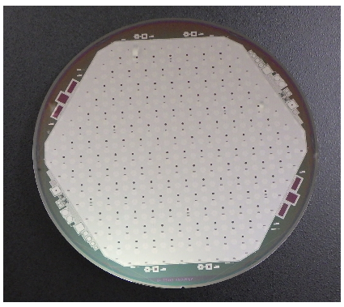
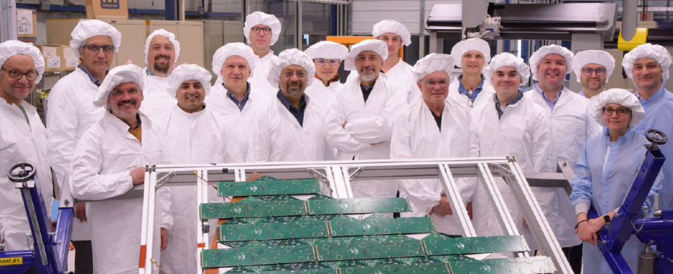
High Granularity Endcap Calorimeter
Final-design silicon sensors received from HPK
  Sensor quality generally good, some scratches on a few sensors from newly commissioned equipment
Full-scale thermal-mockup cassette constructed at FNAL to validate mounting technologies, cooling scheme
  Identified low-cost, high-performance baseplate material for hadron calorimeter modules: PCB
8”, 192 cells, p-type
An excellent, defect free, sensor
Endcap Calorimeter Workshop at Fermilab with cassette thermal mockup

Slide 19
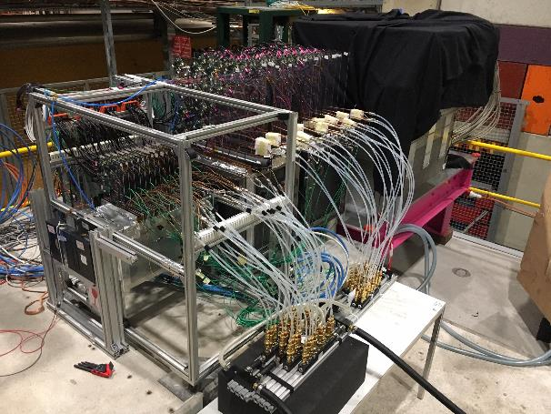
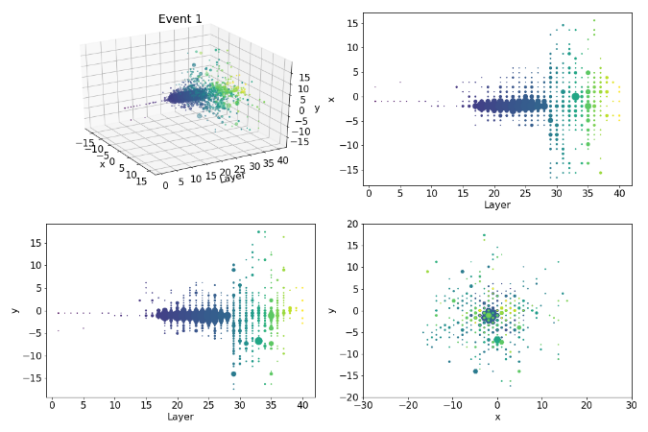
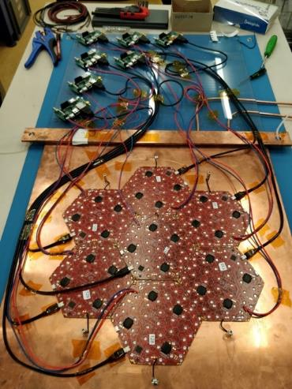
Testbeam 2018
300 GeV π
US-built modules (~100) using automated system at UCSB
US-developed DAQ/readout system (Minnesota)
  Recycling FPGA mezzanine cards from CMS calorimeter trigger
Excellent performance, good opportunity to study reconstruction, grounding, use of precision timing in hadron calorimetry, etc
7 hexagonal Si modules in 1 plane

Slide 20
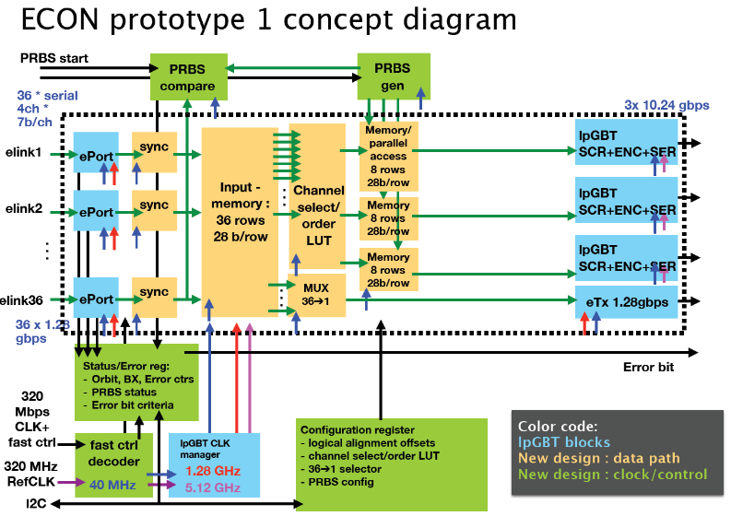
ECON ASIC
Responsible for selecting
data for readout and trigger
computations
Key component, has had a
slow start due to limited ASIC
engineering availability
2019 goal : Submit ECON
prototype 1 for fabrication
at end of August 2019.
  Detailed conceptual specification
  for 1st prototype ECON is complete.
  Gregory Deptuch is the lead engineer for the ECON and has made progress turning conceptual specification into a formal floor plan and creating a plan of work leading to 1st prototype submission.
Rapidly building up team
  FNAL has hired new Senior Engineer for ASIC design who will start work on ECON (100% FTE) the week of Jan 22, 2019.
  FNAL is negotiating for effort from other labs (BNL / ANL), which should be starting soon.
  FNAL has arranged for contributions from EE faculty and post doc from University of Split / FESB, Croatia. Visitors will come in mid-February 2019.

Slide 21
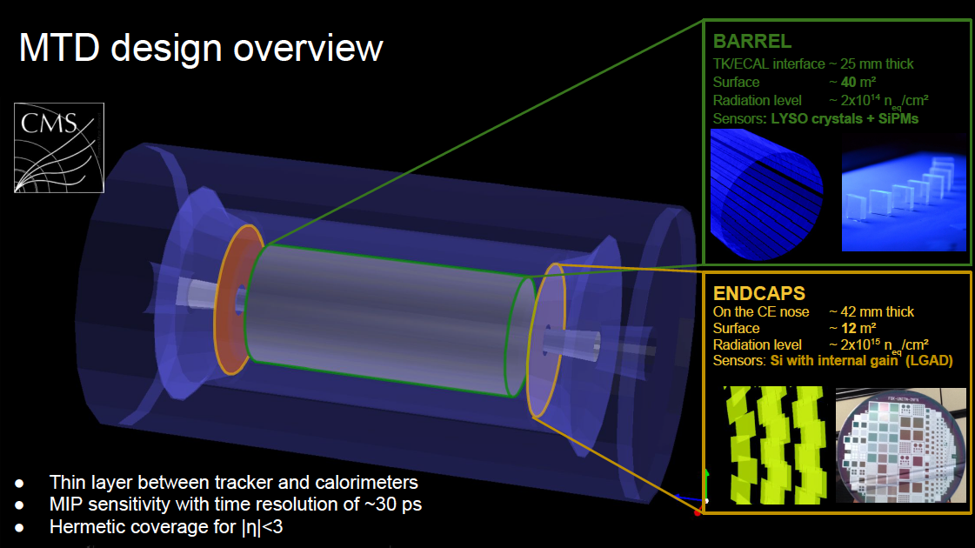
MIP Timing Detector
“BTL”
Barrel “BTL”
Within TST – 20mm thick
Surface – 40 m²
Radiation level – 2E14 n_{eq}/cm²
Sensors: LYSO crystals + SiPMs
Lyso crystals
“ETL”
Endcaps “ETL”
On the CE nose – 42 mm thick
Surface – 17.5 m²
Radiation level – 2E15 n_{eq}/cm²
Sensors: Si w/ internal gain - LGADs
LGAD sensors on Si wafers
Design Requirements: Provide precision time measurement for MIPs with σ_{t}=30-40ps with sufficient radiation tolerance to maintain σ_{t}<60ps up to 4000/fb.

Slide 22
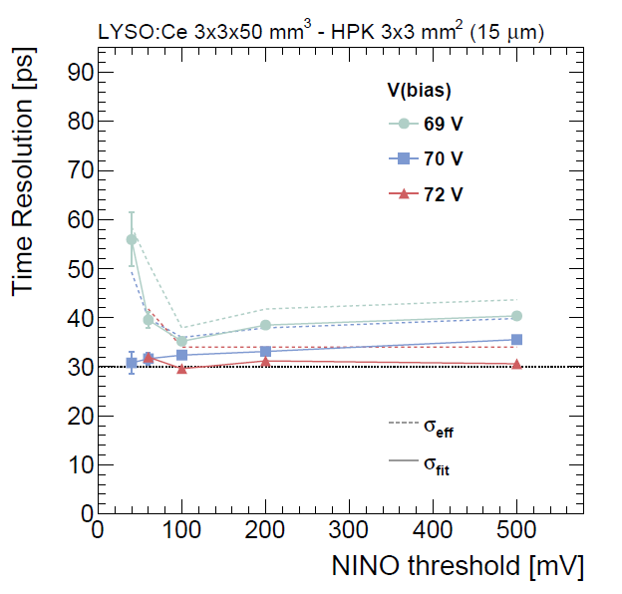
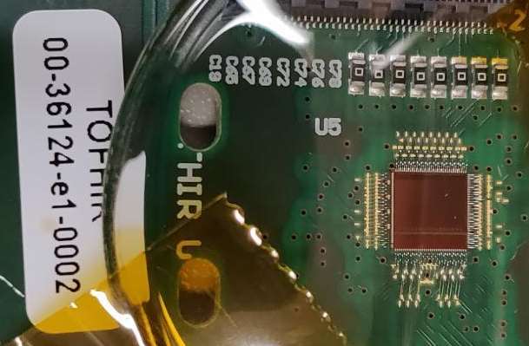
Barrel Timing Layer (BTL)
Active element : LYSO crystals with SiPM readout.
  Demonstrated time resolution ~30 ps in test beam
  Operate at -30 C to mitigate radiation effects, maintaining time resolution up to the end of life of HL-LHC.
First ASIC prototype (TOFHIR) delivered in December 2019, under test in the laboratory.
  Test beams expected in summer 2019
First Prototype of the TOFHIR ASIC (LIP)
Test beam results for BTL sensors

Slide 23
Barrel Timing Layer (BTL)
BTL integrated into the tracker support tube, a carbon fiber structure serving as the mechanical support frame and thermal enclosure.
BTL segmented into trays, consisting of 3 layers :
  An aluminum cooling plate hosting the CO2 cooling pipes and serving as a mechanical support.
  The sensor layer, consisting of LYSO elements with approximately 3 mm thickness, read out by SiPMs.
  The front end electronics, consisting of the TOFHIR ASIC cards and concentrator cards providing connectivity between the ASICs and the backend.
U.S. deliverables:
R&D and prototyping for assembly procedures. Assemble 60% of the BTL trays and associated QC testng, delivery to CERN
BTL Concentrator Card
Prototype, pre-producton BTL SiPM. 40% of the BTL SiPMs
40% of production BTL LYSO crystals
BTL tray with cooling plate, sensor layer and FE

Slide 24
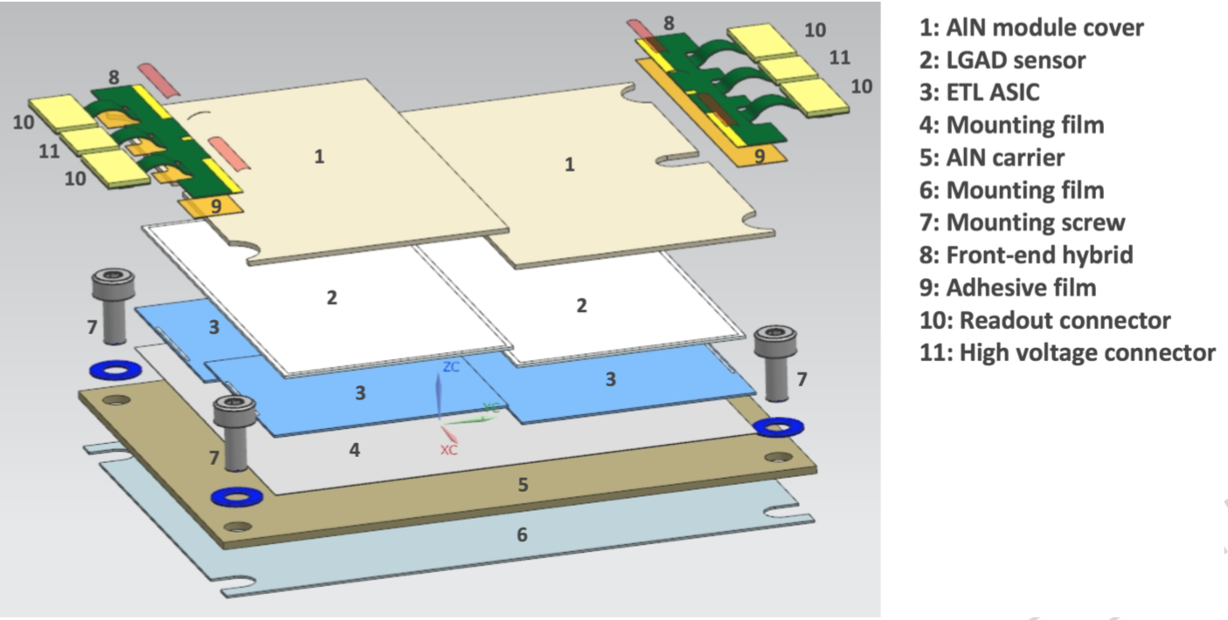
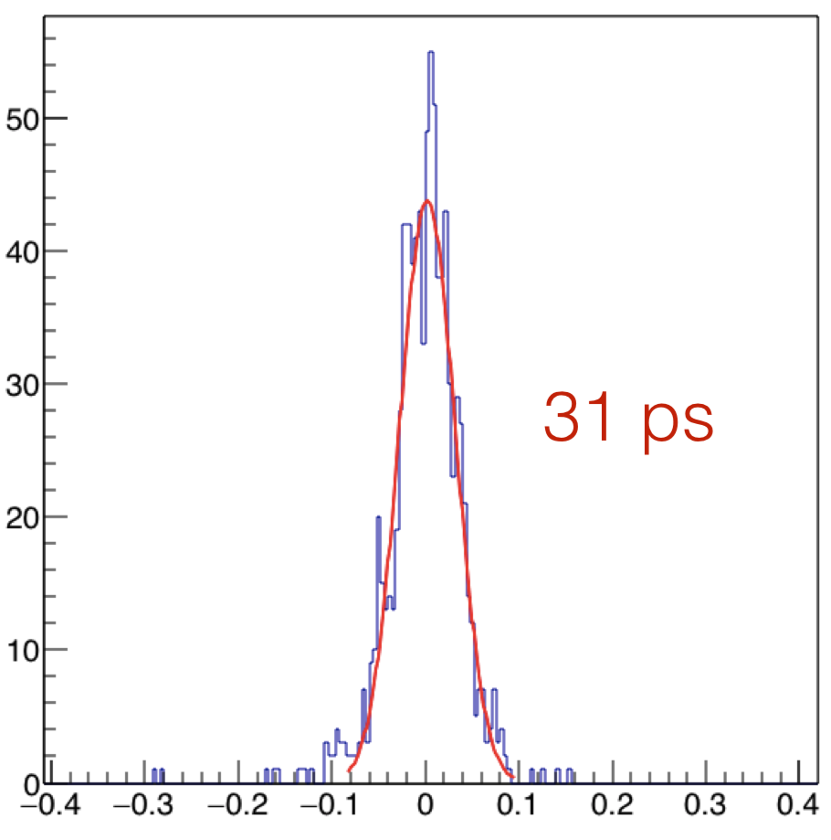
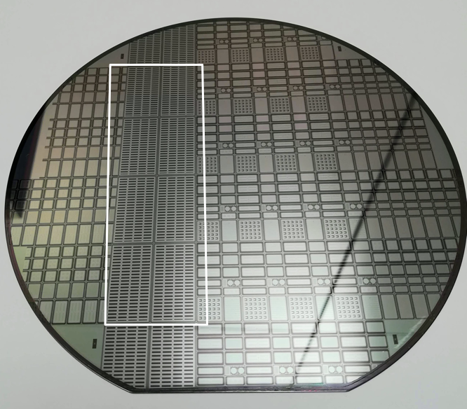
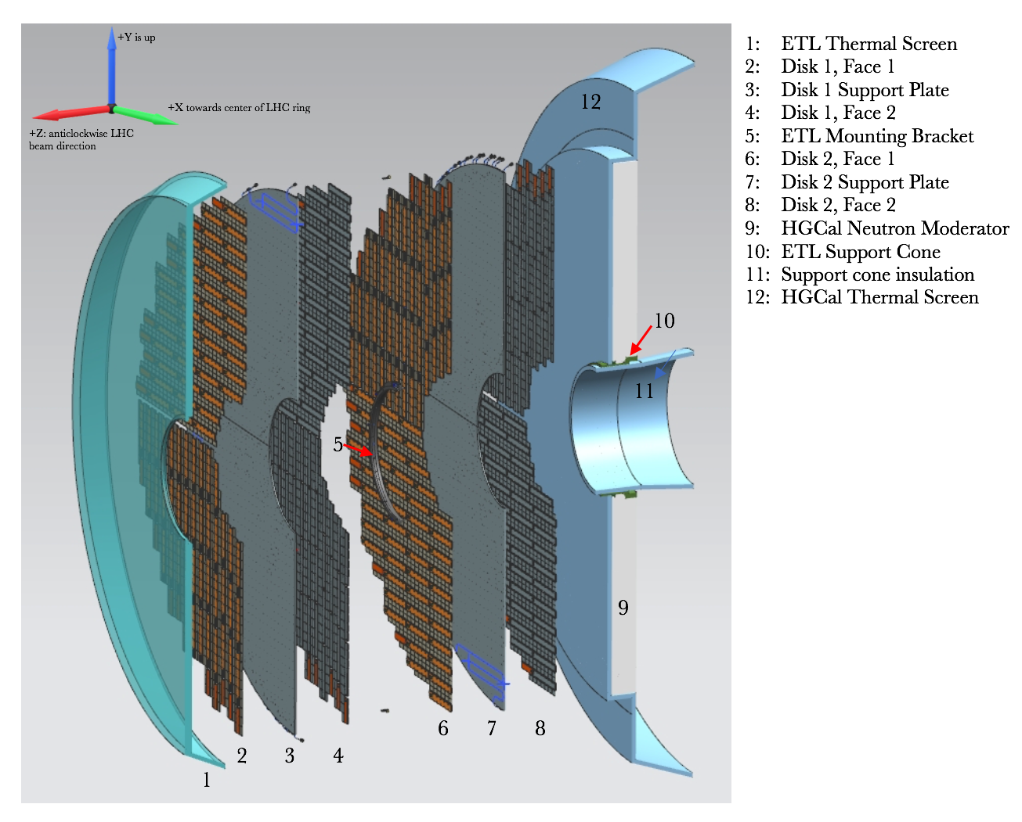
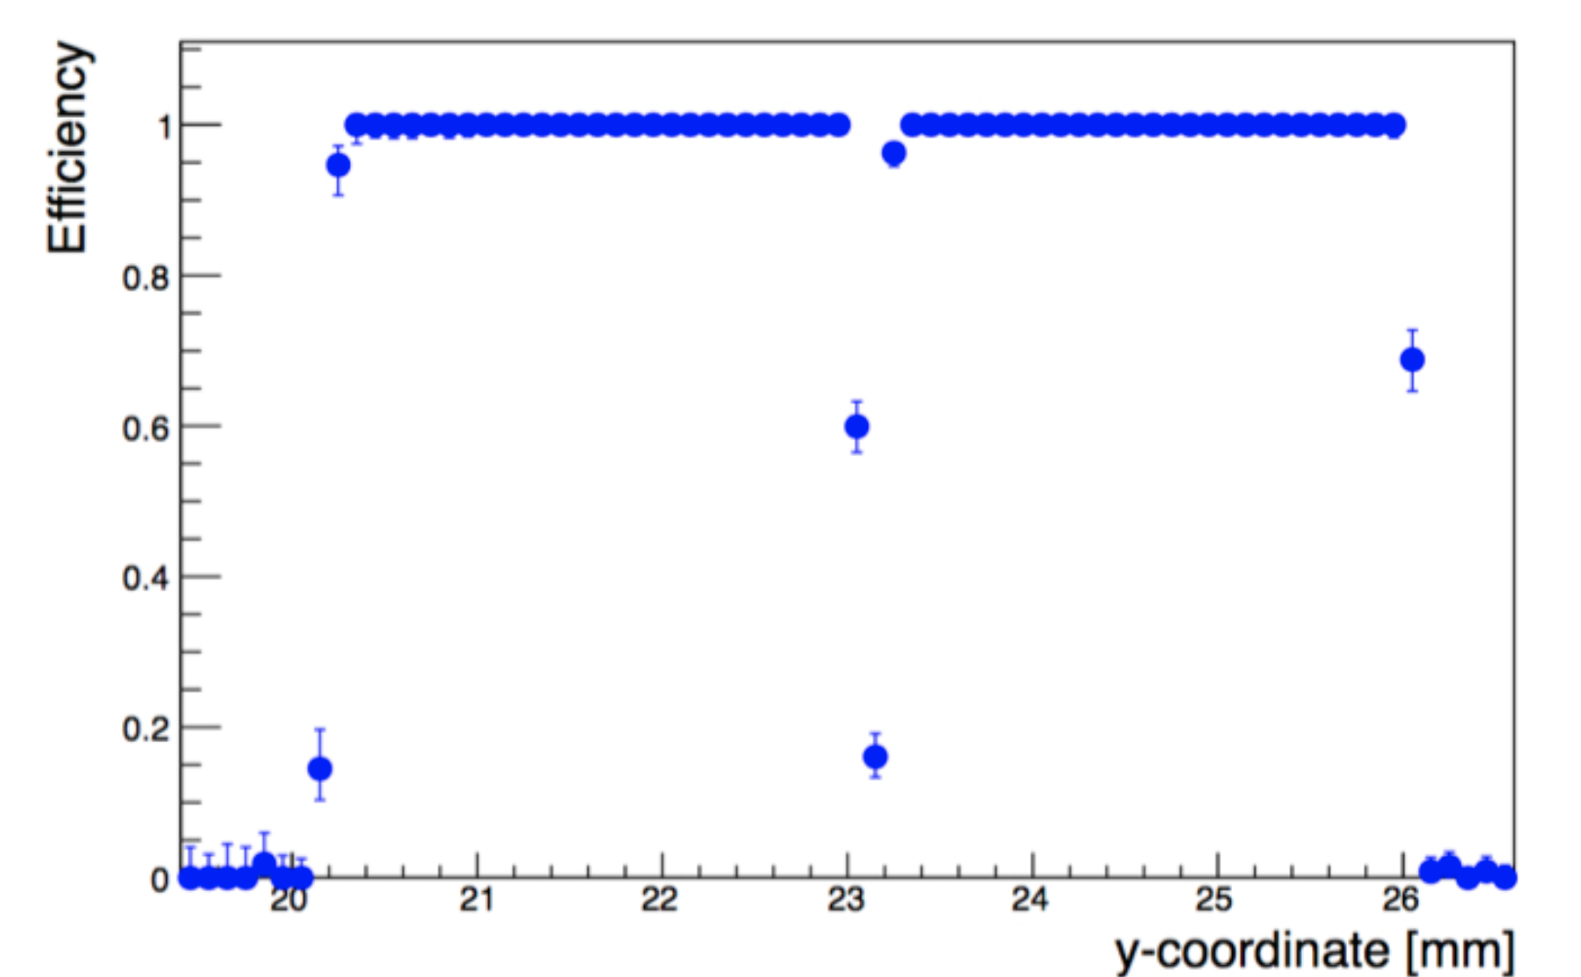
Endcap Timing Layer
Active element: silicon sensors with specially doped region that produces high electric field → produces avalanche signal with 10-30 gain (LGAD)
  Large community: RD50 collaboration, several manufacturers: CNM, FBK, Hamamatsu
  Demonstrated time resolution ~30 ps up to 1x10¹⁵ n_{eq}/cm², and about 40 psec up to 2x10¹⁵ n_{eq}/cm² high uniformity
The ETL detector ensures at least two measurements per track, to achieve better than 35 ps resolution
  Designed to be accessible for repairs and replacements of faulty components
Exploded module view
Time resolution measured in Fermilab test beam
Particle detection efficiency across sensor surface
Measurements performed at Fermilab test beam
FBK wafer with CMS- and ATLAS- sensors
Cross-sectional view of the endcap timing layer (ETL) along the beam axis.

Slide 25
Endcap Timing Layer
Active element: silicon sensors with specially doped region that produces high electric field → produces avalanche signal with 10-30 gain (LGAD)
  Large community: RD50 collaboration, several manufacturers: CNM, FBK, Hamamatsu
  Demonstrated time resolution ~30 ps up to 1x10¹⁵ n_{eq}/cm², and about 40 psec up to 2x10¹⁵ n_{eq}/cm² high uniformity
The ETL detector ensures at least two measurements per track, to achieve better than 35 psec resolution
  Designed to be accessible for repairs and replacements of faulty components
U.S. ETL deliverables
  R&D / prototyping assembly procedures. Deliver 50% of assembled ETL modules, tested and graded, to CERN.
  Design and prototyping of the ETL FE ASIC. Deliver 50% of the production ASICs
Time resolution measured in Fermilab test beam
Particle detection efficiency across sensor surface
Measurements performed at Fermilab test beam
FBK wafer with CMS- and ATLAS- sensors
Cross-sectional view of the endcap timing layer (ETL) along the beam axis.

Slide 26
ETL ASIC status
Have built a strong design team (SMU/Fermilab) that is making rapid technical progress.
  Front-end design, implementation and optimization done (June – Dec 2018)
    Critical front-end (preamp + discriminator) done with good post-layout simulation performance. First single channel mini-ASIC design submitted in Dec 2018, expected in March 2019.
  TDC design study done (July – Dec 2018)
    TDC design optimization and implementation started (complete April 2019)
  Clock distribution implementation study for full size chip started (Dec 2018 - )
Future Milestones:
  Prototype 1 submission: Q2 CY2019 (4x4 pixel matrix, ETROC1)
    Full chain: preamp+disc + TOA/TOT TDC with e-link
    Bump-bondable to LGAD sensor -- test and evaluate the performance of the full-chain
  Prototype 2 submission: Q3 CY2020 (8x8, ETROC2)
    Supporting circuitry: PLL, phase shifter, fast/slow control, I/O, L1 buffer, clock distribution…
  Pre-production submission: Q1 CY2022 (16x16 full size)
    Scale to full-size with clock distribution

Slide 27
Trigger / DAQ
U.S. (Fermilab) leads the international CMS Trigger effort
DOE: Barrel Calorimeter Trigger, Correlator Trigger
NSF: Track Trigger, Muon Trigger
A lot of synergy between DOE/NSF deliverables – for muon / calo / correlator triggers, common base hardware (APx – FPGA ATCA board)

Slide 28
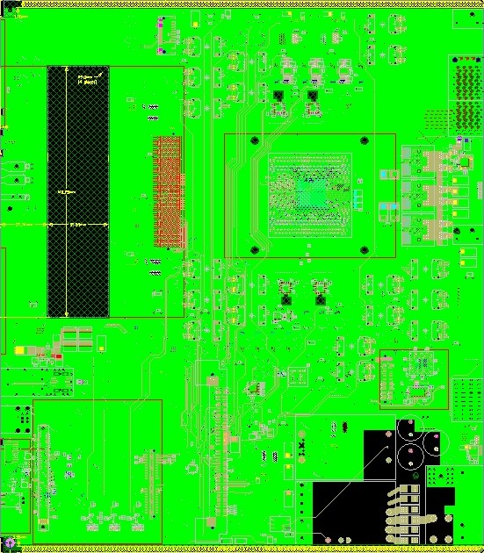
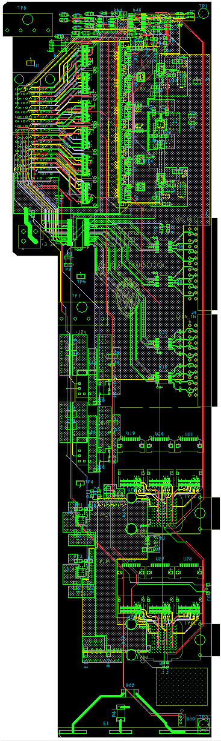
Trigger / DAQ
Main board + RTM
Large UltraScale+ FPGA
  Typically targeting Xilinx VU9P
Embedded Linux mezzanine
for control functions (Xilinx Zynq)
IPMC mezzanine (another
Zynq+Linux)
Gigabit Ethernet as main
control interface
  Option for 10G Ethernet
~100 optical links total
  RX+TX each
  Up to 28 Gb/s each
  On main board with FPGA for
  cleanest high-speed signal path and widest airflow
Optical links
Optical links
Pt LUT
mezzanine
Main FPGA
LVDS I/O
Optical links
Eth
switch
Embedded
Linux
Module
(ELM)
IPMC mezzanine
Optical links
Main board screenshot from T. Gorski
Current Status:
1st prototype APd1 (development board) being assembled now
Testing will start this month
Firmware development using HLS shows that we can run Particle Flow/PUPPI algorithms on the trigger boards within necessary latency and resource limitations
We will test the firmware on actual hardware in the next months!

Slide 29
Fermilab: building on strengths and facilities
  Silicon Detector Facility and silicon expertise
    Critical for: building, assembling and testing Endcap Calorimeter cassettes and Outer Tracker Modules, design, assembly and testing of the Outer Tracker Flat Barrel, Endcap Timing Layer construction
      Size of facility, high capacity dual-phase CO₂ cold plant
      Facilities for custom fabrication of Carbon Fiber support
      Equipment/personnel for precision mounting tasks and alignment survey
  ASIC engineering
    Designing data concentrator chip for Endcap Calorimeter, readout chip for Endcap Timing
  Scintillator / SiPM expertise (Endcap Calorimeter)
  Firmware engineering / algorithm development

Slide 30
Fermilab: building on strengths and facilities
  Test beams
    There will be no test beams at CERN in 2019/2020
    Fermilab has a world class test beam facility: We have taken the lead in test beams in the past due to having both the facilities and the personnel knowledge base.
  Irradiation Test Area (ITA)
    Proposal for irradiation facility at MTEST (see talk from Mandy)
    Shielding studies have launched – viewed favorably by DOE – this is an exciting new capability for Fermilab that will be used by CMS/ATLAS and others
    CMS plans to start using it in April to irradiate test sensors for the Outer Tracker – this is a key step in international CMS testing and qualification plans
    MTEST cleanup is critical path for this!

Slide 31
U.S. CMS Reviews
U.S. CMS project is funded by both DOE (MIE) and NSF (MREFC)
  For the NSF, funding is through an MREFC
    Joint US ATLAS / US CMS MREFC (total of $150M)
    MREFCs are approved by NSF Associate Lab Directors and the National Science Board. The ”gate” reviews are:
      Conceptual Design Review (MREFC cost/schedule range) March, 2016) (check dates)
      Preliminary Design Review (MREFC baseline) Dec, 2017 – NSB approval in Feb. 2018
      Final Design Review (MREFC start construction) Sep, 2019 – NSB approval in Feb 2020
  For the DOE funding for US CMS is through a normal O413.3B project ($162M)
    CD-0 (Mission Need) granted 2016
    CD-1 (Approve Cost and Schedule Range) June 2018/2019
    CD-3a (Approve Long Lead Procurements) Fall, 2019
    CD-2/CD-3 (Project Baseline / Start Construction) Fall 2020.
    CD-4 (Project Closeout) Fall 2027

Slide 32
CD-1 Review (June, 2018)
The upshot: Outer Tracker, Endcap Calorimeter, Trigger/DAQ were all recommended to proceed to CD-1 (>90% of the project by cost)
The MIP Timing Detector was a late addition to the CMS suite of upgrades, and as such was not as mature as the other projects
  i.e. does not yet have a TDR – was only approved to move to TDR last year
  As a result, U.S. planning was not yet at a CD-1 level of maturity
  The project has made huge progress since last June
As a response to the CD-1 review, we have:
  Strengthened the Project Office to respond to CD-1 recommendations
  Firmed up the U.S. plans for the MIP Timing Detector, Appointed Project Management down to Level 4, Held a technical review of the MTD in November (which was quite positive), Preparing for a Fermilab Office of Project Support Services review of cost and schedule in January
We will be addressing CD-1 again this year
  March 19-21 for a Fermilab Director’s Review (chaired by Mike Lindgren)
  June 11-13 for the DOE Independent Project review

Slide 33
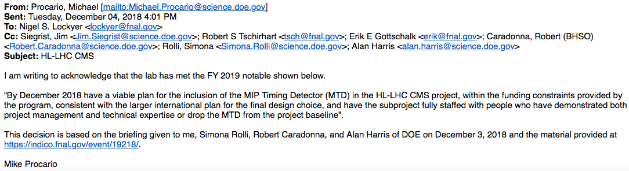
MTD PEMP Notable
  Additionally, the MTD was a topic for a Fermilab PEMP notable
    “By December 2018 have a viable plan for the inclusion of the MIP Timing Detector (MTD) in the HL-LHC CMS project, within the funding constraints provided by the program, consistent with the larger international plan for the final design choice, and have the subproject fully staffed with people who have demonstrated both project management and technical expertise or drop the MTD from the project baseline”.
    We held a DOE briefing on December 3, and successfully demonstrated that the MTD satisfied all of the elements of the PEMP notable (https://indico.fnal.gov/event/19218/)
    The MTD is now included in the project baseline

Slide 34
MTD Technical Review (November, 2018)
Some excerpts from the final report:
Of course, we have some recommendations to address before CD-1

Slide 35
Conclusions
  U.S. CMS contributions are critical to CMS HL-LHC upgrades, and Fermilab is critical to U.S. CMS contributions
  We are making significant technical progress in all areas of the update
  Critical items from the lab that we need to continue our success are:
    ASIC engineering. This is being addressed, however we believe another new hire would help ensure success of FNAL ASIC commitments. CMS depends on the success of the FNAL ASIC group.
    Irradiation Test Area – we really need this by April, 2019. This implies cleanup of MTEST needs to start now.
    Lab scientists are key to the success of CMS and the HL-LHC detector upgrades and strong support for the CMS research program is critical.

Slide 36
CMS HL-LHC upgrades
backup

Slide 37
Fermilab Deliverables for HL-LHC CMS Upgrades
  Outer Tracker:
    2700 total combination of PS/2S modules (includes preproduction & spares) (~17% of the total modules for the OT).
    Flat barrel (mechanical structure + PS modules coming from above production)
    Bump bonding of all MaPSAs (pixel side of PS modules) – oversight and QC
  Endcap Calorimeter
    Design and assemble 375 Cassettes (corresponding to 1st 15 layers of hadronic section + test wedge), test, ship to CERN
    Assemble tile modules for 1st 15 layers
    Design and provide concentrator ASICs for the whole EC project (ECON)
  MIP Timing Detector
    Endcap Timing Layer – design FE ASIC, supply 50% of the final ASICs
    Develop module assembly procedures, share module assembly of 50% of the ETL modules with Nebraska (exact share is unclear right now).
  Trigger/DAQ
    DAQ Storage Manager, trigger algorithms/ firmware/board testing

Slide 38
U. S. CMS HL-LHC Upgrade Organization
Fermilab people are underlined.
Fermilab accounts for 44% of the total project team (down to L3).
Notes:
USCMS organizatioln, highlighting FNAL

Slide 39
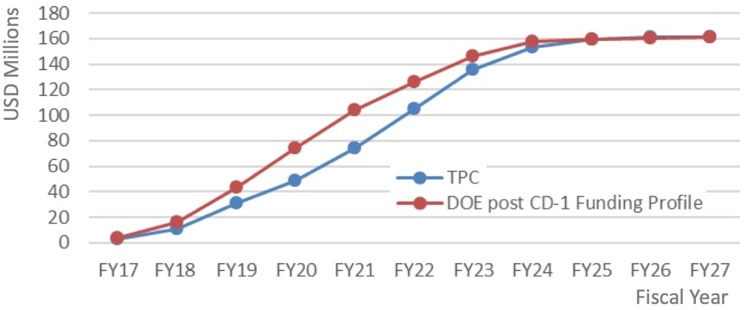
Working towards the CD-1 DOE profile
Project profile vs. DOE funding
Important Caveats:
  For long lead time and large procurements, we may need to shift forward by 3-6 months, especially e.g. large Si purchases through CERN for OT/EC
  This is not the final DOE funding profile
    Funding for FY17-FY19 is “fixed”, from FY20 onwards this could change
    We have run several scenarios for funding from DOE – we believe we are ok profile wise
    We will get a CD-1 funding profile to use for the Fermilab Director’s Review

Slide 40
CERN/CMS Project Approval Process
Four step definition/review process:
Technical Proposal defines the overall scope and cost for the entire upgrade program, with the possibility to maintain different options which may depend on technical issues and/or on funding availability.
The detailed technical design reports (TDR) for subsystems are reviewed individually, with the requirement that each fits in the overall approved plan for scope and cost (Project Baseline).
The final design and construction readiness of the major detector components are reviewed, as well as the installation plan (Start of Construction).
Operations readiness reviews held to evaluate the capability of the completed detectors to provide the expected performance and mark the end of the construction project. (Start of Operations or Project Completion).
We are here*
*Exceptions: MIP Timing Detector (Has TP, TDR submission March, 2019)
Trigger/DAQ will have final TDRs in 2019/2020 (benefit from latest tech.)

Slide 41
The U.S. in International CMS HL-LHC Upgrade
✔
Dmitri Denisov has been named CMS Upgrade Planning Officer (UPO)
Oversees Milestones, Schedules, and Risk Registry across the project.
U.S members
(✔) FNAL
✔
✔
Notes:
Fix lines.

Slide 42
International CMS MTD Management

Slide 43
USCMS HL-LHC upgrades: Fermilab
Fermilab major scientific contributions to the upgrade detectors are:
  International CMS Subsystem Upgrade Coordinators in Trigger and MTD
  International leadership roles in Endcap Calorimeter, Trigger, MTD
  Project office (2 Scientists)
  Tracker (6 Scientists+ 1 new hire+3 postdocs)
    modules and mechanics
    Test stands / test beams / integration tasks
    MaPSA testing
  Endcap Calorimeter (8 Scientists+1 postdoc)
    Cassette design, assembly, testing
    Sensor design, testing
    Data concentrator ASIC
  Trigger/DAQ (6 Scientists+ 2 postdoc)
    Trigger leadership/Calorimeter Trigger / Correlator Trigger / Algorithms
  Fast timing (MTD) (8 Scientists + 2 postdocs)
    Front end chip, barrel mechanics design, endcap design
(#) = headcount, not FTEs.

Slide 44
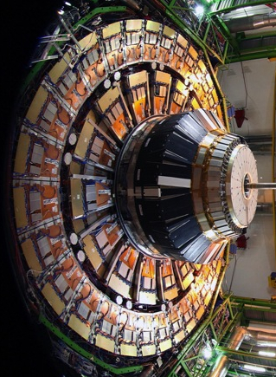

High Granularity Endcap Calorimeter
CMS HL-LHC Upgrade Endcap
Current Detector Endcap
Presenter | Presentation Title
44

Slide 45

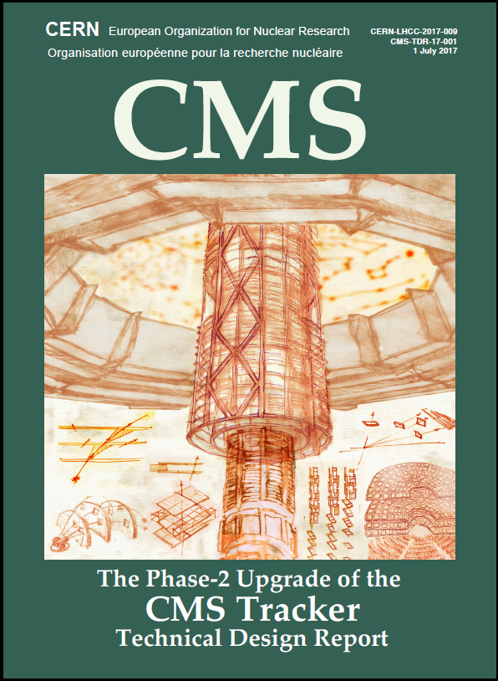
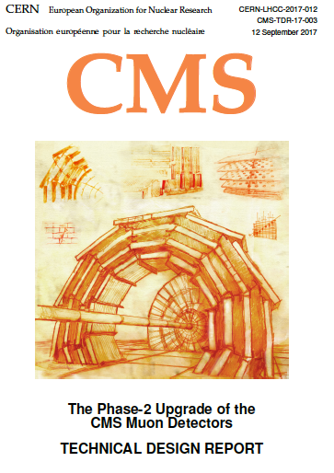
Status of the CMS HL-LHC Upgrades
Subsystems
Tracker: consists of Outer Tracker and Inner (Pixel) Tracker
    Tracker TDR: https://cds.cern.ch/record/2272264. UCG report: https://cds.cern.ch/record/2295762
    Approved by CERN RB Dec. 4, 2017
Barrel Calorimeter: consists of hadronic and electromagnetic
    Barrel Calorimeters (TDR): https://cds.cern.ch/record/2283187. UCG report: https://cds.cern.ch/record/2304338
    Approved by CERN RB March 7, 2018
Endcap Calorimeter: both hadronic and electromagnetic parts
    Endcap Calorimeter (TDR) https://cds.cern.ch/record/2293646. UCG report: https://cds.cern.ch/record/2313441
    Approved by CERN RB April 18, 2018
Muon Systems: both hadronic and electromagnetic parts
    Muon Systems (TDR): https://cds.cern.ch/record/2283189. UCG report: https://cds.cern.ch/record/2304341
    Approved by CERN RB March 7, 2018
L1-Trigger; DAQ
    L1-Trigger (interim-TDR): https://cds.cern.ch/record/2283192. TDR Q1 2020
    DAQ/HLT (Interim-TDR): https://cds.cern.ch/record/2283193 . TDR Q2 2021
    Both iTDRs approved by RB Dec. 4, 2017
MIP Timing Detector
    MIP Timing (Technical Proposal) : https://cds.cern.ch/record/2296612 . TDR Q1 2019
    TP approved by CERN RB March 7, 2018

Slide 46
High Granularity Endcap Calorimeter
Active Elements:
Hexagonal modules based on Si sensors
in CE-E and high-radiation regions of CE-H
Scintillating tiles with SiPM readout in
low-radiation regions of CE-H
Key Parameters:
HGCAL covers 1.5 < η < 3.0
Full system maintained at -30ºC
~600m² of silicon sensors
~450m² of scintillators
6M Si channels, 0.5 or 1.1 cm² cell size, 350k scint-tile channels (η−φ)
  Data readout from all layers
  Trigger readout from alternate layers in CE-E and all in CE-H
~28000 Si modules (incl. spares)
~2.3m
~2m
Electromagnetic calorimeter (CE-E): Si, Cu/CuW/Pb absorbers, 28 layers, 26 X₀ & ~2λ
Hadronic calorimeter (CE-H): Si & scintillator, steel absorbers, 22 layers, ~8λ
46
Notes:
Too much detail, and add in US deliverables and FNAL deliverables

Slide 47
CERN/LHCC Management, Oversight, and Review
Project approvals:
  The LHC Committee (LHCC) reviews and approves TDRs for scientific and technical merit
  The Upgrade Cost Group (UCG) reviews cost, schedule, and risk
  When the LHCC and UCG reviews are passed, the Research Board (RB) approves the project
  When the ensemble of projects is approved it is sent as a package to the Resource Review Board (RRB) to approve final financial obligations
Project monitoring
  The LHCC Phase 2 Upgrade Group has been formed and will review the approved projects annually
  1st such review for CMS is May 20-21, 2019

Slide 48
US CMS Software and Computing During LS2
Significant upgrade of computing facilities and capabilities needed,
to meet Run 2 analysis and Run 3 data processing needs
  maintain & replace aging hardware, increase computing capacity as needed, and use HPC resources
    external resources that might only be available periodically will enter the computing cost equation,
    such as DOE and NSF HPC resources, commercial clouds, and opportunistically shared resources
    re-direction of work to the most cost-effective available resource, through Fermilab HEPcloud
  Already now significant use of DOE and NSF HPC centers:
    CMS was awarded 82M hours at NERSC for 2019, and NSF XSEDE allocations are actively used and ready for renewal, requesting resources at HPC centers to handle ~5% of CMS’s simulation needs for the year
Software development to upgrade aging computing services (data / workflow management etc) to improve infrastructure performance
  Example is work on data management and data access systems, that need significant upgrades
  Run3 will be serving as a “dress rehearsal” for HL-LHC
Ramping up R&D towards software and computing upgrades for HL-LHC
  US CMS efforts at Fermilab and Universities are part of an emerging global work plan
  WLCG “strategy” document prioritizes a program of work, focusing on some of the topics covered by the Community White Paper
  Driven by US leadership, CMS is making significant progress, with a number of concrete examples
  e.g. nanoAOD and push towards use of common software solutions

