Slide 1
Physics Program at the IOTA Ring
Jonathan Jarvis, Associate Scientist: Accelerator Division
(on behalf of the IOTA/FAST team)
Physics Advisory Committee January Meeting
Fermi National Accelerator Laboratory, Jan. 17, 2019

Slide 2
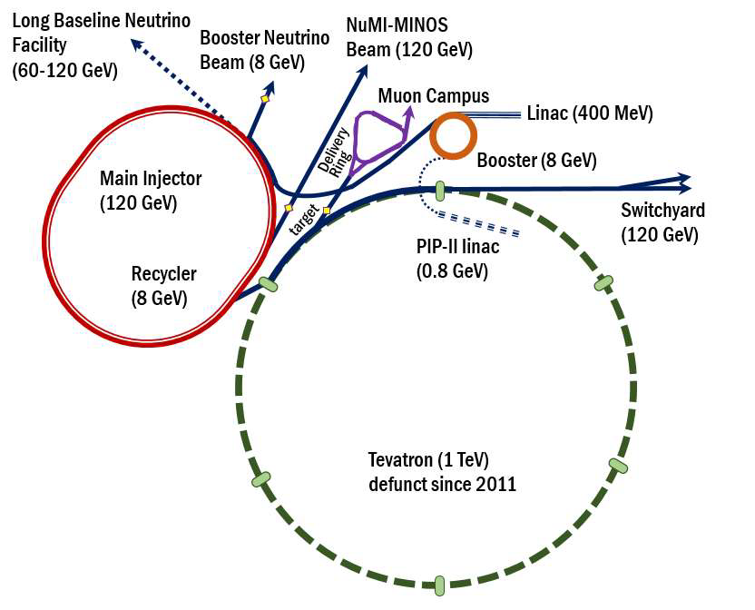
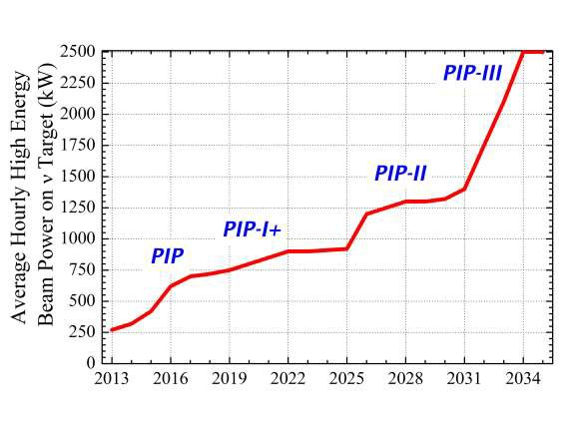
Frontier topics in beam physics will shape future accelerators
Of particular interest for FNAL:
Beam loss at high-intensity:
  Booster, Recycler and MI are intensity-limited by losses (~1 W/m).
Instabilities in high-brightness beams:
  At high space-charge various instabilities appear which can not be suppressed by external dampers, e.g. an “electron cloud” instability (observed in the Recycler)
Beam cooling for next-gen. colliders
FNAL’s singular ability to address these areas was highlighted by results of recent GARD review

Slide 3
Addressing these topics requires a dedicated facility
Need for experimental beam-physics research, especially in circular accelerators
Difficult to conduct R&D in main complex
  Production machines must operate 24/7 for HEP users
  Disruptive studies – opportunities limited by time, impact on operations
  Hardware modifications expensive and time consuming
Dedicated R&D facility is an efficient way to conduct proof-of-principle experiments, train researchers
2015 P5 GARD subpanel: “Construct the IOTA ring, and conduct experimental studies of high-current beam dynamics in integrable non-linear focusing systems.”

Slide 4
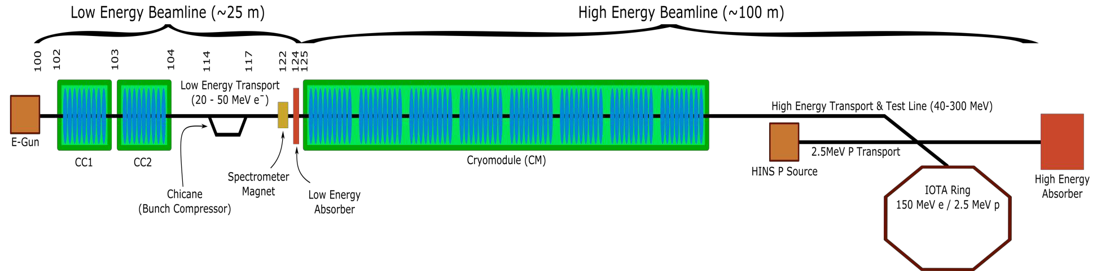
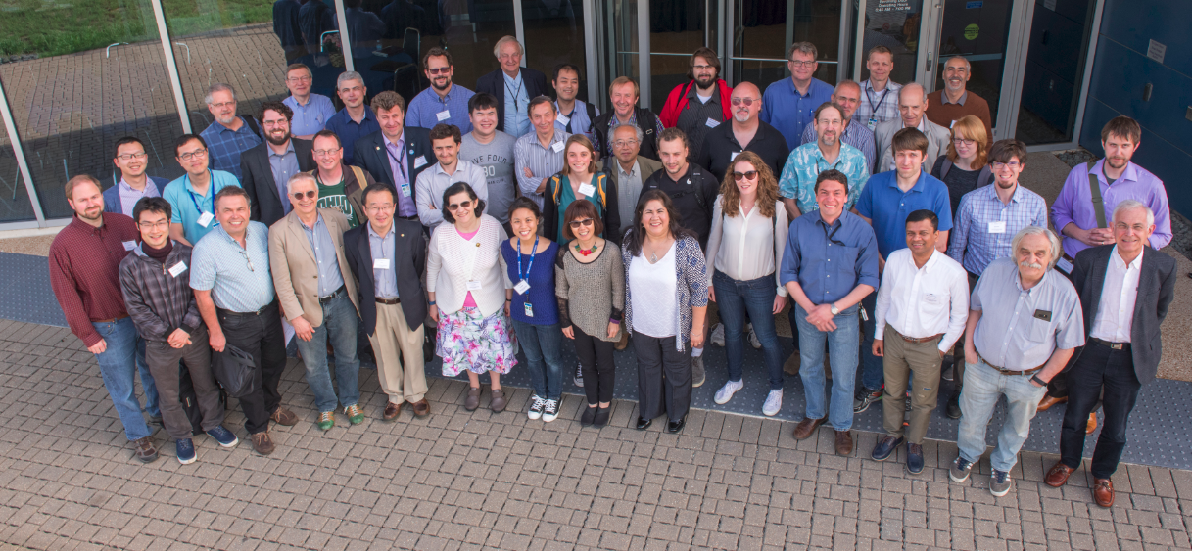
IOTA/FAST Facility: a center for Acc. and Beam Physics
IOTA/FAST establishes a capability at FNAL, unique in the world, to address frontier topics in Accelerator and Beam Physics
The only dedicated facility for intensity-frontier accelerator R&D; ranked as top facility (“Tier 1”) for acc. & beam physics thrust by recent GARD review
~30 Collaborating institutions
Nat. Lab Partnerships: ANL, BNL, LANL, LBNL, ORNL, SLAC, TJNAF
Many opportunities for R&D with cross-office benefit in DOE/SC
IOTA/FAST Collaboration Meeting ’18

Slide 5
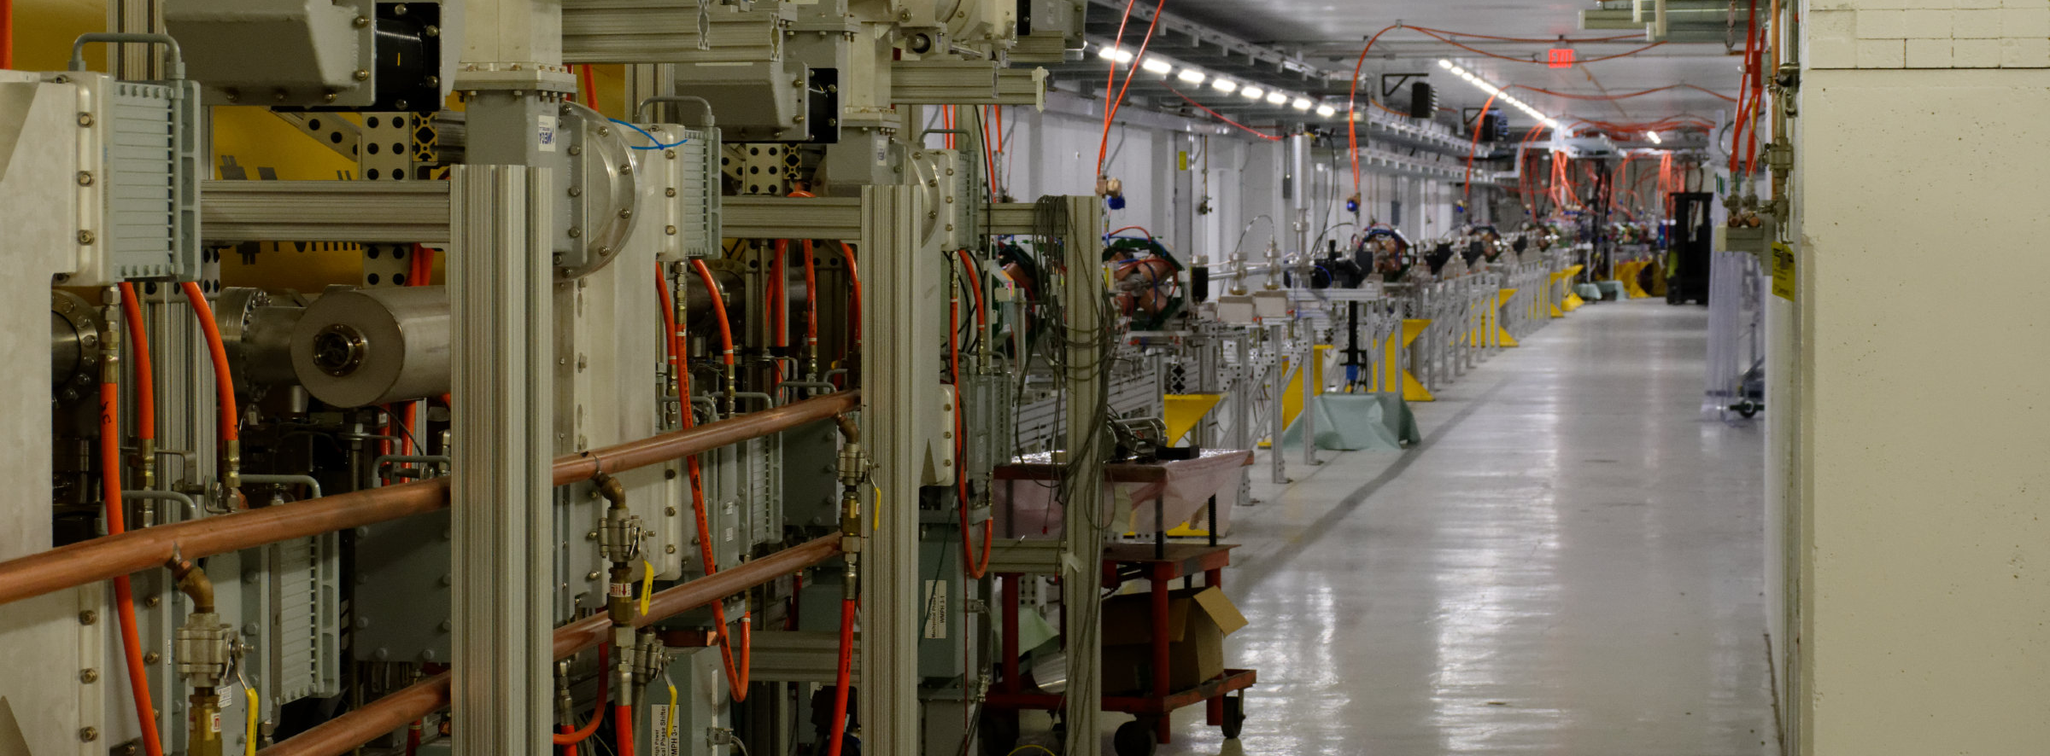
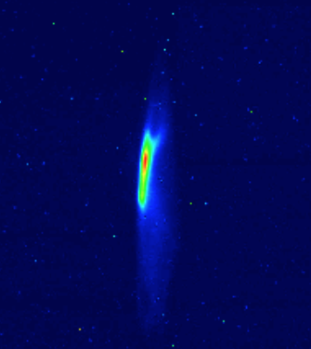
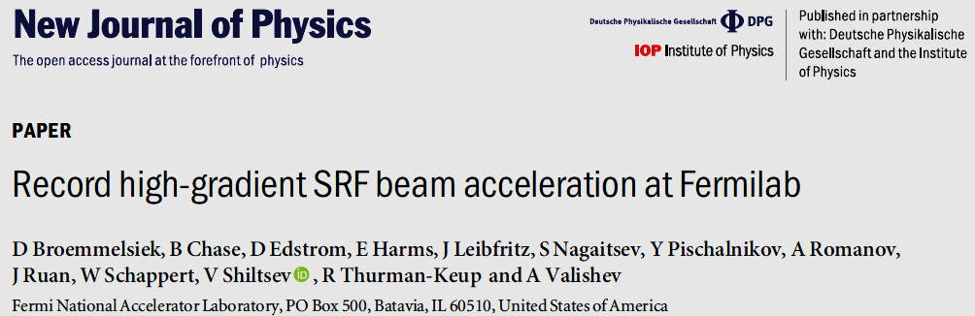
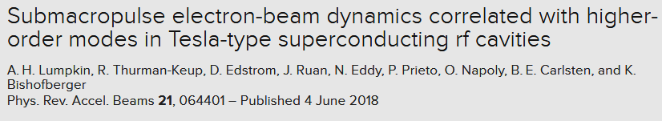
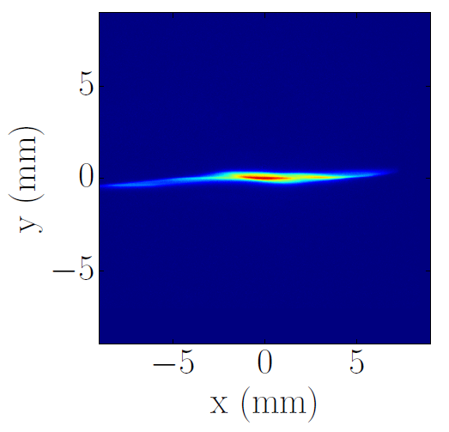
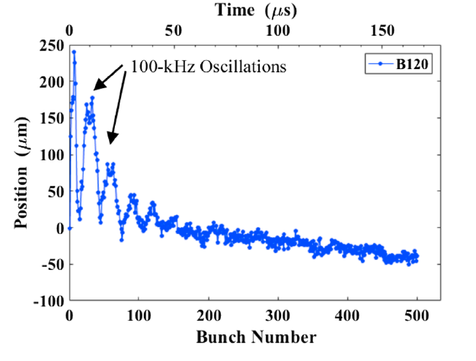
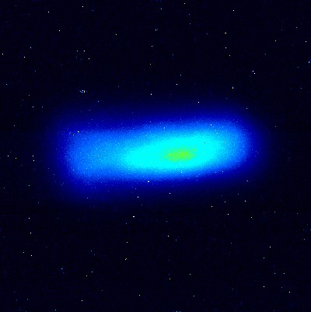
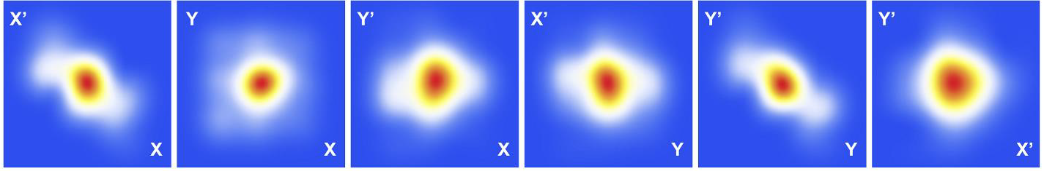
FAST injector has successfully met design goals
Commissioned to full design energy of 300 MeV; ~90% up-time eff.
World-record beam acc. by ILC-type CM: >31.5MV/m (~250MeV gain)
Successful beam delivery to IOTA
Active & expanding scientific program with new results in:
  HOM excitation in SRF cavities & effects on beam emittance
  Advanced beam diagnostics using synchrotron radiation
  Machine learning algorithms for optimization of accelerator controls
  4D phase-space tomographic reconstruction of the beam
  Flat-beam transformations of high-intensity magnetized beams
Flat-beam
transformation
Multi-bunch
HOM effects
Adv. Beam
diagnostics
Tomographic reconstruction of 4D phase space

Slide 6
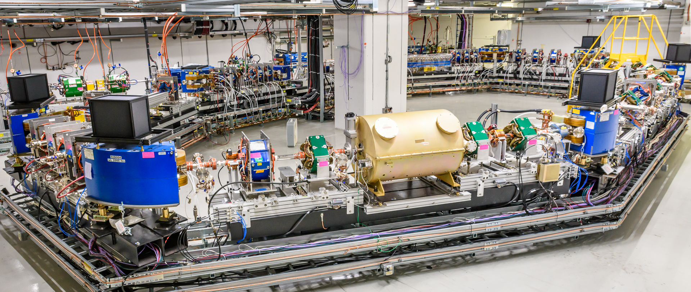
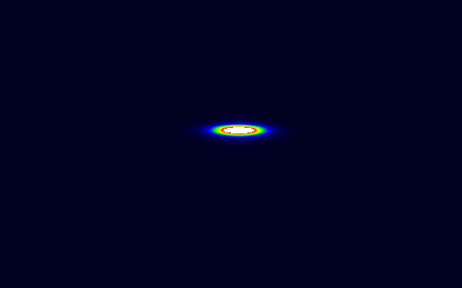
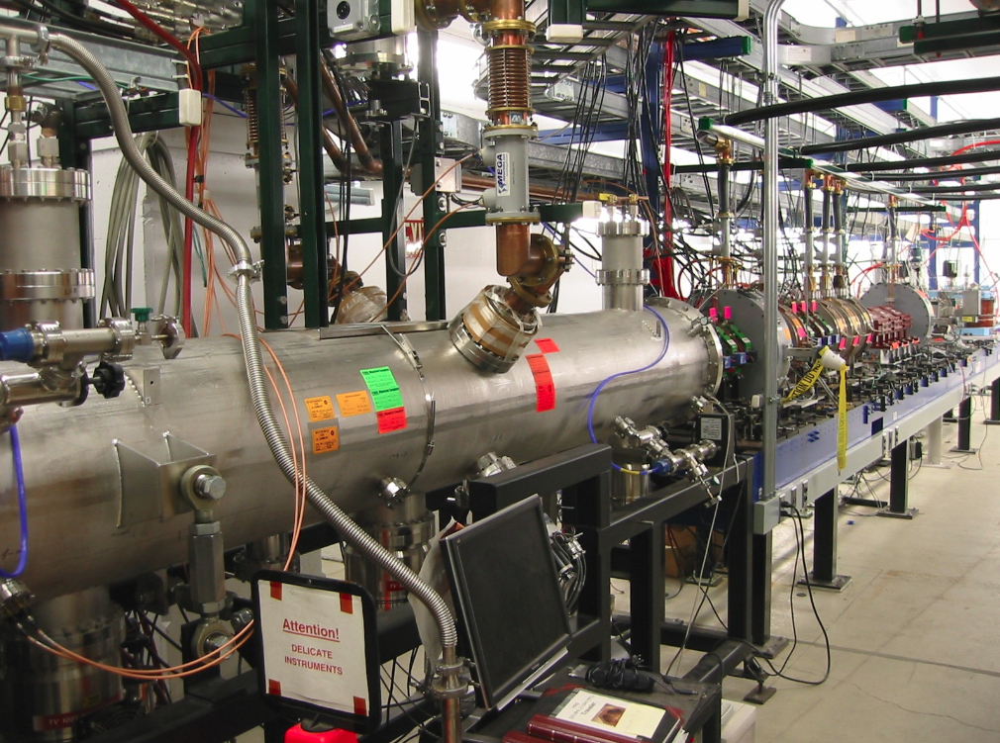
IOTA successfully constructed and commissioned
sync. rad. from IOTA
Commissioned with electrons at 47 MeV and 100 MeV; design charge achieved ~100pC
Proton injector being completed; available for start of proton science program in **FY’20
**requires appropriate funding schedule
IOTA proton injector

Slide 7
Accelerator Science at IOTA/FAST
IOTA Ring – priority research focused on high-intensity proton rings, driven mostly by Fermilab
  Nonlinear Integrable Optics
  Optical Stochastic Cooling
  Space-charge compensation
  Suppression of coherent instabilities
FAST e- Linac and IOTA – opportunities concurrent with main IOTA program, driven mostly by external partners
  Radiation generation
  High average current experiments
  Complementary to FACET-II
  Suitable for LCLS-II commissioning, MARIE and EIC R&D
  Quantum science: single and few-electron experiments
Near-term, high-impact
science with electrons

Slide 8
Nonlinear Integrable Optics
connects to instability mitigation, space-charge effects, dynamic aperture, beam-beam effects, LHC

Slide 9
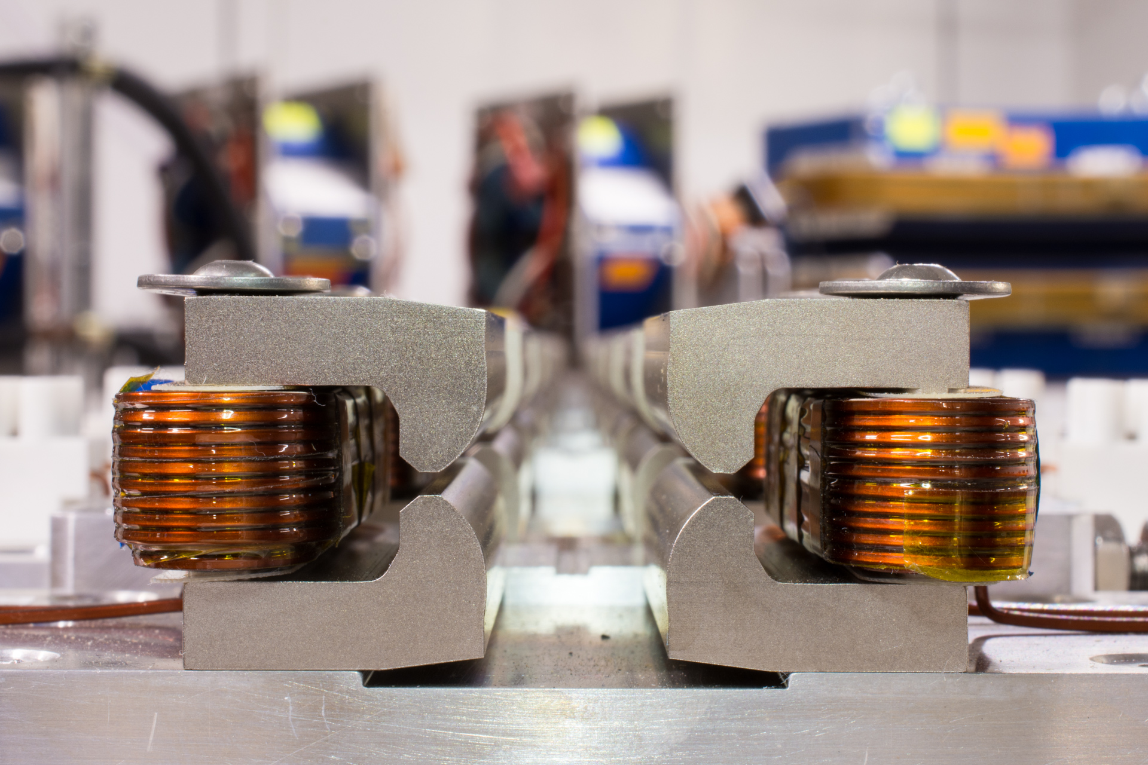
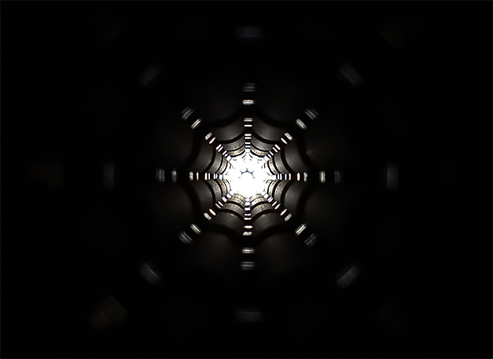
Specialized nonlinearity may transform how we focus beams
$$x”+K_{x}\left(s\right)x=S\left(s\right)x^{2}+O\left(s\right)x^{3}+⋯$$
Nonlinear terms are unavoidable, can be intentional/unintentional, and can help/harm the beam
Specially designed nonlinear magnets (or space-charge potentials) can establish additional integrals of motion that greatly enhance stability and enable higher-intensity operation
May be a critical enabling technology for next-gen. intensity-frontier facilities
IOTA NL mag. string
Potential of NL mag.
IOTA octupole string

Slide 10
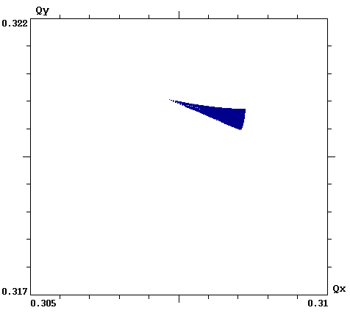
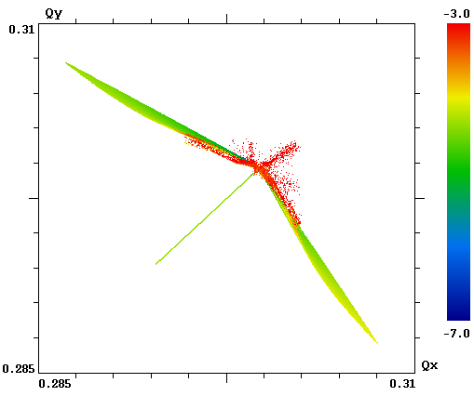
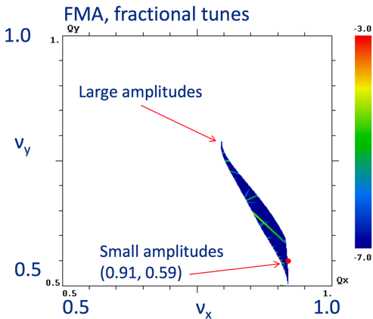
NIO could yield important benefits for future HEP machines
  Reduced chaos in single-particle motion: e.g helpful for space-charge suppression
  Strong immunity to collective instabilities via Landau damping: provides for higher beam current and brightness
  Low cost: brighter beams produce a cascade of cost savings throughout the design, engineering and construction of accelerators
LHC
IOTA w/ Oct.
IOTA w/ NL mag.
ΔQ = 0.001
ΔQ = 0.025
ΔQ = 0.25
Fig. of merit is “tune spread” (ΔQ): the spread in oscillation freq. for beam particles

Slide 11
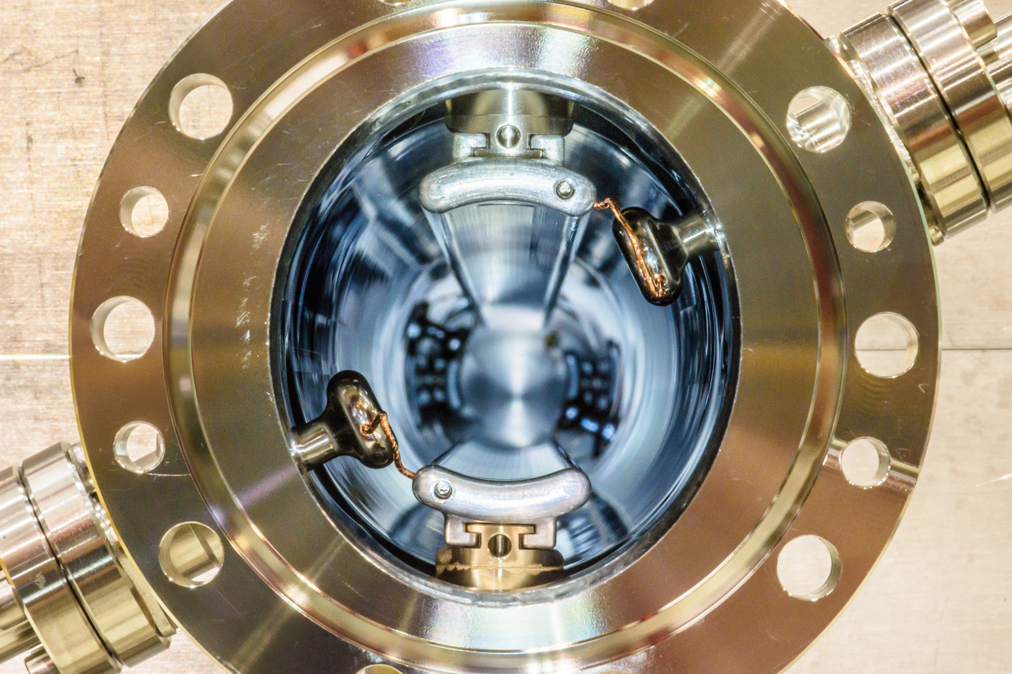
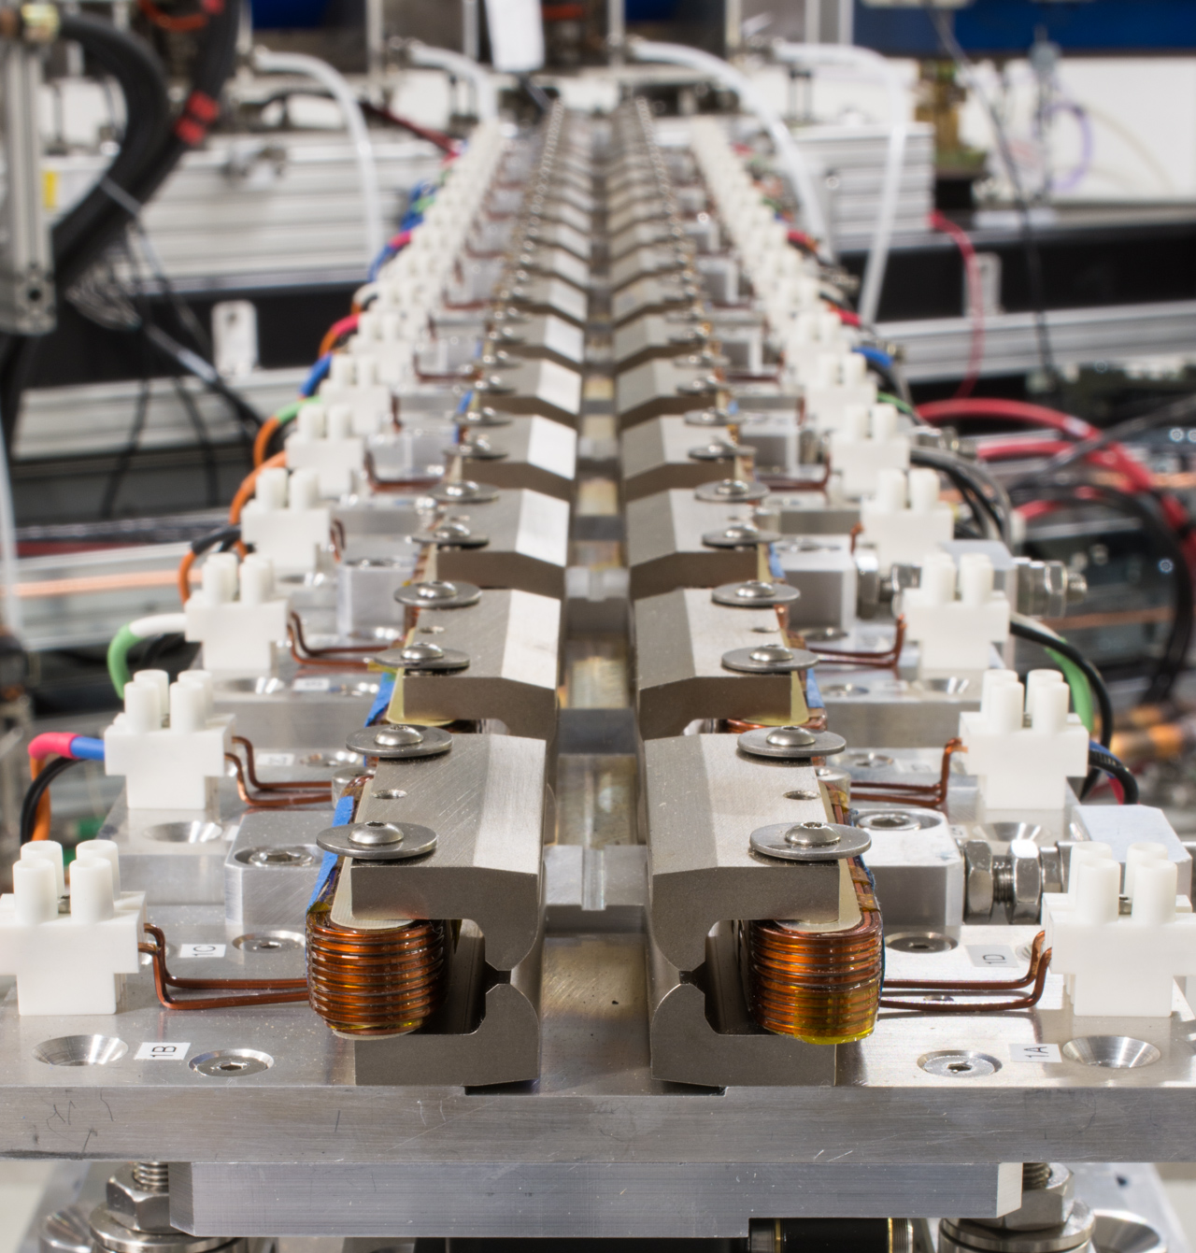
IOTA is purpose-built to explore the NIO concept
Phase I with electrons: 2018-2021
  Probe chaos and beam dynamics for NIO systems
    Octupole string as NIO element
    IOTA NL magnet as NIO element
Phase II with protons: 2020-2022
  Study NIO systems in high-intensity regime
  Study space-charge compensation methods in NIO systems
IOTA stripline kicker
  Goal: Reduce beam losses and improve immunity to coherent instabilities for bright beams
IOTA NL mag. string

Slide 12
Optical Stochastic Cooling
connects to future colliders, EIC, light sources, quantum science

Slide 13

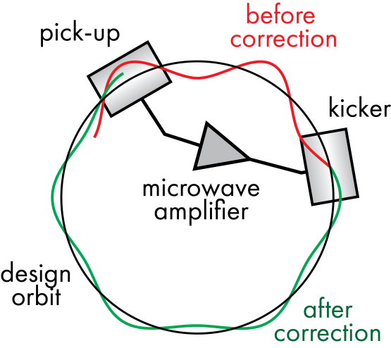

SC: a powerful technique but limited to GHz BW
$$ℒ \sim \frac{fN_{b}N^{2}}{4π{σ_{x}}^{∗}{σ_{y}}^{∗}}$$
1984 Nobel: van der Meer/Rubbia
We can increase beam brightness if we have granular information about particle ensemble.
Bandwidth of feedback system controls cooling rate
Simplified stochastic cooling system

Slide 14
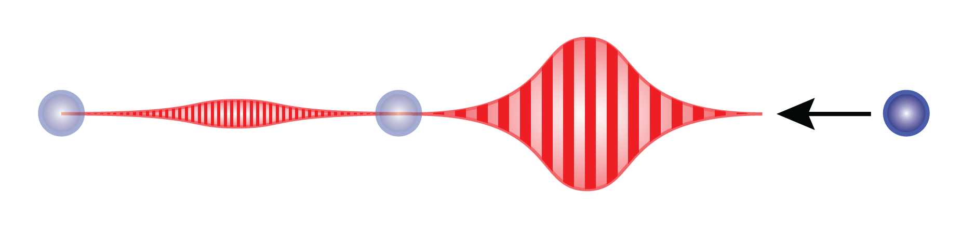
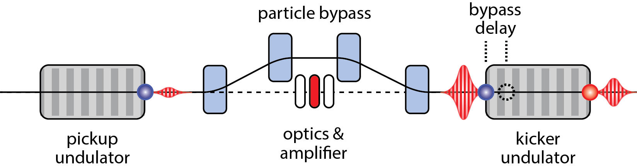
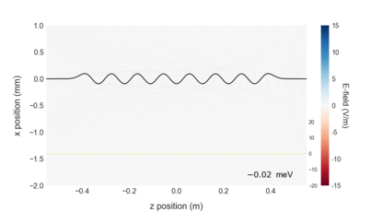
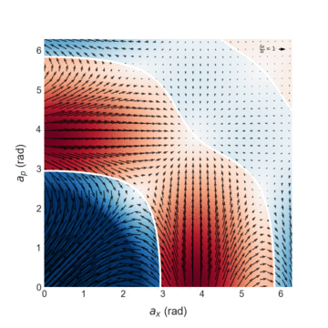
OSC extends the SC principle to optical bandwidth
2
1
4
Energy exchange in kicker
5
3
Wavepacket generated
Particle delayed in bypass
Wavepacket amplified and focused
Corrective kick applied
Cooling accumulates over many passes
Cooling vs. betatron and
synchrotron amplitudes
10³ – 10⁴ increase in cooling rate over SC and extension into an energy range where no cooling solutions exist
A.A.Mikhailichkenko, M.S. Zolotorev, Phys. Rev. Lett. 71 (25), p. 4146 (1993)
M. S. Zolotorev, A. A. Zholents, Phys. Rev. E 50 (4), p. 3087 (1994)

Slide 15

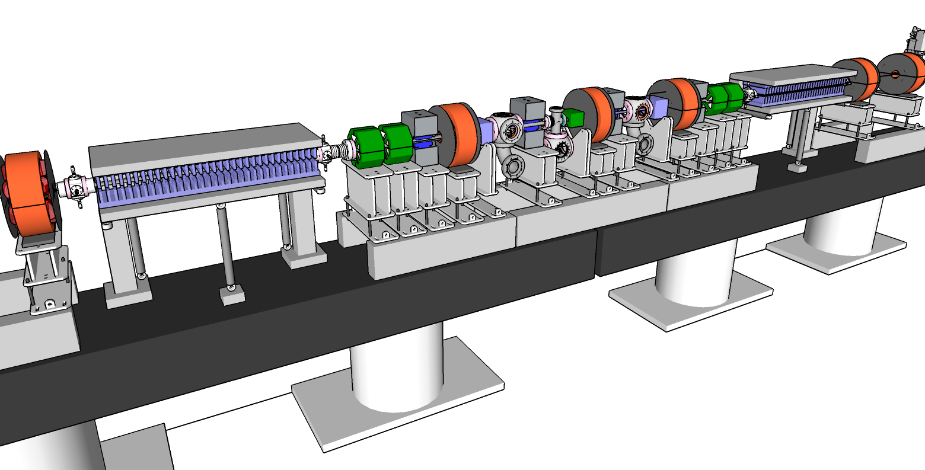
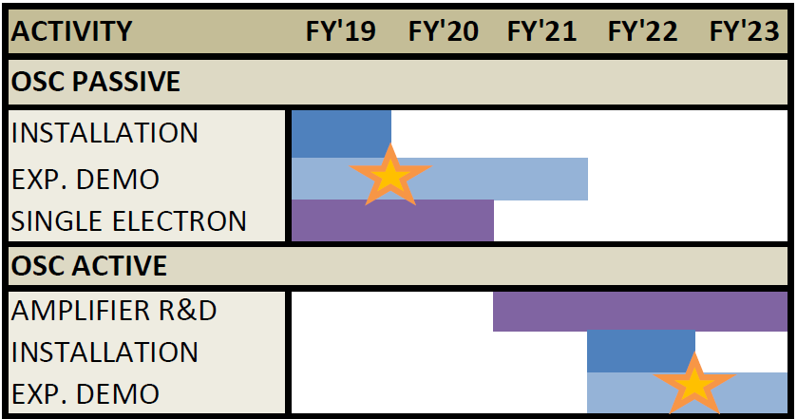
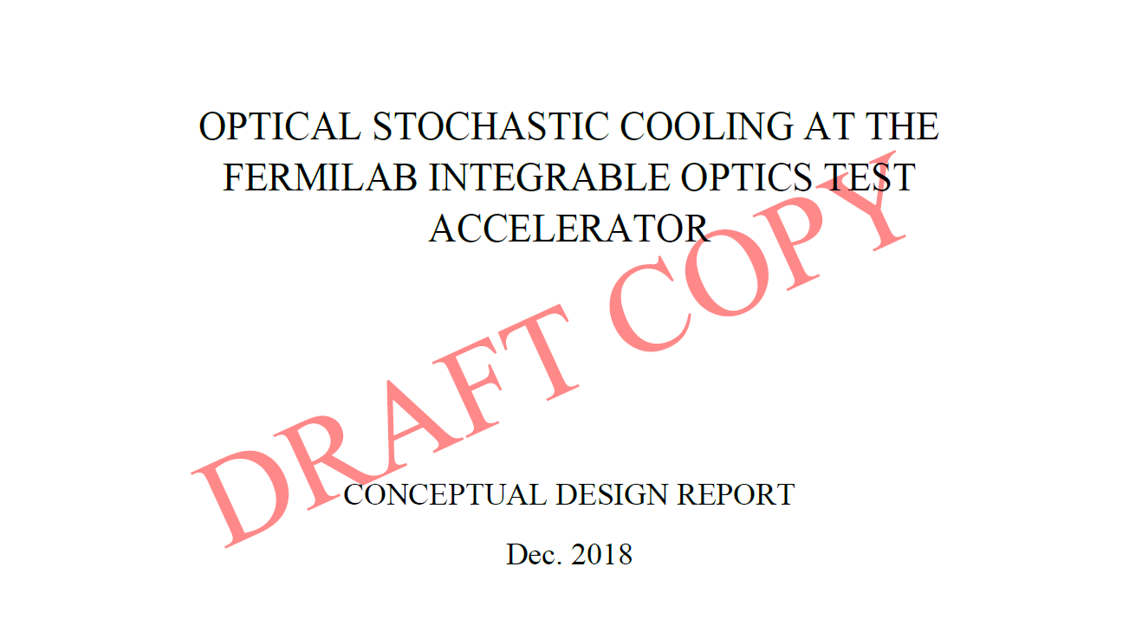
Worlds first OSC demonstration in ~Q4 FY’19
Completing ~100 pg. CDR
Proof of principal begins in mid FY’19;
High-impact with competition from Cornell (NSF funded)
Active OSC demo beginning in FY’22
Facilitate pathfinder experiments towards a near term use in EIC

Slide 16
Electron Lenses
connects to LHC, space-charge effects, beam-beam-effects

Slide 17
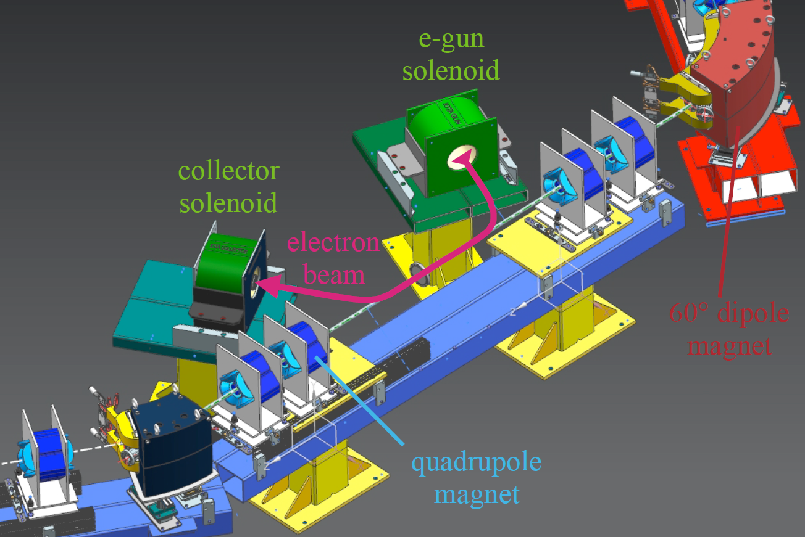
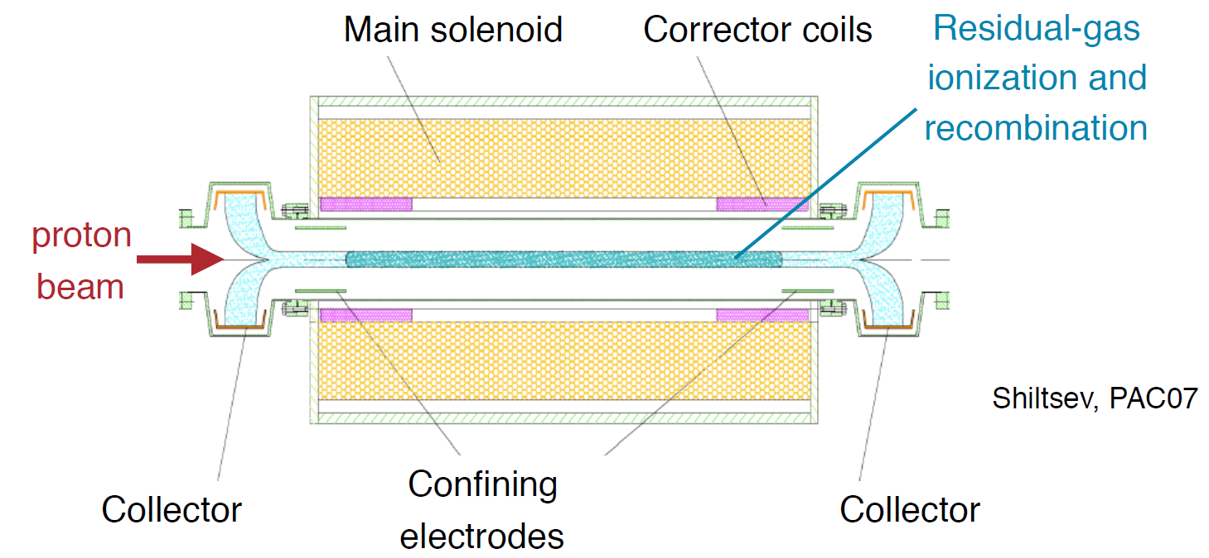
Electron lens is a versatile research tool for IOTA
Research with stored electrons:
Novel nonlinear element for integrable optics (using space charge)
Research with stored protons:
Space-charge compensation: shaped beam or trapped electrons
Electron cooling: extending performance of IOTA for space-charge studies; cooling studies in a NIO lattice

Slide 18
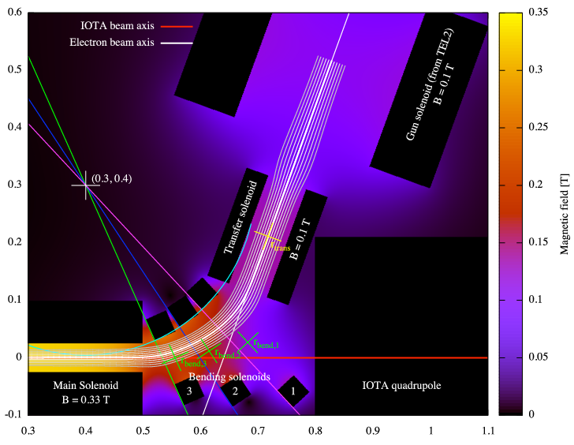
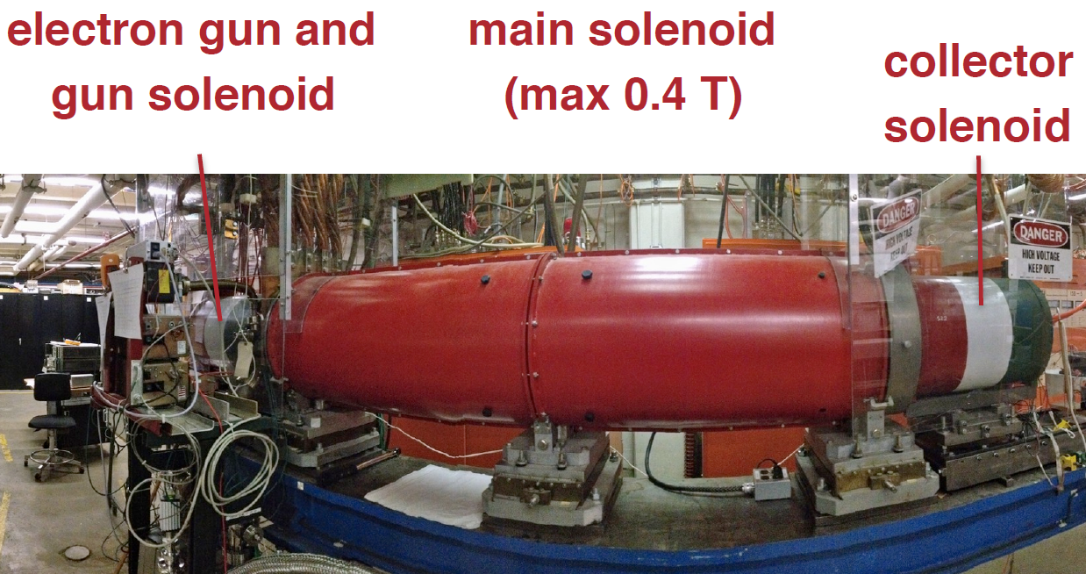
Design work underway with operations target in ‘21
Design, construction and installation in ‘19-’20; Experiments can start in ’21
Key areas under development:
  Completing detailed technical requirements for NIO experiment
  Numerical simulations of space-charge compensation; shaped beam vs. trapped electrons from residual gas
  Experiment design combining cooling and NIO
FNAL maintains only operational e-lens test stand in the world; will leverage heavily for this R&D

Slide 19
Quantum Science
connects to future FELs

Slide 20
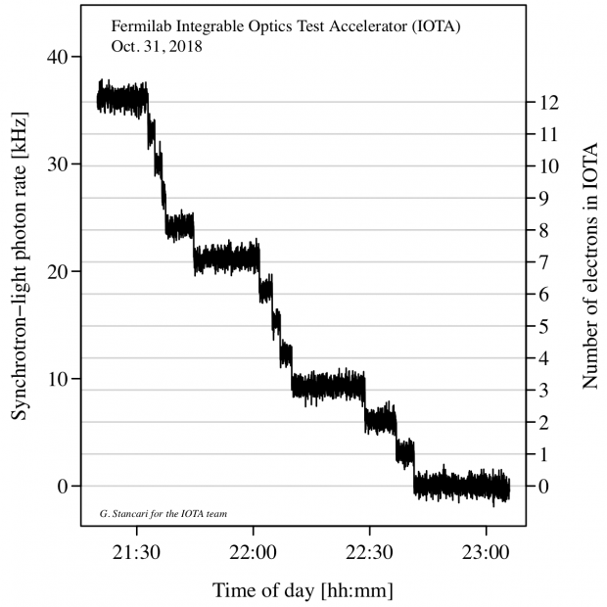
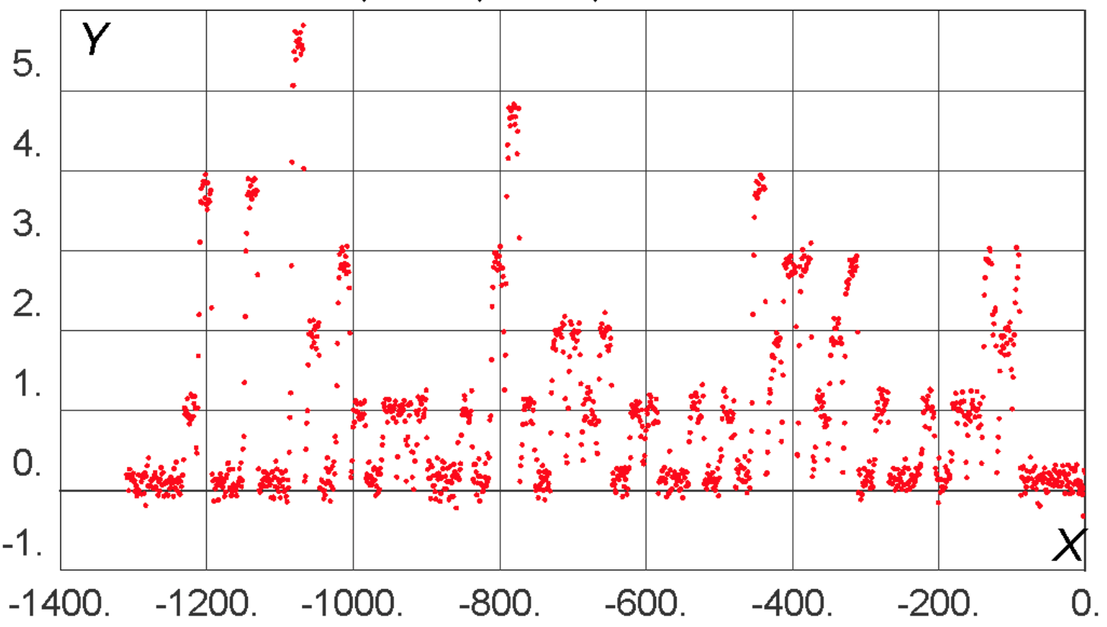

IOTA presents unique opportunities in QS
IOTA demonstrated storage of a single relativistic electron for long periods of time (~10 minutes).
High particle energy (100 MeV) enables observation of SR emission
This opens the way to a wide variety of quantum experiments
Recent One-day Workshop on Single-Electron experiments in IOTA – 30 participants from U.Chicago, LANL, SLAC, ANL, Princeton, RadiaBeam, BNL, UC Berkeley, Fermilab
PMT count rate
Discrete steps from loss
of single electrons
single e- beam
injection every 20 s
Number of Electrons in IOTA
Time (s)

Slide 21
In conclusion…
IOTA/FAST is a unique R&D facility and the only one in the world dedicated to the future of intensity-frontier research.
The IOTA science program explores a wide variety of fundamental topics in accelerator and beam physics
IOTA also constitutes an excellent platform for technological developments that may be vital for realizing next-gen. facilities
Significant opportunities for cross-office benefit inside DOE; draws heavily on FNAL’s heritage in cooling and beam dynamics
As an operational SRF accelerator, FAST cuts across GARD thrusts as a valuable tool for studying SRF technology and its interaction with an intense beam; attracting significant interest from global partners
Fermi National Accelerator Laboratory is operated by Fermi Research Alliance, LLC under Contract No. DE-AC02-07CH11359 with the United States Department of Energy.

Slide 22
Acknowledgments
Fermilab: Y.Alexahin, R.Andrews, D.Barak, V.Bocean, D.Broemmelsiek, A.Burov, K.Carlson, D.Crawford, A.Didenko, N.Eddy, D.Edstrom, J.Eldred, R.Espinoza, D.Franck, J.Jarvis, V.Kashikhin, R.Kellett, M.Kucera, V.Lebedev, J.Leibfritz, A.Lumpkin, C.Jensen, W.Johnson, P.Li, M.McGee, S.Nagaitsev, L.Nobrega, M.Obrycki, H.Piekarz, E.Prebys, I.Rakhno, A.Romanov, J.Ruan, J.Santucci, V.Shiltsev, G.Stancari, E.Stern, A.Valishev, J.VanBogaert, A.Warner, S.Wesseln
NIU: M.Andorf, S.Chattopadhyay, B.Freemire, P.Piot, S.Szustkowski
LBNL: C.Mitchell
BINP: D.Shatilov
Univ. Chicago: S.Antipov, Y.K.Kim, N.Kuklev
CEA/Saclay: O.Napoly
LANL: K.Bishofberger, B.Carlsten
UMD: H.Baumgartner, R.Kishek, K.Ruisard
RadiaSoft: D.Abell, D.Bruhwiler, N.Cook, C.Hall, S.Webb
RadiaBeam: R.Agustsson, A.Murokh, F.O’Shea

Slide 23
EXTRAS

Slide 24
10 Current PhD Students at Fermilab on Accel. Beam Physics
Nikita Kuklev Univ. Chicago IOTA
Ihar Lobach Univ. Chicago IOTA
Yichen Ji IIT
David Tarazona MSU
Jibong Hyun KEK FAST
Saba Fatima NIU
Matt Urfer NIU
Asama Mohsen NIU
Aaron Fewtterman NIU
Sebastian Szustkowski NIU IOTA

Slide 25
Recent IOTA/FAST Peer-Reviewed Publications
A. H. Lumpkin, B. E. Carlsten et al, Submacropulse electron-beam dynamics correlated with higher-order modes in Tesla-type superconducting rf cavities PRAB, 21, 064401 (2018);
M.B. Andorf, V.A. Lebedev, P. Piot, J. Ruan, Wave-Optics Modeling of the Optical-Transport Line for Passive Optical Stochastic Cooling, NIM-A 883 119 (2018);
M. B. Andorf, V. A. Lebedev, J. Jarvis and P. Piot, Computation and Numerical Simulation of Focused Undulator Radiation for Optical Stochastic Cooling, (submitted to PRAB, 2018) ;
D.Broemmelsiek, et al, Record High-Gradient SRF Beam Acceleration at Fermilab, (submitted to NJP, 2018);
D. Mihalcea, A. Murokh, P. Piot, J. Ruan, Development of a Watt-level Gamma-Ray Source based on High-Repetition-Rate Inverse Compton Scattering NIM-B 402 212 (2017);
V. Shiltsev, Y. Alexahin, A. Burov, Landau Damping of Beam Instabilities by Electron Lenses and A. Valishev Phys. Rev. Lett. 119, 134802 (2017);
A. Halavanau et al., Analysis and Measurement of the Transfer Matrix of a 9-cell 1.3-GHz Superconducting Cavity PRAB, 20, 040102 (2017);
S. Antipov, S. Nagaitsev, A. Valishev, Single-particle dynamics in a nonlinear accelerator lattice: attaining a large tune spread with octupoles in IOTA, JINST, V.12 (2017);
S.Antipov, et al IOTA (Integrable Optics Test Accelerator): Facility and Experimental Beam Physics Program JINST 12 T03002 (2017).

Slide 26
FACILITIES EXTRAS

Slide 27
CM2 FAST Linac Performance vs ILC specs
Parameter | FAST Nov. 2017 | ILC specs 2007 RDR/2013TDR | Comments
Total beam energy gain per CM | 255 MeV* 31.8 MV/m 8 cavities | 252 MeV 31.5 MV/m in each 8/9 cavities | above the spec!
Q_0 | 0.8 e10 | 1 e10 | Two cavities have >1e10
Pulse length (beam) | 0.1 ms | 1.0 ms | had 1 ms in other studies
Pulse rep rate | 1 Hz | 5 Hz | had 5Hz in other studies
# bunches per pulse | 10 | 2625 / 1312 | had 1000 bunches in other studies
Bunch intensity | 0.2 nC | 3.2 nC | 1.5nC per bunch in other studies
* compare with European XFEL: there are several CMs in operating at 200+ MeV. The highest gain/CM is 237 MeV.

Slide 28
IOTA Parameters
 | Electrons | Protons
Nominal kinetic energy | 150 MeV | 2.5 MeV
Nominal intensity | 1×10⁹ | 1×10¹¹
Circumference | 40 m
Bending dipole field | 0.7 T
Beam pipe aperture | 50 mm dia.
Betatron tune | 3÷5
Beam size (rms, x,y) | 0.05 ÷ 0.5 mm | 5 ÷ 15 mm
Transverse emittance r.m.s. | 0.04 μm | 2 μm
Synchrotron Radiation damping time | 0.6s, 5×10⁶ turns
Synchrotron tune | 2÷5×10⁻⁴
Bunch length, momentum spread | 12 cm, 1.4×10⁻⁴
Beam pipe vacuum | 2÷4×10⁻¹⁰ Torr
Beam lifetime | 1÷10 hour | 1÷10 min

Slide 29
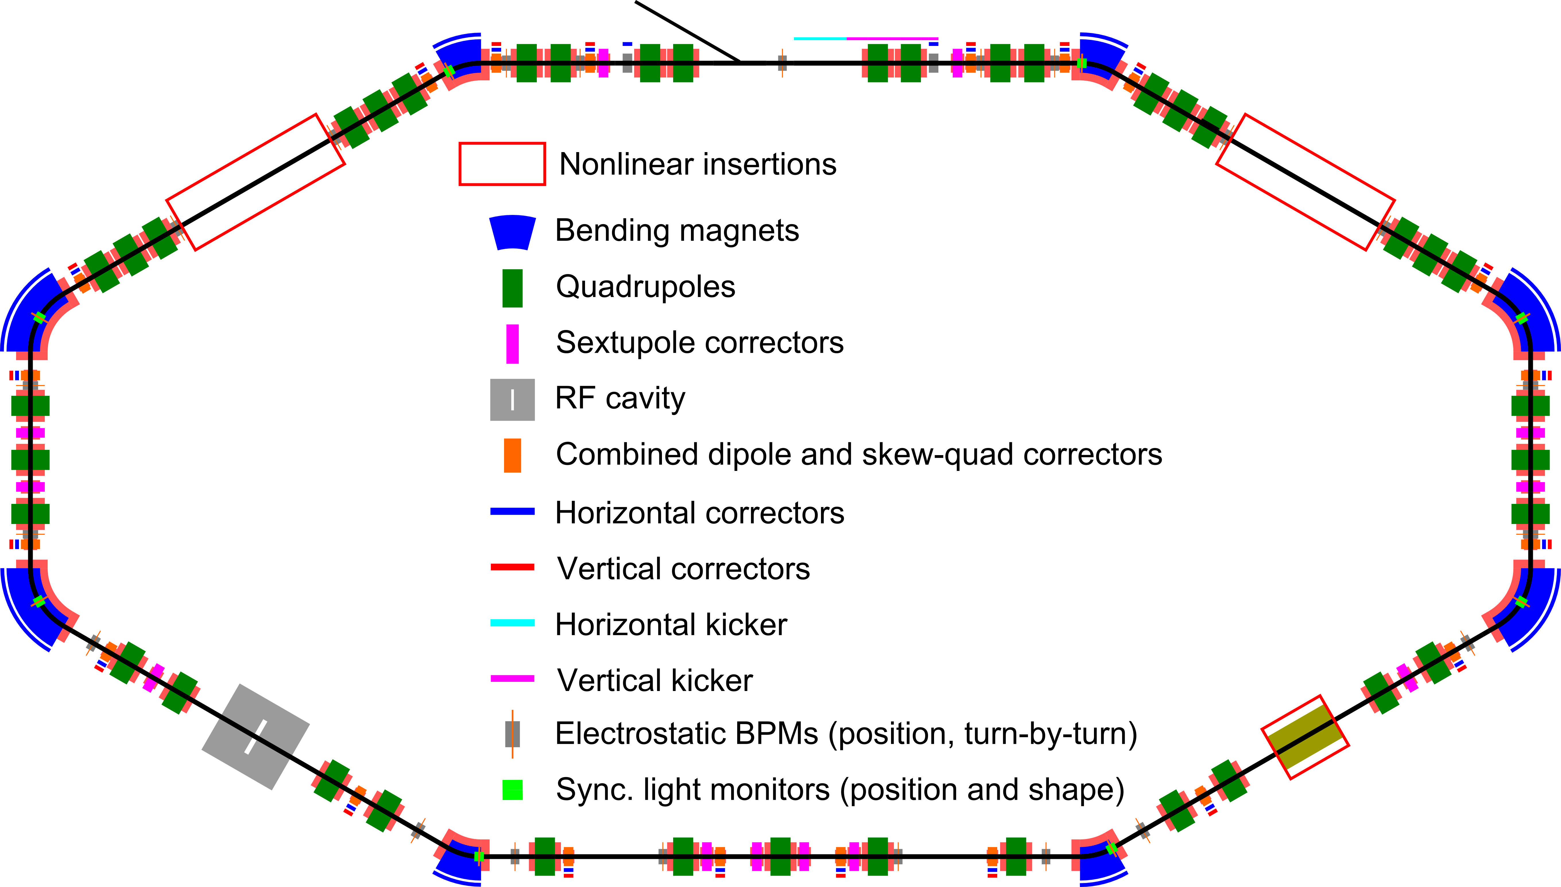
IOTA Layout - Elements
2
8
39
8
1
18
8
2
1
1
21
8

Slide 30
IOTA Experiments
Nonlinear Integrable Optics – Experimental demonstration of NIO lattice in a practical accelerator
Beam Cooling
  Optical Stochastic Cooling – Proof-of-principle demonstration
  Electron Cooling – Advanced techniques
Space Charge Compensation – Suppression of SC-related effects in high intensity circular accelerators
  Nonlinear Integrable Optics
  Electron lenses
  Electron columns
  Circular betatron modes
Quantum Science – storage, manipulation and characterization of a single electron

Slide 31
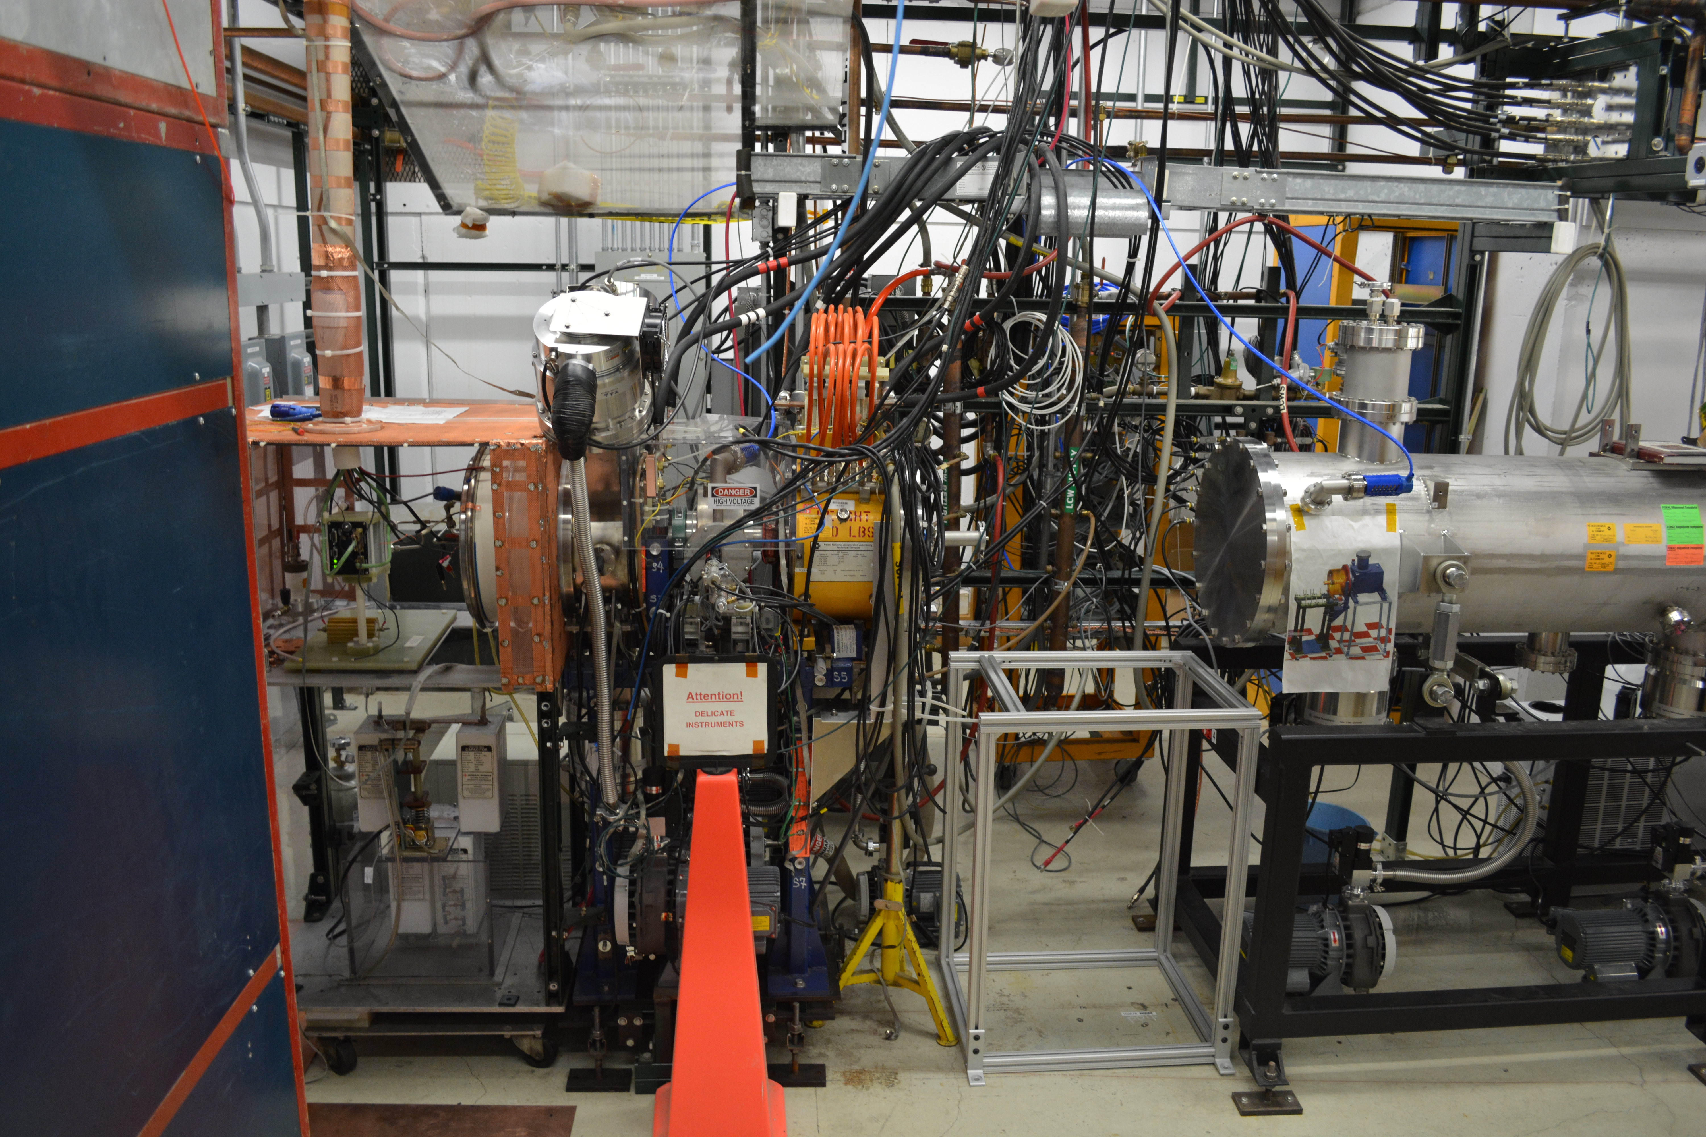
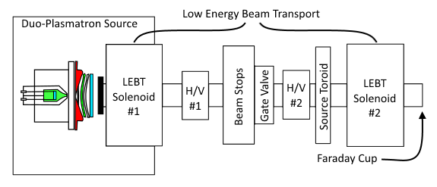
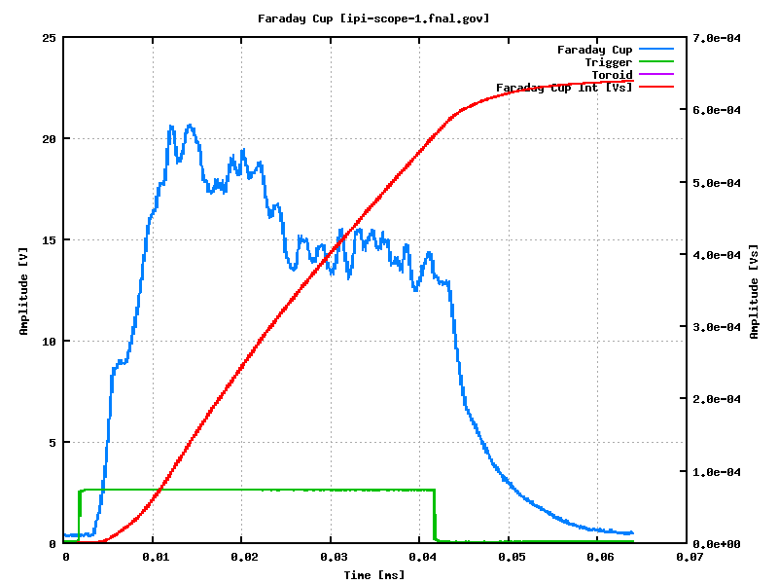
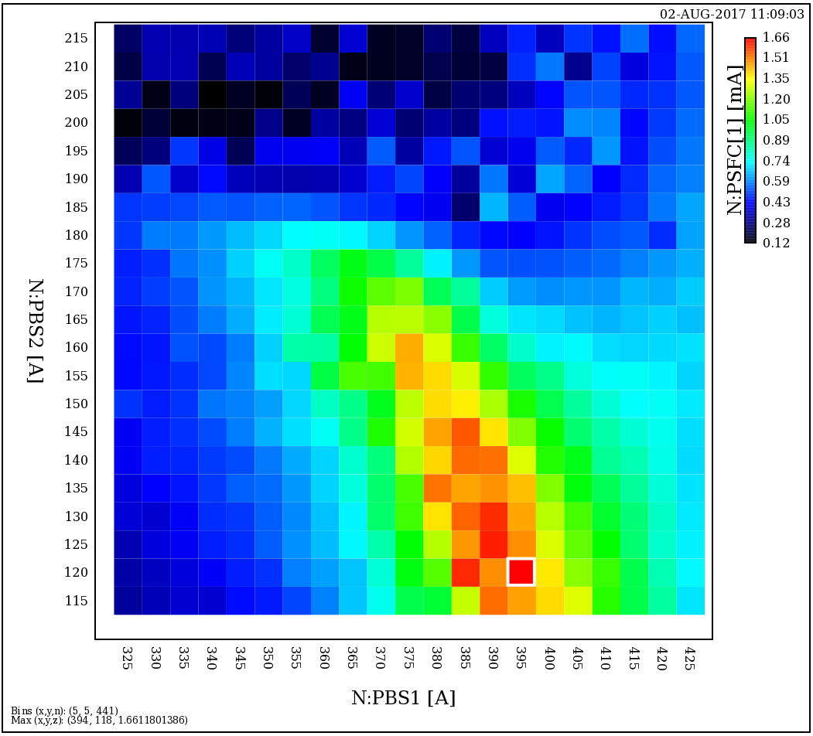
IOTA Proton Injector – Ion Source & LEBT
Ion source (formerly HINS) recommissioned at old location
HV Cabinet rebuilt (original equipment used in PIP2IT)
Parameters achieved:
  Energy: 20 kV (vs 50kV)
  Current: 10 mA - OK
  LEBT Optimized
System for filament activation built
New filaments coated and activated
Phase space optimization
of LEBT – beam current
as function of focusing
Beam signal at Faraday Cup
Current
Solenoid 2
40 μs
Time
Solenoid 1

Slide 32
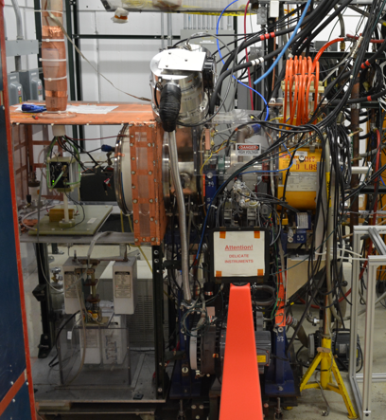
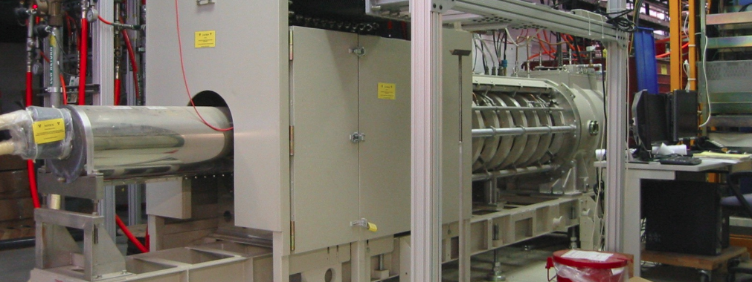
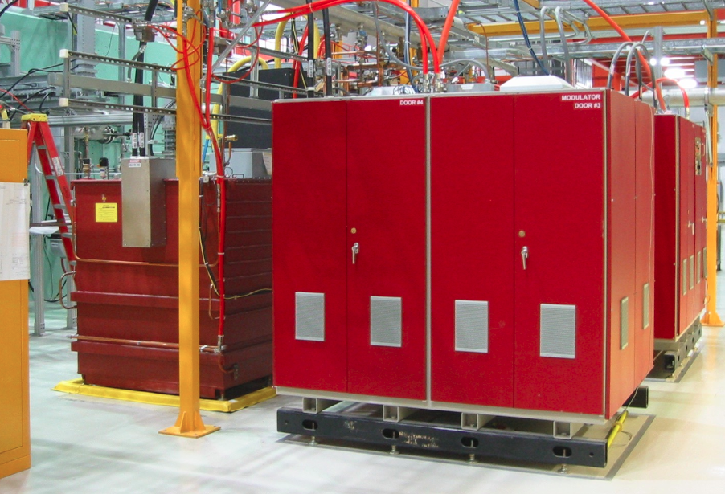
IOTA p+ Injector
325 MHz klystron
2.5 MeV 325 MHz pulsed RFQ
50 kV duoplasmatron source
HV klyston modulator (being assembled)

Slide 33
IOTA Accelerator and Beam Physics Roadmap
Complete the construction of IOTA/FAST facility
  Install and commission IOTA proton injector 2020*
Conduct R&D in IOTA with the goal to develop enabling technologies for next-generation facilities
  Nonlinear Integrable Optics (aim to improve beam stability / losses)
      Phase I – e- beam 2018–2021
      Phase II – p beam 2020–2022
  Optical Stochastic Cooling (enable p-beam cooling at high energy)
      Without optical amplifier 2019–2021
      With optical amplifier 2021–2023
  Space-charge Compensation (aim to reduce space-charge losses)
      Using electron lens 2020–2023
      Using electron column 2022–2023
Expand IOTA/FAST collaboration 2019–2023

Slide 34
NIO EXTRAS

Slide 35
Nonlinear Integrable Optics
We want to build an optical focusing system that
  Is strongly nonlinear = strong dependence of oscillation frequency on amplitude
  Is 2D integrable and stable
  Can be realized with magnetic fields in vacuum
Mathematically, that means the system should
  Possess two integrals of motion
  Have steep Hamiltonian
  Field potential satisfies the Laplace equation
Practical benefits relevant to future HEP machines
  Reduced chaos in single-particle motion, e.g. helpful for space-charge suppression
  Higher beam current and brightness from strong immunity to collective instabilities via Landau damping

Slide 36
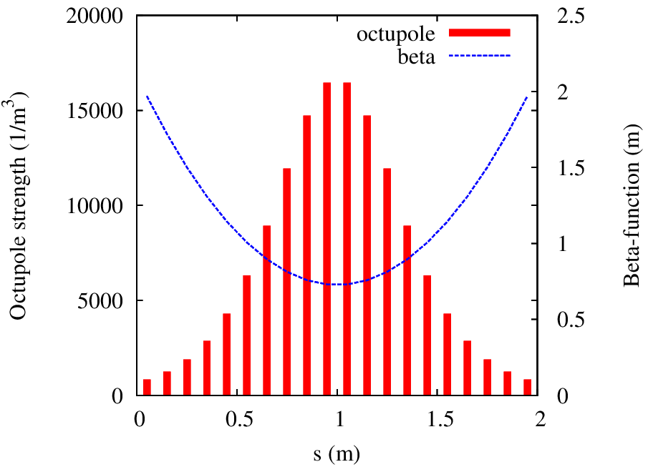
Nonlinear Integrable Optics
Danilov-Nagaitsev Solution (2010)
  Remove time dependence from Hamiltonian thus making it an integral of the motion
    Can be done with any nonlinear potential, for example octupoles
  Shape the nonlinear potential to find a second integral
    General solution was found, which satisfies the Laplace equation (Phys. Rev. ST Accel. Beams 13, 084002, 2010)
2D Expansion of McMillan mapping
  Two invariants of the motion
  Implementation with electron lens
  The steepest Hamiltonian

Slide 37
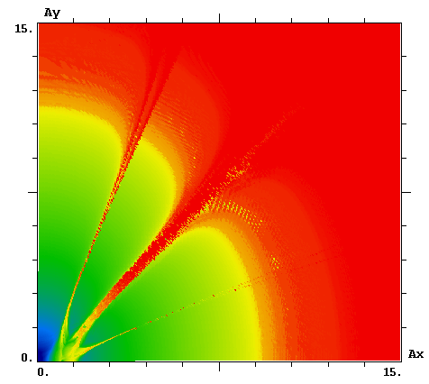
Non-linear systems simulations
Ongoing collaboration between Fermilab, LBNL, RadiaSoft, NIU, U. Chicago and others aimed at detailed studies of beam dynamics for various IOTA experiments
  Chromaticity effects
  Space charge effects
  Halo formation
IOTA linear lattice has to be very close to design to keep integrability:
  Betas ±1%, phases ±0.001, dispersion ±1cm, closed orbit ±0.05mm
0.025
Octupoles: 0.02 tune spread compared to 0.001 in LHC
DN magnets

Slide 38
OSC EXTRAS

Slide 39
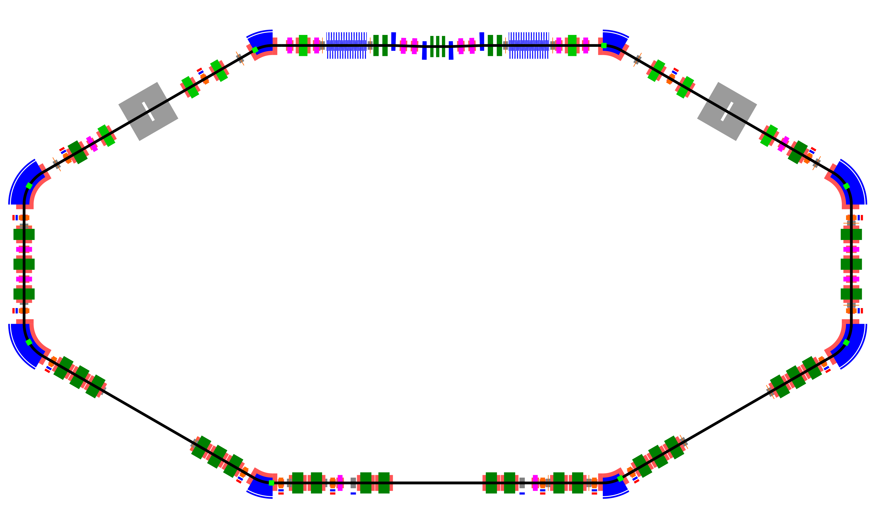
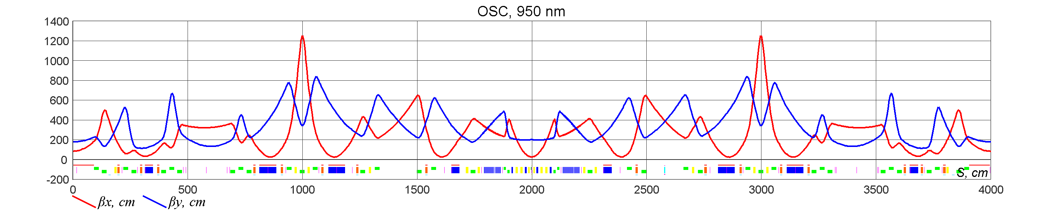
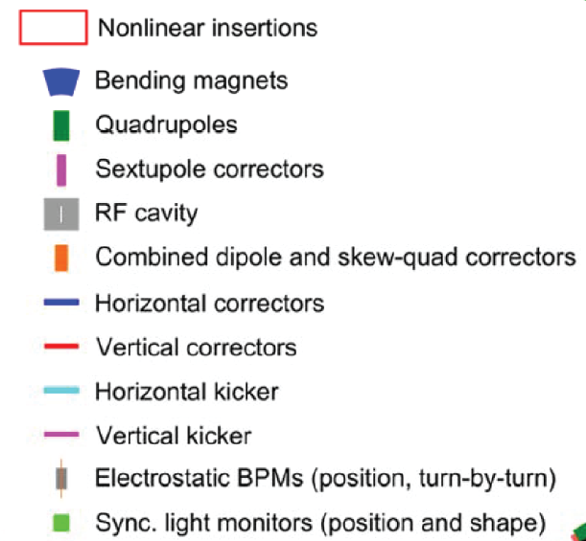

IOTA was designed with OSC as a key requirement
Low energy (100 MeV) reduces equilibrium emittance, energy spread and increases synchrotron radiation damping time (τ_{x}~2sec, τ_{s}~1sec)
Improves cooling ranges and the relative strength of OSC
Our lattice design provides for straightforward coupling of trans. and long. cooling
Other proposed OSC demonstrations would have required high optical gain (~100x) to reach parity with synchrotron damping
IOTA’s OSC dominates sync. rad. damping by ~50x without any optical amplification (τ_{x}~25 ms, τ_{s}~25 ms; uncoupled)

Slide 40






Integrated design completed and hardware being requisitioned
High density of magnetic elements
Special field quality requirements on dipoles to prevent unacceptable feed-down errors in sextupoles
Chambers optimized to balance cost/complexity and OSC performance
Flexible diagnostics and precision motion systems; delay control ~λ/200

Slide 41





Building critical emittance diagnostics for OSC
Must measure the evolution of small emittances (~0.5 nm)
Desired time res.<< OSC time (~1 ms vs ~25 ms for OSC)
IOTA beam-size monitors:
  Direct imaging (>10s of μm)
  π-mode imaging (~5-μm to <100μm)
  sync-rad. interferometry (~10-100’s μm)
IOTA sync-light stations

Slide 42
We have nearly completed a ~100-pg. CDR for OSC
Mechanical and Vac. design
  Chamber/pipe geometries; fab. & assembly procedures
  Required outgassing rates and pumping systems
Beam-lifetime considerations
  IBS, Touschek, residual gas
  Sync. rad. damping
Diagnostics and Control
  Longitudinal and transverse alignment; fine control of optical delay and positioning
  SNR for relevant signals
  Contamination by dipoles
OSC performance
  Simulations and theory
  Cooling rates and ranges
Magnetic Optics
  Lattice design
  Orbit correction
  Field quality and tolerances
  Correction of nonlinearities
Light Optics
  Tolerances on critical params.
  Material and chromatic effects
  Effect of manufacturing tols.
Conceptual design complete; presently finalizing technical sections

Slide 43
Alignment with P5/HEPAP Acc. R&D subpanel goals
Tight alignment with 5 of 8 explicitly stated goals in subpanel report:
  Program balance; medium-term R&D: demonstrate 10³-10⁴ higher cooling rate; lead to systems that expand DOE technology portfolio for future accelerators
  Cost effectiveness: mitigate beam loss & enable higher luminosity; improves efficiency, cost effectiveness and discovery potential of colliders
  Coherence: best machine for OSC program by large margin; no risk of duplication
  R&D facilities: unique beam-physics R&D facility; fundamental R&D for future accelerators
  Workforce development: young scientific staff + students; med./long-term R&D at a unique HEP facility to enable next-gen. particle accelerators
Strong potential for discoveries and innovations with cross-office benefit; future opportunities at proton facilities for beam cooling and advanced beam control(HEP/NP/BES)
An electron OSC program at IOTA provides a flexible platform for demonstration of the basic physics and the development of advanced OSC configurations; this is critical for addressing the well known barriers to use in hadron machines and developing operational systems for DOE

Slide 44
Linear lattice design for 950 nm
A. Romanov
Betas start, x,y | 25, 200 cm
D_{x} start | 27 cm
Tunes, x,y | 5.42, 2.42
Mom. comp. | 0.0025
Emittances, x,y | 0.5 E-7 cm
Energy drop | 13.4 eV
Bunch length @30V | 7.6 cm
Energy spread | 1.00 E-4
Sync. Tune @30V | 2.05 E-5
Damp. times (x,y,s) | (2.0,2.0,0.985) s

Slide 45


Linear lattice design for 2200 nm
A. Romanov
Betas start, x, y | 12, 500 cm
D_{x} start | 48 cm
Tunes, x, y | 5.42, 3.42
Mom. comp. | -0.0165
Emittances, x, y | 1.44 E-7 cm
Energy drop | 13.25 eV
Bunch length @30V | 19.9 cm
Energy spread | 1.06 E-4
Sync. Tune @30V | 5.6 E-5
Damp. times (x, y, s) | (1.9, 1.9, 1.1) s

Slide 46



Contamination from IOTA dipole reasonably low
0-6 eV
0-1.4 eV
Radiation from Und. and Dipole not well separated in time (~100 fs)
~85% of photons in the fundamental band will be from the undulator
With aperture on output window: >90%

Slide 47



Fine tune alignment and delay with a single stage:
Precision slabs centered near the Brewster angle; >95% transmission over +/- 20°
Coordinated adjustment lets us independently select any longitudinal delay and vertical shift
Delay resolution ~λ_{r}/250

Slide 48
E-LENS EXTRAS

Slide 49


E-lens can produce large tune spreads as a NIO insert
Two IOTA configurations:
  Axially symmetric, McMillian-type thin kick; larger tune spread (ΔQ~0.2) but more sensitive to kick shape
  Axially symmetric kick in a long solenoid; smaller tune spread (ΔQ~0.06) but more robust
e.g. IOTA with McMillan lens in 0.7-m solenoid, ke = 0.6 /m (1A); βx = βy = 3 m
McMillian kick

Slide 50

Choice of electron-lens beam size in IOTA

Slide 51

Transverse NIO in IOTA with an electron lens

