Slide 1
High Level Organization of the SBN Program
Steve Brice
Fermilab Physics Advisory Committee Meeting
16 January 2019

Slide 2
Outline
SBN Program Overview
  Location, Beamline, Physics
  Trail Blazing for DUNE
Progress on the SBN Detectors
  Scope and Milestones
  Far Detector (ICARUS T600) Progress
  Near Detector (SBND) Progress
  SBN Director’s Review (Dec 2018)
SBN Multi-Institution MOU
  Philosophy behind the MOU
  Parties to the MOU
  Annexes to the MOU
SBN Collaboration Governance
  SBN Program Office
  SBN Oversight Board
  SBN Institutional Board
  SBN Joint Working Groups

Slide 3
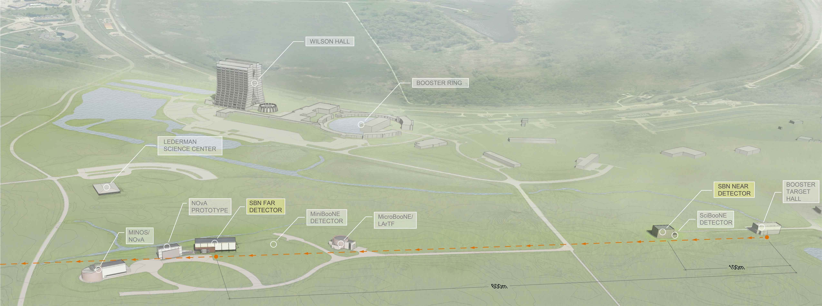
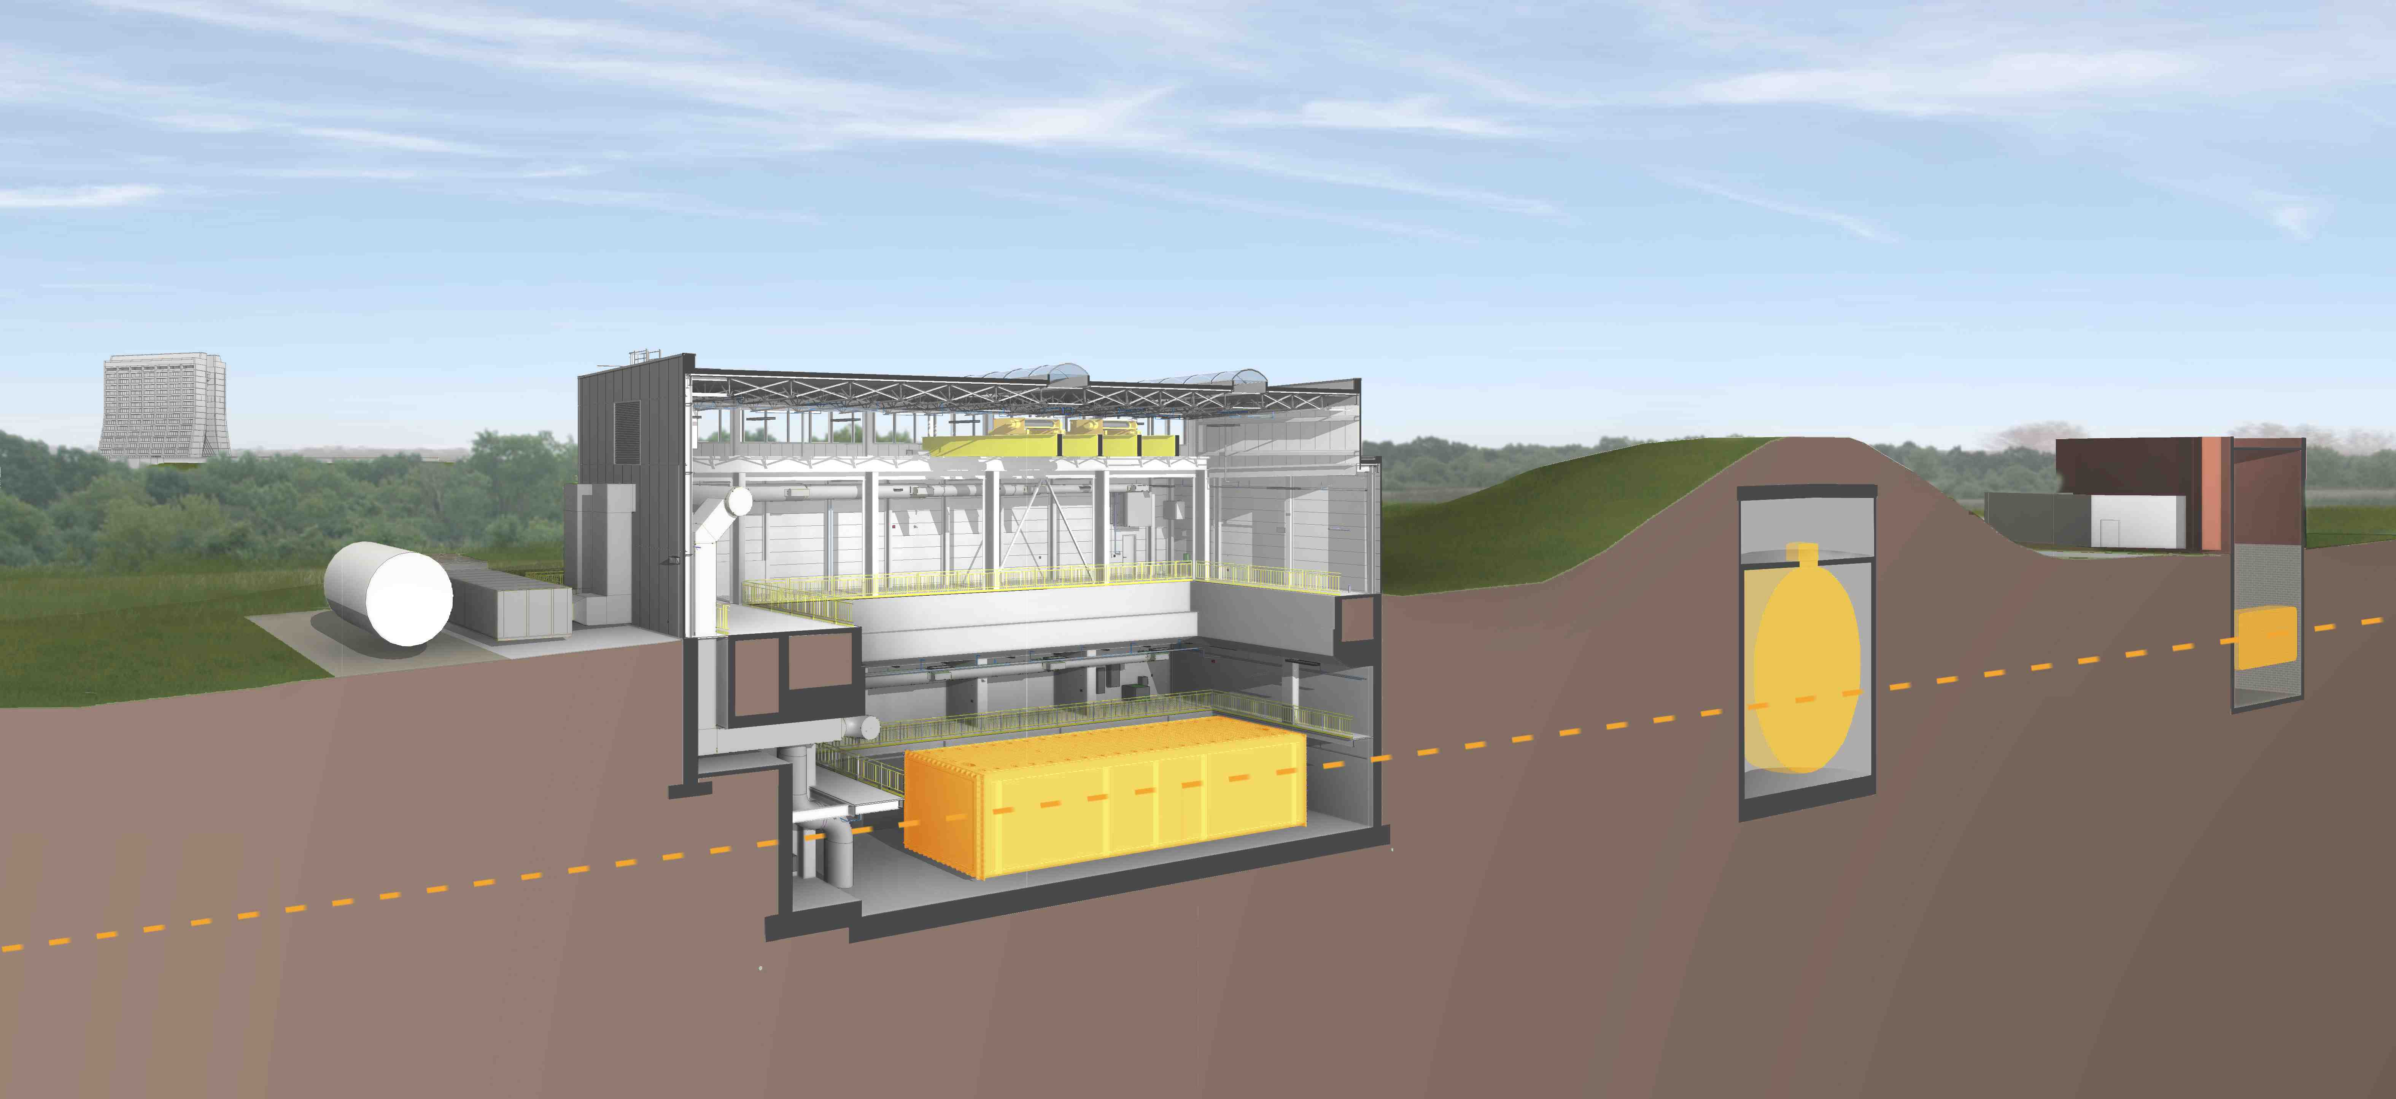
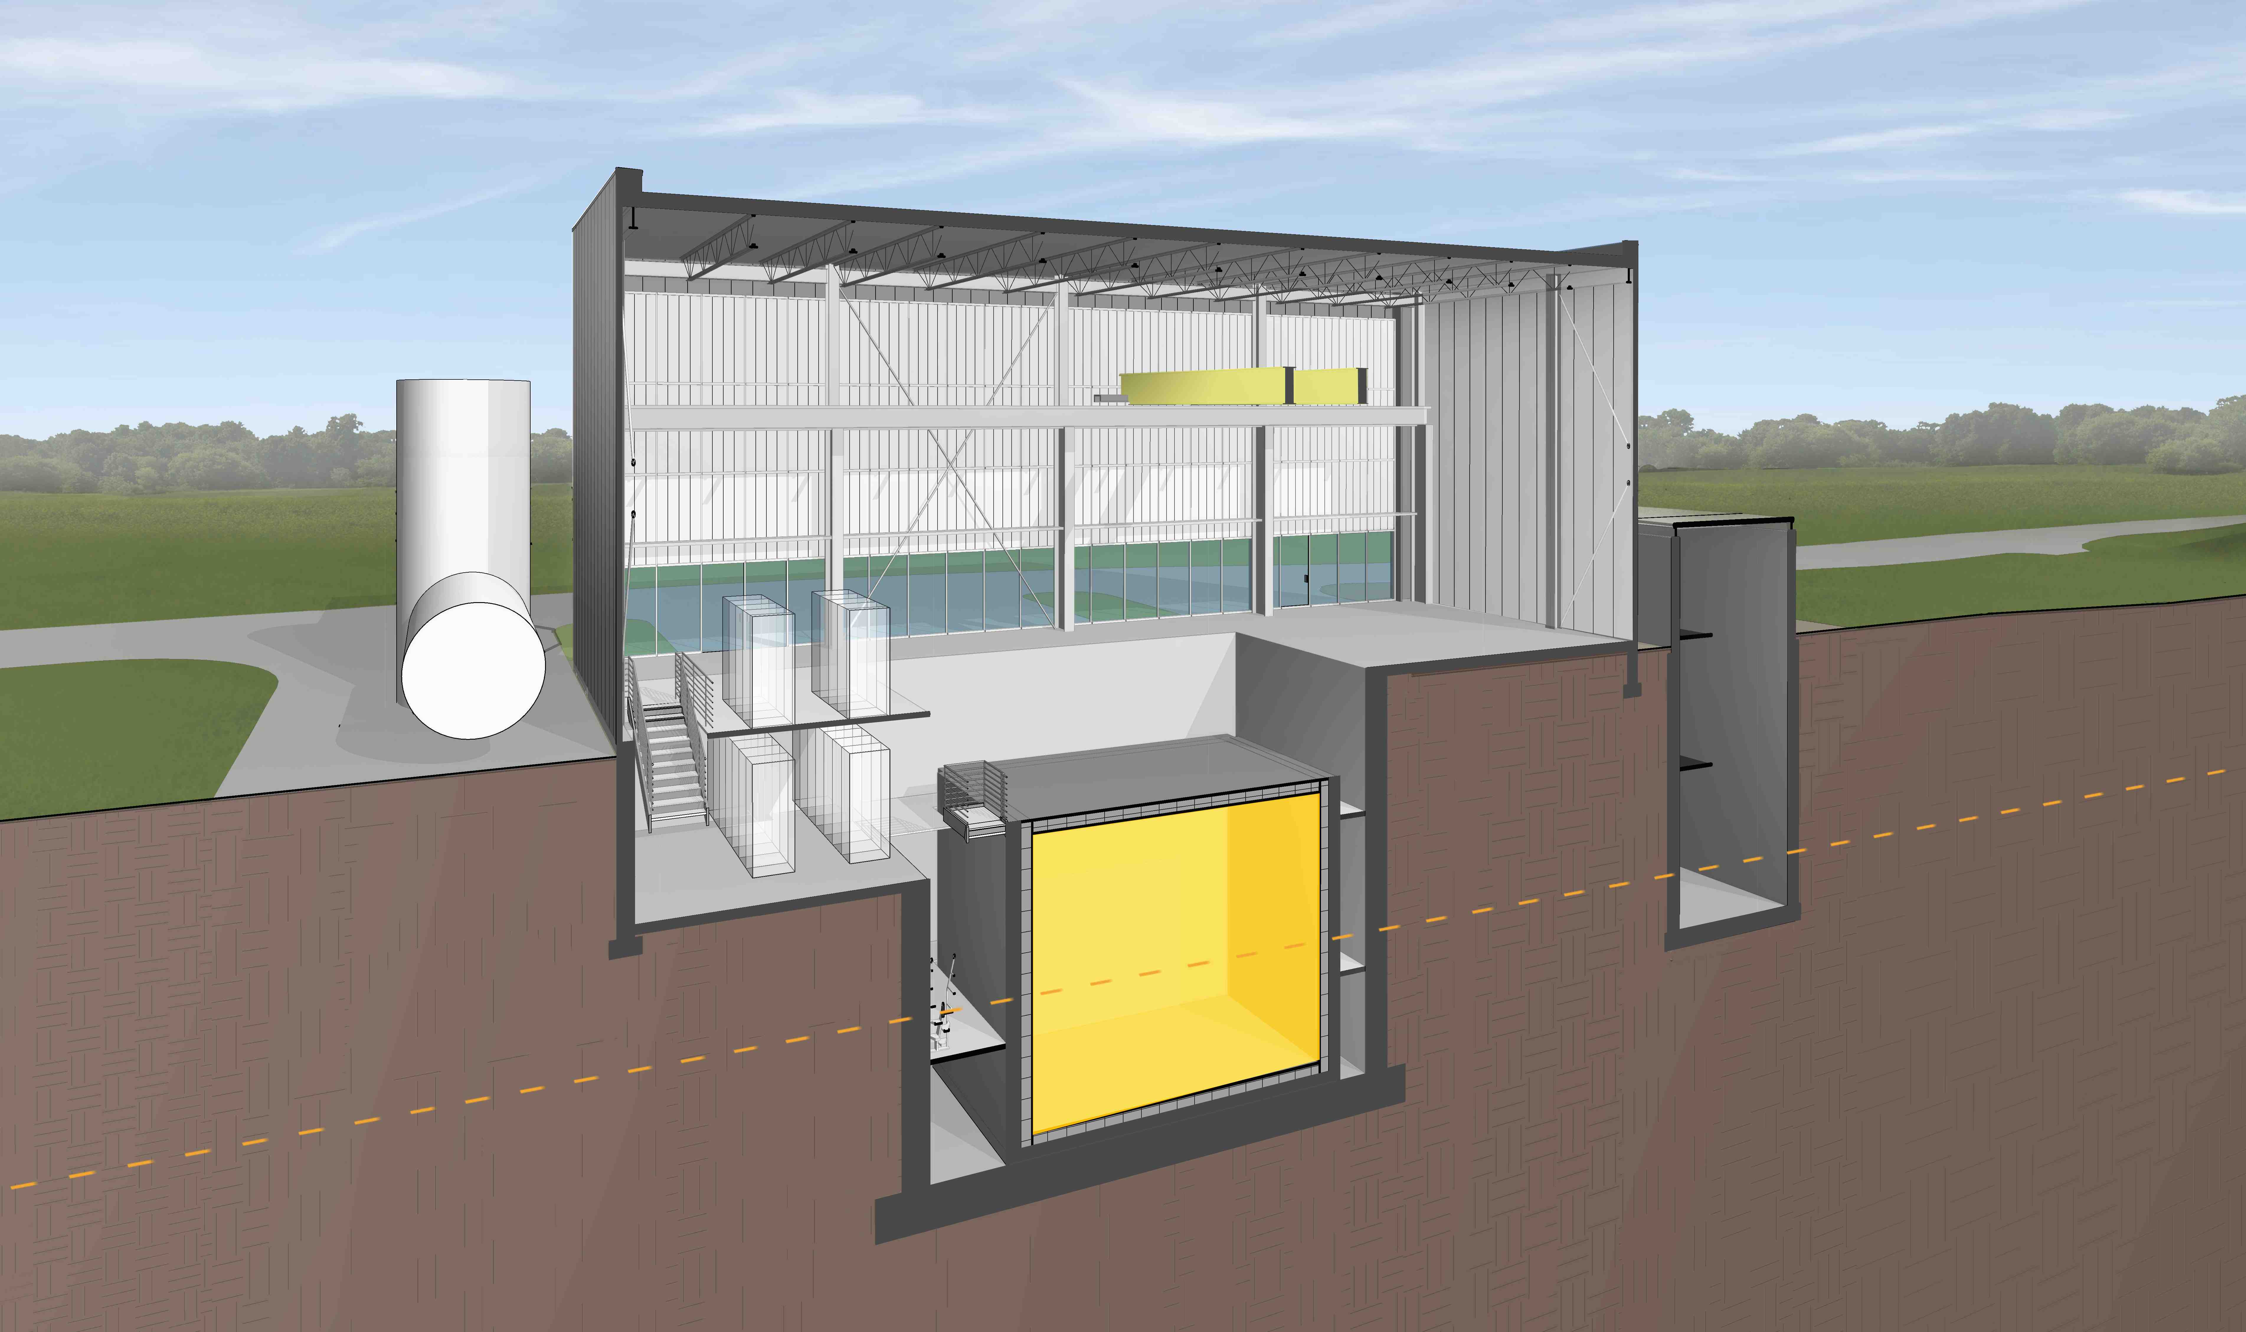
The Short Baseline Neutrino (SBN) Program
Detector | Distance from BNB Target | Active LAr Mass
SBND | 110 m | 112 ton
MicroBooNE | 470 m | 87 ton
ICARUS | 600 m | 476 ton
MiniBooNE
MicroBooNE(operating)
ν
SBND
(new)
ν
Icarus – T600
(Updated and Relocated)

Slide 4
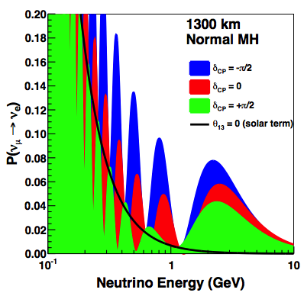

Program Goals
ν_{μ} → ν_{e} appearance
Neutrino oscillation measurements in both ν_{e} appearance and ν_{μ} disappearance channels
  5σ coverage of LSND signal and best global fits
  Requires near-far detector comparison
𝜈-argon cross-sections
  SBN will have world’s largest dataset of 𝜈-argon interactions for the foreseeable future
Technology development
  SBND development provides a next step beyond ProtoDUNE SP in path to DUNE (e.g. cold electronics)
  Transferable development of analysis tools
Collaboration and community building
  Direct experimental activity with LAr for the global community working toward DUNE.
  International collaborative engineering teams on detectors and infrastructure (e.g. cryogenics)
5σ
~3 years
2nd
1st
2nd
1st
SBN Fluxes

Slide 5
SBN Blazing a Trail for DUNE
Physics
  An SBN discovery of a sterile neutrino would reshape the DUNE physics program in a very exciting way
Technology
  SBND and the ProtoDUNEs provide a opportunity to iterate on the DUNE cryostat design
  High Voltage development in MicroBooNE, the ProtoDUNEs, and SBND
  Joint cold electronics development in the ProtoDUNEs and SBND
  A full suite of LAr TPC algorithm development started in ICARUS, ArgoNeut, LArIAT, and MicroBooNE, will be perfected in the SBN Program, and ready for DUNE use (DAQ, data compression, reconstruction, particle ID,….)
  Data from LAr detectors present very significant computing challenges - data volume and compression, algorithm speed, PID challenges and deep learning techniques,….
Internationalization
  SBN Multi-Institution MOU is a model for how we hope to form international DUNE agreements
  ICARUS vessel three party (INFN, CERN, DOE) loan agreement
  Opportunity to switch to a review system where the international stakeholders jointly conduct the reviews
  Established equivalency between CERN and FNAL for many safety training courses
  Acceptance of EU codes for mechanical and cryogenics
Community Development
  Training the community that will deliver the DUNE physics
  Students have theses on SBN whilst also doing work for DUNE
  Comparable to how the Tevatron program (and others) gave the LHC program a running start

Slide 6
SBN Program Scope
Construction Phase:
Design and construct two buildings - complete
Refurbish ICARUS T600 detector - complete
Design and construct new ICARUS components (e.g. CRT) – final fabrication
Install ICARUS detector – on track since arrival of cold shield
Design, construct, and install infrastructure (eg cryogenics) – on schedule
Design and construct SBND detector – moving to assembly phase
Install SBND detector – preparing to start first installations in early CY2019
Operations Phase:
Transition to operations as each system receives partial Operational Readiness Clearance (pORC)
Two major transitions: pORCs to cold commission (LAr fill) ICARUS (mid-CY 2019) and SBND (mid-CY 2020)
Commissioning, physics operations and physics analysis of ICARUS, MicroBooNE and SBND detectors

Slide 7
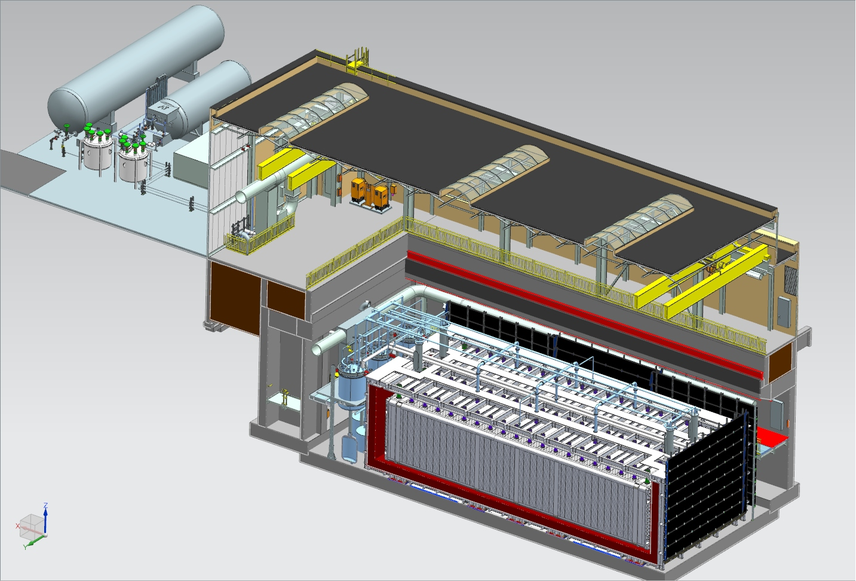
Far Detector - ICARUS
Cryogenic Dewars
TPC Electronics
(not shown)
Top CRT and Overburden
(not shown)
Exterior Filters
Removable Wall Panel
Two 33 ton cranes
Proximity Cryogenics
Not shown in alcoves (mezzanine and pit):
DAQ racks
Controls racks
Cold Vessels (TPCs and PMTs inside)
Bottom CRT
Side CRT

Slide 8
ICARUS T600 Contributions
 | DOE | CERN | INFN
T600 Refurbishing including new PMTs, Cryostats |  | 50% | 50%
TPC Electronics |  |  | 100%
T600 Transport to FNAL |  | 100%
Cosmic Ray Tagger | 33% | 33% | 33%
Cryogenics | 45% | 45% | 10%
DAQ | 50% |  | 50%
Integration and Installation | 33% | 33% | 33%
Civil Construction | 100%
Overburden | 100%
Cryogen Purchase | 100%
All fractions are approximate (~10% level)

Slide 9
Key SBN Milestones - ICARUS
Milestone | Description | Baseline date
I-1 | ICARUS detectors are ready to fill with liquid argon | May 2019
I-2 | ICARUS detectors are filled with liquid argon and ready for detector commissioning (LAr purity adequate for physics has been achieved) | Nov 2019
I-3a | ICARUS detectors are ready for physics data - CRT is operational | Jan 2020
I-3b | ICARUS detectors are ready for physics data - Shielding in place | Feb 2020
Baseline dates for all four ICARUS milestones were set in March 2018.
See intermediate milestone slides later and in backup.
Notes:
Make a description of the steps involved in each of these milestones to make it clear to the members of the team and to the reviewers. Need this for t
I-1
Transport ICARUS inside
Install roof
Install feedthroughs
Test it works
Install cabling
Install cryogenics
Install electronics
Certify that components are all workig
I-2
Filled
Measured purity
Turned on HV
Checked operation of all the
I-3a
1.

Slide 10
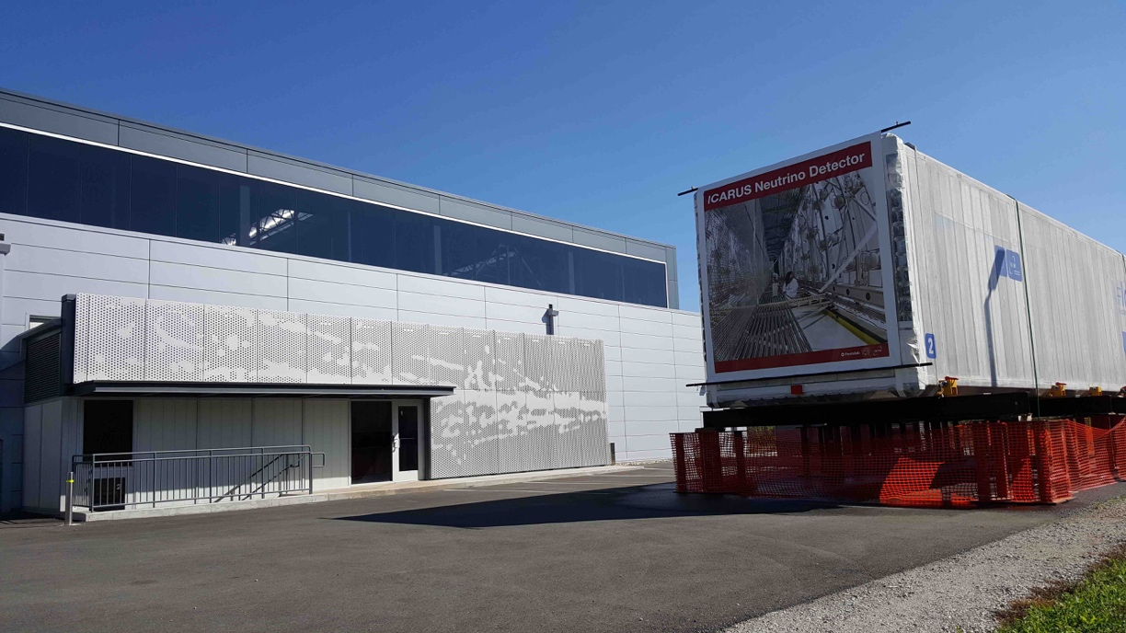
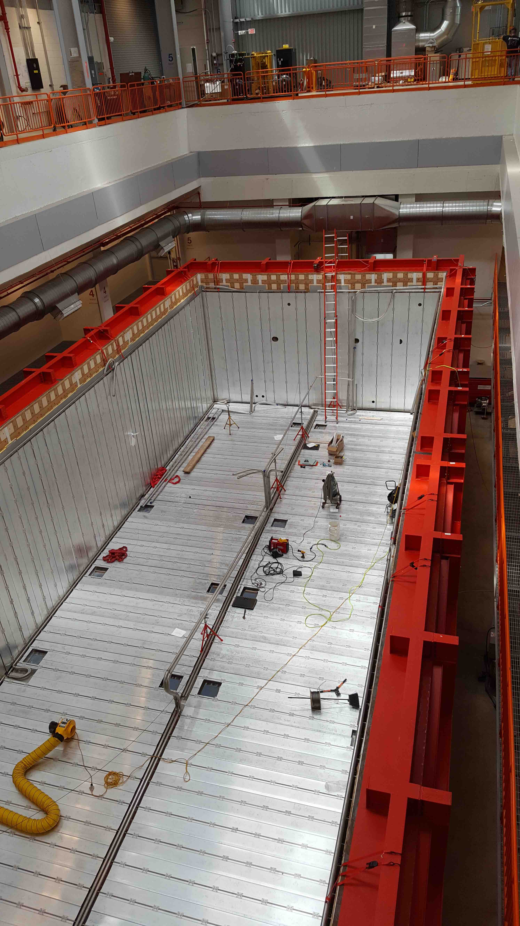
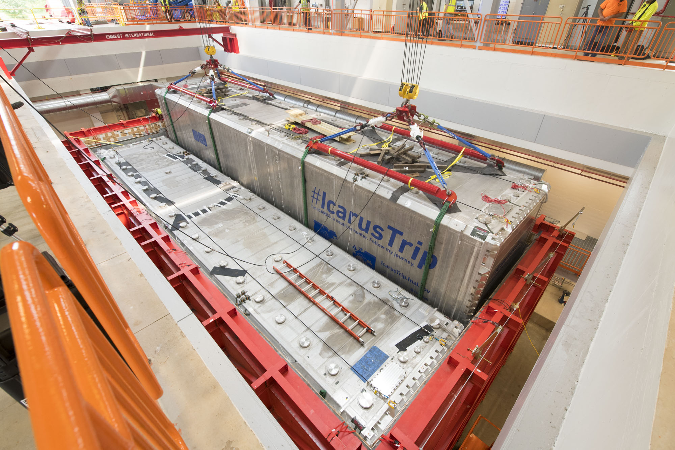
Far Detector Installation
ICARUS Vessel 2 parked west of SBN Far Detector Building
Installation progress (CERN/FNAL/INFN):
  Cold vessel vacuum tested
  Cold vessels rigged into building (Emmert Intl.)
  Cable chimneys installed, continuity tested and vac. tested
  Top cold shield installed and tested
  Cryogenics platform installed
  Warm vessel roof installed
  Proximity cryogenics delivered to Fermilab
  Installation of crosses and electronics feedthroughs in progress
  Proximity cryogenics installation starts Jan 28
Cathode and PMTs Installed
Cold shield installation
Vessels Rigged into building

Slide 11
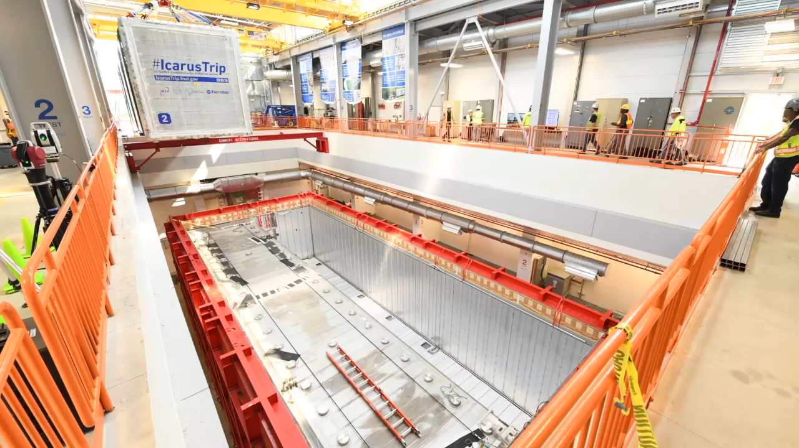
Rigging the ICARUS Vessels
Cathode and PMTs Installed

Slide 12
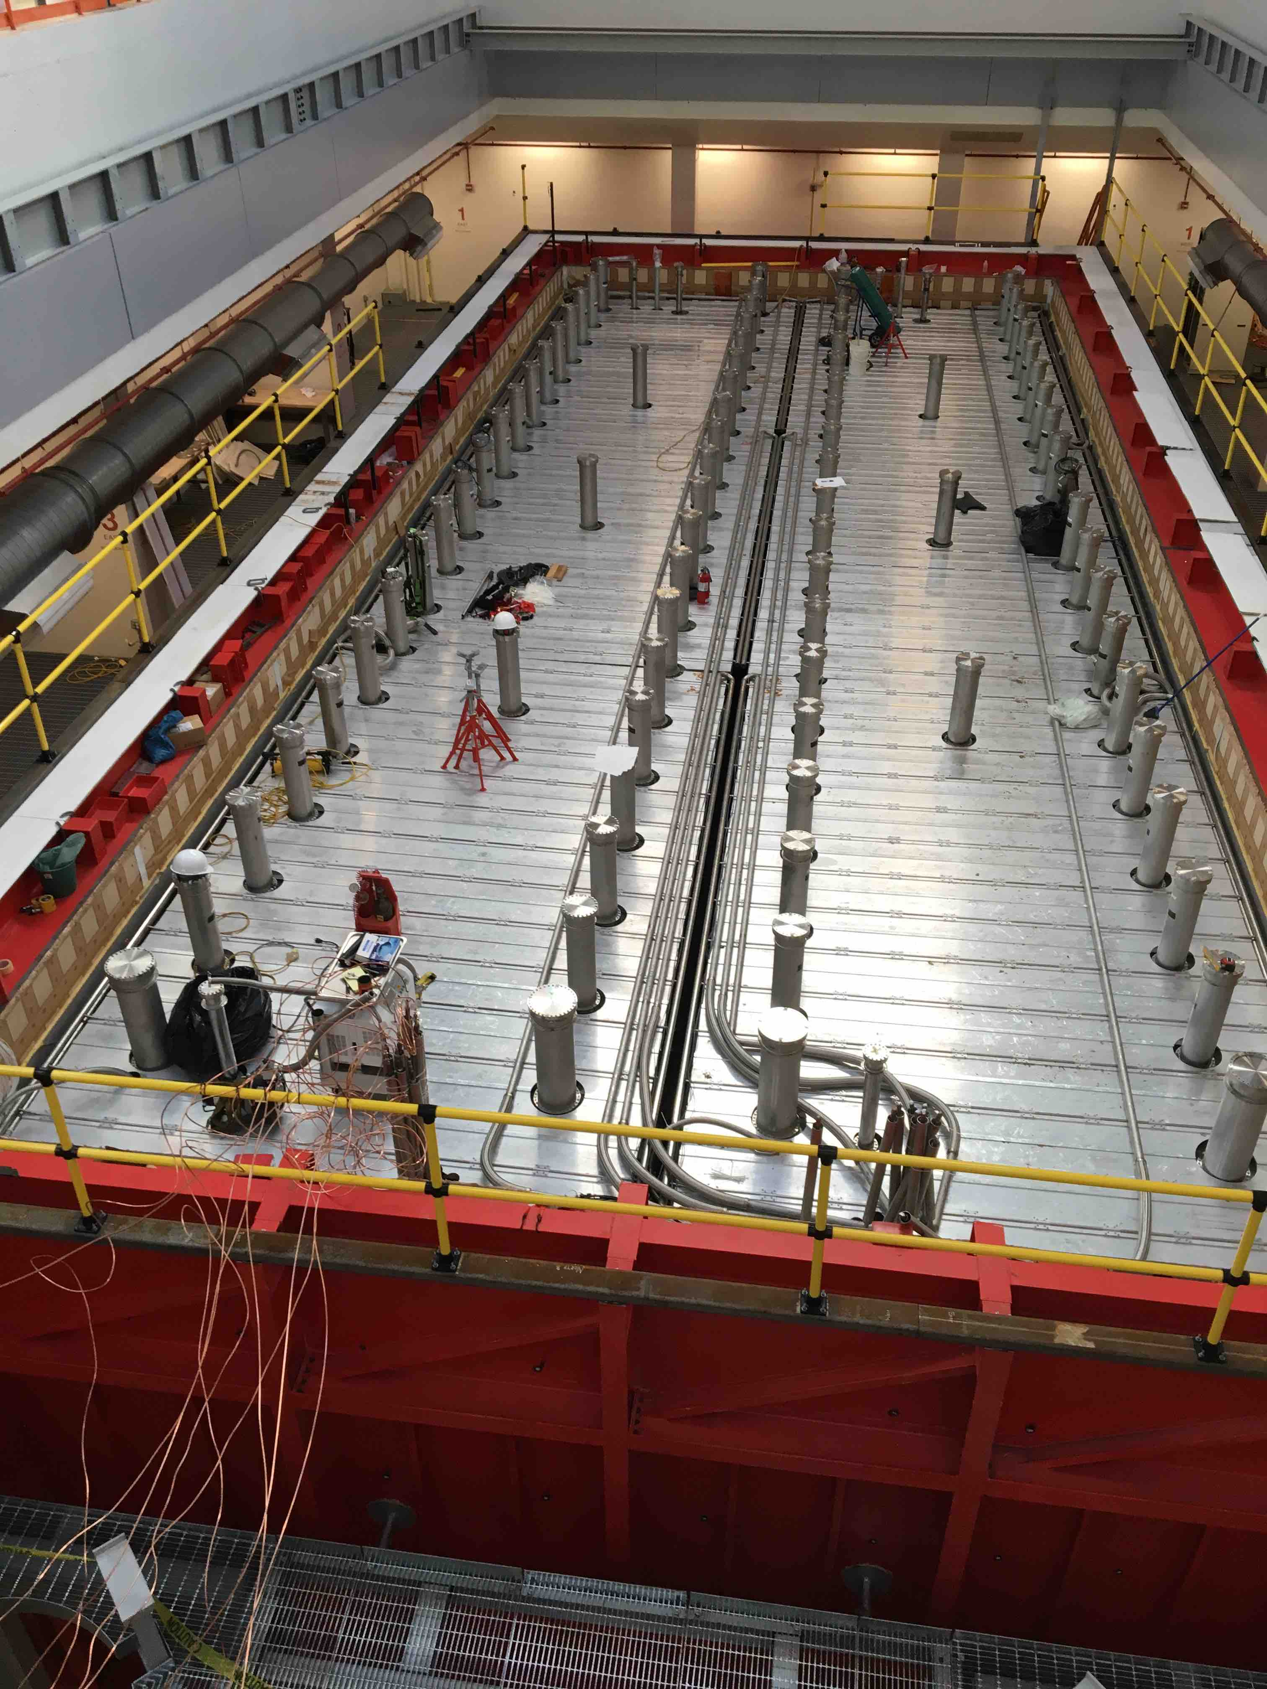
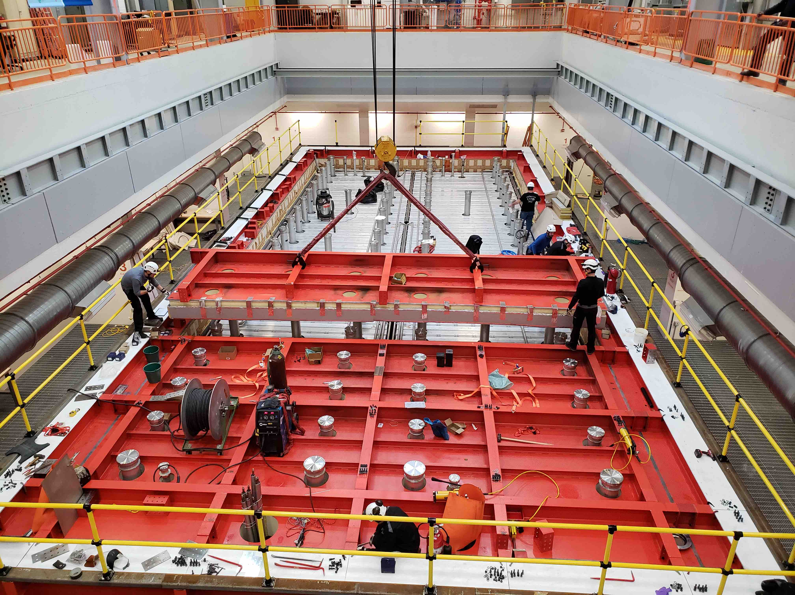
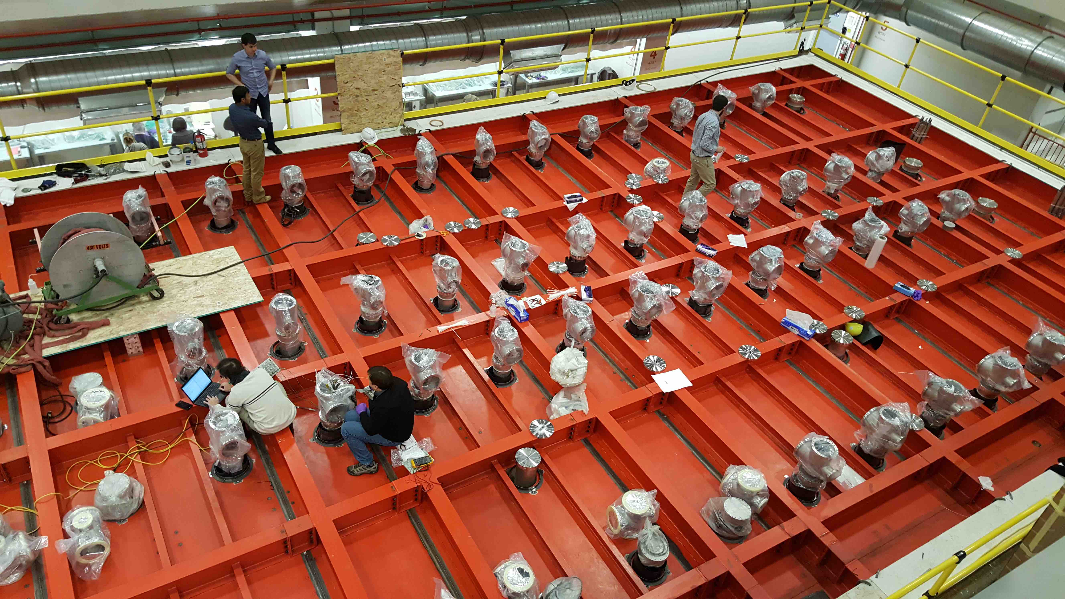
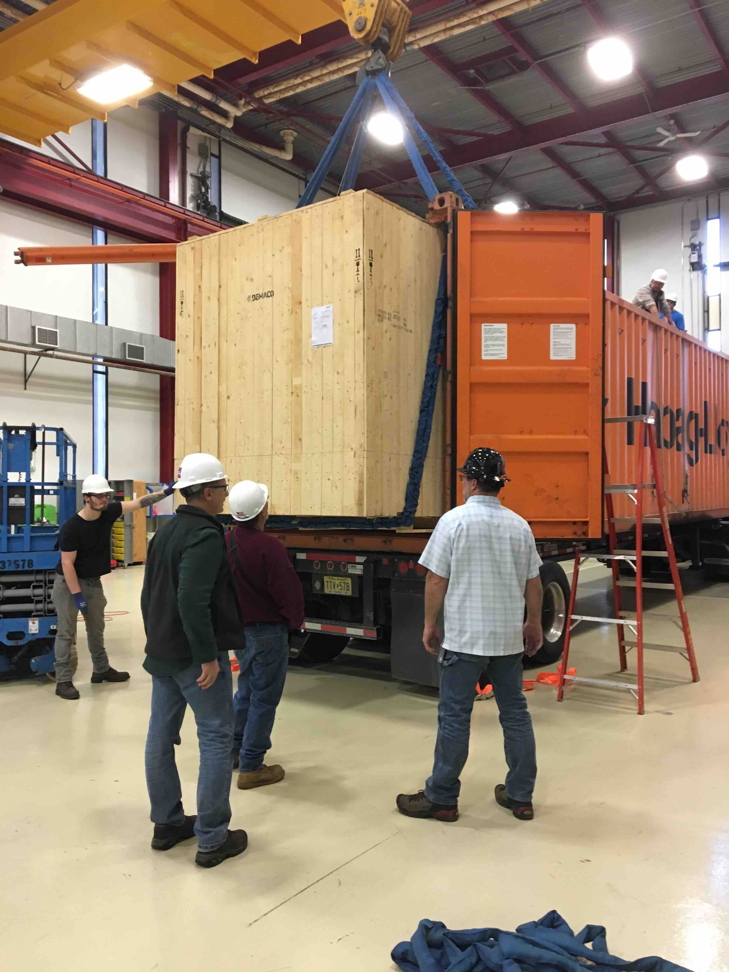
Far Detector Installation
Chimneys and top cold shield
Installation progress (CERN/FNAL/INFN):
  Cold vessel vacuum tested
  Cold vessels rigged into building (Emmert Intl.)
  Cable chimneys installed, continuity tested and vac. tested
  Top cold shield installed and tested
  Cryogenics platform installed
  Warm vessel roof installed
  Proximity cryogenics delivered to Fermilab
  Installation of crosses and electronics feedthroughs in progress
  Proximity cryogenics installation starts Jan 28
Warm vessel roof installation
Installing feedthrough crosses
Proximity Cryogenics Delivery

Slide 13
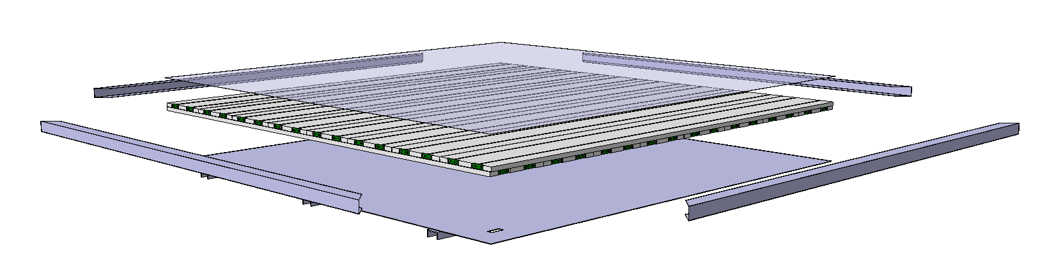
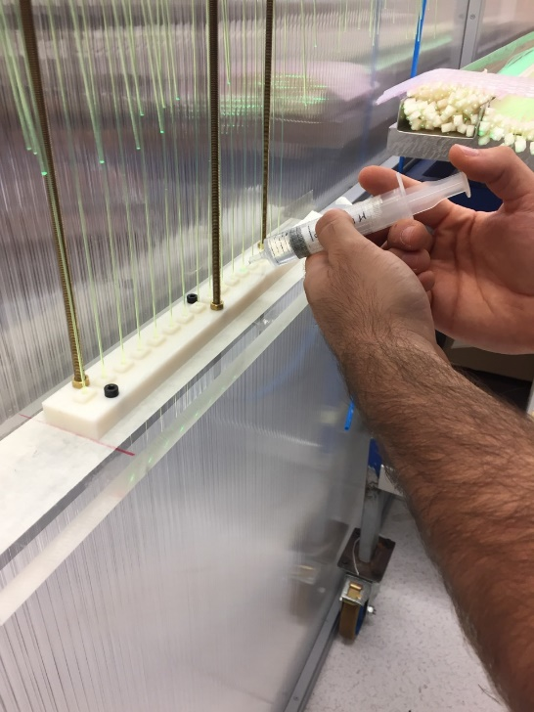
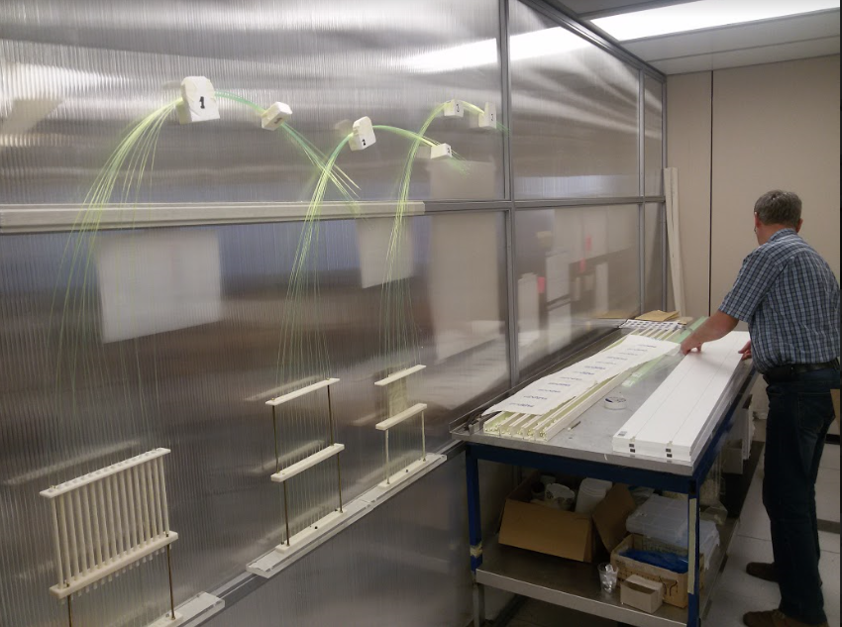
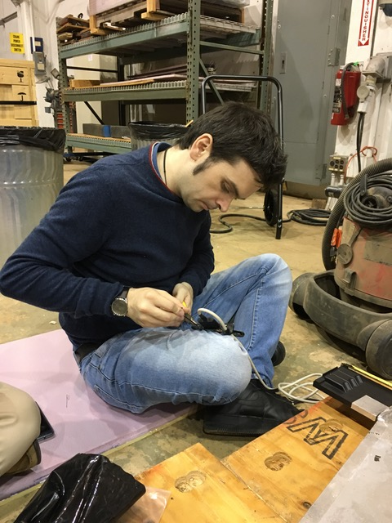
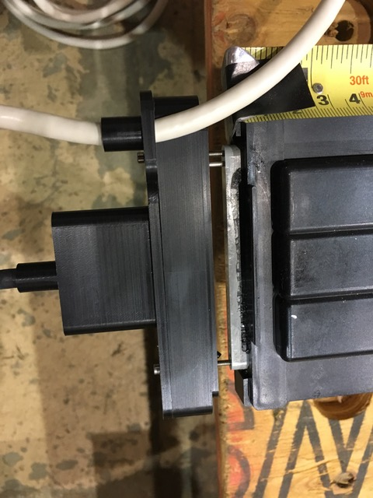
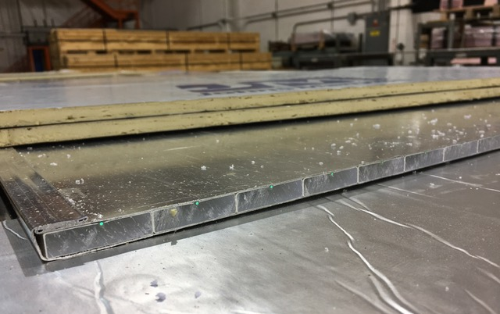
ICARUS Progress
TPC electronics production in final phase (INFN)
  On track to complete delivery to FNAL by May
Cosmic Ray Tagger (CRT)
  Bottom modules installed in 2017 (Double Chooz spares courtesy of U. Chicago)
  Top module production has started at Frascati (CERN/INFN)
    First modules complete in January 2019
    Complete assembly in summer 2019
  Sides re-use MINOS far detector modules (FNAL/US), completing design of SiPM board
    SiPMs ordered
    Review of final prototype in January 2019
  Common electronics for top, sides and SBND – designed by U. Bern, commercialized by CAEN
  Common DAQ/event builder code
Top CRT Production in Frascati
Side CRT SiPM Board and module cutting @ Wideband lab

Slide 14
ICARUS Milestones to I-1 Ready to Fill
Intermediate Milestone | Owner | Baseline Date | Forecast Date |  | Actual Date
Vessels rigged into building | P. Wilson | 16-Aug-2018 |  | ✓ | 16-Aug-2018
Manholes welded and vacuum test successful | C. Montanari | 10-Oct-2018 |  | ✓ | 11-Oct-2018
Warm Vessel roof complete | C. James | 15-Nov-2018 |  | ✓ | 31-Oct-2018
Cryo Platform complete | C. James | 15-Dec-2018 |  | ✓ | 04-Oct-2018
Proximity cryogenics installation begins | B. Norris | 15-Jan-2019 | 30-Jan-2019 | a
DBB & flanges installation complete and tested | A. Fava | 15-Feb-2019 | 21-Feb-2019 | b
Cold proximity cryogenics installation complete | B. Norris | 15-Apr-2019 | 23-Apr-2019 | c
1st T300 readout installation complete | A. Fava | 15-Mar-2019 | 1-Apr-2019 | d
All detector readout installed | A. Fava | 1-May-2019 | 31-May-2019 | e
Begin vacuum pumping | C. Montanari | 15-Jul-2019 | 15-May-2019
Cryogenic operation approved | B. Norris | 15-Jul-2019 | 28-Jun-2019
I1: ICARUS detectors ready to fill with LAr | P. Wilson | 30-May-2019 | 28-Jun-2019 | f

Slide 15
Notes on milestones to I-1
Arrival of subcontractor delayed by CERN to ensure transport of equipment was completed in advance with schedule contingency
Delivery of last cross and PMT flanges from INFN/CERN completed by end of January
Start delayed by 2 weeks, see a) above
Added contingency in materials transport
Added contingency in materials transport
Baseline for I-1 set in March 2018 when delays in delivery of cold shields has not been completely realized. Detailed intermediate milestones were defined and baselined in July 2018

Slide 16
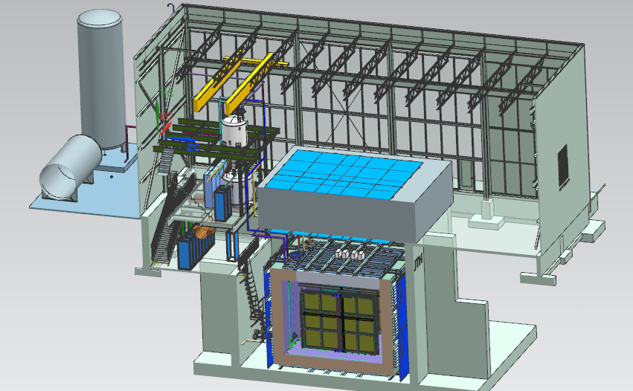
Near Detector - SBND
20 ton crane
Top CRT and Overburden
Cryogenic Dewars
Proximity Cryogenics
Readout racks
TPC
Cryostat
Side CRT

Slide 17
SBND Contributions
 | DOE | US NSF | CERN | INFN | UK UKRI | Switzerland | LANL LDRD | Brazil
TPC Design and Fabrication |  | 50% |  |  | 50%
TPC Electronics | 85% | 15% |  |  | X
PMT System |  |  |  |  |  |  | 100%
Light detection (enhance.) |  | X |  |  | X |  |  | X
Calibration Laser |  |  |  |  |  | 100%
Cosmic Ray Tagger |  |  |  |  |  | 100%
Cryogenics | 50% |  | 50%
Cryostat | X |  | X | X
DAQ | 100%
Integration and Installation | 90% | X |  |  | X |  | X
Civil Construction | 100%
Overburden | 100%
Cryogen Purchase | 100%
All fractions are approximate (~10% level)
X = contribution but specific fraction tbd

Slide 18
Key SBN Milestones - SBND
Milestone | Description | Baseline Date
S-1 | SBND is ready for transport from Dzero Assembly Building to the SBN ND hall | Aug 2019
S-2 | SBND detector is ready to fill with liquid argon | July 2020
S-3 | SBND detector is filled with liquid argon and ready for detector commissioning (LAr purity adequate for physics has been achieved) | Feb 2021
S-4a | SBND detectors are ready for physics data - CRT is operational | March 2021
S-4b | SBND detectors are ready for physics data - Shielding in place | April 2021
Baseline dates for S-2 through S-4b were set in Nov 2018 after schedule re-plan including float relative to forecast dates.
See intermediate milestone slides later and in backup

Slide 19
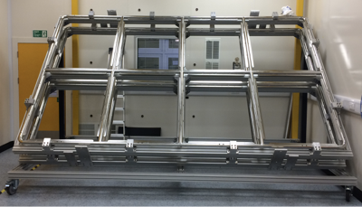
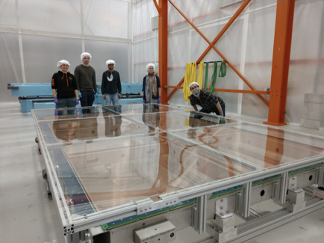
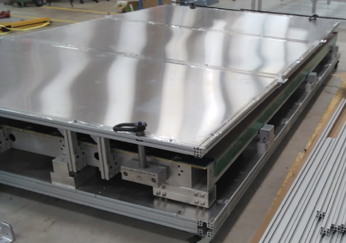
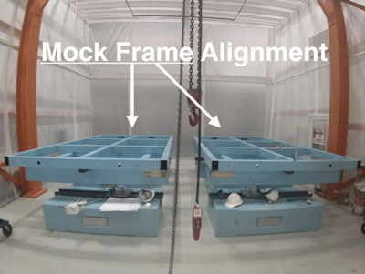
SBND TPC Progress
Joint responsibility of UK, US-NSF, FNAL
UK: Cathode plane, two anode planes, HV feedthrough
US-NSF: field cage, two anode planes, HV feedthrough
FNAL: support integration and assembly
Recent Milestones:
July 2018 Cathode delivered to FNAL
Aug 2018 1st UK anode plane completed
Aug 2018 1st US anode plane completed
Sept 2018 Field cage completed
Oct 2018 1st UK anode delivered to FNAL
Sept 2018 Test of assembly fixture at FNAL
Nov 2018 2nd US anode plane completed
Dec 2018 US anodes shipped to FNAL
Jan 2019 2nd UK anode delivered to FNAL
Cathode @ Liverpool
1st Manchester APA at FNAL in DZero clean tent
Packed Anode Plane @ Yale
Assembly facility at Dzero Assembly
building

Slide 20
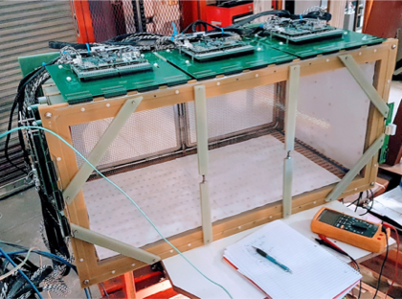
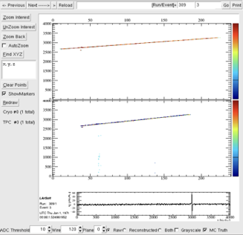
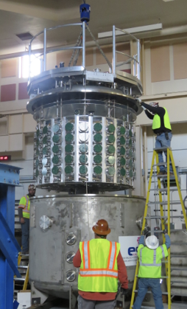
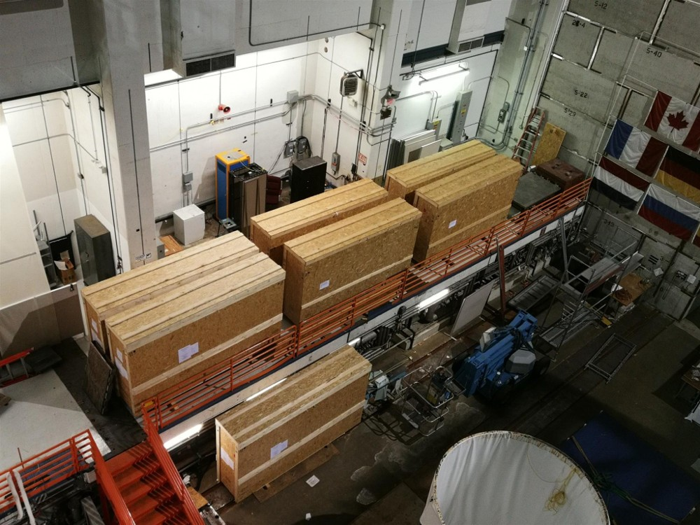
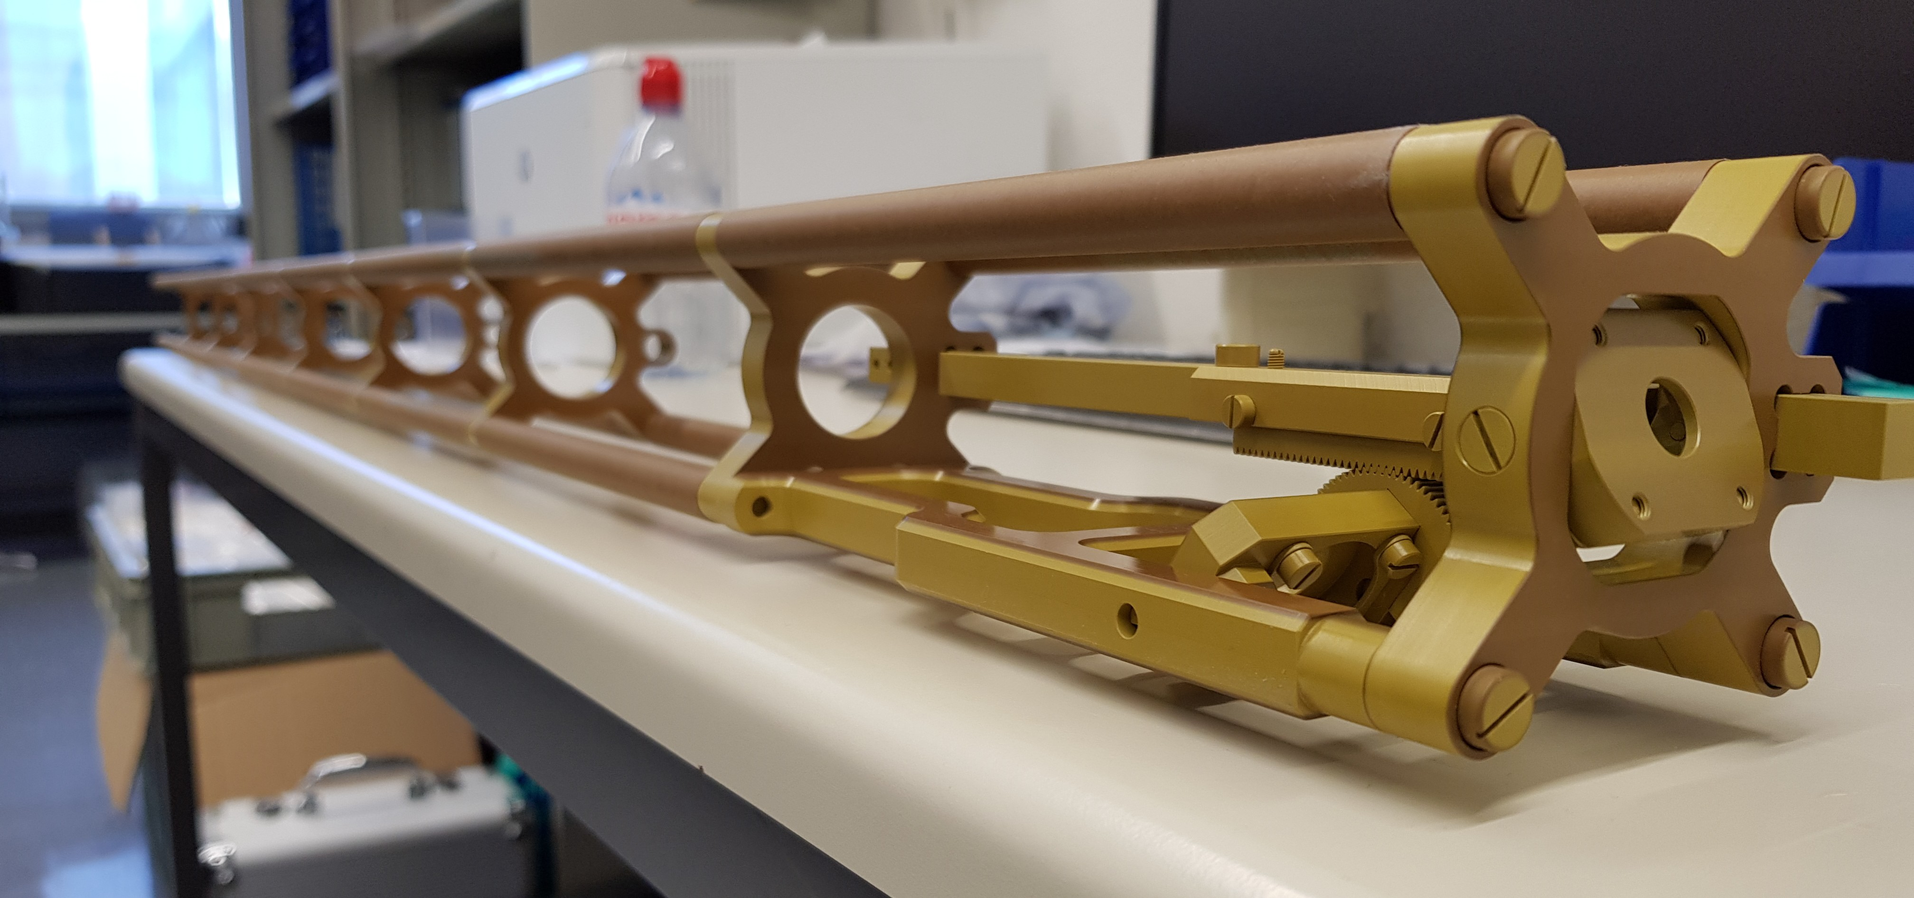
SBND Progress
VST - LArIAT TPC w/ SBND electronics
TPC electronics (BNL, Columbia U.)
  Using same FE ASIC as ProtoDUNE
  Qualified commercial off the shelf ADC for cold operation – excellent lifetime
  Vertical slice test of prototype electronics and DAQ w/LArIAT chamber in FNAL test beam
  Incorporating lessons from ProtoDUNE into production design
  Passed production readiness review on Nov 29
PMT system components at LANL
  Test of all PMTs in LAr late 2018
  Mounting system and DAQ in hand
CRT modules in production at Bern
  Electronics designed by Bern (avail. from Caen)
  Bottom and side modules at Fermilab
  Top modules in production
PMT test at LANL
Side CRT Modules at FNAL
Laser components

Slide 21
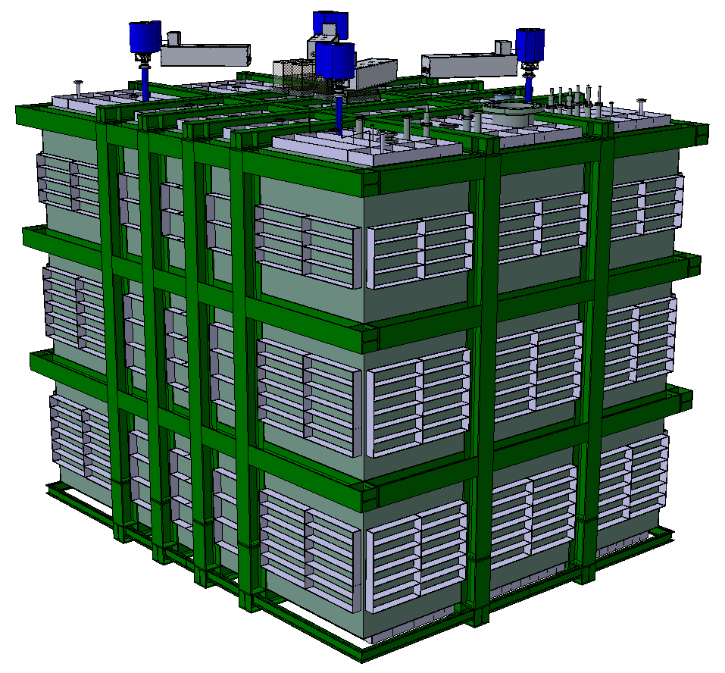
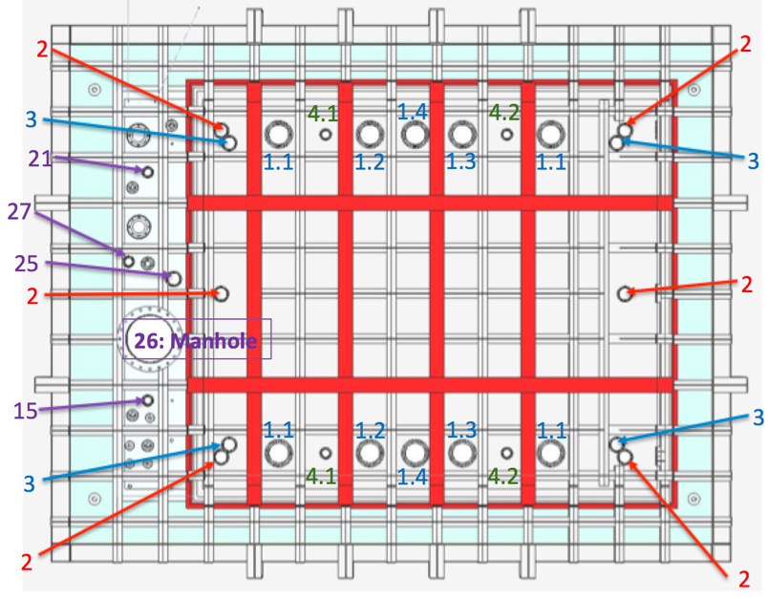
SBND Cryostat
Joint responsibility of CERN, FNAL and INFN
3rd generation prototype for DUNE designed by CERN:
  WA105 1x1x3 ➔ protoDUNEs ➔ SBND
  Steel structure design updated to match LBNF/DUNE as closely as possible
Status:
  Final design of steel structure nearly complete
  Ready to start final design study for membrane cryostat by GTT
SBND Cryostat Model
Cryostat Top Interfaces

Slide 22
SBND Milestones to S-1 SBND ready to move
Intermediate Milestone | Owner | Baseline Date | Forecast Date (Schedule) |  | Actual Date
First set of APAs shipped to Fermilab | K. Mavrokoridis | 24-Sept 2018 | 28-Dec-2018 | a
PO for COTS ADCs placed | H. Chen | 10-Oct-2018 |  | ✓ | 30-Oct-2018
All TPC Components at Fermilab | K. Mavrokoridis | 1-Mar-2019 | 26-Feb-2019
Complete atf assembly at DAB | J. Zennamo | 1-May-2019 | 8-Apr-2019
50% of motherboards delivered to Fermilab | H. Chen | 15-May-2019 | 15-Apr-2019
APAs and CPAs installed in atf | J. Zennamo | 15-Jun-2019 | 23-May-2019
Field cage assembly complete | J. Zennamo | 15-Jul-2019 | 2-Jul-2019
Cold electronics installed and tested | H. Chen | 23-Aug-2019 | 8-Aug-2019
S1: TPC ready to move to SBN ND | A. Schukraft | 30-Aug-2019 | 8-Aug-2019
US APA group decided to ship both their APAs together, delaying shipment of the first from September to December. This should have little to no impact on completion the final assembly

Slide 23
SBND Milestones to S-2 Ready to Fill
Intermediate Milestone | Owner | Baseline Date | Forecast Date |  | Actual Date
GTT Design Study Begins | M. Nessi | 1-Feb-2019 | 1-Jan-2019
Delivery of warm box steel | M. Nessi | 15-Jun-2019 | 30-Apr-2019
Warm vessel installation complete | M. Nessi | 15-Jul-2019 | 29-May-2019
TPC Transport to ND building complete | J. Zennamo | 15-Sept-2019 | 16-Aug-2019
Cryostat material arrives at Fermilab | M. Nessi | 1-Oct-2019 | 22-Aug-2019
Cryostat top plug is ready to attach to atf | M. Nessi | 1-Nov-2019 | 23-Sept-2019
Membrane Cryostat Completed | M. Kim | 1-Mar-2020 | 22-Jan-2020
Plug welded to cryostat | M. Kim, J. Zennamo | 15-Apr-2020 | 6-Mar-2020
Cryogenic operation approved | M. Geynisman | 1-Jul-2020 | 1-Jun-2020
S2: SBND detector is ready to fill with liquid Argon | A. Schukraft | 15-Jul-2020 | 1-Jun-2020

Slide 24
Technical Summary & Outlook
Excellent technical progress for ICARUS
  Installation remains on track since delivery of the cold shield components in April
    Updated planning process is keeping it on track
  Electronics readout delivery on track, installation starting (flanges)
  Proximity cryogenics (near and far) delivered to Fermilab, ready to install in January
  On track to complete milestone I-1, ready to fill, by June 2019
Excellent technical progress for SBND
  TPC components arriving at Fermilab
  TPC electronics production underway
  TPC assembly process has started
  Cryostat design and construction plan being completed
  On track to complete milestone S-1, detector ready for transport, by August 2019
The biggest technical risks have been retired or are near retirement:
  Installation of T600 vessels
  Completion of SBND APA wire winding
  Delivery of APAs to Fermilab

Slide 25
SBN Director’s Review
A Director’s Review for SBN was held Dec 17-19 2018
This review focused on the complete integrated schedule and the DOE High Energy Physics cost of the following program elements:
  Construction and installation of the ICARUS detector systems;
  Construction and installation of the SBND detector systems and cryostat;
  Construction and installation of the necessary support infrastructure such as cryogenic systems, common DAQ and overburden;
  Commissioning plan and transition to experimental operations plan.
The focus of this review was the schedule forecast for completing installation, commissioning and transition to operations for ICARUS and SBND and the associated costs borne by the DOE office of High Energy Physics. Topics included schedule, US costs, management, ES&H, and technical readiness to execute the SBN program.
Review web page

Slide 26
SBN Director’s Review Closeout Exec. Summary
The review committee was pleased with the progress made since the June 2018 review which focused primarily on schedule. The committee congratulates the team for the great progress in getting the far detector modules installed. Progress on the near detector components is also quite impressive.
The committee’s response to the Review Charge questions was nearly unanimously affirmative, with only a few minor caveats noted.
Schedules for reaching each of the key milestones were presented. Most of the recommendations from the previous review have been addressed. The contributions from our international partners were particularly appreciated. The main conclusion of the review was that almost all subsystems are ontrack to meet the baseline schedule presented in June, resulting in the far detector being ready to fill in Summer 2019 and the near detector approximately one year later.
The committee was satisfied with the Program’s attention to ES&H.
The committee reviewed outstanding risks, that if realized would impact the ability of the program to keep on schedule. The committee noted that a number of key risks have been retired.
Two main areas of concern were identified. The first is the funding available for FY19 work. A request for additional funding of $3.9M was made to DOE in FY18. If this funding is not made available within FY19Q2, key procurements for both detectors will have to be delayed, resulting in corresponding delay of meeting milestones.
The second area of concern remains the need to begin the final design of the near detector cryostat so that the schedule for the construction of the cryostat does not significantly delay achieving the milestones S2 and S3.
The committee encourages the Program management team to continue to work with all program contributors to develop robust plans for commissioning, transition to operations and ultimately steady state operation of both the near and far detectors of the SBN Program.

Slide 27
SBN Multi-Institutional MOU
A Memorandum of Understanding (MOU) for building of the SBN program is in draft form
The expectation is that it will be signed by the parties contributing to building the SBN program
Such a multi-institution document is unusual for the US DOE
Blazes an important trail for future DUNE agreements

Slide 28
SBN Multi-Institutional MOU Opening
Memorandum of Understanding
for Collaboration in the
Short-Baseline Neutrino Program
between
The Fermi National Accelerator Laboratory, a United States Department of Energy National Laboratory, managed and operated by Fermi Research Alliance, in Batavia, Illinois (hereinafter referred to as “Fermilab”), as the Host Laboratory
on the one hand,
and
the Funding Agencies/Research Institutions and Universities participating in the Short-Baseline Neutrino Program at Fermilab
on the other hand
for the purpose
of collaboratively carrying out a jointly funded and supported physics research program at Fermilab. The Parties mentioned will individually be referred to as a “SBN Participant” and collectively as the “SBN Participants”

Slide 29
SBN Multi-Institutional MOU Preamble
Preamble
As recommended by the 2014 report of the Particle Physics Project Prioritization Panel and the European Strategy for Particle Physics Update 2013, Fermilab has developed an international Short-Baseline Neutrino Program (“SBN Program”) to pave the way for substantial international involvement in the future Long-Baseline Neutrino Facility and the associated Deep Underground Neutrino Experiment (“LBNF/DUNE”);
The SBN Participants wish to collaborate in the construction, operation, and physics data analysis using a set of liquid argon detectors for the SBN Program that will be deployed in the Fermilab Booster Neutrino Beamline (BNB);
This Memorandum of Understanding (hereafter referred to as “MOU”) is a non-legally binding agreement that records contributions by SBN Participants to the SBN Program, it being understood that the SBN Participants recognize that the success of the SBN Program depends on all the SBN Participants adhering to its provisions.

Slide 30
Parties to the SBN MOU
The Parties to the SBN MOU are the agencies, labs, and universities providing the resources to build the program
  Fermi National Accelerator Laboratory (“Fermilab”);
  The National Science Foundation of the United States ("NSF")*;
  European Organization for Nuclear Research (“CERN”);
  Istituto Nazionale di Fisica Nucleare ("INFN");
  United Kingdom Research and Innovation (“UKRI”);
  University of Bern, Switzerland ("Bern");
  Los Alamos National Laboratory through its associated Laboratory Directed Research and Development program ("LANL");
  *NSF contributions will be listed, but the NSF will not be signing this MOU
There are about 60 institutions in the SBN collaboration that will operate the detectors and analyze the data from them

Slide 31
Proposed Annexes to the SBN MOU
Annex 1: Institutions Collaborating in the SBN Program and Names of Their Contact Persons
Annex 2: SBN Collaboration Organization Structure
Annex 3: SBN Program Governance
Annex 4: SBN Cryogenics, SBND Cryostat, and ICARUS Cosmic Ray Tagger
Annex 5: SBND Cosmic Ray Tagger
Annex 6: Participation of SBN Participant in Each SBN Subproject for ICARUS and SBND
Annex 7: Ownership of Equipment to the SBN Program
Annex 8: Financial Guidelines for the SBN Program

Slide 32
SBN Organization (E-1100)
A set of organizational structures defined to…
  oversee the completion of the ICARUS and SBND detectors,
  develop plans and procedures for commissioning and operation
  coordinate efforts toward combined physics analyses in the future.
  SBN Program Office
  SBN Oversight Board (SBN-OB)
  SBN Institutional Board (SBN-IB)
    SBND Collaboration
    ICARUS Collaboration
    Unaligned collaborators
  SBN Joint Working Groups

Slide 33
SBN Program Office
Purpose: Oversee construction on the SBN near and far detector buildings, install the far detector (ICARUS T600), design, construct, and install the near detector (SBND)
Program Support:
Program Coordinator – Peter Wilson
Deputy Coordinator – Cat James
Program Engineer – Barry Norris
Program Electrical Coordinator – Linda Bagby
Program Integration Engineer – Andy Stefanik
Logistics and Risk Manager – Michael Dinnon
Project Controls – Ken Domann
Financial Officer – Molly Anderson
Administrative Support – Etta Johnson
ES&H Coordinator – Angela Aparicio
CERN Safety Contact – Olga Beltramello (CERN)
Technical Coordinators:
SBND – Brian Rebel
Anne Schukraft - deputy
ICARUS – Claudio Montanari,
Angela Fava – deputy
Infrastructure – Cat James

Slide 34
SBN Oversight Board (SBN-OB)
Purpose: The SBN-OB is internal to SBN and provides a key forum for cross-collaboration communication or agreement development on issues relevant to construction, commissioning, operations, data management, and analysis.
Membership: The group consists of
  ICARUS and SBND spokespersons
  SBN collaborators selected to provide good representation of the international groups making major contributions to the ICARUS and SBND detectors,
    Italy-INFN
    US-DOE and NSF
    UK-UKRI
    Switzerland
    CERN
  As Host Lab, the initial Chair of the board is the head of Fermilab Neutrino Division
Timeline:
  Meetings held quarterly (May 15, Sept 21, Nov 30 in 2018)
  Currently developing an agreement on data sharing, common analyses and publication

Slide 35
SBN Institutional Board (SBN-IB)
Purpose: The SBN-IB provides a forum for program-wide communication on issues relevant to the Program. Procedures, policies, and bylaws covering joint aspects of operation, data sharing, data analysis, publications, etc. can be brought to this body for deliberation or developed from within the group. Agreements developed within the SBN-IB will need to return to the individual collaborations for final ratification.
Membership: The SBN-IB will consist of one member from each institution participating in the SBN Program. Each institution’s representative is selected by that institution and communicated to the IB chairperson who will maintain the official list of membership and mailing list. The chairperson will be elected by the members of the IB from within its membership.
Timeline: Gina Rameika is serving as interim SBN-IB chair. The first meeting was Sept 22. Gina’s first task is to run an election for SBN-IB chair. The SBN-IB signals the formal start of collaboration

Slide 36

SBN Collaborators and Institutions
UK 9
Switzerland 1
CERN
USA 32
Turkey 1
Italy 8
Israel 1
241 collaborators
from 7 countries
139 Senior Scientists
46 Postdocs
56 Graduate Students
Brazil 5

Slide 37
SBN Joint Working Groups
Purpose: A set of SBN Joint Working Groups are needed to co-develop many key aspects of SBN operations and physics analysis. Several joint working groups already exist making extensive use of the experience running MicroBooNE and ICARUS
  SBN Analysis: Explore how combined SBN physics analysis for sterile neutrino oscillation searches can be most effectively performed. Work focuses on implementing a three detector simulation, building reconstruction and analysis tools within a common framework, and developing an end-to-end common analysis scheme in preparation for real data exploitation.
  SBN DAQ and Data Pre-processing: Prepare the infrastructure for the efficient collection of high quality data with ICARUS and SBND using common strategies whenever possible.
  SBN Slow Controls: Compare Slow Controls needs and designs and identify common hardware and software solutions for ICARUS and SBND.
  SBN Cosmic Ray Tagger: Work on the CRTs of both detectors including a common analysis of CRT data and bringing in experience from MicroBooNE.
  SBN Offline computing: Work on data storage, processing and distribution
  New SBN Working Groups shall be set up as needed by the SBN-OB with the intent of spanning all detector subsystems
Membership: The Working Groups are open to all participants in the SBN Program. For each Working Group the SBN-OB will identify a set of conveners to lead the activities of the group and report progress to the SBN-OB and the collaborations.

Slide 38
Summary
SBN construction and installation now progressing well
  There were some early delays
  Now have loan agreement formed and ICARUS vessels rigged
  Need to reach agreement on SBND cryostat
SBN Multi-Institutional MOU drafted and being iterated
  Important trail blazing for DUNE
SBN Governance structures in place and working.

Slide 39
Backup Slides

Slide 40
I1: ICARUS detector is ready to fill with liquid argon
ICARUS is ready to fill when the following tasks are completed:
Cold vessels are installed
Chimneys are installed
Cold shield top is installed and circuits pressure tested
Warm vessel top is installed including guard rails and decking
Crosses and feedthroughs are installed and tested
Cryogenics components and piping are installed
Cryogenics controls, safety, and alarm systems tested
All cryogenic vessels and piping have passed safety reviews
High voltage feed through is installed
Electronics are installed
CRT bottom and side panels are installed
Slow Control System is tested
The procedure for LAr delivery and quality control is approved

Slide 41
I2: ICARUS detector is filled with liquid argon and ready for physics commissioning (LAr purity adequate for physics has been achieved)
ICARUS is ready for final physics commissioning when the following criteria have been met:
Liquid argon level is at the nominal operating value in the cryostat
Liquid argon level is maintained at nominal operating value
Liquid argon is circulating through the pumps
TPC High voltage at nominal for an extended period of time
Electronics passes quality control tests
Gas analyzers register no impurities in the liquid argon
Electron lifetime is > 3 ms
PMT signals observed in time with beam
Cosmic tracks are observed
DAQ throughput demonstrated for >5 Hz operation
The trigger system is operational
Data storage, data logging, and online data monitoring are functional
Run control system is operational

Slide 42
I3a: ICARUS detectors are ready for physics data - CRT is operational
ICARUS is ready for physics data-taking when the following criteria have been met:
TPC is ready for physics operation
Cryogenics are ready for stable operation
Trigger system functionality is verified
Run plan is approved
CRT electronics passes quality control tests
CRT passes safety reviews
CRT is integrated into the DAQ data stream
CRT top panels are in place
Cosmic ray muons can be tracked between CRT panels and the TPC

Slide 43
I3b: ICARUS detectors are ready for physics data - Shielding is in place
This milestone is met when the following criteria have been met:
CRT is ready for operation
Shielding blocks are in place

Slide 44
S1: SBND is ready for transport from D0 Assembly Building to the SBN ND hall
SBND is ready for transport when the following tasks are completed:
APAs are installed in assembly and transport frame
Light reflecting foils are installed in the CPA
CPA is installed in assembly and transport frame
Field cage is installed in assembly and transport frame
Field cage, CPA and APA electrical connections are tested
Cold electronics boards and cabling are connected and tested
APA ground mesh is installed
Assembly and transport frame is wrapped for transport

Slide 45
S2: SBND detector is ready to fill with liquid argon
SBND is ready to fill when the following tasks are completed
Warm vessel is installed
Cold cryostat is installed
Cold cryostat welds pass leak check
Cryostat plug is complete
Cryostat plug is attached to the TPC
Cryostat plug and TPC are inserted into the cryostat
Cryostat plug is welded to the cryostat
Cryogenics components and piping are installed
Cryogenics controls, safety, and alarm systems tested
All cryogenic vessels and piping have passed safety reviews
High voltage feed through is installed
Warm electronics is installed
Warm and cold electronics pass quality control tests
CRT bottom and side panels are installed
CRT electronics pass quality control tests

Slide 46
S3: SBND detector is filled with liquid argon and ready for physics commissioning (LAr purity adequate for physics has been achieved)
SBND is ready for final physics commissioning when the following criteria have been met:
Liquid argon level is at the nominal operating value in the cryostat
Liquid argon level is maintained at nominal operating value
Liquid argon is circulating through the pumps
TPC High voltage at nominal for an extended period of time
Warm and cold electronics pass quality control tests
Gas analyzers register no impurities in the liquid argon
Electron lifetime is > 3 ms
PMT signals observed in time with beam
Cosmic tracks are observed
DAQ throughput demonstrated for >5 Hz operation
The trigger system is operational
Data storage, data logging, and online data monitoring are functional
Run control system is operational

Slide 47
S4a: SBND detectors are ready for physics data - CRT is operational
SBND is ready for physics data-taking when the following criteria have been met:
TPC is ready for physics operation
Cryogenics are ready for stable operation
Trigger system functionality is verified
Run plan is approved
CRT electronics passes quality control tests
CRT passes safety reviews
CRT is integrated into the DAQ data stream
CRT top panels are in place
Cosmic ray muons can be tracked between CRT panels and the TPC

Slide 48
S4b: SBND detectors are ready for physics data - Shielding is in place
This milestone is met when the following criteria have been met:
CRT is ready for operation
Shielding blocks are in place

Slide 49
ICARUS Milestones to I-2 Detector Filled
Intermediate Milestone | Owner | Baseline Date | Forecast Date |  | Actual Date
Cold shield cooldown complete | C. Montanari | 7-Aug-2019 | 15-Jul-2019
Vessels filled with LAr, ready for HV | M. Geynisman | 30-Sept-2019 | 10-Sept-2019
Drift HV operational | F. Garcia | 15-Oct-2019 | 30-Sept-2019
PMTs operational | G. Raselli | 30-Oct-2019 | 15-Oct-2019
Cryogenics commissioning complete | M. Geynisman | 30-Nov-2019 | 22-Oct-2019
Cosmic tracks are observed in the TPC | A. Fava | 30-Nov-2019 | 22-Oct-2019
I2: detector is filled with liquid argon and ready for physics commissioning (LAr purity adequate for physics has been achieved) | P. Wilson | 30-Nov-2019 | 22-Oct-2019

Slide 50
ICARUS Milestones to I-3a ready for physics data – CRT operational
Intermediate Milestone | Owner | Baseline Date | Forecast Date |  | Actual Date
Complete installation of Side CRT modules (a) | A. Schukraft | 31-July-2019 | 28-Jun-2019
Top CRT panels delivered to Fermilab | U. Kose | 30-Sept-2019 | 31-Jul-2019
Slow controls operational for all detector systems | K. Biery | 31-Oct-2019 | 30-Sept-2019
DAQ operational with >5Hz output | K. Biery | 31-Oct-2019 | 30-Sept-2019
Detector system timing synchronized with beam | K. Biery | 30-Nov-2019 | 31-Oct-2019
Trigger system operational | A. Guglielmi | 31-Dec-2019 | 30-Nov-2019
Top CRT panels are installed and ORC’ed | U. Kose/A. Fava | 31-Jan-2020 | 5-Dec-2019
I3a: ICARUS detectors are ready for physics data – CRT is operational | P. Wilson | 31-Jan-2020 | 5-Dec-2019
Notes:
This milestone is currently at T4 in the schedule file. Will promote to T3 at the next schedule statusing

Slide 51
ICARUS Milestones to I-3a ready for physics data – shielding in place
Intermediate Milestone | Owner | Baseline Date | Forecast Date |  | Actual Date
Shielding blocks in place | C. James | 28-Feb-2020 | 6-Feb-2020
I3b: ICARUS detectors are ready for physics data – Shielding in place | P. Wilson | 28-Feb-2020 | 6-Feb-2020

Slide 52
SBND Milestones to S3 Detector Filled
Intermediate Milestone | Owner | Baseline Date | Forecast Date |  | Actual Date
Laser system installation complete | I. Kreslo | 1-Oct-2020 | 31-Mar-2020
Detector checkout at 130-150 K complete | M. Stancari | 15-Nov-2020 | 16-Oct-2020
Vessels filled with LAr, ready for HV | M. Geynisman | 21-Dec-2020 | 30-Oct-2020
Drift HV operational | A. Schukraft | 31-Jan-2021 | 1-Dec-2020
PMTs operational | R. Van de Water | 31-Jan-2021 | 20-Nov-2020
Cryogenics commissioning complete | M. Geynisman | 28-Feb-2021 | 15-Dec-2020
Cosmic tracks are observed in the TPC | M. Stancari | 28-Feb-2021 | 15-Dec-2020
S3: SBND detector is filled with liquid argon and ready for physics commissioning (LAr purity adequate for physics has been achieved) | A. Schukraft/M. Stancari | 28-Feb-2021 | 15-Dec-2020

Slide 53
SBND Milestones to S-4a ready for physics data – CRT operational
Intermediate Milestone | Owner | Baseline Date | Forecast Date |  | Actual Date
Top CRT panels delivered to Fermilab | I. Kreslo | 1-Jul-2019 | 1-Apr-2019
Slow controls operational for all detector systems | S. Gollapinni | 15-Sept-2020 | 17-Jul-2020
DAQ operational with >5Hz output | W. Badgett | 1-Nov-2020 | 2-Oct-2020
Detector system timing synchronized with beam | W. Badgett | 15-Nov-2020 | 11-Sept-2020
Trigger system operational | W. Badgett | 15-Jan-2021 | 15-Dec-2020
Top CRT panels are installed and ORC’ed | I. Kreslo | 31-Mar-2021 | 11-Jan-2021
S4a: SBND detectors are ready for physics data – CRT is operational | M. Stancari | 31-Mar-2021 | 19-Jan-2021

Slide 54
SBND Milestones to S-4b ready for physics data – shielding in place
Intermediate Milestone | Owner | Baseline Date | Forecast Date |  | Actual Date
Shielding blocks in place | C. James | 21-Apr-2021 | 8-Feb-2021
CRT system complete and fully commissioned | I. Kreslo | 30-Apr-2021 | 15-Feb-2021
S4b: SBND detectors are ready for physics data – Shielding | M. Stancari | 30-Apr-2021 | 15-Feb-2021

Slide 55
Some details of the SBN MOU
Multi-Institution MOU is desired by the SBN participants as they wish to see the contributions of all the other SBN participants
  To be assured that all the components will be in place to ensure successful execution of the experimental program
Signed by Fermilab Director (who acts as the librarian) rather than at DOE level so that attention to the detail is appropriately pushed down to the lab level.
All contributions by parties are in kind.
  The agreements are for detector deliverables rather than financial contributions.
All the participating institutions have signed NPUAs (working on equivalent with CERN)
We hope this will be a simple, flexible, relatively fast process that is effective and efficient
Blazes an important trail for future DUNE agreements

Slide 56
Host lab WBS for construction
Includes tracking of some collaboration deliverables
MS Project File covers WBS 1-4
WBS 3 – milestones only
Resource loaded schedule for DOE funded activities
Notes:
Need to explain the PM organization as to how this all comes together through the management

Slide 57
Commissioning Plans
Breakouts 7 & 8
For both detectors, installation and commissioning activities will occur simultaneously
  Commissioning activities have already started for ICARUS (e.g.):
    Testing of cable continuities during chimney and flange installation by collaboration
    Engineering note preparation and review for in-kind contributed cryogenics components
  Commissioning milestones integrated into RLS for both detectors
ICARUS TC and deputy TC have led the development of a draft commissioning plan incorporating detector and cryogenics activities (docDB 10093)
  Technical working groups organized earlier this year are responsible parties
  Resource request made to INFN for Italian collaboration contributions
  Preliminary list for U.S. collaboration contributions
SBND commissioning coordinator, Michelle Stancari, has outlined a commissioning plan
  Close coordination with collaboration and TC and deputy TC
  Similar structure of technical working groups as ICARUS is proposed
  Commissioning coordinator engaged in assembly and installation planning to ensure necessary QC happens

Slide 58
Transition to Operations
Breakouts 5, 7 & 8
There are four major components of the SBN program for which a transition to operations must occur
  SBN Far Detector Building (docDB 1508), transition occurred in May 2017
  SBN Near Detector Building (docDB 1508), transition occurred in May 2017
  SBN Far Detector, ICARUS, transition anticipated in late CY 2019
  SBN Near Detector, SBND, transition anticipated in late CY 2020
For the detectors, the transition to operations is defined as occurring at the milestones I-2 and S-3: “detector is filled with liquid argon and ready for physics commissioning (LAr purity adequate for physics has been achieved)”:
  Cryogenics systems will be in stable operations with near steady state support required
  Collaboration 24/7 shifts will have been established for detector and data monitoring
  Standard experiment support models from Neutrino and Scientific Computing Divisions will be in place
For both detectors, there are about 1 year of commissioning tasks leading up to this transition to operations
  A few more months to install Top CRT and overburden; complete physics commissioning
Expect Fermilab to hold an Operations Readiness Review for each detector to officially complete the transition
Transition to Operation plan in preparation for delivery to DOE in January 2019

Slide 59
Support for Commissioning and Operations
Breakouts 5, 7 & 8
Responsibility for commissioning and operating each detector lies with the collaboration
As host laboratory Fermilab is responsible for support
  Cryogenics operation (w/CERN) by ND
  Experiment Liaison Officer (ELO) provided by ND
    consistent interface to technical resources from ND, PPD, and TD as needed
    Interface to Accelerator Division (attend 9am meeting)
  Support of online computing by ND Computing Professionals
  Support of network, online computing tools, data storage, offline computing, and offline computing tools by SCD teams
  ES&H support through ND Safety Officer, Angela Aparicio
ND support is funded through the individual detector operation budget (i.e. MicroBooNE, ICARUS, SBND).
SCD personnel is funded through a common pool for Intensity Frontier experiments including NOvA, g-2 and Mu2e.

