Slide 1
Acnet Interface for Robotics Workshop
Dennis Nicklaus, AD/Controls
AD Robotics Workshop
6 Feb 2019

Slide 2
Acnet Interfaces
ACNET is able to communicate using a variety of standard ethernet-based protocols:
MODBUS/TCP
VXI11
OPC
We also have a framework which makes it straightforward to develop network-based interfaces using other custom or proprietary protocols, including:
HTTP
Commonly used developed-at-Fermilab protocols
Ascii text over ethernet based protocols
Protocol compiler for developing custom protocols

Slide 3
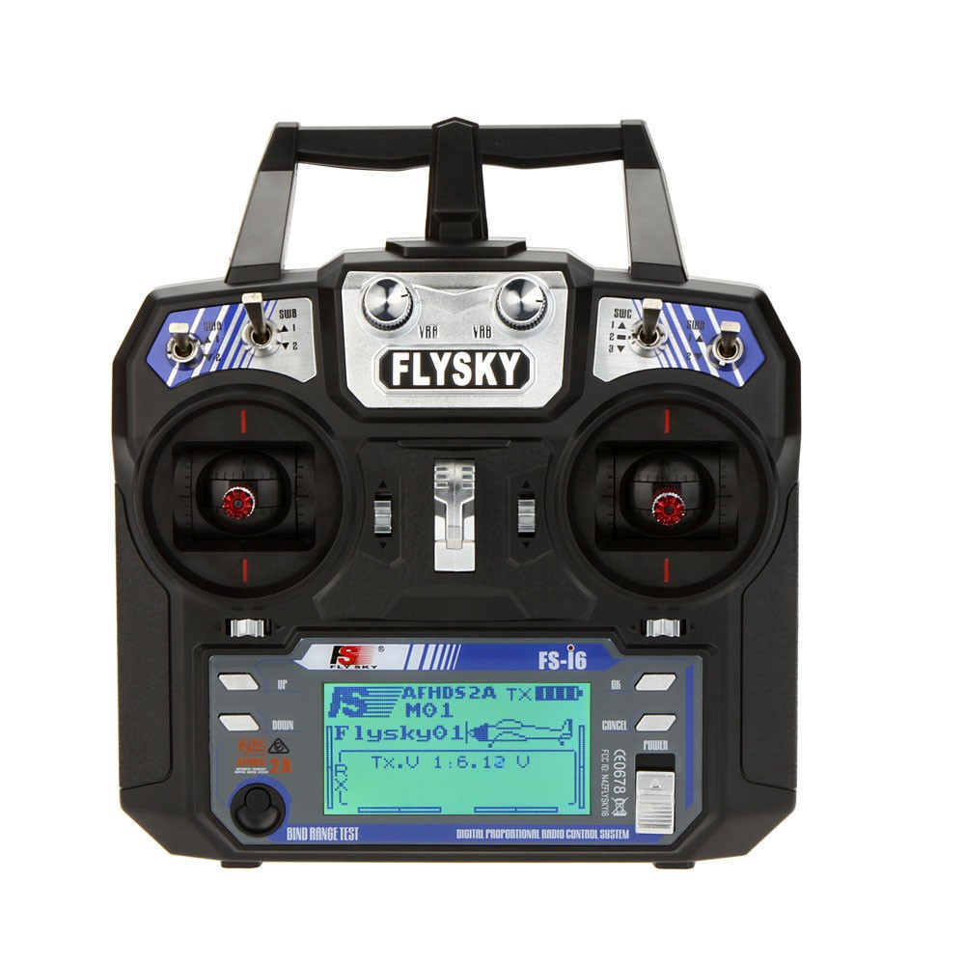
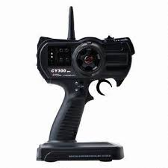
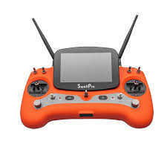
What we can’t interface to
Closed systems, such as a radio-controlled unit.

