Slide 1
P07: 402.06 Trigger and DAQ
Jeffrey Berryhill
CD1 Director’s Review
March 19, 2019

Slide 2
Outline
Introduction
Design of Trigger and DAQ
  Motivation, Scope, and Deliverables
Updates since June 2018 IPR
  Conceptual Design, Maturity
  Organization, Cost, Schedule
  Risks
Response to Previous Reviews
  June 2018 IPR Recommendations
Progress towards CD-2/3
Breakout Session topics
Summary

Slide 3
Biographical Sketches
Charge #5
L2 Manager: Jeffrey Berryhill, Senior Scientist, Fermilab
  Physics PhD (Chicago 2000), PMP certified (2016)
  CMS, BaBar, CDF collaborator
  Working on CMS trigger at FNAL since 2006
  Int’l CMS L1 Trigger Upgrade Co-coordinator 2018-
  USCMS L2 manager for Trigger/DAQ upgrade 2015-
  Int’l CMS PM for LS1 upgrade of calorimeter trigger 2014-5
  CMS Convener: Standard Model Physics 2012-3
L2 Deputy: Rick Cavanaugh, Professor UIC/Fermilab
  International CMS L1 trigger Phase 2 Upgrade Co-manager 2016-18
  L3 Manager: Correlator Trigger (WBS 402.06.05)
  LS1 upgrade of calorimeter trigger 2014-2015
  USCMS Coordinator: LHC Physics Center 2010-2013
  CMS Convener: Particle Flow & Tau ID Group, CMS, 2007-2008
L2 Deputy: Keith Ulmer, Professor Colorado-Boulder
  Physics PhD (Colorado 2007)
  CMS Phase 2 Track Trigger to L1 Trigger interface coordinator 2019-
  CMS Convener: SUSY group 2014-2015

Slide 4
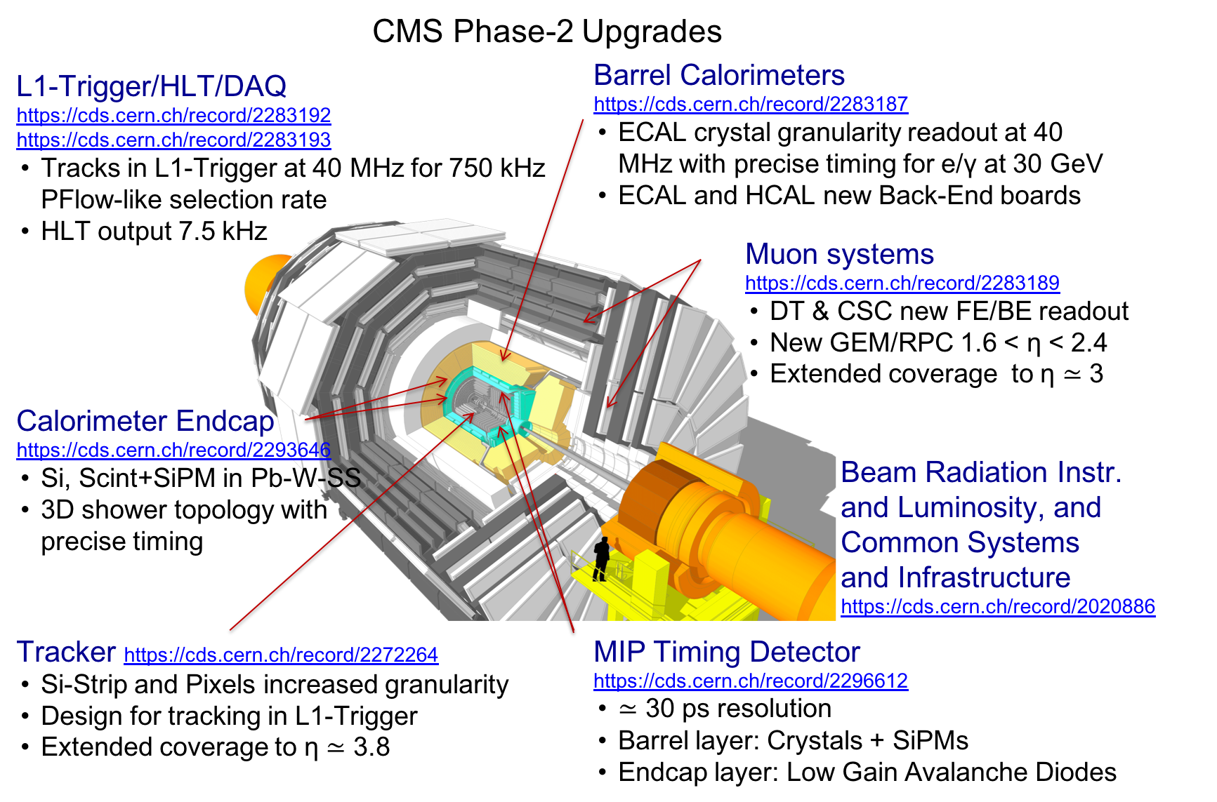
CMS HL-LHC Upgrade Overview
Notes:
Circle your part of the upgrade

Slide 5
402.06 Upgrade Motivation
Charge #2
The L1 trigger system efficiently identifies scientifically relevant pp collisions with low latency to reduce the recorded data output event rate by CMS from 40 MHz down to a rate which meets output DAQ capability.
Phase 1 DAQ capable of readout at 100 kHz and 4 μs latency for a L1 trigger decision. HL-LHC will have 5-7x more luminosity. How do we upgrade to have the same or better efficiency to select events that we enjoy today?
HL-LHC upgrade expands DAQ capability to 750 kHz output and extend latency to 12.5 μs. DAQ expansion keeps up with rising signal rates.
It does not keep up with rising background rates at higher pileup. L1 trigger selection must improve. Phase 1 trigger at HL-LHC would output 4 MHz!
  Trade in higher latency available for more complex algorithms,
  Adding more/better data and computing power.
  Introduce OT tracking to L1 decision.

Slide 6
402.06 Upgrade Motivation
Charge #2
Barrel Calorimeter readout electronics will be upgraded to output higher granularity (all ECAL crystals). Barrel Calorimeter Trigger will be upgraded to accept and process that for highest precision energy cluster reconstruction.
New Correlator Trigger system will combine tracking data with cluster data to reconstruct the entire event at the particle level (“particle flow”), which allows for highest precision object reconstruction, pileup mitigation, and background rejection.
DAQ capacity is expanded to ship up to 31 GB/s for offline reconstruction at HL-LHC startup.

Slide 7
CMS HL-LHC Trigger Architecture
DOE Trigger/DAQ scope
NSF Trigger/DAQ scope
Other US CMS scope
Endcap Calorimeters
Barrel Calorimeters
Outer Tracker
Detector
Endcap Muon
System
Barrel Muon
System
Pixel Tracker
DTC: Outer Tracker BE
MIP Timing Detector
CE BE
EB/HB/HF BE
EMU BE
BMU BE
Barrel Calo
Trigger RCT
Track
Trigger
Endcap Muon
Track Finder
Barrel Muon
Track Finder
36 Boards
13 boards
6 boards
162
boards
Barrel Calo
Trigger GCT
3 Boards
Charge #2
Correlator Trigger Layer-1
27+2 Boards
7.5 kHz
To Offline
BE+L1 System:
40,000 kHz event data
processing
750 kHz To HLT
DAQ/HLT System
Event Builder
HLT
Storage Manager
Correlator / Global Trigger Layer-2
5-10 Boards

Slide 8
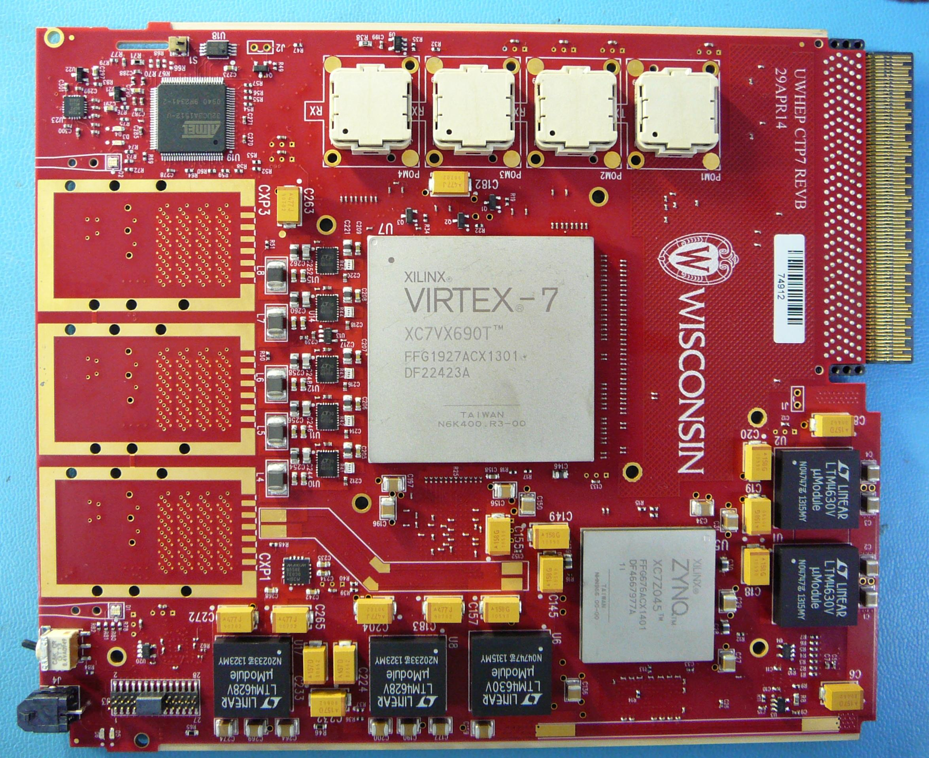
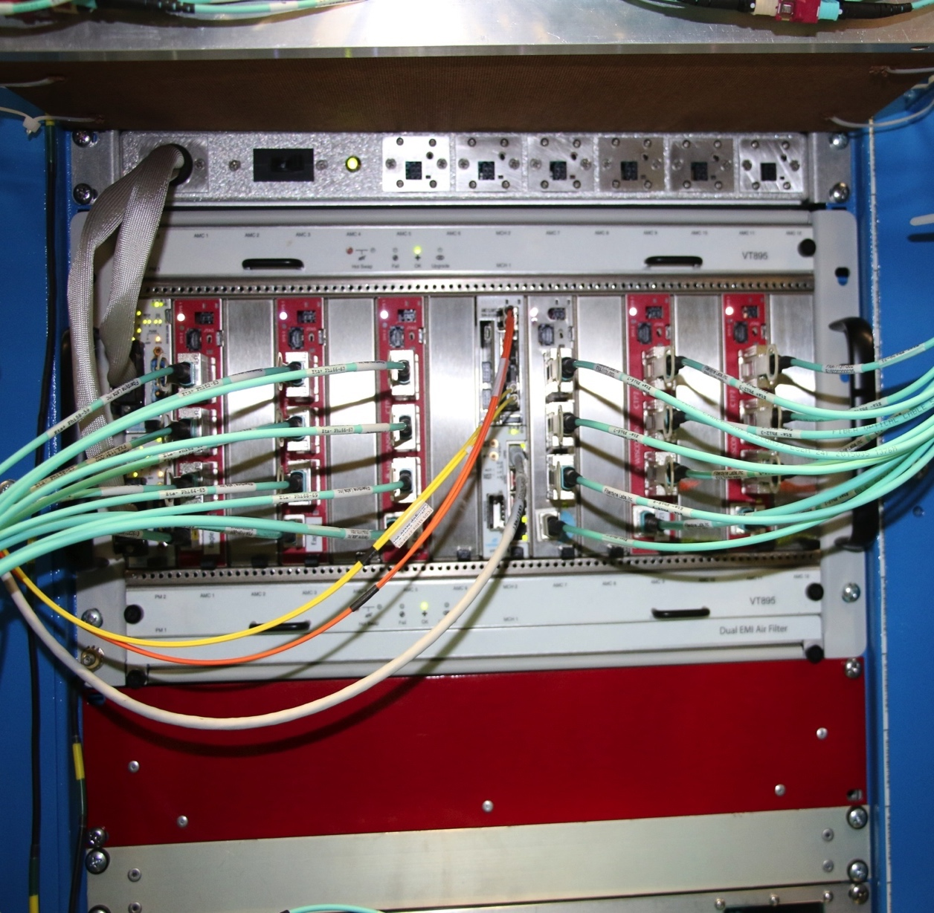
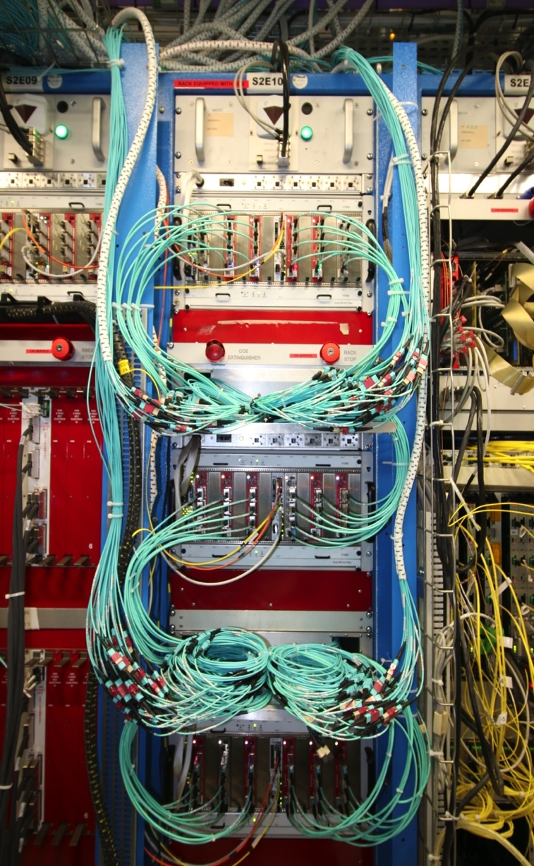
402.06 Conceptual Design
Charge #2
Chief computing unit for L1 trigger systems is an ATCA blade mounted with high-speed, high I/O FPGA(s), linked to other blades with 10-28 Gb/s fiber optic I/O.
Barrel Calorimeter Trigger is a two-stage network of blades which 1) regionally clusters data from the BC backend electronics and 2) globally merges and sums data and identifies energy clusters of interest (jets, taus, electrons/photons).
Correlator Trigger is a two-stage network which 1) merges tracking, calorimeter, and muon data to perform particle reconstruction and mitigate pileup and 2) reconstructs particles of interest (jets, leptons, photons, sums, composites, etc.) for final trigger decision.
There are no changes in the architecture since June 2018, some expected for forthcoming L1 Trigger TDR this year.
Installed Phase 1 μTCA-based hardware with 10 Gb/s optical I/O.

Slide 9
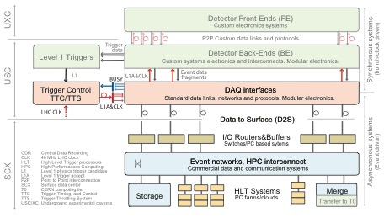
DAQ Architecture
Charge #2
Synchronous timing and control for L1 trigger and backend electronics
Data to surface routing and buffering
Event networks for building events from BE fragments
HLT filtering of built events
Local storage (~2.7 PB) and transfer (up to 31 GB/s) of accepted events to T0 w/COTS computing needed at HL-LHC startup

Slide 10
Trigger/DAQ Upgrade Scope Summary
Charge #2
Trigger/DAQ DOE project consists of digital electronics, associated infrastructure, firmware, and software to enhance or replace the existing CMS L1 trigger system.
  Replace barrel L1 calorimeter trigger system (402.6.3) to exploit new calorimeter electronics
  New L1 correlator trigger system (402.6.5) to enhance trigger decision-making
  Replace Storage Manager and Transfer System (402.6.6) for the DAQ
L1 Barrel Calorimeter trigger
  52 ATCA boards, firmware, software, and infrastructure for accepting “trigger primitive” calorimeter detector input from the barrel calorimeter systems BE electronics and output cluster/particle/sums data to the Correlator Trigger. Benchmarks for electromagnetic cluster position and energy resolution.
L1 Correlator Trigger
  36 ATCA boards, firmware, software, and infrastructure for accepting input from the track trigger, muon trigger, and calorimeter triggers and output particle candidates for downstream use in the correlator trigger system. Benchmarks for track-cluster and track-muon matching efficiency.

Slide 11
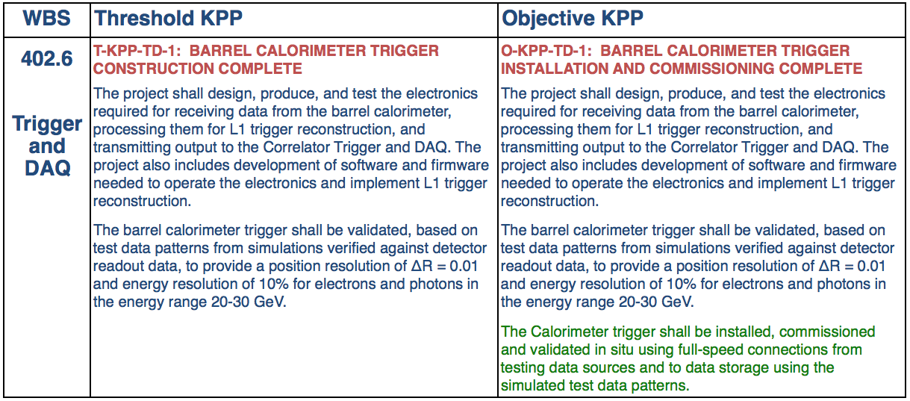
Threshold and Objective KPPs
402.6 Trigger and DAQ
CMS-doc-13237
Calorimeter Trigger

Slide 12
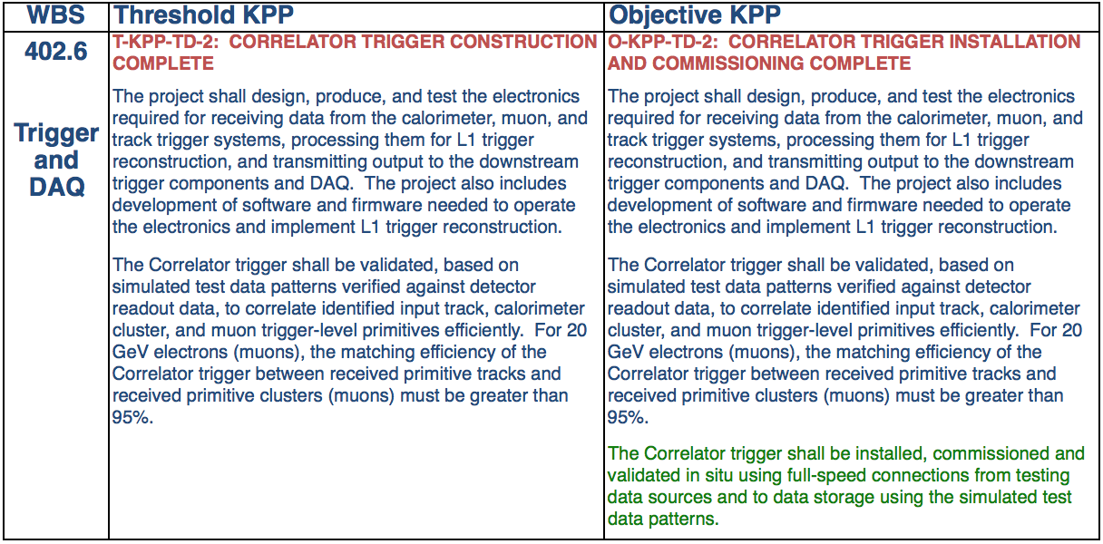
Threshold and Objective KPPs
402.6 Trigger and DAQ
CMS-doc-13237
Correlator Trigger

Slide 13
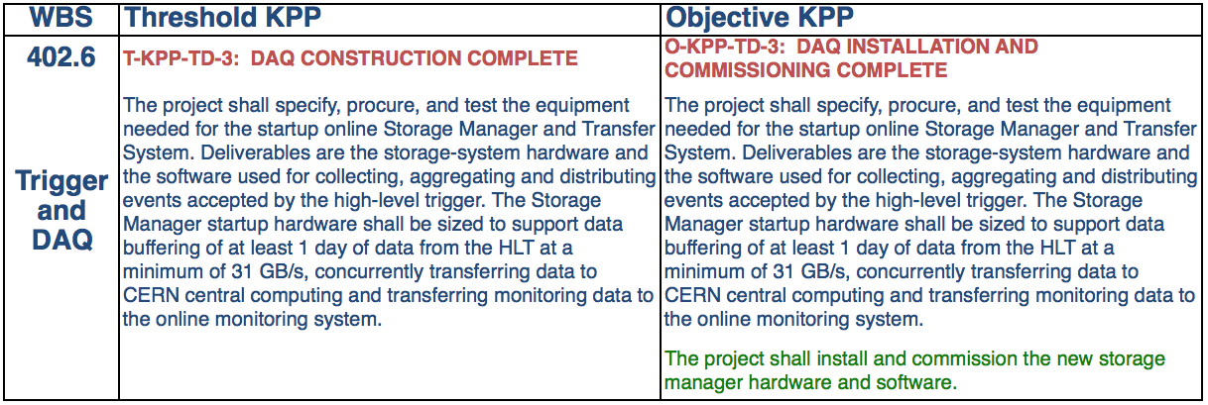
Threshold and Objective KPPs
402.6 Trigger and DAQ
CMS-doc-13237
Data Acquisition (DAQ)

Slide 14
Summary Progress to Date
Domestic and International Project Reviews
L1 Trigger Interim TDR published and accepted by LHCC early 2018 (CMS-TDR-017)
  Presents R&D plan along with algorithms and architectures to be evaluated for 2019 TDR
  First draft of interfaces (data payloads of I/O)
  US APD board R&D and Calo./Corr. Algorithms documented as part of Int’l plan
DAQ Interim TDR published and accepted by LHCC early 2018 (CMS-TDR-018)
DOE scope reviewed with minimal recommendations in June 2018 IPR. “Proceed to CD-1”.
Int’l L1 trigger project annual review Nov. 2018, reviewed positively with minimal recommendations.
DOE CD-1 review in June 2019
NSF FDR in September 2019
L1 trigger TDR draft end 2019, LHCC acceptance end Q2 2020
R&D Milestones
Proof-of-concept firmware demonstration for particle flow reconstruction in correlator
Bench demonstration of high-speed links (up to 28 Gbps)
L1 trigger test board production for ATCA infrastructure complete (IPMC w/ Zync)
L1 trigger ATCA prototype board received and under testing

Slide 15
Recent technical progress: L1 trigger blade design
Xilinx Virtex Ultrascale+ FPGA (VU9P)
100 optical links in and out, up to 28 Gbps each
Rear transition module to accommodate 24 of those links
Various control and memory functions on small mezzanine cards:
  IPMC
  Gb Ethernet switch
  Embedded Linux/Zync control SoC
  Large LUT space

Slide 16
Recent technical progress: L1 trigger blade design
First prototype received at UW Feb. 2019

Slide 17
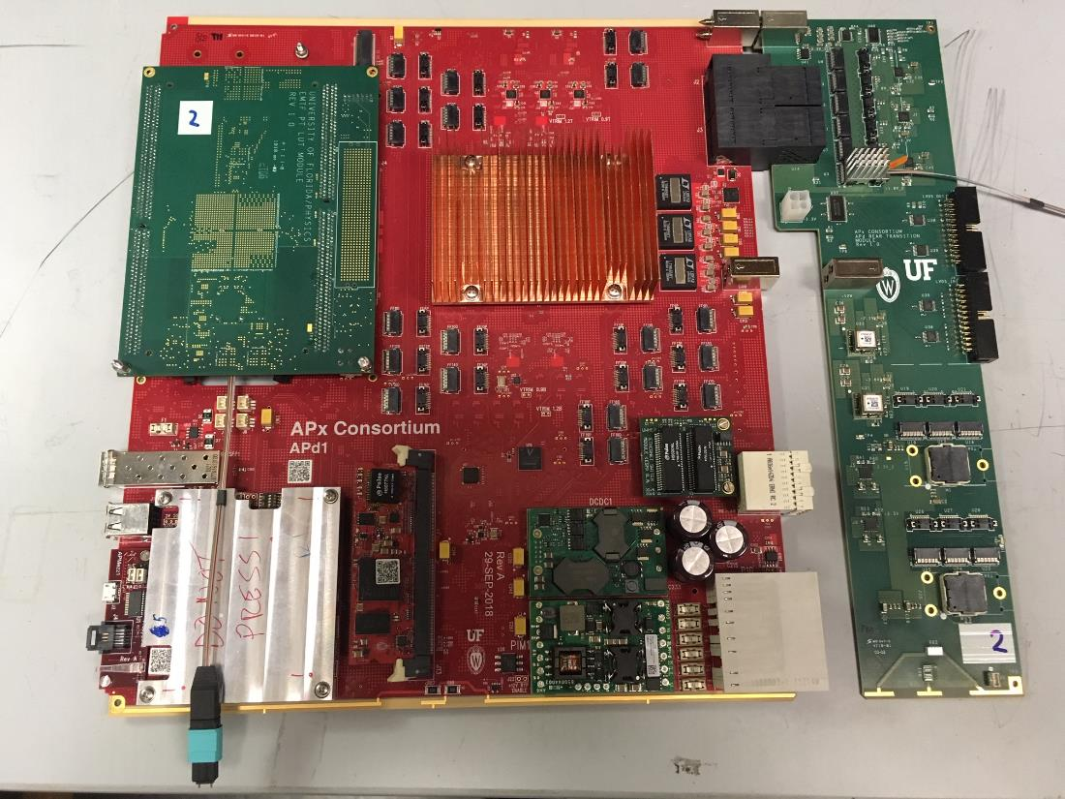
Recent technical progress: L1 trigger blade design
First prototype assembled with mezzanines at UF Mar. 2019
Rear transition
module attached
to APD1 prototype
Heat sink for FPGA
128GB LUT
mezzanine card

Slide 18
Recent technical progress: L1 trigger blade design
voltage level
time after clock edge
“open eye” = clock jitter, rise time, fall time within tolerance
Excellent eye diagram and bit-error-rate performance, up to 28 Gbps, on all links tested so far.

Slide 19
Recent technical progress: Firmware readiness
Algorithm firmware ready for demonstration on APD1, tested on Ultrascale+ on test kits and the cloud
Deploying increasingly realistic system test setups.
Ex: Correlator trigger Layer-1 testing with US correlator team (MIT, FNAL, UF, Colorado, aTm)
L1 PF+PUPPI algorithm features well-specified
On target FPGA, can process up to 30 tracks and 30 clusters simultaneously within latency budget
Resource usage of DSPs/LUTs within margins (55-60% of VU9P)

Slide 20
Recent technical progress: Firmware readiness
Upstream producers to Layer-1
Mockup upstream producers by loading upstream CTP7 BRAM with emulated HL-LHC tt MC data
PF+PUPPI firmware reconfigured for Virtex 7 FPGA, CTP7 link speed (15 clusters and tracks)
Emulation successfully reproduces hardware output of PF+PUPPI
Some layer-2 functionality (NN Tau ID) deployed on a Virtex 7.
Emulation successfully reproduces output of Layer-1 and Layer-2
Will be incrementally replaced with APD1’s, faster links when ready
Layer-1 to Layer-2

Slide 21
L1 trigger blade testing
For first prototype:
  Test remaining on-board optical links (40/72 tested so far)
  Ship to Florida for RTM usage and testing remaining links
  Large LUT mezzanine test at Florida
  Firmware demonstration (Iridis 64b/66b link protocol)
Two other Rev A boards to assemble pending first success
Testing complete end May 2019
By end September 2019:
  Rev B design changes, if needed
  Procurement of up to 8 APD1’s total for test stand usage at UW/FNAL/UF/CERN
  Firmware demonstration for L1 trigger TDR complete (and for NSF FDR/muon trigger)
By end December 2019:
  Testing of APD1 Rev B complete
Jan. 2020: preproduction design begins

Slide 22
402.06 Design Maturity
Charge #2
At June 2018 IPR, Design Maturity was assessed in three areas: hardware design, firmware/software design, and DAQ
  All were past Conceptual Design Phase and in the middle of the Preliminary Design Phase
Correlator component design completion assessment: Progressed from 34% → 54% done
Hardware design tasks (%done)
100 High speed link testing (Firefly)
100 ATCA form factor (CDB)
100 IPMC (IPMI)
100 Embedded Linux controller (ELM)
50 Cooling for Ultrascale+
25 Board integration w/FPGA (APD1)
00 Board integration w/FPGA (APD2)
25 APD1 testing
00 APD2 demonstrator testing
100 Memory module testing
100 PTLUT1 design
00 PTLUT2 design
Software design tasks (%done)
100 CDB base SW
100 CDB test SW
100 APD1 base SW
00 APD1 test SW
00 APD2 base SW
00 APD2 test SW
Firmware/Algorithms tasks (% done)
100 CDB base FW
50 APD1 base FW
00 APD2 base FW
50 PF hadron reco
50 PF muon reco
50 PF photon reco
50 PF neutral reco
50 Puppi
50 Vertexing

Slide 23
402.06 Design Maturity
Charge #2
At June 2018 IPR, Design Maturity was assessed in three areas: hardware design, firmware/software design, and DAQ
  All were past Conceptual Design Phase and in the middle of the Preliminary Design Phase
Progress on remaining Preliminary Design Phase Criteria:
  Hardware: preliminary design is sufficiently developed COMPLETE
  Hardware: Component designs at 30% level COMPLETE
  Firmware: Alternatives have been evaluated COMPLETE
  Firmware: baseline design choice COMPLETE
  Firmware: preliminary design is sufficiently developed COMPLETE
  Firmware: Interfaces, Value engineering, QA COMPLETE
  Firmware: Component designs at 30% level COMPLETE
  Hardware and Firmware: TDR completed PENDING L1 TRIGGER TDR IN EARLY 2020
  DAQ: several open items to specify STMS and its TDR PENDING DAQ TDR IN 2021
June 2018
March 2019

Slide 24
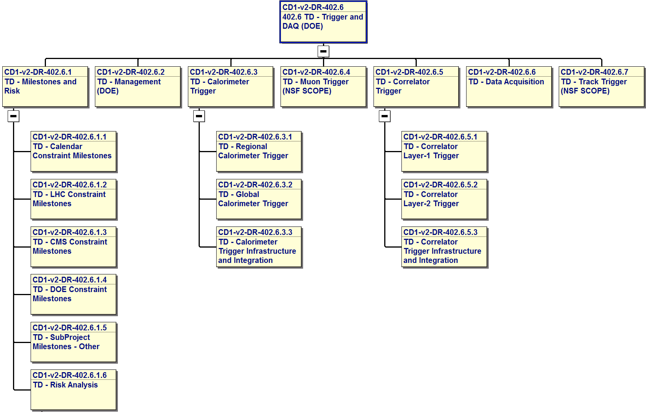
Work Breakdown Structure
402.6 Trigger and DAQ

Slide 25
Work Breakdown Structure
402.6 Trigger and DAQ
L2 J. Berryhill (FNAL)
L2 deputy R. Cavanaugh (UIC)
L2 deputy K. Ulmer (Colorado)
L3 S. Dasu (Wisconsin)
L3 N. Tran (FNAL)
L3 R. Mommsen (FNAL)
J. Berryhill is the current Int’l CMS L1 trigger upgrade co-coordinator, 2018-2020
R. Cavanaugh was the previous Int’l L1 co-coordinator, 2016-18
R. Mommsen is the current Int’l DAQ Deputy PM

Slide 26
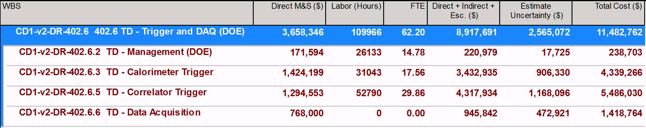
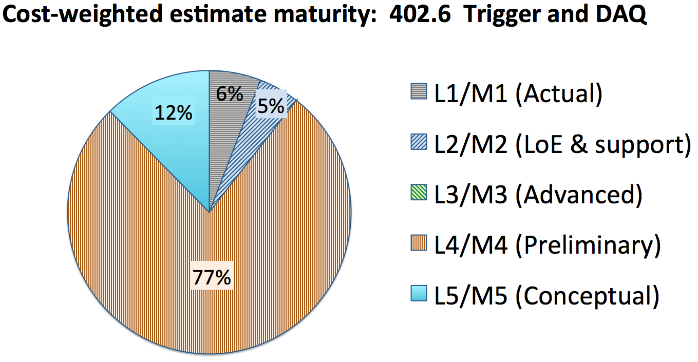
Cost Summary at Level 3 CMS-doc-13215
402.6 Trigger and DAQ
11.5 M$ total with escalation and uncertainty (22%)
risk contingency (8%) adds 0.7M$ → 12.2M$
50/50 Labor/M&S
  labor primarily firmware engineering labor
  M&S primarily ATCA blades
  Correlator firmware has multiple interfaces requiring more labor than Calorimeter
DAQ is 100% M&S COTS computing (0.95M$)
Estimate maturity is 77% “preliminary”,
with a 12% “conceptual” component for DAQ

Slide 27
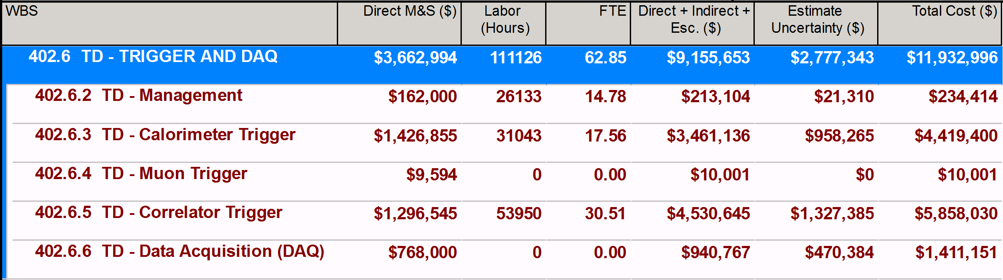
Cost Summary at Level 3 CMS-doc-13215
402.6 Trigger and DAQ
2019 TPC 0.5 M$ less than in June 2018 IPR
Some cost uncertainty retired (2018 actuals)
Some firmware labor reduced
June 2018 IPR

Slide 28
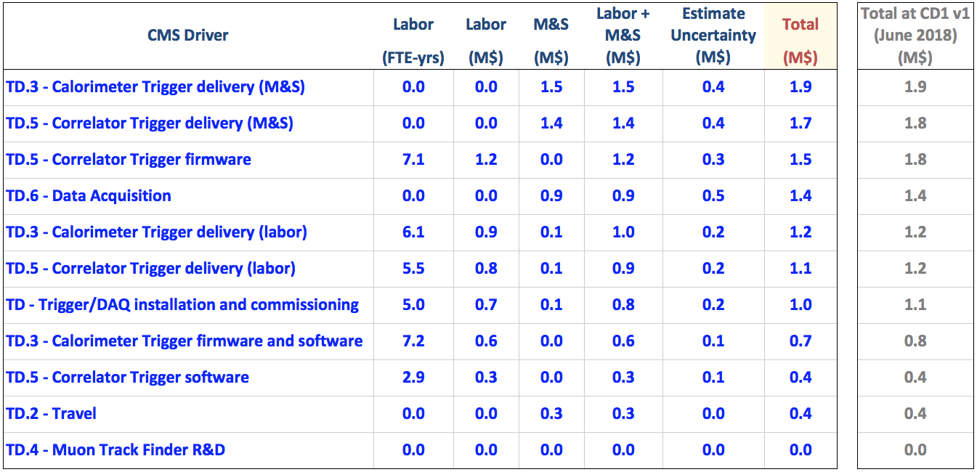
Cost Drivers: Trigger and DAQ
402.6 Trigger and DAQ
Trigger board M&S, Firmware labor, DAQ M&S are largest cost drivers

Slide 29
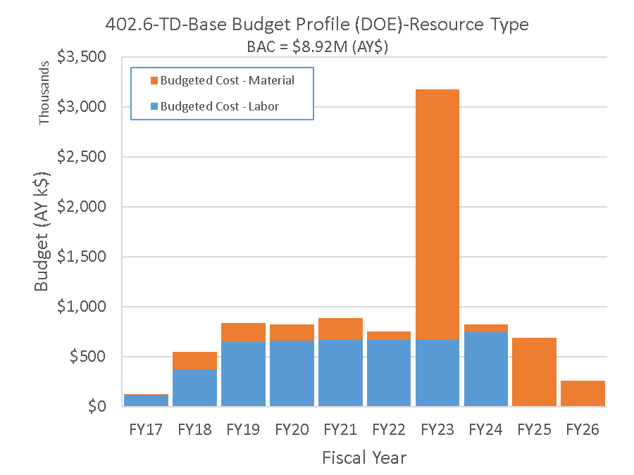
402.06 Cost Profile
Prior to final board procurement in FY23, L1 trigger projects are predominantly a steady rate of labor expenses for prototyping, preproduction, and pilot production
Final board procurement in FY23 (2.4 M$)
DAQ procurement in FY25-6

Slide 30
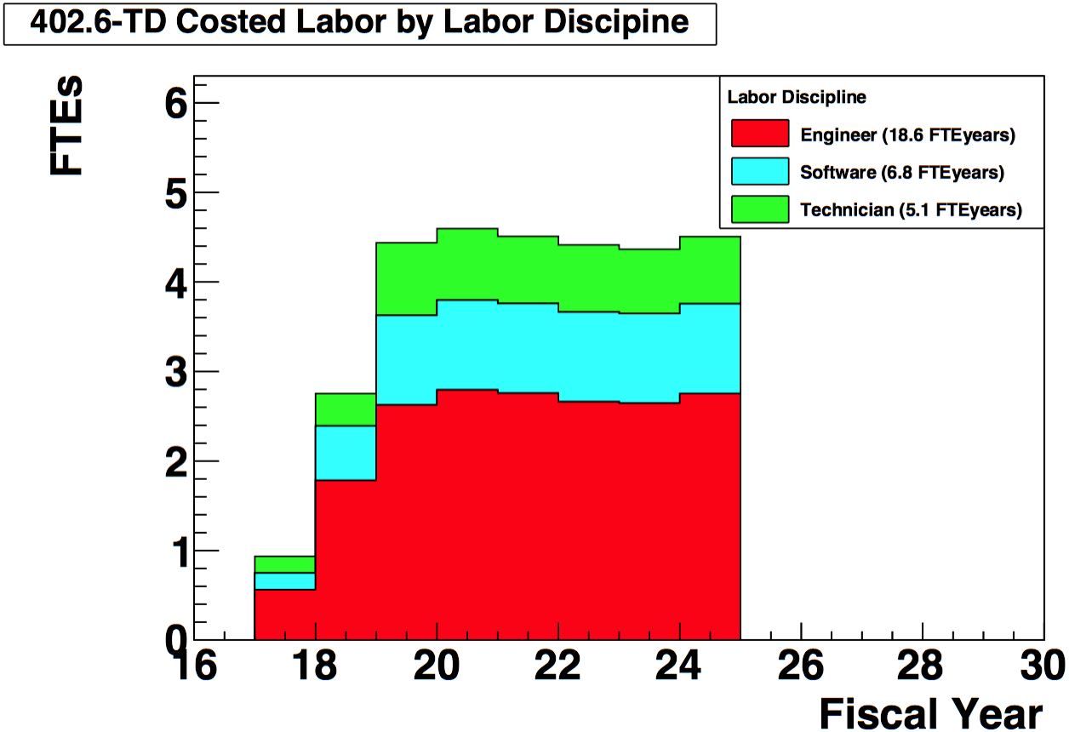
Costed Labor Profile
402.6 Trigger and DAQ
Costed labor distribution roughly:
  1 part SW
  1 part tech
  1 part EE design
  2 parts firmware engineering
  All required costed personnel are currently on staff

Slide 31
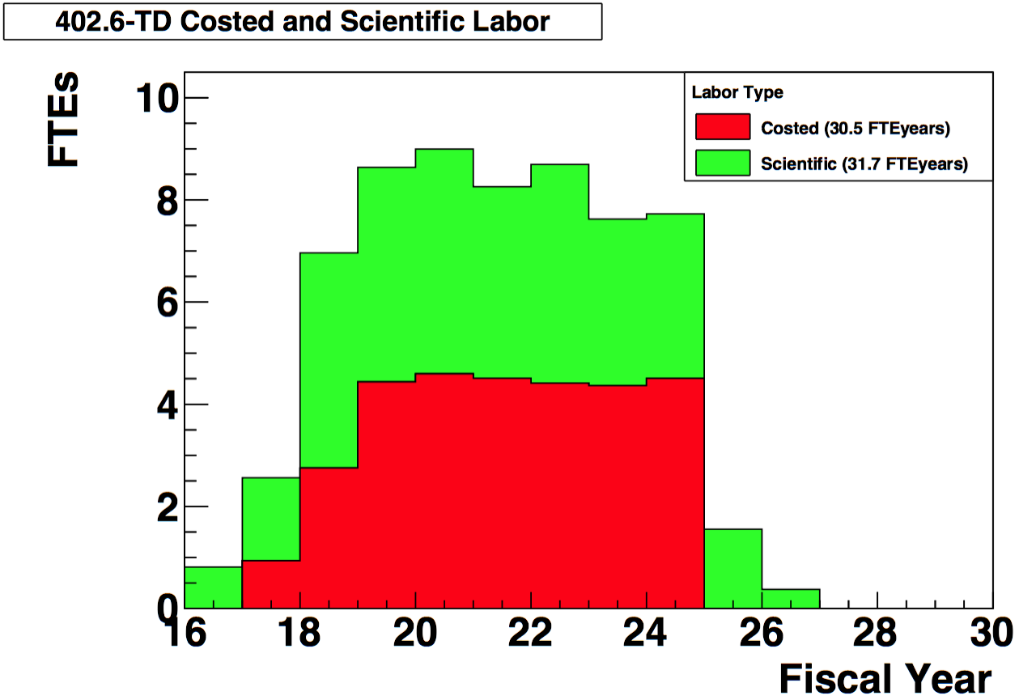
Costed Labor and Contributed Labor
402.6 Trigger and DAQ
Costed labor for electronics, software, firmware engineering at ~4.5 FTE/yr during construction
Comparable contributed labor required for algorithm development and management

Slide 32
402.06 Labor Resources: Institutions
Calorimeter Trigger
Institution | Responsibility
Wisconsin | HW & FW engineering, SW and algorithm development
Correlator Trigger
Institution | Responsibility
Fermilab | FW engineering, algorithm development
Florida | FW engineering, SW and algorithm development
MIT | Algorithm development
Northwestern | Algorithm development
Colorado | FW engineering, SW and algorithm development
UIC | Algorithm development
Wisconsin | HW & FW engineering, SW and algorithm development
DAQ
Institution | Responsibility
Fermilab | Storage Manager specification, procurement, operations
MIT/Rice/UCSD | Storage Manager specification, operations

Slide 33
402.06 Labor Resources
All required costed personnel are currently on staff
A single production line for blades is handled by technical staff and senior engineering at Wisconsin.
Due to many scientific requirements, significant contributed labor is required to develop algorithms and assess their performance in testing. Adequate labor levels here was successfully demonstrated for a recent CMS internal annual review of L1 trigger.
Due to multiple interface requirements in the correlator trigger, firmware development is distributed to several developers responsible for each interface (UW/BC, UF/Muon, Colorado/L1TT, FNAL/EC+Layer2)

Slide 34
Trigger/DAQ schedule
L1 Prototyping/R&D phase 2017-2019, for Trigger TDR at end of 2019 (FDR/CD2)
L1 Preproduction phase 2020, for Trigger ESR
L1 Production phase 2021-2023
L1 Installation phase 2024
DAQ procurement 2024-2026, need by Run 4 start
CD1
CD2/3
CD4
LHC
Physics
TS
Physics
LS 2
Physics
TS
Physics
TS
Physics
LS 3
Calorimeter Trigger
Trigger TDR
Trigger ESR
PrePd
Production
Install
RCT boards
Prototype
PrePd
Production
GCT boards
PrePd
Production
Infrastructure
Correlator
Trigger
Prototype
PrePd
Production
Install
Layer-1 boards
PrePd
Production
Infrastructure
DAQ
DAQ SMTS procurement
FY17
FY18
FY19
FY20
FY21
FY22
FY23
FY24
FY25
FY26

Slide 35
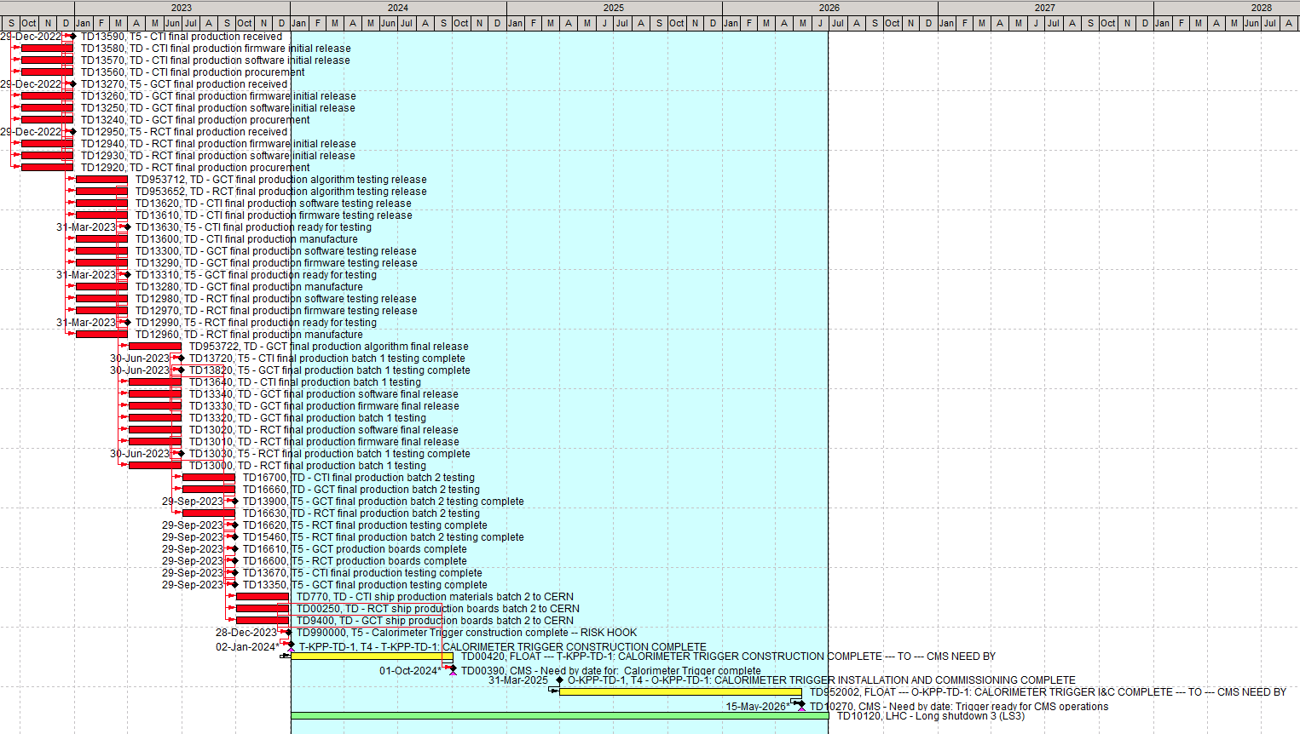
Critical Path and Schedule Contingency
402.6 Trigger and DAQ – Calorimeter Trigger
Long Shutdown 3
Threshold KPP: T-KPP-TD-1
Jan 2024: Calorimeter Trigger Construction Complete
has 9.2 months of float to:
Oct 2024: CMS need-by date
has add’l 19.4 months until ready for pp operations
Red activities denote the critical path
Trigger ready for
CMS operations
35

Slide 36
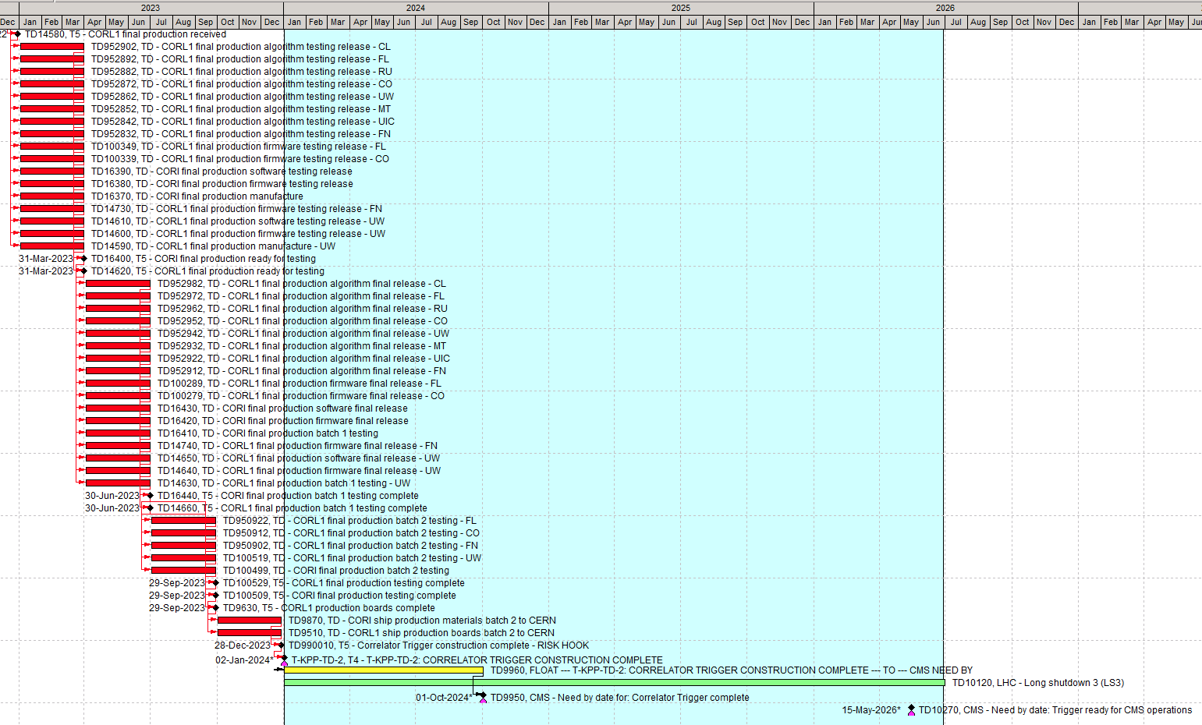
Critical Path and Schedule Contingency
402.6 Trigger and DAQ – Correlator Trigger
Long Shutdown 3
Threshold KPP: T-KPP-TD-2
Jan 2024: Correlator Trigger Construction Complete
has 9.2 months of float to:
Oct 2024: CMS need-by date
Red activities denote the critical path
Trigger ready for
CMS operations

Slide 37
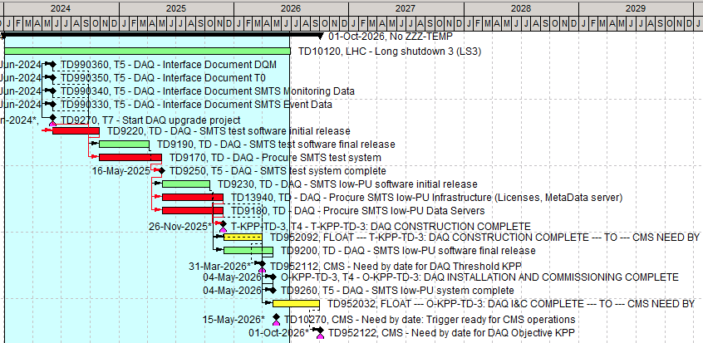
Critical Path and Schedule Contingency
402.6 Trigger and DAQ – DAQ
Threshold KPP: T-KPP-TD-3
Nov 2025: DAQ Construction Complete
has 3.9 months of float to:
Mar 2026: CMS need-by date
N.B. this is not a hard “drop-dead” constraint.
Commodity components – purchase as late as possible to maximize “bang for buck”.
Long Shutdown 3
Red activities denote the critical path

Slide 38
402.06 Risks
Risk register recommendations from June 2018 IPR:
  Milestones should be added to the schedule for the final choice of FPGA which requires input from the firmware and software tasks. Update the expiration dates in the Risk Register to accurately reflect when these risks will be retired. DONE
  The procurement strategy for DAQ should be explicitly detailed in the project documentation, taking into account possible or even likely delays in the CERN tender. DONE
  The risk table should include the risk or opportunity that the total size of the DAQ storage system needs to be increased or decreased due to changes in the event size, compression algorithms, or trigger rate. DONE
Risk review workshop held September 2018 at FNAL:
  Elaboration of text on risk event, response, estimation, and mitigation with reviewers. DONE

Slide 39
402.06 Risks
Risk ranking and mitigation
  Largest risks are having to increase board production or buying bigger FPGAs to meet evolving requirements (probability*cost impact ~ 200k$)
    Mitigation strategy: carefully track requirements and interfaces, schedule board demonstrations emulating or including all interfaces at each prototyping and production stage
  Next are vendor issues with PCBs or PCB redesign (probability*cost impact ~60k$)
    Mitigation: several rounds of incremental prototyping to vet vendors and discover any design issues early. Pilot production round to ensure minimal rework.

Slide 40
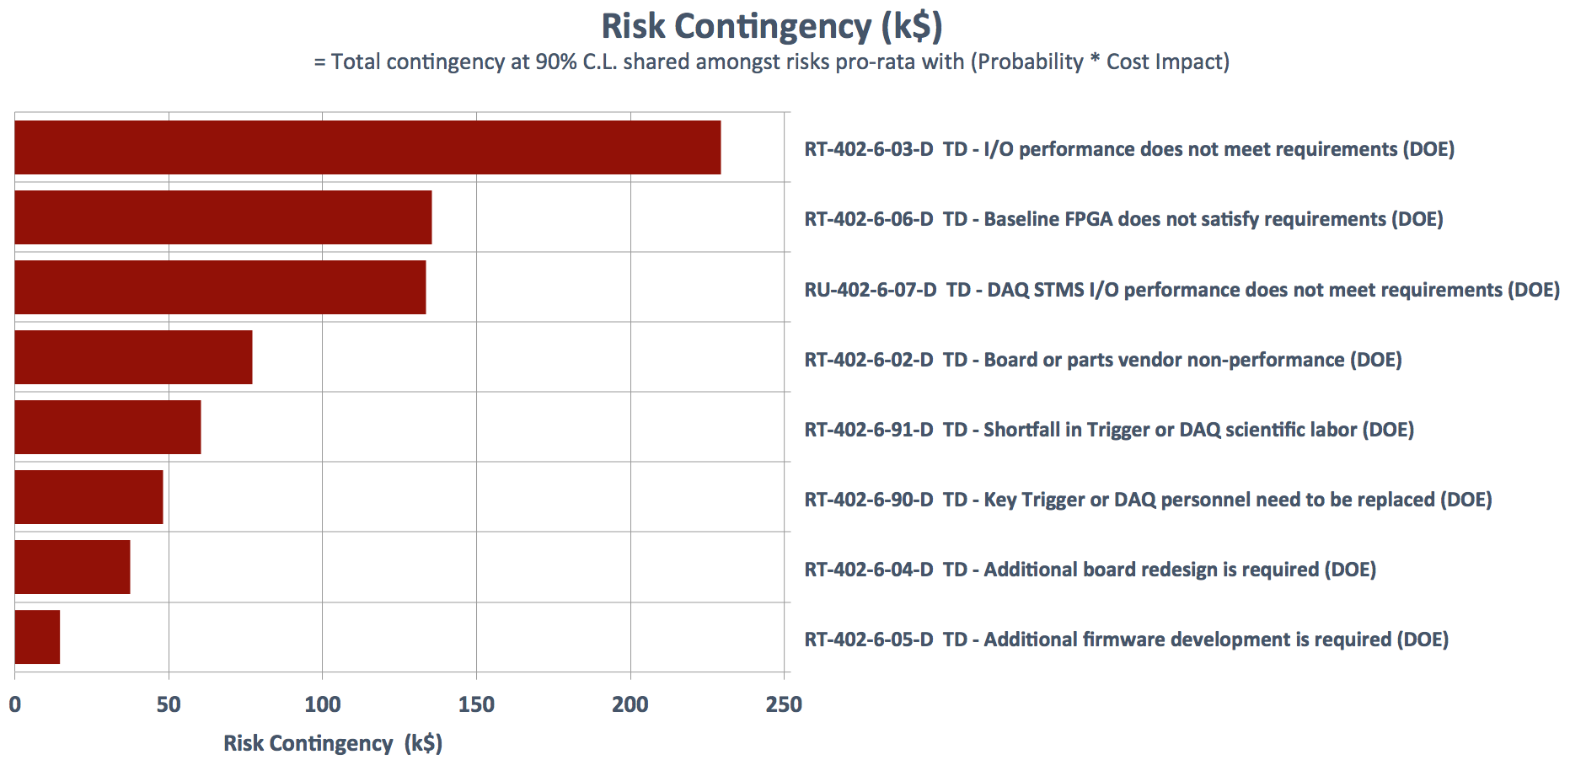
Trigger and DAQ risks
402.6 Trigger and DAQ
TD risk contingency ≈ $0.7M
Main risk changes in the last 12 months are
  Key personnel and scientific labor risks now managed at L2 (+50k$)
  DAQ performance uncertainty added (+130k$)
$0.5M at
June 2018 IPR
Ranked risk threats and opportunities

Slide 41
June 2018 IPR Trigger/DAQ Recommendations
“Restructure Key Performance Parameters (KPPs) for the Calorimeter Trigger and the Correlator Trigger to eliminate external dependencies prior to CD-1 approval. This is to ensure the KPP can be met prior to the start of data taking.”
Action: KPPs for trigger subsystems will include simple performance metrics which are decoupled from interfacing performance requirements
Calorimeter Trigger:
  electron photon and tau trigger performance →
  electromagnetic cluster position and energy resolution
Correlator Trigger:
  electron photon muon and tau trigger performance →
  track-cluster and track-muon matching efficiency
“Update the WBS dictionaries for the Calorimeter Trigger and Correlator Trigger to cover all major activities including those involving hardware, firmware, and software.”
Action: WBS dictionary to include firmware and software delivery
Notes:
MTD skip this slide

Slide 42
Threshold and Objective KPPs
402.6 Trigger and DAQ
CMS-doc-13237
Calorimeter Trigger

Slide 43
Threshold and Objective KPPs
402.6 Trigger and DAQ
CMS-doc-13237
Correlator Trigger

Slide 44
WBS Dictionary
402.6 Trigger and DAQ
CMS-doc-13213

Slide 45
402.06 Progress towards CD-2/CD-3
Production cost and schedule largely unchanged since last summer.
Schedule of preproduction and production to be updated to reflect APD1 actuals.
Production cost/scope/schedule expected to evolve as part of the L1 Trigger TDR baseline design completion in 2019.
  A specific board count and associated FPGA resource re-optimization will be determined
  CERN is negotiating bulk FPGA pricing with AVNET, which could revise FPGA costs downwards by up to 50%
  Will renegotiate need-by dates with detector subsystems which will likely increase float.
L1 TDR baseline architecture to be determined ~end of June 2019. Number of needed boards and the lower FPGA costs will be known at that time as well.
Expect well-developed cost and schedule for CD-2 based on recent actuals, a successful R&D phase, and a L1 trigger TDR baseline.

Slide 46
Quality Assurance
Charge #6
All QA aspects of the HL LHC CMS Detector Upgrade Project will be handled in accordance with the Fermilab Integrated Quality Management approach, and the rules and procedures laid out in the project-wide QA plan
  Project-wide Quality Assurance Program DocDB 13093
All hardware deliverables data and testing results are tracked in a database
Testing/commissioning/production software and firmware are tracked in github or svn repositories
Blade hardware:
  Responsible institute validates HW with tagged FW+SW prior to final shipping
  Validation repeated upon receipt at Electronics Integration Center at CERN
  …and similarly for P5 install, local runs, global runs
Optical connections: live continuous non-invasive monitoring (eye-diagrams) with on-board Zync applications for Xilinx.
LUT Memory: periodic playback validated against offline copies
Firmware & software: follows Fermilab SQA (QAM 12003,12090).

Slide 47
QA/QC Hardware Tracking

Slide 48
ES&H
Preliminary Hazard Analysis Report DocDb 13394
Charge #6
All delivered electronics is off-detector and out of radiation areas. Requirements and hazards are typical of any small scale commercial electronics project: electrical, fire, flammable materials, ESD.
No hazardous materials. No special labor conditions required. No high voltages used.
Safety: follows procedures in CMS-doc-11587, FESHM
All activities and personnel at CERN regulated by CERN Safety Rules
Optical fiber and cabling required to be non-halogen
200W power ceiling on ATCA blades to avoid special labor and equipment conditions related to cooling

Slide 49
402.06 Interfaces and Partners
cms-doc 13318
International partners at L3 have well-defined scope:
  Correlator trigger has a Layer-2/Global Trigger component with
  UK (Imperial/Bristol/RAL)/CERN responsible
  CERN is contributing all M&S for L1 trigger infrastructure (crates/fibers/patch panels)
Key interfaces (mostly US-owned):
  Calo trigger inputs with EB (US) and HB (US)
  Correlator trigger inputs with calo/muon/track trigger (US) and HGC (UK/Croatia/France)
  DAQ storage manager interface with the rest of DAQ
  All: output of trigger data to DAQ (standard blades from DAQ group)
External watchlist:
  Data and Timing Hub blade required for each L1 trigger crate (provided by CERN/DAQ group)
  Prototype DTH needed for preproduction phase 2020
  Preproduction DTH needed before starting final production 2022

Slide 50
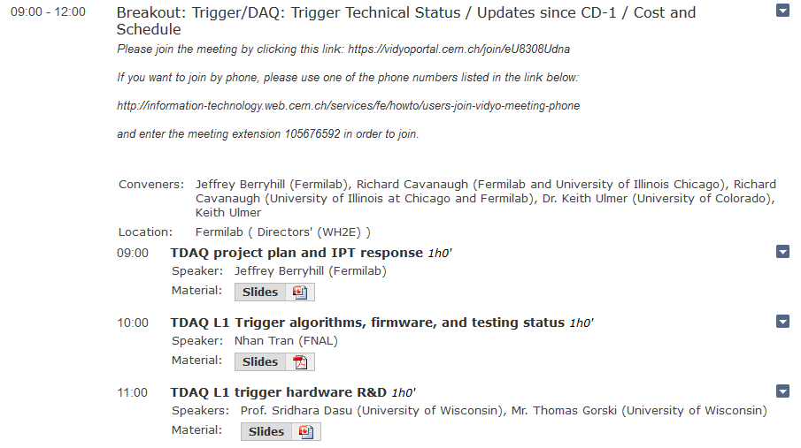
Breakout Sessions
Show B/O session agenda

Slide 51
Summary
Hardware and firmware for L1 Trigger components have progressed since June 2018 IPR:
  including a first demonstrator prototype
  firmware demonstration on available hardware
  ready for firmware demonstration on first prototypes
In sync with planning for L1 Trigger TDR in 2019
Preparing to update the project plan for CD-2/3 based on R&D, L1 TDR outcomes this summer.
We have addressed all recommendations and comments.
Project plan and responses to IPT ready for CD-1.

