Slide 1
B06: CMS Subproject QA Implementation
Carol Wilkinson
HL-LHC CMS Associate Project Manager
CD-1 Director’s Review
March 19-21, 2019
1

Slide 2
U.S. CMS Subproject QA Implementation
Charge #6
Major components for U.S. CMS Subproject (L2) QAP implementation:
Individual QA Implementation Plans (QAP Appendix CMS-doc-13093)
QA Activities Spreadsheets (CMS-doc-13093)
  Summary list of QA/QA activities with links to Technical Requirements
Detailed QA/QC procedures and plans at component level
Experienced, dedicated, and pro-active technical leads
Charge #6 (Adequately mature QA) and Charge #8 (Response to reviews)
Charge #8
2

Slide 3
Outline
Biographical Sketch
Overview of Subproject QA Implementation
Subproject QA Plans (QAP Appendix)
  Outer Tracker example
Subproject QA Activities Spreadsheets
  Outer Tracker and MIP Timing Detector examples
Subcomponent QA Plans and Procedures
  MTD and Endcap Calorimeter examples
Qualifications and Training
  Endcap Calorimeter example
Status / Summary

Slide 4
Biographical Sketch - Carol Wilkinson (Assoc. PM)
  Project Management Consultant for large scientific facilities
    25+ years of experience in managing large scientific facilities for DOE and NSF.
    Panelist for many external reviews of NSF and DOE facility construction / operations
  Caltech Science Research Manager (2003 – 2017)
    Advanced LIGO Project Manager (2003 -2013)
    Visiting Facility Advisor with NSF Large Facilities Office (2013-2016)
  Los Alamos Project Manager - Nuclear Weapons Hydrotesting Program (2002 – 2003)
  Los Alamos Group Leader – DAHRT Accelerator Operations; and Project Manager – DAHRT Facility Construction (1999-2002)
  Los Alamos Deputy Group Leader – DAHRT Accelerator Operations; and Deputy Project Manager– DAHRT Facility Construction(1998-1999)
  Los Alamos LAMPF Team Leader - Beam Line and Accelerator Physics (1989-1998)

Slide 5
Subproject Implementation of the USCMS Quality Assurance Plan (Appendix)
CMS-doc-13093
  The QAP defines general Quality Assurance expectations from international CMS through Fermilab to participating institutions in the U.S.
  Subproject appendices detail how each will implement the QAP given the different organizational structures and interactions within international CMS
  QA roles, responsibilities, and processes may vary in detail from subproject to subproject
Controlled document approved by U.S. CMS PM, Deputy PM, and QA Coordinator
5

Slide 6
QAP Subproject Appendix Contents
CMS-doc-13093
The QAP appendix contains high level descriptions of QA implementation for each L2 U.S. CMS subproject, including:
Short description of the scope of work / deliverables (designs, prototypes, hardware, software, test results, etc.)
Subdetector organization and communication methods within CMS and U.S. CMS
List of participating institutions within U.S. CMS
Short description of the types of QA activities (electronic prototyping, simulations or other modeling, material testing, vendor validation, assembly, QC, performance testing, etc.)
Management of non-conforming parts
Document and Record keeping
6

Slide 7
Ex: Outer Tracker - Scope
A.2.1
OT Scope: Participation in design, production, and performance testing of sensor modules, electronics, and assemblies.
Sample page
7

Slide 8
Subproject Organization
Roles defined within the specific CMS subdetector system
  U.S. leads report to one or more CMS subdetector leads
  Responsibilities may be held at CSM level or delegated to subproject leads
  Some U.S. leads also have lead roles in CMS organization
Subproject may be uniquely in charge of a subcomponent effort or may share tasks with other CMS collaborators.
  Responsibility for defining procedures will vary, although approval rests with CMS
Communication and decision-making varies by subdetector, although most rely on consensus of collaborators

Slide 9
Ex: Outer Tracker– Organization & Interfaces
OT Organization:
One of 11 collaborators producing Outer Tracker deliverables
  Responsible for a percentage of modules
  Shared designs, procurements, and procedures
  Multiple interfaces
Sample page
9

Slide 10
Ex: Outer Tracker Participating Institut’ns
The U.S. CMS OT subproject leverages existing experience and expertise at participating institutes (6 out of 9) and has already instituted cross-site exchanges to spread knowledge and expertise to new comers.
Nine U.S. Participating Institutions:
design
mechanical or electrical assembly
performance testing
production QA/QC
Sample page

Slide 11
Ex: Outer Tracker– Design Validation
Design QA Activity Summary:
Close coordination with CMS
Module design/ prototyping
sensor validation/ testing development
technical reviews
QA/QC plan development
Sample page

Slide 12
Ex: Outer Tracker - Production Verification
Charge #8
Non-conforming Parts: Marked and segregated
Production QA Activity Summary: Managed by CMS module group.
Checks on vendor QC inspections
Sensor validation testing
Assembly site QA planning/mgt
assembly performance testing
Sample page

Slide 13
Ex: Outer Tracker – Documentation
Sample page
Tracking and Documentation:
CMS Technical Coordinator (TC) has ultimate responsibility to keep up-to-date documents, drawings. DocDB and CERN EDMS are the project storage sites, along with a shared e-space.
maintenance and tracking of issue reports
travelers and test records
project plans and documents
13

Slide 14
QA Activity Spreadsheets
CMS-doc-13093
Summary of QA Activities by subproject
Activity titles and descriptions
Assigned responsibilities/contacts
Referenced to technical engineering and/or scientific requirements
  Plans and req’s being finalized during remaining design phase
References to procedures, related hardware, training, calibrations
Working documents: expected to evolve and mature over time
Cross-walk with subproject technical requirements spreadsheet to complete science flowdown
14

Slide 15
Ex: Outer Tracker QA Spreadsheet
Activity titles, WBS, responsibilities, and QA process descriptions
Sample page
15

Slide 16
Ex: Outer Tracker QA Spreadsheet (cont.)
Requirements, procedures, calibrations, records, training
Sample page
16

Slide 17
Ex: QA Flowdown in Technical Requirements
Example: MIP Timing Detector (CMS-doc-13536) Related QA activities
Sample page

Slide 18
Subcomponent QA Plans and Procedures
Charges #6 & #8
Process for creating plans and procedures well known and followed
  Many existing documents for U.S. work from prototyping and from initial and phase 1 construction can be re-used: just need modifications or updates
Status of individual procedures is adequate for stage of the project
  Column in QA Activities spreadsheet ready to record procedures related to activity.
Few detailed procedures readily reviewable now
  Not finalized: Evolution during ongoing design/prototyping
  Not timely: Many not applicable until much later
  Not public: Procedures provided by CMS or collaborators

Slide 19
Ex 1: MTD Draft Subcomponent Procedures
MTD example: CMS-doc-13758
Sample pages

Slide 20
Ex 2: Endcap Cal Draft Subcomponent Procedure
Endcap Cal example: procedures currently in use at UCSB for the production of test beam silicon modules
Sample pages

Slide 21
Qualifications and Training
U.S. CMS Project Managers and subproject leads responsible for ensuring that team members are adequately trained and qualified
  See Endcap Cal example next slide
U.S. CMS Leads and staff have varying level of experience and expertise with respect to QA
  Most are selected based on demonstrated technical skills and experience as well as past project management and CMS experience
  Some are already knowledgeable about formal QA
On-the-job training provided through interactions with the CMS QA Managers, U.S. QA Coordinator, and experienced senior leads
21

Slide 22
Ex: Subproject QA Training
Aug 2018 Training Workshop for assembly of test beam modules for Endcap Cal
Sample pages

Slide 23
Subproject QA Planning Status
Charges #6 & #8
QAP implementation Plans captured in Appendix
QA Activity Spreadsheets drafted and standardized
  Initial activity identification with responsibilities, goals, related hardware
  Post-TDR cross walk to technical requirements in progress (3 out 4 done)
QA Activity Planning being finalized during ongoing design stage
  Technical requirements being finalized
  Actual QA/QC procedures being determined/defined
  Training being determined, defined, and implemented
Responses to June 2018 IPR recommendations completed (See back-up slides for details)

Slide 24
Summary
Charges #6 & #8
Subprojects have well defined QA implementation plans
  Follow the CMS Quality Assurance Plan
  Also satisfy CMS requirements and procedures
QA roles/responsibilities for each subproject are defined & assigned, from CMS down to participating institutions
  Subproject leads are knowledgeable and practice good QA
QA activities are identified and summarized in spreadsheets, linked to technical requirements
  Finalizing details as design progresses
Detailed subcomponent QA/QC procedures are evolving
  Based on maturing design efforts and previous construction work
QA planning well developed and sufficiently mature for project stage. Project on track to be ready for CD-1 review

Slide 25
Back-up slides

Slide 26
Response to June 2018 IPR Recommendations
Charge #8
Revise the ISM and QAP to accurately document the process for receipt, review, concurrence, coordination, and oversight of project specific plans and activities prior to the issuance of any contract instrument.
  Done. Covered in T.J. Sarlina talk on QAP. The QAP (CMS-doc-13093) follows FNAL procurement guidelines for vendors (see Section 6.8) and QAP process for U.S. participating institutions (See Section 7).
  Subproject implementation can be found on the OT subproject example on slide 12 of this talk and in the QAP Appendix (CMS-doc-13093). See section A.2.4.2 for OT or the corresponding section for other subsystems.
Develop a clear plan for identification and documentation of codes, standards, requirements, and timing for inclusion.
  Done. Covered in T.J. Sarlina talk on QAP and found in the QAP, (CMS-doc-13093), Section 6.4.



Slide 27
Relationship with U.S. HL-LHC Project
CMS Organization
U.S. Organization
Subdetector PMs
QA procedures for each CMS subdetector (e.g. L1 Trigger) established by relevant CMS subdetector PM
Corresponding U.S. CMS subproject L2 manager (e.g. 402.6) responsible for implementation, documentation, etc. within U.S. project to satisfy both CMS scrutiny and U.S. project/DOE requisites
Facilitated by the integration of U.S CMS with CMS management
  Sometimes, as for Trigger/DAQ, the CMs subdetector manager is the U.S. CMS L2 manager

Slide 28
CMS Subdetector: QA Roles and Responsibilities
CMS Subdetector Leads
  Oversight and management of each integrated detector subsystem, including efforts from all contributors.
CMS Subdetector QA Managers (assigned by CMS)
  Coordinate of QA processes across all collaborators.
  Define/approve procedures for each component or subassembly
U.S. QA Coordinator
  Provides planning support & review/surveillance of participating institutions’ QA
U.S. CMS Subproject Leads (WBS L2, L3, L4)
  Responsible for QA for their scope of work
  QA contact at participating institutions
  Responsible for QA for their scope of work and communication with Subproject leads
28

Slide 29
QA Oversight for Participating Organizations
Participating U.S. CMS institutions must follow QA plans that satisfy CMS Subdetector requirements and the QAP.
QA plans and procedures created collaboratively
  U.S. L2, L3, L4 leads work with institutional technical and QA representatives and the US CMS QA Coordinator
  U.S. leads ensure adherence to CMS requirements and approved procedures, subject to CMS review and approval process
  Includes work under subawards to vendors or other participating institutions.
  Institution staff responsible for verifying compatibility of QA plans to local institutional QA programs
L2 lead and the US CMS QA Coordinator review and approve the QA plans and monitor/verify compliance.
  Site visits may be required for QA plan approval and surveillance
29

Slide 30
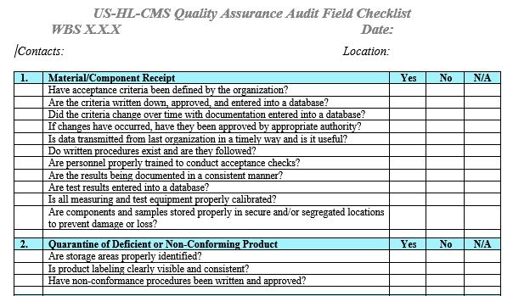
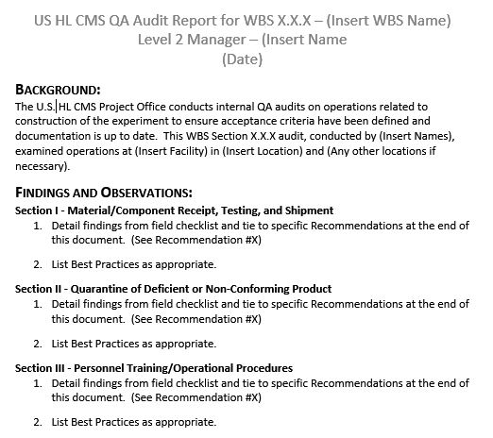
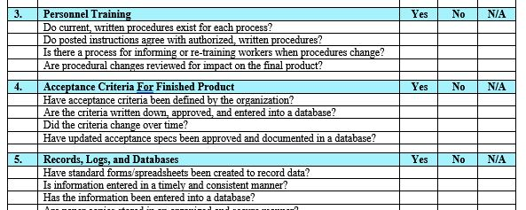
Site Review/Audit Forms
Standardized forms for Site Field Visit Audit Checklists and Reports
30

