Slide 1
Answers to Questions
Vivian O’Dell
DOE CD-1 Director’s Review
March 19, 2019

Slide 2
Q1/3 (combined)
The top of the cost range (183M$) is based AACEI/DOE estimate classes combined with design maturity estimates from the project and is above the DOE guidance (161.5M$). Is there a path for additional cost/scope reductions totaling ~ 20M$ if the risks covered by the 183M$ estimate are realized?
Provide a list of up and down-scopes. Include the estimated value of each one and when they could be implemented.

Slide 3
Descope Options
CMS-doc-13357
3

Slide 4
List of descopes and values

Slide 5
Upscopes
CMS-doc-13357

Slide 6
Upscopes

Slide 7
Q1B
The Monthly report shows a funding profile with 10M$ of OPC starting in 2022. What is this for? Long shutdown 3 doesn’t start until 2024 so it seems offset from when installation and commissioning funding would be needed.
  The funding profile has OPC starting in 2022. This is for the main integration tasks for Tracker in the TIF and for the Endcap Calorimeter in the surface building @ P5. However, this split between OPC/TEC is based on an earlier scenario which has since been refined so that the integration, installation, commissioning tasks are less front loaded.

Slide 8
Q2
The funding type is not mentioned, but it would be good to see what is MIE and what is OPC, etc.

Slide 9
Q4
What is the percent complete now? How much money has the project spent to date?
  At the end of February, the project has spent $11.1M.
  The project is 7.4% complete.
  The information from P6 is consistent, although it lags behind the monthly reporting.

Slide 10
Q5
Can you provide the Schedule Risk Analysis for the overall Project or for each individual Sub-project ? What is the distribution of probability of finishing the project within the ~3.1 years between the last meaningful Project Milestone (Delivery of OT Barrel) and CD-4 ?

Slide 11
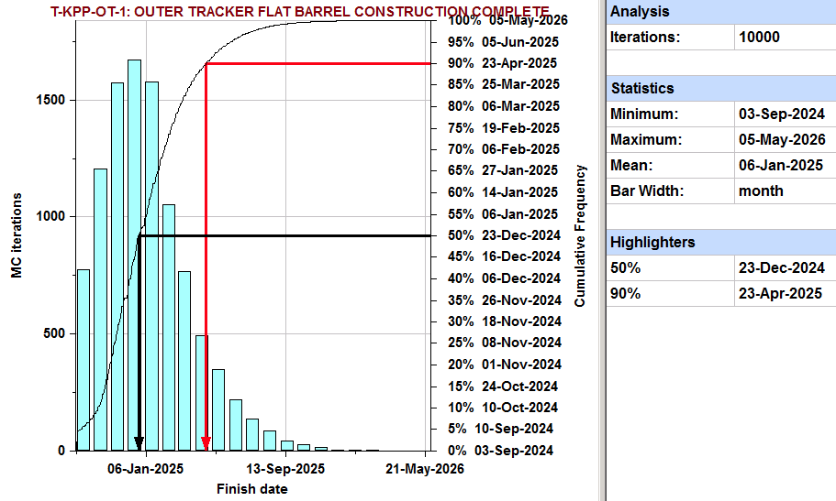
Q5
Latest T-KPP is “Outer Tracker Flat Barrel T-KPP”
  Early finish: 4 Sept 2024
  Late finish: 23 April 2025 (i.e. at 90% C.L. including all risks)
At 90% C.L. the project will finish the ultimate T-KPP more than 2.4 years before CD-4 (30 Sep 2027)
Early finish
(no risks)
90% C.L.
(with risks)
T-KPP-OT-1: OT Flat Barrel construction complete
Schedule has 10.5 months of float to the CMS need-by date
Risks will delay T-KPP by
< 7.6 months (at 90%C.L.)
Integration & commissioning after threshold KPP may offer additional float (5.0 months from T-KPP to OT installation complete)

Slide 12
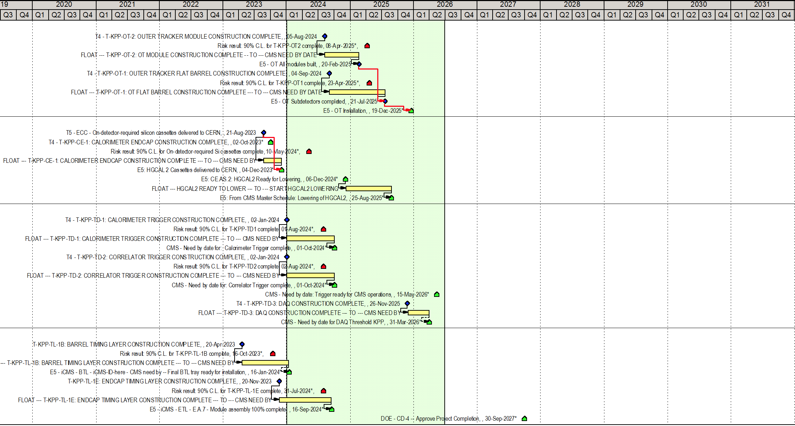
Q5: schedule contingency for each subproject
Legend:
Threshold KPP
(early finish)
Threshold KPP including risk (90% C.L. from MC)
Schedule contingency held by project before iCMS “requests by” date
Note: iCMS also holds additional (shared) schedule contingency
Risk delay < 8.1 months (90% C.L.)
Outer Tracker Modules T-KPP
6.5 months float for modules complete
+ 9.9 more months to OT installation
US project carries schedule contingency to cover delays from risks
iCMS has additional schedule contingency (which US may use, in agreement with iCMS)
KPPs have adequate – but not luxurious – schedule contingency (at 90% C.L.)
For CD-2 we will work to increase schedule contingency further
Risk delay < 7.6 months (90% C.L.)
Outer Tracker Flat Barrel T-KPP
10.5 months float for flat barrel complete
+ 5.0 more months to OT installation
Risk delay < 8.6 months (90% C.L.)
Calorimeter Endcap T-KPP
3.5 months float for cassette delivery
+ 8.6 more months to HGCAL lowering
Long Shutdown 3
Risk delay < 7.0 months (90% C.L.)
Trigger T-KPPs
9.2 months float construction complete
+ 19.4 more months to Trigger operations
Risk delay < 7.0 months (90% C.L.)
DAQ T-KPP
3.9 months float Commodity IT => buy late
Risk delay < 5.8 months (90% C.L.)
Barrel Timing Layer
8.7 months float to CMS need by date
Risk delay < 8.3 months (90% C.L.)
Endcap Timing Layer
9.8 months float to CMS need by date
CD-4
Lucas Taylor (from P6: 15 March 2019)
3.1 years float from last T-KPP to CD-4
(not including commodity DAQ purchase)

Slide 13
Q6
Project is tracking schedule float by subsystem and feels the L2 subsystems are almost independent. Is this true if you include installation and commissioning?
  Integration above ground is independent with the exception of BTL / Tracker integration.
  Integration/installation of the detector below ground is interlinked, following a well defined sequence managed by CMS technical coordination.
  The Objective KPPs represent the U.S. contributions to the international integration, installation, and commissioning effort.

Slide 14
Q7
When does the project plan to implement change control and monthly statusing?
  For the DOE scope, we will begin exercising monthly statusing / change control in Oct, 2019 with a view to having 3-6 months of project EV data by CD-2 in November 2020.

Slide 15
Q8
Are there options for dealing with potential changes in the funding profile (without changing scope)? Are there outstanding contracts that must be funded?
  We do have some options for dealing with potential changes in the funding profile without changing scope. In particular, we can obligate the silicon procurement directly after CD-3a ESAAB approval, which will move the cost profile earlier. There is very little margin to move the project cost profile later without delaying our T_KPPs. We need the majority of our funding by FY23, given current LHC and CMS constraints. At the moment we have about $4M in open commitments which represents funding to University partners.

Slide 16
Q9
Are the profiles that you showed obligations or cost? If cost, does the obligations profile fit in the funding profile?
  Yes, the profile tables were costs. If you advance the major procurements to obligation dates, we still fit comfortably within the current funding profile.

Slide 17
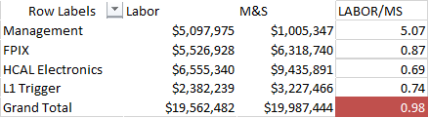
Q10
Total Labor (Costed+Uncosted) appears to be underestimated and significantly lower than historical averages for large detector constructions similar to this Project. Historically we would have expected 2-3$ of FTEs to support 1$ of M&S. Can you provide a justification for your FTEs estimate ?
  Much engineering done for design work off project/internationally, lowers Labor/MS ratio
  In Phase 1, the ratio of labor $ to M&S $ varied depending on the details of the scope, with an average of 1:1.
  The average labor$/M&S$ for Phase 2 is .79
  If you include contributed labor, the ratio is 1.5.

Slide 18
Q11
Provide a list of milestones and how the forecast dates have changed since the June 2018 review
  You will see these in detail in the L2 B/O sessions. The schedule is in rapid development, as we have not yet baselined.
  For the trigger project, while there have been ~ 4 month delays on the R&D plan since last June, this is a combination of vendor delays and additional functionality which will reduce the next design cycle time.
  For the Outer Tracker, the delays are not on the critical path, and the T_KPP schedule has not been impacted.
  For the Endcap Calorimeter, the major delay is in the concentrator ASIC (ECON) which has been delayed, but has been making rapid progress over the last few months, is now adequately resourced, and has a solid design and schedule (you will hear much more about this in the b/o session). For the mixed-cassette prototype, this was originally for a temporary mockup for mechanical & thermal studies, but has now merged into the Major System Prototype effort, and is predicted to be ready this summer.

Slide 19
Q12
We do not understand the overall strategy for CD-3 a&b. Is there a way to consolidate Long Lead Item Procurements in a single CD-3, rather than fragmenting into difference CDs ?
  Yes, we are working on a strategy to do so, which will combine CD-3a / CD-3b into one single CD step. We will have this strategy finalized by the time of CD-1.

Slide 20
Q13
The design maturity for Endcap and DAQ had relatively small increases over the last 9 months. Are they progressing fast enough to be done in time? Is there an overall project design maturity number?
  There is an overall project design maturity number in CMS-doc-13417, which is 37%.
  According to this rubric, 40% is the end of the preliminary design phase which is appropriate for CD-2.
  Up to this point, the rubric has only been evaluated through preliminary design. An evaluation of the “final design” portion of the rubric would indicate significant progress (as for the CE sensors).
Subsystem | Design Maturity
402.2 Outer Tracker | 38%
402.4 Endcap Calorimeter | 38%
402.6 Trigger/DAQ | 34%
402.8 MIP Timing Detector | 33%
Overall design | 37%

Slide 21
Q13
The design maturity for Endcap and DAQ had relatively small increases over the last 9 months. Are they progressing fast enough to be done in time? Is there an overall project design maturity number?
  In the case of the CD-3a scope, for the silicon sensors for the endcap calorimeter, the design maturity went from 38% -> 56% in the last year. The design finalization of the rest of the endcap calorimeter project is expected to advance rapidly during the next twelve months due to the Major System Prototype 1.
  The DAQ can be successfully purchased today and its procurement timing is a cost optimization. There are two interesting milestones between now and 2024 that will inform the procurement choice: (1) the DAQ upgrade for Run 3 during LS2 (early 2021) and (2) the DAQ TDR in 2021. Hence, the design will advance significantly after 2021. Consequently, we expected no advancement in design maturity for 2019. But by the end of 2021, we expect to have significantly advanced the design maturity.

Slide 22
Q14
What are your plans for implementing the constraints for adjusting to the May 2019 international schedule and estimating the impacts on the US-CMS schedule and costs ? How many months do you think are needed to do this work ? Would it be available on a timescale of a CD-1 review in June ?
  Plan is to freeze the U.S. schedule on April 15th for the June CD-1 review. The international schedule has been updated in preparation for the May P2UG, and the U.S. is aligning our schedule with the updates.
  Updating schedule requires
    Updating the milestones for availability of external components
    Analyzing schedule changes and mitigating delays
  This can be done before the CD-1 review
  We expect to have to do this a few more times as we move towards baseline

Slide 23
Q15
Moving toward CD-2 requires that the interfaces with international partners are properly defined. At the current stage it seems that a fairly complete list of interfaces has been identified, however their description is incomplete. What is the plan for reaching a full description of the interfaces, including sharing of engineering documents, and setting in place a process for document approval and monitoring ? How can US-CMS influence this process.

Slide 24
Q15
International CMS recognizes and fully supports formal documentation and approval of interfaces, including all engineering documents.
The process of implementing this has started under the oversight of the international CMS Upgrade Coordinator.
  The standard CERN tool EDMS (Engineering & Equipment Data Management Service) is used, including document approval and monitoring.
  Finalization of documentation usually follows experience with prototyping process.
This documentation is a requirement for the Engineering Design Review (EDR) for each project. The scheduled EDR dates are in most cases within a few months of CD2. For L1 trigger and DAQ, the EDR dates are significantly later than CD2. However, the interfaces with the other projects will already be defined in their EDR.
Regarding approving changes, a formal change control process of proposing, communicating, evaluating and approving changes has been put in place since October 2018 for changes that involve a change of technology, risk, cost or schedule, or may impact other (international) projects than the proponent project.
Smaller changes remain within the responsibility of the international project management, and are reported at the weekly Upgrade Steering Group.

Slide 25
Q16
Provide the full list of ASICs required for the CMS upgrade with DOE involvement such that the objective KPPs can be realised. Please include ASICs that are a responsibility of the US-CMS groups and those that are not, and discuss the development plan and the status.
  We have tabulated the list of ASICs needed for the DOE deliverables here, along with the responsible institution and development plans here:
  https://docs.google.com/spreadsheets/d/1ROm4CbpnrNQBmA9IRil_ci5fUM2keY72aiQrn0XeFBo/edit#gid=0
  We are monitoring closely the ASICs we are not responsible for but are reliant on.

Slide 26
Q17
EndCap Calorimeter: Critical path for HGCal goes through the ECON ASIC development at this time, with only 3.5 months float to need-by-date. This part of the project is at least 1 year late based on the milestones in the Monthly report forecasts. Given this history, what is the project plan to keep this section of the project from slipping more and threatening the need-by-date? What is to prevent additional delays? How will delays impact the rest of the schedule?
  This is a topic that will be covered in detail in the Endcap Calorimeter breakout session. The current ECON ASIC plan is informed by a more complete design of the ASIC, and both project and Fermilab management is monitoring closely the progress.

Slide 27
MTD - Question on Uncosted Labor
8.7 Uncosted labor in MTD:
  It was claimed that the large amount of MTD uncosted labor is only there for meeting objective and not for KPP. Can you give a breakdown of the uncosted labor that is only there for objective and if removed would have no impact at all on KPP? What FTE’s in what institutes and what years?
  There was a misunderstanding:
    We have WBS areas which complement our work towards our tKPPs but are not essential to completing our deliverables
      BTL LYSO, ETL LGADs, BTL and ETL System Testing
    These are not strictly associated with oKPPs
    These areas are included in our WBS and labor estimates to reflect that we have participation in these areas but are mostly pd/students by design
      Participation in BTL LYSO QC for training of 1-2 pd/students from UVa, Caltech
      Pd/student participation in LGAD sensor R&D in FY19,20 at Kansas
      System Testing for both BTL and ETL, driven by pd and students

Slide 28
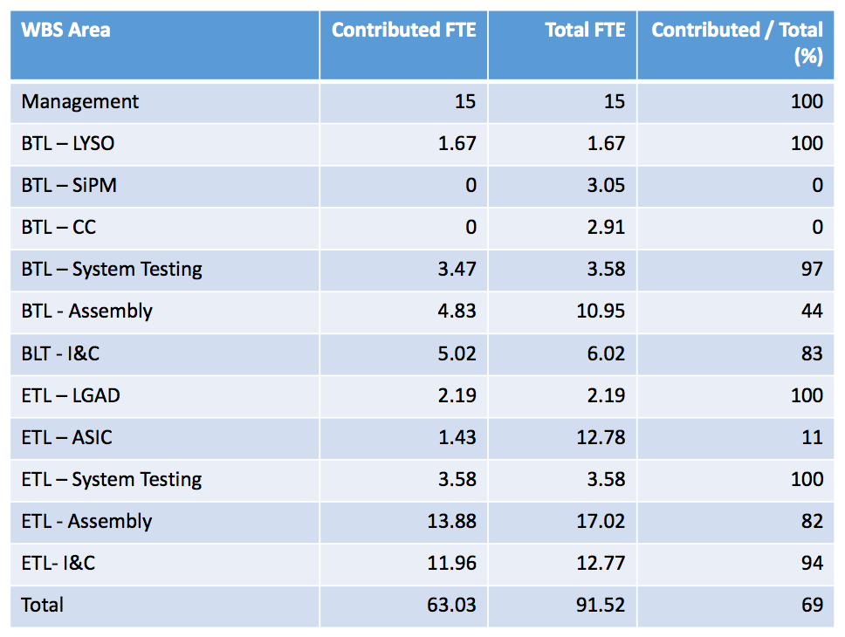
MTD - Question on Uncosted Labor
Labor summary down to L4:
oKPP activities are strictly BTL and ETL I&C
See the ratio for LYSO, LGADs, System Testing – consistent with the model described on the previous page
The ETL Assembly task stands out with a large amount of contributed labor.
Some of this is due to the physicist labor that is needed for the R&D and prototyping
But we also identified an error in our estimate -- this contributed labor number includes senior faculty acting in a supervisory role over the assembly team at UNL, in both the prototyping and production phases, which were over estimated in the FTE appropriate for that supervision.
all uncosted
all uncosted by design
~all uncosted by design
oKPP
all uncosted by design
all uncosted by design
oKPP

Slide 29
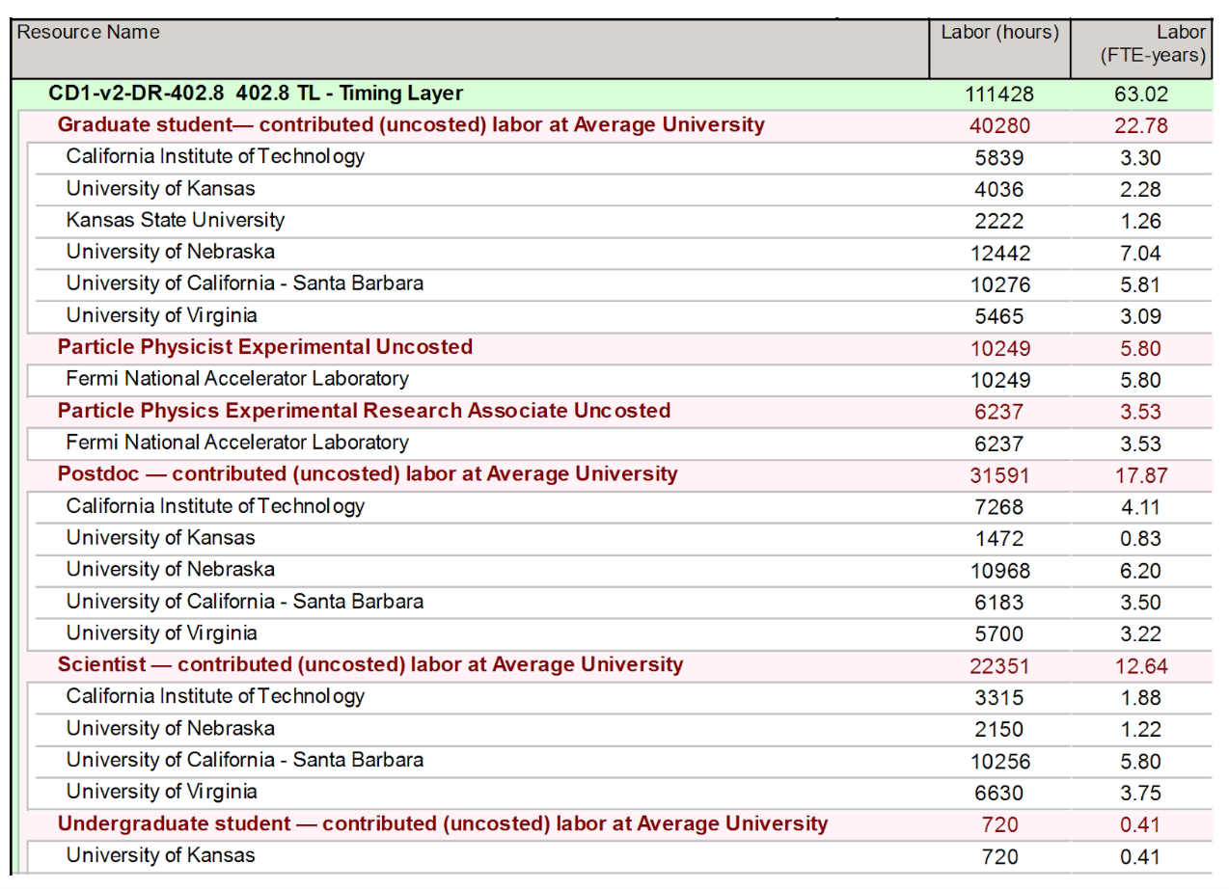
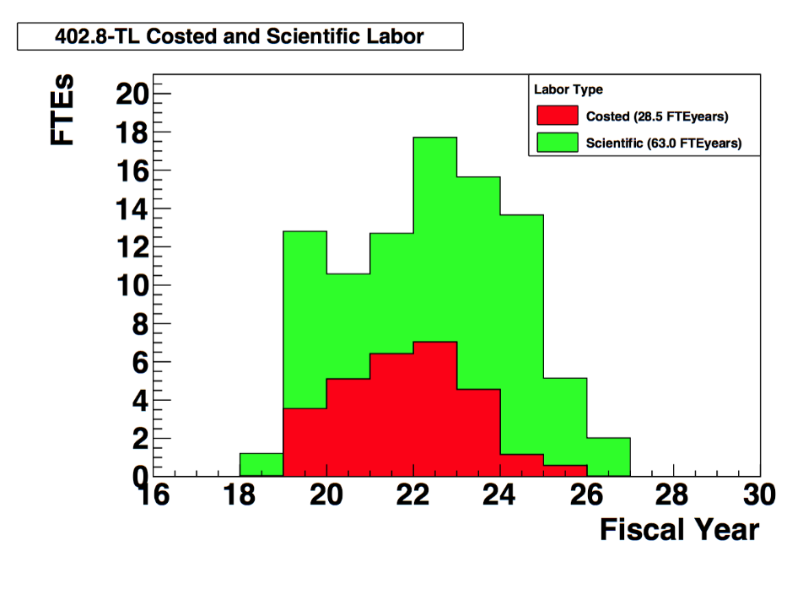
MTD - Question on Uncosted Labor
We do not have the plot of the time profile of uncosted labor per institute at our fingertips but we can make it.
Instead here is the summary of the uncosted labor for each institute integrated over the project duration, and the overall labor profile costed and uncosted

Slide 31
Trigger Milestones
3/18) APd1 conceptual design complete: Milestone completed (3/18)
(7/18) APd1 full design complete: Milestone completed (10/18)
(8/18) Emulated e/g performance: Milestone completed (8/18)
(10/18) APd1 initial software release: Milestone completed (02/19)
(10/18) First fully assembled APd1 board: Milestone completed (02/19)
(10/18) Emulated perf. & eff. for Jets/MET/HT: Milestone completed (10/18)
We note that we are about 4 months behind on the initial prototype delivery due to advancing some features of the second prototype design and vendor delays. We have a credible schedule to catch up by the end of 2019, which was presented in the plenary slides.

Slide 32
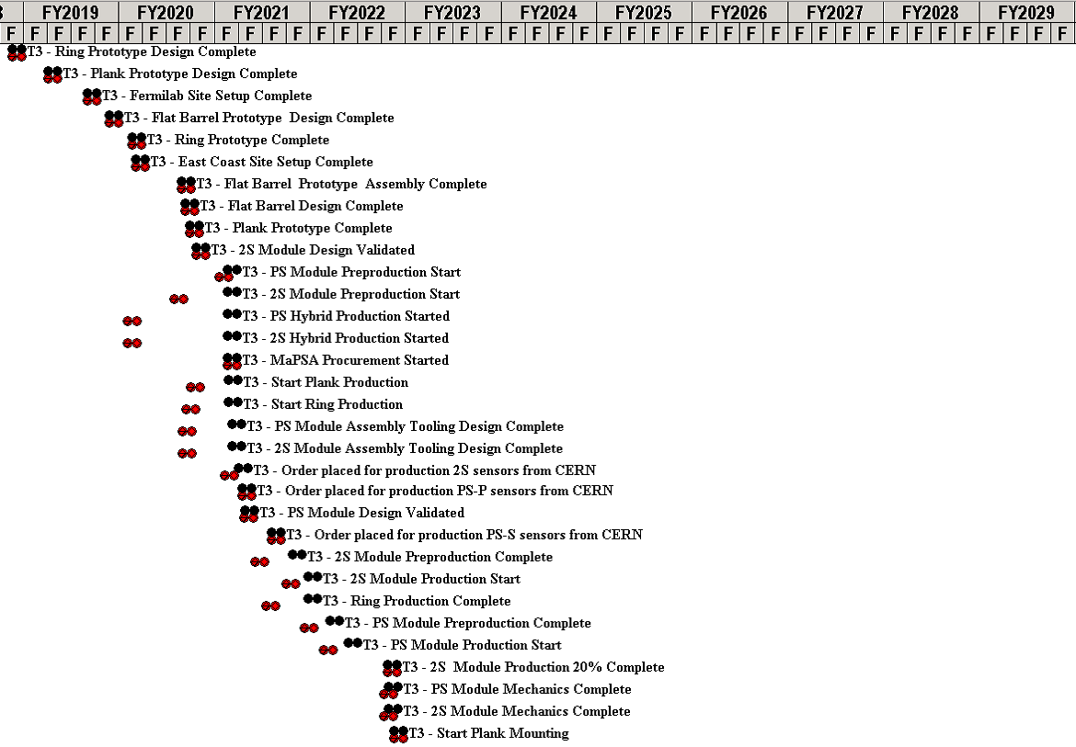
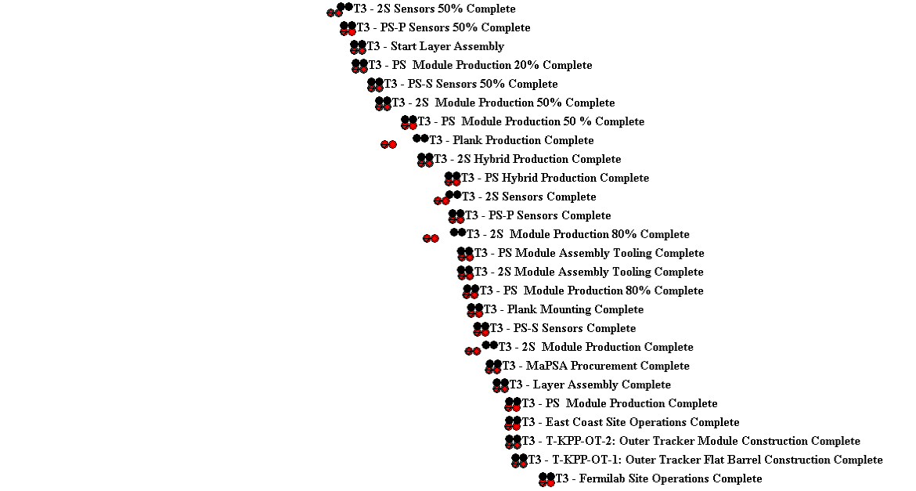
Outer Tracker Milestones
Only a subset of P6 milestones have been included in reporting yet as we have not baselined
On Right, how the current working schedule milestones have changed between June 2018 IPR and now for the full project
Activity | June 2018 IPR | Now | Δ (wd) | Comment
Jigs and Fixtures | 30-Sep-19 | 30-Mar-20 | 129 | Added support in FY20
Plank and Ring Production | 27-Apr-20 | 17-Sep-20 | 100 | CD-3 moved 1 year
Hybrid Delivery | 03-Sep-19 | 17-Sep-20 | 262 | CD-3 moved 1 year
2S preproduction | 27-Feb-20 | 17-Sep-20 | 142 | CD-3 moved 1 year

