Slide 1
Introduction to the US/Japan Collaboration
DEVELOPMENTS IN SLOW EXTRACTION FOR HIGHER INTENSITY BEAMS
Vladimir Nagaslaev (FNAL)
14 January, 2019

Slide 2
This Collaboration is part of the US/Japan S&T cooperation program.
US Collaborations are solicited through the DOE NLAs since 2017
Total annual US funding around $2M
Proposals expected to:
Enhance experiments currently supported by the HEP program or technology development.
Seed funding requests for new ideas to incubate and develop new accelerator and detector systems for application in this time scale will also be considered.
The research areas supported by this program include:
Research and development (R&D) to enhance the physics yield of existing or future HEP experiments
Development of accelerator technology
Development of detectors for high energy physics experiments.
Workshops, conferences and/or travel support to incubate and develop new accelerator, detector and experiment concepts.

Slide 3
DEVELOPMENTS IN SLOW EXTRACTION FOR HIGHER INTENSITY BEAMS
Collaborators:
Brookhaven (2019)
Fermilab
J/PARC
Started in FY2014
Funded in FY2017

Slide 4
Fermilab
Ext. Beamlines
Proton Source
Muon Campus
Recycler
Main Injector

Slide 5
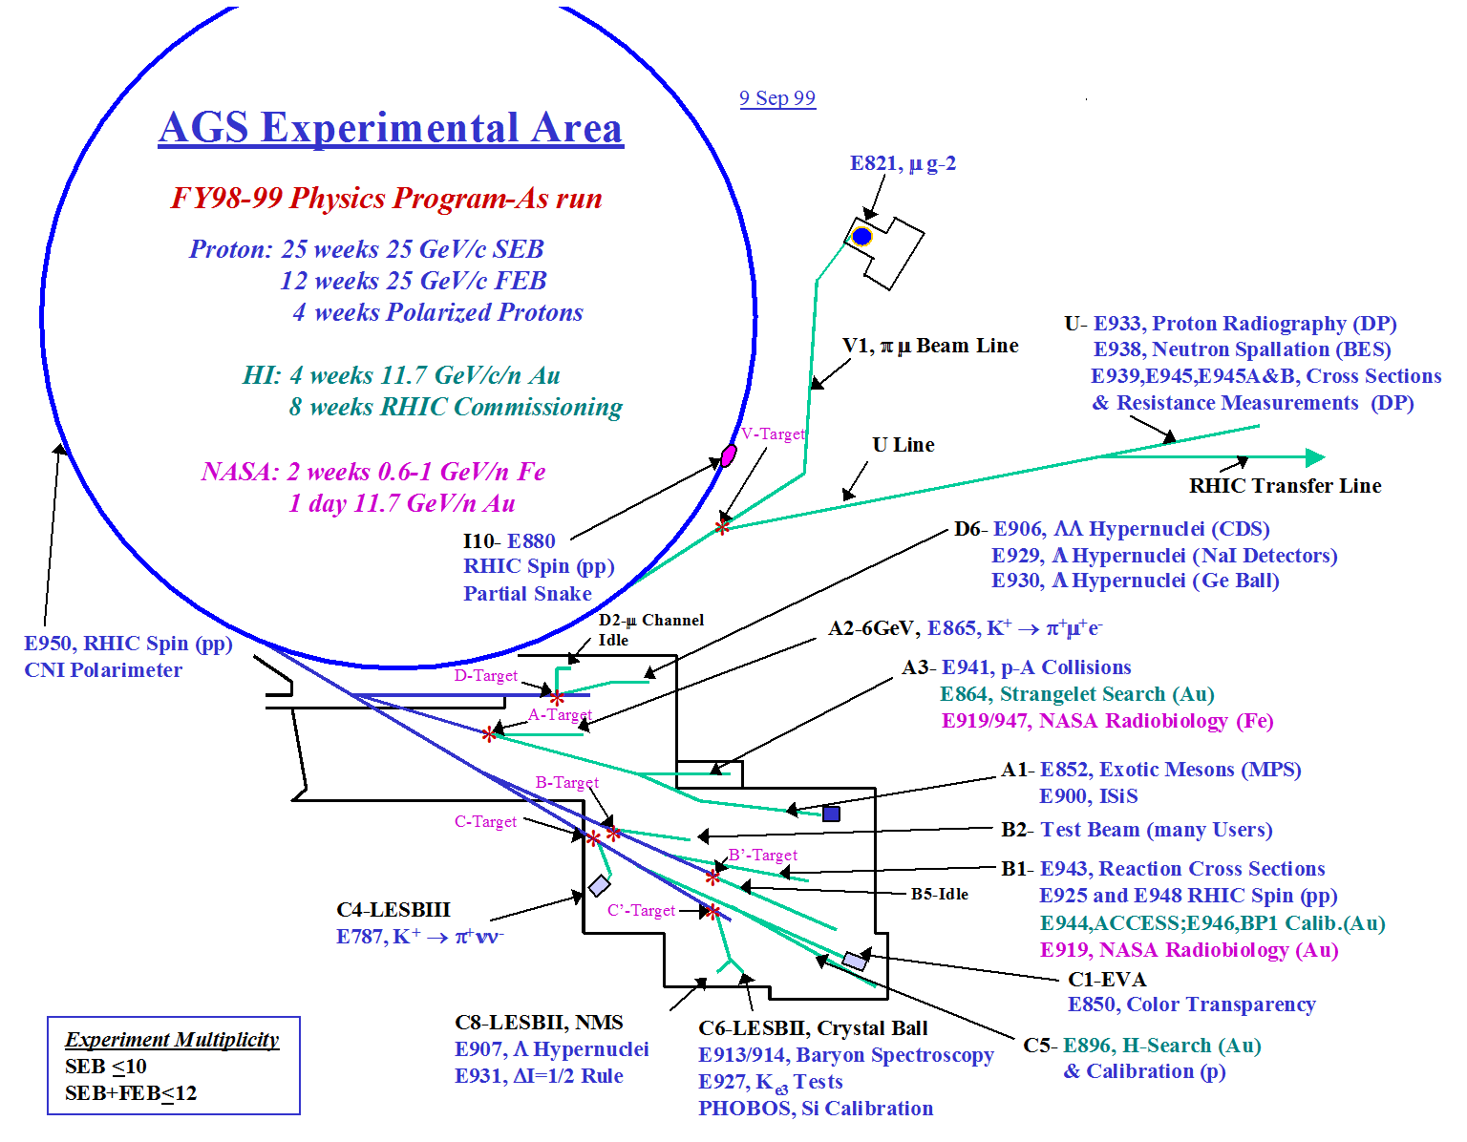
Brookhaven
(1968 - until 2002)

Slide 6
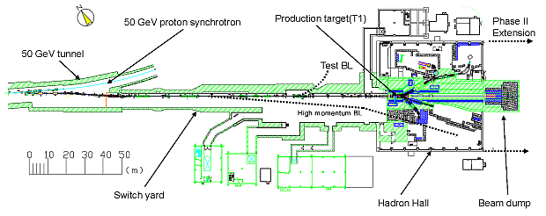
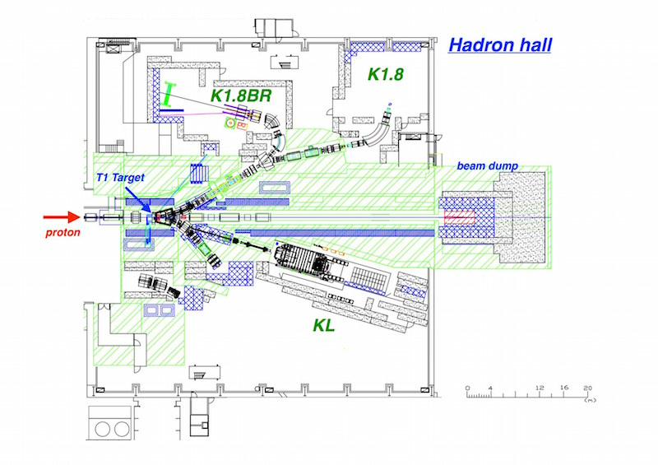
J/PARC Hadron Experimental Facility

Slide 7
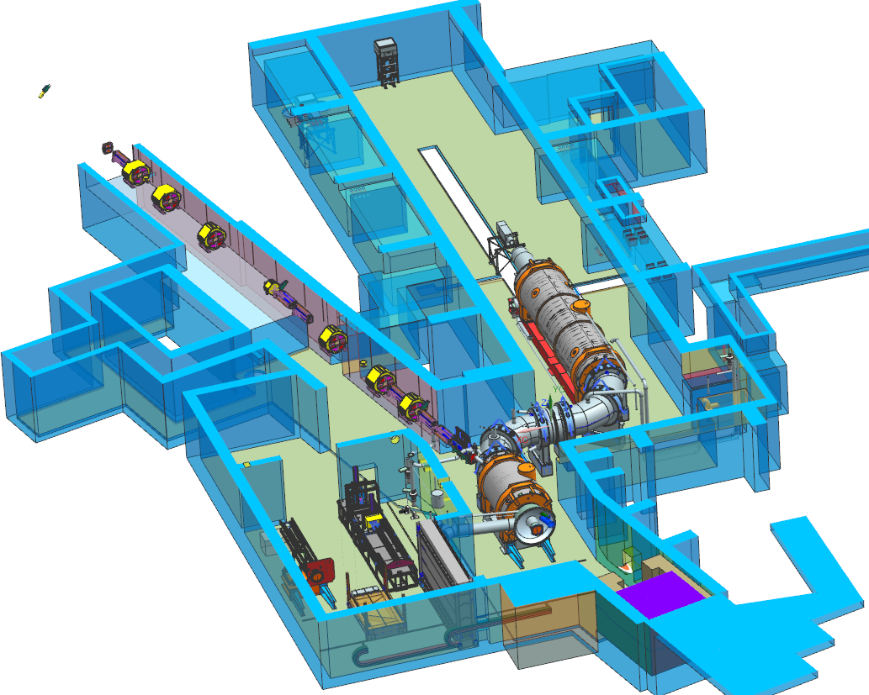
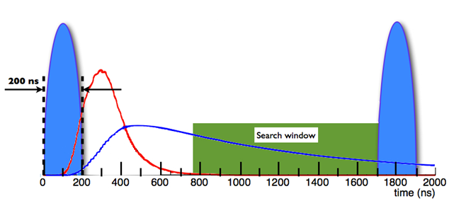
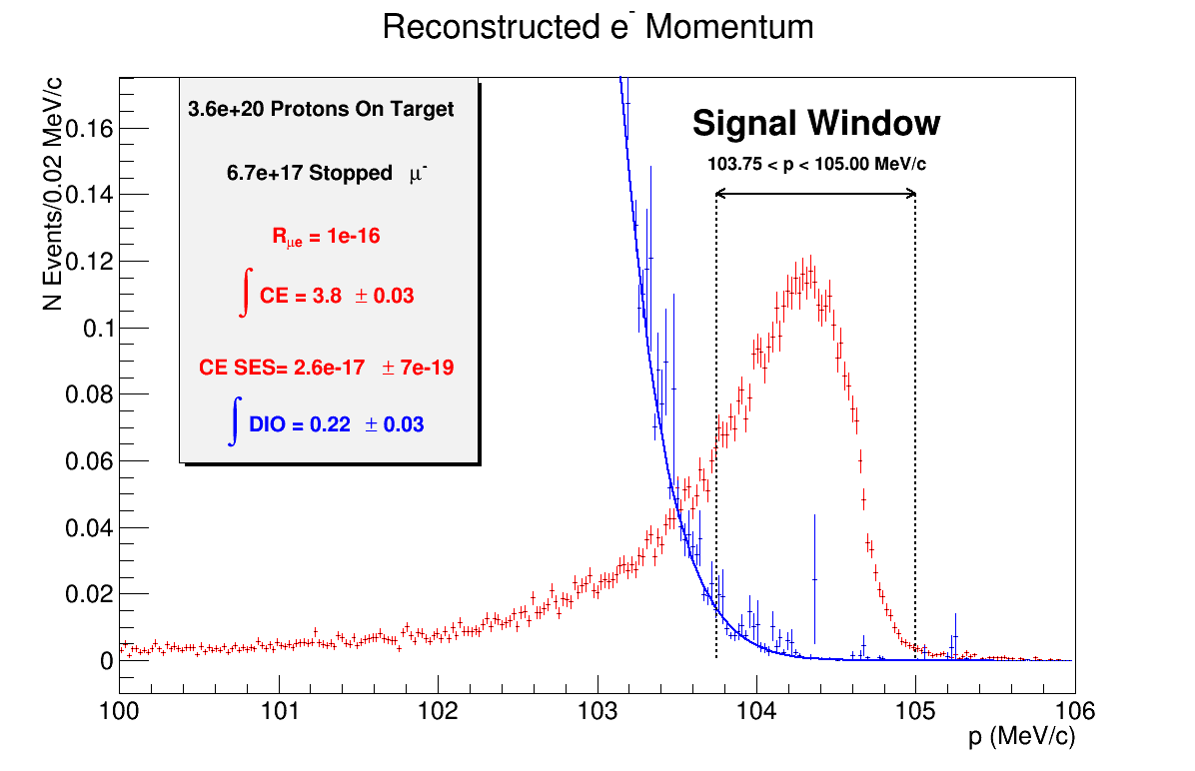
Mu2e Experiment at Fermilab
Mu2e proposes to measure the ratio of the rate of the neutrinoless, coherent conversion of muons into electrons in the field of a nucleus, relative to the rate of ordinary muon capture on the nucleus:
Mu2e TDR, arXiv:1501.05241
Beam Flash
Stopped μ⁻
Signal
Single event sensitivity ~ 3*10⁻¹⁷
Improved sensitivity by ~4 orders of magnitude
Positive result = Evidence of new physics

Slide 8
DEVELOPMENTS IN SLOW EXTRACTION FOR HIGHER INTENSITY BEAMS
Initially focused on viability of SX to higher power beam:
Radiation hard hardware:
Radiation hard septum HV feedthrough
Minimize exposure (geometry)
Reduce losses
use of a diffuser
use of new materials
use of complex multipole fields

Slide 9
DEVELOPMENTS IN SLOW EXTRACTION FOR HIGHER INTENSITY BEAMS
We are now extending the scope of collaboration R&D:
Addition of spill quality in the scope
New approaches to the feedback regulation
Direct monitoring of magnet ripples and feedforward regulation
Use of Machine Learning in the spill regulation
Many great ideas are coming from other areas
Advances in one area may trigger big progress in other
Looking forward for exploring new ideas!

