Slide 1
FNAL SE Overview and plans for Mu2e
Vladimir Nagaslaev
US/Japan Collaboration Meeting, SLAC
14 January, 2018

Slide 2
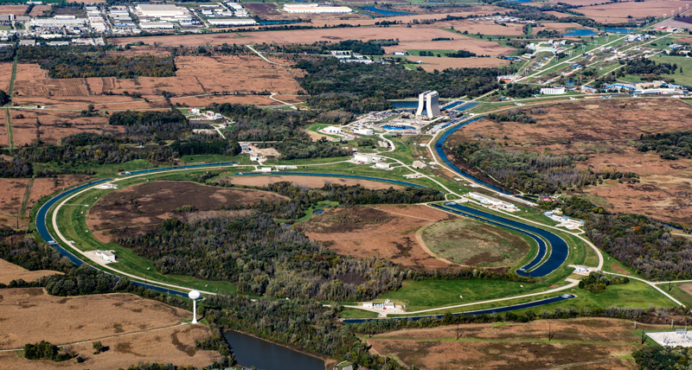
Beam Facilities at Fermilab
Ext. Beamlines
Proton Source
Muon Campus
Recycler
Main Injector

Slide 3
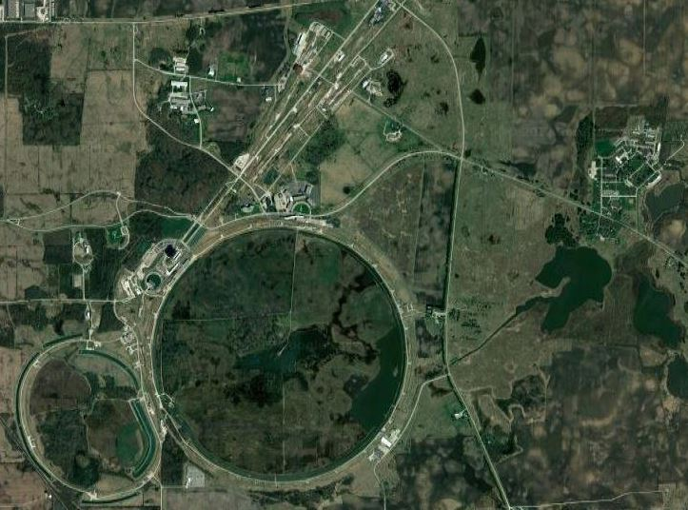
Main Injector Slow Extraction Program
1
2
The Fermilab Main Injector :
120GeV/c
53MHz RF structure
588 RF number
486 bunches @ 2e10 ppb
4 second slow spill
3
Three main user areas for slow spill beam:
1 – Mtest (Detector development)
2 – Mcenter (Detector development)
3 – Neutrino/Muon Hall (SeaQuest/Drell-Yan experiment)

Slide 4
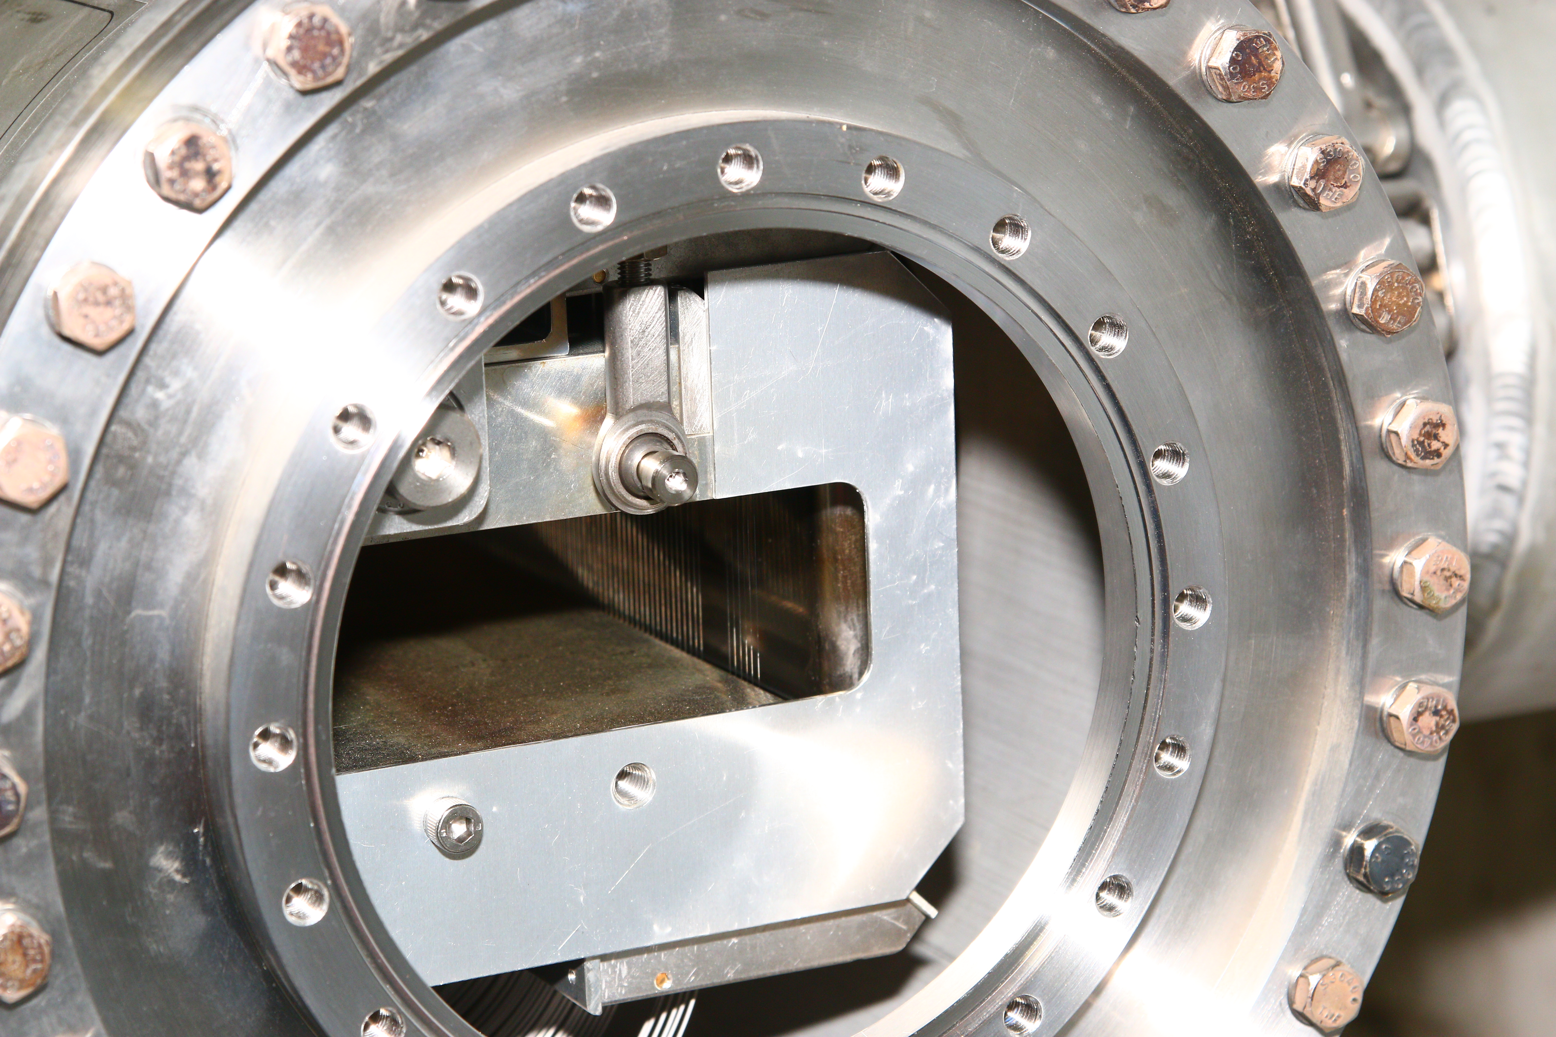
Main Injector Slow Extraction Program
Particle extraction occurs through two 3 meter electrostatic septum
Each septum uses 0.1mm Tungsten (75%) Rhenium (25%) wires to isolate circulating protons from the high voltage extraction field region of the septa.
We have experimented with 0.05mm wire septa. Extraction losses were reduced as expected but the wires experienced a high failure rate.
14mm
Extraction
Gap (14mm)
Field Free
Region
100 Kvolt
cathode
Wire plain

Slide 5
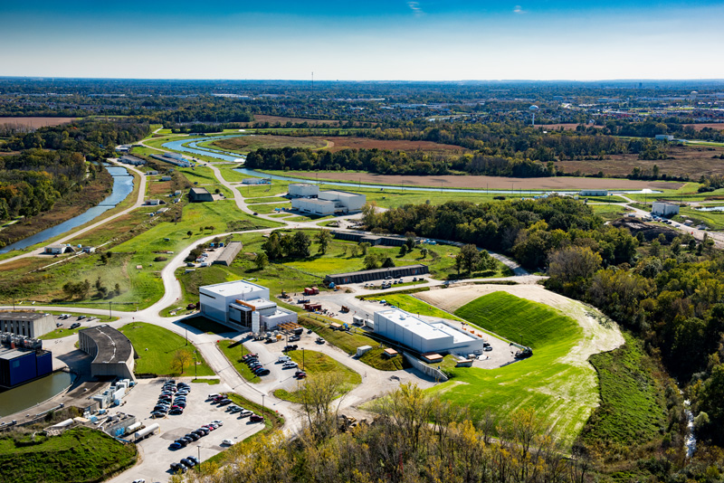
Muon Campus
Recycler/Main Injector
Delivery Ring
G-2
Booster
Mu2e

Slide 6
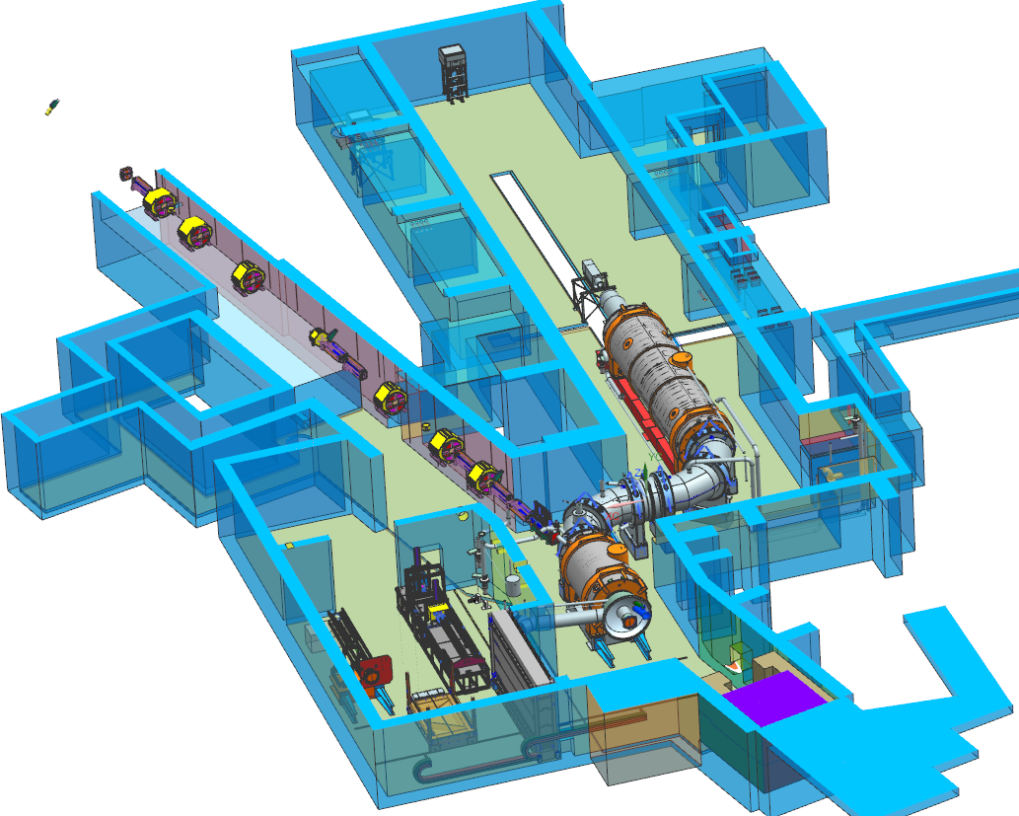
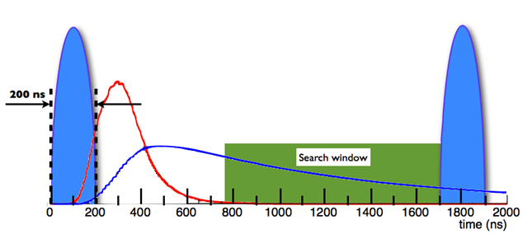
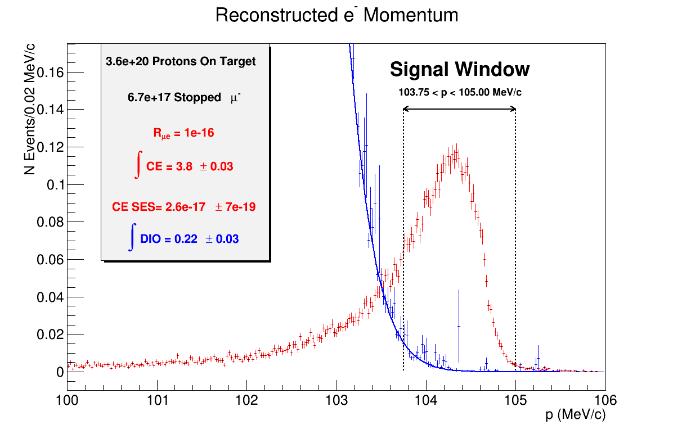
Mu2e Experiment
Mu2e proposes to measure the ratio of the rate of the neutrinoless, coherent conversion of muons into electrons in the field of a nucleus, relative to the rate of ordinary muon capture on the nucleus:
Mu2e TDR, arXiv:1501.05241
Beam Flash
Stopped μ⁻
Signal
Single event sensitivity ~ 3*10⁻¹⁷
Improved sensitivity by ~4 orders of magnitude
Positive result = Evidence of new physics

Slide 7
Muon Campus Slow Extraction Program
Mu2e Beam specs
Pulsed beam structure period | 1.69μsec
Intensity per spill | 1e12p
Average beam power | 8kW
#spills in 1.4 sec MI cycle | 8
Duty factor (time) | 25%
Spill length | 43ms/spill + 5ms reset
Efficiency | >98%
Spill uniformity | <±50%
Uniformity Duty Factor | 93%

Slide 8
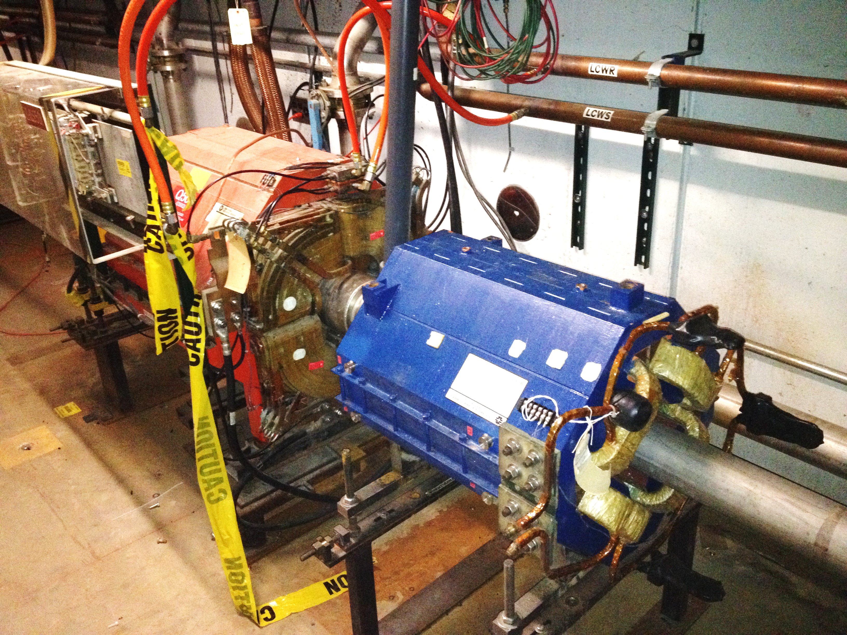
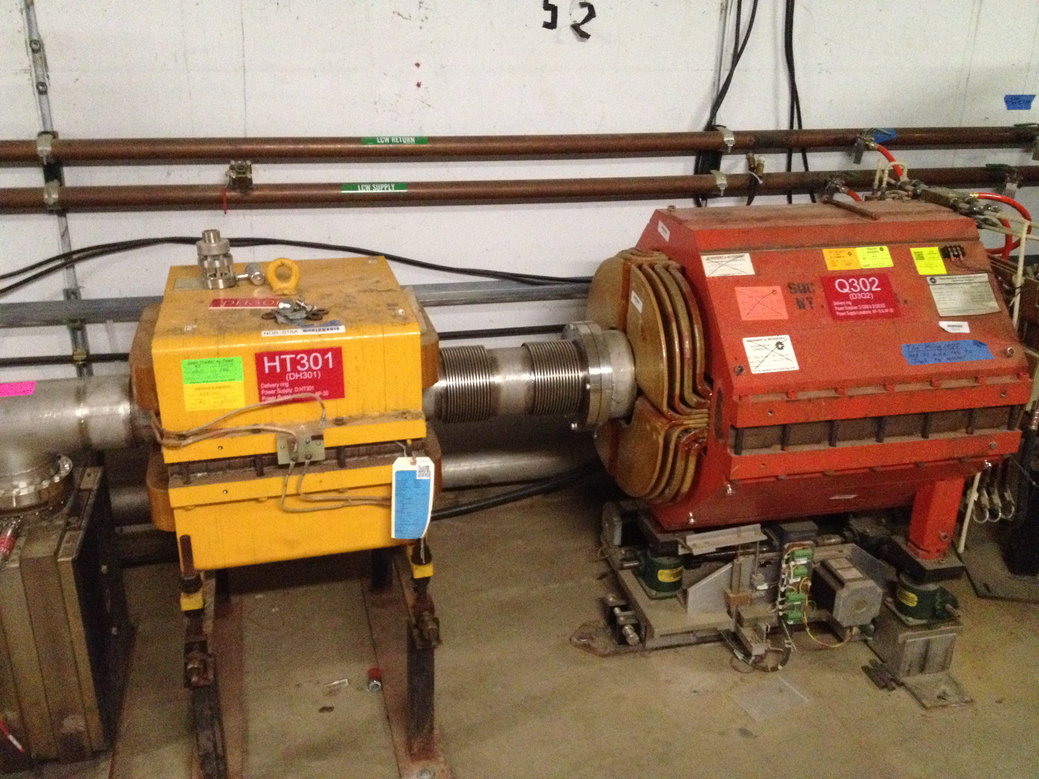
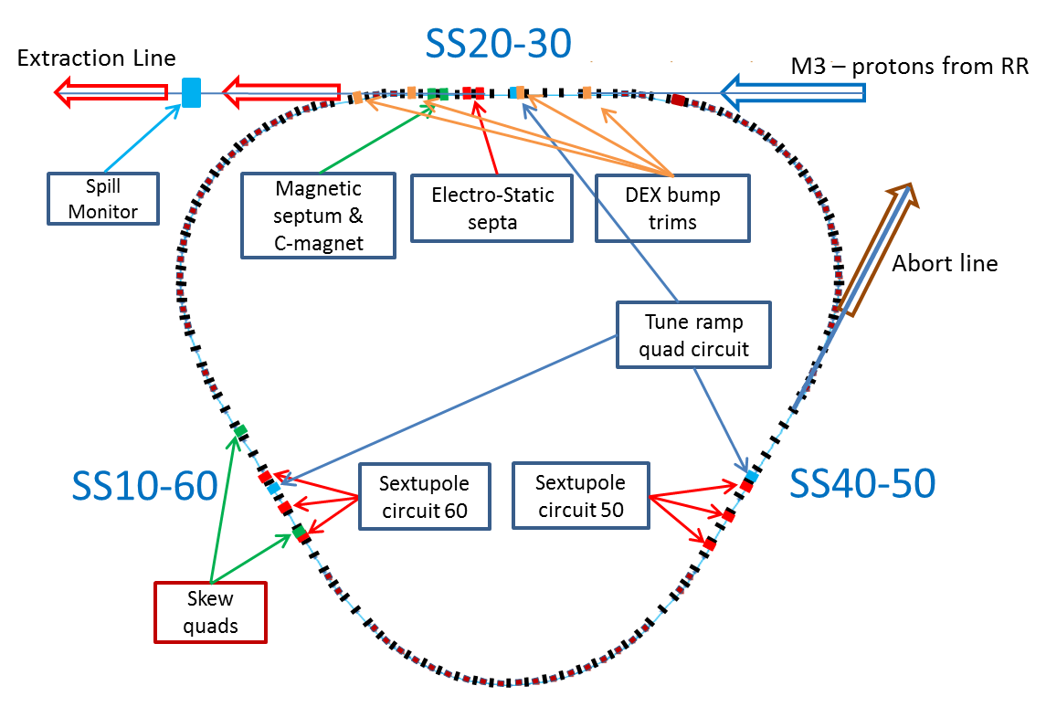
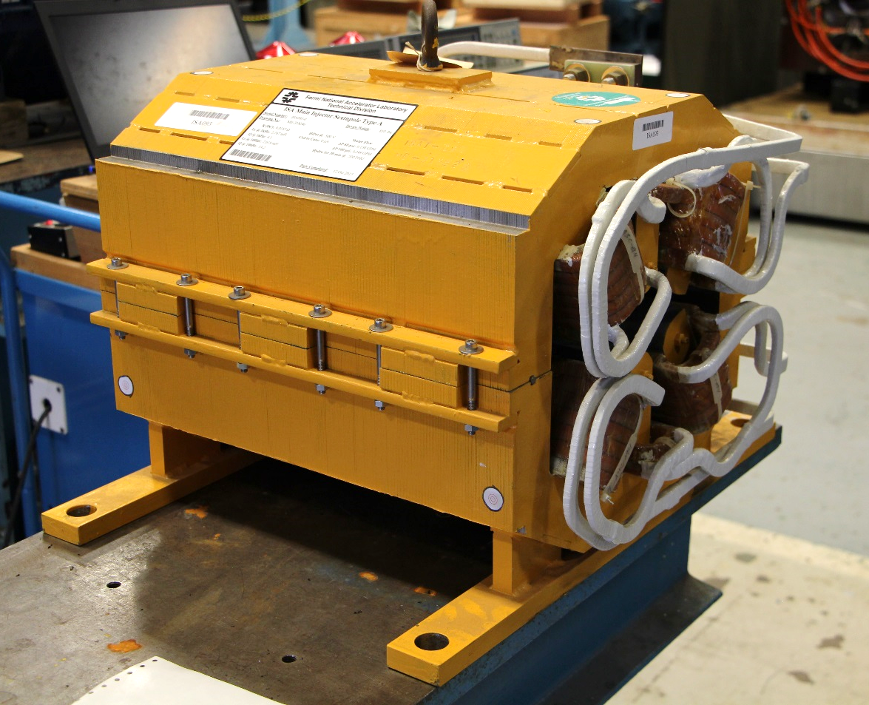
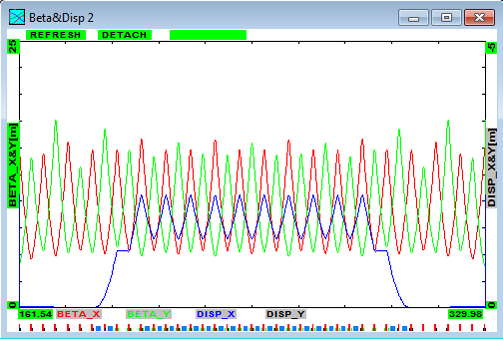
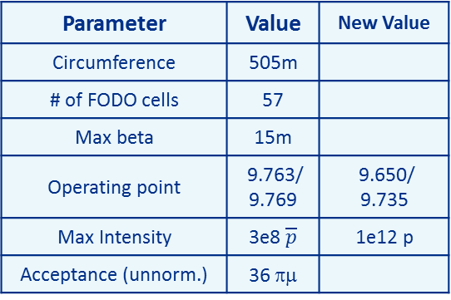
Legacy Debuncher Ring (aka Debuncher)
Installed
Installed
Parameter | Value | New Value
Circumference | 505m
# of FODO cells | 57
Max beta | 15m
Operating point | 9.763/ 9.769 | 9.650/ 9.735
Max Intensity | 3e8 $\overline{p}$ | 1e12 p
Acceptance (unnorm.) | 36 πμ
Built
  Strong focusing, space constraints
  Max beta = 15m
  Machine acceptance = 36 π-mm-mr
  Light enclosure shielding
  Vacuum > 1e-8 Torr
Lattice functions in 1/3 of the Debuncher
(original design)

Slide 9
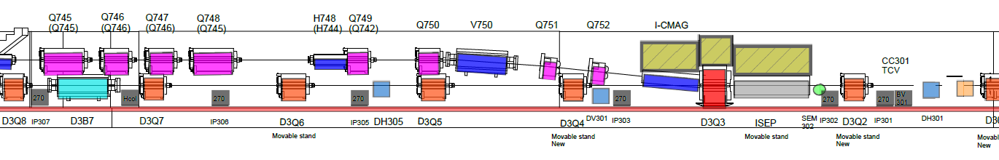
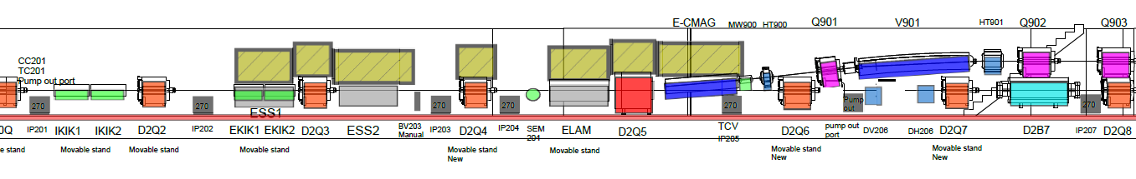
Mu2e SE: Extraction Region SS30-20
Elevation view
SS-30
ESS1
ESS2
SS-20
Space constrained both US and DS – very tight
Conflicts with the g-2 EKIK
No good space to place a collimator
Need local in-tunnel shielding

Slide 10
Electrostatic Septum: Geometry
Elevation view
1.75m
1.25m
MS2
Q205
Q204
Q203
Q202
MS1
ESS2
ESS1
2mR total kick
L1<L2
Two modules – “interchangeable”
Diffuser in ESS1
Small phase advance to MS1

Slide 11
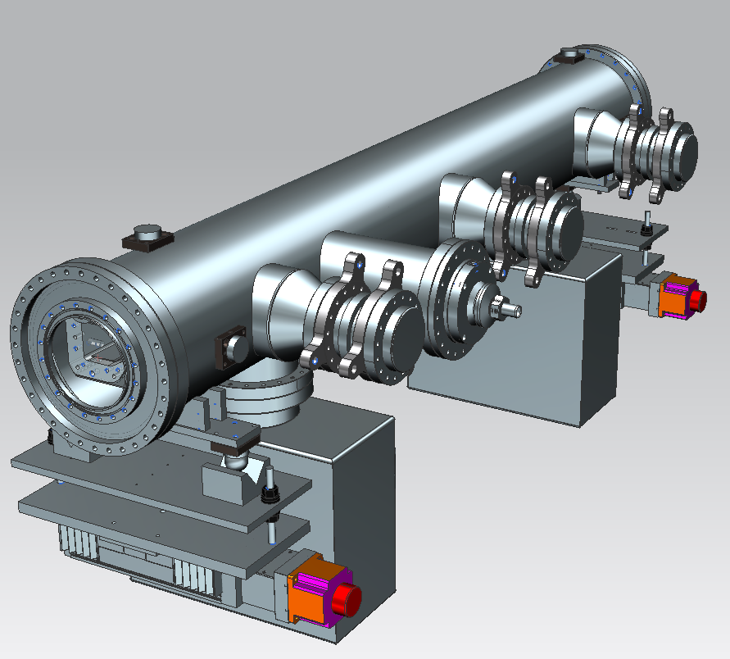
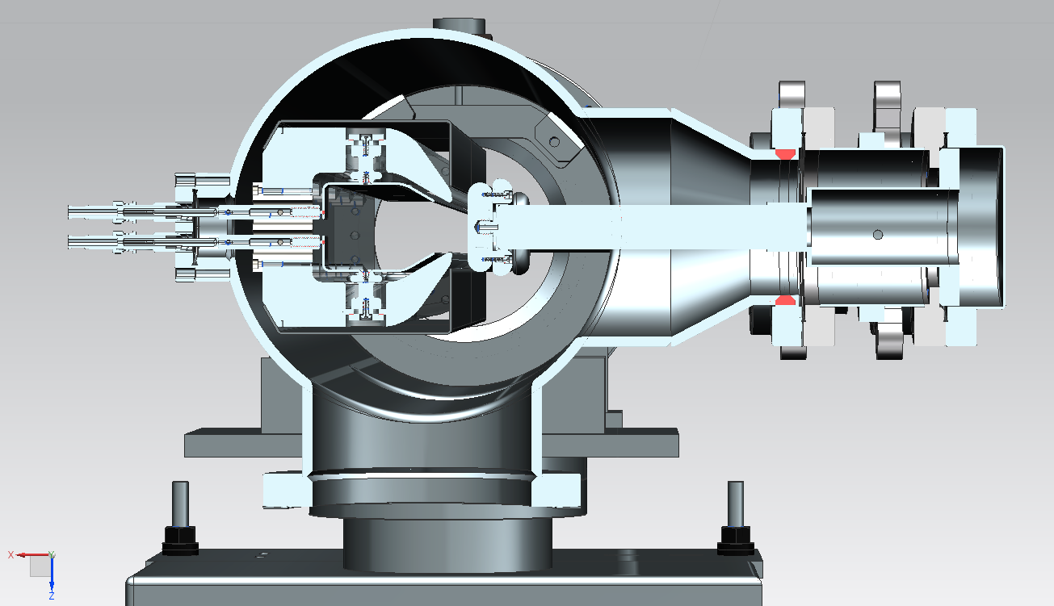
Electrostatic Septum: Technical Specs
Production of the Full Scale prototype in progress
Infrastructure is in place:
    Tools
    Clean room
    HV testing cave
    Transportation cart, foil cleaning, measurement station, assembly fixtures. Etc.
Details in Matt’s presentation tomorrow

Slide 12
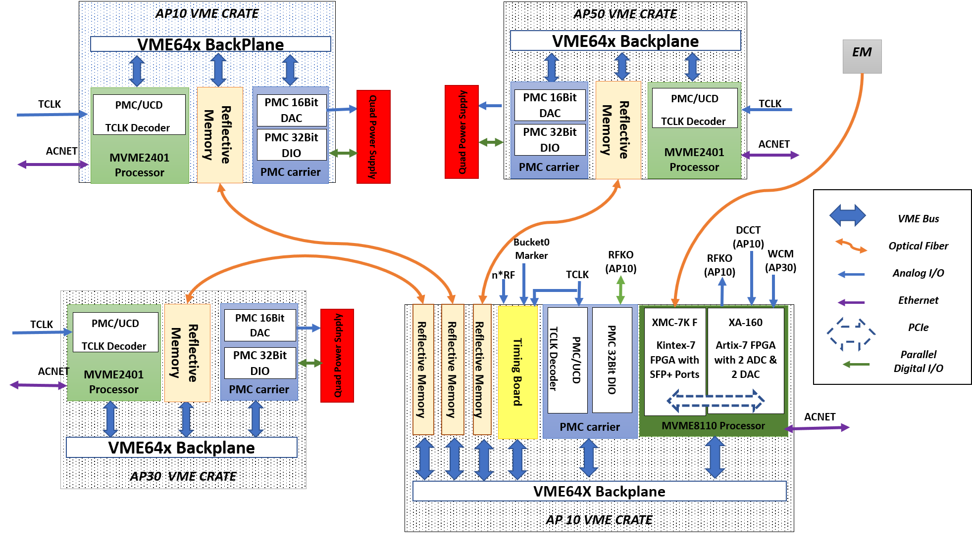
Spill Regulation system: started implementation
Completed the Construction Readiness Review
Board testing began
Details in Aisha’s presentation later today

Slide 13
Schedule
G-2 run ends mid FY2020
Commissioning of the beam line
with single turn extraction after 2020 shutdown
Remove the EKIK and install the ESS,
start SE commissioning beg FY2021
Operations taking over mid FY2021

