Slide 1
Spill Regulation System (SRS)
Spill Regulation System (SRS)
P. Prieto and A. Ibrahim
Resonant Extraction System Electronics CRR-III
15 October 2018
Notes:
10:00am on the Conjectorium meeting room (WH3E)
The web site for this review can be found here:
http://mu2e.fnal.gov/public/project/reviews/ACCCRR/#RESCRR3

Slide 2
SRS Overview
The SRS’s objective is to maintain the intensity uniformity of a stream of ~25K pulses as 1E12 protons are extracted to the target at the Delivery Ring (DR) revolution frequency of 590.08kHz over a 43msec spill period.
The SRS regulates extraction through 2 primary elements:
  a family of three zero-harmonic quadrupoles (tune ramp quads)
  a RF Knock-Out (RFKO) system using a power amplifier and a stripline kicker.
Regulation is implemented through 2 simultaneous feedback loops. Each loop controls one of the regulation elements.
The SRS will use inputs from the DR DC Current Transformer (DCCT), Wall Current Monitor (WCM), and the Extinction Monitor (EM).

Slide 3
SRS Timing
It is critical to coordinate the SRS’ processes within the machine cycle and within each spill interval. To achieve this:
  A board, developed at Fermilab for the BPM system, will generate ADC and DAC clocks, that are derived from the 18.86 MHz clock from the Muon LLRF system.
    Any derived clocks will be phase-locked to the LLRF and will reset anytime the LLRF turns off during RF manipulations.
  This timing board will also count the Muon turn marker, synchronized to bucket0, to keep track of the number of turns during extraction.
  TCLK and Beam Sync (BS) events will be decoded by the PMC-UCD card provided by Controls.
    This allows the timing board to generate appropriate interrupts
    This synchronizes all SRS components throughout the timeline.

Slide 4
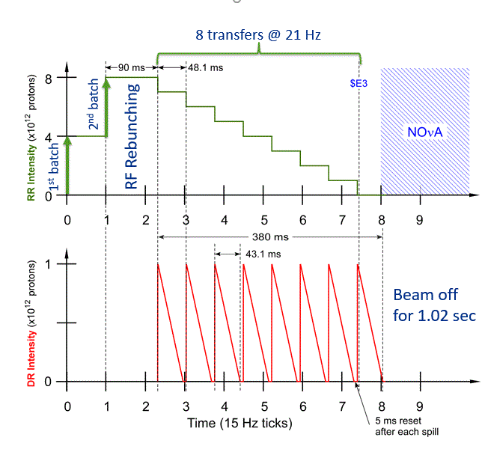
Mu2E Part of Timeline
During the Mu2e part of the cycle, 2 proton batches are sent to the Recycler from the Booster.
After the 2nd batch is injected, the beam is rebunched with 2.5 MHz RF (90 ms).
Each of the resulting 8 bunches is transferred from the RR to the DR.
Each bunch is slow spilled to the Mu2e proton target.
Between each spill, there is a 5 msec reset period in which there is no beam.
After the 8th spill, beam is “off” for 1.02 sec.

Slide 5
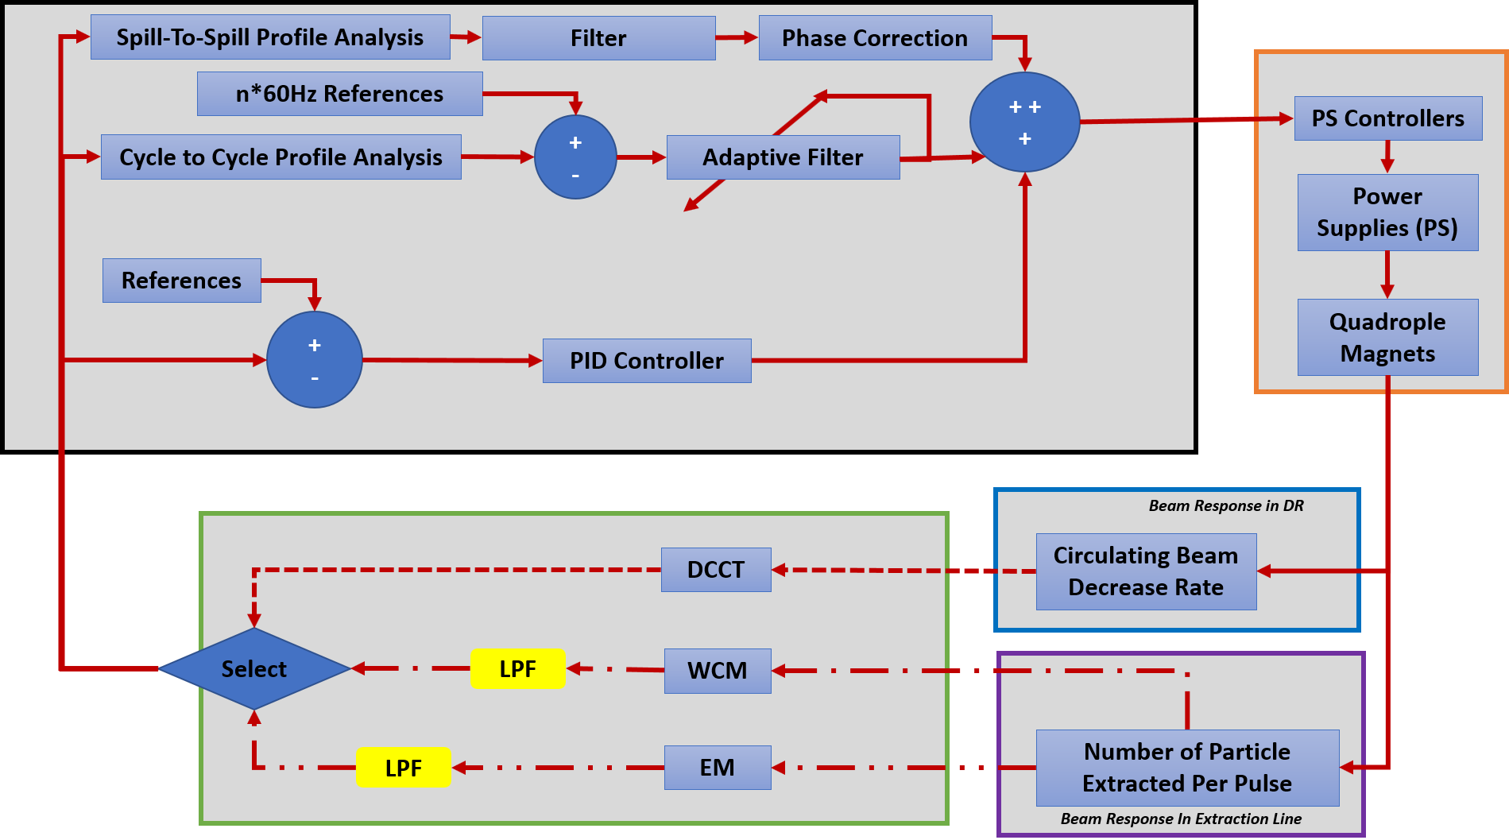
Tune Quad Control Loop
The primary input to this feedback loop is shown in the green. There are 3 possible inputs: DR DC Current Transformer (DCCT), the Wall Current Monitor (WCM) and the Extinction Monitor (EM). They can be used individually or in combination with each other.
The processing within feedback loop is shown in the black box. It consists of 3 main elements: PID controller, an adaptive filter to cancel 60Hz harmonics within the cycle, and a spill-to-spill filter to be applied with phase correction.
It regulates the reference to the tune ramp quads’ controllers, depicted in the orange block. This reference determines the average shape of the beam intensity profile during the spill.

Slide 6
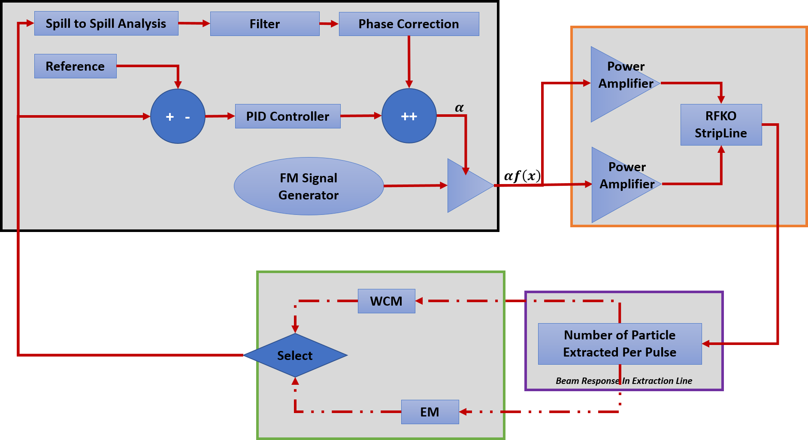
RFKO Control Loop
The primary input to this feedback loop is shown in the green. There are 2 possible inputs: the Wall Current Monitor (WCM) and the Extinction Monitor (EM). Although the WCM will be the source used during commissioning, they can be used individually or in combination with each other.
The processing within feedback loop is shown in the black box. It consists of 2 main elements: PID controller and a spill-to-spill filter to be applied with phase correction.
The RFKO is represented by the orange block. The SRS will generate an FM excitation signal, which will track the betratron frequency based information provided by the Tune Quad Loop. The RFKO Control loop will regulate the amplitude of the excitation signal.

Slide 7
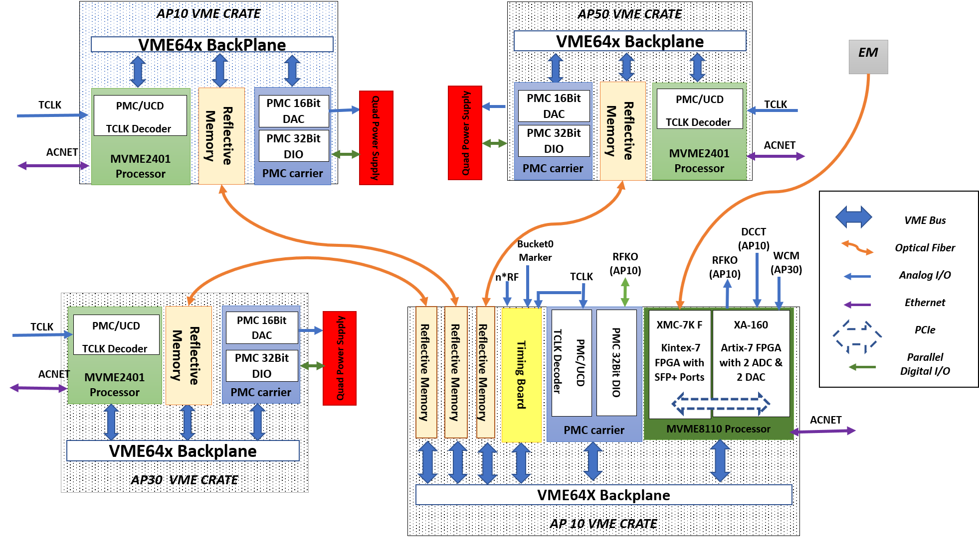
SRS Architecture
The SRS is composed of main VME node and 3 remote VME nodes.
The main node is instrumented at AP10. The main node is the work engine of the SRS.
The 3 remotes nodes will be at AP10, AP30, and AP50. These serve as the front ends to the tune quad power supply (PS) controllers.

Slide 8
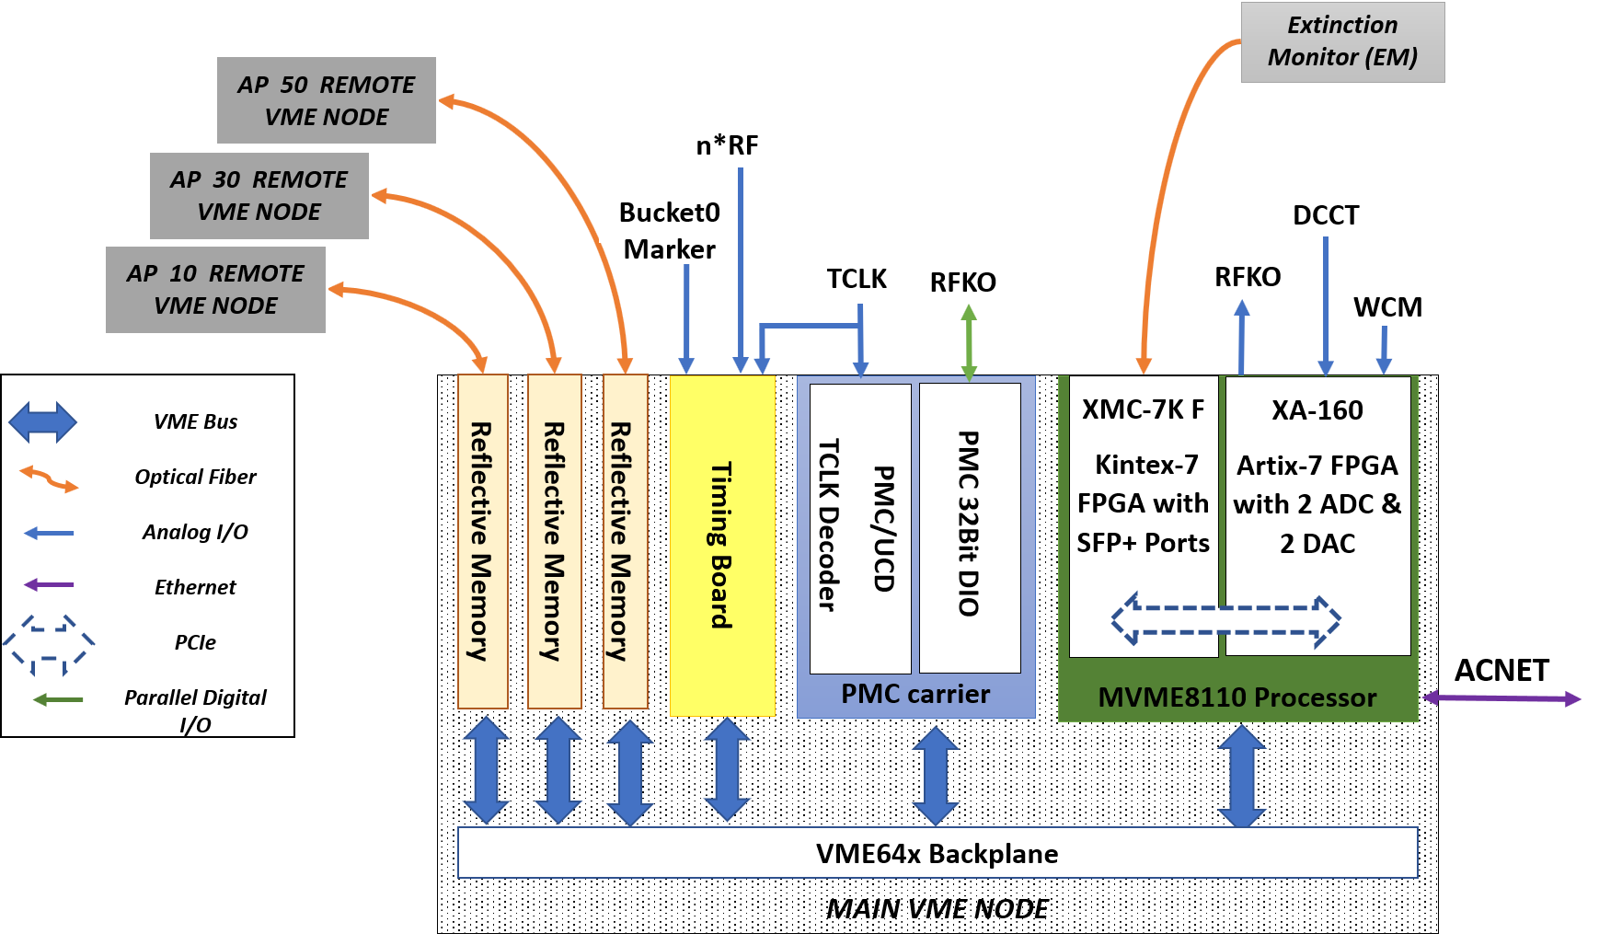
SRS Main VME Node
The main VME node will use the MVME8100 processor, running on a Linux platform to communicate to ACNET.
It also continually updates a data set in reflective memory, which is reflects adjusts to the quads’ ramping curve. Optical links are used to share this data with the remote nodes.
It also controls 2 XMC boards: XA-160A and XMC-7KF.
  The XMC-7KF has an Xilinx Kintex7 FPGA while the XA-160A has an Xilinx Artix7 FPGA. Together, they will programmed to implement both feedback loops.
  The XMC-7KF has the optical ports to receive the Extinction Monitor (EM) signals.
  The XA-160A digitizes the signals from the Wall Current Monitor (WCM) and DR DC Current Transformer (DCCT) at 150.88MHz.
  Using a DAC clocked at 603.52MHz, the XA-160A generates the excitation signal to the RFKO system.
  Together, XMC boards will communicate with each other over PCIe.

Slide 9
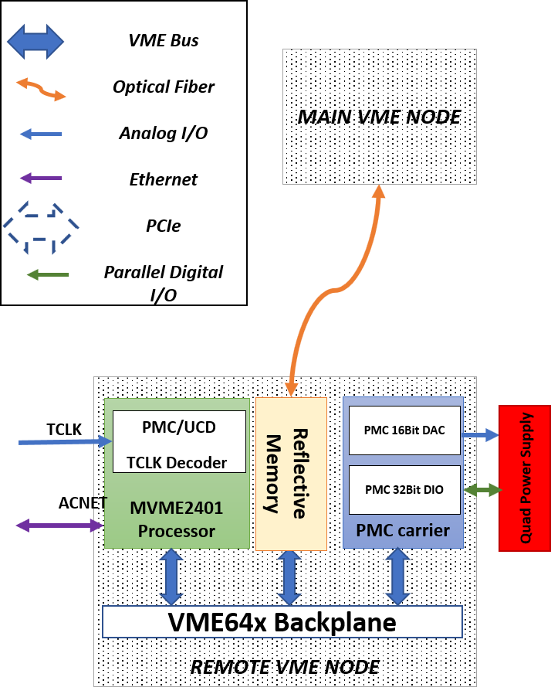
SRS Remote VME Node
Each of the 3 remote nodes are identical.
Each will instrumented in the same rack as its corresponding tune quad’s PS controllers or in the neighboring rack.
Each will using an MVME2401, running VXWorks to communicate to ACNET.
Each share real-time 16bit data set about the tune quads’ references at a deterministic rate via reflective memory.
Each will control 2 PMC Modules: PMC-HPDI32A and PMC-HPDI32A
  PMC-HPDI32A will be used to generate the required 0-10V reference signal. The PS controller requires that the reference be calibrated to 8A/V.
  PMC-HPDI32A will be used to read 24 status bits from the tune quads’ PS controllers.

Slide 10
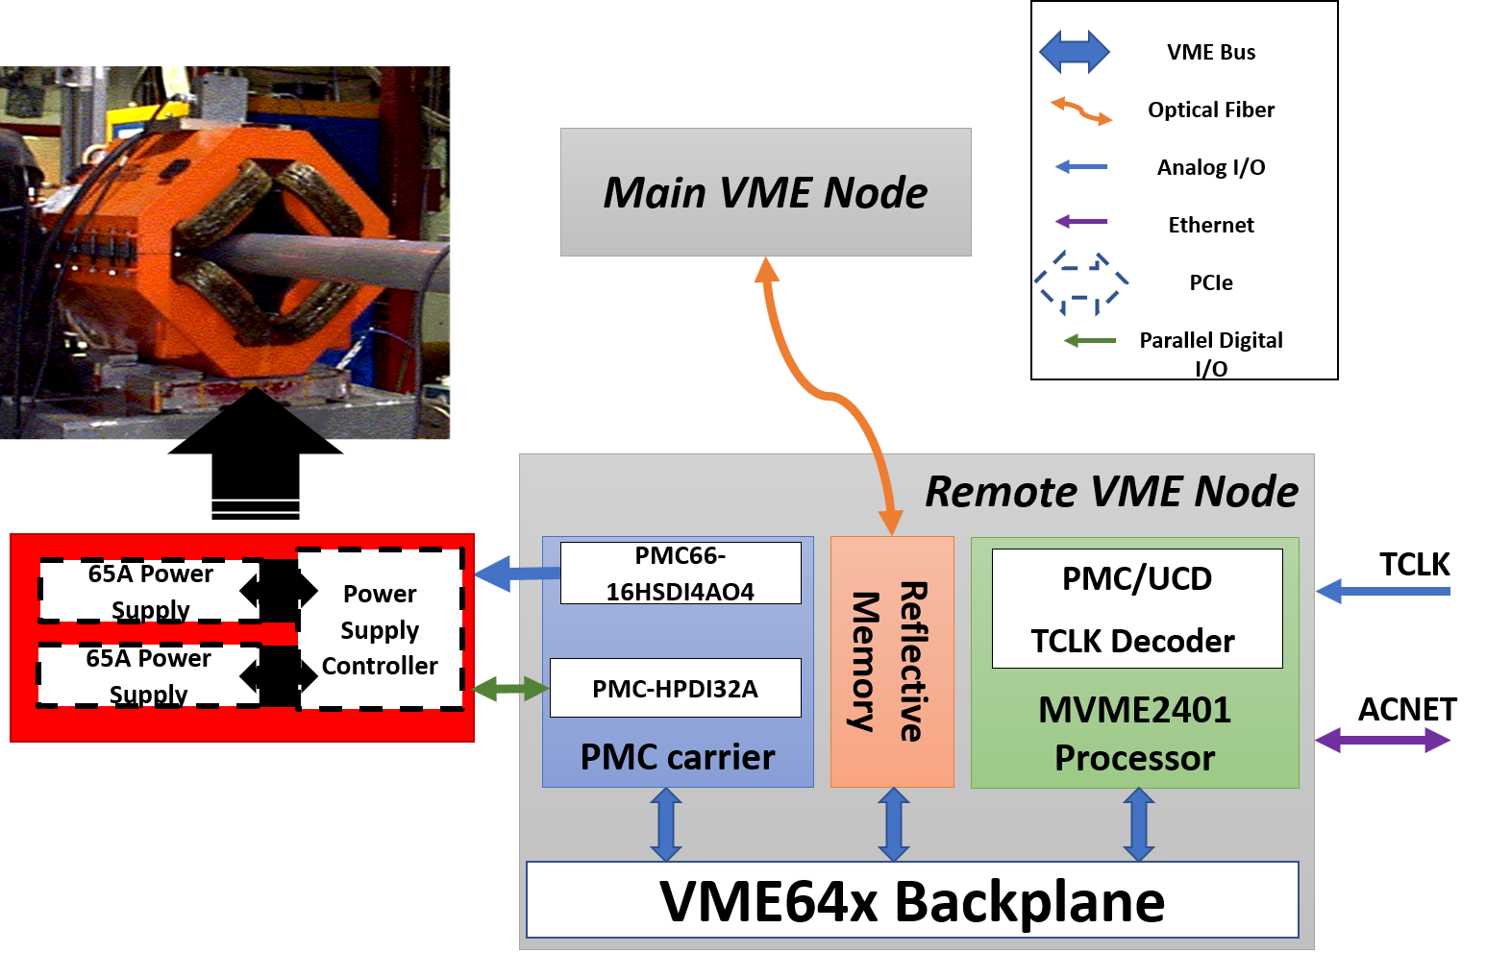
Driving the Tune Quadrupole Magnets
Three remote SRS nodes control a family of three zero-harmonic quadrupoles magnets (tune ramp quad).
Each magnet is a CQA type from e-Ring and is located in the center of each of the three straight sections: AP10 at D10Q, AP30 at DV301, and AP50 at DV401.
Each magnet two 65A switching power supplies (PS), to be run in parallel.
Each power supply will supply 8 status, while the PS controller will have 8 status bits. These 24bits will be monitored by the SRS.
The Tune Quad Control Loop will update a set of 16bit values in reflective memory (256Kbyte, max), which presents a time slice of the ramping curve.
With 16bit DAC clocked at 1MHz, PMC66-16HSDI4AO4 will use the shared data set to generate the reference, calibrated to 8A/V, to the PS controller.
The PMC-UCD will be used to decode TCLK, allowing the remote node to remain synchronous as well as drive magnets to either near zero or 1A pedestal during reset periods.

Slide 11
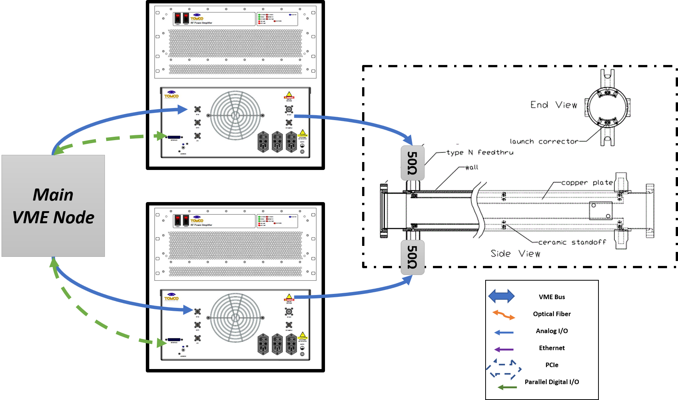
Driving the RFKO System
Using TomCo BT01000-AlphaS-CW and a stripline kicker, the RFKO system is used to fine tune the extraction rate and spill profile, by heating of the beam.
  A 1.4m stripline kicker, previously used as a Tevatron damper kicker, will be used to provide 1uRad single pass kick @ 1kW power. Depicted above is an assembly drawing of a stripline kicker.
  The SRS will generate an amplitude-regulated FM signal, whose carrier frequency is tracking the current betatron sideband. This signal could either a sweep modulation (ex. chirp) or “colored” noise.
  This signal is amplified with a BT01000-AlphaS-CW, which is a 1200W solid state amplifier, linear between 100kHz to 30MHz.
  The excitation signal is applied to each of the stripline’s plates, which will be terminated with a high power 50Ohm terminator.

