Slide 1
Spill Regulation at J-PARC Main Ring Slow Extraction
2019-1-14 US-Japan Meeting
Ryotaro Muto

Slide 2
Contents
・Introduction : J-PARC MR slow extraction
and purpose of the spill regulation system
・Spill feedback system
・Transverse RF system
・Another approach : Ripple canceller
・Attempt for further improvement of spill regulation system
(with machine learning?)

Slide 3
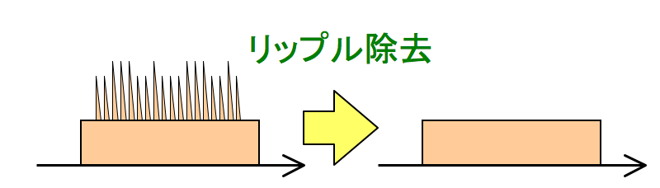
Purpose of the spill regulation
One of the main issues of slow extraction
at J-PARC Main Ring
: Improvement of the spill structure
Large current ripples of the main power supplies induce
spiky time structure of the extracted beam
We want to reduce the time structure
and produce flat beam
intensity
time
~2s

Slide 4
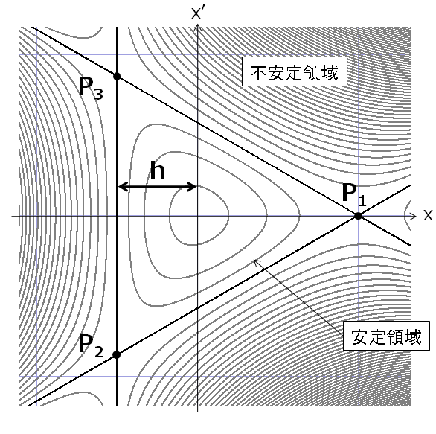
Slow extraction using 3rd-order resonance
Excite 3rd-order resonance using sextupole magnets
→phase space is divided into
stable region and
unstable region
Unstable Region
Size of stable region
S : strength of
sextupoles
Stable Region
・Particles with large amplitude become
unstable and their amplitudes
increase turn by turn until excess the
septa of ESS and extracted
・Gradually make δν small
→ particles are slowly extracted
ESS
Horizontal phase space
at a certain position in ring

Slide 5
Slow extraction using 3rd-order resonance
Instantaneous rate of the extraction beam is
roughly proportional to
(dδν/dt) * (particle density around the separatrices)
The time structure of the extracted beam is determined by the time structure of the δν
Current ripples of the main magnet power supplies
are harmful to the time structure of the extracted beam.

Slide 6
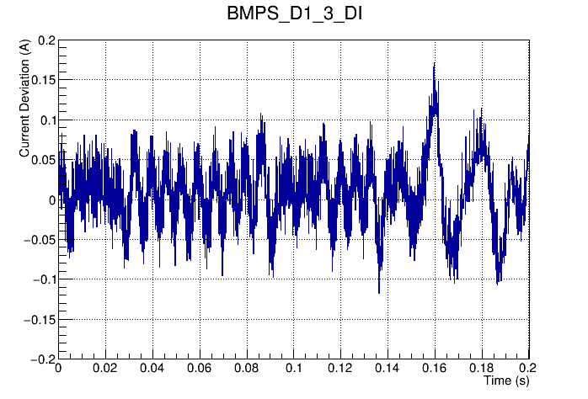
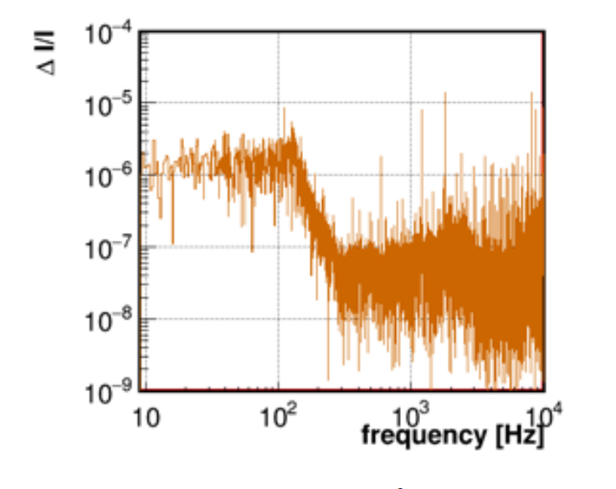
Current Ripple of the Magnet Power Supply (PS)
Current Ripple
ΔI / I
1.2 kHz
ΔI (Amps)
1.8 kHz
FFT
600 Hz
Time [s]
Ripples by the switching and rectification
Noise enhanced by the feedback properties of the PS system（<200 Hz）
From Y. Kurimoto
(J-PARC MR PS group)

Slide 7
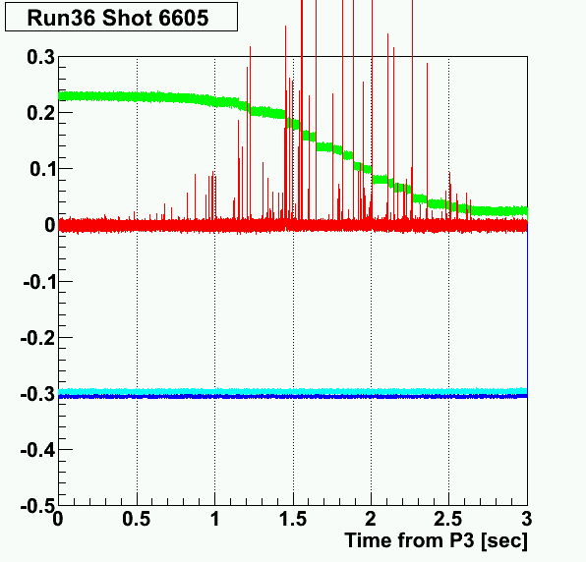
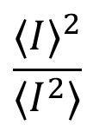
Extraction without spill regulation
Spill Duty Factor : 3%
beam in ring
spill
2s
$$\frac{⟨I⟩^{2}}{⟨I^{2}⟩}$$
Spill duty factor :
I : beam intensity
〈〉: mean during the extraction
F = 100%
F = 50%
Beam intensity
Beam intensity
time
time
extraction
extraction

Slide 8
Correction to tune ripples
J-PARC MR has tune correction quadrupole magnets, EQ (x2) and RQ
We want to cancel out the tune ripples using these correction magnets
We cannot measure the betatron tune directly during the extraction
Feedback control using extracted beam intensity
(Spill feedback system)
Calculate the tune ripple by the PS current ripple and make correction (Ripple canceller)
Another approach : Smear out the amplitude distribution
of the particles
(Transverse RF)

Slide 9
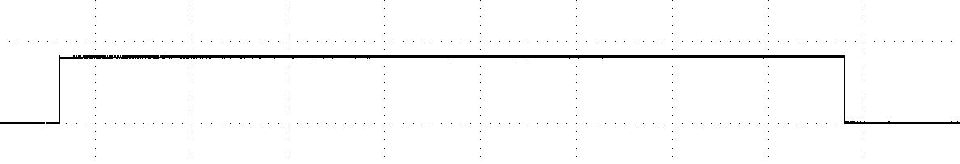
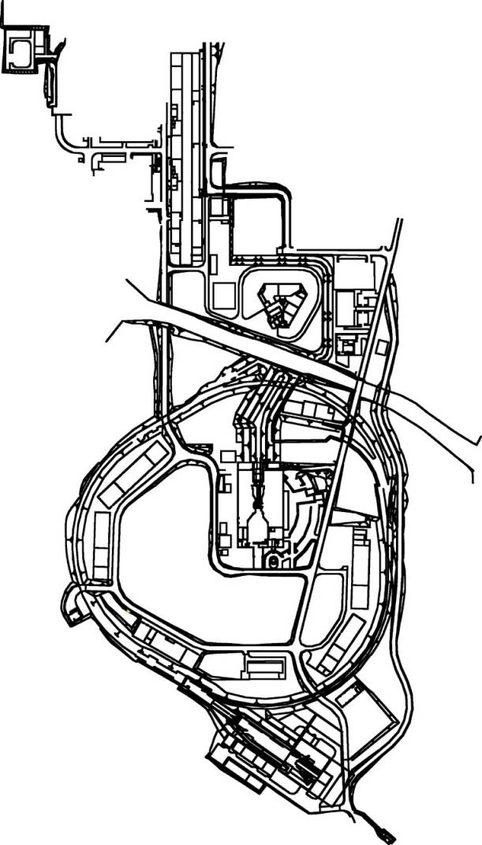
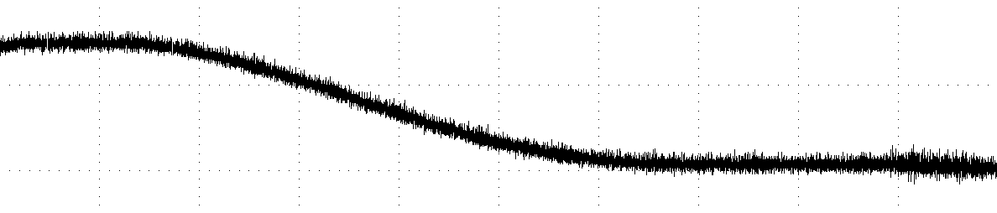
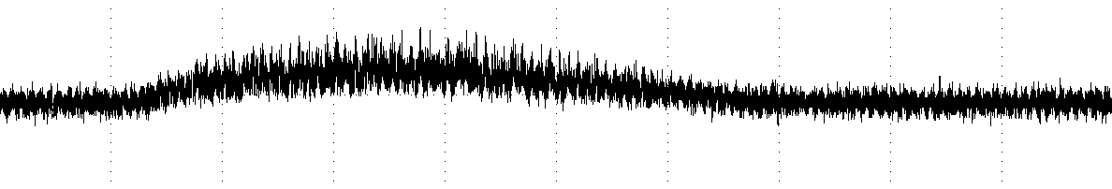
Spill feedback system
Start and end of the extraction
PC
LAN
Gate
Communication
Board
Particle number in ring
Control Unit
DSP
Beam Intensity
sampling :
100 kHz
Extracted beam intensity
MR
Spill
DCCT
EQ,RQ magnet
Magnet control signal
Spill monitor

Slide 10
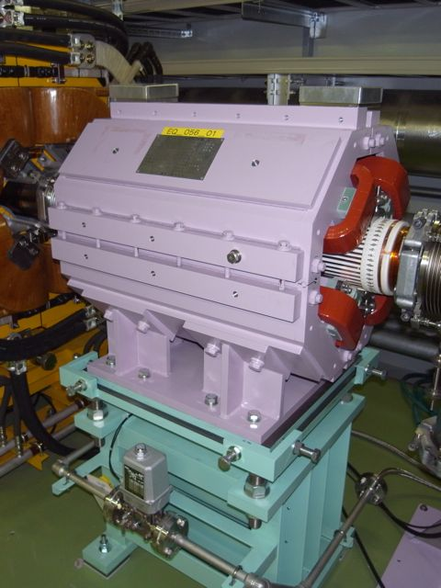
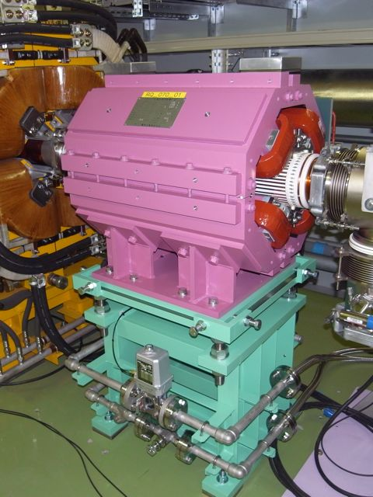
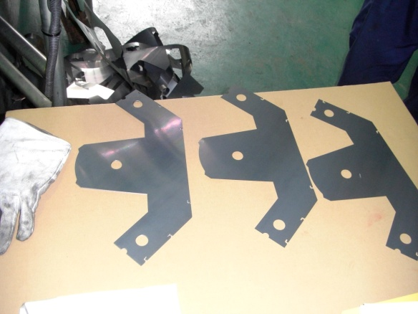
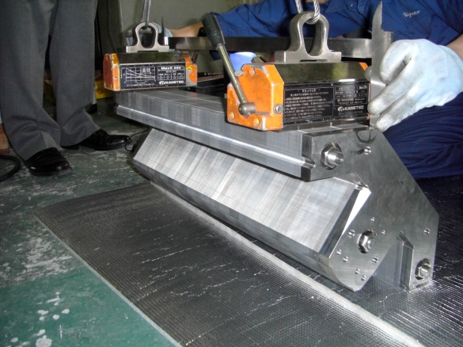
Correction quadrupole magnets
Ceramics duct
EQ
RQ
t 0.1mm
lamination steel
≲100 Hz
Δhtune : 0.011/100A
≲1 kHz
Δhtune : 0.0014/100A
Notes:
スペック

Slide 11
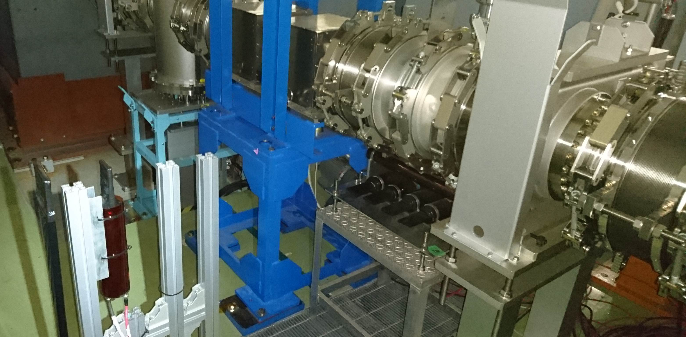
Spill monitor
Spill monitor : plastic scintillator + PMT
detects secondary particles generated at the vacuum partition in the beam duct
Vacuum partition (Al, 0.1 mm)
~1m
Far
~0.4 m
Proton beam
Near

Slide 12
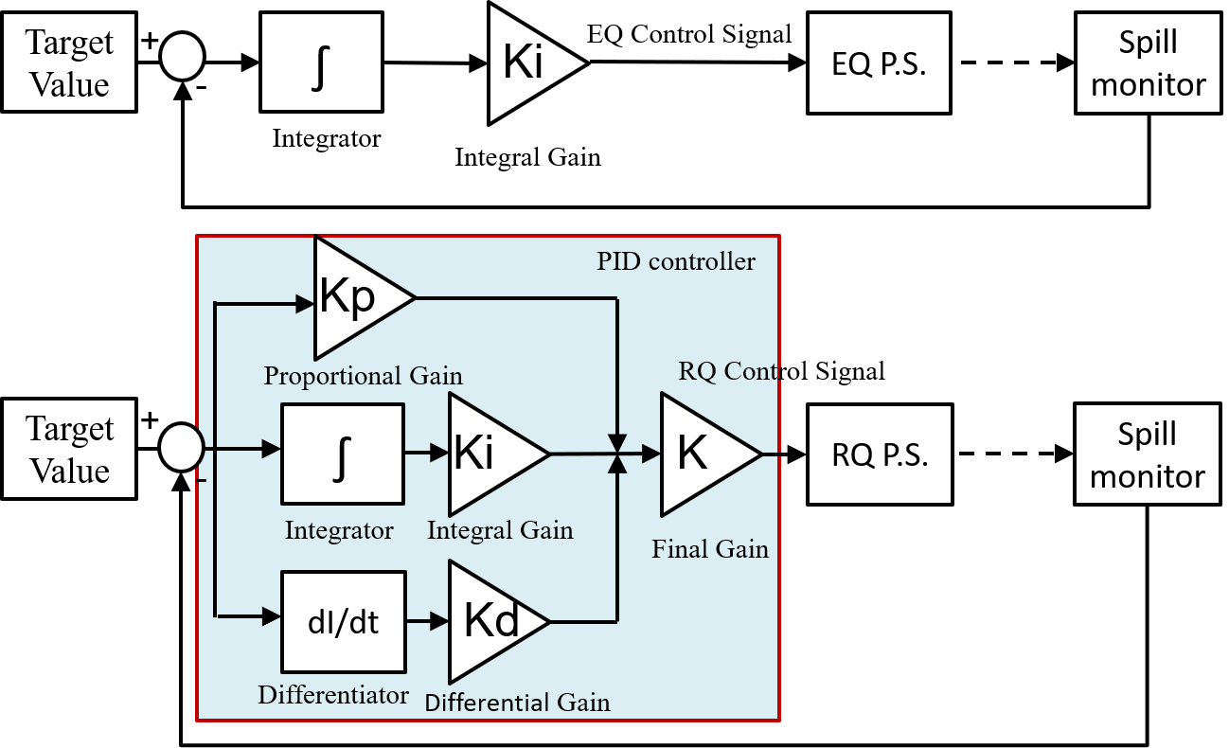
Spill feedback block diagram
Feedback Gain (Feb. 2018)
  EQ: Ki= 62.89
  RQ: Kp=1.0, Ki= 20000, Kd=0.00002, K=0.75
by T. Kimura

Slide 13
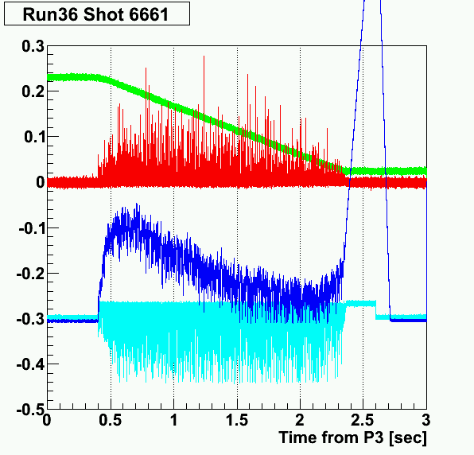
Effect of the spill feedback
beam in ring
beam in ring
spill
spill
EQ
EQ
RQ
OFF
RQ
Duty Factor 3%
Duty Factor 18%
(Trim coils of B&Q magnets are shorted in flat top)

Slide 14
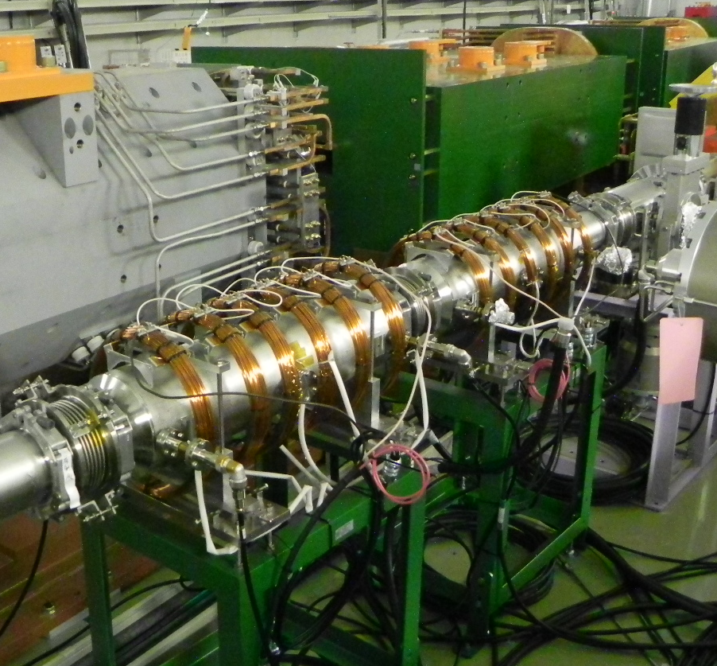
Transverse RF
Increase and smear the betatron oscillation amplitude of the beam
by transverse RF on stripline kickers
0.1-100MHz
3kW
RF noise
Generator
AMP
AMP
3kW
Solenoids to suppress multipactor effect
Stripline kickers
Beam
By A. Schnase, T. Toyama,
M. Okada & J-PARC RF group

Slide 15
Transverse RF
Without transverse RF
stable
unstable (extracted)
# of particles
separatrix
Amplitude
Transverese RF smear the amplitude distribution of the particles in ring
→ Beam becomes less sensitive to the tune ripples
# of particles
Transverse
RF
separatrix
Amplitude

Slide 16
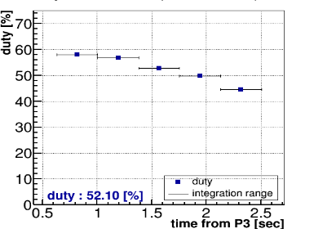
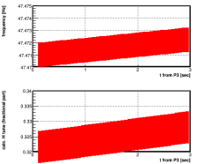
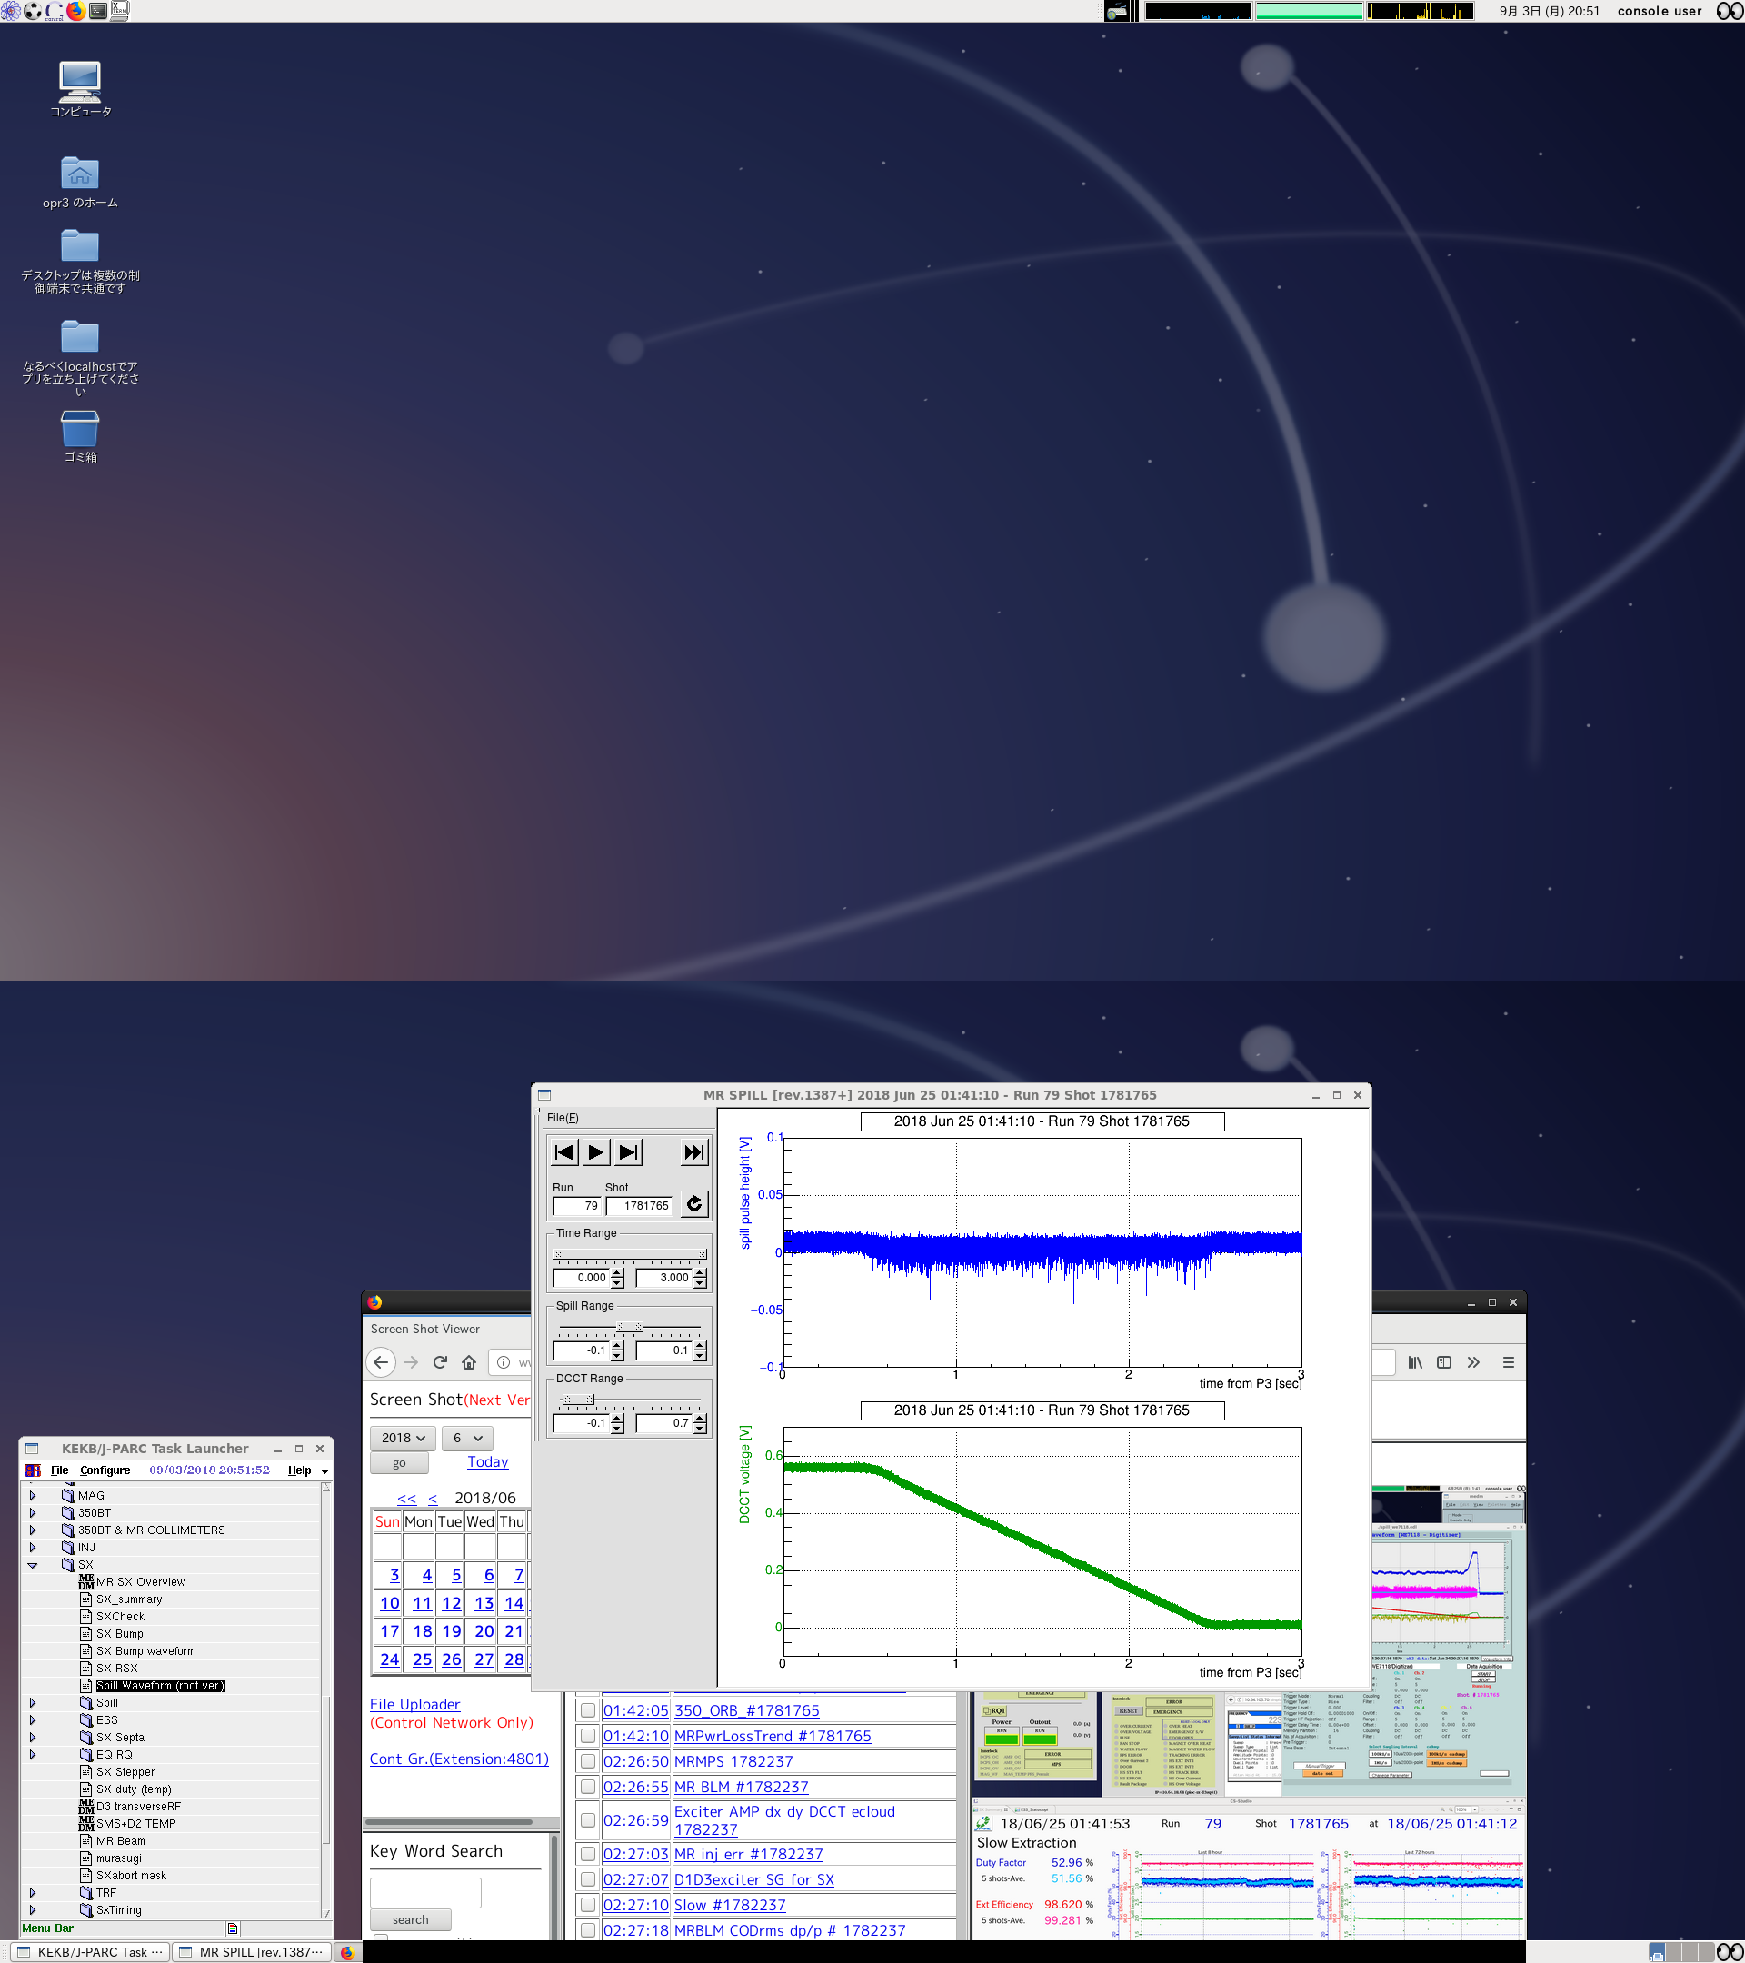
Transverse RF
Freq [MHz]
Time [s]
Fractional tune
Time [s]
f ~ 47.47 MHz
Fractional tune ~1/3
Parameters are searched
to maximize spill duty factor
Spill duty factor was improved
to ~50% with 51 kW beam

Slide 17
Ripple Canceller
We are now testing ripple canceller to correct tune ripples.
(developed by Y. Kurimoto, D. Naito (J-PARC main power supply group))

Slide 18
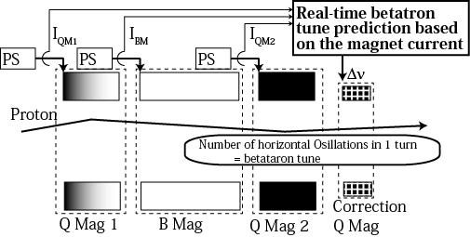
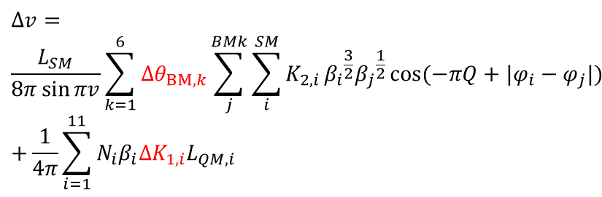


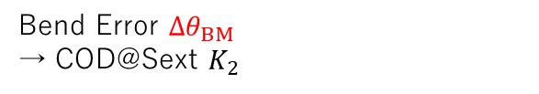
Real-time ν correction with the magnet current
$$∆v=$$
$$\frac{L_{SM}}{8π\sin{πv}}\sum_{k=1}^{6}{∆θ_{BM, k}}\sum_{j}^{BMk}{\sum_{i}^{SM}{K_{2,i}}}{β_{i}}^{\frac{3}{2}}{β_{j}}^{\frac{1}{2}}\cos{(−πQ+|φ_{i}−φ_{j}|) }$$
$$+\frac{1}{4π}\sum_{i=1}^{11}{{N_{i}β}_{i}∆K_{1,i}L_{QM,i}}$$
Conceptual Setup
ΔΙ→Δν
(Real-time !)
①
②
①
Bend Error $∆θ_{BM}$
→ COD@Sext $K_{2}$
$∆v$
②
Quad Error $∆K_{1}$
The correction quadrupole works up to ~ kHz
The ΔI→Δν conversion is done by FPGA within 10 us (ignorable)
Target frequencies of ν correction are less than 200 Hz (5 ms)
Real-time ν correction is possible
From Y. Kurimoto
(J-PARC MR PS group)

Slide 19
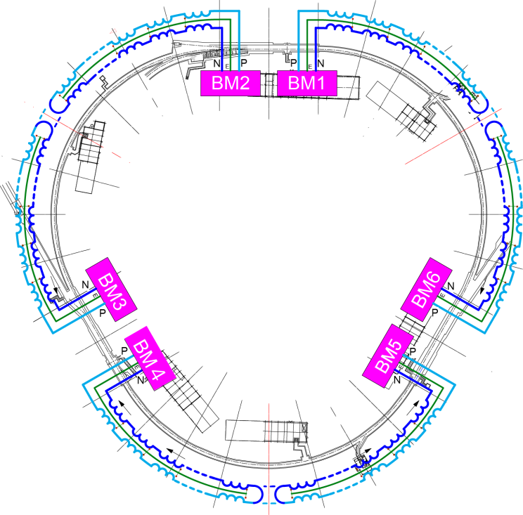
Families and Power Supplies
One power supply drives several magnets connected in series. These several magnets are collectively called “a Family”
#Families = #Power Supplies
Magnet Families in J-PARC MR
Ex. Bending Magnets
#mags : 96
#families : 6
#power supplies : 6
Family | Type | #mags
BM1,BM2,BM3,BM4,BM5,BM6 | B | 16
QFN,QDN,QFX | Q | 48
QDX | Q | 27
QFR | Q | 9
QFP,QFS,QFT,QDR,QDS,QDT | Q | 6
SFA,SDA,SDB | S | 27
Used for the ν correction
16
From Y. Kurimoto
(J-PARC MR PS group)

Slide 20
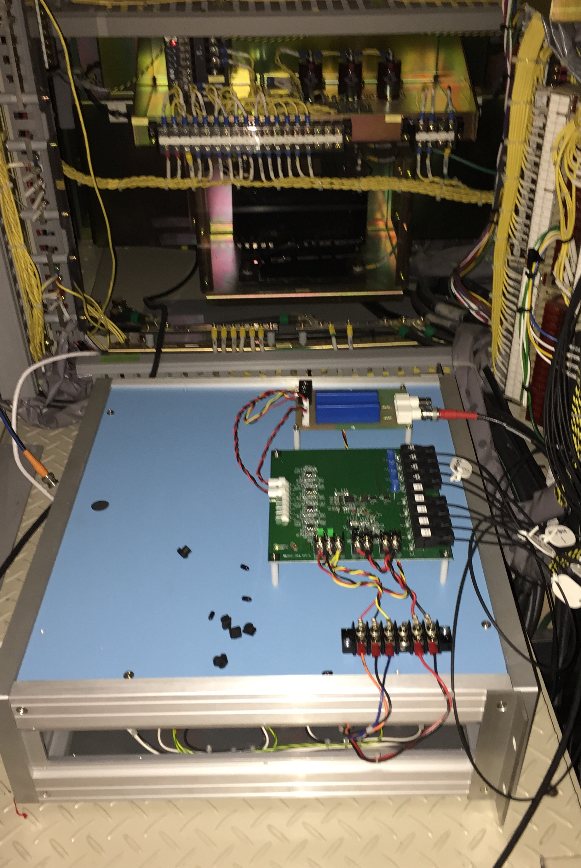
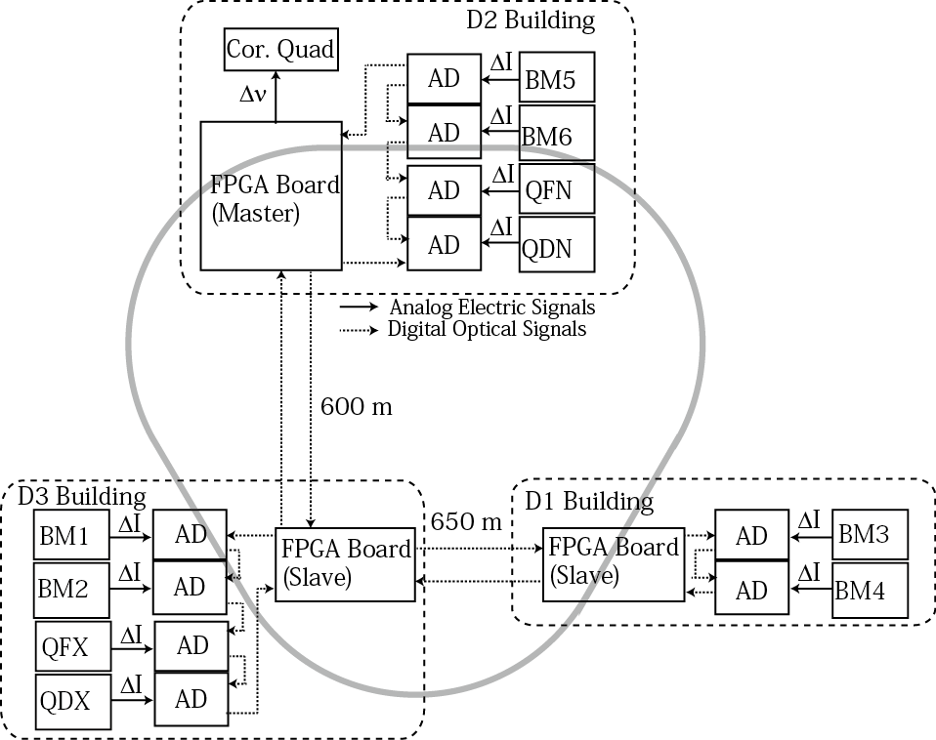
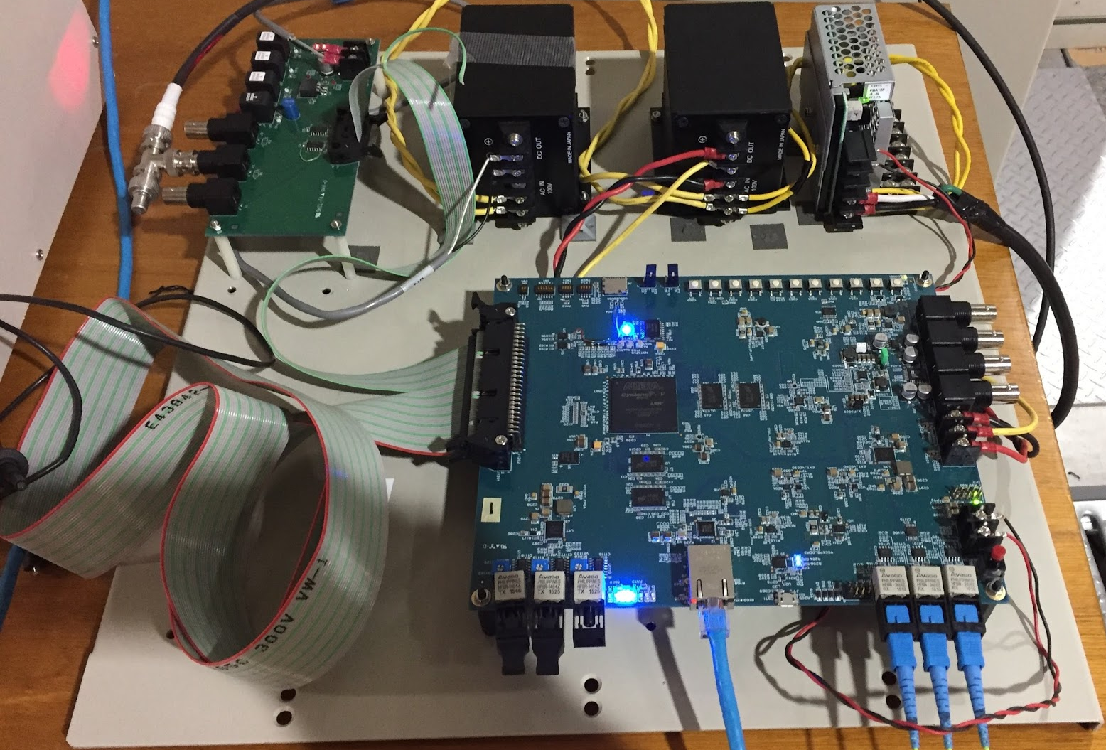
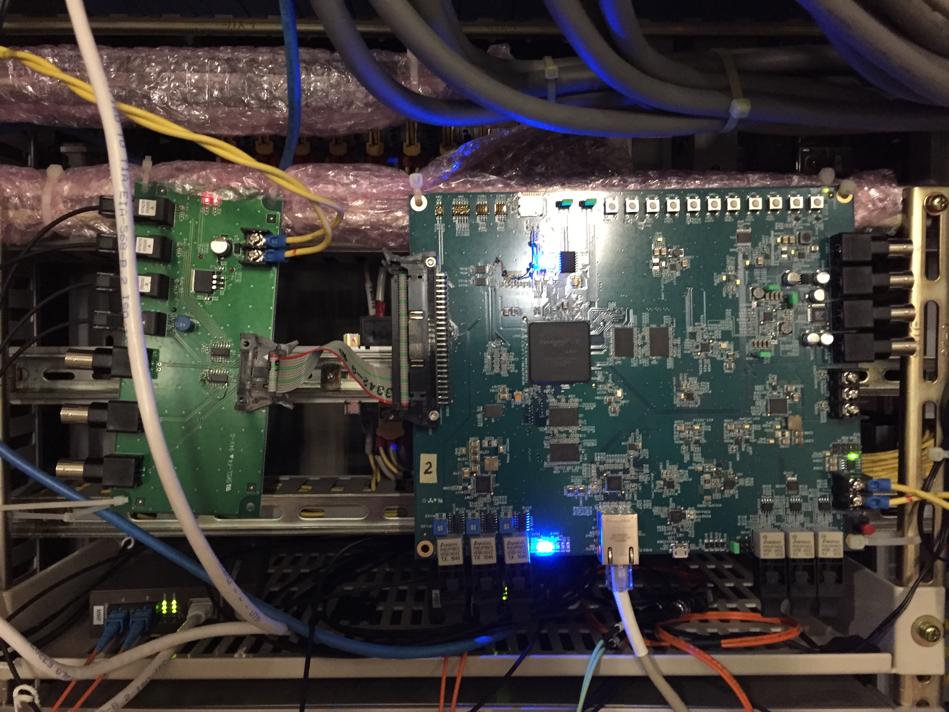
Experimental Setup
A/D Board @ each PS
ΔI is digitized and converted to optical signals
Issues
Several PSs are separately located at different buildings
The PS of the corrector is located at only one building
A/D board
FPGA board for the real-time ΔI → Δν conversion
FPGA /CPU Board @ Each building
ΔI s from each PS are collected and transferred to another building.
From Y. Kurimoto
(J-PARC MR PS group)

Slide 21
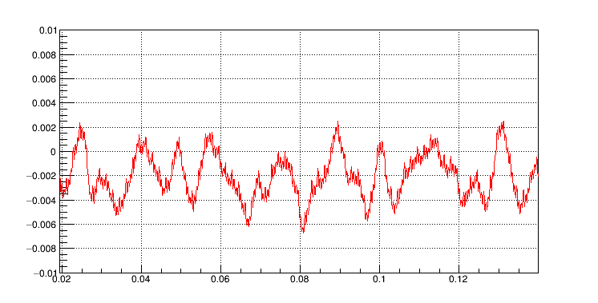
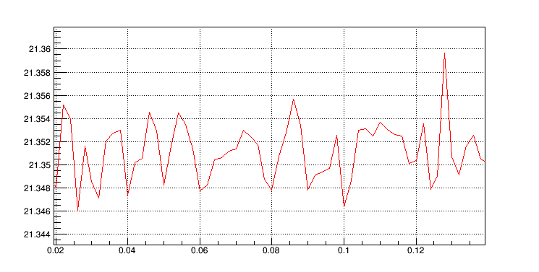
Direct Measurement and Prediction
Before correction, the real-time prediction was compared with the direct measurement
Real-time Δν_{x} prediction
δν~0.008 (peak-to-peak) for both prediction and measurement
Similar time structure
Similar
Time (s)
Correction can be safely done
Direct ν_{x} measurement
Reasons for the discrepancy
Not all magnets are included
Prediction is done by not magnetic field but magnet current
Time (s)
From Y. Kurimoto
(J-PARC MR PS group)

Slide 22
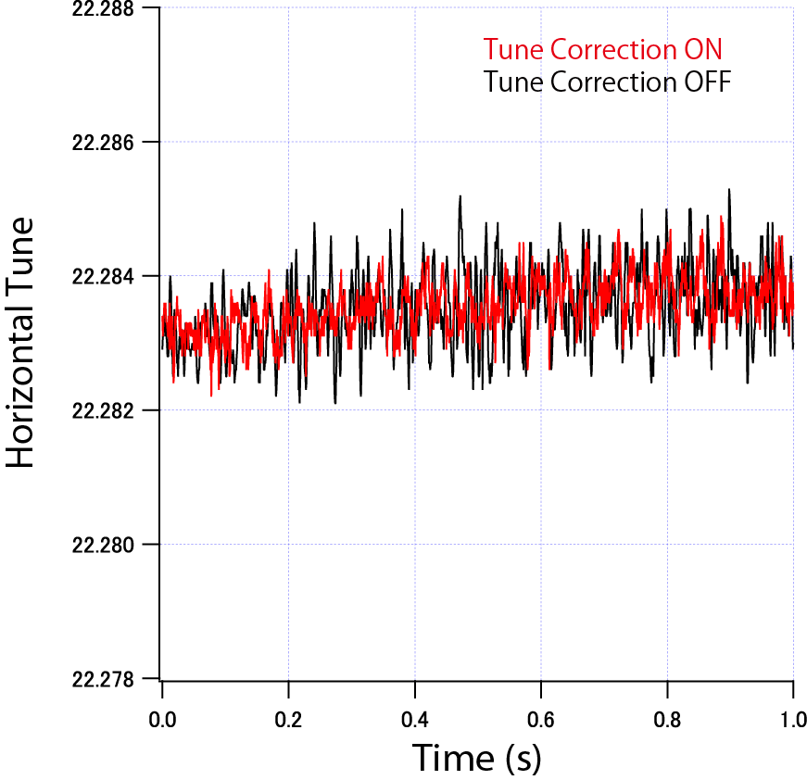
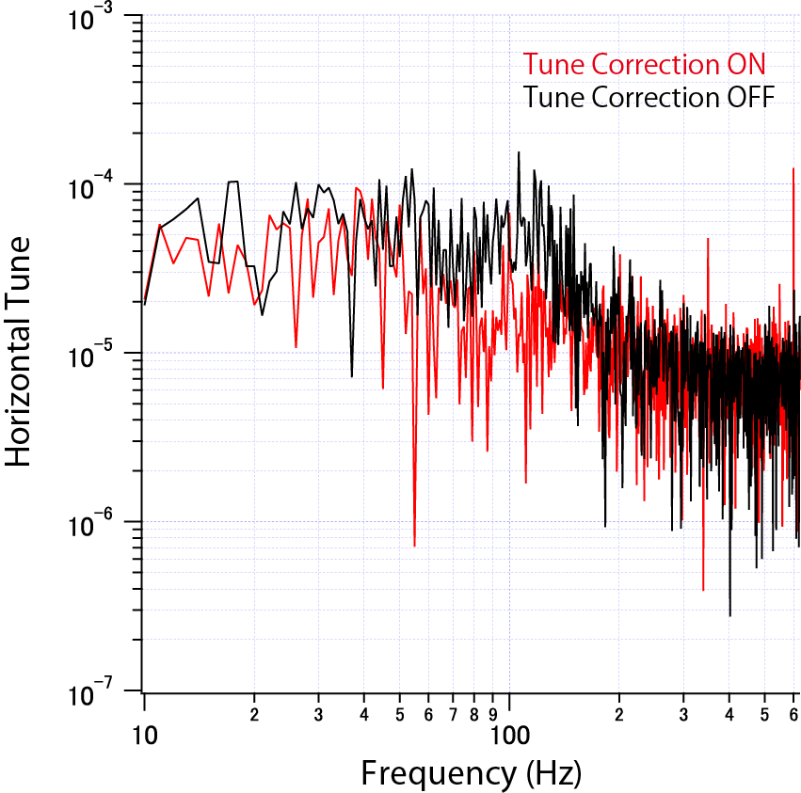
ν_{x} correction
ν_{x} measurement with and without the real-time correction
FFT
δν around f=100 Hz is by 1/3~1/2 reduced
δν @ f > 200 Hz is increased
From Y. Kurimoto
(J-PARC MR PS group)

Slide 23
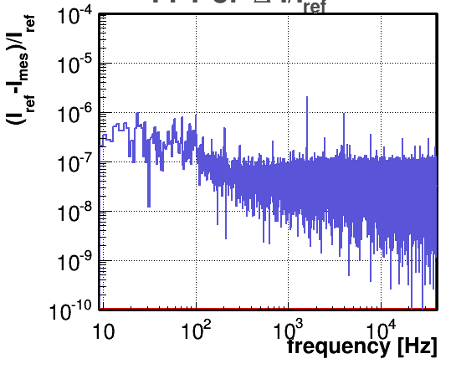
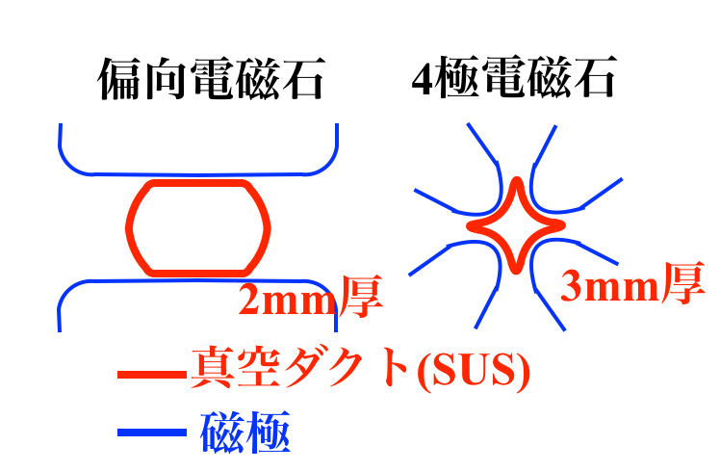

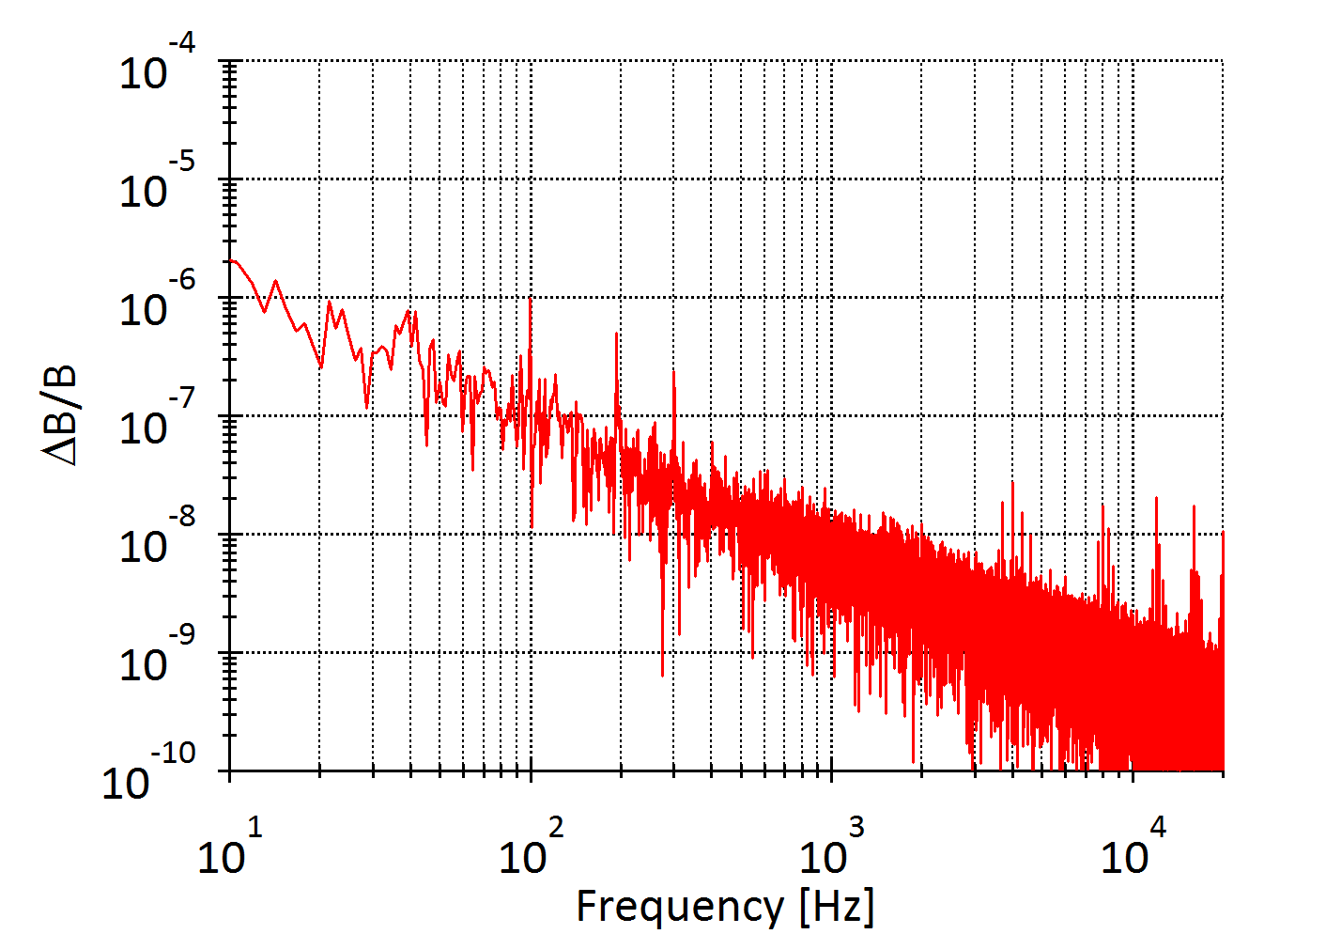
δI vs δB
Current Deviation
1x10⁻⁶
Bending Magnet
Quadrupole Magnet
t=2mm
t=3mm
Induced B
Stainless Duct
dB/dt
Magnetic Pole
Magnetic Field Deviation
Magnetic field at f>200 Hz is reduced by the eddy current
Eddy Current
Duct
1x10⁻⁶
Our system is effective below 200 Hz
From Y. Kurimoto
(J-PARC MR PS group)

Slide 24
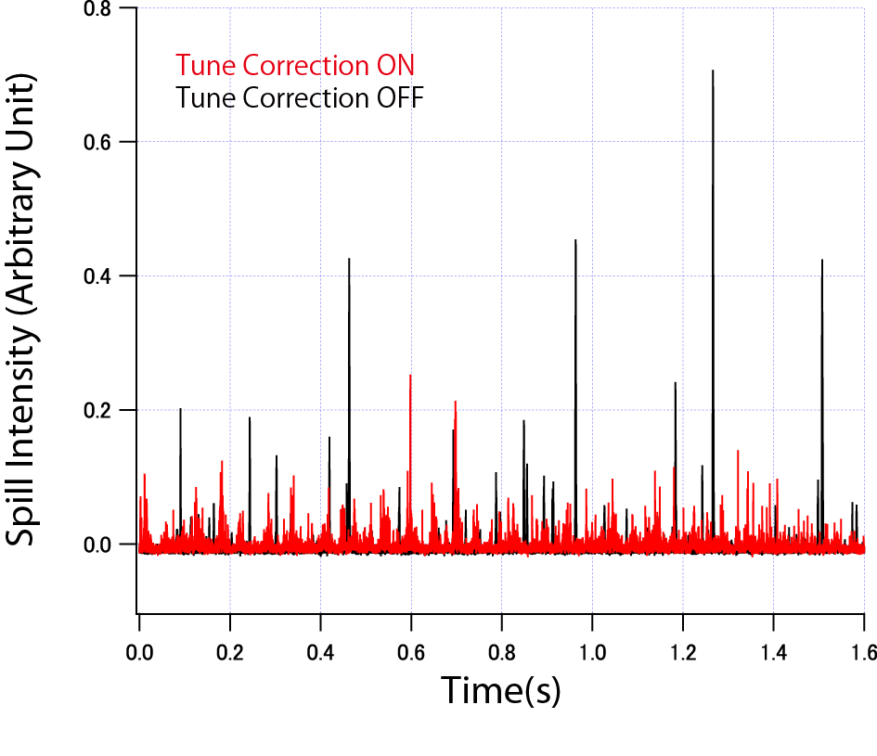
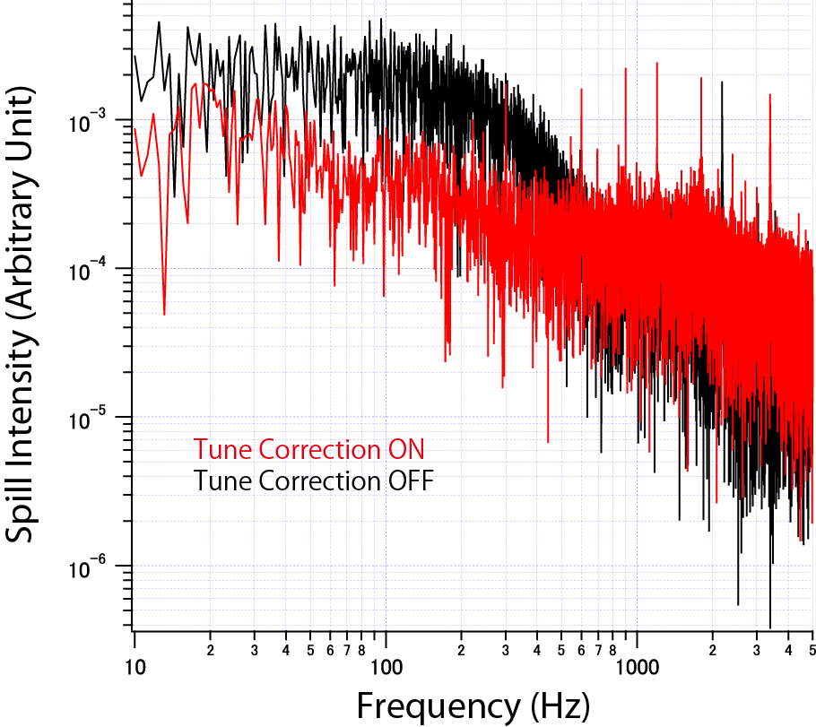
Spill Duty with the Correction
To see the effect of the ν correction, the spill feedback and transverse RF was turned off
The spill duty is defined as $\frac{{<I>}^{2}}{<I^{2}>}$ ($I$: beam intensity)
FFT
Duty 3.2 %→28.1 %
Spill intensity fluctuation is reduced at f < 200 Hz while enhanced at f > 200 Hz (consistent with ν measurement)
From Y. Kurimoto
(J-PARC MR PS group)

Slide 25
To improve the spill regulation system
Weak points in spill feedback :
・Spill signal cannot be negative
→ appropriate spill feedback is difficult especially with large tune ripple
・Delay (~200us) from a ripple in tune to the correspondent beam extraction
Weak points in ripple canceller :
not effective to the components which is not reproduced by the current ripples
e. g.
・Magnet field with high frequency
・Transverse RF
Ripple canceller + TrRF is currently lower performance (~30%) than
Spill feedback + TrRF (~50%)
Further improvement of the spill feedback system with the information of current ripples is possible ?

Slide 26
Model to predict next value of spill
Spill monitor ([t-1], [t-2],…[t-n_{SM}])
Δtune calculated by
Main Mag current ripple ([t-1], [t-2],…[t-n_{MM}])
model
Δtune by EQ ([t-1], [t-2],…[t-n_{EQ}])
Δtune by RQ ([t-1], [t-2],…[t-n_{RQ}])
Predict next value of spill
and determine EQ[t] & RQ[t]
Trial to make a sufficient model
has just begun

Slide 27
Summary
One of the main issues of J-PARC MR SE is the time structure of the extracted beam.
We currently use spill feedback system and transverse RF system to improve the time structure from ~3% to ~50% in spill duty factor.
We are now testing the ripple canceller, which corrects tune ripples using current ripples of the power supplies.
So far we obtain spill duty factor of ~30% with the ripple canceller.
Further improvement of the spill structure is desirable and we are now searching other possibilities.

