Slide 1
3.9 GHz Cryomodule Testing
Elvin Harms
LCLS-II 3.9 GHz CM Delta Final Design Review
29-30 January 2019

Slide 2
Outline
Status of and plans for infrastructure modifications
Cryomodule handling at CMTS
Status of test plan and traveler
Lessons learned from 1.3 GHz
Respond to charge questions:
Q5: Is the design likely to meet performance expectations?
Q8: Have lessons learned from the 1.3 GHz cryomodule quality assurance, assembly and test been applied?

Slide 3
Test stand infrastructure
Move end cap girder
~half the distance to the feed cap
Replace cabling in cave as needed
Cryo unchanged
Reviewing/comparing instrumentation differences with 1.3 GHz
6-8 week changeover
Testing at ~1/month rate

Slide 4
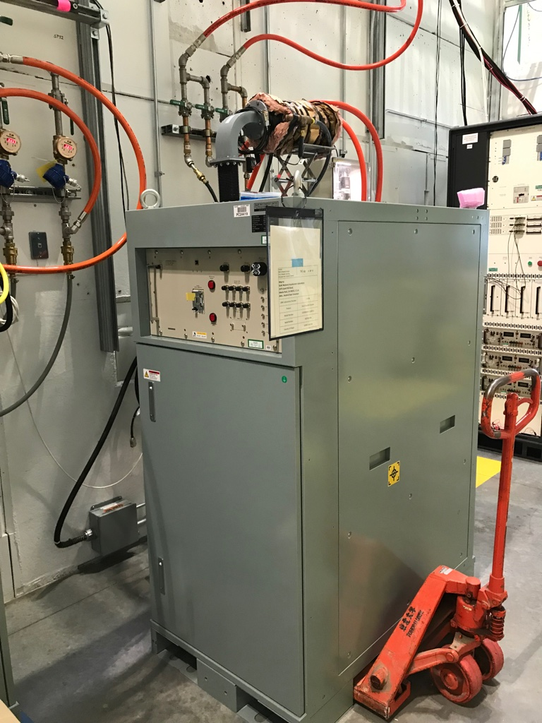
Test stand infrastructure – RF
3.9 GHz Amplifiers
All SSA’s in hand
One at CMTF and getting prepped for testing
Acceptance data received from SLAC
LLRF will be different
Use the LCLS-II production system
Commissioning time will be needed
Schedule, staff availability of some concern

Slide 5
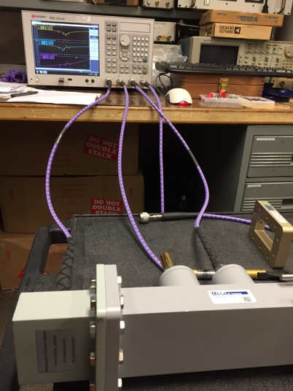
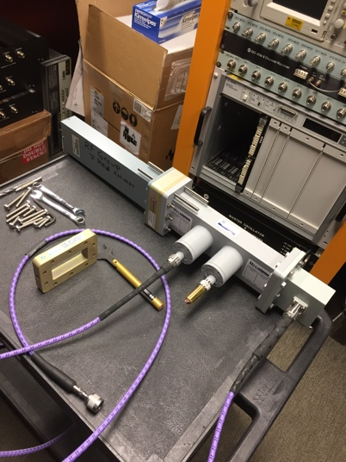
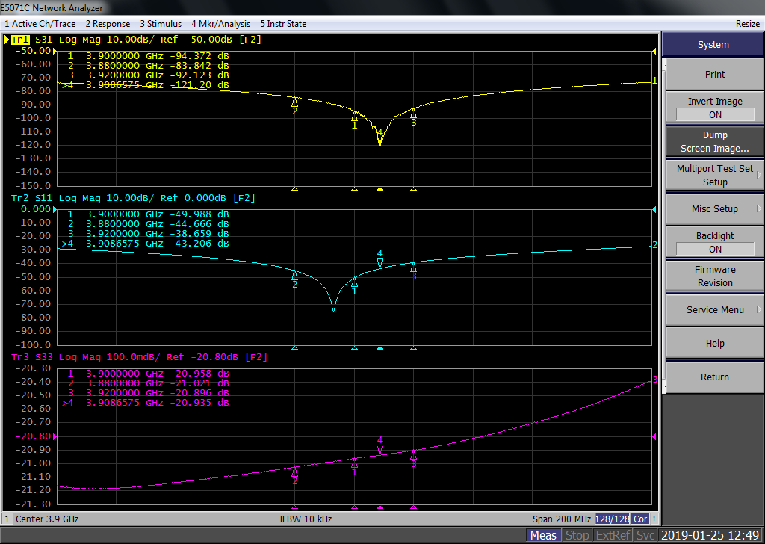
Test stand infrastructure – RF
All RF distribution hardware received
Characterization in progress
Waveguide through wall pre-installed
Mega WR284 Dual Directional Coupler
Jan, 2019 --- Feb, 2019
Data @ 3.9 GHz
Part No | Insertion Loss (from Input to Output Port) db | Return Loss (Input Port) db | Forward Coupling db | Reflected Coupling db | Return Loss (Output Port) db | Return Loss (Forward Coupling Port) db | Return Loss (Reflected Coupling Port) db | Directivity at Forward Coupling Port db | Directivity at Reflected Coupling Port db
1845196 | 0.007 | 41.720 | 40.196 | 40.498 | 41.065 | 22.789 | 22.003 | 34.117 | 38.064
1845194 | 0.007 | 38.461 | 40.439 | 39.944 | 39.671 | 22.788 | 20.827 | 43.875 | 48.447
Courtesy Ding Sun

Slide 6
Cryomodule handling at CMTF
Vacuum and cryogenics connections are identical to 1.3 GHz cryomodules
Use clean room practices where appropriate
1.3 GHz experience valuable
Proven quality techniques and staff
All aspects
Arrival
Installation
Prep for test
Cooldown
Cold testing
Warmup & removal

Slide 7
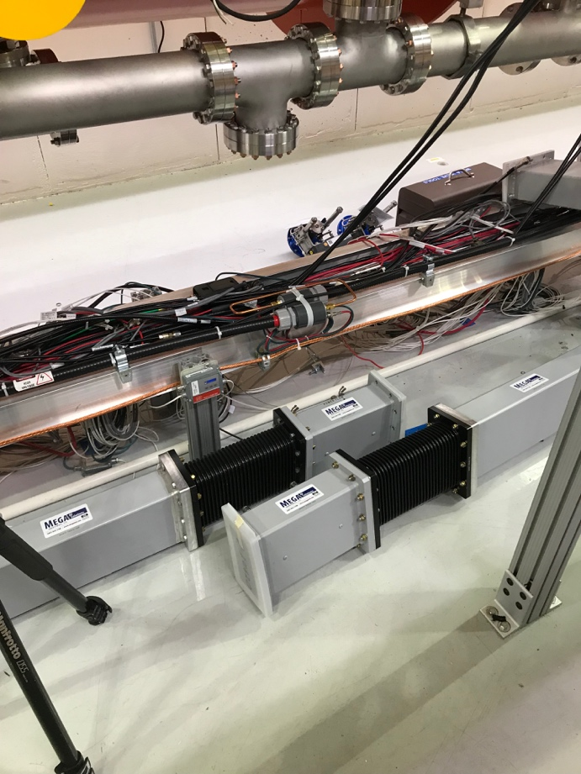
Test stand operation – ESH&Q
ESH&Q engaged
ORC for 3.9 GHz is being planned for
Existing shielding and detectors appear adequate
Do due diligence and confirm
TLM detector already modified
Runs the length of the cryomodule
Split into 2 parts to ensure easy switchover for shorter length.

Slide 8
Status of test plan & traveler
Acceptance criteria drafted
Under initial review
Test plan under development
Based on 1.3 GHz plan with appropriate changes
Traveler draft prepared and under review
Based on 1.3 GHz Test Traveler, # 464421

Slide 9
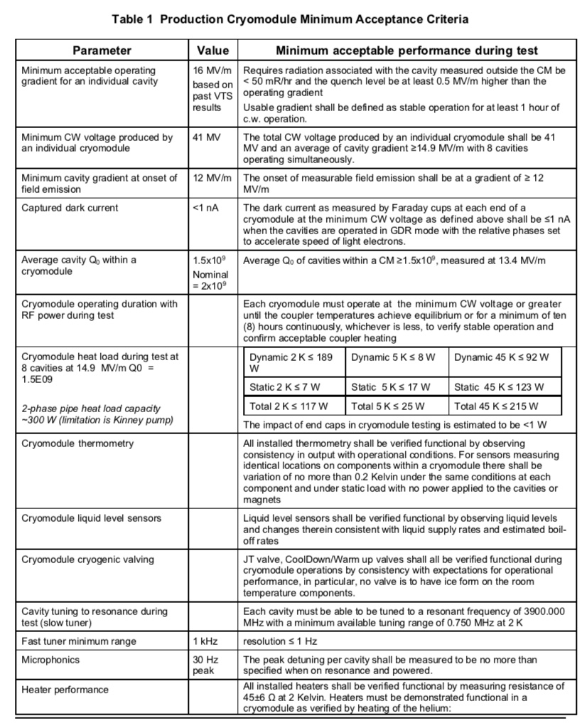
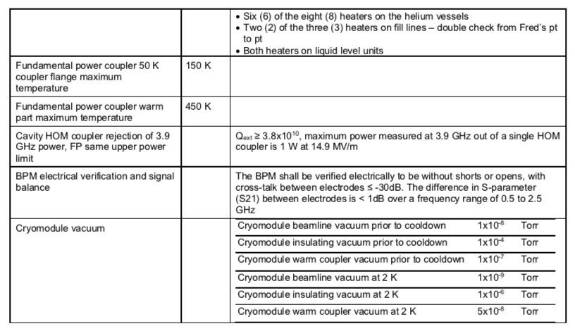
Acceptance criteria (draft)
LCLSII-4.1-PR-0097-R2: 3.9 GHz Physics Requirements (4/7/2016)
LCLSII-4.1-FR-0096-R1: 3.9 GHz Functional Requirements Specification (12/8/2016)

Slide 10
Test stand operation
1.3 GHz cryomodule testing has already demonstrated mature and proven applications
Adaptable for 3.9 GHz testing
Techniques and test sequencing evolving for optimum throughput

Slide 11
Testing differences/similarities with 1.3 GHz
Simplifications
QL set, fixed couplers
No magnet
Flux expulsion not needed
Fast cooldown not necessary
Cro vacuum connections identical
Radiation monitoring/faraday cups unchanged
Potential Challenges
LLRF
Blade vs. end lever tuners
Microphonics

Slide 12
Lessons learned
CMTS1 is a proven, reliable test bed
Necessary modifications understood
Majority of the changes are mechanical
8-cavity cryomodule makes change-over simpler
Staff continuity
Learn from past experience
Test stand already commissioned
Alignment
Cryo heat exchanger failure
Microphonics mitigation
Post-test leak check
3.9 GHz for FLASH (and XFEL) experience
don’t assume ‘success is in the bag’

Slide 13
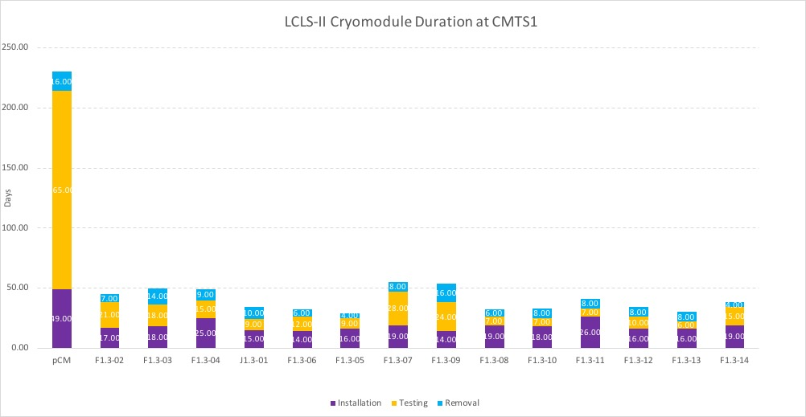
Response to charge
Q5: Is the design likely to meet performance expectations?
Early results from single cavity testing
CMTS1 performance to date
Strong, experienced team
Q8: Have lessons learned from the 1.3 GHz cryomodule quality assurance, assembly and test been applied?
Following on to experience of testing 19 modules over 3 years already

Slide 14
Summary
Preparation for testing 3.9 GHz cryomodules begun
Regular (at least bi-weekly) dialogue
Test documents under development largely based on existing PRD and FRS
ESH&Q already engaged
RF hardware in hand and being assessed
1.3 GHz testing a valuable experience
Excellent results achievable on schedule
Production mindset being embraced

Slide 15
Thank you for your attention – Questions?

Slide 17
Back up slides

