Slide 1
3.9 GHz Design Verification (Cavities)
Sebastian Aderhold
LCLS-II 3.9 GHz CM Delta FDR
Jan 29-30, 2019

Slide 2
Outline
  Cavities for design verification
    Cavity processing work flow and test results
  Horizontal testing results
    Magnetic shielding
    Chimney heat load limit
  Cavity production
    Hold point data
    Incoming inspections
    First VTS results
  Summary

Slide 3
3.9 GHz Cryomodule Parameters
Physics Requirement Document: SCRF 3.9 GHz Cryomodule LCLSII-4.1-PR-0097-R2

Slide 4
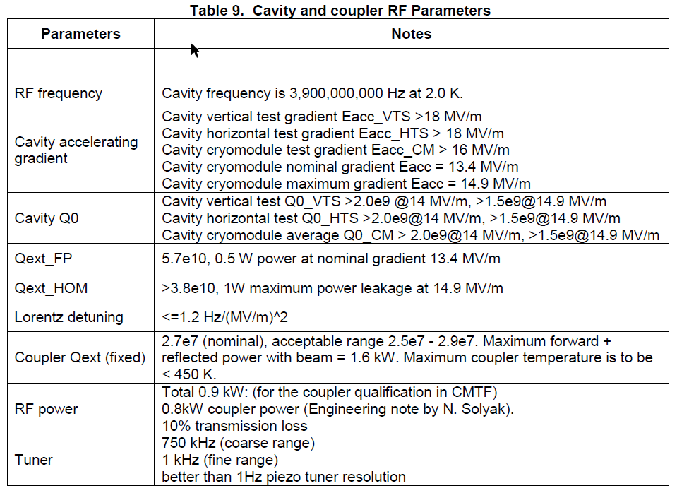
Cavity performance specification
From: 3.9GHz Cryomodule Technical Specification, LCLSII-4.5-ES-0879-R0

Slide 5
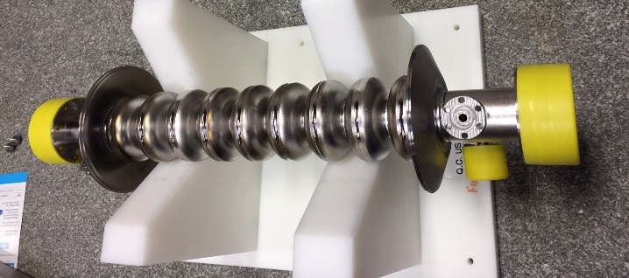
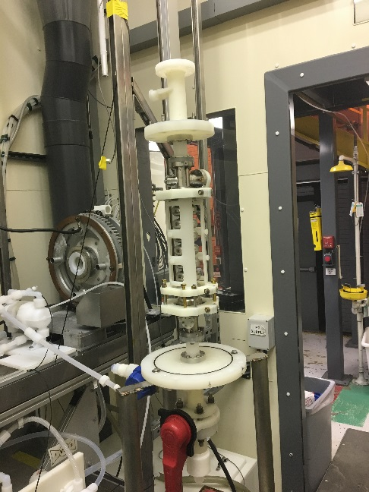
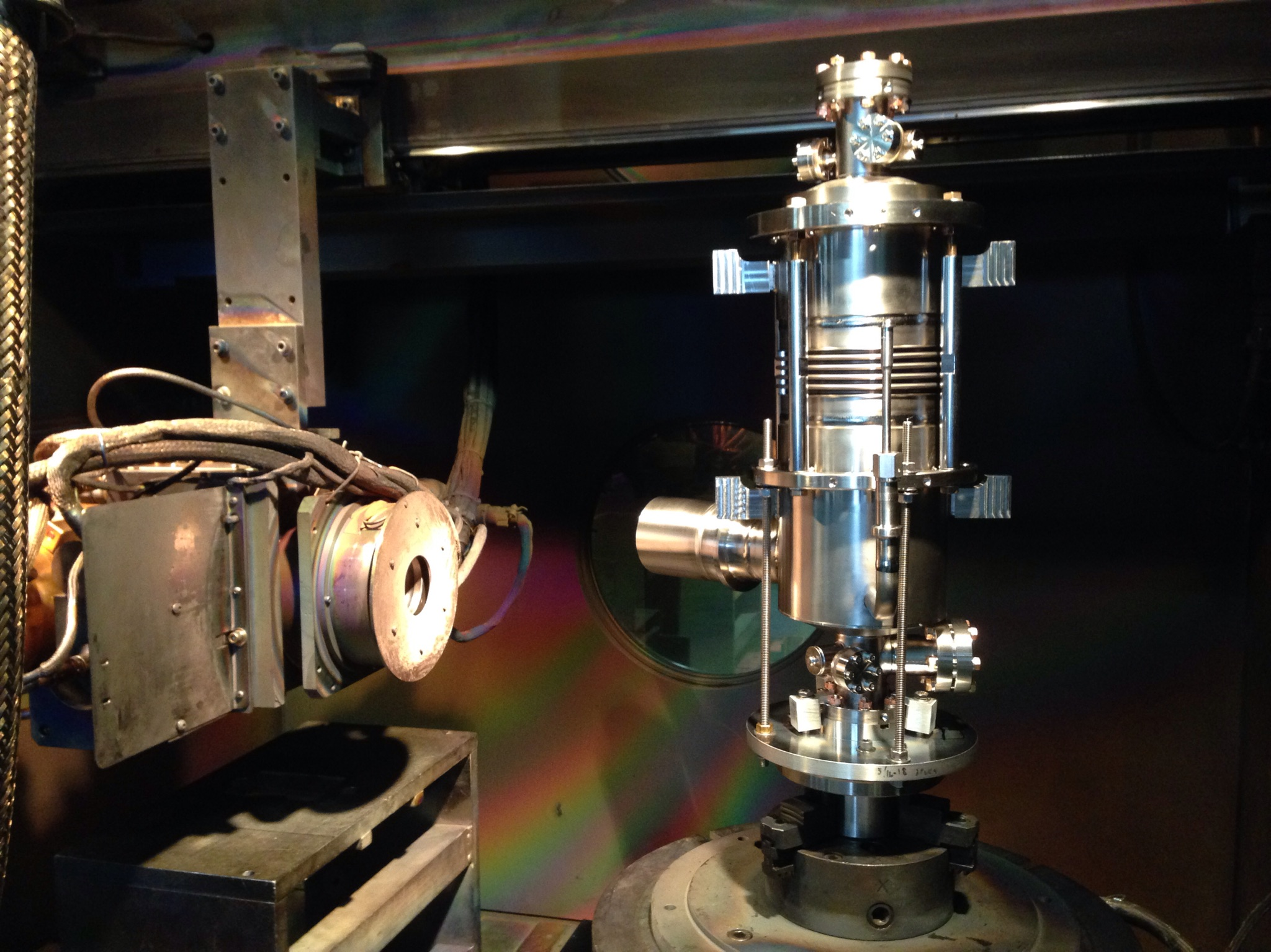
3.9 GHz cavities for design verification
Four bare cavities fabricated by RI
  All four cavities have been chemically processed and completed H-degas at ANL and Fermilab
  All four cavities VTS tested at Fermilab
Three cavities were dressed at Fermilab
One cavity has been tested in HTS
Niobium bare cavity
BCP
Dressing a cavity at Sciaky

Slide 6
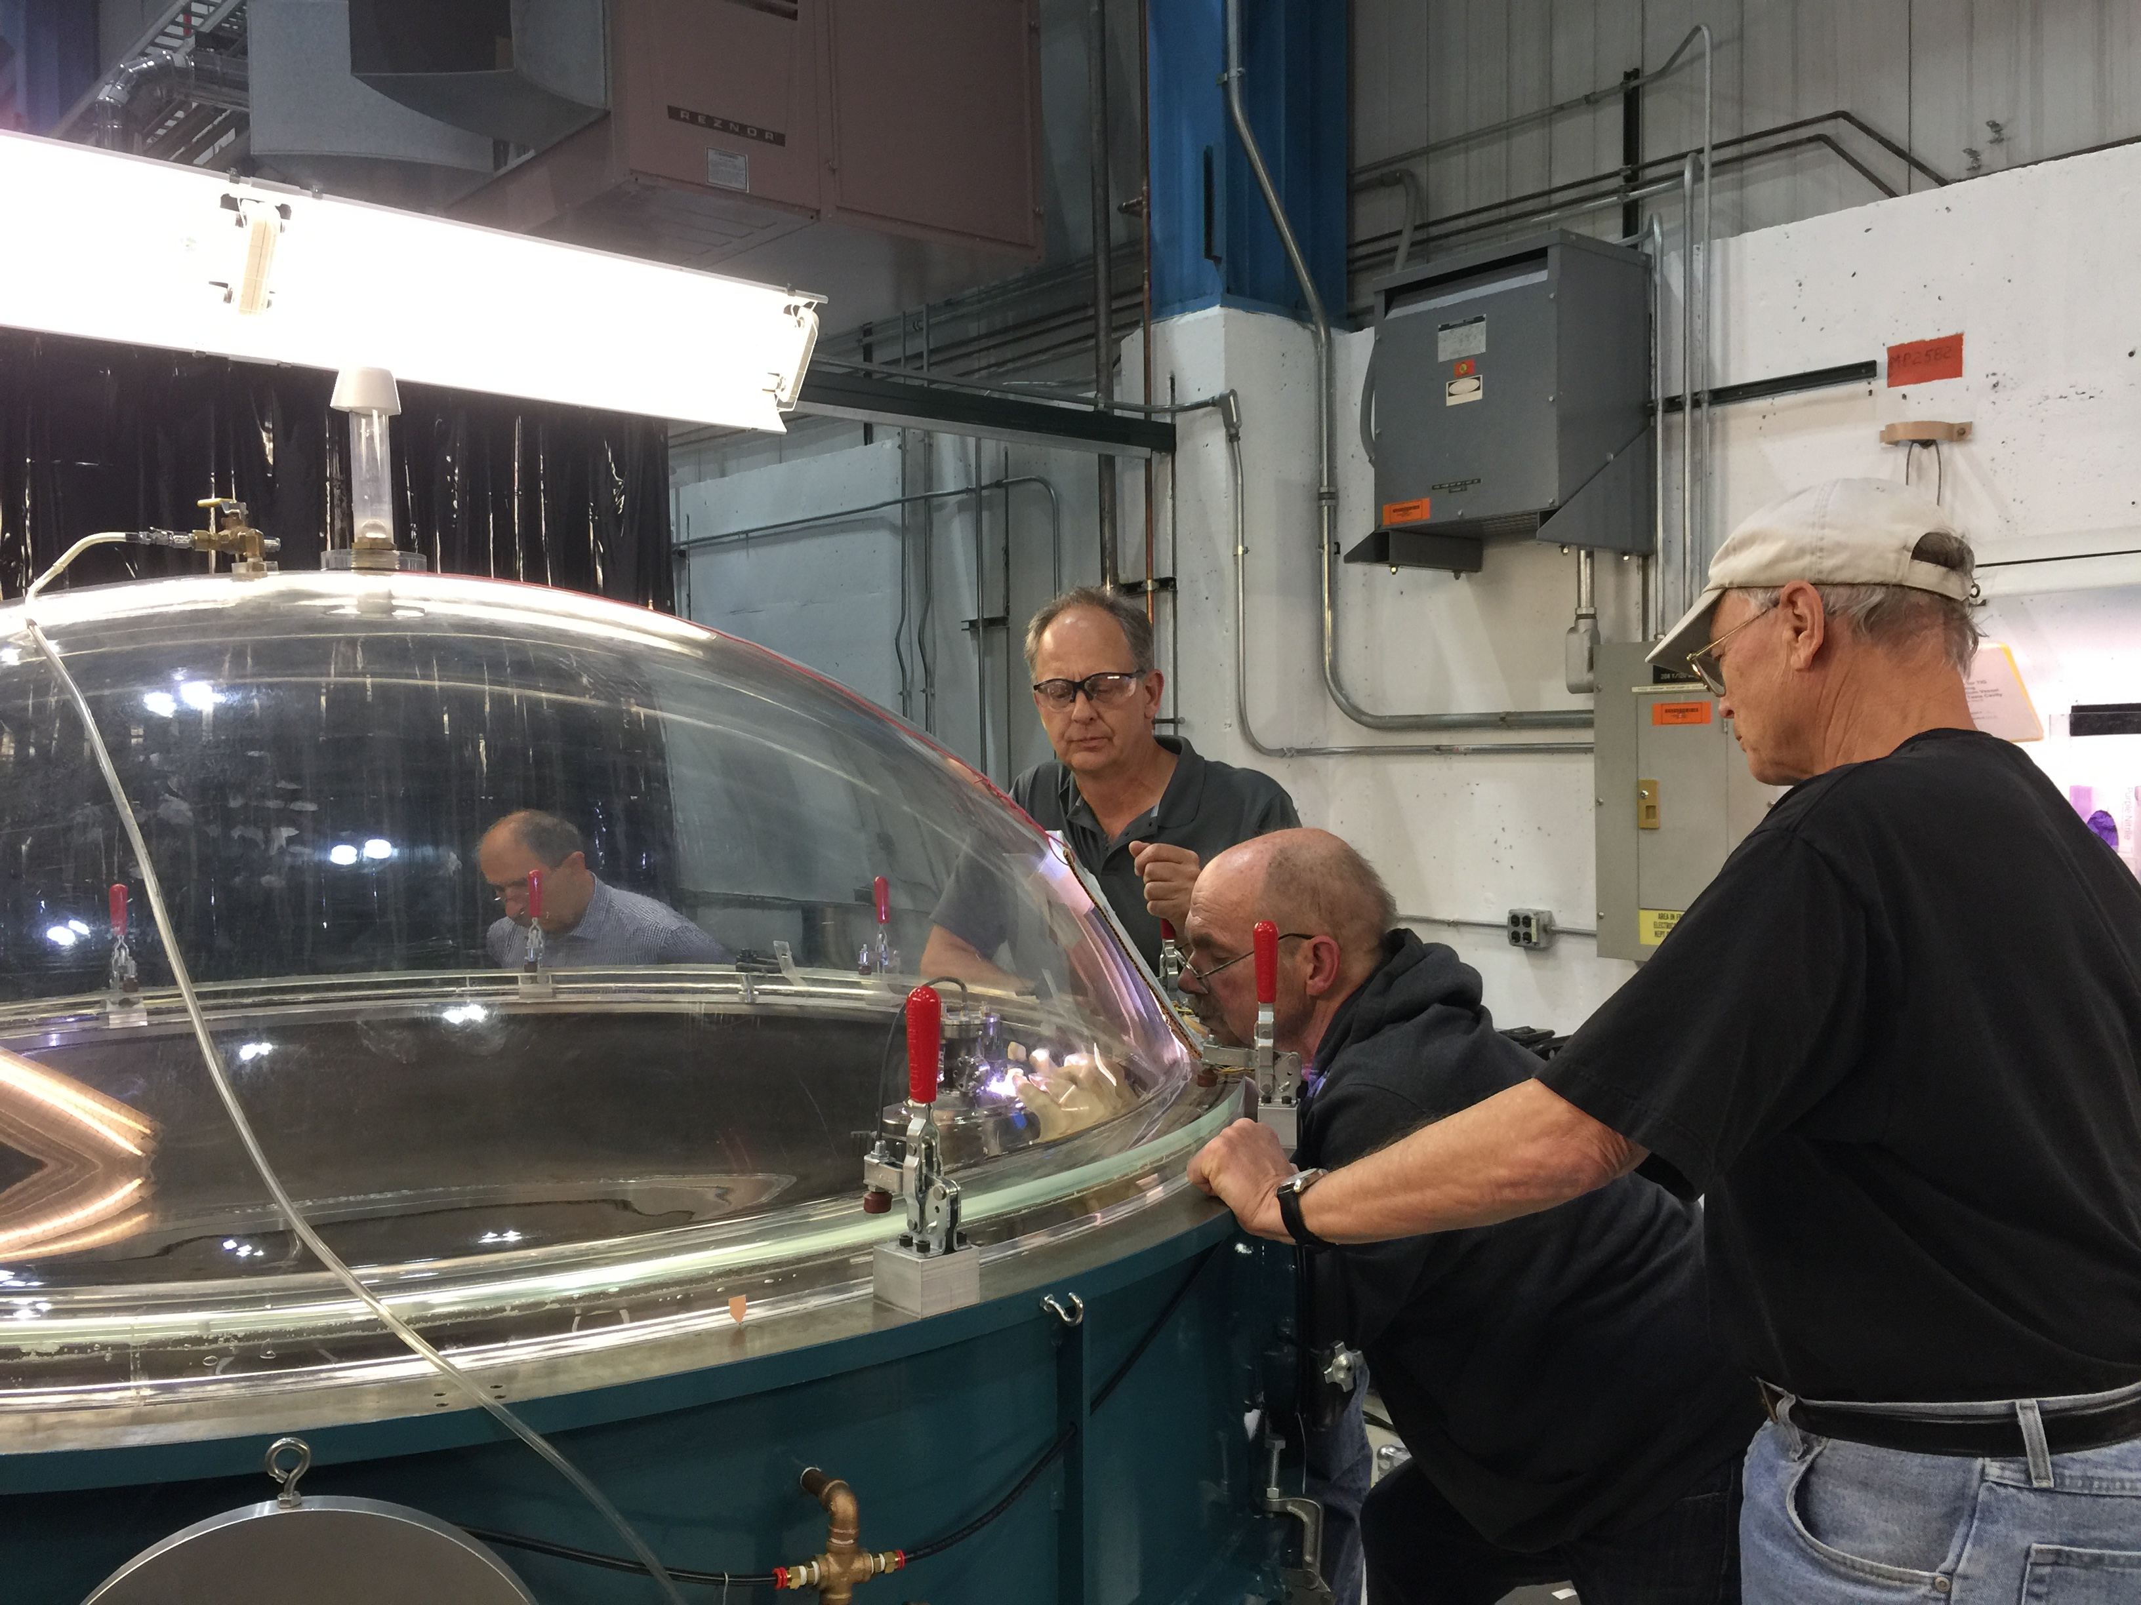
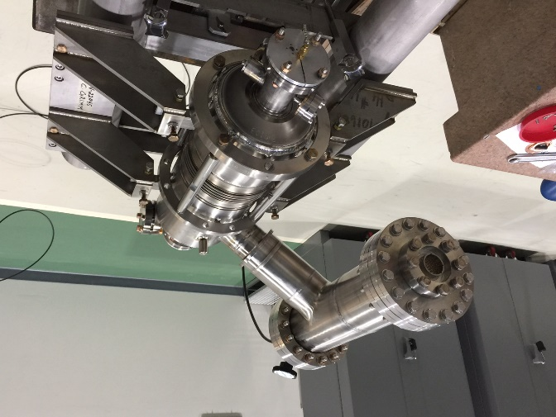
3.9 GHz helium vessel dressing
Helium vessel on a cavity in E-beam vacuum chamber
Helium vessel Final TIG welding
Pressure test
3HRI01, 3HRI02 and 3HRI03 fully dressed and pressure tested.

Slide 7
Cavity processing work flow
  Major difference from 1.3 GHz cavities:
    No N-doping
      Not necessary
      Electropolishing for 3.9 GHz 9-cell cavities would have to be established
  Sufficiently high Q for 3 CMs reached by BCP + 120C bake
  Cavity processing work flow validated at Fermilab and transferred to awarded cavity vendor

Slide 8
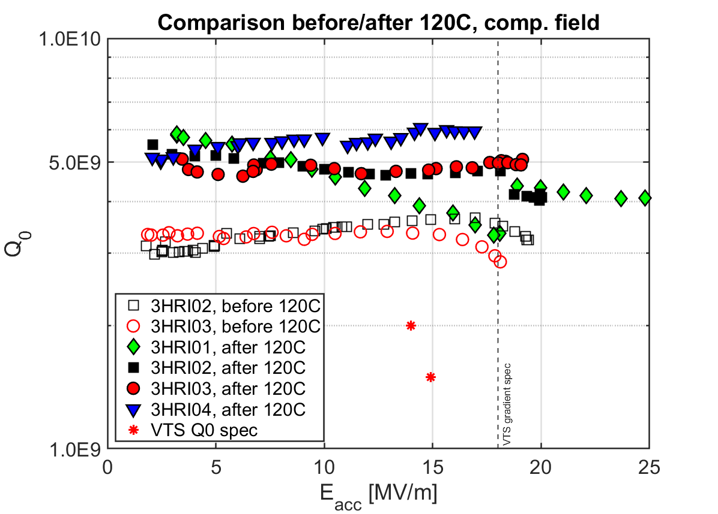
Design verification cavities: VTS results
  Post-120C bake test of 3HRI03 is the only one with field emission
  BCP and 120 bake surpasses Q0 specification with big margin

Slide 9
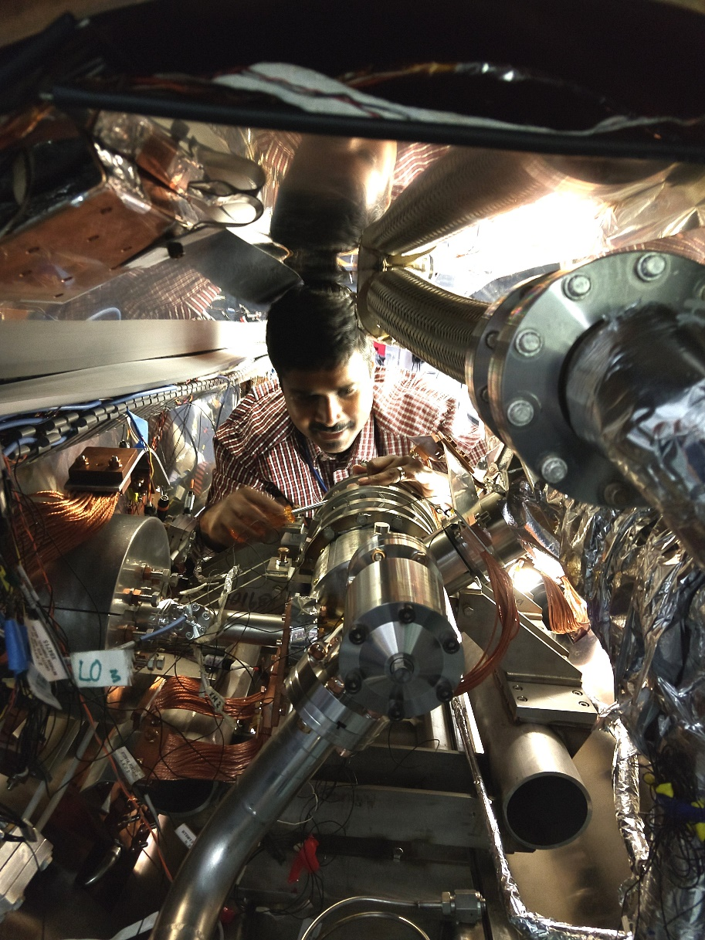
Horizontal testing
  Conditions similar to cryomodule operation
  Integrated testing of all components
    Including: Magnetic shielding, power coupler, tuner, HOM couplers
  Resolve possible interference

Slide 10
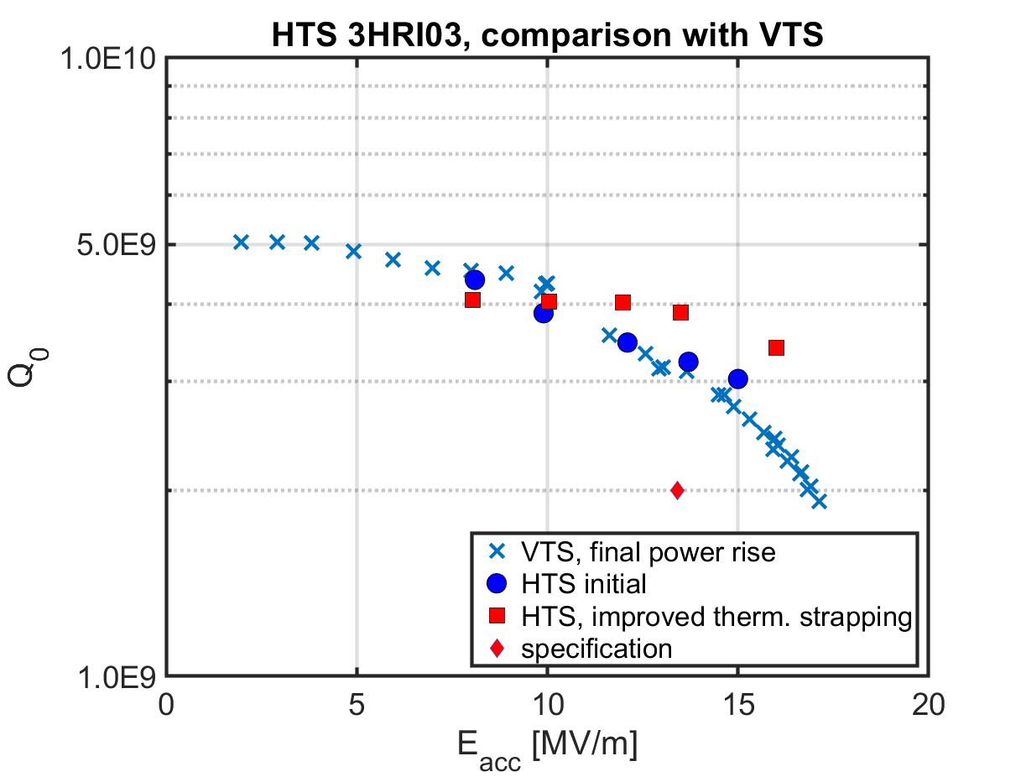
HTS: design verification cavity performance
  Q in HTS matches VTS performance
  Ultimate quench in HTS at 20.4 MV/m (FE present)

Slide 11
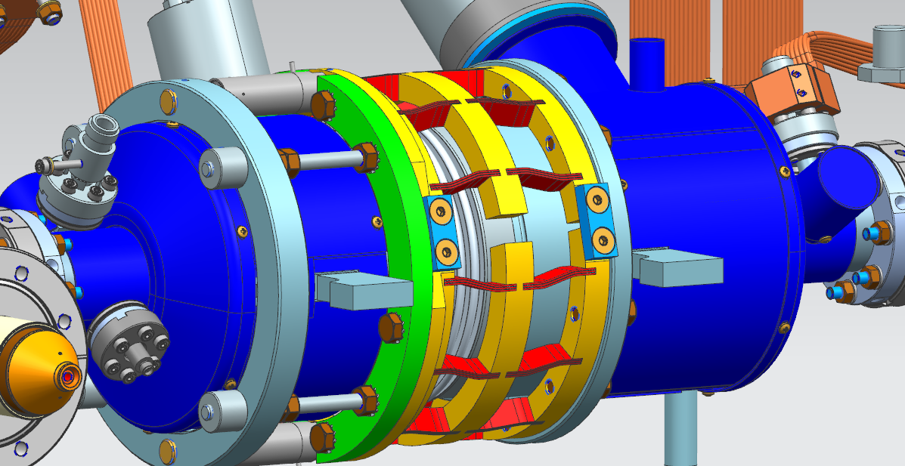
Magnetic shielding
  Specification is <15 mG average over cavity in cryomodule
  Hard/impossible to cover outside of helium vessel
    hybrid shield approach
    External magnetic shield – primarily “end caps” to shield beam tube and chimney openings

Slide 12
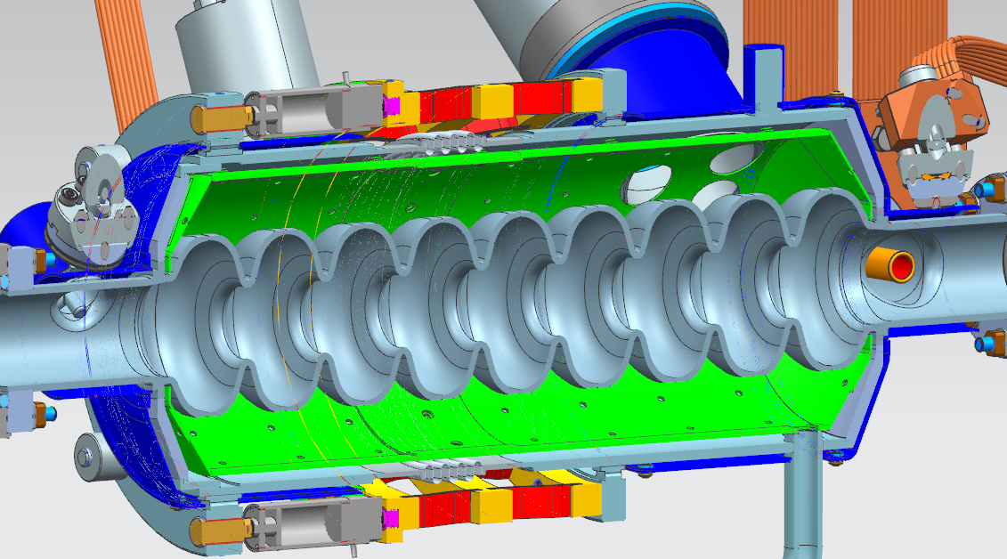
Magnetic shielding
  Internal magnetic shielding covering cavity
  Small holes to allow liquid helium/heat transfer
  3 big holes next to chimney

Slide 13
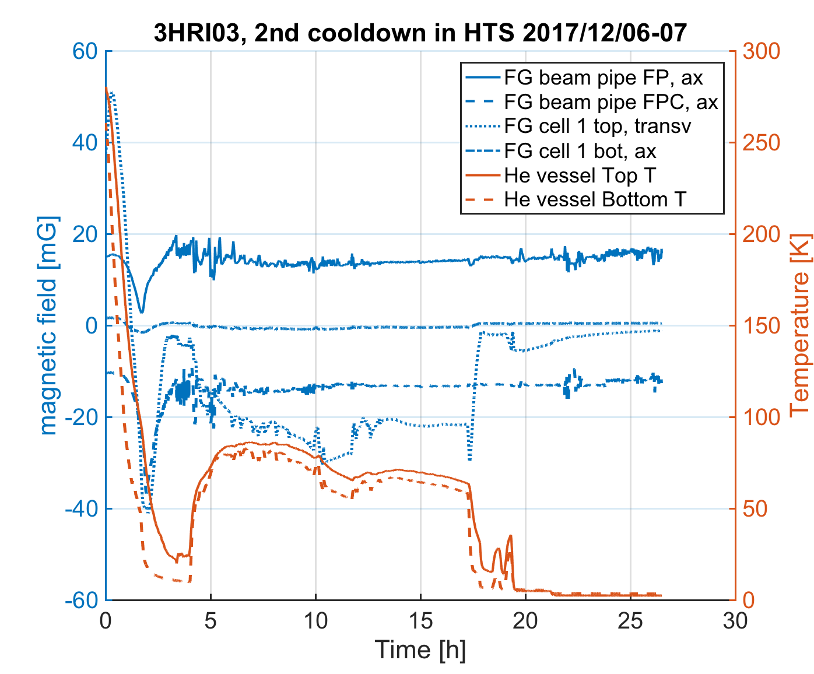
Magnetic shielding: Cooldown data
  2 FGs on beam pipe
  2 FGs inside He vessel on cell 1
    Reading <0.5 and <1.5 mG

Slide 14
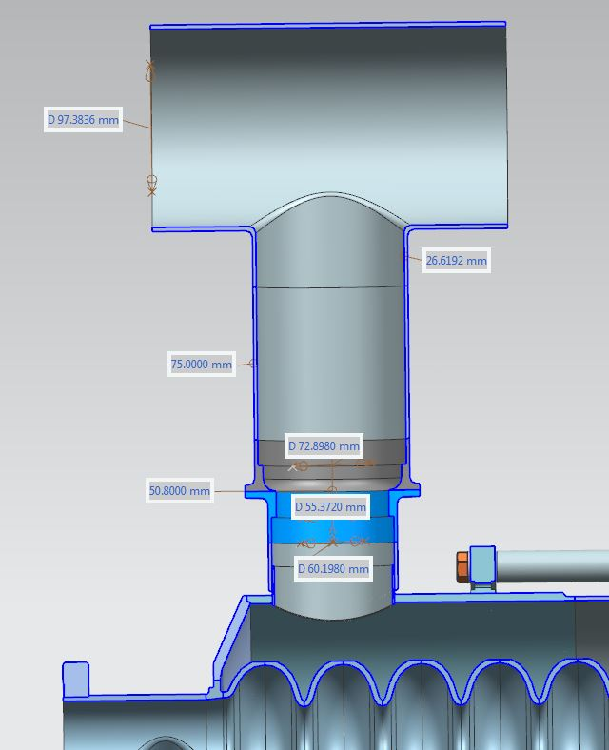
Chimney heatload limit
Heat load capacity limited by chimney size
Limited area on helium vessel
-> stepwise diameter increase
Gradient [MV/m] | Q0 | Dynamic Heat Load [W]
13.4 | 2.0e9 | 14.3
14.9 | 1.5e9 | 23.6
14.9 | 4.0e9 | 8.9
Nominal operation
Max. operation
Maximum heat load capacity is calculated ~ 36.2 W (50% margin)
Heater (28 W) operated in parallel to cavity (12 W):
~40 W heatload capacity

Slide 15
HTS: Achieved goals
  Cavity Q and E performance surpasses specification
  Magnetic shielding performs well and surpasses requirements
  Chimney heatload limit measured to be slightly above prediction

Slide 16
Cavity production
  24 production cavities ordered
    Up to 4 cavities already on hand from design verification
  Cavities are delivered ready for acceptance testing
  First 4 cavities have been delivered
  Finish production of all 24 cavities by end of March according to schedule at vendor

Slide 17
Production hold point data
  3 holdpoints throughout cavity production
    HP1: after mechanical completion of cavity
    HP2: after bulk BCP and 800C degassing
    HP3: after completion of cavity preparation for VTS test
  Data is uploaded by RI and reviewed by Fermilab/SLAC experts for release
    21 cavities past HP1
    9 cavities past HP2
    4 cavities past HP3

Slide 18
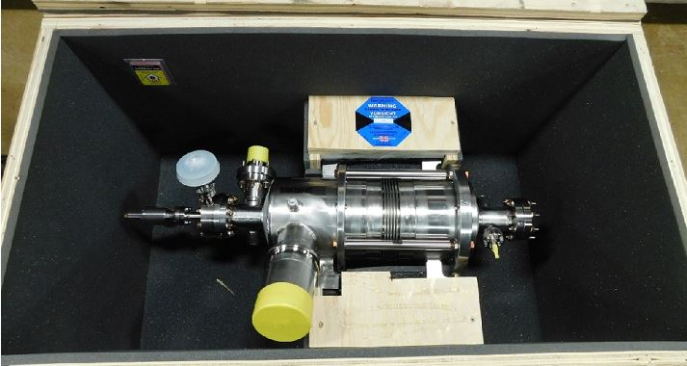
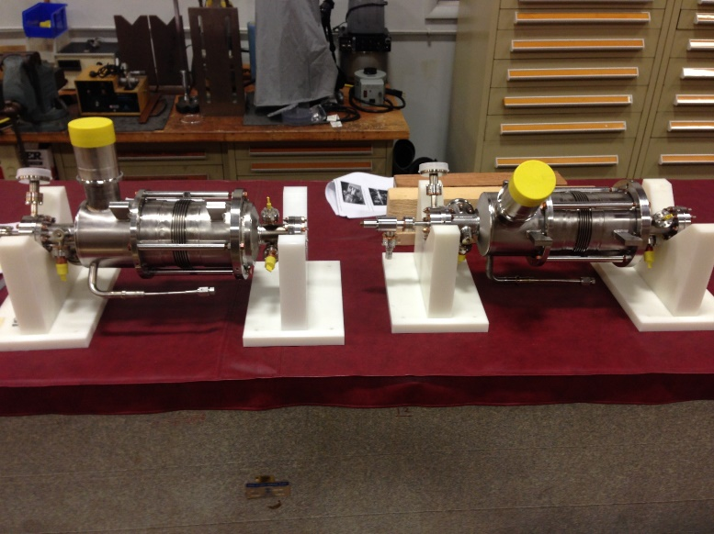
Production cavity incoming inspections
  Visual inspection, leak check of He space,
  RF checks
  4 cavities received to date at Fermilab (3HRI05, 3HRI06, 3HRI08, 3HRI12)
  No major non-conformances (1 burst disc position)

Slide 19
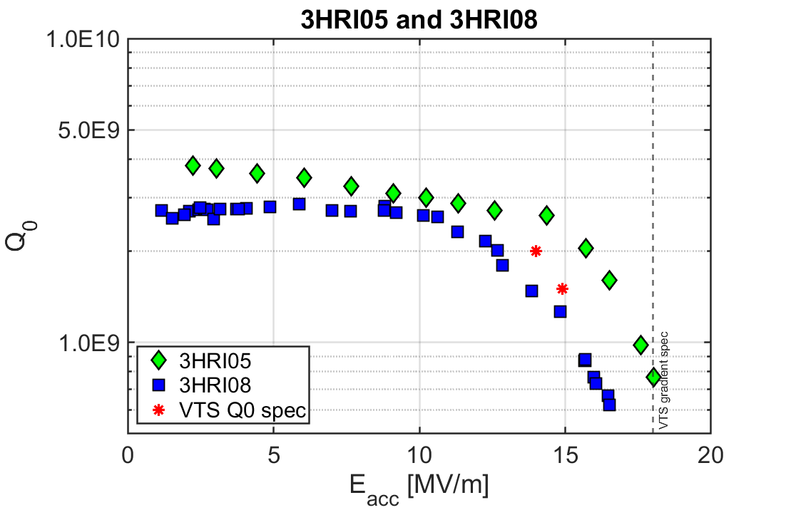
Production cavity VTS results (3HRI05+3HRI08)
  Both cavities show field emission and need to be
  re-rinsed
  3HRI05 meets specification for Eacc and Q0 despite strong radiation
Test results communicated to cavity vendor, implementing changes to HPR design

Slide 20
Summary
Processing work flow and VTS performance verified with
4 design verification cavities
BCP + 120C bake yields sufficient Q margin
  In VTS: average Q = 4.7E9 at 13.4 MV/m,
  Avgerage E_{acc,max} = 20 MV/m
3HRI03 cavity performance in HTS matches VTS performance
Hybrid magnetic shielding approach works well
First 4 production cavities delivered and first 2 cavities VTS tested

Slide 21
Acknowledgements
Many thanks to everyone who contributed to this talk, special thanks to S. Chandrasekaran, C. Ginsburg,
C. Grimm, Y. He, J. Kaluzny, Y. Orlov, T. Peterson,
N. Solyak and G. Wu

Slide 22
Additional slides

Slide 23
Cavity processing work flow (detailed)
  Difference from 1.3 GHz:
    No N-doping, BCP + 120C bake yields sufficiently high Q for 3 CMs
Continue
Continue
Receiving at Fermilab as a ready to test dressed cavity
Cavity processing work flow validated and transferred to awarded cavity vendor

Slide 24
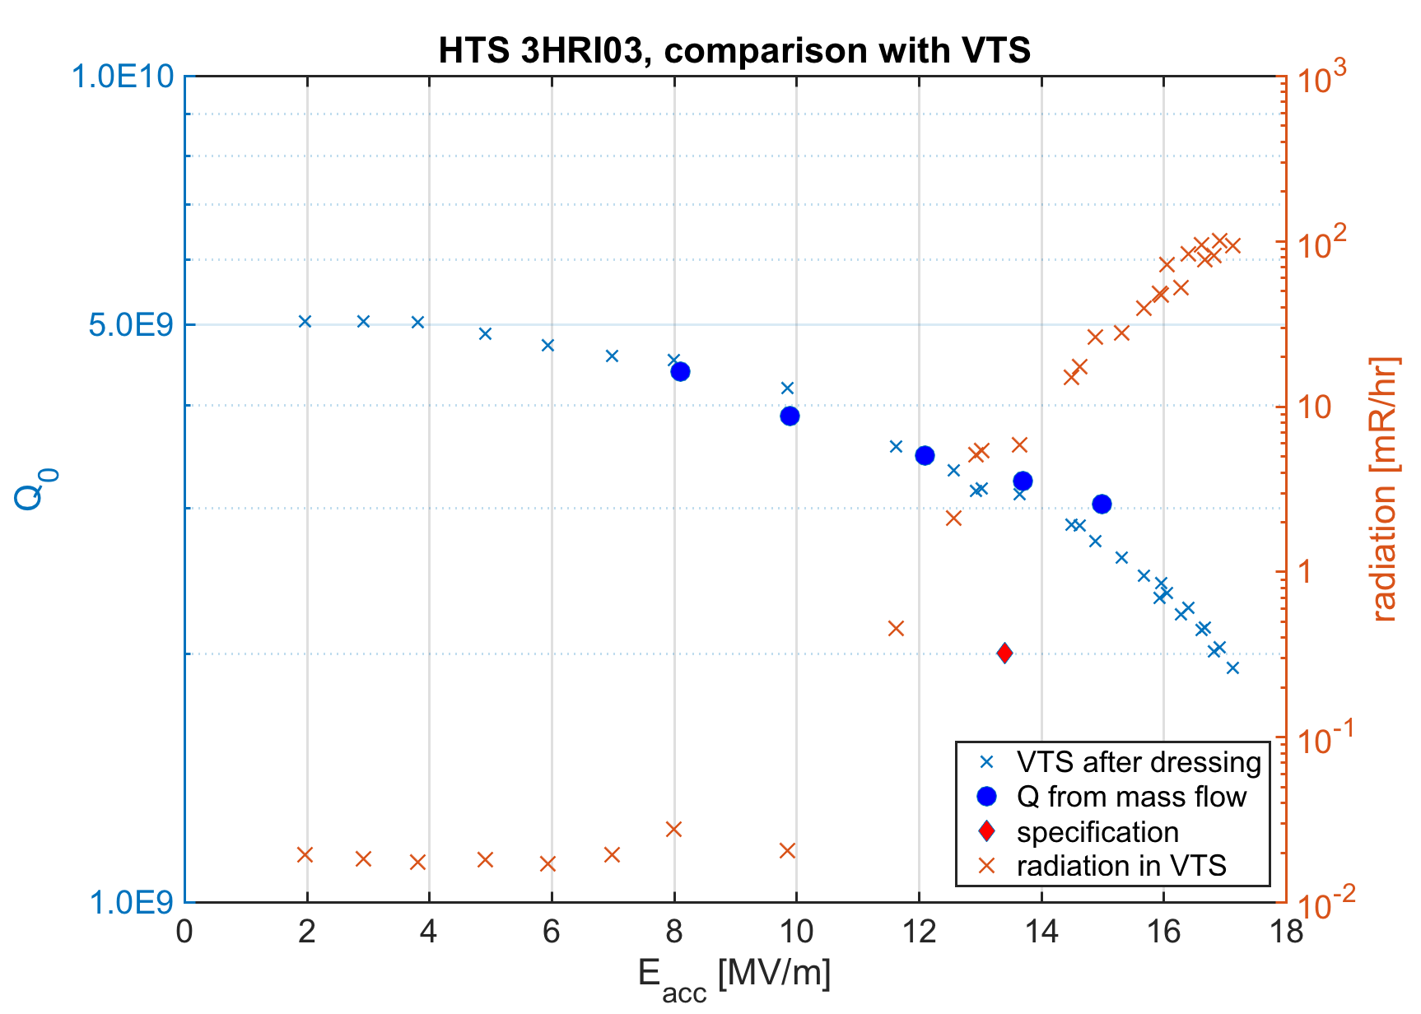
HTS: cavity performance

Slide 25
Field emission in HTS

Slide 26
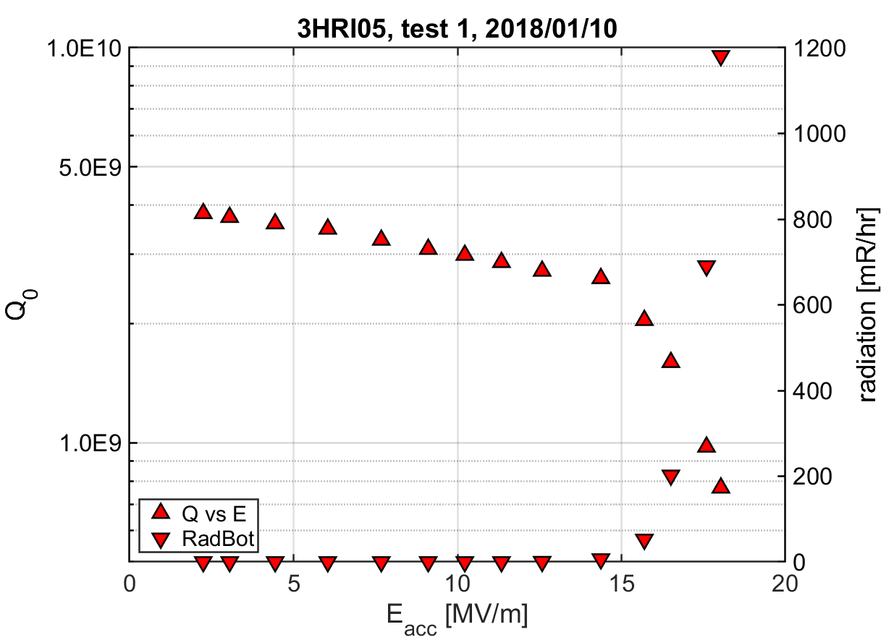
Production cavity VTS results (3HRI05)

Slide 27
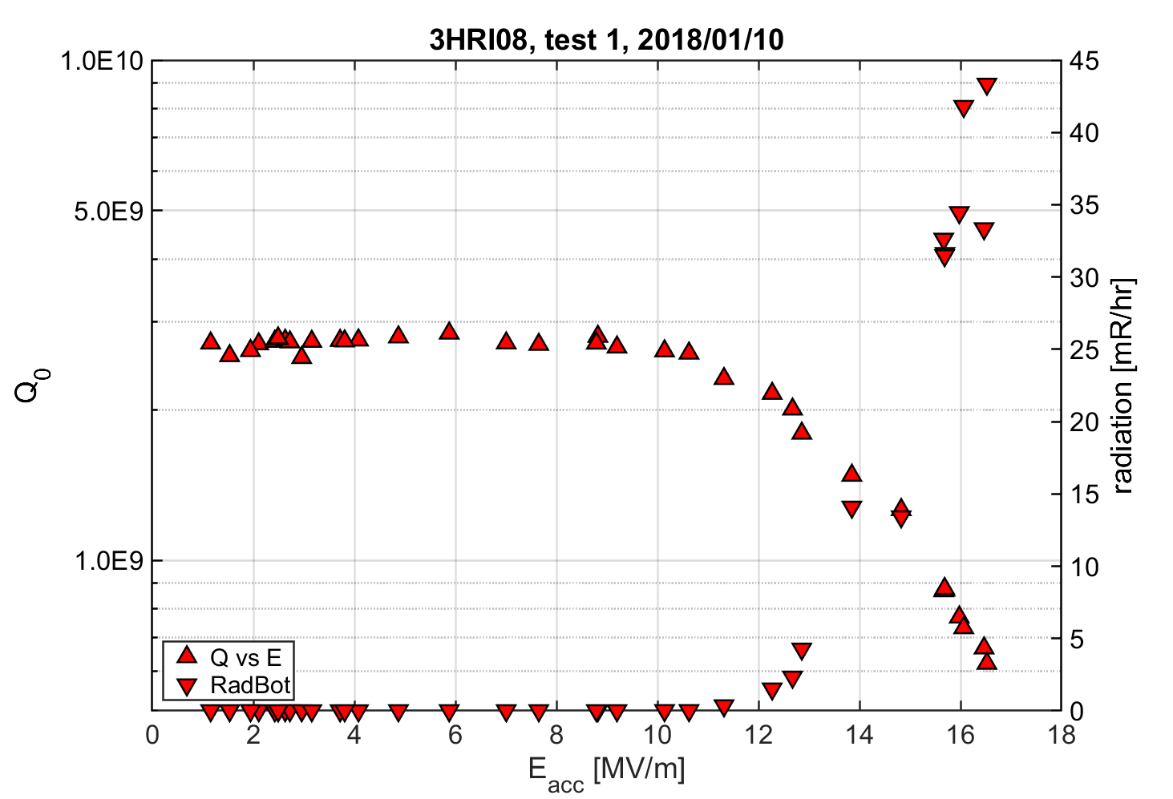
Production cavity VTS results (3HRI08)

