Slide 1
Cryomodule Transportation
Brian Hartsell for the Cryomodule Transportation Team
LCLS-II 3.9 GHz CM Delta Final Design Review
January 29-30, 2019

Slide 2
Outline
Past experience and lessons learned
Known differences between LCLS-II 1.3 GHz and 3.9 GHz relating to transportation
Testing and modeling in preparation for 3.9 GHz transport
Testing using 3.9 GHz cryomodule
Considerations at SLAC

Slide 3
Transportation experience
Successfully transported FLASH 3.9 GHz cryomodule from Fermilab to DESY in April 2009.
Members from this team are part of the LCLS-II 3.9 GHz transport team.
FLASH was a very different transport (multi-modal, international), but ideas were borrowed from this transport.
LCLS-II 1.3 GHz cryomodules
Most recently, successfully transported three 1.3 GHz cryomodules from Fermilab to SLAC after a failed shipment.
Members of this team are directly involved with the 3.9 GHz shipping plan.
Many lessons learned from this experience are integrated into the LCLS-II 3.9 GHz shipping plan.

Slide 4
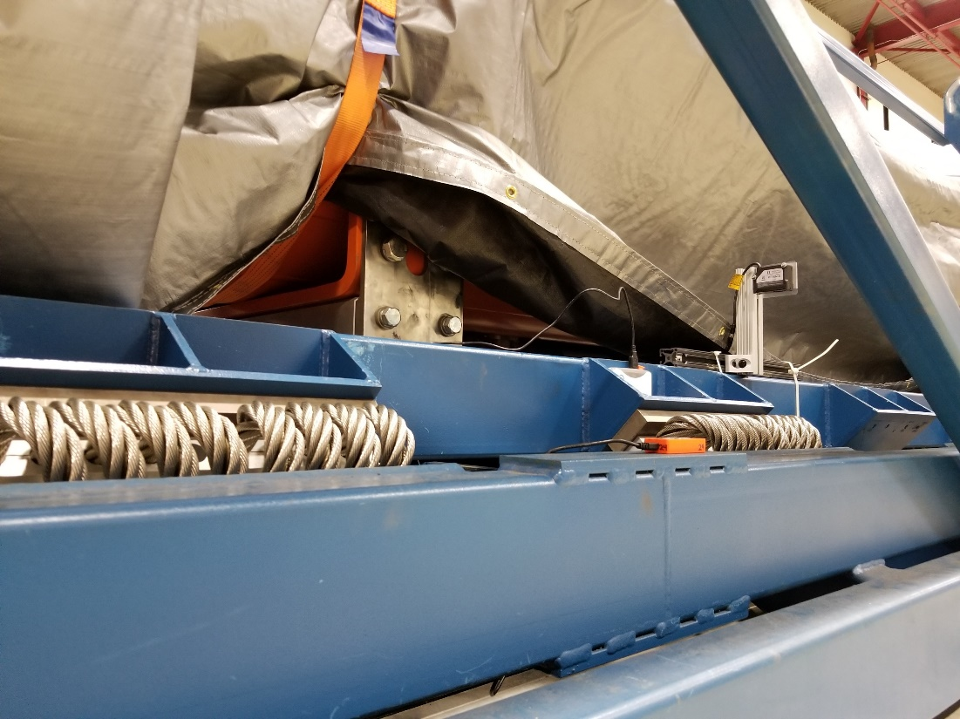
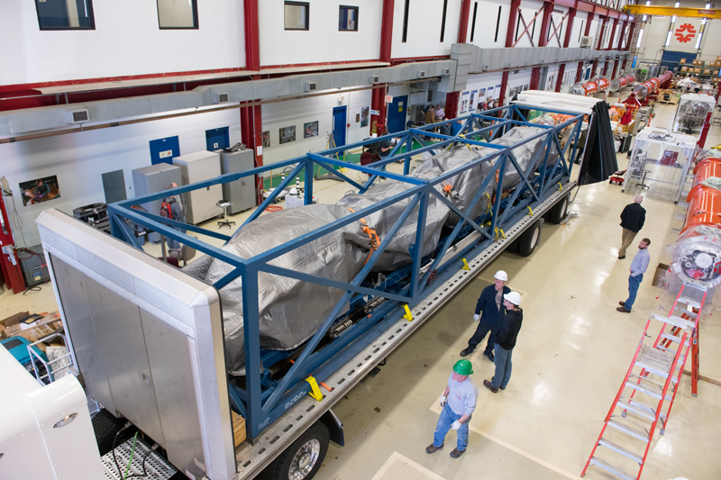
LCLS-II 1.3 GHz shipping: Quick summary
Cryomodules are transported over the road using an isolation frame mounted on an air ride trailer.

Slide 5
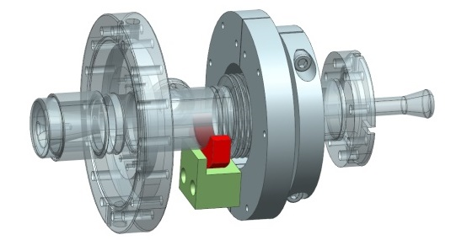
LCLS-II 1.3 GHz shipping: Quick summary
Failures during shipping and shipment tests of the cold coupler bellows led to optimization of the transportation system and development of stabilization for sensitive parts.
Image and design courtesy Jefferson Lab

Slide 6
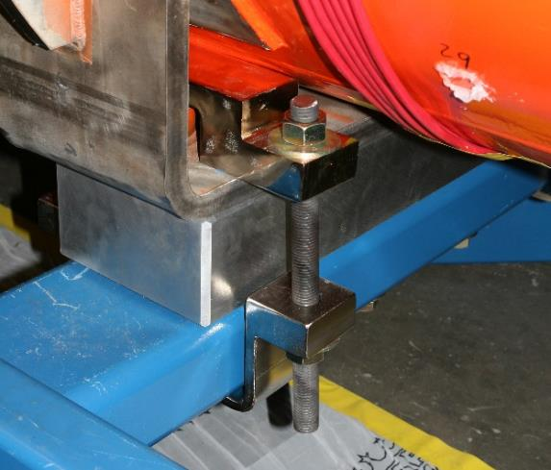
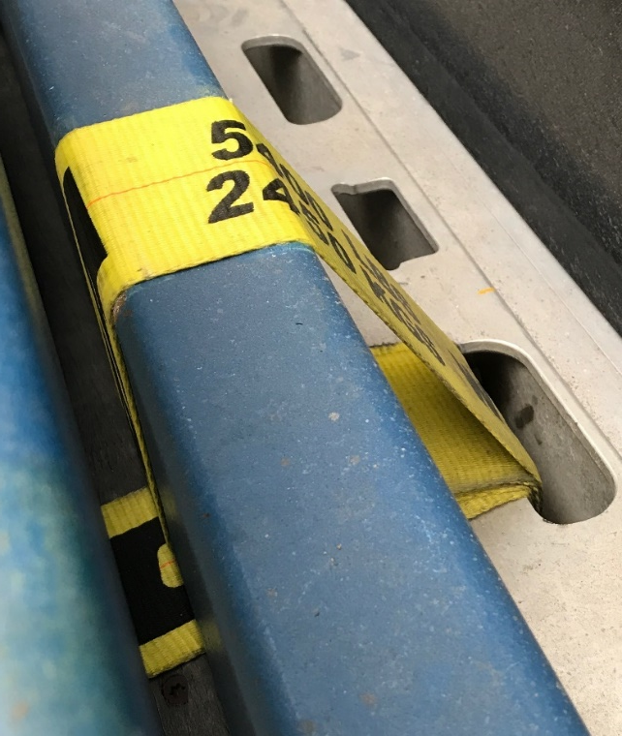
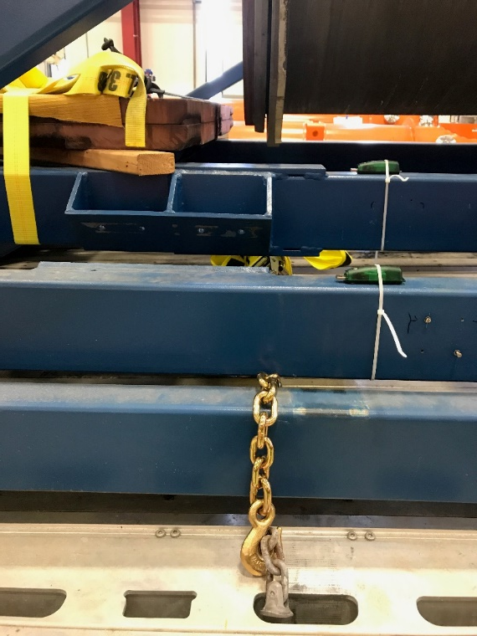
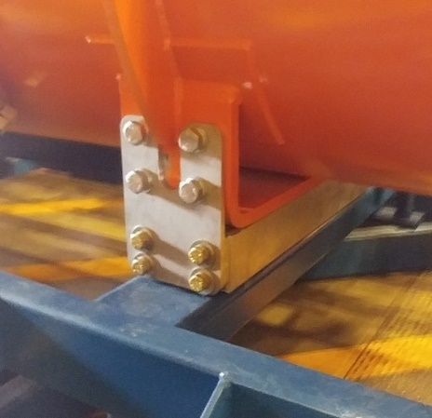
Lessons learned from 1.3 GHz shipping: Frame
Rigidly fix the isolation frame to trailer.
Optimize spring selection and placement to provide low resonant frequency and optimal attenuation.
Stiffen inner frame so springs are effective.
Use of ‘shear plates’ to hold CM to the frame.

Slide 7
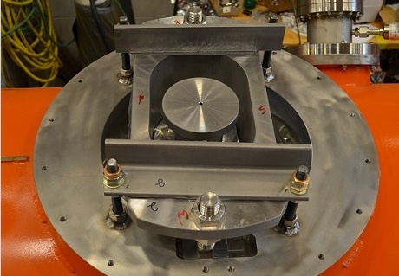
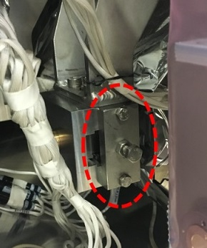
Lessons learned from 1.3 GHz shipping: Restraints
The coupler cold bellows was identified as the source of 1.3 GHz beamline leaks that developed during shipping.
Methods to limit movement of this bellows were implemented.
Cold mass support restraints added.
Cavity string restraints installed.

Slide 8
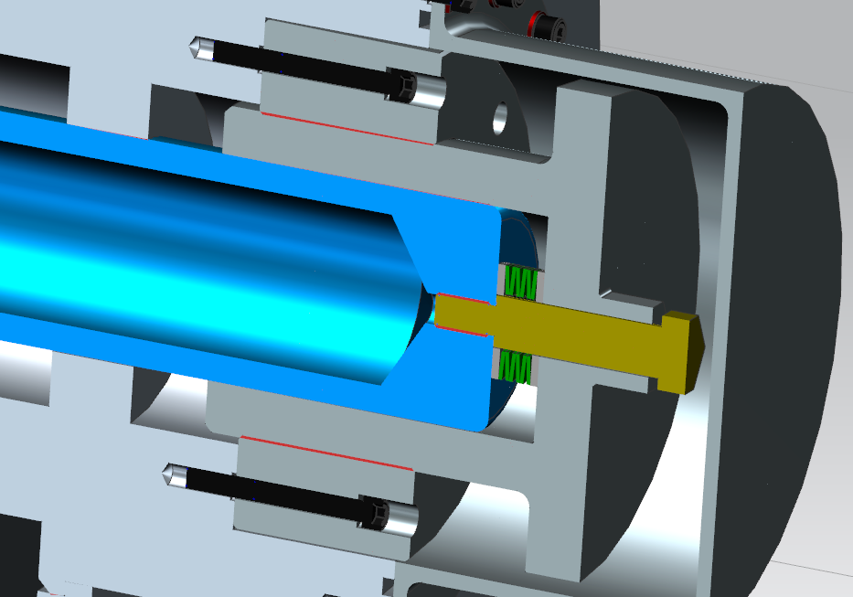
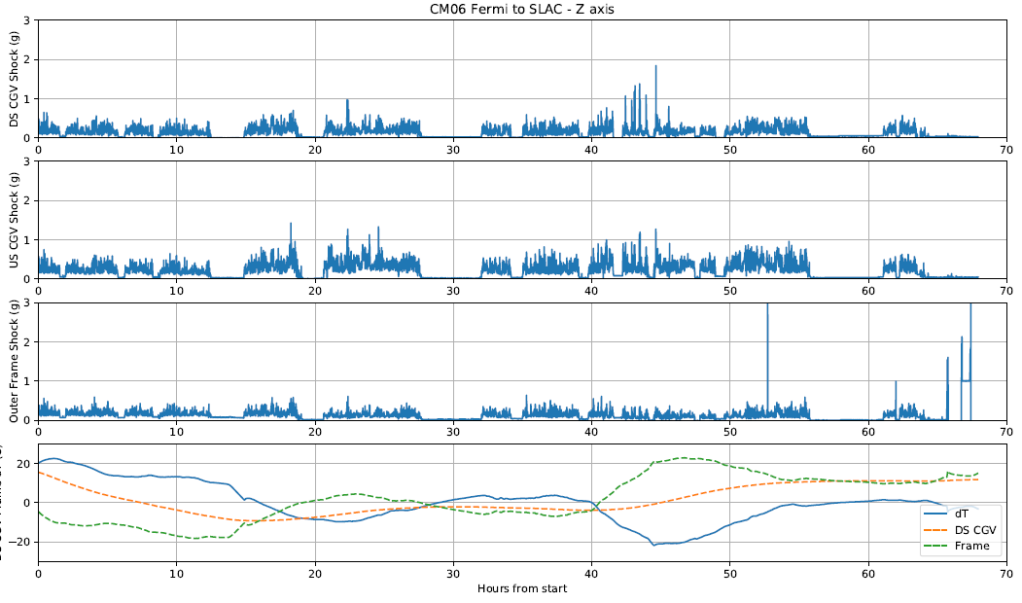
Lessons learned from 1.3 GHz shipping: Thermal Transients
Differences in thermal expansion coefficients between the HGRP and vacuum vessel and/or temperature differential between the two leads to possible loss of contact between transport cap and HGRP adapter.
Implemented spring washers in the transport cap.
Install blankets on the cryomodule.

Slide 9
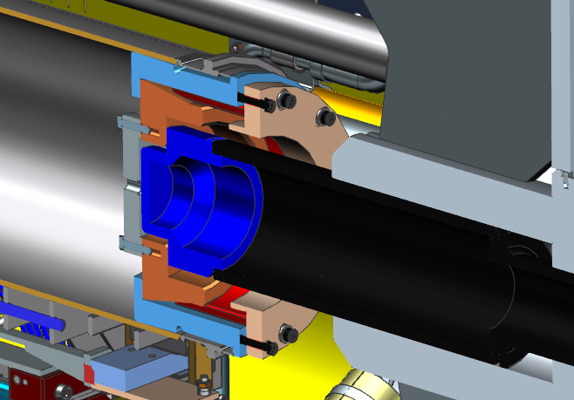
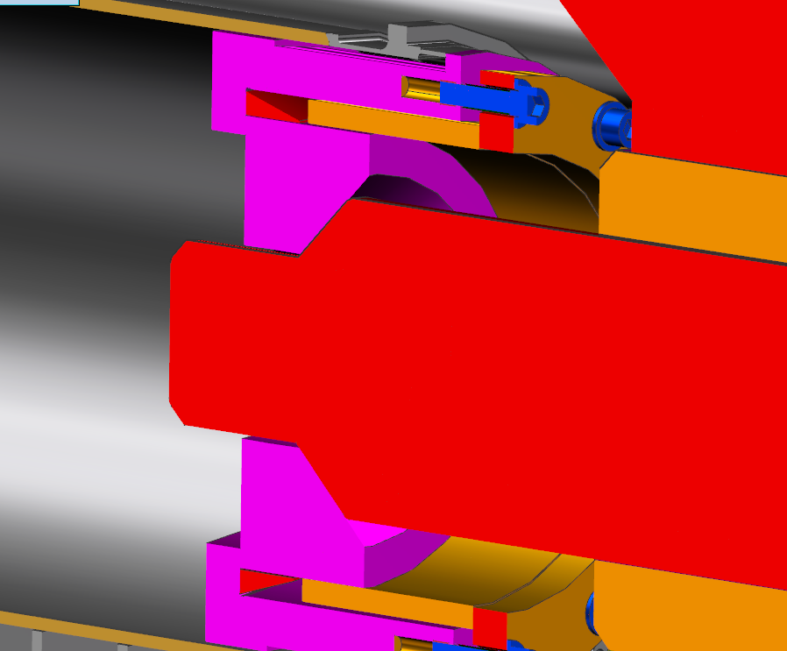
Lessons learned from 1.3 GHz shipping: Cold mass stabilization
Planar interface between transport cap and HGRP adapter used for F1.3-06 allowed for movement during thermal contraction or high shock loading
Reverted to the XFEL transport system with a conical interface.
LCLS-II used on F1.3-06
XFEL

Slide 10
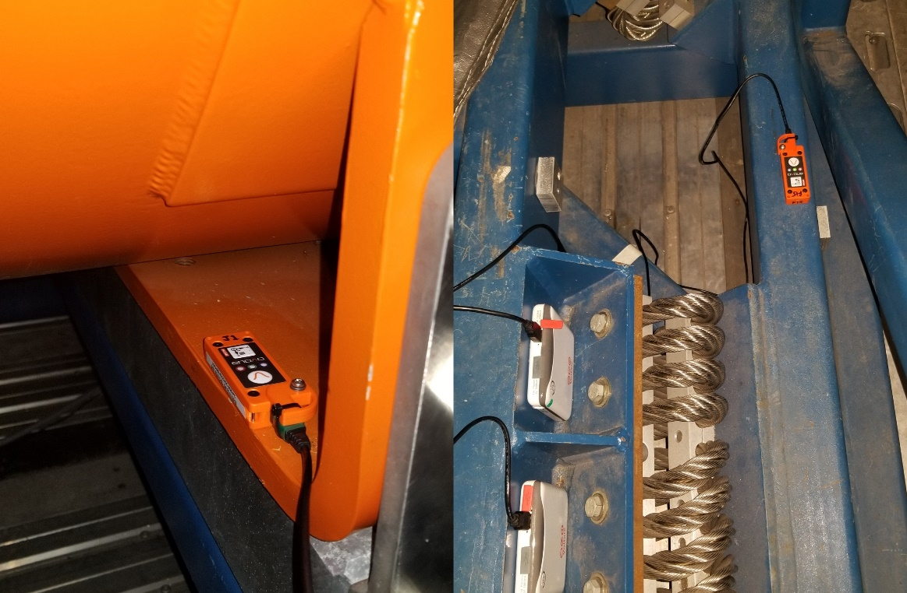
Lessons learned from 1.3 GHz shipping: Sensors and their placement
Sensor placement plays a large role in transfer function quality, especially when the frame is relatively flexible.
Slam Sticks were qualified for use on 1.3 GHz shipments.

Slide 11
Lessons learned from 1.3 GHz shipping
Incorporate testing with a dummy load as much as possible.
When a real cryomodule is not needed, do not use it.
Integrate offline testing (shaker table, fatigue, modal, etc) during the evaluation of sensitive components.
Lessons learned from 1.3 GHz shipping will be applied to 3.9 GHz shipping.

Slide 12
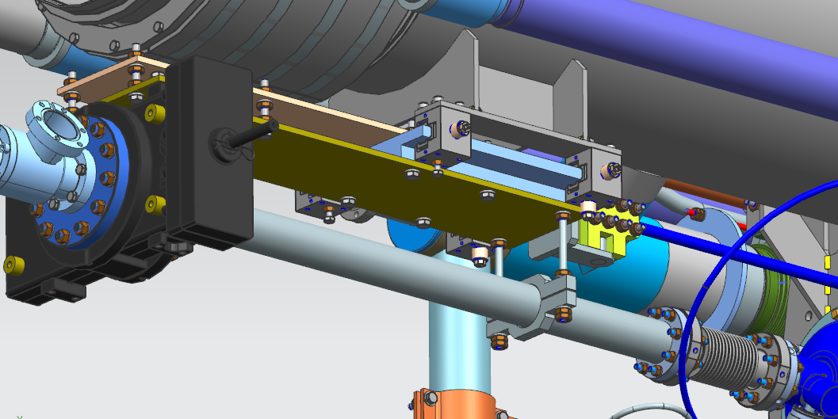
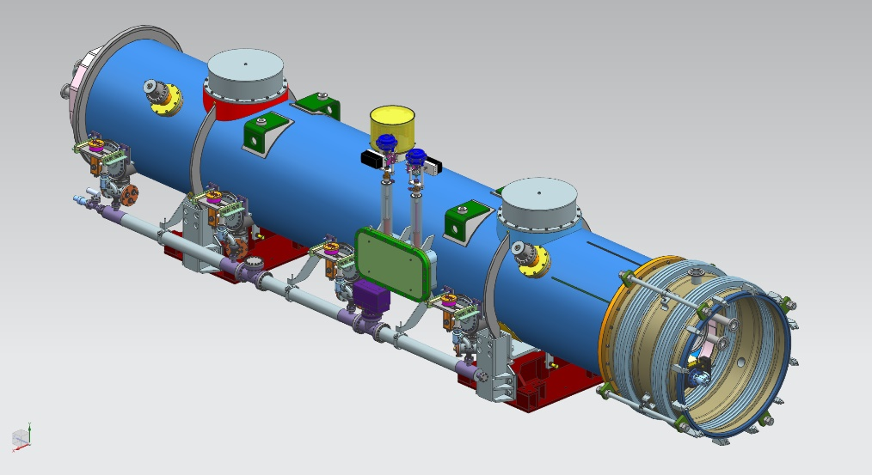
Differences between LCLS-II 1.3 GHz and 3.9 GHz cryomodules
Tom N. will lead an internal “fresh look” at the design from a transportation perspective:
Evaluate all connection points from the cold mass to the cryostat for possible sensitive components.
Evaluate assembly for issues that can be mitigated by design.
Long lever arm in the spool has already been identified and corrected.

Slide 13
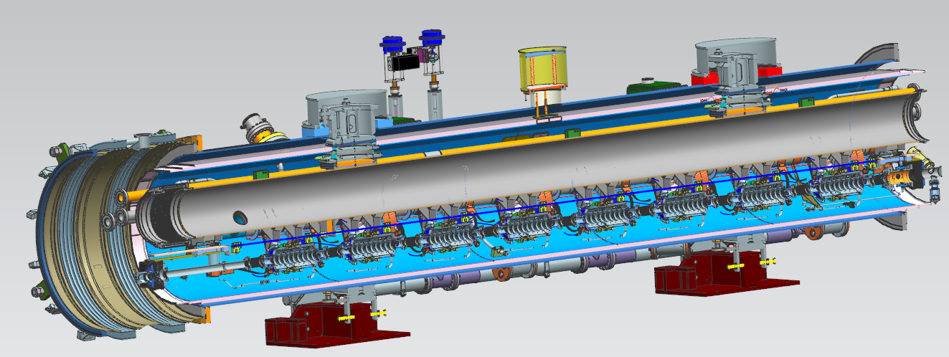
Differences between LCLS-II 1.3 GHz and 3.9 GHz cryomodules
Known differences relevant to transport:
Different input coupler design.
Couplers are on both sides of the CM.
No magnet on 3.9 GHz CM.
No tuner access ports on 3.9 GHz CM.
Restricts access for mounting shock log devices and restraints.

Slide 14
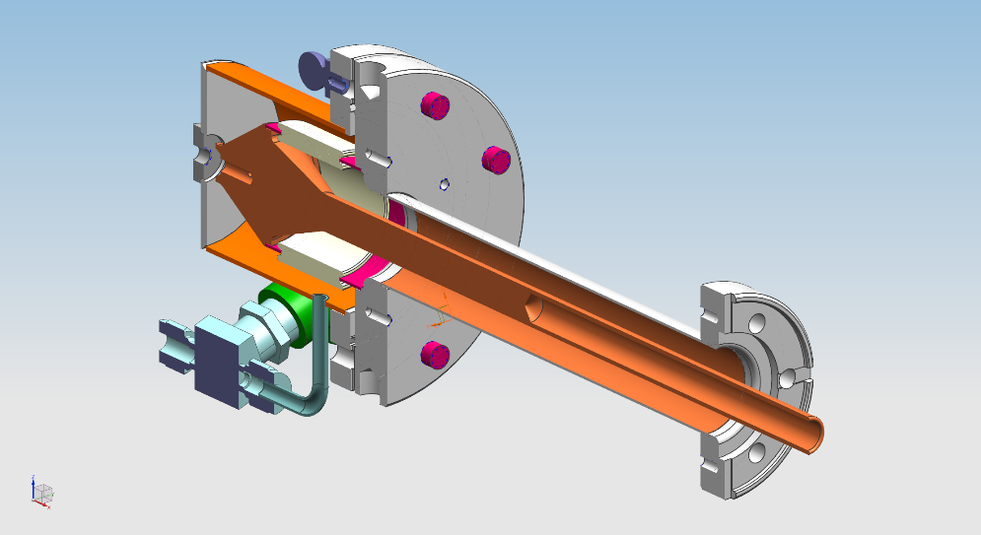
Preparation for 3.9 GHz transport: Simulations
Identify sensitive components of 3.9 GHz CM via examination of CAD models.
Conduct static, dynamic, and modal analyses to look for potential issues:
Detailed models of identified sensitive components
Input coupler, especially ceramic
Beamline bellows
Thermal analysis to identify any problems with expected thermal gradients during shipment (~20C dT)

Slide 15
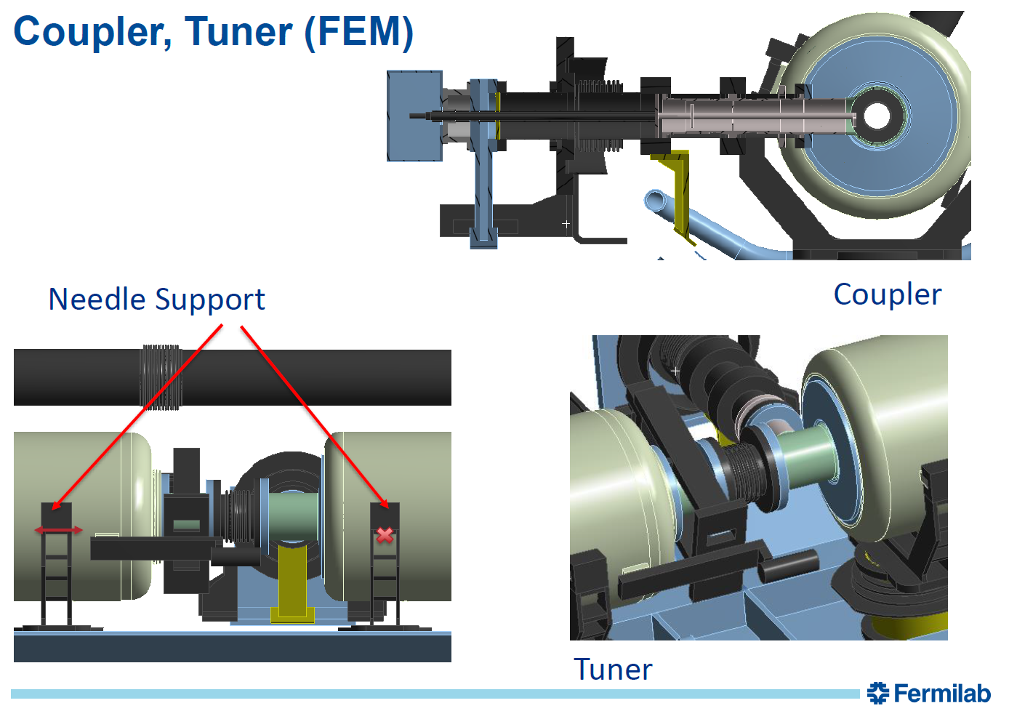
Preparation for 3.9 GHz transport: Simulations
Simplified assembly models to help further identify sensitive components.
These images are from the 650 MHz cavity cryomodule.
(Sergey Cheban)

Slide 16
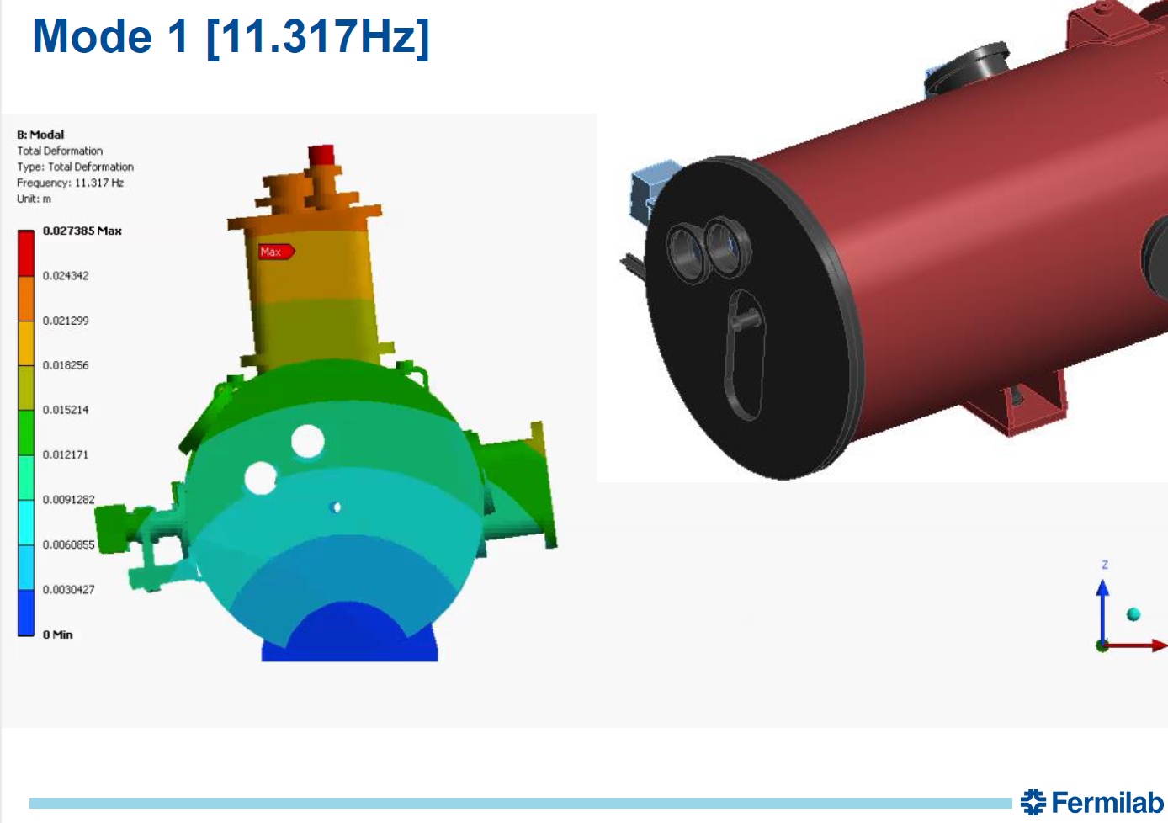
Preparation for 3.9 GHz transport: Simulations
Example of results
These images are from the 650 MHz cavity cryomodule.
(Sergey Cheban)

Slide 17
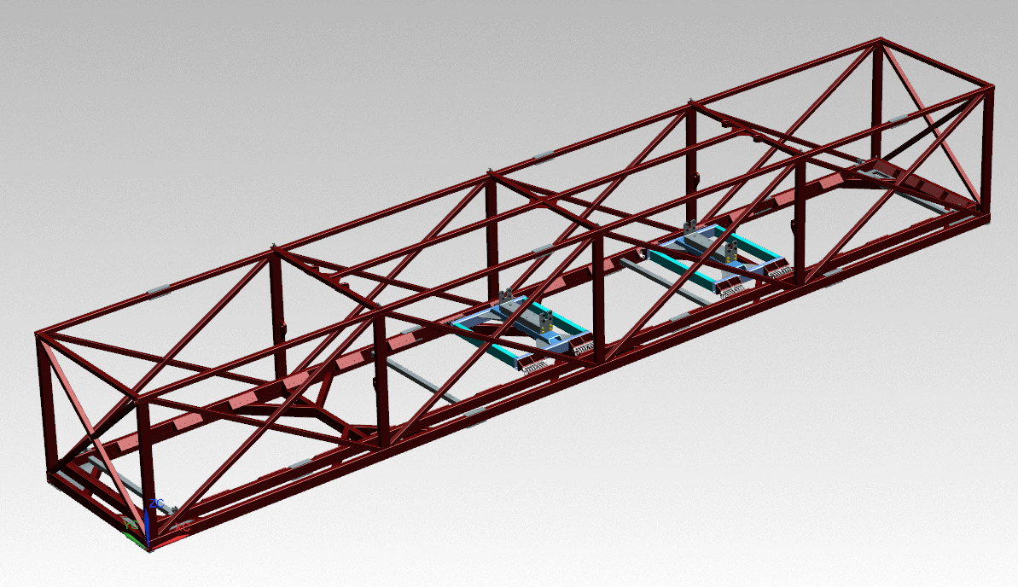
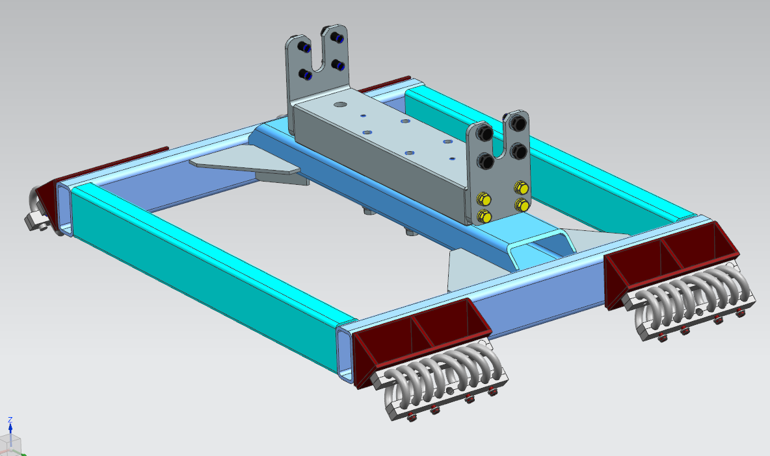
Concept for 3.9 GHz transport system
Re-use ‘outer frame’ of cryomodule transport frame.
Fabricate new platforms for mounting the cryomodule.
Reduces possible resonant modes from the inner frame.
Details still pending (sizing of beams, springs used)

Slide 18
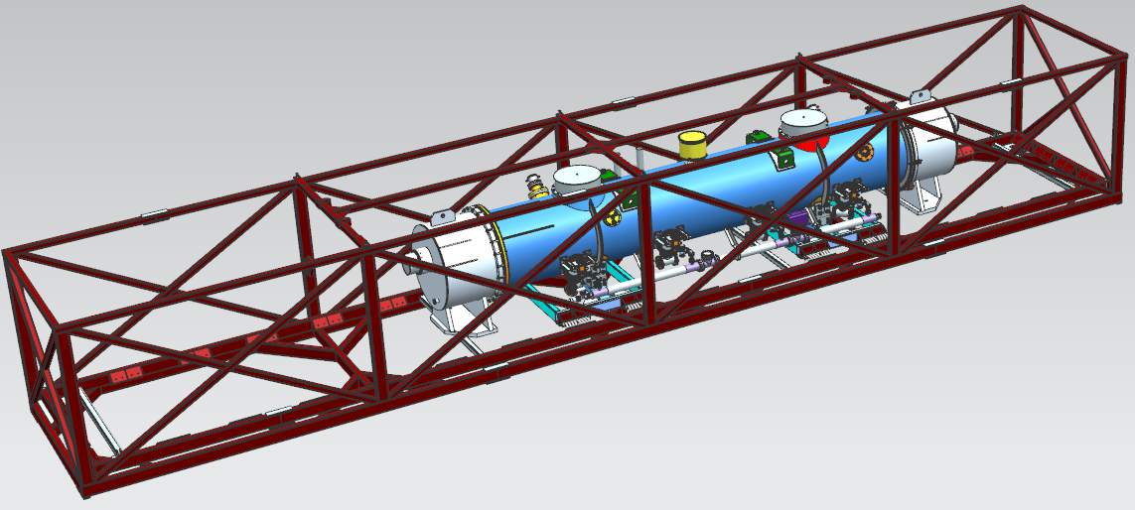
Concept for 3.9 GHz transport system
CM sits offset in the frame so that it is centered between the axles and the 5th wheel.

Slide 19
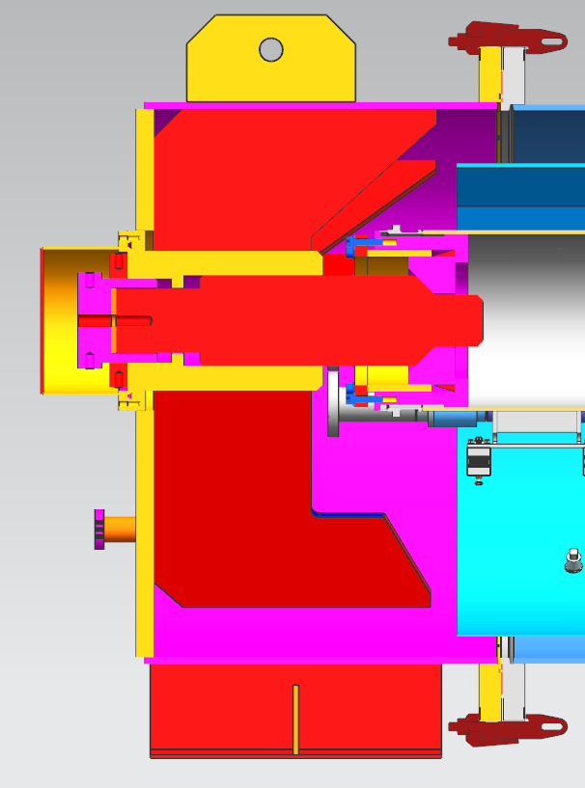
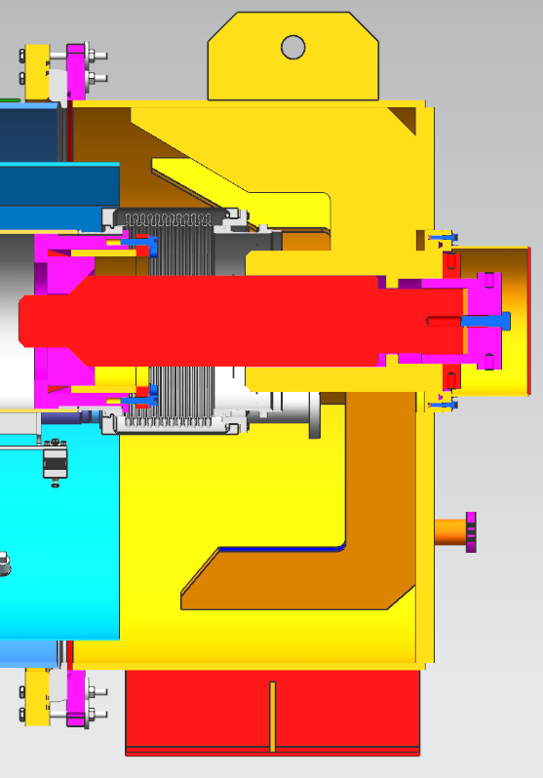
Concept for 3.9 GHz transport system
Use XFEL transport caps and HGRP insert for 3.9 GHz with minimal to no modifications needed for cold mass stabilization.

Slide 20
Physical testing
Use a dummy load to tune the isolation system.
Use concrete blocks on a support stand connected to the cryomodule mount points.
Match centers of gravity between dummy and 3.9 GHz CM.
Concrete stand will be engineered to safely restrain the concrete blocks.
After isolation system is proven, simulations are complete and any mitigations implemented, move to testing with 3.9 GHz CM.

Slide 21
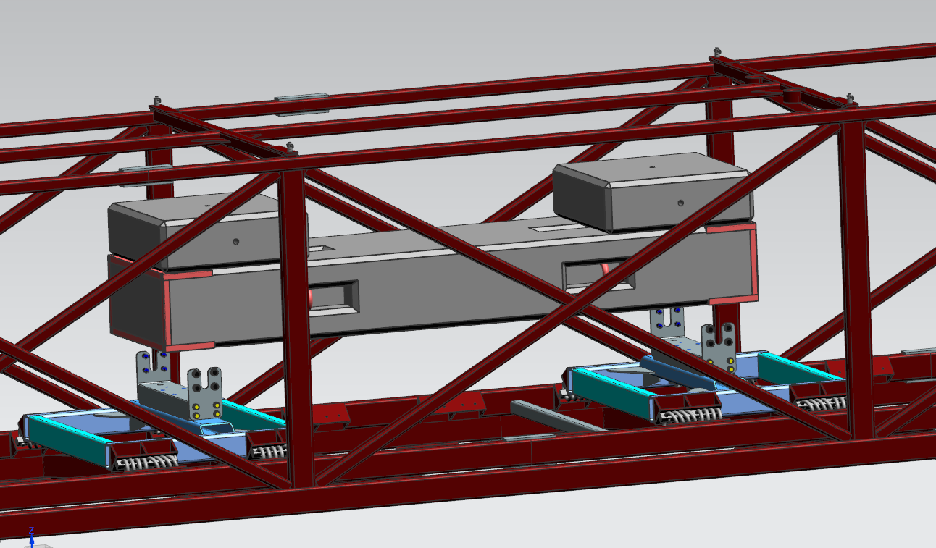
Dummy load testing plan: Setup
Commonly found concrete shielding blocks can be used to replicate weight and center of gravity.
Support structure and safe block connections to each other and the transport fixture be engineered.
Component | Weight (lb)
J Block | 8100
K Block | 1400 x2
Total | 10,900
3.9 GHz CM + Caps (Est. from 3D model) | 11,300

Slide 22
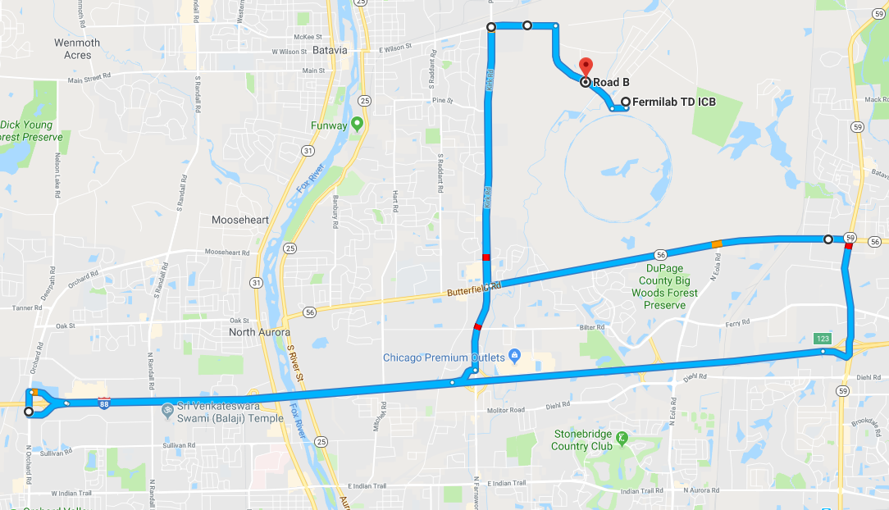
Dummy load testing plan: Route
Low speed transports on-site to verify attenuation and proper fixation of blocks.
“Short” test route out I-88 to Orchard Rd x mi.
“Long” test route out to Morris, IL x mi.
Long Route
Short Route

Slide 23
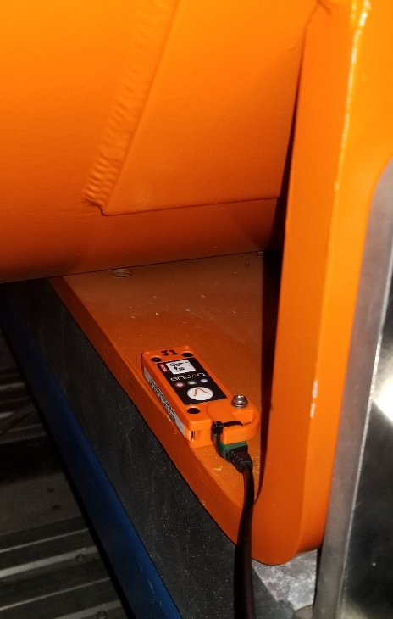
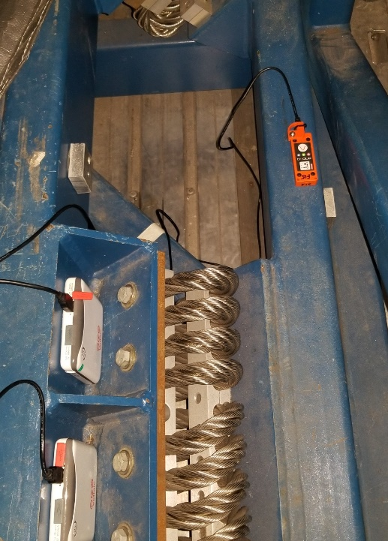
Dummy load testing plan: Instrumentation
Integrate lessons learned from 1.3 GHz dummy load testing into sensor placement:
Instrument the outer frame, inner frame, and concrete blocks using Slam Sticks proven from 1.3 GHz experience.
Instrument both fore and aft mounting points with the same setup.

Slide 24
Dummy load testing plan: Criteria for success
What do we define as a successful test?
Shocks under 1.5g (1.3 GHz spec) or set new limits via analysis of sensitive components.
Adequate dampening is shown from the frame to concrete transfer functions.
Resonant frequencies are below critical values determined through simulation and testing of sensitive components.

Slide 25
Transport testing with 3.9 GHz CM
Begin work with live CM once:
Simulations are complete
Any needed mitigations for sensitive components are in place
Physical testing for these components may be conducted
Dummy load testing is successful
Transport specifications that adequately protect sensitive components have been developed.
Based on calculations, testing, simulation.
Examples: maximum displacement, maximum shock, sustained loading.
A successful review is conducted on live CM test plan and mitigations.

Slide 26
Transport testing with 3.9 GHz CM
Testing progresses through a similar progression as the dummy load:
Low speed, on-site testing
Short road tests
Longer road tests, building to a ~3hr test.
Integrate lessons learned from each test into successive transport tests.

Slide 27
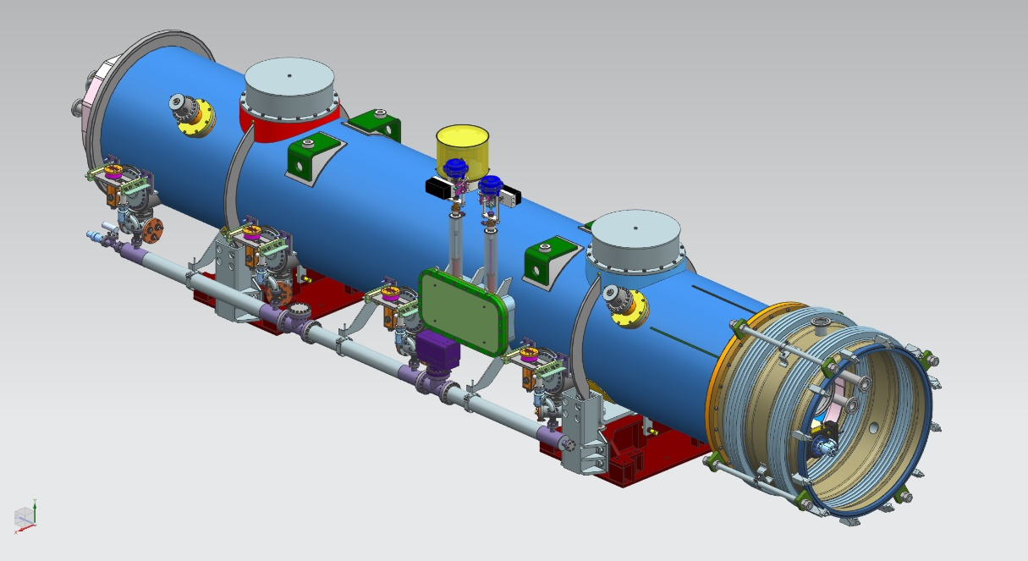
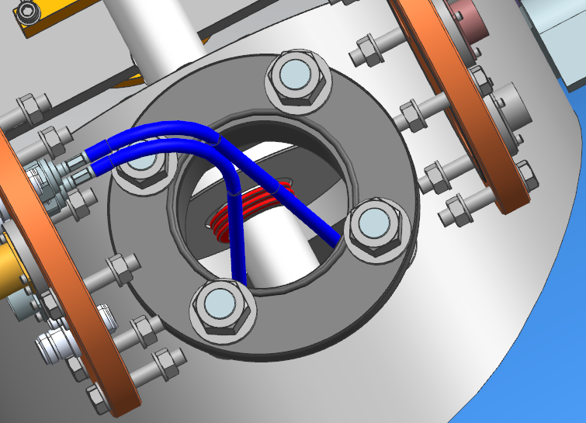
Transport testing with 3.9 GHz CM: Lack of access ports
Currently there are no access ports for post-assembly installation of instrumentation or mitigations for sensitive components. These ports are used extensively for 1.3 GHz shipping preparation.
Sensors may be mounted before the cold mass is inserted into the cryostat for sensitive areas not able to be accessed.
Special versions of the slam stick without the integrated battery and remote buttons are available.
Coupler bellows can be reached through instrumentation ports (below right).

Slide 28
Transport to SLAC
Considerations:
All preparation work will have a written procedure, documented in traveler form with signoffs.
Prior to shipping preparation to SLAC, a shipping configuration drawing will be released.
Put PO in place with a transport company that understands the sensitivity of the transport.
Interface with SLAC receiving team to finalize an acceptance and handling plan.

Slide 29
Summary
An experienced team is working on this project.
A plan is in place to provide a path to safely ship LCLS-II 3.9 GHz cryomodules to SLAC.
Start with reviews and simulations of the design to identify sensitive components of the CM.
Develop mitigations for sensitive components if necessary.
In parallel, develop the isolation system and test with a dummy load.
Hold a review of the 3.9 GHz shipping plan before testing a live cryomodule.
Slowly build up mileage testing with a live CM.

