Slide 1
LCLS-II 3.9GHz Cryomodules Assembly at Fermilab
Tug Arkan / Chuck Grimm
LCLS-II 3.9 GHz CM Delta Final Design Review
January 29-30, 2019

Slide 2
Outline
    Production Strategy
    Fermilab Cryomodule Assembly Facility (CAF) infrastructure
    Detailed CM Assembly Workflow at CAF
    Travelers and Part kits
    Summary

Slide 3
Planned LCLS-II Production CMs
Workflow at Fermilab
Receive dressed, ready to be tested in VTS (vertical test stand) cavities from the vendors (Beamline under vacuum)
Incoming Inspection at IB4
Test cavities in VTS at IB1
Qualified Cavities go to CAF-MP9 cleanroom WS1. Non qualified cavities will be re-processed (HPR, light EP etc.) and re-tested.
8 qualified cavities, Cold end FPCs, BPM, Gate Valves, Interconnecting Bellows/Spool: Cavity String Assembly at CAF-MP9 Cleanroom (WS1)
Cold Mass Assembly at CAF-MP9 (WS2)
Cold Mass Assembly at CAF-ICB (WS3 & WS4)
Final Assembly and QC checks (WS5) and prep for transport to CMTS at CAF-ICB (WS6)
Cryomodule Test at CMTS
Transport the module back to CAF-ICB
Prepare and Ship Module to SLAC (WS6)

Slide 4
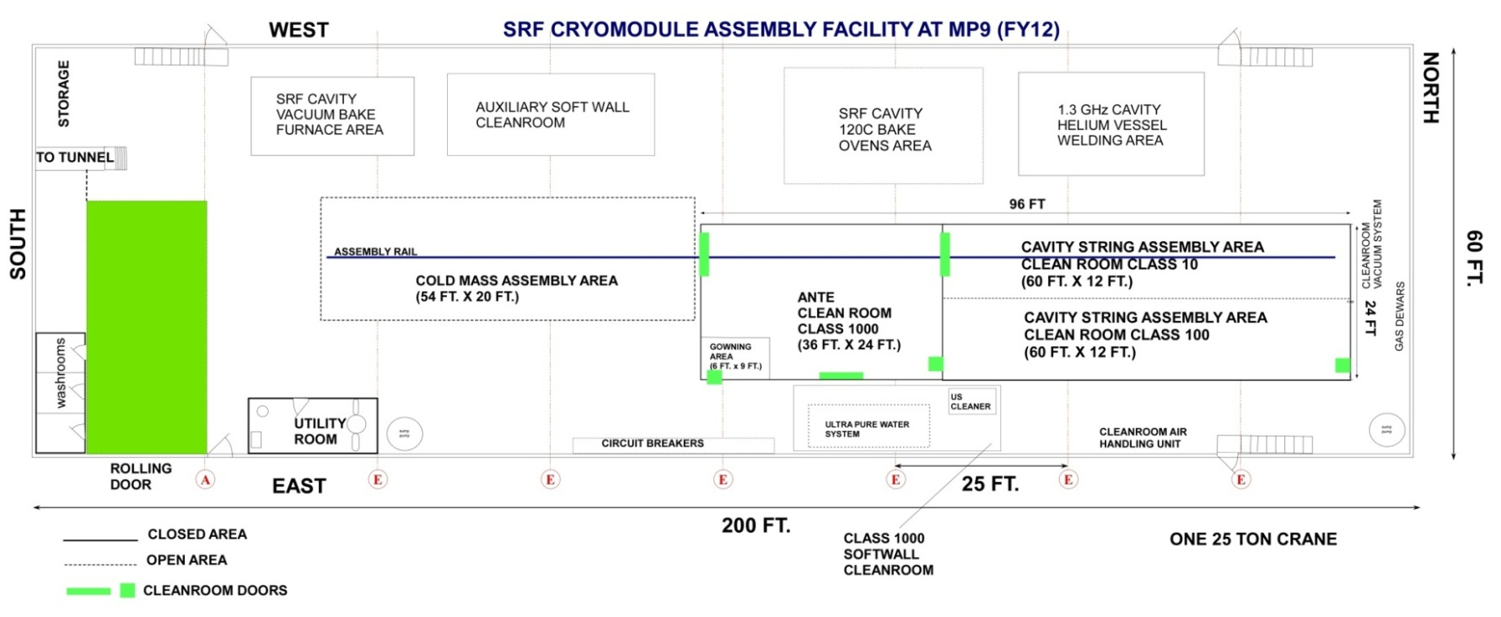
CAF-MP9 during LCLS-II Production
Parts Staging & Sub-assemblies Area
WS2
WS1
WS2 prime
WS0
WS0 will not be used during 3.9GHz CM cleanroom assembly, cold end FPC will be installed at WS1

Slide 5
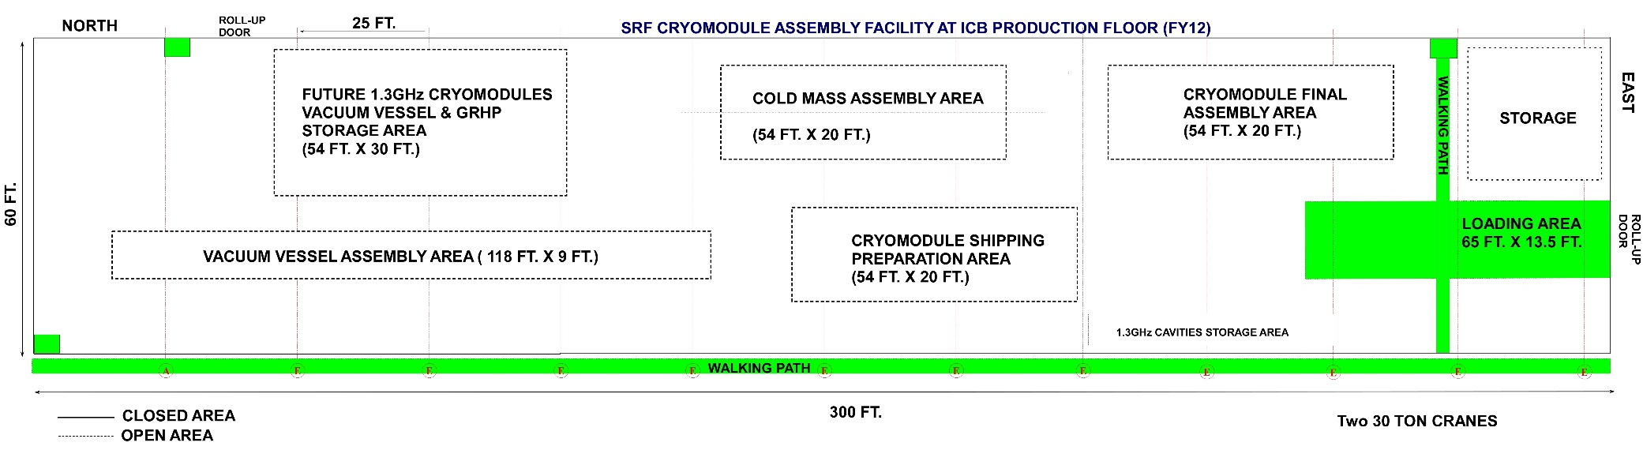
CAF-ICB during LCLS-II Production
WS3 prime
WS3
WS5
WS4
WS6

Slide 6
Supply Chain
Dressed cavities (RI) delivered ready to be tested
Fundamental power couplers (CPI) delivered ready to be assembled at WS1 and WS5
Gate valves (VAT) cleaned to Class 100 standard at the vendor
BPM cleaned to Class 10 standard at DESY
BPM electrical feedthroughs (Solcera)
Copper plated beamline components (Ameriflex, copper plated at SLAC)
Cavity String Assembly Hardware (JT industries) and Seals (Wepek)
Cold Mass Upper assembly (WXCX, China)
Cold Mass peripherals from various U.S. vendors
Instrumentation (U.S and International vendors)
Vacuum Vessel (WXCX, China)
Vacuum vessel peripherals from various U.S. vendors
Full or batch delivery FNAL Supply Chain Manager working with SOTRs & TD QMD for qualified parts storage in TD inventory system Parts are kitted (MBOM) & delivered to work stations Sort, magnetic hygiene QC, clean and use

Slide 7
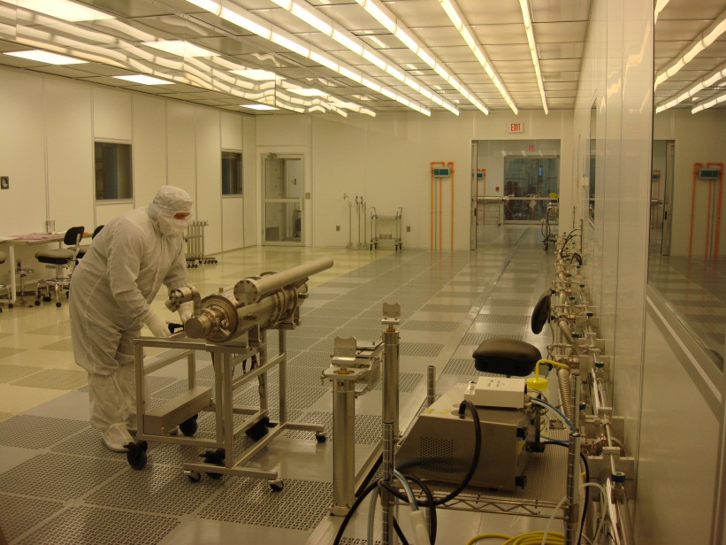
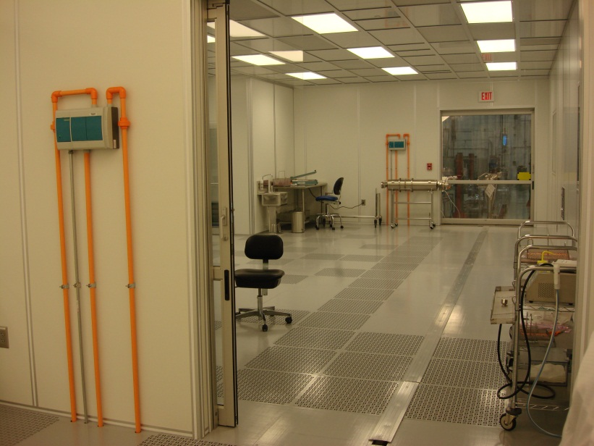
MP9 Clean Room
Cavity String Assembly Clean Room (WS0 & WS1)
A ~250 square-meter clean room:
  Class 1000 (ISO6) ante cleanroom area
  Class 100 (ISO5) sluice area
  Class 10 (ISO4) assembly area
  Class 100 (ISO5) staging/storage area
Class 100
Class 10
Class 1000
Rail
Sluice Class 100

Slide 8
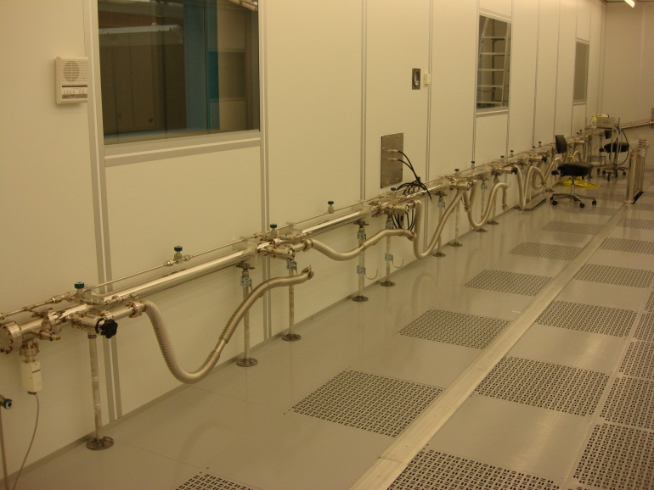
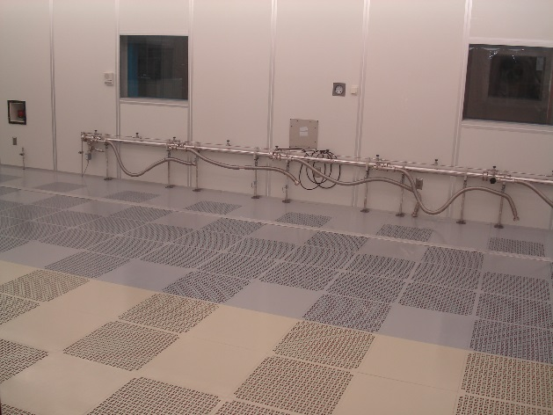
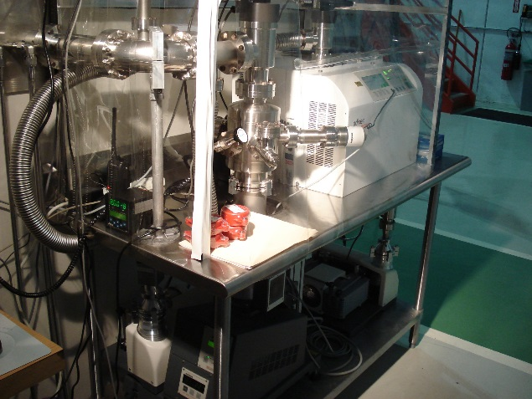
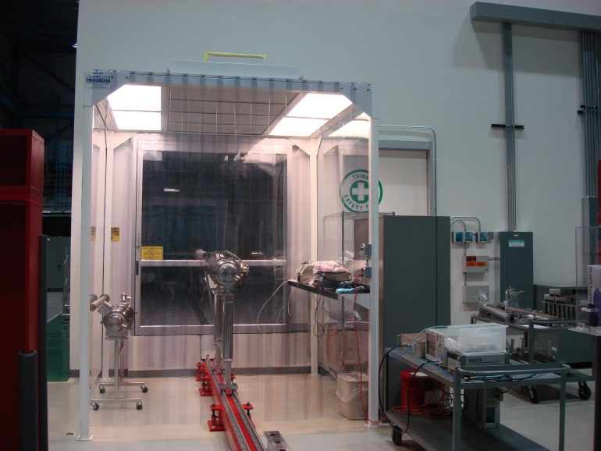
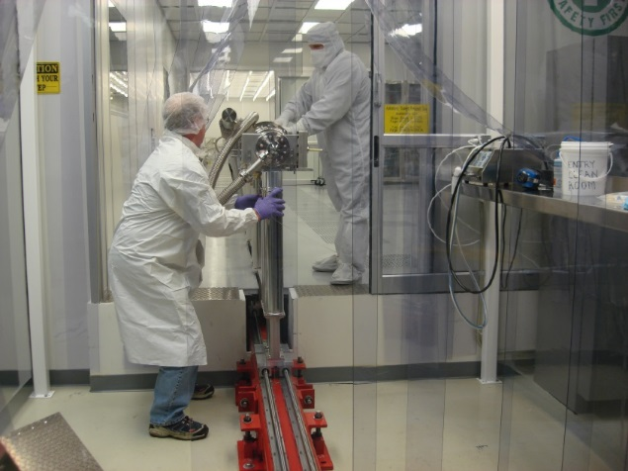
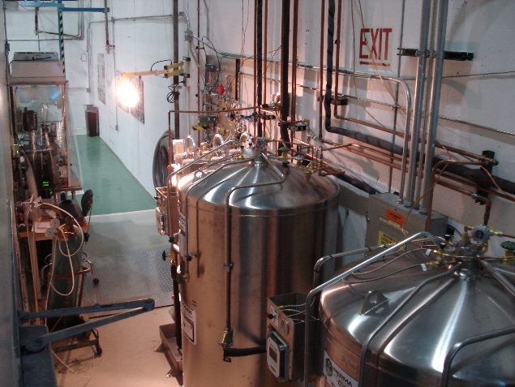
Cleanroom Infrastructure
Vacuum / Gas Manifold
8 stations for pumping, purging and backfilling
Particle Free UHV Pumps System
Cavity Support Fix Rail System
Boiled-off LN2 gas dewars and gas delivery panels
Class 1000 softwall cleanroom for dry cleaning before entry to ante cleanroom

Slide 9
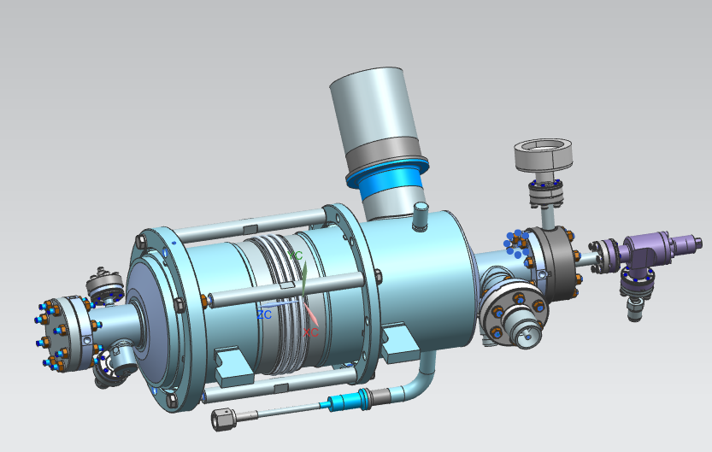
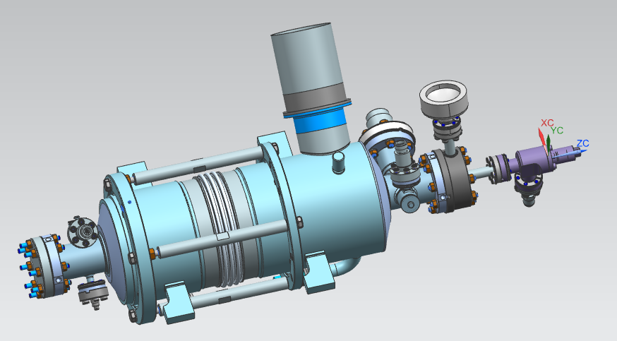
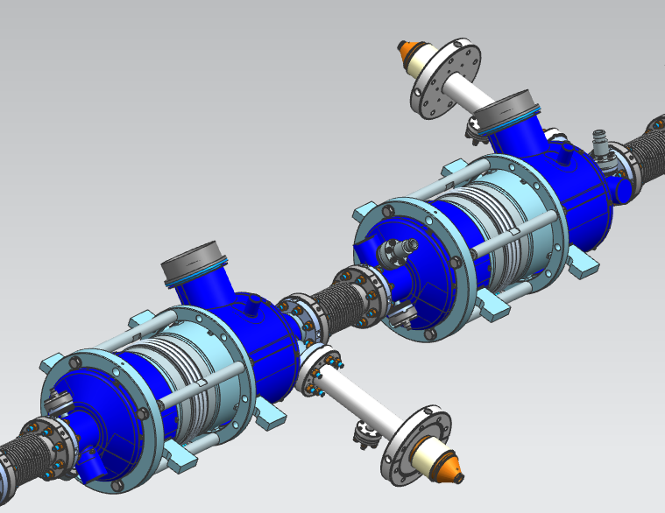
Dressed cavities that will be delivered to CAF-MP9 cleanroom
Dressed Cavity Type A
Dressed Cavity Type B

Slide 10
String Assembly Workflow at CAF-MP9 Cleanroom
Receive dressed qualified Cavities
Receive/Clean peripheral parts/hardware
Assemble dressed Cavities with cold end FPC and then into a string at WS1
Leak Check & Backfill
Roll the string out of the cleanroom to WS2

Slide 11
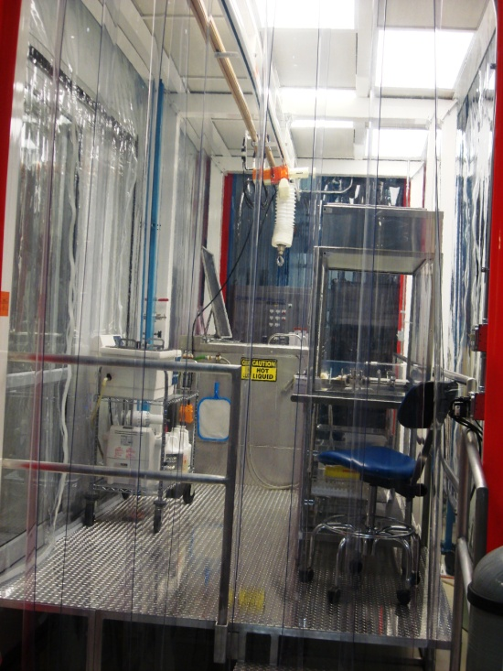
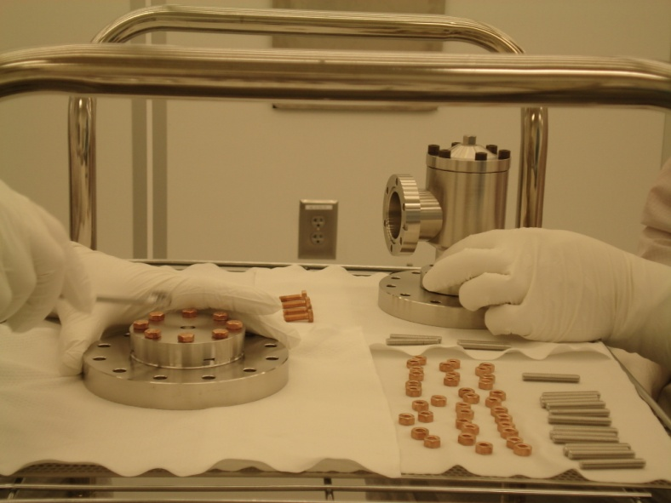
Parts / Fixtures / Hardware
Entrance to Cleanroom Preparation
Magnetic Hygiene Quality Control for every part, hardware, fixtures, tools that will be used in the cleanroom for assembly prior cleaning: Even though the cavities are not nitrogen doped, the same scrutiny will be followed for magnetic hygiene to achieve the highest Q0
ISO 6 softwall cleanroom
ISO 4 Hood
Assembly hardware:
  Wash in the ultrasonic bath
  Dry under ISO 4 hood
  Move into the ISO 6 ante clean room
  Blow clean with ionized nitrogen while monitoring the particle count in the sluice area (ISO 4)
  Transport into the ISO 4 assembly area
US cleaners
Electro-polished, rolled thread 316L stainless steel studs; silicon bronze nuts

Slide 12
Cleanroom Audit Recommendation (S. Berry)
Recommendations | Description | Priority | Schedule Impact | Cost Impact
1 Implemented | Guarantee the inside cleanliness for inter-cavity bellow, spool piece, coupler… | High | No | No
2 Not implemented | Increase the purging rate to 3L/min instead of 1L/min | High | No | No
3 Implemented | Install the purge line closer to the cavity | High | 5 days | 120 Hours
4 Not implemented | Revise the Bellows Assembly Procedure
5 Implemented | Pump slowly 3 L/min (50 mbarL/s) and vent slowly | High | No | No
6 will be implemented for 3.9GHz | Move WS0 to WS1 location | Medium | 5 days for every string assembly | No
7 will be implemented for 3.9GHz | Reduce valve opening | Medium | -5 days | No
8 Implemented | WS5 Improvement | Medium | No | No
9 Implemented | CMTF Improvement | Medium | No | No
10 Implemented | Gowning Area Improvement | Medium | No | No
11 Implemented | Miscellaneous Improvement | Medium | No | No

Slide 13
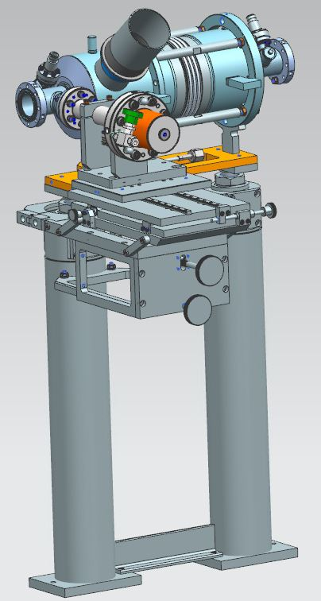
Cold End Coupler Assembly (WS1)
Verify torque and tighten as needed all the fasteners for the cavity beamline(under vacuum) as received (lesson learned from 1.3GHz)
Assemble & leak check new pump/backfill/purge flex hose with tee to the cavity (Recommendation 3 needs to be implemented for WS1)
Open cavity right angle valve (RAV)
Record as received vacuum levels
Leak check, RGA
Backfill (vent) the cavity
Remove a cold end coupler from the storage manifold
Assemble cold end coupler to the cavity using particle free flange assembly (PFFA) procedures with nitrogen purge of 1 liter / minute (Recommendation 2 is to increase to 3 liter / minute, not implemented based on the actual purge rates measured and recent good results of tested 1.3GHz CMs at CMTS)
Pump down, leak check, RGA, Backfill (Recommendation 3)
Leave cavity RAV open (Recommendation 7 will be implemented)
Leave the beamline vented with nitrogen until the cavity is ready be interconnected to the string (Recommendation 3)

Slide 14
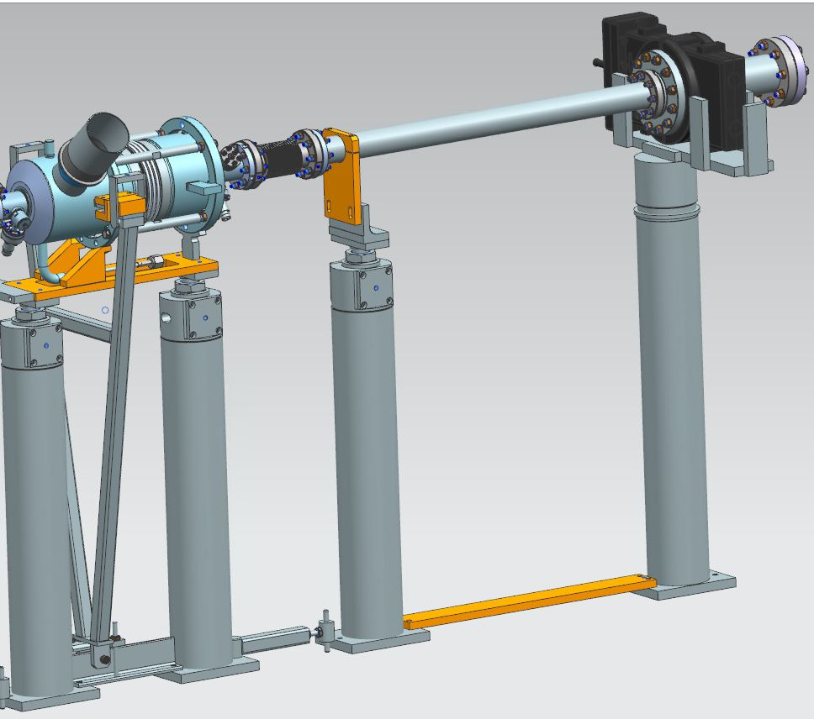
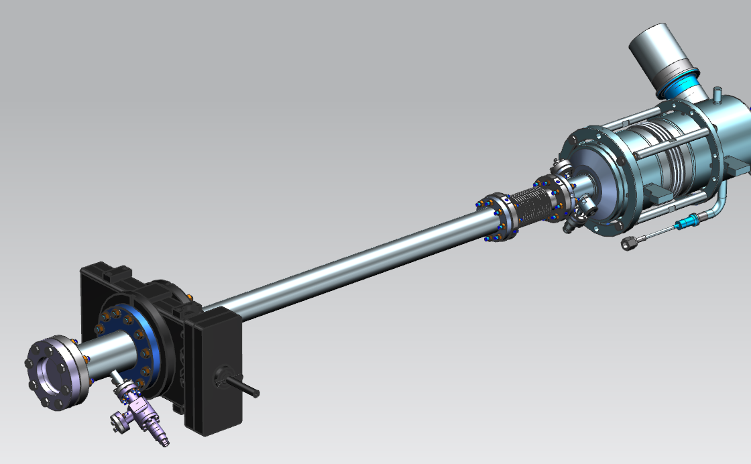
String Assembly-I (WS1)
Rotational alignment of cavities
Gate Valve (GV1) to Cavity #1 Assembly:
  Check the particle free cleanliness of the GV and clean as needed
  Sub-assembly of the GV peripherals
  Installation to the support post and vacuum hose assembly
  Alignment to the cavity beam line flange
  Assemble the gate valve to the cavity

Slide 15
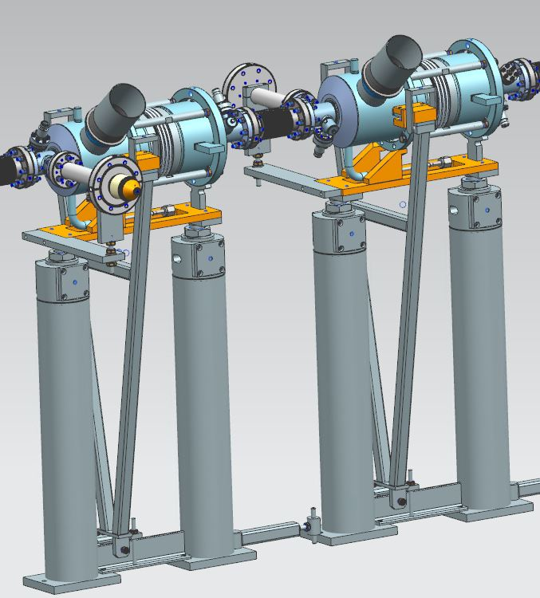
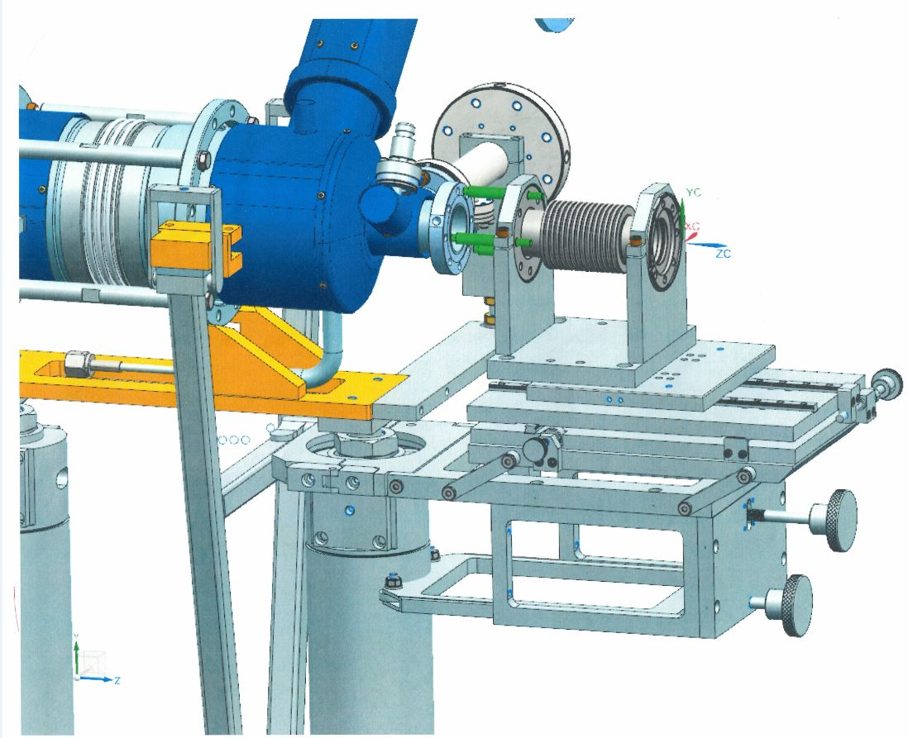
String Assembly-II (WS1)
Cavity to Cavity Assembly with the interconnect bellows:
  Assemble flex hose to the cavity RAV
  Pump down, leak check the hose connection to the RAV, backfill
  Align the interconnect bellows to the cavity field probe end beampipe flange
  Assemble with PFFA
  Align the bellows to the cavity coupler end beampipe flange
  Assemble with PFFA

Slide 16
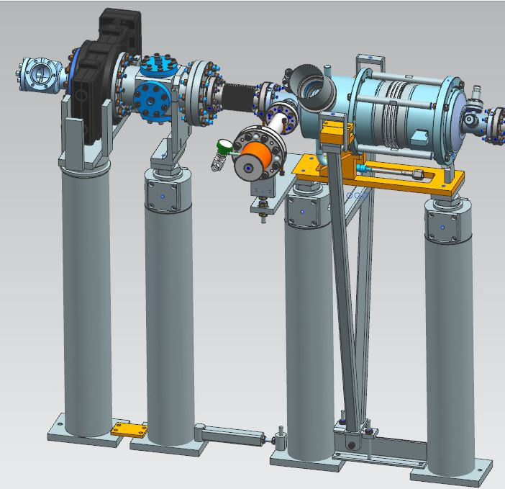
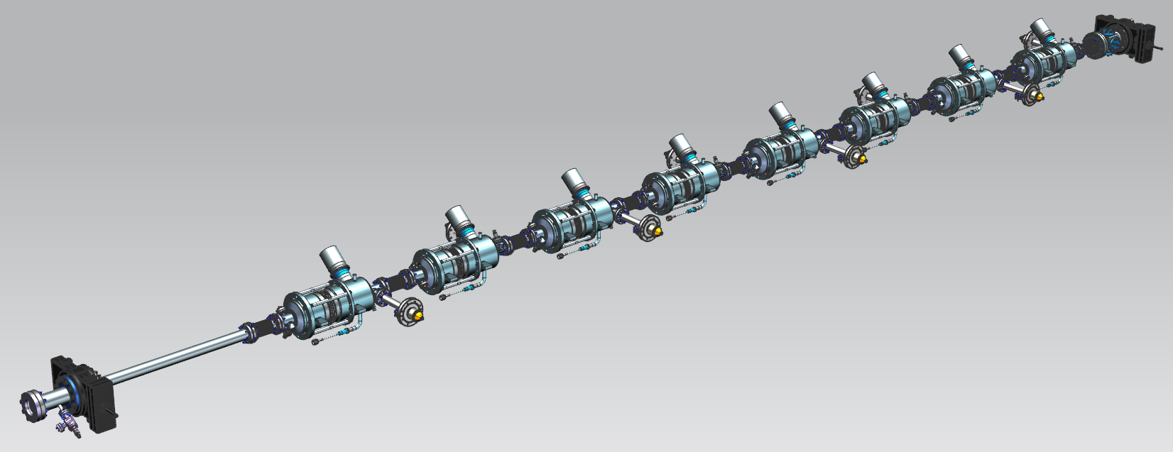
String Assembly-III (WS1)
BPM+GV2 assembly and leak check
BPM/GV2 subassembly to the 8 cavity string
Pump down fully assembled cavity string, bag the bellows, leak check. Backfill
Roll out of the cleanroom to WS2

Slide 17
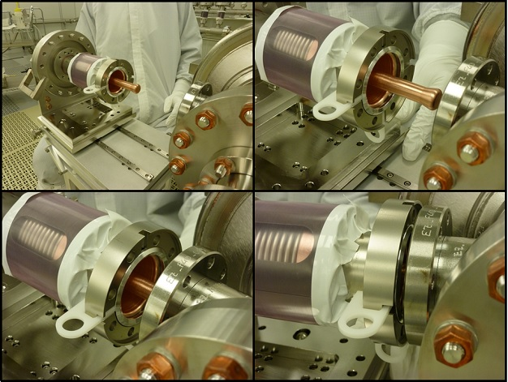
Lessons Learned that will be applied to 3.9GHz CM assembly in the cleanroom
Cavity fasteners torque check& adjust post vertical test before starting the string assembly in the MP9 cleanroom
Al/Mg seals hardness certified by the vendor
Delrin holders for NW40 size (and smaller) Al/Mg seals: NW78 size seals can be slightly deformed and will not fall once placed in the flange during assembly, small size seals need holders.
BPM electrical feedthroughs titanium grade 5 fasteners
Bellows between Cav#1 and upstream end gate valve (microphonics optimization)
Gate valves and right angle valves leak check to verify that sealing through before assembling these valves to the cavity string
Reduce torque for M6 size hardware from 20 N-m to 13.5 N-m
Final torqueing and verification of the string assembly fasteners before string rolls out to WS2

Slide 18
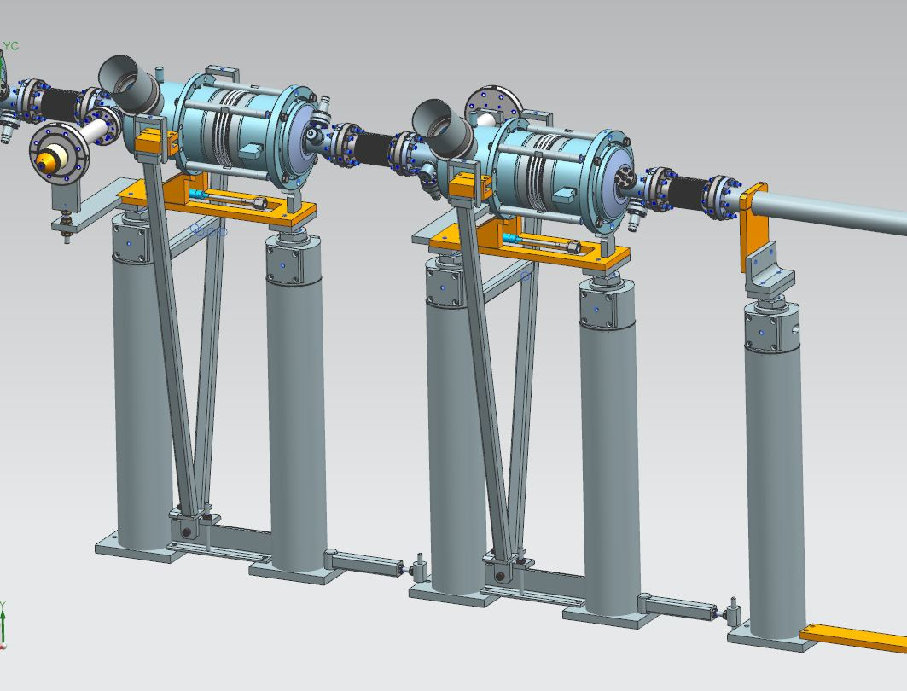
Cold Mass Assembly at WS2
After Roll-Out at WS2
Dressed Cavity Ordered Without Tee

Slide 19
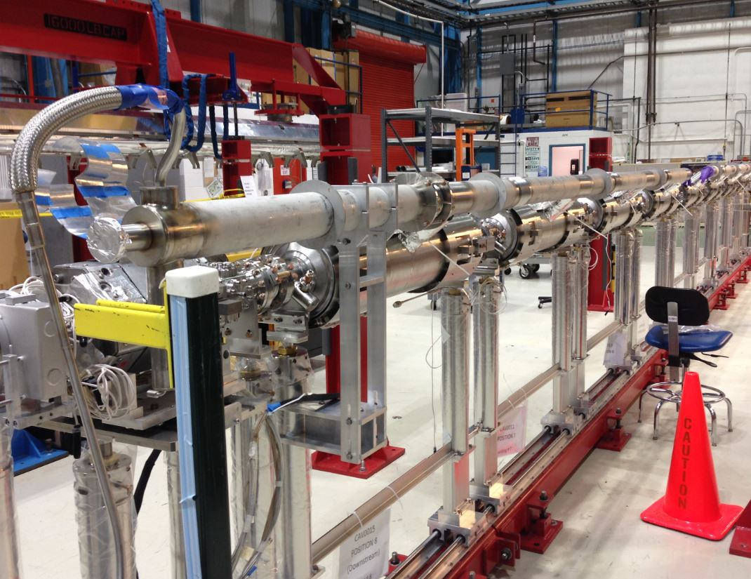
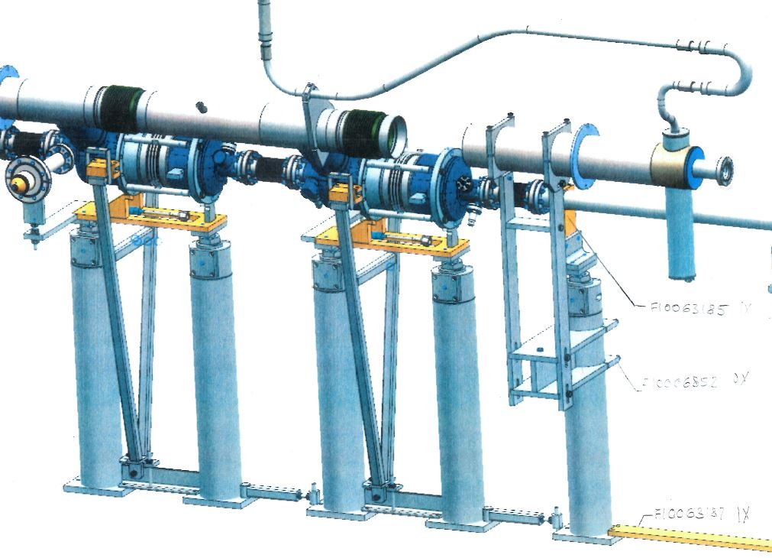
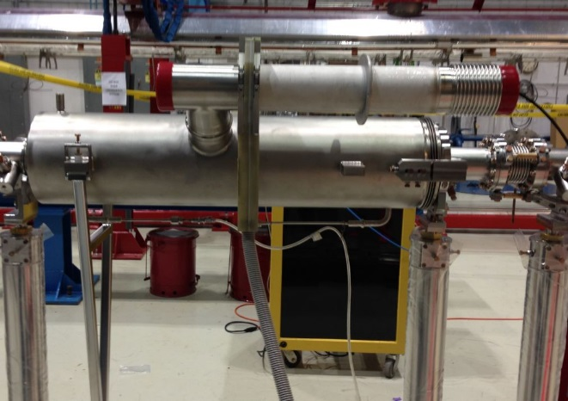
2-Phase Line Welding at WS2
Same welding configuration and parameters
Tee will be added as part of the procedure
Tack weld then majority of the welds are done with automatic orbital welding machine. Some welds are done manually. All the welders are qualified and certified to provide code compliant welds

Slide 20
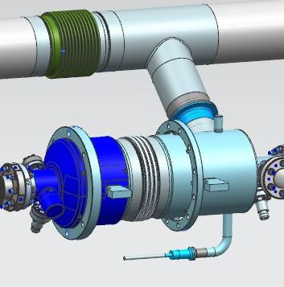
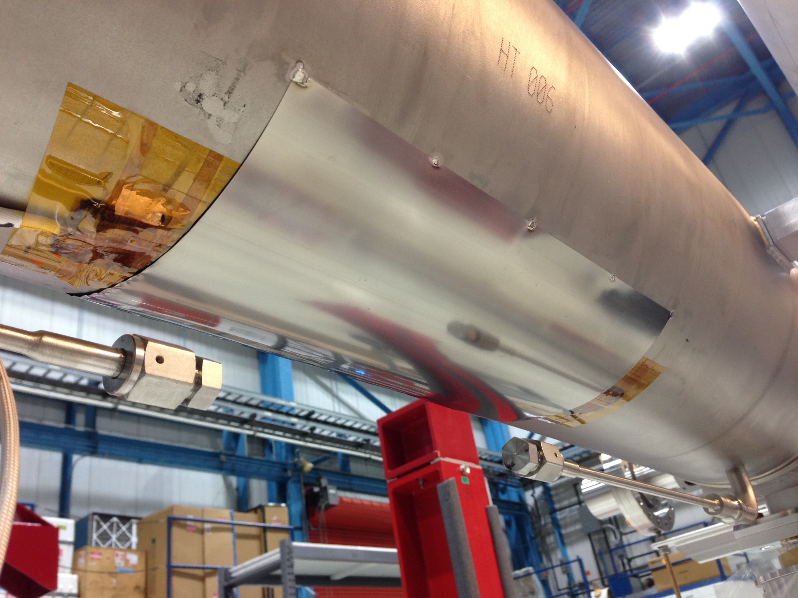
Tank Heaters at WS2
Heaters will be installed in this location
Along with Kapton tape and Stycast, Ti shim material will keep
heaters securely fastened to He tanks like 1.3GHz

Slide 21
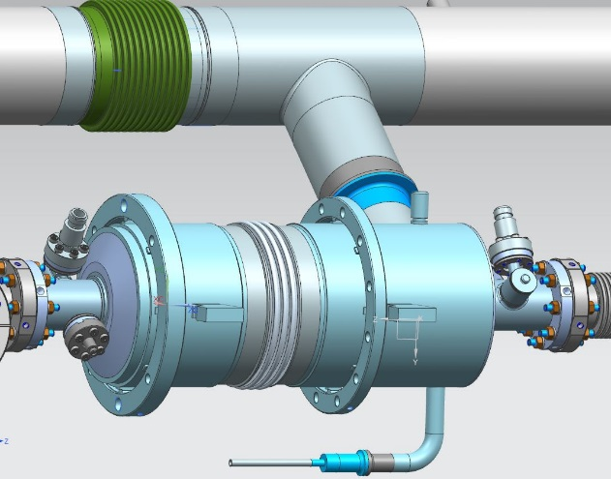
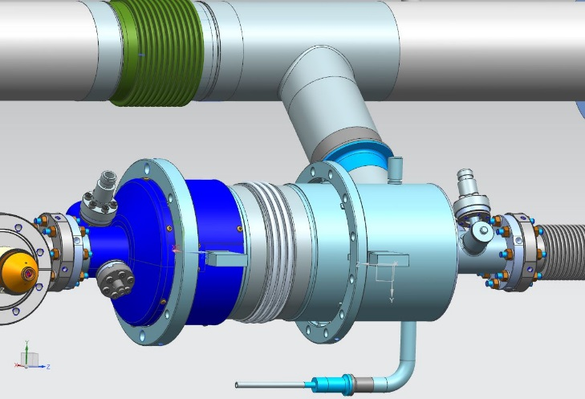
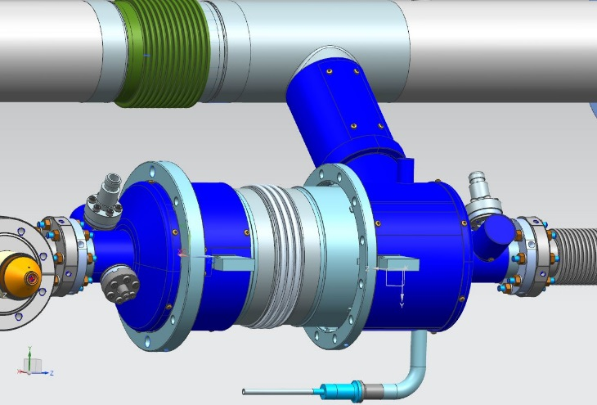
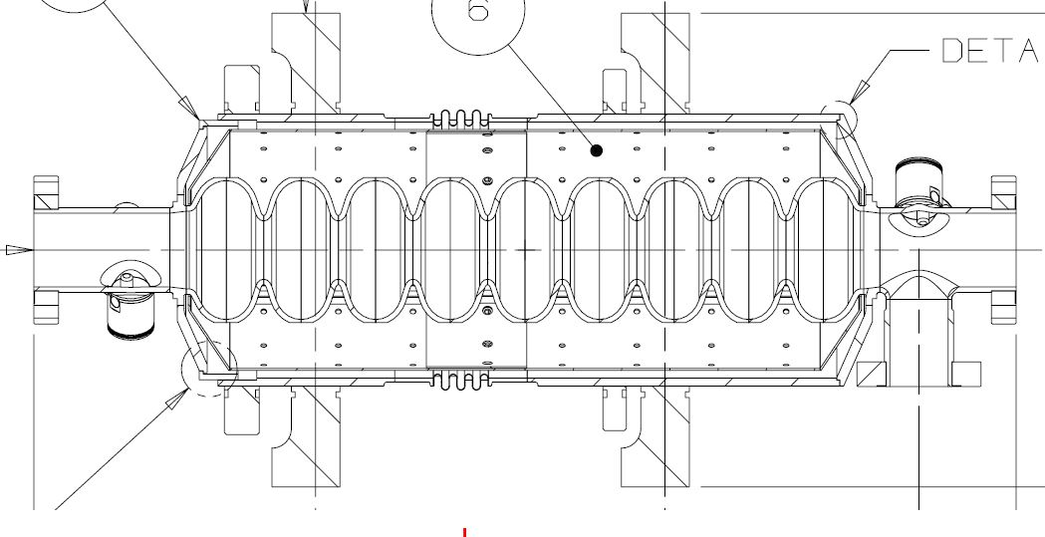
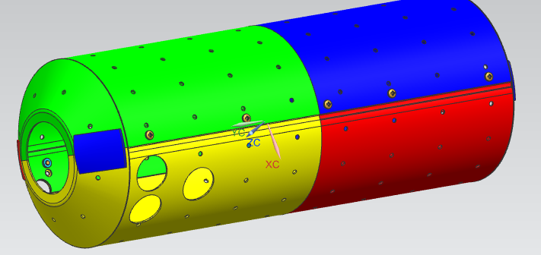
Magnetic Shielding Assembly at WS2
Shields installed on the upstream and downstream ends and up the chimney – not on the outside center section
Internal He vessel shield will cover length of cavity end-to-end

Slide 22

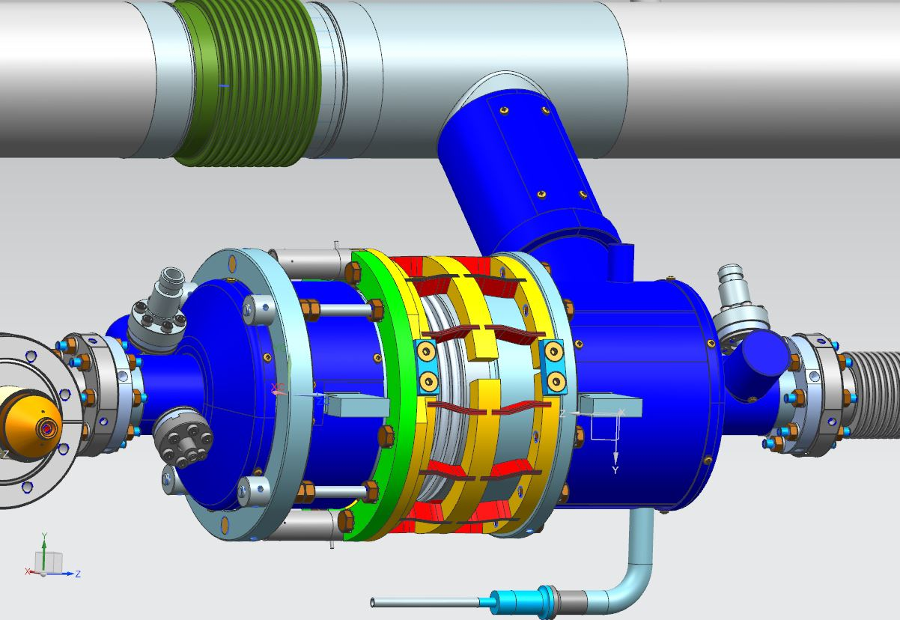
Blade Tuner Installation at WS2
Safety rods
Bladetuner and piezos installed at WS2 (1.3 GHz lever tuner was installed at WS3)
Bladetuner has safety rods for safe transport

Slide 23
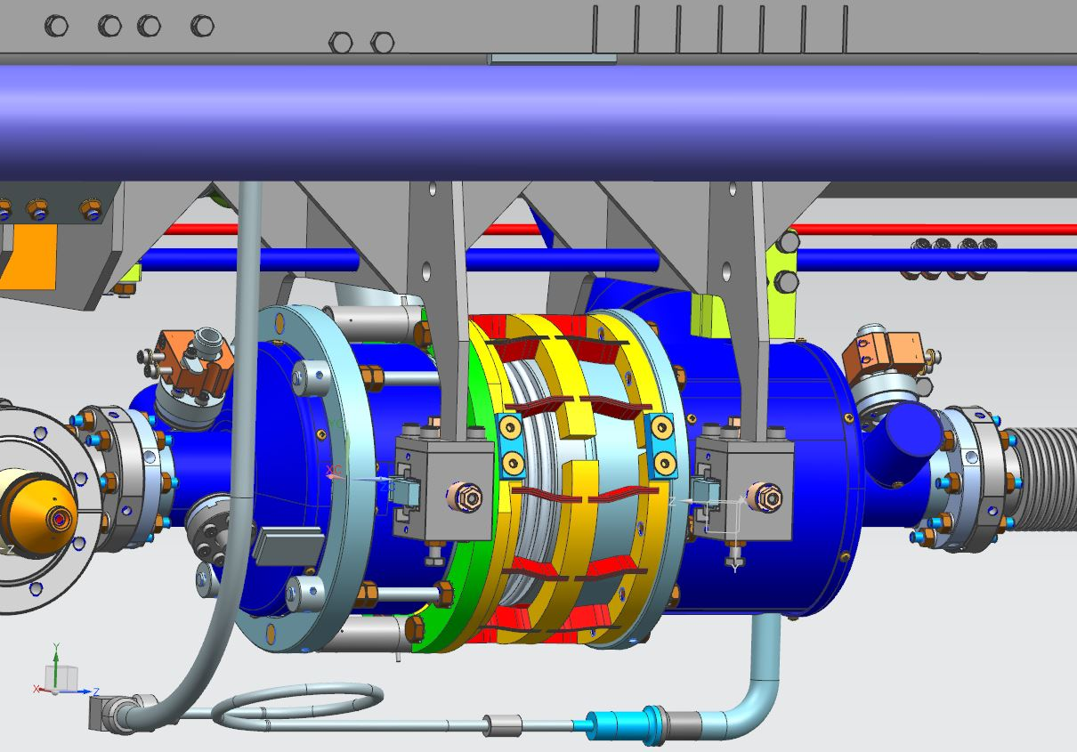
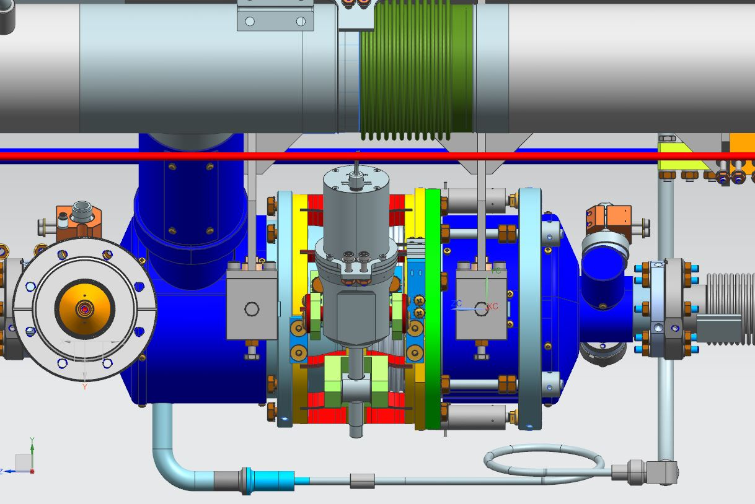
Upper Cold Mass (UCM) to String Assembly at WS2
Warm-up/Cool-down welding same as 1.3 GHz
Due to a slight interference issue with the bearing block leg and 2-phase chimney, the cavity string will need to be rolled upstream slightly on the lollipop stands than back downstream after clearing the chimney

Slide 24
Remaining tasks at WS2 before transport to WS3
Leveling of the cold mass
Z alignment of the cavity string
Weld 2-phase pipe invar rod radial clamps (2-phase pipe end are closed)
Leak check 2-phase circuit (after blade-tuner is setup to specified configuration)
Prep for transport to WS3

Slide 25
Lessons Learned that will be applied to 3.9GHz CM assembly at WS2
Optimized orbital welding programs for 316L stainless steel welding (to compensate wall thickness variations, sulfur content etc.)
Welding of the warm/up-cool down capillaries, tee from 2-phase pipe to HGRP and 2-phase pipe invar rods radial clamps after Z longitudinal of the cavities are done.
Shimming optimizations to ensure that the liquid level probes housing at the ends of the 2-phase pipe are welded and assembled leveled and free to allow HGRP contraction and expansion
Invar rod reinforced clamps for Cav#1 and Cav#8 where the reacted vacuum forces are highest
Leveling and alignment of the upper cold mass to the cavity string with the help of alignment group using laser tracker. Plumb bobs and mechanical means for alignment do not work well for CW CMs where the 2-phase pipe is connected to the HGRP
Increased attention for fasteners locking mechanism (at least two such as torqueing, lock washers, Belleville washers, Loctite etc. to prevent loosening during operation and transports
White gloves handling of the magnetic shielding parts

Slide 26
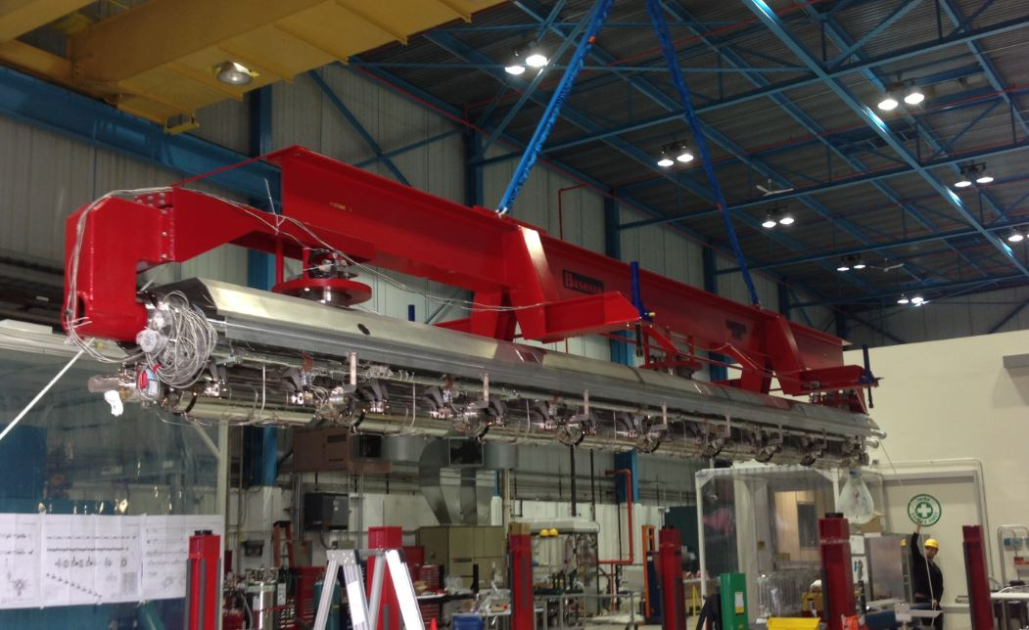
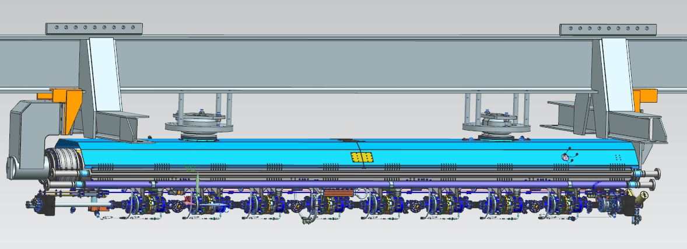
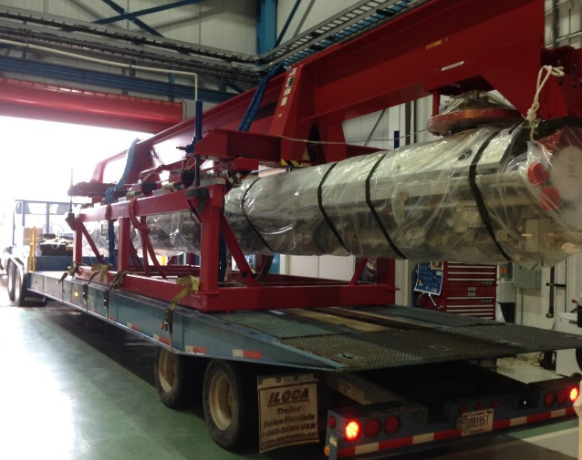
Transport to WS3 at CAF-ICB
Modifications to red fixture allows to use for 3.9 GHz upper coldmass move (fixture is already modified, engineering note is updated, upper cold mass#1 incoming QC done using this modified fixture
1.3 GHz upper coldmass fixture
Same transport fixture will be used

Slide 27
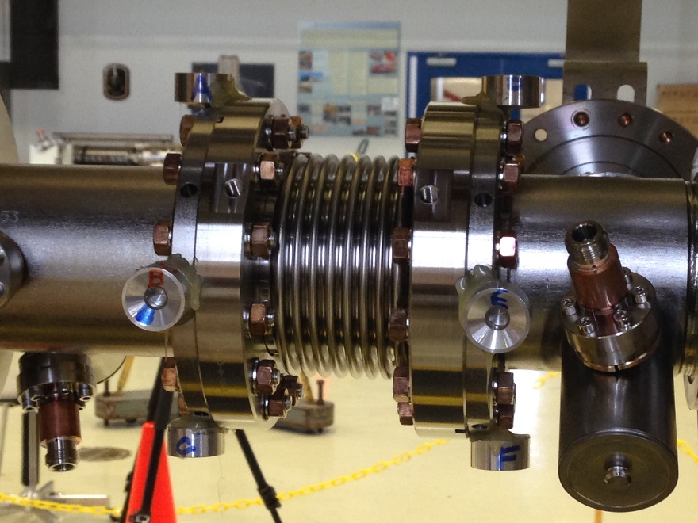
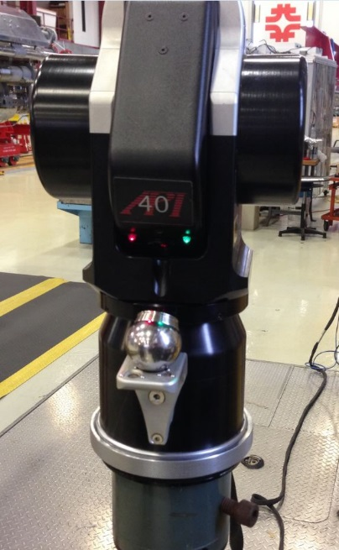
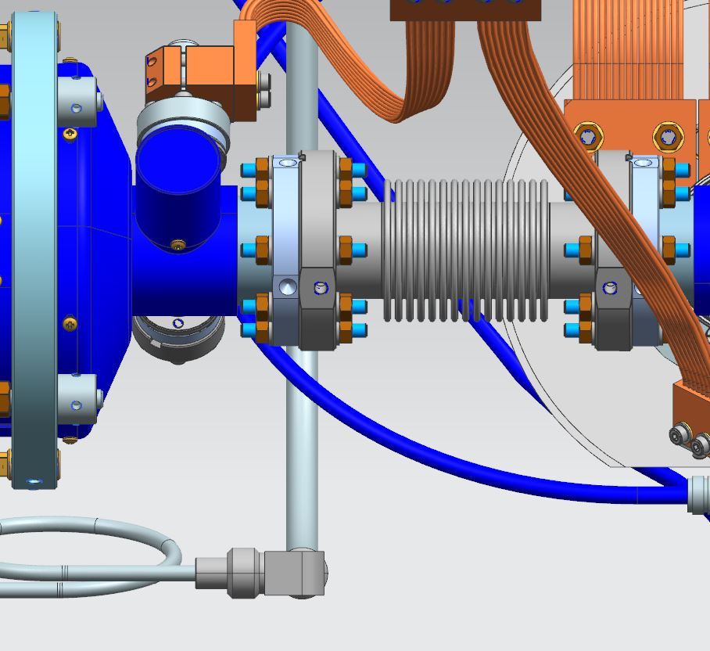
Cavity String Alignment at WS3
Fiducials Glued on Beam Flanges
Laser Tracker
Verify Z alignment then complete X-Y alignment

Slide 28
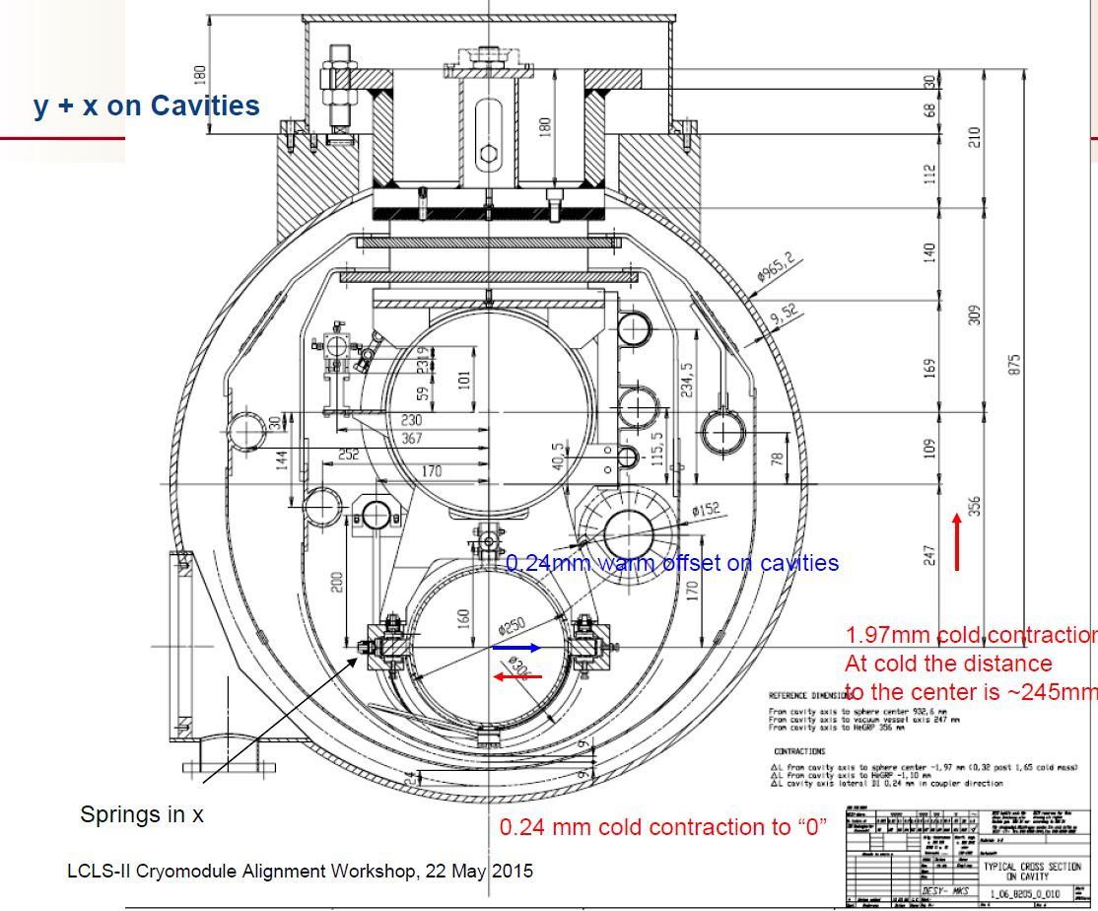
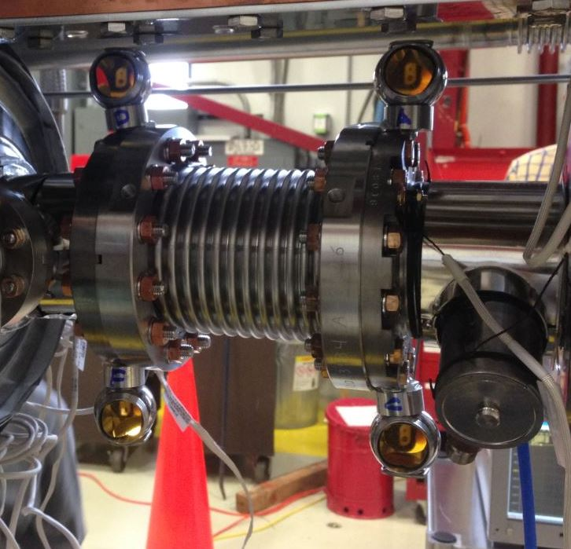
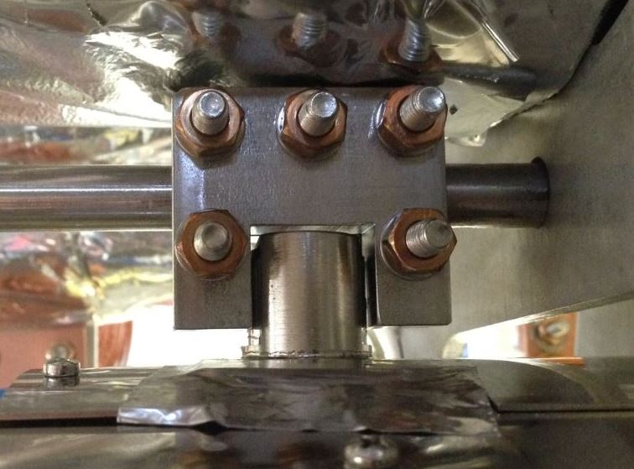
Cavity String Alignment at WS3
Cavity clamp to invar rod
“Z” tolerance +/- 0.5 mm
Relative to FPC spacing
“X” tolerance +/- 0.150 mm
“Y” tolerance +/- 0.150 mm
Relative to electrical centerline of cavity
Larger diameter prisms are more desirable

Slide 29
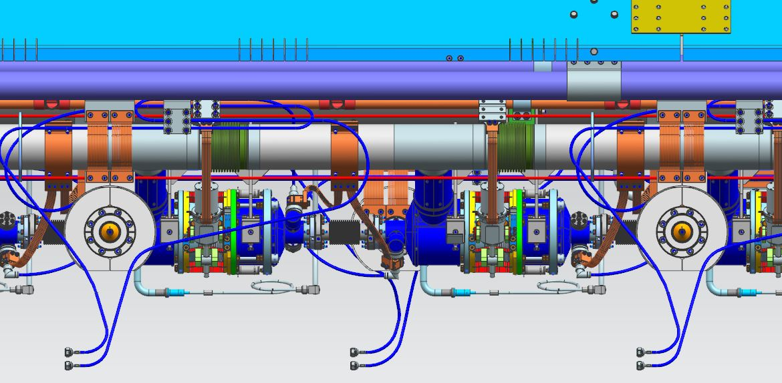
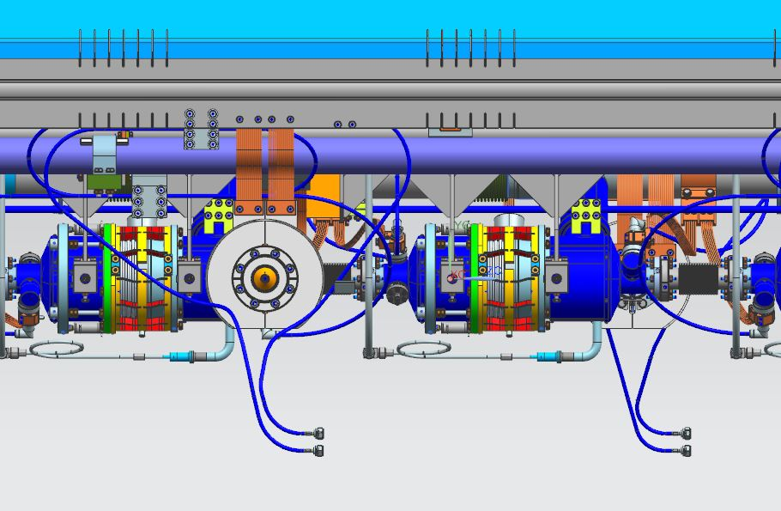
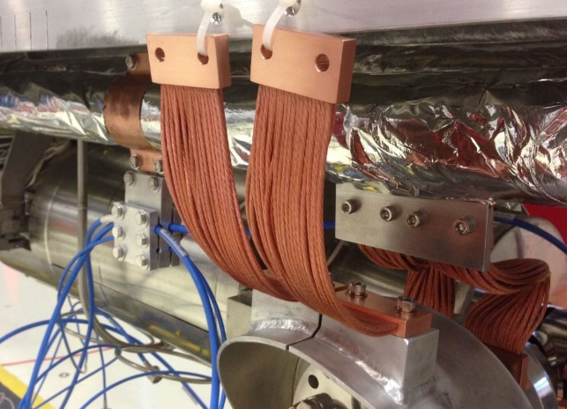
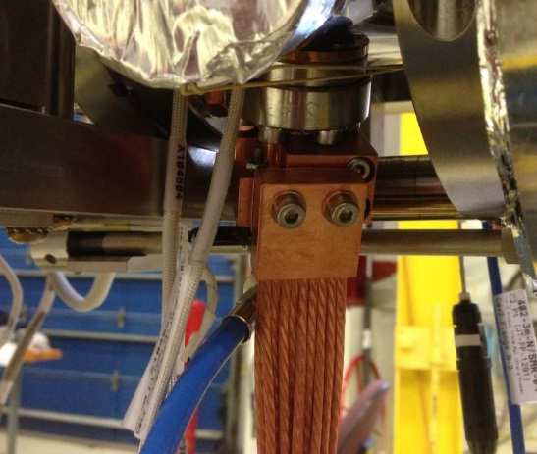
Thermal Straps and Cables Installation at WS3
Follow all the requirements as it was done for 1.3GHz CMs: indium, torqueing fasteners with intervals sequence, additional visual and manual verifications

Slide 30
QC checks before proceeding to weld lower shields
Full electrical check
Full tuner system check
Full magnet and current leads check
Verify fasteners torque
HOM notch frequency tuning and final RF checks (ensure that this is the last task done before proceeding to install lower heat shields)

Slide 31

Lower Thermal Shields at WS3
Finger Welds
Same setup as 1.3 GHz except coupler ports on opposite sides

Slide 32
Lessons Learned that will be applied to 3.9GHz CM assembly at WS3
Increased attention for fasteners locking mechanism (at least two such as torqueing, lock washers, Belleville washers, Loctite etc. to prevent loosening during operation and transports
Additional scrutiny for thermal intercepts assembly hardware
RF group support during the RF cables 5K and 50K thermal intercepts installation
HOM notch frequency tuning as the last step before installation of the lower heat shields
Install lower heat shields one by one and inspect to ensure that shield does not have any contact with internals of the cavity string including RF cables. Weld lower heat shields and inspect again for any contact
Ensure that upper cold invar rod hole locations are measured during incoming QC. This will ensure that we can complete the vertical alignment of the cavities without any interference between invar rod and cavity helium vessel titanium pin

Slide 33


MLI and Vacuum Vessel Integration at WS4
Setup on cantilever fixture same as 1.3 GHz
MLI blankets
Coldmass integration to vacuum vessel same as 1.3 GHz
Cantilever fixtures does not need any modification to support 3.9GHz CM cold mass and vacuum vessel

Slide 34



Final Cavity Alignment at WS4
Once the vacuum vessel and coldmass is leveled, the roll is taken out by adjusting the support nuts
Setup on fixture same as 1.3 GHz

Slide 35

Final Cavity Alignment at WS4
Bring the cavity string beam axis to the designed z (longitudinal) position wrt. vacuum vessel (VV) by using the along the vessel push bolts.

Slide 36

Final Cavity Alignment at WS4
Final Cavity Alignment and Cod Offset
Bring the 2 posts into a plane normal to local gravity and at such a height that the cavity string beam axis is at the designed vertical offset from the VV center. Use the up and down bolts.

Slide 37


Lessons Learned that will be applied to 3.9GHz CM assembly at WS4
MLI pre-made blankets
Full incoming QC of the vacuum vessel, especially sealing surfaces for the O-rings
RF measurements and full electrical checks after cold mass is inserted into the vacuum vessel before the alignment
Tightening and torqueing scheme and sequence of the cold mass support fasteners to ensure contraction/expansion and also secure the cold mass inside the vacuum during CM transport
Fixture support, all the fasteners (vertical & horizontal) are in contact with vacuum vessel, torqued to spec
Sliding support horizontal fasteners have a 0.075 mm gap, not in contact with vacuum vessel

Slide 38
Cryogenics Valves Welding at WS5
Welding Phase-I
Leak check
High Pressure Test
Welding Phase-II
Leak Check
X-ray QC
Low Pressure test
X-ray location
JT and CD valves assembly same as 1.3 GHz: Established procedures for welding, leak checks, pressure tests, X-ray QC

Slide 39
Lessons Learned that will be applied to 3.9GHz CM assembly at WS5
Increased attention for fasteners locking mechanism (at least two such as torqueing, lock washers, Belleville washers, Loctite etc. to prevent loosening during operation and transport
N-type RF connectors (hermetically sealed) vacuum leak tightness reliability with proper torqueing of the connectors on the bench then during installation of the RF cables
Insulating vacuum leak check duration shortening with optimized pumps/purge setup and ICB production floor doors, exhaust/ceiling fans configuration to minimize helium background contamination negative effects

Slide 40


3.9 GHz Cryomodule Assembly at WS5
Warm End Couplers , Waveguides, Coupler pumping lines, Instrumentation flanges installation
Insulating vacuum leak check, beamline leak check are performed at this workstation prior transporting completed CM to CMTF for testing

Slide 41
Assembly Drawings
F10014812-D;1-ASSEMBLY, 3.9GHz CAVITY STRING
F10014819-B;1-ASSEMBLY, 3.9 COLDMASS
F10014857-C;1-ASSEMBLY, 3.9GHz CRYOMODULE LCLS-II

Slide 42
Travelers

Slide 43
WS1 through WS5 master travelers (in progress)
464480 - NONE - LCLS-II 3.9 GHz Beamline Components - Leak Check and Visual Inspection Traveler (RFCH)
464434 - A - LCLS-II 3.9 GHz Incoming Acceptance and Receiving for Cold End Couplers (RFCH)
464481 - NONE - LCLS-II 3.9 GHz Cold End Coupler Assembly Traveler – WS1 (RFCH)
464356 - NONE - LCLS-II 3.9 GHz Cavity String Assembly Traveler - WS1 (RFCH)
464416 - NONE - LCLS-II 3.9 GHz Cryomodule Cold Mass Assembly - WS2 (RFCH)
464417 - NONE - LCLS-II 3.9 GHz Cryomodule Cold Mass Assembly – WS3 (RFCH)
464419 - NONE - LCLS-II 3.9 GHz Cryomodule Vacuum Vessel Assembly - WS4 (RFCH)
464420 - NONE - LCLS-II 3.9 GHz Cryomodule Final Assembly – WS5 (RFCH)
464418 - NONE - LCLS-II 3.9 GHz Cryomodule Vacuum Vessel Incoming Inspection (RFCH)
464415 - NONE - LCLS-II 3.9 GHz Upper Cold Mass Incoming Inspection Traveler (RFCH)

Slide 44

Parts Kit Lists (MBOM)
We are in process of checking/ verifying that all the parts/hardware are ordered, received and QC’ed.
Parts kit lists are being created
Parts/hardware are stored at Technical Division (TD) Storage Areas and are organized by the TD inventory management systems
When a kit is requested by the production floor, LCLS-II supply chain manager will ensure that the parts/hardware are kitted as specified and the kit is delivered to the specific work station
This system is established well and it currently works seamlessly for 1.3GHz CM production.
Excerpt from the 1.3GHz CM cavity string assembly at WS1 parts kit list

Slide 45
Summary
CAF infrastructure is a proven, fully operational facility to assemble 1.3GHz and 3.9GHz cryomodules.
Each work station infrastructure is ready for the LCLS-II CMs assembly.
To date, we have completed the assembly of 15 1.3GHz CM. 14 CMs are tested at CMTF. 2 CMs are delivered to SLAC successfully. 3 CMs are currently being assembled.
3.9GHz CMs will be assembled when we complete the 1.3GHz Production CM assembly at CAF. Trained and experienced technician workforce is in place.
We will use the same tooling/fixtures from the 1.3GHz CM for 3.9GHz CM with reconfiguration as needed. String assembly tooling is in house. We are in process for tooling shake down and verify the PFFA assembly procedures for cavity string assembly.

