Slide 1
Introduction to DUNE Computing
Eileen Berman (stealing from many people)
DUNE Collaboration Meeting
Jan 29, 2018

Slide 2
What Does This Include?
Getting Started
LArSoft (thanks to Erica Snider)
Gallery (thanks to Marc Paterno)
Data Management (Storage) (thanks to Pengfei Ding and Marc Mengel)
FIFE Tools (Grid Submission) (thanks to Mike Kirby)
Best Practices (thanks to Ken Herner)
Many Many Help Links
Extra – DAGs, GPUs (thanks to Ken Herner)

Slide 3
Getting Started
Getting Started (Joining DUNE, Computer Accounts, Mailing lists, etc, etc, etc,…)
  https://web.fnal.gov/collaboration/DUNE/SitePages/Getting%20Started%20in%20DUNE.aspx
Information on: DUNE Approved Plots, DUNE Data Catalog, DocDB, doxygen for DUNE, github, redmine, DUNE Service Portal, dunescience Slack team, DUNE wiki, etc, etc, etc,… -
  https://web.fnal.gov/collaboration/DUNE/SitePages/Overview%20of%20DUNE%27s%20and%20LBNF%27s%20Collaborative%20Tools.aspx
LArSoft introduction refers to homework/exercises that are at –
  https://wiki.dunescience.org/wiki/DUNE_Computing/Getting_Started_with_DUNE_Computing#runsimreco
Exercise

Slide 4
Getting Started
IMPORTANT: If you already have Fermi accounts from another experiment –
  You still need to get authorized to use DUNE resources at –
    request experiment affiliation (requires Services username/password)
    Affiliation/Experiment - “E-1071 DUNE(Deep Underground Neutrino Experiment)”

Slide 5
LArSoft

Slide 6








What is LArSoft?
LArSoft is a collaboration of experiments
This is what we will cover here.
LArSoft is a body of code
Experiment-
specific code
dunetpc!
Experiment-
specific code
External software
projects
Shared
core LArSoft
code
lar*...
Experiment-
specific code
Experiment-
specific code
Experiment-
specific code
art
framework
software
External
product
libraries
External software
projects

Slide 7
LArSoft Code
larcore Low level utilities
larcoreobj Low level data products
larcorealg Low level utilities
lardata Data products
lardataobj Data products
lartoolobj Low level art tool interfaces (new!)
larsimtool Low level simulation tool implementations (new!)
lardataalg Low level algorithms
larevt Low level algorithms that use data products
larsim Simulation code
larreco Primary reconstruction code
larana Secondary reconstruction and analysis code
lareventdisplay LArSoft-based event display
larpandora LArSoft interface to Pandora
larexamples Placeholder for examples
The code for each product lives in a set of git repositories at Fermilab

Slide 8
LArSoft Code
larcore Low level utilities
larcoreobj Low level data products
larcorealg Low level utilities
lardata Data products
lardataobj Data products
lartoolobj Low level art tool interfaces (new!)
larsimtool Low level simulation tool implementations (new!)
lardataalg Low level algorithms
larevt Low level algorithms that use data products
larsim Simulation code
larreco Primary reconstruction code
larana Secondary reconstruction and analysis code
lareventdisplay LArSoft-based event display
larpandora LArSoft interface to Pandora
larexamples Placeholder for examples
The code for each product lives in a set of git repositories at Fermilab
1) All publicly accessible at http://cdcvs.fnal.gov/projects/<repository name>
2) For read/write access:
ssh://p-<repository name>@cdcvs.fnal.gov/cvs/projects/<repository name>
(requires valid kerberos ticket – get Kerberos account with Fermi computing acounts

Slide 9
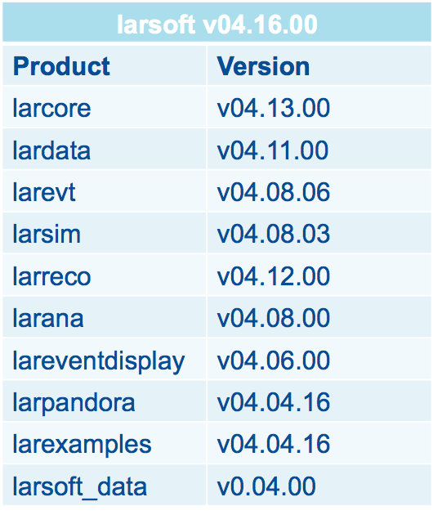
What is a LArSoft Release?
A LArSoft release is a consistent set of LArSoft products built from tagged versions of code in the repositories
  Implicitly includes corresponding versions of all external dependencies used to build it
  Each release of LArSoft has a release notes page on scisoft.fnal.gov
    http://scisoft.fnal.gov/scisoft/bundles/larsoft/<version>/larsoft-<version>.html
larsoft
  An umbrella ups product that binds it all together under one version, one setup command
    setup larsoft v06_06_00 -q …
larsoft_data
  A ups product with large configuration files (photon propagation lookup libraries, radiological decay spectra, supernova spectra)
UPS is a tool that allows you to switch between using different versions of a product

Slide 10
What is a LArSoft Release?
A LArSoft release is a consistent set of LArSoft products built from tagged versions of code in the repositories
  Implicitly includes corresponding versions of all external dependencies used to build it
  Each release of LArSoft has a release notes page on scisoft.fnal.gov
    http://scisoft.fnal.gov/scisoft/bundles/larsoft/<version>/larsoft-<version>.html
larsoft
  An umbrella ups product that binds it all together under one version, one setup command
    setup larsoft v06_06_00 -q …
larsoft_data
  A ups product with large configuration files (photon propagation lookup libraries, radiological decay spectra, supernova spectra)
dunetpc is DUNE’s experiment software built using LArSoft/art
2) A dunetpc release (and UPS product) is bound to a particular release of LArSoft
3) By convention, the version numbering is kept in sync, aside from possible patching of production releases
dunetpc is DUNE’s experiment software built using LArSoft/art - https://wiki.dunescience.org/wiki/DUNE_LAr_Software_Releases
2) A dunetpc release (and UPS product) is bound to a particular release of LArSoft
3) By convention, the version numbering is kept in sync, aside from possible patching of production releases
UPS is a tool that allows you to switch between using different versions of a product

Slide 11
LArSoft and the art Framework
LArSoft is built on top of the art event processing framework
The art framework
  Reads events from user-specified input sources
  Invokes user-specified modules to perform reconstruction, simulation analysis, event-filtering tasks
  May write results to one or more output files
Modules
  Configurable, dynamically loaded, user-written units with entry points called at specific times within the event loop
  Three types
    Producer: may modify the event
    Filter: like a Producer, but may alter flow of module processing within an event
    Analyzer: may read information from an event, but not change it

Slide 12
LArSoft and the art Framework
Services
  Configurable global utilities registered with framework, with entry points to event loop transitions and whose methods may be accessed within modules
Tools
  Configurable, local utilities callable inside modules
  See this talk at LArSoft Coordination Meeting for details on tools
The run-time configuration of art, modules, services and tools specified in FHiCL (.fcl files)
  See art workbook and FHiCL quick-start guide for more information on using FHiCL to configure art jobs
  See https://cdcvs.fnal.gov/redmine/projects/fhicl-cpp/wiki/Wiki for C++ bindings and using FHiCL parameters inside programs

Slide 13
Running LArSoft
Don’t need to build code, use DUNE’s code
  # setup the dunetpc environment
  source /cvmfs/dune.opensciencegrid.org/products/dune/setup_dune.sh
  setup –B dunetpc v06_63_00 -q e14:prof
  lar -n 1 -c prod_muminus_0.1-5.0GeV_isotropic_dune10kt_1x2x6.fcl
The ‘source’ line sets up versions of the software ups products and the environment needed to run the DUNE-specific code using LArSoft
The ‘setup’ line says to use version 06_63_00 of the dunetpc software ups product. This release is bound to a particular release of LArSoft
The ‘lar’ line runs the art framework using a DUNE ‘fcl’ file as input, which defines what the software is supposed to do
Exercise

Slide 14
Running LArSoft – fcl Files
How does art find the fcl file?
  FHICL_FILE_PATH environment variable
  Defined by setup of dunetpc and other software products
How do I examine final parameter values for a given fcl file?
  fhicl-expand
    Performs all “#include” directives, creates a single output with the result
  fhicl-dump
    Parses the entire file hierarchy, prints the final state all FHiCL parameters
    Using the “--annotate” option, also lists the fcl file + line number at which each parameter takes its final value
    Requires FHICL_FILE_PATH to be defined
How can I tell what the FHiCL parameter values are for a processed file?
  config_dumper
    Prints the full configuration for the processes that created the file

Slide 15
LArSoft – Processing Chain
Major processing steps are in a set of pre-defined fcl files
Event generation
First example was SingleGen Module
  In larsim/larsim/EventGenerator
  fcl was in dunetpc/fcl/dunefd/gen/single/
Geant4 simulation
Detector simulation
Detector simulation
Reconstruction
Reconstruction

Slide 16
LArSoft – Processing Chain
Major processing steps are in a set of pre-defined fcl files
Event generation
Other event generation options
  GENIE: GENIEGen module
  NuWro: NuWroGen module
  CORSIKA: CORSIKAGen module
  CRY: CosmicsGen module
  NDk: NDKGen module
  TextFileGen module
  When all else fails...reads a text file, produces simb::MCTruth
larsim/larsim/EventGenerator/
  Others in larsim/larsim/EventGenerator
Geant4 simulation
Detector simulation
Detector simulation
Reconstruction
Reconstruction

Slide 17
LArSoft – Processing Chain
Event generation
Geant4 simulation
  Traces energy deposition, secondary interactions within LAr
  Also performs electron / photon transport
  LArG4 module in larsim/larsim/LArG4
  Note:
    Many generator / simulation interfaces are defined in nutools product.
  Homework fcl:
    standard_g4_dune10kt_1x2x6.fcl
    In dunetpc/fcl/dunefd/g4/
Event generation
Geant4 simulation
Detector simulation
Detector simulation
Exercise
Reconstruction
Reconstruction

Slide 18
LArSoft – Processing Chain
Event generation
Detector simulation
  Detector and readout effects
  Field response, electronics response, digitization
  Historically, most of this code is experiment-specific
    dunetpc
    More recently, the active development is part of wire-cell project with interfaces to LArSoft
  Homework fcl:
    standard_detsim_dune10kt_1x2x6.fcl
    In dunetpc/fcl/dunefd/detsim/
Event generation
Geant4 simulation
Geant4 simulation
Detector simulation
Exercise
Reconstruction
Reconstruction

Slide 19
LArSoft – Processing Chain
Event generation
Event generation
Reconstruction
  Performs pattern recognition, extracts information about physical objects and processes in the event
  May include signal processing, hit-finding, clustering of hits, view matching, track and shower finding, particle ID
    2D and 3D algorithms
    External RP interfaces for Pandora and Wire-cell
  Homework fcl:
    standard_reco_dune10kt_1x2x6.fcl
    In dunetpc/fcl/dunfd/reco/
Geant4 simulation
Geant4 simulation
Detector simulation
Detector simulation
Exercise
Reconstruction

Slide 20
LArSoft – Modify Config of a Job
Suppose you need to modify a parameter in a pre-defined job
Several options. Here are two.
  Option 1
    Copy the fcl file that defines the parameter to the “pwd” for the lar command
    Modify the parameter
    Run lar -c … as before
      The modified version will get picked because “.” is always first in FHICL_FILE_PATH
  Option 2
    Copy the top-level fcl file to the “pwd” for the lar command
    Add an override line to the top-level fcl file
      E.g., in the homework generator job, all those lines at the bottom:
...
services.Geometry: @local::dune10kt_1x2x6_geo
source.firstRun: 20000014
physics.producers.generator.PDG: [ 13 ] # mu-
physics.producers.generator.PosDist: 0 # Flat position dist.
...

Slide 21
LArSoft – Modify Code of a Job
In cases where configuration changes will not be sufficient, you will need to modify, build, then run code:
Create a new working area from a fresh login + DUNE set-up
  (Note, if dunetpc/larsoft is already set up, then only need “mrb newDev”)
  This creates the three following directories inside <working_dir>
mkdir <working_dir>
cd <working_dir>
mrb newDev -v <version> -q <qualifiers>
<working_dir>/localProducts_<MRB_PROJECT>_<version>_<qualifiers>
/build_<os flavor>
/srcs
Local products directory
Source directory
Build directory

Slide 22
LArSoft – Modify Code of a Job
In cases where configuration changes will not be sufficient, you will need to modify, build, then run code:
Create a new working area from a fresh login + DUNE set-up
  (Note, if dunetpc/larsoft is already set up, then only need “mrb newDev”)
  This creates the three following directories inside <working_dir>
An aside:
mrb : multi-repository build system
Purpose is to simplify building of multiple products pulled from separate repositories
setup mrb command executed in experiment setup
Most commonly used commands
  mrb --help #prints list of all commands with brief descriptions
  mrb <command> --help #displays help for that command
  mrb gitCheckout #clone a repository into working area
  mrbsetenv #set up build environment
  mrb build / install -jN #build/install local code with N cores
  mrbslp #set up all products in localProducts...
  mrb z #get rid of everything in build area
mkdir <working_dir>
cd <working_dir>
mrb newDev -v <version> -q <qualifiers>
<working_dir>/localProducts_<MRB_PROJECT>_<version>_<qualifiers>
/build_<os flavor>
/srcs
Local products directory
Source directory
Build directory

Slide 23
LArSoft – Modify Code of a Job
Set up local products and development environment
  source localProducts_<MRB_PROJECT>_<version>_<qualifiers>/setup
  Creates a number of new environment variables, including
    MRB_SOURCE points to the srcs directory
    MRB_BUILDDIR points to the build_... directory
    Modifies PRODUCTS to include localProducts... as the first entry
Check out the repository to be modified (and maybe others that depend on any header files to be modified)
  cd $MRB_SOURCE
  mrb g dunetpc # g is short for gitCheckout
  Clones dunetpc from current head of “develop” branch
  Adds the repository to top-level build configuration file (CMakeLists.txt)

Slide 24
LArSoft – Modify Code of a Job
Make changes to the code…
  Look in <working_dir>/srcs/<repository-name>
Go to the build dir and setup the development environment
  cd $MRB_BUILDDIR
  mrbsetenv
Build the code
  mrb b # b is short for build
Install local ups products from the code you just built
  mrb i # i is short for install. This will do a build also.
  Files are re-organized and moved into localProducts... directory
    All fcl files are put into a top-level “job” directory with no sub-structure
    All header files are put into a top-level “include” directory with sub-directories
    Other files are moved to various places, including source files, while some, such as build configuration files, are ignored and not put anywhere in the ups product

Slide 25
LArSoft – Modify Code of a Job
Now set-up the local versions of the products just installed
  cd $MRB_TOP
  mrbslp
Run the code you just built
  lar -c <whatever fcl file you were using> …
Another useful command: get rid of the code you just built so you can start over from a clean build
  cd $MRB_BUILDER
  mrb z

Slide 26
LArSoft – Navigating art/root files
lar -c eventdump.fcl -s <file>
  Uses the FileDumperOutput module to produce this:
Begin processing the 1st record. run: 20000014 subRun: 0 event: 1 at 17-May-2017 01:59:11 CDT
PRINCIPAL TYPE: Event
PROCESS NAME | MODULE_LABEL.. | PRODUCT INSTANCE NAME | DATA PRODUCT TYPE.......................................... | SIZE
SinglesGen.. | generator..... | ..................... | std::vector<simb::MCTruth>................................. | ...1
SinglesGen.. | rns........... | ..................... | std::vector<art::RNGsnapshot>.............................. | ...1
SinglesGen.. | TriggerResults | ..................... | art::TriggerResults........................................ | ...-
G4.......... | largeant...... | ..................... | std::vector<sim::OpDetBacktrackerRecord>................... | ..99
G4.......... | rns........... | ..................... | std::vector<art::RNGsnapshot>.............................. | ...2
G4.......... | TriggerResults | ..................... | art::TriggerResults........................................ | ...-
G4.......... | largeant...... | ..................... | std::vector<simb::MCParticle>.............................. | ...8
G4.......... | largeant...... | ..................... | std::vector<sim::AuxDetSimChannel>......................... | ...0
G4.......... | largeant...... | ..................... | art::Assns<simb::MCTruth,simb::MCParticle,void>............ | ...8
G4.......... | largeant...... | ..................... | std::vector<sim::SimChannel>............................... | .684
G4.......... | largeant...... | ..................... | std::vector<sim::SimPhotonsLite>........................... | ..99
Detsim...... | TriggerResults | ..................... | art::TriggerResults........................................ | ...-
Detsim...... | opdigi........ | ..................... | std::vector<raw::OpDetWaveform>............................ | .582
Detsim...... | daq........... | ..................... | std::vector<raw::RawDigit>................................. | 4148
Detsim...... | rns........... | ..................... | std::vector<art::RNGsnapshot>.............................. | ...1
Reco........ | TriggerResults | ..................... | art::TriggerResults........................................ | ...-
Reco........ | trajcluster... | ..................... | std::vector<recob::Vertex>................................. | ...2
Reco........ | pmtrajfit..... | kink................. | std::vector<recob::Vertex>................................. | ...0
Reco........ | pandora....... | ..................... | std::vector<recob::PCAxis>................................. | ...0
Reco........ | pmtrack....... | ..................... | std::vector<recob::Vertex>................................. | ...2
Reco........ | pandoracalo... | ..................... | art::Assns<recob::Track,anab::Calorimetry,void>............ | ...3
Reco........ | pandora....... | ..................... | art::Assns<recob::PFParticle,recob::SpacePoint,void>....... | .581
...
...

Slide 27
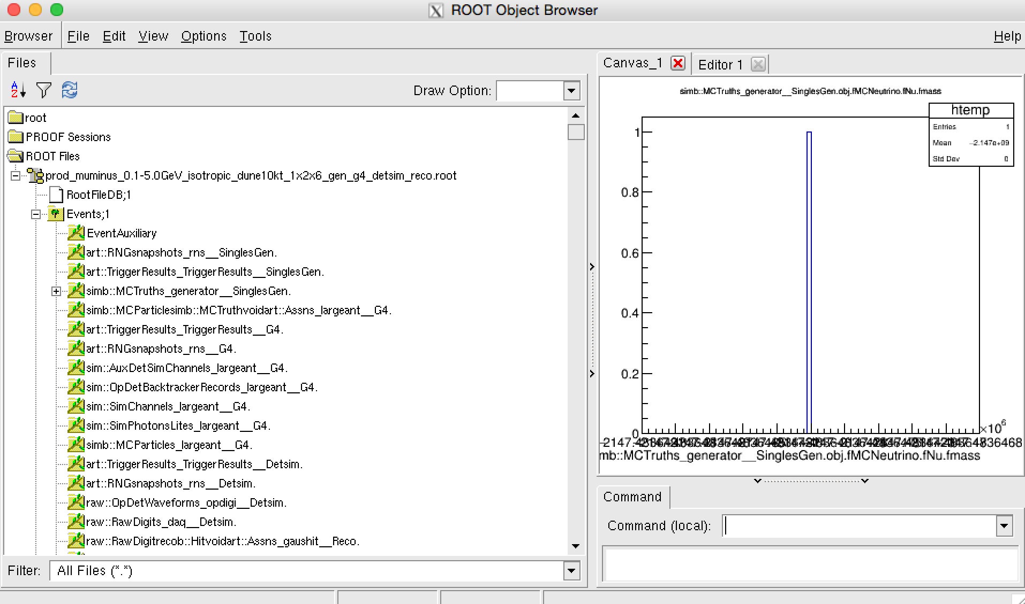
LArSoft – Navigating art/root files
Examine the file within a Tbrowser (in root)
The event
TTree
Data product
branches

Slide 28
LArSoft – Navigating art/root files
Dumping individual data products
  ls $LARDATA_DIR/source/lardata/ArtDataHelper/Dumpers
  ls $LARSIM_DIR/source/larsim/MCDumpers
  Dedicated modules named “Dump<data product>” produce formatted dump of contents of that data product
  Run then with fcl files in those same directories: dump_<data type>.fcl
  E.g.: lar -c dump_clusters.fcl -s <file>
    General fcl files are in $LARDATA_DIR/job

Slide 29
Gallery

Slide 30
Gallery – Reading Event Data Outside of art
gallery is a (UPS) product that provides libraries that support the reading of event data from art/ROOT data files outside of the art event-processing framework executable.
gallery comes as a binary install; you are not building it.
art is a framework, gallery is a library.
When using art, you write libraries that “plug into” the framework. When using gallery, you write a main program that uses libraries.
When using art, the framework provides the event loop. When using gallery, you write your own event loop.
art comes with a powerful and safe (but complex) build system. With gallery, you provide your own build system.

Slide 31
Gallery – What does it do?
gallery provides access to event data in art/ROOT files outside the art event processing framework executable:
  without the use of EDProducers, EDAnalyzers, etc., thus
  without the facilities of the framework (e.g. callbacks for runs and subruns, art services, writing of art/ROOT files, access to non-event data).
You can use gallery to write:
  compiled C++ programs,
  ROOT macros,
  (Using PyROOT) Python scripts.
You can invoke any code you want to compile against and link to. Be careful to avoid introducing binary incompatibilities.

Slide 32
Gallery – When should I Use It?
If you want to use either Python or interactive ROOT to access art/ROOT data files.
If you do not want to use framework facilities, because you do not need the abilities they provide, and only need to access event data.
If you want to create an interactive program that allows random navigation between events in an art/ROOT data file (e.g., an event display).

Slide 33
Gallery – When Should I NOT Use IT?
When you need to use framework facilities (run data, subrun data, metadata, services, etc.)
When you want to put something into the Event. For the gallery Event, you can not do so. For the art Event, you do so to communicate the product to another module, or to write it to a file. In gallery, there are no (framework!) modules, and gallery can not write an art/ROOT file.
If your only goal is an ability to build a smaller system than your experiment’s infrastructure provides, you might be interested instead in using the build system studio: https://cdcvs.fnal.gov/redmine/projects/studio/wiki.
You can use studio to write an art module, and compile and link it, without (re)building any other code.

Slide 34
Data Management

Slide 35
Data Management
Storage volumes:
  More volumes to be added (EOS at CERN, /pnfs at BNL etc.)
Data handling tools:
  IFDH
  SAM and SAM4Users”
Storage systems | Path on GPVMs
BlueArc App | /dune/app/users/${USER}
BlueArc Data | /dune/data/users/${USER}; /dune/data2/users/${USER}
Scratch dCache | /pnfs/dune/scratch/users/${USER}
Persistent dCache | /pnfs/dune/persistent/users/${USER}
Tape-backed dCache | /pnfs/dune/tape_backed/users/${USER}
Not accessible on grid worker nodes

Slide 36
Data Management - BlueArc
  Not mounted on grid nodes, only on interactive nodes (dunegpvm01.fnal.gov etc)
  a Network Attached Storage (NAS) system;
  App area, /dune/app
    used primarily for code and script development;
    should not be used to store data;
    slightly lower latency;
    smaller total storage (200 GB/user).
  Data area, /dune/data or /dune/data2
    used primarily for storing ntuples and small datasets (200 GB/user);
    higher latency than the app volumes;
    full POSIX access (read/write/modify);
    throttled to have a maximum of 5 transfers at any given time.
    Cannot copy to/from /dune/data areas in a grid job.

Slide 37
Data Management - dCache
A lot of data distributed among a large number of heterogeneous server nodes.
Although the data is highly distributed, dCache provides a file system tree view of its data repository.
dCache separates the namespace of its data repository (pnfs) from the actual physical location of the files;
the minimum data unit handled by dCache is a file.
files in dCache become immutable (they cannot be modified)
  Opening an existing file for write or update or append fails;
  Opening an existing file for read works;
  Opens can be queued until a dCache door (I/O protocols provided by I/O servers) is available (good for batch throughput but annoying for interactive use).

Slide 38
Data Management - dCache
Areas | Location | Storage type | Space | File lifetime | When disk/tape is full
Scratch | /pnfs/dune/scratch | Disk | No hard limit. Scratch area is shared by all experiments (>1PB as of today). | refer to the scratch lifetime plot: http://fndca.fnal.gov/dcache/lifetime/PublicScratchPools.jpg | LRU eviction policy, new files will overwrite LRU files.
Persistent | /pnfs/dune/persistent | Disk | 190 TB | > 5 years, Managed by DUNE | No more data can be written when quota is reached.
Tape-backed | /pnfs/dune/tape_backed | Tape | Pseudo-infinite | >10 years, Permanent storage. | New tape will be added.

Slide 39
Data Management – Scratch dCache
Copy files needed on the grid to scratch dCache, and have jobs fetch from there
Least Recently Used (LRU) eviction policy applies in scratch dCache
Scratch lifetime: http://fndca.fnal.gov/dcache/lifetime/PublicScratchPools.jpg
NFS access is not as reliable as using ifdh, xrootd
Don’t put thousands of files into one directory in dCache;
Note: Do not use “rsync” with any dCache volumes.

Slide 40
Data Management – Persistent/Tape-backed dCache
Storing files into persistent or tape-backed area is only recommended with “sam_clone_dataset” tool, or other tools that automatically declare locations to SAM.
Grid output files should be written to the scratch area first. If finding those files is valuable for longer term storage, they can be put into the persistent or tape-backed area with SAM4users tool:
  sam_add_dataset, create a SAM dataset for files in the scratch area;
  sam_clone_dataset , clone the dataset to the persistent or tape-backed area;
  sam_unclone_dataset , delete the replicas of the dataset files in the scratch area.
  NOTE: SAM4users will change your filename to insure it is unique.

Slide 41
Data Management – Best Practices
Avoid using “rsync” on any dCache volumes;
Store files into dCache scratch area first;
Always use SAM to do bookkeeping for files under persistent or tape-backed areas;
For higher reliability, use “ifdh” or “xrootd” in preference to NFS for accessing files in dCache.

Slide 42
FIFE Tools

Slide 43
FIFE Tools (Grid Job Submission)
The FabrIc for Frontier Experiments centralized services includes:
  Submission to distributed computing – JobSub, GlideinWMS
  Processing Monitors, Alarms, and Automated Submission
  Data Handling and Distribution
    Sequential Access Via Metadata (SAM) File Transfer Service
    Interface to dCache/enstore/storage services
    Intensity Frontier Data Handling Client (IFDHC)
  Software stack distribution – CERN Virtual Machine File System (CVMFS)
  User Authentication, Proxy generation, and security
  Electronic Logbooks, Databases, and Beam information

Slide 44

FIFE Tools – Job Submission
Users interface with the batch system via “jobsub” tool
Common monitoring provided by FIFEMON tools
User
FNAL GPGrid
Jobsub client
Jobsub server
Condor schedds
OSG Sites
Monitoring (FIFEMON)
GlideinWMS pool
GlideinWMS frontend
Condor negotiator
AWS/HEPCloud

Slide 45
FIFE Tools – Job Submission
What happens when you submit jobs to the grid?
  You are authenticated and authorized to submit
  Submission goes into batch queue (HTCondor) and waits in line
  You (or your script) hand to jobsub an executable (script or binary)
  Jobs are matched to a worker node
  Server distributes your executable to the worker nodes
  Executable runs on remote cluster and NOT as your user id – no home area, no NFS volume mounts, etc.

Slide 46
FIFE Tools – Job Submission
kinit
ssh -K dunegpvm01.fnal.gov #don't everyone use duneand use 02-10
Now that you've logged into DUNE interactive node, create a working area and copy over some example scripts
cd /dune/app/users/${USER}
mkdir dune_jobsub_tutorial
cd dune_jobsub_tutorial
cp /dune/app/users/kirby/dune_may2017_tutorial/*.sh `pwd`
source /cvmfs/fermilab.opensciencegrid.org/products/common/etc/setup
setup jobsub_client
jobsub_submit -N 2 -G dune --expected-lifetime=1h --memory=100MB --disk=2GB --resource-provides=usage_model=DEDICATED,OPPORTUNISTIC,OFFSITE file://`pwd`/basic_grid_env_test.sh

Slide 47
FIFE Tools – Job Submission (jobsub)
jobsub_submit -N 2 -G dune --expected-lifetime=1h --memory=100MB --disk=2GB --resource-provides=usage_model=DEDICATED,OPPORTUNISTIC,OFFSITE file://`pwd`/basic_grid_env_test.sh
  N is the number of jobs in a cluster
  G is the experiment group
  expected-lifetime is how long it will take to run a single job in the cluster
  memory is the RAM footprint of a single job in the cluster
  disk is the scratch space need for a single job in the cluster
jobsub command outputs jobid needed to retrieve job output
  EX: JobsubJobId of first job: 17067704.0@jobsub01.fnal.gov

Slide 48
FIFE Tools – Job Submission
What do I need to know to submit a job?
  What number of CPUs does the job need?
  How much total memory does the job need? Does it depend on the input? Have I tested the input?
  How much scratch hard disk scratch space does the job need to use? staging input files from storage? writing output files before transferring back to storage?
  How much wall time for completion of each section? Note that wall time includes transferring input files, transferring output files, and connecting to remote resources (Databases, websites, etc.)

Slide 49
FIFE Tools – Submitting Production Jobs
To submit Production jobs you need to add to the jobsub_submit command line –
  --role=Production
And you must be authorized for this role in DUNE
All subsequent jobsub commands you issue must also use the
  --role=Production option.

Slide 50
FIFE Tools – Check on Jobs
jobsub_q --user=${USER}
  USER specifies the uid whose jobs you want the status of.
  Job status can be the following
    R is running
    I is idle (a.k.a. waiting for a slot)
    H is held (job exceeded a resource allocation)
  With the --held parameter, held reason codes are not printed out. Need to use FIFEMON.
Additional commands
  jobsub_history – get history of submissions
  jobsub_rm – remove jobs/clusters from jobsub server
  jobsub_hold – set jobs/clusters to held status
  jobsub_release – release held jobs/clusters
  jobsub_fetchlog – get the condor logs from the server

Slide 51
FIFE Tools – Fetching Job Logs
Need your jobid
jobsub_fetchlog -G dune --jobid=nnnnnn
Returns a tarball with the following in it –
  shell script sent to the jobsub server (.sh)
  wrapper script created by jobsub server to set environment variables (.sh)
  condor command file sent to condor to put job in queue (.cmd)
  an empty file
  stdout of the bash shell run on the worker node (.out)
  stderr of the bash shell run on the worker node (.err)
  condor log for the job (.log)
  the original fetchlog tarball

Slide 52
FIFE Tools – Accessing Software/Libraries
The standard repository for accessing software and libraries is CVMFS (CERN Virtual Machine File System)
  mounted on all worker nodes
  mounted on all interactive nodes
  can be mounted on your laptop
  used for centralized distribution of packaged releases of experiment software – not your personal dev area
  not to be used for distribution of data or reference files
locally built development code should be placed in a tarball on dCache, transferred to the worker nodes from dCache, and then unwound into the scratch area
details about tarball transfers available here:
https://cdcvs.fnal.gov/redmine/projects/jobsub/wiki/Jobsub_submit

Slide 53
Accessing CVMFS
LArSoft and dunetpc software versions are accessible at FNAL and remotely using CVMFS.
  https://wiki.dunescience.org/wiki/DUNE_Computing/Access_files_in_CVMFS
  Don’t miss the Quick Start guide at the bottom of the page
  This tells you how to install CVMFS on your computer.
You will need two repositories –
  /cvmfs/dune.opensciencegrid.org. (to get DUNE software)
  /cvmfs/fermilab.opensciencegrid.org (to get LArSoft and dependencies)
Adding files to CVMFS – you will need permission from the DUNE S&C coordinators first.

Slide 54
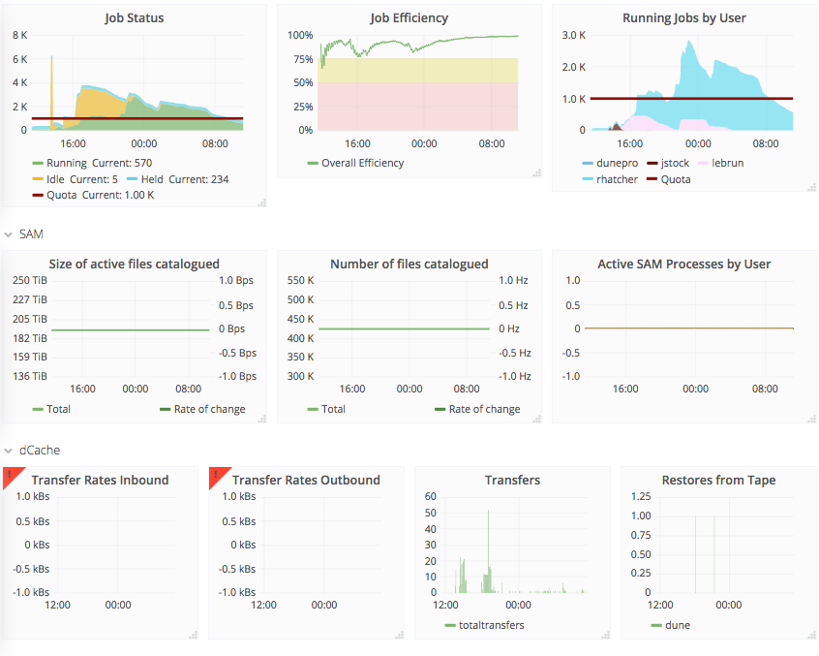
FIFE Tools - Monitoring
FIFEMON for DUNE – need services account to login
Some of what is monitored ->

Slide 55
Best Practices

Slide 56
Best Practices – Common Complaints/Problems
Jobs are taking too long
Fewer jobs run simultaneously than expected
Jobs fail due to missing mount points
Jobs run longer than expected or get held after exceeding resource requests (memory, local disk, run time)

Slide 57
Best Practices -
Jobs are taking too long
Fewer jobs run simultaneously than expected
Most Likely Cause – there are no available slots that match your request.
Have you submitted to all available resources, including offsite?
  There are potentially 1000’s of cores beyond FermiGrid.
  Make your scripts OSG-ready from the beginning.
  Recommend NOT choosing specific sites.
  https://cdcvs.fnal.gov/redmine/projects/fife/wiki/Infor mation_about_job_submission_to_OSG_sites

Slide 58
Best Practices
Jobs are taking too long
Fewer jobs run simultaneously than expected
Have you accurately specified your needed resources? The more you request, the harder it is to match.
  Check memory, disk and run time
  Request only what you need. Don’t just stick with the default, you can gain by requesting less than the default.
  Jobs are matched to slots based on the resource requests.
  Requesting too little isn’t good either.
    Your job will be automatically held if it goes above the requested memory, local disk, or run time request.
    Held = stopped and will restart from the beginning when manually released.
  Memory/disk usage checks run every two minutes.

Slide 59
Best Practices – Requesting Resources
Jobsub has --memory, --disk, --cpu, --expected-lifetime opts
--memory and --disk will take units of KB, MB, GB, TB
  1 GB = 1024 MB, not 1000 MB
Example of a well-formed request
  --cpu=1 –memory=1800MB –disk=15GB –expected-lifetime=6h
You might not be using jobsub directly, consult the documentation of whatever you are using to pass resource requests to jobsub_submit

Slide 60
Best Practices – Requesting Resources
 | Accepted Units | Default Units | Default Request | Limit (FermiGrid)
--memory | KB, MB, GB, TB | MB | 2000MB | 16,000MB
--cpu | integer | integer | 1 | 8
--disk | KB, MB, GB, TB | KB | 35,000,000 KB
--expected-lifetime | h (hours), m (minutes), s (seconds) Can also use - short (3h), medium (8h), long (24h) | s | 8 hours max run time | 4 days

Slide 61
Best Practices
Jobs fail due to missing mount points
Grid nodes do not have /pnfs directly mounted.
Non-FermiGrid nodes do not have any of the following mounted
  /grid/fermiapp/anything
  /experiment/anything
  /pnfs/anything
  Jobs fail due to missing mount points
Write scripts without using these mounts.
  Get experiment software from CVMFS and/or tarballs copied from dCache
  Do not hardcode file paths (CVMFS is ok to hardcode)
You can test to make sure you don’t need these mounts by running your job script on fermicloud168.fnal.gov. Follow these instructions –
  https://cdcvs.fnal.gov/redmine/projects/fife/wiki/Using_'grid-like'_nodes

Slide 62
Best Practices
Jobs run longer than expected
Your job could be stuck copying inputs/outputs
  Did you use a /grid/… or /dune/… (bluearc) disk?
  Did you allow enough time for file transfer from remote sites?
  If you are running with a SAM dataset, did you pre-stage it? This is important as files may have to be fetched from tape which can take a while.
  Did you spell your filename correct on an ‘ifdh cp’ line?
    Pass –e IFDH_CP_MAXRETRIES=2 to jobsub
    Use the –timeout self-destruct timer option to jobsub_submit so the job self-destructs before being held
  Was your job held for some reason? Check here –
    https://fifemon.fnal.gov/monitor/dashboard/db/why-are-my-jobs-held?orgId=1 (choose your username from the drop-down menu in the upper left corner)

Slide 63
Best Practices - A Common Denominator
All of following problems –
  Inability to use offsite resources
  Slow run times and slow file transfer rates
  Job failures due to missing mount points
  Stuck in idle waiting for jobs to copy
Can be caused by using BlueArc areas in your job
It is OK to do a jobsub_submit <options> file:///dune/app/foo
But, /dune/app/foo should not use BlueArc inside of it.

Slide 64
Best Practices - A Common Denominator
Get rid of BlueArc - Change from
#!/bin/bash
# setup SW
. /grid/fermiapp/products/dune/setup_dune.sh
setup some_packages
ifdh cp -D /pnfs/dune/scratch/users/${GRID_USER}/my_input_file ./
/dune/app/users/${GRID_USER}/my_custom_code/mycode -i my_input_file -o my_output_file
ifdh cp -D my_output_file /pnfs/dune/scratch/users/${GRID_USER}/some_dir/

Slide 65
Best Practices - A Common Denominator
Change to
#!/bin/bash
# setup SW
. /cvmfs/dune.opensciencegrid.org/products/dune/setup_dune.sh
setup some_packages
ifdh cp -D /pnfs/dune/scratch/users/${GRID_USER}/my_input_file ./
ifdh cp -D /pnfs/dune/scratch/users/${GRID_USER}/my_custom_code.tar.gz ./
tar zmfx my_custom_code.tar.gz
./my_custom_code/mycode -i my_input_file -o my_output_file
ifdh cp -D my_output_file /pnfs/dune/scratch/users/${GRID_USER}/some_dir/
Still needs error checking, dependency checking, …

Slide 66
Best Practices
Submit test jobs before any large submissions after changes
Test interactively (gpgtest, fermicloud168)
Consult with the DUNE S&C Coordinators before submitting large jobs
If you have specific requirements the worker node must meet, put them in the job requirements via –
  --append_condor_requirements jobsub option
  These might include, veto of a specific site, specific version of CVMFS you need, …
Prestage your input files
If you need to pass environment variables to your script to be evaluated on the worker node, preface them with a ‘\’ (variable will be expanded in the job, not during submission)
  --source=\$CONDOR_DIR_INPUT/script.sh

Slide 67
Best Practices
How many jobs can I submit at once?
  Max in a single submission is 10K
  For multiple submissions, do not exceed 1000 jobs/minute
How many jobs can I have queued?
  No hard limit, but no more than you could run in a week using DUNE’s FermiGrid quota
Don’t forget to account for slot weight! For 4 GB memory jobs, again divide by 2.

Slide 68
Many Many Help Links

Slide 69
Getting Help
https://wiki.dunescience.org/wiki/DUNE_Computing/Getting_Started_with_DUNE_Computing
  Getting Accounts and Logging in
  Kerberos, UPS, General Overviews,
  Getting Started Exercises
https://wiki.dunescience.org/wiki/DUNE_Computing/Computing_How-To_Documentation
  List of DUNE & Related Tutorials
  DUNE Interactive Resources
  Running Grid Jobs
  Data Storage Resources
  Software
  Databases
Use the DUNE Service Portal. (need Services username/password)
Issues with job submission, data movement, trouble with SAM, …
  Open a service desk ticket.

Slide 70
Get More Info On LArSoft
These slides were taken from – DUNE S&C Tutorial from Aug
Main public LARSoft web page : https://larsoft.org
  LArSoft wiki - https://cdcvs.fnal.gov/redmine/projects/larsoft/wiki
    Quick page with links to quick-start guides by experiment
Forum to discuss LArTPC software - http://www.larforum.org/
  LArSoft email list - larsoft@fnal.gov
Bi-weekly meeting 9am Central in WH3NE - LArSoft Indico site
    LArSoft issue tracker - https://cdcvs.fnal.gov/redmine/projects/larsoft/issues/new
2015 LArSoft course material
Best practices for writing fcl files explained by Kyle Knoepfel
  Not needed for typical user. Required for user who writes modules or production workflows.

Slide 71
Get More Info on Gallery
These slides were taken from – DUNE S&C Tutorial from Aug
Gallery main web page - http://art.fnal.gov/gallery/
Gallery demo - https://github.com/marcpaterno/gallery-demo

Slide 72
Get More Info on Data Management
These slides were taken from – DUNE S&C Tutorial from Aug
Using DUNE’s dCache - https://wiki.dunescience.org/wiki/DUNE_Computing/Using_DUNE%27s_dCache_Scratch_and_Persistent_Space_at_Fermilab
Understanding storage volumes https://cdcvs.fnal.gov/redmine/projects/fife/wiki/Understanding_storage_volumes
SAM4Users wiki https://cdcvs.fnal.gov/redmine/projects/sam/wiki/SAMLite_Guide
SAM wiki https://cdcvs.fnal.gov/redmine/projects/sam/wiki/User_Guide_for_SAM

Slide 73
Get More Info on FIFE Tools
These slides were taken from – DUNE S&C Tutorial from Aug
https://web.fnal.gov/project/FIFE/SitePages/Home.aspx
https://cdcvs.fnal.gov/redmine/projects/jobsub/wiki/Jobsub_submit
List of environment variables on worker nodes:
  https://cdcvs.fnal.gov/redmine/projects/jobsub/wiki/Jobsub_enviornment_variables
Full documentation of the jobsub client here
  https://cdcvs.fnal.gov/redmine/projects/jobsub/wiki/Using_the_Client
https://cdcvs.fnal.gov/redmine/projects/fife/wiki/Wiki
https://cdcvs.fnal.gov/redmine/projects/fife/wiki/Introduction_to_FIFE_and_Component_Services
https://cdcvs.fnal.gov/redmine/projects/fife/wiki/Advanced_Computing
https://cdcvs.fnal.gov/redmine/projects/jobsub/wiki#Client-User-Guide
https://cdcvs.fnal.gov/redmine/projects/ifdhc/wiki

Slide 74
Learn More About Running DAGs

Slide 75
A bit on DAGs
Directed Acyclic Graphs (DAGs) are a way to run jobs that depend on other jobs (e.g. run geant4 on the output of the event generator step)
User can define structure and dependencies, but there is only a single submission (no babysitting required!) Later stage jobs start automatically after previous stage finished.
Note: if parent job fails, dependent jobs will not run
Possible to create DAGs for jobsub with simple xml schema, and then submit with jobsub_submit_dag

Slide 76
XML Schema
There are serial jobs, parallel jobs, and each section runs as a different stage (note ALL jobs in stage N must finish before stage N+1 starts)
Consider this simple workflow:
Intro job does prep work (like starting a SAM project)
Intro Job
Analysis Job 1
Analysis Job 2
Analysis Job 3
Finalize Job
Finalize job looks at
Outputs of analysis jobs and
Does something and/or ends project

Slide 77
Toy Workflow XML
cat mytoy.xml
  <serial>
  jobsub -n --memory=500MB --disk=1GB \ --expected-lifetime=1h \ --resource-provides=usage_model=DEDICATED,OPPORTUNISTIC,OFFSITE file://init_script.sh ARGS0
  </serial>
  <parallel>
  jobsub -n --memory=2000MB --disk=1GB \ --expected-lifetime=3h \ --resource-provides=usage_model=DEDICATED,OPPORTUNISTIC,OFFSITE file://analysis_script.sh ARGS
  jobsub -n --memory=2000MB --disk=1GB \ --expected-lifetime=3h \ --resource-provides=usage_model=DEDICATED,OPPORTUNISTIC,OFFSITE file://analysis_script.sh ARGS
  jobsub -n --memory=2000MB --disk=1GB \ --expected-lifetime=3h \ --resource-provides=usage_model=DEDICATED,OPPORTUNISTIC,OFFSITE file://analysis_script.sh ARGS
  </parallel>
  <serial>
  jobsub -n --memory=1000MB --disk=5GB \ --expected-lifetime=2h \ --resource-provides=usage_model=DEDICATED,OPPORTUNISTIC,OFFSITE file://finalize_script.sh ARGS2
  </serial>

Slide 78
Toy Workflow XML
cat mytoy.xml
  <serial>
  jobsub -n --memory=500MB --disk=1GB \ --expected-lifetime=1h \ --resource-provides=usage_model=DEDICATED,OPPORTUNISTIC,OFFSITE file://init_script.sh ARGS0
  </serial>
  <parallel>
  jobsub -n --memory=2000MB --disk=1GB \ --expected-lifetime=3h \ --resource-provides=usage_model=DEDICATED,OPPORTUNISTIC,OFFSITE file://analysis_script.sh ARGS
  jobsub -n --memory=2000MB --disk=1GB \ --expected-lifetime=3h \ --resource-provides=usage_model=DEDICATED,OPPORTUNISTIC,OFFSITE file://analysis_script.sh ARGS
  jobsub -n --memory=2000MB --disk=1GB \ --expected-lifetime=3h \ --resource-provides=usage_model=DEDICATED,OPPORTUNISTIC,OFFSITE file://analysis_script.sh ARGS
  </parallel>
  <serial>
  jobsub -n --memory=1000MB --disk=5GB \ --expected-lifetime=2h \ --resource-provides=usage_model=DEDICATED,OPPORTUNISTIC,OFFSITE file://finalize_script.sh ARGS2
  </serial>
Notes:
You can put jobsub and jobsub_submit, inside the xml. You also need a -n after jobsub.
You do not specify group and role here; that is part of jobsub_submit_dag
The arguments to each job can be different. You can also switch resource requirements and arguments around from job to job

Slide 79
Submitting a toy DAG; Fetching Logs
In our example you would do
  jobsub_submit_dag -G myexpt file://mytoy.xml
If you wanted to run as the production user, add --role=Production to jobsub_submit_dag (NOT inside the xml)
If any of the analyze jobs were to fail, the finalize job would not run. But: no need to monitor and submit each sage separately
Other notes:
  The jobs do NOT share a cluster ID; each gets its own. There is a variable called JOBSUBPARENTJOBID (based on the control job) that is the same in all jobs in the DAG
  If you do jobsub_fetchlog --jobid=<job ID of submission> you will get the logs for ALL jobs in the DAG. If you want them only for a specific job, do jobsub_fetchlog --jobid=<job ID of particular job> --partial (the --partial option does the trick)

Slide 80
Learn More About GPUs

Slide 81
GPU Access
Lots of (justified) excitement about GPUs. Some of you may be familiar with the Wilson Cluster at Fermilab; this requires a separate account
Other GPU clusters available via OSG and reachable via jobsub, with some extra options
I don't have a specific task set up for GPUs, but will instead offer general advice
First, get a test job running...

Slide 82
GPU Test Job
In general you just have to add
  --lines='+RequestGPUs=1' to your jobsub_submit command
  The FNAL frontend will see this and steer to you an appropriate site
  Can request >1 but no promises made about availability or fast start time. Could also add options for specific site if needed (not recommended)
So try the following:
  $ jobsub_submit -G des -M --memory=1000MB --disk=1GB --expected-lifetime=1h -N 8 \ --resource-provides=usage_model=OFFSITE --lines='+RequestGPUs=1' \ file:///home/s1/kherner/basicscript_GPU.sh
  -N 8 needed on the development server. N can be anything you want in production.

Slide 83
😀

