Slide 2
Outline
Introduction
Configuration
Ion Pumps
NEG
Cold Trap
Turbo Pump
MolFlow+ Simulation
Criterion for Optimization
Pressure Profile of residual gas (Hydrogen)
Vacuum Protection Test Results
Failure at Upstream of Differential Pumping Insert (DPI)
Failure at Downstream of DPI, (applied for HEBT)

Slide 3
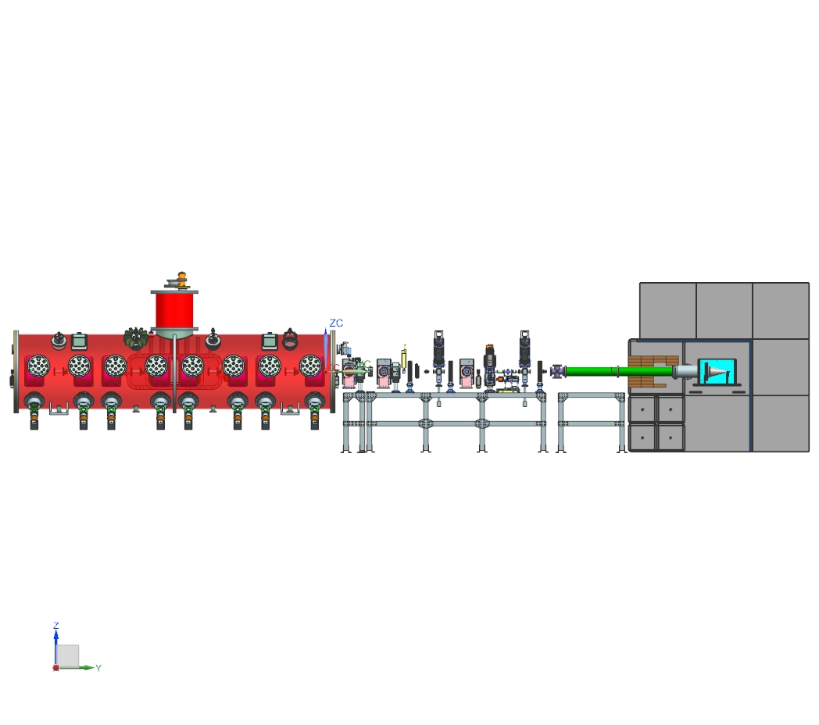
HEBT VACUUM (Introduction)
Low Particulate Vacuum
1E-9 torr at the entry of CM
Protect CM from vacuum failure
Beam Dump and Shielding
SSR1
HEBT

Slide 4
Configuration
Ion Pumps: to achieve UHV, HV for reliable operation, (4 vs 3)
NEG: in order to enhance hydrogen pumping at entrance of CM
Cold Trap: not chosen for cost/benefit reason
Turbo Pump: only for initial pumping down SSR1,
HEBT vacuum will be initially evacuated by slow pumping cart at downstream port
Venting will be done through slow pumping cart from upstream port near SSR1
One gate valve is used for segmentation

Slide 5
HEBT VACUUM Configuration (to SSR1 and Beam Dump)
Ion Pump4
(optional)
Ion Pump2 200 l/s
Ion Pump3 200l/s
Ion Pump1 200 l/s w/ NEG
SSR1 GV
Beam Dump and Shielding
port capable to Pumping down/venting SSR1
NEG ( Capacitor Z400 by SAES)
Fast Close Valve
Gate Valve

Slide 6
SSR1-HEBT VACUUM Simulation (Simplified Model in MolFlow+ )
CM: 2K, 0.99 Stick factor
Transition:
2-5K (0.7)
5-50K(0.1)
50-300K, (0.0)
Hydrogen outgassing rate on all inner surfaces All 2.E-10 mbar.L/s.cm²
2.77E-6 mbar.L/s
@Dump
2mA, 1.1%
Ion Pumps 200 L/s
LPM
(2.4E-7 mbar.l/s)
SLIT1
(4.6E-7 mbar.l/s)
F.C
(3.5E-7 mbar.l/s)
SLIT2
(4.6E-7 mbar.l/s)
F.C.
(3.5E-7 mbar.l/s)
Lg Tube
(2.2E-6 mbar.l/s)
2nd Half SSR1 Cavity String
HEBT
Dump

Slide 7
SSR1-HEBT VACUUM Simulation (Pressure Profile, Hydrogen)

Slide 8
HEBT VACUUM (Warm Section) (MolFlow Simulation: intermedium results)

Slide 9
HEBT VACUUM (Warm Section) (MolFlow Simulation)
Goal: to achieve 1E-9 Torr at the entrance of CM
Studied: the pump size and its locations
pump3

Slide 10
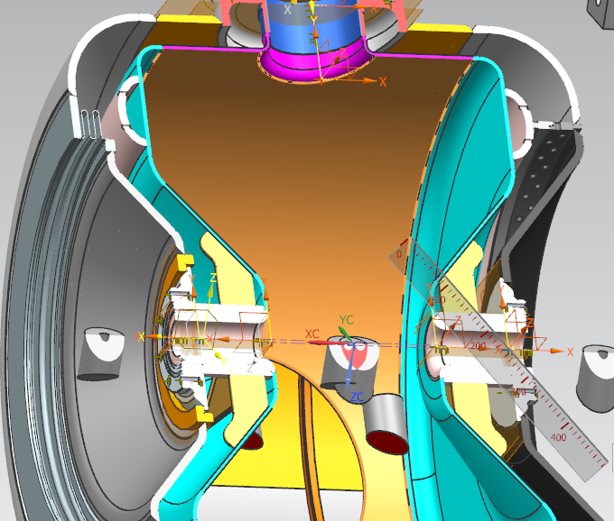
SSR1 (MolFlow Simulation)
Transition:
300K-50K-5K-2K
pump3

Slide 11
SSR1 (Pumping Down with 160 l/s)

Slide 12
SSR1-HEBT VACUUM Simulation (Hydrogen Condensation on 1st Cavity surface)
The sticking factors of hydrogen for the three transit region 2-5K, 5-50K, 50-300K are 0, 0.1, 0.7
Entire cavity was under 2K, sticking factor 0.99 was assigned
Most significant hydrogen flux arrived on the face of down stream wall
It takes 1.5 week to buildup one monolayer on the face, however, on 1st cavity, H2 will diffuse on the other surfaces due to beam induced desorption
Entire Cavity under 2K, 0.99 sticking factor, surface 8900cm²
5-50K
(0.1)
2-5K
(0.7)
50-300K
(0.0)

Slide 13
SSR1-HEBT VACUUM Simulation (Hydrogen Condensation on Cavity surface)
 | Facet # | Sticking | Opacity | structure | area (cm²) | Temp (K) | Imping. rate (s⁻¹m⁻²) | Presure (mbar) | Monolayer time, year | even dist. Entire cavity
Cavity4 | 67 | 0.99 | 1 | 5 | 125.085 | 2 | 2.72E+10 | 1.89E-15 | 1.32E+01 | 6.10E+02
 | 777 | 0.99 | 1 | 5 | 125.085 | 2 | 1.46E+10 | 8.55E-17 | 2.45E+01
Cavity3 | 875 | 0.99 | 1 | 4 | 125.085 | 2 | 6.23E+10 | 4.29E-15 | 5.75E+00 | 3.50E+02
 | 1585 | 0.99 | 1 | 4 | 125.085 | 2 | 1.06E+10 | 6.06E-17 | 3.39E+01
Cavity2 | 1683 | 0.99 | 1 | 3 | 125.085 | 2 | 1.44E+11 | 9.89E-15 | 2.50E+00 | 1.70E+02
 | 2393 | 0.99 | 1 | 3 | 125.085 | 2 | 6.19E+09 | 3.61E-17 | 5.79E+01
Cavity1 | 2491 | 0.99 | 1 | 2 | 125.085 | 2 | 1.17E+13 | 3.43E-13 | 3.07E-02 | 2.18E+00
 | 3200 | 0.99 | 1 | 2 | 125.085 | 2 | 2.67E+10 | 1.46E-16 | 1.34E+01

Slide 14
Protection to CM from Vacuum Failure
Low particulate Vacuum practice in handling & installation
HEBT vacuum will be initially evacuated by slow pumping cart at downstream port
Venting will be done through slow pumping cart from upstream port near SSR1
One gate valve is used for segmentation
Fast close valve installed to minimize the vacuum failure impact on CM
Test was done at MEBT,
Gas flux into CM is sufficiently low

Slide 15
1st Test on MEBT DPI-FV
M71S2P
M81VFC
M61VSO
M72WRP
M63WRP
M92WRP
M52WRP
M63DIP
M72PIO
M11PIP
V1=36.5 liters(M61VSO-FV)
V2=95.1 liters(POST FV)
Permeation rate from Scanner O-Ring is about 6E-7 torr.l/s
Leaker Volume=0.29 liter
PG
LD

Slide 16
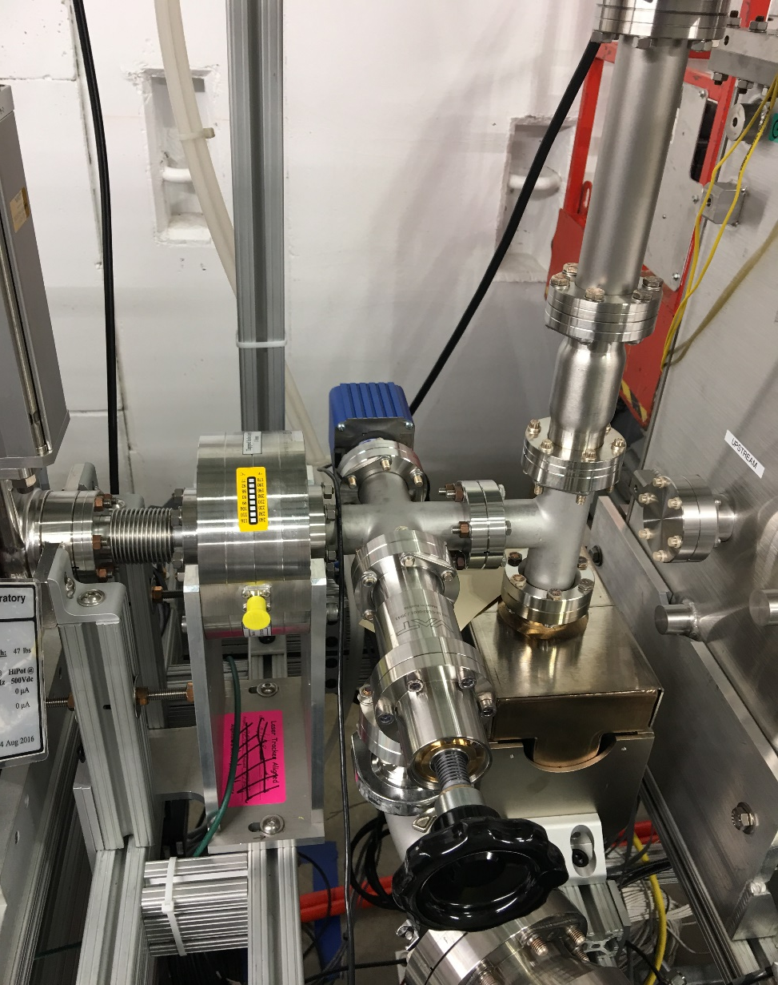
Setup of 2nd Test
FV
CC Gauge
RGA
Pirani Gauge
Ion Pump
N2 Reservoir (0.33 Liter)
Post FV Volume
(2.79 liter)

Slide 17
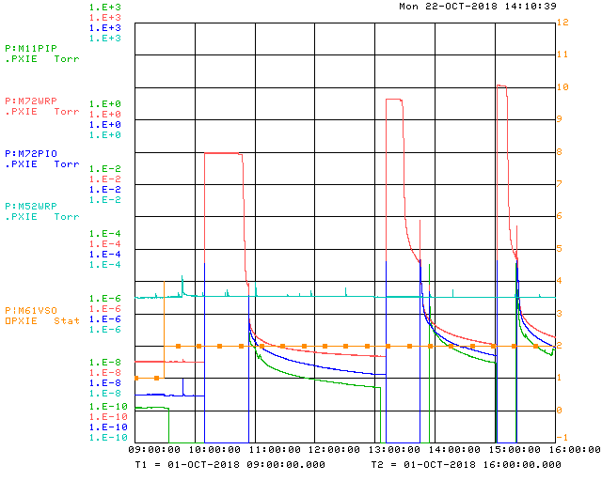
2nd Test With Smaller and Tighter Volume (Leak From Downstream of DPI)
6.6E-6
Pressure rise at US of DPI
7.6E-7
Pressure rise DS of PDI
4.6E-8
1.5E-8
With current setup of DPI and IPs,
DPus/DPds =188

Slide 18
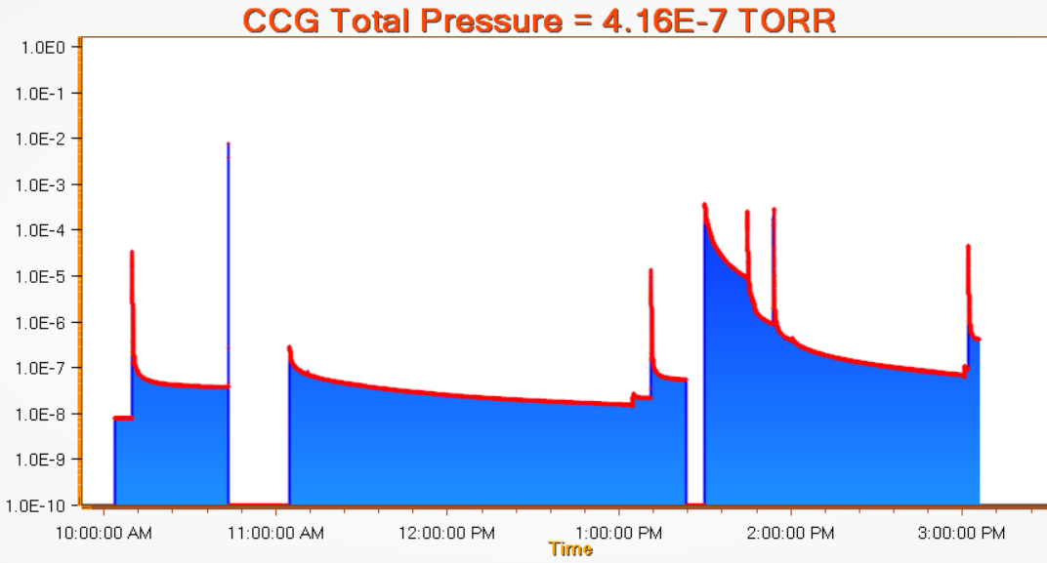
2nd Test With Smaller and Tighter Volume (Leak From Downstream of DPI)
3.8E-5 with Leaker at 9.5 Torr
1.4E-5 with Leaker at 350 Torr
4.5E-5 with leaker at 810 Torr
2.3E-8
1.0E-7
7.3E-9
Oct 1, 2-18

Slide 19
Summary of Results for Vacuum Protection
 | Leaker | P0 | P1 | dP | Gas Amount | monolayer coverage | Leaker Location
 | torr | torr | torr | torr | torr.liter | cm2
23-Aug | 1.7 | 6.2E-09 | 1.7E-07 | 1.6E-07 | 4.6E-07 | 1.3E-02 | US DPI
 | 52 | 7.5E-09 | 1.9E-07 | 1.8E-07 | 5.1E-07 | 1.5E-02
24-Aug | 760 | 7.9E-09 | 2.0E-07 | 1.9E-07 | 5.4E-07 | 1.6E-02
 | 760 | 2.3E-08 | 2.3E-07 | 2.1E-07 | 5.8E-07 | 1.7E-02
1-Oct | 9.5 | 7.3E-09 | 3.8E-05 | 3.8E-05 | 1.1E-04 | 3.1E+00 | DS DPI
 | 350 | 2.1E-08 | 1.4E-05 | 1.4E-05 | 3.9E-05 | 1.1E+00
 | 810 | 1.0E-07 | 4.5E-05 | 4.5E-05 | 1.3E-04 | 3.6E+00
8-Oct | 1.2 | 6.1E-09 | 5.1E-04 | 5.1E-04 | 1.4E-03 | 4.1E+01
9-Oct | 130 | 6.0E-09 | 5.8E-07 | 5.7E-07 | 1.6E-06 | 4.6E-02
 | 760 | 3.0E-08 | 2.5E-06 | 2.5E-06 | 6.9E-06 | 2.0E-01

Slide 20
Summary
Configure can satisfy the vacuum requirement
MolFlow simulation was done, and residual gas (Hydrogen) pressure profile along beamline was established,
However the hydrogen condensation on the cavity at ends may be a concern if no sufficient desorption induced by beam or electrical power.
Fast valve to minimize gas flux into CM during vacuum failure
One gate valve to isolate the UHV region near CM from HV region near dump
All installation, pumping down, venting up follow practice of low particulate vacuum

Slide 21
DPI (differential pumping insert)
Al. cooling Disc
SS tube 1.5”(OD)
Beam
Copper Tube 10mm(ID),200mm(Long)
Ceramic Breaker (3kV)
Ion Pump (100 l/s)

