Slide 1
Plan For Installation Of The HEBT
Rich Andrews

Slide 2
Outline of Presentation
1) Status of HEBT Mechanical Design
a) Bill of Materials
b) Examples:
Photos of existing elements
Drawing number references
2) HEBT Installation Planning
a) HEBT Assembly Options
b) Sequence of Assembly
c) Particle Free Assembly and Service

Slide 3
Bill of Materials
Beamline Element | Status | Support Structure | Drawing No.
HEBT Girder | in house | N/A | See photo
HEBT Girder Add On | Design in progress
Dump Girder | Design in progress
SSR-1 Isolation Valve |  | N/A
Ion Pump T | Procure elements | Design Complete | TC# F10070746
ACCT | in house | Need design | TC# F10070746
Quadrupole Magnet | in house | Modify Existing Design | TC# F10021417
BPM | in house | Need design | TC# F10018276
Ion Pump T | Procure elements | Design Complete | TC# F10070746
Quadrupole Magnet | in house | Modify Existing Design | TC# F10021417
Fast Acting Valve | in house | Modify Existing Design
Dipole Magnet | in house | Design Complete | TC# F10042979
RWCM |  | Need design | TC# F00484270-A
BPM | in house | Need design | TC# F10018276
Housing (wire & slits) | Procure elements | in house
Dipole Magnet | in house | Design Complete | TC# F10042979
Ion Pump T | Procure elements | Design Complete | TC# F10070746
Pneumatic Valve | in house | Modify Existing Design
Fast Faraday Cup | in house | Design Complete | TC# F1003100
Time of Flight Monitor | in house | Design Complete | TC# F10039331
Housing (wire & slits) | Procure elements | in house
Dipole Magnet | in house | Design Complete | TC# F10042979
Cross |  | Future Expansion
BPM | in house | Need design | TC# F10018276

Slide 4
Design of HEBT
Elements in the HEBT chosen by the needs of the required beam measurements
Most of the components have been used in the various configurations of the MEBT
The Pumping T’s are a new design driven by the vacuum requirements of the HWR & SSR1
The stand-alone quadrupole magnets incorporate a modification of the support and alignment structure used in the MEBT
Extensive particle free assembly experience:
In FAST
From CC1 to the Superconducting Cryo Module
In PIP2 IT
Connection of MEBT to the HWR

Slide 5
Pumping T (w/o Turbo Pump)
This version shows one of the configurations that will be used in the HEBT.
Additional Pumping T’s will not include a NEG Pump

Slide 6
Other Elements Already In Use
Fast Faraday Cup
(Team Center # F10031000)
Time of Flight
(Team Center # F10039331)

Slide 7
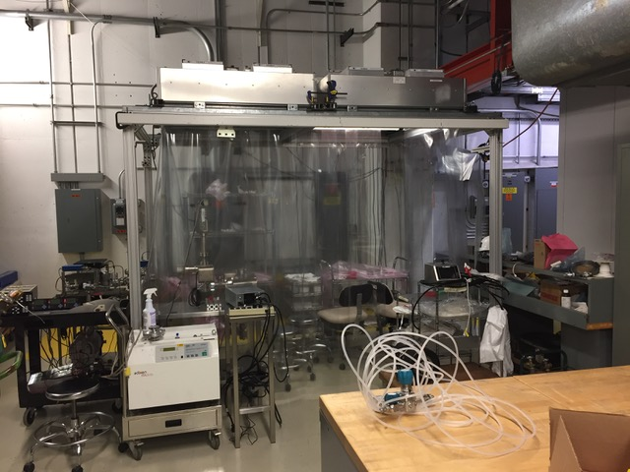
Portable Clean Room At NML
(this design will be replicated for HEBT Installation)

Slide 8
HEBT Installation Planning (this is what the final configuration will look like)
Dump
HEBT
SSR1
HWR
MEBT

Slide 9
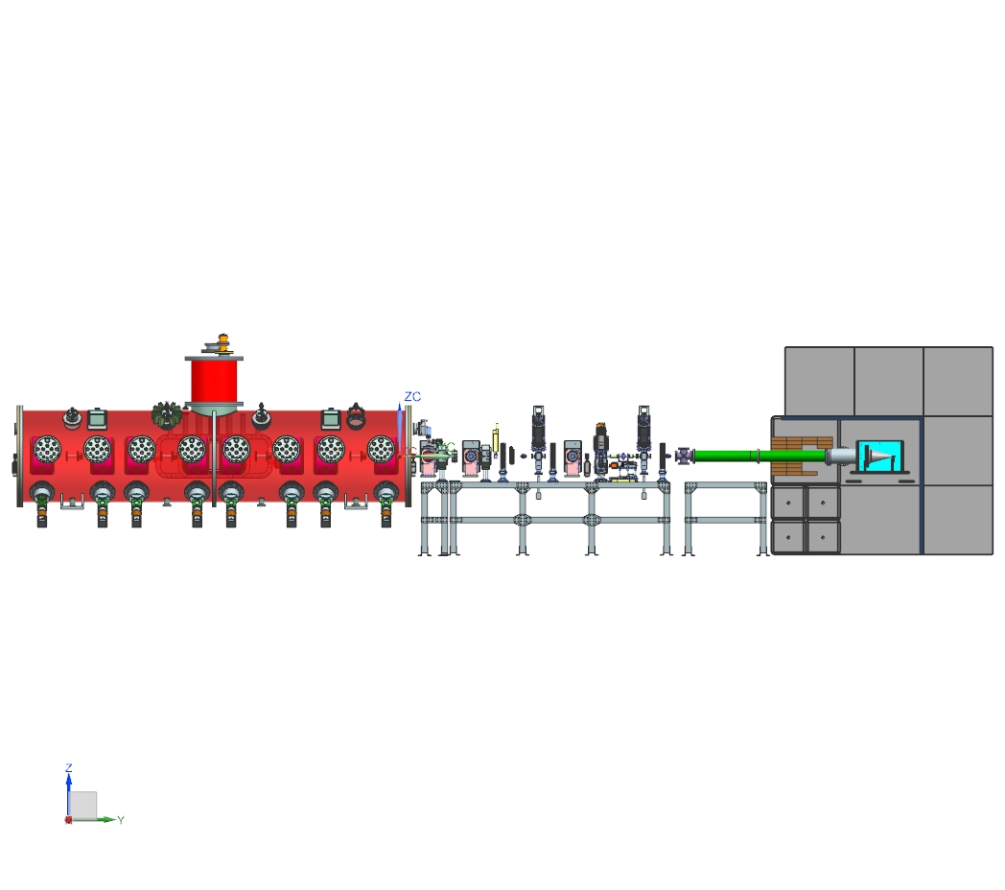
HEBT Connection (to SSR1 and Beam Dump)
SSR1
HEBT
Beam Dump and Shielding

Slide 10
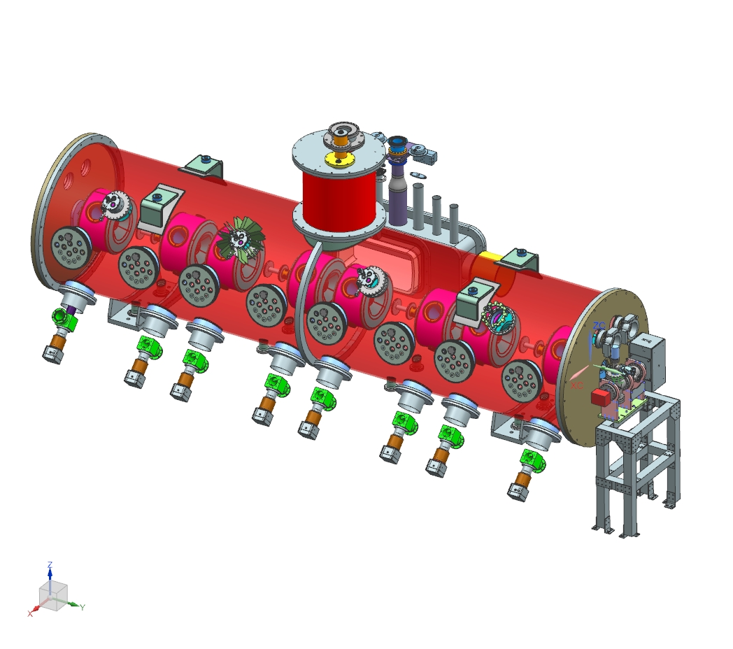
Initial Configuration
Pumping Tee with Ion Pump and NEG Pump
SSR-1 Prototype

Slide 11
Beam Dump:
SSR1
HEBT
Beam Dump and Shielding
Plan to install Dump and shielding prior to HEBT install

Slide 12
1) Install and Align Girder
Anchor to the floor

Slide 13
2) Install and Align Beam Dump

Slide 14
3) Connect Tee and Spool
Portable cleanroom will be required at this point

Slide 15
4) Begin addition of concrete shielding blocks

Slide 16
5) Surround beam pipe with steel bricks

Slide 17
6) Continue construction with concrete shield blocks

Slide 18
7) Add 2.0” of steel around dump (4 sides)
This is conceptual for the steel. It will need to be secured to the floor and adjacent pieces

Slide 19
8) Add concrete blocks around sides (1.5’ thick on East side & 3’ thick on the West side)

Slide 20
9) Complete shielding on top and rear end (3’ everywhere)
This assembly is conceptual and needs some further definition:
The design of the steel structure may be modified to require such large pieces
Some tuning of the block configuration may also be required
The duration of the assembly of the shielding is estimated to take between 2 to 4 weeks
This does not include time required to collect materials
Most materials are located on site
There are some exceptions:
2” steel may need to be procured
“E” blocks are in short supply and may need to be procured as well

Slide 21
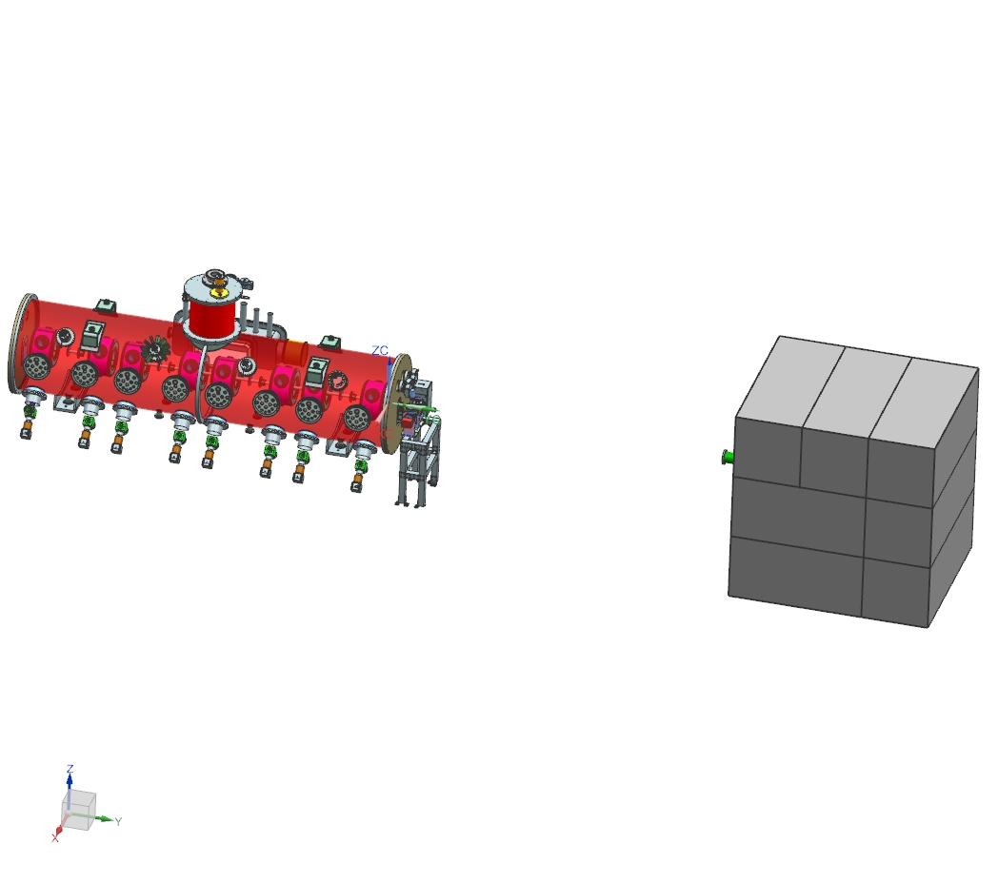
HEBT Installation Starting Configuration

Slide 22
HEBT Assembly Options
Plan A
Assemble complete girder in Class 10 Clean Room
Move to cave and connect to SSR-1 and Beam Dump
Plan B
Assemble components into sub-assemblies in Class 10 Clean Room
Locate sub-assemblies on a free standing girder
Rough align
Make interconnections using a portable clean room
Blank flanges on the ends
Move into position between the SSR-1 and the Beam Dump
Rough align assembly and anchor to the floor
Final align
Plan C
Move empty girder into position, align and anchor
Install sub-assemblies (initial work done in Class 10 Clean Room)
Rough align sub-assemblies
Using a Portable Clean Room, make the interconnections
Will depend on the status of SSR1 testing

Slide 23
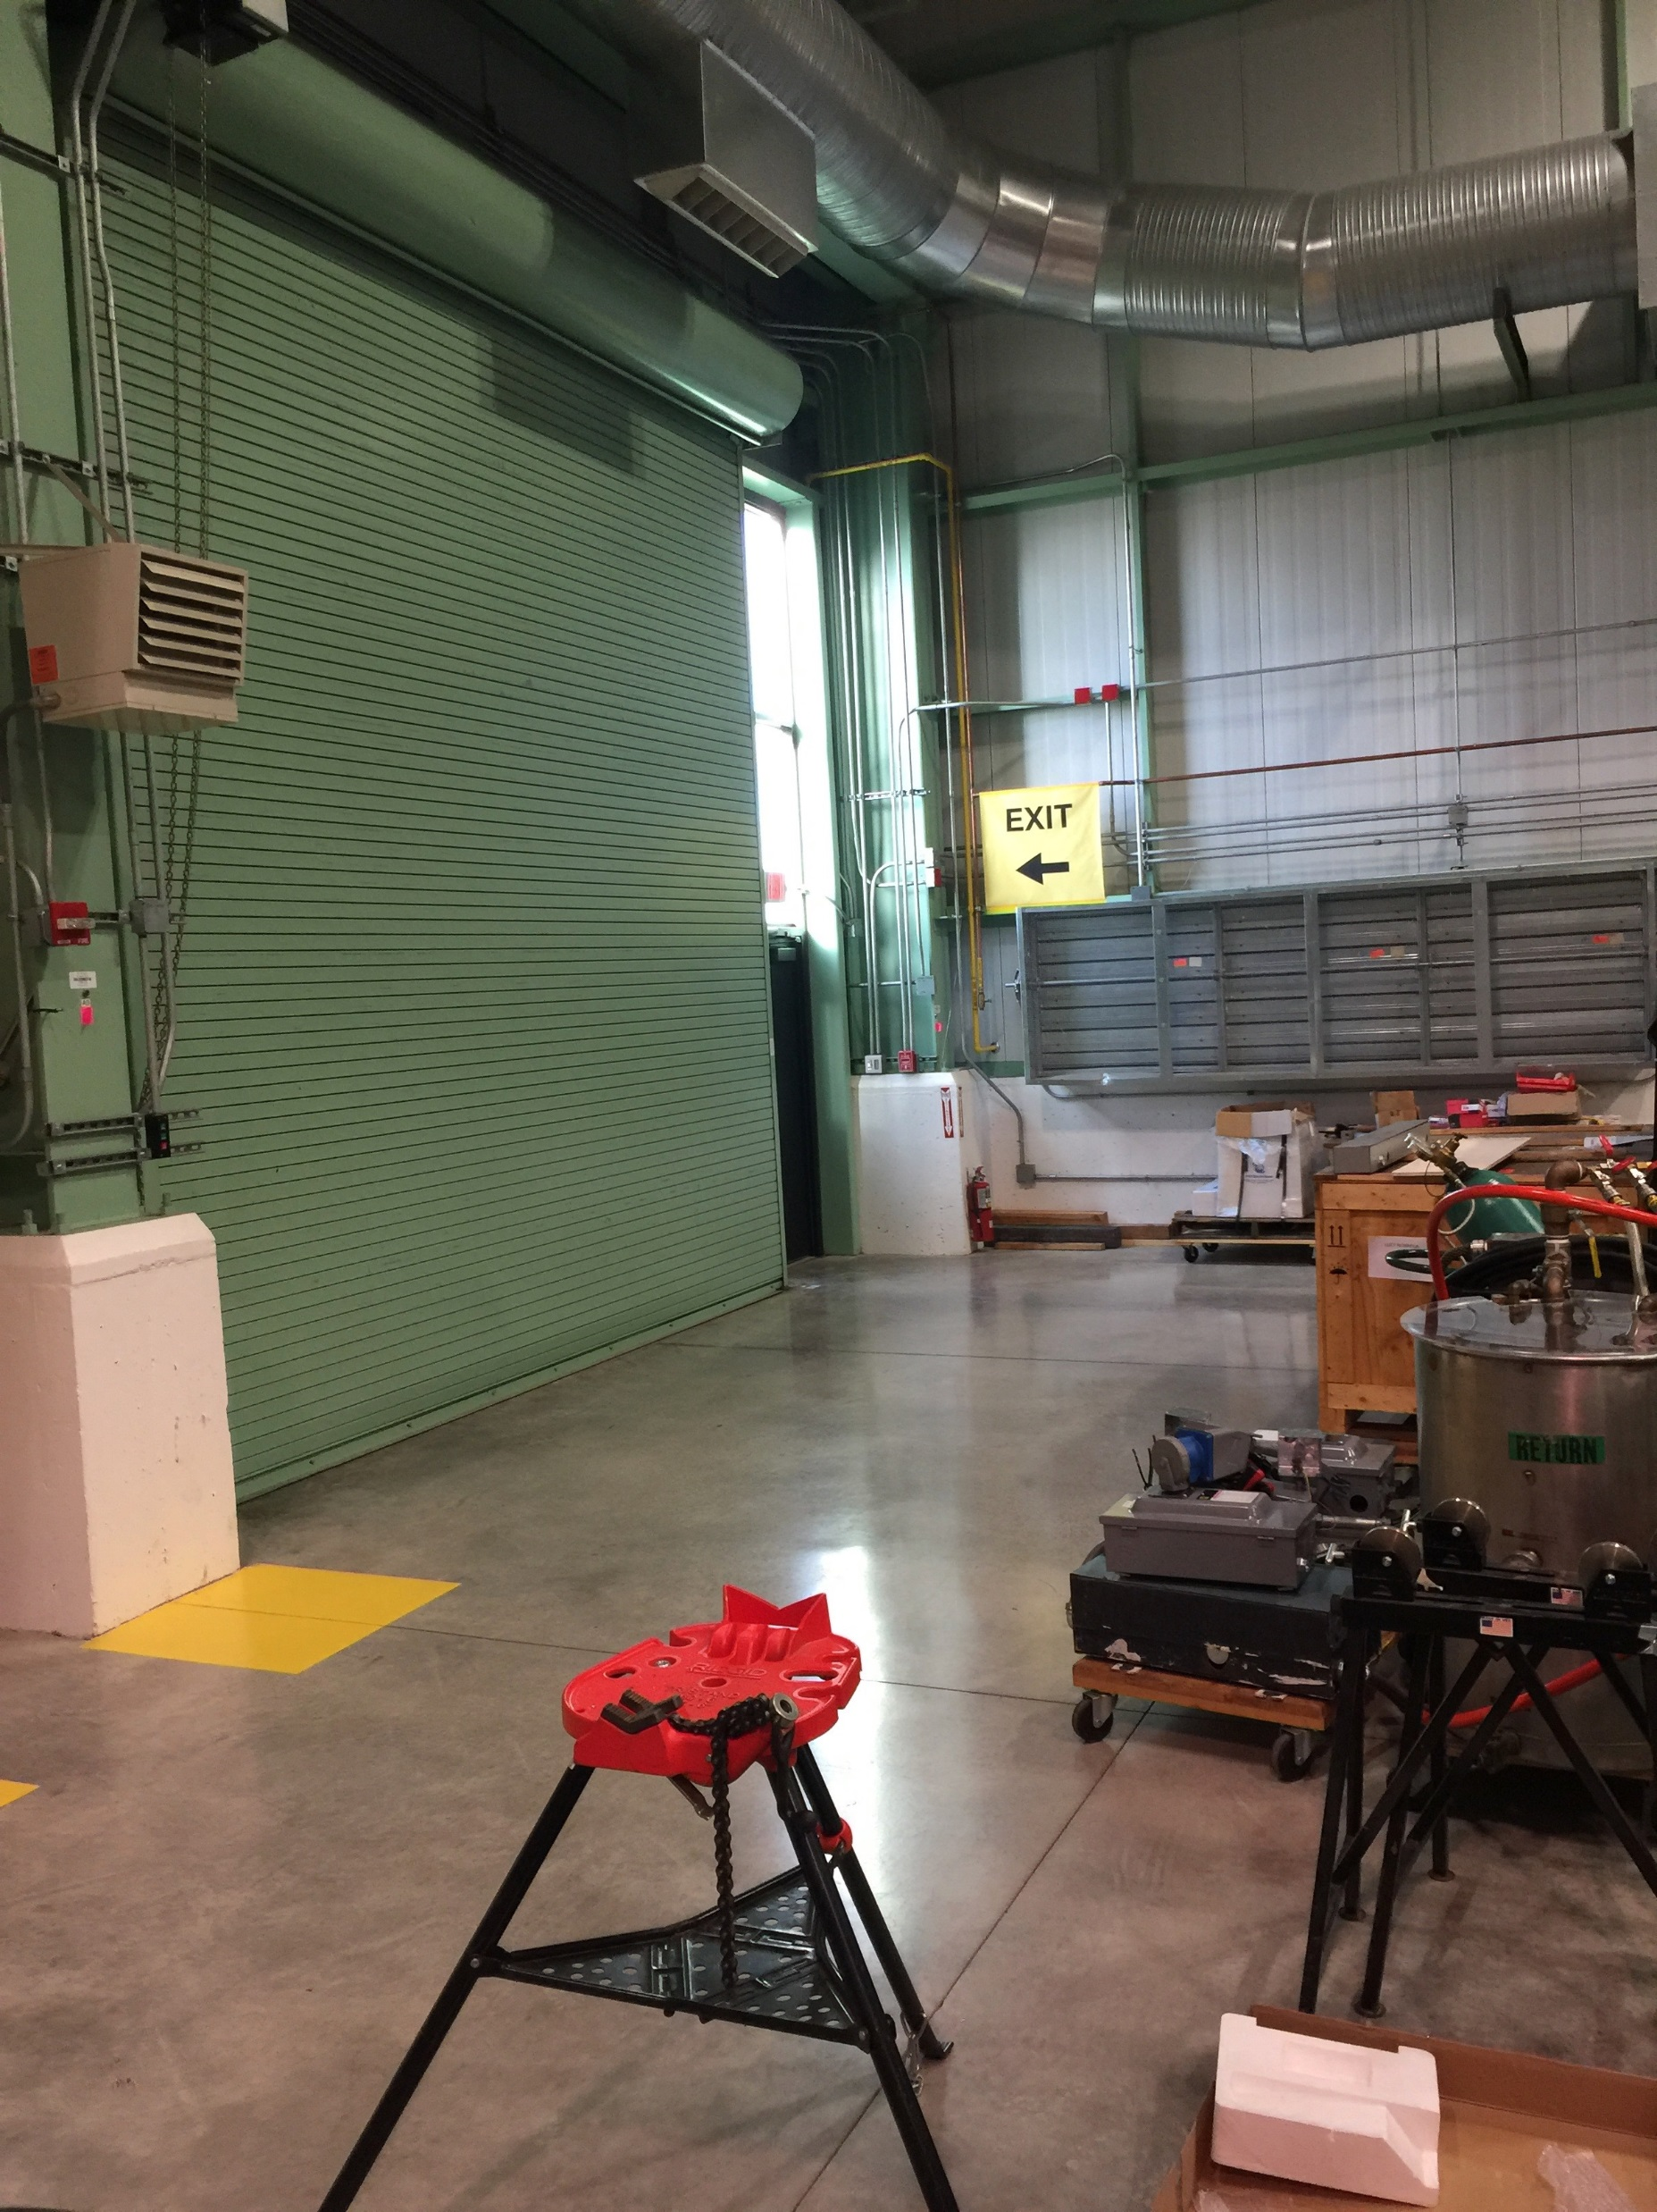
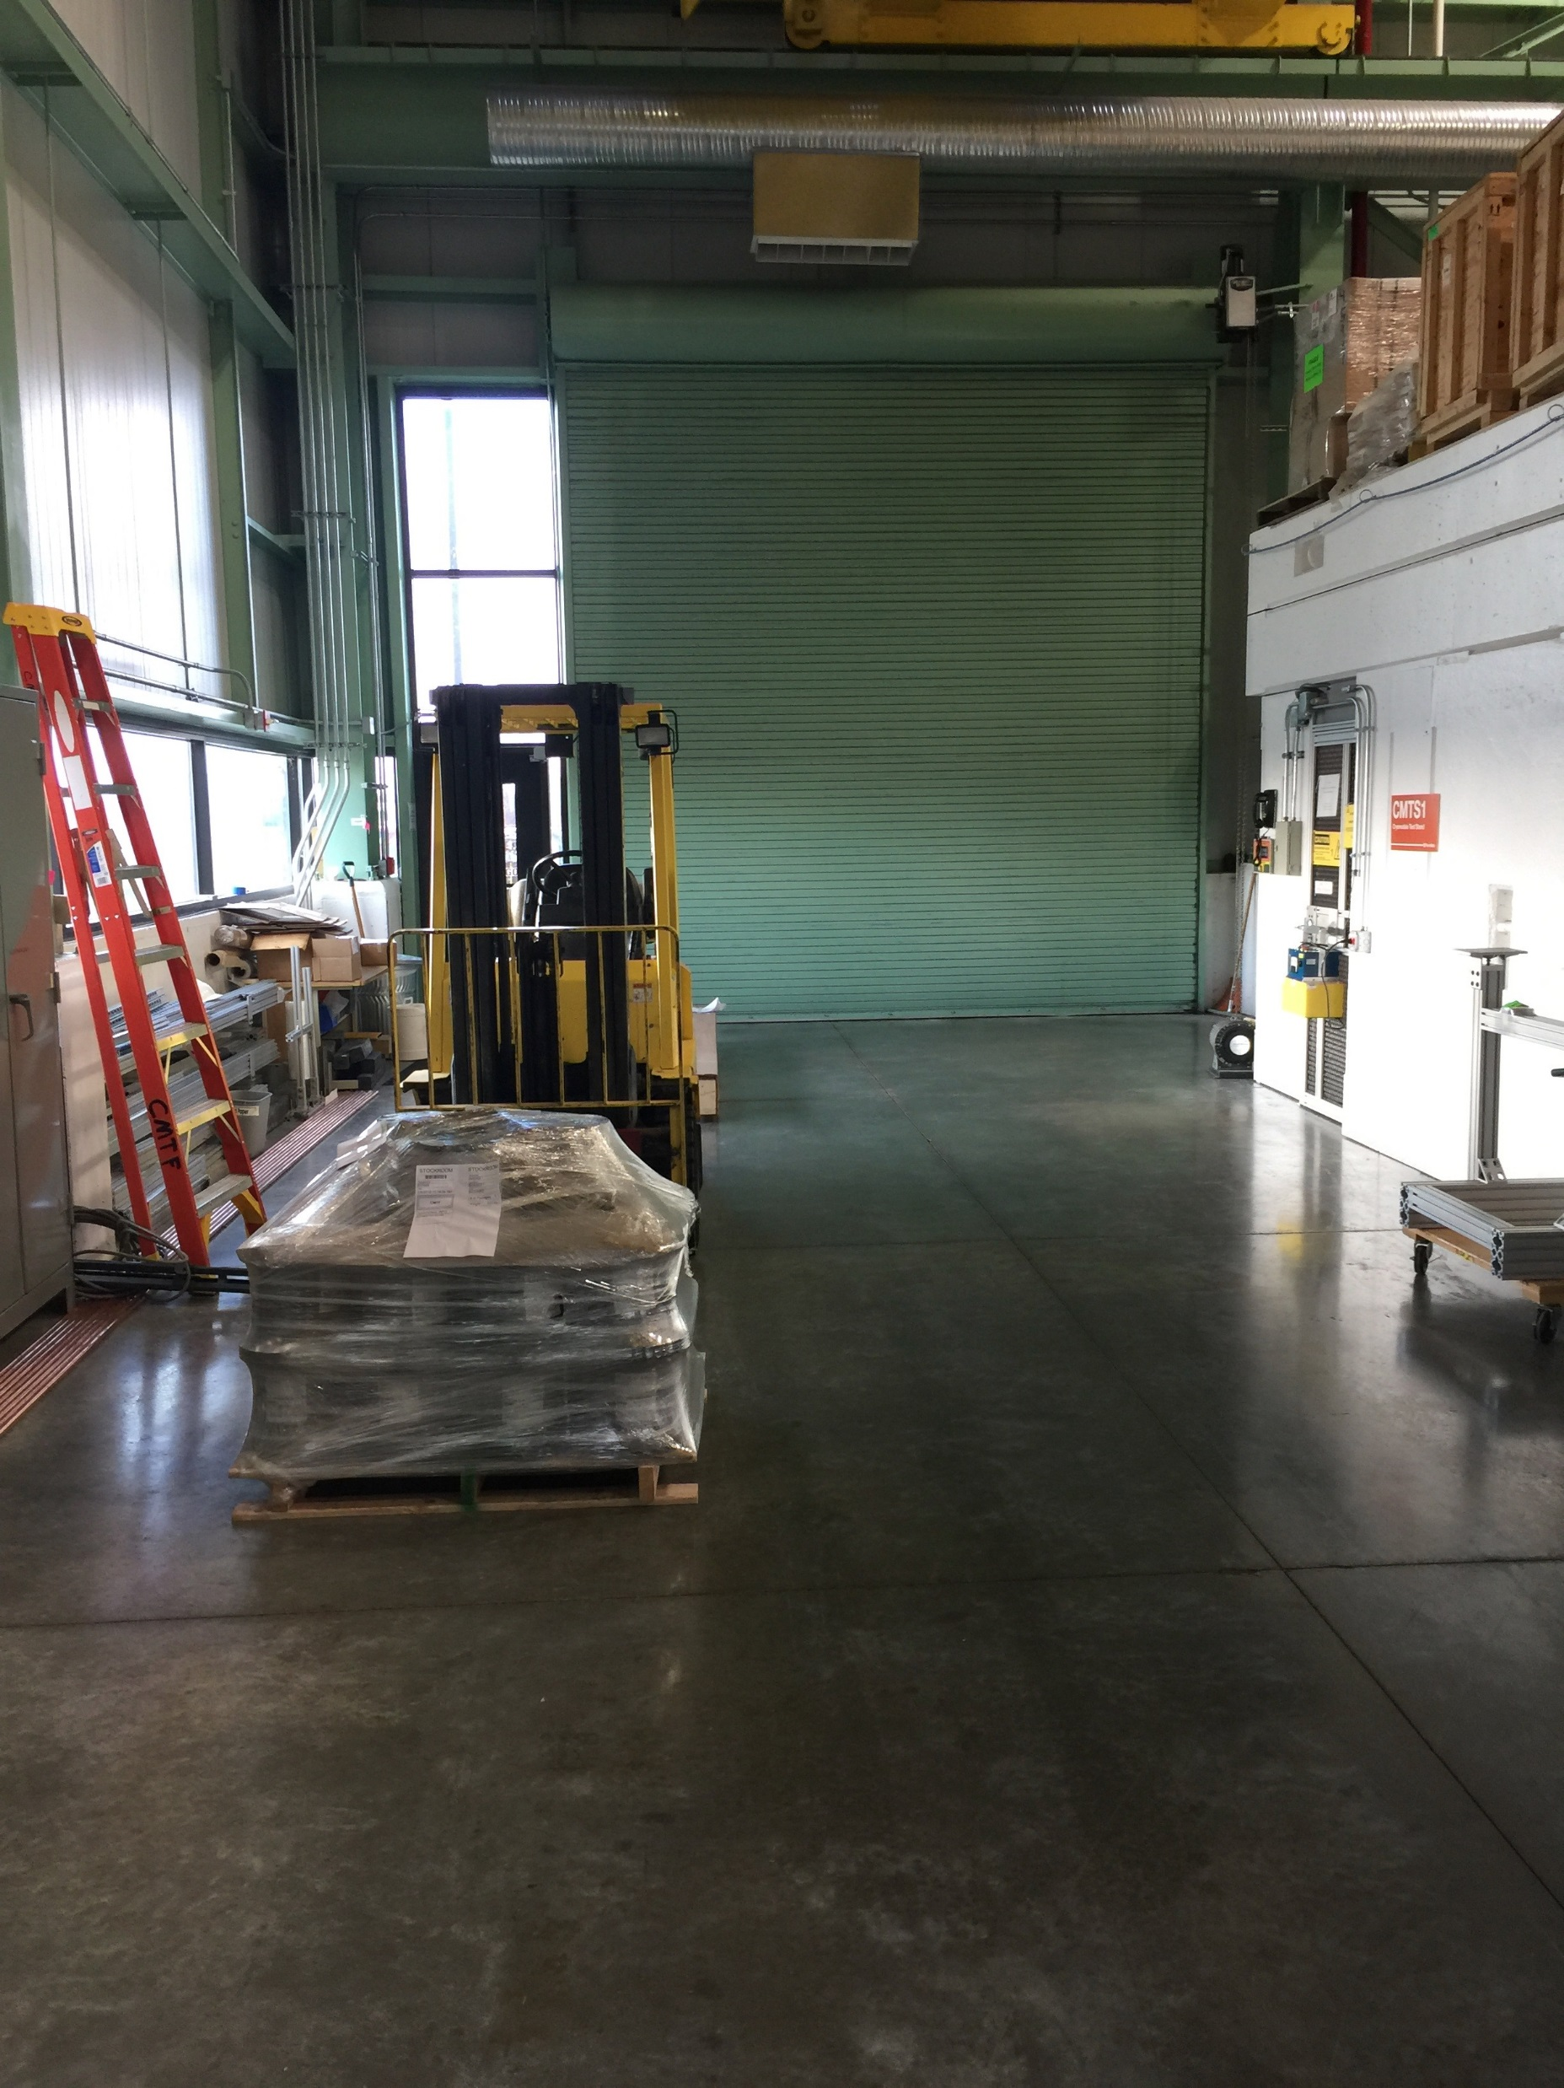
Installation Planning
Plan B Location
Plan C Location
(in situ)

Slide 24
Plan C is the preferred choice:

Slide 25
Sequence Of Assembly
Pre-assembly Work:
SSR1 and Dump shall be installed and aligned first
Assemble all HEBT subcomponents in the Class 10 Clean Room:
Pumping Tees
Valves (Pneumatic and Fast)
Scrapers
BPM and spool subassemblies
All instrumentation
Mount sealed components and subassemblies on their respective girders
May be located in situ or in the CMTF Hi Bay
A portable clean rom will be required
Rough align on the girder (Alignment task)
Connect HEBT to SSR1 and the Dump:
Pumping Tee to HEBT Connection
HEBT to Dump Girder Connection

Slide 26
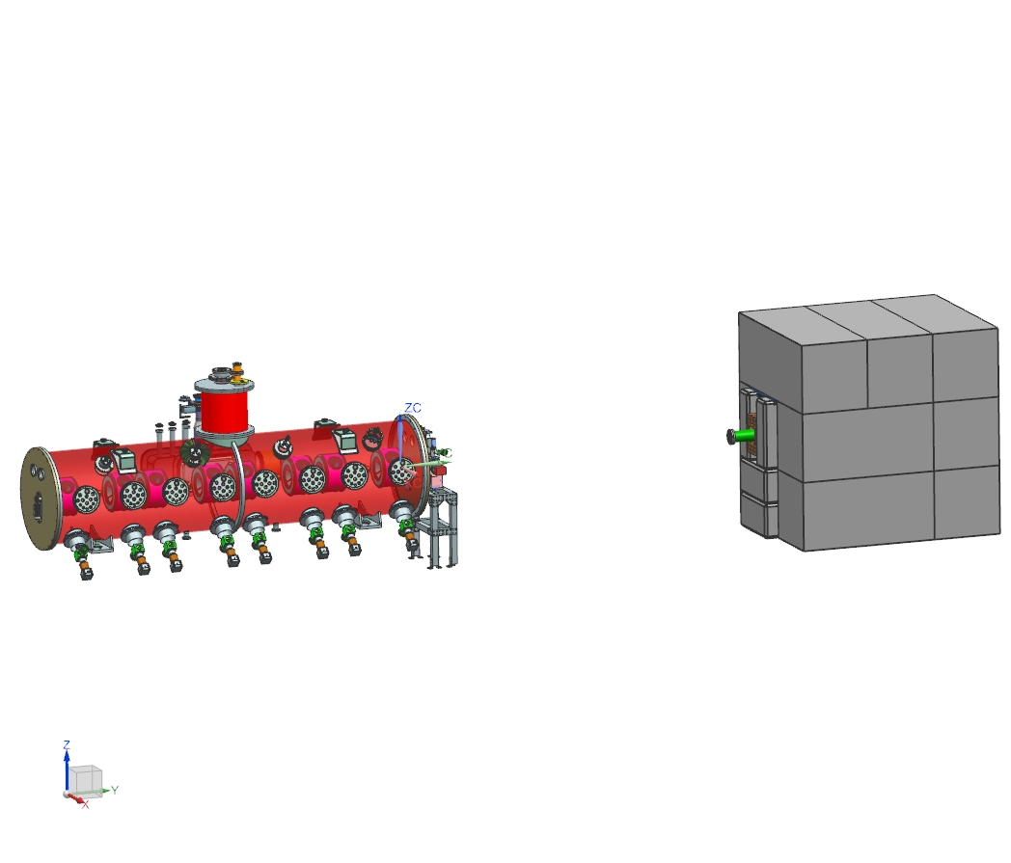
1) Starting Point: (for HEBT Installation)
Dump Installed w/ Shielding
SSR1 Installed with Pumping Tee

Slide 27
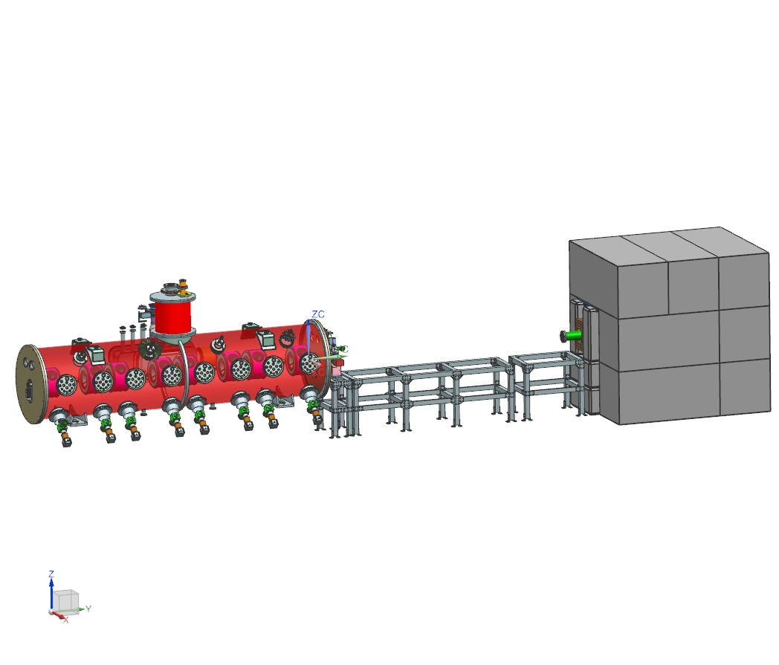
2) Install Girders:
Installed, Aligned and Anchored

Slide 28
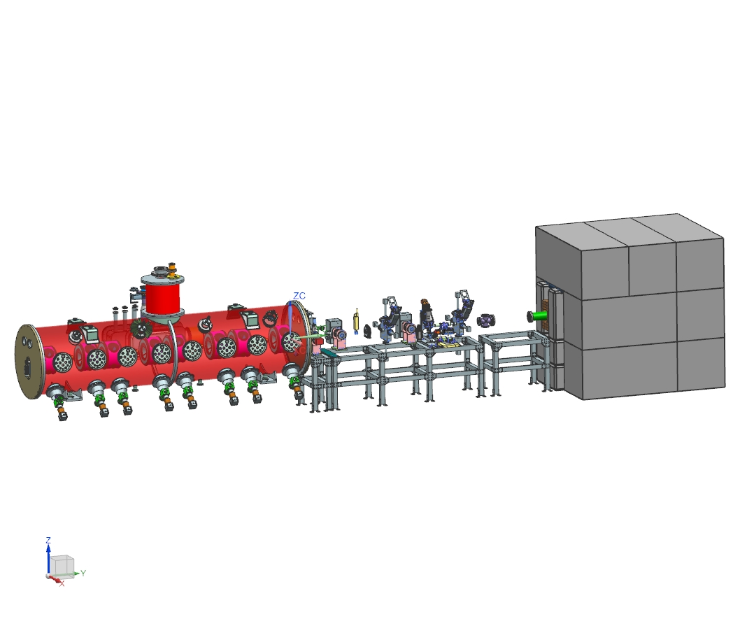
3) Install Major Devices
(Particle Free Cleaned and Blanked Off)
(Pumping T’s, ACCT, Fast Faraday Cup, RWCM, Time of Flight, Scrapers, Gate Valves, Magnet Bottom Halves)
Rough Align these devices

Slide 29
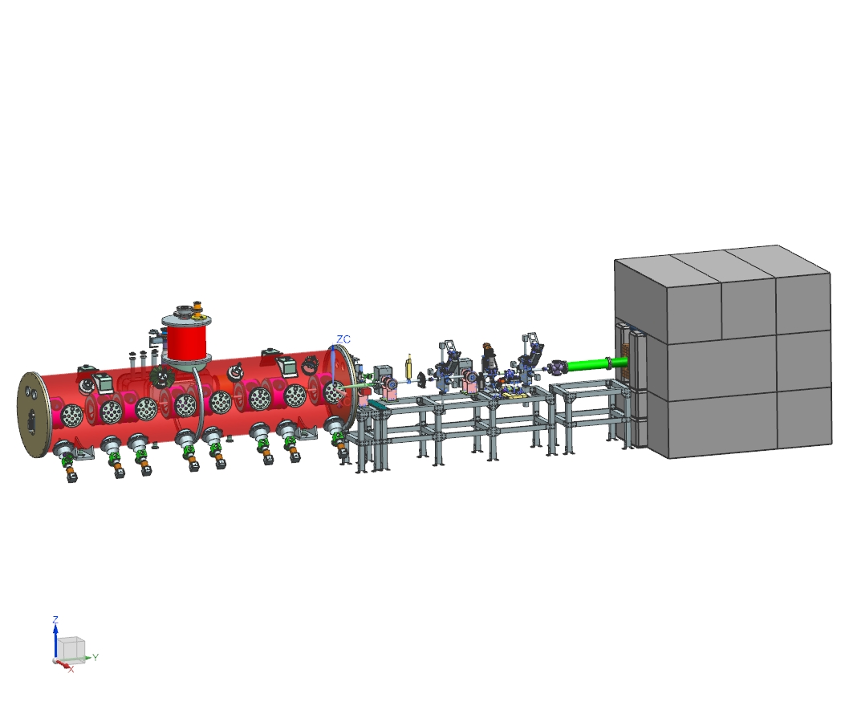
4) Install Spools Between Devices
(From US to DS)
(Portable Clean Room required for this step)
Leak Check Assembly:
Low Particulate Vacuum Cart will be used
RGA scan of assembly after

Slide 30
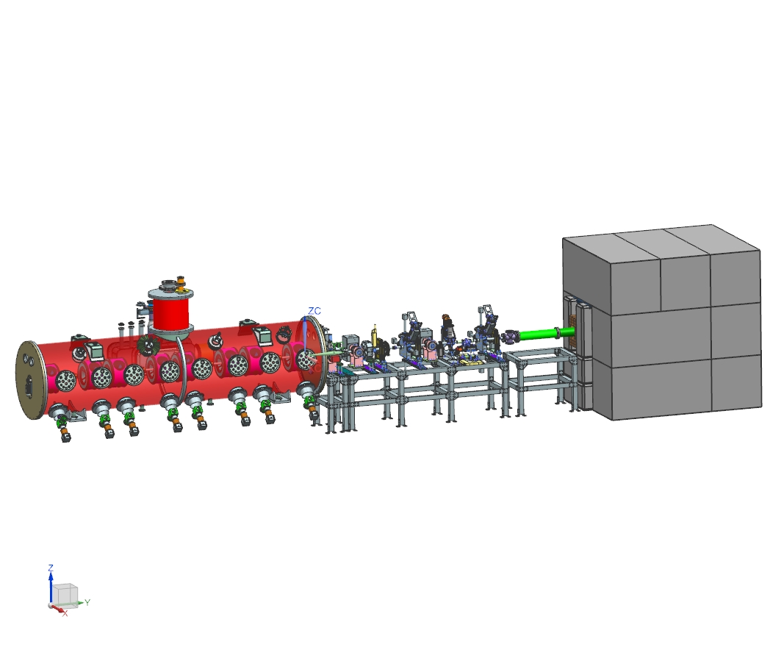
5) Install Magnets (top halves)
Final Align Magnets and Devices
This installation task is estimated to require between 4 to 6 weeks

Slide 31
Particle Free Assembly and Service
The HEBT will be prepared for particle free service using procedures developed here at Fermilab:
Slow Flow Pumping Cart will be used for both start-up and bringing the system back to atmospheric pressure
ED0000373 (Operation of the mass-flow vacuum cart)
Any newly procured items will be cleaned in a Class 10 Cleanroom:
All elements on the Pumping Tee
Beam Pipe (with bellows and BPM’s)
We will use the standard practices that have been developed here at Fermilab
ED0003571 (Cleaning for particle-free vacuum service)
Already installed items (that have been previously cleaned) will not be disassembled if:
We can do an RGA analysis to previously installed equipment to demonstrate their cleanliness:
Fast Faraday Cup
Time of Flight Monitor
Beam Dump
In all cases, these elements will be blown off to demonstrate that they are particle free

Slide 32
Particle Free Assembly
An example of a subcomponent built from newly procured elements
An example of a subcomponent built from elements already in use

Slide 33
Summary:
Most of the HEBT elements are in house:
Magnets
Time of Flight monitor
Fast Faraday Cup
Fast Acting Valve
ACCT
RWCM
BPM’s
Will need some rework
Also need to consider how they will be mounted so the positioning is assured
Additional design work required:
Dump Shielding (securing the steel, fitting the blocks into the design)
Some of the support structures (most will be derivatives of existing designs)
Portable cleanroom
Procurement required:
Housings for Slits
Girders (3 required) need to be procured; one girder is in house
Hardware for spools (tubing, bellows and flanges)
Cleanroom components

