Slide 1
HEBT beam line overview
A. Shemyakin
PIP2IT HEBT Final Design Review
13 February 2019

Slide 2
Outline
Introduction: PIP2IT in its final configuration
HEBT specifications and scheme
HEBT in operation
Measurements to be carried out

Slide 3
Final configuration of PIP2IT
Expectations for state of PIP2IT in Spring 2020
Ion source, LEBT, RFQ, MEBT are in a working shape as they were in May 2018, plus:
MEBT chopping system is installed and ready to produce a bunch-by-bunch chopped beam
Downstream portion of the MEBT is assembled particle –free
Two cryomodules are assembled and RF-commissioned
HEBT is ready to accept the beam
The main goal: accelerate in the cryomodules a beam that is eventually suitable for Booster injection
22 MeV x 2 mA x 0.55 ms x 20 Hz to dump; aperiodic bunch structure
Ion source and LEBT
30 keV
Dump
MEBT
2.1 MeV
HWR
10 MeV
SSR1
HEBT
RFQ
22 MeV

Slide 4
The HEBT goals
The main goal: safely accept the beam from cryomodules
No beam damage
No cryomodule contamination by dust or outgassing
Do not create difficulties for future conversion of the PIP2IT cave into PIP-II cryomodule test facility
Also, measure the beam properties to the level of ensuring that there are no large deviations from simulation predictions. While doing that,
Take into account budget and schedule constrains
Assume that more measurements will be made after installation of the front end into the PIP-II tunnel

Slide 5
HEBT specifications (ED0008220)
Table 1: Nominal beam parameters in the HEBT
Parameter | Value | Unit
Ion type | H⁻
Beam (kinetic) energy | 22 | MeV
Macro-pulse length | 0.55 | ms
Macro-pulse repetition rate | 20 | Hz
Frequency of bunches (within macro-pulse) | 162.5 | MHz
Beam current (averaged over 1 µs) | 2 | mA
Nominal charge per bunch | 30 | pC
Beam size (X/Y) at the exit of the SSR1 cryomodule (rms) | 2.2 | mm
Bunch length at the exit of the SSR1 cryomodule (rms), s_{z} | 20 | ps
Table 2: Range of beam parameters that the HEBT shall be able to accommodate
Parameter | Value | Unit
Beam (kinetic) energy | 10 - 25 | MeV
Macro-pulse length | 5 - 550 | µs
Macro-pulse repetition rate | 1 - 20 | Hz
Beam current (averaged over 1 µs) | 0.2 - 2 | mA
Charge per bunch | 3 - 60 | pC

Slide 6
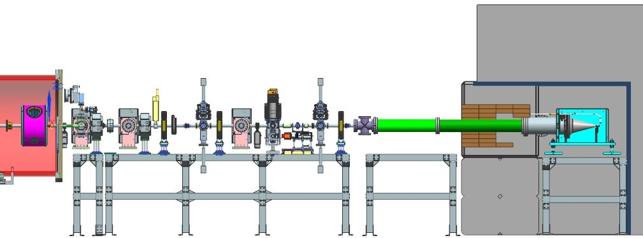
HEBT scheme
Two quadrupoles, 3 dipole correctors
On hand (made by BARC, India). Identical to MEBT magnets.
3 pumping stations; fast acting valve + 1 “slow” valve
Beam dump in a concrete “doghouse”
Moved as far as possible from SSR1 and diagnostics
Set of diagnostics
Pumping station
SSR1
Quads
Dump
Cavity
Solenoid

Slide 7
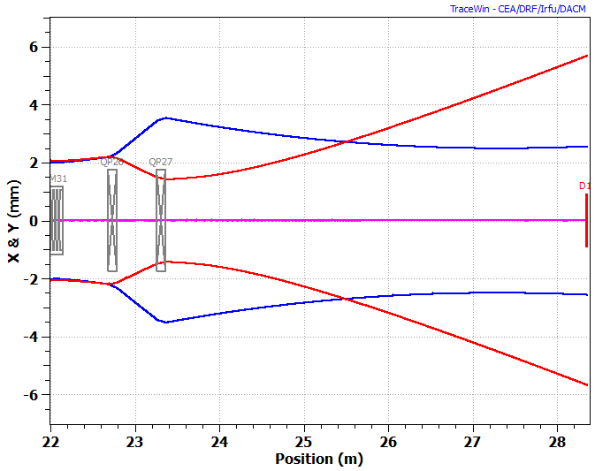
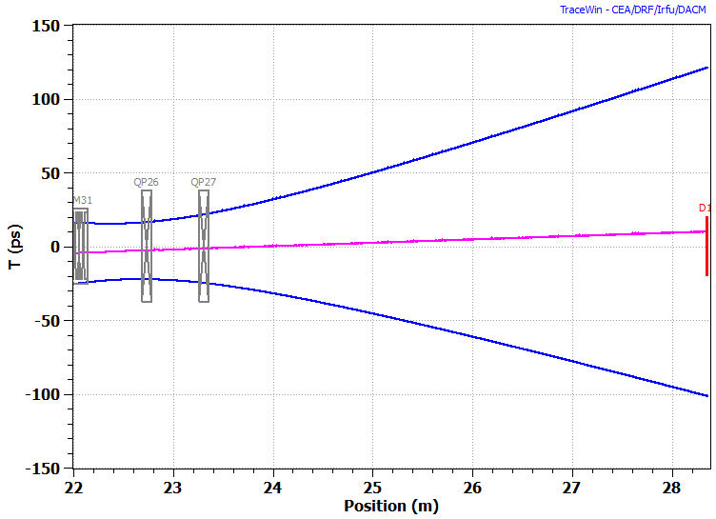
Beam envelope
The beam envelope in the HEBT will be heavily determined by settings of the last solenoid and cavity in the SSR1 cryomodules
Assuming that upstream elements’ settings are optimized for acceleration
Nominal transverse (left) and longitudinal (right) beam rms envelopes. A.Saini

Slide 8
Some of considerations for the HEBT scheme
The highest priority: do not damage the cryomodules
Proper positions for the pumping stations, fast acting valve,…
Quadrupoles are mainly for convenience of measurements; placed at the beginning so the beam can’t be focused at the dump
Strong preference to use either existing parts or new ones that could be re-used at PIP-II
In diagnostics lines
Will heavily rely on the experience gained with the MEBT
Extra attention to the high-power mode

Slide 9
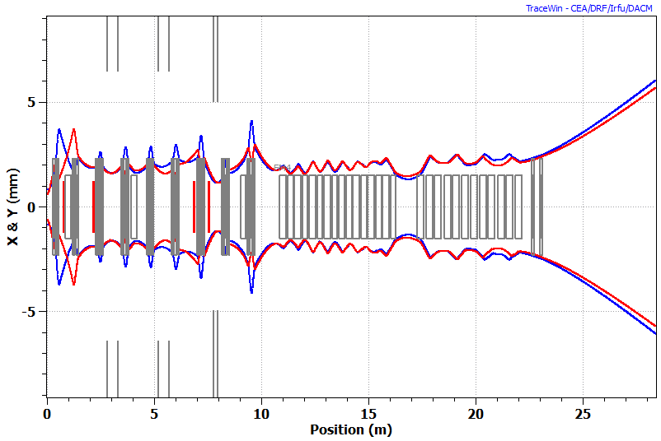
Preventing a damage by the beam
2 mA x 0.55 ms x 20 Hz x 22 MeV = 484 W
Instantaneous power density at the beam center ~2∙10⁷ W/cm²
Passive measures
The dump is placed as far as possible from focusing elements
The beam can’t be focused tightly (details later)
Large-aperture pipe upstream of the dump
Quads are off for high-power operation
Active
Machine Protection System
Comparison of current readings
Dump vs ACCT
Loss monitors
Step-by-step path to high power
Transverse rms beam envelope with quads off. A.Saini

Slide 10
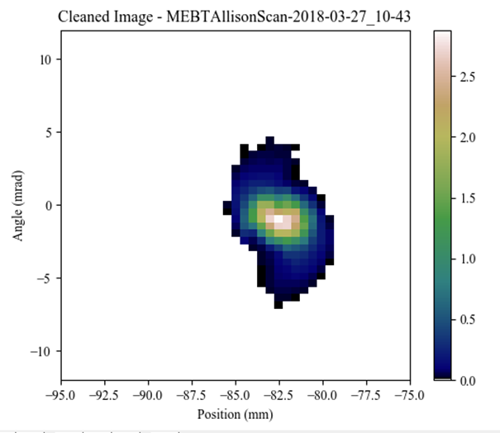
Path to high-power operation
Start with low-emittance mode
5 mA from the RFQ, 10 µs x (1 – 20) Hz; kickers off
The beam is heavily scraped in the MEBT
Decreasing the beam current by 2-10 times
It has been demonstrated at the MEBT. Scraping ~40% of the beam in one plane (“flat beam”) decreases the rms emittance by a factor of ~2.5
Pass the beam to the dump; correct large errors
Commission operation with the chopping system on
Full bunch charge, low duty factor (10 µs x 20 Hz); no big scraping; the MEBT chopping system removes 60% of bunches
Understand the transverse envelope
Turn off quads; increase the pulse length by steps

Slide 11
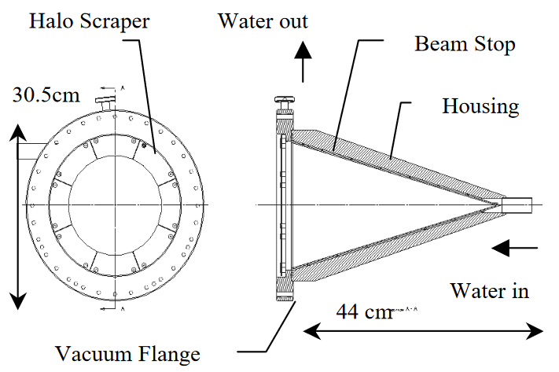
Dump
The plan is to use the dump used at SNS then HINS then PIP2IT MEBT
Was designed (and used at SNS) for 16 kW at 7.5 MeV
Used at up to 5 kW at MEBT
B. Hartsell simulation: can sustain up to 20 kW CW if beam is large
C. Baffes: In-pulse thermal cycling should not have detrimental effect at expected σ~6 mm
“Halo Scrapers” to indicate a too large or misplaced beam
O-ring seal is somewhat a concern because of radiation

Slide 12
List of baseline measurements
ED0008280; details about diagnostics are in Vic’s talk
Beam parameter | Nominal value | Accuracy of the measurement
Beam energy | 22 MeV | ±2 %
Current (averaged over 1 ms)* | 2 mA | ±1.5 %
Transmission through both cryomodules | 98% | ±2 %
Beam position (averaged over the macro-pulse) | N/A | ±10 µm (relative)
Transverse emittance (rms, normalized) | 0.25 µm | ±10 %
Longitudinal emittance (rms, normalized) | 0.4 µm | ±20 %
Bunch extinction | < 5×10⁻³ | ±10⁻³
Transverse phase space distributions | N/A | 0.1% (relative)†
* The beam current should be measured at the exit of the SSR1 cryomodule (to measure beam transmission) and at the end of the beam line (i.e. the beam dump).
† Relative phase space density at the tails of the distribution

Slide 13
Diagnostics in HEBT line
Details are in Vic’s presentation
Front slits and Wire scanner
Back slits and Wire scanner
ACCT
RWCM
Insertable Faraday Cup
Dump
BPM
FFC
ToF
BPM
BPM

Slide 14
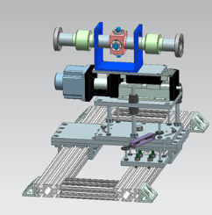
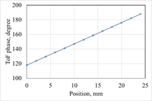
Energy
Initial measurement: Time-of-Flight monitor (ToF)
Was successfully used at the MEBT (0.3% accuracy)
http://accelconf.web.cern.ch/AccelConf/ipac2017/papers/tupva139.pdf
A capacitive pickup (BPM) precisely moved longitudinally
The slope of the recorded phase vs ToF position gives the bunch velocity
$$V=\frac{ω}{{dφ}/{dz}}$$
The slope decreases for higher energy
Expected accuracy in HEBT is ~1%
For routine measurements, will use phases of 3 fixed-position BPMs
Also, for phasing the last SSR1 cavity
ToF model and example of a measurement in MEBT

Slide 15
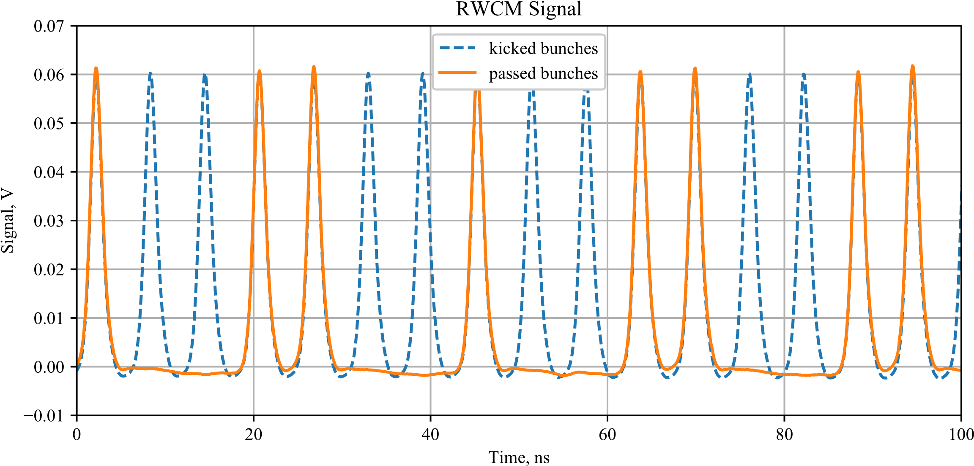
Bunch structure
MEBT chopping system will produce an aperiodic bunch sequence within each pulse to mimic future optimization for Booster injection
Need to measure the amount of beam populating the “empty” buckets to 0.1%
Modified version of the RWCM used at MEBT
Part of the MEBT RWCM signal recording the 0.55 ms Booster injection sequence (orange), superimposed over the signal when the kicker is off (blue).
http://accelconf.web.cern.ch/AccelConf/hb2018/papers/thp1wc03.pdf

Slide 16
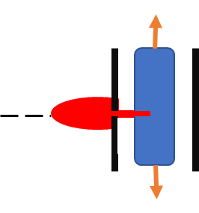
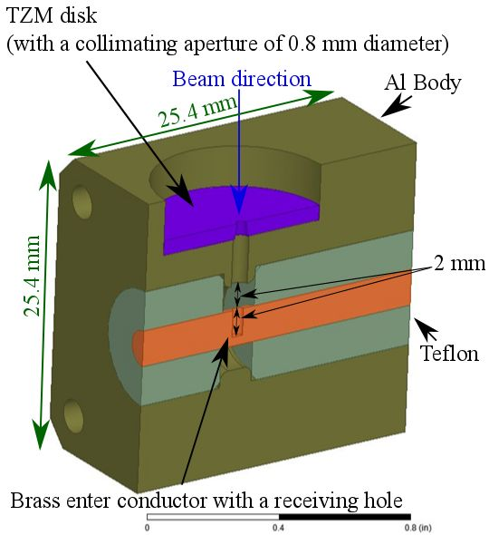
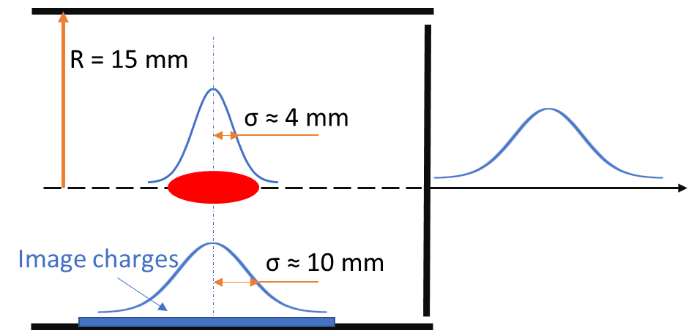
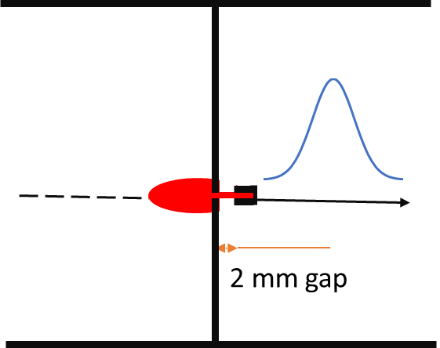
Longitudinal measurements: FFC
Plan to use the Fast Faraday Cup from the MEBT
Measured beamlet rms length down to 0.1 ns
Found that the beamlet length depends on the radial position of the FFC
Unlike MEBT measurements, the fast scope needs to be outside of the cave because of radiation concerns
May significantly affect the resolution
Principle of FFC operation and its 3D model (D. Sun).

Slide 17
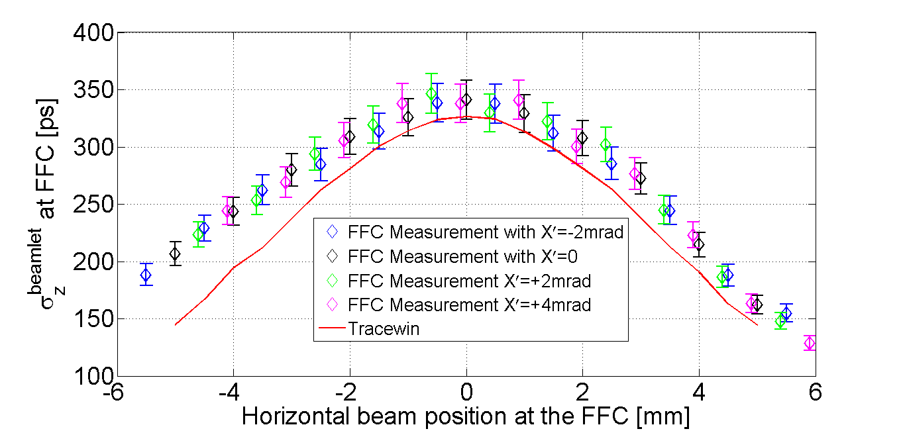
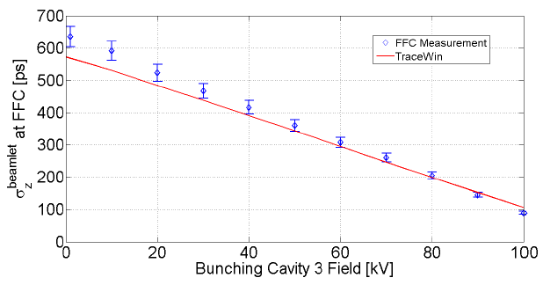
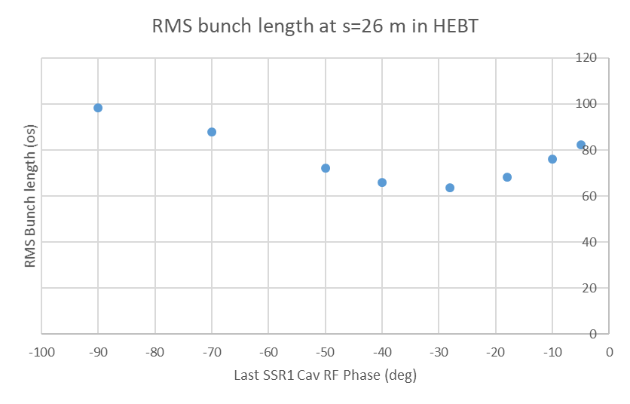
Bunch length and longitudinal emittance
To calculate the rms length of the entire bunch, FFC measurements are performed at various transverse locations
Longitudinal emittance is reconstructed from comparing the measurements of beamlet length vs settings of the last SSR1 cavity with simulations
Comparing FFC measurements in the MEBT with simulations. J.-P. Carneiro et al., CPO-10/ICAP’18 conference
Bunch length vs cavity phase. Simulation by A. Saini

Slide 18
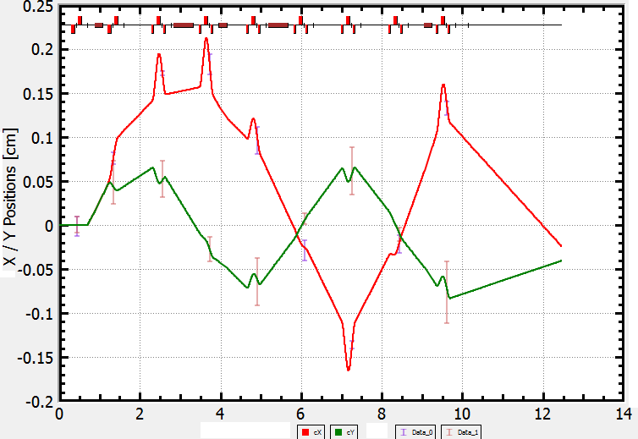
Trajectory
3 stationary BPMs (4-buttons capacitive pickups)
Possibility to use ToF’s pickup as well
To tune the beam through the HEBT into the dump
To help with transverse optics reconstruction
Differential trajectories method (as in the MEBT)
Response of trajectories to changing the current in the first dipole correctors by 0.4 A: horizontal x (red) and vertical y (green). http://accelconf.web.cern.ch/AccelConf/hb2018/papers/MOP1WB03.pdf

Slide 19
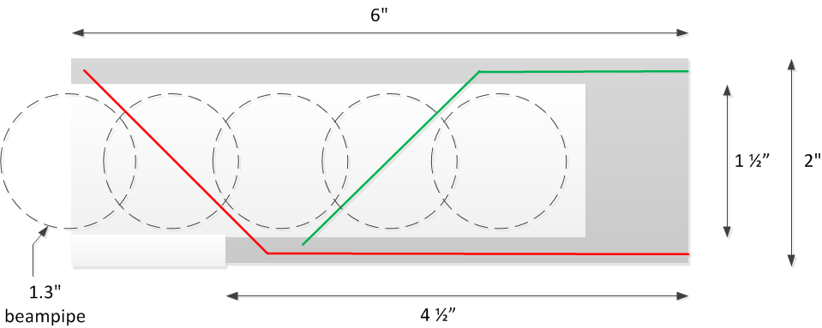
Beam size and transverse rms emittance
The main tool is two Wire Scanners
A prototype was preliminary tested at MEBT
Measurement of two profiles (X/Y) in one pass
<1% of beam is intercepted => low radiation
Can be biased positively or negatively
Signal amplitude vs cross-talk and intercepting stray particles
Emittance can be reconstructed from analysis of the beam size vs quadrupole current (quad scan)
Schematic of the Wire Scanner.
V. Scarpine, http://pip2-docdb.fnal.gov/cgi-bin/ShowDocument?docid=2249

Slide 20
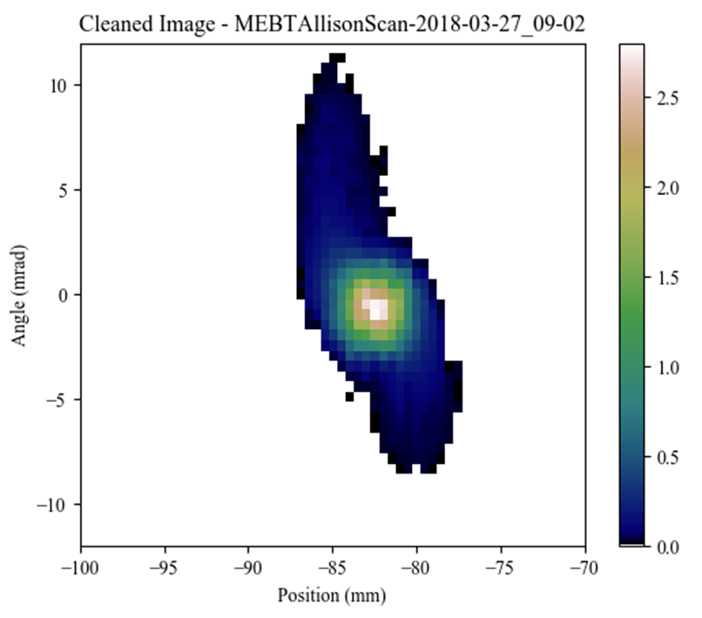
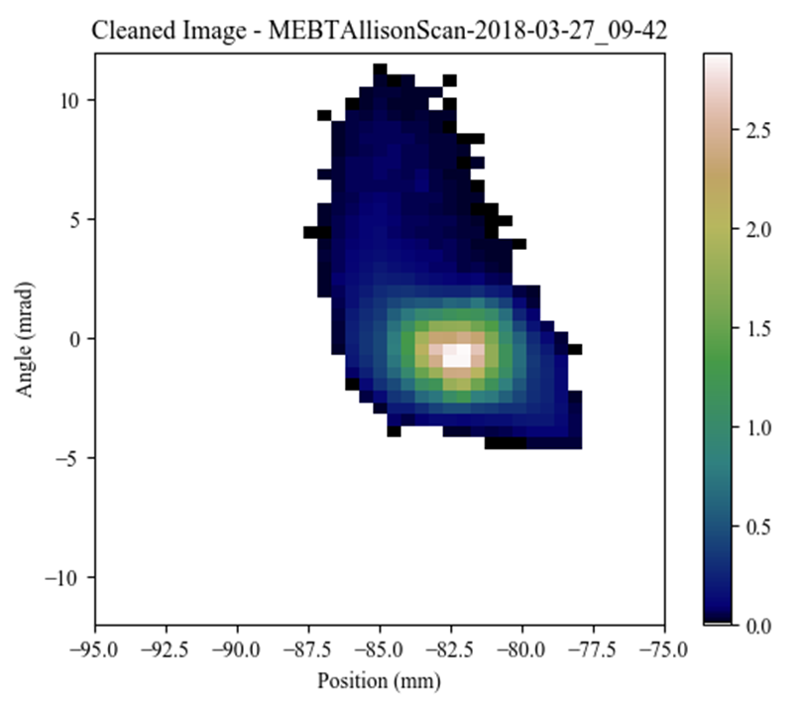
Beam transverse distribution
Allison scanners were extensively used in LEBT and MEBT
One scan gives a complete description of a plane
Rms parameters as well as tails
The pixel’s angle is defined by a deflecting electric field
Proposal: measure the beam transverse phase space in HEBT with a slit-slit emittance scanner
2 pairs (X/Y) of independently movable slits
Phase space pixels are defined by position of slits
E.g. front slit defines X
back slit defines X’
Comparison of two phase portraits recorded with MEBT Allison scanner, for a full beam and after cutting 10% with a scraper
Beam
Front slit
Back slit
Faraday Cup

Slide 21
Slit-slit scanner discussion
Allows to understand growth of tails in the cryomodules and efficiency of scraping in the MEBT
Important to prepare a realistic distribution for PIP-II beam simulations
can measure correlations between transverse planes
Drawbacks: slow; intercepts the entire beam
Measurements speed and the amount might be limited by radiation issues
Possible difficulty for resolving far tails: secondary electrons
Dipole correctors between slits should help
Front slits
Back slits
Dipole
Insertable Faraday Cup
Dipole
Dipole

Slide 22
Summary
The HEBT design allows for safe beam operation
Set of diagnostics is large enough to tune the beam and comprehensively characterize it in transverse planes
FFC measurements would catch a large deviation from expectations

