Slide 1
Design Bright Muon Source
Katsuya Yonehara
Workshop on Beam Acceleration in Crystals and Nanostructures
06/25/2019

Slide 2
Introduction
Muon
  Lifetime 2.2 μsec
  105 MeV/c² which is 200 times heavier than electron
Bright muon source is attractive for high energy physics
  Less synchrotron radiation than electron in acceleration and collision
  μ+ μ- collision events are much cleaner than p p (or pbar) collisions
How to create bright muon beam?
  Many good ideas
  Efficiency is matter
Proton

Slide 3
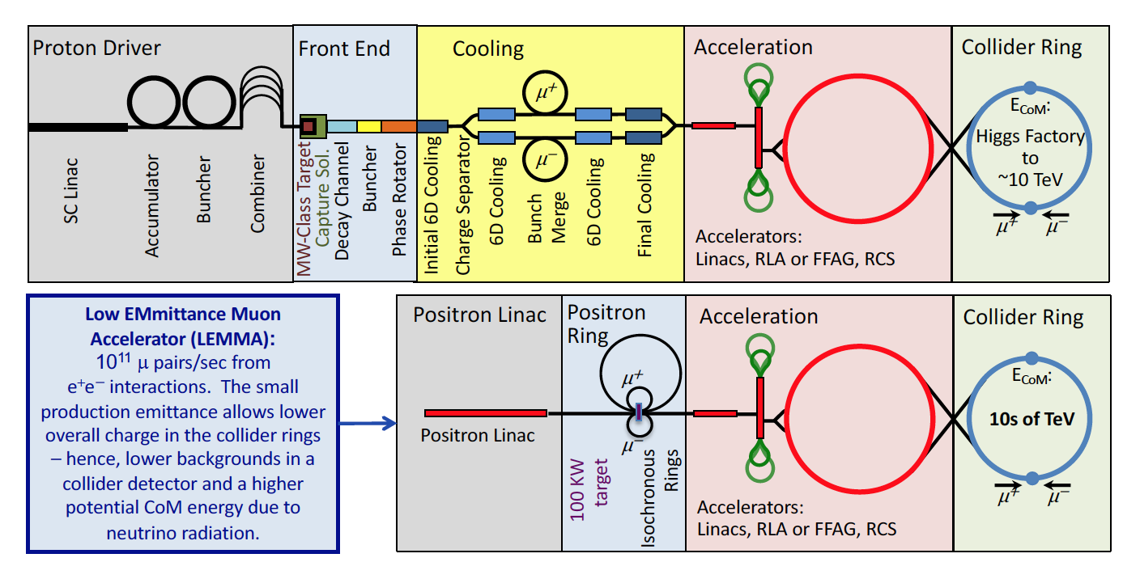
Two schemes of muon source
J.P. Delahaye et al., arXiv:1901.06150v1 (2019)
Tertiary muon production Scheme
Direct muon pair production Scheme

Slide 4
Tertiary muon production scheme
“Conventional” scheme
  High energy proton smashing on target to make fragments
  Collect pions, which are decayed into muons (and neutrino)
  Need ionization cooling to shrink a 6D muon phase space for high energy accelerations
    Beam size changes from 0.01 meter to order of 100 micro-meter
Efficiency
  Conversion ratio from protons to muons is ~1 % or less
Require multi-MW proton beam and multi-MW target system
  Expensive
  Consider more energy-efficient method

Slide 5
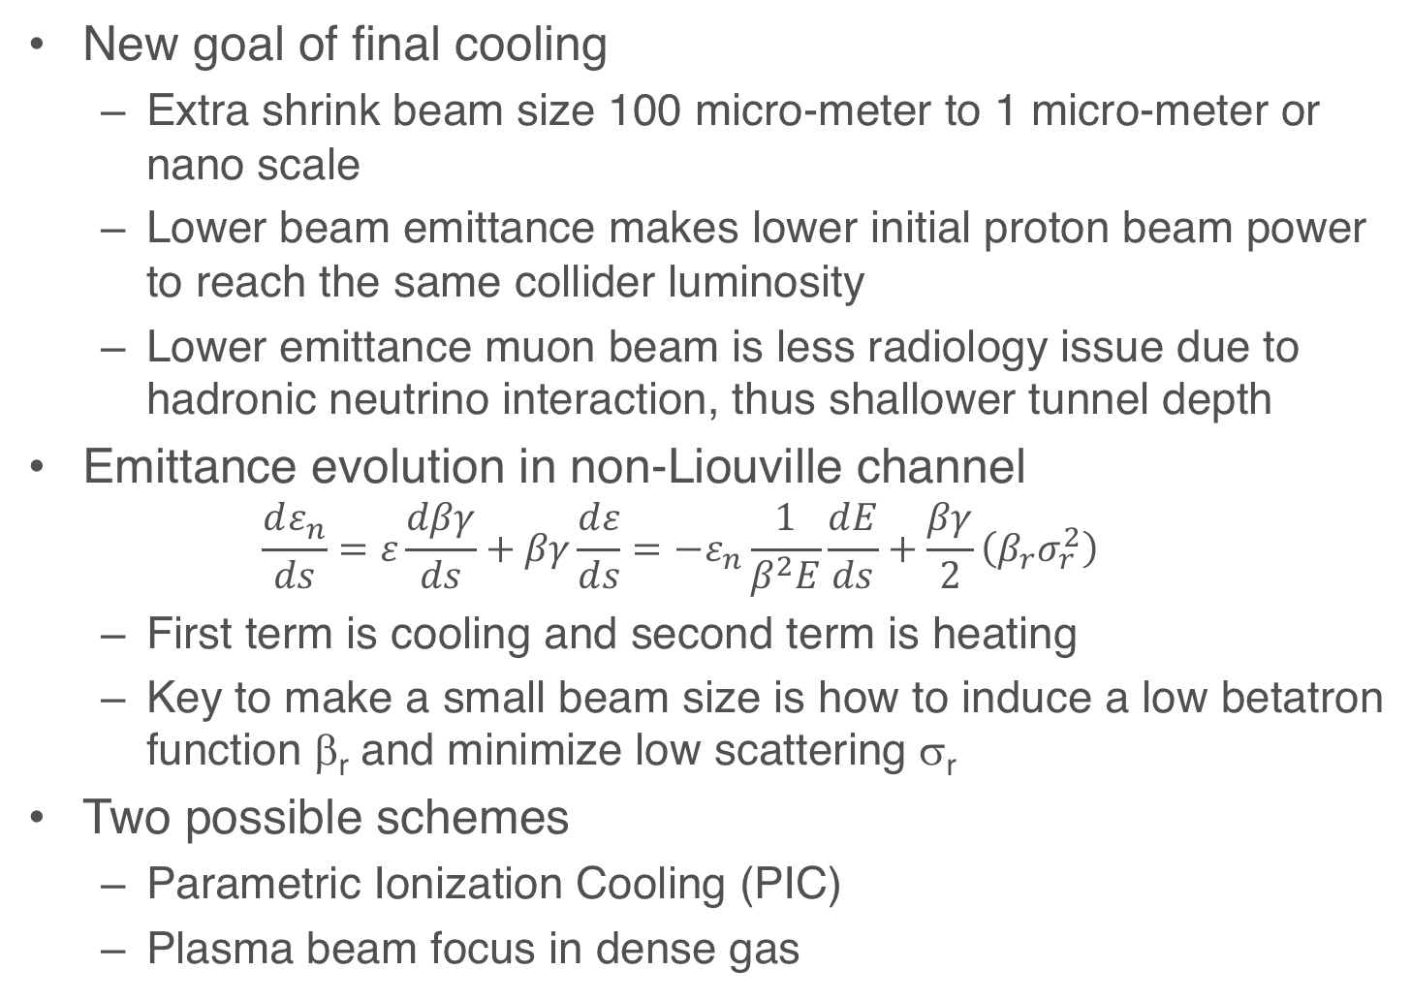
Extra cooling for final cooling
New goal of final cooling
  Extra shrink beam size 100 micro-meter to 1 micro-meter or nano scale
  Lower beam emittance makes lower initial proton beam power to reach the same collider luminosity
  Lower emittance muon beam is less radiology issue due to hadronic neutrino interaction, thus shallower tunnel depth
Emittance evolution in non-Liouville channel
  $$\frac{dε_{n}}{ds}=ε\frac{dβγ}{ds}+βγ\frac{dε}{ds}=−ε_{n}\frac{1}{β^{2}E}\frac{dE}{ds}+\frac{βγ}{2}\left(β_{r}σ_{r}^{2}\right)$$
  First term is cooling and second term is heating
  Key to make a small beam size is how to induce a low betatron function β_{r} and minimize low scattering σ_{r}
Two possible schemes
  Parametric Ionization Cooling (PIC)
  Plasma beam focus in dense gas

Slide 6
Parametric Ionization Cooling (PIC)

Slide 7

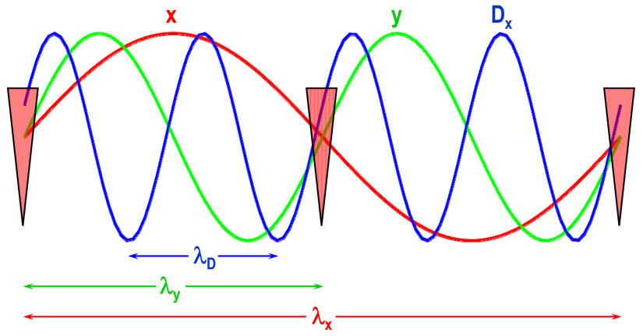
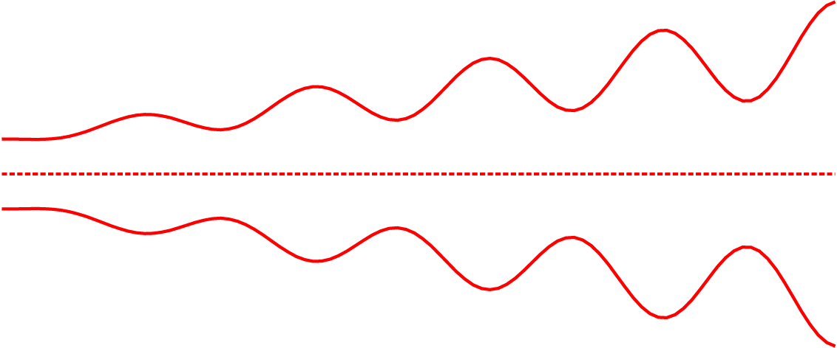
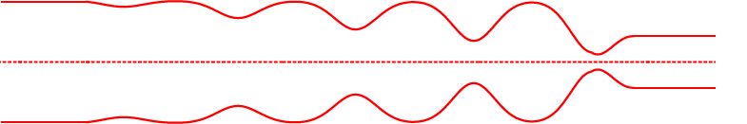
Extreme Cooling: Skew PIC
Concept: 10x emittance reduction from Parametric-resonance Ionization Cooling (PIC) and 10x from Reverse Emittance Exchange (REMEX) combine for 100x luminosity increase
Half-integer resonance at absorber positions drives reduction in x, growth in x’
Correlated optics for periodic focusing at absorber positions
Ionization cooling occurs at absorber plates, and RF cavities restore longitudinal momentum
Absorbers
Optics to restore parallel beam envelope
Beam envelope without absorbers

Slide 8
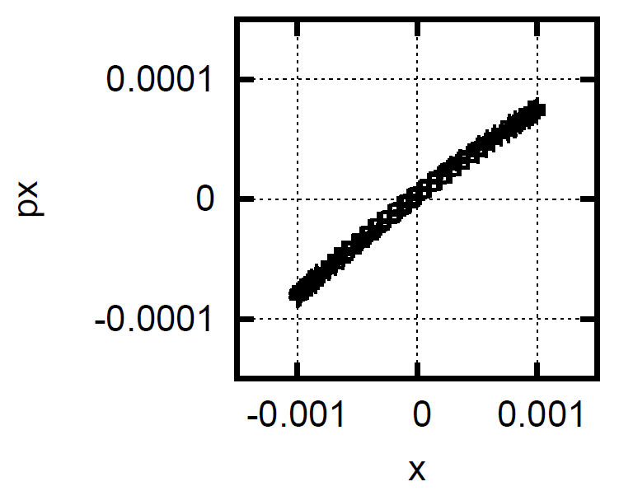
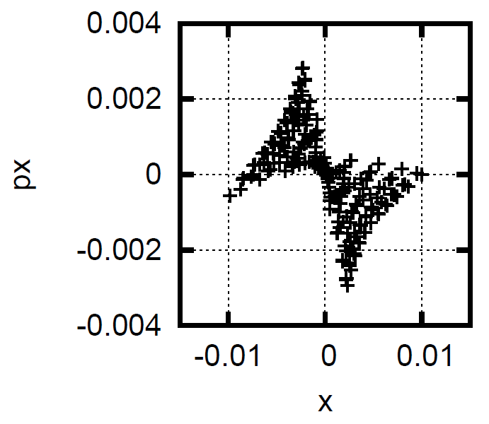
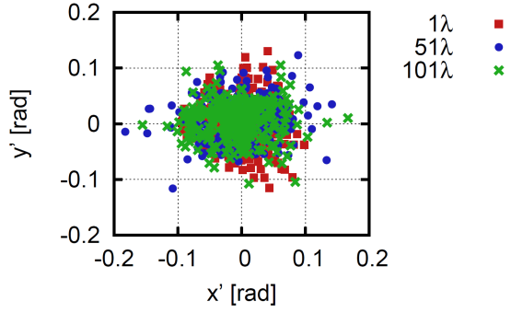
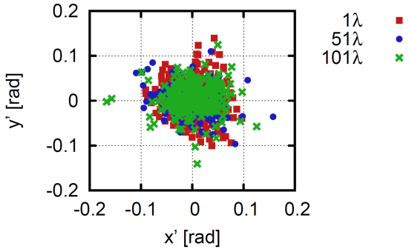
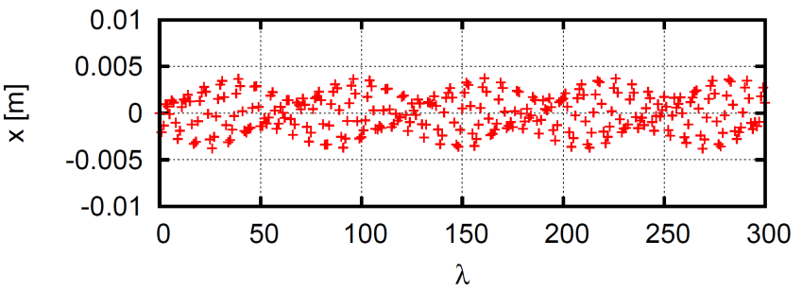
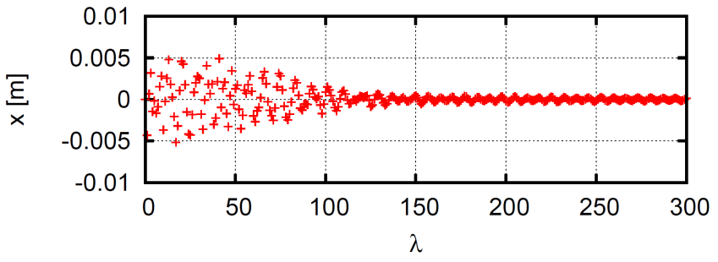
Skew PIC Status and Challenges
PIC optics causes beam instability with any octupole harmonic
Skew PIC: add coupling to PIC for easier aberration compensation
Induced parametric resonance in coupled channel
Fewer quad harmonics needed to excite the resonance due to coupling between x and y planes
Dynamic aperture optimization
Particle distributions with θ_{max} = 82 mrad controlled through 101 periods of the coupled channel with single sextupole, octupole, decapole harmonics
Damping with simple cooling model in coupled channel

Slide 9
Skew PIC Status and Challenges
Challenges remain:
  Increased angular spread requires higher multipole orders that are difficult to optimize
  Loss of parametric resonance behavior in the presence of RF cavities due to dispersion effects
Paths forward:
  Advanced optimization routines (i.e. genetic algorithms, etc.) for aberration compensation
  Development of 6D (previously 4D) PIC theory
A. Afanasev et al., Proc. IPAC2015, Richmond, VA, TUPHA013.
A. Sy et al., Proc. IPAC2015, Richmond, VA, WEPJE015.
V. S. Morozov et al., Proc. COOL2015, Newport News, VA, TUWAUD04.
A. Sy et al., Proc. IPAC2017, Copenhagen, Denmark, WEPIK116.

Slide 10
Plasma beam focus in muon beam cooling

Slide 11

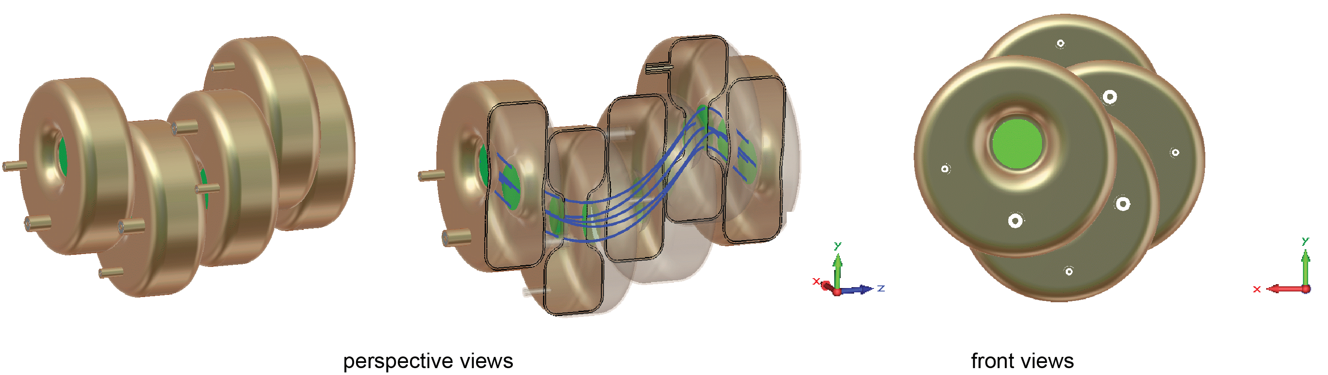
Study beam-plasma interactions in dense gas
We studied beam-plasma interactions in a cooling channel
Operating hydrogen gas density
  3-6 10²¹ molecules per cc
Plasma density induced by incident beam
  10¹⁶ - 10¹⁹ ions per cc
Activate plasma chemistry
Looking plasma parameter quite different from conventional plasma focus and plasma wake field accelerators
Helical beam path in a dense-hydrogen gas filled RF cavity

Slide 12
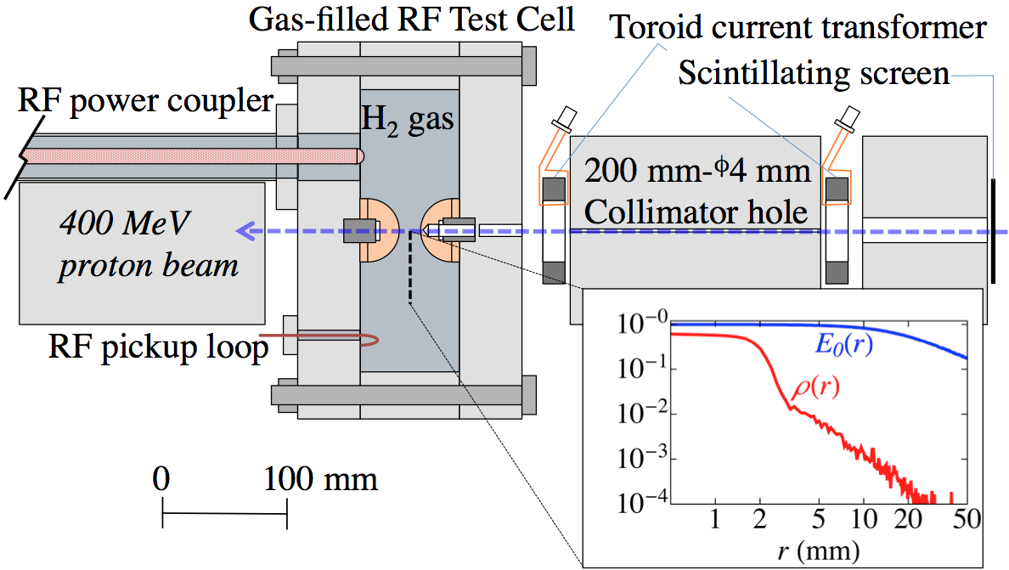
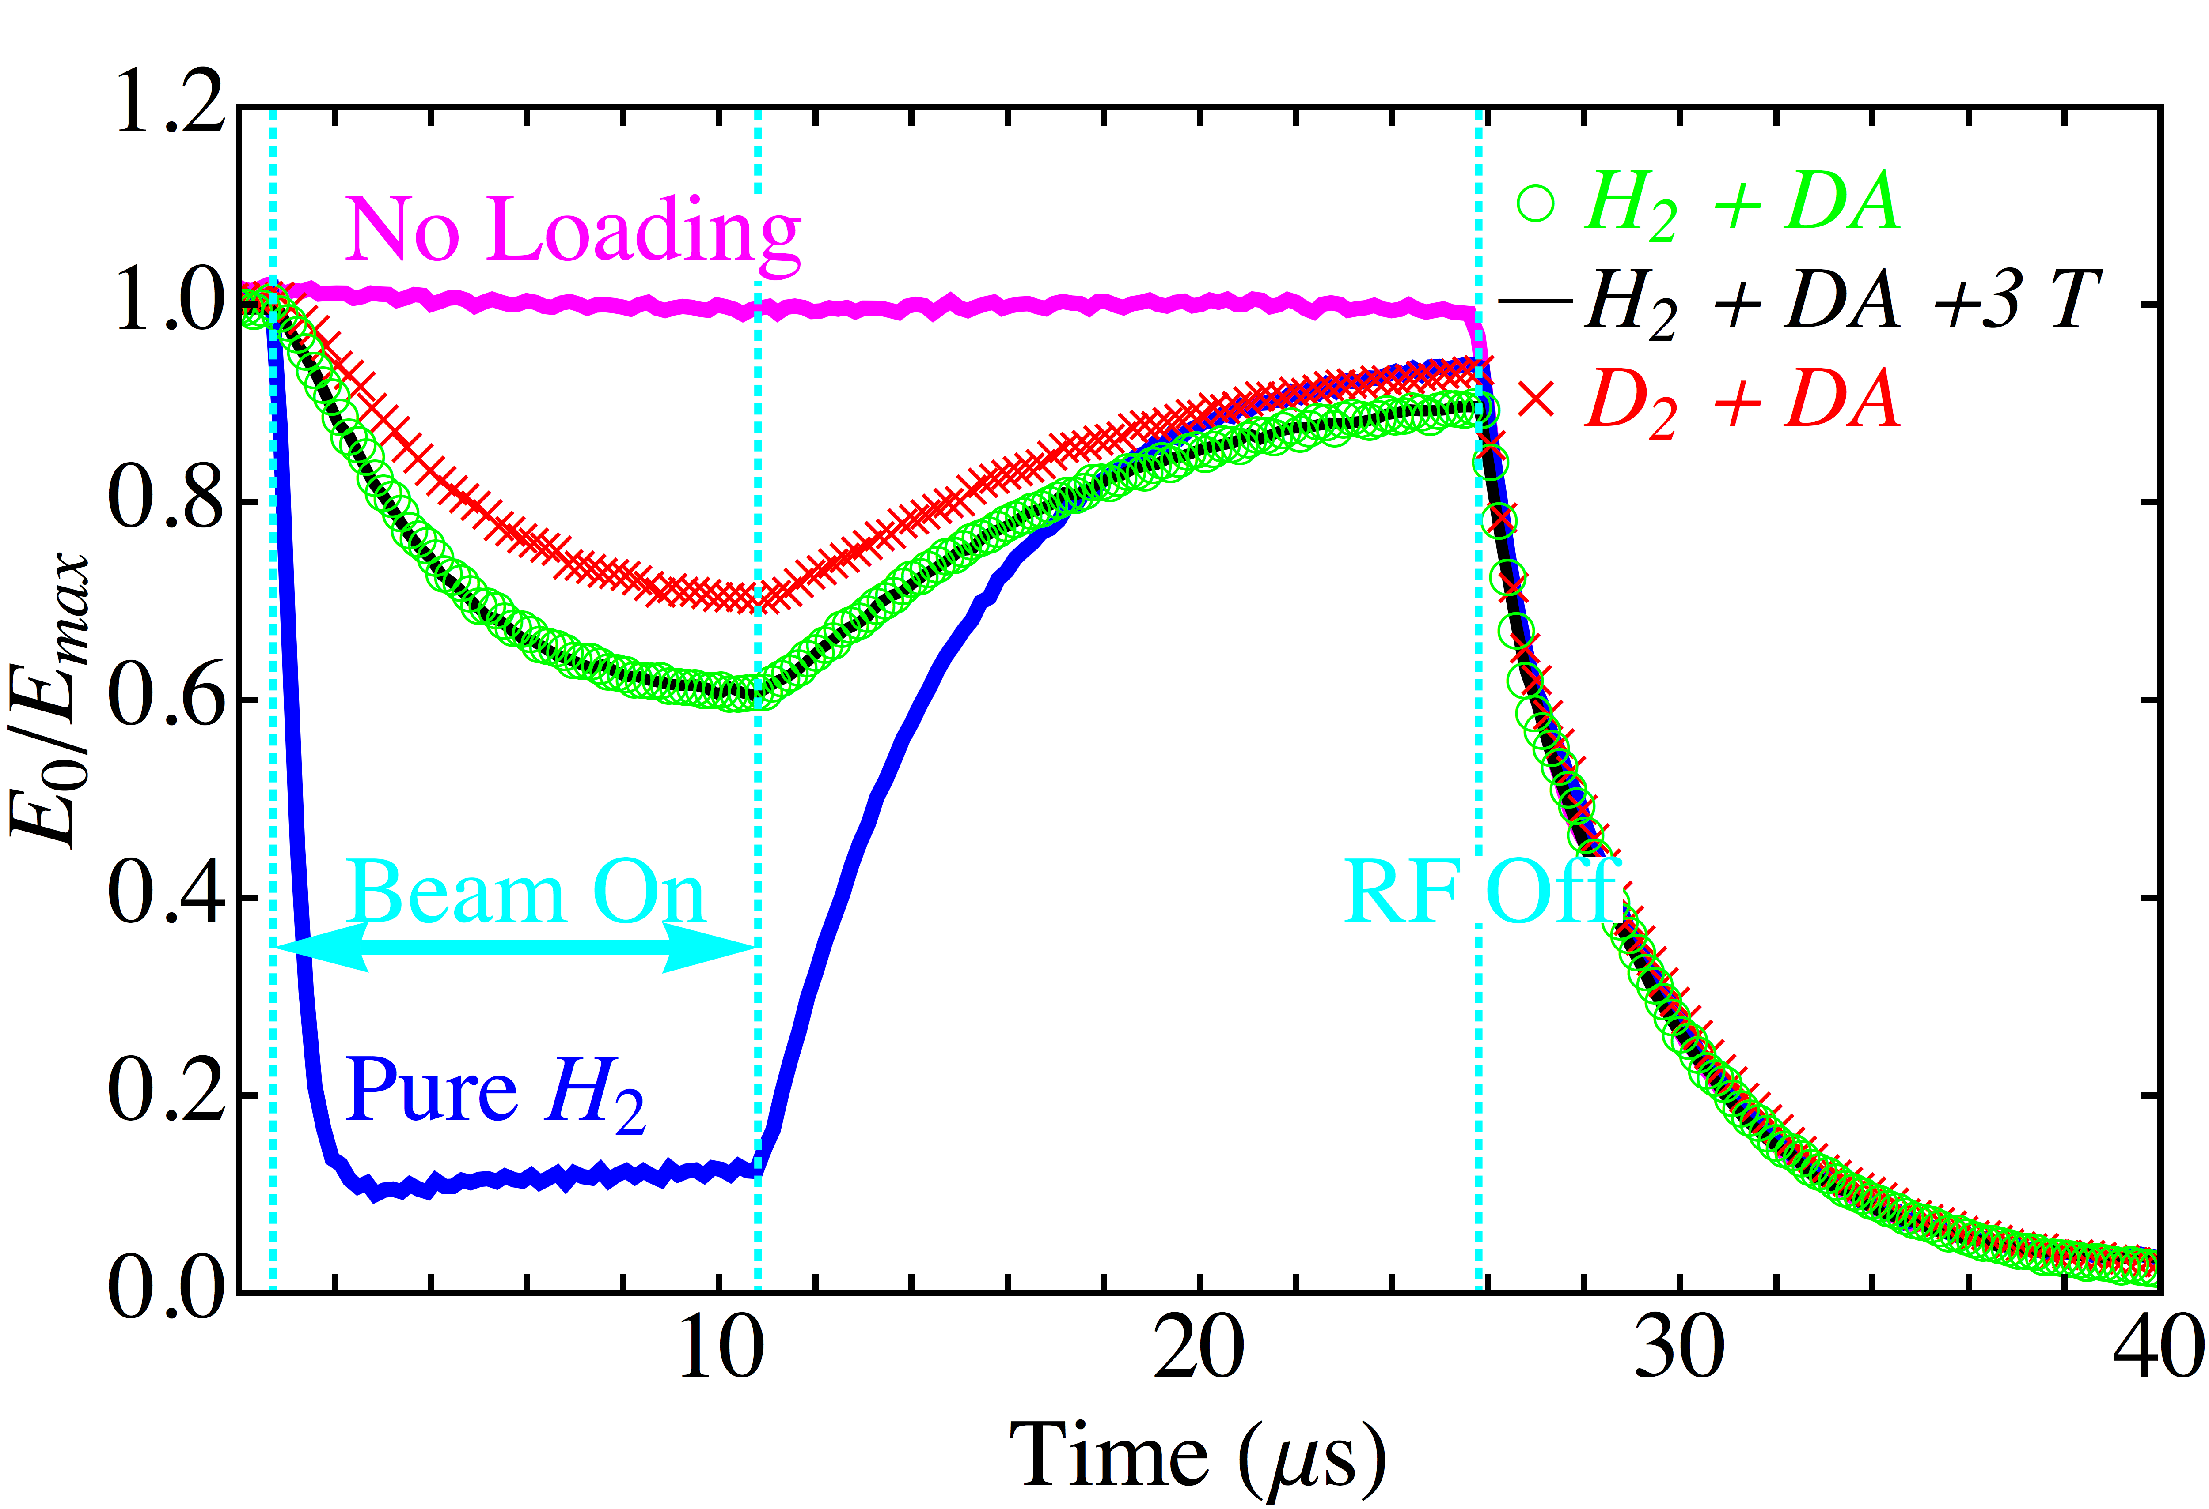
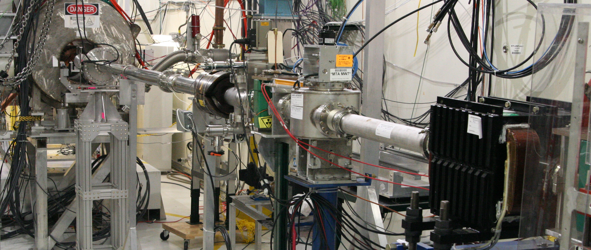
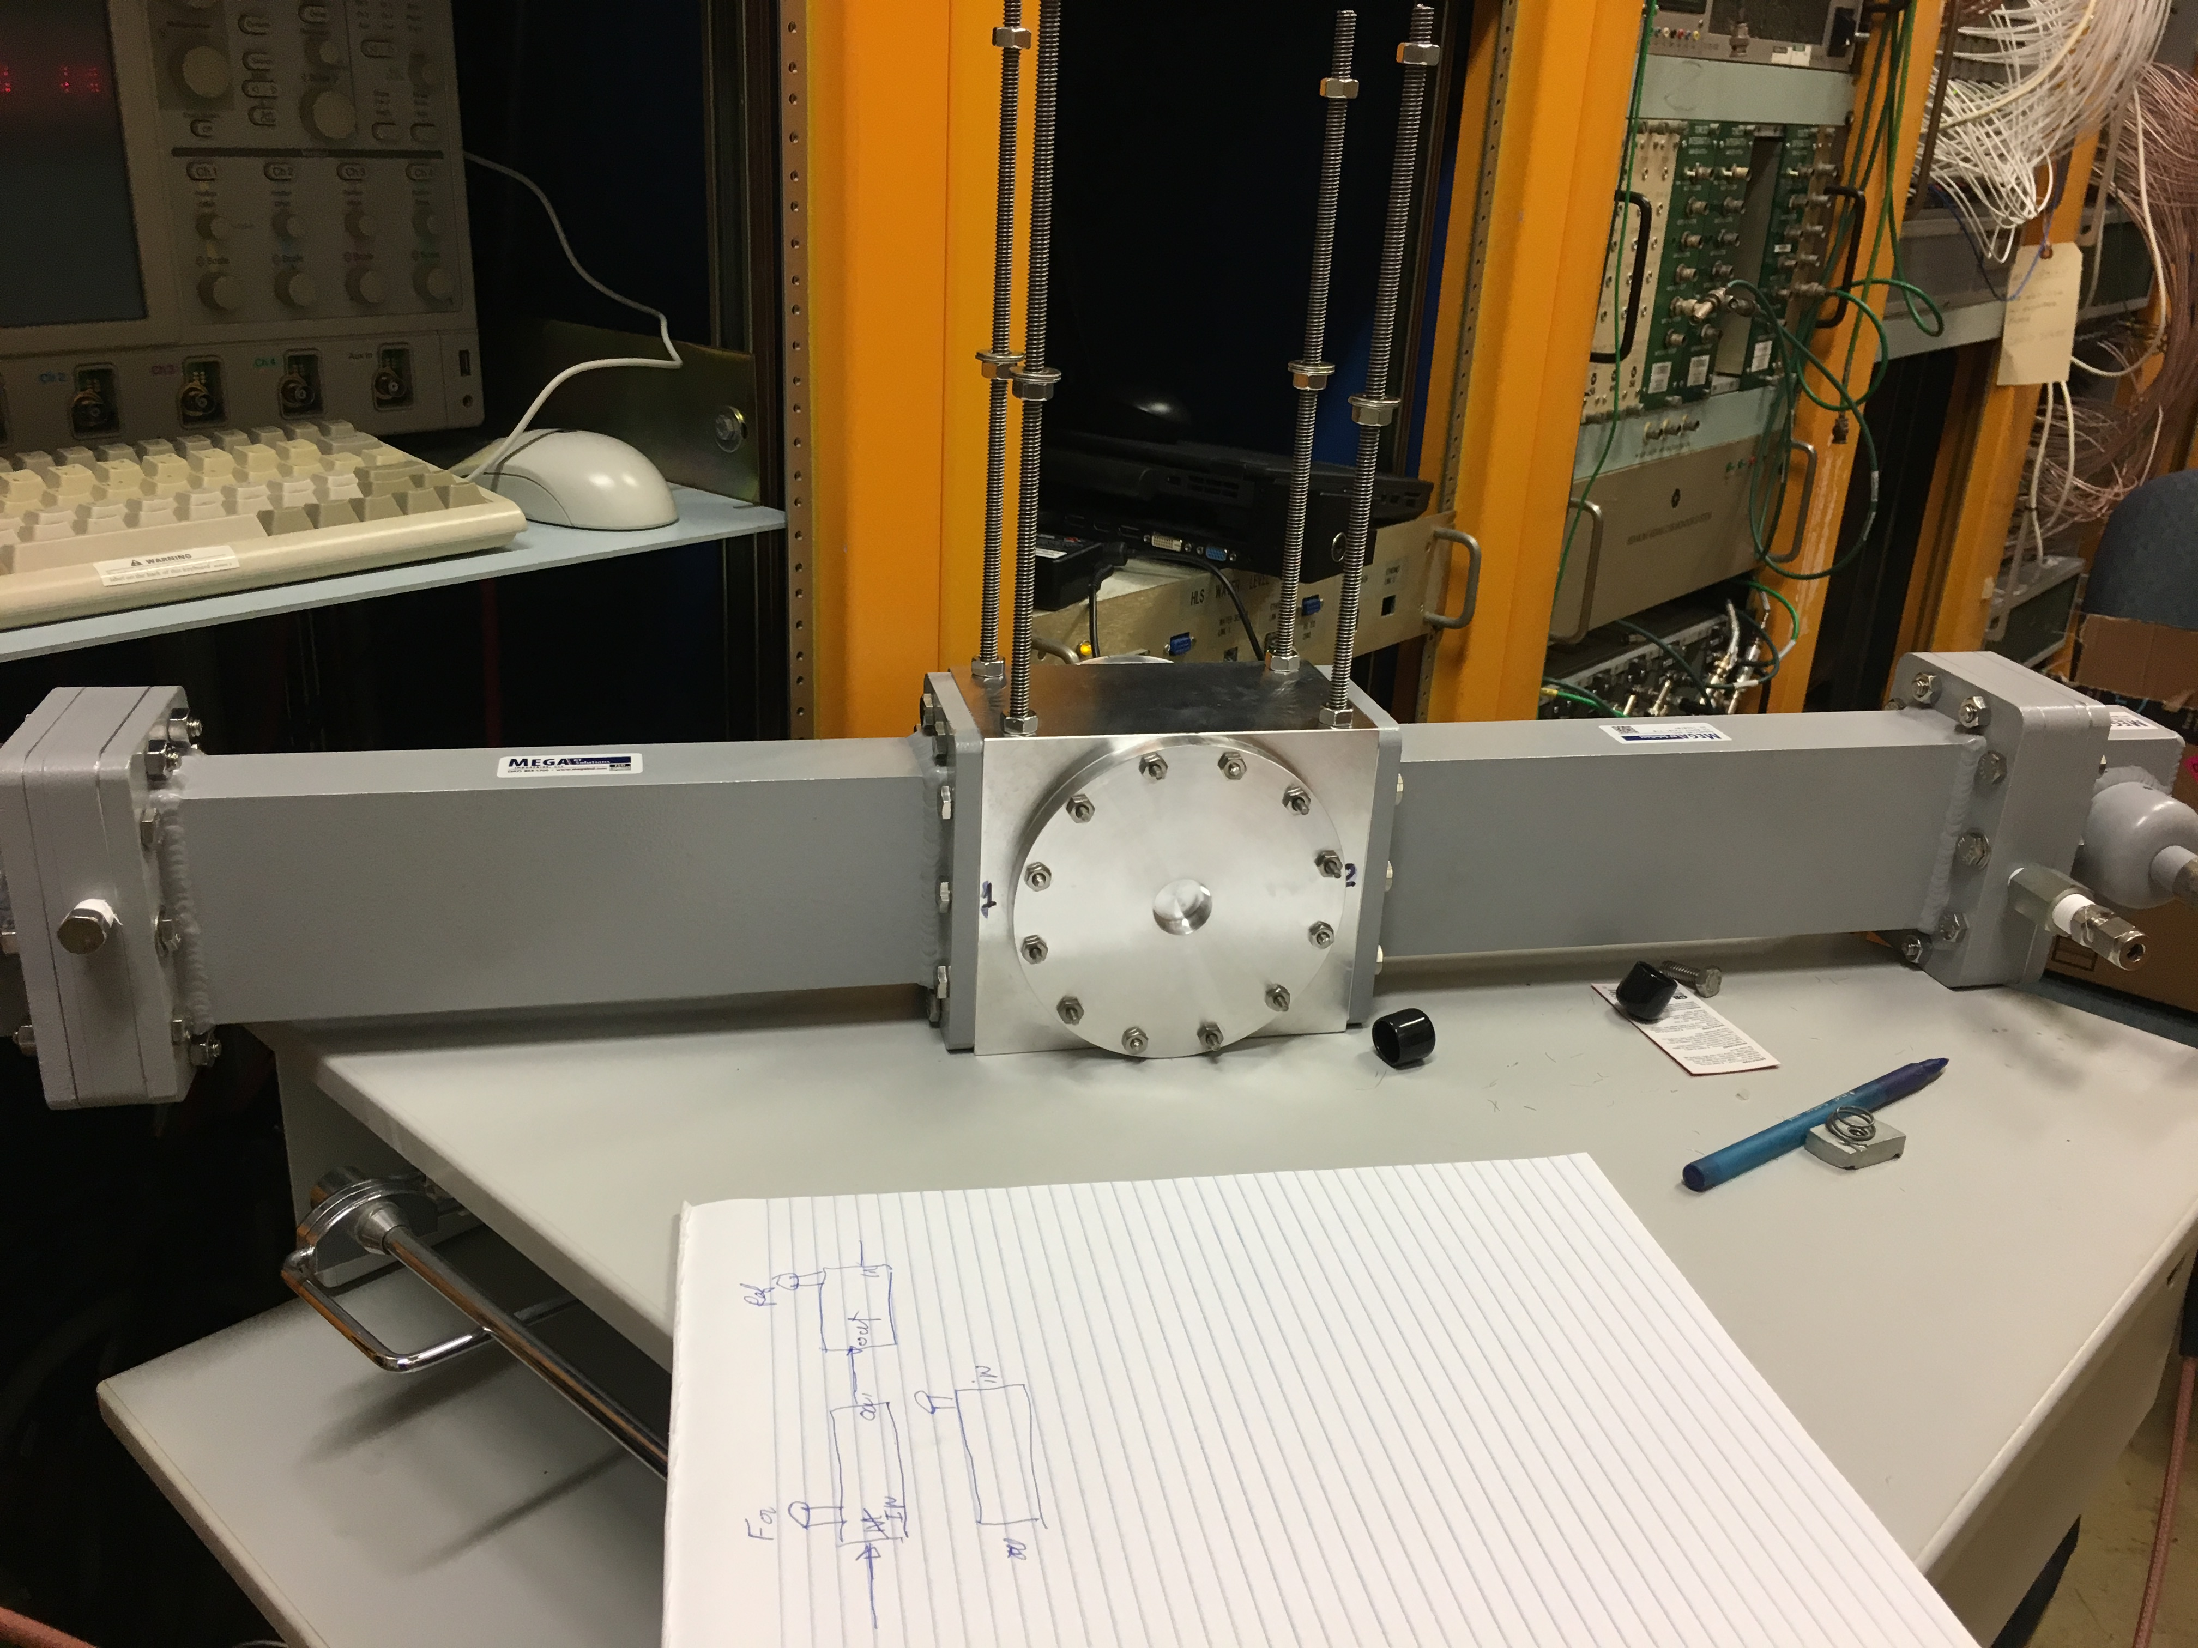
Measure beam-plasma interactions
M. Chung et al., PRL 111, 184802 (2013)
DA: Dry Air (20 % O₂)
2.4 GHz test cavity
MTA beam line and 800 MHz test cavity

Slide 13
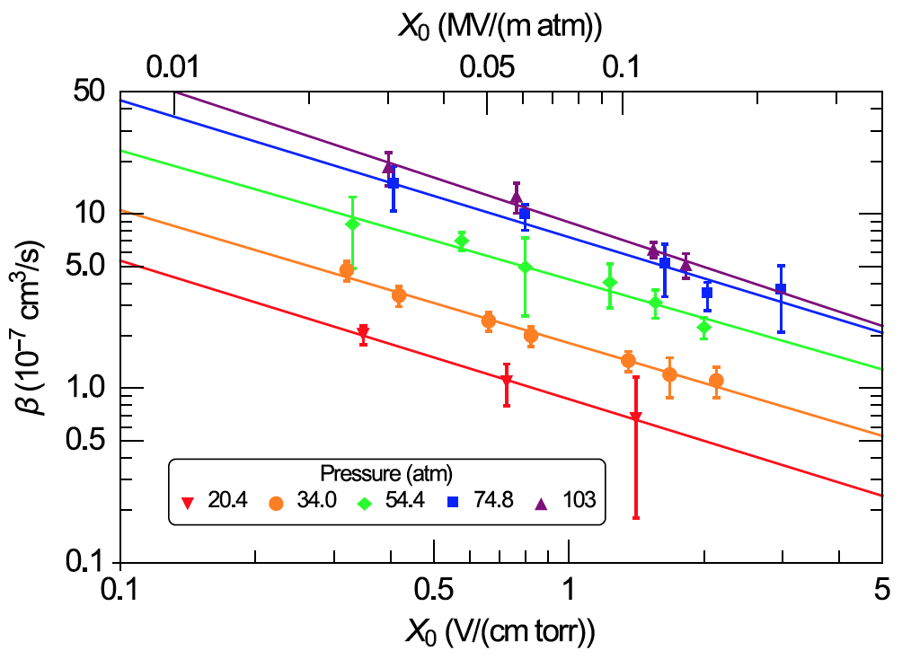
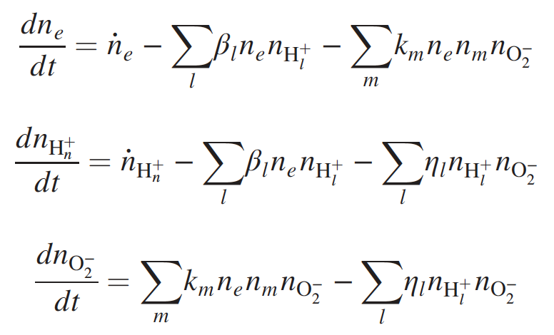
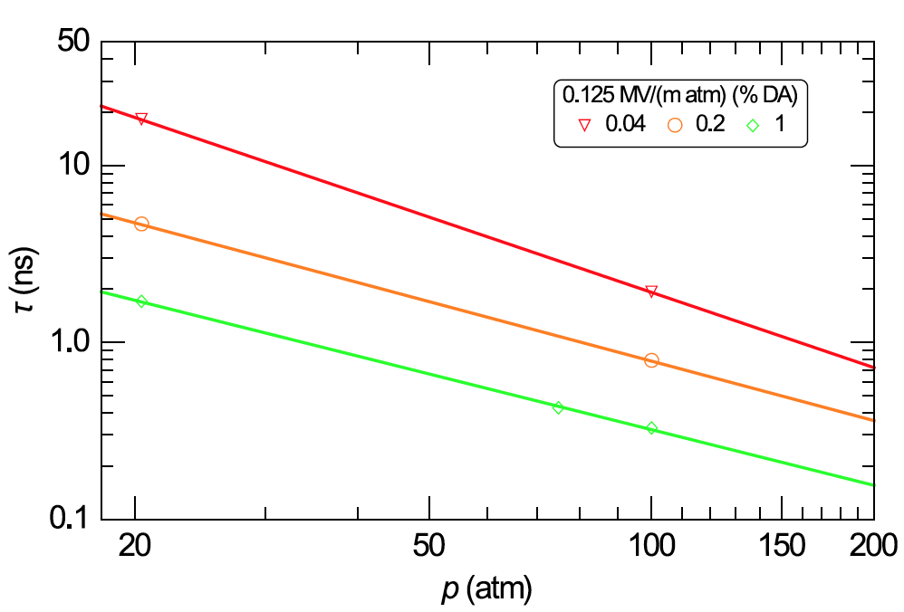
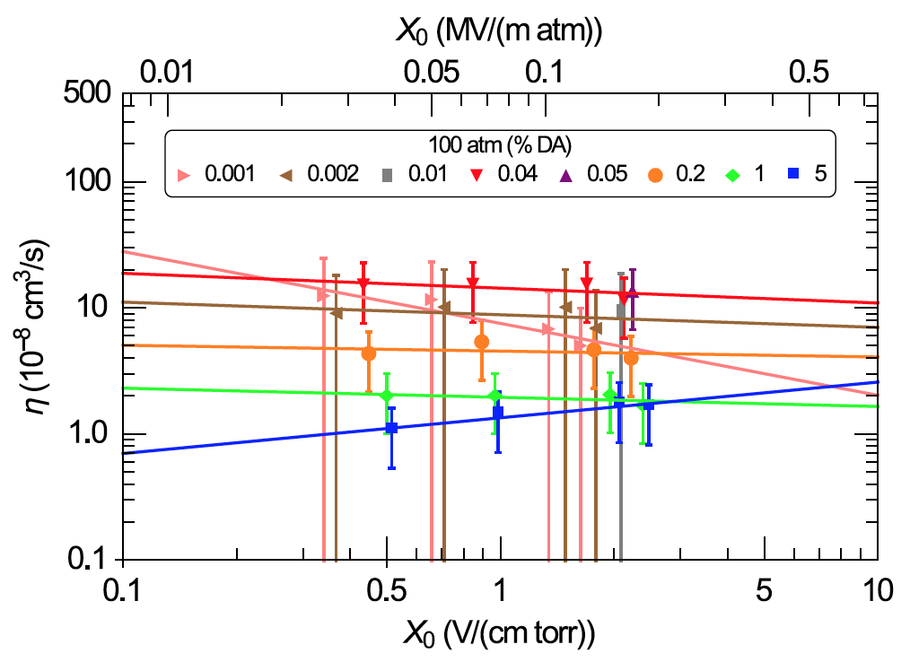
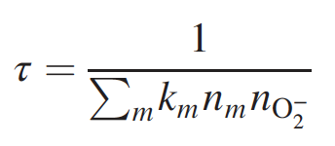
Observed Plasma Chemistry
Electron-Ion recombination rate
Electron capture time
Ion-Ion recombination rate
B. Freemire et al., PRAB 19, 062004 (2016)

Slide 14
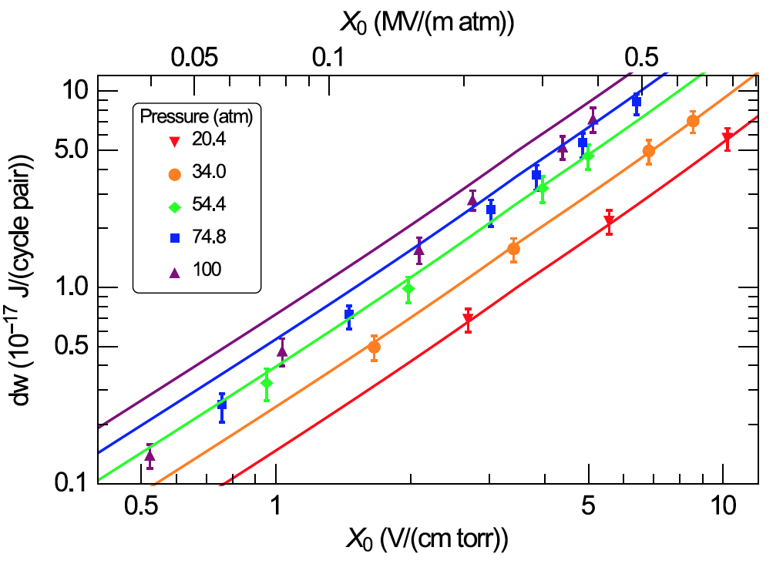
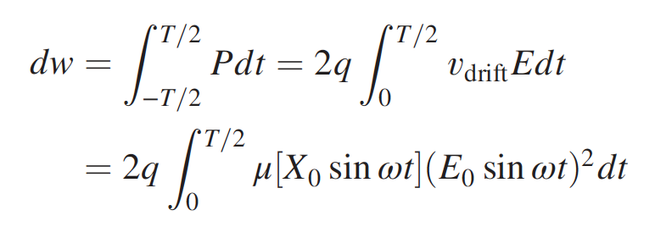
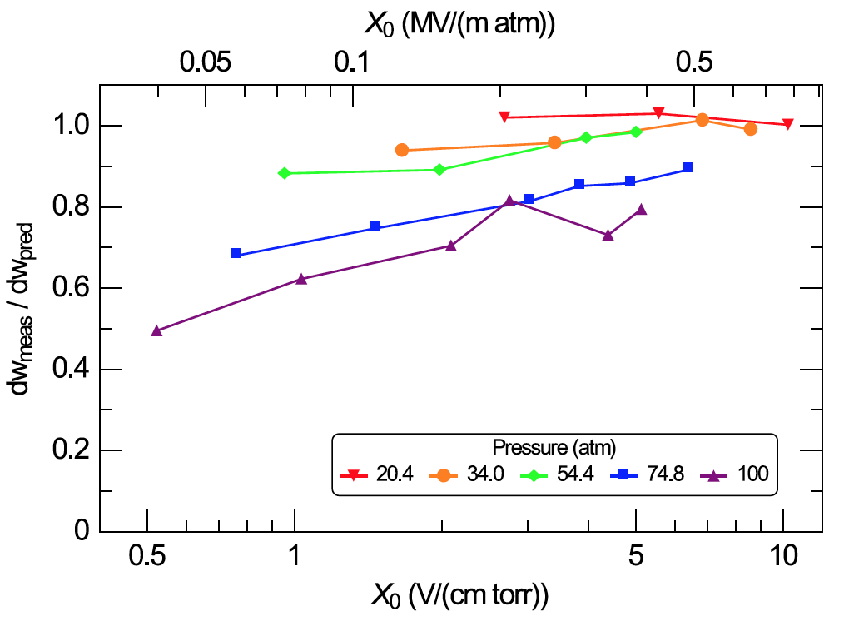
Density effect
RF power dissipation by beam induced plasma
Bottom plot shows the discrepancy between measurement and prediction
Bigger discrepancy in denser gas due to a quantum effect (coherent)

Slide 15
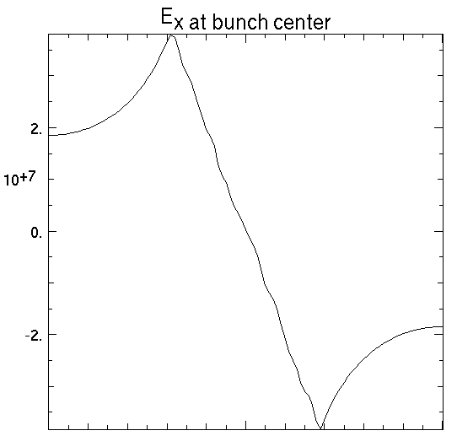
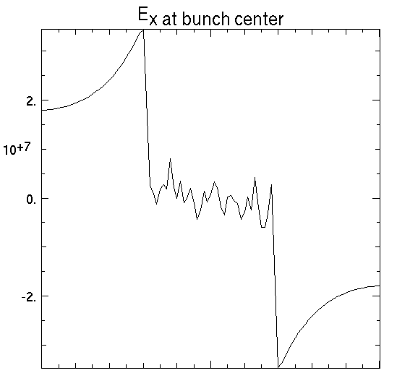
Space-Charge Neutralization Can Take Place
Space-charge of the muon beam
pushes electron outward
Electron column expands slightly, making E-field inside the beam banish
Time scale for the neutralization process
e-
μ-
μ-
Other time scales:
- Bunch length ~ 100 ps
- Electron removal by attachment to O₂ ~ 0.5 ns
- Bunch spacing = 3.1 ns / Pulse length = 60 ns
- Plasma removal by ion-ion recombination > 100 ns
WARP simulation reproduces
the neutralization process:
Issues to be addressed:
- Numerical noise
- Any change in net focusing of the beam ?
- Different neutralization degree between head and tail
- Effect of electron attachment to O₂
-0.0075
0
0.0075
-0.0075
0
0.0075
X (m)
X (m)

Slide 16
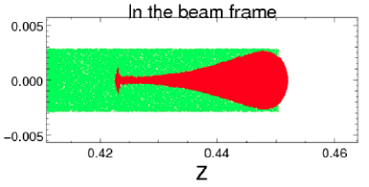
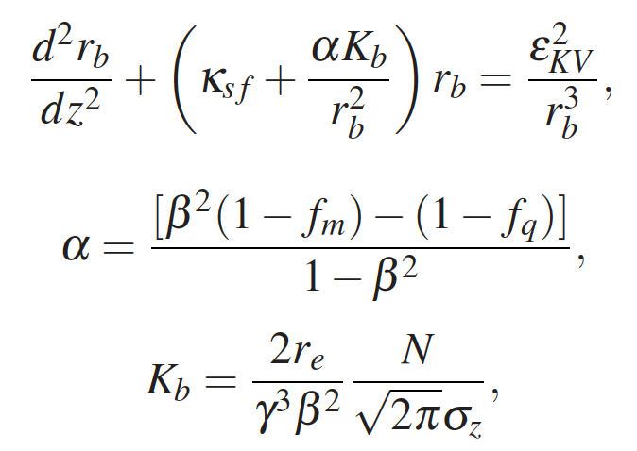
Simulate plasma beam focus
WARP simulation
Simulated plasma beam focus, which is agreed with a plasma lens model
Charge neutralization degree between head and tail is quite different
Add dispersion to mix the head tail condition
No instability found in the simulation
Consider a proton beam/laser driven pre-form plasma
Red: muons
Green: electron
Simple plasma lens model
f: form factor
of electric and magnetic fields
Ex) f_{m} = 0, f_{q} = 1, α = -1
To see the validation of plasma simulation with
the experimental result,
K. Yu et al., PRAB 20, 032002 (2017)

Slide 17
Low EMittance Muon Accelerator (LEMMA)

Slide 18
Direct muon pair production
Direct muon pair production via e+ e- → μ+ μ-
  45 GeV e+ accelerator and e- target (3-mm-thick Be) to create a 22 GeV μ+ μ- pair
  μ+ μ- are separated by their charges and captured in an accumulation ring
Efficiency
  10¹⁸ e+/s to create 10¹² μ+ μ- pairs, conversion rate is 10⁻⁶
Nevertheless, there are many advantages
  No cooling needed
  Very low muon decay loss
  Significantly reduce a radiological issue on target

Slide 19
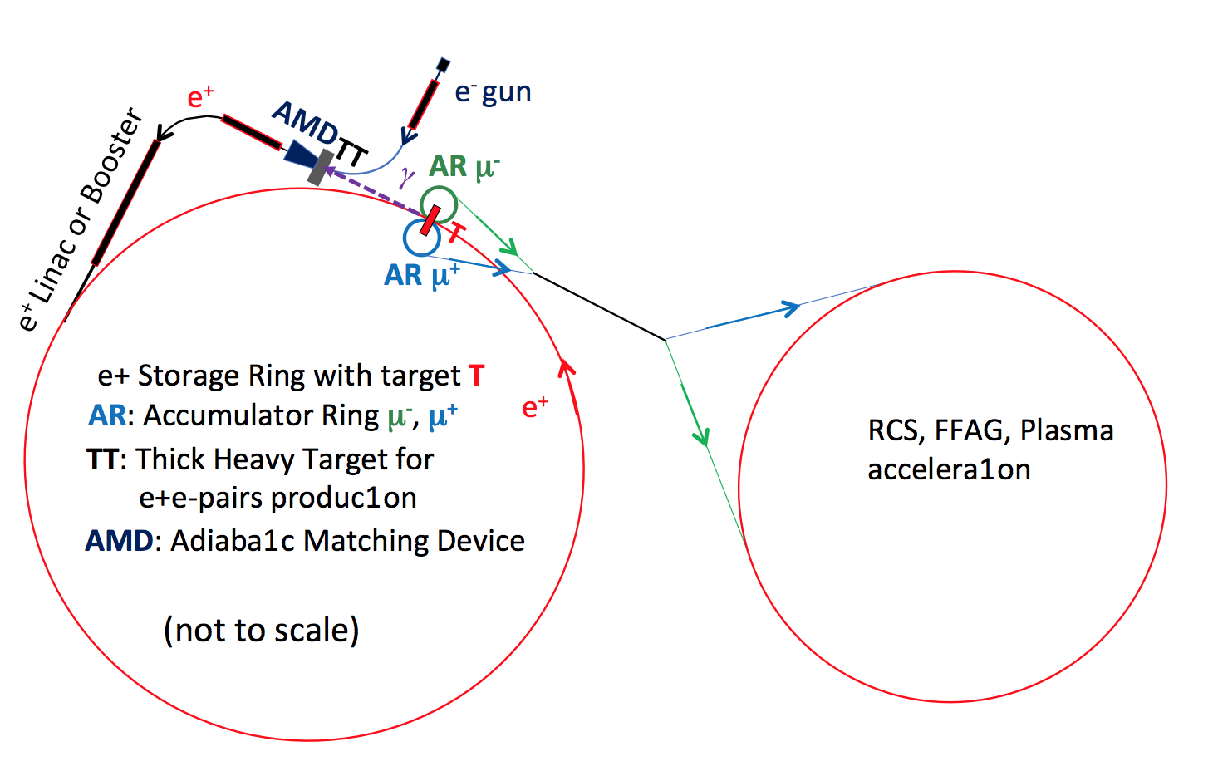
Schematic view of LEMMA
M. Boscolo, ARIES Muon Collider Workshop (2018)
Design challenge:
e+ beam emittance growth during multiple-pass to the pair production target
Too large energy spread for Higgs factory
Ultimate goal emittance: 40 nm!

Slide 20
Conclusion
CERN studies 14 TeV muon collider by using the LHC (CERN Muon Collider, CMC) after MAP
Two possible bright muon sources discussed
Tertiary muon production source
  Studied PIC and plasma beam focus for extra cooling
  Theoretical lowest beam emittance in PIC/REMEX is 3 micro-meter
  Plasma beam focus channel has a potential to achieve a nano-scale muon beam
  Fine plasma control is required to achieve nano-scale muon beam with plasma beam focus channel
Direct muon pair production muon source
  Very cost effective if e+ beam exists
  Goal emittance is 40 nm

