Slide 1
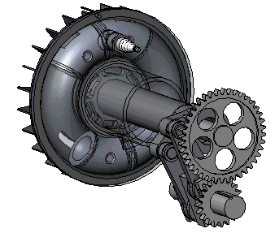
Welcome to the All Engineers Retreat!
21 February 2019

Slide 2
Safety Reminders
Exits
Nearest tornado shelter
Building assembly area – edge of east parking lot
In event of an emergency, call x3131 or 630-840-3131
Restrooms

Slide 3
Purpose of Today’s Retreat
Provide a chance for the engineering professionals at the lab to come together as a community
Update everyone on the work of the Engineer Advisory Council/EAC sub-committees over the past year
Talk about items of common community interest
Celebrate accomplishments of engineering community in support of Fermilab’s science mission!
Provide an opportunity to network with your fellow engineers – develop connections outside of your area. And have some pizza and a beer! Or wine.

Slide 4
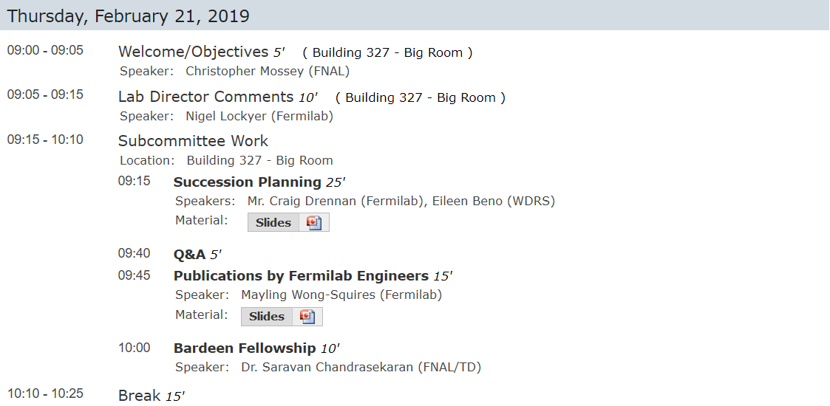
A Very Ambitious and Full Agenda!

Slide 5
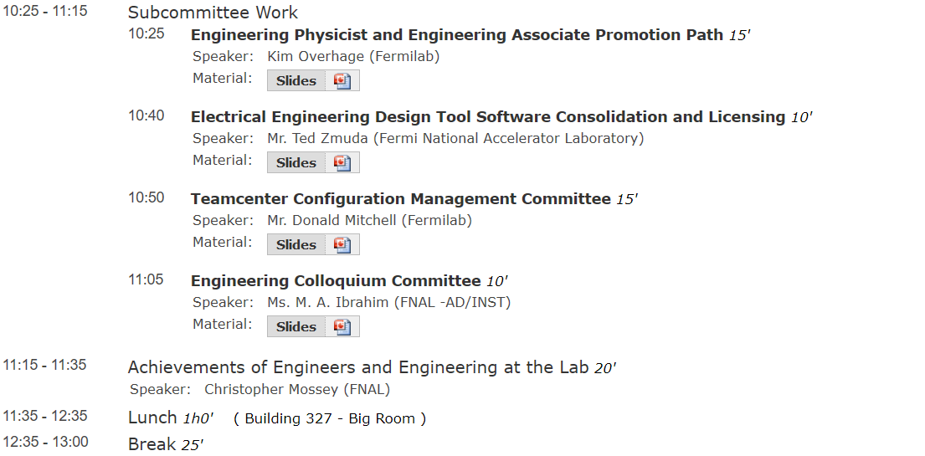
A Very Ambitious and Full Agenda!
Bus transport available to WH from 12p to 1p

Slide 6
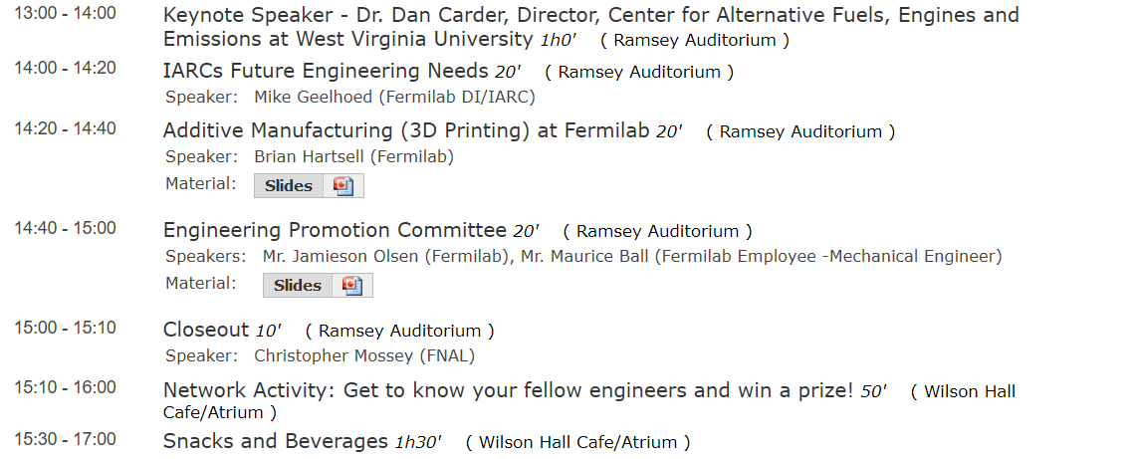
Afternoon…shift to Wilson Hall for Keynote Address

Slide 7
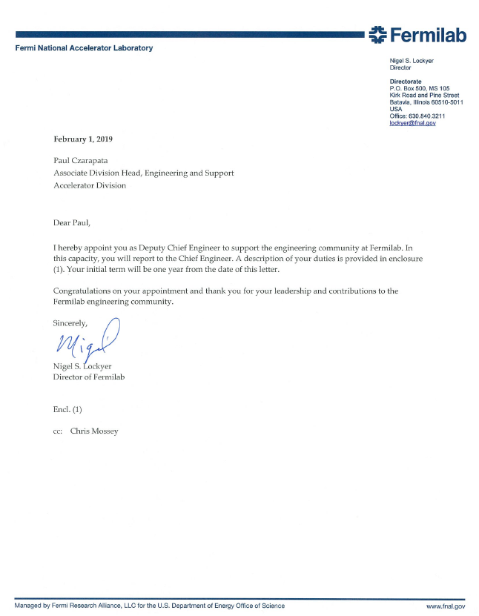
Deputy Chief Engineer
Paul Czarapata has agreed to serve as Deputy Chief Engineer. Will help support:
Focus on consistent enterprise systems, processes, and maturation of the Contractor Assurance System.
A wide variety of engineering initiatives and issues…
A tremendous resource for the entire engineering community!

Slide 8
National Engineer Week… Other Events
Friday:
Engineering Symposium: Raquel Tamez – the CEO of the Society of Hispanic Professional Engineers – will deliver a talk on “Diversifying Diversity: Rethinking how we create a truly inclusive workspace”
Location: One West at 2:00pm
Thank you to the Fermi-SHPE chapter for organizing this and making it happen!

