Slide 1
Draft Installation and Integration
Workshop Agenda
J Stewart
B Miller
January 10 2018 TB meeting

Slide 2
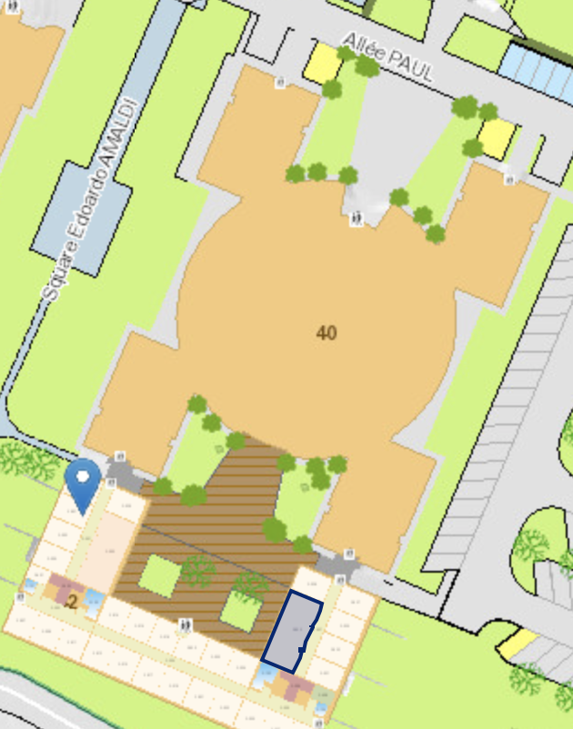
Critical information
Thursday Friday January 24th and 25th (just before the collaboration meeting.)
Location CERN room 42-3-032 (CERN)
Draft Agenda can be found at
  https://indico.fnal.gov/event/19488/
CERN indico page is
  https://indico.cern.ch/event/775943/
  Please register so we are sure the room is big enough
Atlas
Building

Slide 3
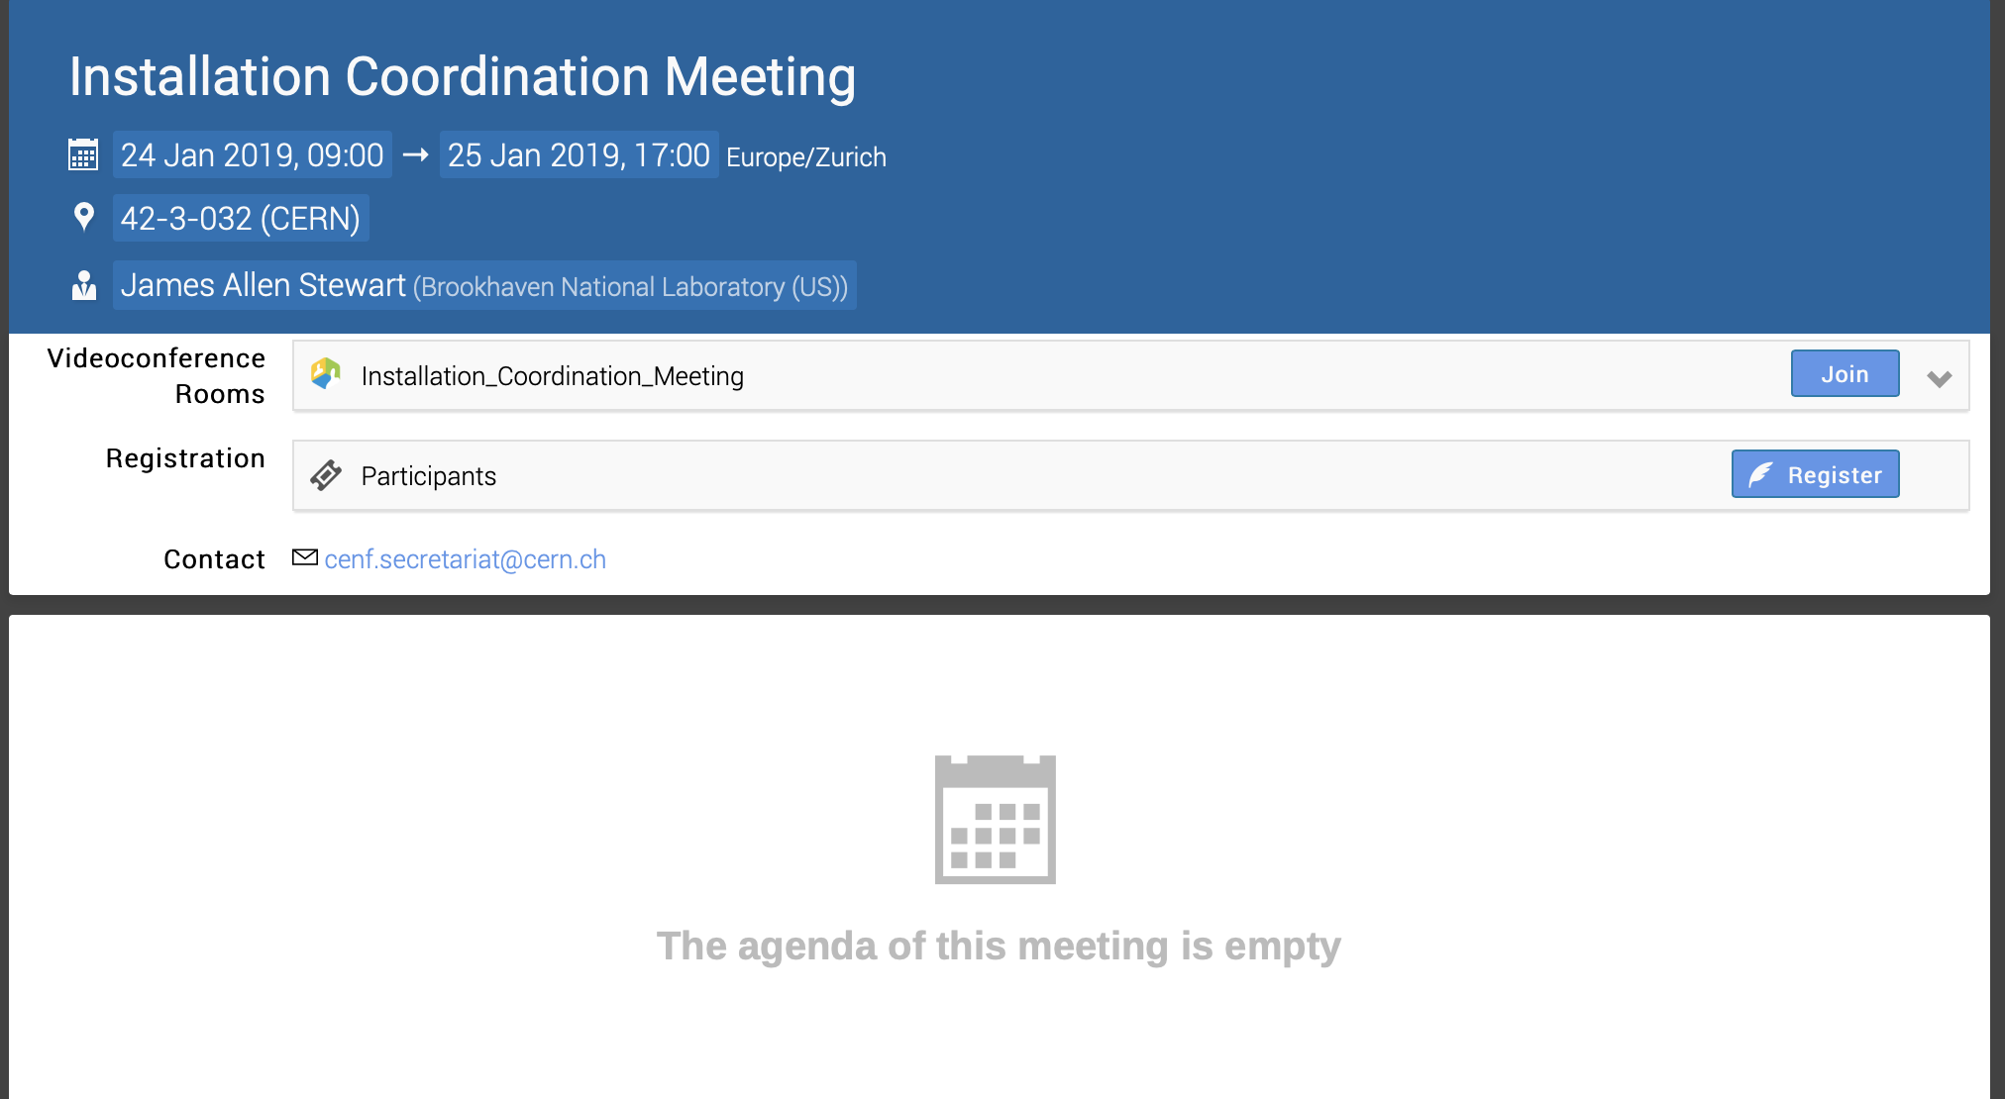
Register

Slide 4
Agenda Topics-Thursday Morning
Schedule & Documentation Overview:
Update on 3-D Model-Dimitar
Discussion Model/Drawing updates, Approval and change control process-Jack
Interface to Detector and placement of the detector in the cryostat -Farshid
Example of a Part Breakdown structure-Marzio
Schedule Overview-60% EXE & BSI-Elaine
Single Slide schedule material delivery ITF & Installation-Consortia
Single Slide Schedule-Delivery to SD from each of the consortia:

Slide 5
Overall Schedule

Slide 6
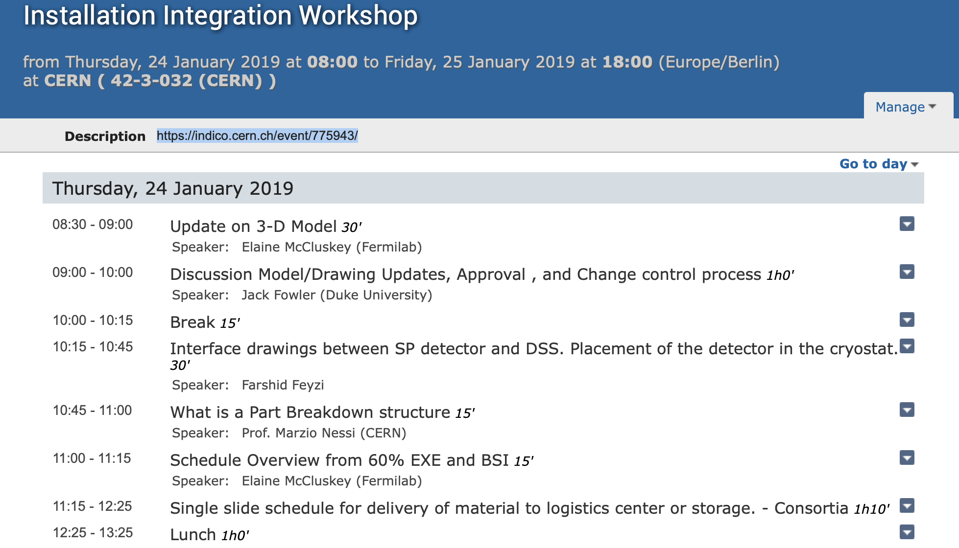

Slide 7
Agenda Topics-Thursday Afternoon
ITF, Logistics Facility & Material Flow
ITF scenarios and ITF Building requirements Update - Jim
Update on Logistics Facility, - Ladia
  Include material handling at Ross
Summary of storage needs - Zhao
Details of APA Handling at ITF-Shipping box, process cart, transport box: Peter/Dan
ITF integration sequence
Discussion on APA handling at the ITF
  Different shipping and transport underground boxes?
  Integration process-pair of APA’s or handling single APA,
  Moving into the horizontal cold box
We to cross check the high level summary of the estimated schedule for both tasks and FTE level for in the both ITF and Underground Installation

Slide 8
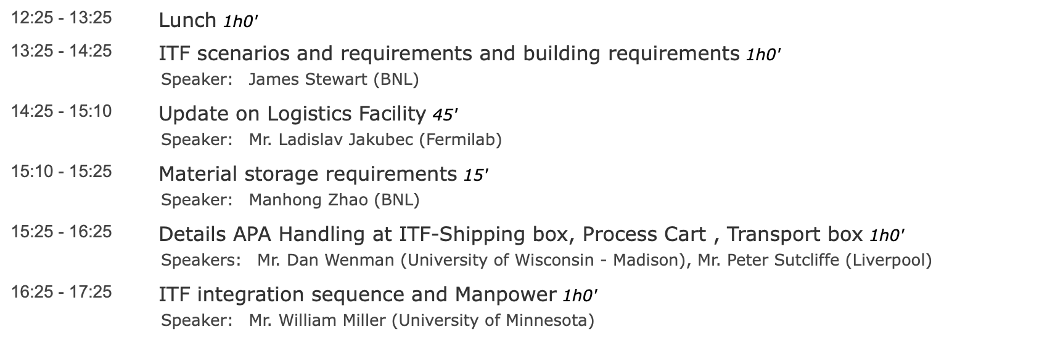

Slide 9
Agenda Topics-Friday Morning
Underground Infrastructure
Installation Infrastructure- Jim/Bill
Plans for Data Room- Tim Durkin
Update on cable trays, DUNE Mezzanine and other cryostat interfaces-Dimitar
Update on Cold Boxes-Dimitar
Plans for installation cryogenics-Andrew
Discussion on closing the TCO
Installation Infrastructure:
4950 level
  Cleanroom
  SAS
  Shuttle Beam/Crane
  APA Assembly and cable towers
  Access Equipment
  Materials handling equipment
  Storage
  Workshop

Slide 10
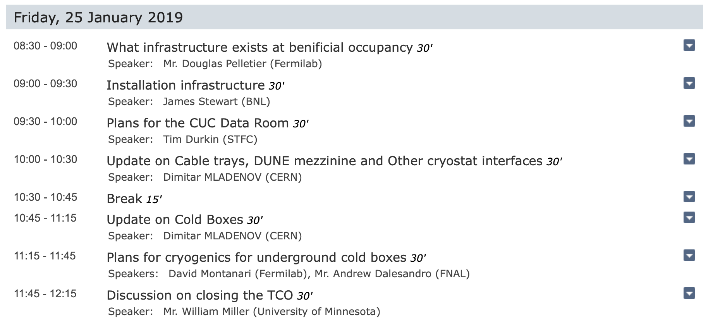

Slide 11
Agenda Topics- Friday Afternoon
Overview underground installation sequence and manpower-Bill
Update on Trial Assembly at Ash River
Open discussion-Integration Project Office- Marzio
Open discussion- TDR- Jim

Slide 12
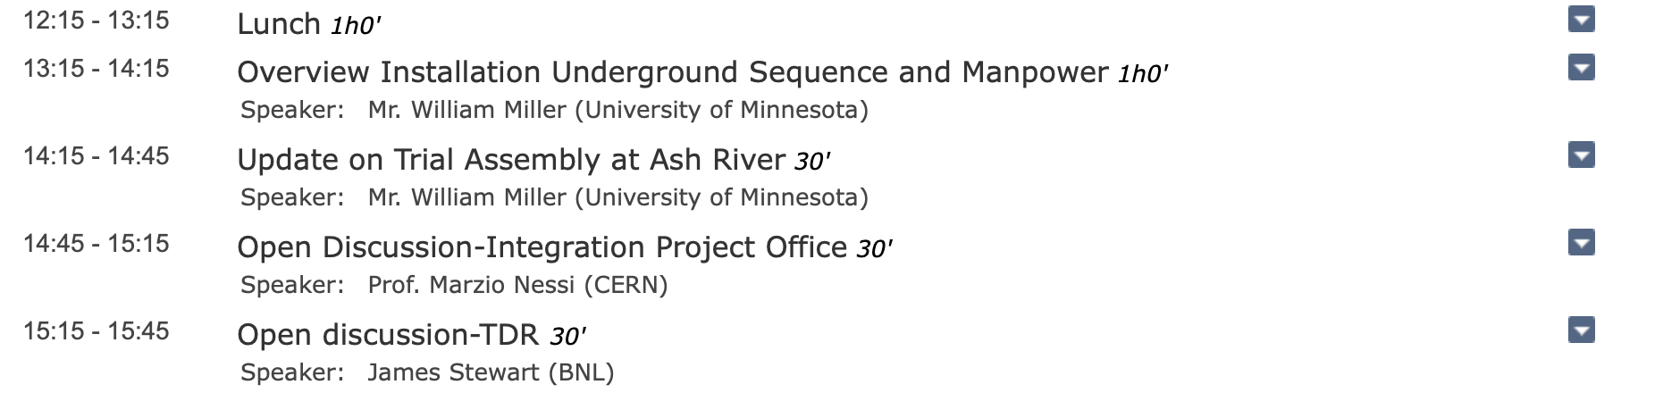

Slide 13
SP installation chapter of the TDR
I would like to have a meeting one-on-one of the SP consortia to discuss the status of the TDR and the next steps.
  Draft 1 is due the week after the collaboration meeting.
  Draft 2 in March
I have contacted most groups now to look over what I have drafted and to get input for the testing sections.
I will send around a doodle poll for the meetings during the collaboration week

