Slide 1
Hall considerations and thoughts on MgB2
Alan Bross
1/11/19

Slide 2
Hall width limitation
~ 3m wider than in
baseline.
It would be good if
we can make the magnet
Diameter smaller.

Slide 3
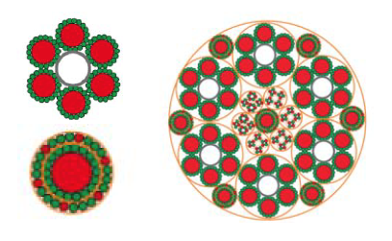
MgB₂
I have been in contact with Amalia Ballarino at CERN
Lead on MgB₂ power transmission lines for HL-LHC
Much progress at Columbus
Over 300km of wire has been made
Cabling
Some done at CERN and then taken to industry for 20kA, 60m prototype
Still more expensive than NbTi
Ready for Prime time?
20 kA MgB₂ cable, ∅=6.5 mm (top), 2X3 kA MgB₂ concentric cables, ∅=8.2 mm (bottom), 150 kA cable assembly for LHC P1 and P5 (6X20 kA, 2X7X3 kA, 4X0.4 kA, 18X0.12 kA), ∅=65 mm

