Slide 1
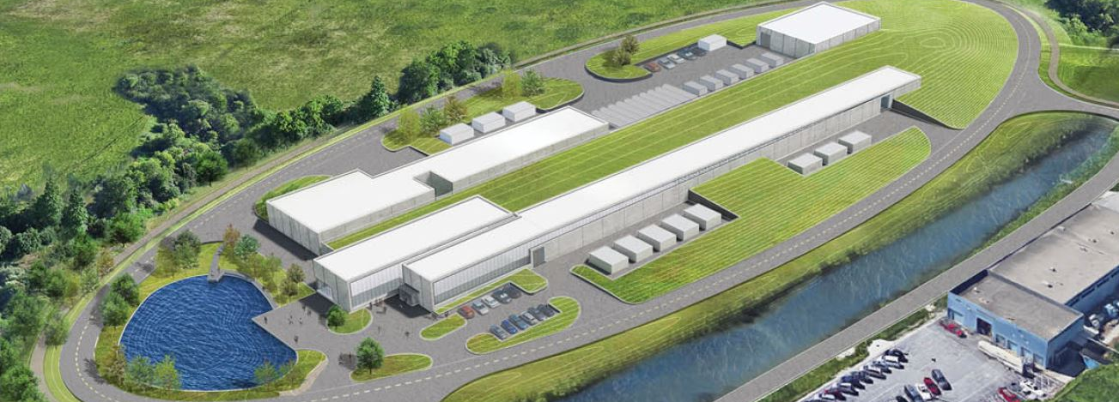
PIP-II Project Manager’s Report
Marc Kaducak
Project Management Group
16 Jan 2019

Slide 2
Outline
Staffing/Organization
Funding, financials
International Updates
Technical Updates
CD-2/3a Preparations
Shutdown Schedule

Slide 3
Staffing
Project Controls Manager position still open.
  Collecting rates from contractors.
  Thanks to OPSS for continued support.
Procurement Manager and Administrator
  Procurement Manager Frank Minton started Monday Nov.12.
  Chris Rossman assigned as Procurement Administrator as of 14-Jan-2019.
Risk Manager
  Lucas Taylor (at Fermilab this week) assigned at 25%, which should be sufficient for CD-2 preparations.
LLRF
  Josh Einstein-Curtis (LLRF CAM) is leaving Fermilab.

Slide 4
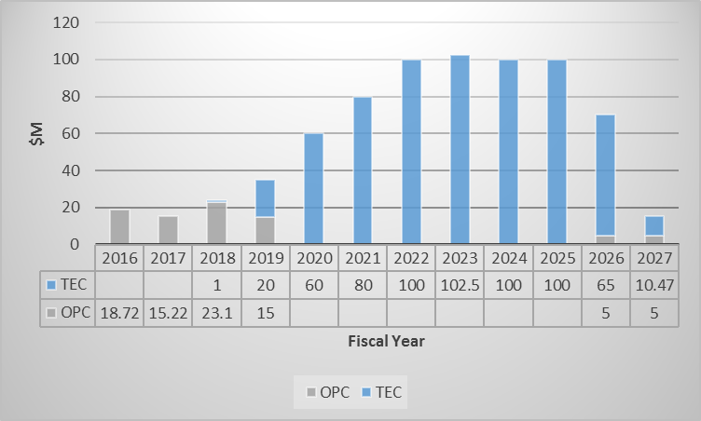
Funding Profile and Milestones
Milestone | Actual or Forecast
CD-0 | 12-Nov-2015 (A)
CD-1 | 23-Jul-2018 (A)
CD-2/3a | Q4FY2019
CD-3b | Q4FY2020
CD-3 | Q4FY2021
CD-4 | Q3FY2027
CD-1 Cost Range -> $653M - $928M.
CD-1 Cost Estimate -> $721M
TPC today -> $894M

Slide 5
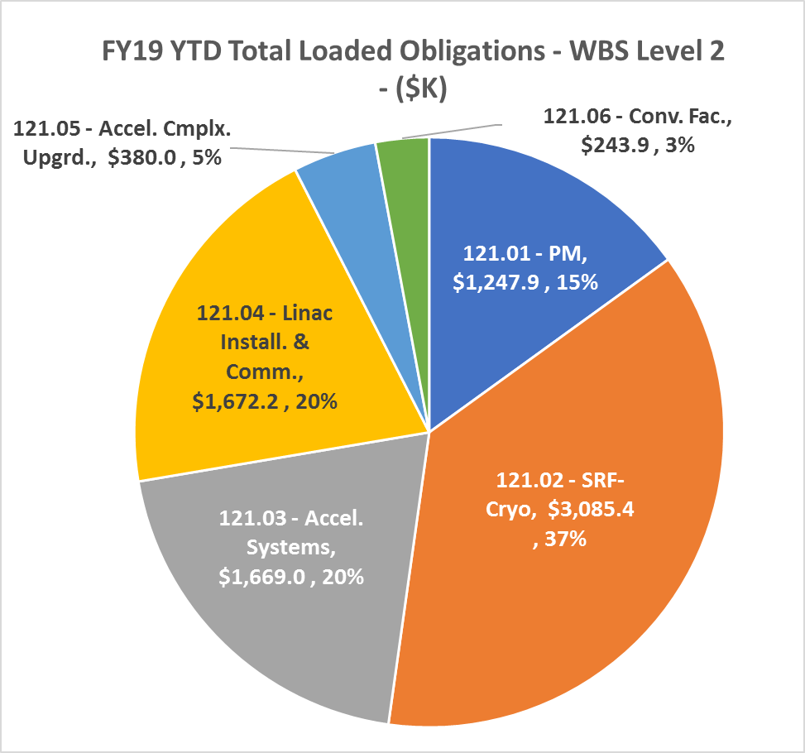
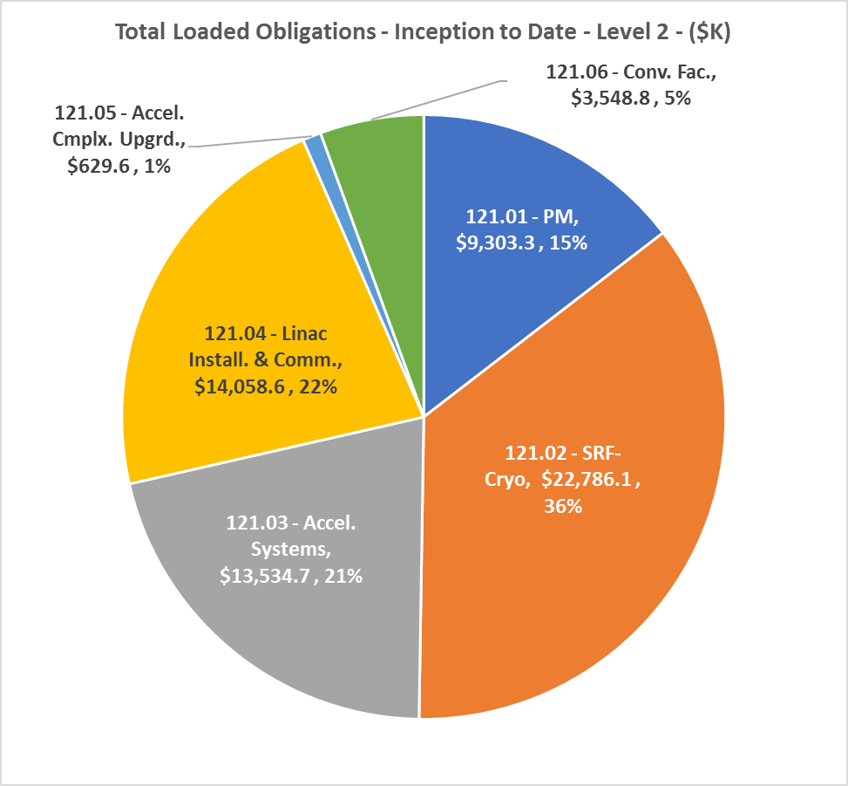
Financials Thru Dec.2018
YTD FY19 | Inception to Date

Slide 6
Partner Activities
UK
  STFC funding review on 17 & 18 Dec at Swindon, UK – Saravan attended
  UKRI/STFC Daresbury: Final scope & funding review in January 2019 FNAL/STFC teams drafted milestones for PPD – Jan 3-4
  UK team to visit Fermilab Feb 11
France - IN2P3
  Secured 2019 preliminary budget of ~200k€ R&D/prototyping
  Waiting for first preliminary hearing at the ministry level – this might come by Spring
India
  Combine PC/TC meeting with Groundbreaking, March 15
  Meeting focus: Sign addenda and finalize construction deliverables

Slide 7
ESH&Q Update
PIP-II EA is complete
  Waiting for FONSI determination from FSO
  Determination has been delayed over NEPA approval delegation
  DOE SC HQ is working to delegate NEPA authority down to the SC site offices
Completed reviews of the ESH chapter of the PIP-II PDR
Developing the PIP-II HAR
  Anticipate reviewable draft by 2/1/2019
  Needed for the CD-2 and CD-3a reviews
First draft of the PIP-II Construction Safety and Health Plan is complete
Updates for the final PIP-II IT shielding assessment to support 25 MeV operations are in progress
Updates to the PIP-II QA Plan in progress, including Partner expectations.
QA and QC Planning with L2 and L3 Managers in progress
Planning for traveler development in areas outside of APS-TD work (Project expectation)

Slide 8
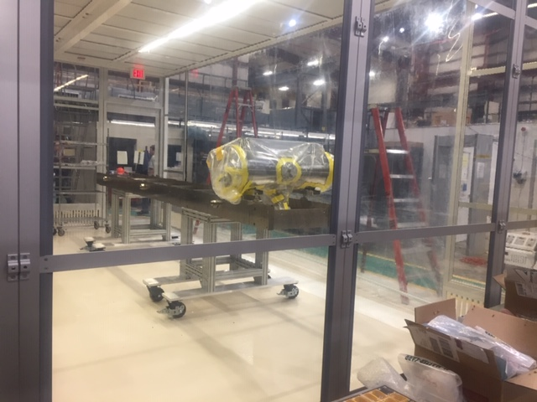
WBS 121.2 SRF Updates – HWR Cryomodule
  All cavities were tested with high power coupler.
  Clean preparation is now in progress
    Three cavities were cleaned and prepared for string assembly
    All 8 solenoids have been cleaned and ready for string assembly.
  Strong back fiducialized, alignment measurements performed, cleaned, and in cleanroom for string assembly.
  Cryomodule lid fiducialized, thermometer and instrumentation feedthroughs installed
  Transportation fixture and shipping contract are being procured. Transportation test is scheduled in March and final transportation review in April.
Titanium strong back is in clean room, first cavity in place.

Slide 9
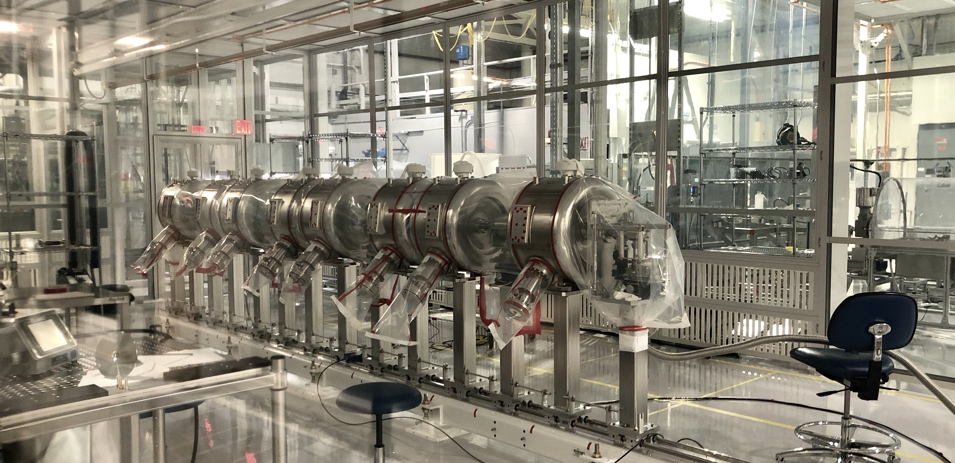
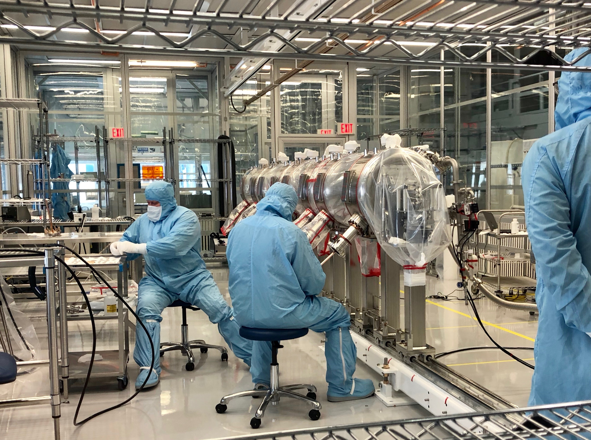
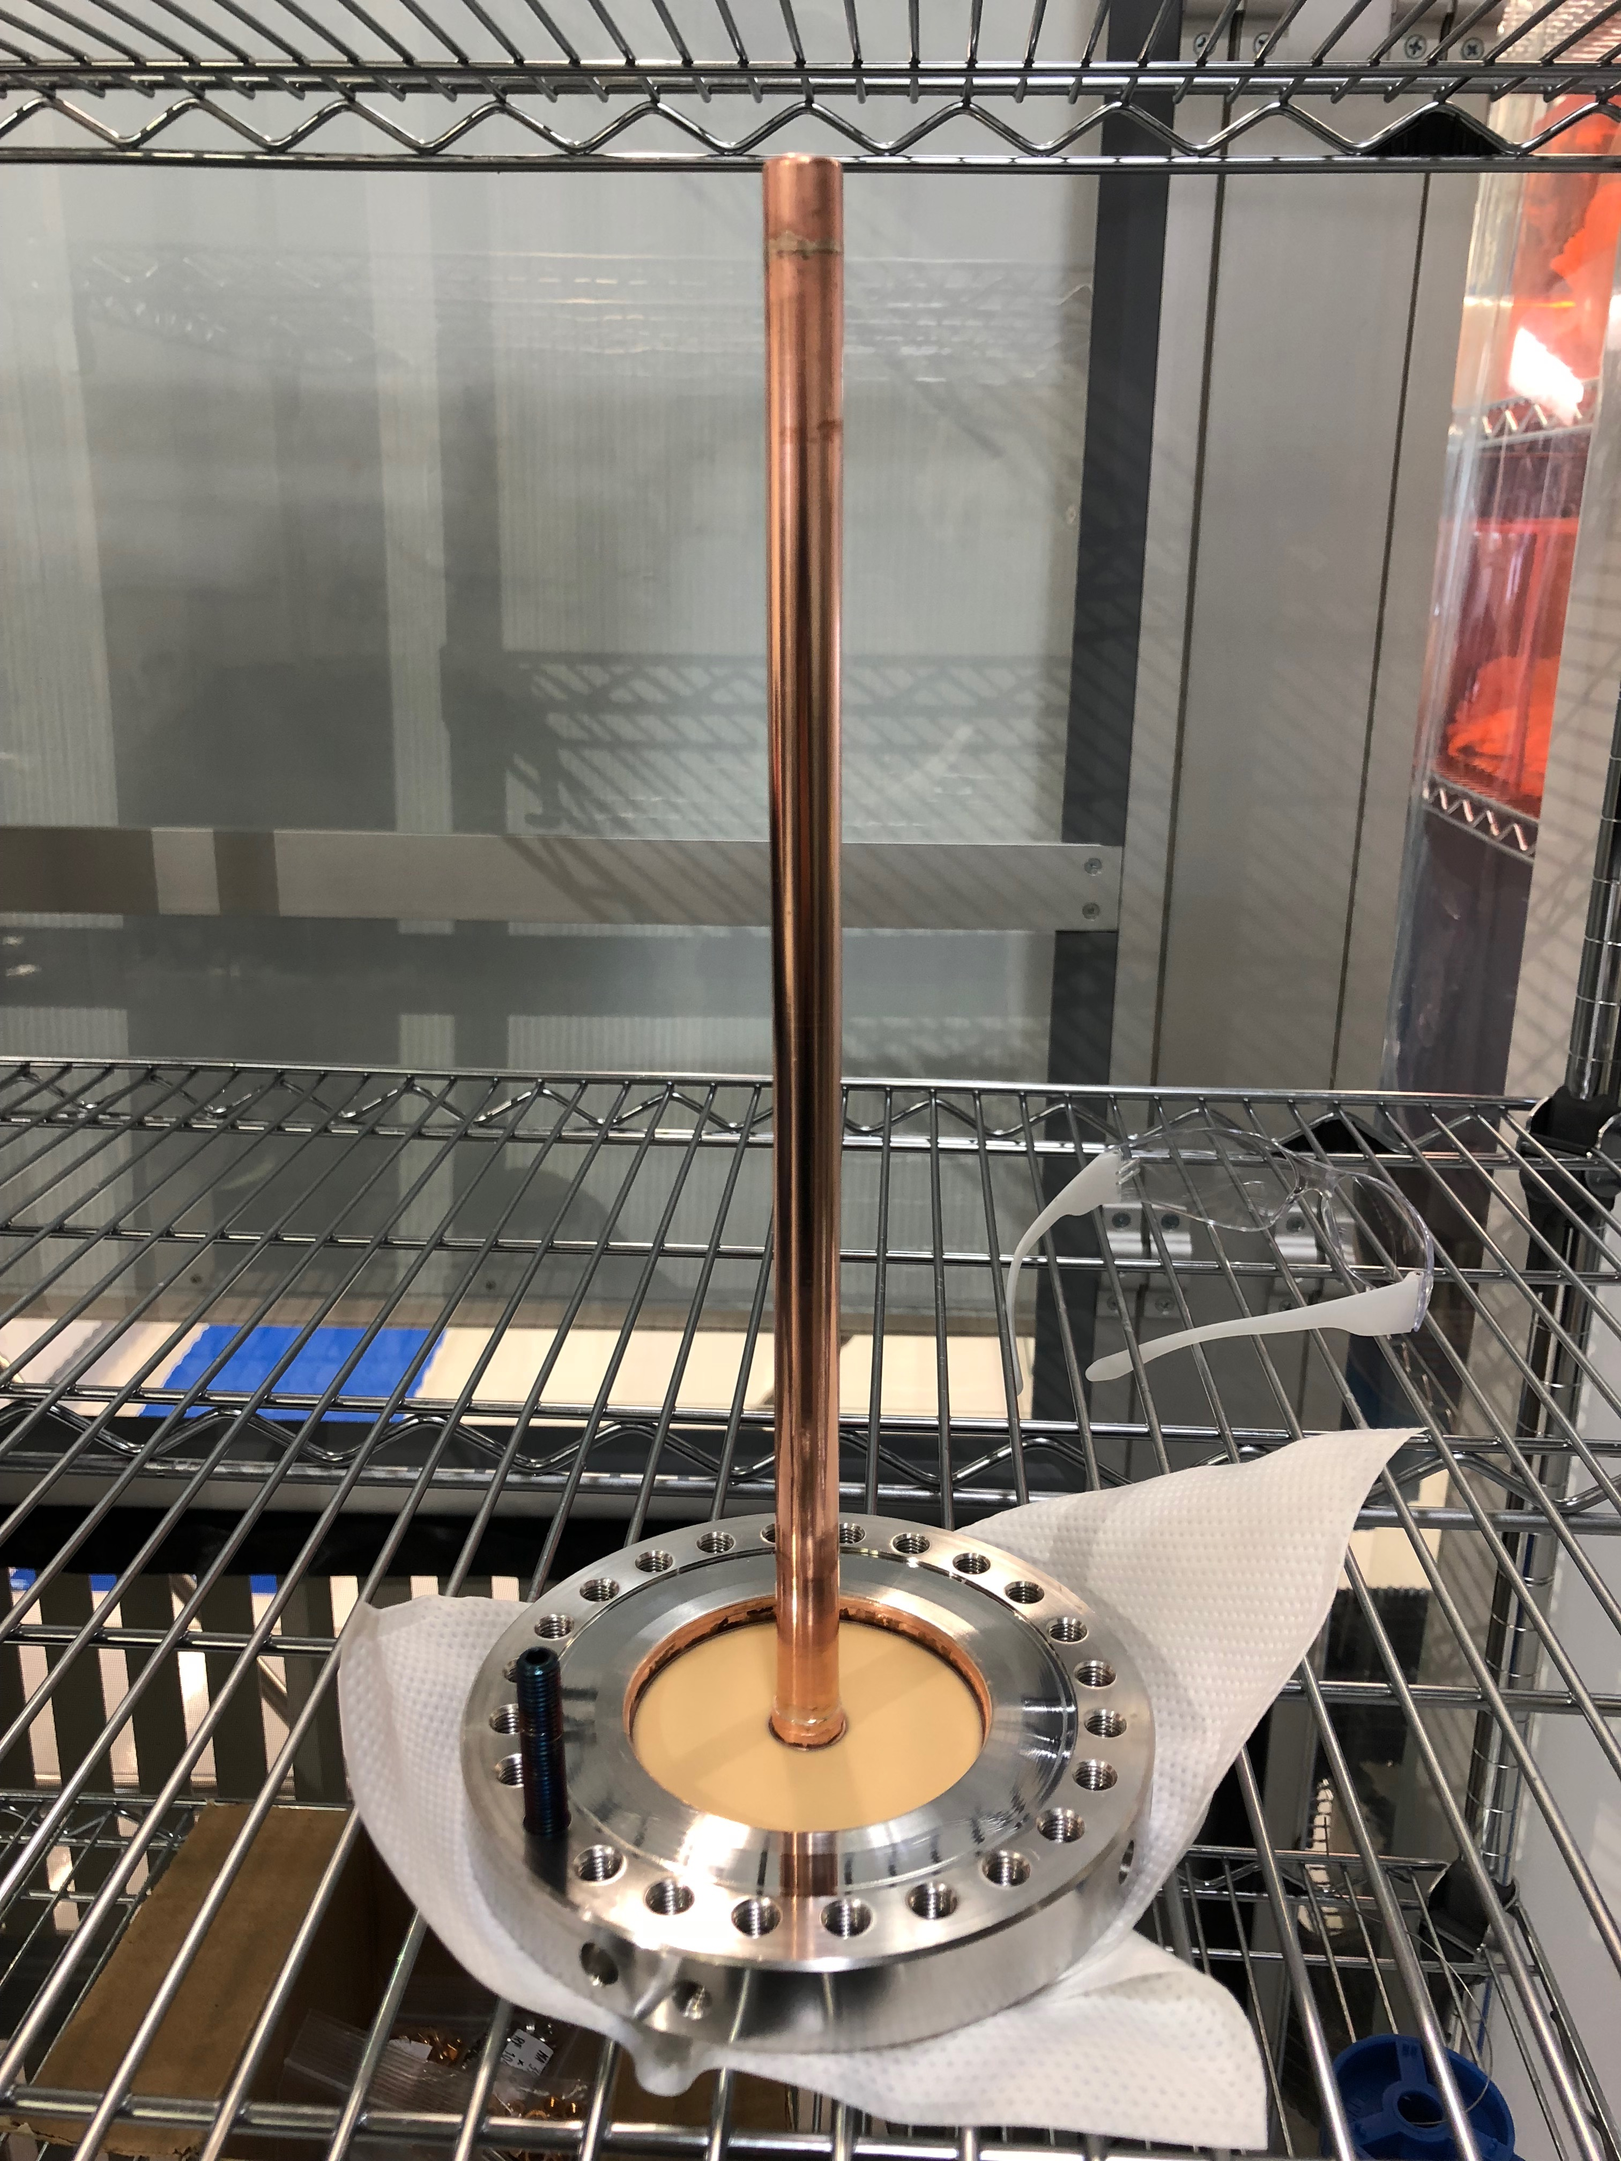
WBS 121.2 SRF Updates – SSR Cryomodules
SSR1: String assembly was completed. Leak checking is in progress
  Initial pump down and leak check found two coupler windows developed leaks. These two couplers were leak tight before their previous STC tests.
  The two defective coupler windows were replaced. Investigation is in progress to understand the root cause of window failure.
  SSR1 string assembly is being evacuated and leak checking is in progress.
    Preliminary leak checking indicated no leaks
    Pending final leak check at higher resolution
SSR2: Jacketed cavity mechanical design is in progress.
Leak checking of SSR1 string assembly
Replacing one of SSR1 coupler
Leaking SSR1 coupler

Slide 10
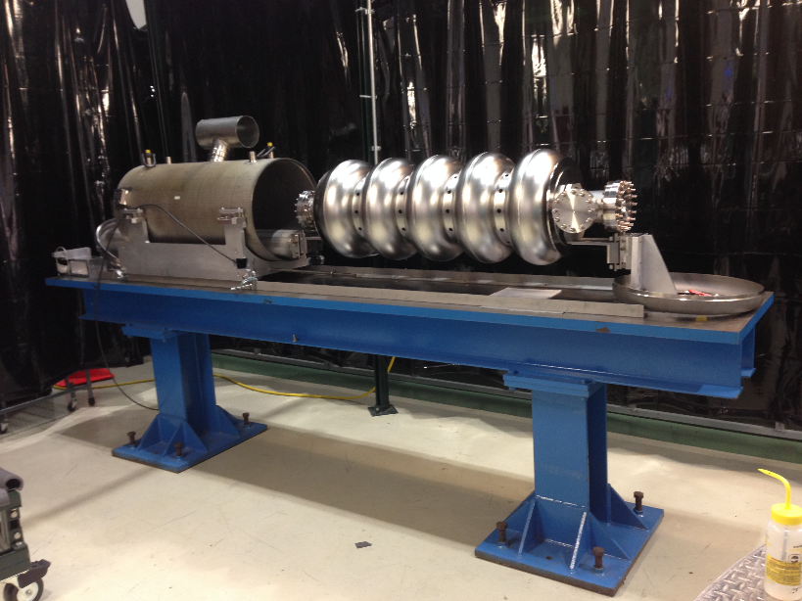
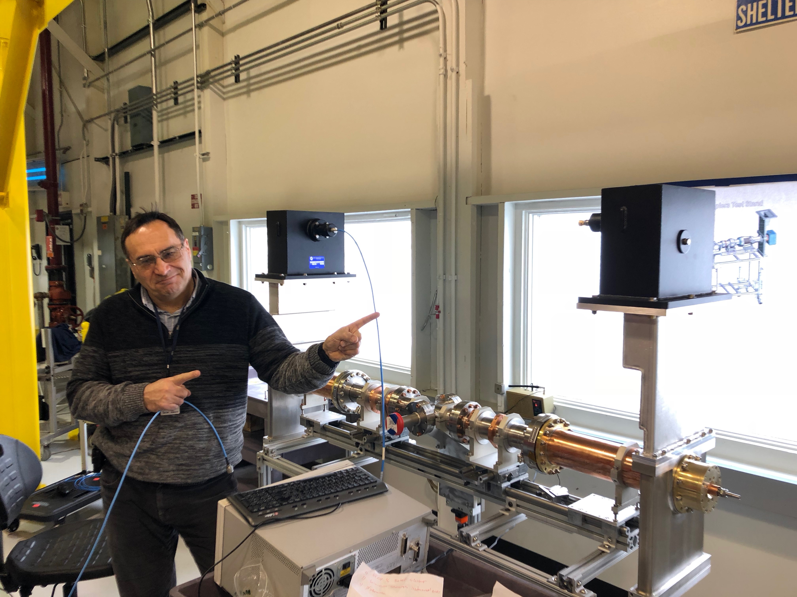
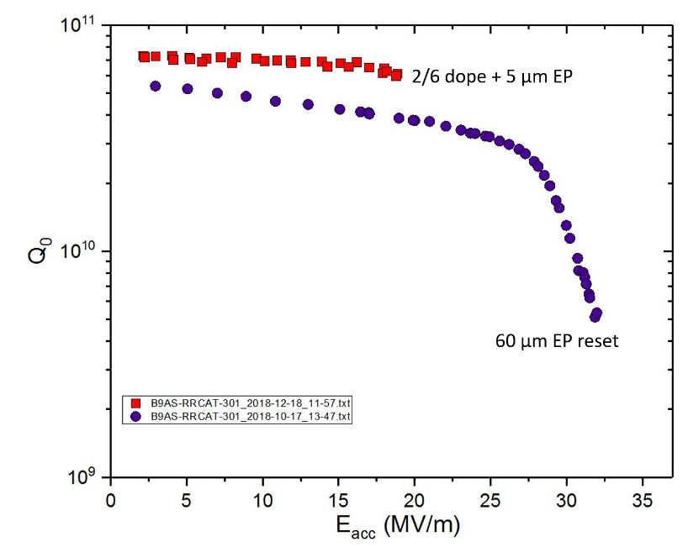
WBS 121.2 SRF Updates – 650 Cryomodules
HB650 partner lab support: B9AS-RRCAT-301 N-doping study is in progress.
5-cell cavity qualification is in progress.
B9A-AES-010 instrumentation is completed. Dressing is scheduled to be in the next week.
Couple test preparation is in progress.
Cryomodule design team is formed including partner labs. Cryomodule design is in progress
B9A-AES-010 pre-dressing instrumentation completed.
650 MHz coupler test preparation
2/6 doped B9AS-RRCAT-301 showed promising results. Additional EP to be done next week, and retested

Slide 11
WBS 121.2 SRF Updates - Cryogenics
Received Budgetary quotes for, LHe Dewar, LN2 Dewar, Cryoplant LHe Dewar transfer line, and External Helium Purifier
Received detailed cost information for LCLS-II Cryoplant Installation contract and began applying it to PIP-II cryoplant installation as BOE
Planning trip to SLAC to gather lessons learned from their cryoplant experience, installation contract, and building

Slide 12
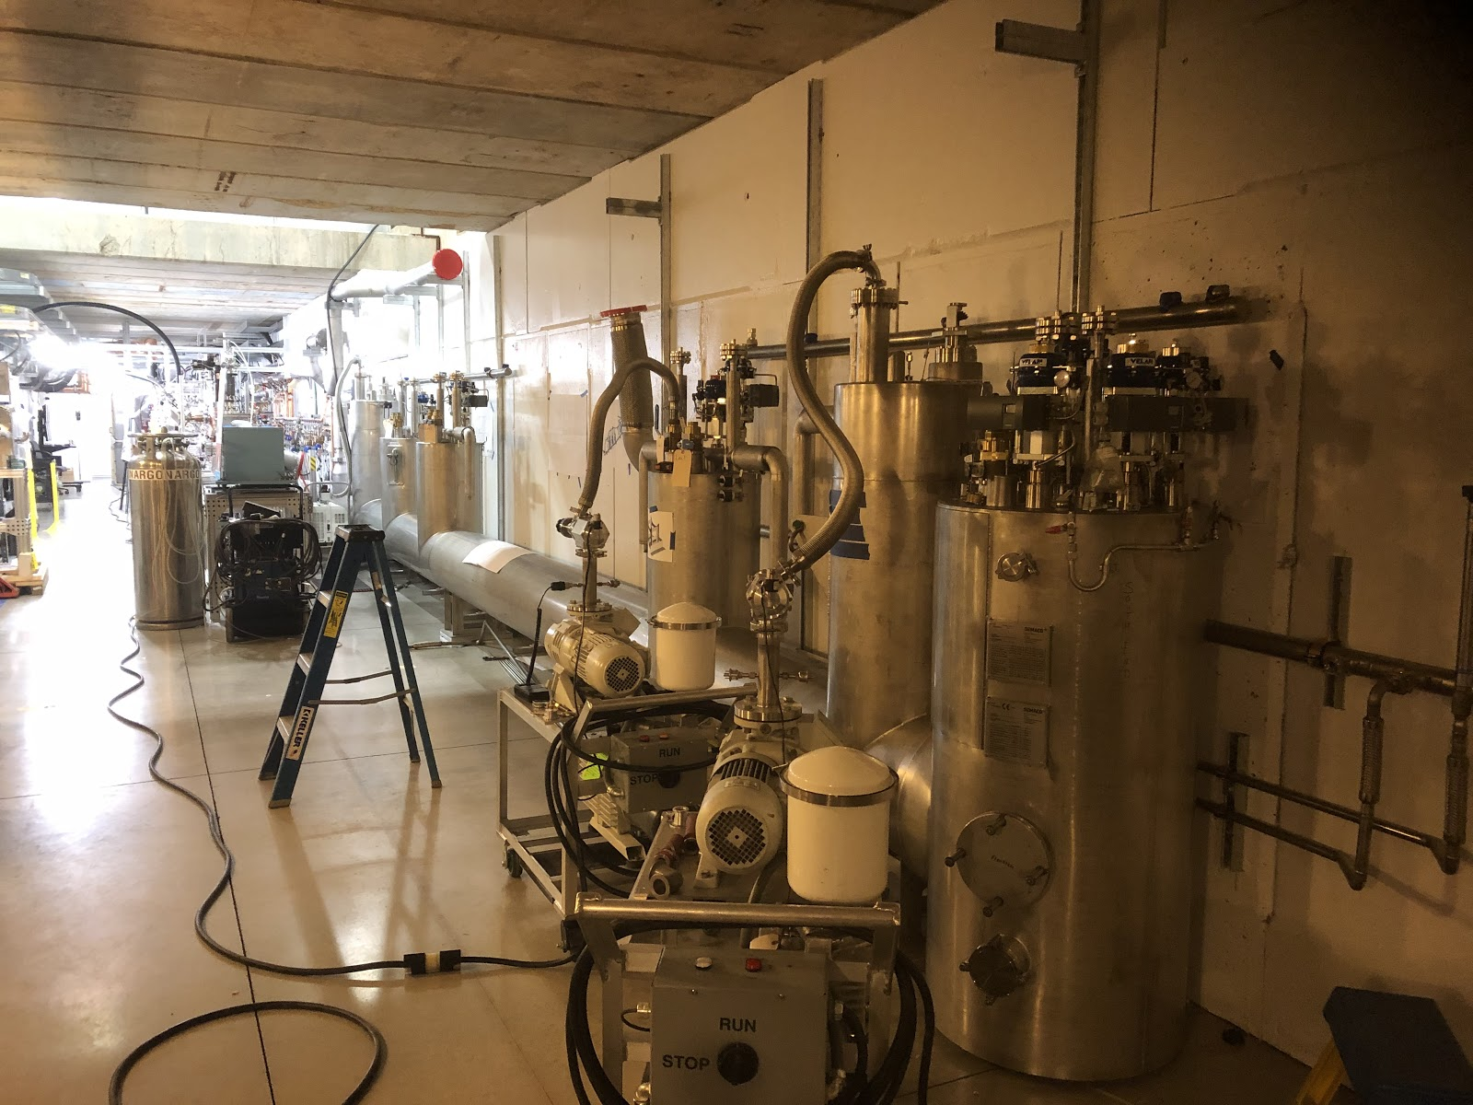
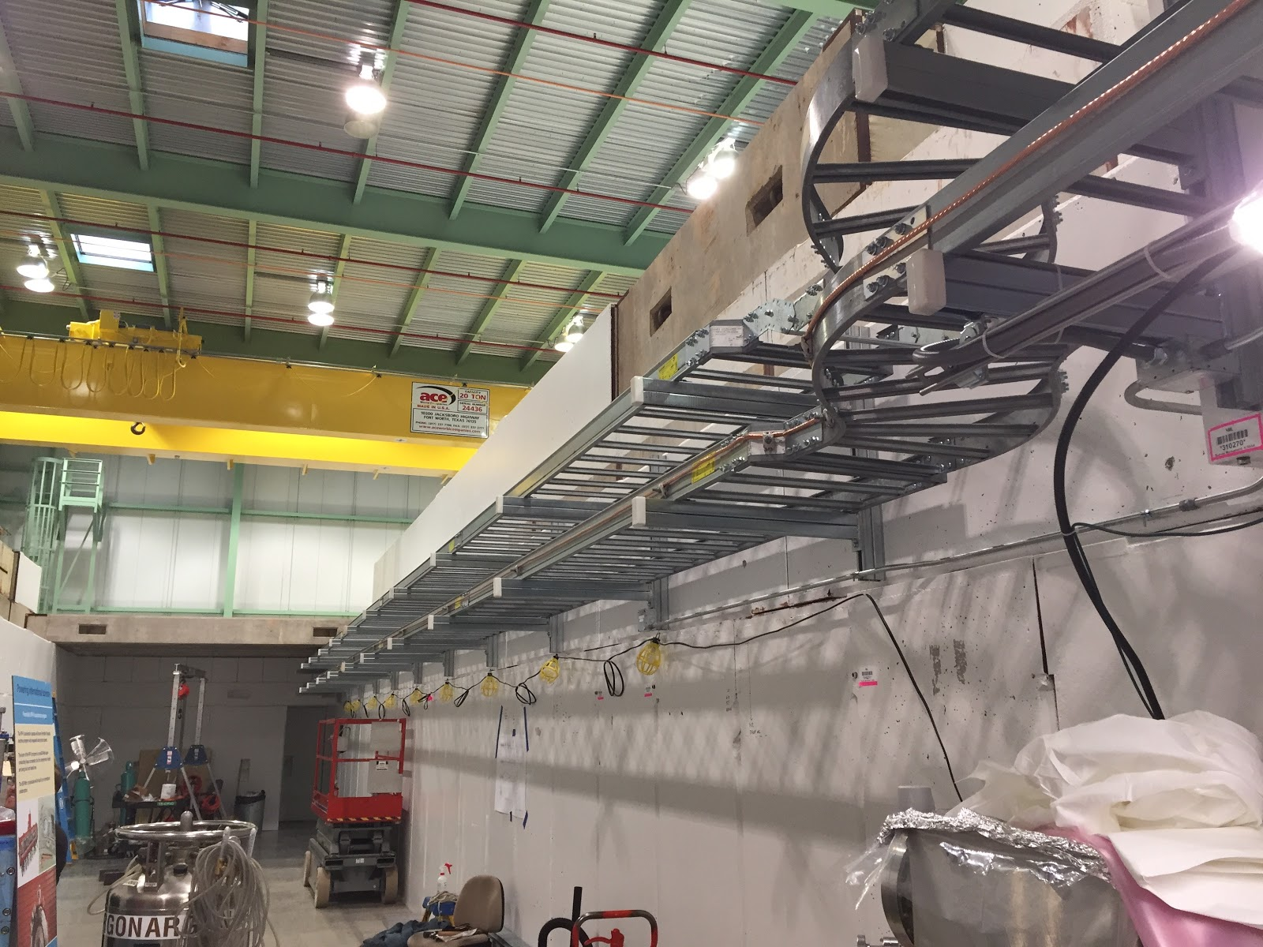
Updates - WBS 121.4 Linac Installation and Commissioning (1 of 2)
WFE
  Final Design Review of the HEBT for PIP2IT is scheduled for Feb 13th
Test Infrastructure
  Progress continues with the PIP2IT CTL installation
  Cable tray installation complete
  Laser pipe from laser hut, through PIP2IT entry labyrinth installed
  ODH fan mounted in place (duct and electrical installation still to be done)

Slide 13
Updates - WBS 121.4 Linac Installation and Commissioning (2 of 2)
Building Infrastructure
  Room Data Sheet finalized January 11th.
    Current organizing the sign-off by all L3s
    The information will be used to assist with Final Design Review of CF Site Preparation
  Significant adjustments in FY19
    Change strategy – drafter support for 2D drawings generation for Mechanical and Electrical Design moved to CF A/E contract
Installation
  Proposal to add a mezzanine in the Linac Gallery has been presented
  First draft of CAD standards document prepared
  Working with Visual Media team to create images for groundbreaking
  Released requisition for the ORCA stand procurement and with fabrication engineer to prepare strut procurement package
  Collaboration with NIU finalized –
    Mechanical Engineer to assist with the design of the warm units region

Slide 14
Updates - WBS 121.6 Conventional Facilities
Site Prep Design
  100% Design Documents due 31JAN19;
Site Clearing Construction
  3 Proposals Received in November 2018. All below estimate.
  Subcontractor safety performance under review;
  Anticipate award in late January 2019;
  Goal: In place for 15MAR19 Groundbreaking;
  SWPPP documentation being prepared by FESS;
  Reminder: Need EA FONSI to start construction;
A/E Selection
  IDIQ signed on 08JAN19;
Cryo Plant Building Design
  IDIQ task issued on 11JAN19.
  Lessons Learned Meeting week of 14JAN19
  Kick-off meeting scheduled for week of 22JAN19

Slide 15
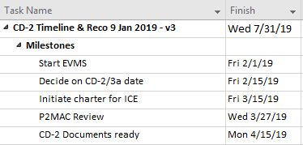
CD-2/3a Preparation Activities
Detailed plan managed by Project Director in MS Project, presented at IPT
Major thrusts:
  RLS/EVMS
    BOE completion, review
    Adjustments to funding profile, especially FY19/20
    Initiate EVMS performance vs. plan measurement, control
    Risk Analysis
  Value Engineering
  Scope
    Transition to Operations
    Plan to 1.2MW
    Shutdown schedule
    Spares
  International
    PPDs

Slide 16
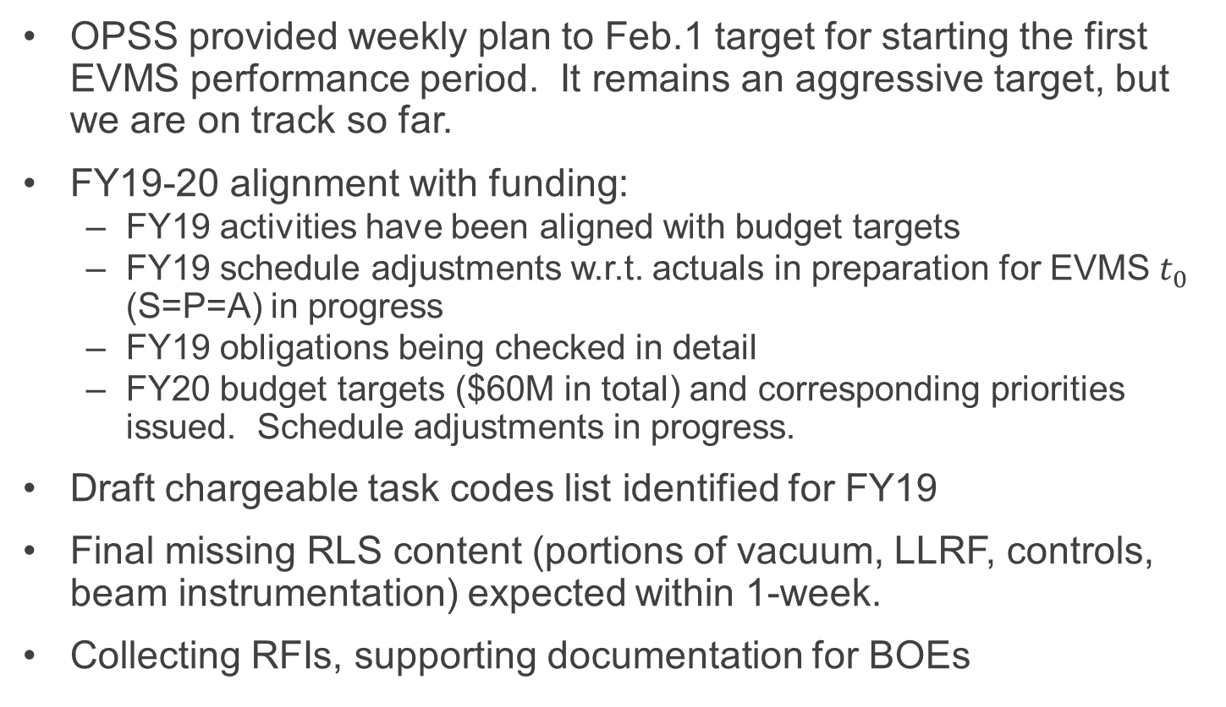
RLS, EVMS status
OPSS provided weekly plan to Feb.1 target for starting the first EVMS performance period. It remains an aggressive target, but we are on track so far.
FY19-20 alignment with funding:
  FY19 activities have been aligned with budget targets
  FY19 schedule adjustments w.r.t. actuals in preparation for EVMS $t_{0}$ (S=P=A) in progress
  FY19 obligations being checked in detail
  FY20 budget targets ($60M in total) and corresponding priorities issued. Schedule adjustments in progress.
Draft chargeable task codes list identified for FY19
Final missing RLS content (portions of vacuum, LLRF, controls, beam instrumentation) expected within 1-week.
Collecting RFIs, supporting documentation for BOEs

Slide 17
Integrated Planning between PIP-I+ and PIP-II
Project | Component | 900 kW to NOvA | 1.2 MW to LBNF (20 Hz) | Issue #ID
PIP-II | Linac |  | ✓ | 1.1, 1.2
 | Transfer Line |  | ✓ | -
 | Booster Injection |  | ✓ | 2.1
 | Booster 20 Hz |  | ✓ | 2.2
 | Main Injector RF |  | ✓ | 4.2
 | Recycler RF |  | ✓ | 3.1, 3,2
PIP-I+ | NuMI Target Syst | ✓ |  | -
 | Booster Intensity | ✓ | ✓ | 1.1 – 1.4
 | Booster D-Magnets | ✓ | ✓ | -
 | MI gamma-t | ✓ | ✓ | 4.1
 | Booster RF | ✓ | ✓ | 2.3

Slide 18
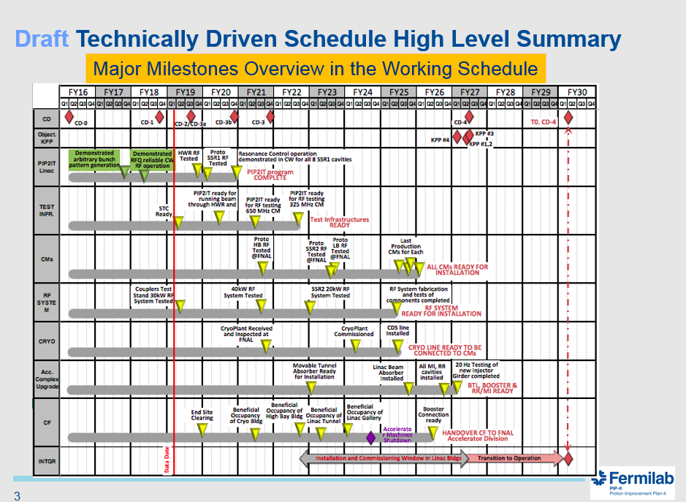
Shutdown Schedule
Meeting held 14-Jan-2019 with Director and representatives from LBNF, AD, Mu2e, NOvA, and PIP-II to discuss shutdown strategies
CD-4 ➔ FY27
Issue: Current PIP-II plan is to make the Booster connection during 2 year shutdown (July 2024 to July 2026); start of LBNF shutdown currently scheduled one year later
Slide is courtesy of Luisella Lari

Slide 19
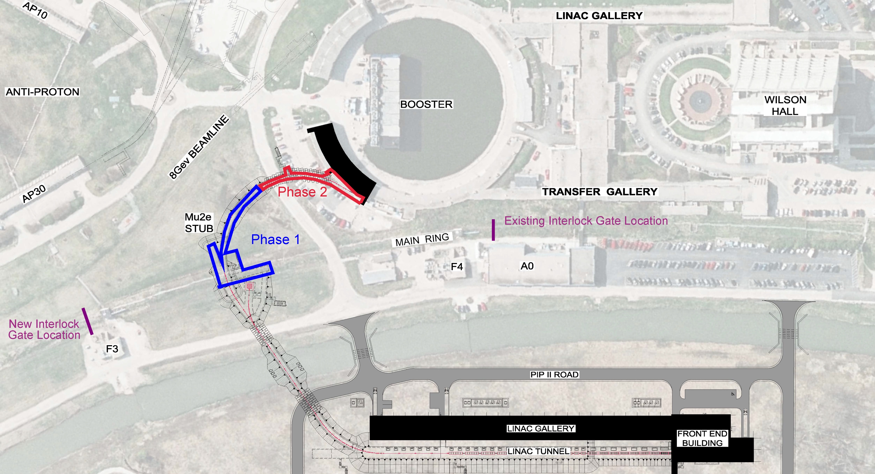
Potential Solution - Phased CF Connection
Booster Connection
Main Ring/TeV crossing
Phase 0
Linac Construction up to Main Ring/TeV
Impact: Once the Main Ring/TeV construction commences (Phase 1), the Switchyard 120 fixed target program are off until PIP-II comes on line replacing the old Linac

Slide 20
Proposed Timeline
CY 2023
CY 2024
CY 2025
CY 2026
CY 2027
Prep work
CF Phase 1
7/2023 - 4/2024
Prep work
CF Phase 2
9/2025 - 5/2026
Equipment Installation and Commissioning 5/2026 - 4/2027
PIP-II CD4
4/2027
FY22 Shutdown start
7/2022
FY23 Shutdown start
7/2023
LBNF Shutdown start
9/2025
Beam to the experimental program from the existing linac and Booster
STOP
Beam to Switchyard 120
STOP
Start Date | Major activity
July 2022 | Prep work - Relocate TeV access gates
July 2023 | Start PIP-II CF work Phase 1 – Main Ring/TeV crossing
July 2023 | STOP ➔ beam to the Switchyard 120
May 2025 | Start Prep work – Booster connection
September 2025 | Start PIP-II CF work Phase 2 – Booster connection
September 2025 | STOP ➔ beam to the experimental program
May 2026 | Equipment installation and commissioning

Slide 21
Summary
Plan to decide CD-2/3a IPR date in Mid-Feb 2019
Racing toward Feb.1 EVMS performance period
Need to reduce TPC
Working with AD to clarify path to 1.2MW
P2MAC meeting is 25-27-Mar-2019
PIP-II groundbreaking is 15-Mar-2019
Site clearing still planned for March 2019.
  Need to resolve FONSI approval process issue

