Slide 1
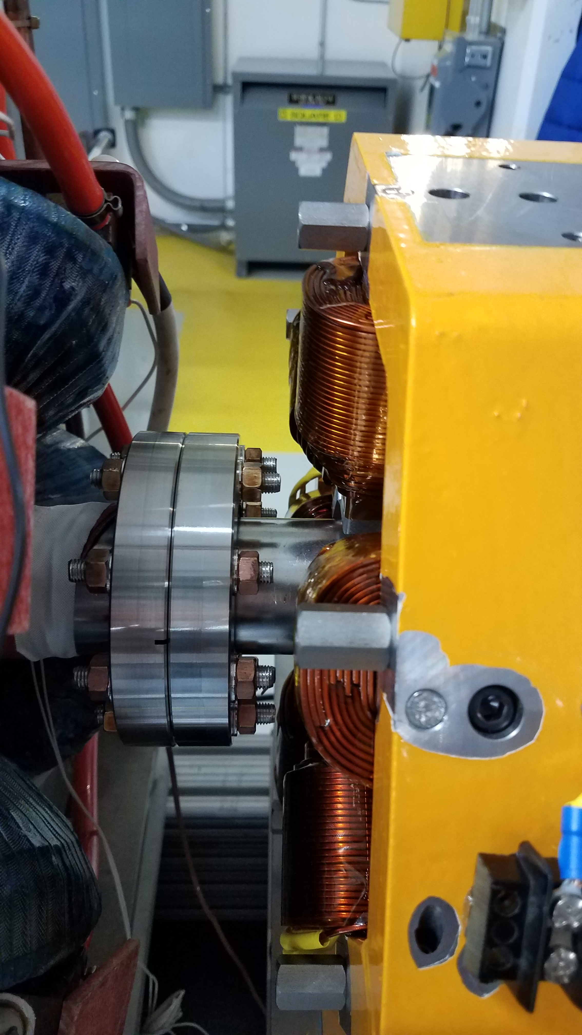
FAST Facility Department
IOTA lattice adjustment made and now injecting 1.5 mA
Instability at higher current
IOTA RF Cavity
Several accesses to adjust the capacitance circuit
DCCT noise coupled to RF
X118
Parameters for linear pot were created for H and V stepper motors
Anti-collision software created and loaded
In/out limits are now consistent with X107
Sextupole magnets
SC1R and SC2R shorted during assembly
SC1L and SC2L have been electrically disconnected
Improve stability of supports
Resolve coil shorting issues
Figure out the way to roughly align the magnets
Determine the maximum operational current without water cooling

Slide 2
FAST: Next Week
Normal Monday morning controlled access has been moved to Tuesday:
Contact FAST RunCo, Dan Broemmelsiek, with all requests
FESS: CMTF switch-over to new potable water lines will be on Tuesday. Washroom facilities at CMTF will be offline all day. Thursday will be NML’s turn. We will need to use the CMTF washrooms. Weather dependent so schedule may shift.
RF capacitance circuit adjustments?
X118
Continue installation work. Test anti-collision software.
Install vacuum tube for ICS experiment IR laser transport
Investigate HE TPM camera triggering issues

Slide 3
