Slide 1
SW and FW Hit-finding Update
J. Greer, K. Kothekar, J. Brooke

Slide 2
In this talk
Recent updates to hit-finding fw
Demonstration fw is working in simulation for hit-finding on a single channel
Demonstration that the hits and their quantities found in fw are the same as those found in sw
What to do next
Where to get instructions for the whole process of running the sw and fw hit-finding and making the comparison

Slide 3
Recent updates to fw hit-finding algorithm
These bring it in line with the algorithm implemented in software
The main update is that the hit-finder now treats all ‘packets’ of adc samples (ie: 256 ADCs in a packet) independently
This should allow a round-robin style allocation of packets to hit-finders in future
To achieve this, if a hit is lasting beyond the end of a packet, then the hit quantities are read out as they are at the end of the packet along with a Boolean which indicates whether this hit continues up to the last ADC value in the packet (True) or not (False)
Just in case a hit doesn’t actually continue to next packet, the end tick of the hit and the start tick of the next allow a check to be made

Slide 4
FW Results
prod_eminus_20MeV_parallelx_dune10kt_1x2x6_nonoise_Channel3695results.txt
1channel number, 2event_number, 3random, 4collection/induction, 5packet_number, 6hit_continues, 7hitstart, 8hitsize, 9hitpeak(time), 10hitpeak(adc) , 11hitsumadc
9005 6123 888 1 9 0 2489 59 2532 614 32973

Slide 5
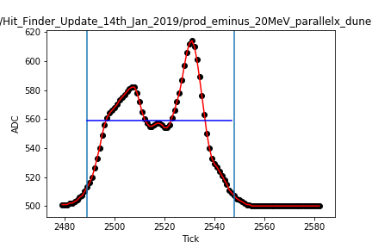
FW Results
1channel number, 2event_number, 3random, 4collection/induction, 5packet_number, 6hit_continues, 7hitstart, 8hitsize, 9hitpeak(time), 10hitpeak(adc) , 11hitsumadc
9005 6123 888 1 9 0 2489 59 2532 614 32973

Slide 6
FW Results
prod_muminus_100MeV_parallely_dune10kt_1x2x6_nonoise_Channel5436results.txt
1channel number, 2event_number, 3random, 4collection/induction, 5packet_number, 6hit_continues, 7hitstart, 8hitsize, 9hitpeak(time), 10hitpeak(adc) , 11hitsumadc
9005 6123 888 1 15 1 3835 6 3840 545 3144
9005 6123 888 1 15 0 3841 24 3854 1211 20183

Slide 7
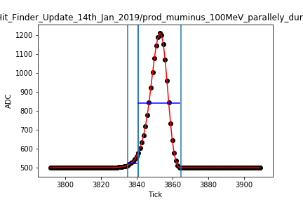
FW Results
1channel number, 2event_number, 3random, 4collection/induction, 5packet_number, 6hit_continues, 7hitstart, 8hitsize, 9hitpeak(time), 10hitpeak(adc) , 11hitsumadc
9005 6123 888 1 15 1 3835 6 3840 545 3144
9005 6123 888 1 15 0 3841 24 3854 1211 20183

Slide 8
Comparison of fw and sw hits
There are still a couple of bugs I’m correcting and investigating – already found source of some
Here are some early results (without bugs removed yet)
At the moment just comparing the start tick, end tick, hitsize, summed adc of the hits, whether the hit continues or not (1-Yes, 0-No)

Slide 9
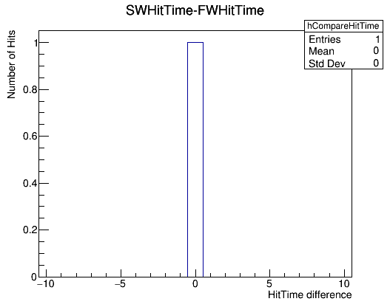
Comparison of fw and sw hits – start tick
Using the 20MeV result with a single hit
Both start ticks found to be the same

Slide 10
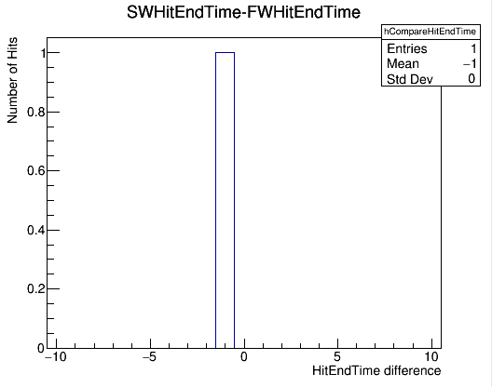
Comparison of fw and sw hits – end tick
End ticks not found to be the same
SW ends 1 tick earlier than FW hit
Double check hit_size is consistent with this before looking at why

Slide 11
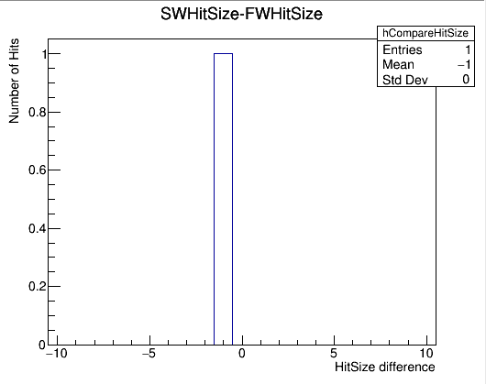
Comparison of fw and sw hits – hit size
SW hit is 1 tick shorter than FW hit
The reason why becomes apparent when comparing the sumADC values of the hits found

Slide 12
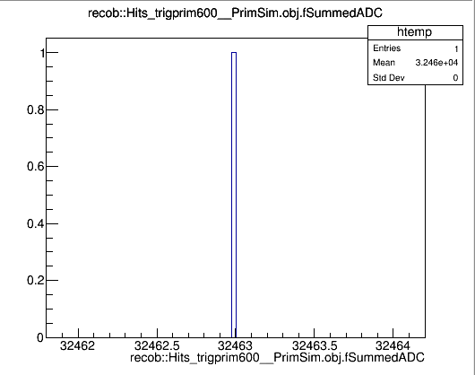
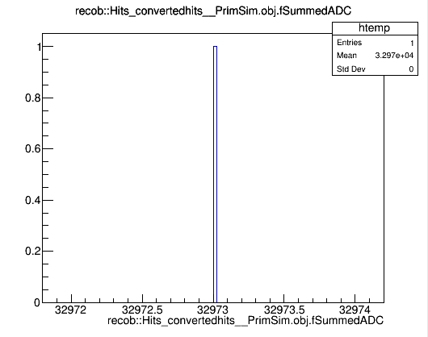
Comparison of fw and sw hits–summedADC
There is a difference of 510. A threshold of 510 was used for these hits. Looking again at the SW hit-finder it considered a hit to be >510 whereas FW hit-finder considered a hit to be >=510

Slide 13
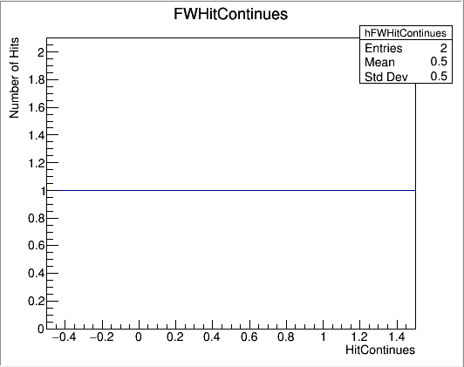
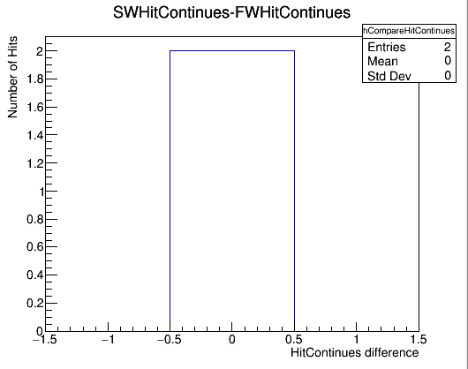
Comparison of fw and sw hits–hit_continues
Looking this time at the 100MeV sample with a two hits, split by the packet boundary

Slide 14
Next steps
Evaluate the resources requirements of the new hit-finder algorithm?
Look at performance of current algorithm (SNB simulation, protoDUNE data etc.)
What extensions can be made, their performance gain and feasibility in terms of FPGA resources
Extension to multiple channels
Implement in hardware?

Slide 15
Instructions for running SW and FW
The instructions for running the software and the hit-finder firmware, as well as file locations will be available very soon on the wiki
Need to add the new hit-finder code to the git repo

Slide 16
Summary
FW algorithm now treats packets independently
FW working in simulation on single channel
SW and FW hit quantities are either the same or will be when corrections applied
Instructions and documentation soon!

