Slide 1
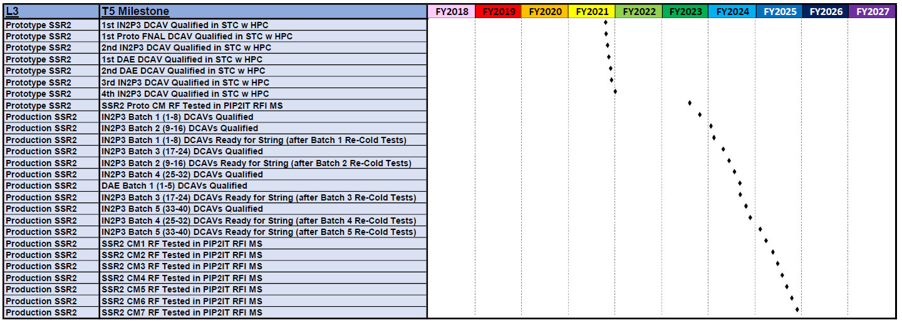
P6 schedule: SSR2 DAE cavities delivery
DAE#1 Receive 6/1/2021, Qualify 8/12/2021
DAE#2 Receive 6/15/2021, Qualify 8/26/2021
SSR2-0 String Assembly Starts 3/18/22
Notes:
String Assembly finish

Slide 2
Major RF Parameters
Parameters | SSR2 v 2.6 Comsol | SSR2 v 3.1 Comsol
Optimal beta β_{opt} | 0.475 | 0.472
Aperture [mm] | 40 | 40
Frequency [MHz] | 325 | 325
Effective length 2β_{opt}λ/2 [m] | 0.438 | 0.436
E_{peak}/E_{acc} | 3.39 | 3.51
B_{peak}/E_{acc} [mT/(MV/m)] | 5.93 | 6.75
G [Ohm] | 115 | 115
R/Q [Ohm] | 296.6 | 305.2
E_{peak} [MV/m] @ 5 MeV | 38.7 | 40.2
B_{peak} [mT] @ 5 MeV | 67.7 | 77.4
Max energy gain [MeV] | 5.0 | 5.0
Max gradient [MV/m] | 11.42 | 11.47
Multipacting : Acceptable Superior

Slide 3
Options for path forward
Options | Pros | Cons
Option 1: RF volume v2.7 Nb 3.15 mm | RF design finalized by BARC Material at BARC Fastest track for delivery to FNAL for integration in SSR2-0 CM | Parallel mechanical design effort needed Thinner material may turn out to be an issue for pressure safety Not optimal performance for LFD and dF/dP
Option 2: RF volume v3.1 Nb 3.15 mm | Improved design, overall better for PIP-II Material at BARC Common design effort, more resources available | Design not finalized yet Same as above for safety and performance
Option 3: RF volume v3.1 Nb 4 mm | Improved design, overall better for PIP-II Better performance Same design under all aspects, more resources available | Design not finalized Material not ordered yet Longest turn-around

