Slide 1
SSR2 v3.1 Summary
P. Berrutti, G. Romanov
FNAL
12/18/2018

Slide 2
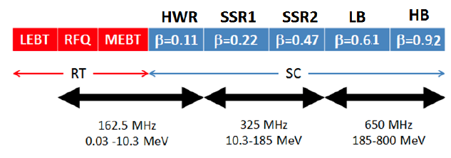
Introduction
PIP-II technology map
SSR2 is part of the SC LINAC of PIP-II, it will accelerate the H⁻ beam from the end of SSR1 (MeV) to the beginning of the first 5-cell cavity section (185 MeV).
The total number of SSR2 cavities needed is 35 divided into 7 cryomodules, having 5 resonators each.
SSR2 beam pipe aperture is 40 mm
CW as well as PULSED operation is planned for SSR2 cavities.

Slide 3
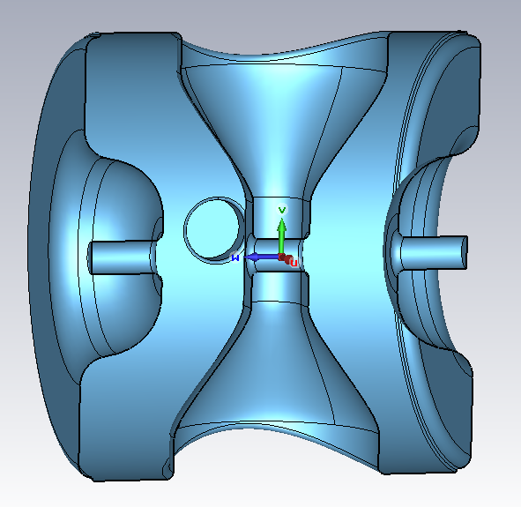
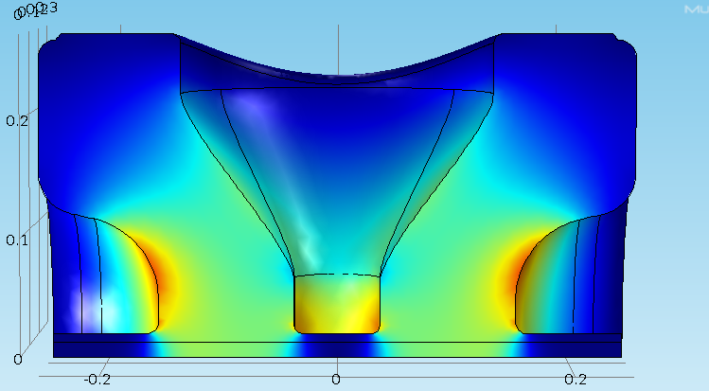
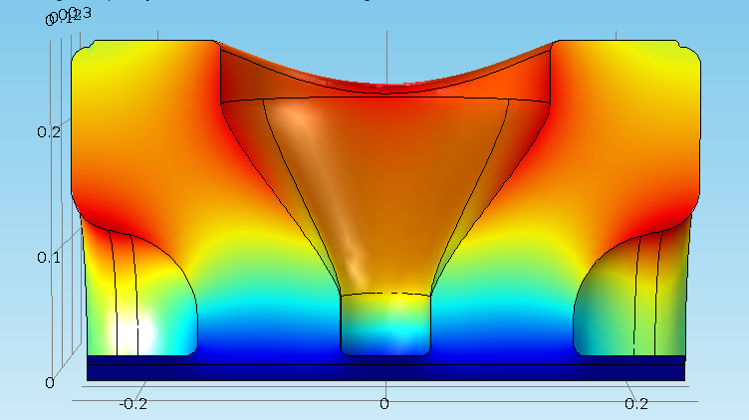
SSR2 v2.6 design evolution summary
SSR2 has been redesigned in 2010 since beta went from 0.4 to 0.47.
Beta optimal is now 0.47 and MP needs to be mitigated.
Geometry has been remodeled to mitigate MP
EM parameters look satisfying
MP study still ongoing to finalize results
New cavity EM designed completed and shown on the right
Electric (left) and magnetic (right) fields simulated with Comsol

Slide 4
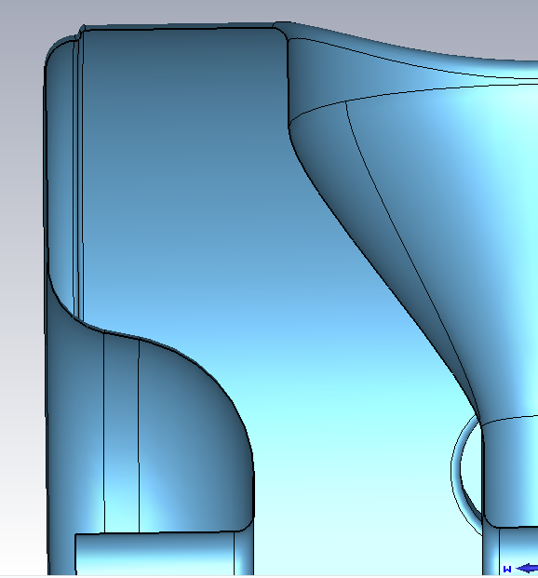
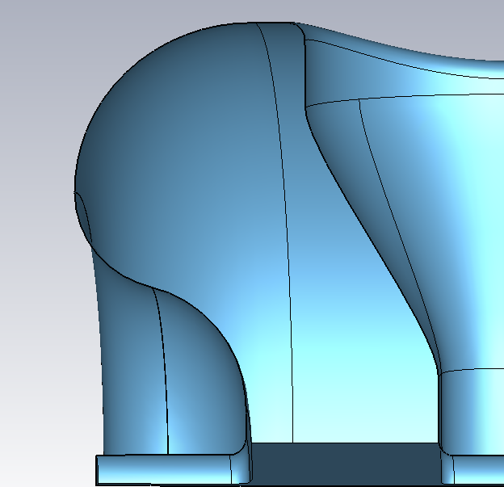
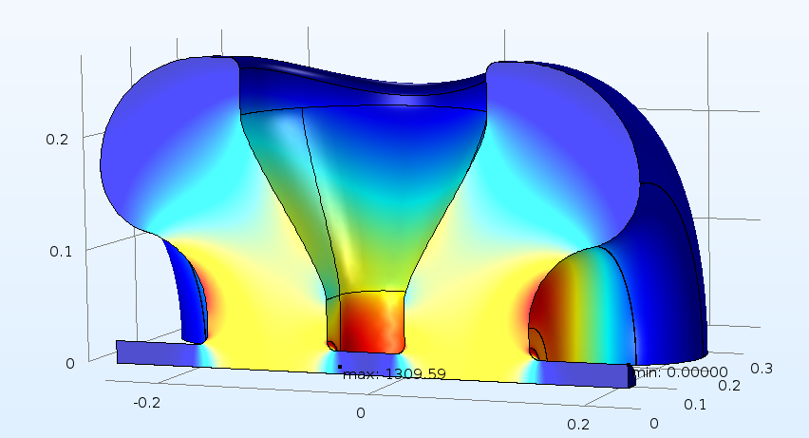
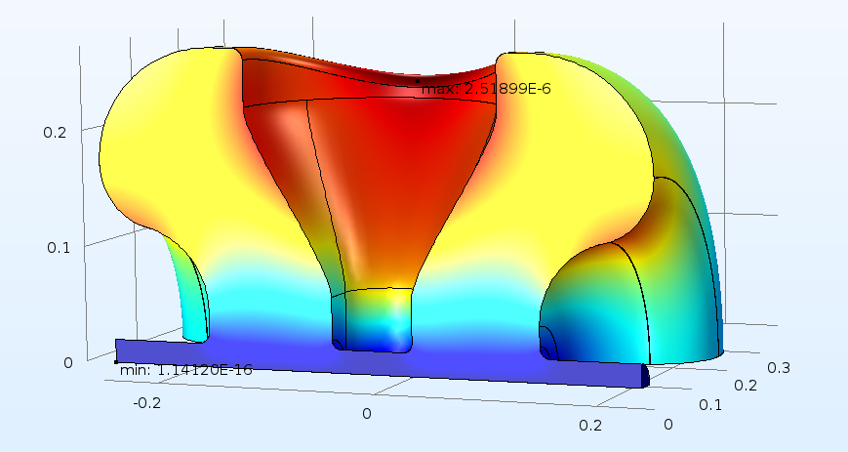
SSR2 from v2.6 to v3.1
Most severe multipacting take place near transition of cylindrical part to end walls.
Eliminating the corner seems to improve the MP barrier at operating gradient
v2.6
v3.1

Slide 5
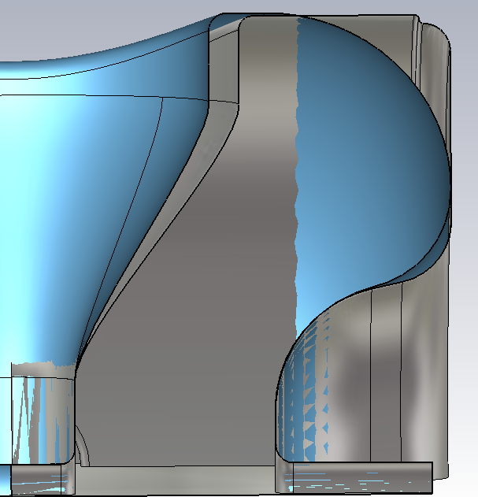
SSR2 from v2.6 to v3.1 Geometry comparison
Overlapping the two geometries for comparison→ v2.6 in gray v3.1 in blue.
Cavity Z length has not been changed.
Cavity radius has changed minimally.
New shape improves MP but it penalizes magnetic field volume (see following slides)
v3.1
v2.6

Slide 6
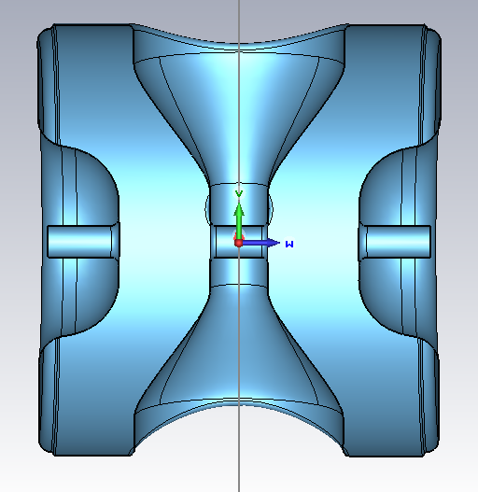
Single spoke resonator geometry COLD v2.6
The lengths are reported in the table below.
All dimensions are for the cold cavity (2K)
R_spoke
L_cav
Parameter | Length [mm]
L_cav | 500
R_cav | 271.6
R_spoke | 130.71
D_aperture | 40
Gap_to_gap | 185.9
W_spoke | 72.26
Gap_to_gap
D_aperture
W_spoke
R_cav
Z-Y cavity cross section

Slide 7
Single spoke resonator geometry COLD v3.1
All the main geometry parameters are shown in the picture.
Dimensions in the table below are in mm.
R_spoke
L_cav
Parameter | Length [mm]
L_cav | 500
R_cav | 273.25
R_spoke | 114
D_aperture | 40
Gap_to_gap | 185.878
Gap | 113.631
D_aperture
Gap_to_gap
R_cav

Slide 8
RF design and parameters
EM parameters allow 5.0 MeV energy gain at max peak fields and optimal β .
Parameters | SSR2 v 2.6 Comsol | SSR2 v 3.1 CST | SSR2 v 3.1 Comsol
Optimal beta β_{opt} | 0.475 | 0.472 | 0.472
Aperture [mm] | 40 | 40 | 40
Frequency [MHz] | 325 | 325 | 325
Effective length 2β_{opt}λ/2 [m] | 0.438 | 0.436 | 0.436
E_{peak}/E_{acc} | 3.39 | 3.46 | 3.51
B_{peak}/E_{acc} [mT/(MV/m)] | 5.93 | 6.79 | 6.75
G [Ohm] | 115 | 115 | 115
R/Q [Ohm] | 296.6 | 305.2 | 305.2
E_{peak} [MV/m] @ 5 MeV | 38.7 | 39.6 | 40.2
B_{peak} [mT] @ 5 MeV | 67.7 | 77.8 | 77.4
Max energy gain [MeV] | 5.0 | 5.0 | 5.0
Max gradient [MV/m] | 11.42 | 11.46 | 11.47
E
H

Slide 9
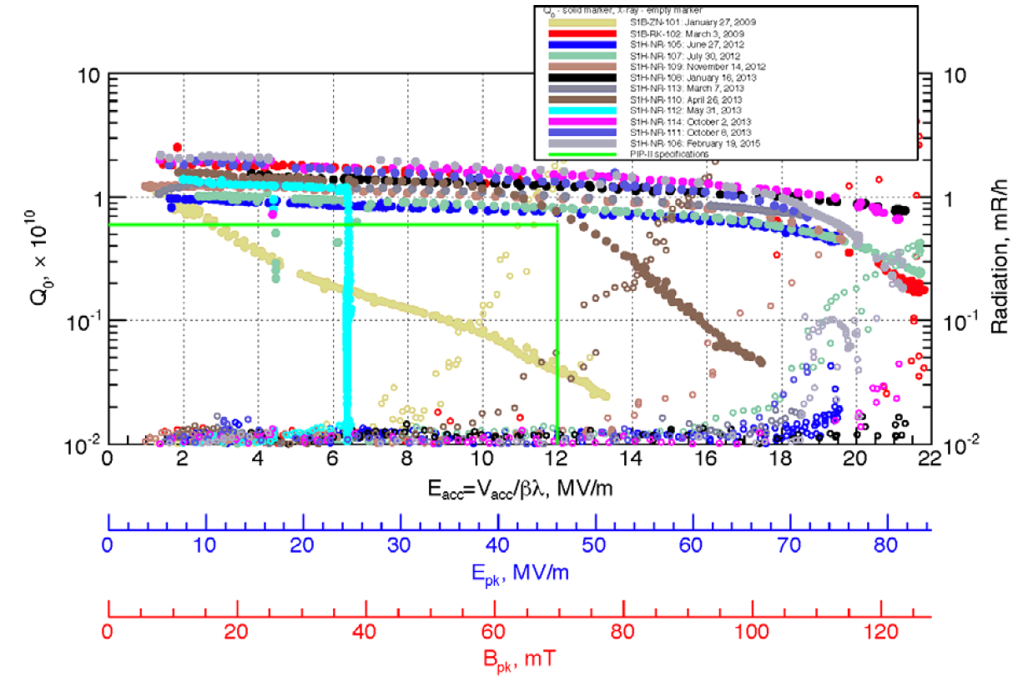
Higher surface magnetic field: not critical!
SSR2 v3.1 magnetic peak field @ 5 MeV gain will exceed 77 mT from both Comsol and CST.
Given the experience of SSR1 test this does not represent a critical value: all cavities quench above 100 mT.

Slide 10
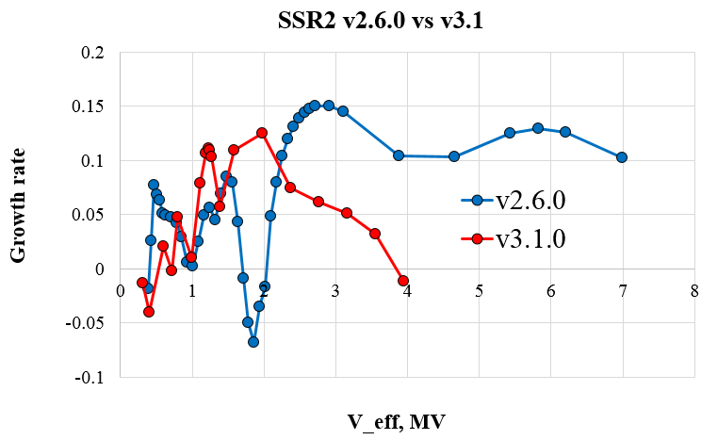
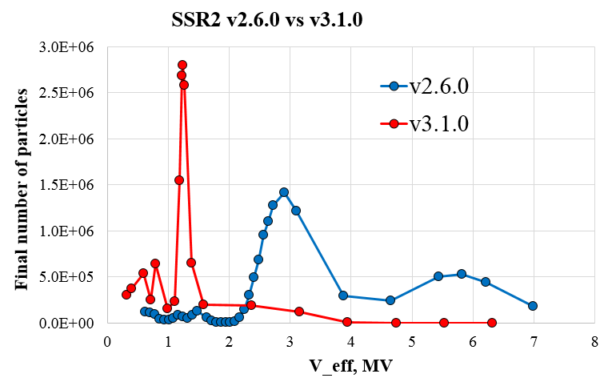
Design evolution steps led by MP reduction
Operating Voltage range
All cases have been simulated for the same amount of time, final number of particles is comparable from case to case

Slide 11
SSR2 MP simulations

Slide 12
Summary
SSR2 v 3.1 improves MP characteristic: no MP in operating voltage range (4-5 MV).
EM parameters satisfy PIP-II project needs providing reliably 5 MeV accelerating voltage.
SSR2 v2.6: slightly better from the point of view of magnetic peak field, MP barrier much higher than v3.1 at operating voltage (from 4 to 5 MV)

